Slide 1
Phenomenology of Dark Matter Capture in Neutron Stars and White Dwarfs
21st Rencontres du Vietnam

Slide 2
MOTIVATIONS
01
Our works on Capture in compact stars:
Neutron Stars:
JCAP 09 (2018) 018 (1807.02840)
JCAP 06 (2019) 054 (1904.09803)
JCAP 09 (2020) 028 (2004.14888)
JCAP 03 (2021) 086 (2010.13257)
Phys.Rev.Lett. 127 (2021) 11, 111803 (2012.08918)
JCAP 11 (2021) 056 (2108.02525)
JCAP 04 (2024) 006 (2312.11892)
White Dwarfs:
JCAP 10 (2021) 083 (2104.14367)
JCAP 07 (2024) 051 (2404.16272)

Slide 3
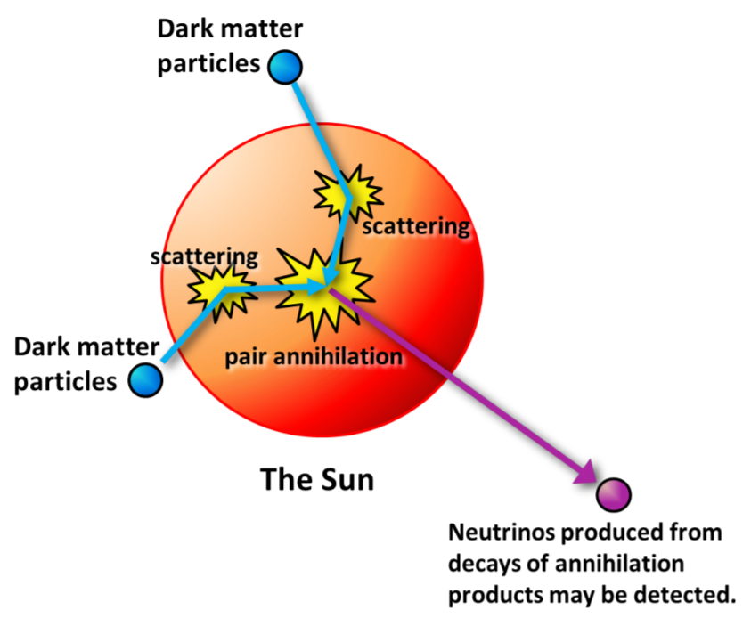
MOTIVATIONS
01
Dark Matter Capture in Stars (Sun) well studied
Capture driven by $σ_{χN}$
Subsequent scatterings cause infall towards core
Observable for the Sun: annihilation into neutrinos
Relevant rates:
Capture rate
Thermalisation rate/time
Annihilation rate
(Evaporation rate)
Other Stars recently investigated:
Neutron Stars
WD

Slide 4
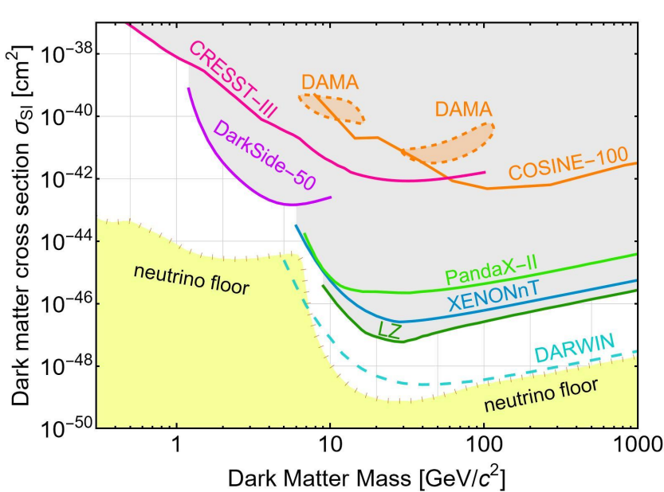
MOTIVATIONS
01
NS made of degenerate matter
Neutrons
Protons
Electrons
Muons
Exotic hadrons?
WD made of Ions and degenerate electrons
Capture rate will be driven by $σ_{χN}$
Parameter space is same as Direct Detection

Slide 5
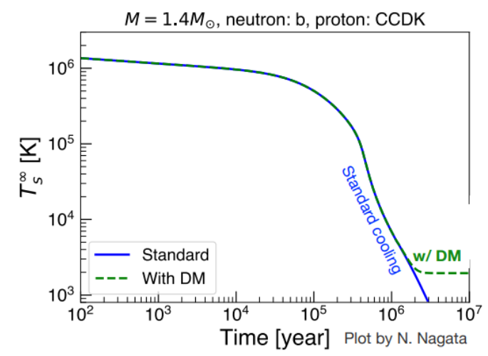
MOTIVATIONS (NS)
01
High density, extreme condition, highly favourable to accumulation of large DM quantities
Powerful probe to test and constrain dark matter (DM)
This generally involves the accumulation of DM particles
Increase in their temperature
DM-triggered black hole formation
Modified EOS/Gravitational wave signal

Slide 6
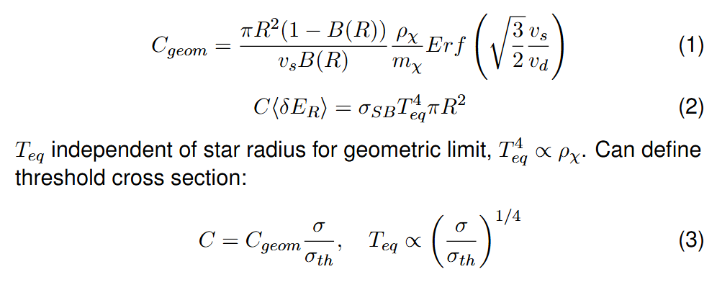
MOTIVATIONS (NS)
01
$$B\sim 0.2−0.6$$
Maximum capture rate is the geometric value
The maximum equilibrium temperature is $T_{eq}^{MAX}\sim 2000K$
$σ<σ_{th}{\left(\frac{T_{eq}}{T_{eq}^{MAX}}\right)}^{4}$< $σ_{th}{\left(\frac{T}{T_{eq}^{MAX}}\right)}^{4}\text{< }σ_{th}$

Slide 7
MOTIVATIONS (NS)
01
DM speed in halo $u\sim 300km/s$
DM in halo, kinetic energy $K\sim \frac{1}{2}m_{χ}u^{2}\sim {10}^{−6}m_{χ}$
DM after gravitational infall, $K^{G}∼m_{χ}\left(\frac{1}{\sqrt{B}}−1\right)\sim ℴ(m_{χ}$)
DM energy loss in recoil $q_{0}\sim ℴ(μ)\sim \left\{\begin{aligned}1GeV, m_{χ}≳10GeV \\ ℴ(m_{χ}\text{)}, m_{χ}≲1GeV\end{aligned}\right.$
If $K<q_{0}$ a single scattering is enough to capture
Requires $m_{χ}≲{10}^{6}GeV$
Energy transferred to the star by Capture $K^{G}∼m_{χ}\left(\frac{1}{\sqrt{B}}−1\right)$
Energy transferred to the star by subsequent annihilation $K^{A}∼m_{χ}$
$$T_{eq}^{MAX}\sim 1700K$$
(Kinetic Heating)
$$T_{eq}^{MAX}\sim 2300K$$
(Kinetic + Annihilation Heating)

Slide 8
MOTIVATIONS (NS)
01
$$\frac{dN}{dt}=C−(EN)−AN^{2}$$
Capture
Threshold Cross section
Thermalisation/
Energy Distribution
Kinetic Heating
$$\dot{E}=C×K^{G}$$
$$T_{eq}^{MAX}\sim 1700K$$
Annihilation Rate
C/A Equilibrium timescale
Annihilation Heating
$$\dot{E}=AN^{2}×K^{A}$$
$$=Cm_{χ}{Tanh}^{2}\left(\frac{t}{t_{C/A}}\right)$$
$$t_{C/A}=\frac{1}{\sqrt{CA}}$$
$$T_{eq}^{MAX}\sim 2300K$$
$$N=\sqrt{\frac{C}{A}}Tanh\left(\frac{t}{t_{C/A}}\right)$$

Slide 9
CAPTURE (NS)
02
Need to use/include:
Schwarzschild metric, star structure (EOS)
Relativistic kinematics
Pauli blocking
Capture probability/average energy transfer (for multiple scattering/heavy DM)
Hadronic Form Factors
Target effective mass due to self-interactions

Slide 10
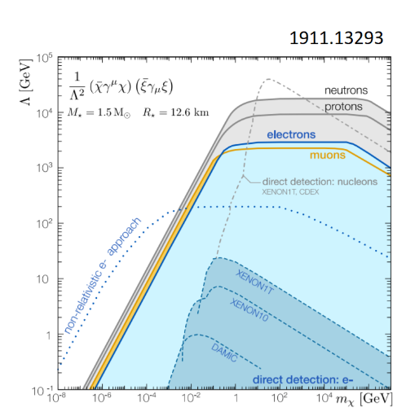
CAPTURE (NS)
02
Need to use/include:
Schwarzschild metric
Relativistic kinematics
Pauli blocking
Capture probability/average energy transfer (for multiple scattering/heavy DM)
Hadronic Form Factors
Target effective mass due to self-interactions
Non-relativistic kinematics vs relativistic kinematics

Slide 11
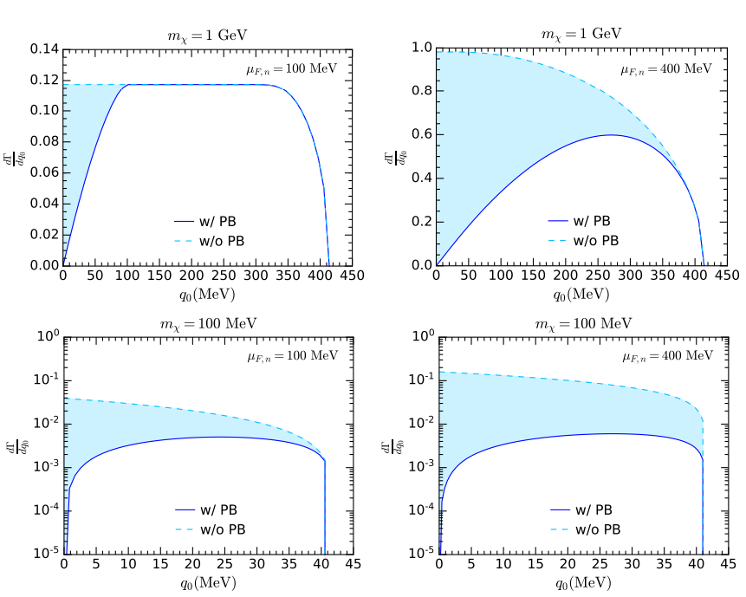
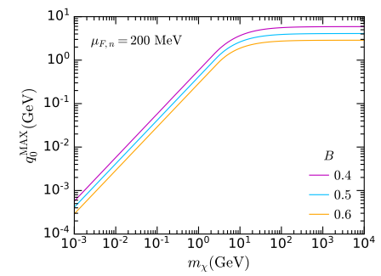
CAPTURE (NS)
02
Need to use/include:
Schwarzschild metric
Relativistic kinematics
Pauli blocking
Capture probability/average energy transfer (for multiple scattering/heavy DM)
Hadronic Form Factors
Target effective mass due to self-interactions
Effective $\frac{m_{χ}}{p_{f}}$ suppression at low mass

Slide 12
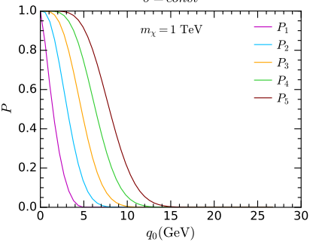
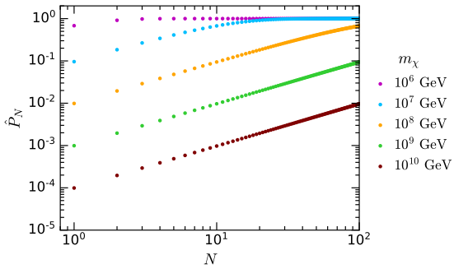
CAPTURE (NS)
02
Need to use/include:
Schwarzschild metric
Relativistic kinematics
Pauli blocking
Capture probability/average energy transfer (for multiple scattering/heavy DM)
Hadronic Form Factors
Target effective mass due to self-interactions
For large mass, one has $P_{1}\sim \frac{m^{∗}}{m_{χ}}$, and for small $σ$ the capture rate is suppressed by $P_{1}$
$$m^{∗}\sim ℴ\left({10}^{5−6}GeV\right)\left(hadrons\right)$$
$$m^{∗}\sim ℴ\left({10}^{4−5}GeV\right)(leptons)$$

Slide 13
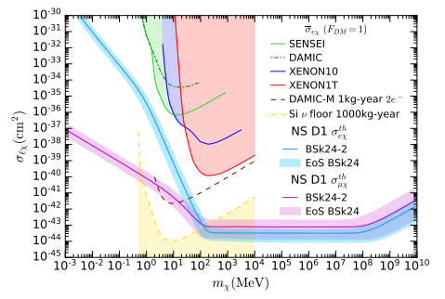
CAPTURE (NS)
02
Need to use/include:
Schwarzschild metric
Relativistic kinematics
Pauli blocking
Capture probability/average energy transfer (for multiple scattering/heavy DM)
Hadronic Form Factors
Target effective mass due to self-interactions
$σ<σ_{th}{\left(\frac{T_{eq}}{T_{eq}^{MAX}}\right)}^{4}$< $σ_{th}{\left(\frac{T}{T_{eq}^{MAX}}\right)}^{4}$

Slide 14
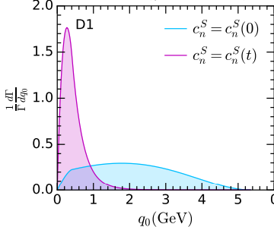
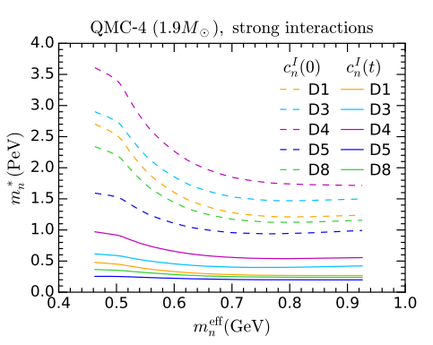
CAPTURE (NS)
02
Need to use/include:
Schwarzschild metric
Relativistic kinematics
Pauli blocking
Capture probability/average energy transfer (for multiple scattering/heavy DM)
Hadronic Form Factors
Target effective mass due to self-interactions
Lower average energy transfer
Larger suppression at large mass

Slide 15
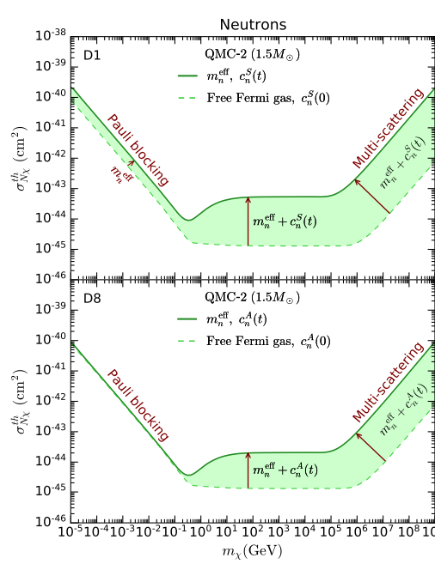
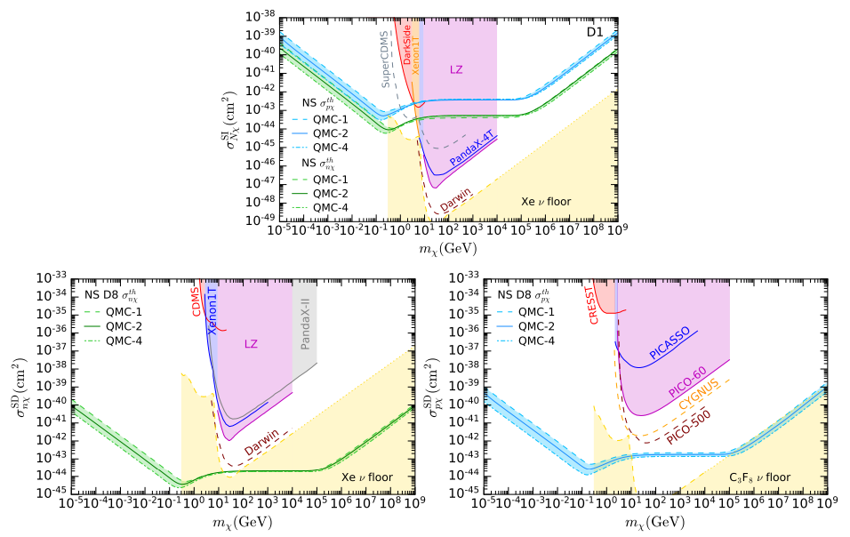
CAPTURE (NS)
02
Need to use/include:
Schwarzschild metric
Relativistic kinematics
Pauli blocking
Capture probability/average energy transfer (for multiple scattering/heavy DM)
Hadronic Form Factors
Target effective mass due to self-interactions

Slide 16
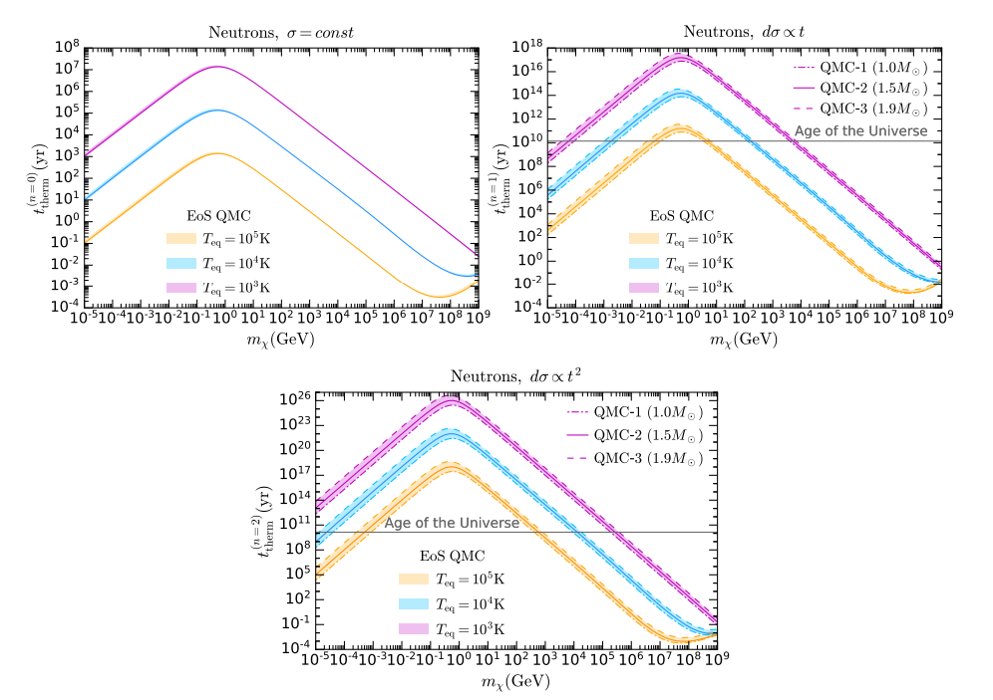
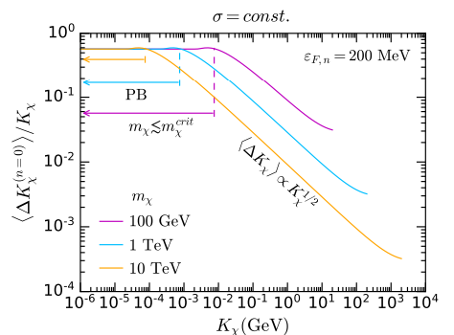
Thermalisation (NS)
03
JCAP 04 (2024) 006
Interaction rate $(R)$ is decreasing function of energy $\left(x\right)$
Most energy is transferred in a very short timeframe Kinetic heating always happens
Thermalisation time driven by the last few scatterings
Unless DM mass very large, last scatterings are pauli suppressed

Slide 17
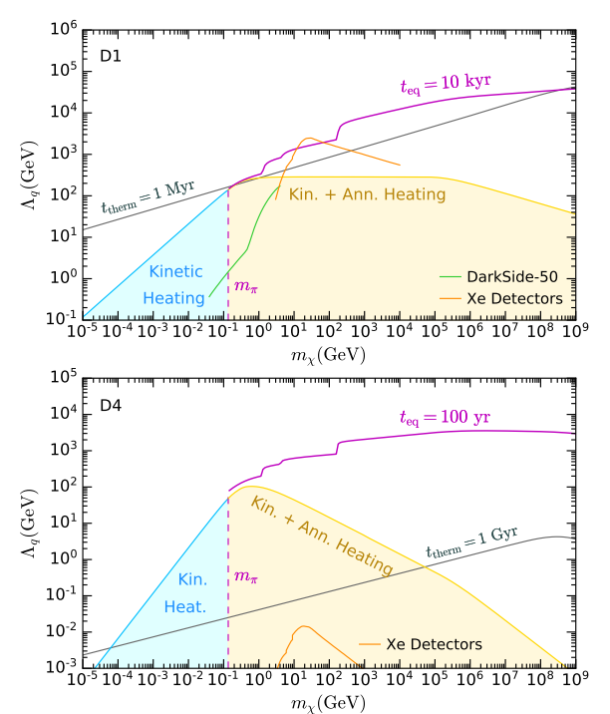
Thermalisation (NS)
03
Ultimate goal: is DM energy released in the star on a timescale smaller than the star lifetime (1Gy)?
What about annihilation heating?
If DM thermalizes within star lifetime:
Use DM temperature to compute annihilation rate
Use Annihilation rate to compute the Capture-Annihilation equilibrium timescale
Check that it is smaller than star age
If DM DOES NOT thermalize within star lifetime:
Find DM average energy
Use average energy to compute annihilation rate
Use Annihilation rate to compute the Capture-Annihilation equilibrium timescale
Check that it is smaller than star age
Result: Capture-Annihilation equilibrium is always reached if DM annihilation channels kinematically open

Slide 18
MOTIVATIONS (WD)
01
More than 90% of the stars in the Galaxy are White Dwarfs (WDs)
High density, extreme conditions and the existence of observational data
Powerful probe to test and constrain dark matter (DM) models
This generally involves the accumulation of DM particles
Increase in their luminosity
DM-triggered supernova ignition/black hole formation

Slide 19
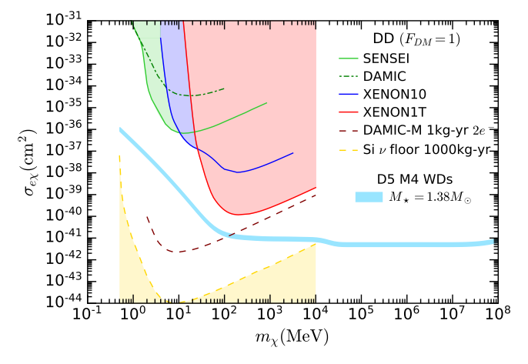
CAPTURE (WD)
02
Set limit from minimum observed luminosity
No relativistic speed, needs annihilation to increase luminosity
Electrons: degenerate, similar to NS
Ions: non-degenerate, similar to Sun

Slide 20
MOTIVATIONS (WD)
01
$$\frac{dN}{dt}=C$$
Capture
Thermalisation/
Energy Distribution
Space distribution
Critical DM quantity
Limit from collapse
$$N=Ct$$

Slide 21
MULTIPLE SCATTERING (WD)
02
JCAP 07 (2024) 051
DM Capture usually based on Gould seminal work for Capture in the Earth:
(i) DM trajectories are unaffected by collisions
(ii) Constant escape velocity
(iii) Constant iron (target) density
(iv) DM follows linear trajectories outside and inside the Earth’s core, thereby neglecting gravitational focusing/gravity effects
Assumptions (ii-iv) are actually unnecessary
We will see that the rate can be calculated (nearly) exactly

Slide 22
MULTIPLE SCATTERING
02
Additional approximations usually made:
Optical depth inside the star $Rn_{T}σ$, equal to the value at the center, for any point inside the star
Differential cross section on target $dσ/dcosθ\sim$constant
What we do:
Only assume (i) DM trajectories are unaffected by collisions
Optical depth inside star depends on interaction rate
Same interaction rate used for Capture for consistency
Optical depth depends on the point in the star
Need to average over all trajectories
Cross section very suppressed at large $E_{R}$ (realistic)
$σ_{χp}\sim const→σ_{χT}∝e^{−E_{R}/E_{0}}$

Slide 23
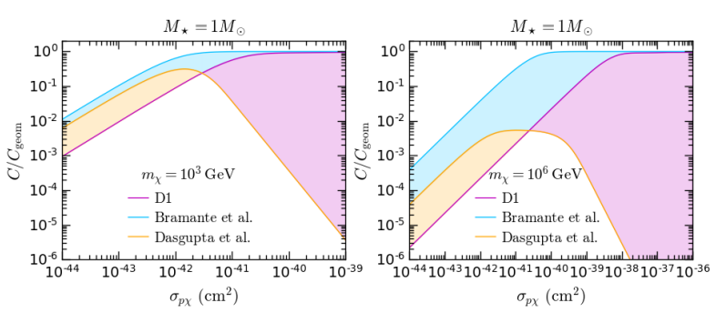
multiple scattering
02

Slide 24
Thermalisation (WD)
03
JCAP 07 (2024) 051
Two approximations are possible, they require 2 different assumptions
One needs relative speed to be dominated by either DM or Target
The other one, for large DM mass, requires Target speed to be small
Zero temperature approximation (high energy DM)
Appropriate for capture
Both approximations can be applied
Large mass approximation
Appropriate for Thermalisation of very heavy DM
Thermalisation time driven by last part where DM speed very low
Only one assumption is verified

Slide 25
Thermalisation (WD)
03
Thermalisation time give by
Interaction rate
Large number of scatterings
Energy loss per unit time
Note
$$Ω_{T}^{−}≡Γ$$
$$R_{T}^{−}≡\frac{dΓ}{dq_{0}}$$

Slide 26
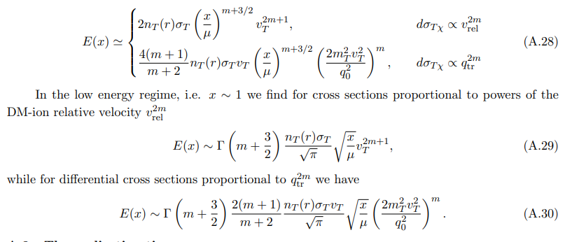
thermalisation
03
In the large energy limit/zero temperature approx.:

Slide 27
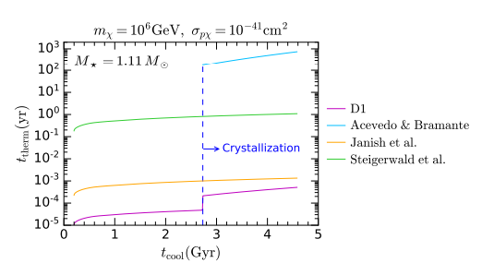
thermalisation
03

Slide 28
Self gravitation
04
No DM self-repulsive forces
DM collapses to isothermal sphere of radius
Gravitational field due to DM at center can reach same order of magnitude of the one generated by ordinary matter
Requires
Star develops an instability and Core-Collapse is triggered

Slide 29
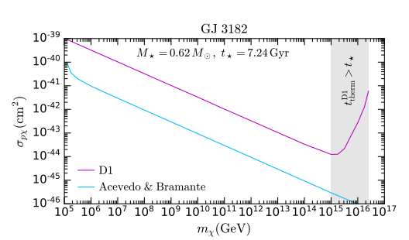
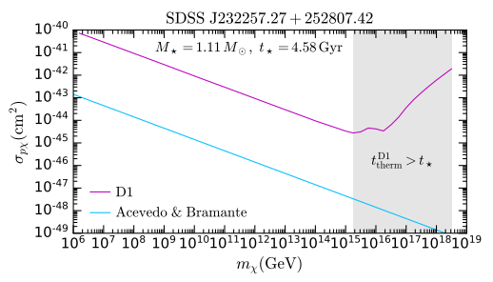
Self gravitation
04
3 orders of magnitude

Slide 30
Conclusions
05
NS and WD are interesting probe for DM
Capture, thermalisation (and annihilation) rates necessary to predict observables
Typical observables (NS): BH collapse, modified GW, heating
Typical observables (WD): luminosity, DM triggered collapse/Supernova
(Potential) limits highly competitive with DD
For NS heating, outperforming DD for SD
For WD, luminosity outperforming DD for electrons
For WD, SN constraint very strong at large mass
DM-induced WD collapse revisited using updates rates
Cross section required up to 3 orders of magnitude larger

