Slide 1
GRAINE project : a balloon experiment for cosmic GeV Gamma rays
TMEX 2025, 10th Jan. 2025
○Shogo Nagahara^{B}, GRAINE collaboration^{A, B, C, D, E, F}
^{A}Kobe University, ^{B}Nagoya University,
^{C}Okayama University of Science,
^{D}Gifu University, ^{E}Aichi University of Education and ^{F}ISAS/JAXA
Notes:
Thank you for inviting our group the opportunity to speak.
My name is Shogo Nagahara.
Today, I talk about GRAINE project, a balloon-borne experiment for cosmic GeV Gamma rays.

Slide 2
Outline
Introduction
  What is GRAINE?
    Gamma-Ray Astro Imager with Nuclear Emulsion
    Balloon-borne experiment.
    World’s Highest imaging of Vela pulser.
      0.4deg 68%radius (>80MeV)
Our latest flight (2023 flight @Australia)
  We started scientific observation.
  Latest analysis status of GRAINE 2023.
Future prospect
Fermi-LAT resolution
GRAINE 2018 resolution
GRAINE 2018, Vela pulser
Takahashi et al., (2024)
Our telescope of GRAINE2023
Fermi-LAT> 1GeV
Notes:
Today, I would like to introduce the GRAINE project, Gamma-Ray Astro Imager with Nuclear Emulsion.
We are developing a unique balloon-borne Gamma-ray telescope using nuclear emulsion technology.
Our telescope has 1 order of magnitude higher angular resolution compared with Fermi-LAT.
In 2018 experiment, we imaged Vela pulser with world highest angular resolution.
As a next step, we started scientific flight.
This experiment was conducted in April, 2023 in Australia.
This is the first flight of scientific observation.
Today, I talk about the latest analysis status of this flight data.
And last, I talk future prospect of this project.

Slide 3
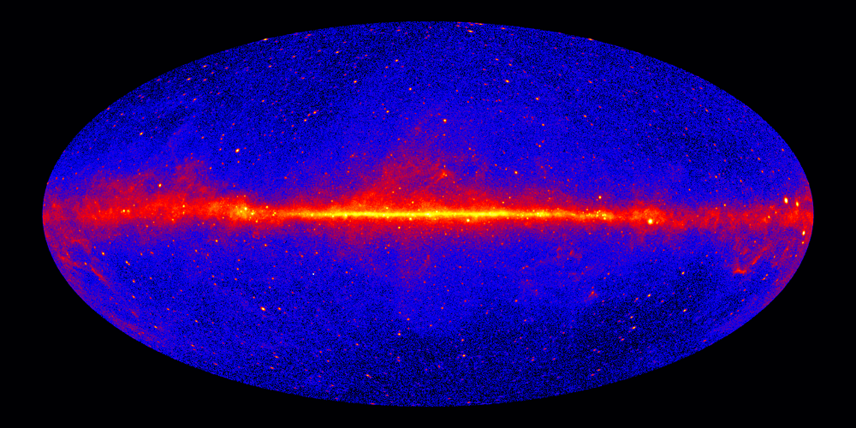
Cosmic Gamma ray(sub-GeV,GeV)
γ-ray observations have made great progress with the discovery of many γ-ray sources by Fermi-LAT.
NASA Fermi-LATによる9年間の観測 >1GeV
Image Credit:
NASA/DOE/Fermi LAT Collaboration
Fermi-LAT> 1GeV
Notes:
High-energy gamma rays are very important probes for understanding high-energy phenomena in space and cosmic ray acceleration mechanisms. Because gamma rays arrive at Earth without being influenced by the effects of interstellar magnetic fields, gamma rays keep information about the source.
High energy gamma-ray observations have made great progress with the discovery of many γ-ray sources by observations with the Fermi-LAT detector. This is Fermi-LAT results.
However, the observations made using the Fermi-LAT are limited by its angular resolution.
宇宙ガンマ線は電磁場の影響を受けないため、宇宙で発生した高エネルギー事象の発生源探索と、その現象理解に重要な情報を与える。
Fermi-LATによる全球観測により、多くのγ線天体が発見されたが、光学技術が使えないγ線観測ではその解像度は多波長に比べ十分とは言えない。

Slide 4
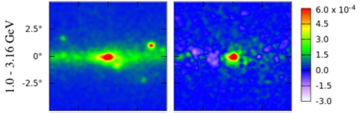
Cosmic Gamma ray(sub-GeV,GeV)
However, there are some unresolved issues in this energy observation.
Galactic Center
Vela Pulsar
All photons
Subtracts
NASA Fermi-LATによる9年間の観測 >1GeV
T. Daylan et al., P hys.DarkUniverse,Vol.12,pp1 (2016)
Fermi-LAT> 1GeV
Notes:
However, there are some unresolved issues in this energy observation.
Here we focus on Angular resolution and polarimitry.

Slide 5
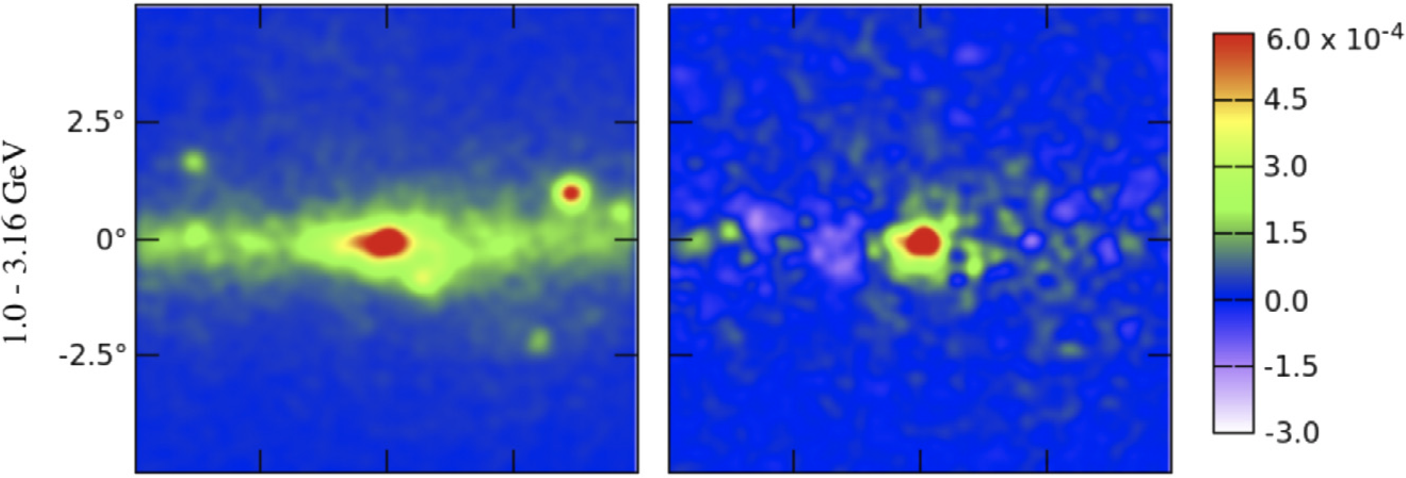
Unresolved issues in gamma-ray observation
・Unknown gamma-ray emission in the Galactic center region
Count map (All photons)
Subtracted
Known sources
BG (model)
Galactic Center
GeV Excess
Annihilation of WIMPs ?
Unresolved astrophysical object ?
The discussion has been going on for more than a decade.
One of the known-unknown issues
Notes:
There are some unresolved issues in this energy observation.
One of them is Unknown γ-ray emission in the Galactic center region in the energy band is 1 to 3 GeV.
The upper left figure shows the distribution of the all photons near the galactic center region as observed by Fermi.
The upper right figure shows the number of photons subtracted from the known sources and background model.
Is this annihilation of dark matter WIMPs or unresolved astrophysical objects?
The discussion has been going on for more than a decade.
This topic is one of the known-unknown issues of GeV gamma-rays.
Weakly Interacting Massive Particle
銀河中心領域には、未知のγ線源の存在が知られています。
左上はFermiで観測された銀河中心領域の全photon数分布です。エネルギー領域は1.0から3.16GeVです。
右上は既知のγ線源とバックグラウンドモデルを差し引いたものです。
銀河中心の周辺１度の範囲にexcessが存在しています。
この議論は１０年以上続いています。
これはGeVガンマ線の重要なトピックの一つです。

Slide 6
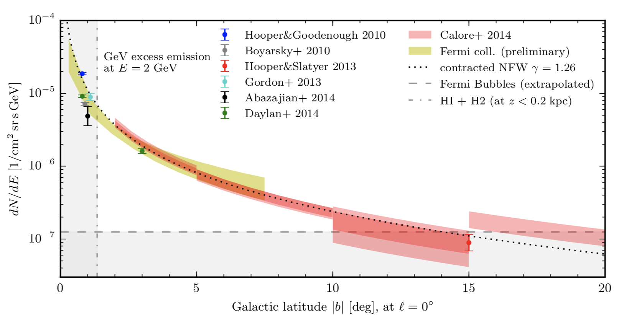
Unresolved issues in gamma-ray observation
・Unknown gamma-ray emission in the Galactic center region
Francesca Calore, Ilias Cholis, et al.,Phys. Rev. D 91, 063003
DM Density increases near the center
→ Gamma-ray emissions sharply increase
The most central region is interesting to confirm this trend with more reliable
Excess gamma-ray flux
All data points are results from
Fermi data analyzed by different groups
NFW(DM density profile),γ=1.26 is favored
Contamination of
Galactic Diffuse Component
(Fermi)
Distance
from the Galactic center
Inner region cannot be verified
due to limitations of Fermi's angular resolution.
Notes:
However, we can not solve this issue by continuing to observe Fermi.
This figure shows the relationship between the distance from the galactic center and the flux of γ-ray excess.
All data points are results from Fermi observation data analyzed by various groups.
This dotted line shows simple dark matter density profile.
Dark matter density profile increases near the center, so Gamma-ray emissions sharply increase.
So we are interested in the most central region to confirm this trend with more reliable.
However, inner region Inner region cannot be verified due to limitations of Fermi's angular resolution.
It is about 1 degree.
しかし、我々はFermiの観測を続けてもこの問題は解決できません。
この図は銀河中心からの距離とγ線エクセスのフラックスの関係です。
点が異なるグループによるFermiの全解析結果です。
青い線がFermiの角度分解能です。

Slide 7
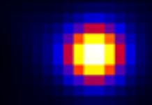
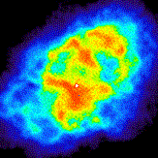
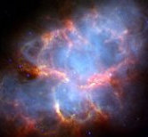
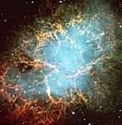
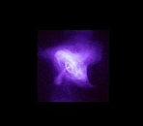
  Imaging Performance
  of Fermi-LAT
γ ray >1GeV
(Fermi-LAT)
Radio
Crab Nebula
（M1:SN1054）
Infrared
0.1°
0.1度
Same scale
Visible
All objects are blurred
with the size of the moon!!
X ray
Improvement of Angular res. is needed
Notes:
You know the angular resolution of gamma-ray is very poor.
This is a comparison of crab nebula observations in Fermi and other wavelength bands.
In other wavelength bands, angular resolution is less than 0.1 degree.
However, in case of Fermi, more than 1degree.
So, All objects are blurred with the size of the moon. We need to improvement of angular resolution.

Slide 8
Gamma-ray Polarimetry
High-energy-photon polarization provides information on the emission mechanism of pulsars and AGNs.
X-ray : IXPE (2021～)
  Vela pwn:
  >60%(local), 45%(ave.)
γ-ray : Unexplored
  Models predict high polarization degree at MeV-GeV
  Pulsars : 40-80%
    J. Takata and H.-K. Chang, Astrophys. J. 670 (2007) 677
    J. P ́etri, Mon. Not. Roy. Astron. Soc. 434 (2013) 2636
  Blazars : >70%(hadronic)
    Zhang and B ̈ottcher, Astrophys.J. 774, 18 (2013)
  Detector capable of polarization observations in the gamma-ray band is awaited.
IXPE, Xie et al, Nature (2022)
*COSI will start in sub-MeV/MeV region
Notes:
Second, I focus on gamma-ray polarimetry.
You know the high-energy photon provides information on the emission mechanism of pulsars and AGNs (Active Galactic Nucleus).
In X-ray band, IXPE observed of X-ray polarimetry imaging.
This figure shows high polarization degree from the Vela pulser wind nebula.
On the other hand, gamma-ray observation is unexplored.
Some models predict high polarization degree at MeV to GeV energy bands of the pulsers and blazars.
Detector capable of polarization observations in the gamma-ray band is awaited.

Slide 9
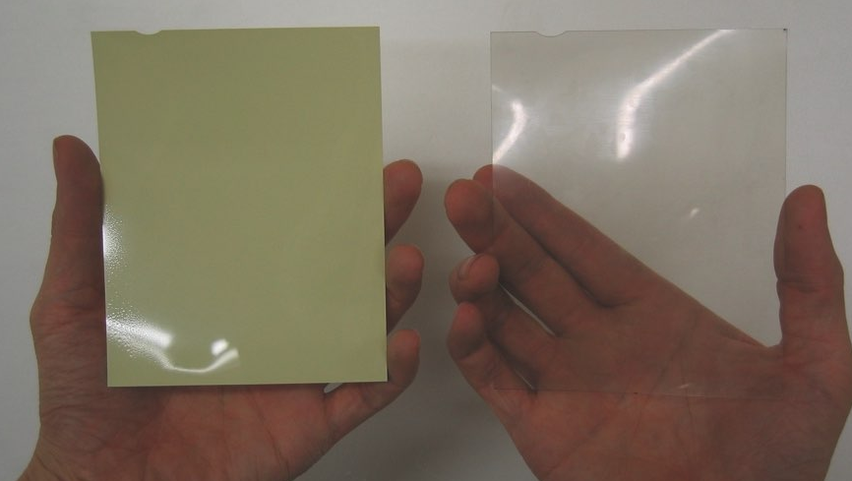
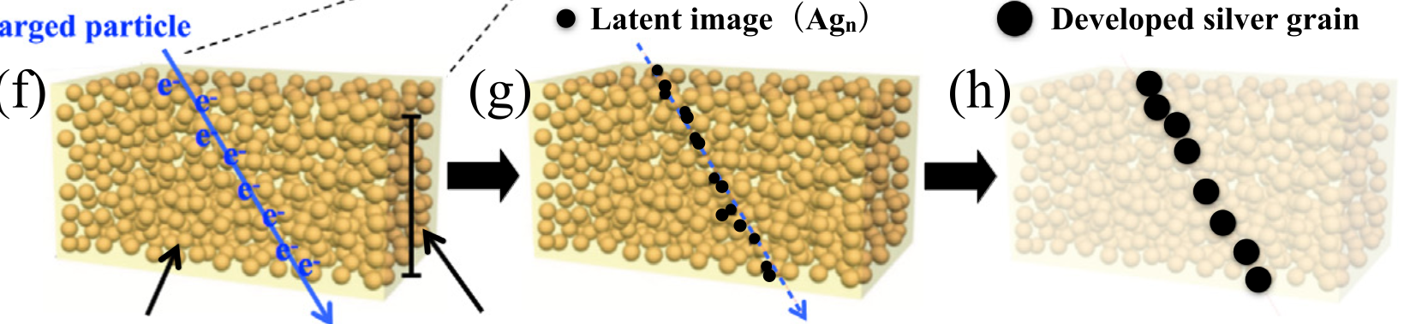
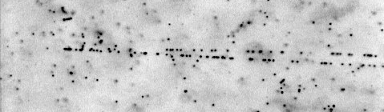
Nuclear Emulsion
A photographic film that can record the trajectories
of charged particles in 3D with high resolution.
Charged Particle
AgBr crystals
(diameter: 200 nm)
Gelatin
Intrinsic Res. ~50 nm
10㎛
γ-ray
e＋
Pair Creation
e－
Emulsion functions a converter and tracker at the same time.
High-Angular Res. / Polarimetry / Scalability
Notes:
So, we are developing unique gamma-ray telescope using nuclear emulsion technology.
Nuclear emulsion is the photographic films that can record the trajectories of charged particles in 3-dimensional with high resolution.
Middle figure shows the principle of our nuclear emulsion detector.
Intrinsic position resolution achieve that 50 nanometer, so very high resolution.
Bottom figure shows the microscopic view of nuclear emulsion.
Emulsion is function as converter of gamma-ray, so this microscopic image detect the gamma-ray pair creation event.
And it is also tracker for the electron and positron tracks at the same time.
Emulsion film can determine the gamma-ray direction with high angular resolution.
And it has also polarization sensitivity because we can determine the direction of electron and positron before Multiple Coulomb scattering.
And it has large scalability because it is just a film.
Nuclear emulsion has three layers: an emulsion gel, a plastic base and an emulsion gel. Typically, the thicknesses are 50-80μm for gel and 180-210μm plastic base. The main components of the gel are AgBr crystals and gelatin. When a charged particle passes through the gel layer, latent images are created nearby the trajectory of the particle. After chemical development, these latent images become sub-micron silver grains. The three-dimensional line that connects silver grains is the trajectory of the charged particle.
Intrinsic : 本質的な

Slide 10
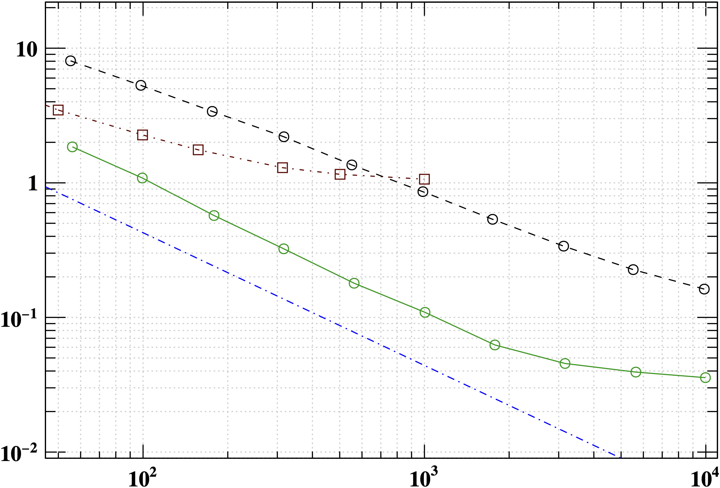

Comparison Post-Fermi (AMEGO/APT)
APT/ADAPT
AMEGO-X(Future)
Angular resolution[$°$]
Fermi-LAT(2008～)
Emulsion Film has High-Angular Res.
Recoil nucleus uncertainty
Emulsion film
100MeV
1GeV
Gal. GeV Excess
10GeV
Our Energy Band
Energy
Notes:
This is angular resolution of gamma-ray of each energy.
This line shows the Fermi-LAT launched in 2008.
And I also plot the performance of post Fermi telescope, such as AMEGO-X(アミーゴエクス) or APT(エーピーっティー).
On the other hand, this green line shows the performance of emulsion film.
Our detector has very high resolutions compared with these projects even in the galactic GeV excess resions.
GRAINE2018の分解能が、68%区間で0.42度。
ゴンドラ：0.3[deg/s]
※方位角変化。なのでvela方位ぐらいだともっといい。
tanθ＝1.0ぐらいで見積もると√2分の1で大体0.2[deg/s]。
2018シフター：0.8[s]
青：原理限界。eペア生成時の原子核にエネルギー与える分の不定性
緑：Emulsionの角度分解能
黒：Fermi
茶：AMEGO-X：eペアの角度分解能。2030年代衛星実験計画

Slide 11
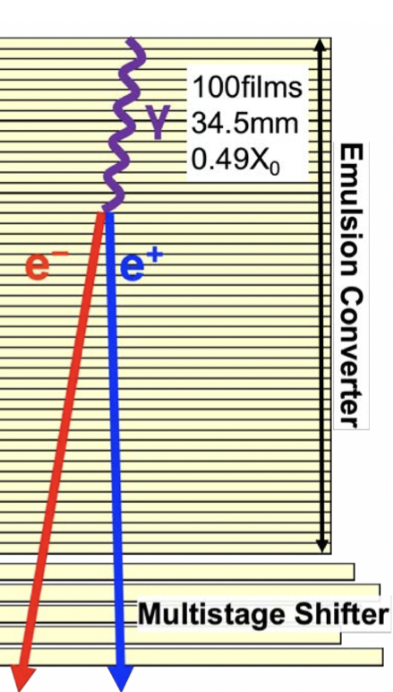
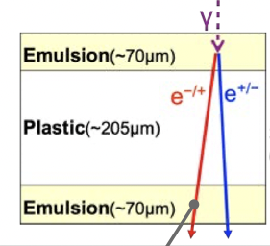
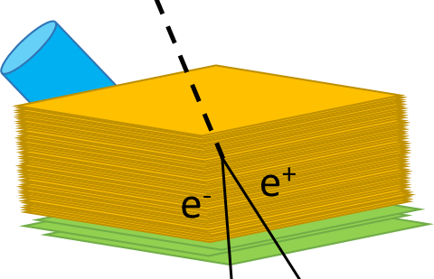


Balloon-borne Emulsion Gamma-ray Telescope
Gamma-Ray Astro Imager with Nuclear Emulsion
●Attitude monitor
●Converter
γ
●Timestamper
 | Fermi-LAT | GRAINE
Angular Res. @100MeV | 6.0° | 1.0°
@1GeV | 0.9° | 0.1°
Polarization Sensitivity | － | Yes
Effective Area@100MeV | 0.25㎡ | 2.1㎡*
@1GeV | 0.88㎡ | 2.8㎡*
x1/6
High-angular resolution
Polarization sensitive
Large aperture area
x1/9
x8
x3
*10㎡×$ε_{trans}$× $ε_{conv}$× $ε_{det}$
Notes:
So we are developing the balloon-borne emulsion gamma-ray telescope. This project name is Gamma-Ray Astro Imager with Nuclear Emulsion : GRAINE.
The telescope of GRAINE consists of three major components: Conveter, Timestamper and attitude monitor.
The converter part consist of 100 emulsion films.
It determined gamma-ray direction precisely.
At the bottom point, timestamper gives time information to electron positron tracks.
This part consist of multistage shifter. We can determine the track time from the positon of connection each films.
Attitude monitor consists of star camera.
This part capture the image to determine the telescope direction of each time.
By combining these information, we can determine the gamma-ray direction to celestrial direction coordinate.
GRAINE has higher angular resolution compared with Fermi-LAT by factor of 9 or 6.
And it has polarization sensitivity.
And our telescope made by the film. So we can enlarge the detecter area easily.
the celestrial direction : 天体の方向
最新の衛星と比べて
・１桁近く高い角度分解能
・初の偏光有感
・最大口径

Slide 12
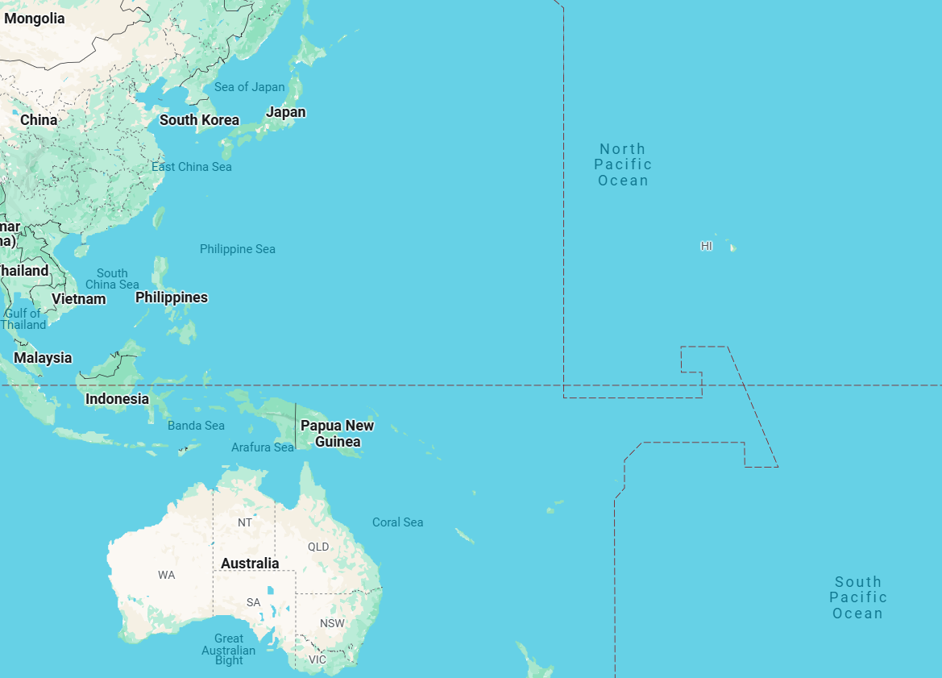
GRAINE Project
2011 1st Balloon exp. @Hokkaido, JPN
1.6hour, 0.0125㎡
Checking Feasibility
H.Rokujo et al. NIMA 701, 127 (2013).
S.Takahashi et al. PTEP 2015 043H01.
2015 2nd Balloon Exp. @AliceSprings, AUS
11.5hour, 0.378㎡
Detector Performance
K.Ozaki et al. JINST 10, P12018 (2015)
S.Takahashi et al. PTEP 2016, 073F01
H. Rokujo et al. PTEP 2018, 063H01
Qui Nhon
2018 3rd Balloon Exp. @AliceSprings, AUS
14.7hour, 0.378㎡
Detection & Highest imaging of Vela pulser
H. Rokujo et al. JINST 14, P09009 (2019)
Y. Nakamura et al. PTEP 2021, 123H02
S.Takahashi et al., ApJ. 960 (2024) 47
Y. Nakamura et al. Astroparticle 165 (2025) 103055
2023 4th Balloon Exp. @AliceSprings, AUS
24.3hour, 2.5㎡
Notes:
So far, we have promoted GRAINE project step by step.
At the first, we conducted the small area experiment to check the feasibility in Japan in 2011.
And then, we moved to launch site to Australia.
In 2015, we checked detector performance at AliceSprings, Australia.
In 2018, we succeeded in imaging the Vela pulsar at high resolution with small tepescope.
As a next step, we developed a telescope with a larger aperture area (6.5 times larger than in 2018) to 2.5 m² and performed a balloon experiment in Australia in April 2023.
I will talk about the latest analysis status of 2023 experiment in a later section.
GRAINEではこれまで3度のフライトにより原理、性能実証を進めてきた。
2018年の観測ではVelaパルサーの世界最高解像度撮像に成功し、2023年には科学観測が予定されている。
この観測ではFermi-LATと比較し角度分解能で6倍、有効面積で3倍以上の観測を予定している。
2018年観測に比べ13倍の面積での観測を目指し準備を進めている。
GRAINEではこれまで3度のフライトにより原理、性能実証を進めてきた。
2018年の観測ではVelaパルサーの世界最高解像度撮像に成功し、2023年には科学観測が予定されている。
この観測ではFermi-LATと比較し角度分解能で6倍、有効面積で3倍以上の観測を予定している。
2018年観測に比べ13倍の面積での観測を目指し準備を進めている。
大円：Fermi-LAT PSF相当（>100MeV）。3.2度@68%信頼度
小円：GRAINE 2018のPSF。0.68度@68%信頼度
0.3[°/s]でゴンドラが回転（天頂を回転軸にして）。姿勢変化はこれがメイン（振り子や日周変化もあるが、これらは桁で小さい）。
時間分解能が1sだと角度分解能は大体このぐらいに落ち着く。0.1°を目指すならもう一声いる（0.1sが欲しい）
Velaパルサーはほ座の方角で、北半球からはほとんど見えない位置。

Slide 13
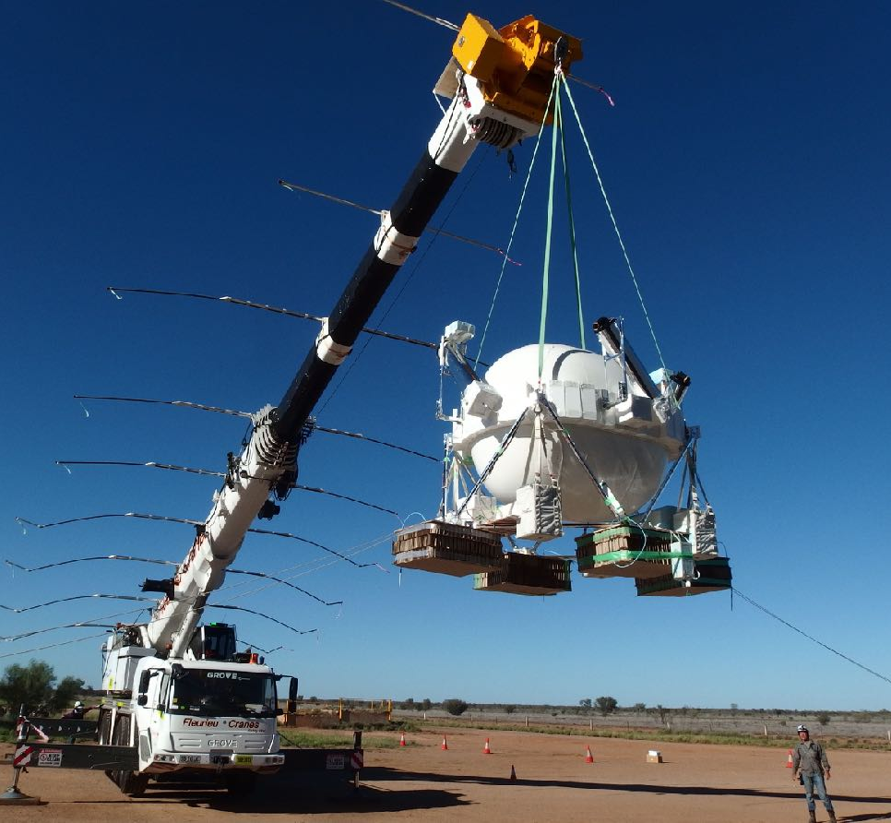
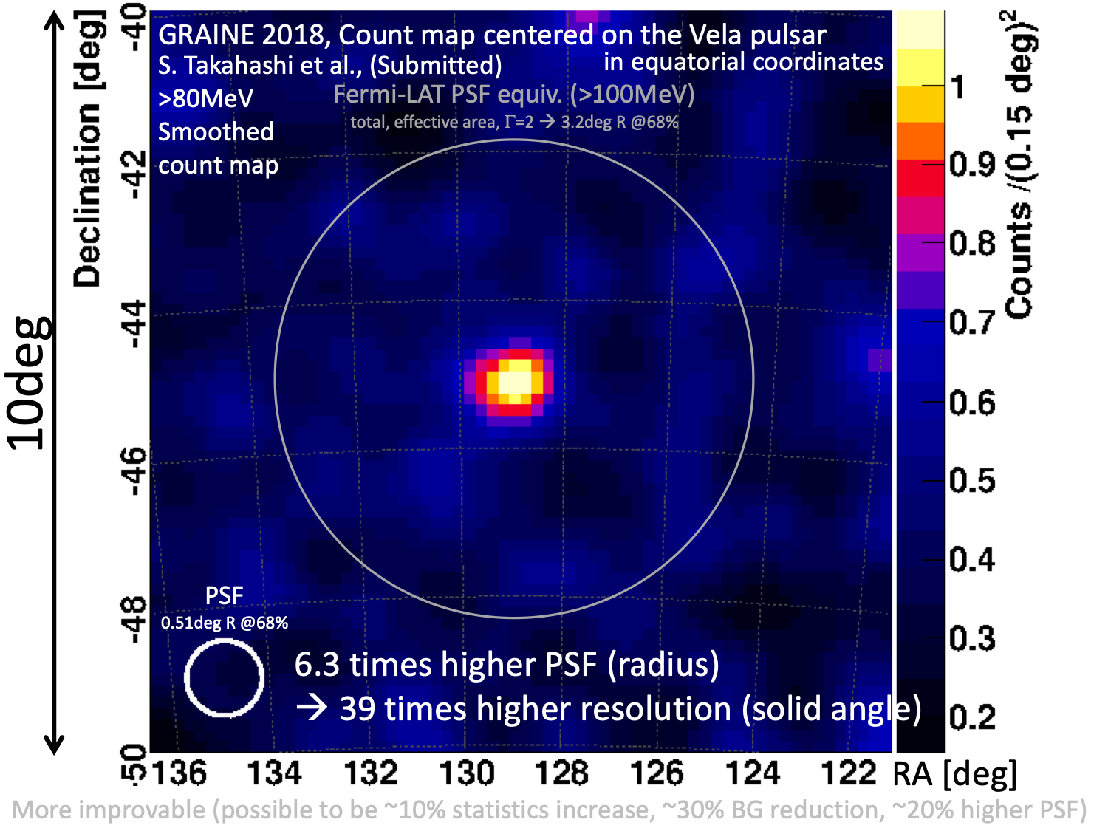
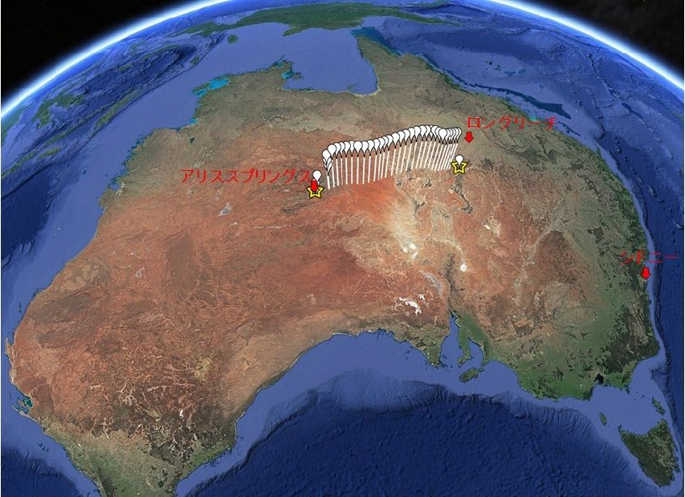
GRAINE 2018
First Detection of Vela pulsar
>80 MeV
0.4m² telescope
Balloon Flight in AUS
Flight duration ~17h
Takahashi et al., (2024, ApJ 960 47)
↑Link for this article
Detection of Vela pulsar (>80MeV)
World’s Highest imaging
  0.4deg 68%radius (>80MeV)
JAXA Balloon Program
The size is not enough for scientific observation.
Notes:
Here, I show the result of GRAINE 2018.
The aim of this experiment is to demonstrate overall performance by detecting Vela pulsar at the energy band 100 MeV with imaging resolution about 1 degree.
This is our telescope of 2018 model. The aperture area was 0.4 square meters.
The white shell is pressure vessel. And we put the 3 star cameras on the gondola with different direction.
Balloon flight was conducted April 28th in 2018. This figure shows the flight path. Flight duration is 17 hours.
This figure shows the final result of Vela image from GRAINE 2018.
We succeeded in the first detection of celestrial object using our telescope.
This large white circle indicate the performance of Fermi-LAT at 100 MeV.
And this small circle shows the performance of our telescope.
We demonstrated world highest angular resolution using Vela pulser.
However, the number of events is very small about 40 gamma-ray event.
So this telescope size is not enough for scientific observation.
大円：Fermi-LAT PSF相当（>100MeV）。3.2度@68%信頼度
小円：GRAINE 2018のPSF。0.68度@68%信頼度
0.3[°/s]でゴンドラが回転（天頂を回転軸にして）。姿勢変化はこれがメイン（振り子や日周変化もあるが、これらは桁で小さい）。
時間分解能が1sだと角度分解能は大体このぐらいに落ち着く。0.1°を目指すならもう一声いる（0.1sが欲しい）
Velaパルサーはほ座の方角で、北半球からはほとんど見えない位置。

Slide 14
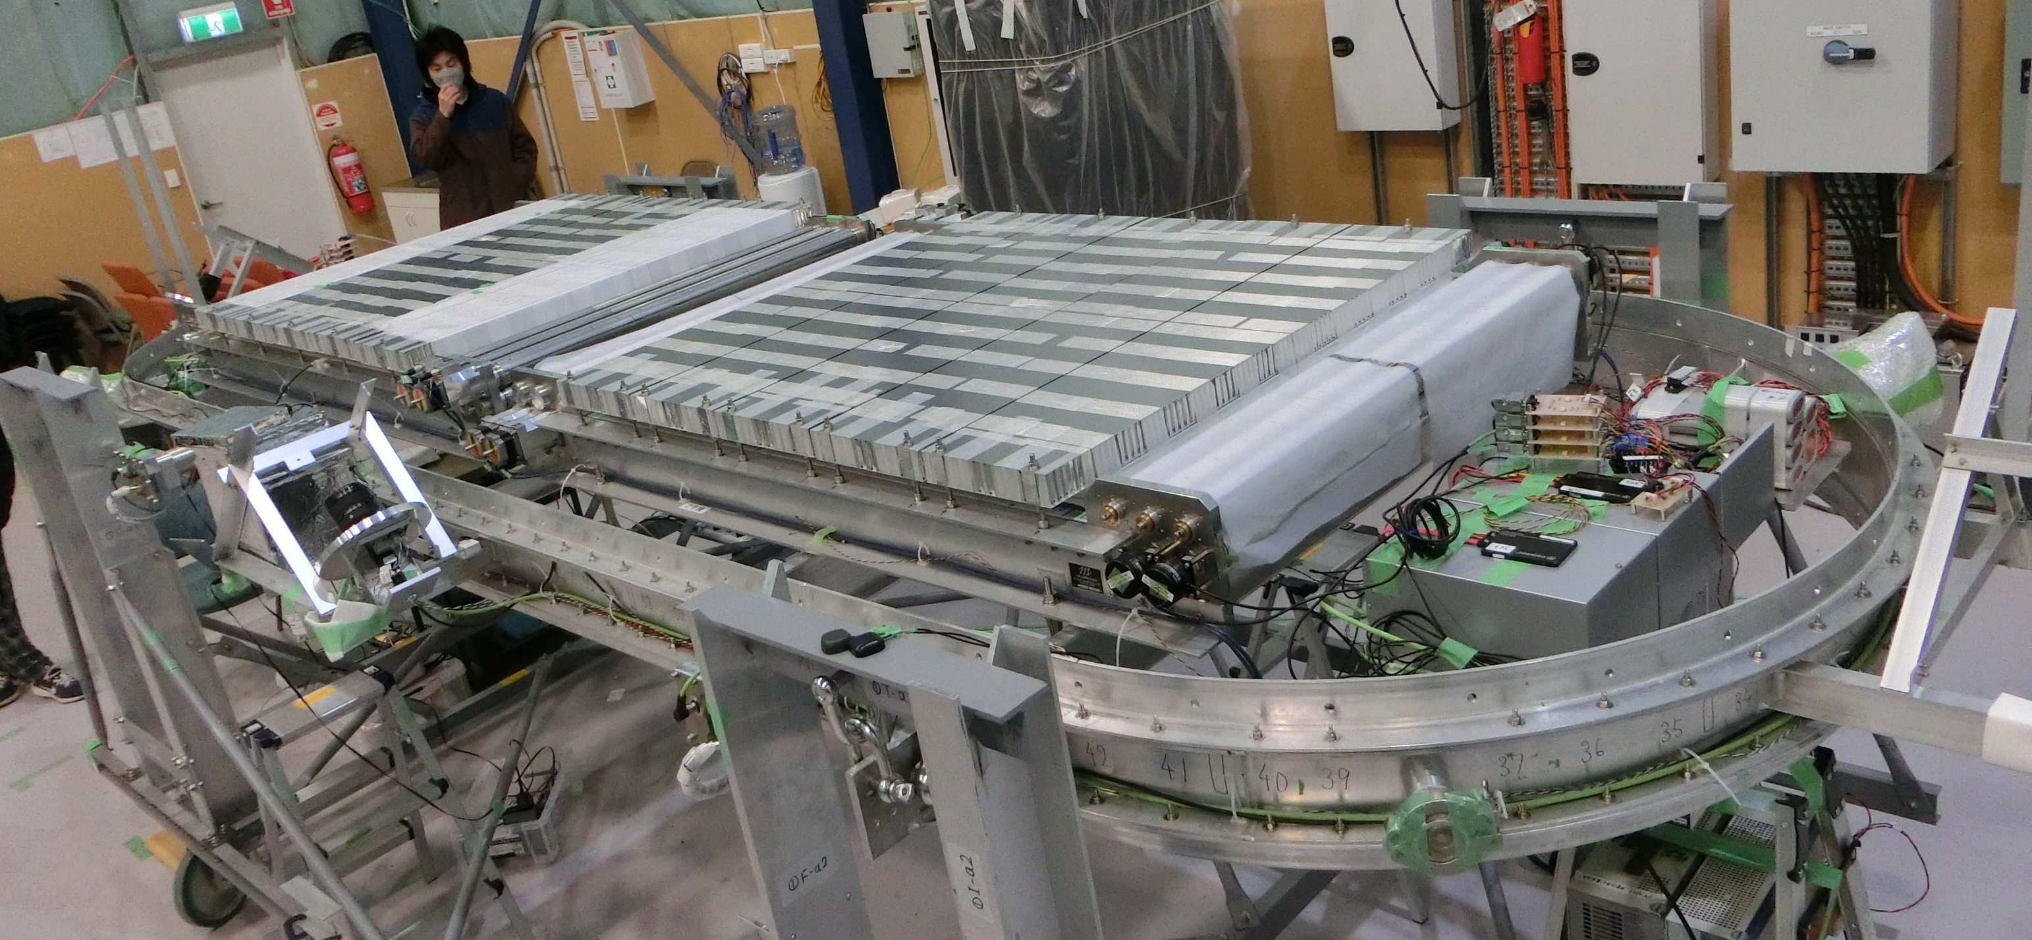
GRAINE 2023
First Scientific observation
Converter
2.5m² telescope
Attitude monitor
γ
Timestamper
Pressure vessel gondola
2.5m² telescope (6.5 times larger than in 2018)
Notes:
So toward the scientific observation, we developed our telescope to enlarge aperture area.
In 2023, we conducted the first experiment for scientific observation.
This figure shows our telescope of GRAINE 2023.
This orange area is converter, that has 2.5 square meters of aperture area.
This is 6.5 times larger than in 2018.
Converter consist of 90 films, it has 3 centimeter thickness.
The 30 percent of gamma-ray interact our converter.
24時間17分のレベルフライトを達成

Slide 15
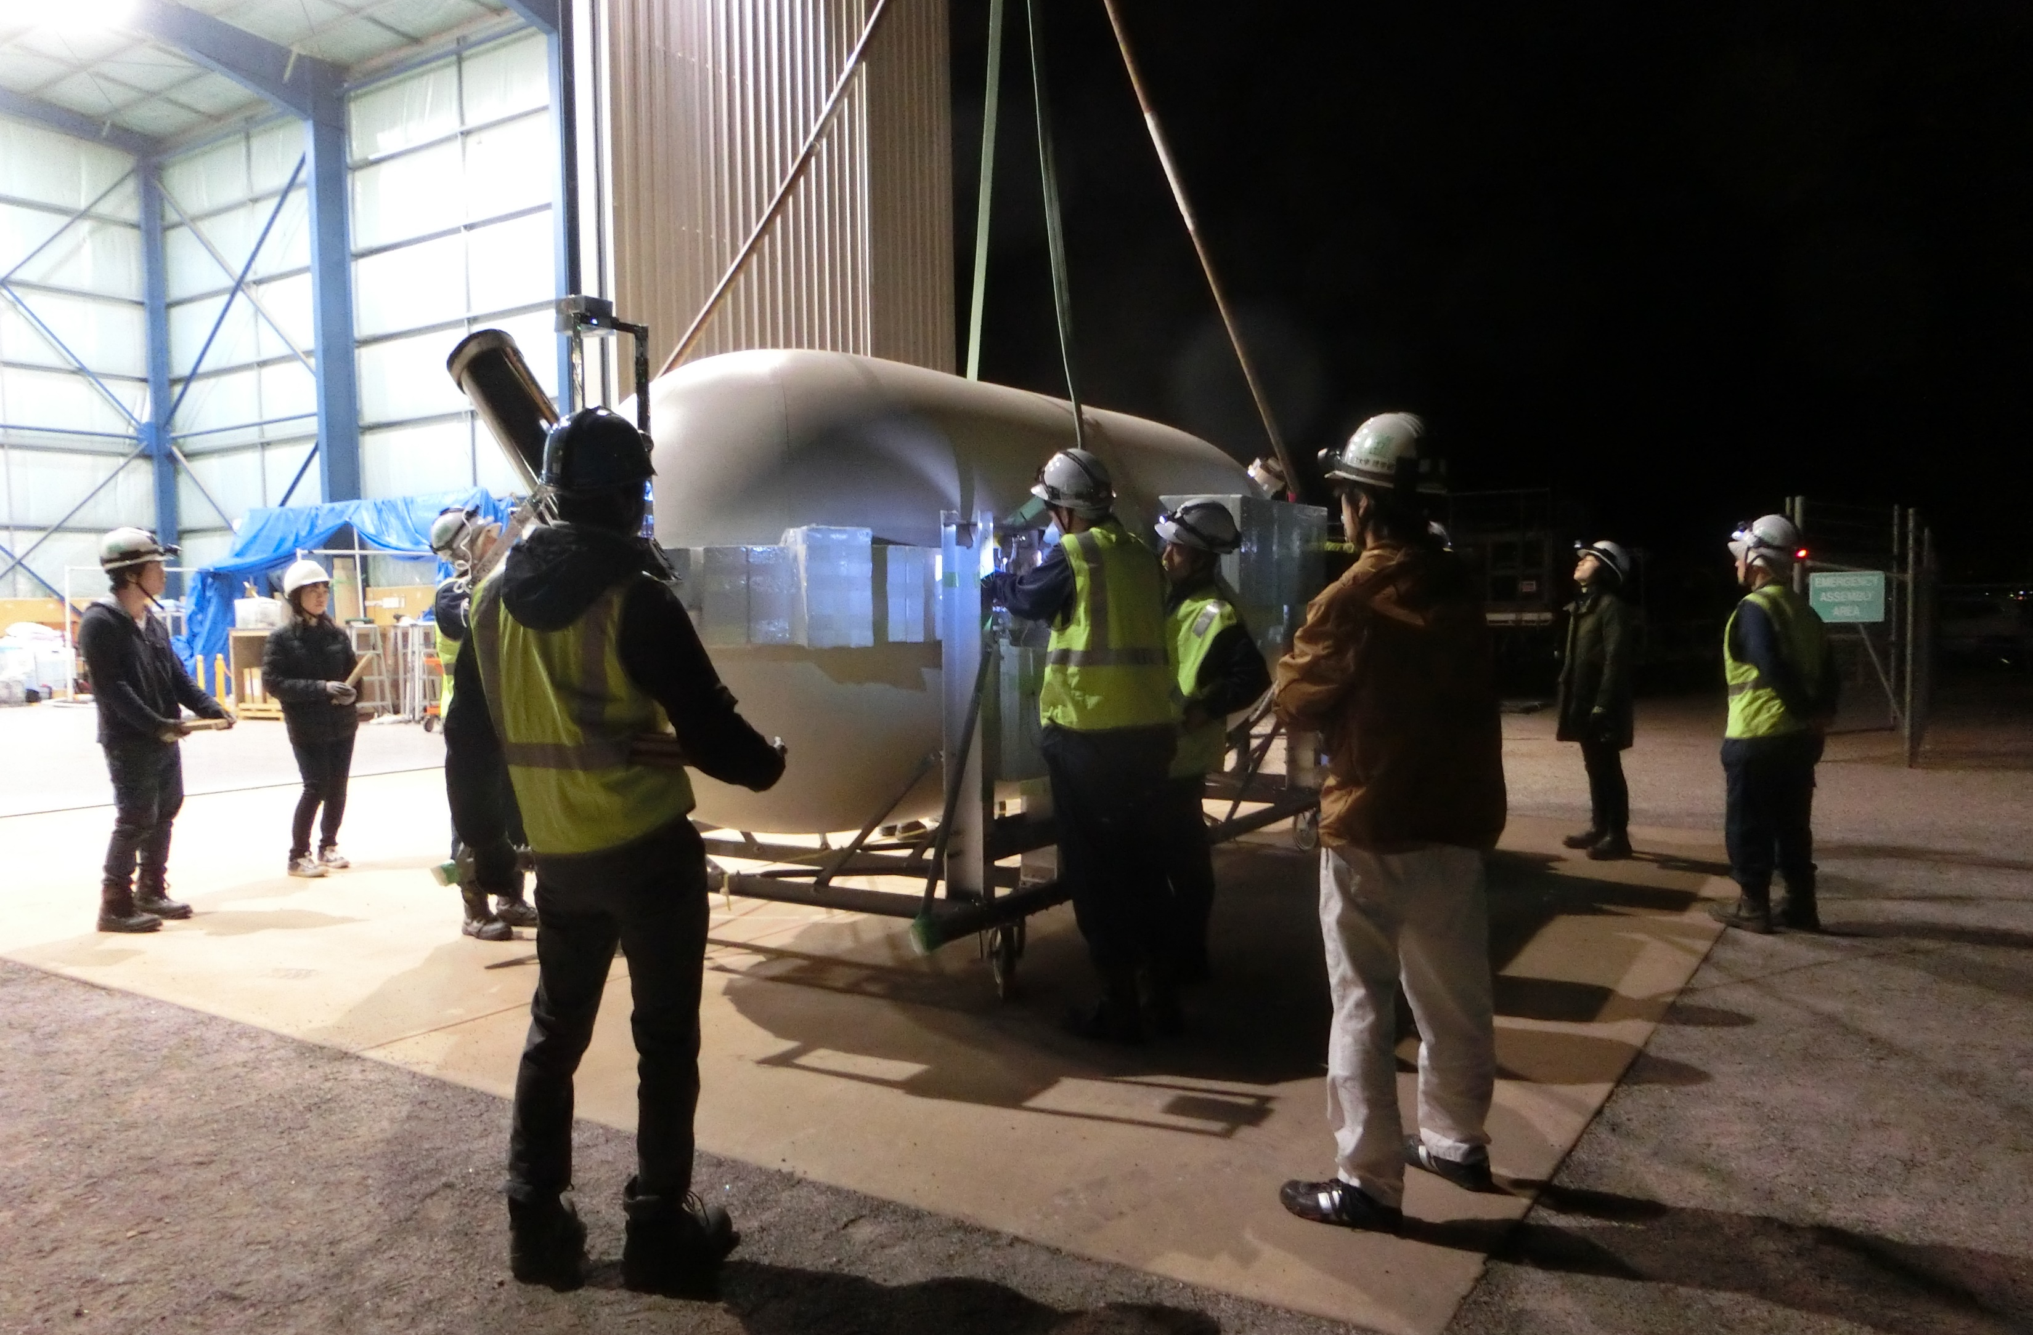
GRAINE 2023 Flight (Apl. 30th)
Notes:
The balloon was launched on April 30th in 2023.
This picture is the scene of pickup our gondola by crane at midnight.
24時間17分のレベルフライトを達成

Slide 16
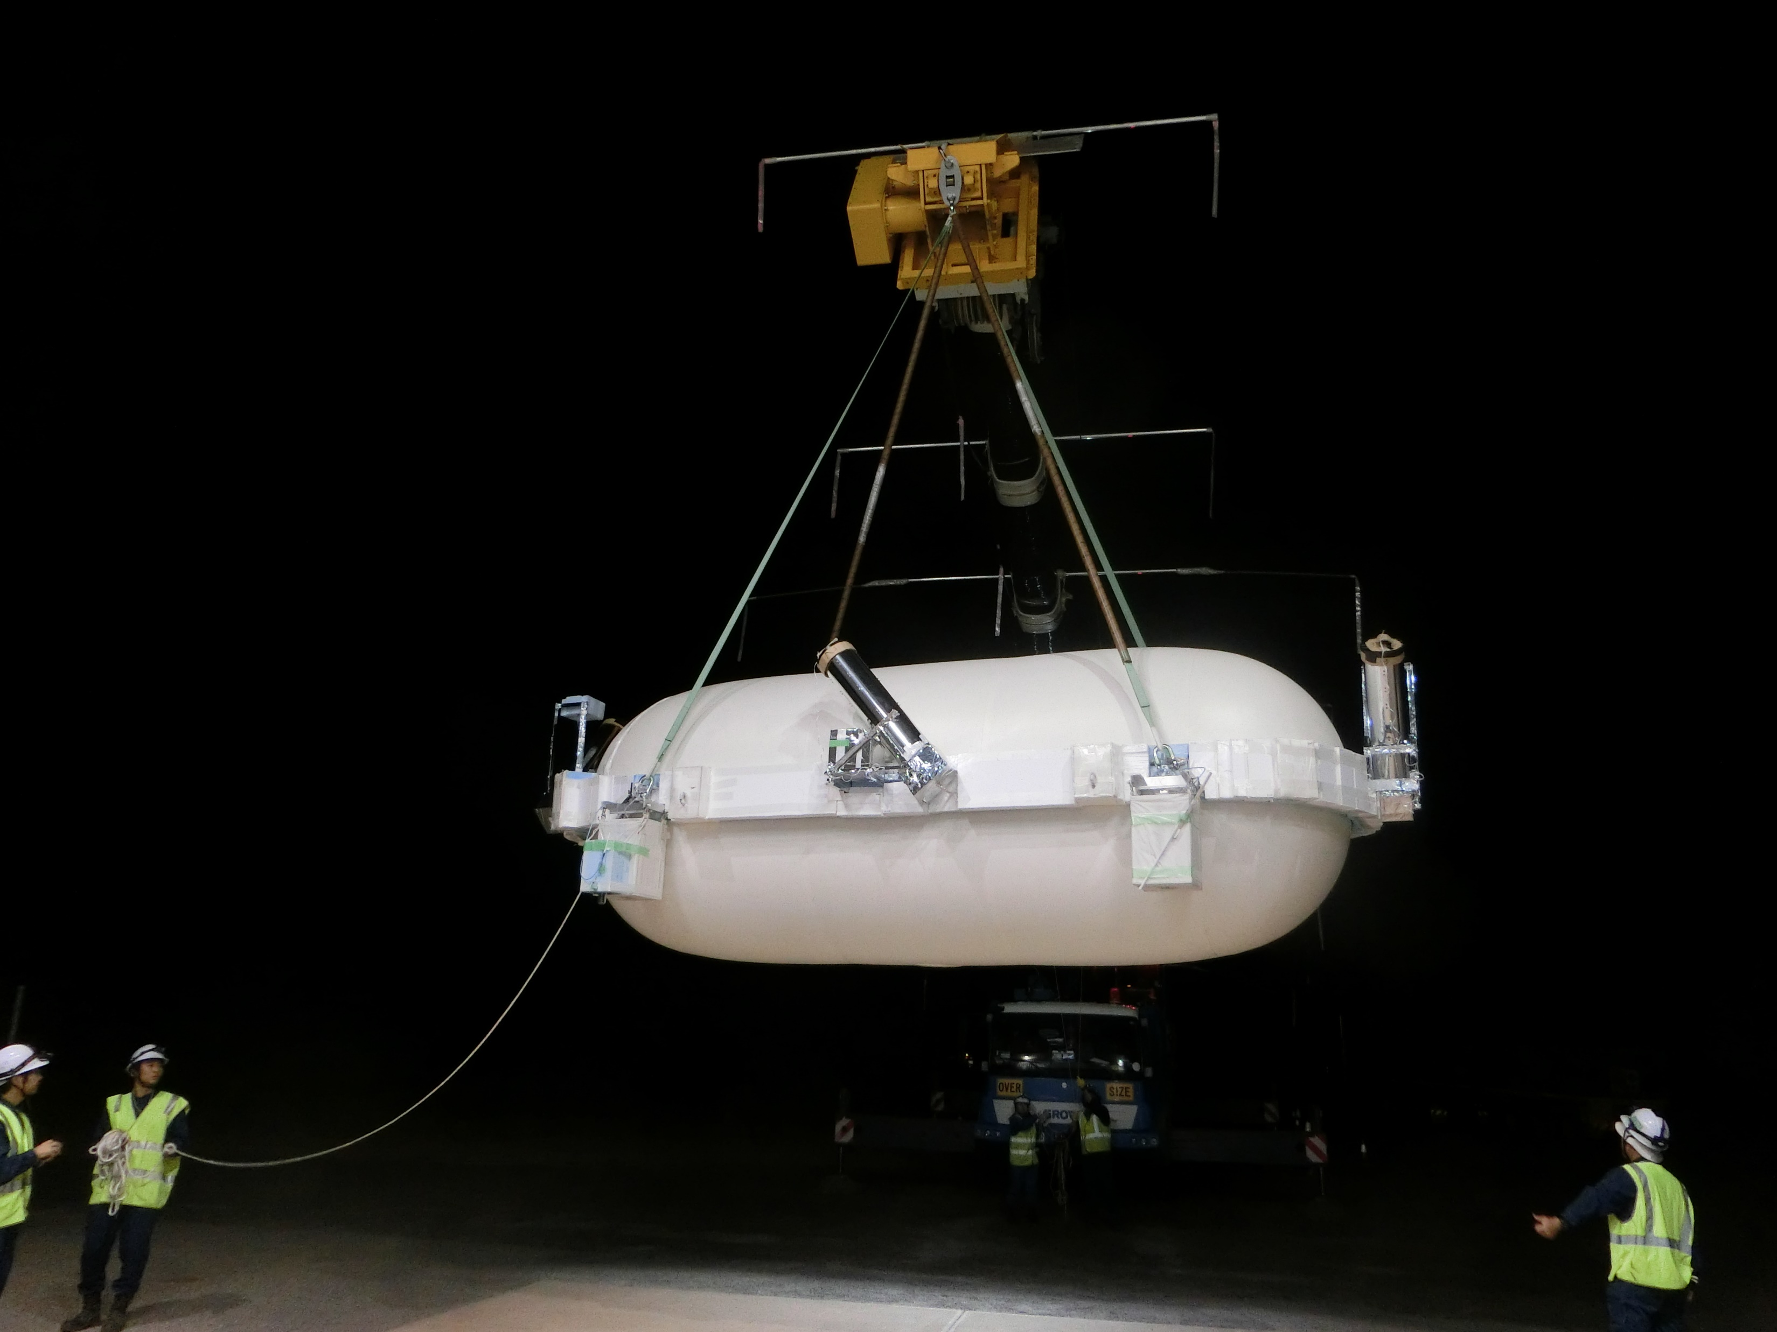
GRAINE 2023 Flight (Apl. 30th)
Notes:
After pickup our telescope, crane went to launch position.
24時間17分のレベルフライトを達成

Slide 17
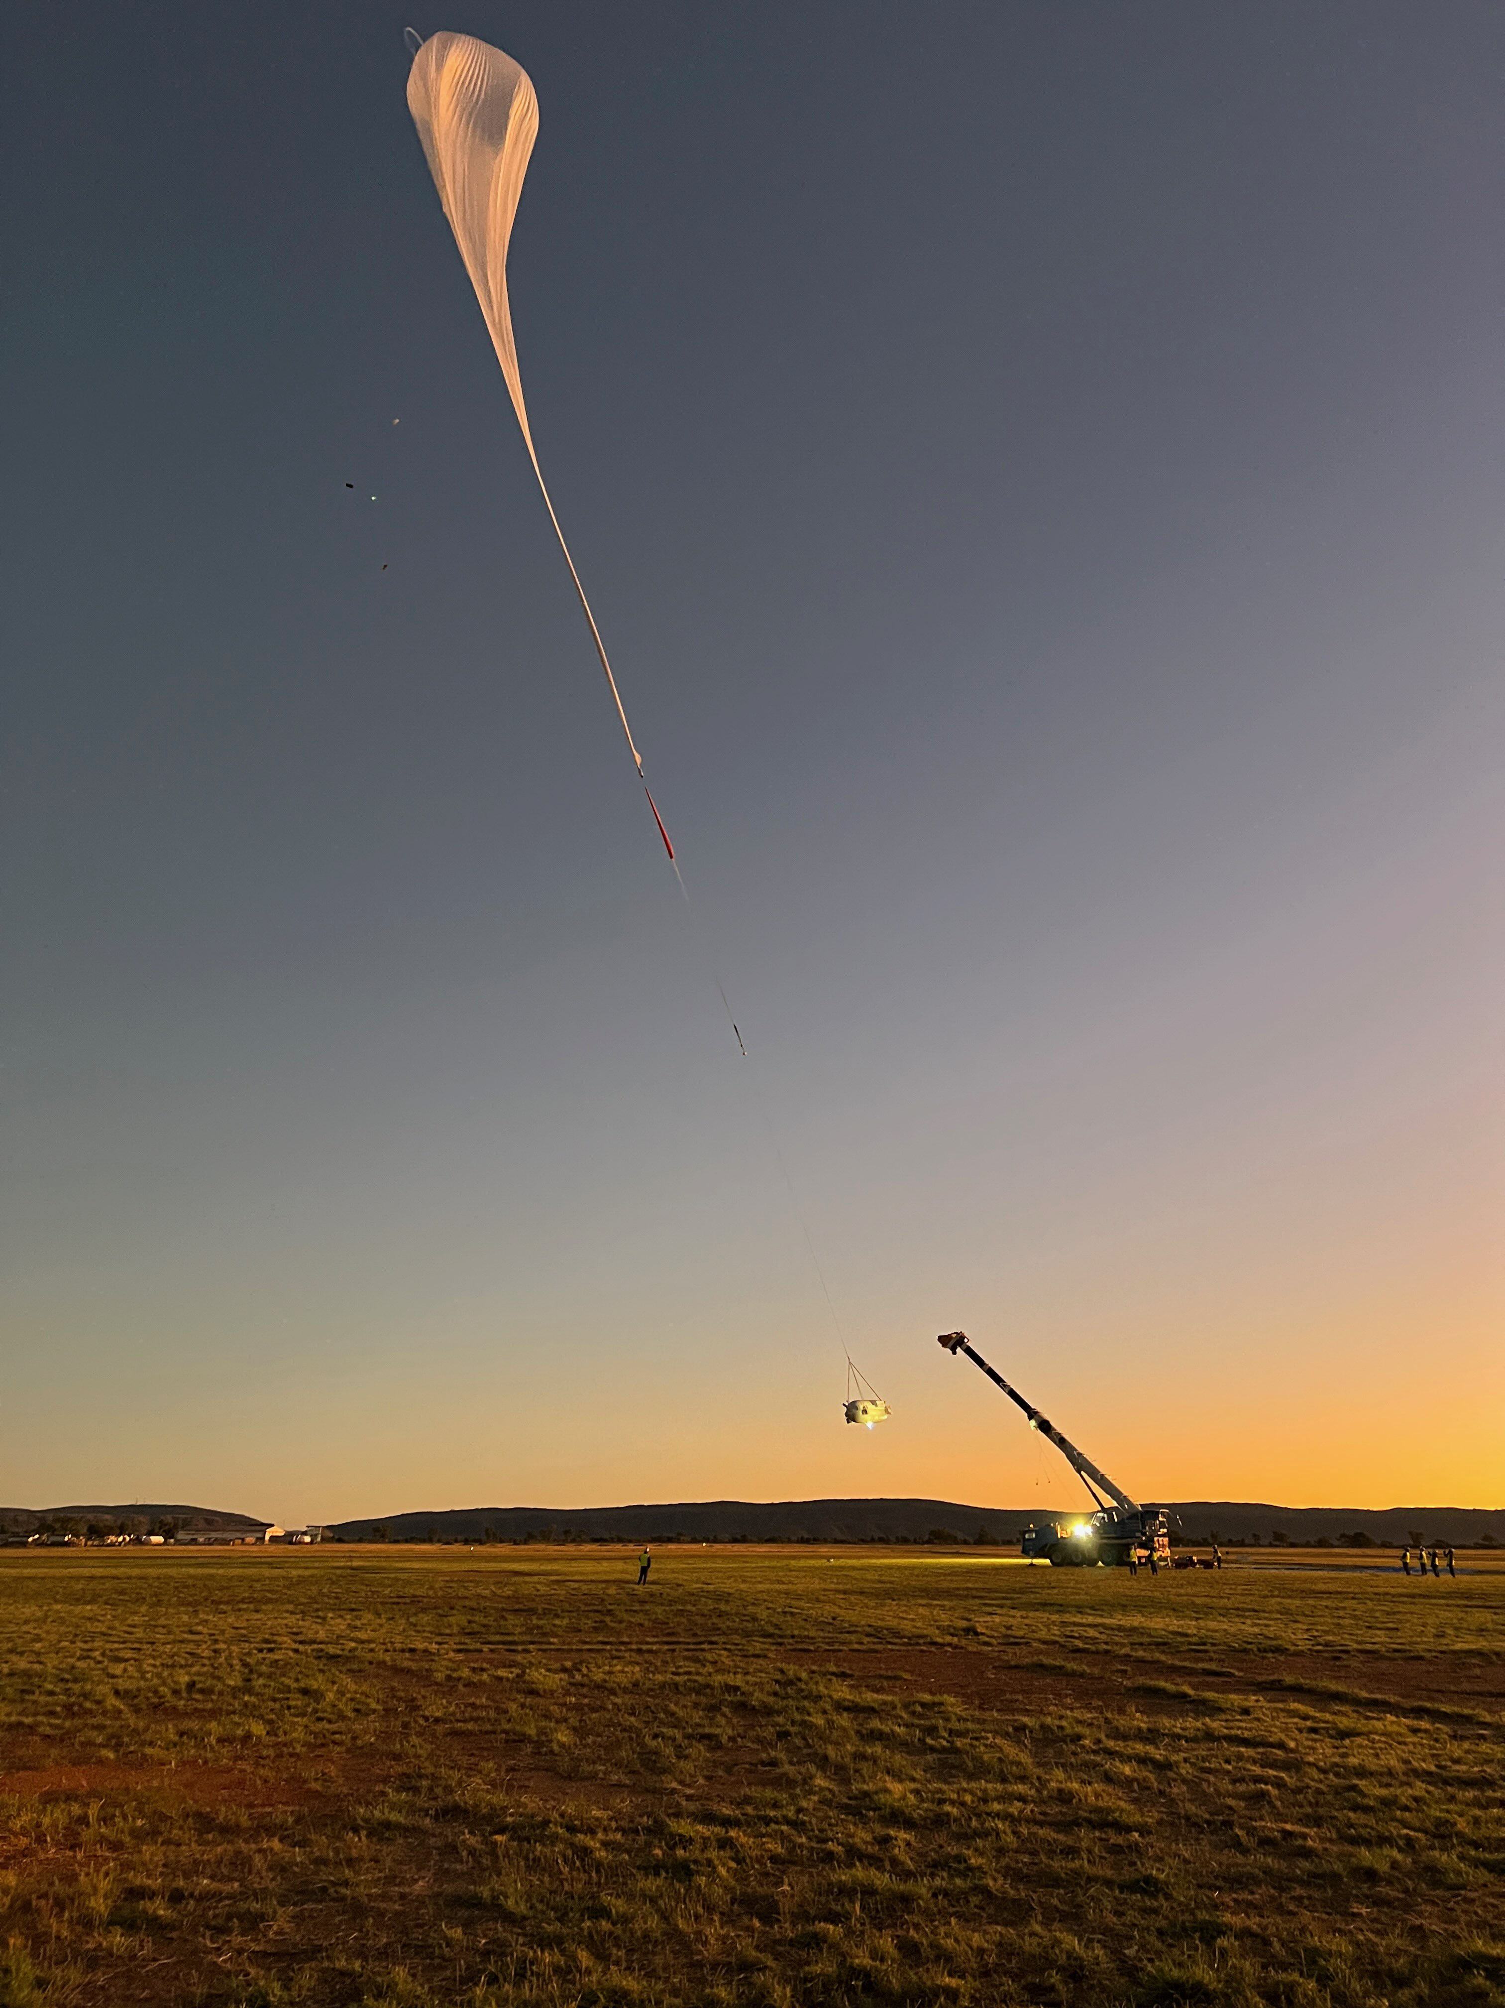
Launch on
Apl. 30th,
6:32am
Emulsion Telescope
Balloon successfully
released by JAXA team
Notes:
Balloon was launched at the 6 32 am.
Balloon was successfully released by JACA team.
24時間17分のレベルフライトを達成

Slide 18
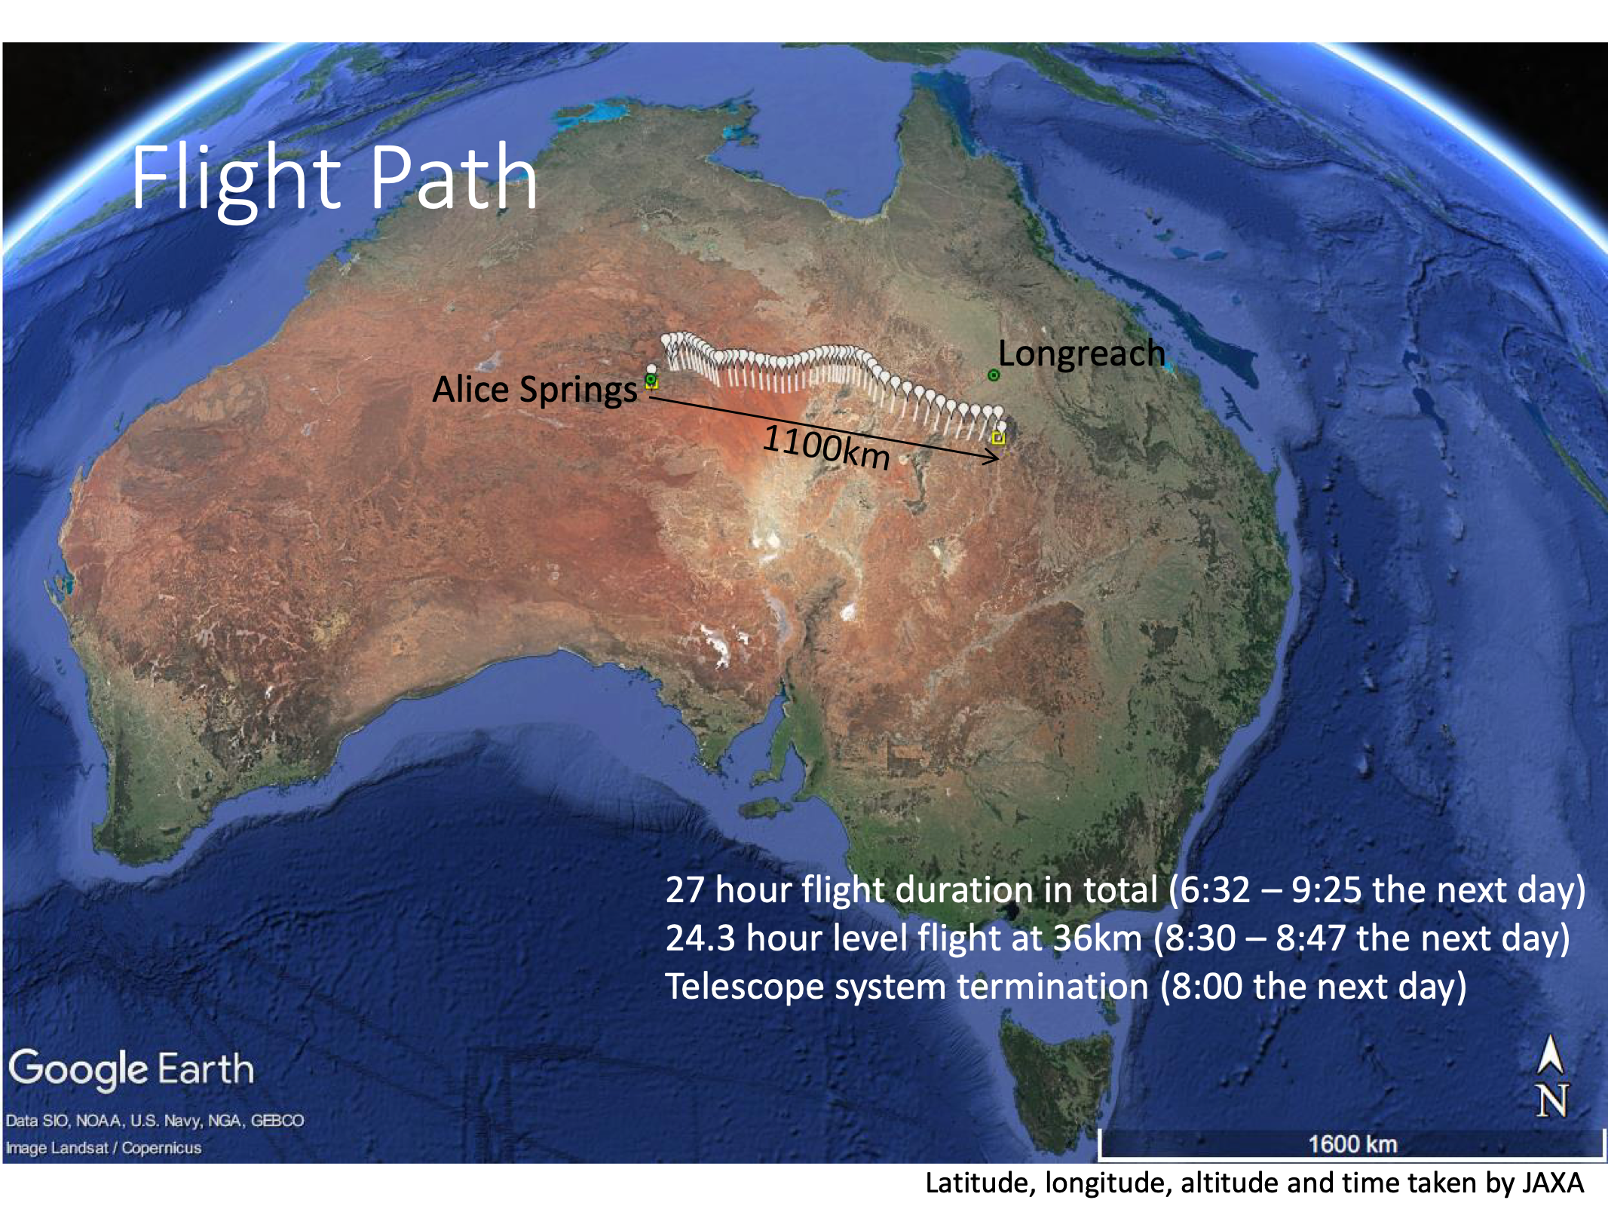
Notes:
This is the flight path. This line indicate the 1100 kilometers.
The flight duration is 27 hours more than 1 day.

Slide 19
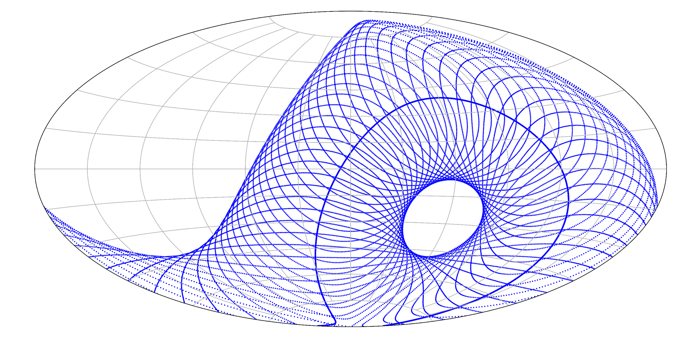
Celestial regions observed
by the Emulsion Telescope (FoV ±45°)
GRAINE2023
Vela pulsar
15pm–21pm
overlayed circles
with a 45-deg. radius every 30min.
Galactic Center
0am–6am
Geminga
G.C.
Vela
Crab
Center of view
(≒zenith direction)
successfully observed full coverage of the Vela pulsar and G.C.
Notes:
And this is the celestial regions observed by the emulsion telescope.
I override circles with plus minus 45 degree radius. This is our field of view every 30 minutes.
In this experiment, we were successfully observed full coverage of Vela pulser and Galactic Center.
This line indicate the

Slide 20
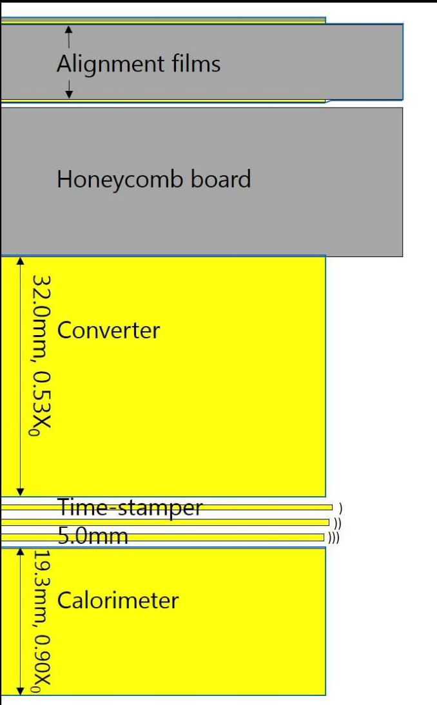
Analysis Flow
P,α,e etc
Emulsion data scanning
Converter
・Event Selection
・Angle, Energy
reconstruction
0.47 g/cm²
Time stamper
・Arrival Timing
γ
e⁻
e⁺
Attitude monitor
・Arrival direction on celestial coord.
0.37 g/cm²
Combined Analysis
・Mapping detected events on celestial coord. (on going analysis)
Notes:
After the all films were developed, we started to analysis this flight data.
This is the analysis flow after flight.
At first, we scan the emulsion data to Convert Analog Tracks into Digital Data for converter and timestamper films.
Next, in converter part, we select the electron and positron pair event, and determine the angle and energy.
On the other hand, timestamper determine the arrival time of all charged tracks.
To combine the converter and timestamper, we can select the event during flight.
Attitude monitor determine the direction of telescope each time.
So, we can map the detected event on celestial coordination.
Now, we are checking the analysis result each part, and now combined analysis ongoing.
We have not yet reached celestial imaging.

Slide 21
Analysis Flow
P,α,e etc
Emulsion data scanning
Converter
・Event Selection
・Angle, Energy
reconstruction
0.47 g/cm²
Time stamper
・Arrival Timing
γ
e⁻
e⁺
Attitude monitor
・Arrival direction on celestial coord.
0.37 g/cm²
Combined Analysis
・Mapping detected events on celestial coord. (on going analysis)
Notes:
At first, I talk about Attitude monitor analysis.
24時間17分のレベルフライトを達成

Slide 22
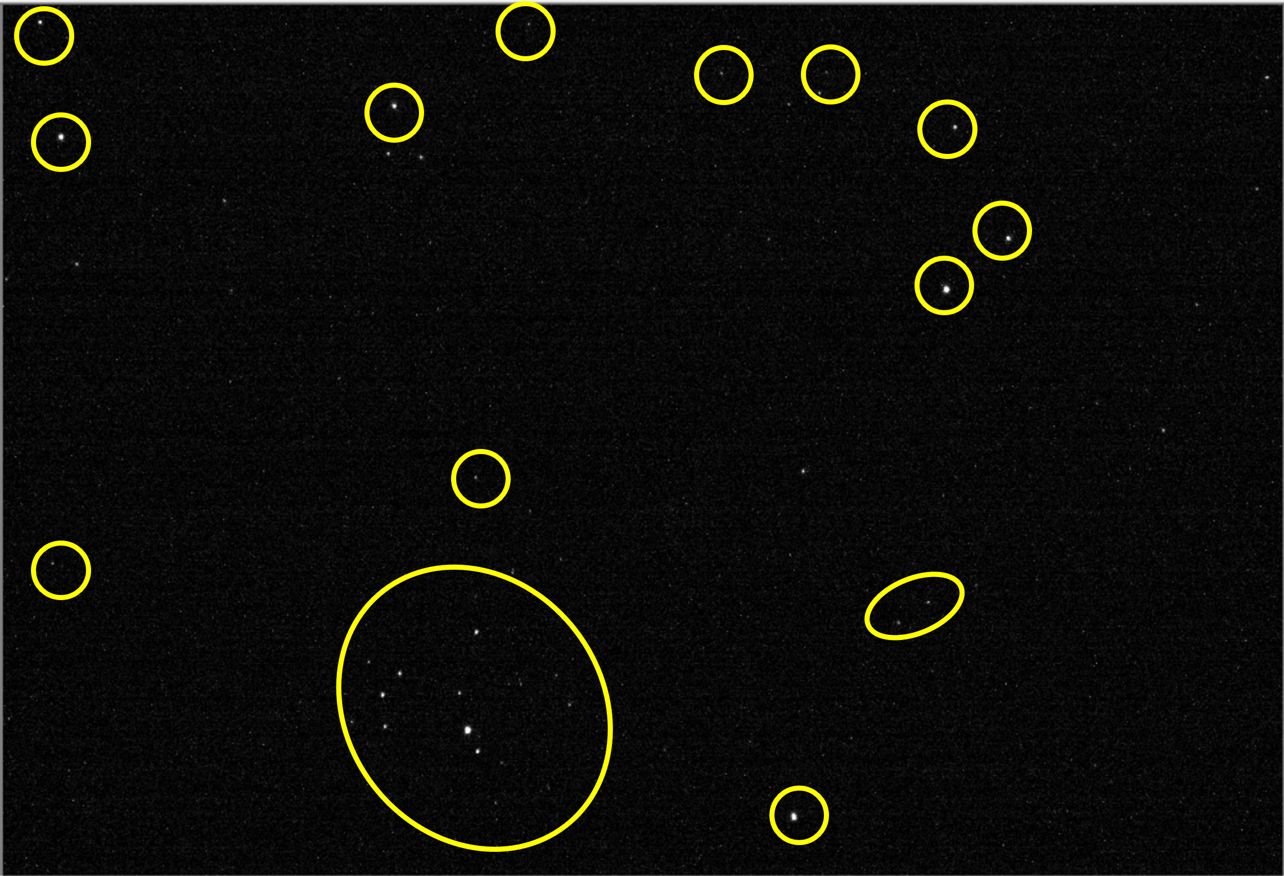
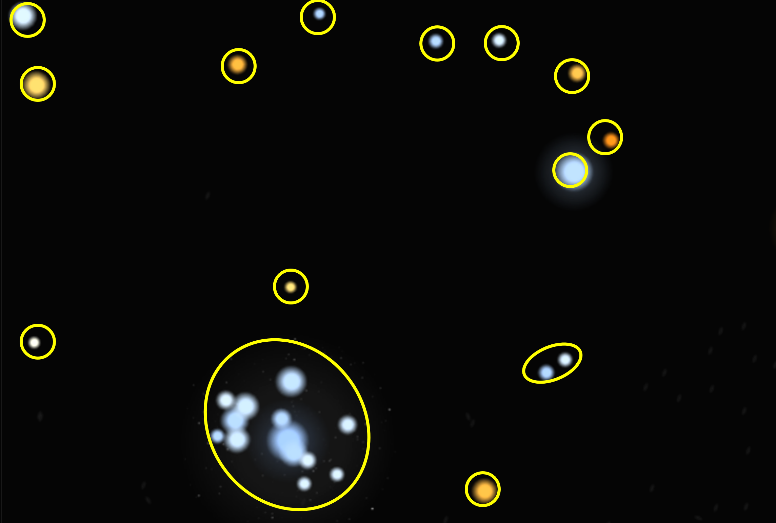
Star Camera
4.9°
Camera Photo
Star Catalog
2000
σ=0.0042°
Dev=0.0059°
Pattern matching to determine camera direction.
Preliminary
1000
Entries
Attitude accuracy is less than 0.01°
0
-0.04
-0.02
0.00
0.02
0.04
Azimuth resolution
[degree]
Notes:
Attitude monitor is the star camera.
Camera take a star picture. Left figure shows the example of photo of star camera and right one shows the star catalog data near the camera image region.
We can determine the direction of star camera by matching the pattern of star position.
This figure shows the azimuth resolution of camera direction.
The horizontal axis is the azimuth displacement from the interpolation point of three continuous images.
The deviation of azimuth angle is less than 0.01degree, so it has sufficient angular resolution.
表示：7等級以下、散開星団なし
画像範囲：5.9度×4.4度
2018年実験におけるカメラの方向決定精度は0.01～0.02°（1.7～3mradぐらい）

Slide 23
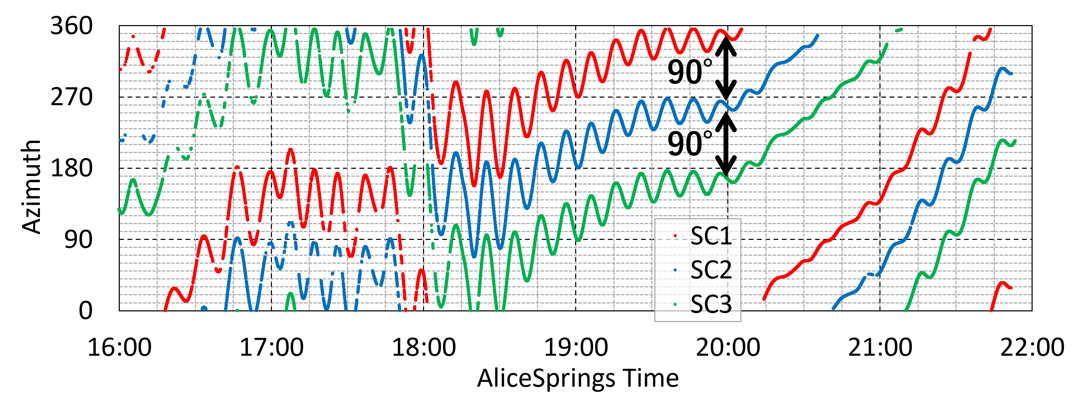
Star Camera
SC1
SC3
Mean rotation velocity
= 0.25[deg/s]
We need time resolution at least 0.4s for 0.1[deg] imaging.
SC2
Preliminary
All Camera direction was determined through Vela Time.
Notes:
Our telescope has 3 cameras to recover the all time when one camera take a sun or moon and so on.
This figure shows each camera azimuth directions through vela observation time.
Horizontal axis is Alice Springs time and vertical axis is azimuth angle.
The three cameras are mounted at 90-degree angles to each other.
You can see that the determined direction is also shifted by 90 degrees.
Mean rotation velocity is 0.25 degree per second. So we need time resolution at least 0.4 second for 0.1 degree imaging.
Twist : ねじれ
Non-uniform wind
表示：7等級以下、散開星団なし
画像範囲：5.9度×4.4度
2018年実験におけるカメラの方向決定精度は0.01～0.02°（1.7～3mradぐらい）

Slide 24
Analysis Flow
P,α,e etc
Emulsion data scanning
Converter
・Event Selection
・Angle, Energy
reconstruction
0.47 g/cm²
Time stamper
・Arrival Timing
γ
e⁻
e⁺
Attitude monitor
・Arrival direction on celestial coord.
0.37 g/cm²
Combined Analysis
・Mapping detected events on celestial coord. (on going analysis)
Notes:
Next, Emulsion data scanning.

Slide 25
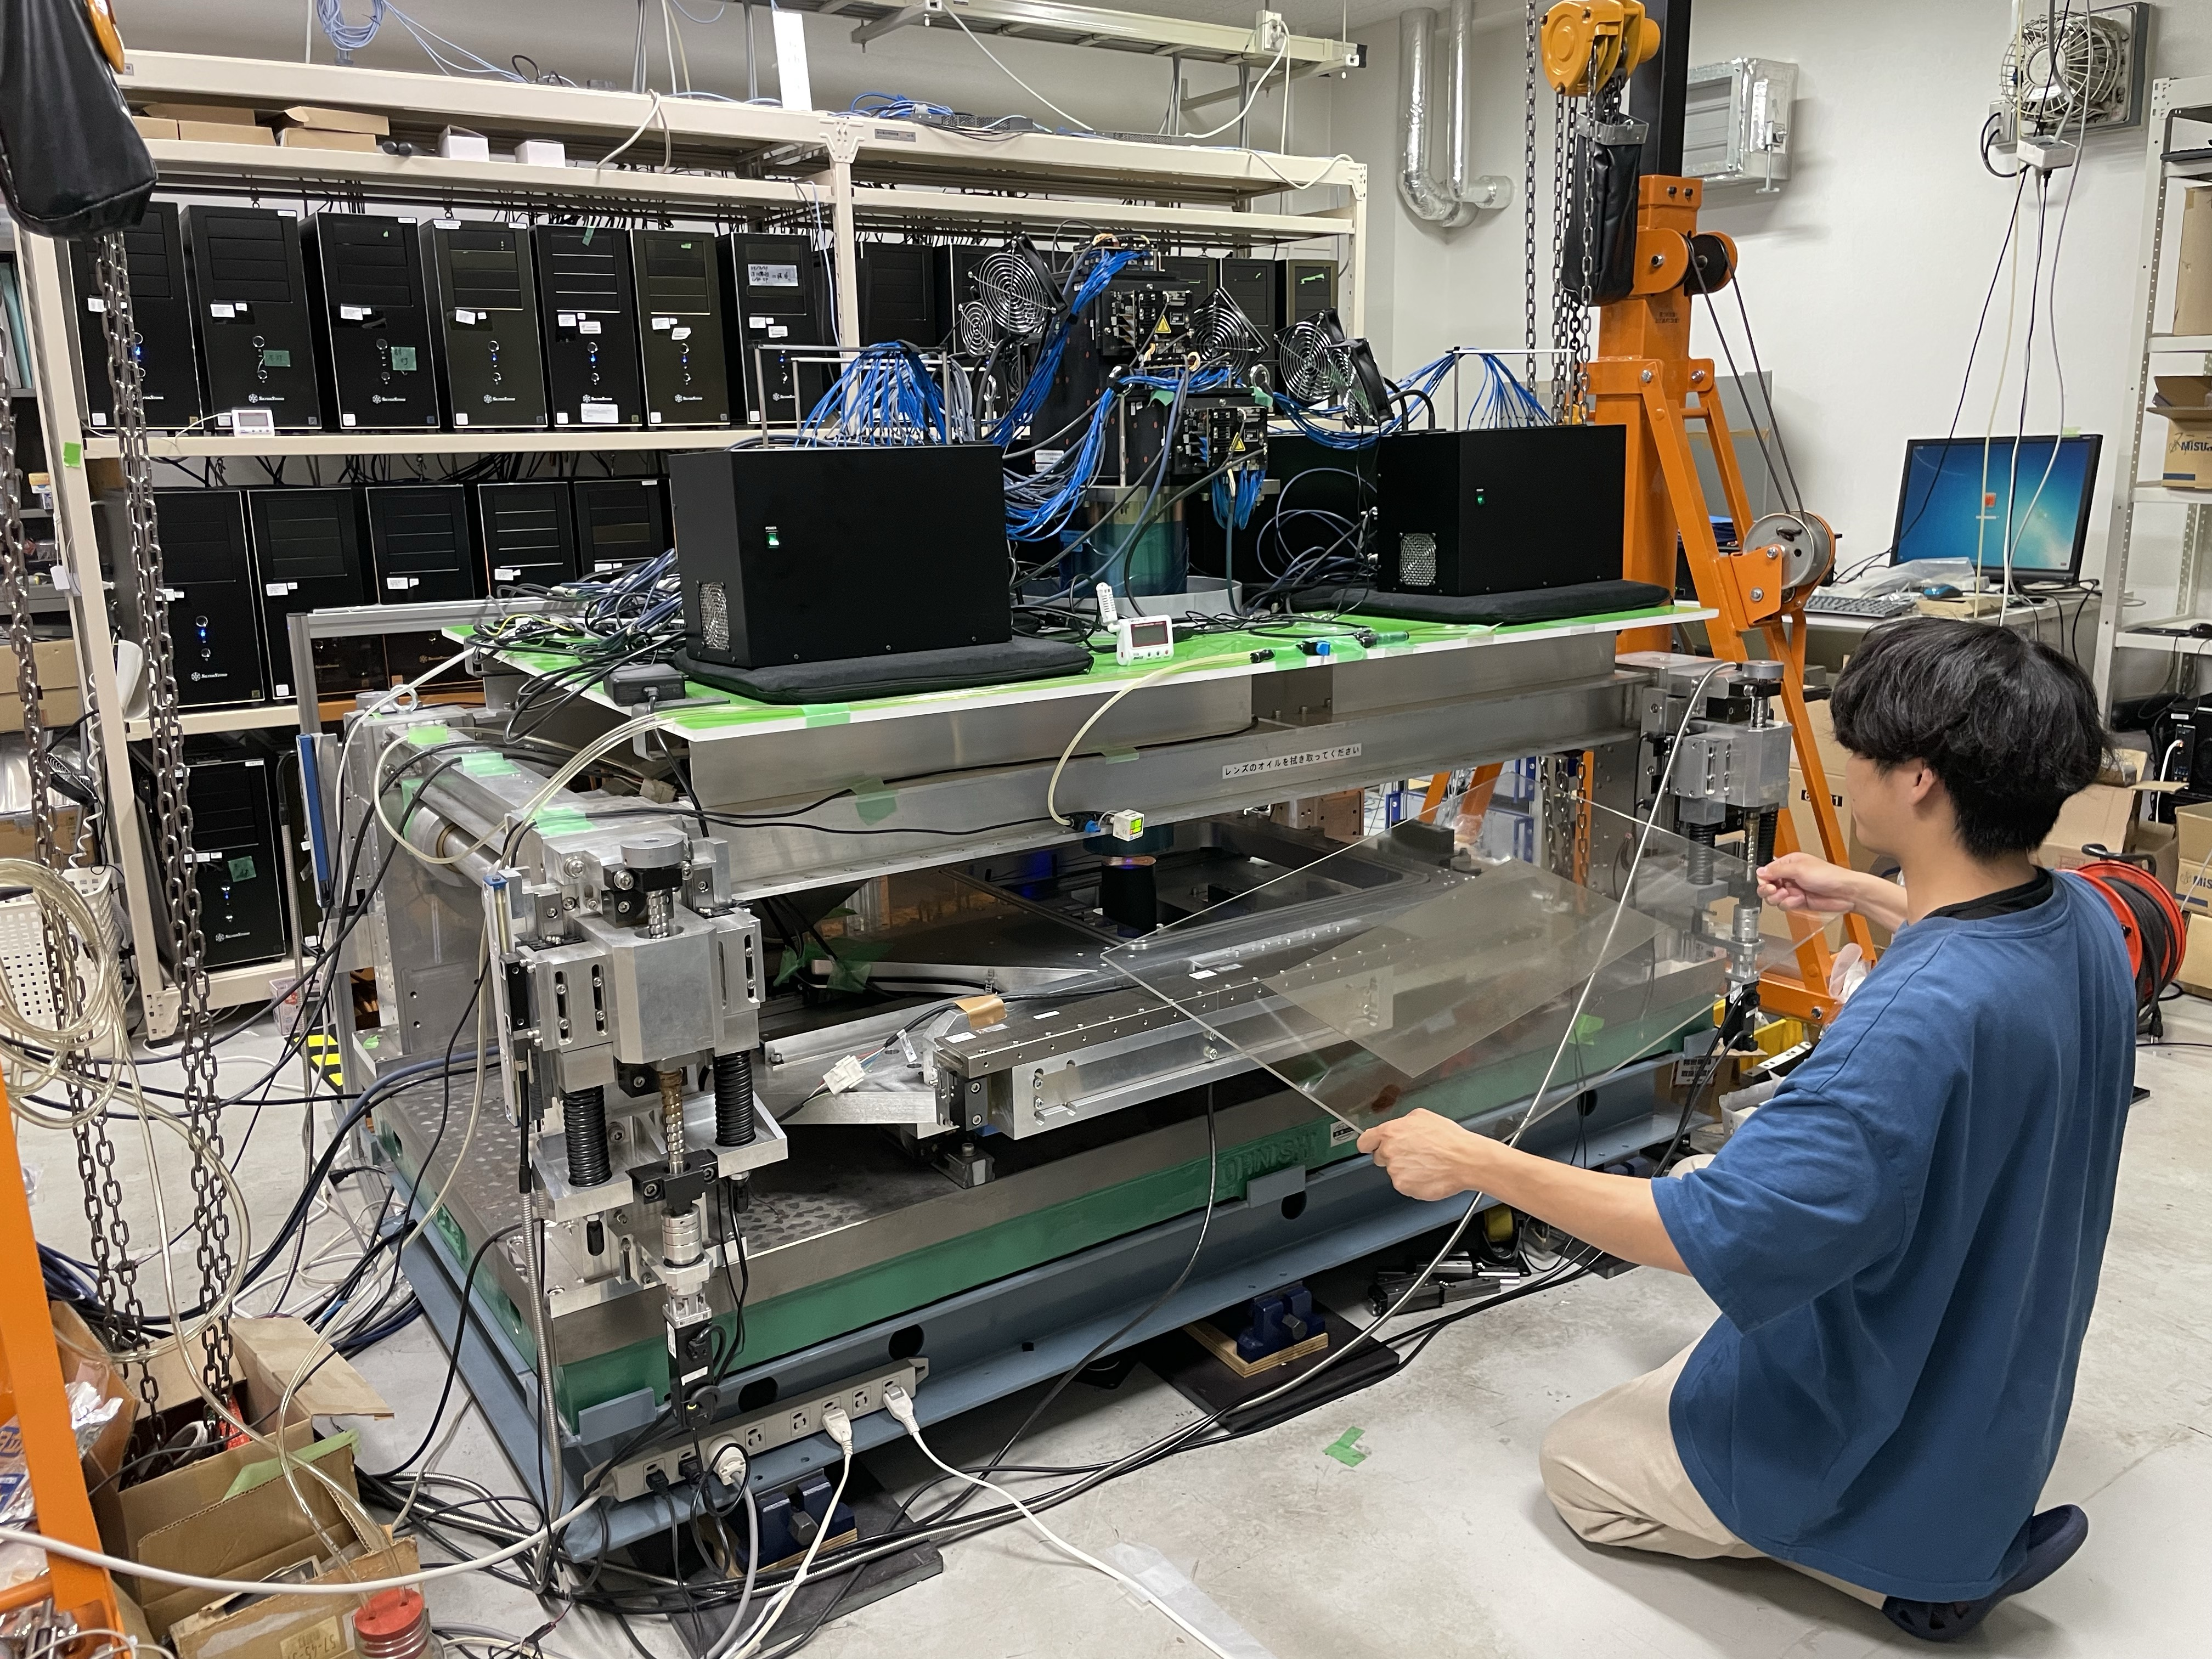
Emulsion Data Readout System
Hyper Track Selector 2 (2023-)
50 cm x 25 cm
1800 plates
Converted Analog Tracks into Digital Data
the Fastest Scanning Speed 9400㎠/h
Notes:
Nagoya University developed automatic scanning system.
This is the large microscope. We put the emulsion film on this stage, and we can convert analog tracks into digital data.
The fastest scanning speed is 9400 square centimeters per hour.
In GRAINE 2023, we use 1800 plates of 50 centimeters times 25 centimeters size film.

Slide 26
Emulsion Data Readout System
Hyper Track Selector 2 (2023-)
1800
Completed
at the end of 2024 !
1000
Number of Films
0
2023
7/2
2023
11/1
2024
3/1
2024
7/1
2024
10/31
50 cm x 25 cm
1800 plates
Converted Analog Tracks into Digital Data
the Fastest Scanning Speed 9400㎠/h
Notes:
This graph shows the progress of the scanning films.
We completed the scan at the end of 2024.

Slide 27
Analysis Flow
P,α,e etc
Emulsion data scanning
Converter
・Event Selection
・Angle, Energy
reconstruction
0.47 g/cm²
Time stamper
・Arrival Timing
γ
e⁻
e⁺
Attitude monitor
・Arrival direction on celestial coord.
0.37 g/cm²
Combined Analysis
・Mapping detected events on celestial coord. (on going analysis)
Notes:
Next, converter analysis.

Slide 28
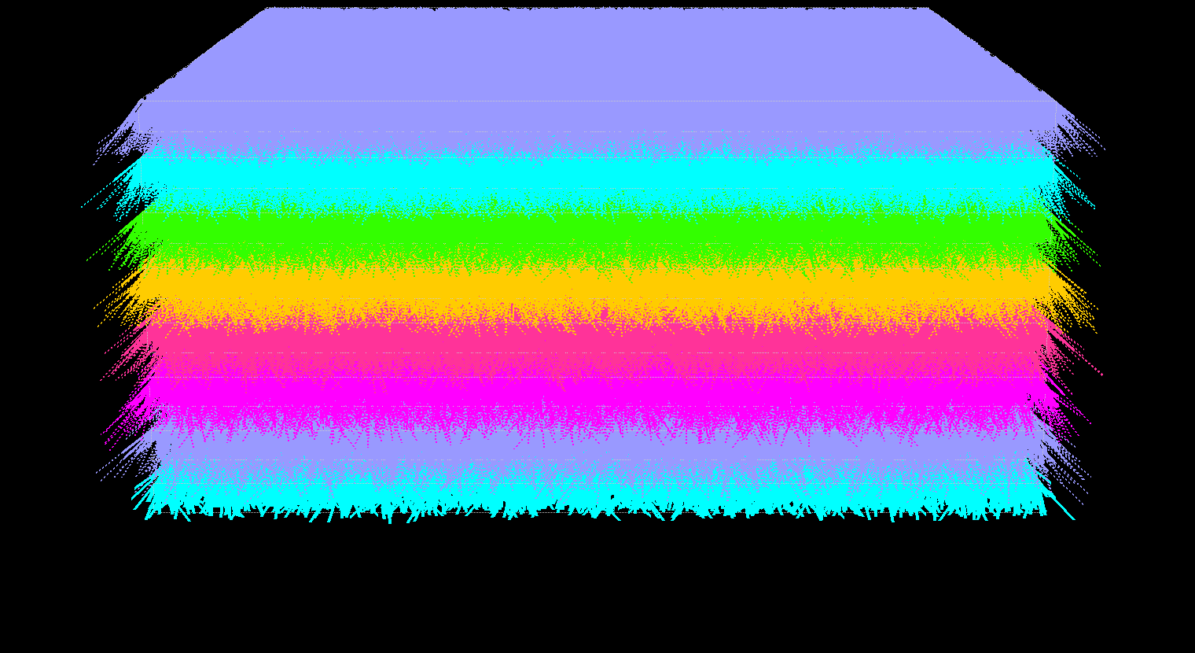
γ→e⁺e⁻ Event Selection
5mm
5mm
8 films
/(5mm x 5mm )
All
Notes:
Here, I show the almost raw data of the emulsion scanning system.
I displayed 5 millimeters times 5 millimeters and the 8 films of same regions.
Each lines show the all tracks detected charged particle.
The scan data for a single film contains position and angle information.
Using this data, we select the electron and positron pair event using topological analysis.
In this events, the track start intermediate films.

Slide 29
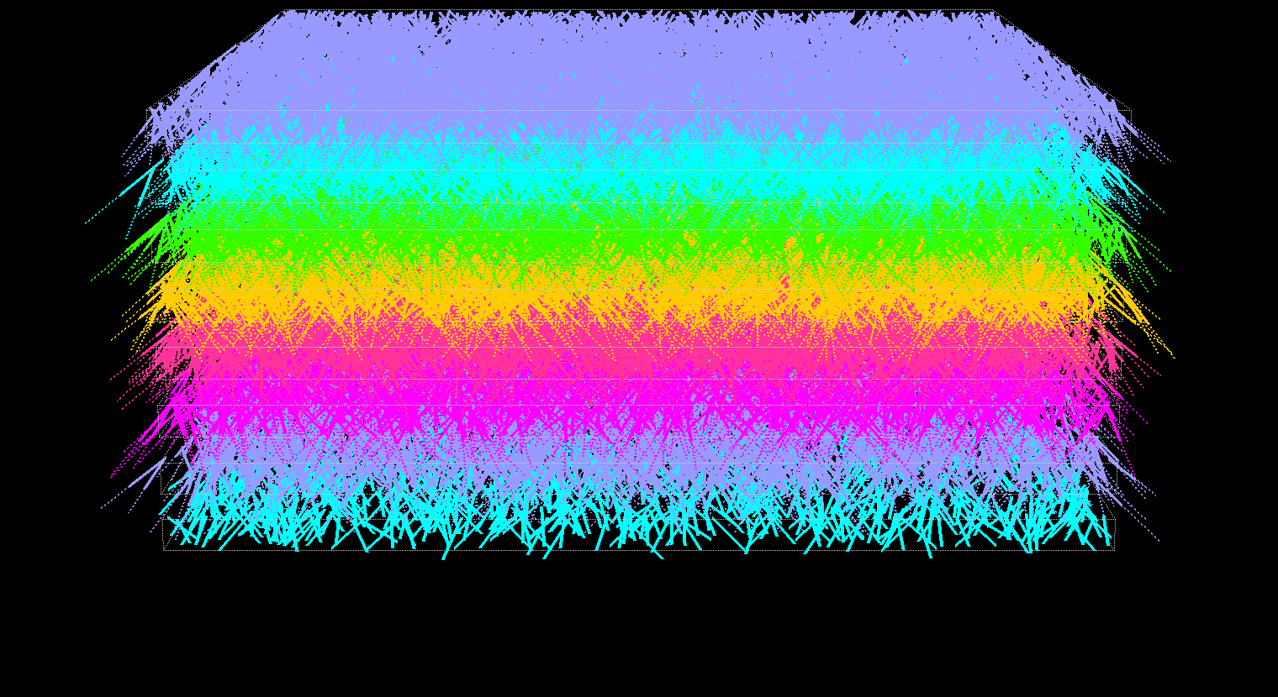
γ→e⁺e⁻ Event Selection
/(5mm x 5mm )
All
Remove
penetrating track
Notes:
At first, we remove the track of penetrating all films.

Slide 30
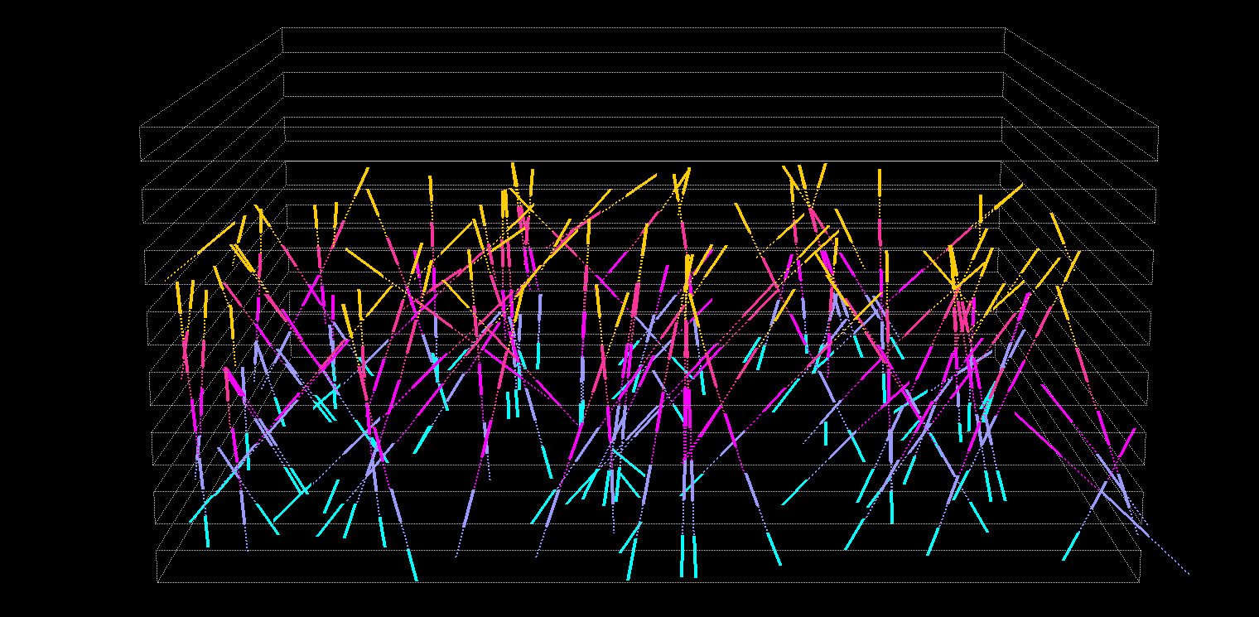
γ→e⁺e⁻ Event Selection
select the tracks that start intermediate films
/(5mm x 5mm )
All
Remove
penetrating track
start intermediate films
Notes:
Next, we select the tracks that start intermediate films.

Slide 31
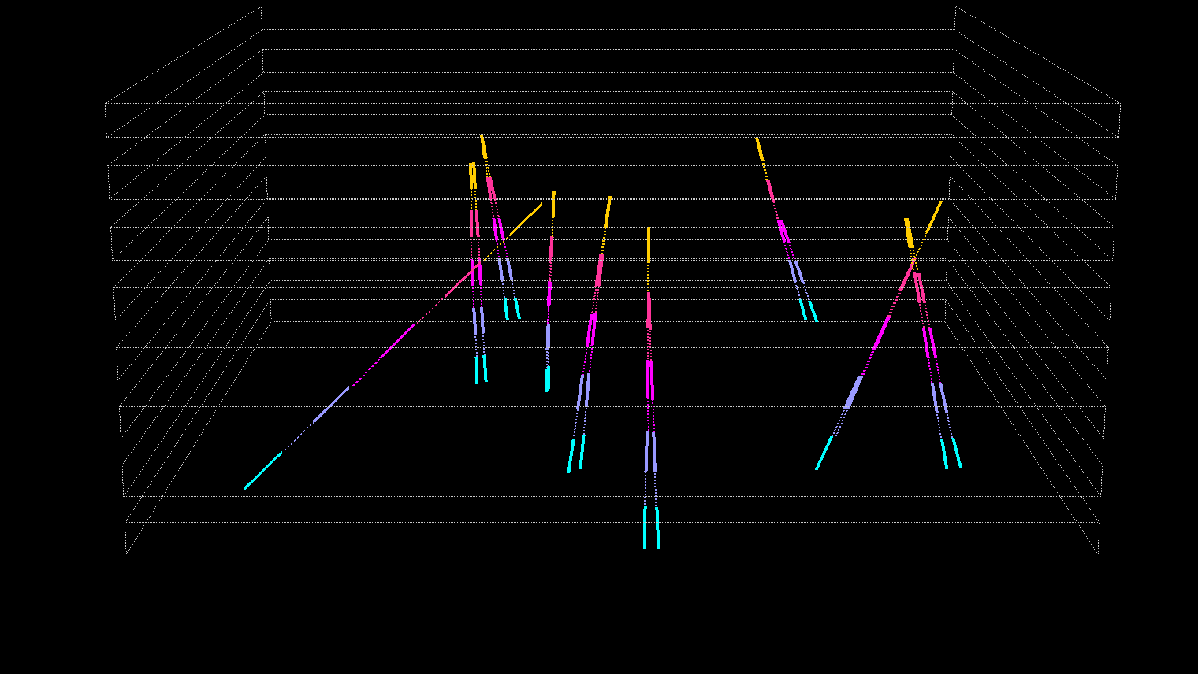
γ→e⁺e⁻ Event Selection
select the pair topology events
/(5mm x 5mm )
All
Remove
penetrating track
start intermediate films
Pair topology
Notes:
Last, we select the pair topology events like this.

Slide 32
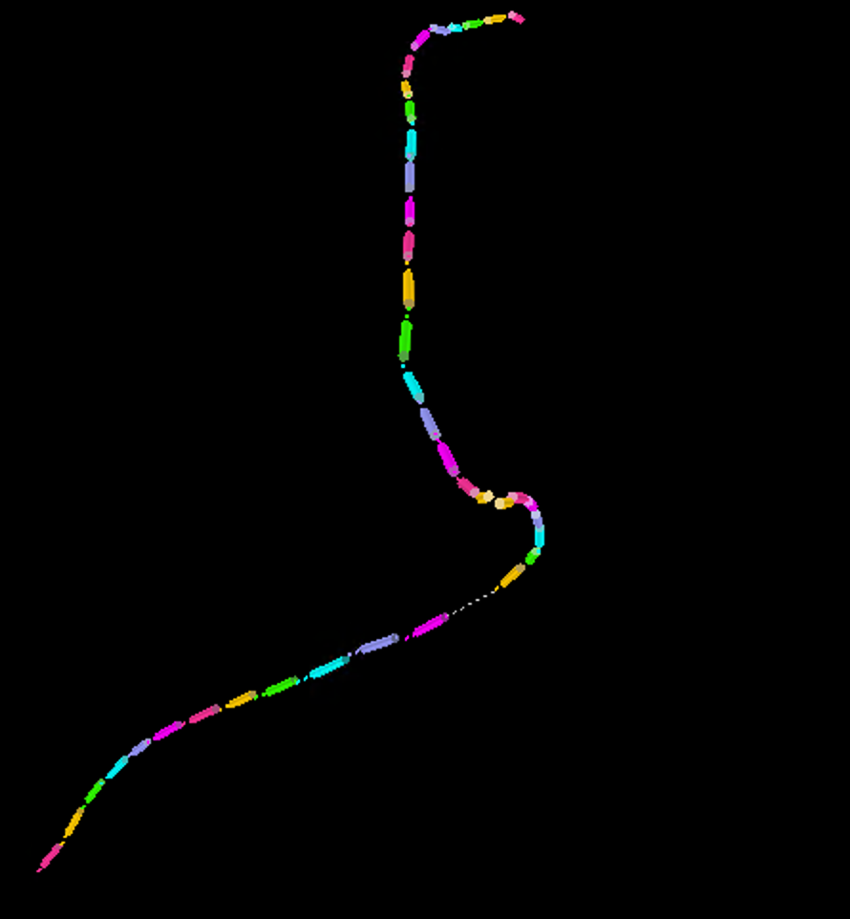

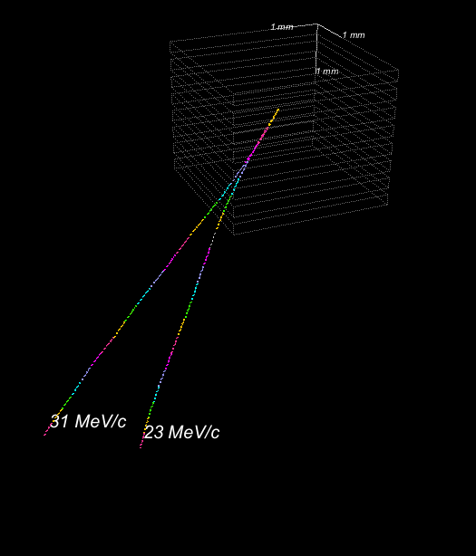
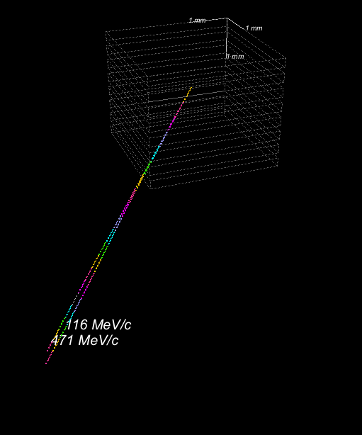
Detected “e-pair” event topologies
View from γ-ray direction
View from γ-ray direction
unit 10
start_pl 25
gid 6915973
θ_zenith 29.6°
θ_open 5.17°
E_gamma
54±19 MeV
a
unit 10
start_pl 25
gid 8237284
θ_zenith 30.5°
θ_open 1.36°
E_gamma
587±204 MeV
a
31 MeV/c
116 MeV/c
1.926 mm
vertex
vertex
471 MeV/c
0.387 mm
23 MeV/c
We can calculate the momentum of electron and positron by measuring Multiple Coulomb scattering angle.
Notes:
This is event view. This is full reconstruction in the converter.
The left figure shows the low energy event, and right one shows the higher energy event.
We can calculate the momentum of electron and positron by detect Multiple Coulomb scattering angle.
And we also calculate the gamma-ray energy and the we can determine the gamma-ray direction at the beginning point.

Slide 33
Performance of the angular measurement
Notes:
We checked the performance of the angular measurement of converter.
In converter tracks, Hadronic interaction event caused by primary cosmic ray exist.
These event create pi0 and decay 2 gammas.
This gamma-ray emit from the top of hadronic shower.
Therefore, we can estimate the angular resolution of γ-rays by measuring the direction of γ-rays from hadronic interactions.
This figure shows the angle difference distribution of these events.
The angular resolution is 0.64 degree at 250MeV.
This result is before final tuning. It was confirmed that sufficient angular resolution is expected for this step.

Slide 34
Analysis Flow
P,α,e etc
Emulsion data scanning
Converter
・Event Selection
・Angle, Energy
reconstruction
0.47 g/cm²
Time stamper
・Arrival Timing
γ
e⁻
e⁺
Attitude monitor
・Arrival direction on celestial coord.
0.37 g/cm²
Combined Analysis
・Mapping detected events on celestial coord. (on going analysis)
Notes:
Next, timestamper analysis.

Slide 35
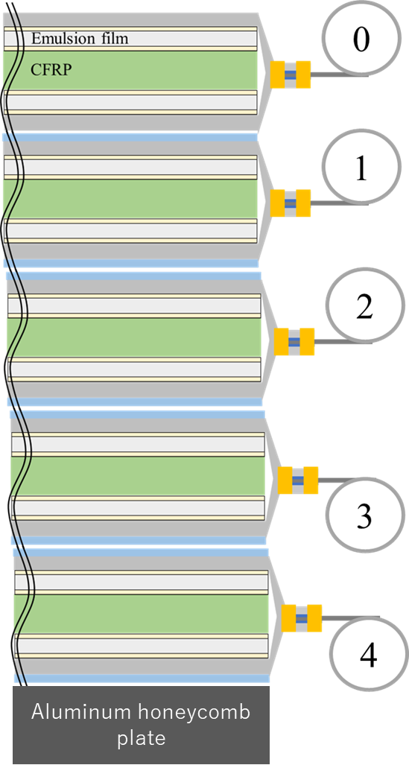
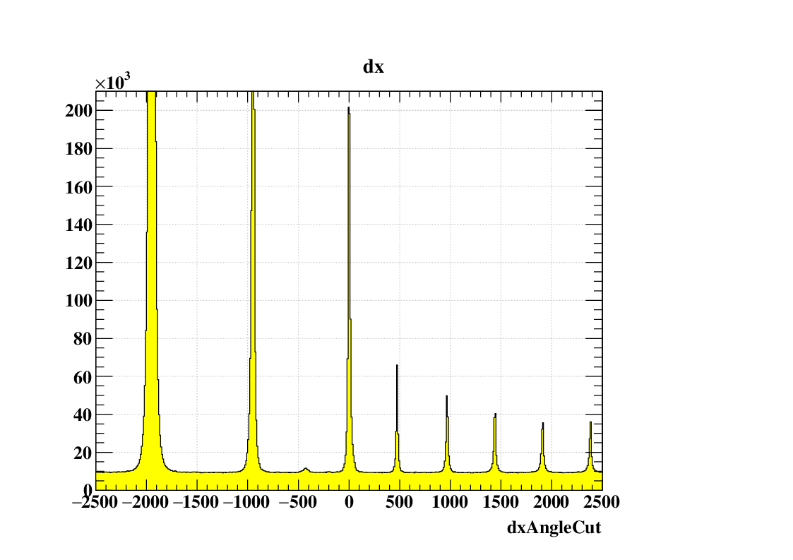
Timestamper Analysis
Fixed
On ground tracks（～8×10⁵）/10µm
200000
9h
Move every 2 hours
2h
Entries / 10 µm
2 h/step
100000
1500 µm
500 µm
0
-1000
0
1000
2000
3000
Position displacement dx[µm]
1500㎛
Separate tracks by time with position displacement
Notes:
The concept of the timestamper is the same of analog clock.
Time stampers add time to tracks using the misalignment between films.
For example, this film is fixed, and this film moves every few hours.
Then, this figure shows the relationship between position displacement and track entries.
You can see the many peak exist.
Each peak represents the tracks during this film was stopped.
Therefore, we can separate tracks by time with position displacement.
元データメモ
C:\mnt\ana_gr23_s1_01\S2T1\allarea\linklet\012-021\01\fromTop1_temp 地上蓄積のピークは370×10^3ぐらい。

Slide 36
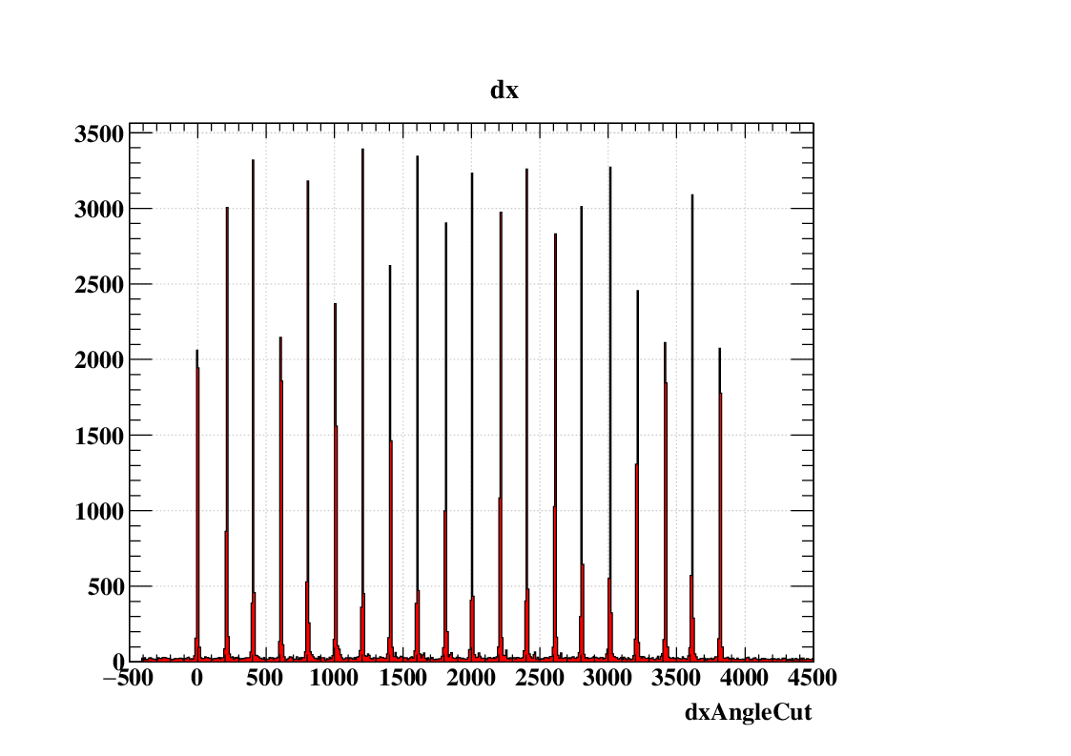
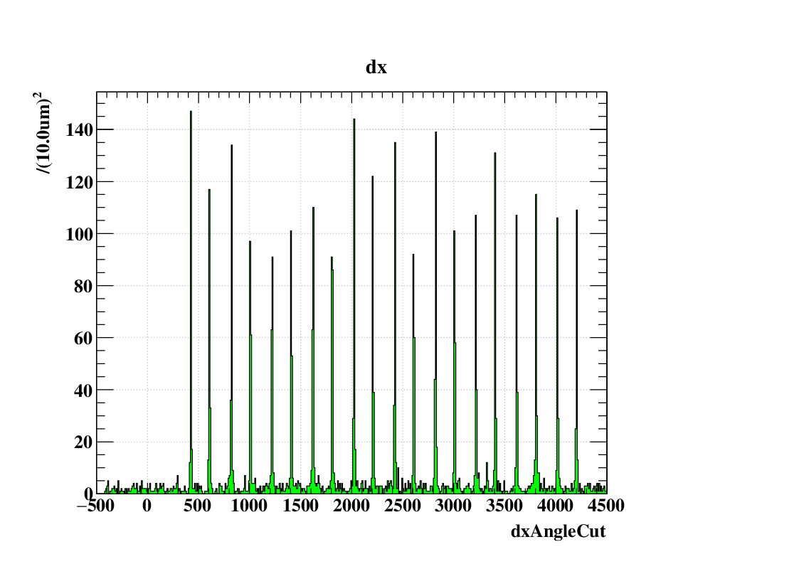
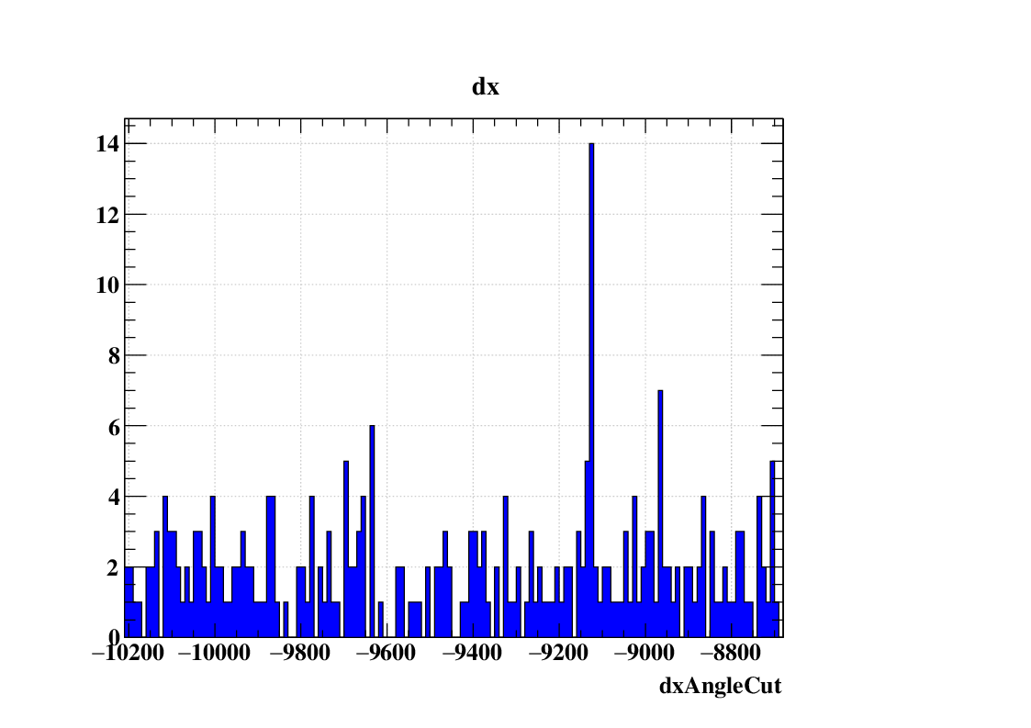
Timestamper Analysis
200000
2h/step
100000
2 h/step
Entries / 10 µm
500 µm
0
-1000
0
1000
2000
3000
dx[µm]
6 min/step
200 µm
Entries/10µm
2000
0
0
1000
2000
3000
4000
dx[µm]
15 sec/step
200 µm
100
Entries/10µm
0
0
1000
2000
3000
4000
dx[µm]
100 µm/sec constant velocity
1500 µm
10
Entries/10µm
0
-10000
-9600
-9200
-8800
dx[µm]
Notes:
In the same way, a 2-hour group can be divided into every 6 minutes.
The 6-minute group can be further divided into 15-second groups.
The bottom shifter was moved at a constant velocity of 100 um/s, so the displacement and the time correspond one-to-one.
So, we can determine the track time by displacement like this.
同様にして、2時間の集団をさらに６分ごとに分割できます。
さらに６分の集団を１５秒ごとに分割できます。
一番下は100um/sで等速運動させることで、位置ズレと時刻を１対１で対応させることができます。
mid%%2==1 bottom%2==1 150 エリア合体 2stroke 300s蓄積 (10min)
20 * 20 =400 /4 =100 (2h) 15 エリア合体 20stroke 300s蓄積(4mid 24min)

Slide 37
Timestamper Analysis
200000
2h/step
100000
2 h/step
Entries / 10 µm
500 µm
0
-1000
0
1000
2000
3000
dx[µm]
6 min/step
200 µm
Entries/10µm
2000
0
0
1000
2000
3000
4000
dx[µm]
15 sec/step
200 µm
100
Entries/10µm
0
0
1000
2000
3000
4000
dx[µm]
100 µm/sec constant velocity
1500 µm
10
Entries/ 0.1sec
0
16:21:44.1
16:21:48.1
16:21:52.0
16:21:56.0
Time（Alice Springs Time）
Notes:
The bottom shifter was moved at a constant velocity of 100 um/s, so the displacement and the time correspond one-to-one.
So, we can determine the track time by displacement like this.
TimeStamp Efficiencyは天頂角、エネルギーにもよるが、100～300MeV、天頂角tanθ＝0.5（26°）の電子に対して3割ぐらい。
これは１段当たり２まいずつあるシフターに対して、１枚飛ばしまで接続することで倍ぐらいまでは改善できると見込んでいる。
Figure 6-(d) shows the distribution of roller 4’s position displacement relative to roller 3. There is a banded cluster about 1.5 mm long, consistent with the continuous driving of roller 4.
We then evaluated the reconstruction accuracy for each cluster. We made Gaussian fitting 𝑑𝑦 distribution for | tan 𝜃𝑦 | < 1.0; 1𝜎 was defined as the accuracy of the track reconstruction 𝜎𝑑𝑦.
The reconstruction accuracy is 9.1um.
Time resolution is
mid%%2==1 bottom%2==1 150 エリア合体 2stroke 300s蓄積 (10min)
20 * 20 =400 /4 =100 (2h) 15 エリア合体 20stroke 300s蓄積(4mid 24min)

Slide 38
Analysis Flow
P,α,e etc
Emulsion data scanning
Converter
・Event Selection
・Angle, Energy
reconstruction
0.47 g/cm²
Time stamper
・Arrival Timing
γ
e⁻
e⁺
Attitude monitor
・Arrival direction on celestial coord.
Combine converter with timestamper
0.37 g/cm²
Combined Analysis
・Mapping detected events on celestial coord. (on going analysis)
Notes:
Last, I talk the conbined result of converter with timestamper.

Slide 39
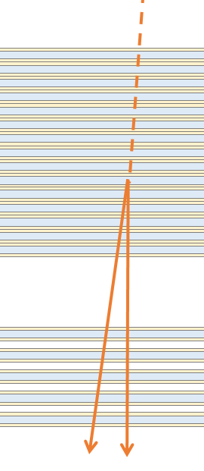



Time resolution
Preliminary
Counts[/0.01s]
40
30
σ=0.039 s
20
10
$$t_{1}$$
$$t_{2}$$
0
-1.0
-0.8
-0.6
-0.4
-0.2
0.0
0.2
0.4
0.6
0.8
1.0
Time difference（$t_{1}−t_{2}$）[s]
*Gondola rotation velocity = 0.3 [deg/s]
0.3 [deg/s] × 0.039 [s] = 0.0117 [deg]
We confirmed that sufficient time resolution was obtained for the gondola rotation speed.
Notes:
By combining the information from Converter and Timestamper, we can determine the arrival time to both electron and positron pairs of γ-rays, independently.
Since these two events occurred at the same time, this time difference is the time resolution of timestamper.
This histogram shows the time difference between electron pairs of each events.
The 1σ of the distribution is 0.04second.
Here we recall the gondola rotation velocity, it is less than 0.3 degree per second.
So, the uncertainty from gondola rotation is 0.01 degree.
This is sufficiently small compared to emulsion's angular resolution of 0.1degree.
We confirmed that sufficient temporal resolution was obtained for the gondola rotation speed.
ConverterとTimestamperの情報をcombineすることで、γ線のelectron pairの両方に時刻を付与できる場合があります。
この２本は同時に発生したイベントなので、この時刻差がtimestamperの時間分解能です。
このヒストグラムはイベントごとのeペアの時間差を表しています。
分布の１σは0.04secondです。
ゴンドラの回転速度(0.25degree per second)を考慮したtrackの方向決定精度は0.01degreeです。
これはemulsionの角度分解能である0.1degreeに比べて十分小さい。
したがって、emulsionの原理限界に迫る角度分解能が得られることが期待されます。
→1本あたりの時刻決定精度は$1/\sqrt{2}$倍で0.028s
絶対時刻との同期はまだ検証の必要があるが、シフター内での同時性は十分な精度が出ていることが確認された。
ツノが立っている理由
コンバータでのγ線エネルギー決定限界以上の高エネルギートラックに対しては時刻差が0.029秒とさらに良くなっていることが確認されている。
こうした高エネルギー成分による影響と考えている。
このイベントはeペアのエネルギーは両方800MeVぐらい（新運動量で）。
StepIDが異なっている数：17/399（4.3%）
各組合せ別
U04-top2:3/75
U04-top3:3/68
U19-top2:4/73
U19-top3:1/67
U20-top2:2/68
U20-top3:5/48

Slide 40
Atmospheric gamma ray observation at the balloon attitude (～36km)
10⁻⁴
We understand our main background and the detector response
Notes:
This is the result of background measurement.
Our main background is atmospheric gamma-ray produced in the atmosphere.
This is energy spectrum from various balloon experiments.
The result of GRAINE 2023 is consistent with previous our flight and old experiments.
So we understand our main background and detector response well.
ConverterとTimestamperを組み合わせた解析で、上空待機ガンマ線fluxが過去の実験と矛盾していない（＝解析上、大きな問題は起きていない）ということを話す。

Slide 41
Analysis Flow
P,α,e etc
Emulsion data scanning
Converter
・Event Selection
・Angle, Energy
reconstruction
0.47 g/cm²
Time stamper
・Arrival Timing
γ
e⁻
e⁺
Attitude monitor
・Arrival direction on celestial coord.
0.37 g/cm²
Combined Analysis
・Mapping detected events on celestial coord. (on going analysis)
Notes:
And now, we are in the process of analyzing the mapping of events onto the celestial coordinate.
現在、私たちはイベントを天球にマッピングする解析を進めているところです。

Slide 42
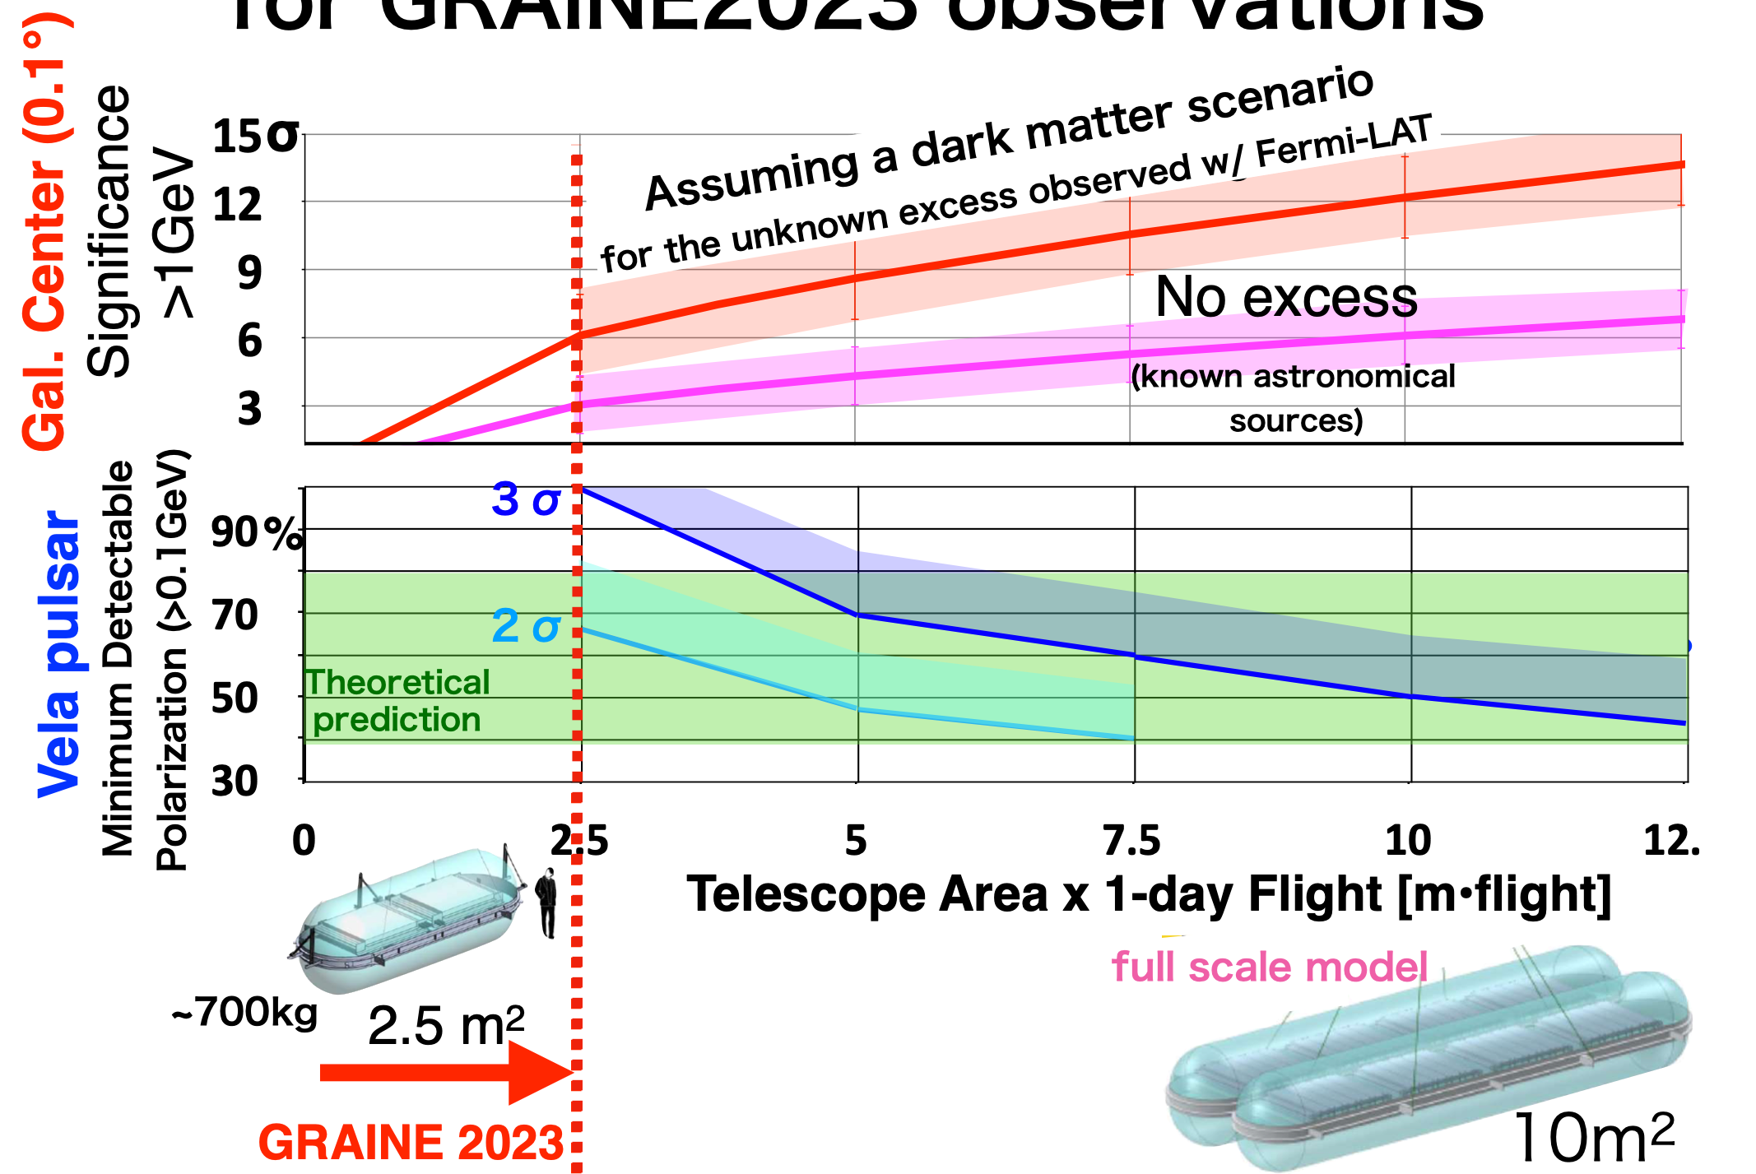
Preliminary predictions for GRAINE2023 observations
10㎡
2027?
Notes:
Now, analysis ongoing preliminary prediction for GRAINE2023 observation.
Top figure shows galactic center detection significance at 1 GeV.
Bottom figure shows the Vela pulser minimum detectable polarization at 0.1 GeV.
Finally, we start the scientific observation, but MDP about 100 percent.
So towards the discovery of polarization of Vela pulsar or precise measurement in galactic center, we have to repeat more balloon flight or large aperture area detector.
But now we start observation, at first, we reached this line.
異方性のところでのプチ展望
・スターカメラとの同期、ゴンドラ姿勢変化と対応するかを確認していく。
時刻正答率のところでのプチ展望
・２timestampイベントの正答率を高められるよう飛跡接続評価の改良などに取り組んでいく。
91.5％は十分なのか？
・1本あたりの話
接続条件を改良することで高められる見込みはあるが、初期量産解析としてはまずまずの結果。
・eペアのγ線イベントに対しての話
ガンマ線イベントに対しては、eペアの2本から適切に1本を選ぶことで最大99％まで
低efficiencyフィルムの属性の割合：48枚/160枚→全体の30％
飛跡の時間分離、再構成精度の評価が進んでいる。
時間分解能 = 飛跡再構成精度/最下段駆動速度
σt = 9.4 [µm] /100 [µm/s] = ~0.1 [s] 高時間分解能の実現
2018年実験のゴンドラ回転角 0.31 deg/s
姿勢決定精度 0.31 [deg/s] × ~0.1 [s] = 0.03 [deg]
0.1°の高解像度撮像実現が見込める
tanθ<1.0
飛跡再構成精度
σ=9.4±0.1

Slide 43
Summary
GRAINE (Gamma-Ray Astro Imager with Nuclear Emulsion)
  Frontier of high-resolution imaging at GeV (G.C.)
  Pioneer of gamma-ray polarimetry at sub-GeV (Vela)
  In GRAINE 2018, we successfully detected the Vela pulsar with the world’s highest angular resolution (0.4 deg) at 0.1GeV.
GRAINE2023
  We started scientific observation.
  Performed the successful 1-day flight in Alice Springs.
    successfully observed full coverage of the Vela pulsar and G.C.
  Data analysis is ongoing!
    Basic performance are well consistent with expected values in each parts.
    We will image Vela and the Galactic center with angular resolution 0.1 degree at 1 GeV until the end of 2025.
Future prospects
  We want to conduct repeatedly balloon experiments with larger aperture area and longer flight duration.
Notes:
異方性のところでのプチ展望
・スターカメラとの同期、ゴンドラ姿勢変化と対応するかを確認していく。
時刻正答率のところでのプチ展望
・２timestampイベントの正答率を高められるよう飛跡接続評価の改良などに取り組んでいく。
91.5％は十分なのか？
・1本あたりの話
接続条件を改良することで高められる見込みはあるが、初期量産解析としてはまずまずの結果。
・eペアのγ線イベントに対しての話
ガンマ線イベントに対しては、eペアの2本から適切に1本を選ぶことで最大99％まで
低efficiencyフィルムの属性の割合：48枚/160枚→全体の30％
飛跡の時間分離、再構成精度の評価が進んでいる。
時間分解能 = 飛跡再構成精度/最下段駆動速度
σt = 9.4 [µm] /100 [µm/s] = ~0.1 [s] 高時間分解能の実現
2018年実験のゴンドラ回転角 0.31 deg/s
姿勢決定精度 0.31 [deg/s] × ~0.1 [s] = 0.03 [deg]
0.1°の高解像度撮像実現が見込める
tanθ<1.0
飛跡再構成精度
σ=9.4±0.1

