Slide 1
Status Report of the GRANDProto300
Sei Kato for the GRAND Collaboration
(Institut d’Astrophysique de Paris)

Slide 2
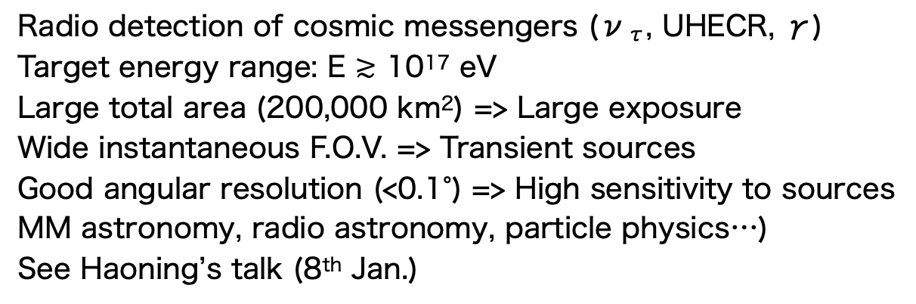
Giant Radio Array for Neutrino Detection (GRAND)
of extensive air showers
Tau neutrino
Radio detection of cosmic messengers (ν_{τ}, UHECR, γ)
Target energy range: E $≳$ 10¹⁷ eV
Large total area (200,000 km²) => Large exposure
Wide instantaneous F.O.V. => Transient sources
Good angular resolution (<0.1°) => High sensitivity to sources
MM astronomy, radio astronomy, particle physics…)
See Haoning’s talk (8th Jan.)
http://grand.cnrs.fr/

Slide 3
From the Kumiko’s slide for Fête de la science 2024

Slide 4
Prototype Experiments of GRAND
From Haoning’s slide

Slide 5
Prototype Experiments of GRAND
GRANDProto300
From Haoning’s slide

Slide 6
GRANDProto300
Gobi dessert near Xiao Dushan, Dunhuang @ China
Altitude ~ 1,100 m a.s.l.
Cover 200 km² using O(300) radio antennas
(~90 CR events/day)
1km step + 577m step infill
Site for the full array is approved in 2024
China
Chiche et al., PoS(ARENA2024)059

Slide 7
Motivation of GRANDProto300
1. Instrumental validation
China
・Stability of detectors
Durable & Robust radio detector in dessert environment
・Noise calibration
Establish our knowledge of noise. Important to autonomous EAS trigger
・Autonomous EAS trigger …
To make the experiment cost effective w/o using particle detectors
1st attempt for the detection of very inclined EASs w/ a sparse radio array

Slide 8
Motivation of GRANDProto300
2. Physics
・ CRs @ 10^{16.5-18.5} eV (Galactic-extragalactic transition)
1st spectral & composition studies in the transition region w/ radio detectors
~90 CR events/day (@ comparable rate w/ Pierre Auger Observatory)

Slide 9
Motivation of GRANDProto300
2. Physics
・γ-ray astronomy @ 10¹⁸ eV (diffuse emission, point source search)
Installation of some particle detectors to measure muons?
・Radio astronomy
Solar physics, Fast radio bursts, Giant radio pulses, Epoch of reionization
Your idea is more than welcome!

Slide 10
Radio Detector Unit (DU)
Z-arm
Y-arm
・Antenna arms extending along NS (X), EW (Y), & vertical (Z) directions
・Sensitive frequency range: 50MHz~200MHz
・Signal processing (up to signal digitization) @ antenna level
・Data transmission through a Wi-Fi antenna
・100% duty cycle using a solar panel
X-arm
Amplifier
(LNA)
Communication
antenna (Wi-Fi)
Design of the installed front-end board
Pole
Front-end-board
housing
GPS antenna
Solar panel
Foundation box
Alves Batista et al., Comp. Phys. Com. 308, 109461 (2025)

Slide 11
Signal Processing in DUs
Open circuit voltage
Air shower signal
Adapted from Alves Batista et al., Comp. Phys. Com. 308, 109461 (2025)

Slide 12
GP13 (February 2023 〜)
Positions of 13 DUs
577 m

Slide 13
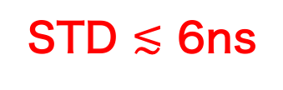
GP13: Calibration of Timing Using a Beacon
A beacon DU on the DAQ hut
Detection timing of the beacon signal with some DUs
Chiche et al., PoS(ARENA2024)059
Kotera et al., arXiv:2408.16316v2
STD $≲$ 6ns

Slide 14
GP13: Calibration of Timing Using a Beacon
Spherical Wavefront Fit
Beacon
DU_{i}: (X_{i}, t_{i})
×
●
Time difference with a reference antenna:
Minimization of
●
DU_{j}: (X_{j}, t_{j})

Slide 15
GP13: Calibration of Timing Using a Beacon
Reconstruction of the beacon’s position
STD ~ 16 m
STD ~ 8 m
From Beatriz’s slide in UHECR2024
Chiche et al., PoS(ARENA2024)059

Slide 16
GP13: Other Results
Power spectrum density
(in one DU)
Periodicity of RMS of time traces
Coincident pulse b/w X-arms of some DUs
X-arm
From Beatriz’s slide in UHECR2024
See also
Mitra et al., PoS(ICRC2023)236
Duan et al., PoS(ICRC2023)298
Ma et al., PoS(ICRC2023)304
Chen et al., PoS(ICRC2023)1023
Xu et al., PoS(ICRC2023)1024,
Chiche et al., PoS(ARENA2024)059,
Kotera et al., arXiv:2408.16316v2, …
Y-arm

Slide 17
1st Extension of GRANDProto300 (October 2024)
GP13
: w/ FEB
GP13
GP35
GP65
Northing (m)
Easting (m)
Mechanical structures of 65 new DUs installed & 36 DUs are already taking data
In total ~50 DUs over the whole array are now taking data

Slide 18
https://grand.cnrs.fr/grandproto300-is-growing/

Slide 19
Preliminary Results After the Extension

Slide 20
Power Spectrum Distribution (PSD) of Noise
A set of monitoring data (MD) on 1st Nov. 2024
Monitoring data: Non-biased data taking for 10s
X-arm
Preliminary
Y-arm
PSD (ADC²/MHz)
Colors: different DUs
Preliminary
Frequency (MHz)
Frequency (MHz)
Very clean spectra for all antenna arms (bandpass = [30MHz, 250MHz])
Peaky lines from e.g., airplanes, FM, etc.
Global structure = Galactic noise + Instrumental noise (see later)

Slide 21
Power Spectrum Distribution (PSD) of Noise
A set of monitoring data (MD) on 1st Nov. 2024
Monitoring data: Non-biased data taking for 10s
Z-arm
Preliminary
PSD (ADC²/MHz)
Colors: different DUs
Frequency (MHz)
Very clean spectra for all antenna arms (bandpass = [30MHz, 250MHz])
Peaky lines from e.g., airplanes, FM, etc.
Global structure = Galactic noise + Instrumental noise (see later)

Slide 22
Stability of Data
RMS of ADC traces of DU1011 in 60-80MHz (MD)
Preliminary
X-arm
Preliminary
Y-arm
Very stably taking data
Periodic behavior: Likely due to the periodicity of Galactic noise

Slide 23
Detector Calibration: Modeling of PSD of Noise
1st main contribution: Galactic noise (Radio synchrotron emission of electrons)
Radio noise spectrum
arXiv:1810.09994v3

Slide 24
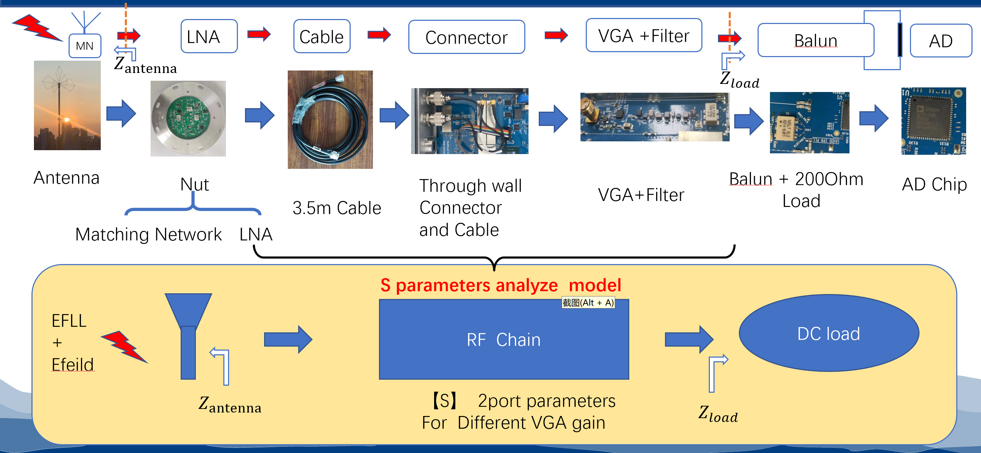
Detector Calibration: Modeling of PSD of Noise
2nd main contribution: Inner hardware noise from the radio frequency chain
Schematic diagram of the radio frequency chain
Hardware noise model is created from the S-parameters measurements in laboratory (@T = 25K)

Slide 25
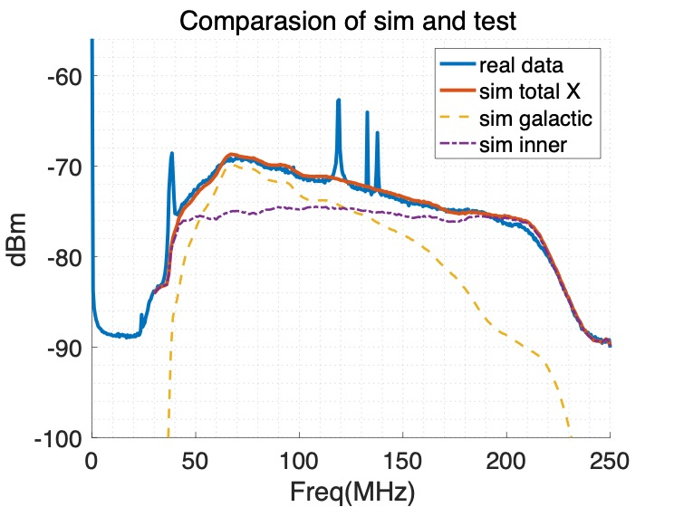
Detector Calibration: Modeling of PSD of Noise
PSD of X arm (MD, average of 32 DUs)
LST = 11h
Real data
Preliminary
Model Total
Hardware noise model
Galactic noise model
Model (Galactic noise + Hardware noise) well explains the data

Slide 26
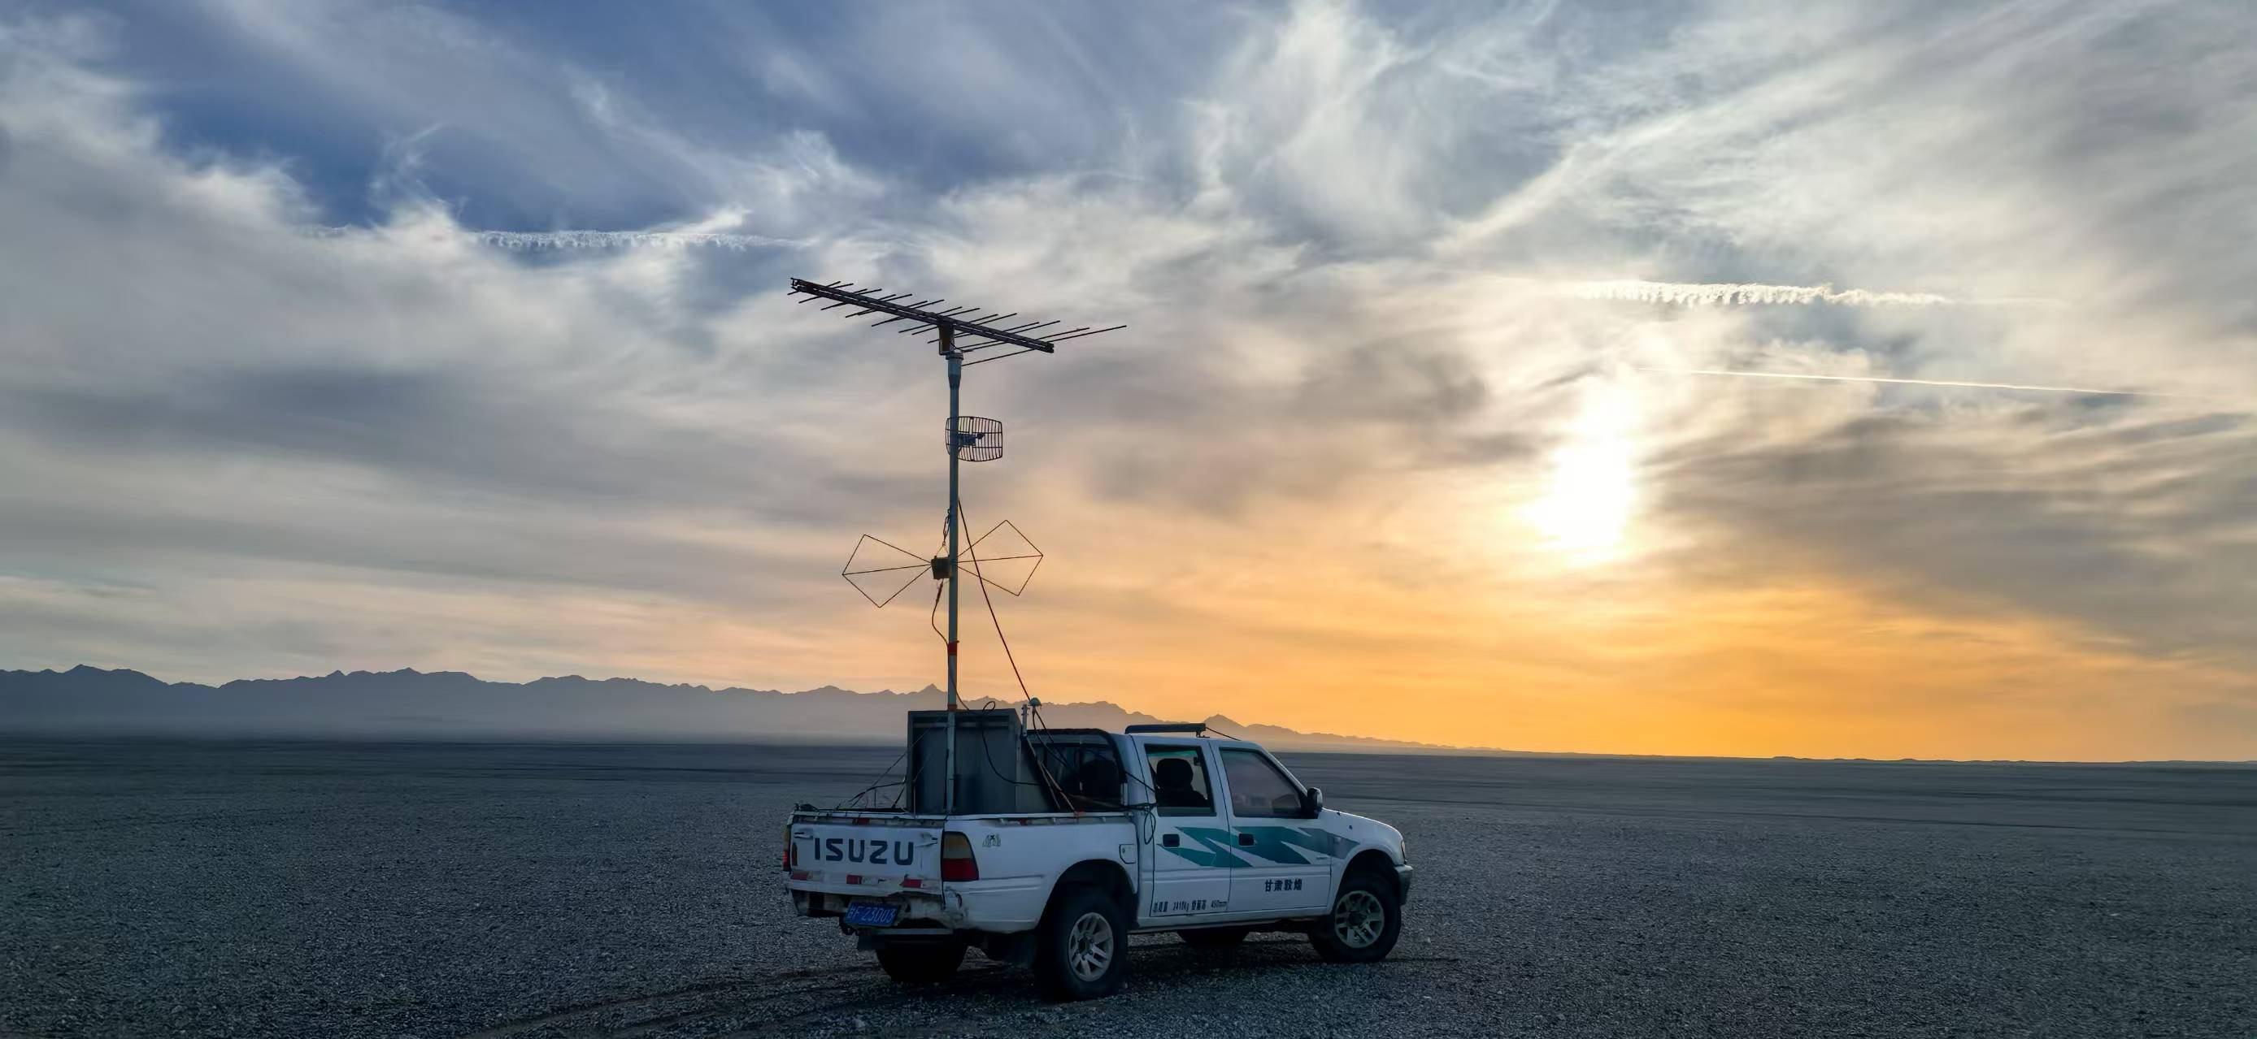
Calibration of Timings Using a Beacon
Beacon positions (1st Nov. 2024)
Beacon on a car
Northing (m)
●: Beacon positions
Data analysis is currently ongoing!

Slide 27
Reconstruction of Parameters of Primary Particles
Simulation-based studies for GRANDProto300
E-field pattern of EAS radio emission
(Important to reconstruct energy, direction, etc.)
Distribution of error of direction
[50MHz, 200MHz]
Mean = 0.09 deg. < 0.1 deg.
X_{max} resolution
See
Decoene et al., Astroparticle Physics 145, 102779 (2023)
Decoene PhD tesis
Chiche et al., PRL 132, 231001 (2024)
Guelfand et al JCAP 5, 055 (2024)
Alvarez-Muniz et al., arXiv:1810.09994 (2018)
Macias et al., Pos(ARENA2024)062
Benoit-Lévy et al., JINST19(4), P04006 (2024)

Slide 28
Summary
GRANDProto300 @ China as a prototype of GRAND
13 radio detector units (DUs) have been taking data since February 2023
Accuracy in detection timing is < 6ns, enough for the angular resolution of < 0.1 deg.
1st extension of the array completed in October 2024 (~50 DUs are taking data)
Data taking is very stable, showing a periodic behavior likely due to the Galactic noise
Power spectrum distribution is well understood with Galactic noise + Hardware noise
Sim-based performance studies are ongoing
Search for CR events is now ongoing! (~30 CR events / day expected)
Full GRANDProto300 to be completed in 2026
Next stage GRAND10k (10,000 km²) in 2030 for the 1st detection of UHE neutrinos

