Slide 1
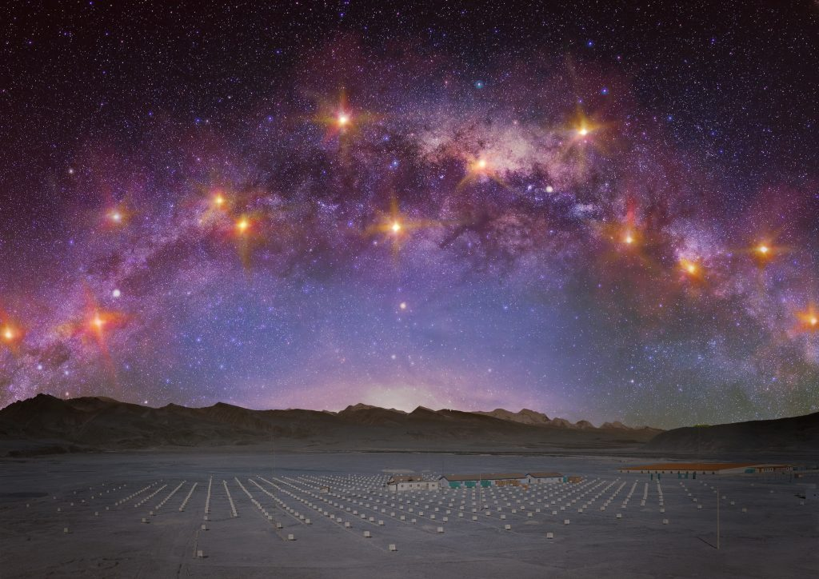
Sub-PeV gamma-ray astronomy by the Tibet ASγ experiment
Sei Kato
(Institut d’Astrophysique de Paris)
The picture taken from https://www.icrr.u-tokyo.ac.jp/news/10202/

Slide 2
Origin of PeV cosmic rays
Mean logarithmic mass (LHAASO)
Supporting light elements (p, He) @ Knee
All particle CR spectrum
Knee @ 4PeV
Cao et al., PRL 132, 131002 (2024)
Knee: Dominated by light elements
Acceleration limit of CRp in the MW?
=> Search for Galactic PeV CRp accelerators
PeVatrons
Navas et al. (PDG), PRD 110, 030001 (2024)

Slide 3
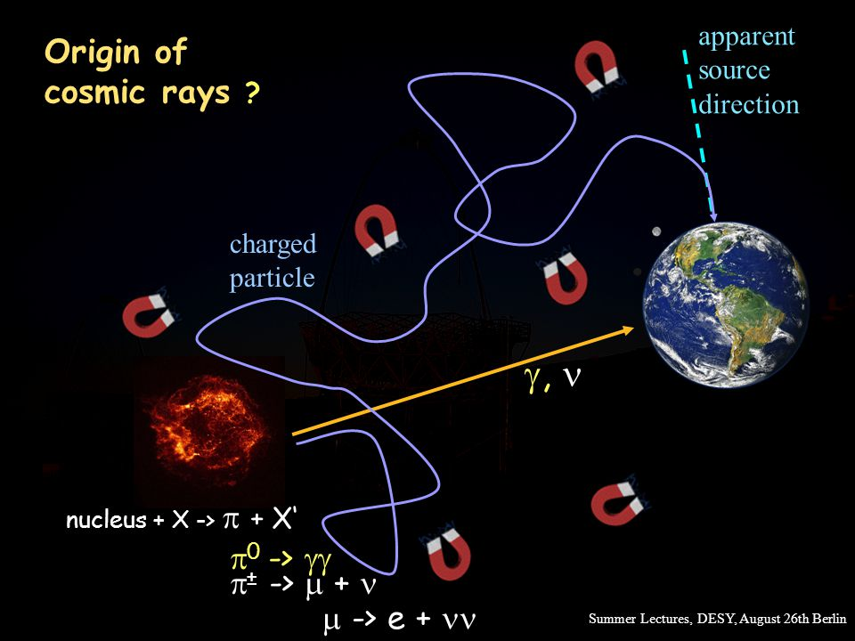
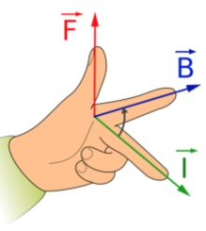
Methodology of Observation
Apparent arrival dir.
Galactic MF (~3μG)
PeV CR
r_{L} ~ 1pc
PeVatron
PeVatrons cannot be localized
from the CR obs.
Notes:
銀河系で宇宙線がどのような旅を経るかを考えてみる。
生まれて、漂って、地球へ到達する。
1. Birth -> スペクトルと最高エネルギーは天体種、加速過程、宇宙線の逃走、原始核種に依存
2. Propagation -> 拡散のエネルギー・空間依存性、磁場構造に依存
Birth
Where?
Acceleration process?
Escape?
Chemical composition?
Propagation：
Diffusion speed?
Spatial dependence?
Magnetic-field structure?

Slide 4

Methodology of Observation
Dense gas
PeV CR
PeVatron
If there is a dense gas near the source …
Notes:
銀河系で宇宙線がどのような旅を経るかを考えてみる。
生まれて、漂って、地球へ到達する。
1. Birth -> スペクトルと最高エネルギーは天体種、加速過程、宇宙線の逃走、原始核種に依存
2. Propagation -> 拡散のエネルギー・空間依存性、磁場構造に依存
Birth
Where?
Acceleration process?
Escape?
Chemical composition?
Propagation：
Diffusion speed?
Spatial dependence?
Magnetic-field structure?

Slide 5

Methodology of Observation
γ
γ
PeV CR
PeVatron
π⁰ → 2γ from CR-gas collisions
Notes:
銀河系で宇宙線がどのような旅を経るかを考えてみる。
生まれて、漂って、地球へ到達する。
1. Birth -> スペクトルと最高エネルギーは天体種、加速過程、宇宙線の逃走、原始核種に依存
2. Propagation -> 拡散のエネルギー・空間依存性、磁場構造に依存
Birth
Where?
Acceleration process?
Escape?
Chemical composition?
Propagation：
Diffusion speed?
Spatial dependence?
Magnetic-field structure?

Slide 6
Methodology of Observation
γ
γ
PeV CR
PeVatron
E_{γ} > 100 TeV (sub-PeV)
Sub-PeV γ rays & dense gas
Notes:
銀河系で宇宙線がどのような旅を経るかを考えてみる。
生まれて、漂って、地球へ到達する。
1. Birth -> スペクトルと最高エネルギーは天体種、加速過程、宇宙線の逃走、原始核種に依存
2. Propagation -> 拡散のエネルギー・空間依存性、磁場構造に依存
Birth
Where?
Acceleration process?
Escape?
Chemical composition?
Propagation：
Diffusion speed?
Spatial dependence?
Magnetic-field structure?

Slide 7
Methodology of Observation
γ
γ
γ
γ
PeV CR
PeVatron
Notes:
銀河系で宇宙線がどのような旅を経るかを考えてみる。
生まれて、漂って、地球へ到達する。
1. Birth -> スペクトルと最高エネルギーは天体種、加速過程、宇宙線の逃走、原始核種に依存
2. Propagation -> 拡散のエネルギー・空間依存性、磁場構造に依存
Birth
Where?
Acceleration process?
Escape?
Chemical composition?
Propagation：
Diffusion speed?
Spatial dependence?
Magnetic-field structure?

Slide 8
Methodology of Observation
Diffuse γ rays
γ
γ
γ
γ
Source γ rays
PeV CR
PeVatron
Notes:
銀河系で宇宙線がどのような旅を経るかを考えてみる。
生まれて、漂って、地球へ到達する。
1. Birth -> スペクトルと最高エネルギーは天体種、加速過程、宇宙線の逃走、原始核種に依存
2. Propagation -> 拡散のエネルギー・空間依存性、磁場構造に依存
Birth
Where?
Acceleration process?
Escape?
Chemical composition?
Propagation：
Diffusion speed?
Spatial dependence?
Magnetic-field structure?

Slide 9
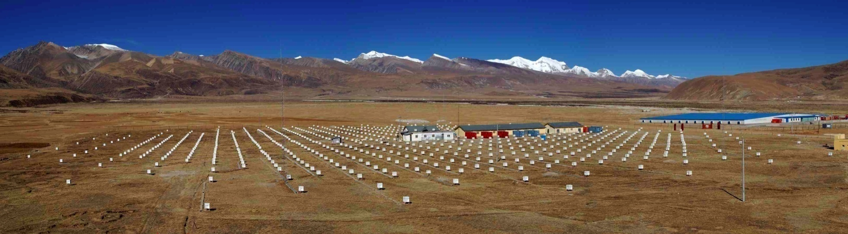
Tibet air shower array
Tibet, China(90.522ºE, 30.102ºN) 4,300 m a.s.l.
Air shower array operating since 1990
Wide F.O.V. (~ 2 sr) & high duty cycle (>90%)
Angular resolution：0.2° for 100TeV γ
Energy resolution：20% for 100TeV γ

Slide 10
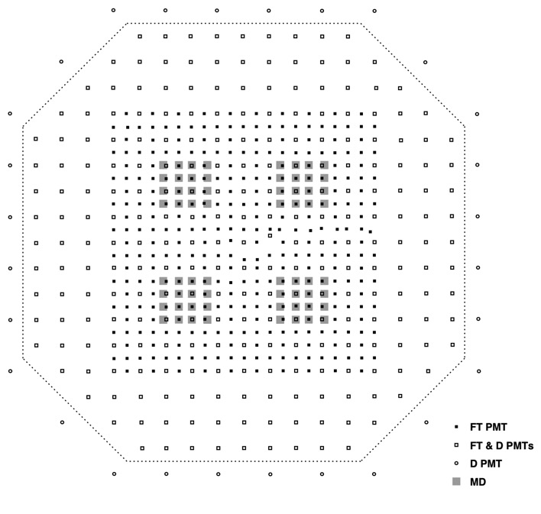
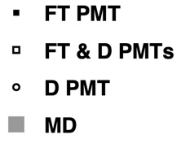
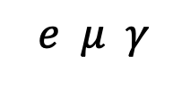
Tibet Air Shower Array
Geometrical area: 65,700 m²
(597scintillation detectors)
$$e μ γ$$
Lead plate (5mm)
Plastic scintillator (0.5m²×3cm)
Scintillation light
SUS4 box
PMTs
30 m

Slide 11
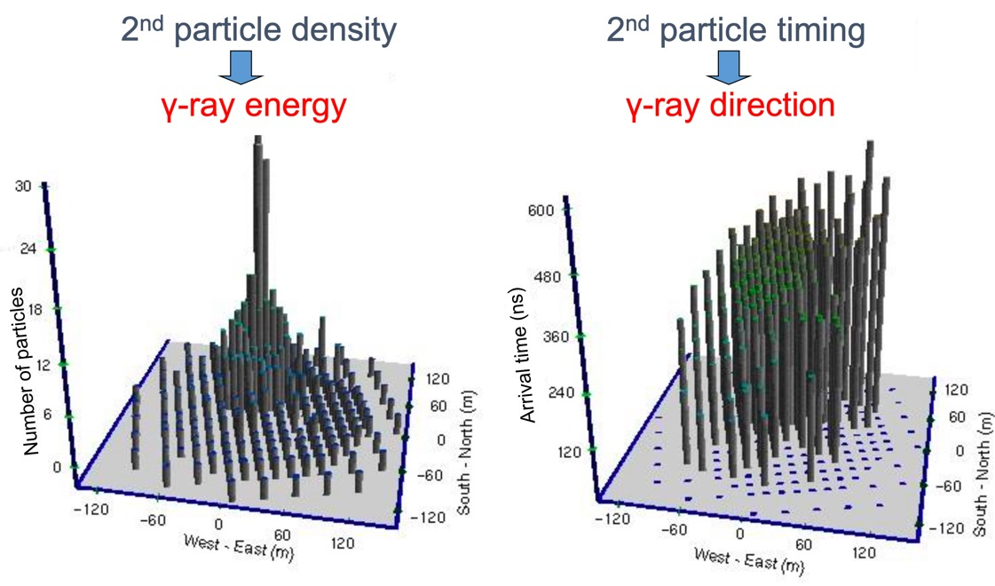
Estimation of Energy & Direction
Notes:
Wide F.O.V. => New-source search
Large detection area (~10⁴ m²) & High duty cycle
=> Statistical improvement

Slide 12
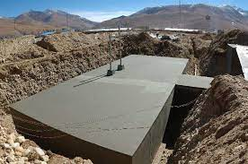
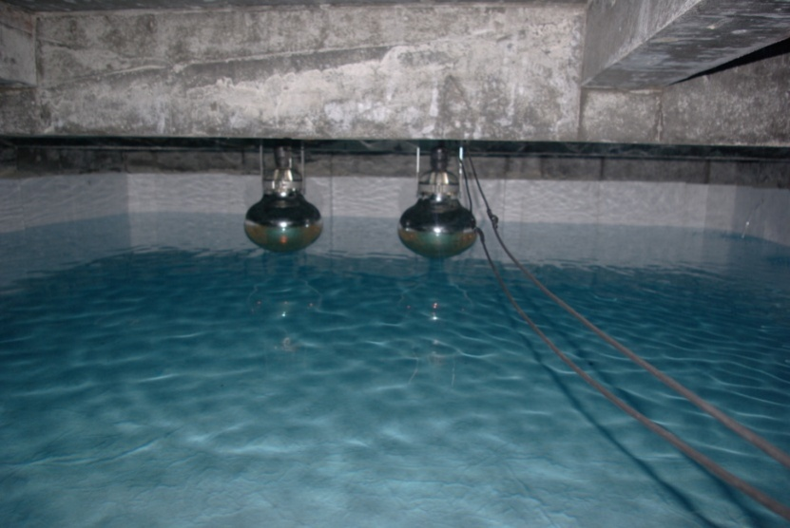
BG Rejection w/ an Underground Muon Detector Array
BGCR/Srcγ > 10² @ sub-PeV
PMT
Concrete tank
Water
Notes:
CRの研究をしたいのだが、ガンマ線を観測する。そうすると、今度はCR自体がBG!!

Slide 13
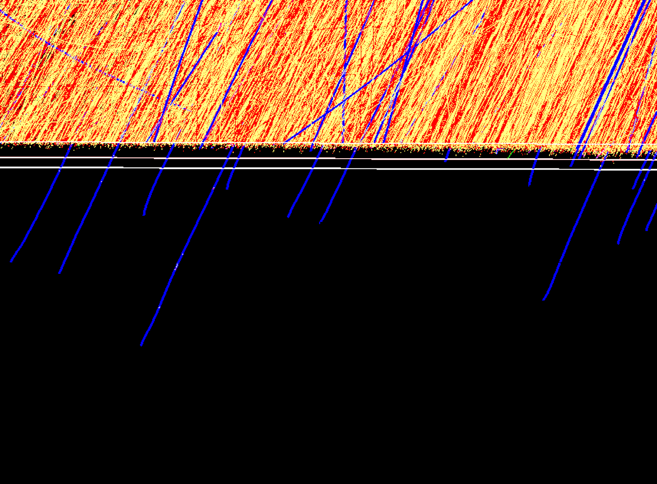
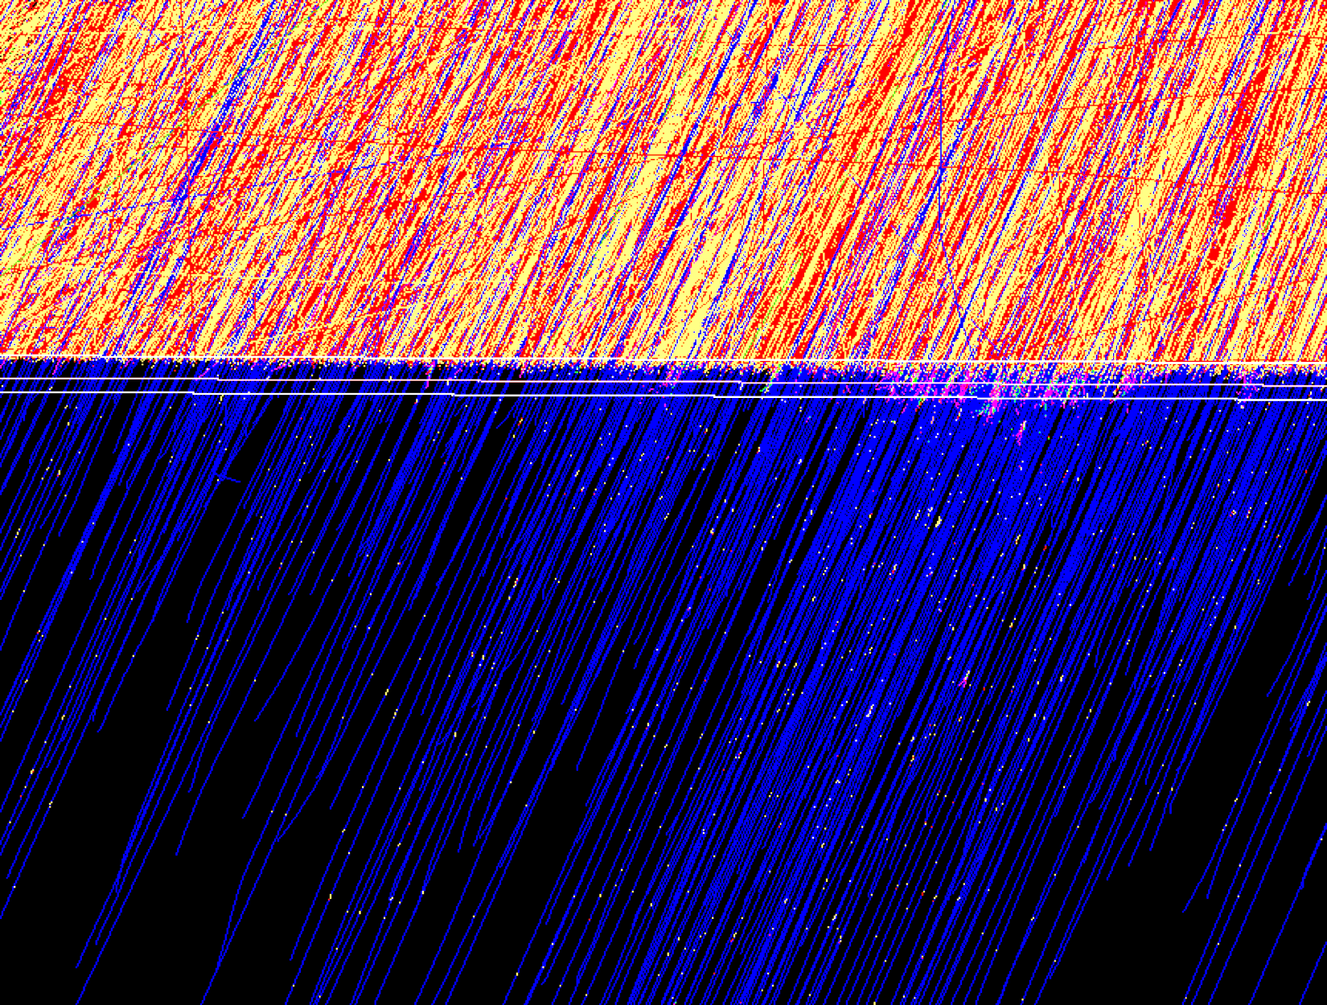
BG Rejection w/ an Underground Muon Detector Array
2 m soil layer
μ’s from the decay of mesons
200TeV γ shower
e− ・ e+ ・μ+/μ−
Few muons (~1)
: Surface detectors
: Underground detectors
200TeV CR shower
BG rejection：>99.9% @ sub-PeV
Sensitivity toγ: improvement by > 10
e− ・ e+ ・μ+/μ−
Many muons (~100)
Notes:
空気シャワー中が検出器を通過した時のチェレンコフ光を検出する。
実際に土盛りを通過できるのはほとんどがミュー粒子なので、ミュー粒子数を調べているに等しい。

Slide 14
Sub-PeV gamma-ray astronomy by the Tibet ASγ experiment (2019~)

Slide 15
1st Detection of Sub-PeV γ Rays from the Crab Nebula (2019)
Amenomori et al., PRL 123, 051105 (2019)
Significance map
E > 100 TeV
5.6σ detection
Point-like source
Energy spectrum (red)
×: Crab pulsar
Curve: leptonic model
E_{γ,max} = 450 TeV
Consistent w/ ICS of electrons & CMB
Notes:
E > 250 TeV で Non = 4 events, Noff, av = 0.8 events.
Energy resolutionによる E < 250 TeV からの染み出しは, MCから0.4 events
100TeV<E<250TeV bin (20 events). E < 100TeVからの染み出しは14%. E > 250TeVからの染み出しは3%
=> E < 100TeVからの染み出しは20*0.14 ~ 3 events
250TeV<E<630TeV bin (4 events). E < 250TeVからの染み出しは12%. E > 630TeVからの染み出しは2%

Slide 16
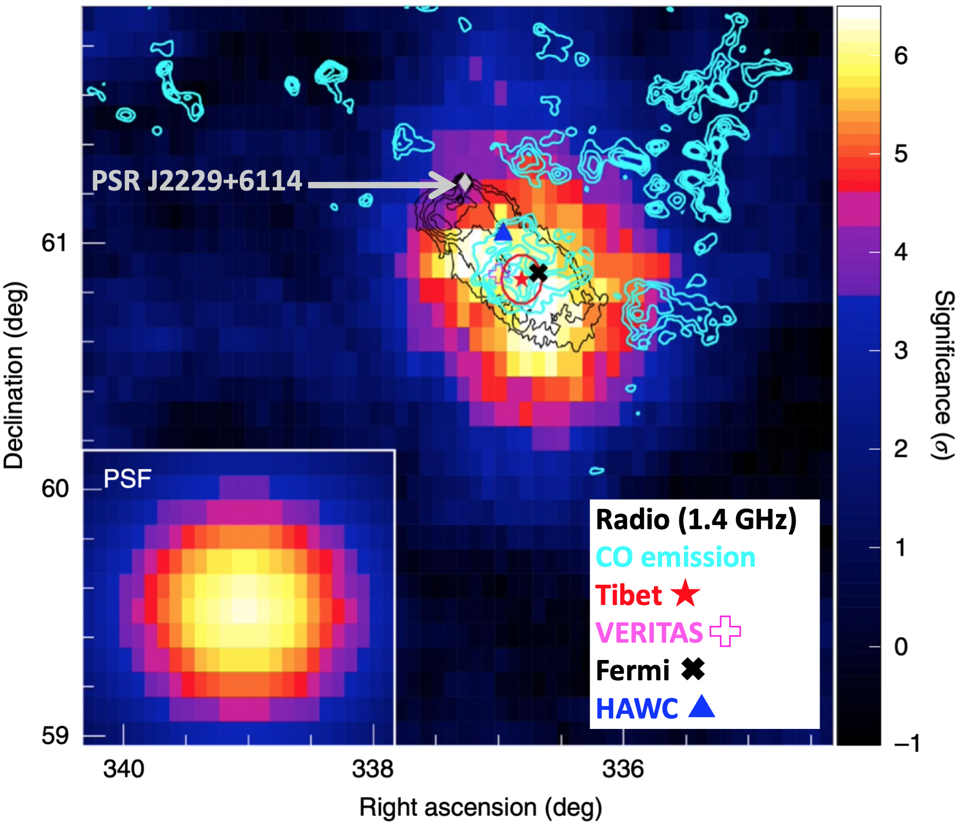
Detection of a PeVatron Candidate：SNR G106.3+2.7 (2021)
M. Amenomori et al., Nat. Astron. Lett, 5, 460 (2021)
SNR G106.3+2.7 (E >10 TeV)¹
Molecular cloud
Point-spread function
  SNR G106: discovered in radio continuum (1.4GHz)¹
  Gamma-ray emission coming from a molecular cloud
  Hadronic modeling gives E_{p,cut} ~ 500TeV
1. Pineault & Joncas, Astron. J. 120, 3218 (2000)
See also
Albert et al., ApJL 896, 29 (2020)
Cao et al., Nature 594, 33 (2021)
Notes:
多くのsub-PeVガンマ線天体が北天で見つかっている。

Slide 17
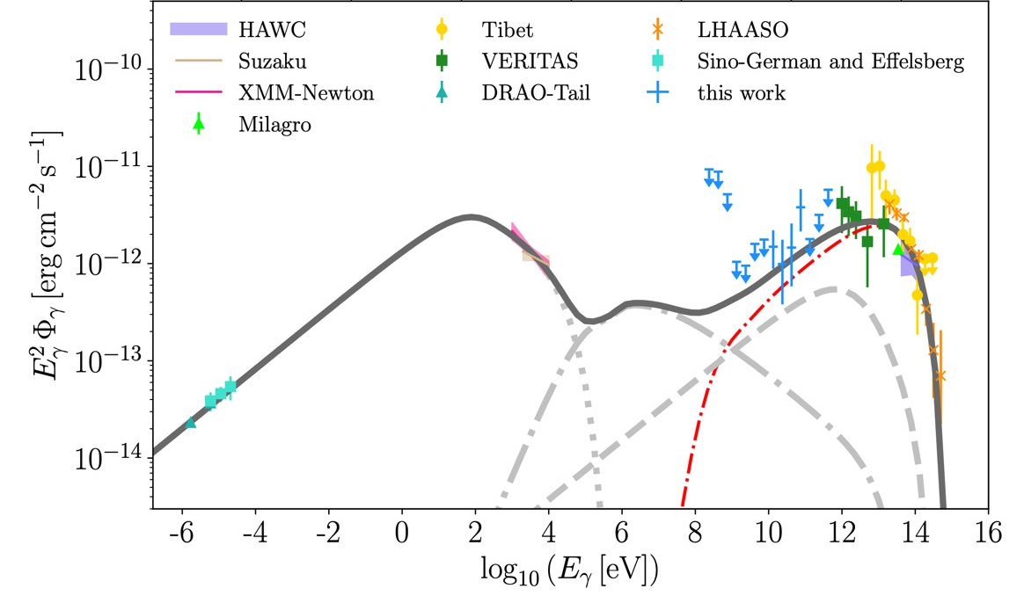
MW Spectral Analysis of SNR G106.3+2.7 (Fang et al., 2022)
Fang et al., PRL 129, 071101 (2022)
  Fermi-LAT off-pulse flux (95%UL)
p π⁰ decay
e IC
e Brems.
e Sync.
n_{gas} = 1 cm⁻³
  Leptonic modeling of γ violates the GeV ULs
  => Hadronic component is needed for γ @ 100GeV – 500TeV
  E_{p,max} ~ 1PeV:
See also MAGIC Collaboration, A&A 671, A12 (2023)
Notes:
多くのsub-PeVガンマ線天体が北天で見つかっている。

Slide 18
First Detection of Galactic Sub-PeV Diffuse γ Rays (2021)
Amenomori+., PRL 126, 141101,(2021)
Directions of γ-ray events (E > 398 TeV, Yellow)
Gal. coordinates
Outside the F.O.V.
White：HI gas
6.0σ detection @ E > 398 TeV
NOT coming from TeVCat sources => Hadronic origin
BG rejection power of 1.2×10⁻⁶ @ E > 398TeV
=> 23 events in |b| < 10° (N_{BG} = 2.7, E_{γ, max} = 957 TeV)
PeVatron(s) must exist in the Galaxy !!
Notes:
Sub-PeV拡散ガンマ線の検出(過去に天体で加速された宇宙線が宇宙空間を漂う間に星間ガスと衝突して生じるガンマ線)
銀河系内で宇宙線が10 PeVにまで加速されていることを示す証拠が得られた。

Slide 19
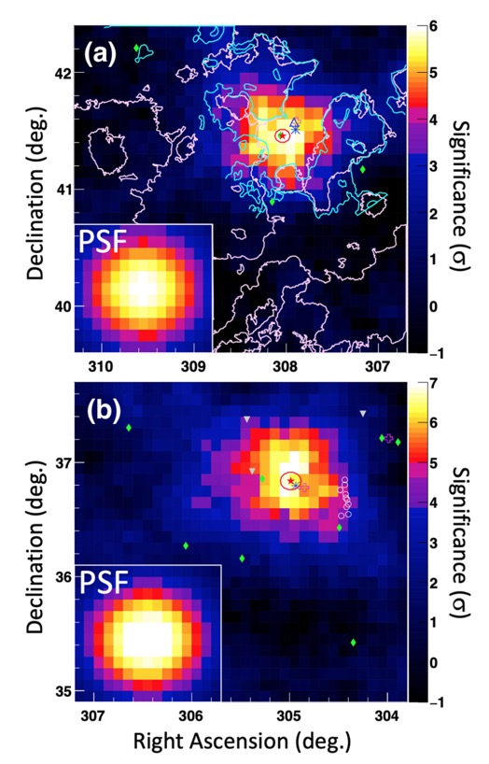
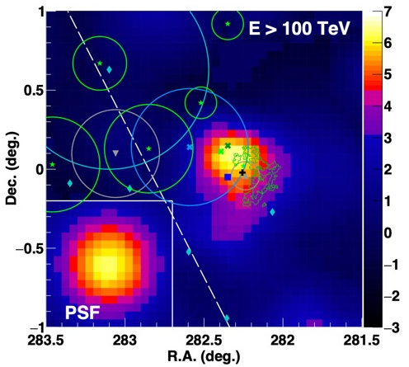
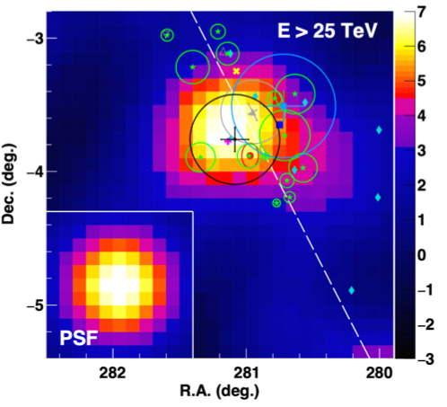
Detection of Other Sub-PeV γ-Ray Sources
Crab (E > 100TeV)
Cygnus OB1
(E > 10TeV)¹
Cygnus OB2
(E > 10TeV)¹
HESS J1849-000
(E > 100TeV)³
TASG J1844−038 &
HESS J1849−000
are PeVatron candidates^{2,3}
TASG J1844-038
(E > 25TeV)²
1. Amenomori et al., PRL 127, 031102 (2021)
2. Amenomori, …, S.K. et al., ApJ 932, 120 (2022)
3. Amenomori, …, S.K. et al., ApJ 954, 200 (2023)

Slide 20
What We Learned:
We have astrophysical sub-PeV γ rays
We do have promising PeVatron candidates
(e.g., SNR G106.3+2.7)
3. PeVatron(s) must exist in the MW

Slide 21
What We Need to Study More:
We have astrophysical sub-PeV γ rays
We do have promising PeVatron candidates
(e.g., SNR G106.3+2.7)
3. PeVatron(s) must exist in the MW
Which sources are exactly the PeVatrons
Which source significantly contribute to the local CRs
Do CRs propagate in the MW homogeneously or not?
…

Slide 22
What We Need to Study More:
We have astrophysical sub-PeV γ rays
We do have promising PeVatron candidates
(e.g., SNR G106.3+2.7)
3. PeVatron(s) must exist in the MW
Which sources are exactly the PeVatrons
Which source significantly contribute to the local CRs
Do CRs propagate in the MW homogeneously or not?
…
=> High sensitivity, Wide F.O.V., high-resolution, South. sky obs.,…

Slide 23
A Bit More about Galactic Diffuse γ Rays…
S.K. et al., ApJL 961, L13 (2024)
S.K. et al., ApJL 977, L3 (2024)
※These are not collaboration papers

Slide 24
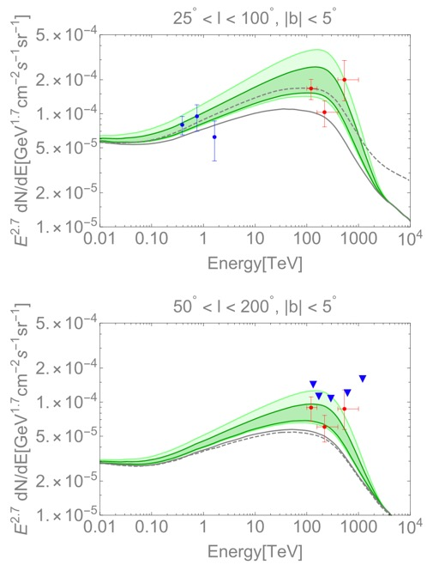
Potential Source Origin of Tibet GDE?
GDE: Galactic diffuse (γ-ray) emission
Tibet GDE = True GDE + Unresolved sources?
Modeling by Vecciotti et al., ApJ 928, 19 (2022)
CASAMIA ULs
Tibet
ARGO
Tibet
Black: True GDE model
Green: True GDE model + Unresolved Sources model
See also,
Riu & Wang, ApJL 914, L7 (2021)
Yan et al., Nat. Astron. 8, 628 (2024)

Slide 25
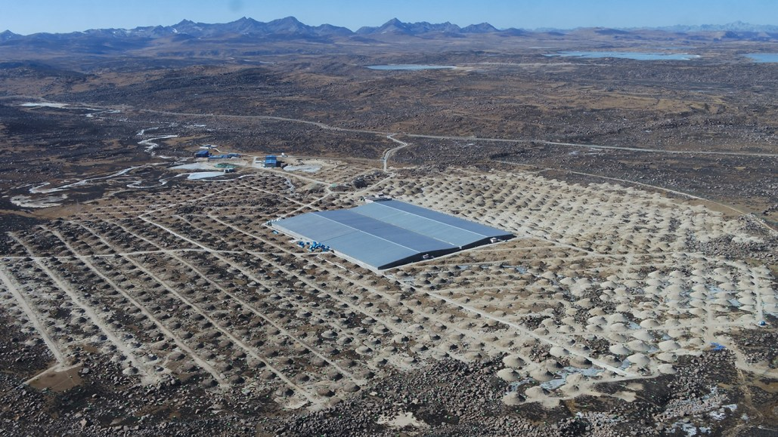
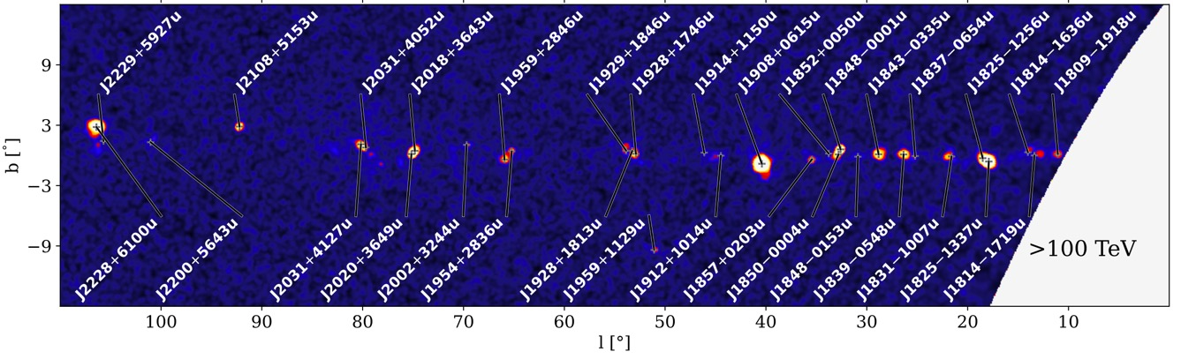
Potential Source Origin of Tibet GDE?
GDE: Galactic diffuse (γ-ray) emission
1st LHAASO catalog (2024) helps us to study the origin of Tibet GDE
LHAASO (×15 Tibet ASγ)
43 1LHAASO sources @ E >100TeV (2024)
Air shower array (1,000,000 m²)
+ Muon Detector Array
Cao et al., ApJS 271, 25 (2024)

Slide 26
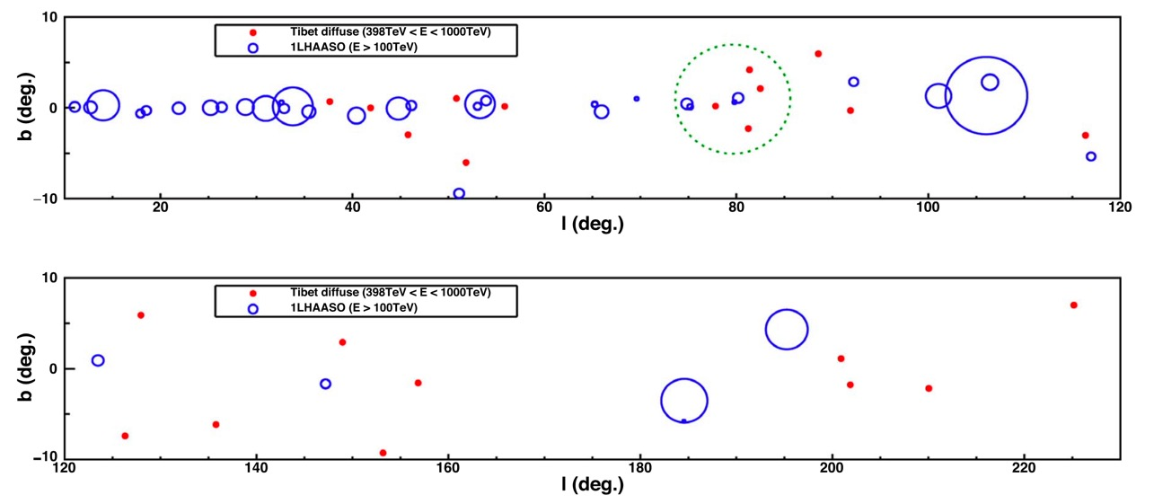
Tibet GDE @ E > 398TeV & 1stLHAASO Sources @ E >100TeV
S.K. et al., ApJL 961, L13 (2024)
Cygnus Cocoon
Tibet GDE events (E > 398TeV)
sub-PeV LHAASO sources (95% containment extension)
Sub-PeV LHAASO sources: 1LHAASO sources detected @ E >100TeV
No overlap b/w Tibet GDE events & sub-PeV LHAASO sources

Slide 27
Tibet GDE @ E > 398TeV & 1stLHAASO Sources @ E >100TeV
S.K. et al., ApJL 961, L13 (2024)
Cygnus Cocoon
The 23 Tibet GDE events @ E > 398 TeV are likely of diffusive nature,
although their potential origin in yet-unresolved sources cannot be ruled out
Tibet GDE events (E > 398TeV)
sub-PeV LHAASO sources (95% containment extension)
Sub-PeV LHAASO sources: 1LHAASO sources detected @ E >100TeV
No overlap b/w Tibet GDE events & sub-PeV LHAASO sources

Slide 28
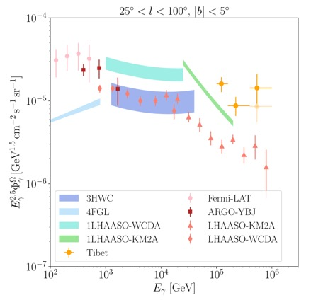
Source Contribution to the Tibet GDE Flux @ >100TeV
Fang & Murase, ApJL 957, L6 (2023)
Tibet GDE (E > 100TeV, 25° < l < 100° & |b| < 5°)
1st LHAASO src.s (E > 25TeV)
LHAASO GDE (10TeV<E<1PeV, 15° < l < 125° & |b| < 5°)
Questions:
Significant contribution to Tibet GDE from LHAASO src.s?
Tibet GDE / LHAASO GDE ~ 5 @ 100TeV. How to explain it?
Tibet GDE = LHAASO src.s + LHAASO GDE?

Slide 29
Source Contribution to the Tibet GDE Flux @ >100TeV
Fang & Murase, ApJL 957, L6 (2023)
Tibet GDE (E > 100TeV, 25° < l < 100° & |b| < 5°)
1st LHAASO src.s (E > 25TeV)
LHAASO GDE (10TeV<E<1PeV, 15° < l < 125° & |b| < 5°)
Questions:
Significant contribution to Tibet GDE from LHAASO src.s?
Tibet GDE / LHAASO GDE ~ 5 @ 100TeV. How to explain it?
Tibet GDE = LHAASO src.s + LHAASO GDE?
However,

Slide 30
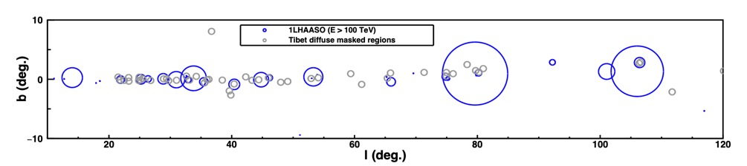
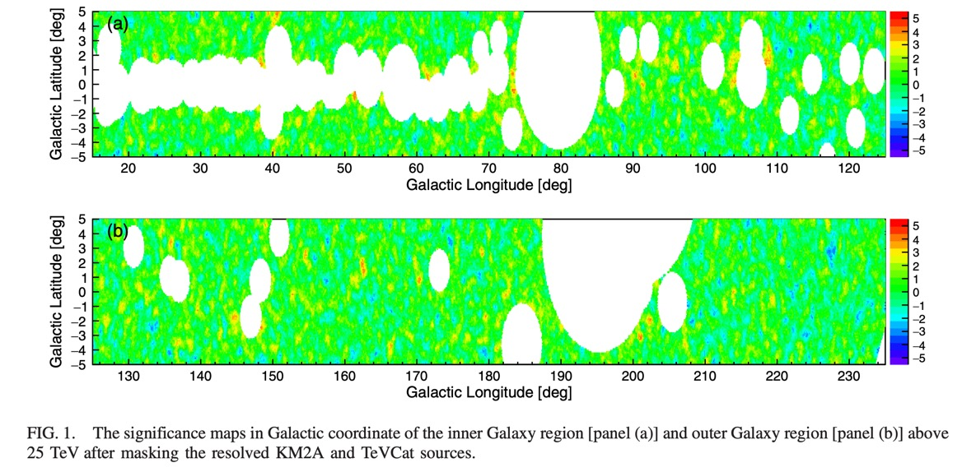
Sky Masking by Tibet & LHAASO
Tibet masking (10° < l < 120°) & 1LHAASO sources (E > 100 TeV & 95% extension)
S.K. et al., ApJL 977, L3 (2024)
LHAASO masking (15° < l < 125°)
Fang & Murase (2023)
Tibet GDE (>100TeV, 25° < l < 100°)
LHAASO src. (>25TeV)
LHAASO GDE (10TeV<E<1PeV, 15° < l < 125°)
Cao et al., PRL 131, 151001 (2023)
Tibet masking should be considered to estimate source contamination
LHAASO masking should be considered to discuss the difference
in the GDE flux measurements b/w Tibet & LHAASO

Slide 31
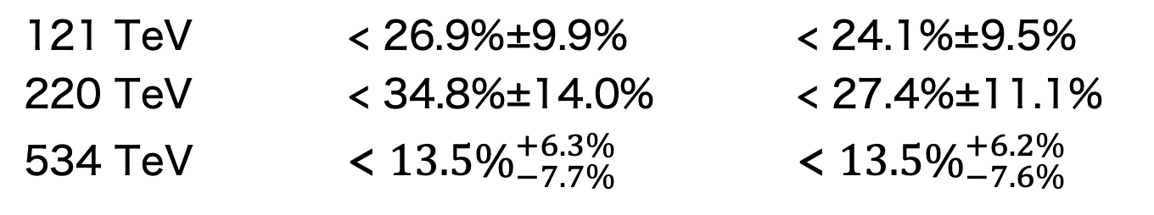
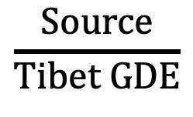
Source Contribution to the Tibet GDE Flux
S.K. et al., ApJL 977, L3 (2024)
Tibet GDE flux (stat. & syst.)
1LHAASO(>100TeV)+Cygnus Cocoon
$$\frac{Source}{Tibet GDE}$$
Region A
(25°<l<100° & |b|<5°)
Region B
(50°<l<200° & |b|<5°)
121 TeV < 26.9%±9.9% < 24.1%±9.5%
220 TeV < 34.8%±14.0% < 27.4%±11.1%
534 TeV < ${13.5\%}_{−7.7\%}^{+6.3\%}$ < ${13.5\%}_{−7.6\%}^{+6.2\%}$
Source contribution is
subdominant

Slide 32
Source Contribution + LHAASO GDE Flux
Fang & Murase, ApJL 957, L6 (2023)
+
LHAASO diffuse
1LHAASO(>100TeV)+Cygnus Cocoon
(Src + LHAASO GDE)/Tibet GDE
Region A
(25°<l<100° & |b|<5°)
1LHAASO source contribution cannot explain the difference
b/w Tibet & LHAASO GDE fluxes
121 TeV < 49.4%
220 TeV < 65.5%
534 TeV < 25.8%

Slide 33
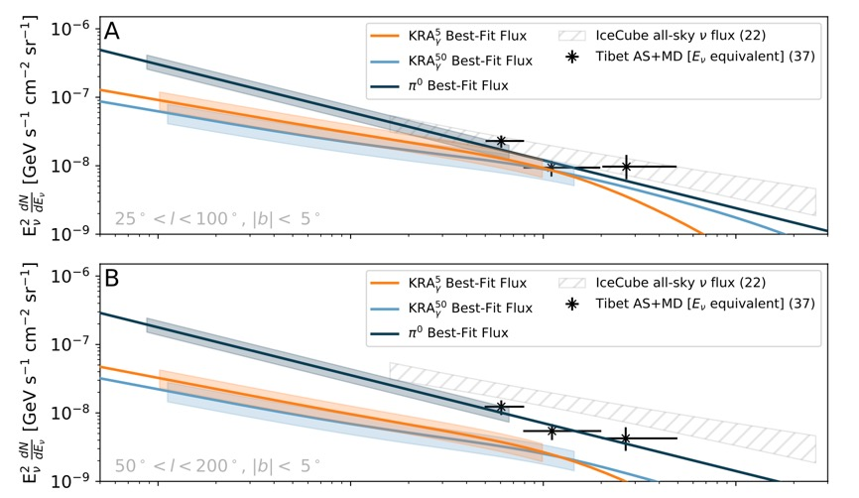
Nature of the Tibet GDE Flux
S.K. et al., ApJL 977, L3 (2024)
Estimation of unresolved Leptonic contribution¹
IceCube Galactic ν & Tibet GDE²
Tibet diffuse flux
1LHAASO(>100TeV)+Cygnus Cocoon
Unresolved leptonic (Kaci et al, 2024)
Consistent w/ ICν flux (π⁰ model)
Supporting the hadronic origin of Tibet GDE
1. Kaci et al., ApJL 975, L6 (2024)
2. IceCube Collaboration, Science 380, 1338 (2023)

Slide 34
Nature of the Tibet GDE Flux
S.K. et al., ApJL 977, L3 (2024)
GDE in Region A (25° < l < 100° & |b| < 5°)
GDE in Region B (50° < l < 200° & |b| < 5°)
Amenomori+., PRL 126, 141101,(2021)
: Tibet GDE − 1LHAASO src.
Black solid & dashed lines:
Lipari & Vernetto PRD 98, 043003 (2018)
(Tibet GDE – Source) is consistent w/ the GDE model of Lipari & Vernetto
Supporting the diffusive origin of Tibet GDE
※ Significant contribution from unresolved hadronic sources cannot be ruled out

Slide 35
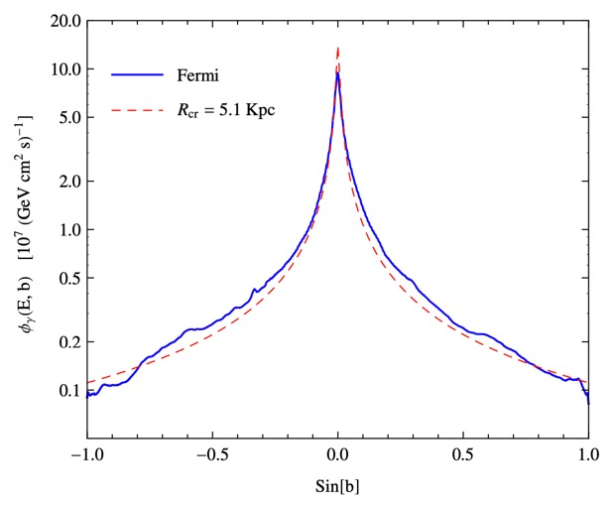
Interpretation of the Tibet & LHAASO GDE Fluxes
S.K. et al., ApJL 977, L3 (2024)
$\frac{Tibet GDE ({25}^{°}<l<{100}^{°}, { \left|b\right|<5}^{°})−Source}{LHAASO GDE1 ({15}^{°}<l<{125}^{°}, { \left|b\right|<5}^{°})}$ = 3, 2, & 7 @ 120TeV, 220TeV, & 530TeV
LHAAASO masking in the inner Galaxy¹
LHAASO masks most regions in |b| < 2°
(Tibet masking: ~5% of F.O.V.)
1. Cao et al., PRL 131, 151001 (2023)
2. Lipari & Vernetto, PRD 98, 043003 (2018)
: Tibet region A (25° < l < 100° & |b| < 5°)
GDE latitudinal distribution* by Lipari & Vernetto (2018)²
*The distribution is Integrated over |l| < 180°
Using the theoretical prediction,
Flux(|b|<5°) ÷ Flux(2°<|b|<5°) ~ 3
~ Tibet region A ~ LHAASO inner Gal. plane
The following scenario can explain the difference:
They observe hadronic GDE, but in the different Galactic latitudinal regions due to their different masking schemes
E = 12GeV
sin(b)

Slide 36
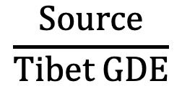
Implications of the Results: Fraction of GDE
$$\frac{Source}{Tibet GDE}$$
Region A
(25°<l<100° & |b|<5°)
Region B
(50°<l<200° & |b|<5°)
121 TeV < 26.9%±9.9% < 24.1%±9.5%
220 TeV < 34.8%±14.0% < 27.4%±11.1%
534 TeV < ${13.5\%}_{−7.7\%}^{+6.3\%}$ < ${13.5\%}_{−7.6\%}^{+6.2\%}$
Source : Tibet GDE – Source ~ 3 : 7
Sub-PeV Galactic γ rays are dominated by GDE?
=> Spectral analysis @ E > 100 TeV for individual sources

Slide 37
Implications of the Results: Cygnus Super Bubble
γ-ray significance maps (E >100TeV)
LHAASO Collaboration, Science Bulletin 69, 449 (2024)
γ-ray energy spectrum
Longitude distribution (E >100TeV)
GDE estimation does not consider the GDE flux from
the sky regions masked by LHAASO GDE analysis
=> Higher contamination from GDE ??

Slide 38
Summary
From the γ-ray observation by Tibet ASγ, we found
1. Astrophysical sub-PeV γ rays (Crab Nebula)
2. Promising PeVatron candidates (e.g., SNR G106.3+2.7)
3. Evidence for Galactic PeVatrons (Galactic diffuse)
Regarding the GDE flux @ E > 100 TeV measured by Tibet,
1. GDE events @ E > 398 TeV are likely of diffusive nature※
2. Contribution from resolved γ-ray sources is subdominant
3. A large fraction (>70%) is likely of hadronic diffusive nature※
4. Tibet & LHAASO are observing hadronic GDE under different sky
masking schemes, which would lead to a difference in their GDE flux
measurements
※ Significant contribution from unresolved hadronic sources cannot be ruled out

