Slide 1
New physics research at LHAASO
Xiao-Jun Bi (毕效军）(On behalf of the LHAASO collaboration)
Institute of High Energy Physics, CAS
Theory meeting experiments: particle astrophysics and cosmology
ICISE, Jan 5 - Jan 11, 2025

Slide 2
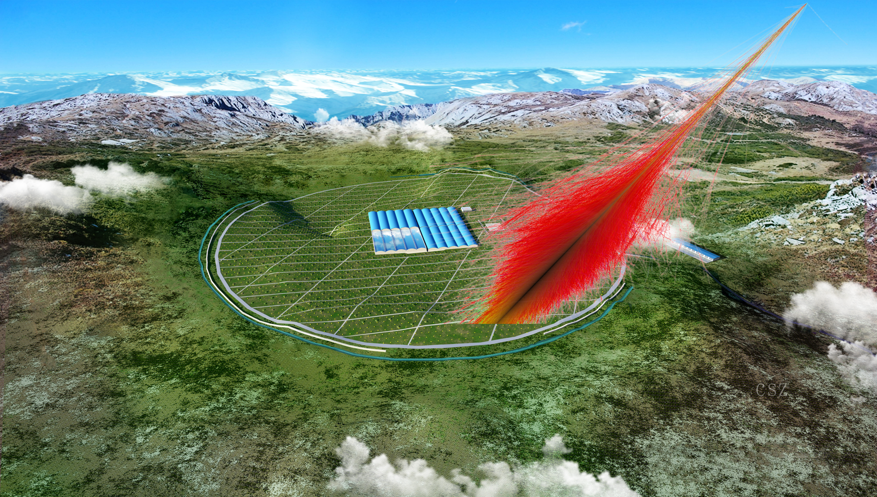
LHAASO: Large High Altitude Air Shower Observatory
2008/4 R&D
2015/12 approved
2017/5 start construction
2021 full array completed

Slide 3


LHAASO aerial image，2021/12
Haizi Mountain, Sichuan province, China
Altitude 4410 m a.s.l.
Area: 1.3km²
BJ
DC
CD

Slide 4
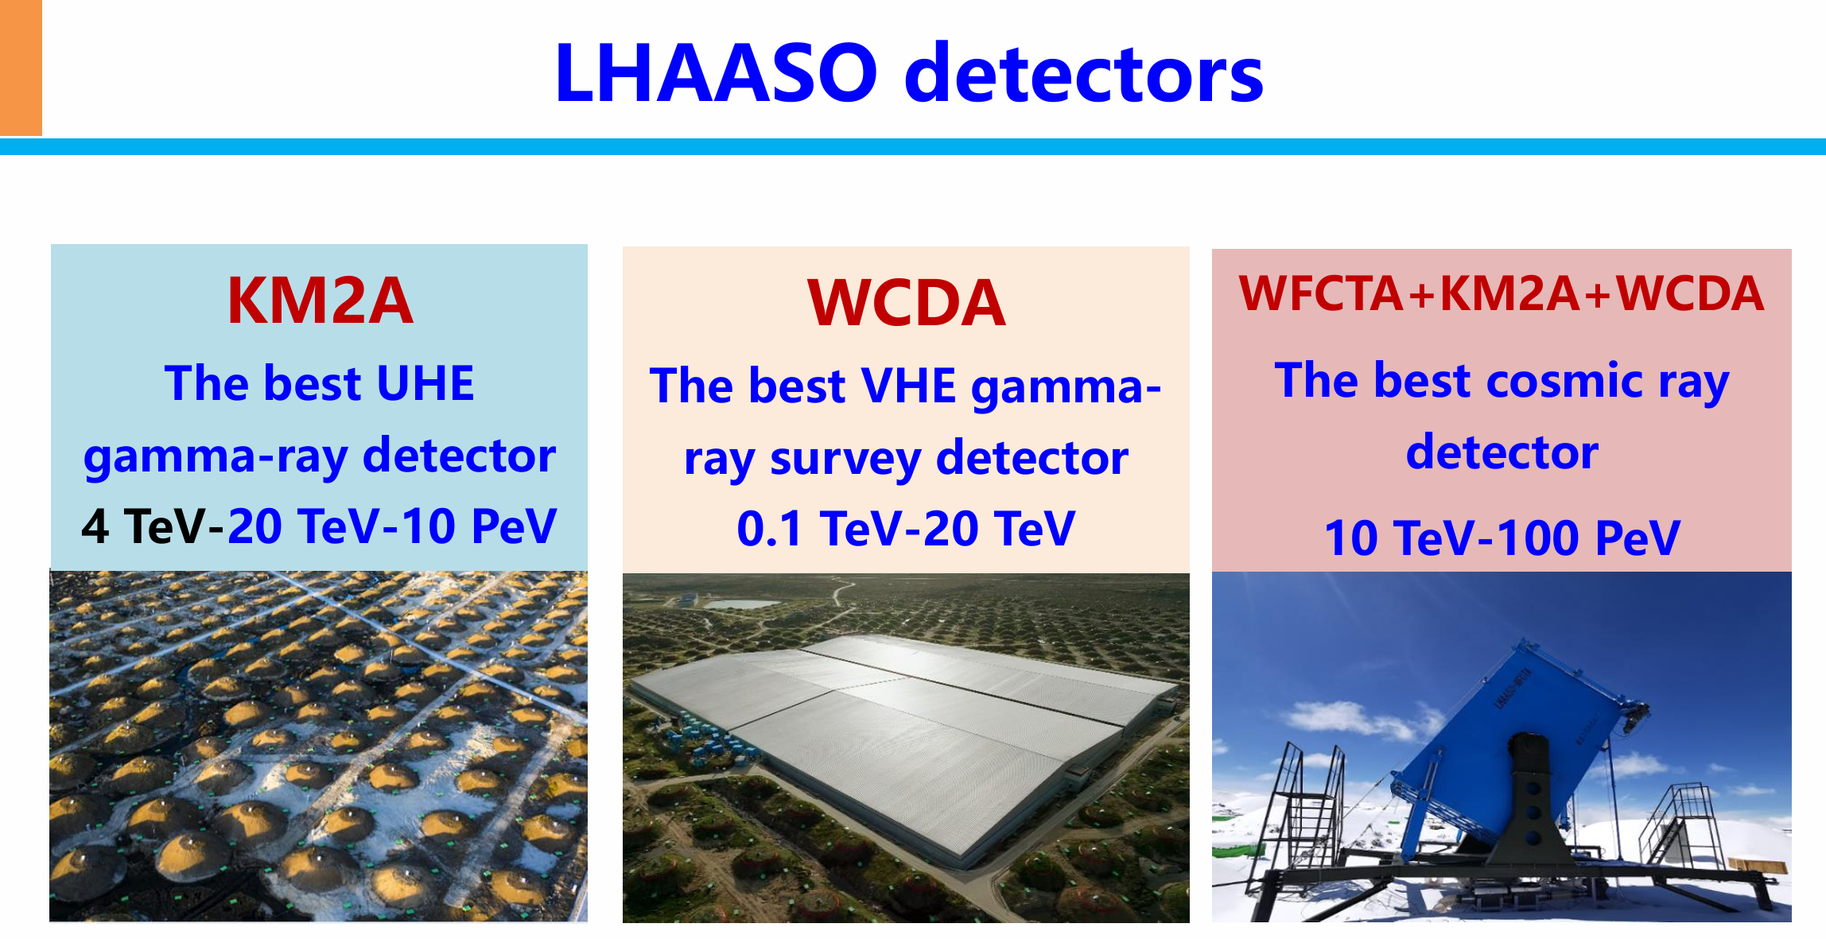

Slide 5
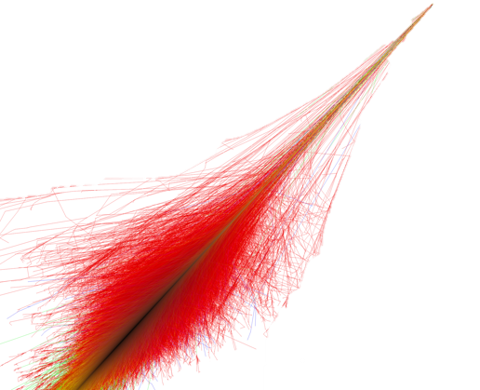
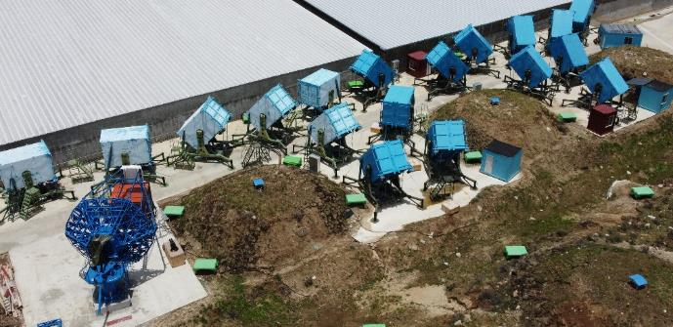
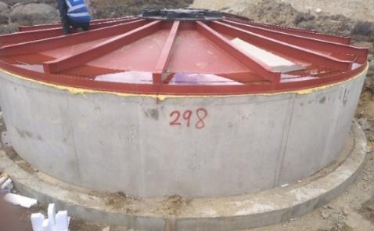
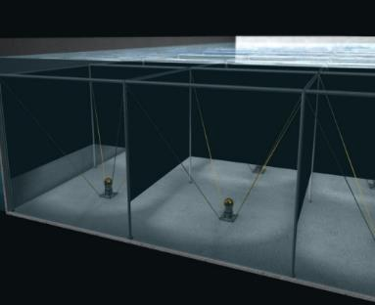
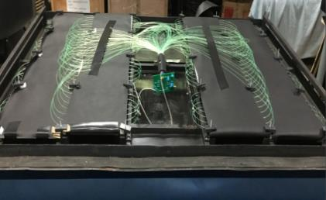
LHAASO detectors
KM2A
Cosmic-ray/γ
7m
WFCTA
18x4.7m²
MD: 1188x36m²
1.2m
5m
WCDA
ED: 5216x1m²
1.3 km²
3120x25m²

Slide 6
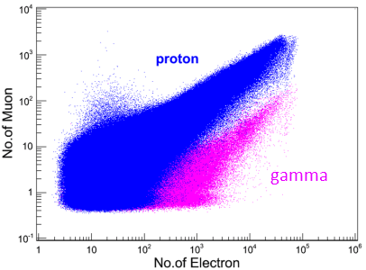
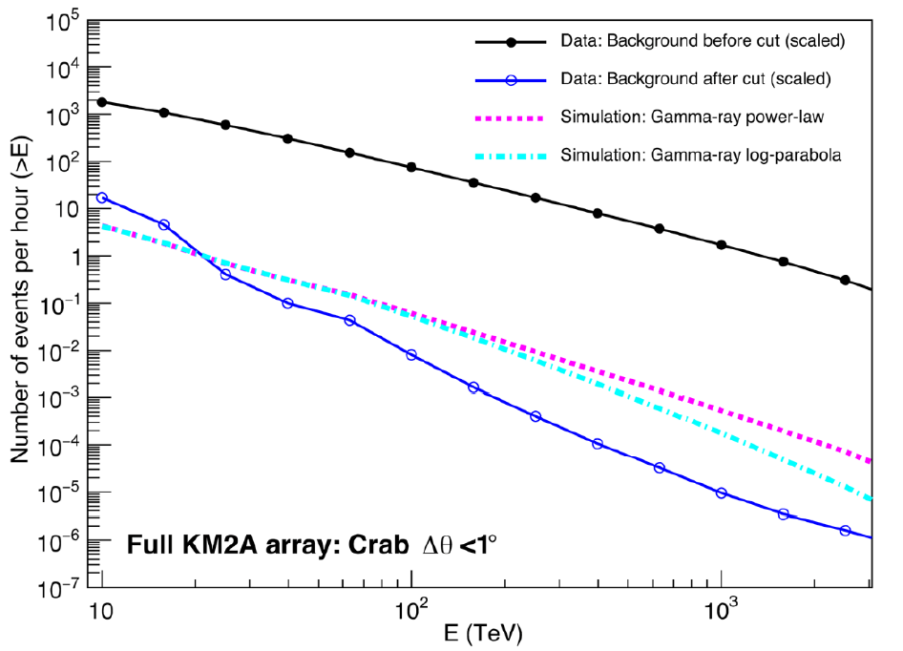
Gamma-ray/cosmic ray discrimination
Before cut: CR rate
10⁻⁵
Gamma-ray rate
After cut: CR rate

Slide 7
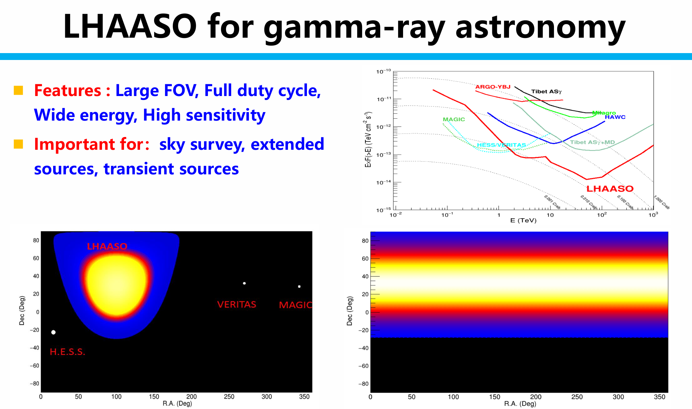
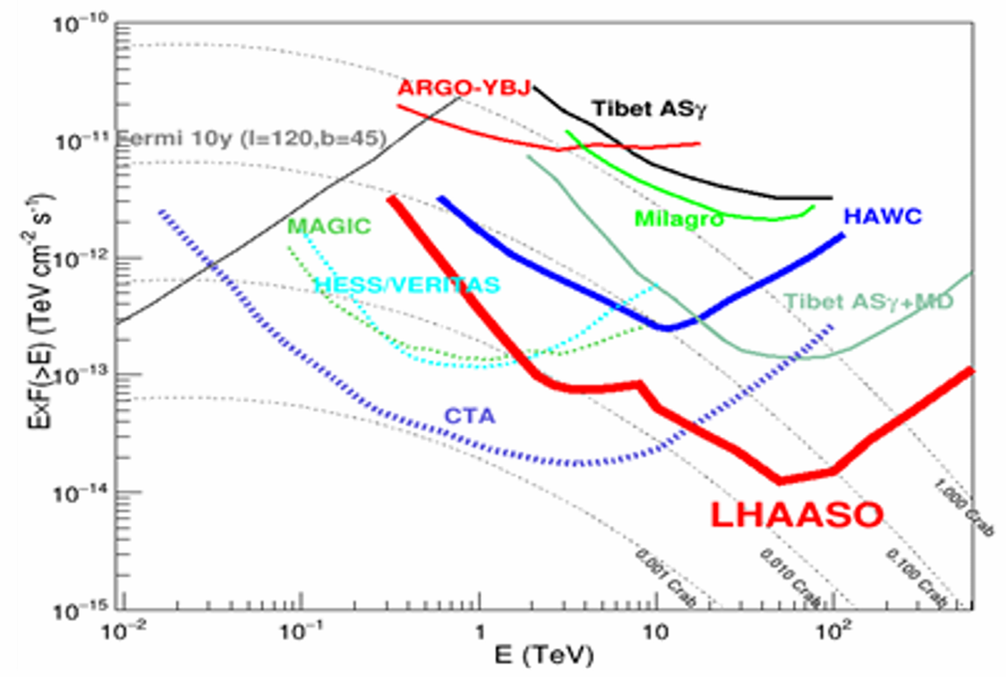

Slide 8
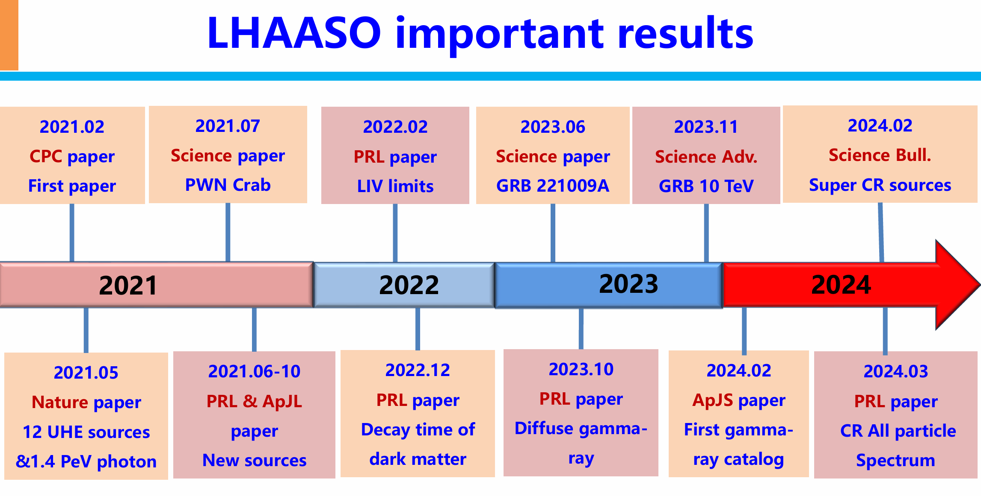

Slide 9


LHAASO research of new physics beyond the standard model
The SM is an extremely successful model that describes nearly all micro phenomena with high accuracy. However it still has many problems ……
It doesn’t account for dark matter/dark energy.
It can not explain why the world consists only normal matter but no antimatter.
It has the strong CP problem.
  Broken of PQ symmetry predicts axion, which is a DM candidate.
It has the hierarchical problem.
  SUSY/extraD generally predicts WIMP as dark matter.
It does not include gravity.
  Quantum gravity theories which may indicate Lorentz invariance violation.
……

Slide 10
Outline
Heavy dark matter signals
axion signals
Lorentz invariance violation (LIV)

Slide 11
Advantages of new physics search at LHAASO
LHAASO is unique of new physics signal searches. For example, it observes highest energy gamma rays from a cosmological distance. Tiny effects may accumulate with distance.
Heavy dark matter signals (> PeV)
Lorentz invariant violation (LIV) （high energy）
LIV from the light curve （distance accumulation）
axion scenario （distance accumulation）

Slide 12
Dark matter searches

Slide 13


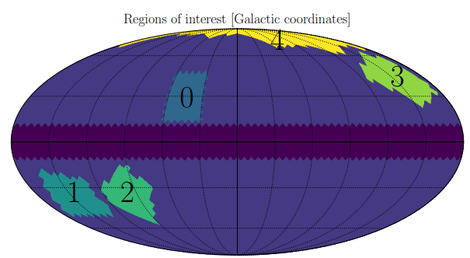
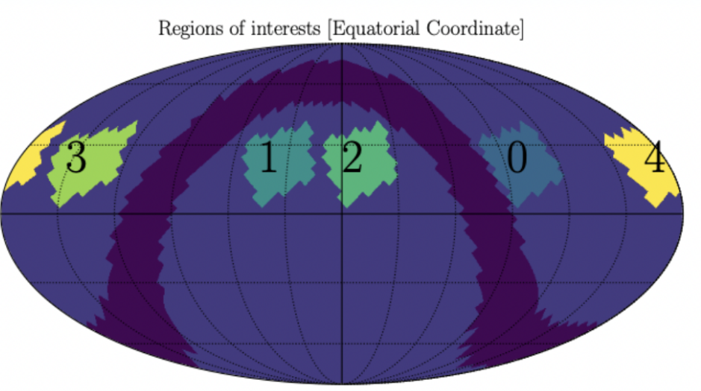
I -Superheavy DM decay from the Galactic halo
The signal region is chosen
  Away from Galactic plane and Fermi bubble
  As close to the GC as possible
4 control regions by shifting ROI₀ along the RA direction by 90°, 135°, 240°, 285° respectively
  Same declination and same detector performance
  For accurate estimate the bkg and
  eliminate systematics

Slide 14
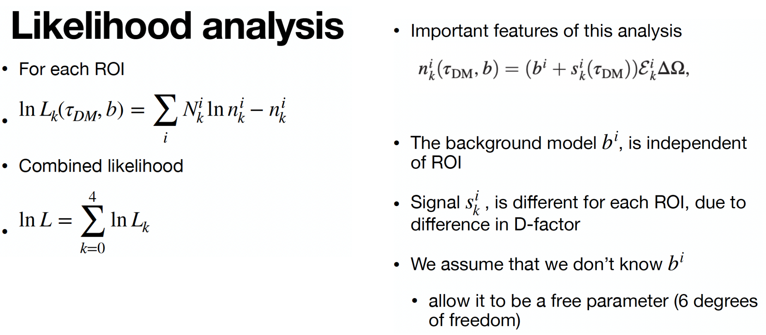
a

Slide 15
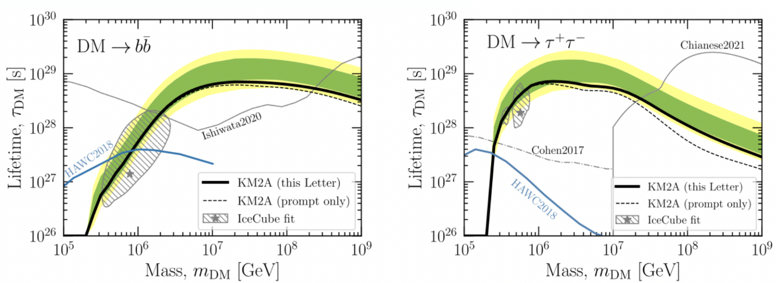
Constraints on Heavy Decaying Dark Matter from 570 Days of LHAASO Observations
Phys.Rev.Lett. 129 (2022) 26, 261103

Slide 16
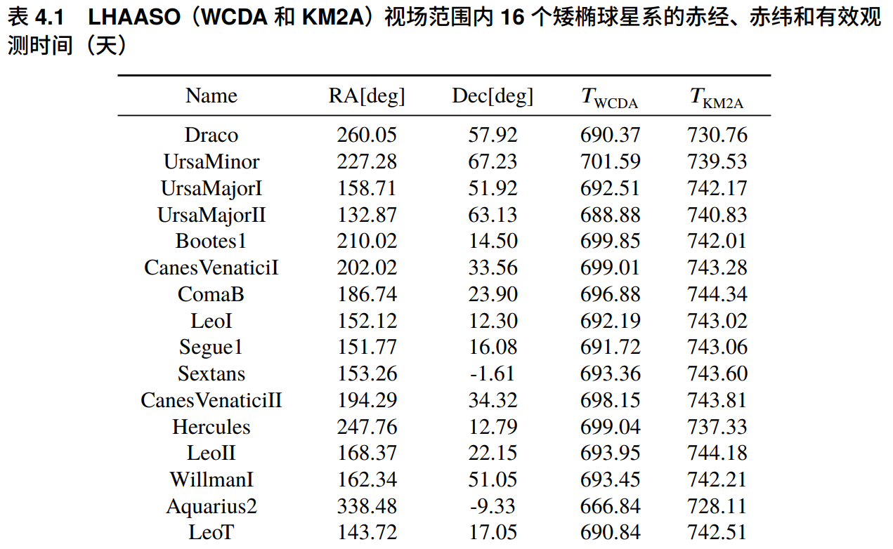
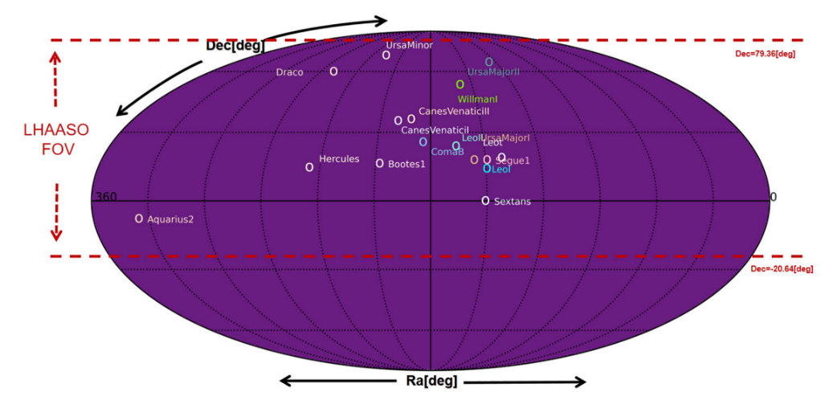
II -Dark matter annihilation/decay signals from the dwarf galaxies

Slide 17
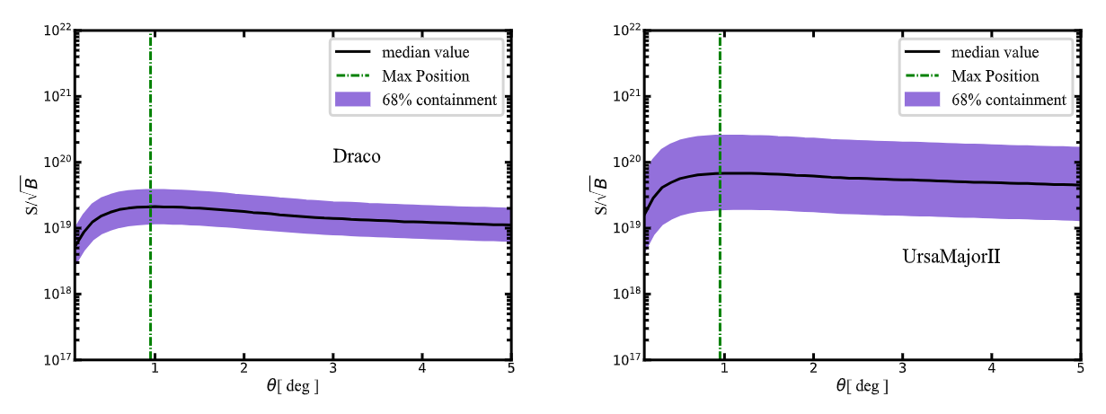
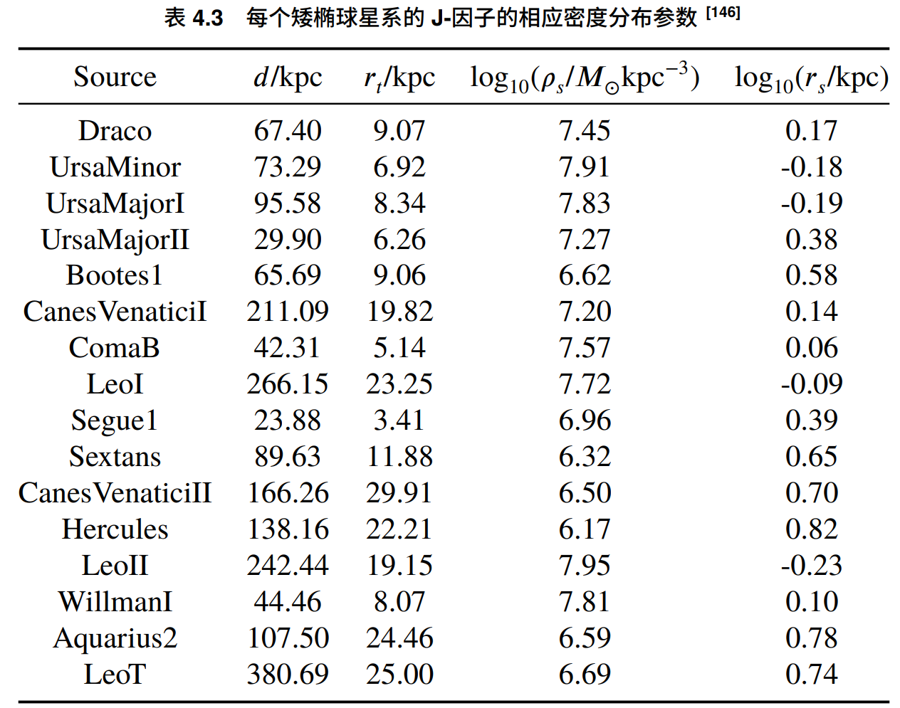
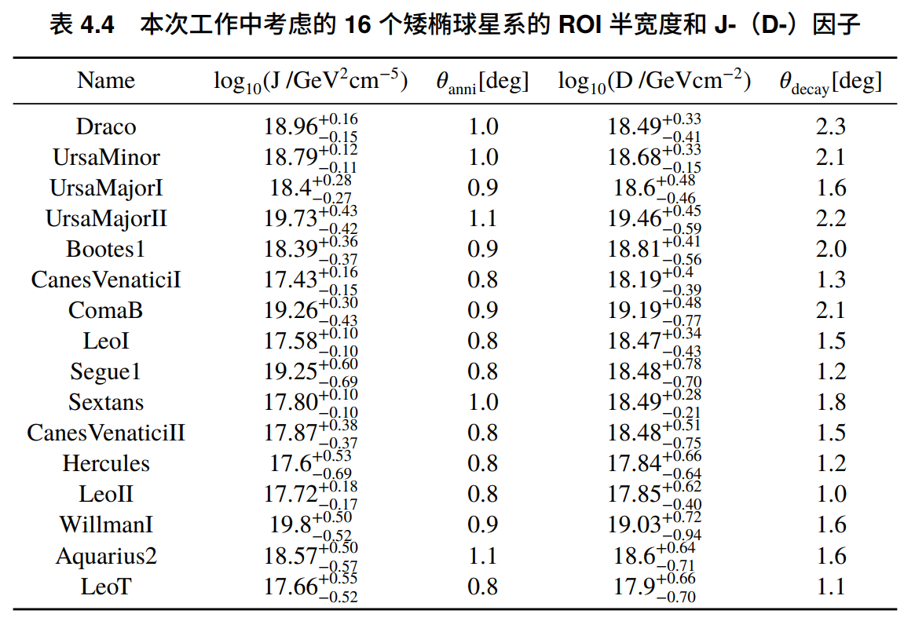
Density profile of DM in the dwarf galaxies

Slide 18
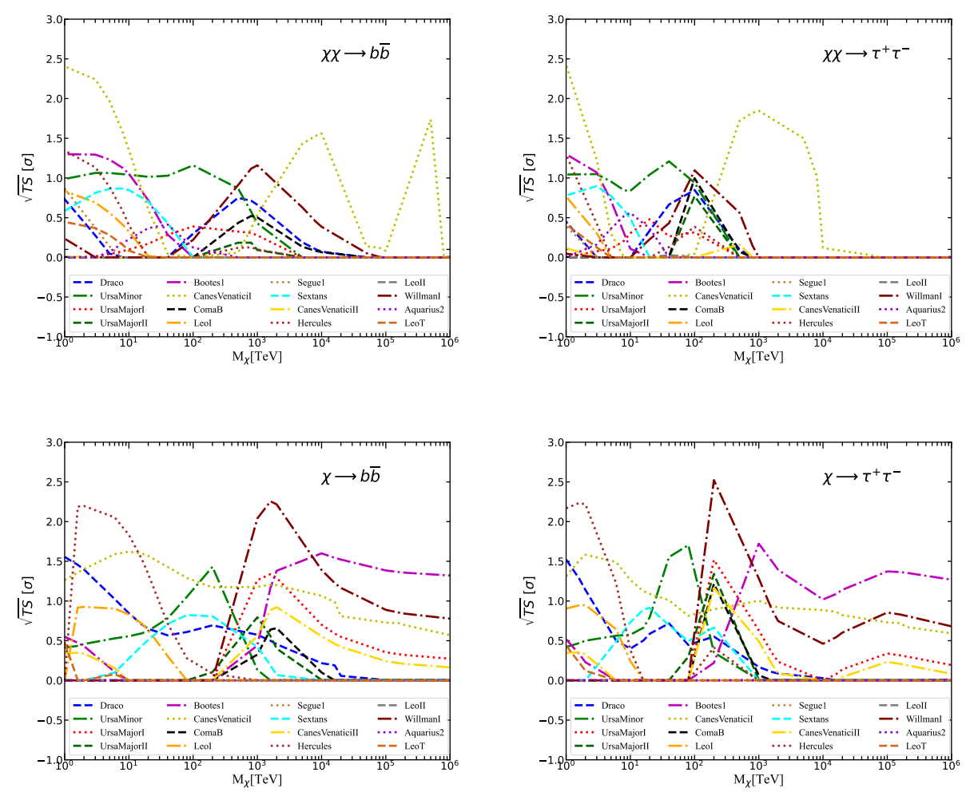
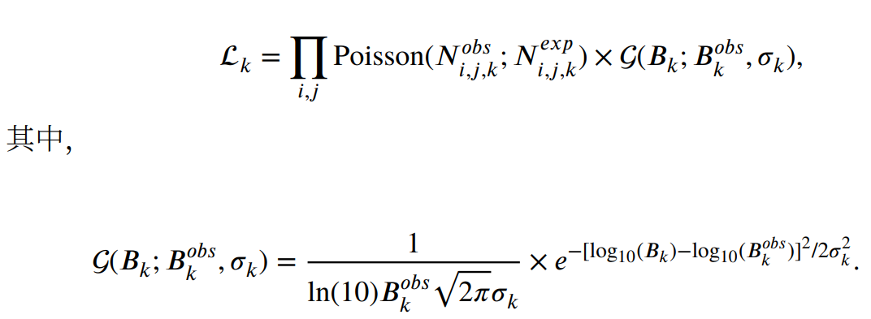
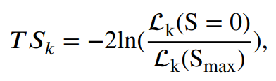
TS distribution from different dwarf galaxies
Compute the 3-dimensional likelihood function, and the TS values of different dwarf galaxies.

Slide 19
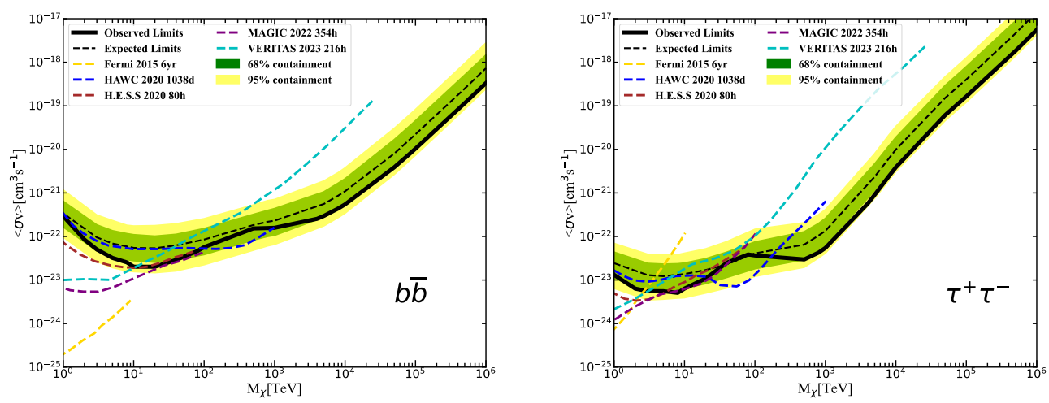
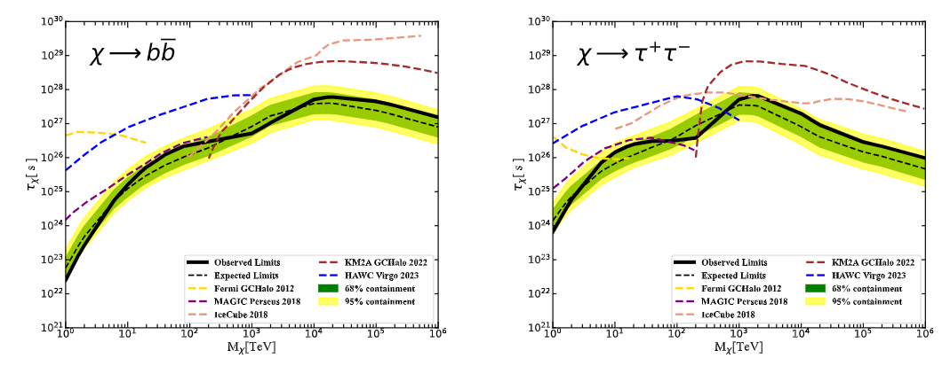
Most stringent constraint on heavy DM annihilation by LHAASO
Phys.Rev.Lett. 133 (2024) 6, 061001
With 756 dates WCDA and 794 dates KM2A data and by combining the 16 dwarfs the most stringent constraint on DM annihilation is derived.

Slide 20
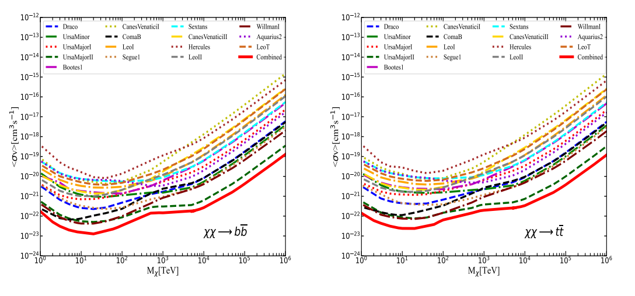
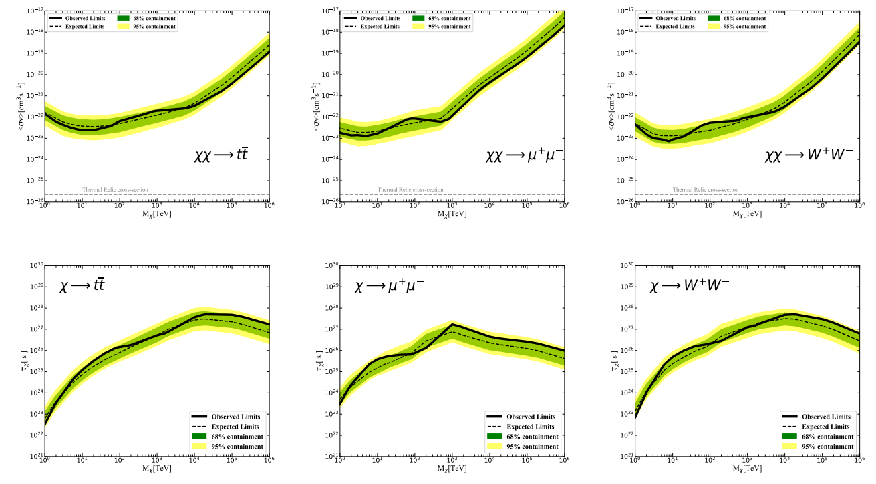
Different channels

Slide 21
GRB 221009A and axion

Slide 22
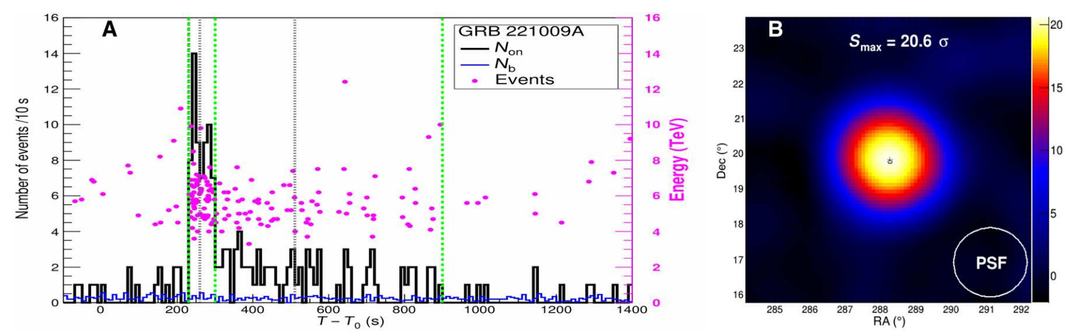

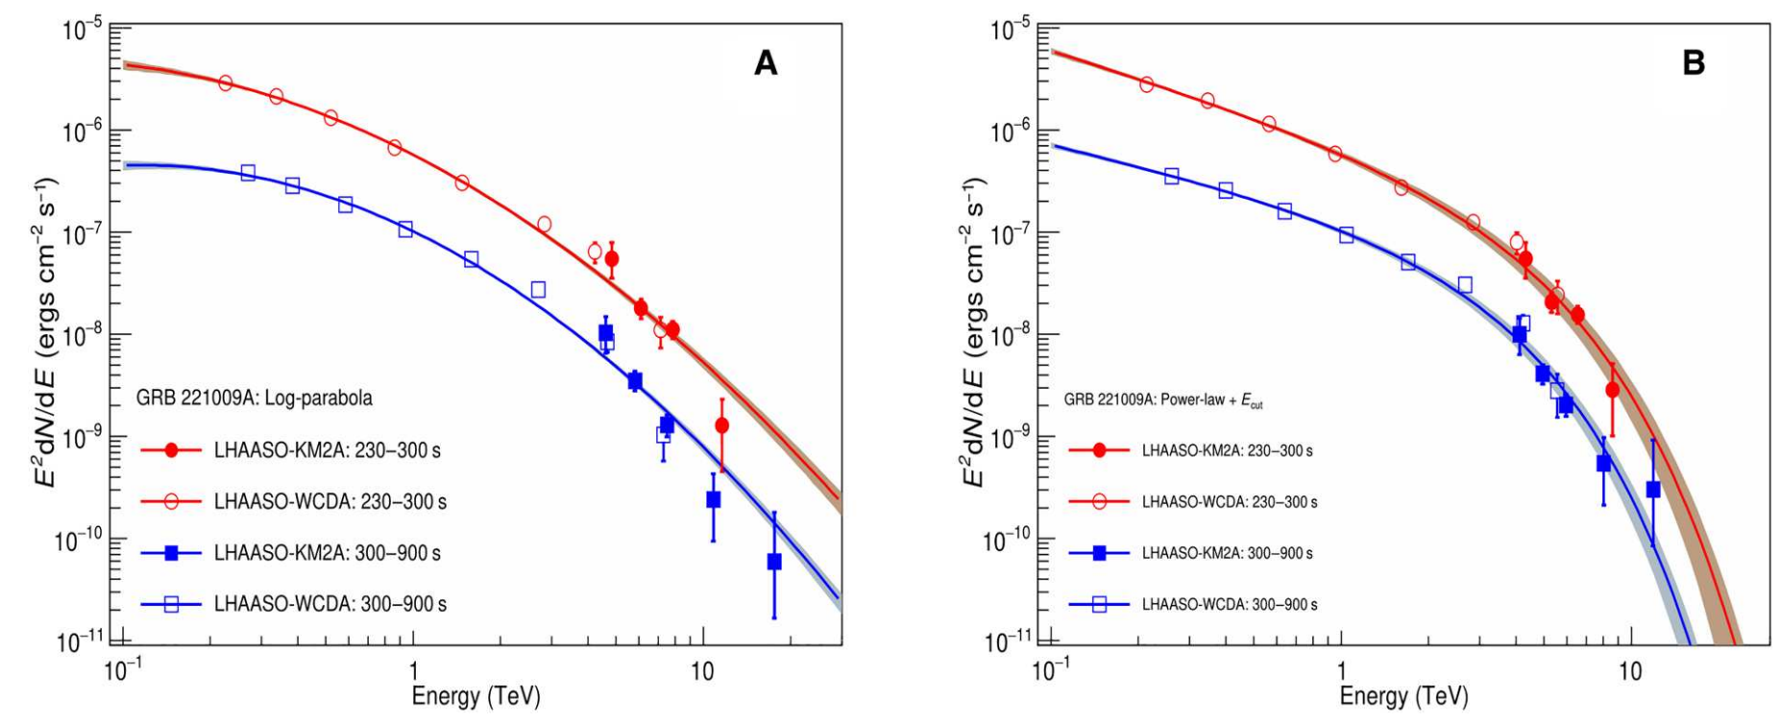
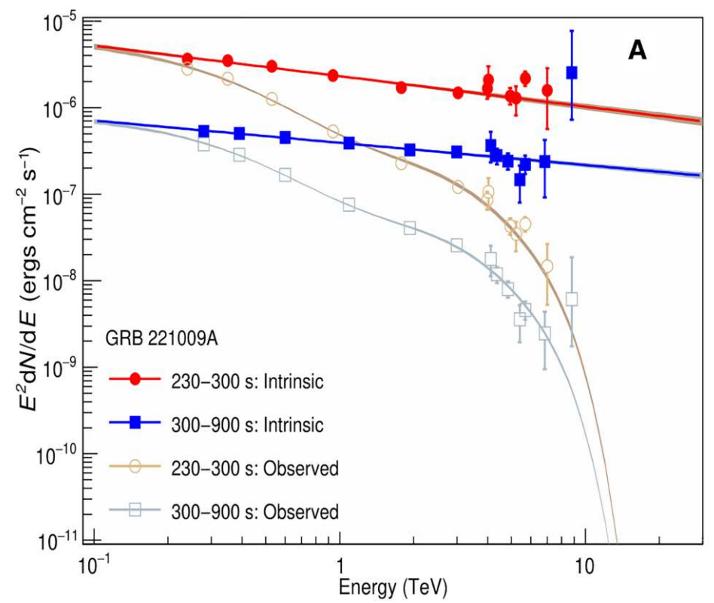
LHAASO observation of GRB 221009A (BOAT)
LHAASO coll. 2023 (Science adv. 9, 2778)
Direct observation of the extragalactic background light (EBL) absorption of gamma flux
The highest energy photon is about ~13TeV, depending on the spectrum
The 13 TeV event is out of expectation for a source at z=0.151. Flux is about 1 order of magnitude higher than expectation.

Slide 23
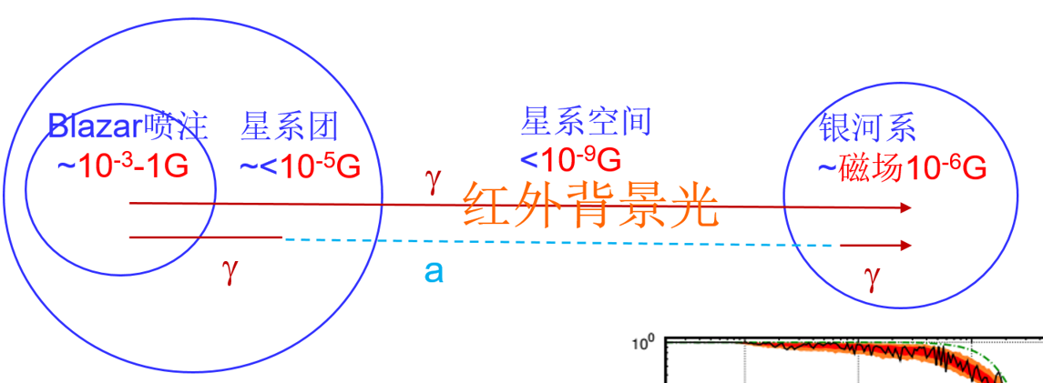
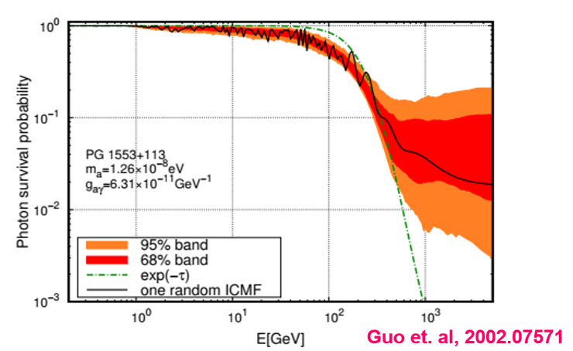
gamma-axion oscillation
Oscillation between axion-gamma evade the absorption by EBL
The gamma ray spectrum is modified
EBL

Slide 24
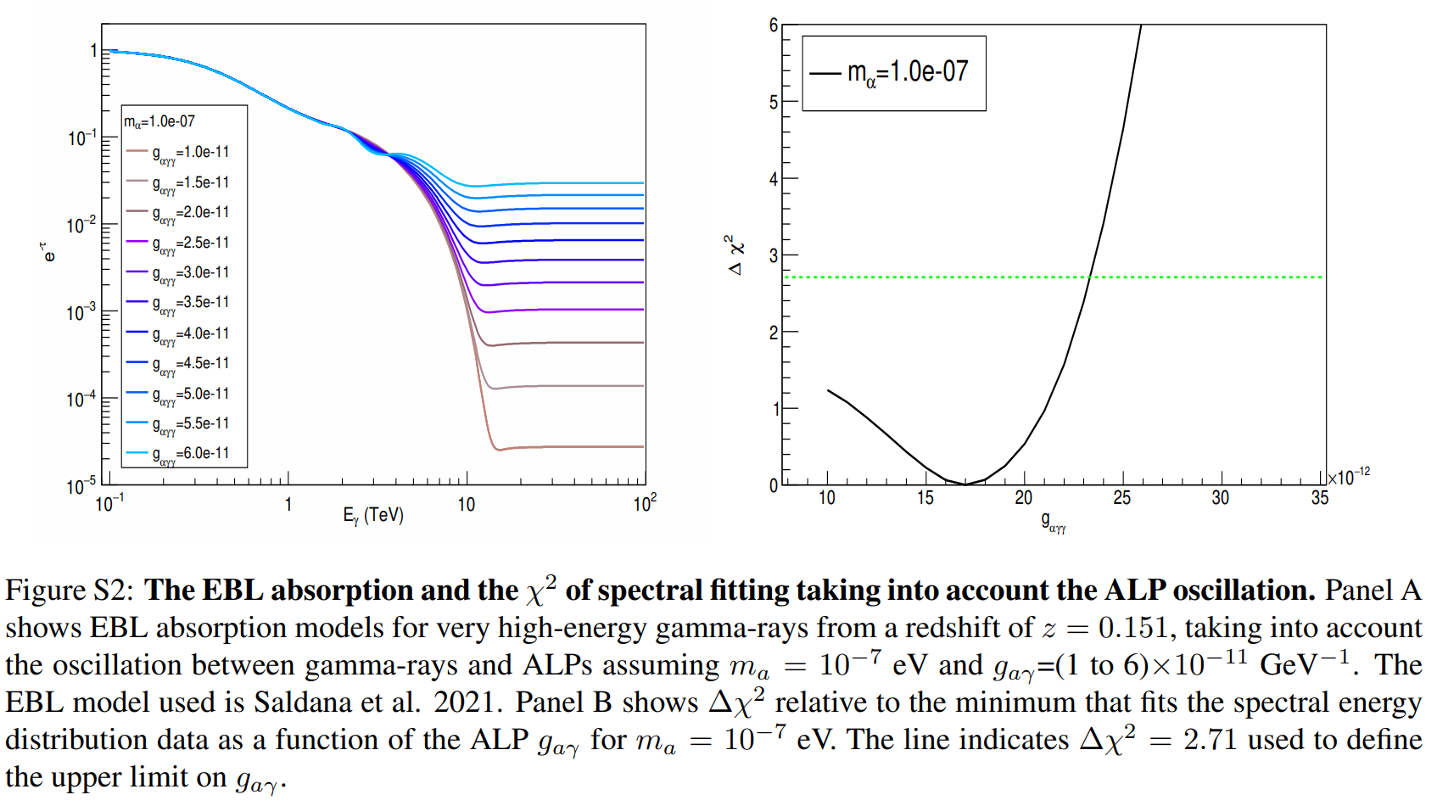
Best fit of axion scenario

Slide 25
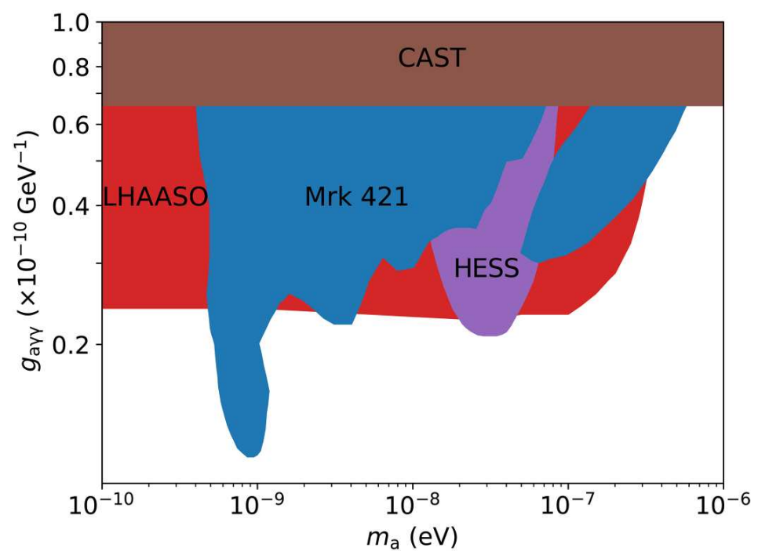
A stringent constraint is set on axion coupling
LHAASO coll. 2023 (Science adv. 9, 2778)
Axion significance < 2sigma, we give constraints on axion coupling
ARGO

Slide 26
Constraints on Lorentz Invariance violation

Slide 27
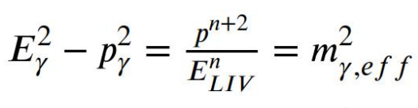
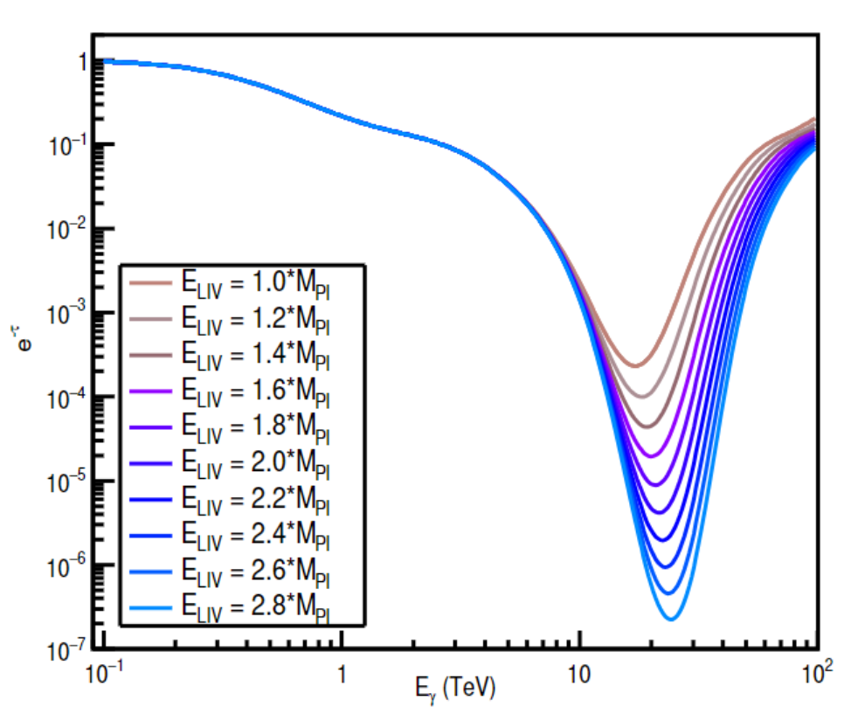
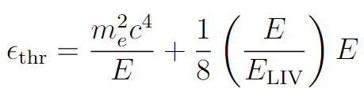
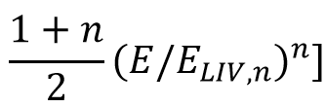
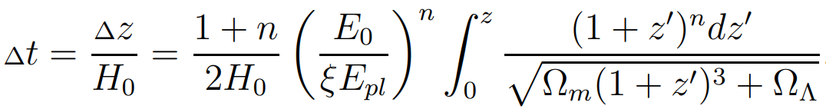

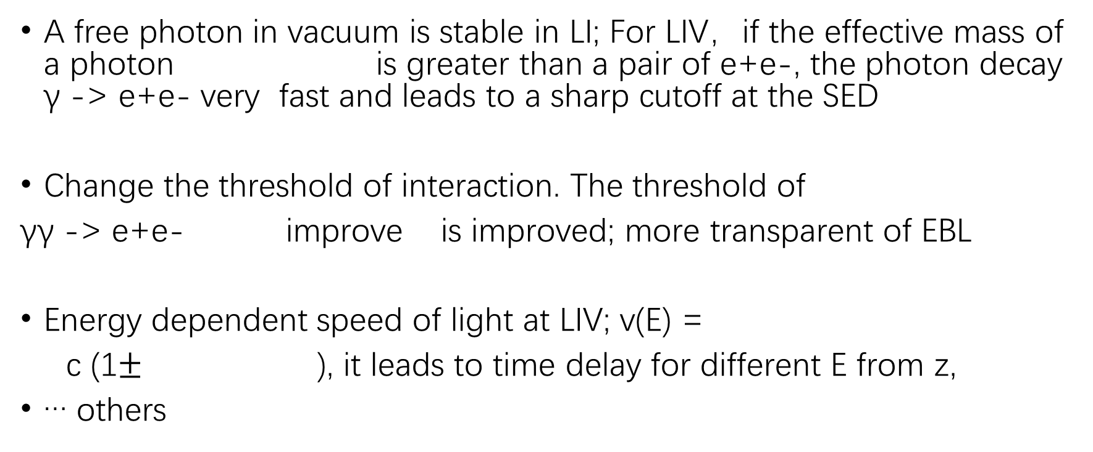
Kinetics with LIV E² = p² c² *(1 + a1(pc/ M_{pl} c²)+ a2(pc/ M_{pl} c²) ² + …)
A free photon in vacuum is stable in LI; For LIV，if the effective mass of a photon is greater than a pair of e+e-, the photon decay γ -> e+e- very fast and leads to a sharp cutoff at the SED
Change the threshold of interaction. The threshold of
γγ -> e+e- improve is improved; more transparent of EBL
Energy dependent speed of light at LIV; v(E) =
c (1$±$ ), it leads to time delay for different E from z,
… others
$$≈$$

Slide 28
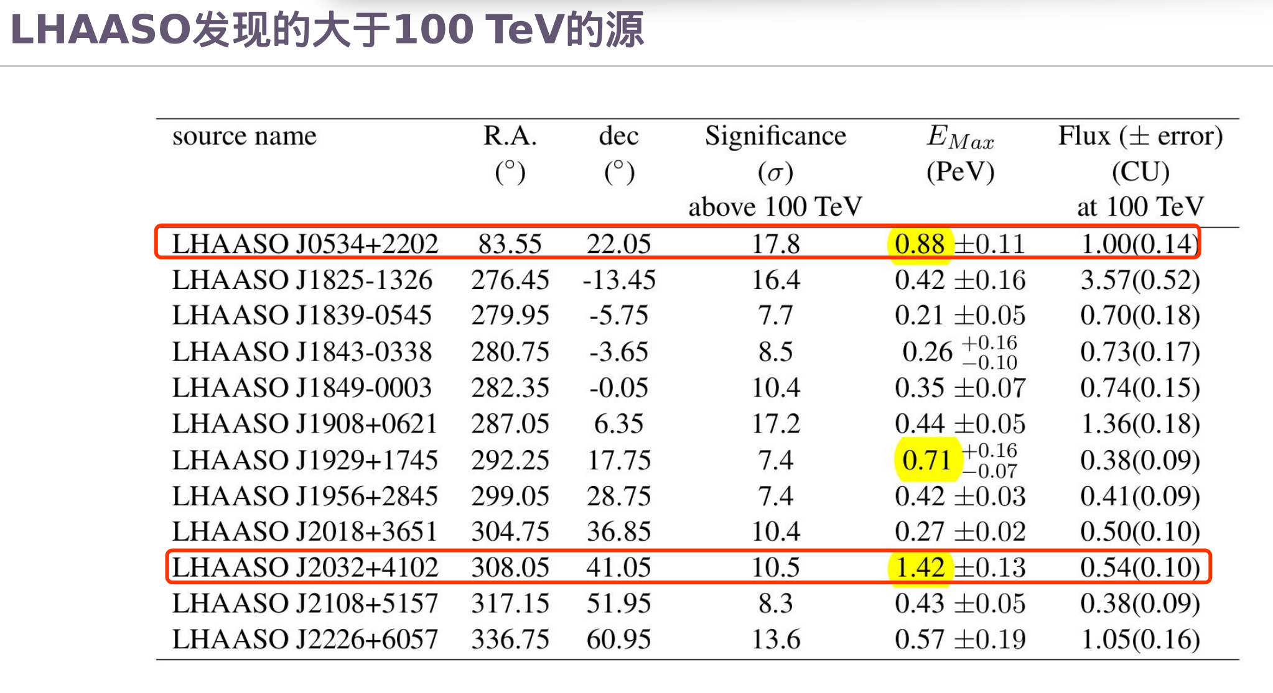
Z. Cao, et al., Nature 594, 33 (2021)

Slide 29
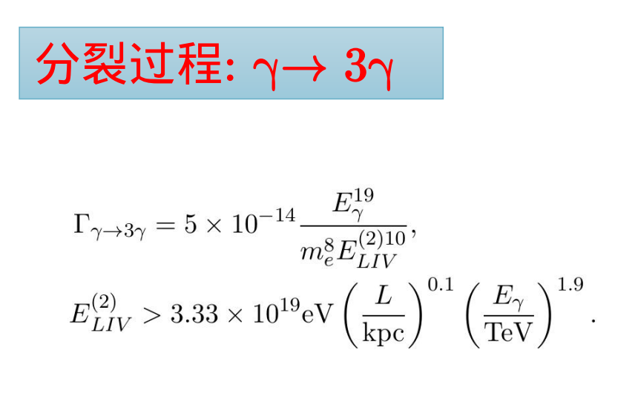
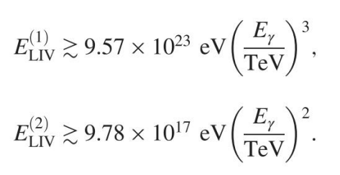
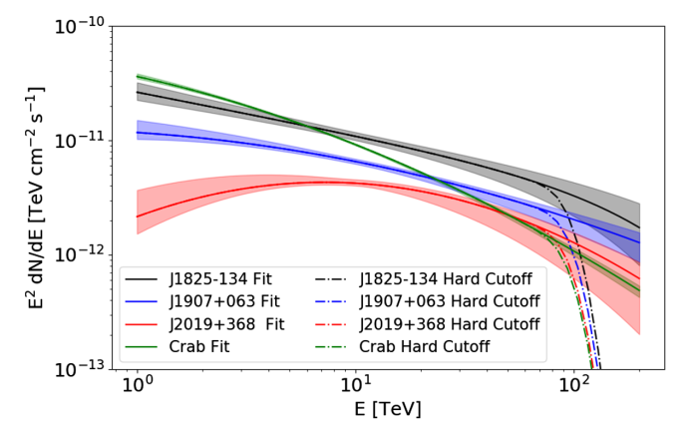
Photon decay or splitting
LIV also leads to a photon decay or splitting to 3 photons
LIV decay or splitting leads to sharp cutoff the
high energy end of the spectrum
We analyze the LHAASO data of gamma ray SED
to look for the LIV cutoff
Decay：γ-> e+e-
Splitting:

Slide 30
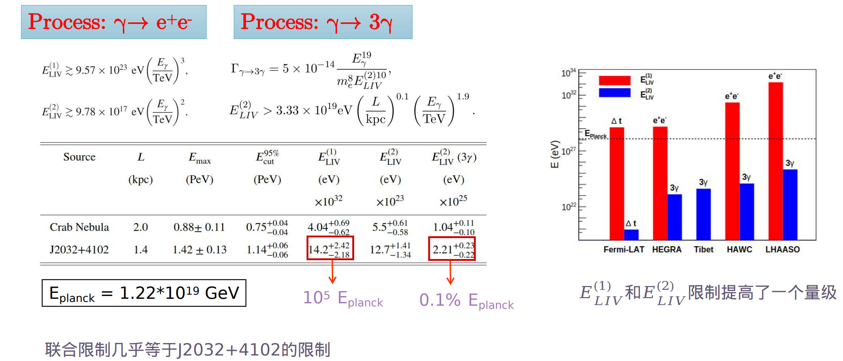
The result
Phys.Rev.Lett. 128 (2022) 5, 051102
more than 1 order of magnitude

Slide 31
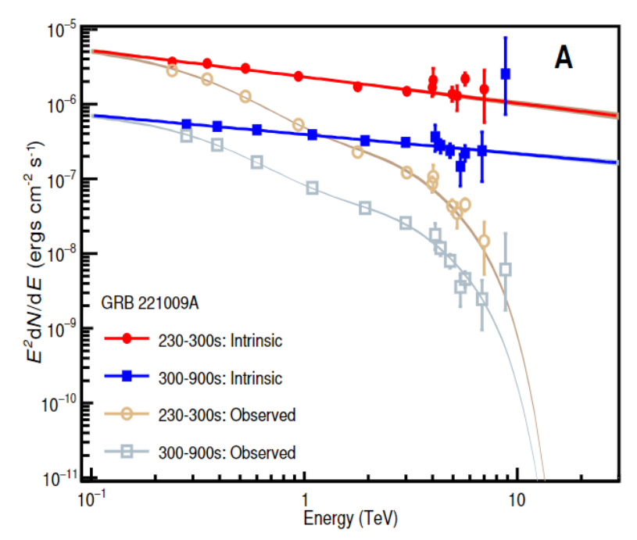
LIV by GRB 221009A
The intrinsic gamma spectrum shows a rise at the highest energy. LIV is a possible solution which leads to more transparent EBL.
As the significance is not high. Constraint on LIV is set finally E_{LIV} > 1.5 M_{Pl}.

Slide 32
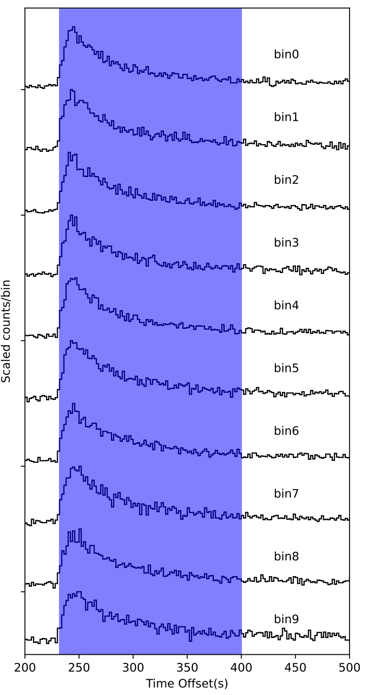
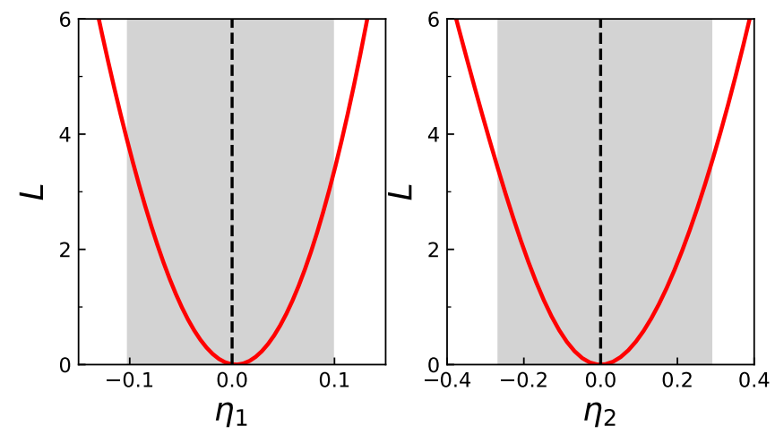
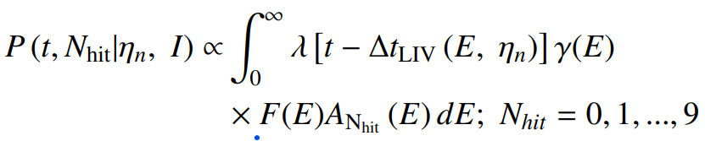
Time lag by LIV of different energy photons from GRB 221009A
Cross correlation function (CCF). Light curves of different energy bands are given by the WCDA data. CCF method is adopted to derive the time lags of the different light curves.
Maximal likelihood method. The probability density function (PDF) of a photon at time t and N_{hit} is given. λ(t) is the intrinsic light curve with possible time lag Δt_{LIV}(E).
Light curves of different energy bins by WCDA

Slide 33

The stringent LIV constraint by time of flight
LHAASO Coll, PRL 133 (2024) 7, 071501
For the 2nd LIV the LHAASO constraint is the best one with 6-8 times improvement to Fermi-LAT result.

Slide 34

Yang, BXJ, Yin, JCAP 04 (2024) 060
Combining the KM2A and WCDA data to give a strict limit on LIV

Slide 35


Yang, BXJ, Yin, JCAP 04 (2024) 060
About 2 times improvement to WCDA

Slide 36
Summary
LHAASO is a powerful instrument for gamma ray astronomy with large FOV, wide energy range, high sensitivity. It achieves impressive success.
We have looked for dark matter signals, axion signals, LIV at LHAASO. No new physics signals are observed and the strongest constraints are set on the new physics parameters.
With the progress of the LHAASO observation and data accumulation we expect to get some exciting results in the astrophysical observation.

Slide 37



