Slide 1
Measurement of Galactic diffuse gamma-ray emission with LHAASO
Qiang Yuan
for the LHAASO collaboration
Purple Mountain Observatory, Chinese Academy of Science
(2023, PRL, 131, 151001; arXiv:2411.16021)
Theory metting experiment: particle astrophysics and cosmology
Jan. 5-11, 2025, Quy Nhon, Vietnam

Slide 2
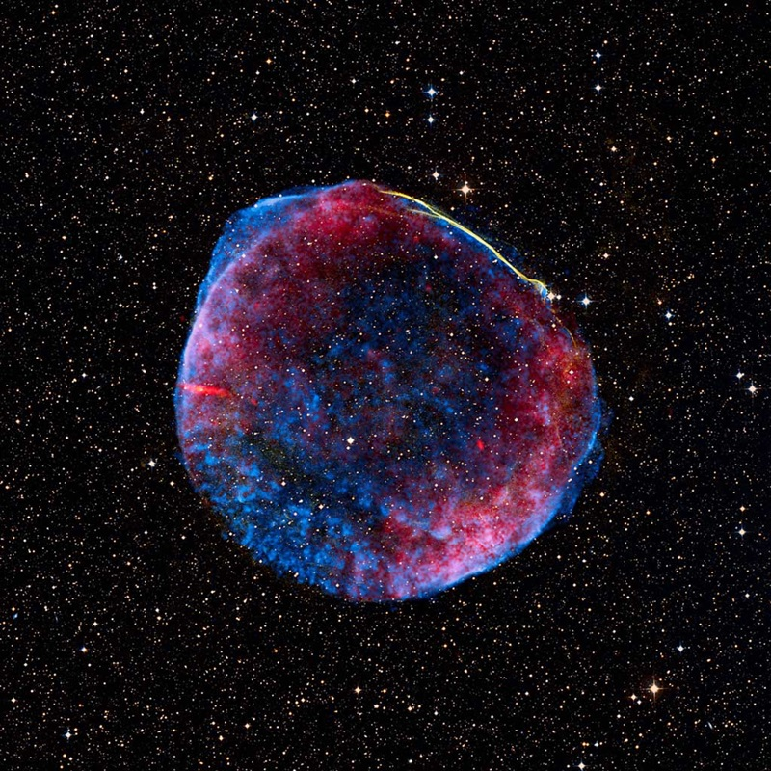
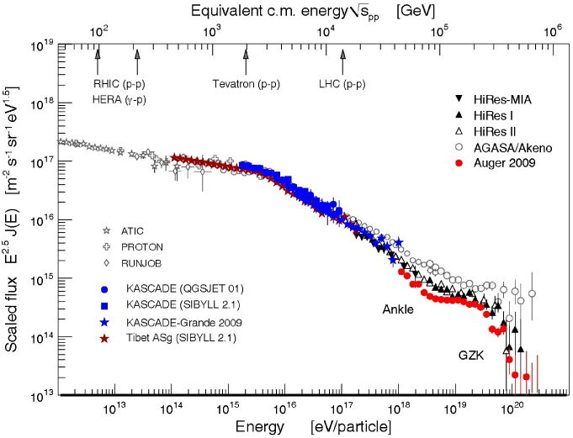
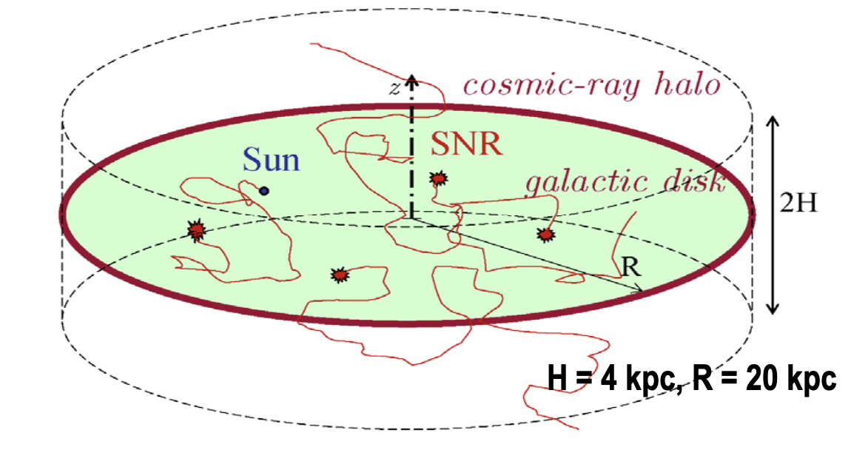
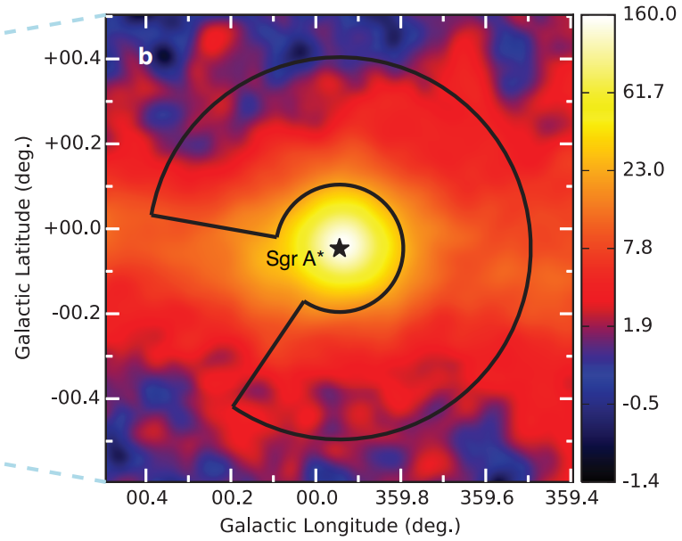
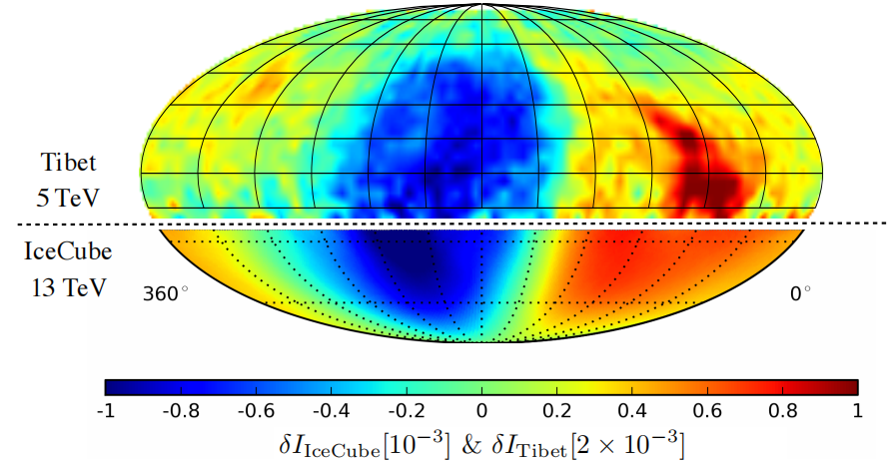
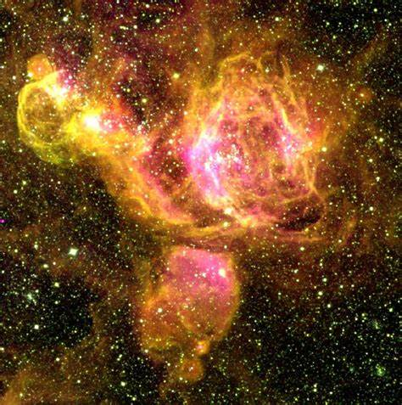
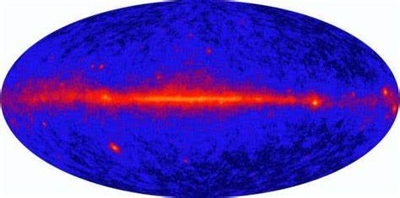
General picture of Galactic cosmic rays
Spectra
SNR
BH
Anisotropy
DM？
Star cluster
EM emission
Diffuse γ rays are expected a priori to be produced by CR interactions during the propagation, and are thus powerful probe of CR propagation
2

Slide 3
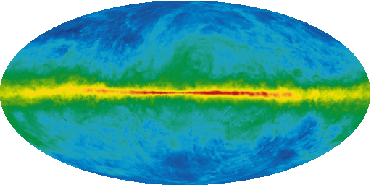
Origins of Galactic diffuse γ rays
p,α + ISM → π⁰ → 2γ
e + ISM → γ (bremsstrahlung)
e + ISRF → γ (inverse Compton)
3

Slide 4
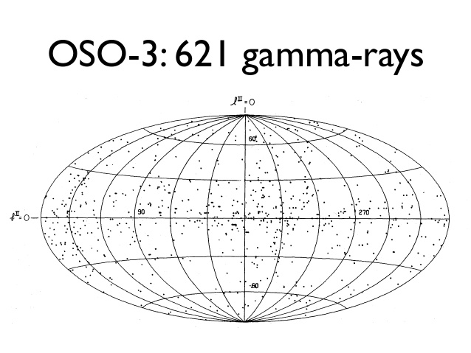
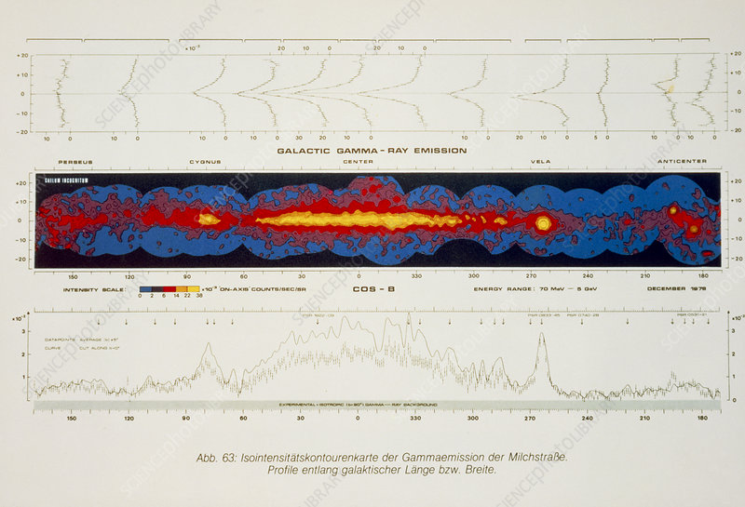
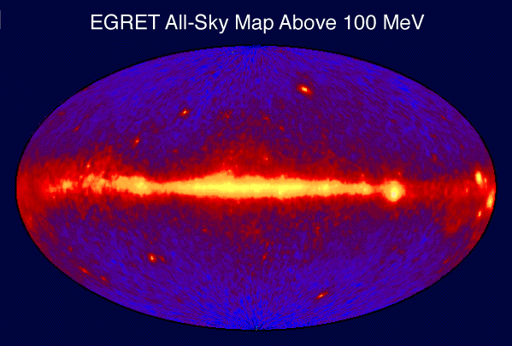
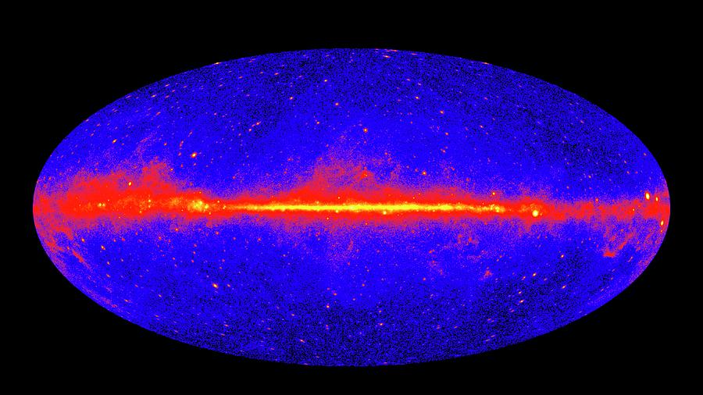
Diffuse γ-ray observations from space
COS-B
Fermi
4

Slide 5
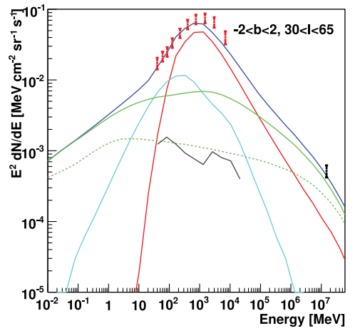
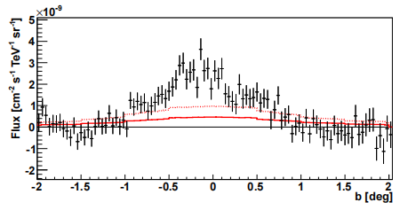
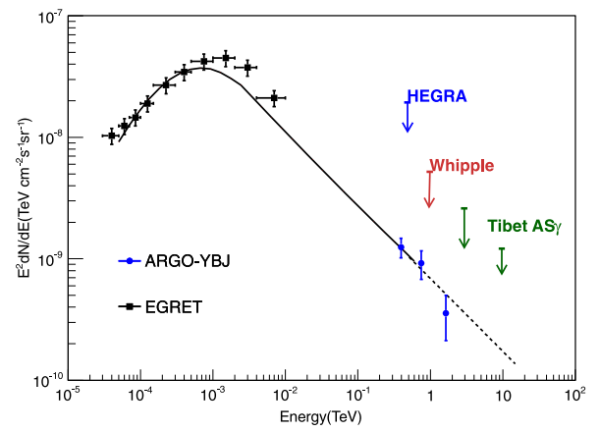
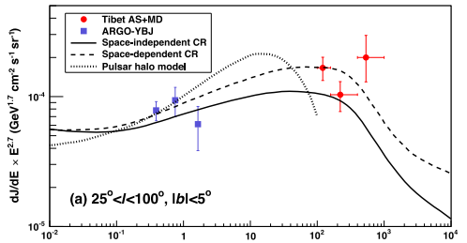
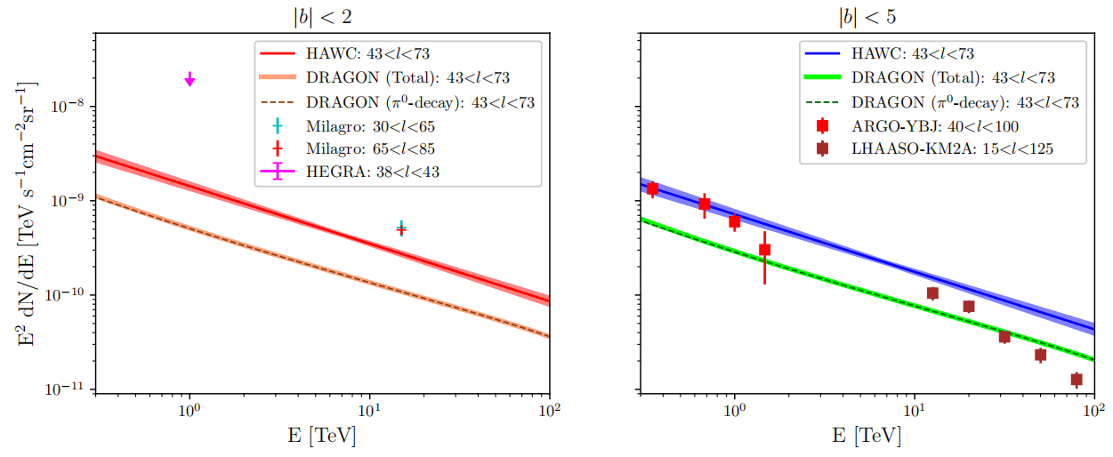
VHE diffuse measurement on ground
Milagro (2008)
HESS (2014)
ARGO-YBJ (2015)
HAWC (2024)
Tibet-ASγ (2021)
5

Slide 6
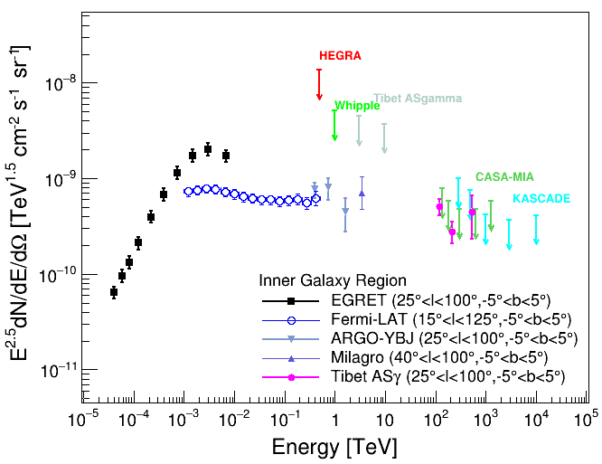
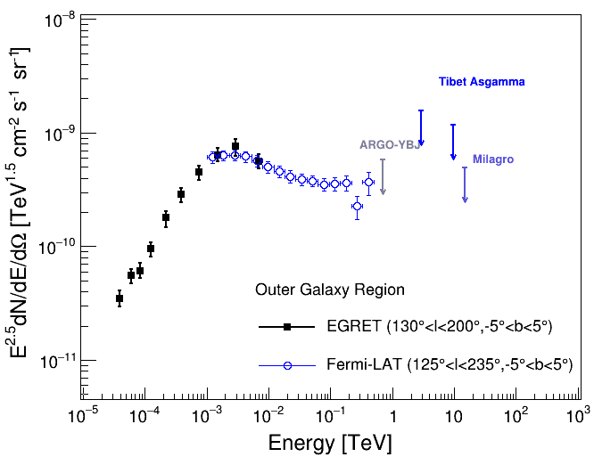
Wide-band diffuse emission measurements
Upper limits:
HEGRA (99% C.L., 38° < l < 43°, |b| < 2°),
Whipple (99.9% C.L., 38.5° < l < 41.5°, |b| < 2°)
Tibet ASγ (99%C.L., 20° < l < 55°, |b| < 2°)
CASA-MIA (90%.C.L., 50° < l < 200°, |b| < 5°)
ARGO-YBJ（99% C.L., 130°< l < 200°, |b| < 5°）
Milagro (95%C.L., 136° < l < 216°, |b| < 2°)
Tibet ASγ (99% C.L., 140° < l < 225°, |b| < 2°)
6

Slide 7
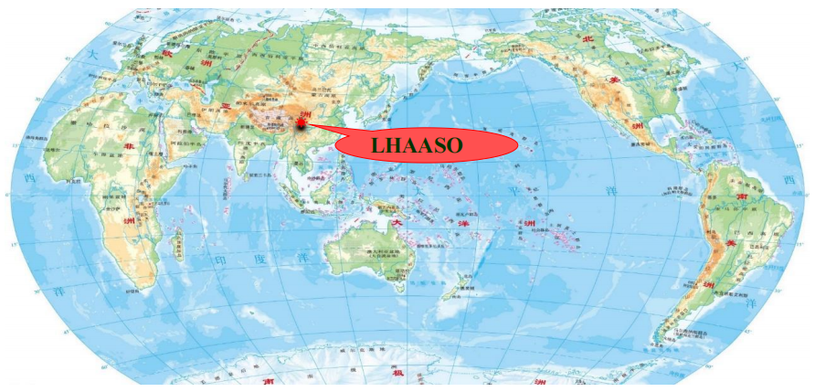
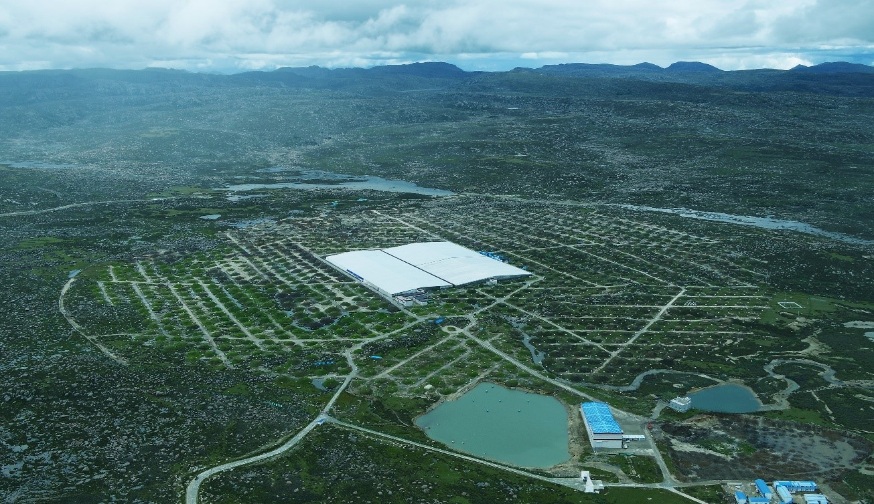
Large High Altitude Air Shower Observatory——LHAASO
Haizi mountain, Sichuan, China, 4410 m above the sea level
LHAASO uses hybrid detector arrays: the square kilometer array (KM2A), the water Cherenkov detector array (WCDA), and the wide field-of-view Cherenkov telescope array (WFCTA)
Full operation since July 2021
7

Slide 8
Air shower detection of cosmic rays
18
8

Slide 9
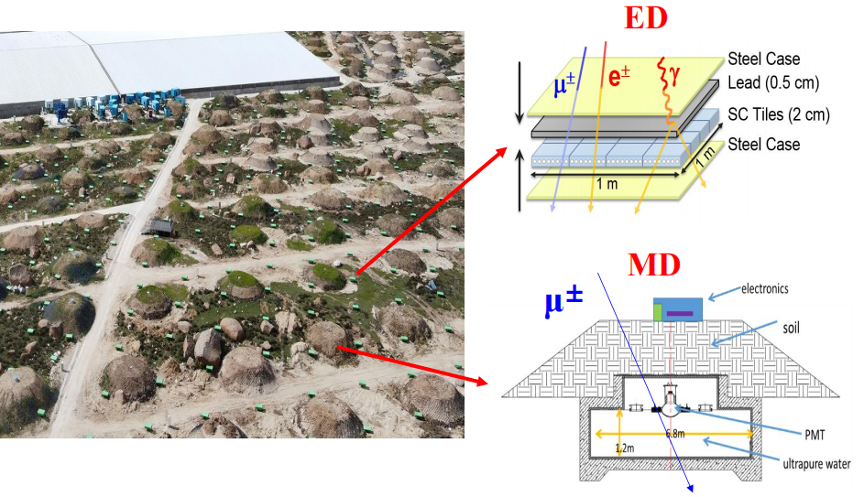
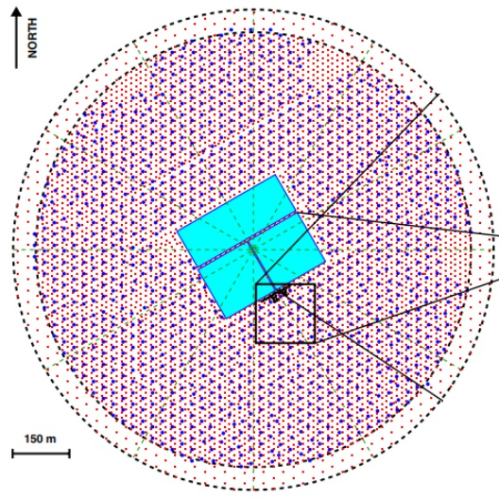
KM2A: Square Kilometer Array
5155 EDs
1188 MDs
1.3 km² area covered by 5155 electromagnetic detectors, used for energy and direction reconstruction
1188 muon detectors used for gamma/hadron distinguish
Energy coverage: 10 TeV - 100 PeV
9

Slide 10
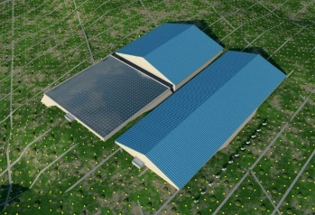
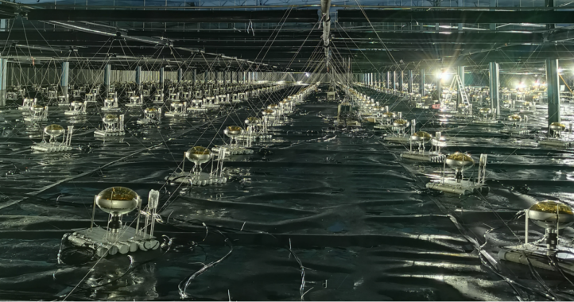
WCDA: Water Cherenkov Detector Array
78000 m² water tank to detect Cherenkov light produced by air shower particles in water
Energy coverage: 0.3 TeV - PeV
10

Slide 11
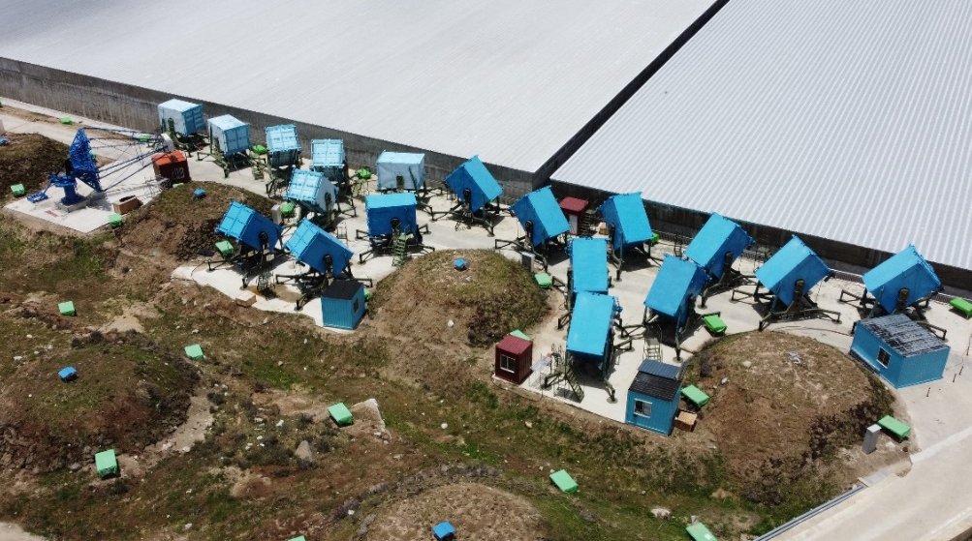
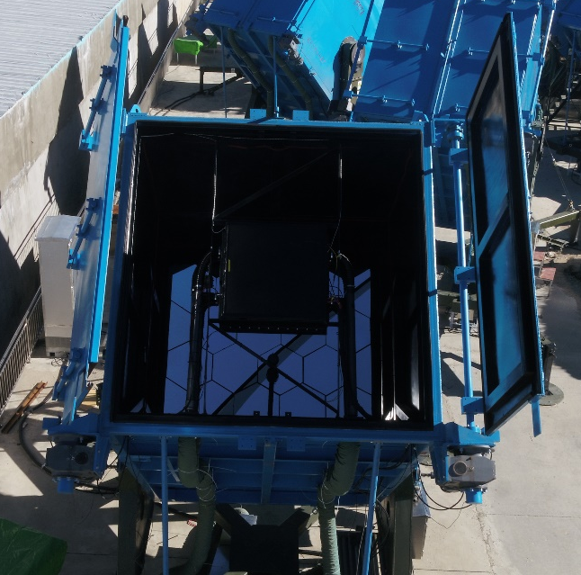
WFCTA: Wide Field Cherenkov Telescope Array
18 WFCTA used to distinguish particles with different mass, each one has an area of 4.7 m² each and covers a square sky with area 16°×16°
Energy coverage: 10 TeV - 100 PeV
11

Slide 12
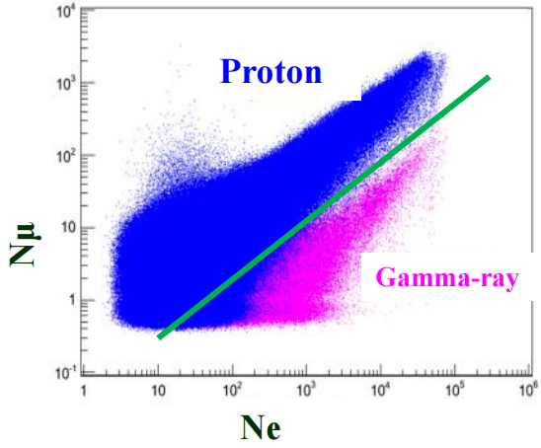
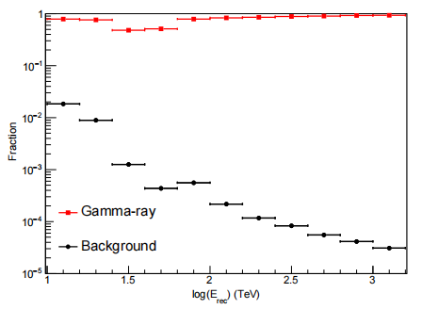
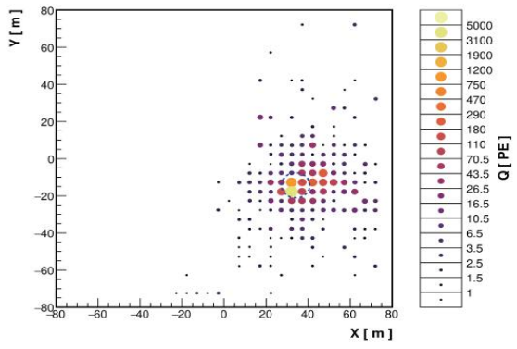
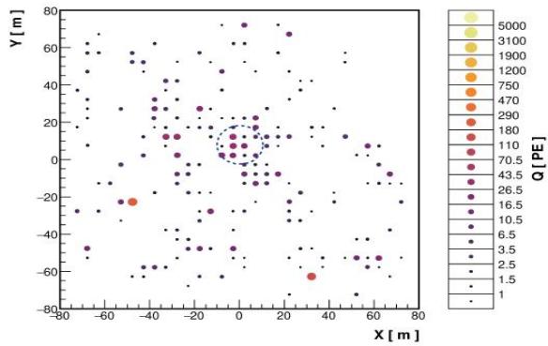
Gamma-CR discrimination
Chin. Phys. C, 45, 025002 (2021)
KM2A
Chin. Phys. C, 45, 085002 (2021)
WCDA
12

Slide 13
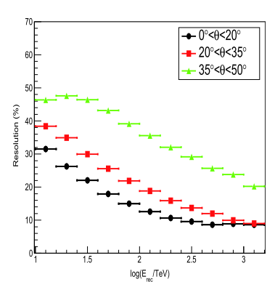
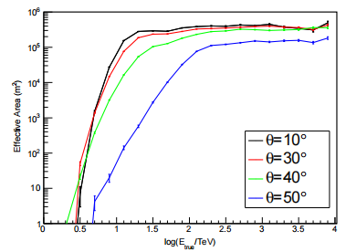
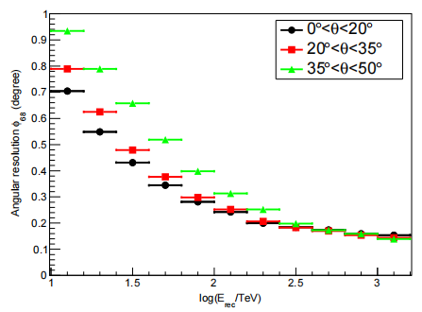
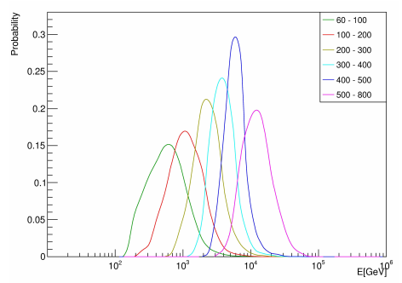
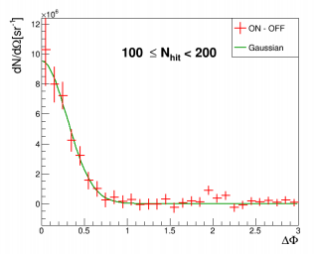
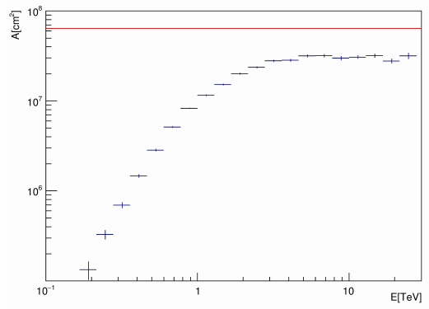
Gamma-ray performance
Energy resolution
Angular resolution
Effective area
13

Slide 14
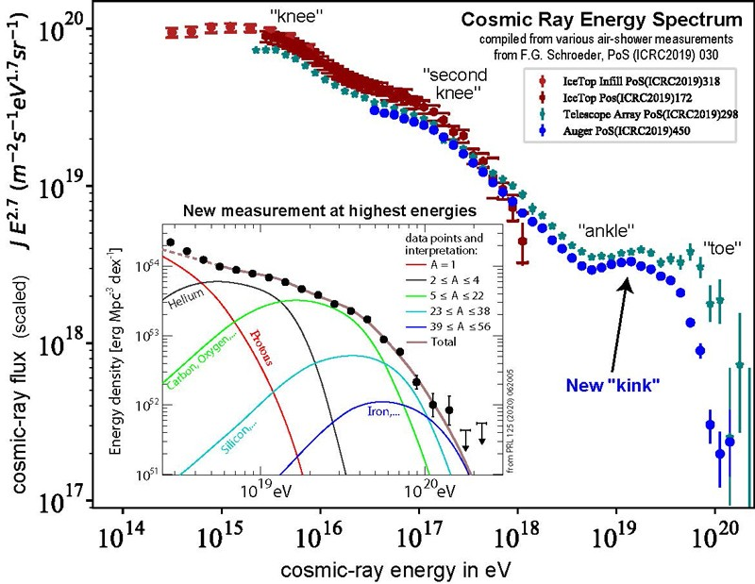
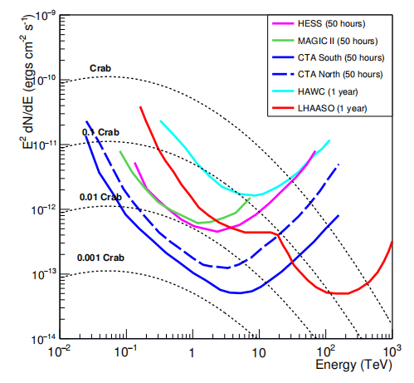
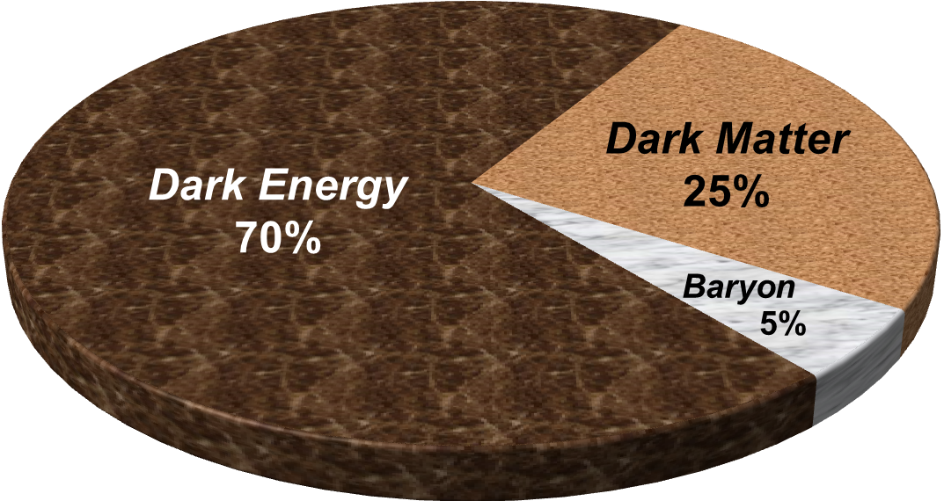
Objectives of LHAASO
Probe the origin of CRs, via precise measurements of spectra and anisotropies
Survey the ultra-high-energy gamma-ray sky with unprecedented sensitivity
Search for new physics
See X.-J. Bi’s talk
14

Slide 15
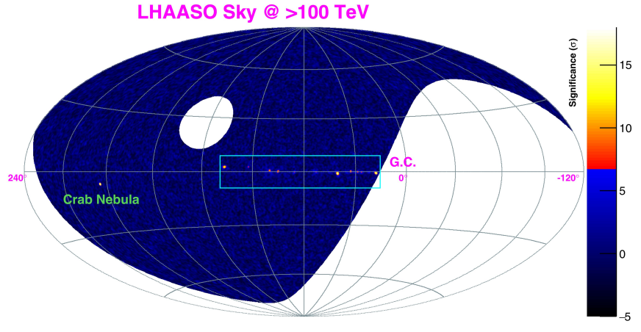
LHAASO sky coverage
15°< l < 235°
15

Slide 16
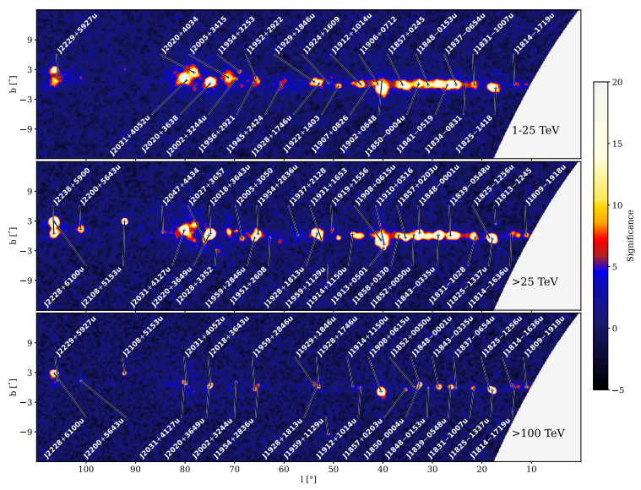
Resolved source masks
n=2.5 is chosen
PSF of the lowest energy bin is used
Source catalogs: LHAASO catalog + TeVCat
For overlapping sources, LHAASO parameters are used
LHAASO first catalog (2024, ApJS)
16

Slide 17
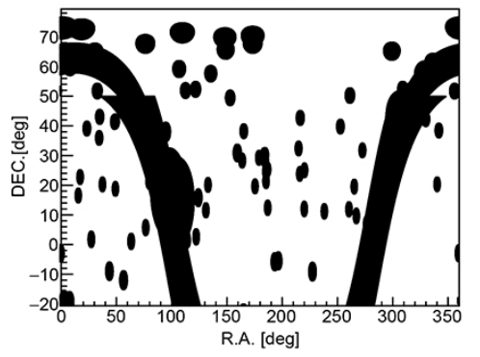
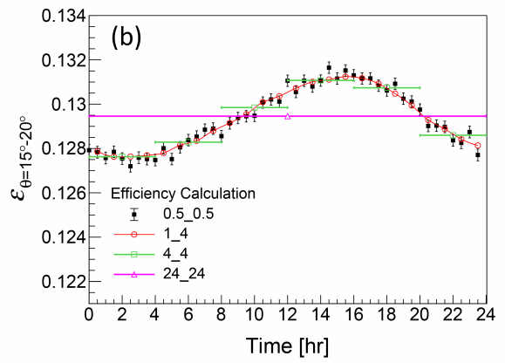
Background estimate
Direct integral method: assuming the spatial distribution in detector coordinate is stable in a reasonably short time bin
Efficiencies do vary slightly with time, and thus a sliding window method is adopted (1_10 is used as benchmark, 1 hr step and +/-5 hr window)
17

Slide 18
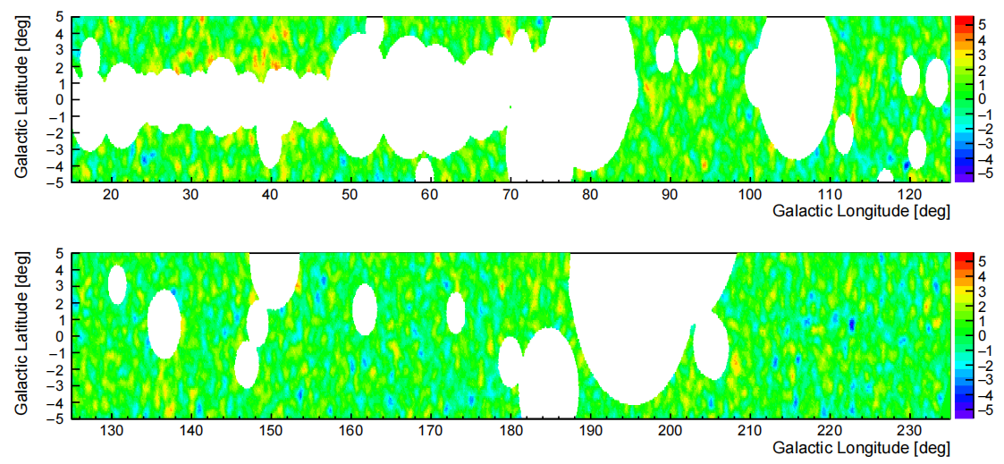
LHAASO diffuse results
LHAASO, arXiv:2411.16021
18

Slide 19
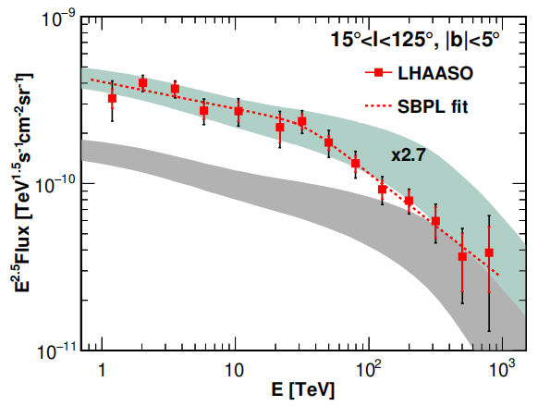
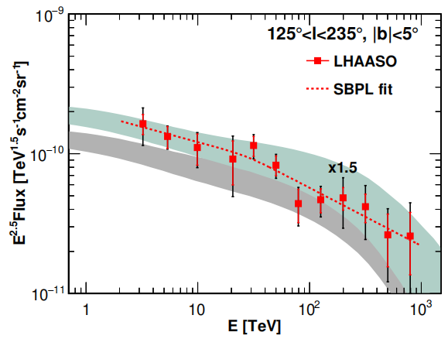
LHAASO diffuse results
LHAASO measures diffuse emission from 1 TeV to 1 PeV with high significnace, and gives the first detection from the outer Galactic plane
A spectral break around 30 TeV is revealed in the inner Galactic plane
19

Slide 20
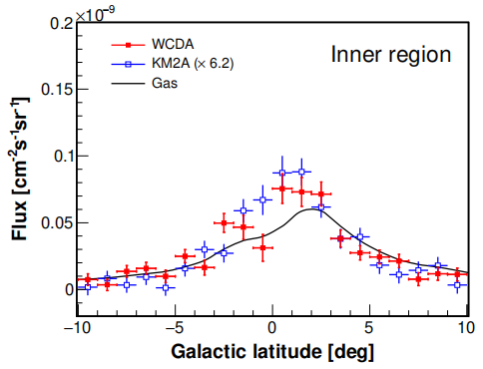
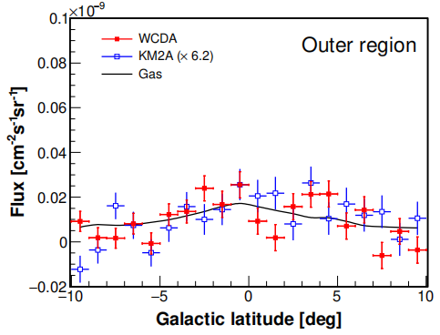
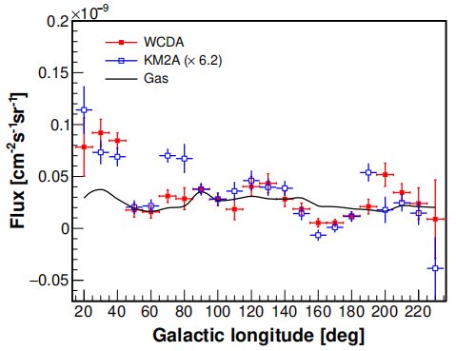
Longitude and latitude profiles
Roughly consistent with gas distributions for b, but show significant deviation for l
20

Slide 21
Spatial distribution
E>10 TeV
Difference between data and gas is also shown in the angular spectra at low-l
21

Slide 22
Possible spatial variation of spectra
Hints of spectral variations aross the Galactic plane (~2σ)
22

Slide 23
Confront LHAASO data with a toy model
Toy model prediction: local CR × gas column
Measured fluxes are higher by a factor of 1.5~2.7 than predictions
Spectra are slightly different from the prediction
23

Slide 24
Confront LHAASO data with a GALPROP model
Excess?
Excess?
Zhang et al. (2023, ApJ, 957, 43)
24

Slide 25
Unresolved source contribution?
Inner Galaxy
Number
Intrinsic flux distribution
Observed flux distribution
Outer Galaxy
Flux
The contribution of unresolved sources is able to describe the exta conponent for Outer Galaxy region, while it is insufficient for Inner Galaxy region.
Larger extended sources were not included
Additional contributions from unknown mechanisms
He et al. (2025, ApJ in press)
25

Slide 26
Pulsar halo interpretation
HAWC (2017, Science)
Extended halos around middle-aged pulsars are expected to be common in Milky Way, which could form a diffuse component of gamma-ray background (e.g., Aharonian & Atoyan 2000; Linden & Buckman 2018).
Predicted gamma-ray map in 25–100 TeV from halos of ATNF pulsars
K. Yan et al. (2024, Nat. Astron.)
See also Dekker + (2024, PRD), Chen + (2024, CPC)
26

Slide 27
Pulsar halo interpretation
K. Yan et al. (2024, Nat. Astron.)
27

Slide 28
Alternative scenario: secondary interaction around sources
The confinement and interaction around sources can account for the diffuse excess, together with the B/C、B/O breaks and Galactic neutrinos
Confinement time: 0.2~0.5 Myr
He et al. (2024, ApJ); Sun et al. (2024, PRD); Yang & Aharonian (2024)
28

Slide 29
IACTs in LHAASO site (LACT)
Funded
8×4 array at LHAASO site
6-m telescopes
Two proto-type telescopes
First light soon!
29

Slide 30
High energy Underwater Neutrino Telescope (HUNT)
•Angular resolurion: ~0.1° (tracks), <3°(cascades)
•Energy resolution: ΔlogE~0.3(tracks), ΔE~10-30% (cascades)
•Discovering ν sources (>100 TeV) at 5σ level within several years
•Volume: 6×6 = 36 km², ~30 km³
•Separations of strings: Dstring ~ 130 m
•Separation of optical modules: DOM~36 m
•Length of each string: ~860 m
•2,300 strings, 24 OMs in each string, 55000 OMs in total
30

Slide 31
Summary
The diffuse emission from 1 TeV to 1 PeV from two regions of the Galactic plane was observed with high significance; Firstly detected in the outer Galaxy region!
A spectral break around 30 TeV is found in the inner region, with a change of indices by ~0.5
The longitude distribution deviates from gas distribution; there is possible spectral variation of the spectra across the Galactic plane
Together with Fermi-LAT, the wide-band data show excesses from several GeV to 10s TeV compared with a traditional CR propagation model, which could be explained by a population of unresolved sources (pulsar halos or secondary interaction at source)
31

