Slide 1
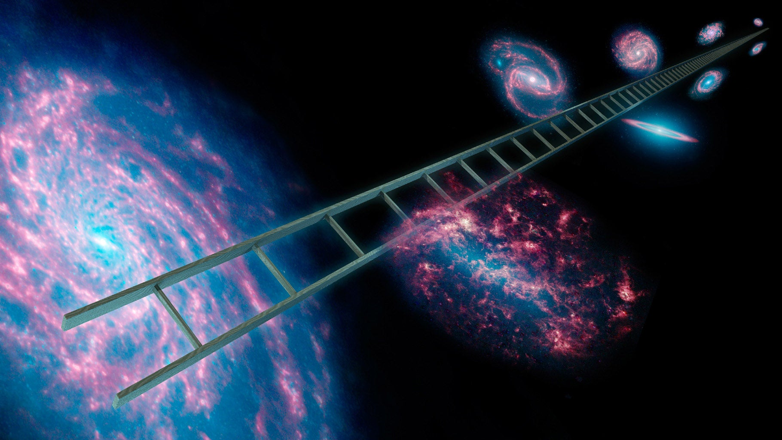
A New Master Supernovae Ia sample and the investigation of the H₀ tension
Maria Giovanna Dainotti
National Astronomical Observatory of Japan (NAOJ)
The Graduate University for Advanced Studies (SOKENDAI)
Vietnam Cosmology Reincontre, 10-15 August

Slide 2
Are SNe Ia alone able to reveal the presence of Evolutionary Dark Energy?
2

Slide 3






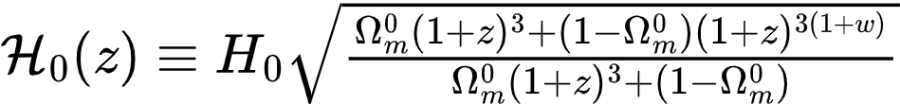
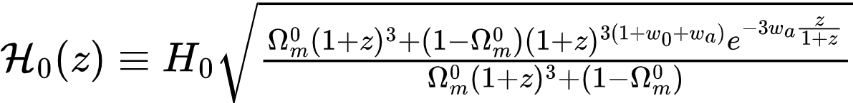

What is the effective running Hubble constant?
Similar diagnostic tool for DE: DESI Collaboration, 2503.14743 Sahni et al., 0807.3548
A new diagnostic for Dark Energy:
Theory:
E(z)^ΛCDM denotes the standard ΛCDM Hubble rate
Dainotti et al., 2103.02117 Kazantzidis et al., 2004.02155 Jia et al., 2212.00238

Slide 4
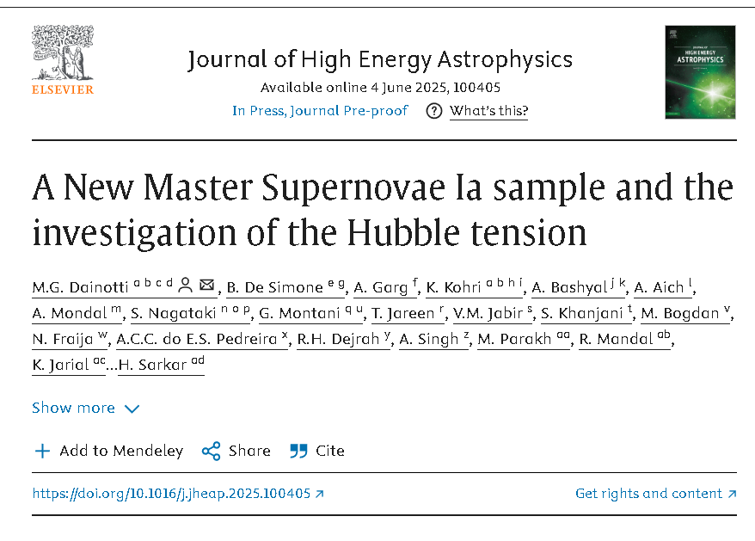
Accepted two months ago!
M. G. Dainotti et al. 2025 –JHEAP, JHEAp, 48, id 100405, https://arxiv.org/abs/2501.11772)
hereafter
Dainotti et al. 2025

Slide 5
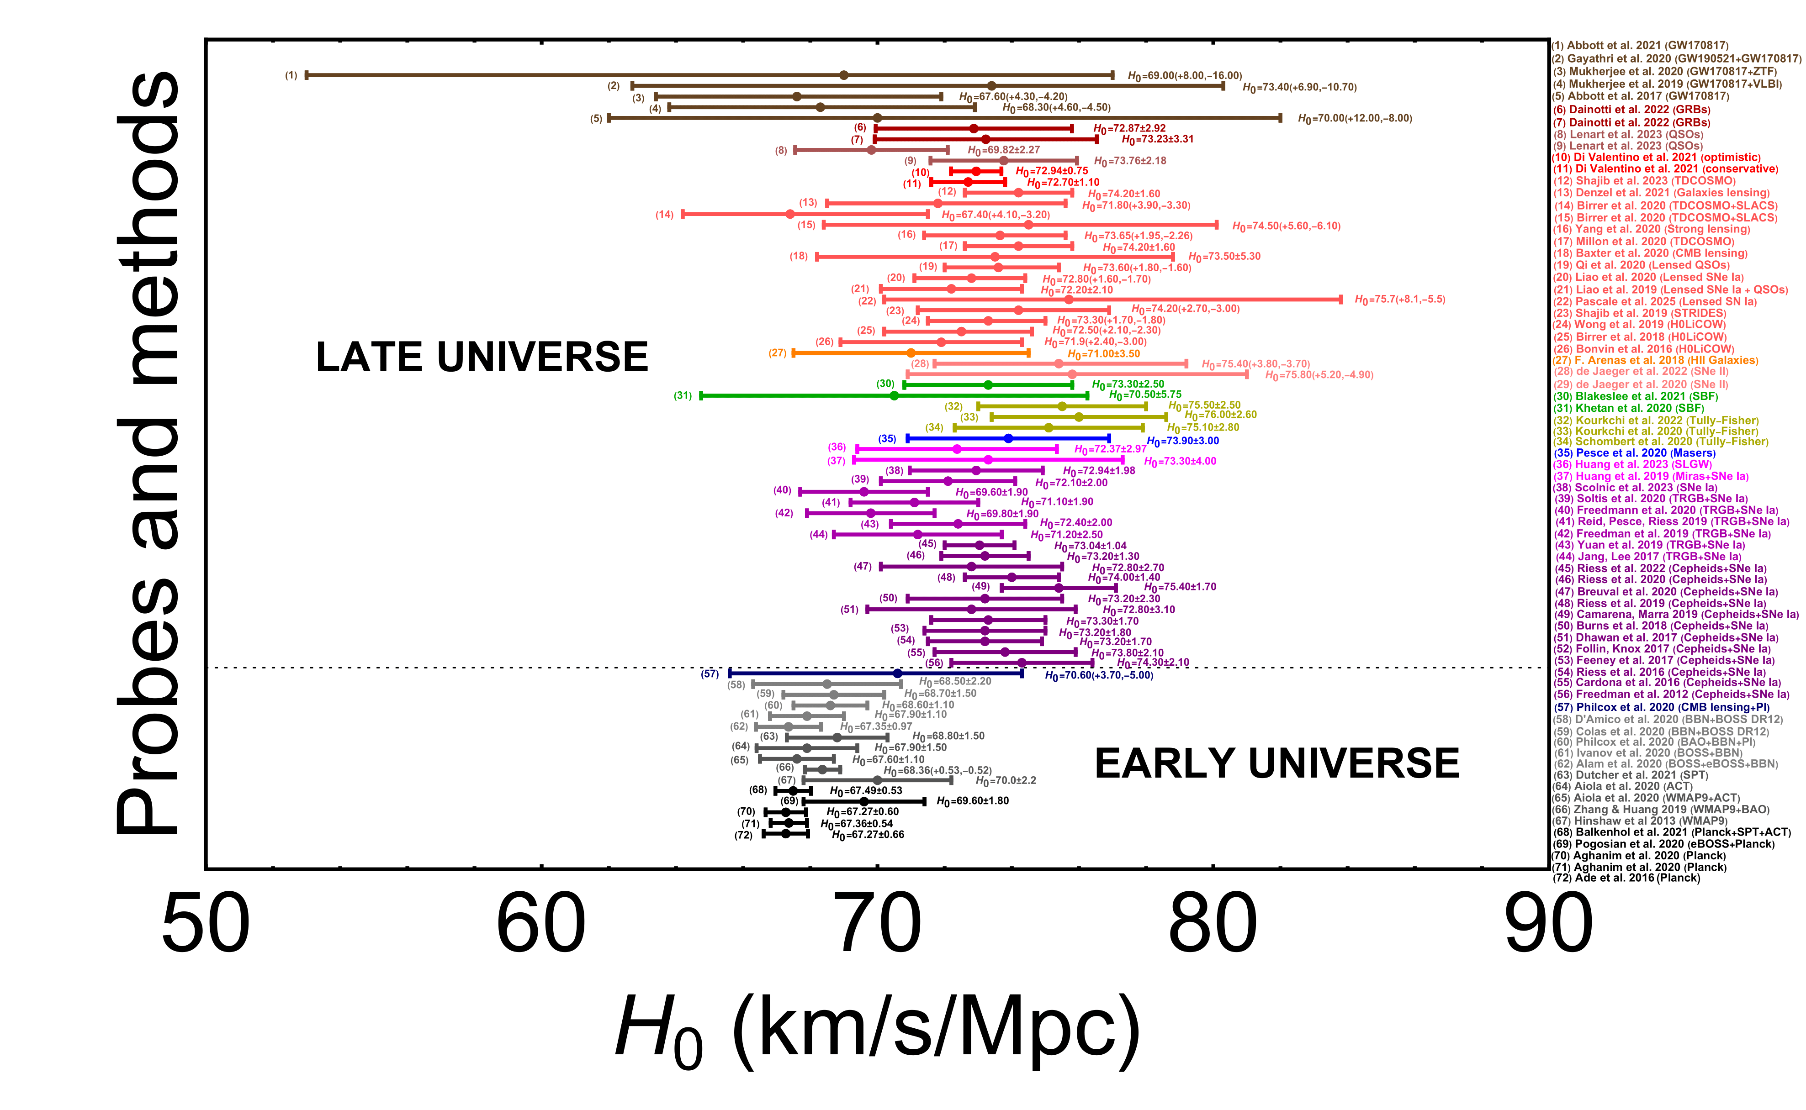
Dainotti et al. 2025
M. G. Dainotti, et al., 2021, ApJ, 912, 150

Slide 6
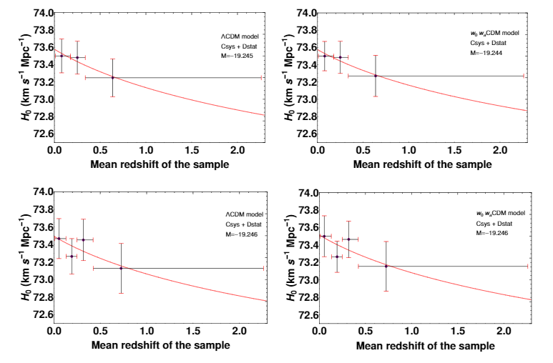

6
The Pantheon sample: Results for ΛCDM and wowaCDM model (3, 4 bins)
The $w_{0}w_{a}$CDM model results are compatible with the ΛCDM ones
µobs-M=αx1-βc+δM…
The evolution of the Ho is similar to the evolution of the MB parameter
(L. Kazantzidis and L. Perivolaropoulos
Phys. Rev. D 102, 023520)
M. G. Dainotti, et al., 2021, ApJ, 912, 150

Slide 7
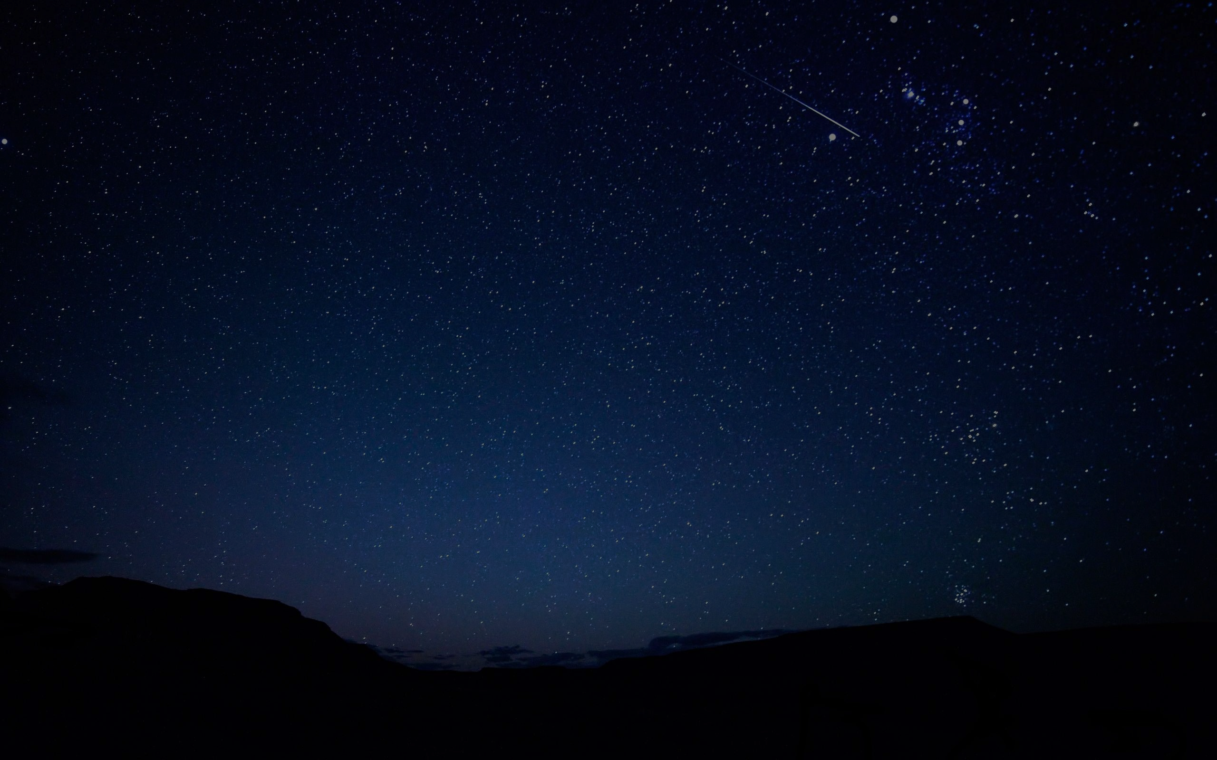
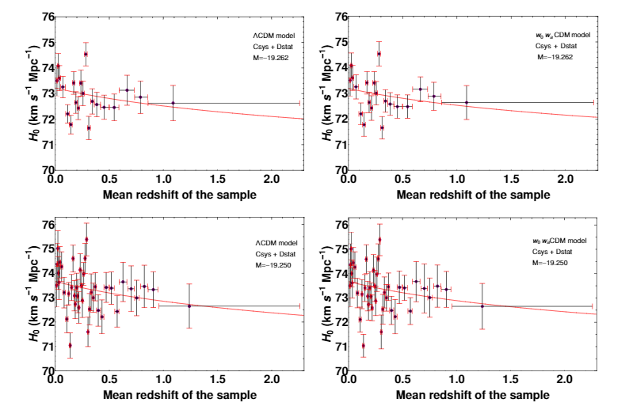
7
Results for ΛCDM and w0waCDM models (20, 40 bins)
M. G. Dainotti et al 2021, ApJ, 912, 150

Slide 8
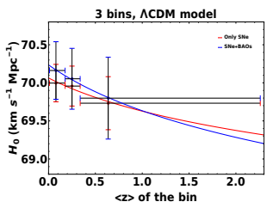
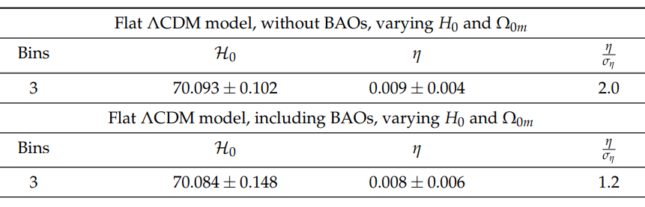



8
$Continuing with$BAOs
$H_{0}\left(z\right)$ fitting (3 bins $Λ$𝐶𝐷𝑀) + BAOs
M.G. Dainotti, et al., 2022, Galaxies, 10, 1, 24
M.G. Dainotti, et al., 2022, Galaxies, 10, 1, 24
Varying $H_{0}$ and $Ω_{0m}$

Slide 9
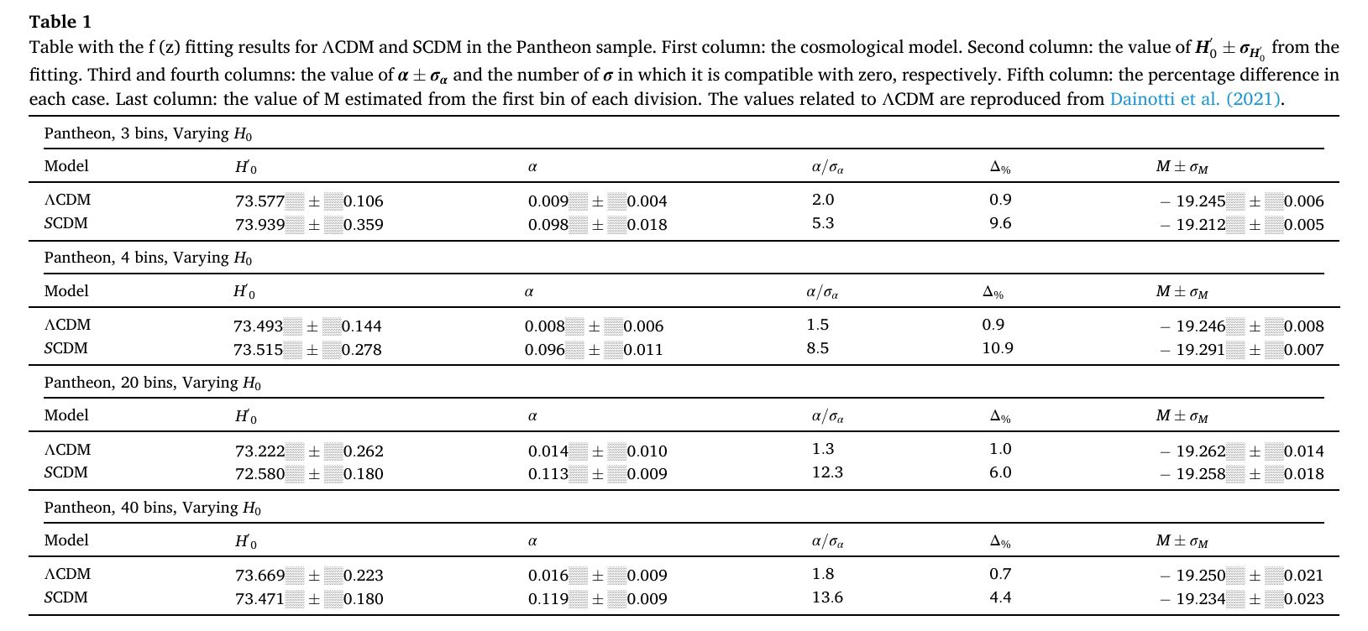
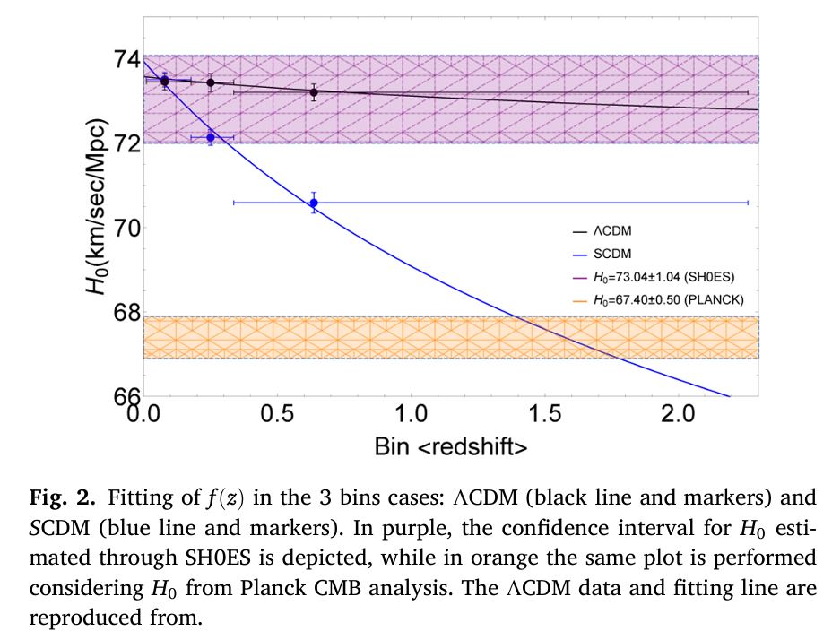
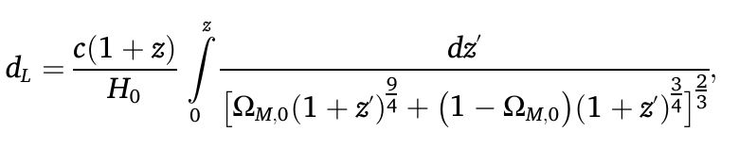
9
Challenge for Ho Tension: Maeder (2017) → the cosmic accelerating expansion phase explained via scale-invariance of empty space
De Simone, Van Putten, Dainotti, Lambiase, JHEA, 45, 290.

Slide 10
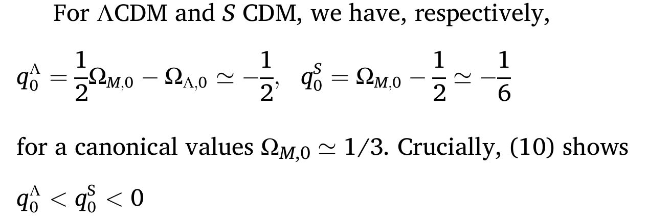
10
10
11
In light of the H0-tension, the current findings (Tables 1) in light of (11) suggest searching for models with q0 below that of ΛCDM, rather than q0 closer to zero as in SCDM.

Slide 11
Investigations with the Pantheon sample data
11
Slow-rolling scalar dynamics to alleviate the Hubble tension
Montani, Carlevaro, Dainotti, PDU, 44, May 2024, 101486;
Montani, De Angelis, Dainotti, 2025, PDU,4901969;
Decay of dark energy into dark matter in a metric f(R) gravity: Effective running Hubble constant
Running Hubble constant: Evolutionary Dark Energy, Phys. Dark Univ. 48, 101847 (2025);

Slide 12
SNe Ia catalogs
We investigated the Hubble constant tension in the following:
The Dark Energy Survey 5-year Dataset (DES): 1829 SNe Ia with redshift range 0,10 < z < 1,13 (Abbott et al. 2024)
PantheonPlus sample: 1701 SNe Ia in the redshift range 0,001 < z < 2,26 (Scolnic et al. 2022) -> THE ANALYSIS IS PERFORMED IN THE CASE OF PANTHEONPLUS WITHOUT DUPLICATES
Pantheon sample: 1048 SNe Ia in the redshift range 0,01 < z < 2,26 (Scolnic et al. 2018)
Joint Lightcurve Analysis (JLA): 740 SNe Ia with redshift range 0,01 < z < 1,30 (Betoule et al. 2014)
>>> The combination of DES, PantheonPlus, Pantheon and JLA, without duplicates: the Master Sample! 3714 SNe Ia
NEW ADDITION!
>>> Two high-z SNe Ia recently discovered with James Webb Space Telescope: SN 2023aeax at z = 2.15 (Pierel et al. 2024) and SN 2023adsy at z = 2.9 (Vinko and Regos 2024) -> for the analysis without covariance matrix

Slide 13

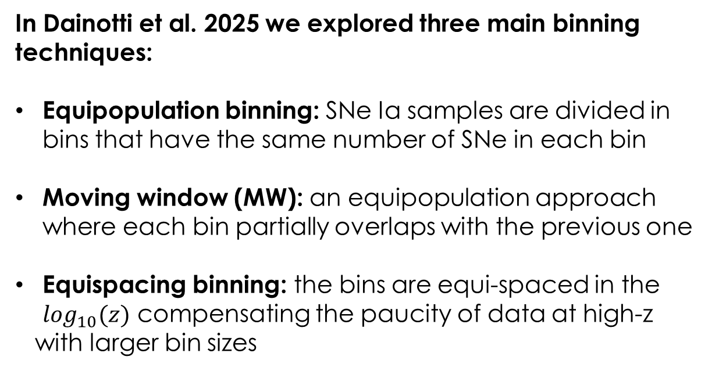
Methodology:
the binning techniques
In Dainotti et al. 2025 we explored three main binning techniques:
Equipopulation binning: SNe Ia samples are divided in bins that have the same number of SNe in each bin
Moving window (MW): an equipopulation approach where each bin partially overlaps with the previous one
Equispacing binning: the bins are equi-spaced in the $\log_{10}(z)$ compensating the paucity of data at high-z
with larger bin sizes
M. G. Dainotti, et al., 2021, ApJ, 912, 150

Slide 14
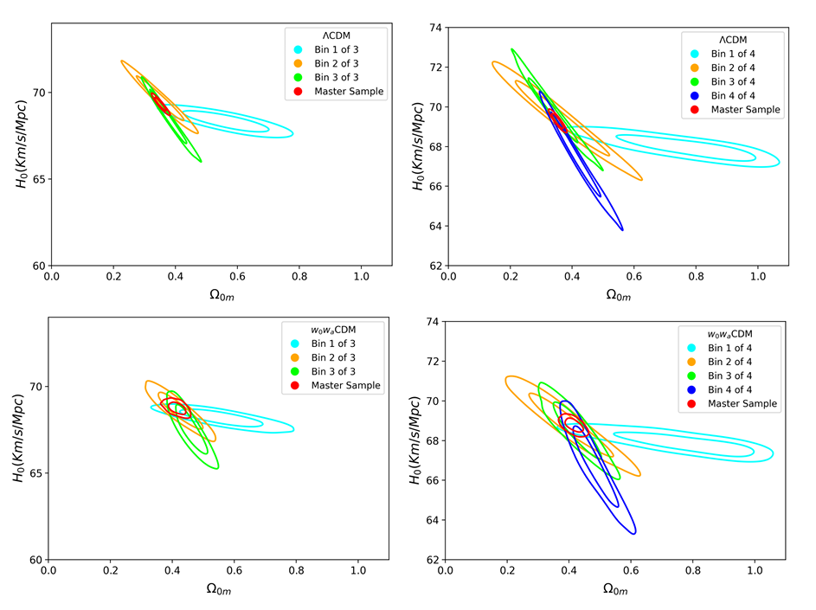
Compatibility among the 2D distributions (Master ΛCDM)
M. G. Dainotti, et al., 2021, ApJ, 912, 150

Slide 15
Compatibility among the 2D distributions (Master w0waCDM)
M. G. Dainotti, et al., 2021, ApJ, 912, 150

Slide 16
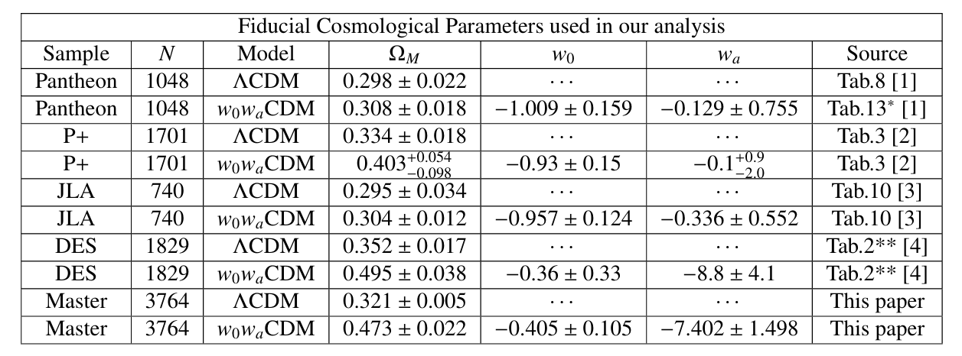
The cosmological analysis
ΛCDM -> varying $H_{0},Ω_{0m}$ WITH GAUSSIAN PRIORS on 5 σ on $Ω_{0m}$ or on H0 only
$H_{0}$ w0waCDM -> varying $H_{0},w_{a}$ WITH GAUSSIAN PRIORS on $w_{a},$or ONLY H0
The priors on $Ω_{0m}$ and $w_{a}$ are estimed according to the following:
(in the Master Sample case, the cosmological parameters are given by the MCMC analysis on the total sample)
[1]=(Scolnic et al., 2018); [2]=(Brout et al., 2022); [3]=(Betoule, M. et al., 2014);[4]=Abbott et al. 2024, Collaboration et al., 2024), where we have averaged the errorbars and run the full analysis with these priors
M. G. Dainotti, et al., 2021, ApJ, 912, 150

Slide 17
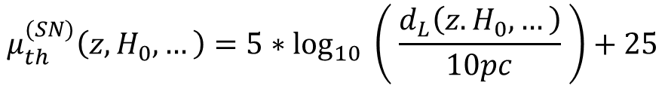


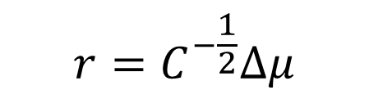

The likelihood selection (1)
THE RESIDUALS OF THE THEORETICAL MODEL FOR THE DISTANCE MODULI OF SNe Ia UNDERGO A BEST-DISTRIBUTION FITTING
Fiducial abs. mag.
Host-mass corr.
Color
Bias corr.
App. magnitude
Stretch
$$μ_{th}^{(SN)}\left(z,H_{0},…\right)=5∗\log_{10}\left( \frac{d_{L}\left(z.H_{0},…\right)}{10pc} \right)+25$$
$$μ_{obs}^{(SN)}=m_{B}−M+αx_{1}−βc+ΔM+ΔB$$
SNe Ia observed distance moduli (with modified Tripp formula)
SNe Ia theoretical distance moduli
With the covariance matrix $C$
we define the residuals $r$
Otherwise other functional forms for the likelihoods are adopted (Student, Logistic, Mixed…)
> according to the BIC of FindDistribution (Mathematica)
In case the residuals best-fit distribution is Gaussian:
$$r=C^{−\frac{1}{2}}Δμ$$
$$χ_{SNe}^{2}={Δμ}^{T}C^{−1}Δμ$$
$$Δμ=μ_{obs}^{(SN)}−μ_{th}^{(SN)}$$

Slide 18
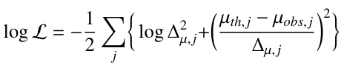


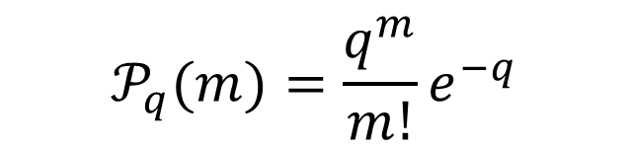
The likelihood selection (2)
WE ALSO TEST THE SO-CALLED MARSHALL’S LIKELIHOOD (MARSHALL 2024)
Starting from Poisson’s distribution, in the approximation of large value for $q$
Gaussian distribution where the SNe Ia are treated as single events multiplied in factors
$$𝒫_{q}(m)=\frac{q^{m}}{m!}e^{−q}$$
Such a likelihood form allows adding the two high-z SNe Ia at z=2.15 and z=2.9, which are provided without a covariance matrix, thus having only statistical uncertainties on their distance moduli
Marshall’s likelihood, $Δ_{μ,i}$ being the statistical uncertainty on the i-th SN distance modulus

Slide 19
One step back: We strive to reach precision cosmology
19
BUT
What about the assumptions of the likelihood?
Common assumption: Gaussian likelihood of the SNe Ia.
Are all this valid?

Slide 20
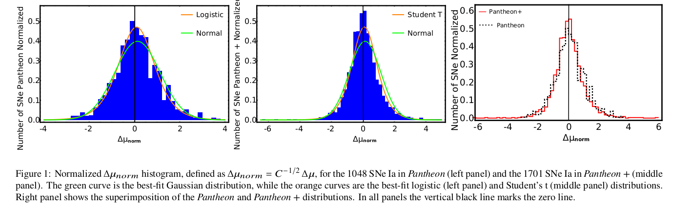
NO! SNe Ia, do not fulfill the Gaussian likelihoods. Starting with SNe Ia
20
Dainotti, M.G., Bargiacchi, G., Bogdan M., Capozziello, S. and Nagataki S, ”Reduced uncertainties up to 43% on the Hubble constant and the matter density with the SNe Ia with a new statistical analysis”, JHEAP, 41, 30-41.

Slide 21
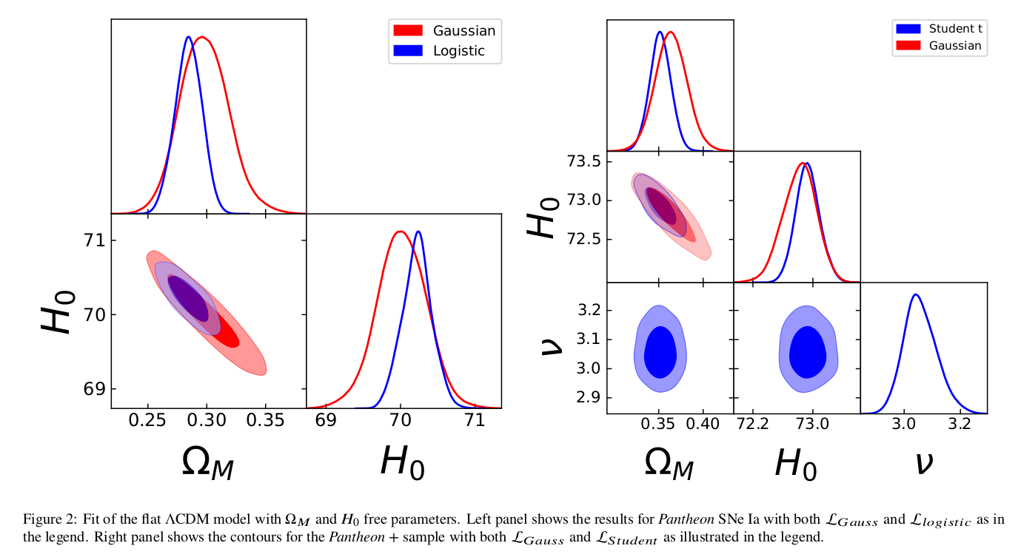
The two different Cosmological analysis
21

Slide 22
Results on Ω𝑀 and 𝐻0 within a flat ΛCDM model
22
Both Ω𝑀 and 𝐻0 are free parameters,
The L𝑙𝑜𝑔𝑖𝑠𝑡𝑖𝑐 for the Pantheon
L𝑆𝑡𝑢𝑑𝑒𝑛𝑡 for the Pantheon +
significantly reduce the uncertainties on both parameters.
L𝑙𝑜𝑔𝑖𝑠𝑡𝑖𝑐 on Ω𝑀 by 43% (from 0.021 to 0.012) and 41% (from 0.34 to 0.20) for H0, respectively,
L𝑆𝑡𝑢𝑑𝑒𝑛𝑡 by 42% (from 0.019 to 0.011) for Ω𝑀 and 33% (from 0.24 to 0.16) for H0.

Slide 23
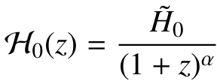

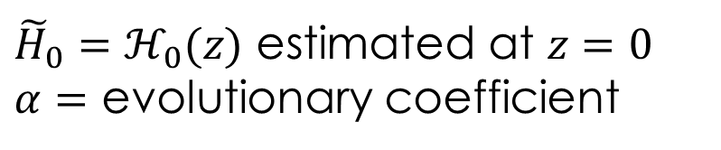
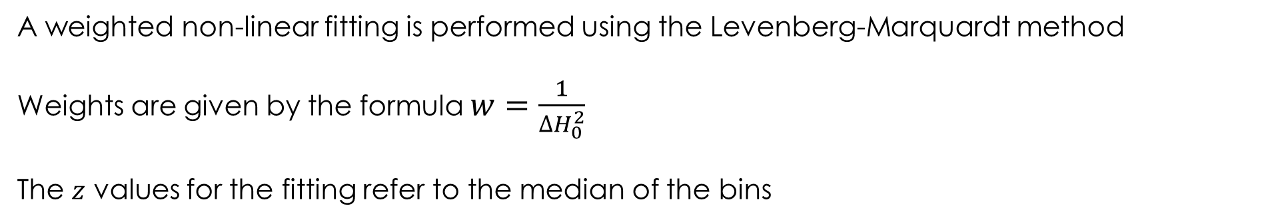
The fitting procedure
THE H₀ VALUES ARE FITTED WITH A DECREASING FUNCTION OF THE REDSHIFT
${\tilde{H}}_{0}=ℋ_{0}(z)$ estimated at $z=0$
$α=$ evolutionary coefficient
A weighted non-linear fitting is performed using the Levenberg-Marquardt method
Weights are given by the formula $w=\frac{1}{{∆H}_{0}^{2}}$
The $z$ values for the fitting refer to the median of the bins
A comparison with the linear fitting model is carried out through the log Bayes factor

Slide 24



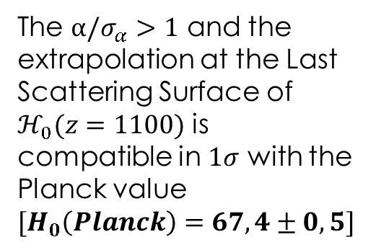
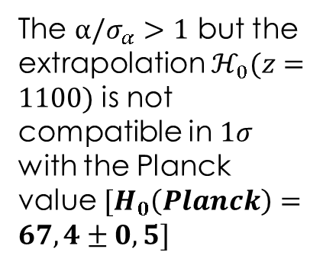

The results
ARE DIVIDED INTO TWO MAIN CATEGORIES: DIAMOND AND GOLD
Fitting $ℋ_{0}(z)$
Checking the $\frac{α}{σ_{α}}$
The $α/σ_{α}>1$ but the extrapolation $ℋ_{0}(z=1100)$ is not compatible in $1σ$ with the Planck value ${[H}_{0}\left(Planck\right)=67,4±0,5]$
The $α/σ_{α}>1$ and the extrapolation at the Last Scattering Surface of
$ℋ_{0}(z=1100)$ is compatible in $1σ$ with the Planck value ${[H}_{0}\left(Planck\right)=67,4±0,5]$
Is $\frac{α}{σ_{α}}>1$?
NO
Skip
YES
Is $ℋ_{0}(z=1100)$ compatible in $1σ$ with $H_{0,CMB}$?
Diamond
YES
NO
Gold
M. G. Dainotti, et al., 2021, ApJ, 912, 150

Slide 25



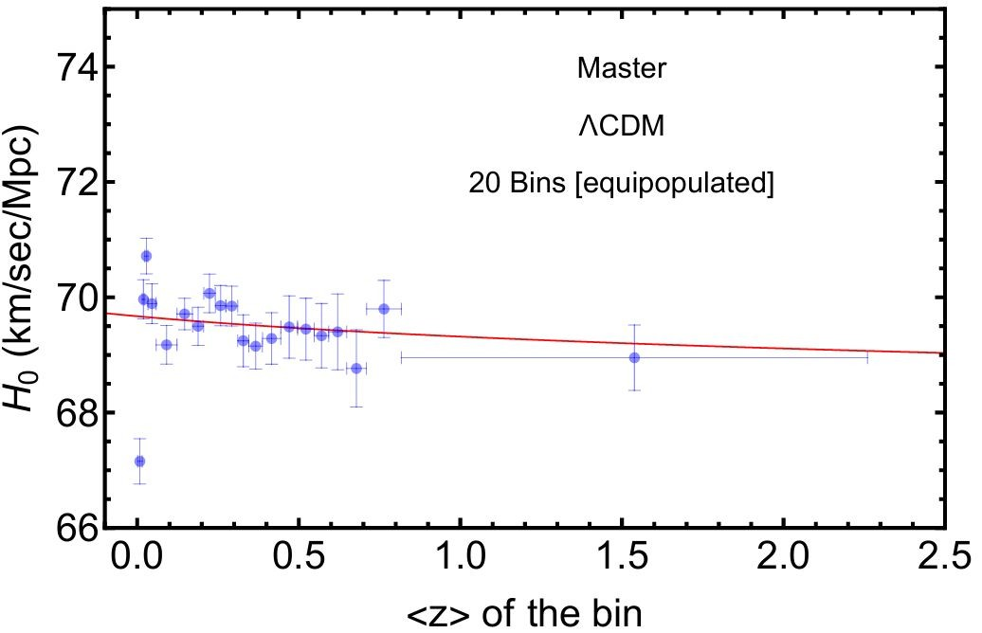
Method - Datasets
25
Dainotti et al., 2201.09848 Dainotti et al., 2501.11772
Binned SNe Ia datasets:
Pantheon binned SNe Ia sample
Master binned SNe Ia sample:
SNe Ia from DESY5, Pantheon+,
Pantheon and JLA
without duplicates

Slide 26
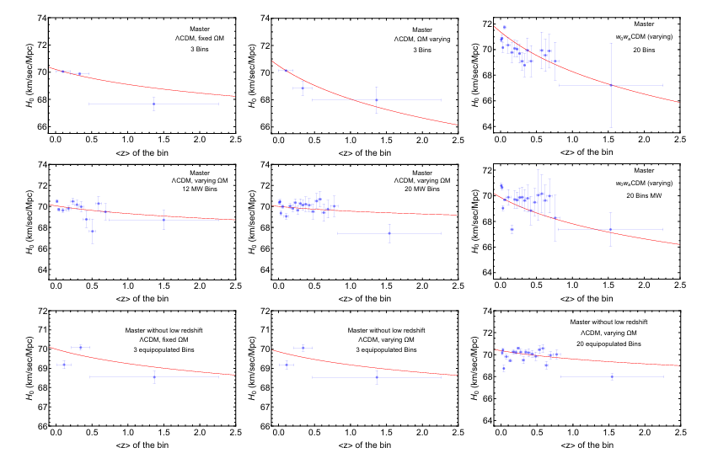
Results: Master Sample
M. G. Dainotti, et al., 2021, ApJ, 912, 150

Slide 27
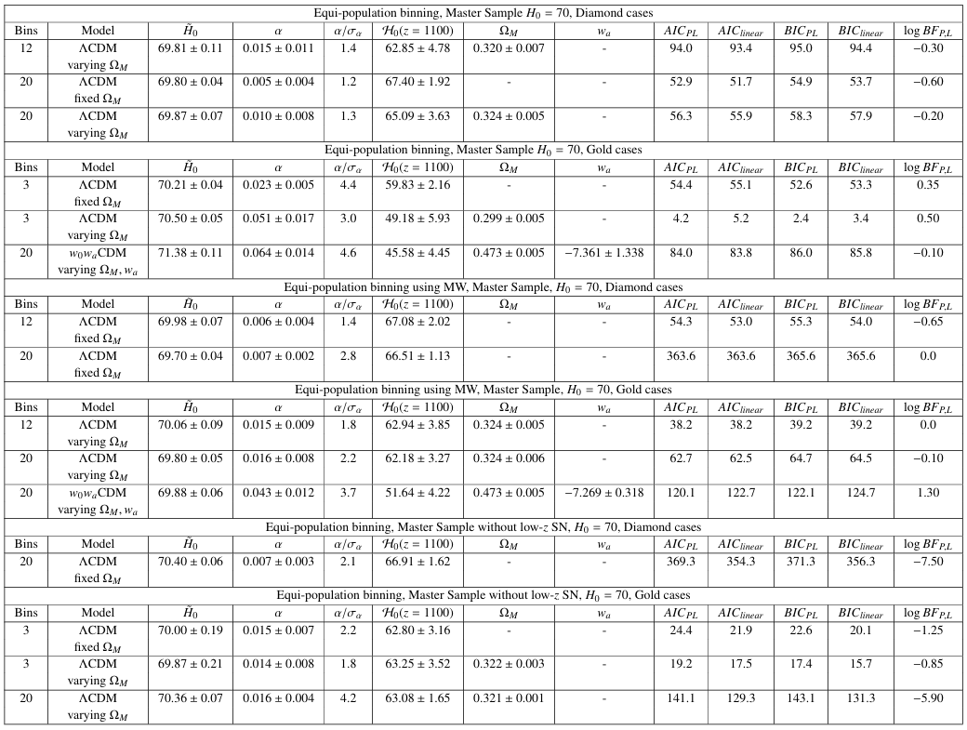
Results: Master Sample
Future perspective is to use the SNe Ia (see Ariel’s talk)
M. G. Dainotti, et al., 2021, ApJ, 912, 150

Slide 28
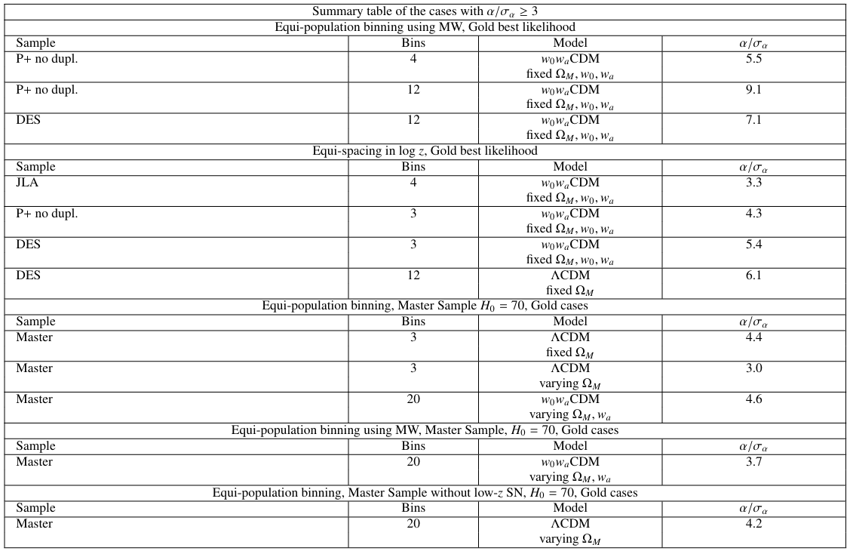
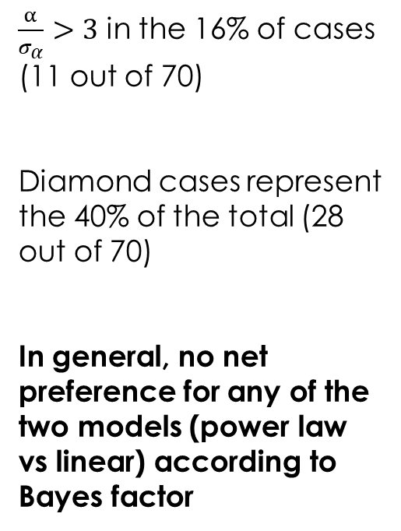
Summary of the results
$\frac{α}{σ_{α}}>3$ in the 16% of cases (11 out of 70)
Diamond cases represent the 40% of the total (28 out of 70)
In general, no net preference for any of the two models (power law vs linear) according to Bayes factor

Slide 29
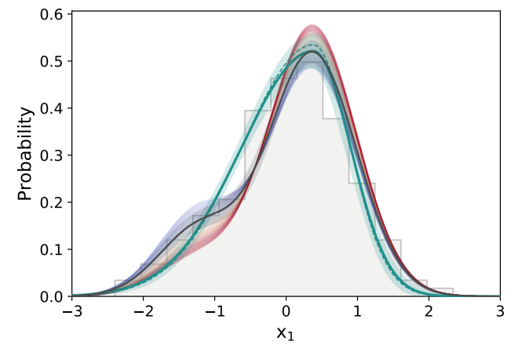
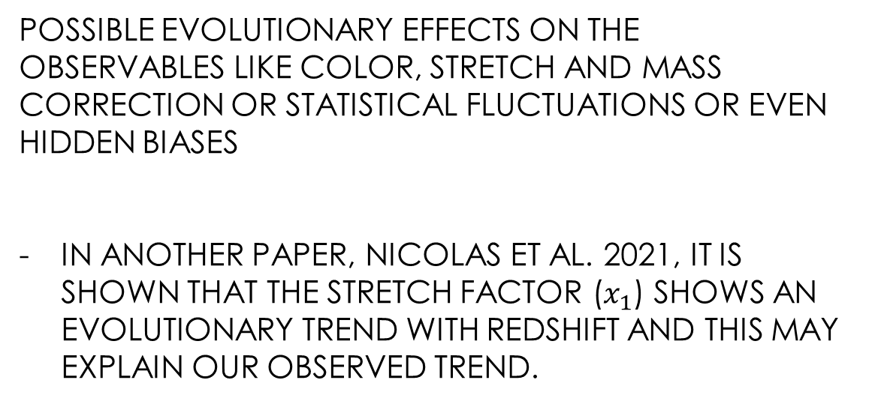
Discussion of the results (1)
SNe Ia ANALYSIS: POSSIBLE ASTROPHYSICAL EFFECTS
POSSIBLE EVOLUTIONARY EFFECTS ON THE OBSERVABLES LIKE COLOR, STRETCH AND MASS CORRECTION OR STATISTICAL FLUCTUATIONS OR EVEN HIDDEN BIASES
IN ANOTHER PAPER, NICOLAS ET AL. 2021, IT IS SHOWN THAT THE STRETCH FACTOR ($x_{1}$) SHOWS AN EVOLUTIONARY TREND WITH REDSHIFT AND THIS MAY EXPLAIN OUR OBSERVED TREND.
Asymmetric distribution
N. Nicolas, et al., 2021, A&A, 649, A74

Slide 30
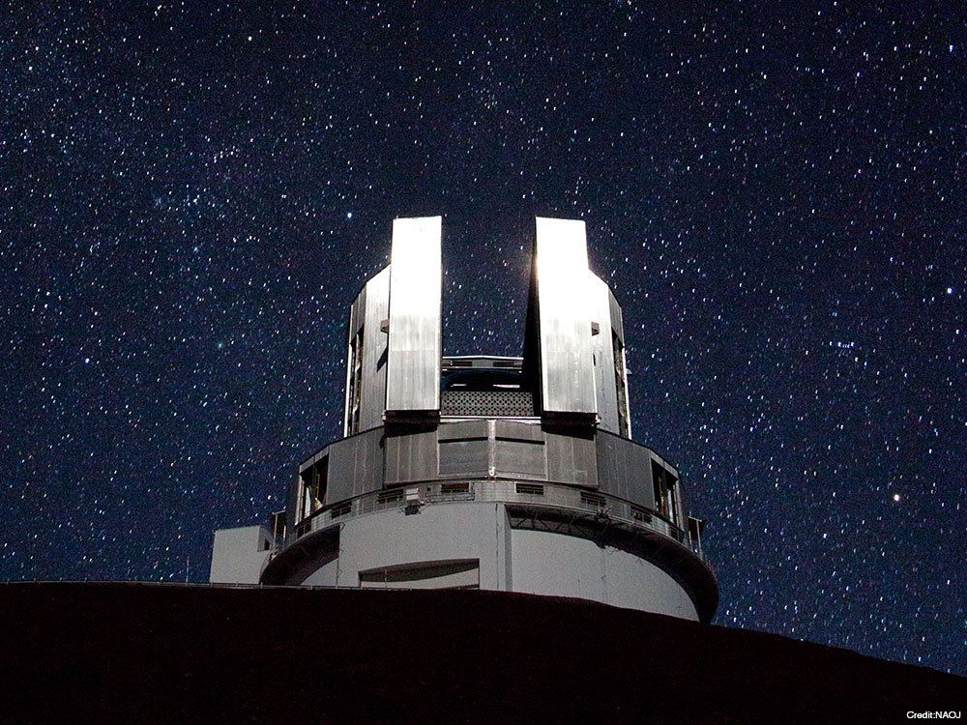
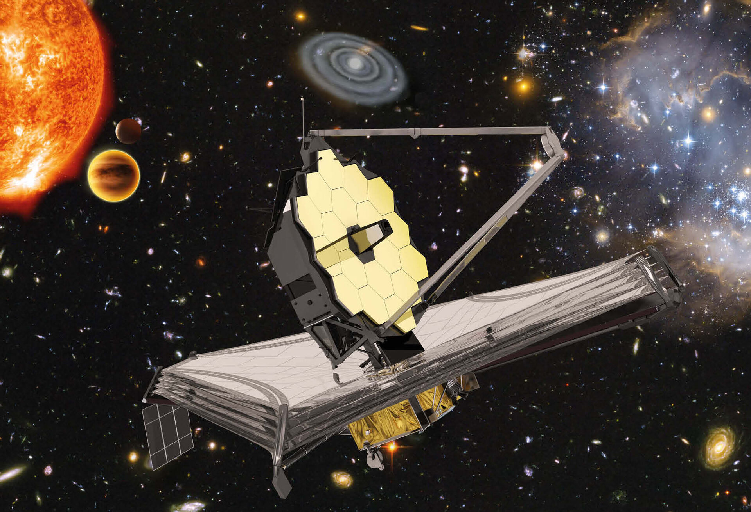
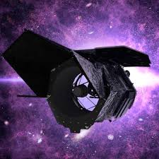
How can we possibly solve the tension?
FUTURE SNe Ia SURVEYS AND NEW TELESCOPES
SUBARU TELESCOPE
(Kodaira 1992)
JAMES WEBB SPACE TELESCOPE
(Gardner et al. 2023)
ROMAN TELESCOPE
(Eifler et al. 2021)

Slide 31
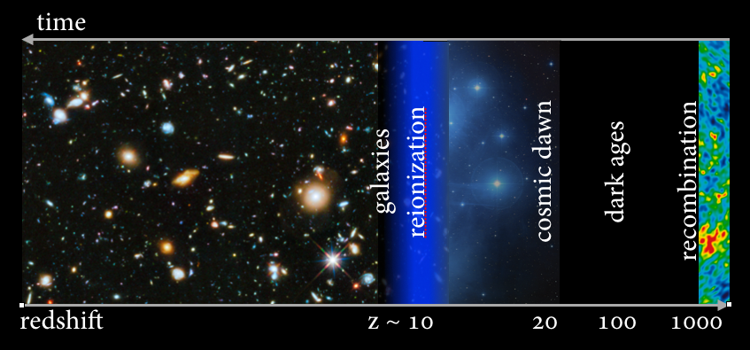

How can we possibly solve the tension?
Excellent candidates:
Gamma-ray Bursts
Using probes in
$$2.9<z<1100$$
Quasars, standard sirens, Tip of Red Giant Branch method, Megamasers,
lensed quasars and lensed SNe, and …

Slide 32

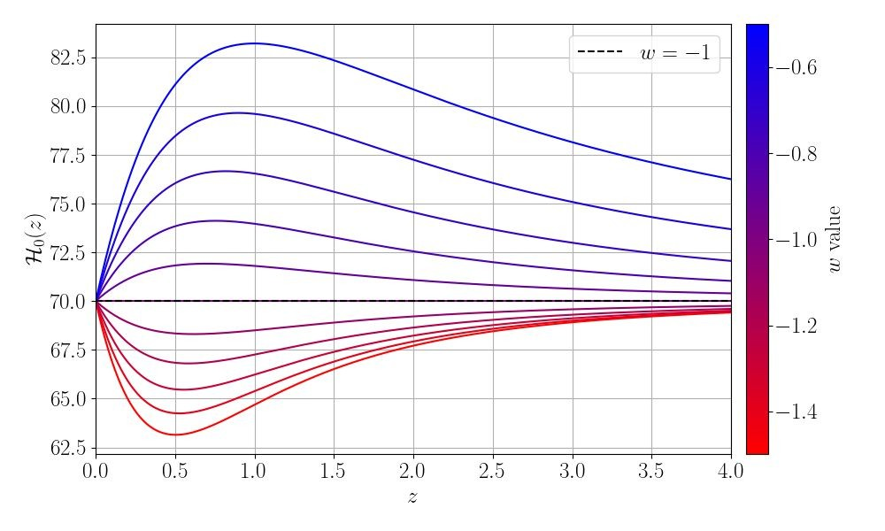
Effective running Hubble constant
E. Fazzaria, M. G. Dainotti, G. Montani, A. Melchiorri
32
Quintessence
Phantom

Slide 33

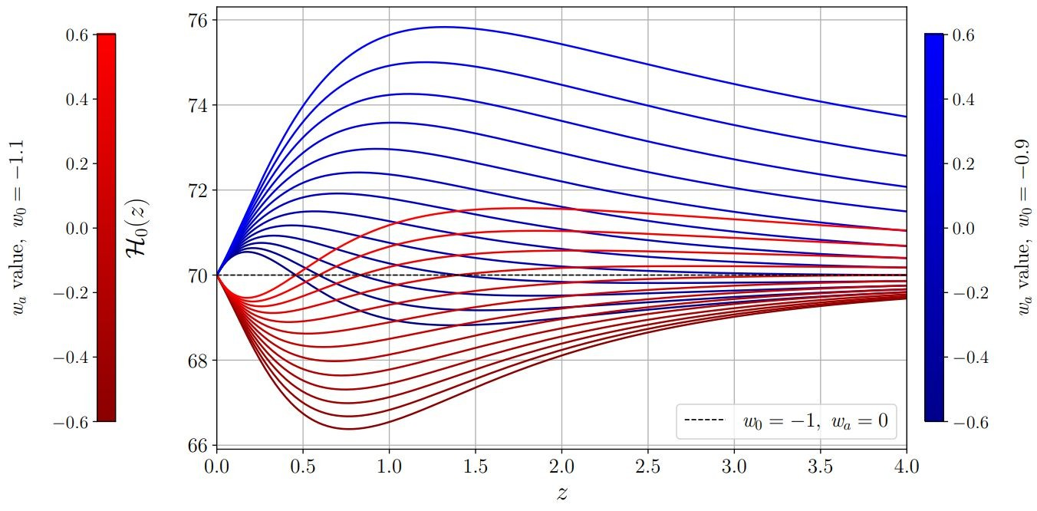
Effective running Hubble constant
33
Quintessence
Phantom

Slide 34
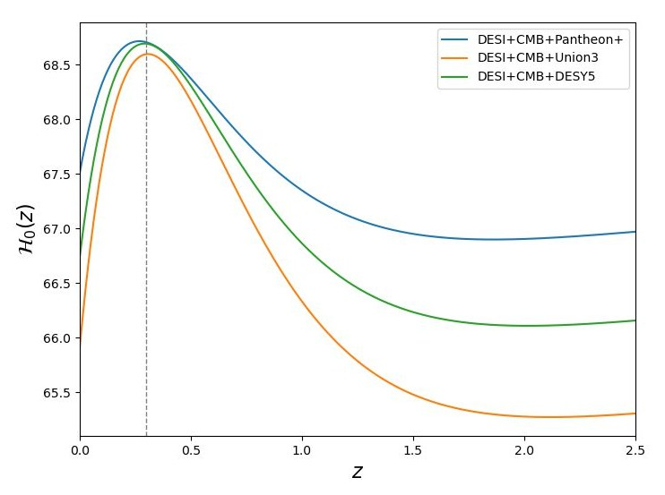
Effective running Hubble constant
34
Quintessence

Slide 35
Effective running Hubble constant
35
Quintessence
Phantom

Slide 36

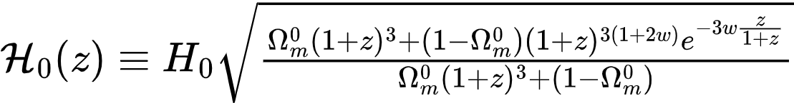

Dark energy models analyzed
36
1.
2.
3.
Dark energy created by the variation of cosmological gravitational field

Slide 37


Dark energy models analyzed
37

Slide 38


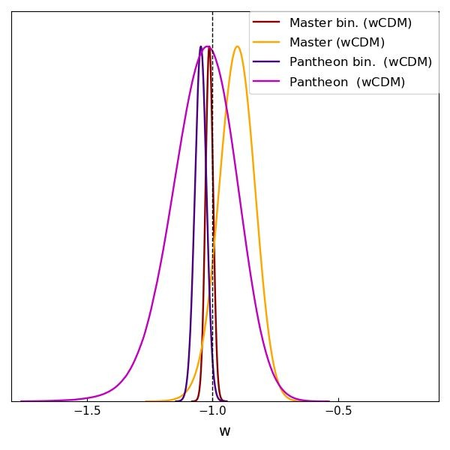
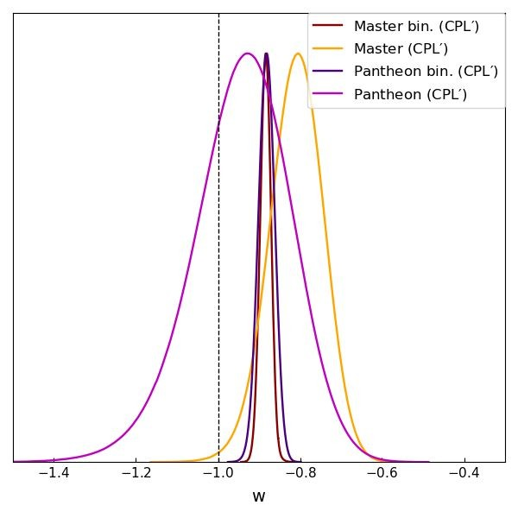
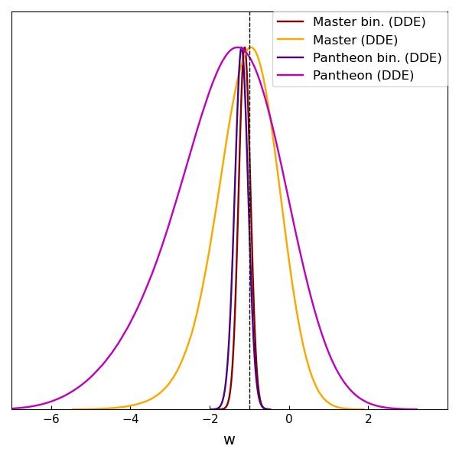
Results
38
constrained with higher precision from binned SNe Ia compared to the full SNe Ia dataset

Slide 39

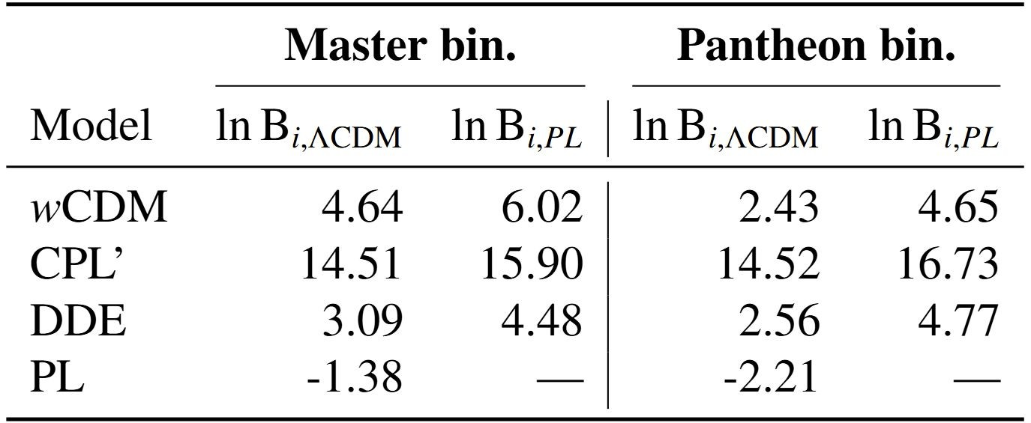

Results
Jeffreys et al., 1998 arXiv:2506.04162
●
and DDE perform better compared to the CPL'
39
CPL' model is significantly disfavored with respect to
PL model emerges as the favored one
Differences in BIC relative
To the ΛCDM and PL reference models, for the Master and Pantheon binned datasets. Positive values indicatea preference for the reference model.

Slide 40
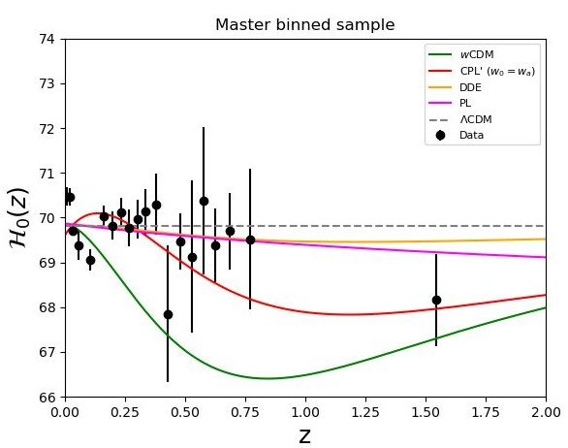
Effective running Hubble constant
40

Slide 41


Take home messages
41
1.
is a useful tool able to discriminate between quintessence or phantom DE simply looking at its increasing or decreasing behavior with the redshift
Among the DE models, binned data prefer phantom dark energy scenario
PL and are the most favoured parametrizations from the SNe Ia
binned data from the Bayes criterion information.

Slide 42
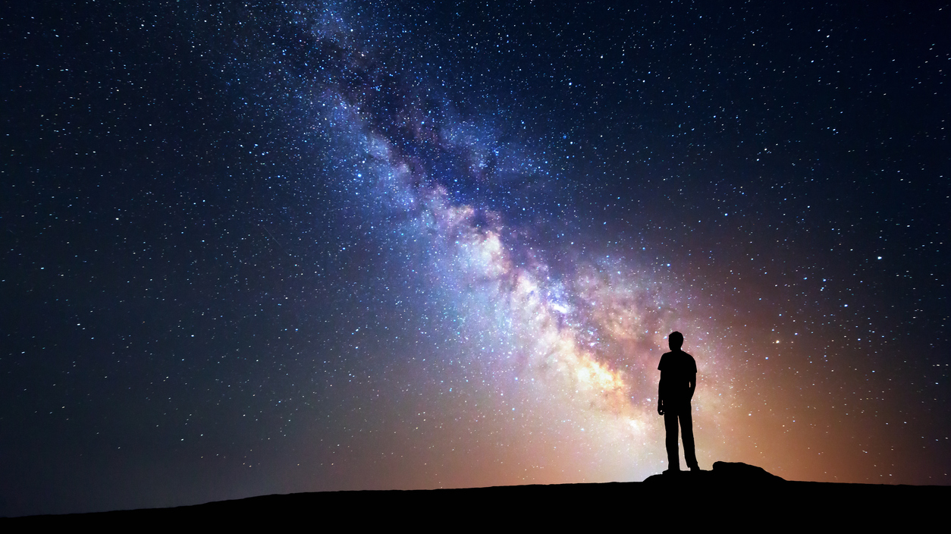

Thank you for your attention!
If you want to join us:
maria.dainotti@nao.ac.jp
Any comments or questions?

Slide 43
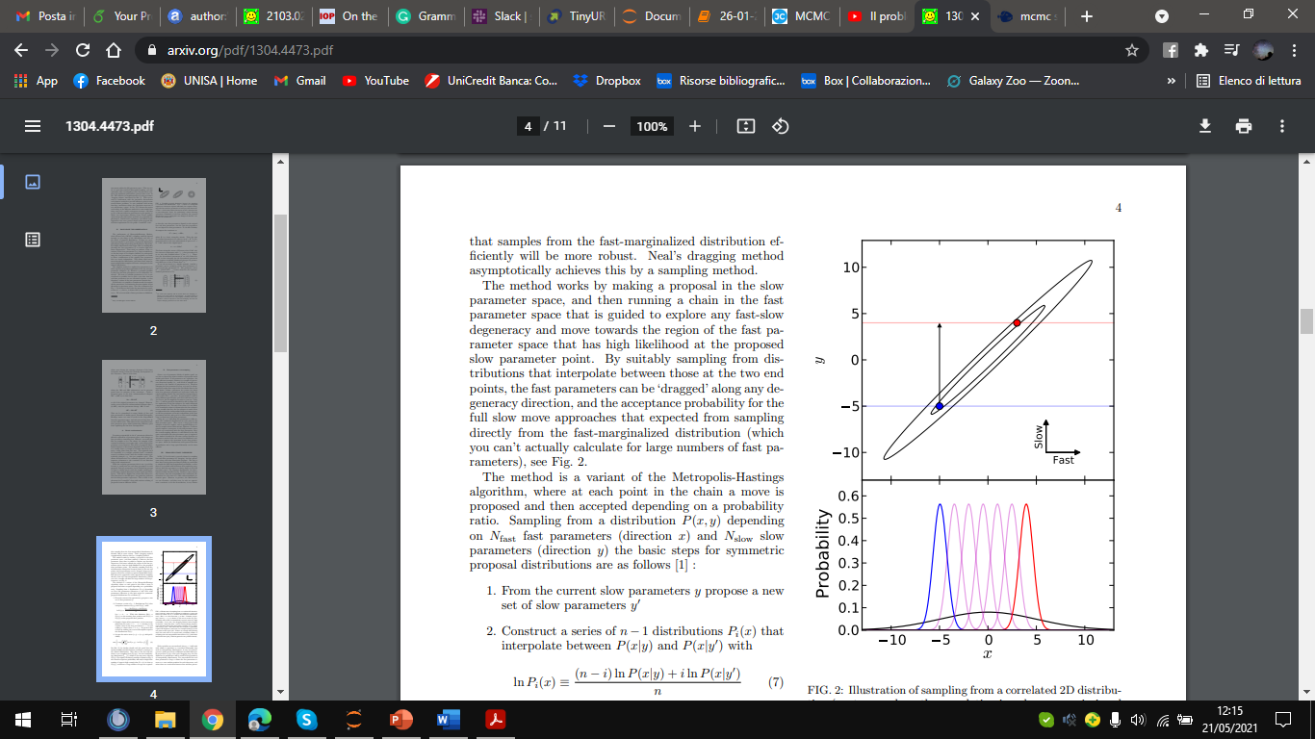




The MCMC analysis (2)
LET’S CONSIDER $y$ AS SLOW VARIABLE AND $x$ AS FAST VARIABLE
FROM THE SLOW $y$ VALUE A NEW $y′$ VALUE IS PROPOSED
A SERIES OF POISSON DISTRIBUTIONS $P_{i}(x)$ INTERPOLATE BETWEEN $P(x|y)$ AND $P(x|y′)$ VALUE WHEN A NEW $y′$
VALUE IS PROPOSED
THE STEP $\left(x,y\right)→(x^{′},y′)$IS ACCEPTED WITH A GIVEN PROBABILITY
Lewis, A., 2013

Slide 44


The MCMC analysis (1)
FOR EACH BIN OF SNe, A MARKOV CHAIN MONTE-CARLO APPROACH IS ADOPTED TO ESTIMATE $H_{0},Ω_{0m}$ IN THE ΛCDM OR $H_{0},w_{a}$ IN THE w0waCDM WITH GAUSSIAN PRIORS
MARKOV-CHAIN: the chain of creation of the random samples.
Markov property: the step $x_{i}$ depends on the step $x_{i−1}$ but not on the step $x_{i−2}$
MONTE CARLO: estimate the properties of a distribution studying extracted random samples
CONSIDERING $H$ = THE COSMOLOGICAL MODEL FOR OBSERVED DATA
$$P\left(H | A\right)\sim P(H)∗P(A|H)$$
Starting from a guess prior value for the $P(H)$, a series of posterior values $P\left(H | A\right)$ is obtained to check the average and 1-sigma for the posterior distribution
After the first guess prior value, adding a small perturbation to $P(H)$, a proposal step is created
If accepted, the proposal becomes the new value from which the next proposal is drawn, otherwise another proposal is created
Lewis, A., 2013

Slide 45

The SH0ES constraints
WE TESTED THE CONTRIBUTION OF THE LIKELIHOOD FROM SH0ES (RIESS ET AL. 2022) IN THE FIRST BIN OF PANTHEONPLUS SAMPLE
The SH0ES is built up of Cepheids in galaxies with and without SNe Ia + other constraints from the Hubble flow

Slide 46

The talk of Eric Linder

Slide 47

Results: equipopulation binning
M. G. Dainotti, et al., 2021, ApJ, 912, 150

Slide 48

Results: equipopulation binning
M. G. Dainotti, et al., 2021, ApJ, 912, 150

Slide 49

Results: equi-population binning
log BFP,L = -1/ 2 (BICL − BICP)
M. G. Dainotti, et al., 2021, ApJ, 912, 150

Slide 50


Results: equipopulation with MW
M. G. Dainotti, et al., 2021, ApJ, 912, 150

Slide 51

Results: equipopulation with MW
M. G. Dainotti, et al., 2021, ApJ, 912, 150

Slide 52

Results: equipopulation with MW
M. G. Dainotti, et al., 2021, ApJ, 912, 150

Slide 53

Results: equispace binning
M. G. Dainotti, et al., 2021, ApJ, 912, 150

Slide 54

M. G. Dainotti, et al., 2021, ApJ, 912, 150

Slide 55

M. G. Dainotti, et al., 2021, ApJ, 912, 150

Slide 56


Results: equispace binning, Marshall’s likelihood
M. G. Dainotti, et al., 2021, ApJ, 912, 150

Slide 57

Results: equispace binning, Marshall’s likelihood
M. G. Dainotti, et al., 2021, ApJ, 912, 150

Slide 58

Results: SH0ES constraints on the PantheonPlus
M. G. Dainotti, et al., 2021, ApJ, 912, 150

Slide 59






Outlook
Evolutionary Dark Energy vs Cosmological Constant scenario:
DESI-DR2 results with a Flat- model:
DESI Collaboration, 2503.14738

Slide 60

Outlook
Evolutionary Dark Energy vs Cosmological Constant scenario:
DESI-DR2 results with a Flat- model:
DESI Collaboration, 2503.14738

Slide 61




Outlook
Evolutionary Dark Energy vs Cosmological Constant scenario:
D. Brout, D. Scolnic et al., 2202.04077
DES-Y5 Collaboration, 2401.02929

Slide 62



Outlook
Evolutionary Dark Energy vs Cosmological Constant scenario:
DESI Collaboration, 2503.14738

Slide 63
What is the effective running Hubble constant?
Similar diagnostic tool for DE: DESI Collaboration, 2503.14743 Sahni et al., 0807.3548
A new diagnostic for Dark Energy:
Dainotti et al., 2103.02117 Kazantzidis et al., 2004.02155 Jia et al., 2212.00238

Slide 64
Effective running Hubble constant

Slide 65

Effective running Hubble constant
DESI-Collaboration, 2503.14738

Slide 66



Dark energy models analyzed
Particle creation mechanism
phenomenological constant particle creation rate
Lima et al., 0708.3397 Montani., 0101113
Elizalde et al., 2407.20285

Slide 67


Dark energy models analyzed
Particle creation mechanism
phenomenological constant particle creation rate
Lima et al., 0708.3397 Montani., 0101113
Elizalde et al., 2407.20285

Slide 68



Dark energy models analyzed
Particle creation mechanism
Theoretical constrain
Lemos et al., 1806.06781 Efstathiou, 2103.08723

Slide 69
Dark energy models analyzed

Slide 70
Dark energy models analyzed

Slide 71



Recap of models
1.
2.
3.
Dainotti et al., 2103.02117

Slide 72
Model testing part

Slide 73
Results
constrained with higher precision from binned SNe Ia compared to the full SNe Ia dataset

Slide 74


Results

Slide 75


Method - Datasets
Same priors as those used to obtain the binned data samples

Slide 76



Results
●
and DDE perform better compared to the CPL'
Jeffreys et al., 1998 Trotta, 0803.4089 Giarè, wgcosmo GitHub

Slide 77

Results
●
and DDE perform better compared to the CPL'
CPL' model is significantly disfavored with respect to
Jeffreys et al., 1998 Trotta, 0803.4089 Giarè, wgcosmo GitHub
arXiv:2506.04162

Slide 78


Method - Datasets
Background analysis:
Pantheon and Master SNe Ia
DESI DR2 calibrated with Planck constraint on
Cosmic Chronometer

Slide 79
Dark energy models analyzed
1.
2.

Slide 80

Results
Statistical uncertainties larger than those obtained from the binned SNe Ia data alone
No discrimination between phantom and quintessence regimes for the and DDE models

Slide 81




Results

Slide 82

Method - Datasets
MCMC performed with Cobaya
Backy [Giarè, Fazzari, in prep.]
code interfaced with Cobaya for testing late-time modified cosmological models using background observables
mostly useful for Dark Energy and Hubble tension

Slide 83

Dark Energy EoS

Slide 84
Take home messages
1.
is a useful tool able to discriminate between quintessence or phantom DE simply looking at its increasing or decreasing behavior with the redshift

Slide 85
Take home messages
1.
is a useful tool able to discriminate between quintessence or phantom DE simply looking at its increasing or decreasing behavior with the redshift
2. Among the DE models, binned data prefer phantom dark energy scenario

