Slide 1



Populating Hidden Sectors Through
Cosmological Gravitational Particle Production (CGPP)
Gravity can produce particles with mass > T_{RH}, and/or no coupling to SM fields
More complete treatment in
Cosmological gravitational particle production & its implications for cosmological relics
EWK and Andrew Long, Reviews of Modern Physics 96, December 2024
Rocky Kolb XXIst
University of Chicago August 2025

Slide 2
Cosmological Gravitational Particle Production (CGPP)
Dark Matter Through the “Schrödinger mechanism”
Chung, EWK, Riotto (1998); Kuzmin & Tkachev (1999)
My collaborators:
      Ivone Albuquerque
      Edward Basso
      Christian Capanelli
      Tammi Chowdhury
      Daniel Chung
      Patrick Crotty
      Michael Fedderke
      Gian Giudice
      Lam Hui
      Leah Jenks*
      Siyang Ling
      Andrew Long
      Evan McDonough
      Guillaume Payeur
      Toni Riotto
      Rachel Rosen
      Leo Senatore
      Alexi Starobinski
      Keyer Thyme
      Igor Tkachev
      Jingyuan Wang
      Mark Wyman

Slide 3
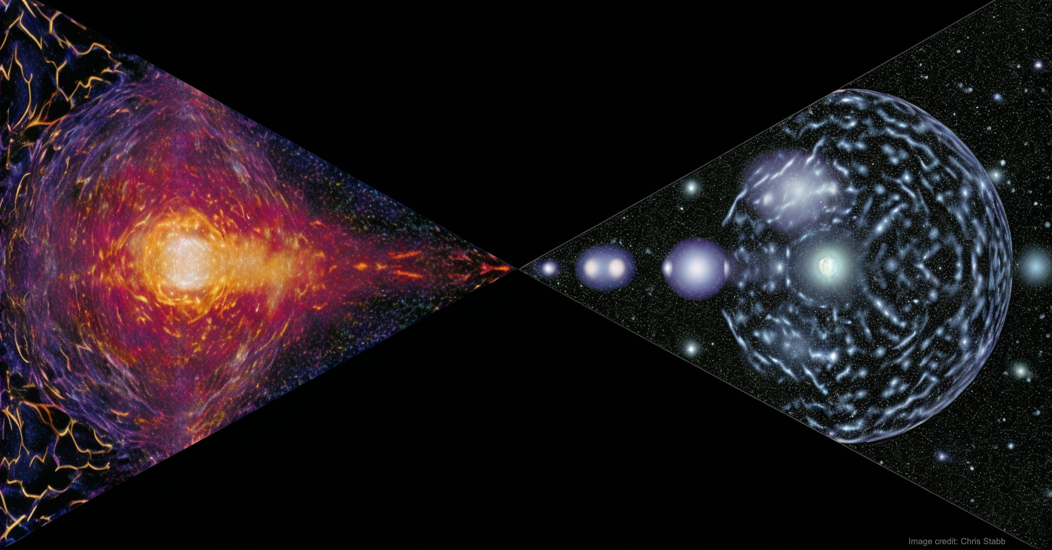
Inner Space/Outer Space Interface
Cosmological limits on particle properties:
1. neutrinos
2. axions
3. magnetic monopoles
4. all sort of BSM particles (e.g., SUSY)
    5. cosmological defects
    6. Kaluza-Klein modes
    7. String theorists suggest a lot of things,
    have to get rid of them
Mostly assume LTE
I will consider limits from “cosmological gravitational particle production (CGPP)”

Slide 4
Inner Space/Outer Space Interface
Big Bang as accelerator assumes
1. at some point temperature larger than some mass scale m
2. particle interacts with SM plasma
BUT
1. Maximum temperature of the radiation-dominated universe is the
“reheat” temperature after inflation, T_{RH}
T_{RH} may be as low as 8 MeV (to set stage for BBN)!
2. What about particles with no SM interactions (or) interactions
too weak to be populated in the primordial soup?
(No evidence that dark matter interacts non-gravitationally with SM particles)
CGPP can populate hidden sectors

Slide 5
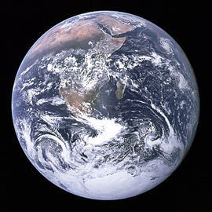
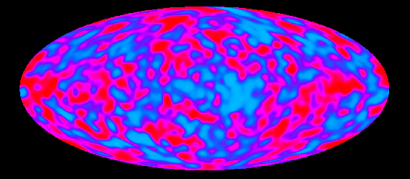
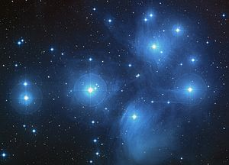
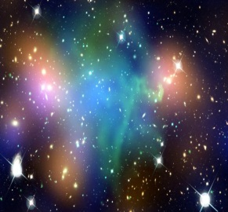
Radiation:
0.005%
Chemical Elements:
(other than H & He) 0.025%
Neutrinos:
0.17%
ν_{e}
ν_{μ}
ν_{τ}
Stars:
0.8%
H & He:
gas 4%
?
Dark Matter: 25%
?
Dark Energy: 70%
Notes:
I am a cosmologist; often confused with cosmetologist. They are different. One deals with the universe of makeup and the other with the makeup of the universe.
One is much more lucrative. We spend $39B per year in the US on cosmetology, several hundred times more then we spend on cosmology.

Slide 6
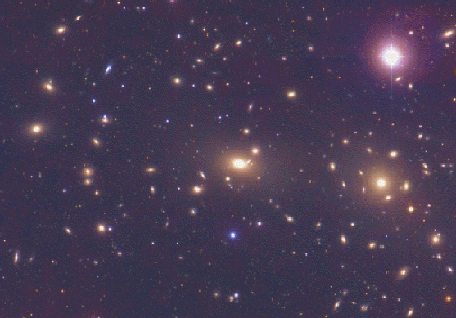
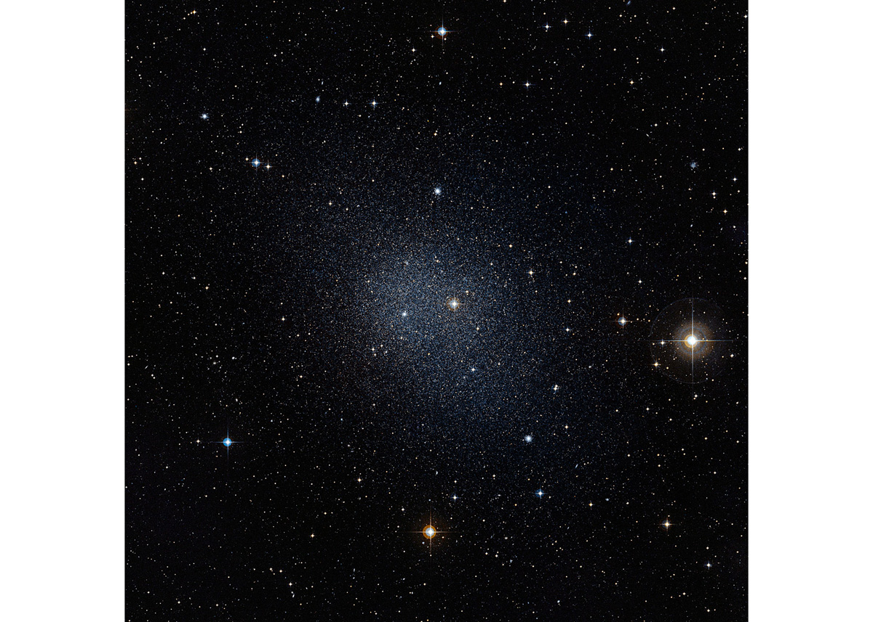
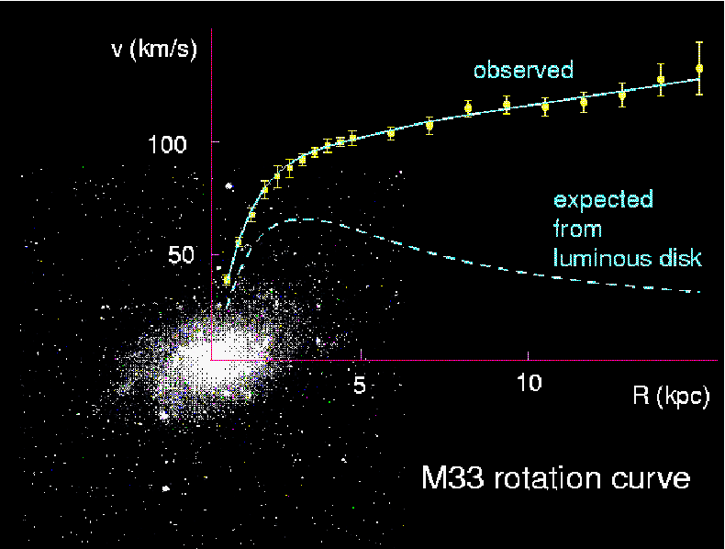
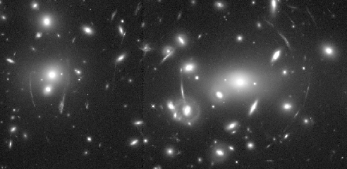
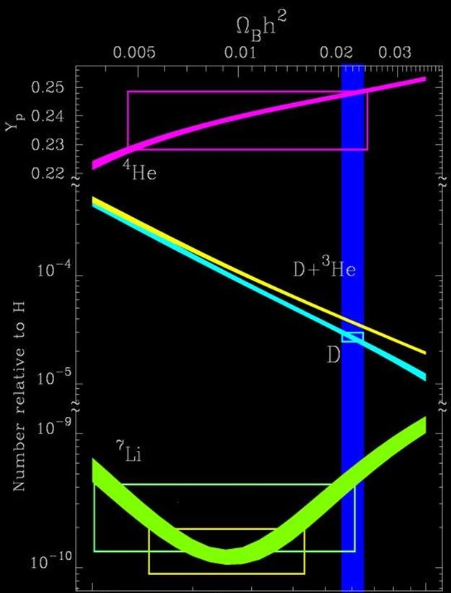
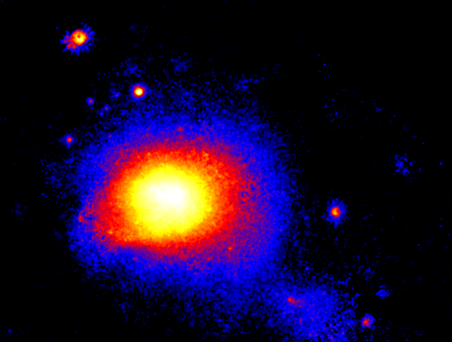
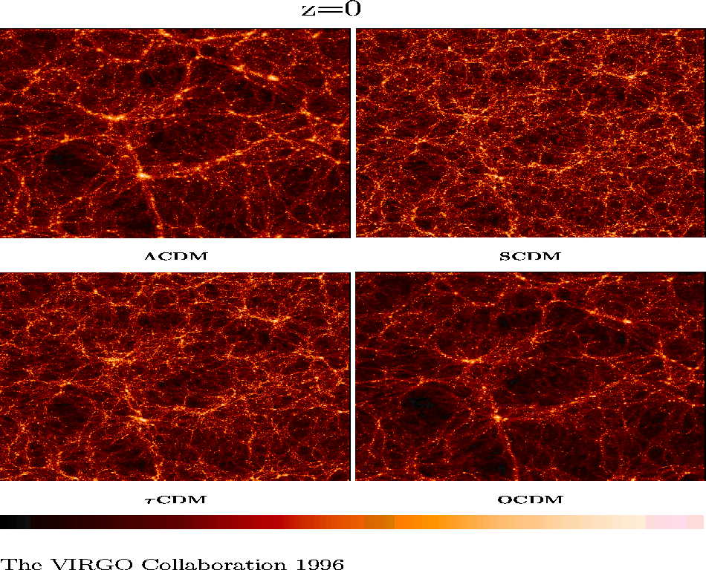
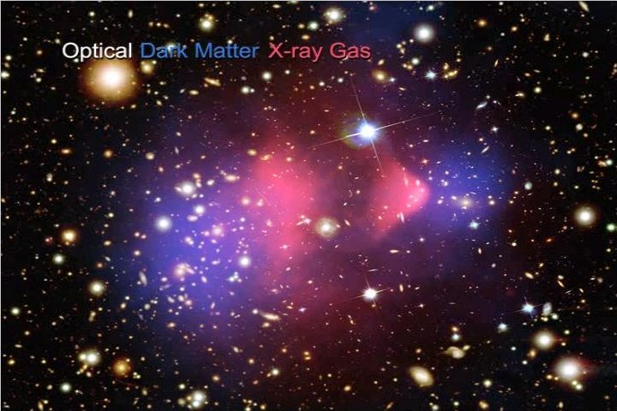
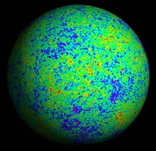
observed
luminous
disk
cluster dynamics
galactic rotation curves
dwarf galaxies
Evidence for
Dark Matter
gravitational lensing
nucleosynthesis
cluster gas in x-rays
background radiation
structure formation
cluster collisions

Slide 7
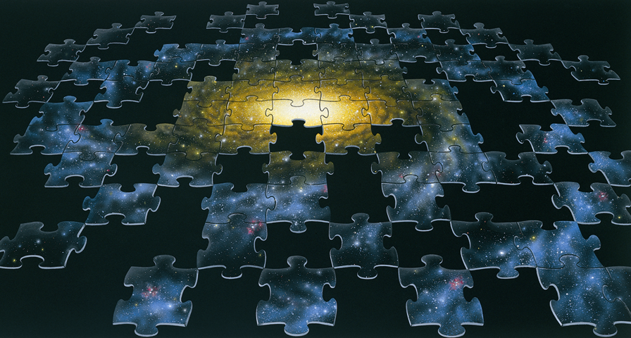
Particle dark-matter candidates
(hot)
(warm)
(cold)
(cold)
(sub-) eV mass neutrinos (WIMPs exist!)
sterile neutrinos, gravitinos
lightest supersymmetric particle
lightest Kaluza-Klein particle
thermal relics, or decay of or oscillation from
thermal relics
Bose-Einstein condensates
axions, axion miniclusters
solitons (Q-balls, B-balls, …)
supermassive WIMPZILLAs from inflation
from phase
transitions
nonthermal relics
Mass
10⁻²² eV (10⁻⁵⁶ g) Bose-Einstein
10⁻⁸ M_{ʘ} (10⁺²⁵ g) axion miniclusters
Interaction Strength
only gravitational: WIMPzillas
strongly interacting: B balls
Notes:
Axion miniclusters Hogan and Rees
Won’t discuss axions, 3.5 keV neutrinos, sterile neutrinos, etc.
Concentrate on cold thermal relics

Slide 8
Freeze Out of a Cold Thermal Relic, Y ≡ n/s
Freeze-out value of Y
determines present
mass density
The WIMP Miracle!
EWK & Turner

Slide 9
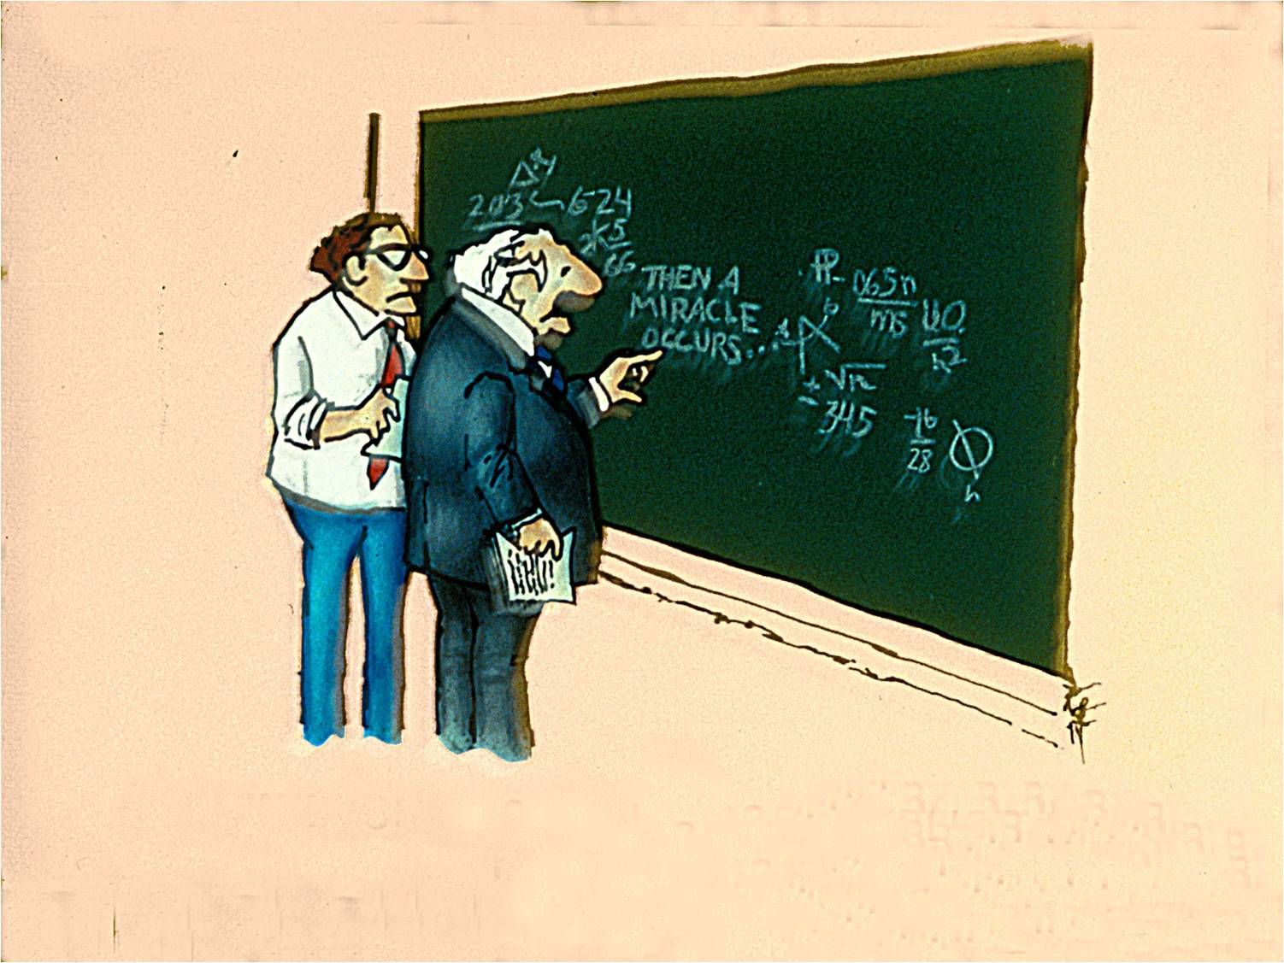

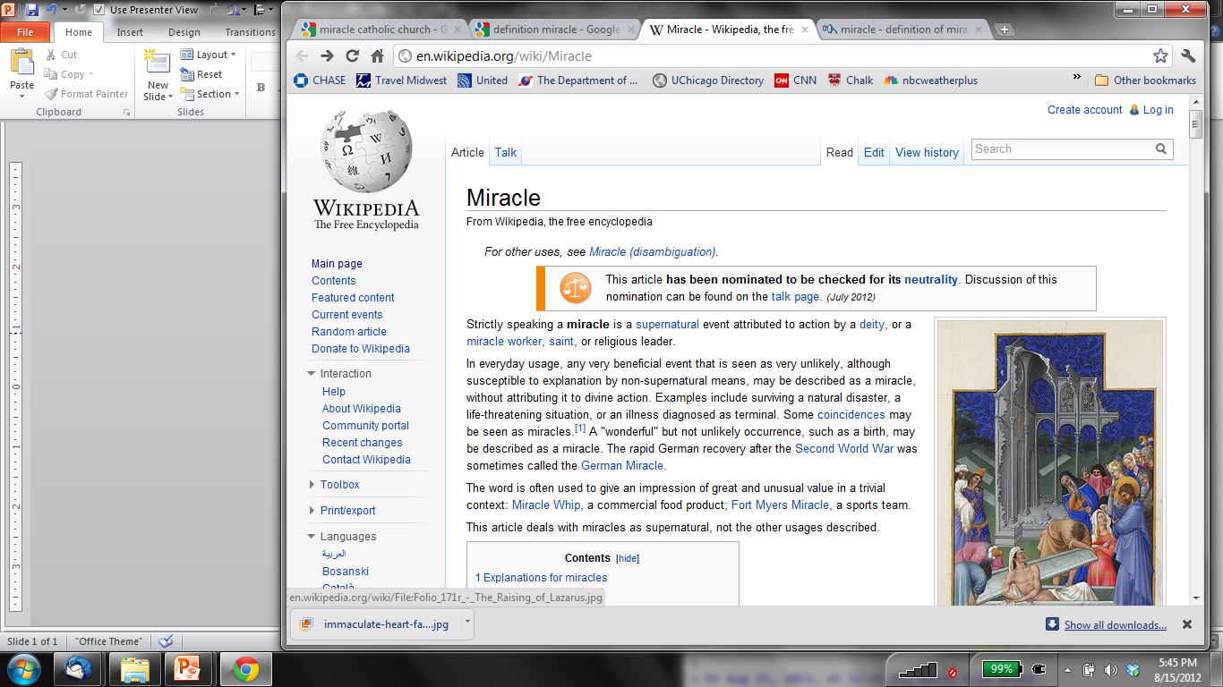
The WIMP “Miracle”
Cold thermal relic: weak-scale mass & interactions
(1 GeV − 1 TeV ) WIMP (Weakly Interacting Massive Particle)
WIMPs are BSM, but not far BSM
mir·a·cle
\ˈmir-i-kəl \
noun
1 : an extraordinary event manifesting
divine intervention in human affairs
S. Harris
… often used to give an impression of great and
unusual value in a trivial
context …
I think you should be more
explicit here in step two

Slide 10
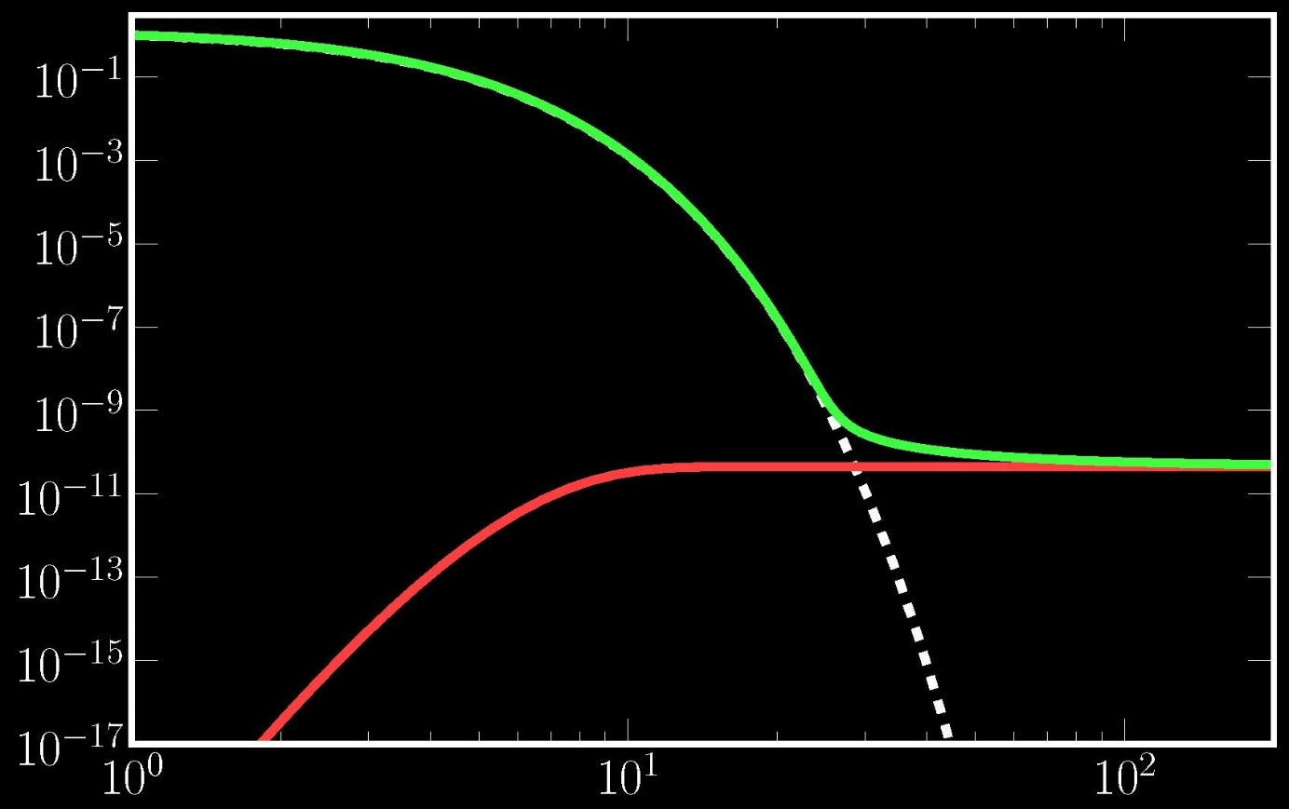
Most popular paradigm: cold thermal relic*
DM abundance set by creation/annihilation with standard-model particles
Equilibrium abundance of DM determined by m_{χ} / T (no asymmetry)
DM species final abundance determined by
  “freeze-out” to final abundance, or
  “freeze-in” to final abundance
Freeze-out/Freeze-in: interplay between
particle physics (DM—SM interactions) and cosmology (expansion rate)
Freeze-out
Freeze-in
Equilibrium
* An object of particular veneration.

Slide 11
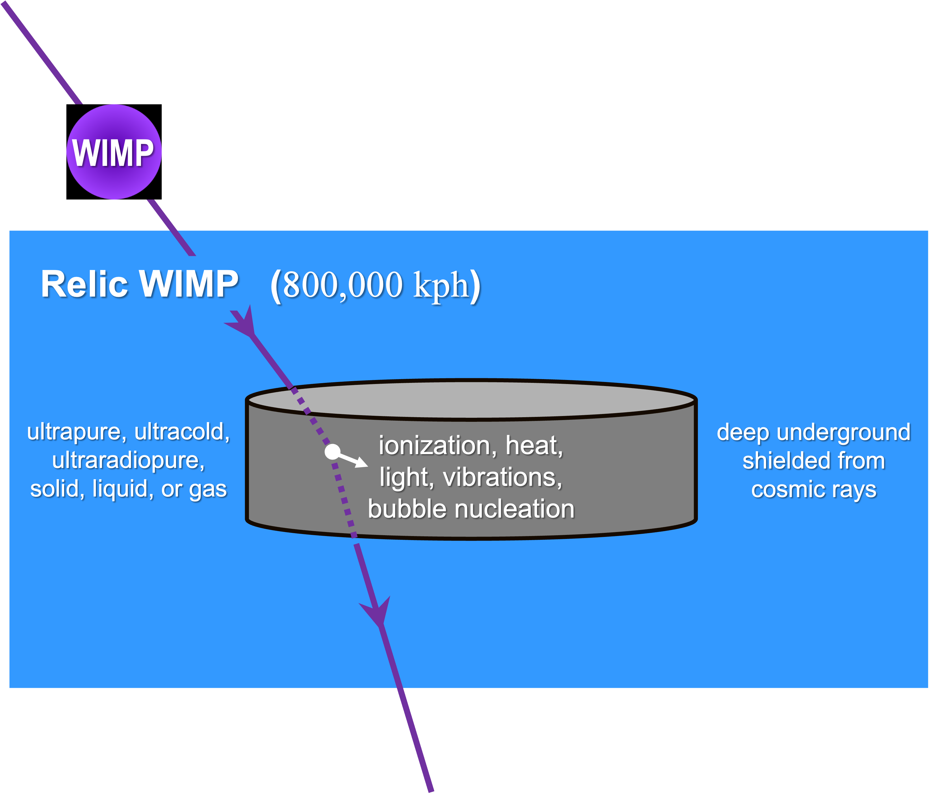
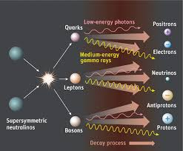

If DM interacts with SM, perhaps it can be discovered!
Direct Detection Indirect Detection Accelerator Detection
Relic dark matter has rare scattering with a target. Issues include background and detection.
Relic dark matter in, e.g., galactic center annihilates and produces detectable radiation. Issue is astronomy foregrounds.
SM particles produce DM in collisions. Issues are background, neutrinos, and detection.
DM
I often presented talks in the 2010s:The Decade of the WIMP!

Slide 12
Direct, Indirect, Accelerator
Where is the WIMP?
No signal in direct (DAMA?), indirect (galactic center γ – ray excess?), or accelerator searches.
Even more troubling, no sign of BSM physics at LHC.
This doesn’t seem to be the decade of the WIMP!!!
(Perhaps) DM is NOT a WIMP (cold thermal relic), time to focus elsewhere
go lighter go ultralight go ultraheavy boldly go where no
dark sector axion, dark photon WIMPzilla one has gone before

Slide 13
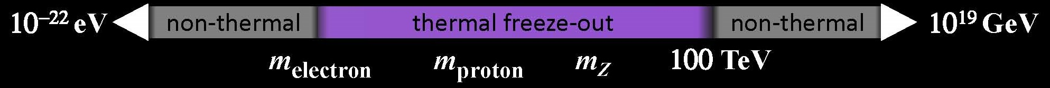
Dark Matter particle mass range
Mass Range for Particle Dark Matter
m ≥ 10⁻²² eV: de Broglie wavelength smaller than dark-matter dominated objects
m ≤ 10¹⁹ GeV: mass less than Planck mass
m ≥ few eV: if fermion (exclusion principle)
If thermal freeze-out
m ≥ m_{e} : annihilation to SM particles
m ≤ 100 TeV: annihilation cross section too small for larger masses
Is Dark Matter a Particle Or a Wave?
m ≤ 1 eV: occupation number in de Broglie-wavelength volume ≥ 1 → WAVE
m ≥ 1 eV: occupation number in de Broglie-wavelength volume ≤ 1 → PARTICLE
Notes:
50 orders-of-magnitude

Slide 14
Dark Matter particle mass range (mere 41 orders of magnitude)
Plancktons: m ∼ m_{Planck} = 10¹⁹ GeV
WIMPzillas: m ∼ m_{inflaton} = 10¹⁰ – 10¹³ GeV
Supermassive: m > 100 TeV
WIMP range (e.g., neutralino): m_{proton} < m < 1 TeV
Light dark matter (e.g., dark photon): m_{electron} < m < m_{proton}
Ultralight dark matter (e.g., axion): m < 1 eV
Fuzzy dark matter: m ∼ 10⁻²² eV
Notes:
20 micrograms 50 orders-of-magnitude

Slide 15
Is Dark Matter Really a WIMP?
Observation/experiment will tell!
So far, after 30 years of effort nothing definite seen.
or, …
Hope for a disruptive discovery.
Pursue other ideas, e.g., gravitational production.
KEEP
CALM
AND
CARRY ON SEARCHING
FOR
DARK MATTER

Slide 16
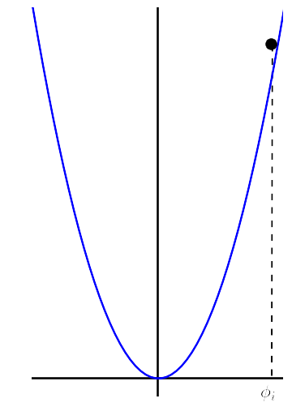
Ideas for gravitational particle production
Produce particles through misalignment mechanism
EOM of homogeneous scalar field in FRW:
Scalar field has quantum fluctuations during inflation:
After inflation field frozen by “Hubble drag” until
After which it oscillates with energy density in
oscillating field
E.g., axion
φ_{i}

Slide 17
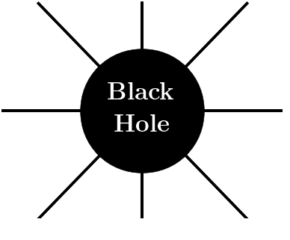
Ideas for gravitational particle production
Produce particles via Hawking radiation from primordial black holes
(Hooper, Krnjaic, & McDermott)
PBHs of current interest (after first LIGO event)
Seeds for PBHs from inflation
Assumes DM mass about 10¹¹ GeV (WIMPzilla)
Notes:
M < 10^8 g

Slide 18
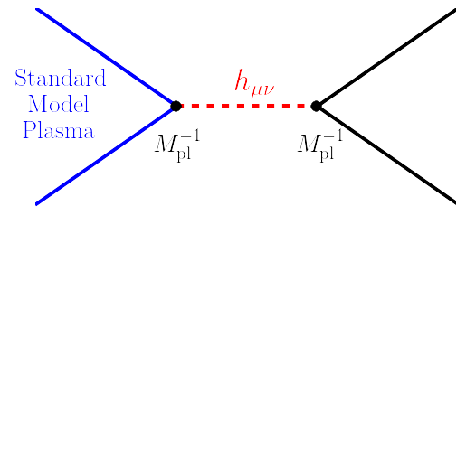
Ideas for gravitational particle production
Produce particles from SM plasma via graviton exchange
Garny, Sandora, & Sloth
standard
model
plasma
DM
Freeze-in
For DM mass about 10¹³ GeV (WIMPzilla)
Assumes m_{DM} < T_{RH}

Slide 19
Ideas for gravitational particle production
Produce particles from inflaton field after quasi-de Sitter era via graviton exchange
Ema, Nakayama, Tang; Mambrini & Olive
cold
inflaton
condensate
DM
Only works for m_{DM} < m_{inflaton}
DM mass for correct Ωh² involved function of several parameters
“Boltzmann” approach not complete treatment (Kaneta, Lee, Oda; Basso, Chung, EWK, Long)
Notes:
Return to this later

Slide 20
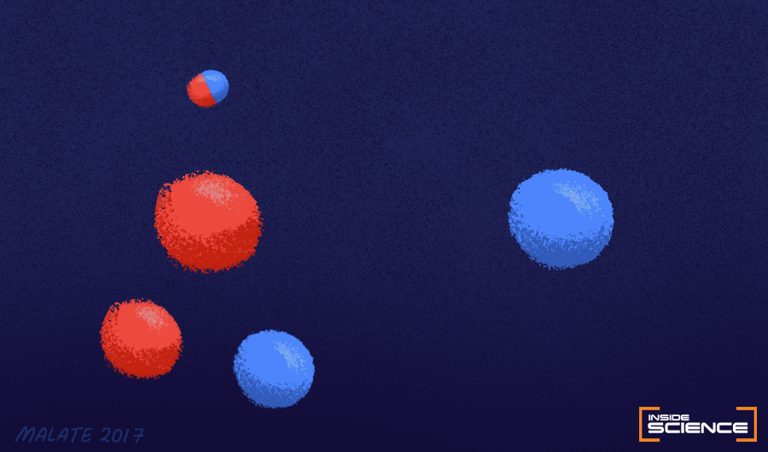
Disturbing the Quantum Vacuum
Electric field
Particle creation
Quantum
Vacuum
Seething Sea of Uncertainty
Image: Malate 2017 (AIP)
Particle creation if energy gained in acceleration from an external
field over a Compton wavelength exceeds the particle’s rest mass.
Schwinger Mechanism (1951)
Schrödinger Mechanism (1939)
Turn on field
Turn on expansion
expansion
Notes:
Sauter; Heisenberg; Weisskopf (1930s);
I = 10^30 W cm^2, B = 5X10^13 G
Non perturbative. quantum

Slide 21
Cosmological Gravitational Particle Production (CGPP)
In Minkowskian QFT, classify particle by IR of the Poincaré algebra.
But, expanding universe not Poincaré invariant!
Notion of a “particle” is approximate.
Schrodinger (1939); Parker (1965, 68); Fulling, Ford, & Hu; Zel’dovish; Starobinski; Grib, Frolov, Mamaev, & Mostepanenko; Mukhanov & Sasaki, Birrell & Davies…
cosmological
expansion
time-dependent
Hamiltonian
mixing of + and –
frequency modes
particle
production

Slide 23
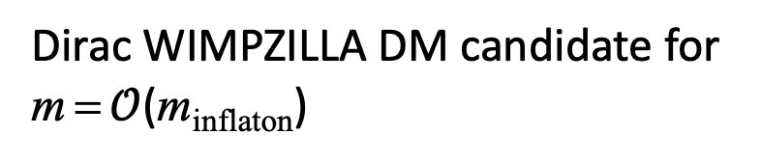
Dirac field in FRW background
No nonminimal dimension−4 operator
Dirac Equation in FRW:
Dispersion relation similar to
conformally-coupled scalar
Blue spectrum: no isocurvature issues
na³
Dirac WIMPZILLA DM candidate for
m = $𝒪$(m_{inflaton})
m_{χ} / H_{e} ≈ 2 m_{χ} / m_{inflaton}
Notes:
helicity eigenspinors

Slide 24
WIMPzillas
Chung, Kolb, Riotto; Kuzmin, Tkachev; …. Kolb & Long
Inflation indicates a new mass scale
In most models, m_{inflaton} ≈ H_{inflation} ≈ 10¹² − 10¹⁴ GeV?
H_{inflation} detectable via primordial gravitational waves in CMB
(I, at least) expect other particles with mass ≈ m_{inflaton}
mass
all produced à la
the Schrödinger
mechanism
m_{inflaton}
lightest stable? Dark Matter “WIMPzilla”

Slide 25
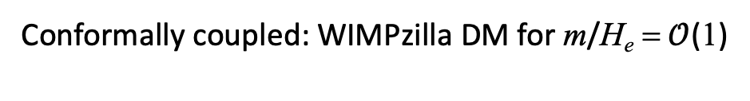
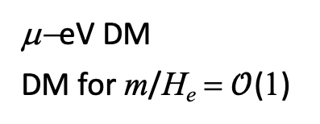
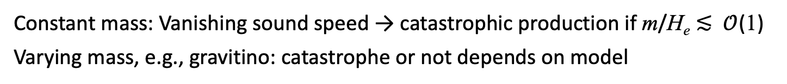
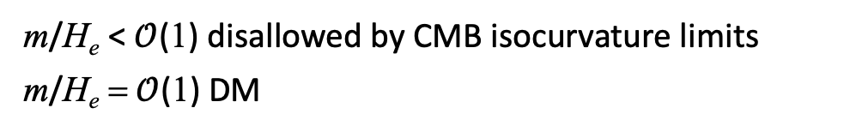
Schrödinger Mechanism for Dark Matter
Conformally coupled: WIMPzilla DM for m/H_{e} = $𝒪$(1)
Scalars:
m/H_{e} < $𝒪$(1) disallowed by CMB isocurvature limits
m/H_{e} =$𝒪$(1) DM
Minimally-coupled:
Dirac Fermions (s=1/2): similar to conformally-coupled scalars; WIMPzilla DM candidate for m/H_{e} = $𝒪$(1)
μ−eV DM
DM for m/H_{e} = $𝒪$(1)
Minimally-coupled:
Depends on (T_{RH}, H_{e})
Dark photons (s=1):
Non-minimally-coupled: potential runaway production
Kalb-Ramond (s=1): CGPP similar to dark photons
Constant mass: Vanishing sound speed → catastrophic production if m/H_{e} ≲ $𝒪$(1)
Varying mass, e.g., gravitino: catastrophe or not depends on model
Rarita-Schwinger (s=3/2):
Fierz-Pauli (s=2): Generalized Higuchi bound (m/H_{e} ≥ 2 [1 + ε] to avoid ghosts)
Higher spin (s>2):

Slide 26
Schrödinger Mechanism for Dark Matter
Conformally coupled: Chung, EWK, Riotto (1998) Kuzmim & Tkachev (1999)
Scalars:
Minimally-coupled: Chunk, EWK, Riotto, Senatore (2005)
Dirac Fermions (s=1/2) Chung, EWK, Riotto (1998)
Minimally-coupled: Graham, Mardon, & Rajendran (2016); Ahmed, Grzadkowski, & Socha (2020); EWK & Long (2020)
Dark photons (s=1):
Non-minimally-coupled: Capanelli, Jenks, EWK, McDonough (2024)
Kalb-Ramond (s=1): Capanelli, Jenks, EWK, McDonough
Rarita-Schwinger (s=3/2): Kallosh, Kofman, Linde Van Proeyen (1999); Giudice, Riotto, Takachev (1999); EWK, Long, McDonough (2021); Dudas, Garcia, Mambrini, Olive, Peloso, Verner (2021) Antoniadis, Benaki, Ke (2021), …
Fierz-Pauli (s=2): EWK, Ling, Long, Rosen (2022)
Higher spin (s>2): Jenks, Koutrolikos, McDonough, Alexander, Gates (2023)

Slide 27

Gravity can produce dark matter, m_{DM} = $𝓞$(10¹⁰ – 10¹⁴ GeV)
WIMPZILLAS are your friend, they can be Dark Matter!

Slide 28
Populating Hidden Sectors Through
Cosmological Gravitational Particle Production (CGPP)
Gravity can produce particles with mass > T_{RH}, and/or no coupling to SM fields
More complete treatment in
Cosmological gravitational particle production & its implications for cosmological relics
EWK and Andrew Long, Reviews of Modern Physics 96, December 2024
Rocky Kolb XXIst
University of Chicago August 2025

