Slide 1



Robust cosmology through combined probes
Alexander Reeves
With Andrina Nicola, Alexandre Refregier,
Simone Ferraro, Martin White
Recontres du Vietnam

Slide 2
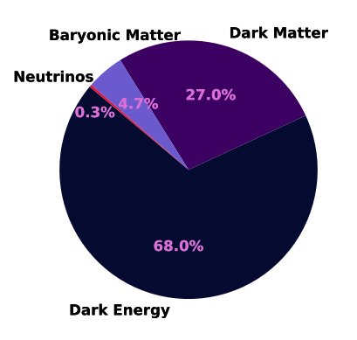
Our Universe
What is the nature of dark energy? Is this really a cosmological constant?
What is the Neutrino mass? What constraint can we put on this from cosmology?

Slide 3
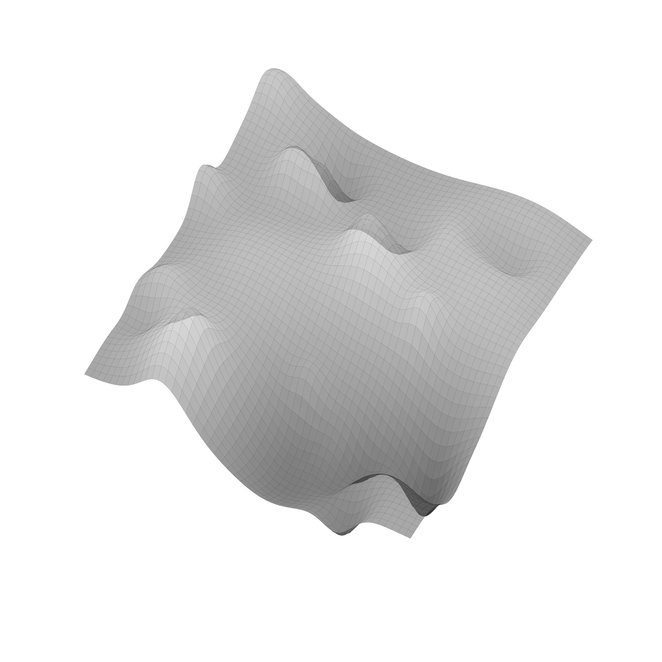



Our past lightcone: a multiprobe view
𝛅
𝚽
$$\dot{Φ}$$

Slide 4
Our past lightcone: a multiprobe view
𝛅
𝚽
$$\dot{Φ}$$
Clustering
biased tracer of DM field at source

Slide 5
Our past lightcone: a multiprobe view
𝛅
𝚽
$$\dot{Φ}$$
BAO
Standard ruler tracer of background evolution
Clustering
biased tracer of DM field at source

Slide 6
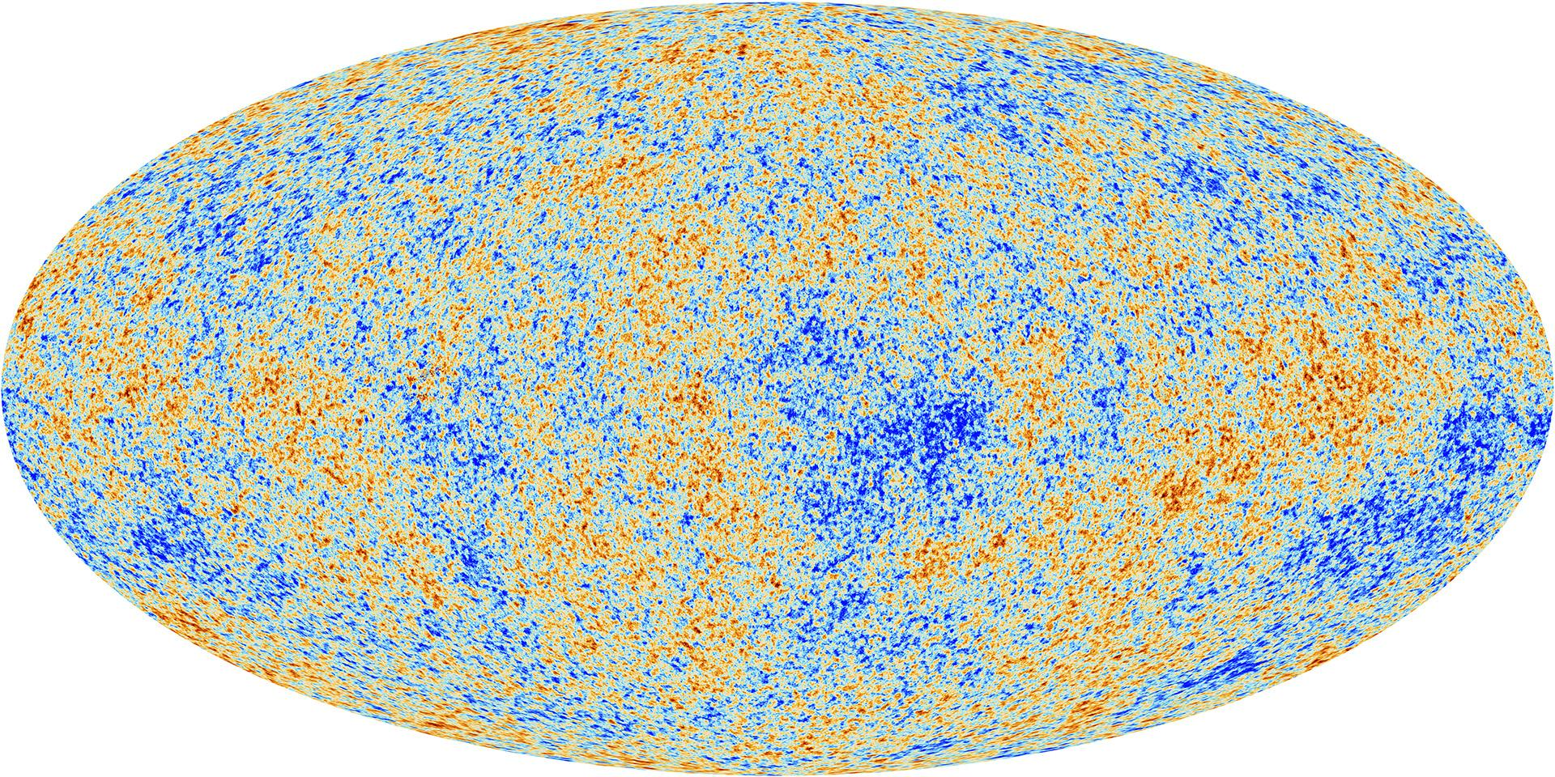
Our past lightcone: a multiprobe view
Image credits: Planck
𝛅
𝚽
CMB
(Gaussian) perturbations in early Universe
$$\dot{Φ}$$
BAO
Standard ruler tracer of background evolution
Clustering
biased tracer of DM field at source

Slide 7
Our past lightcone: a multiprobe view
Image credits: Planck
Weak lensing unbiased probe of DM field between source galaxy and observer
𝛅
𝚽
CMB
(Gaussian) perturbations in early Universe
$$\dot{Φ}$$
BAO
Standard ruler tracer of background evolution
Clustering
biased tracer of DM field at source

Slide 8
Our past lightcone: a multiprobe view
Image credits: Planck
Weak lensing unbiased probe of DM field between source galaxy and observer
𝛅
𝚽
CMB
(Gaussian) perturbations in early Universe
$$\dot{Φ}$$
BAO
Standard ruler tracer of background evolution
(L)ISW probe of time evolution of potential
Clustering
biased tracer of DM field at source

Slide 9
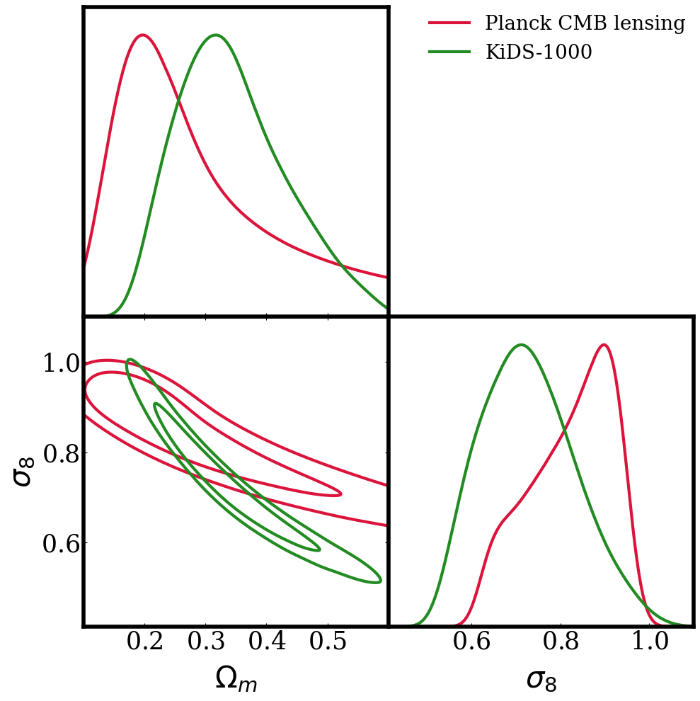
Combined probes: motivations
Combining data from independent experiments allows to identify and mitigate systematics
Test consistency between probes analysed in a consistent framework
Many different scales and redshifts: end-to-end test of cosmological models with strong constraints due to degeneracy breaking

Slide 10
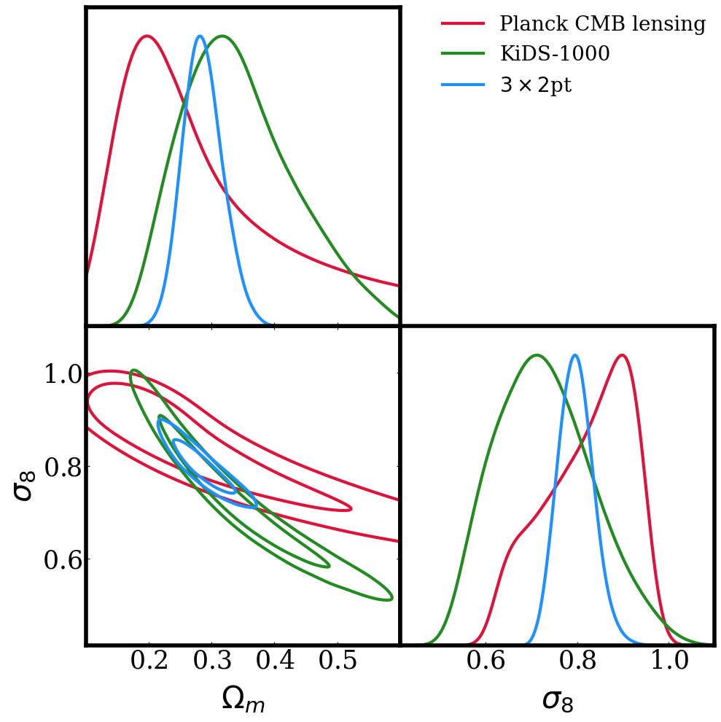
Combined probes: motivations
Combining data from independent experiments allows to identify and mitigate systematics
Test consistency between probes analysed in a consistent framework
Many different scales and redshifts: end-to-end test of cosmological models with strong constraints due to degeneracy breaking

Slide 11
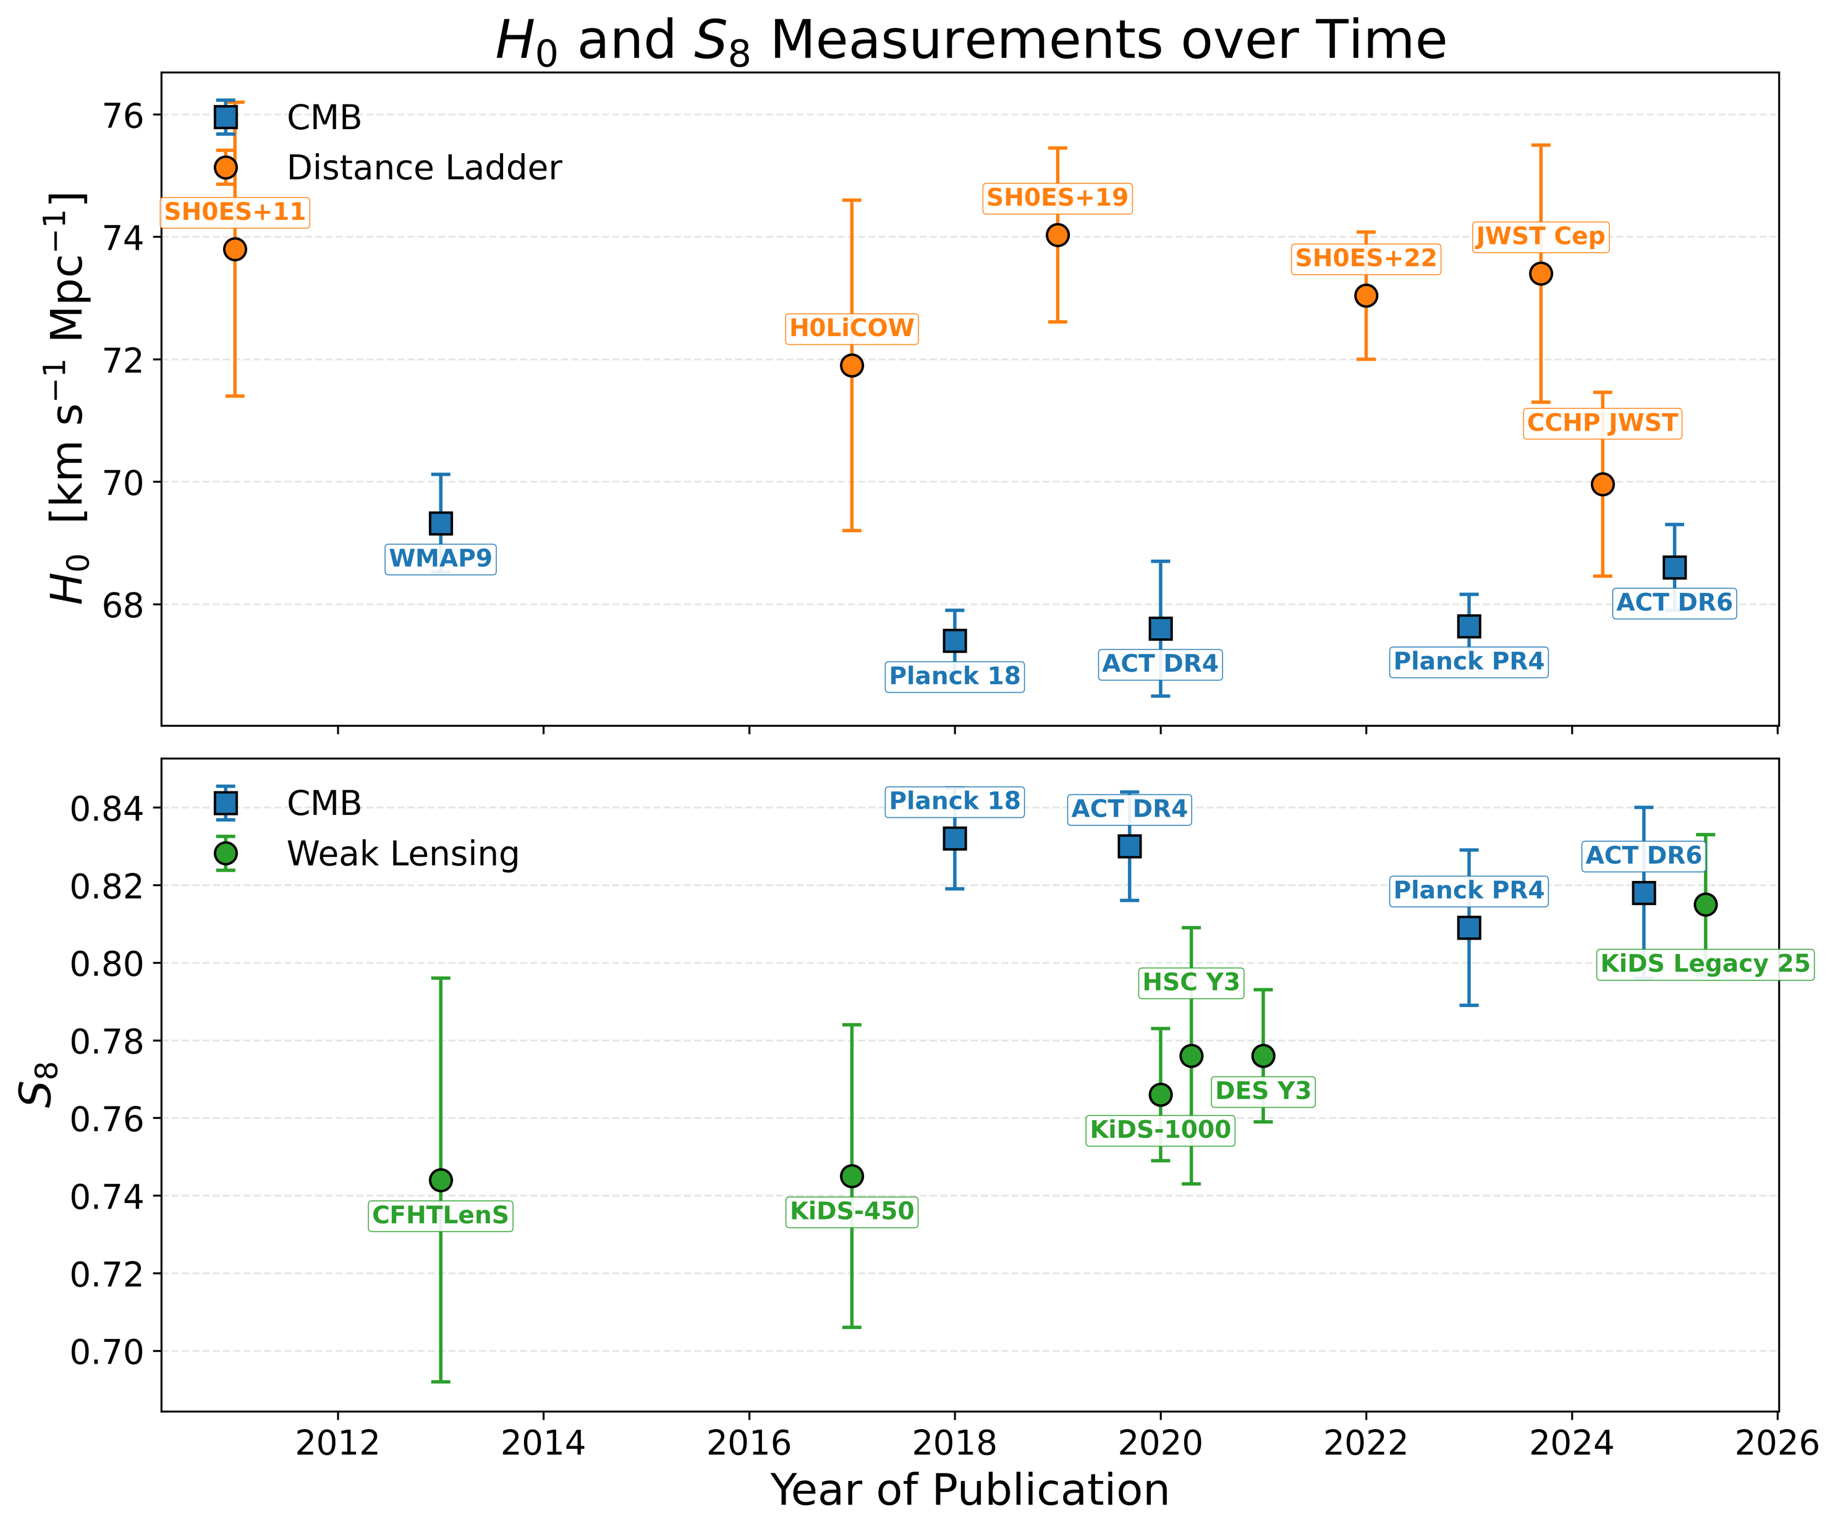
Combined probes: key challenges
Large data vectors/covariance matrix – numerically unstable
Slow theory predictions
Different systematics and noise modelling for each probe with many associated parameters – large parameter space
Tensions between datasets

Slide 12
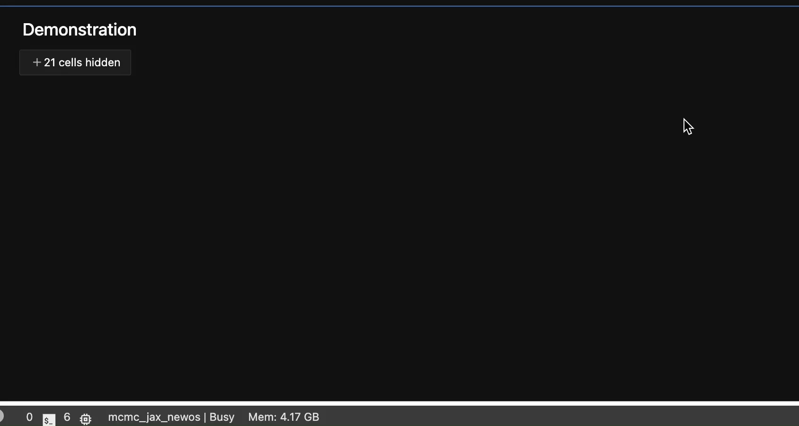
Combined probes: our approach
Build a consistent pipeline integrating several probes at the 2pt level
Restrict to scales (and summary statistics!) where simple modelling can be applied
Carefully quantify tensions between data before combining
Use emulators for theory predictions and implement all likelihoods in JAX for JIT + GPU acceleration when sampling

Slide 13
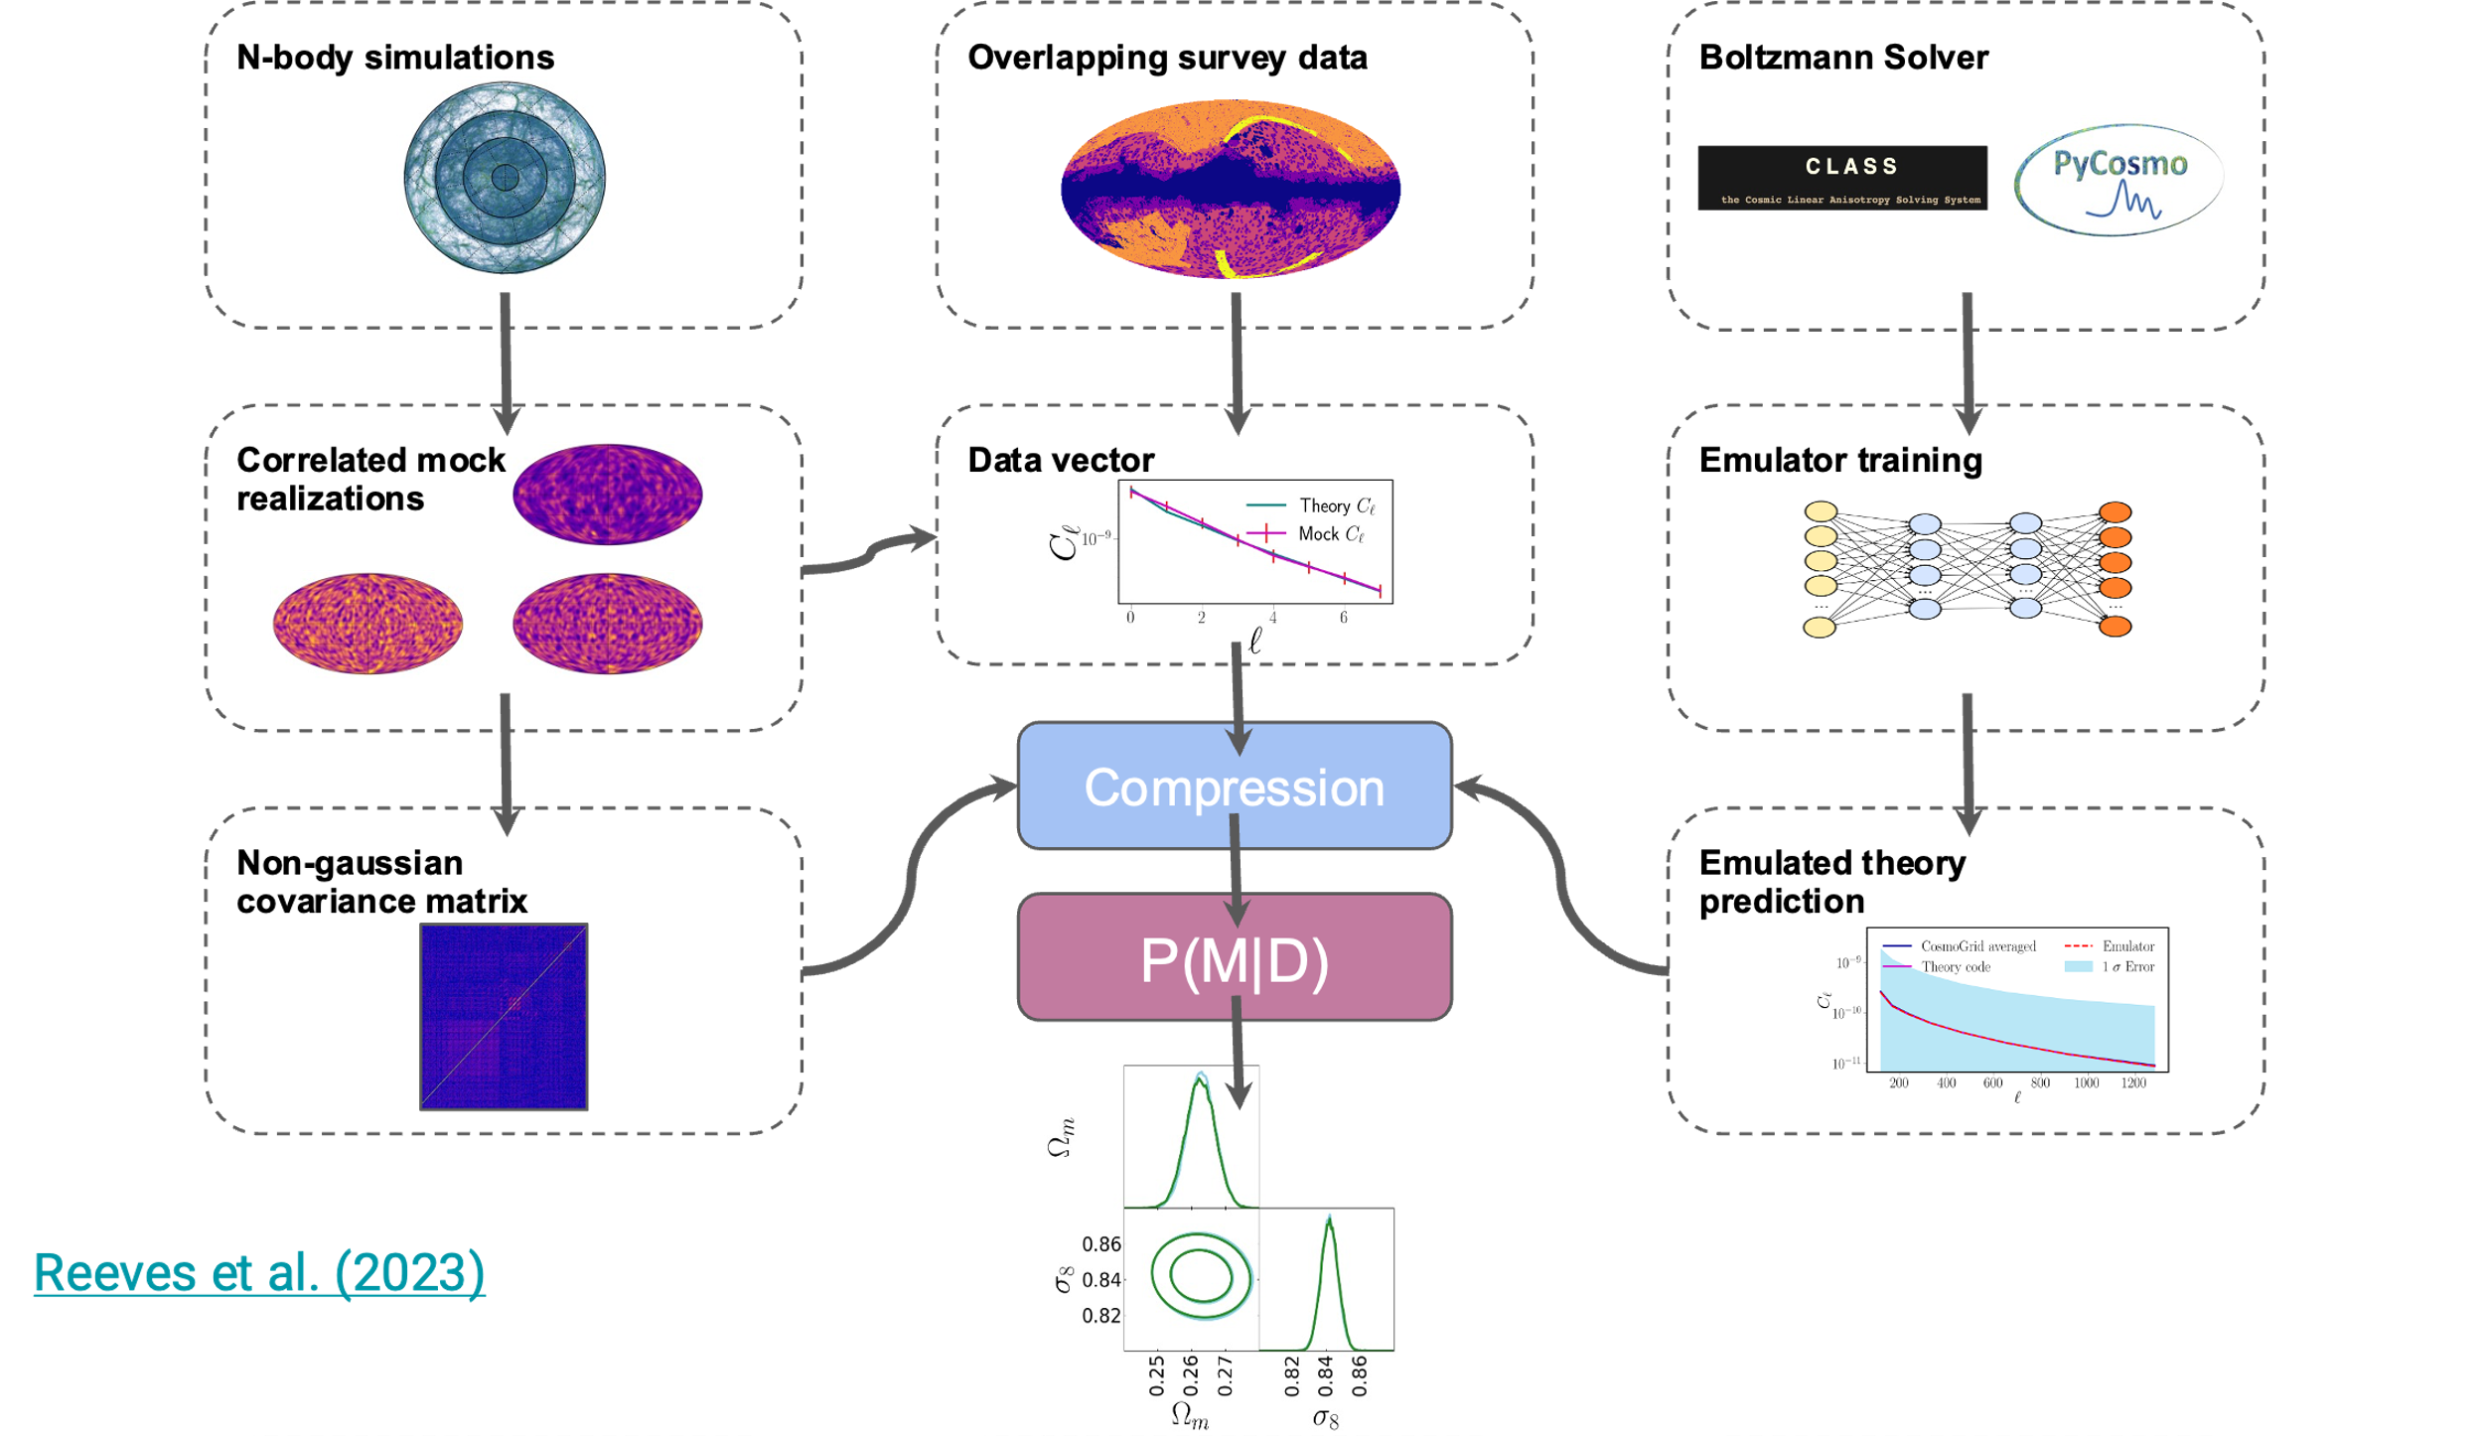

The combined probes pipeline

Slide 14

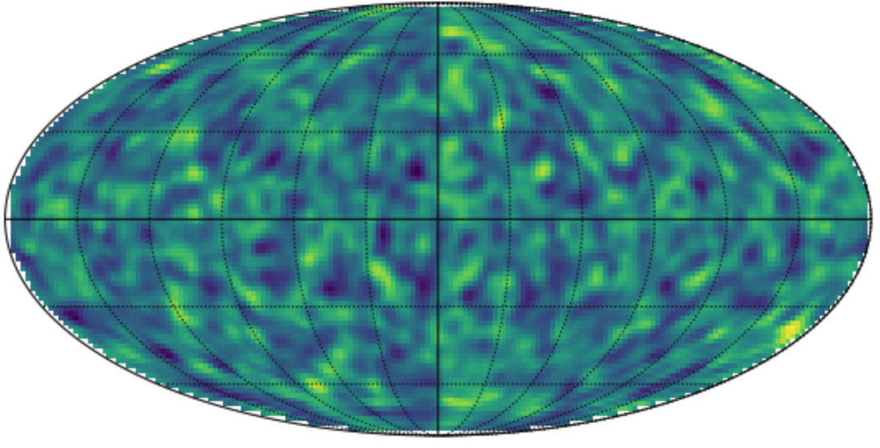
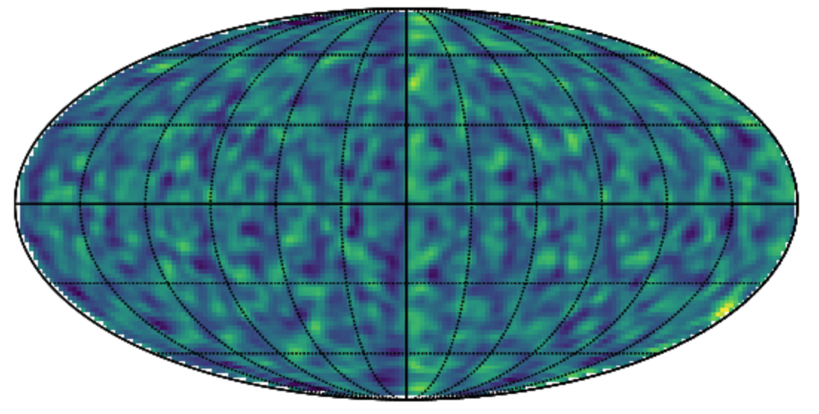
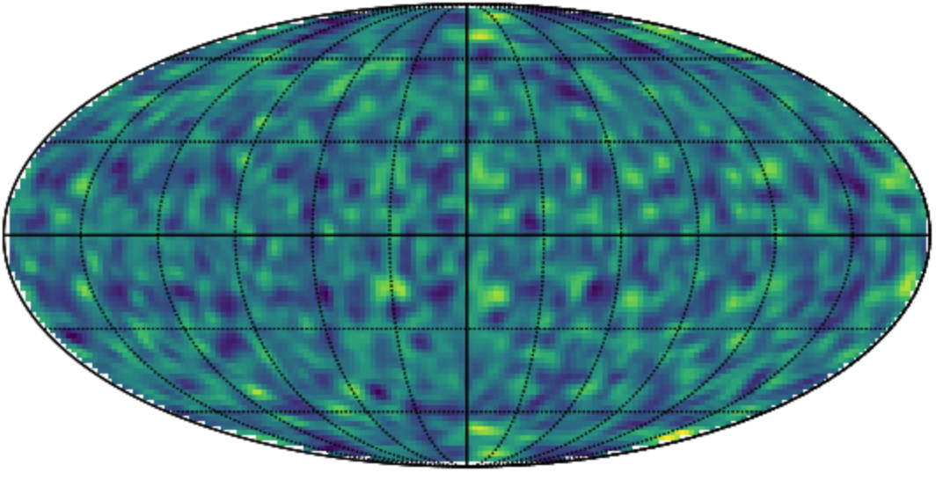
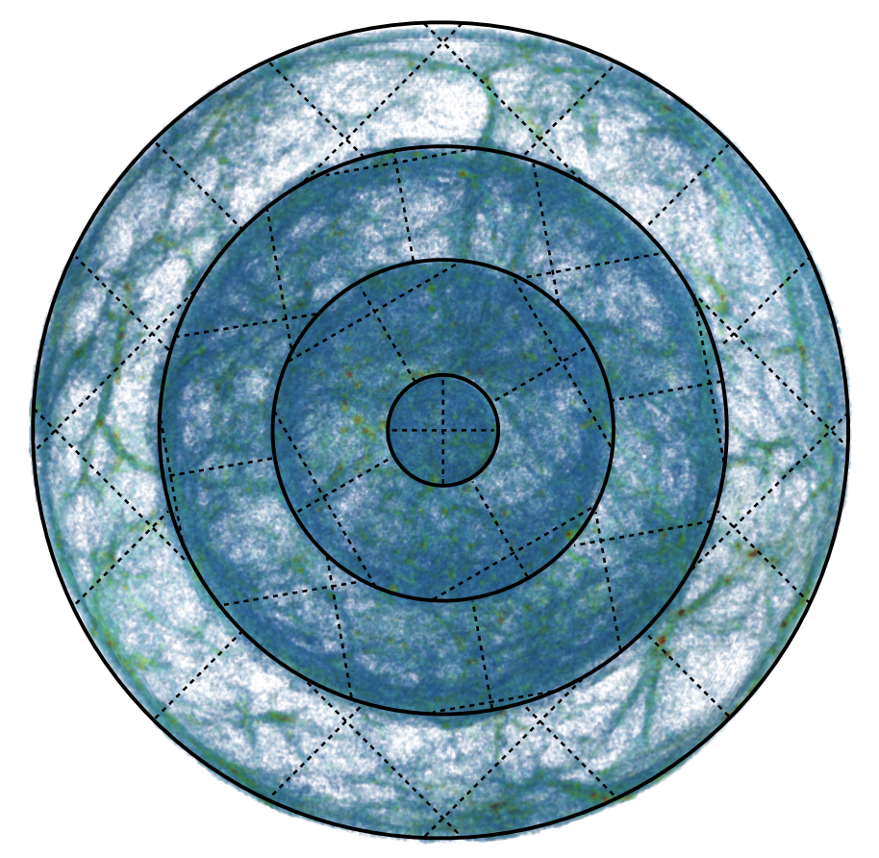
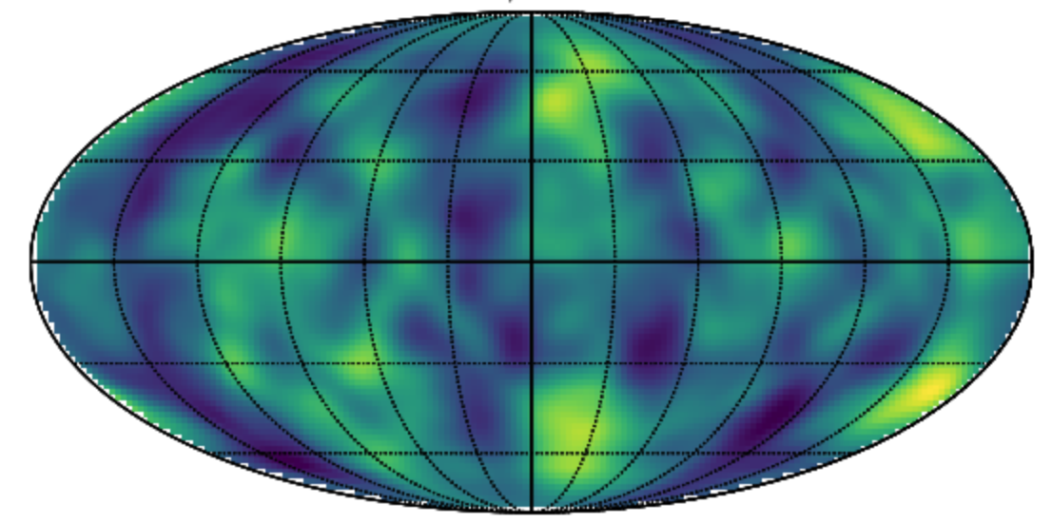
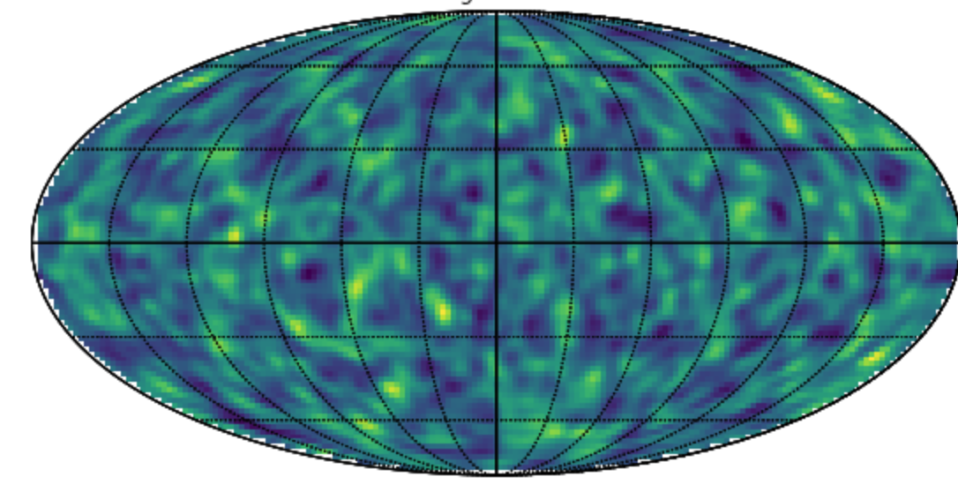
UFalcon2
ϰ_{weak lensing}
δg (CMASS)
ϰ_{CMB}
δT/T_{ISW}
δg (LOWZ)
Cosmogrid (PkDGraV N-body simulations)

Slide 15
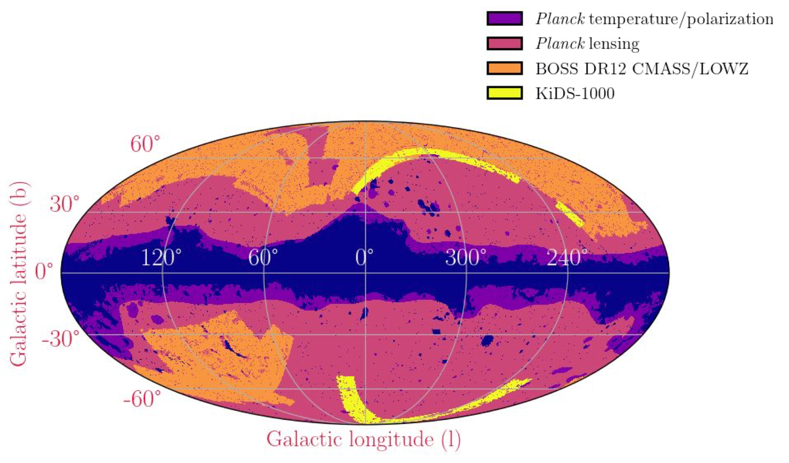
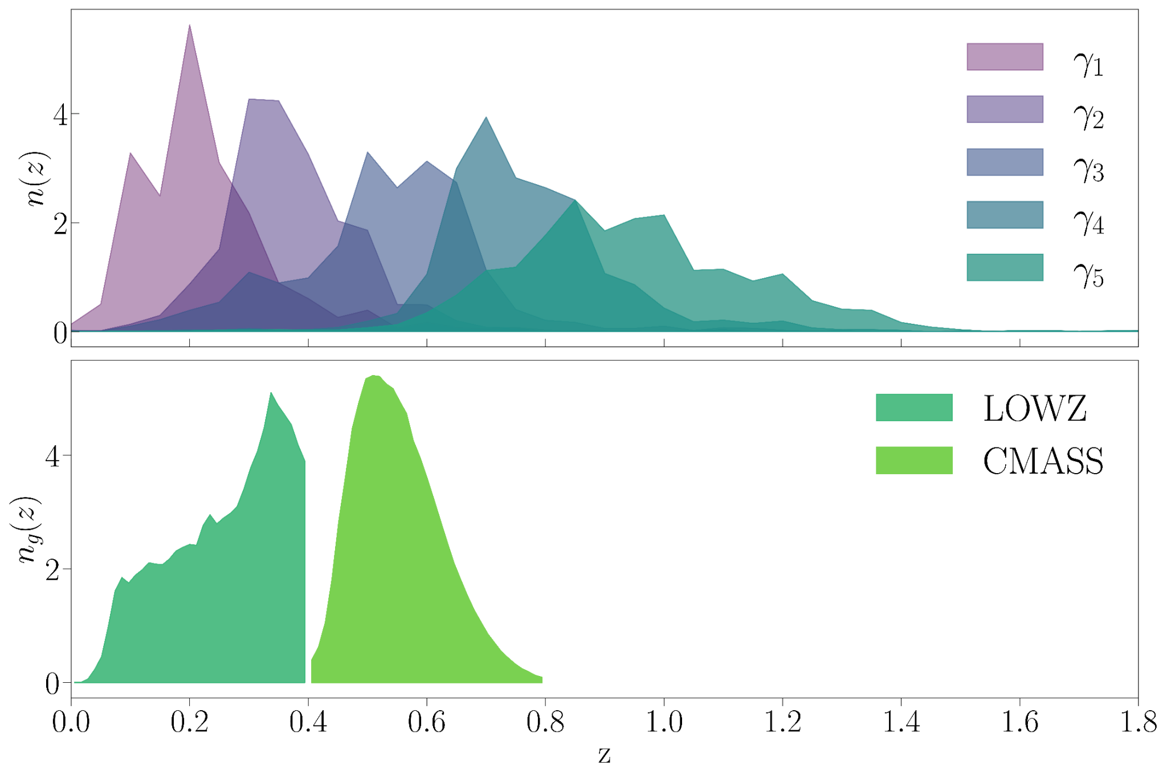
Apply framework to data
Combined probes LSS data: CMB lensing + ISW (PR3) X KiDS-1000 X BOSS DR12 (9x2pt)
Tomographic - measure 43 separate 2-point functions for “low-z” data vector
Two external likelihoods:
  CMB: Planck PR3, Planck PR4 (Hillipop), ACT DR4+WMAP
  BAO: DESI Y1

Slide 18
Internal consistency
Amplitude parameter let free for each probe
Three deviations from expectations:
  Planck PR3: A-lens systematic detection
  KiDS z-bin 2: redshift systematic detection
  KiDS z-bins 4/5: S8 tension

Slide 19
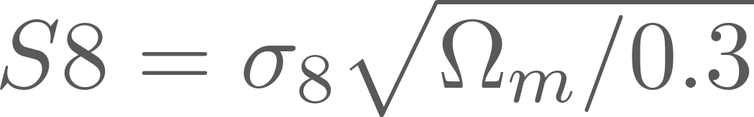
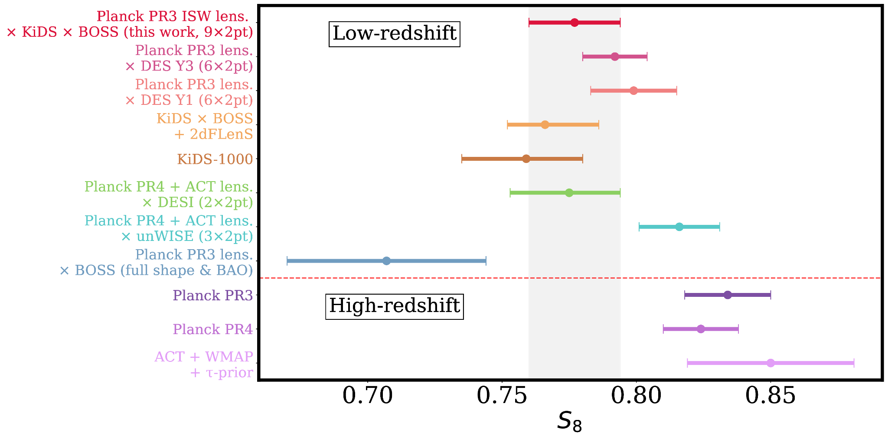
S8 measurement (ΛCDM)
9x2pt measurement from this data combination. Consistent with S8 found in other contemporary analyses
Tension with CMB likelihoods - “S8-tension” which is 2.2σ in for our baseline (Planck PR4)
In full parameter space reduced to 1.7σ and further still in extended models, and adding BAO (see later)
S8 measurements from (in order vertically):
DES collaboration, 2022, Xu et. al 2023, Heymans et. al 2020, Asgari et.al, 2020, Sailer et. al 2024, Farren et. al 2024, Chen et. al 2024.
Reeves et al. (2025)

Slide 20
Dynamical dark energy- single probe constraints
Low-z here is the 9x2pt combination of LSS data shown previously (KiDS-1000 X BOSS-DR12 X CMB lensing / ISW)
Before combining you see:
  Some tension in S8 as previously discussed
  Some constraining power on w0 from low-z alone
Reeves et al. (2025)

Slide 21
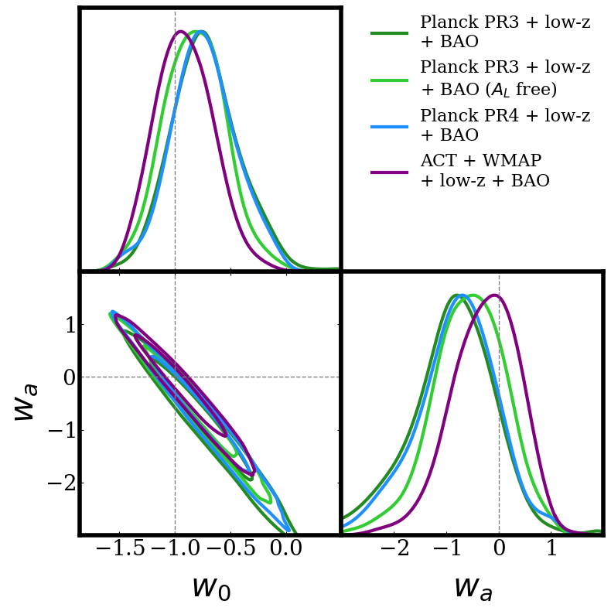
Dynamical dark energy: multiprobe constraints
Find a reduction in preference for DDE when combining LSS data set with CMB and DESI Y1 BAO
Driven by internal tension in the full dataset which cannot be resolved in models far from a CC
Based on DESI Y1 BAO and KiDS-1000 (both updated now!)
Reeves et al. (2025)

Slide 22

Neutrino masses
Fiducial neutrino mass measurement from combination:
Explored the effect of “A-lens” parameter, finding the combined probes approach makes upper limits robust to this systematic
In a DDE scenario upper limit is significantly loosened, and for the full combination of data, we find a ~2 sigma constraint
Reeves et al. (2025)

Slide 23
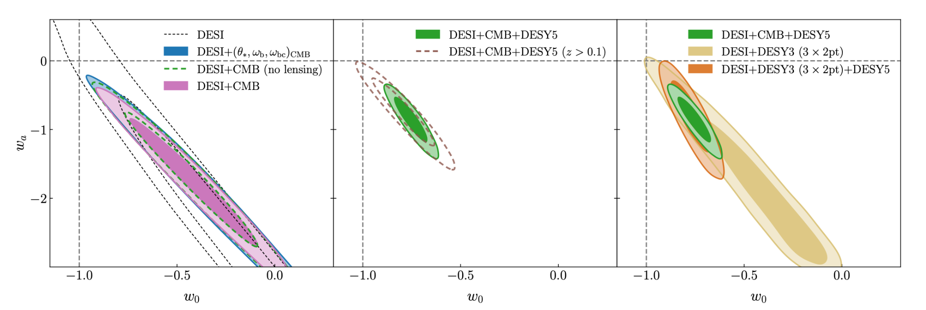
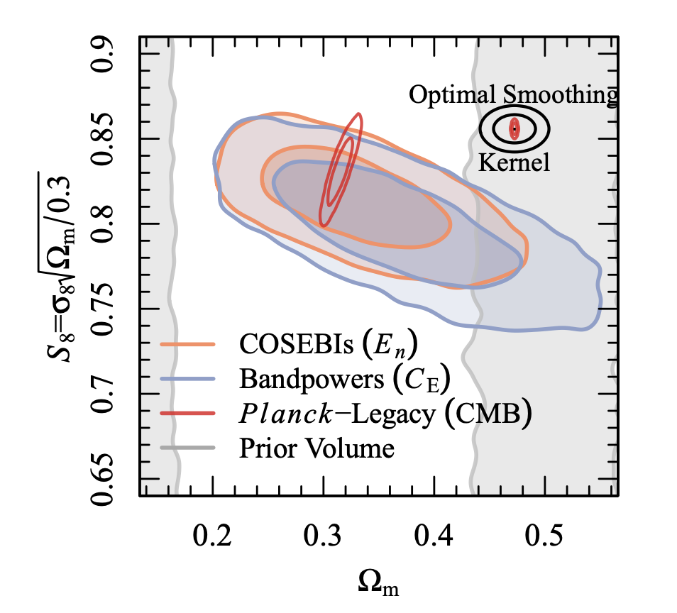
New data, new possibilities…
DESI collaboration, 2025
KiDS collaboration, 2025

Slide 24
Preliminary results: adding DESI imaging LRGs
Add DESI imaging LRGs to the LSS dataset and measure 3x2pt correlation with ACT DR6 CMB lensing
S8 measurement consistent with CMB
Upgrade BAO likelihood to DESI DR2
KiDS-legacy data included as S8 prior (also consistent with CMB)
Ongoing analysis – expected on ArXiv early September ’25!

Slide 25

Preliminary results: adding DESI imaging LRGs
PRELIMINARY
Add DESI imaging LRGs to the LSS dataset and measure 3x2pt correlation with ACT DR6 CMB lensing
S8 measurement consistent with CMB
Upgrade BAO likelihood to DESI DR2
KiDS-legacy data included as S8 prior (also consistent with CMB)
Ongoing analysis – expected on ArXiv early September ’25!

Slide 26
Preliminary results: adding DESI imaging LRGs
PRELIMINARY
Add DESI imaging LRGs to the LSS dataset and measure 3x2pt correlation with ACT DR6 CMB lensing
S8 measurement consistent with CMB
Upgrade BAO likelihood to DESI DR2
KiDS-legacy data included as S8 prior (also consistent with CMB)
Ongoing analysis – expected on ArXiv early September ’25!

Slide 27
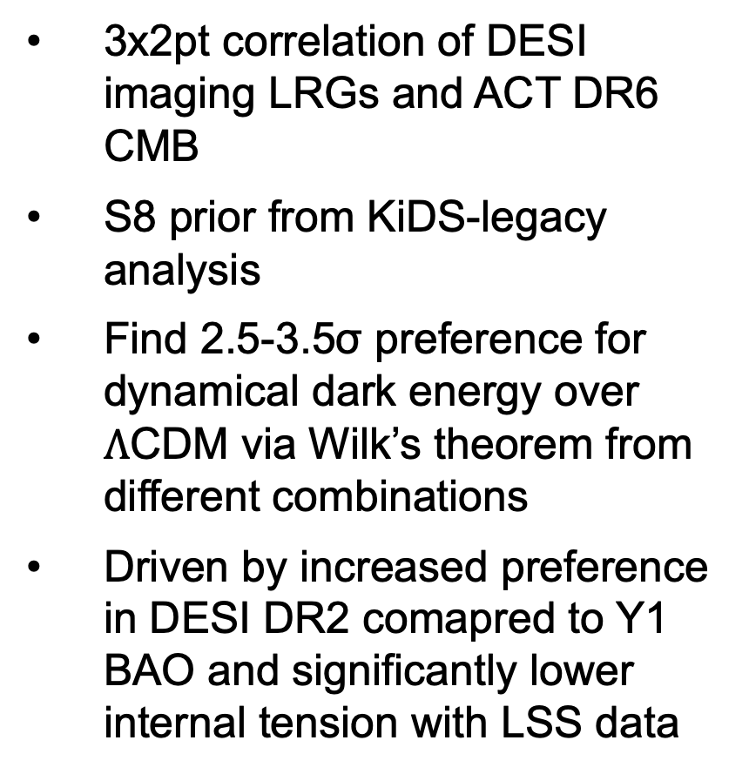
Preliminary results on preference for dynamical dark energy
PRELIMINARY
3x2pt correlation of DESI imaging LRGs and ACT DR6 CMB
S8 prior from KiDS-legacy analysis
Find 2.5-3.5σ preference for dynamical dark energy over $Λ$CDM via Wilk’s theorem from different combinations
Driven by increased preference in DESI DR2 comapred to Y1 BAO and significantly lower internal tension with LSS data

Slide 28
Outlook and conclusions
Multiprobe analyses are powerful for:
  Identifying and mitigating systematics that do not correlate between datasets
  Exploring and understanding tensions between datasets
  Providing strong constraints on cosmological parameters via degeneracy breaking
Including KiDS-1000 to CMB and BAO reduces preference for DDE
DDE models can loosen neutrino mass bounds, relieving apparent tension with neutrino oscillation data in LCDM
Several recent data releases- DESI DR2 BAO, KiDS legacy, currently working analysis with updated BAO, LSS and SNe data
Exciting time for cosmology with many experiments about to come online – this is an era in which combined probes and cross-correlations will be increasingly important!
Based on 2309.03258, 2502.01772

