Slide 1
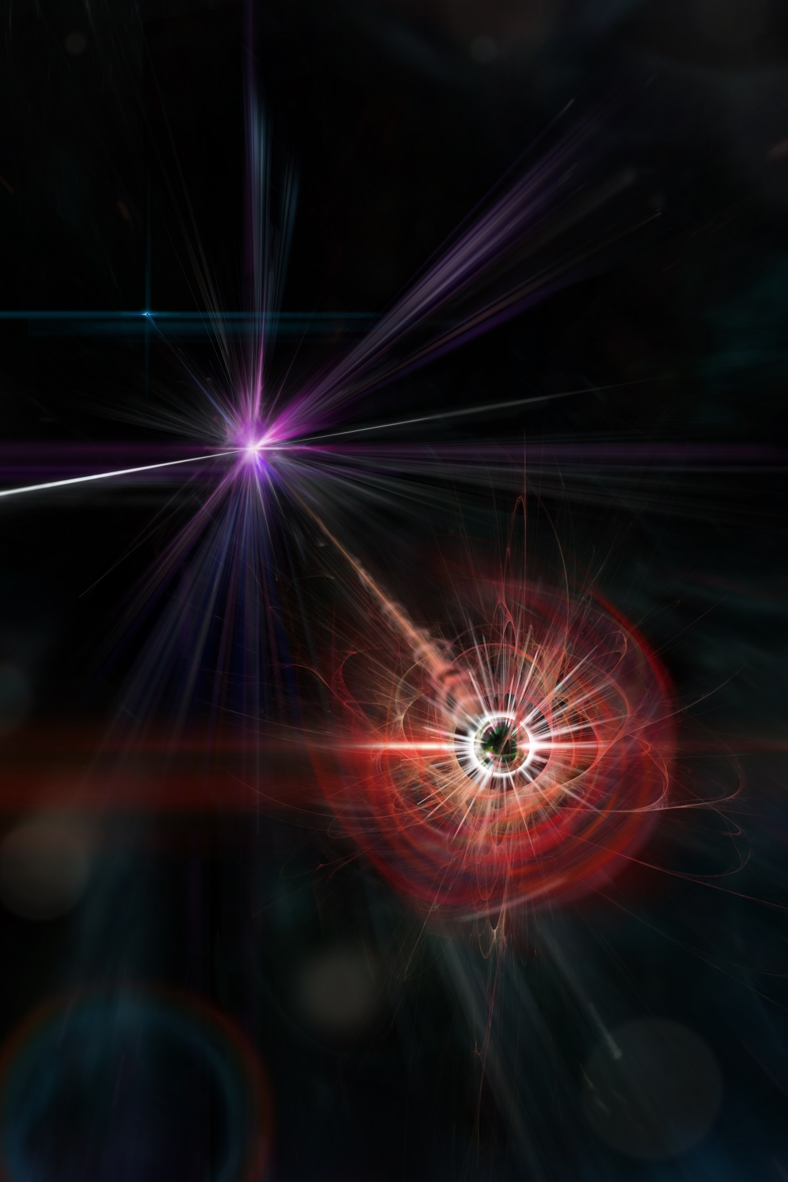


Magnetic Monopoles
Theory Overview
Arttu Rajantie
PASCOS 2024, 12 July 2024

Slide 2
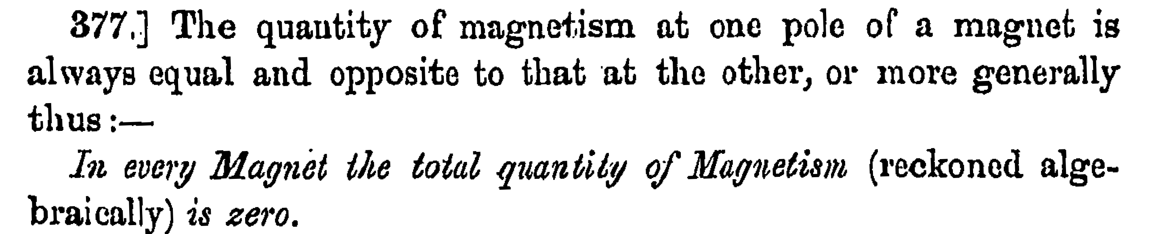

Maxwell Equations
No magnetic
charges
$$\vec{∇}⋅\vec{E}=ρ_{E} \\ \vec{∇}⋅\vec{B}=0 \\ \vec{∇}×\vec{E}=−\frac{∂\vec{B}}{∂t} \\ \vec{∇}×\vec{B}=−\frac{∂\vec{E}}{∂t}+{\vec{j}}_{E}$$
(Maxwell, Treatise on Electricity and Magnetism, 1873)

Slide 3
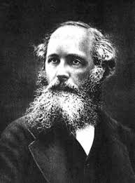
Maxwell Equations
Maxwell 1873:
Empirical reason for not
including magnetic charges
Floating magnet feels no net force
Magnetising an object does not
change its weight
When a long magnet is cut
into pieces, each piece has
two poles
James Clerk Maxwell

Slide 4



Magnetic Charges
$$\vec{∇}⋅\vec{E}=ρ_{E} \\ \vec{∇}⋅\vec{B}=ρ_{M} \\ \vec{∇}×\vec{E}=−\frac{∂\vec{B}}{∂t}−{\vec{j}}_{M} \\ \vec{∇}×\vec{B}=\frac{∂\vec{E}}{∂t}+{\vec{j}}_{E}$$
Duality $\vec{E}+i\vec{B}→e^{iθ}\left(\vec{E}+i\vec{B}\right)$
Magnetic monopole = Particle with non-zero magnetic charge $g$
Dyon = Particle with electric charge $e$ and magnetic charge $g$
N

Slide 5


Dirac Monopole (1931)
Quantum mechanics: Dirac monopole configuration (Dirac 1931)
Dirac string unobservable if all electric charges $e$ and magnetic charges $g$
satisfy the Dirac quantisation condition $eg∈2πℤ$
The magnetic charge $g$ must be an integer multiple of
the Dirac charge $g_{D}=\frac{2π}{e_{0}}≈20.7$, where $e_{0}$ is the elementary electric charge
N

Slide 6
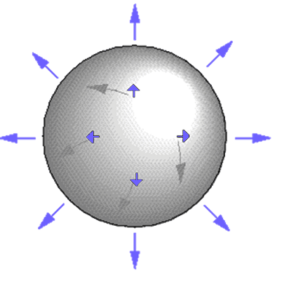
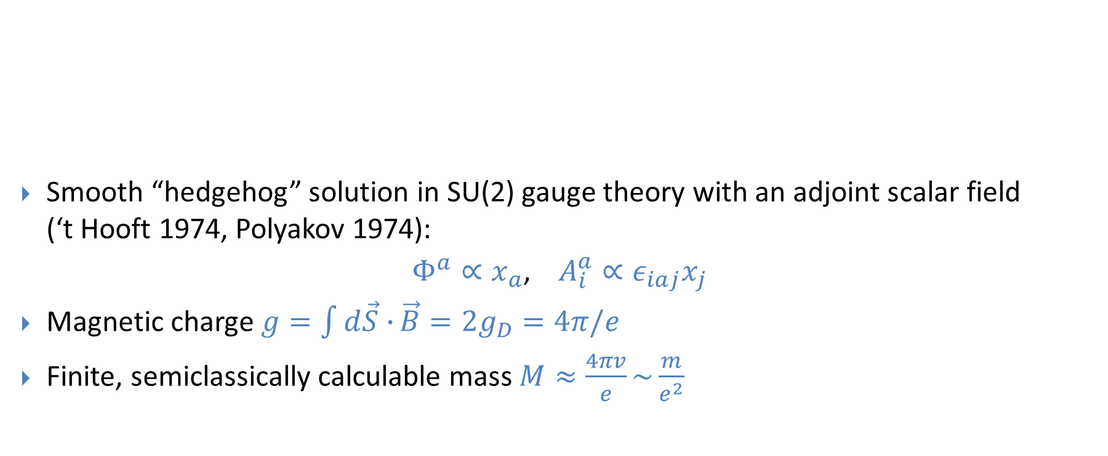
‘t Hooft-Polyakov Monopole
Smooth “hedgehog” solution in SU(2) gauge theory with an adjoint scalar field
(‘t Hooft 1974, Polyakov 1974):
$Φ^{a}∝x_{a}$, $A_{i}^{a}∝ε_{iaj}x_{j}$
Magnetic charge $g=\int{d\vec{S}∙}\vec{B}=2g_{D}=4π/e$
Finite, semiclassically calculable mass $M≈\frac{4πv}{e}\sim \frac{m}{e^{2}}$

Slide 7
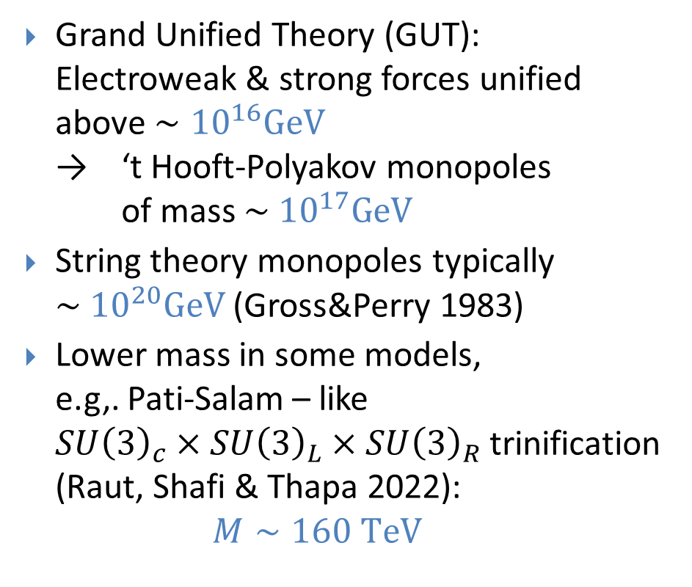
GUT Monopoles
Grand Unified Theory (GUT):
Electroweak & strong forces unified
above $∼{10}^{16}GeV$
→ ‘t Hooft-Polyakov monopoles
of mass $\sim {10}^{17}GeV$
String theory monopoles typically $\sim {10}^{20}GeV$ (Gross&Perry 1983)
Lower mass in some models,
e.g,. Pati-Salam – like
$SU{\left(3\right)}_{c}×SU{\left(3\right)}_{L}×SU{\left(3\right)}_{R}$ trinification (Raut, Shafi & Thapa 2022):
$M∼160 TeV$
energy
Theory of Everything
10¹⁹ GeV
Grand Unified Theory
10¹⁶ GeV
Electro- weak Theory
gravity
strong
weak
electromagnetic
10² GeV

Slide 8
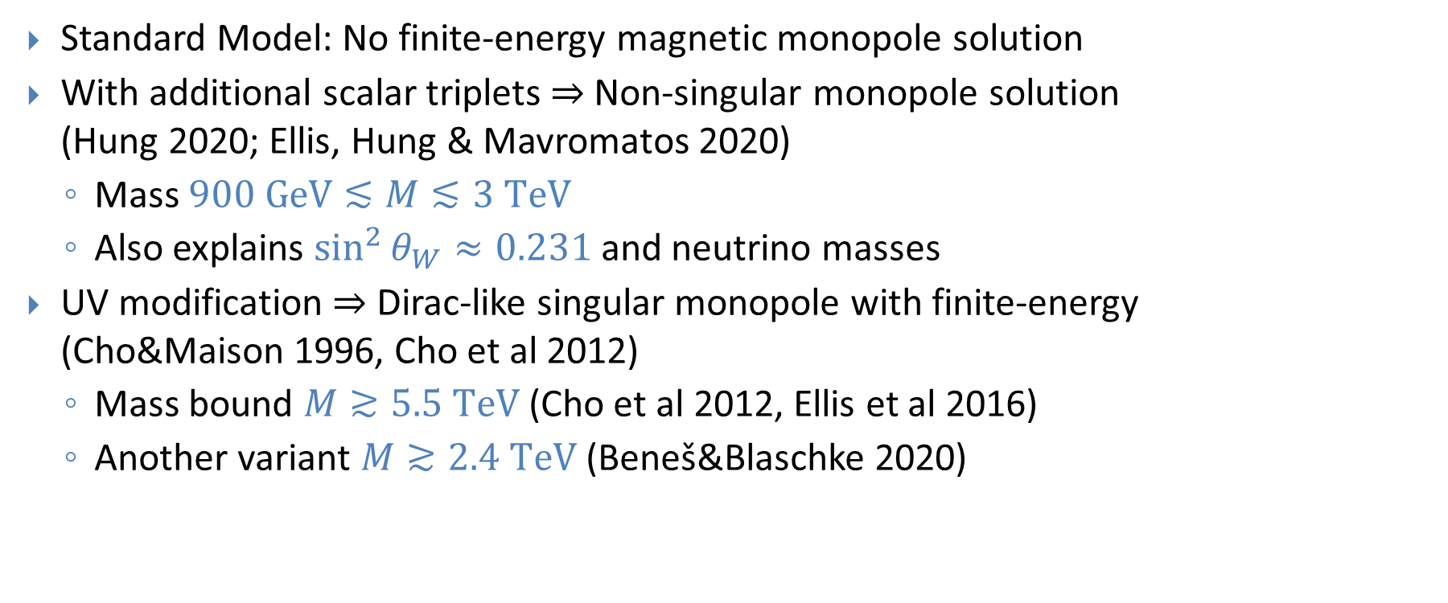
Electroweak Monopoles
Standard Model: No finite-energy magnetic monopole solution
With additional scalar triplets $⇒$ Non-singular monopole solution
(Hung 2020; Ellis, Hung & Mavromatos 2020)
  Mass $900 GeV≲M≲3 TeV$
  Also explains $\sin^{2}{θ_{W}}≈0.231$ and neutrino masses
UV modification $⇒$ Dirac-like singular monopole with finite-energy
(Cho&Maison 1996, Cho et al 2012)
  Mass bound $M≳5.5 TeV$ (Cho et al 2012, Ellis et al 2016)
  Another variant $M≳2.4 TeV$ (Beneš&Blaschke 2020)

Slide 9


Elementary Monopoles
Elementary particle with a magnetic charge, arbitrary mass
Quantum field theory formulations: Schwinger 1966, Zwanziger 1971
  Also lattice formulation (Farakos et al 2024)
Dirac quantisation condition $g=2π/e≈20.7≫1$ $⇒$ Non-perturbative
Quantum effects $⇒$ Effective size $R∼g^{2}/4πM$? (Goebel 1970)
N

Slide 10
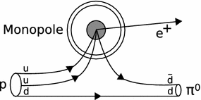
Probes of New Physics
Strong, precisely known EM interactions
Electrodynamics ⇒ Stable particles
Interaction with charged fermions depends on core structure (Rubakov, Callan 1981)
  Cross section not suppressed by monopole mass
  Some GUT monopoles catalyse proton decay
  See also Kitano&Matsudo 2022;
  van Beest et al 2023; Khoze 2023, 2024
Properties related to beyond the SM physics:
  Unification of forces
  Fundamental aspects of QFT & EM
(Aartsen et al, 2019)

Slide 11
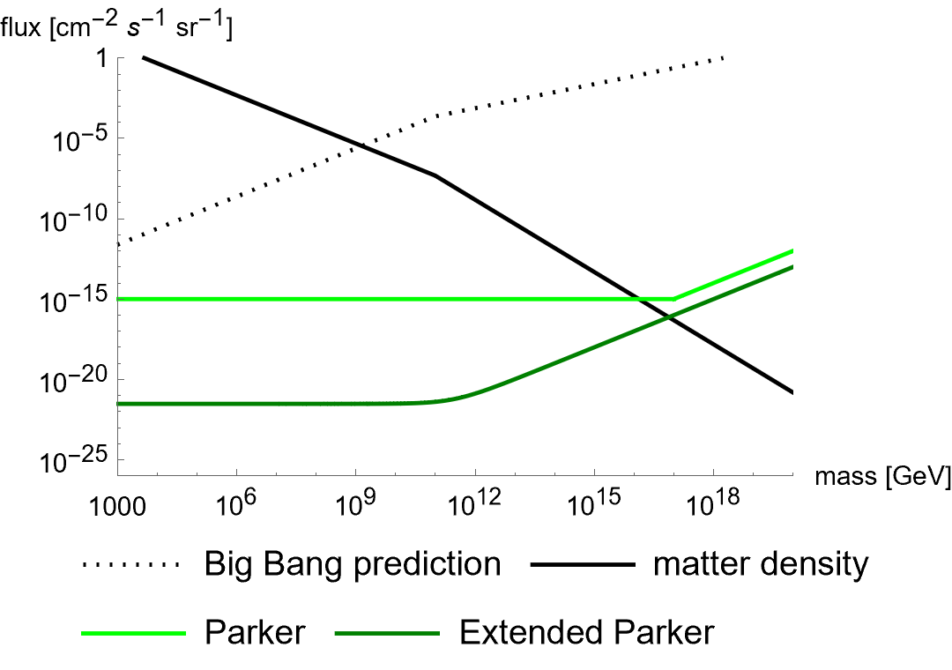
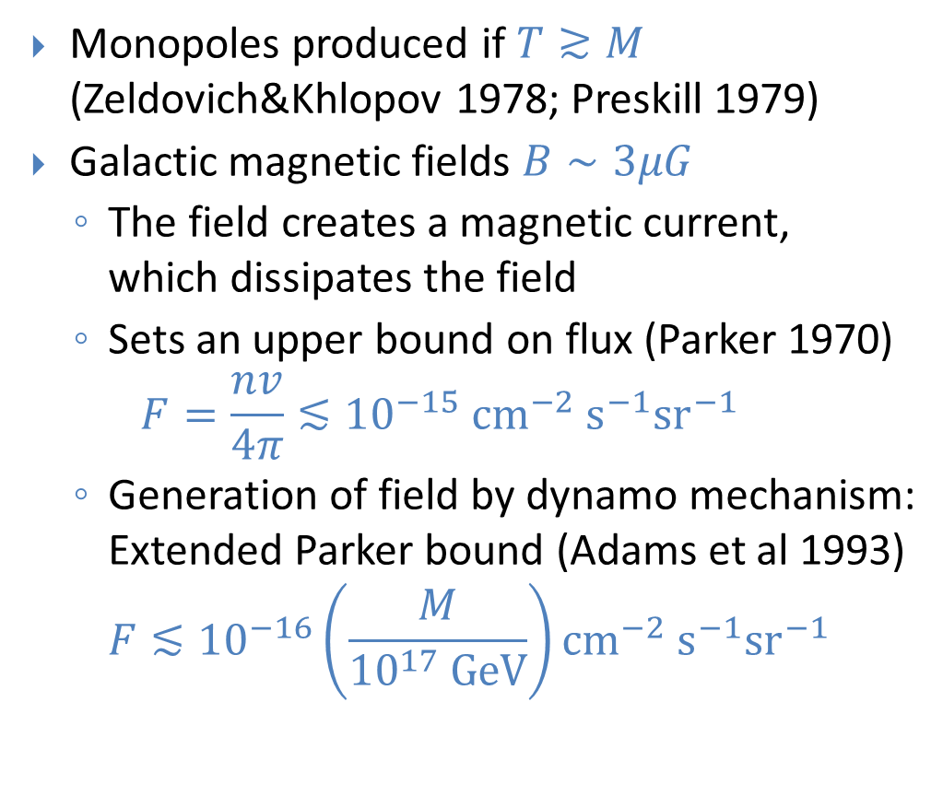
Cosmic Monopoles
Monopoles produced if $T≳M$
(Zeldovich&Khlopov 1978; Preskill 1979)
Galactic magnetic fields $B∼3μG$
  The field creates a magnetic current,
  which dissipates the field
  Sets an upper bound on flux (Parker 1970)
  $F=\frac{nv}{4π}≲{10}^{−15} {\text{cm}}^{−2} {\text{s}}^{−1}{\text{sr}}^{−1}$
  Generation of field by dynamo mechanism:
  Extended Parker bound (Adams et al 1993)
  $F≲{10}^{−16}\left(\frac{M}{{10}^{17} GeV}\right){\text{cm}}^{−2} {\text{s}}^{−1}{\text{sr}}^{−1}$

Slide 12
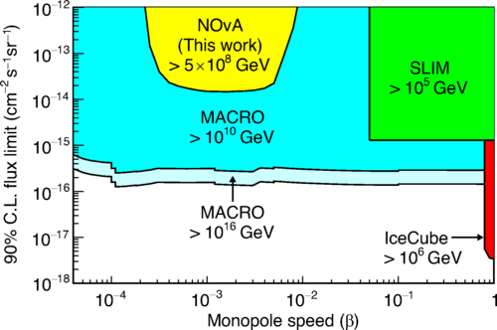
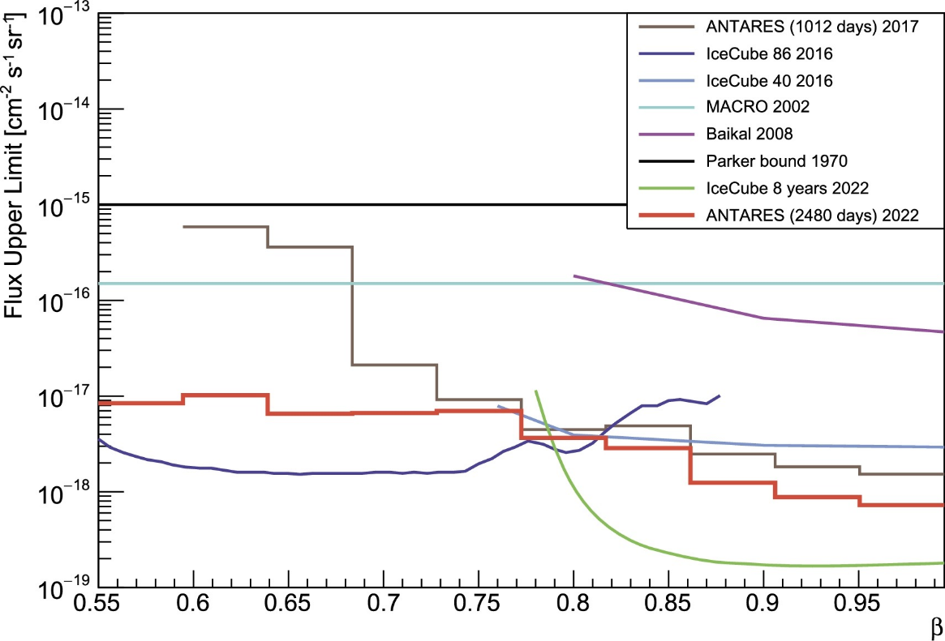
Cosmic Rays
Monopoles not present in the Universe in numbers predicted by hot Big Bang
(NOvA Collaboration, 2021)
(ANTARES Collaboration, 2022)

Slide 13
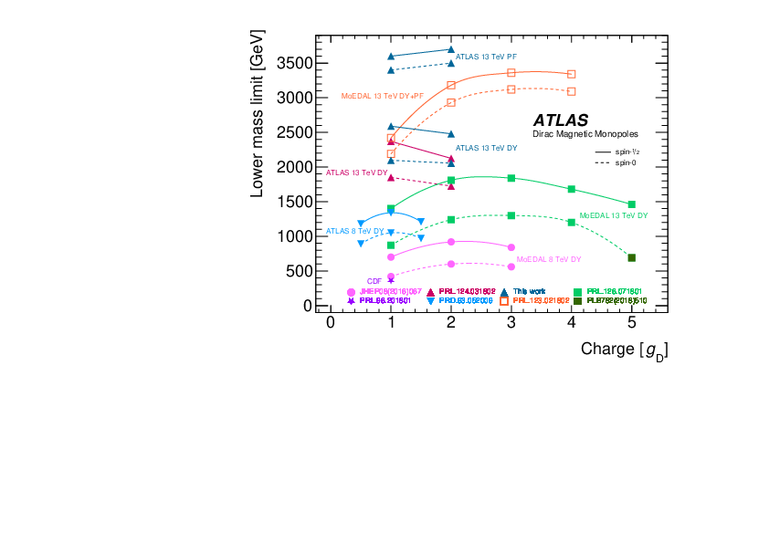
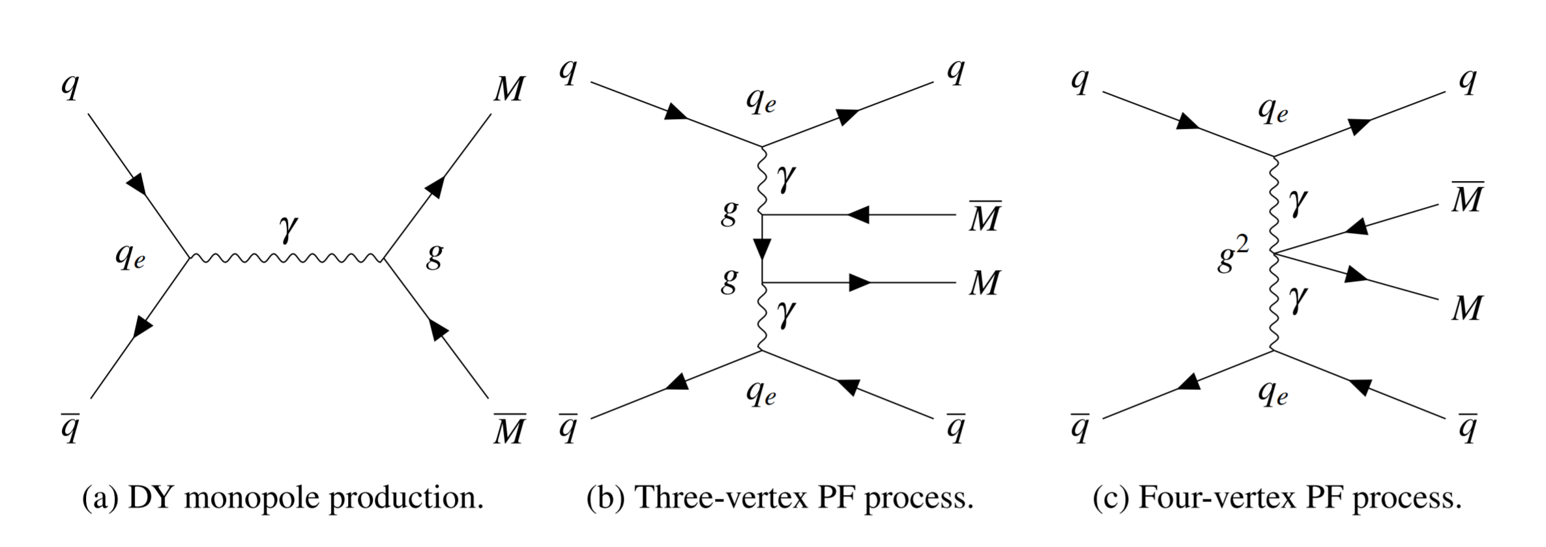


LHC $pp$ Results
Nominal mass bound $M≳3 TeV$
Based on tree-level
Drell-Yan/photon fusion processes
But perturbation theory is not valid
because $g_{D}=2π/e≈20.7≫1$
(ATLAS Collaboration, 2023)

Slide 14

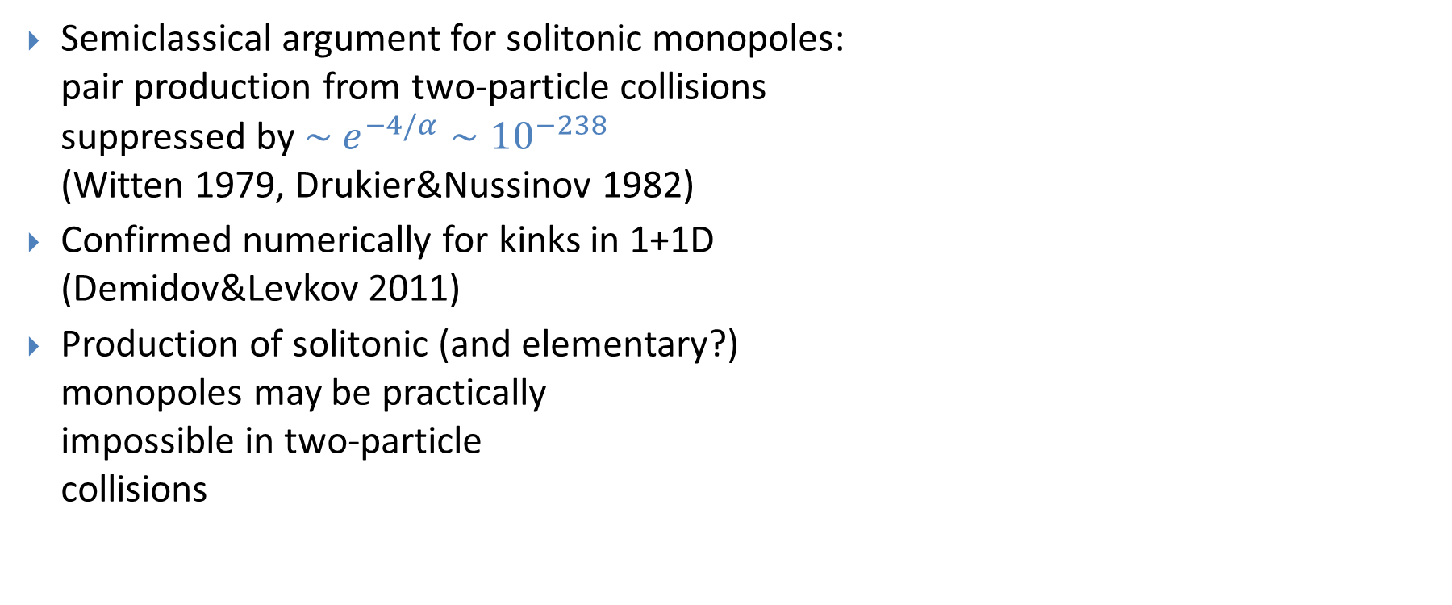
Exponential Suppression
Semiclassical argument for solitonic monopoles:
pair production from two-particle collisions
suppressed by $\sim e^{−4/α}∼{10}^{−238}$
(Witten 1979, Drukier&Nussinov 1982)
Confirmed numerically for kinks in 1+1D
(Demidov&Levkov 2011)
Production of solitonic (and elementary?)
monopoles may be practically
impossible in two-particle
collisions

Slide 15
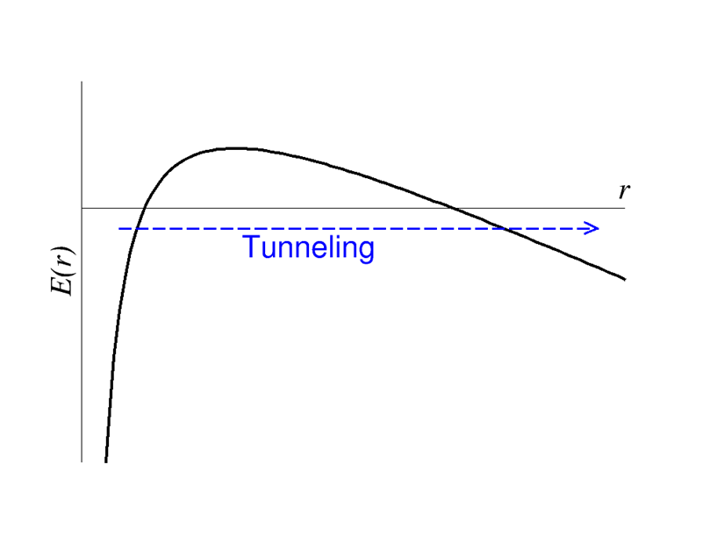


Schwinger Pair Production
Consider instead pair production from a strong magnetic field
Electromagnetic dual to usual Schwinger pair production:
(Sauter 1931, Heisenberg&Euler 1936, Schwinger 1951)
Tunneling through Coulomb potential barrier
No direct experimental
confirmation yet:
  $e^{+}e^{−}$ pairs need
  $\left|\vec{E}\right|≫\frac{m^{2}}{e}∼{10}^{18} V/m$
  1000 x stronger than the
  most powerful lasers
$$E\left(r\right)=2m−\frac{e^{2}}{4πr}−e\vec{E}⋅\vec{r}$$

Slide 16
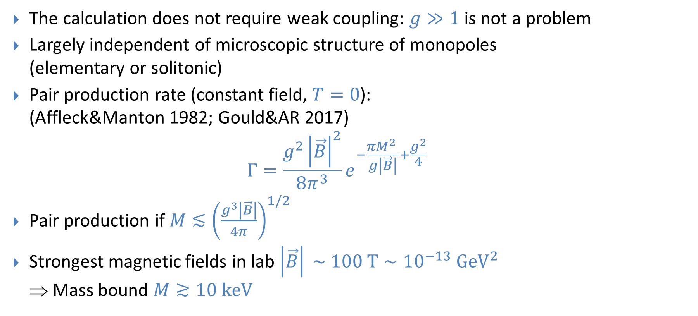
Monopoles from Schwinger Process
The calculation does not require weak coupling: $g≫1$ is not a problem
Largely independent of microscopic structure of monopoles
(elementary or solitonic)
Pair production rate (constant field, $T=0$):
(Affleck&Manton 1982; Gould&AR 2017)
$Γ=\frac{g^{2}{\left|\vec{B}\right|}^{2}}{8π^{3}}e^{−\frac{πM^{2} }{g\left|\vec{B}\right|}+\frac{g^{2}}{4}}$
Pair production if $M≲{\left(\frac{g^{3}\left|\vec{B}\right|}{4π}\right)}^{1/2}$
Strongest magnetic fields in lab $\left|\vec{B}\right| \sim 100 T∼{10}^{−13} GeV^{2}$
⇒ Mass bound $M≳10 keV$

Slide 17
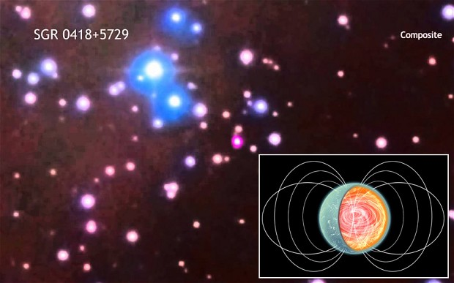

Magnetars
Neutron stars with very strong magnetic fields
Exterior: $B \sim {10}^{11} T≈{10}^{−4} GeV^{2}$
  Monopole pair production would
  make the field decay
  Bound
  $M≳0.3 GeV, g=g_{D}$
  $M≳0.7 GeV, g={2g}_{D}$
  (Gould&AR 2017)
Interior: $B \sim {10}^{13} T$ ?
  Monopoles production would
  lead to field fluctuations
  (Klyuev 2024)

Slide 18
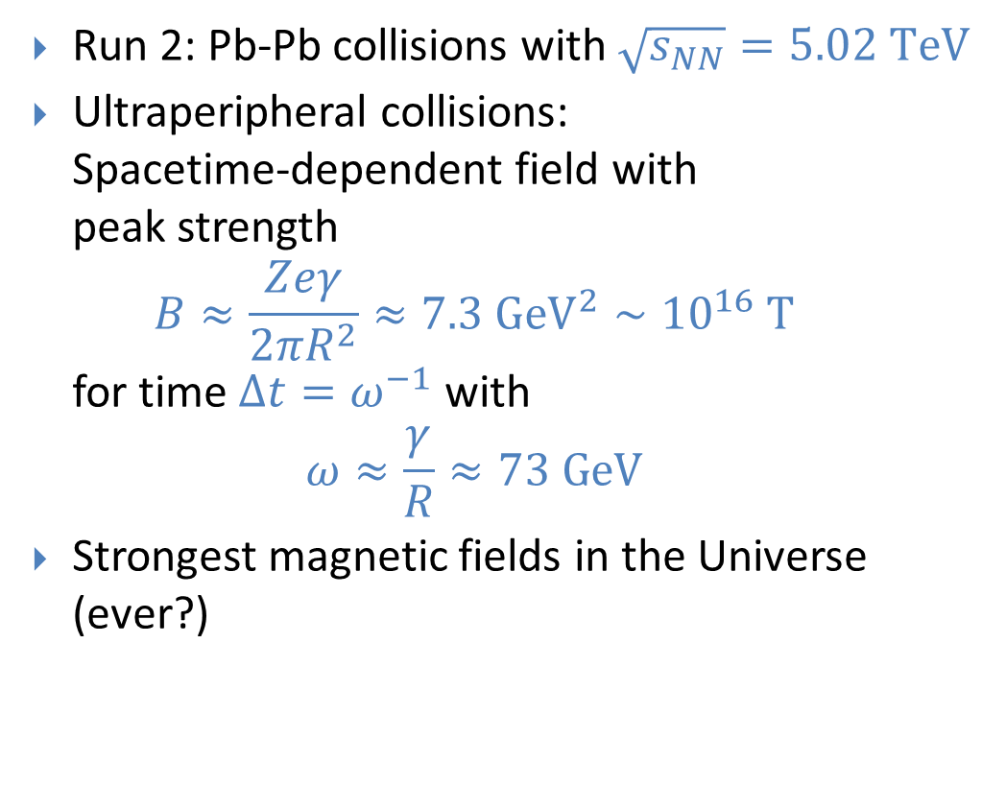
LHC Heavy Ion Collisions
Run 2: Pb-Pb collisions with $\sqrt{s_{NN}}=5.02 TeV$
Ultraperipheral collisions:
Spacetime-dependent field with
peak strength
$B≈\frac{Zeγ}{2πR^{2}}≈7.3 GeV^{2}∼{10}^{16} T$
for time $Δt=ω^{−1}$ with
$ω≈\frac{γ}{R}≈73 GeV$
Strongest magnetic fields in the Universe (ever?)

Slide 19
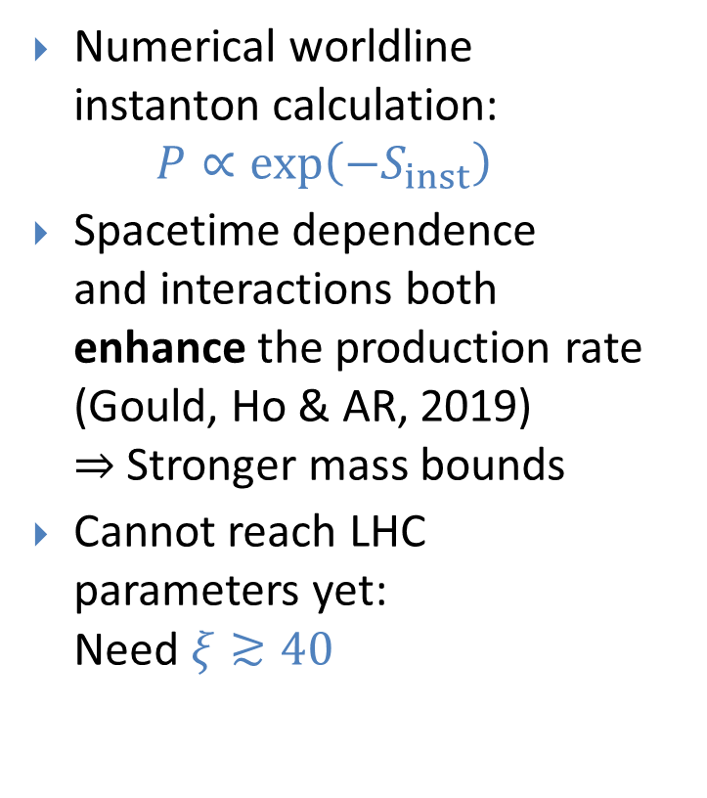



Spacetime Dependence
Numerical worldline
instanton calculation:
$P∝\exp\left(−S_{inst}\right)$
Spacetime dependence
and interactions both
enhance the production rate
(Gould, Ho & AR, 2019)
$⇒$ Stronger mass bounds
Cannot reach LHC
parameters yet:
Need $ξ≳40$
$$Γ∼exp(−S)$$
Self-interactions:
None
Leading order
All orders
$$ξ≈M/(2nGeV)$$
$$=\frac{Mω}{gB}$$

Slide 20
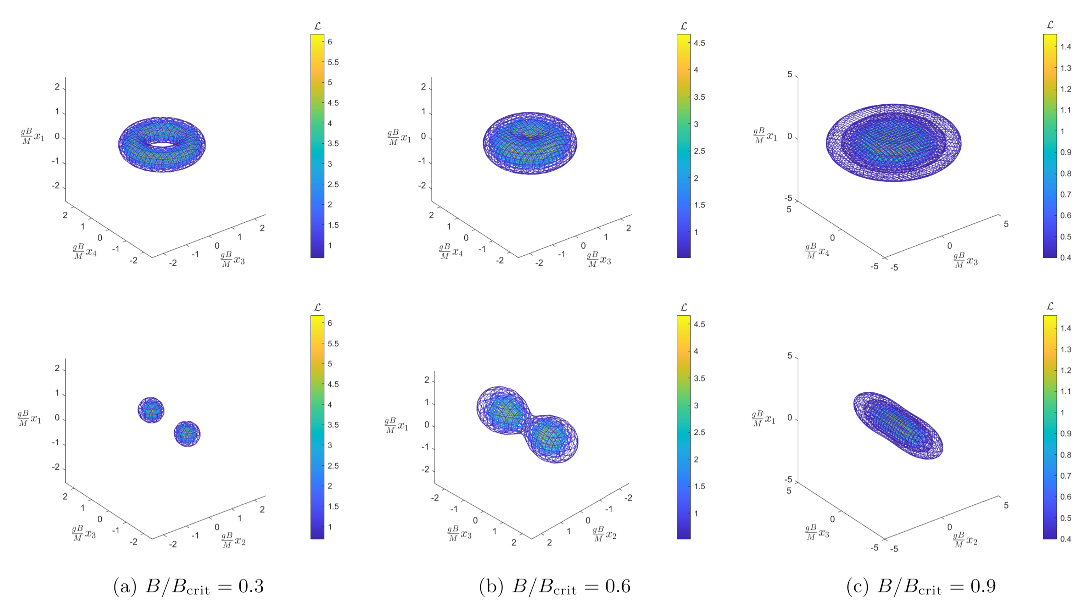

Monopole Size
4D field theory
instanton solution
(Ho&AR 2021)
Georgi-Glashow model:
SU(2)+adjoint scalar
Action determines the
quantum Schwinger rate
$Γ∝\exp\left(−S_{inst}\right)$
(Ho and AR, 2021)

Slide 21
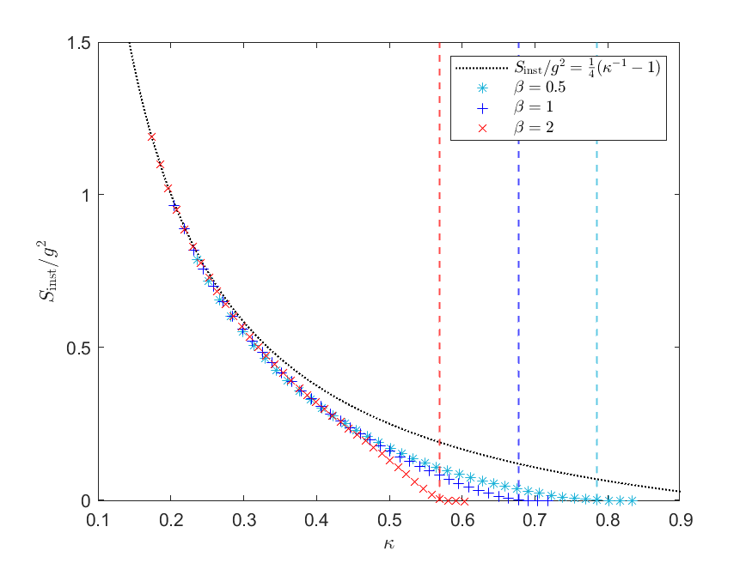



Monopole Size
$$β=m_{s}/m_{v}$$
4D field theory
instanton solution
(Ho&AR 2021)
Georgi-Glashow model:
SU(2)+adjoint scalar
Action determines the
quantum Schwinger rate
$Γ∝\exp\left(−S_{inst}\right)$
  Enhanced by nonzero size
  Becomes unsuppressed at
  critical field $B_{crit}=m_{v}^{2}/e$
$$=g^{3}B/4πM^{2}$$
(Ho and AR, 2021)

Slide 22
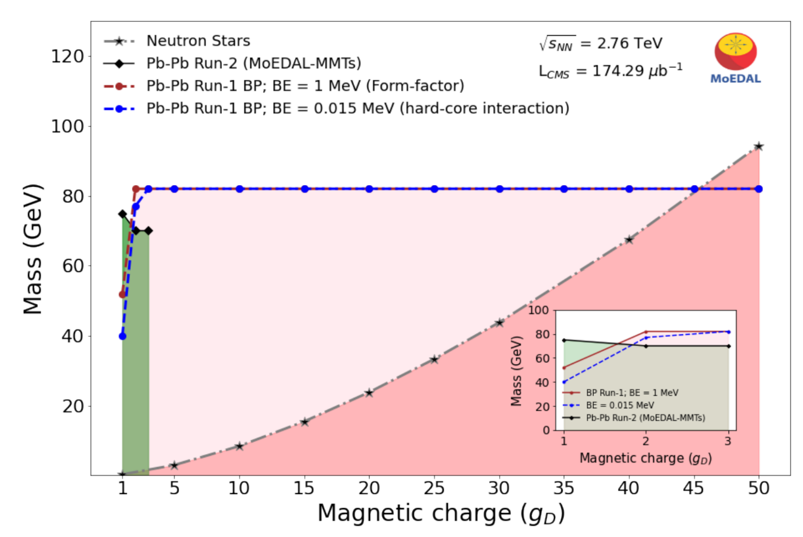

Monopoles from Heavy Ion Collisions
Most conservative bounds:
Worldline instanton with
the free particle approximation
  Rapid pulse $P∼exp⁡(−4M/ω)$
MoEDAL searches
  LHC Run 1: CMS beampipe
  (MoEDAL 2024)
  LHC Run 2: Al trapping detectors
  (MoEDAL 2022)
Lower mass bound $M≳80 GeV$
for all magnetic charges
(MoEDAL Collaboration, 2024)

Slide 23
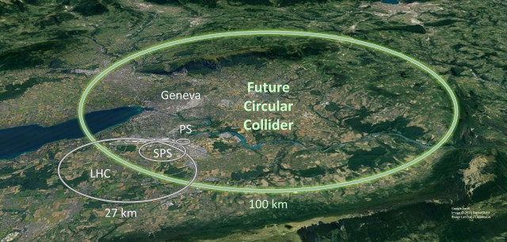
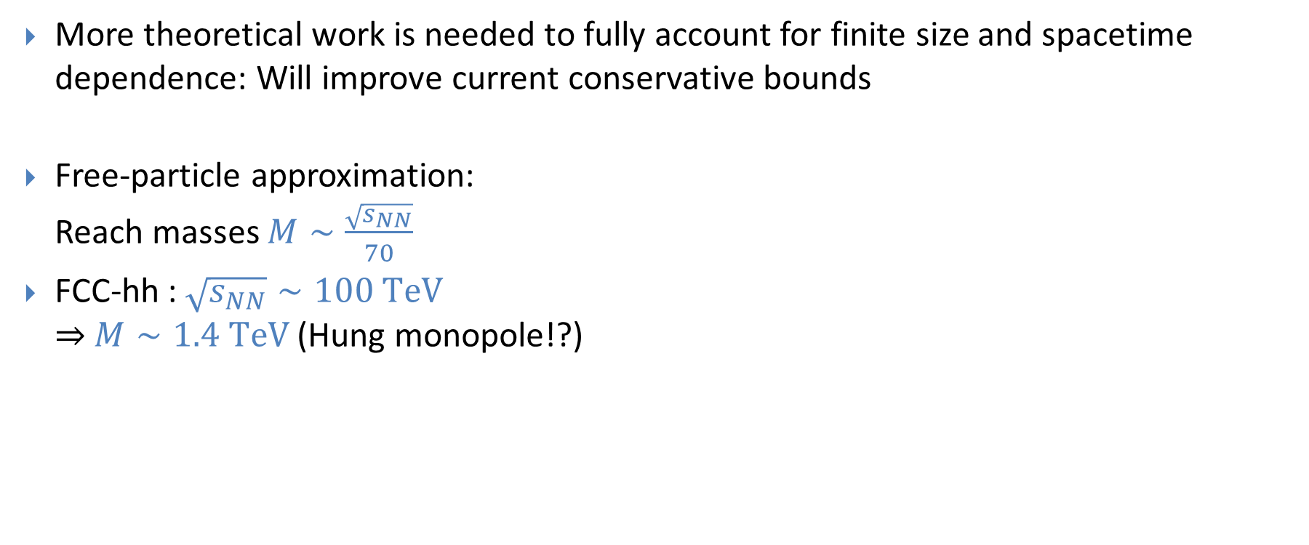
Future Prospects
More theoretical work is needed to fully account for finite size and spacetime dependence: Will improve current conservative bounds
Free-particle approximation:
Reach masses $M∼\frac{\sqrt{s_{NN}}}{70}$
FCC-hh : $\sqrt{s_{NN}}∼100 TeV$
$⇒$ $M∼1.4 TeV$ (Hung monopole!?)

Slide 24
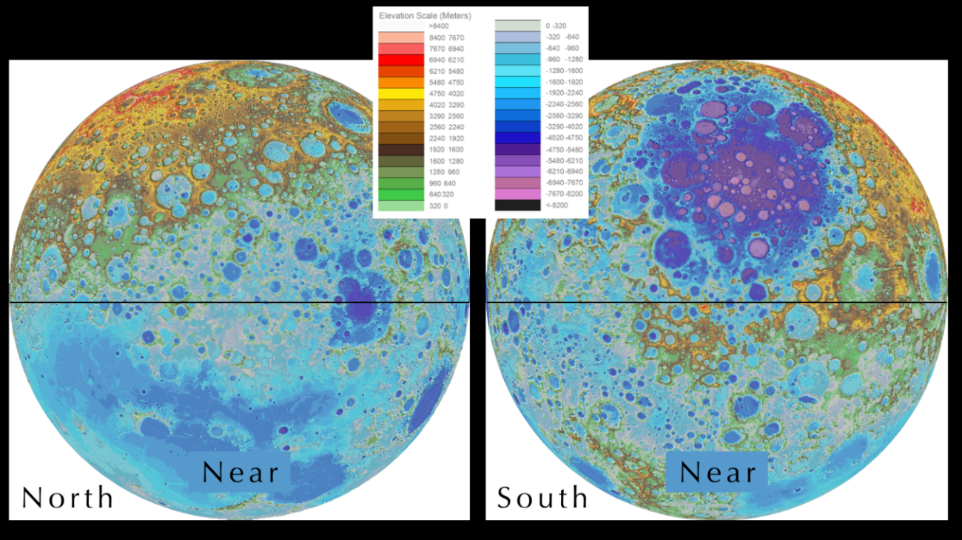
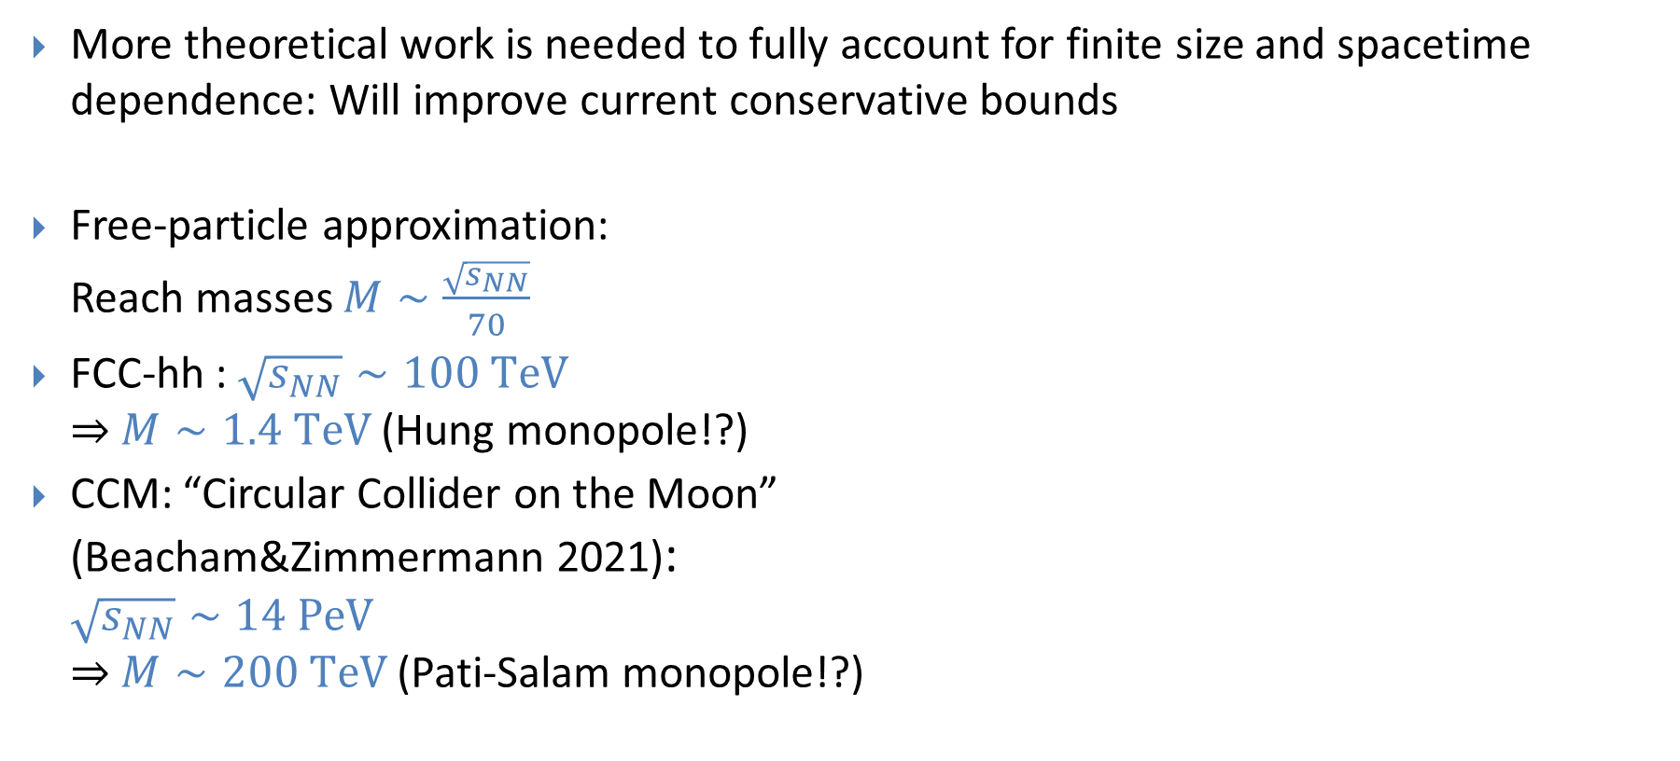
Future Prospects
More theoretical work is needed to fully account for finite size and spacetime dependence: Will improve current conservative bounds
Free-particle approximation:
Reach masses $M∼\frac{\sqrt{s_{NN}}}{70}$
FCC-hh : $\sqrt{s_{NN}}∼100 TeV$
$⇒$ $M∼1.4 TeV$ (Hung monopole!?)
CCM: “Circular Collider on the Moon”
(Beacham&Zimmermann 2021):
$\sqrt{s_{NN}}∼14 PeV$
$⇒$ $M∼200 TeV$ (Pati-Salam monopole!?)

Slide 25
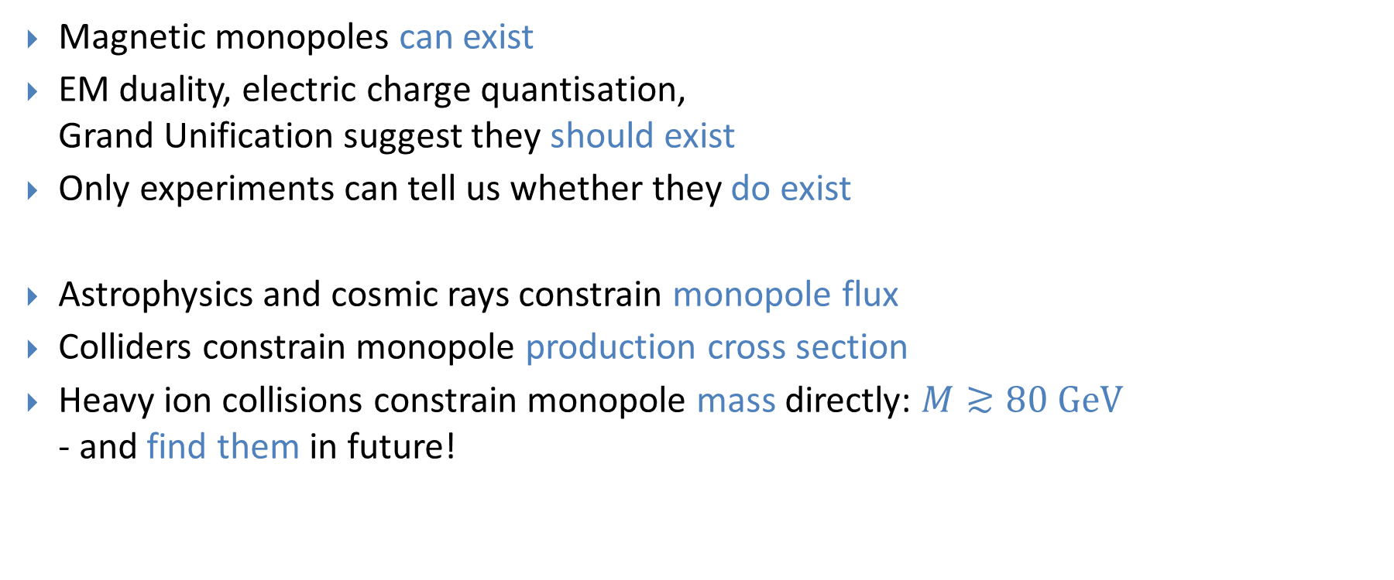
Summary
Magnetic monopoles can exist
EM duality, electric charge quantisation,
Grand Unification suggest they should exist
Only experiments can tell us whether they do exist
Astrophysics and cosmic rays constrain monopole flux
Colliders constrain monopole production cross section
Heavy ion collisions constrain monopole mass directly: $M≳80 GeV$
- and find them in future!
N

Slide 26
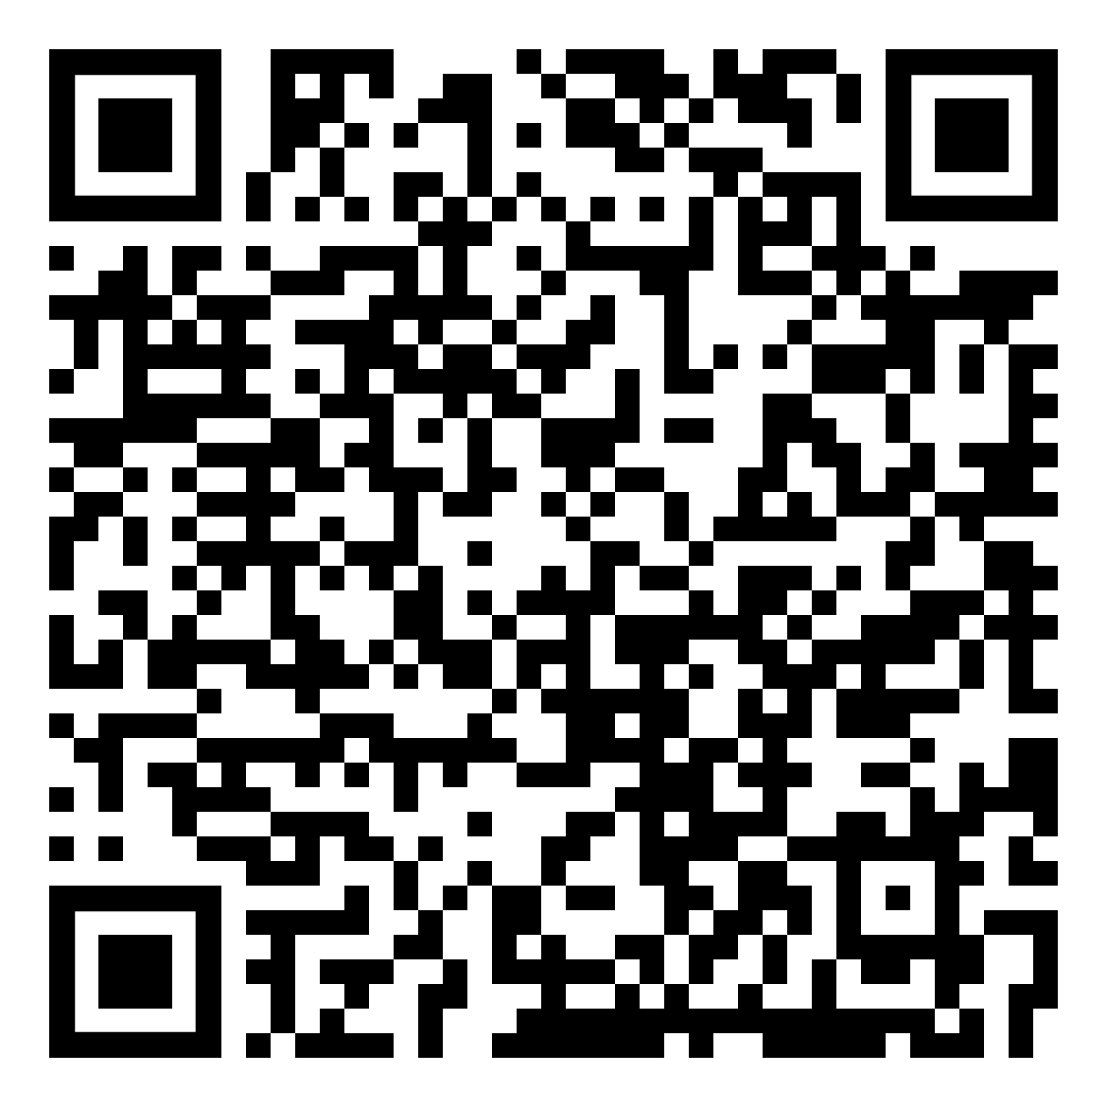
We are hiring!
Five Lecturer or Senior Lecturer positions in Physics at Imperial College London
(=permanent assistant/associate professor)
Any area of physics, but preference given to:
  Atmospheric dynamics of extreme weather.
  Direct search for dark matter.
  Physics implementation of neuromorphic hardware.
  Quantum technology.
  Quantum Field Theory and gravity.
  Application of Artificial Intelligence to
  astrophysical modelling.
Deadline 19 August 2024

