Slide 1
Recent τ g-2 measurement at CMS
Zongsheng He
Peking University
on behalf of the CMS Collaboration
PASCOS, 2024, Quy Nhon, Vietnam
July-10th, 2024
zongsheng.he@cern.ch
PASCOS

Slide 2
Outline
Introduction
Constraint on τ g-2 in Pb-Pb collisions at $\sqrt{s_{NN}}$=5.02TeV
based on Phys. Rev. Lett. 131, 151803
Constraint on τ g-2 in proton-proton collisions at $\sqrt{s_{NN}}$=13TeV
based on arXiv:2406.03975,submitted to ROPP
Summary
PASCOS

Slide 3
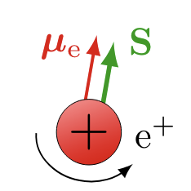
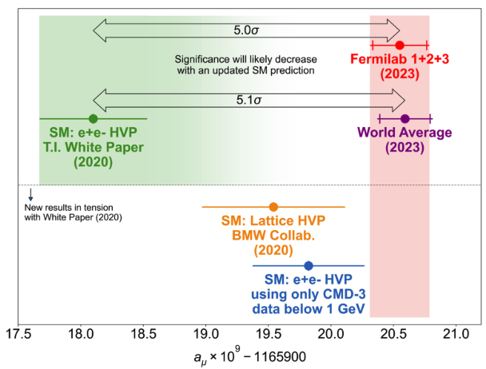
Anomalous Magnetic Moments of lepton
μ=g$\frac{e}{2m}$S$a_{l}=\frac{g_{l}−2}{2}$
Measurements of (g-2)_{e} agreement with SM of 12 significant digits
Measurements of (g-2)_{μ} in longstanding tension with theoretical computations
Many BSMs predict the enhancement of τ
e.g. Yukawa-like coupling:$\frac{m_{τ}^{2}}{m_{μ}^{2}}≈$280
$⟹$probe for New Physics
Constraints on (g-2)_{τ} in e⁺e⁻ collisions:
-DELPHI@LEP: -0.052<a_{τ}<0.013(95%CL)
PASCOS

Slide 4
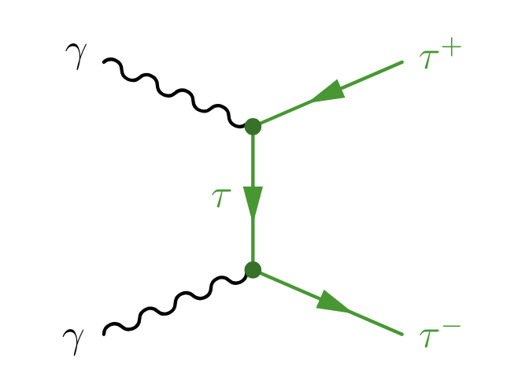
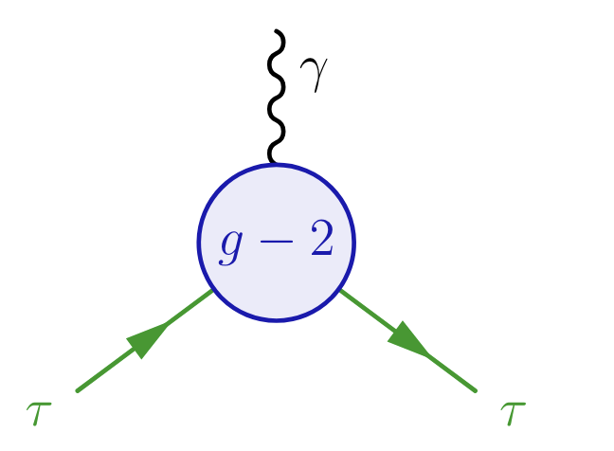
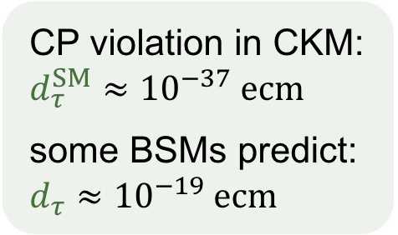
Constraints on τ electromagnetic moments by $γγ→ττ$
a_{τ} and electric dipole moment d_{τ} can be probed from γττ vertex
$γγ→ττ$ process contains 2 γττ vertices
a_{τ} & d_{τ}
Constraints on electromagnetic moments a_{τ} & d_{τ} with form factors ( DELPHI & ATLAS ) or SMEFT (these 2 studies)
PASCOS

Slide 5
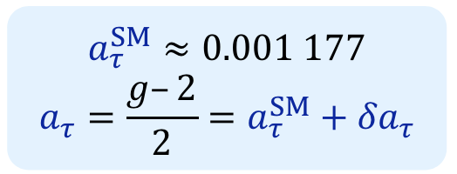
EFT Interpretation
Deviations of $δa_{τ}$ & $δd_{τ}$ from the SM can be parameterized in terms of a BSM Lagrangian with dim-6 operators with new physics scale Λ:
$ℒ_{BSM}=\frac{C_{τB} }{Λ^{2}}{\overline{L}}_{L}σ^{μν}τ_{R}HB_{μν}+\frac{C_{τW} }{Λ^{2}}{\overline{L}}_{L}σ^{μν}τ_{R}σ^{i}HW_{μν}^{i}+h.c.$
$δa_{τ}$ and $δd_{τ}$ are linearly dependent through the complex Wilson coefficients:
$$δa_{τ}=\frac{2m_{τ}}{e}\frac{\sqrt{2}ν}{Λ^{2}}Re[cosθ_{W}C_{τB}−sinθ_{W}C_{τW}]$$
$$δd_{τ}=\frac{\sqrt{2}ν}{Λ^{2}}Im[\cos{θ_{W}C_{τB}}−sinθ_{W}C_{τW}]$$
PASCOS

Slide 6
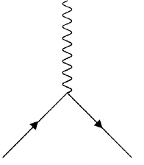
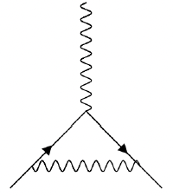
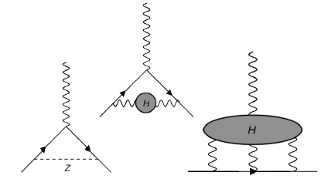
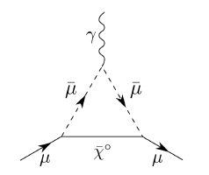
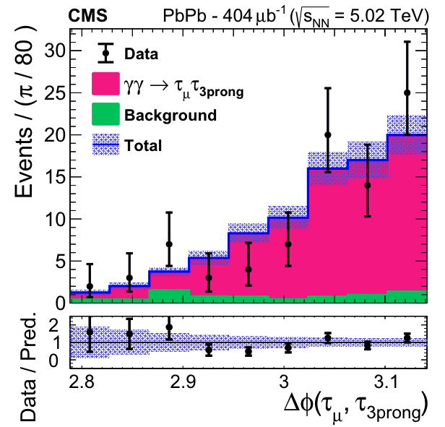
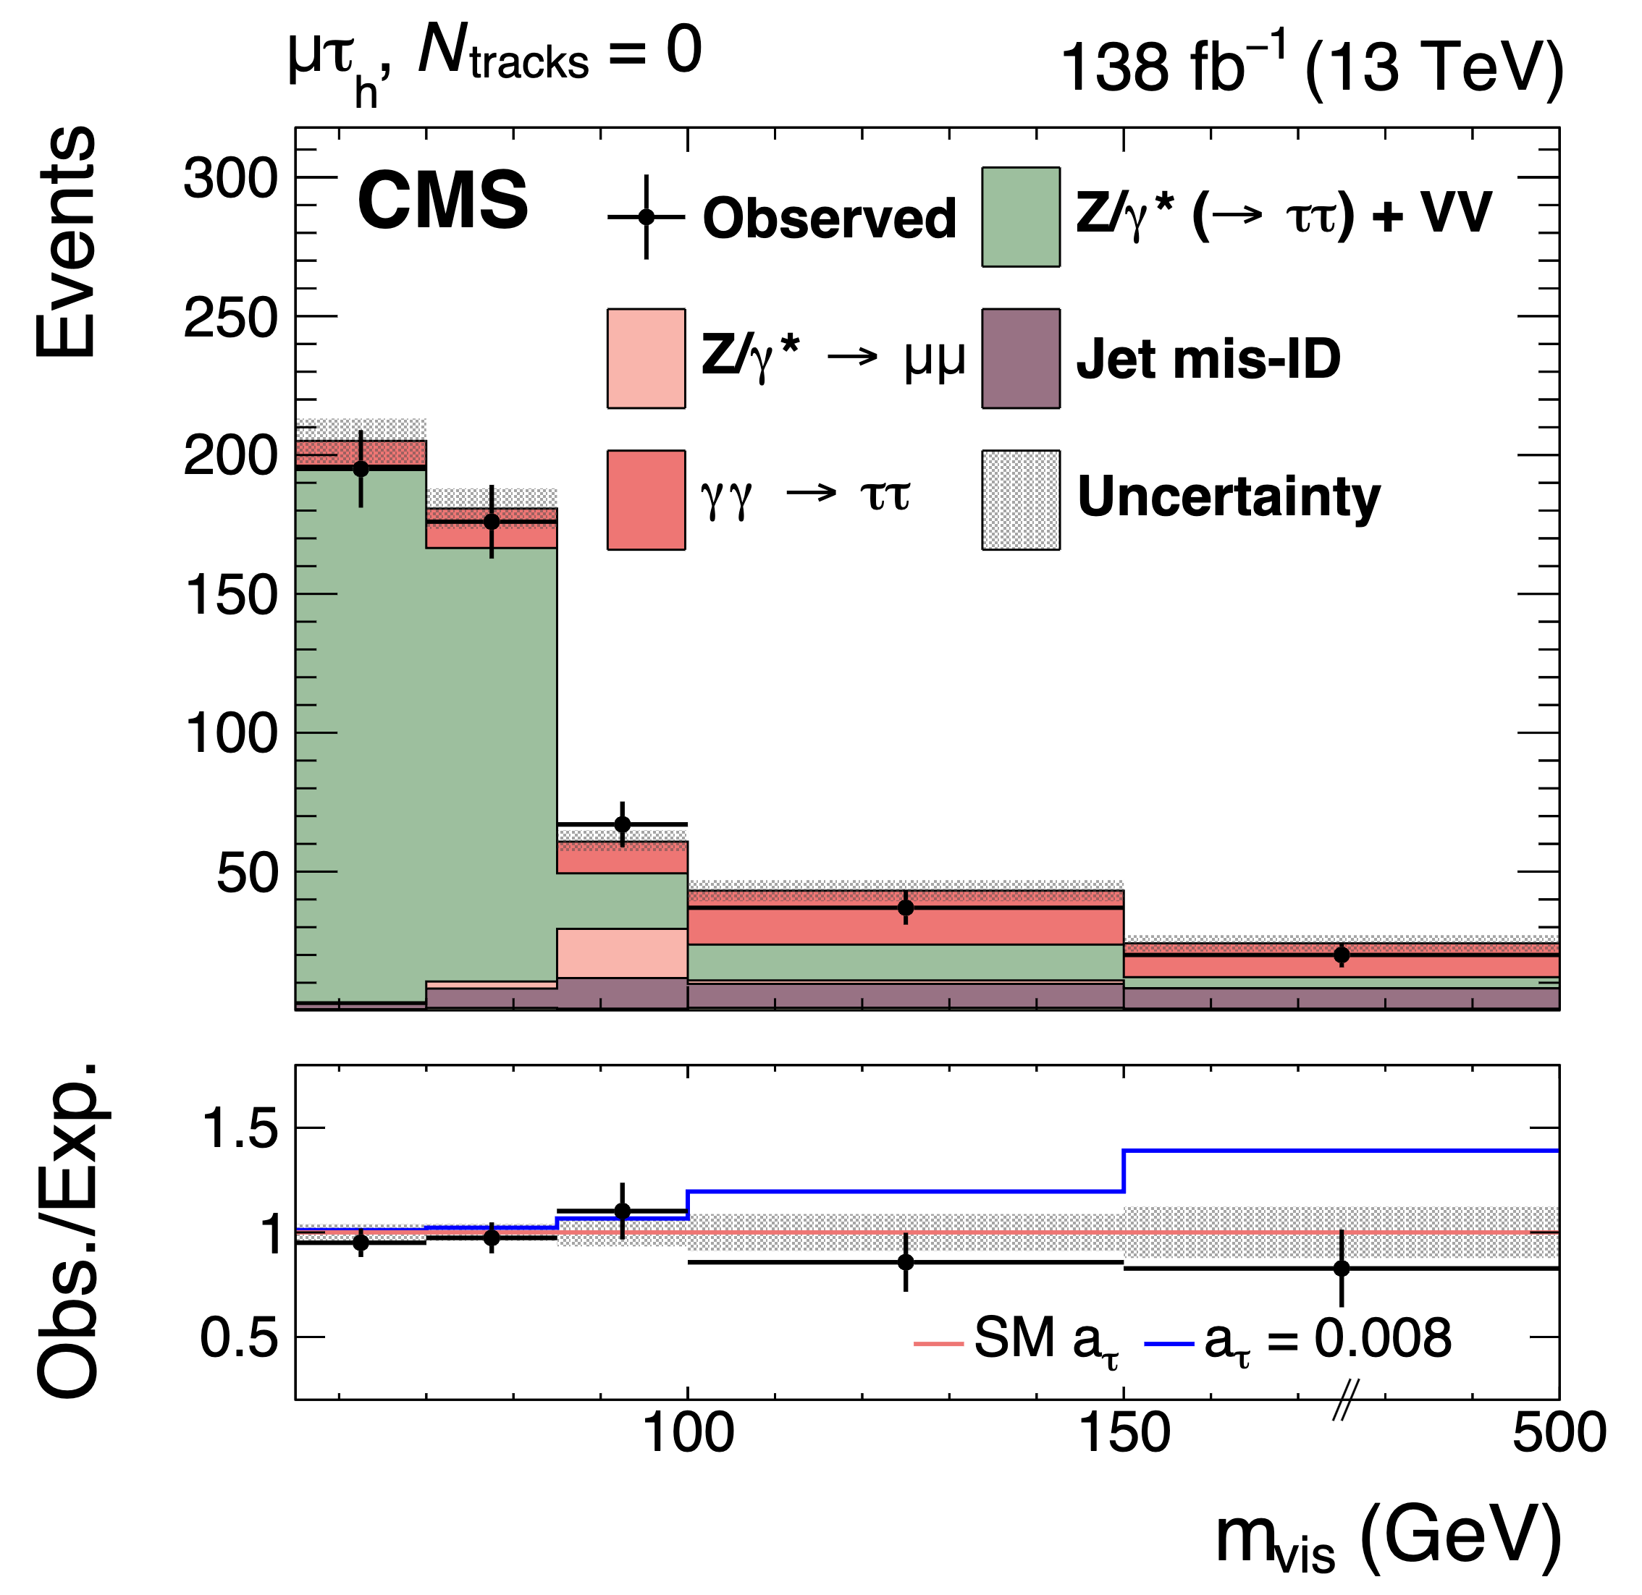
$a_{τ}$ Measurements
DELPHI
OPAL
CMS PbPb
CMS pp
Approaching the Schwinger term
More precision needed to probe BSM effects scaling with $m_{l}^{2}$...
a_{τ} precision
Schwinger term
Higher-order corrections
BSM effects
Dirac
Heavy ion
pp with track counting
pp with proton tagging
PPS approved for Run-4
m_{ττ}
50GeV
350GeV
2TeV
PASCOS

Slide 7
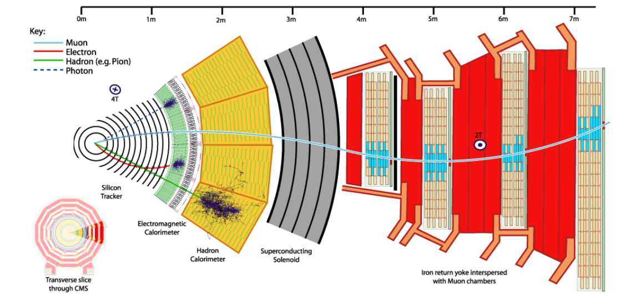
CMS Detector
excellent muon reconstruction
PASCOS

Slide 8
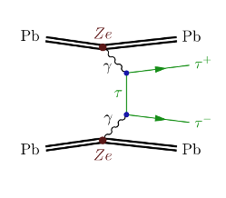
$a_{τ}$ Measurement in Pb-Pb collisions at $\sqrt{s_{NN}}$=5.02TeV with integrated luminosity = 404$μb^{−1}$
PASCOS

Slide 9
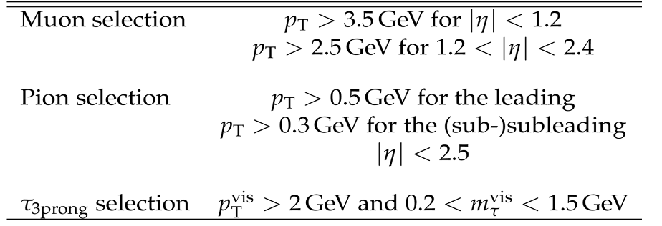
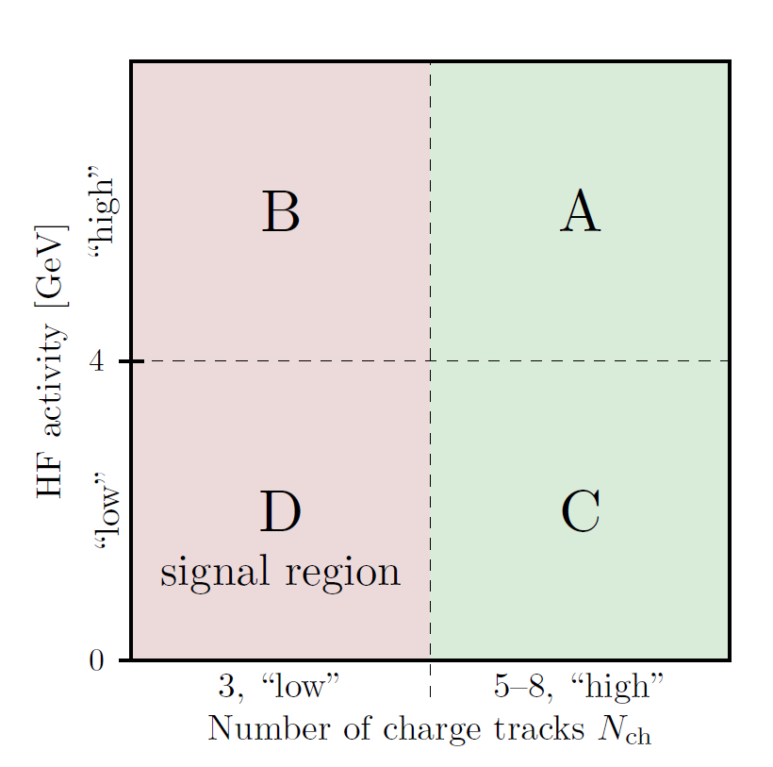
Analysis Overview
Final states:$τ_{μ}+τ_{3prong}$
Background estimates used ABCD method signal region:D
Exclusive selections:
opposite sign of $τ_{μ}τ_{3prong}$
low charged track number:
n_{ch}=3($τ_{3prong}$)
low forward hadron calorimeter energy:
HF<4GeV
Basic selections
PASCOS

Slide 10
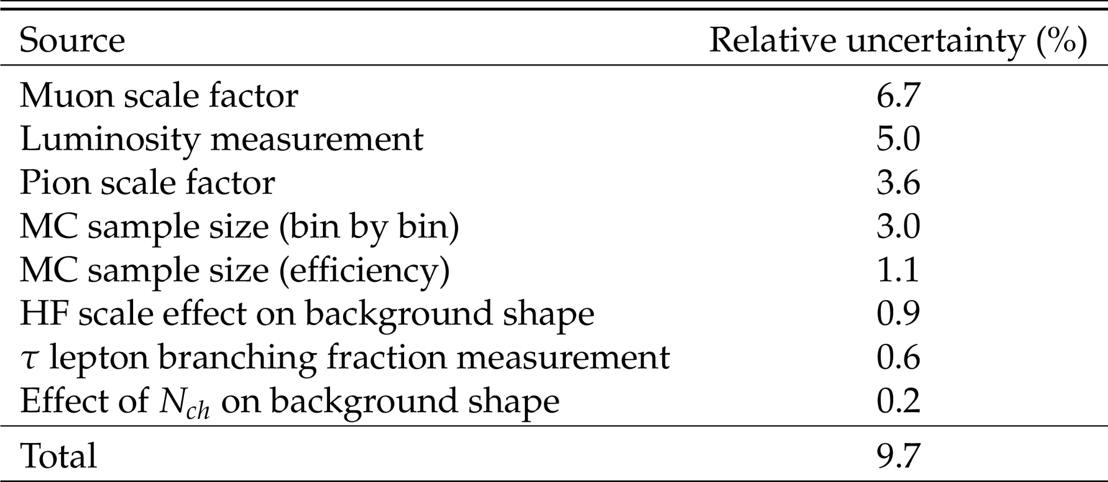
Systematics
Main systematic uncertainties sources: trigger, tracking and luminosity
PASCOS

Slide 11
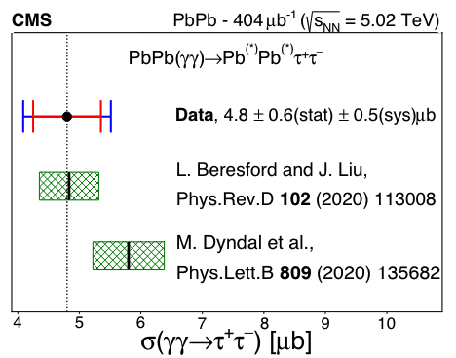
First Observation of $γγ→ττ$ in Heavy Ion Collisions
signal significance:14.2σ (observed),14.5σ (expected)
$σ\left(γγ→τ^{+}τ^{−}\right)=4.8±0.6(stat)±0.5(syst)μb$
$a_{τ}={0.001}_{−0.089}^{+0.055}$
PASCOS

Slide 12
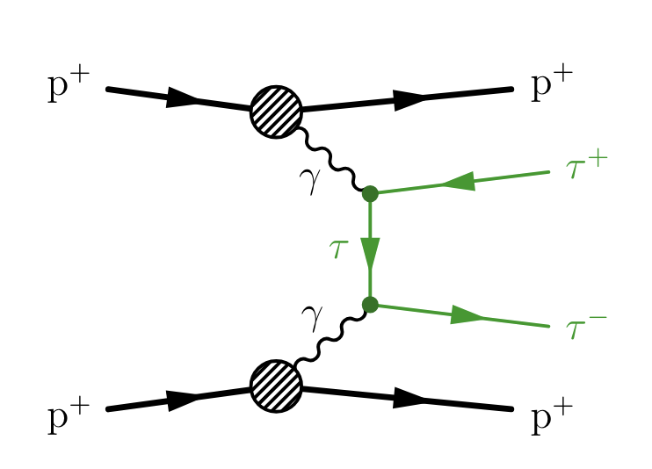
$a_{τ}$ Measurement in proton-proton collisions at $\sqrt{s_{NN}}$=13TeV with integrated luminosity = 138${fb}^{−1}$
PASCOS

Slide 13
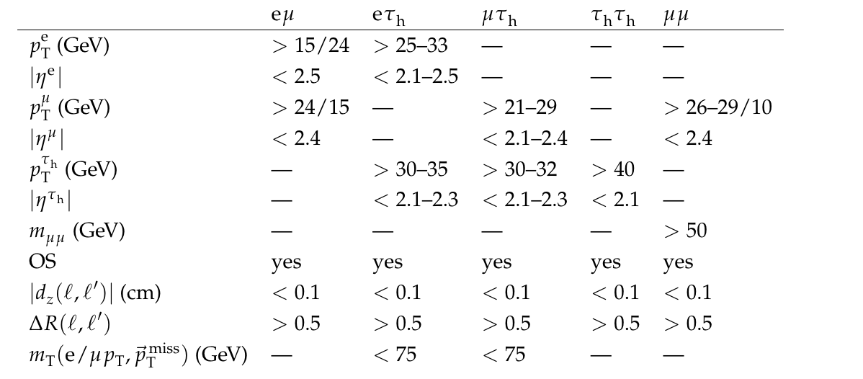
Analysis Overview
Combine 4 ττ final states: $eμ, eτ_{h}, μτ_{h}, τ_{h}τ_{h}$
PASCOS

Slide 14
Analysis Overview
Acoplanarity A = $1−\frac{|ΔΦ|}{π}≈0$
Exclusive selection of SR:
opposite sign $τ^{+}τ^{−}$
A<0.015
$N_{tracks}=0,1$ in the 0.1 cm width window of the di-τ vertex (N_{tracks}:number of extra charged tracks)
Use μμ events($Z→μμ, γγ→μμ$) to measure corrections to simulations
acoplanarity correction
pileup track multiplicity correction
hard scattering track multiplicity correction
photon-induced elastic process simulation correction to include dissociative components
simulated backgrounds: Drell-Yan, Di-boson, Top quark
data-driven method to estimate QCD and W+jets background
PASCOS

Slide 15
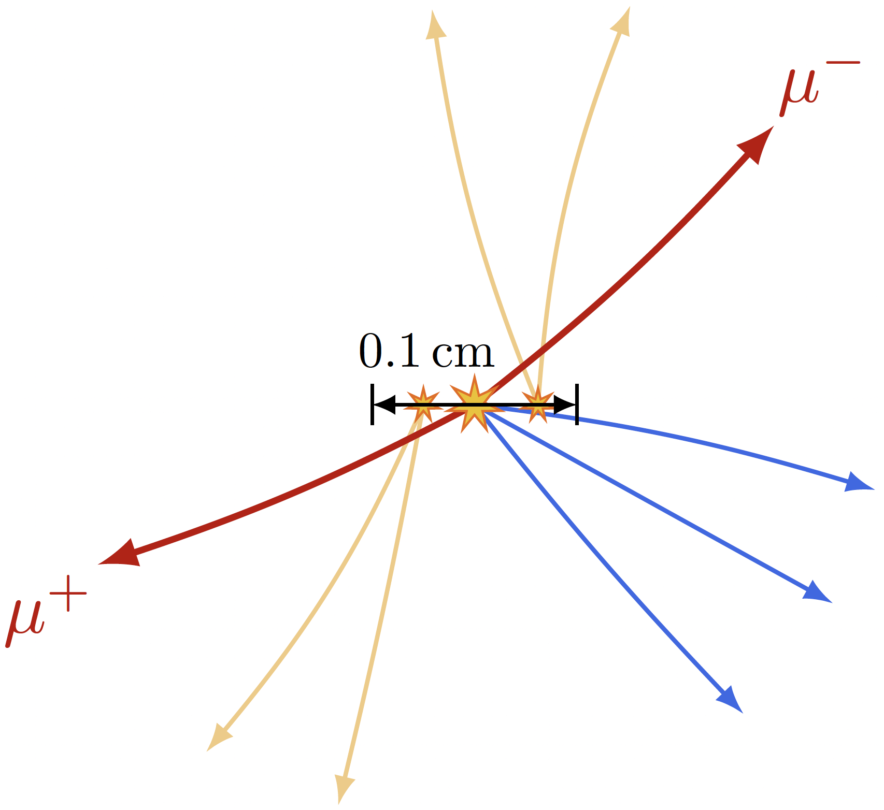
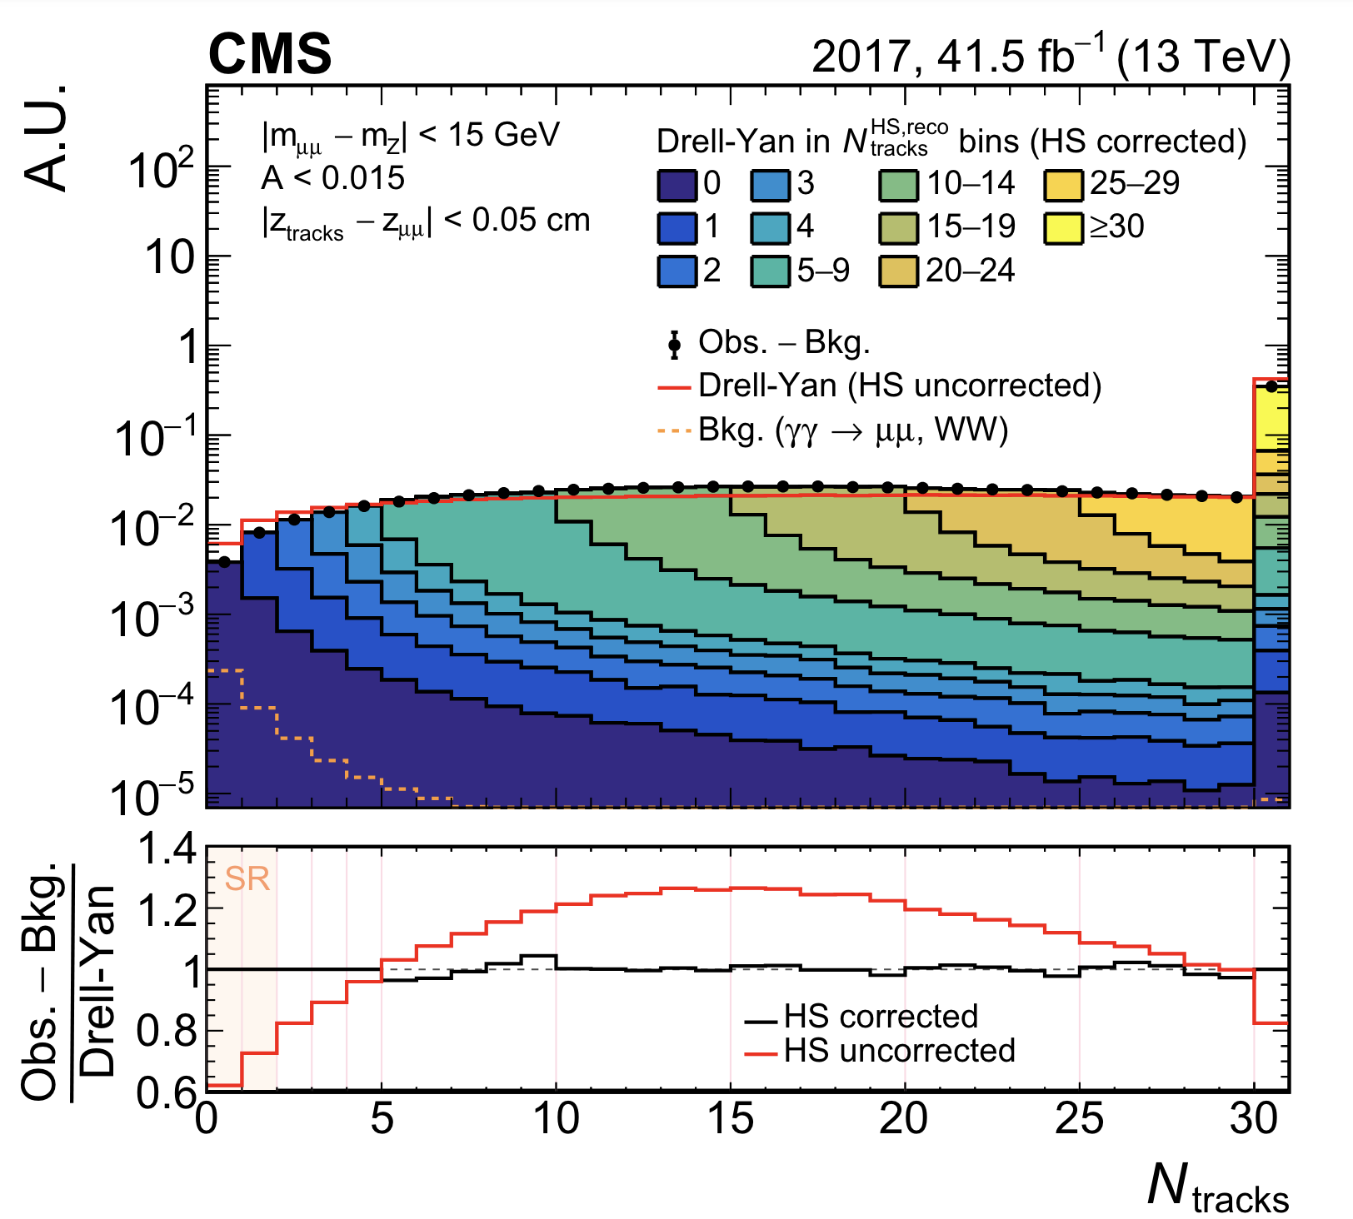
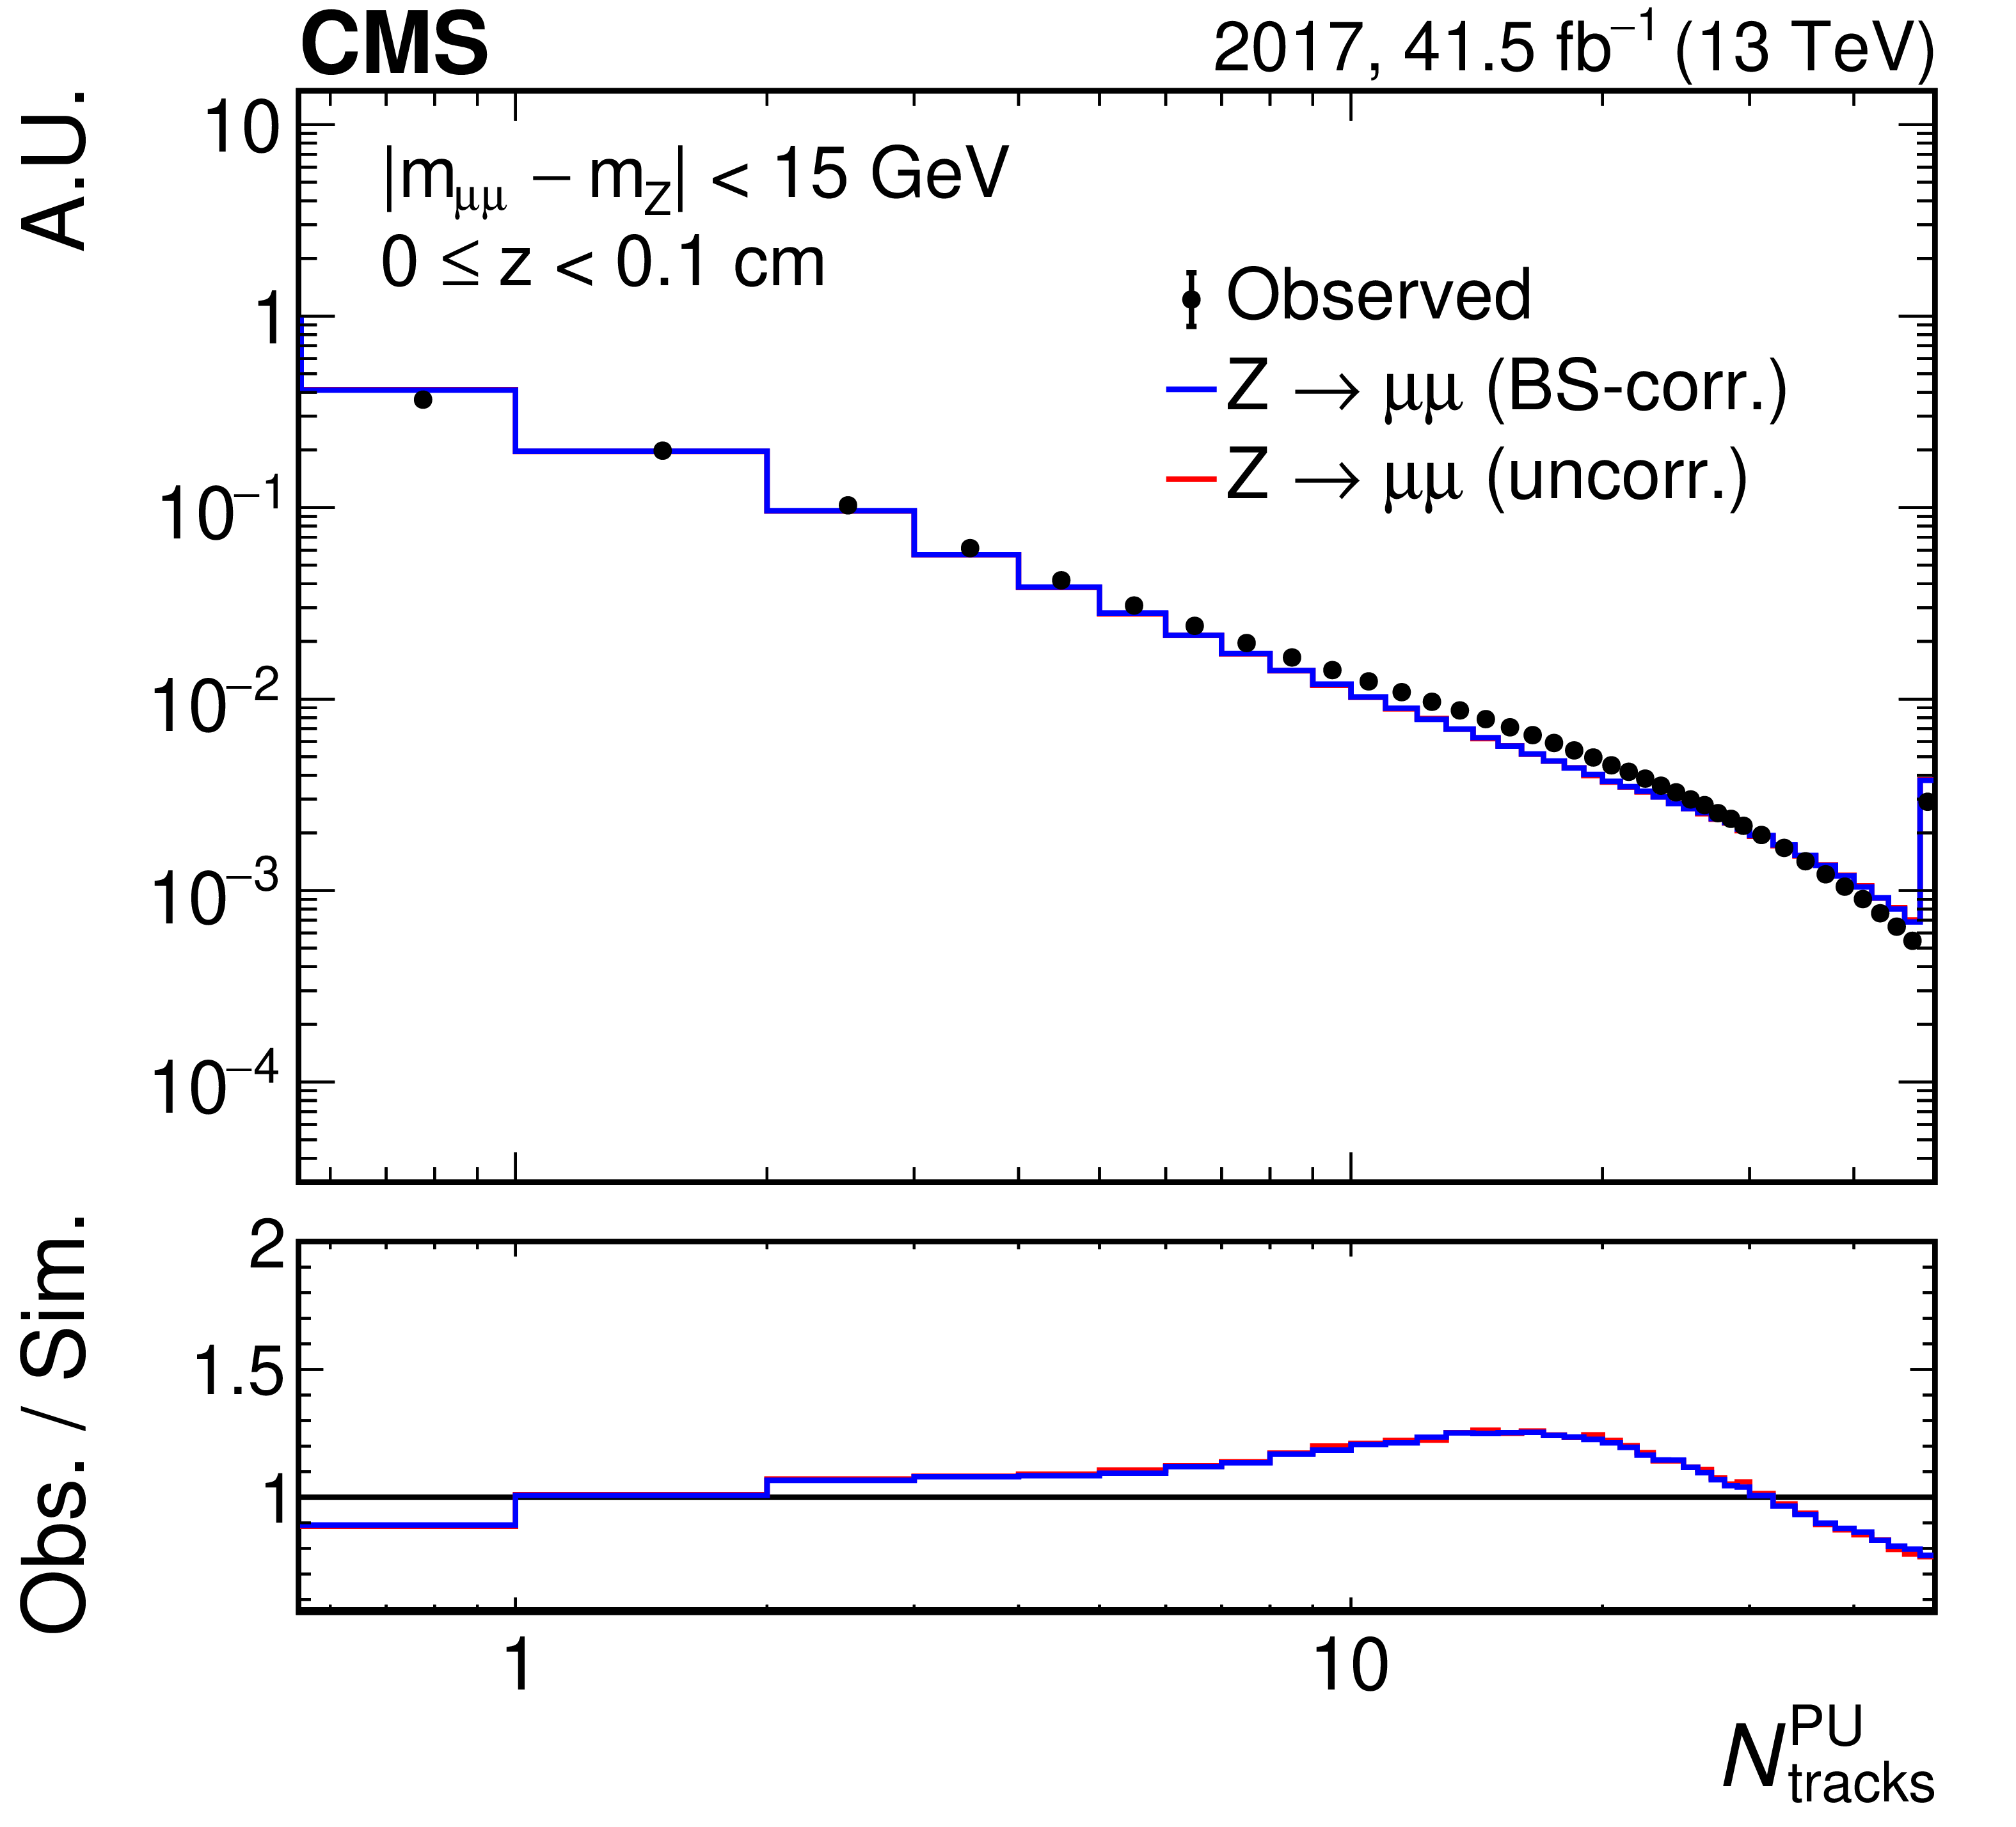
Pileup/Hard Scattering Track Multiplicity Correction
$$N_{tracks}=N_{tracks}^{PU}+N_{tracks}^{HS}$$
windows far from the di-μ vertex to discard the tracks from the hard scattering interactions
0.1 cm width window around the μμ vertex to correct hard scattering track multiplicity
PASCOS

Slide 16
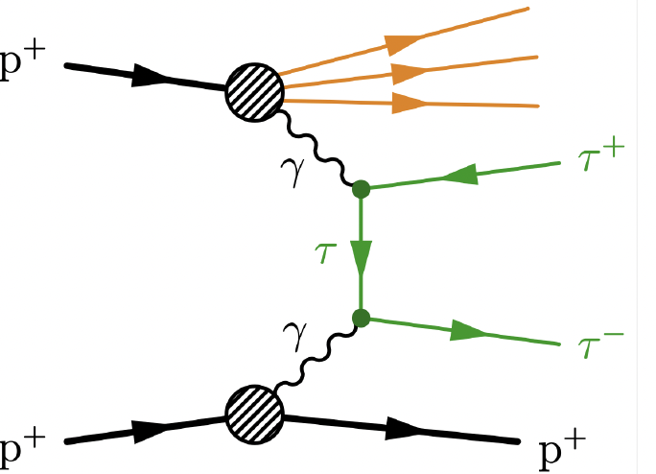
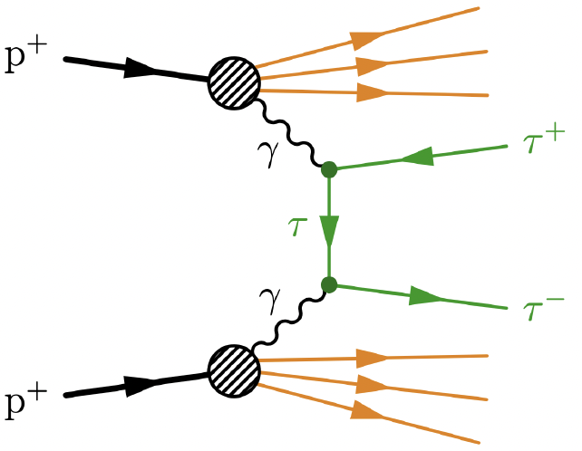
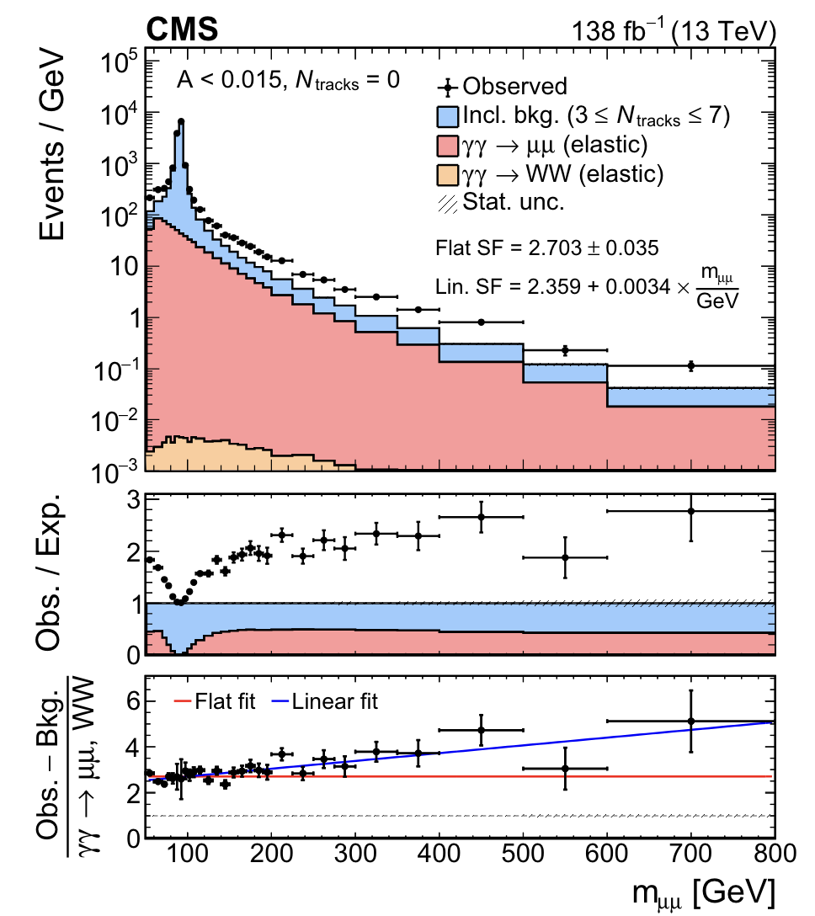
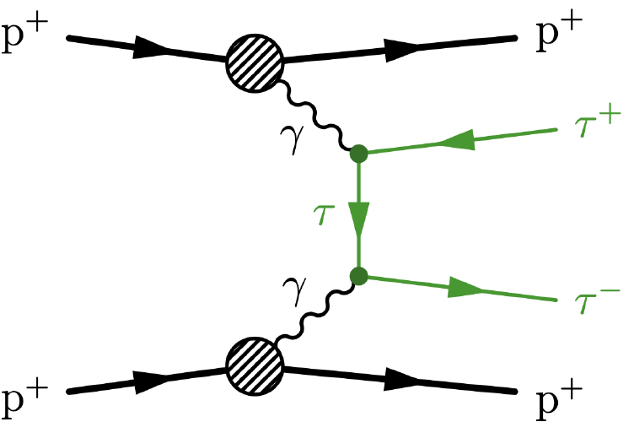
Photon-induced Process Correction
elastic
semi-dissociative
fully-dissociative
gammaUPC
scaling factor = $\frac{(N_{elastic}+N_{semi−dissociative}+N_{fully−dissociative })}{{[N}_{elastic}]}$
scaling factor = $\frac{N\left(obs\right)−N(inclusive background)}{N\left(γγ→μμ\right)+N(γγ→WW)}$
applied to $γγ→ee/μμ/ττ/WW$ in the signal region
PASCOS
Notes:
要把inclusive background从nTrk=3～7取形状要说一下

Slide 17
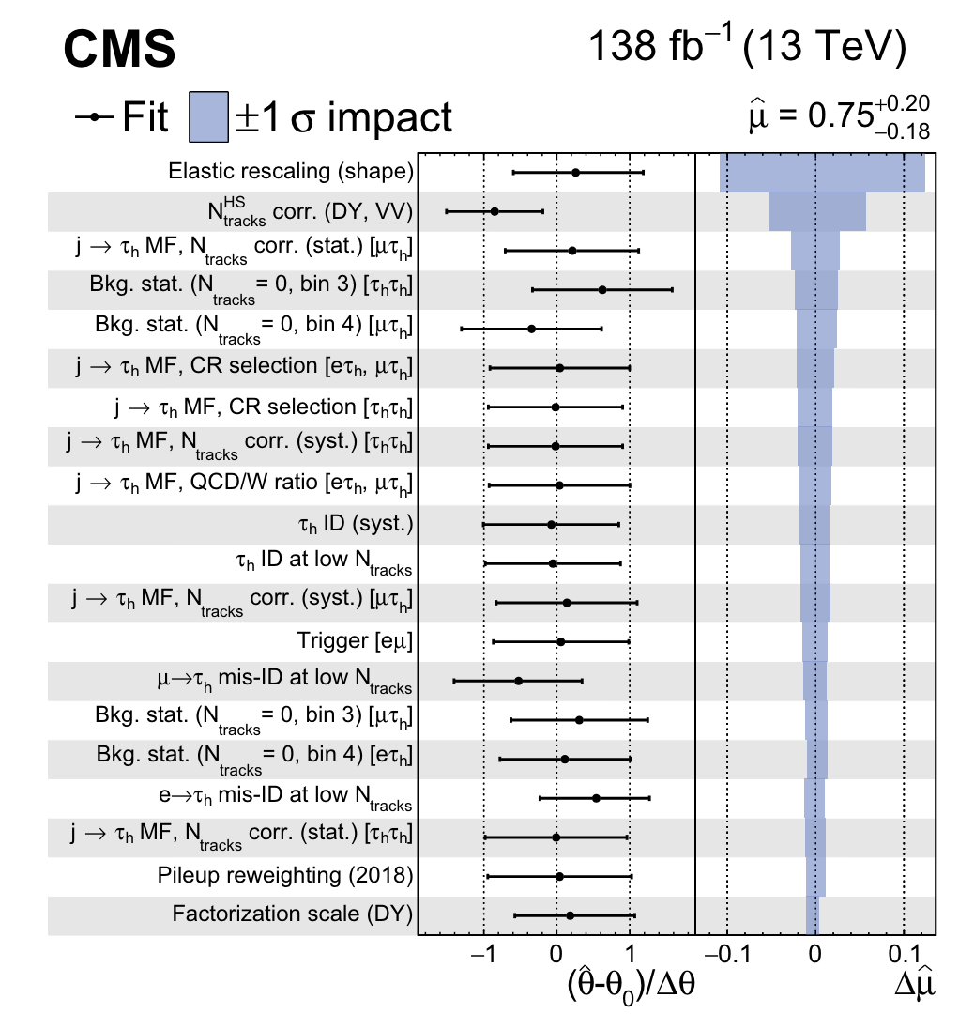
Leading Systematics on the signal significance
shape uncertainty of the elastic rescaling: the difference between the flat factor and the linear factor
PASCOS

Slide 18
First Observation of $γγ→ττ$ in pp collisions
5.3σ observed, 6.5σ expected
based on $m_{vis}$ distribution for 4 final states with nTrk=0,1 with respect to gammaUPC elastic prediction rescaled by our data-driven correction
 | Observed | Expected
 | 2.3σ | 3.2σ
 | 3.0σ | 2.1σ
 | 2.1σ | 3.9σ
 | 3.4σ | 3.9σ
Combined | 5.3σ | 6.5σ
PASCOS

Slide 19
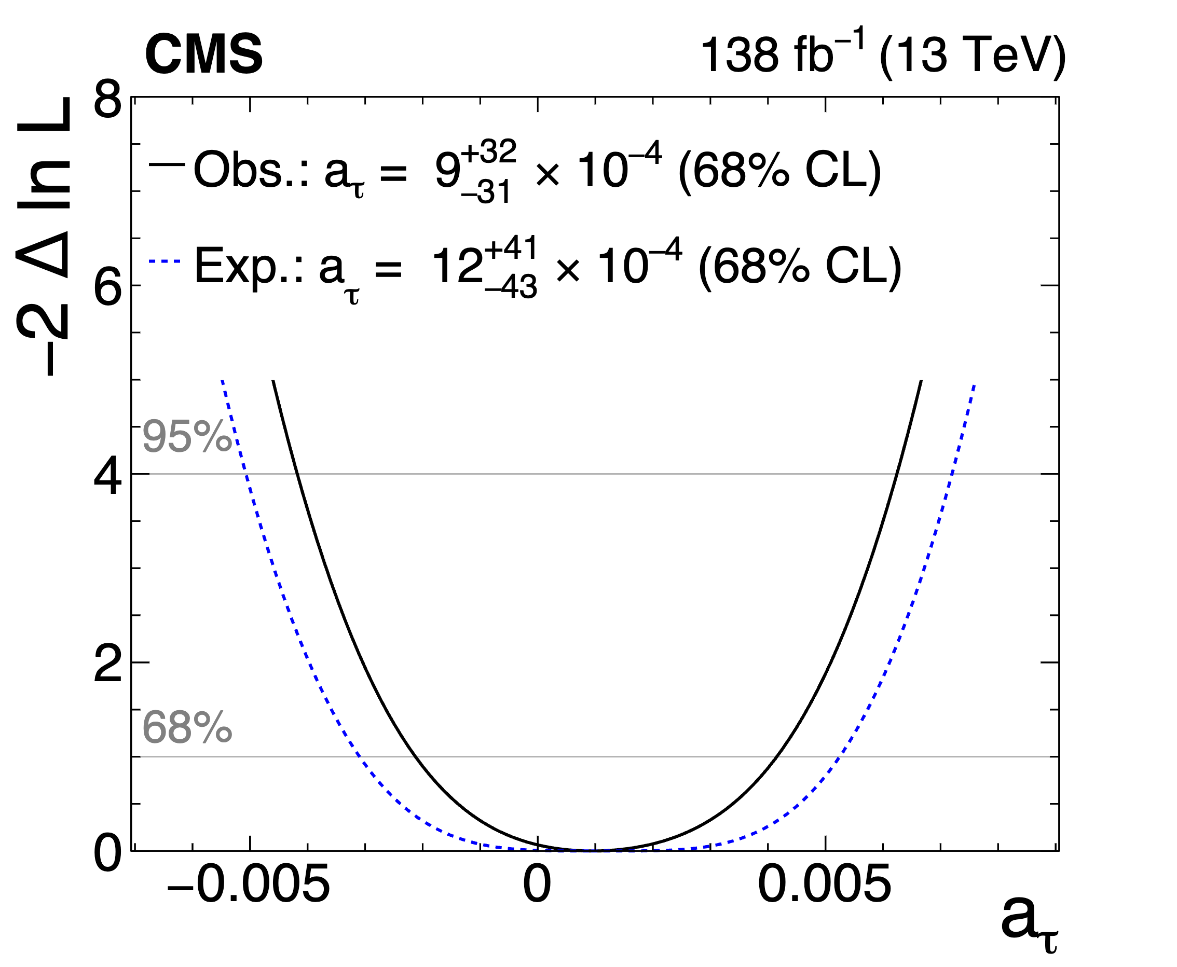
Constraint on a_{τ}
full $m_{vis}$ distributions in the SR, perform negative log-likelihood scan over δa_{τ}, which modifies the signal and normalization
In the m_{ττ} range considered in this analysis, both a_{τ}>0 and <0 increase the signal prediction
observed $γγ→ττ$ deficit: tighter constraints than expected, compatibility with SM
$$a_{τ}=δa_{τ}+SM a_{τ}$$
1σ uncertainty of 0.003
only 3 times the Schwinger term
Dirac
a_{τ}=0
Schwinger
a_{τ}=0.00116
SM
a_{τ}=0.00118
PASCOS

Slide 20
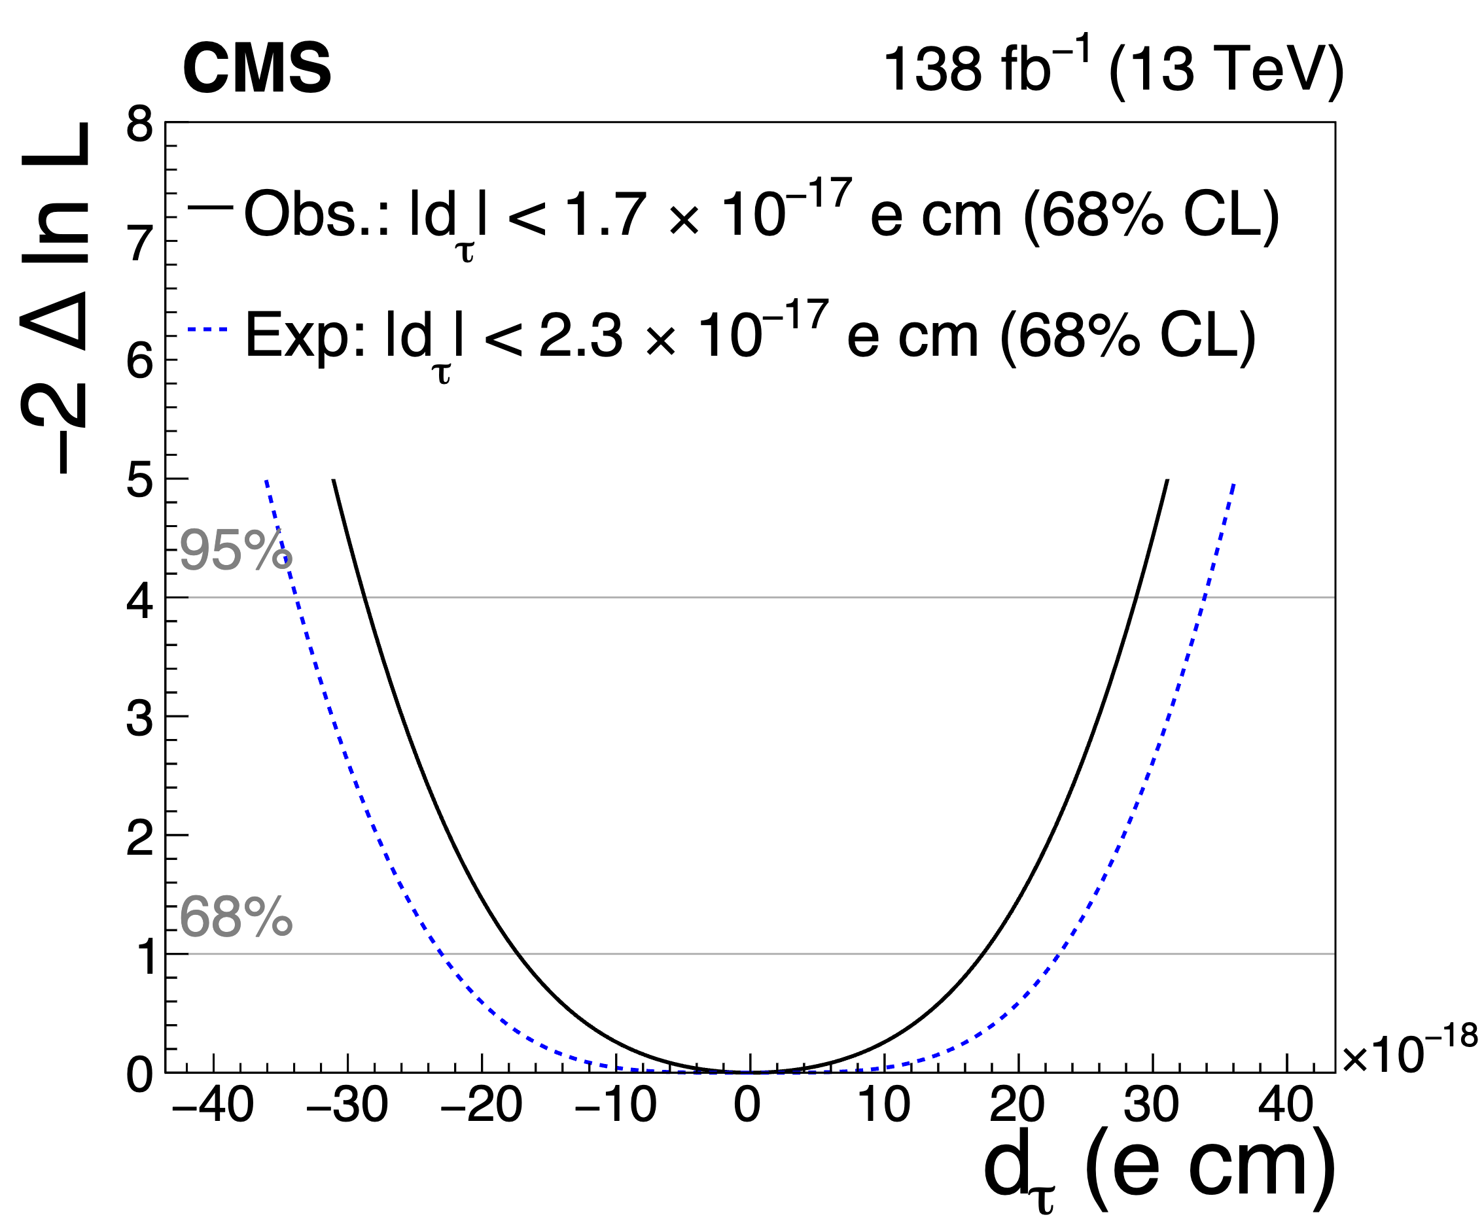
Constraint on d_{τ}
BSM effects symmetric with sigh of δd_{τ}
In the m_{ττ} range considered in this analysis, both d_{τ}>0 and <0 increase the signal prediction
observed $γγ→ττ$ deficit: tighter constraints than expected, compatibility with SM
PASCOS

Slide 21
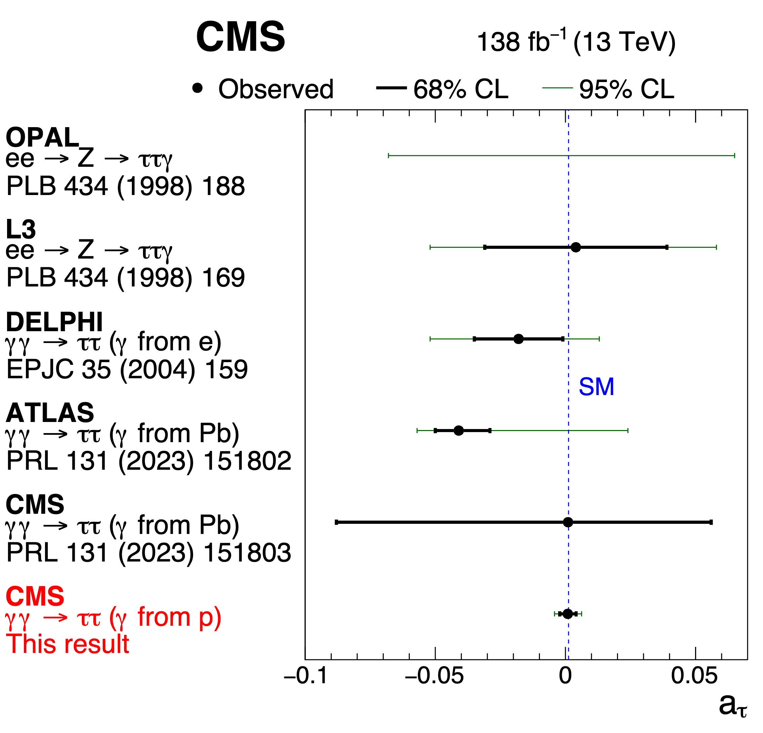
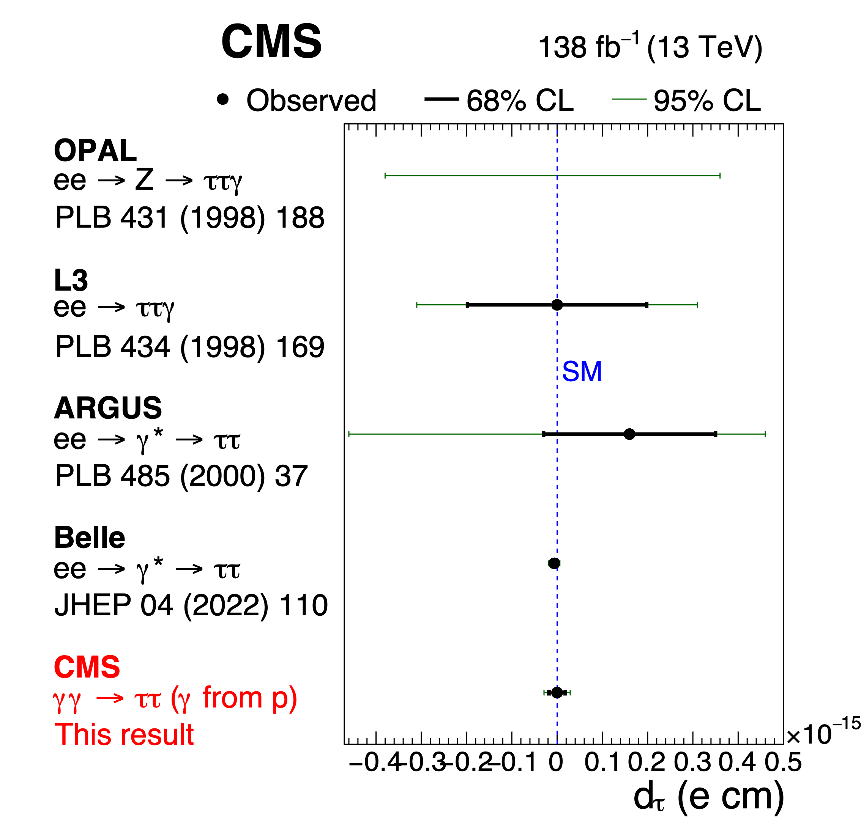
Comparing to Previous Results
$$d_{τ}=(−0.62±0.63)×{10}^{−17}ecm$$
$$d_{τ}=(−0.0±1.7)×{10}^{−17}ecm$$
Large improvement over LEP and LHC PbPb
Approaching Belle precision
PASCOS

Slide 22
Summary
The CMS Collaboration has first observed $γγ→ττ$ process in heavy ion collisions with 14.2σ
These events were used to constrain the τ electromagnetic moments with an EFT approach
$a_{τ}=0.001+0.055−0.089$ at 68% CL
The CMS Collaboration has first observed $γγ→ττ$ process in pp collisions with 5.3σ
These events were used to constrain the τ electromagnetic moments with an EFT approach
$a_{τ}=0.0009+0.0032−0.0031$ at 68% CL
${−0.0042<a}_{τ}<0.0062$ at 95% CL
$−1.7×{10}^{−17}$ecm<d_{τ}<$1.7×{10}^{−17}$ecm
Improving previous constrains on a_{τ} by a factor of ~5 (PDG:-0.052<a_{τ}<0.013 at 95% CL) and approaching the precision of the Schwinger term(0.00116)
PASCOS

