Slide 1
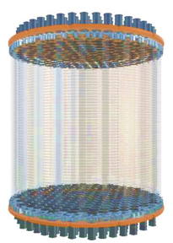
Detecting Neutrinos from Supernova Bursts in PandaX-4T
Binyu Pang (Shandong University)
on behalf of the PandaX Collaboration
The 29th International Symposium on Particles, String and Cosmology
(PASCOS 2024@Vietnam)
July 09,2024
1

Slide 2
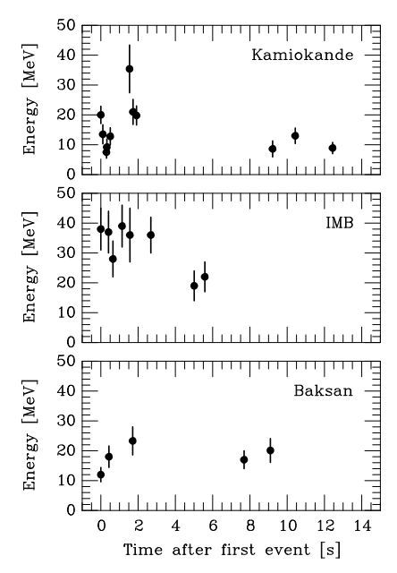
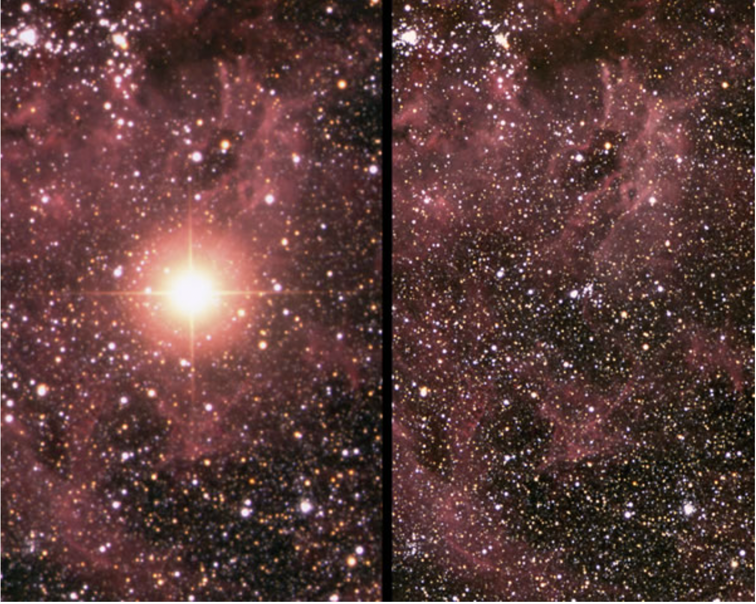
Supernova 1987A
First/only observation of supernova (SN) neutrinos
Masatoshi Koshiba
Nobel 2002
Before and after SN 1987A explosion
Location: The Magellanic Cloud
Distance to Earth: ~50kpc
Stellar mass: ~20$M_{sun}$
Start of neutrino astronomy!
(PASCOS 2024@Vietnam)
2

Slide 3
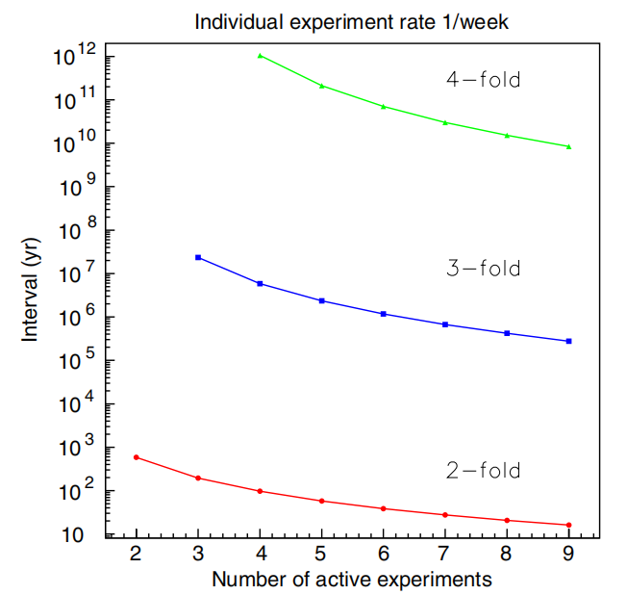
SN Neutrino Early Warning
Motivation：To study supernova dynamics and neutrino physics.
Principle：Neutrinos arrive on earth much earlier than electromagnetic radiation.
alert astronomical community
Approximately three times per century
lasts for ~10 s
Total energy ${\sim 10}^{53}$ erg
The delay from minutes to days
(PASCOS 2024@Vietnam)
3

Slide 4
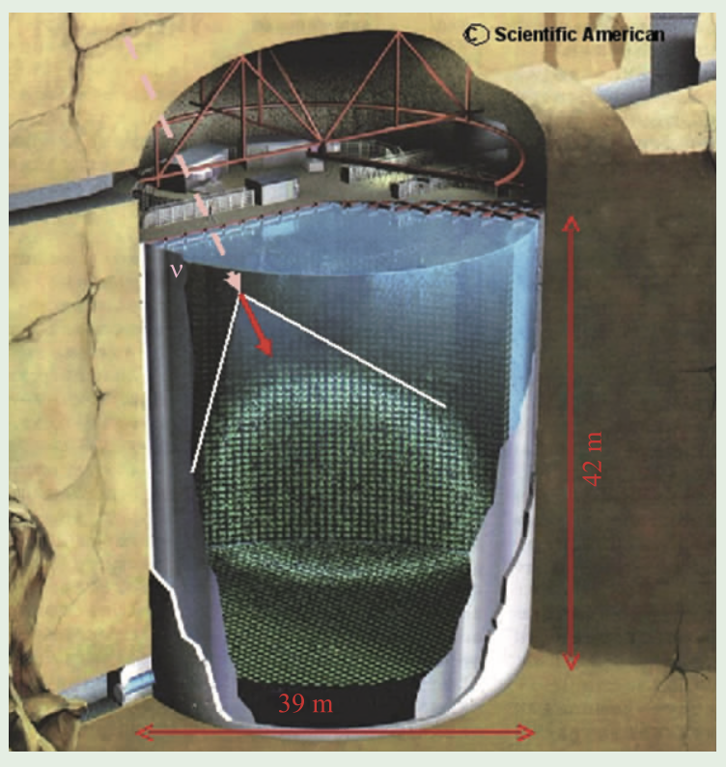
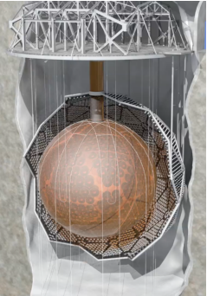
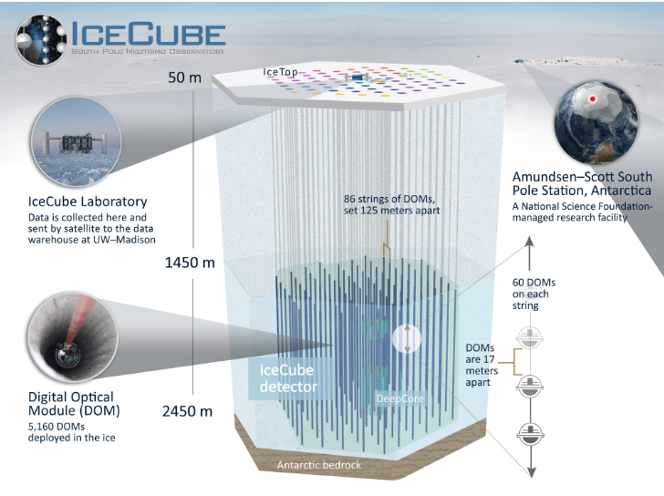
SNEWS
IceCube (The South Pole, jointed)
Super-K（Japan, joined）
SNO+（Canada, soon to join）
To better understand supernova explosions, more neutrino data is required!
(PASCOS 2024@Vietnam)
4

Slide 5
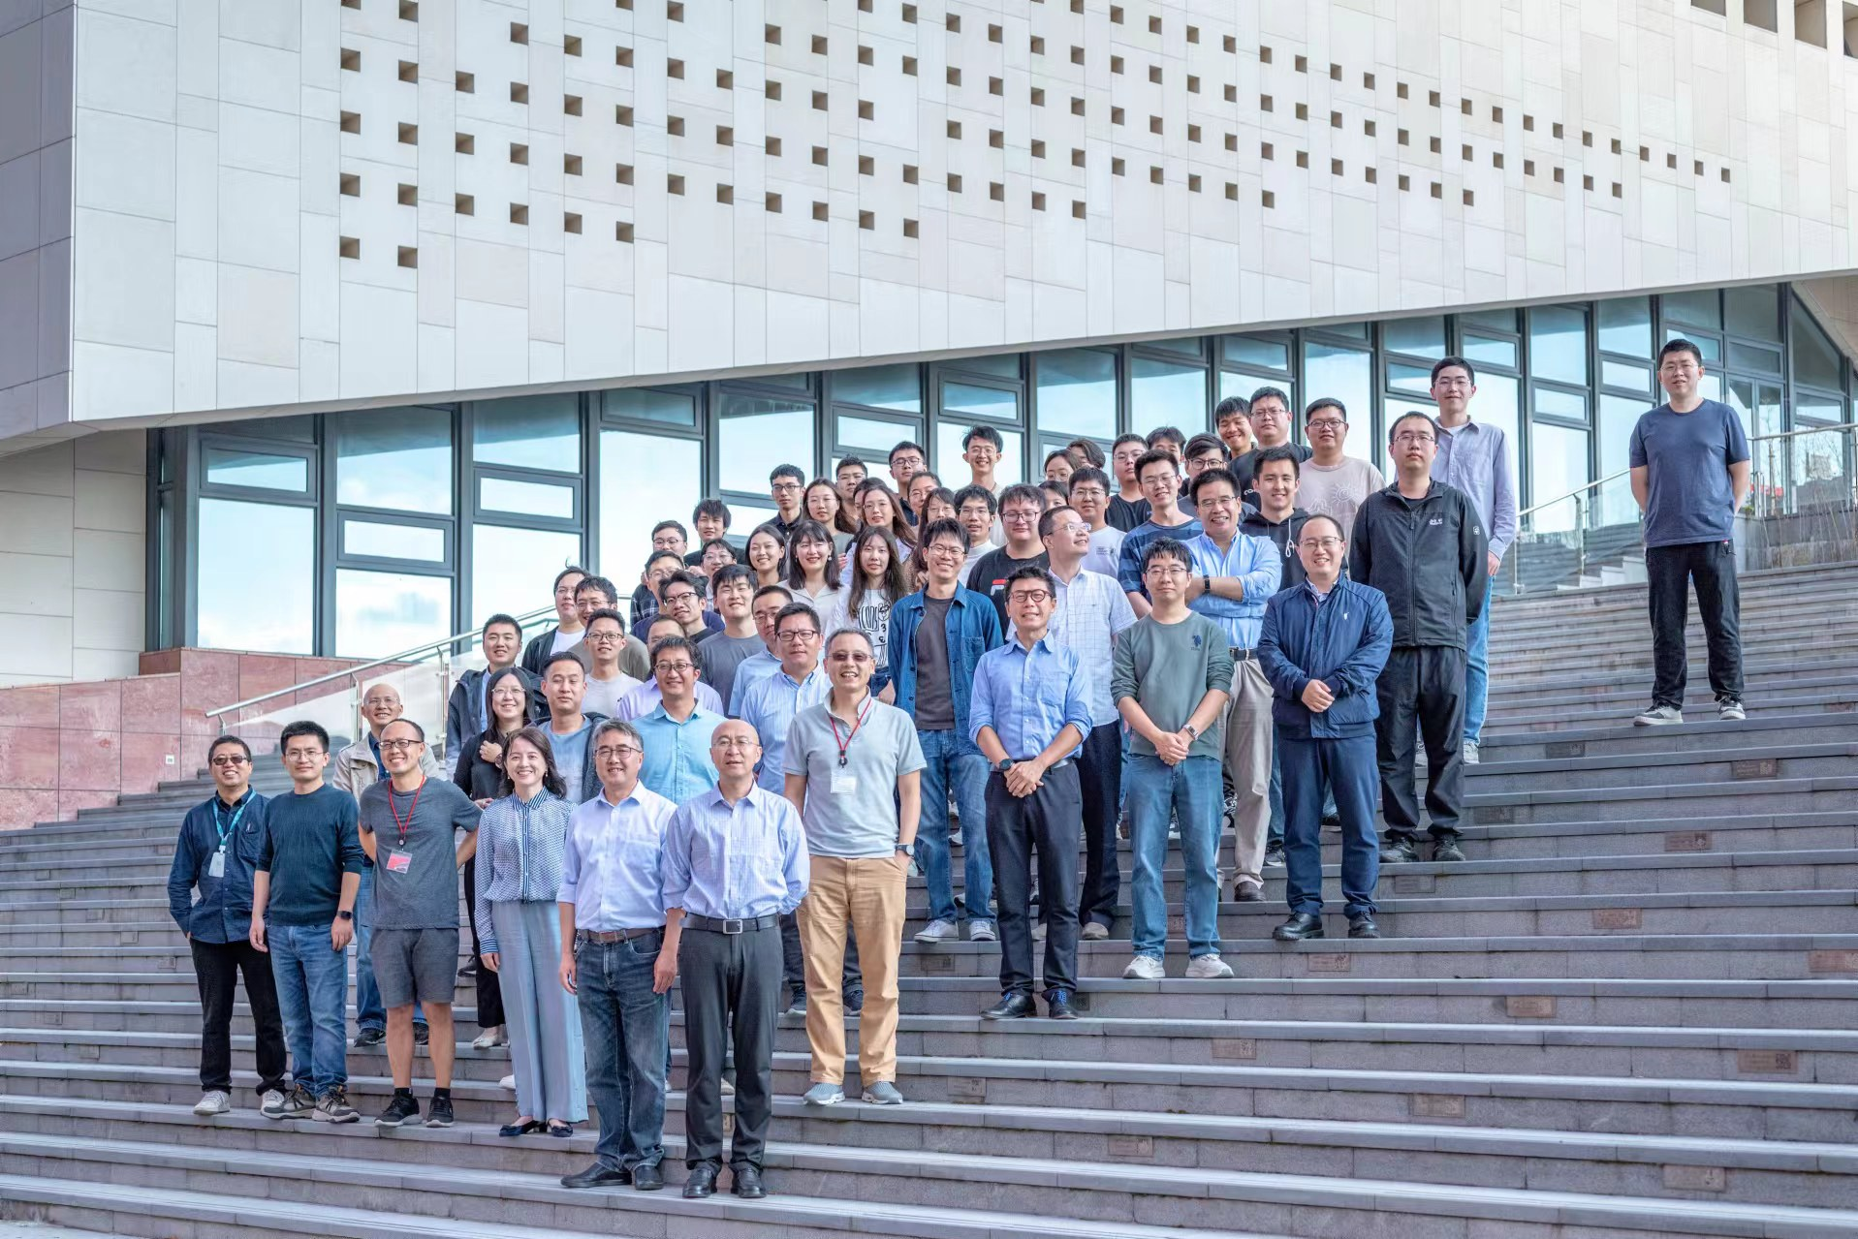
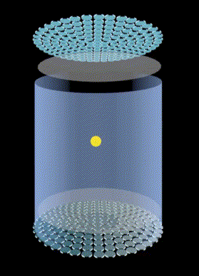
PandaX: Particle and Astrophysical Xenon
…
S2
Incident particle
S1
(PASCOS 2024@Vietnam)
5

Slide 6
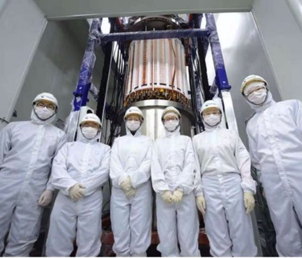
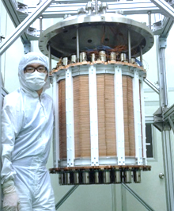
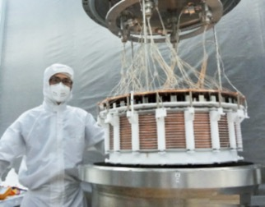
PandaX experiment
Increasing the detector sensitive target volume
Lowering radioactive background
PandaX-4T
(3.7 tonne)
PandaX-II 580kg
PandaX start
PandaX-I 120kg
2009
2010-2014
2015-2019
2020-
(PASCOS 2024@Vietnam)
6

Slide 7
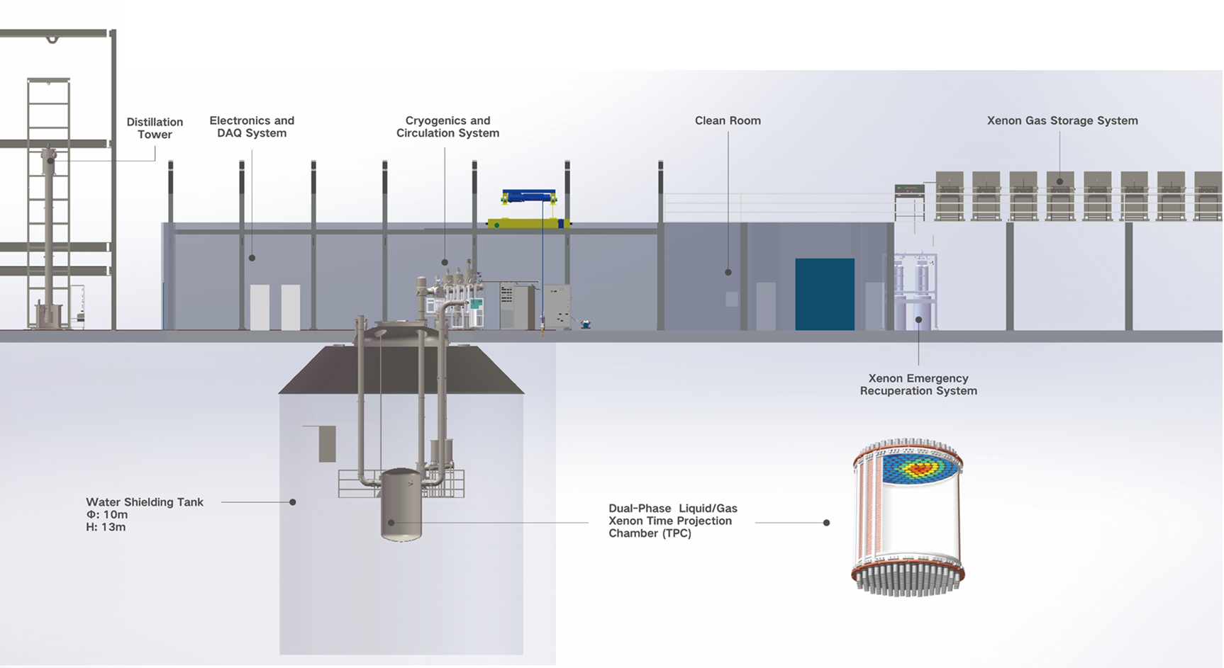
PandaX-4T layout
(PASCOS 2024@Vietnam)
7

Slide 8
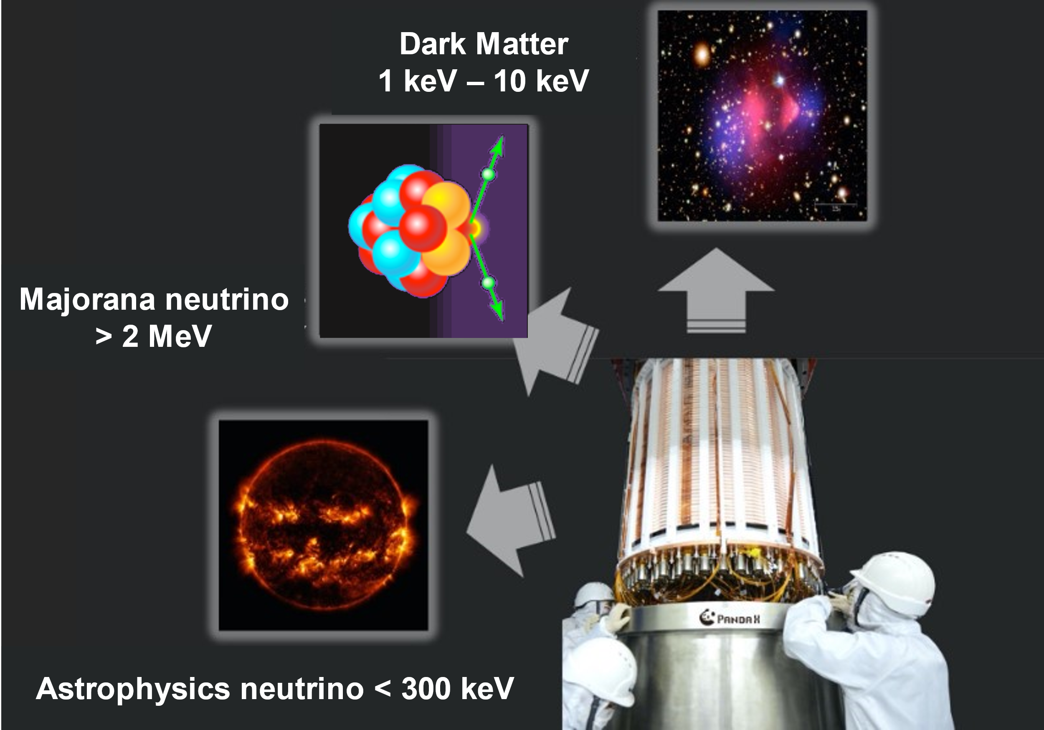
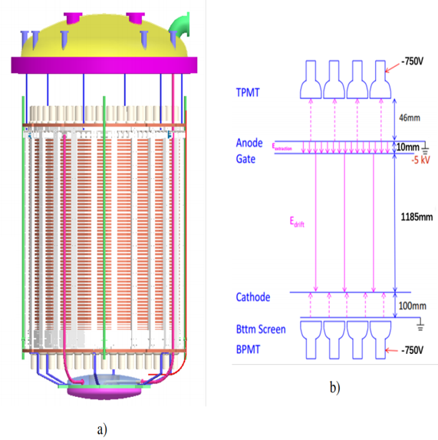
PandaX-4T detector
Dual-phase xenon time projection chamber (TPC)
Sensitive volume: 3.7 ton LXe
3-inch PMTs: 169 top / 199 bottom
ER(electron recoil)/NR(nuclear recoil) discrimination
3D position reconstruction
Physics search in PandaX-4T
Dark matter
Majornana nuetrino
Astrophysics neutrino (Supernova neutrino, …)
…
(PASCOS 2024@Vietnam)
8

Slide 9
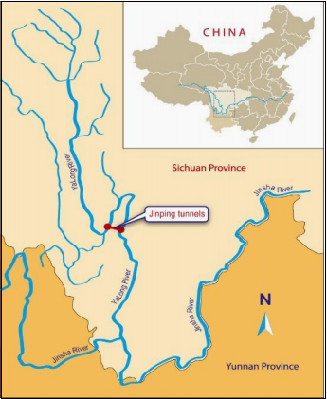
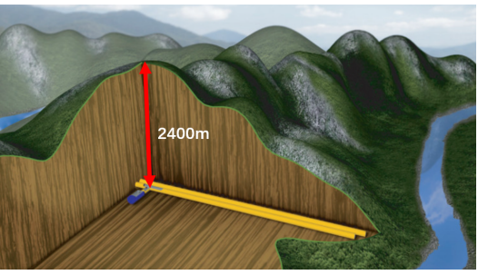
Adv. & challenge of detecting SN neutrinos
Low background;
Good background/signal distinguishing ability;
Larger interaction cross sections；
Neutrino oscillation may be ignored;
Dominant interaction channel is less;
Lower nuclear recoil energy ;
The smaller sensitive volume;
(PASCOS 2024@Vietnam)
9

Slide 10
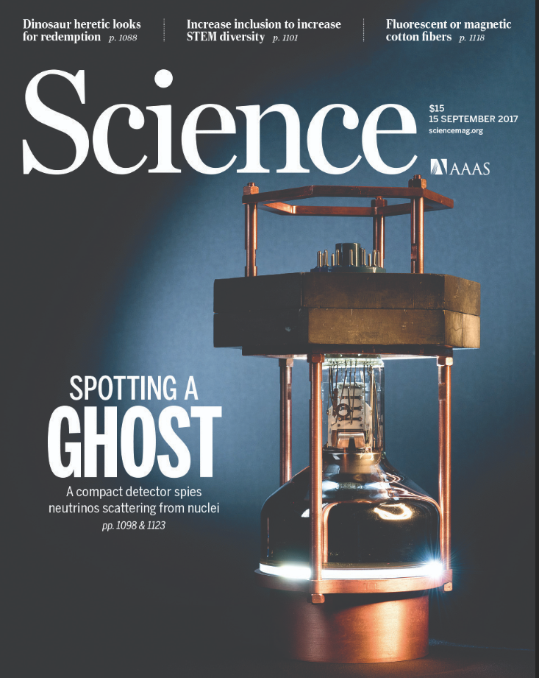
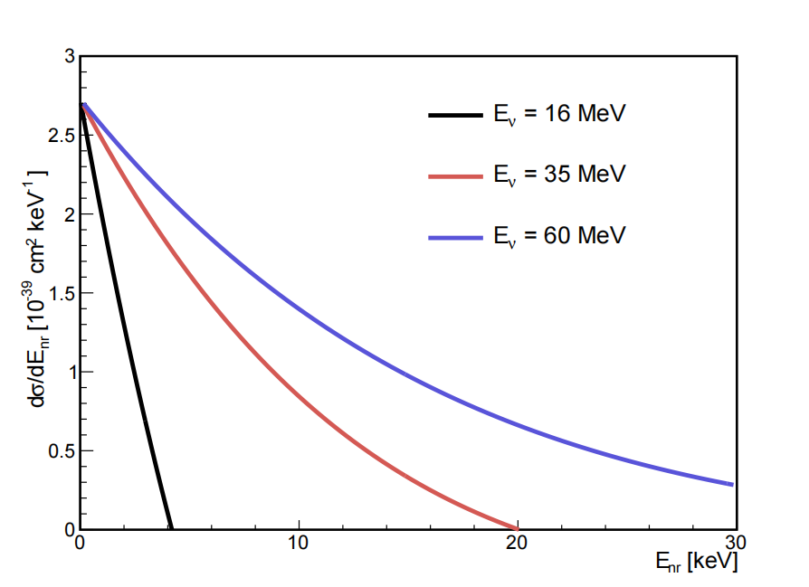
Coherent elastic neutrino-nucleus scattering(CE$ν$NS)
The CE𝜈NS process can be expressed as:
$$ν+nucleus→ ν + nucleus$$
The differential cross section of the CE$ν$NS($∝N^{2}$) :
Science 2017: CsI(Na)
10
(PASCOS 2024@Vietnam)

Slide 11
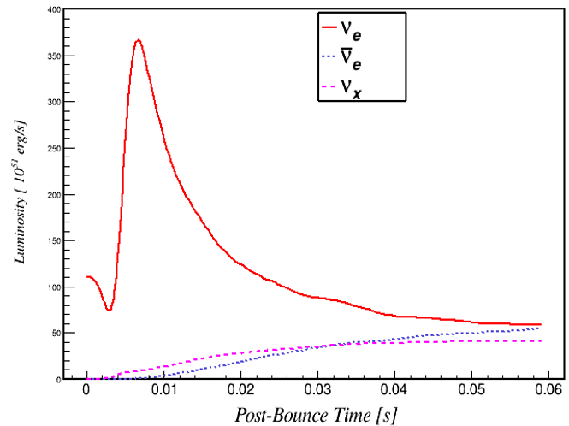
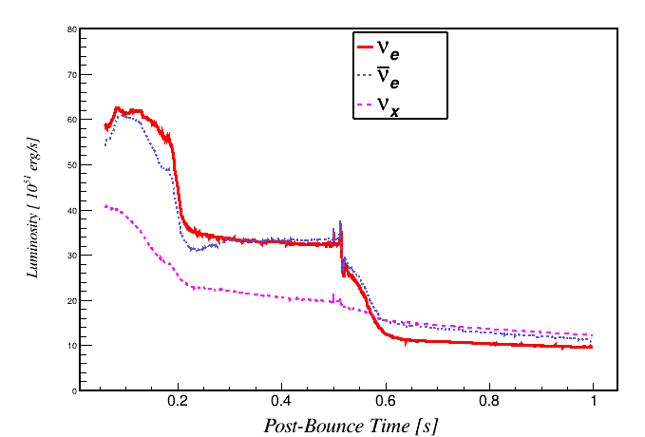
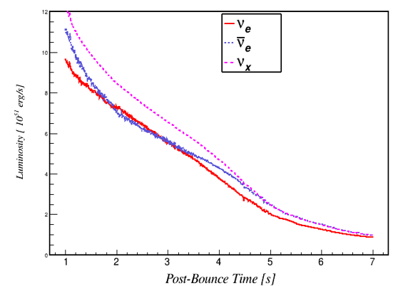
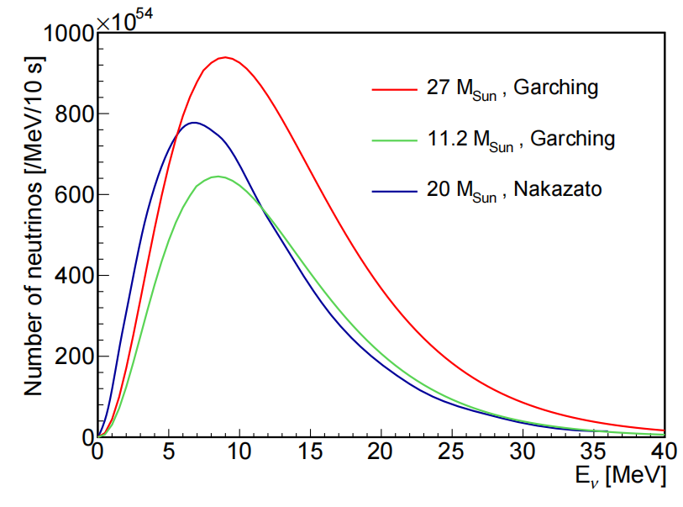
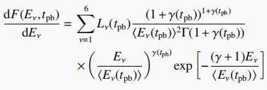
Energy spectrum of SN neutrinos
Luminosity [ 10⁵¹ erg/s ]
Luminosity [ 10⁵¹ erg/s ]
Luminosity [ 10⁵¹ erg/s ]
Accretion
Cool down
Neutronization
For Garching model, it can be characterized using Keil-Raffelt-Janka (KRJ) parametrization:
(PASCOS 2024@Vietnam)
11

Slide 12
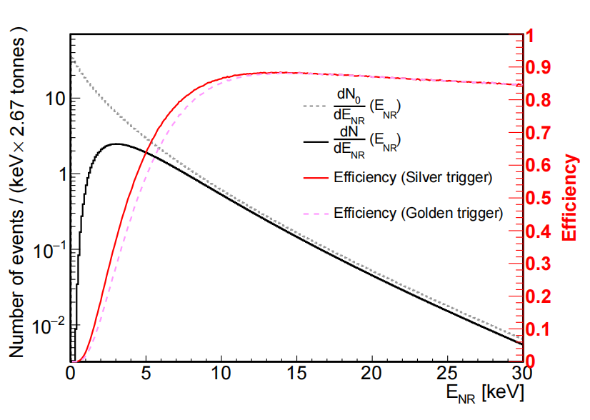
Signal spectrum in liquid xenon detectors
The differential event rate :
Considering the detection efficiency:
$$\frac{dN}{{dE}_{NR}}=ε(E_{NR})×\frac{{dN}_{0}}{{dE}_{NR}}(E_{NR})$$
The red (pink) line corresponds to silver (golden) trigger.
Chinese Physics C Vol. 48, No. 073022 (2024)
[arXiv:2403.06220]
(PASCOS 2024@Vietnam)
12

Slide 13
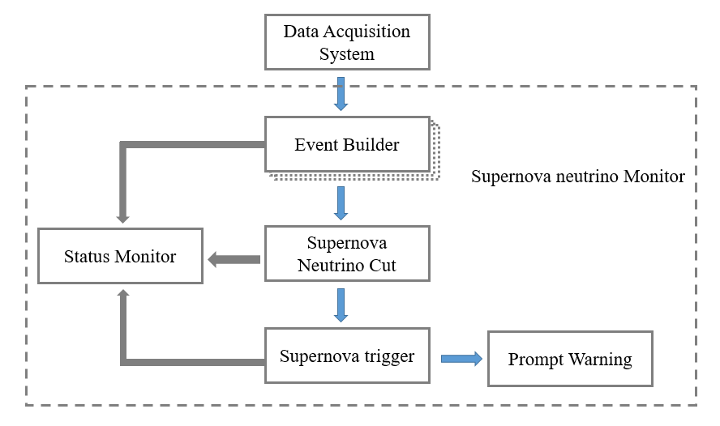
SN off-line trigger system of PandaX-4T
Level 1: Preliminary filter to event builder
Level 2: Apply data quality selection to reduce background
Level 3: The trigger algorithm to search alarm signal
The entire process takes several minutes for each individual file on average.
(PASCOS 2024@Vietnam)
13

Slide 14
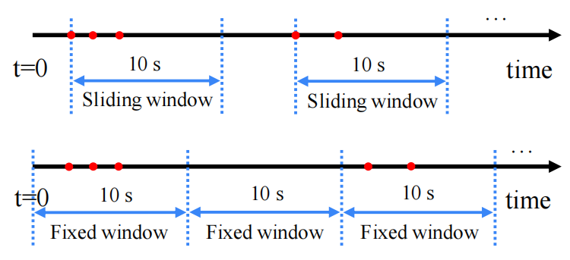
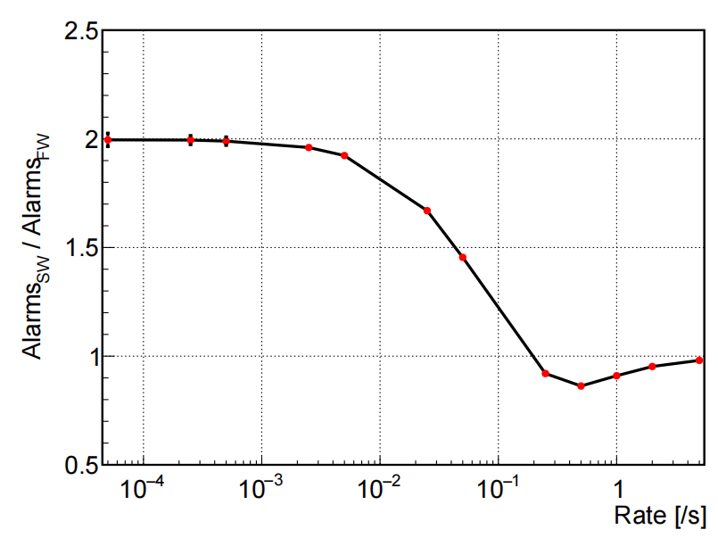
Estimation of false alert rate & trigger efficiency
Trigger probability:
$$p\left(N_{thr};T_{SN};r\right)=$$
The false alert rate per week
The signal trigger efficiency
$$T_{SN}=10s, N_{thr}=2$$
(PASCOS 2024@Vietnam)
14

Slide 15
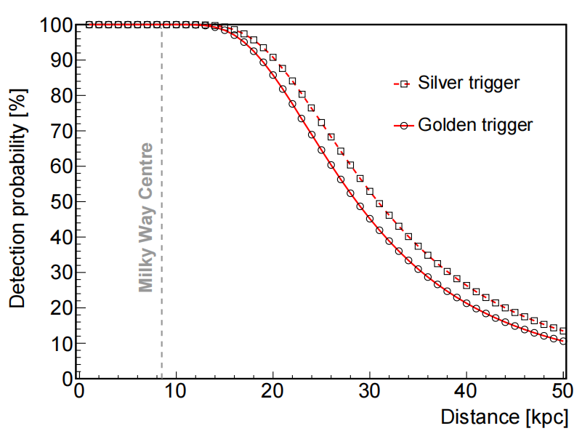
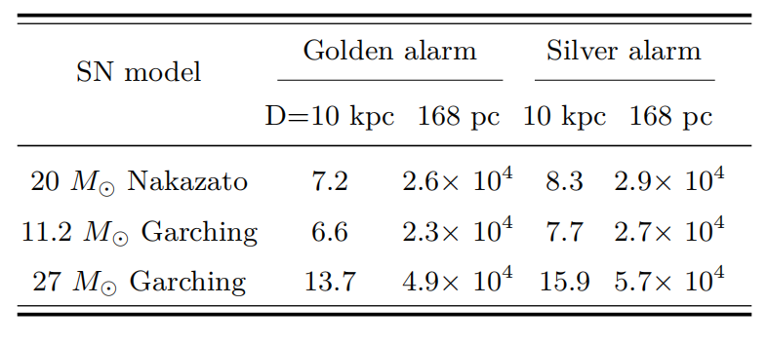
The detection probability of the SN explosions
Golden alarm : false alert rate one per month
Silver alarm : one per week
10 kpc: ~distance to center of the Milky Way
168 pc: ~distance to Betelgeuse
The probability of detecting SN explosions at different distances.
(PASCOS 2024@Vietnam)
15

Slide 16
Summary & future prospects
SN explosions neutrino signals are studied.
SN off-line trigger algorithm is built.
The relevant electronics is being designed.
Pandax-4T will apply to join SNEWS.
PandaX-xT ( ~40-tonne liquid xenon) has been proposed.
13.7 (4.9$×$10⁴) expected neutrino events in PandaX-4T at 10 kpc (168 pc).
Approximately 100% detection probability at 10 kpc.
(PASCOS 2024@Vietnam)
16

Slide 17
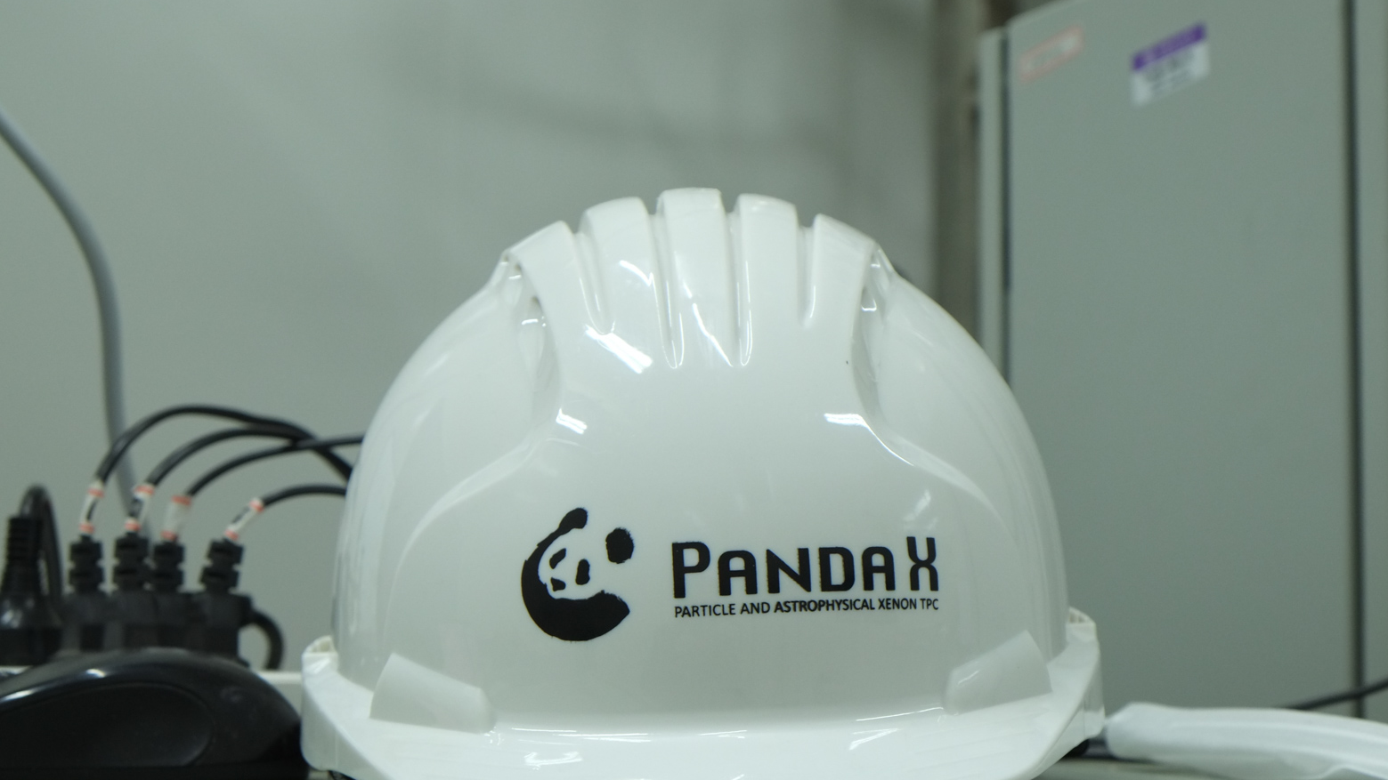
Thank you! Stay tuned!

