Slide 1
The Stochastic formalism in a curvaton scenario
Tomotaka KURODA
Tokyo Institute of Technology/ Institute for Basic Science
with A NARUKO, M YAMAGUCHI, V VENNIN (ongoing)
PASCOS, 9th July 2024

Slide 2
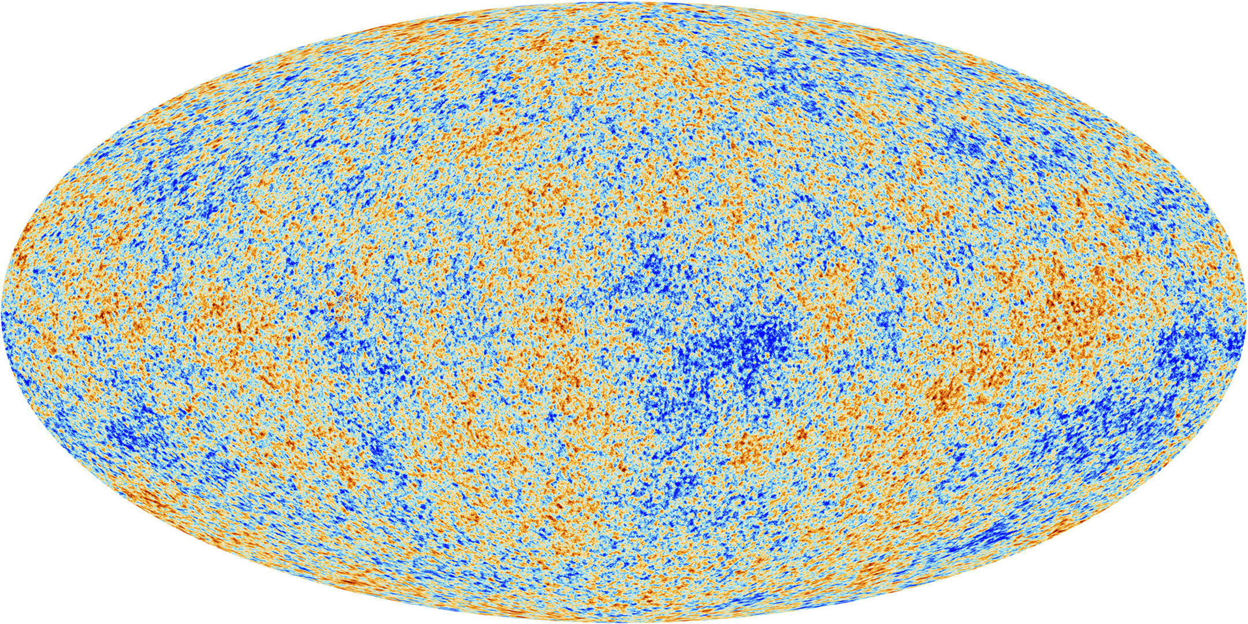
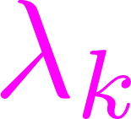
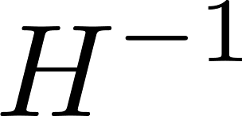
Footprints of inflation
1/11
inhomogenity & anisotropy from fluctuations generated during inflation
length
Cosmic Microwave Background😁👍
Big-bang universe
Inflation
small amplitude
almost Gaussian
horizon reentry
[ESA and the Planck Collaboration]
Primordial Black Holes🤔??
PBH
CMB
large amplitude
deviate from Gaussian
horizon exit
(large scale)
Dark Matter ?
PBH??
small scale
threshold
time ~ e-folds

Slide 3
Motivation
2/11
Some mechanism to generate large perturbations…
~
~
~
~
~
~
~
~
~
~
~
~
~
~
~
~
~
multi-field inflation
Stochastic formalism
inflaton
curvaton
+
theory
non-perturbatively
including both fields with detail analysis
phenomenology
large non-Gaussianity ⇒ PBHs

Slide 4
Contents of my talk
3/11
Analytical calculations by the stochastic-δN formalism
Non-Gaussianity from curvaton
Implication for PBHs

Slide 5
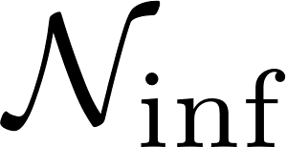
Overview & strategy
4/11
To evaluate curvature perturbations,
very light scalar field (spectator field)
generate which grew at super-horizon
stochastic
⇒
local-type
Inflation
⇒
Curvaton reheating scenario
e.g)
(⇒ )
(stochastic) δN
Probabilities for , are necessary to calculate

Slide 6
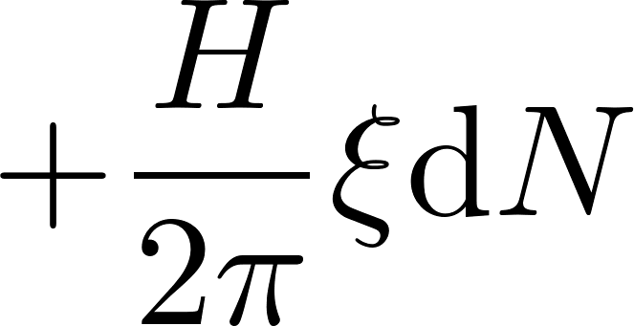
Stochastic formalism
5/11
[Starobinsky (1986)]
Focused, Classical
focusing
long wavelength modes
quantum, linear
EoM:
(Langevin eqs)
sub-horizon
from sub-horizon to super-horizon
at
as Gaussian noise
s u p e r - h o r i z o n

Slide 7
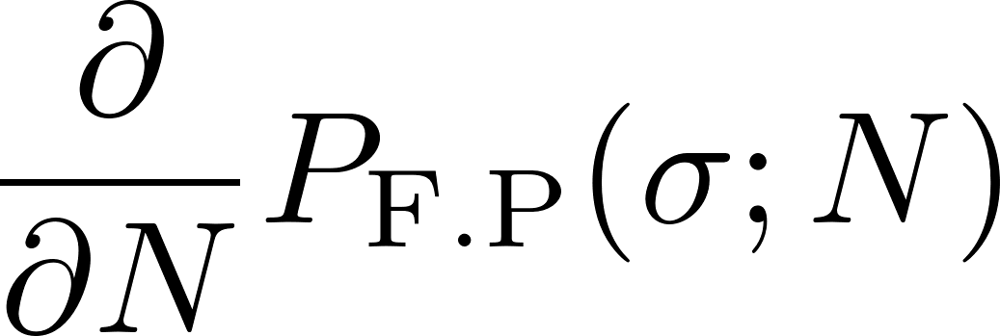
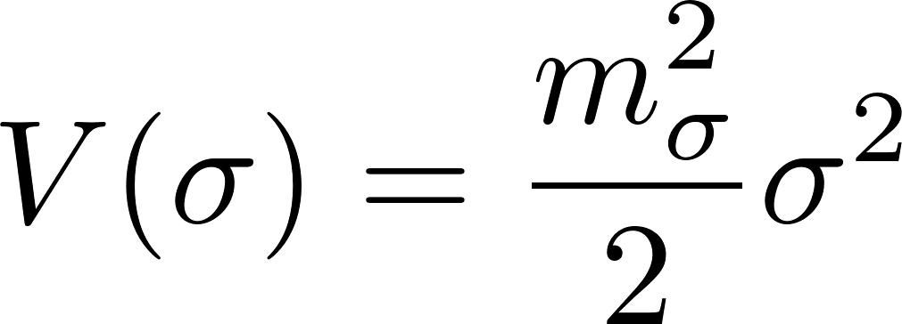
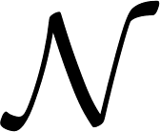
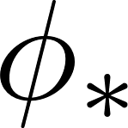
Probability distributions
6/11
[Fujita, et al 1308.4754]
[Vennin, et al 1506.04732]
[Assadullahi, et al 1604.045027]
[Pattison, et al 1707.00537]
Fokker-Planck eq.
Eq for First Passage Time
~
~
~
~
~
~
~
~
~
~
~
~
~
~
~
~
~
⇒ inflation driven by only
; spectator field
( )
+FP eq. for
e.g.)
for e-folds from an initial set to the end
for the field value at time

Slide 8
What we finally calculate
7/11
Inflation
⇒
Curvaton reheating scenario
prob.
for and
for the field value at the end
for e-folds during inflation

Slide 9
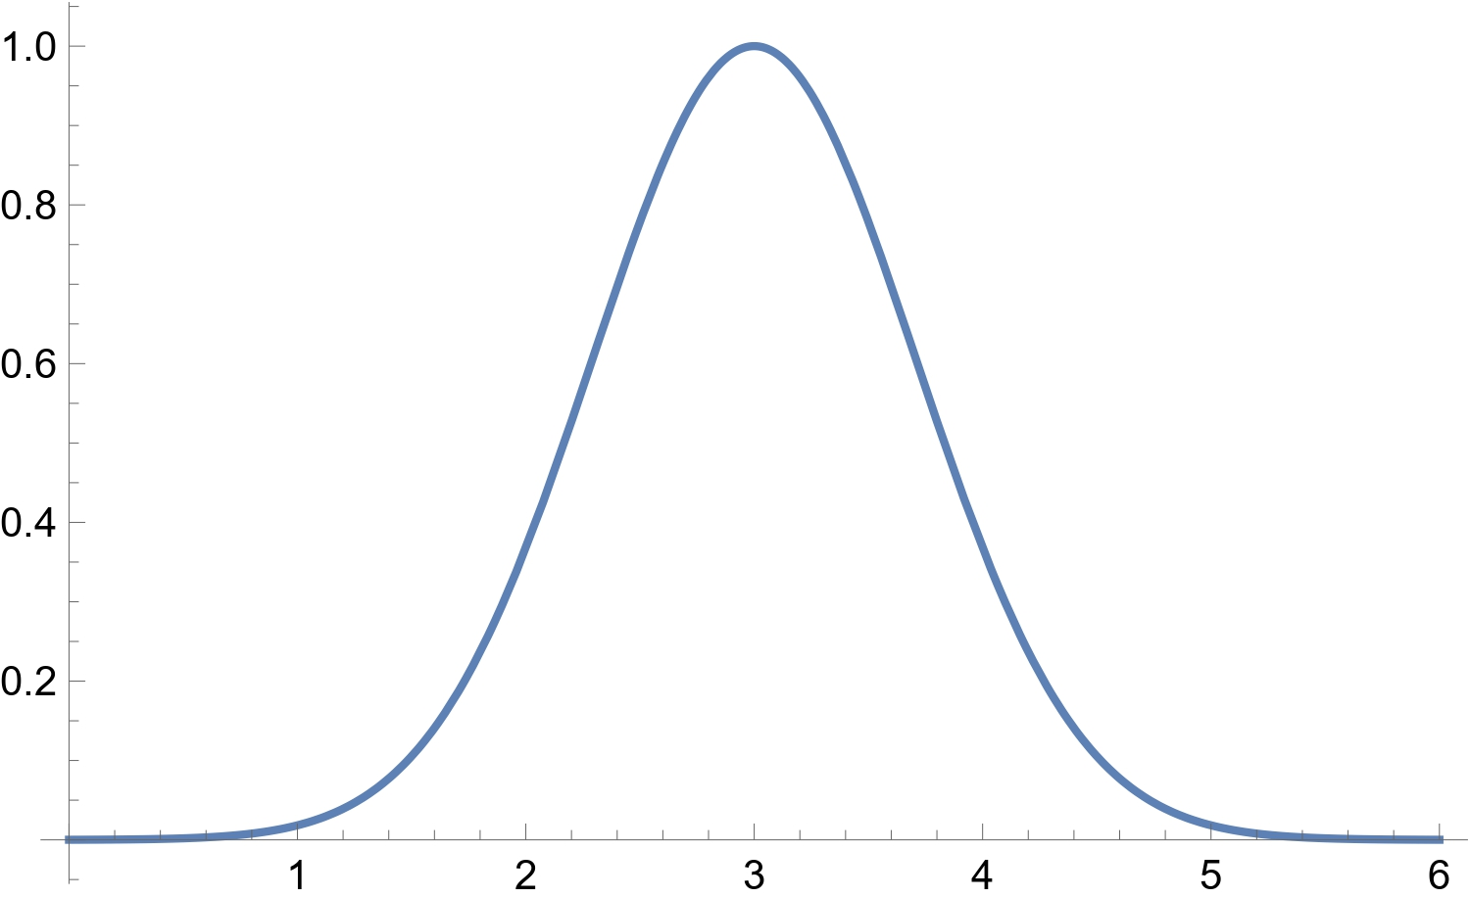
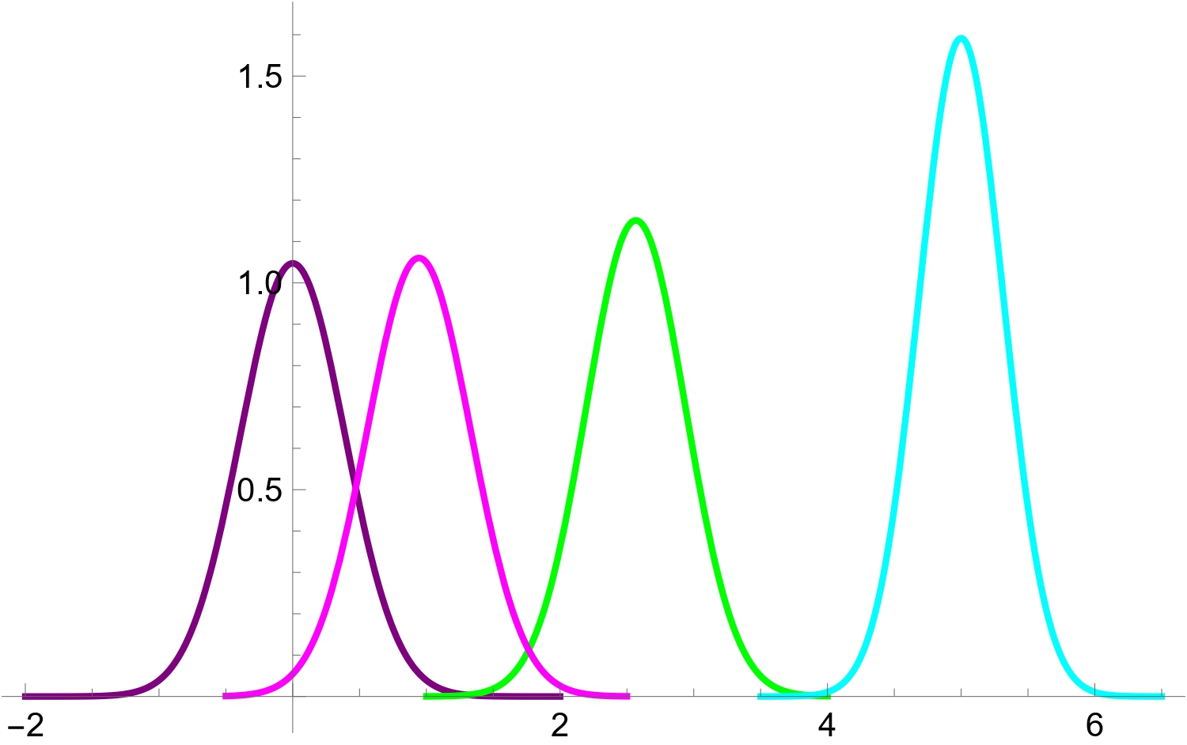
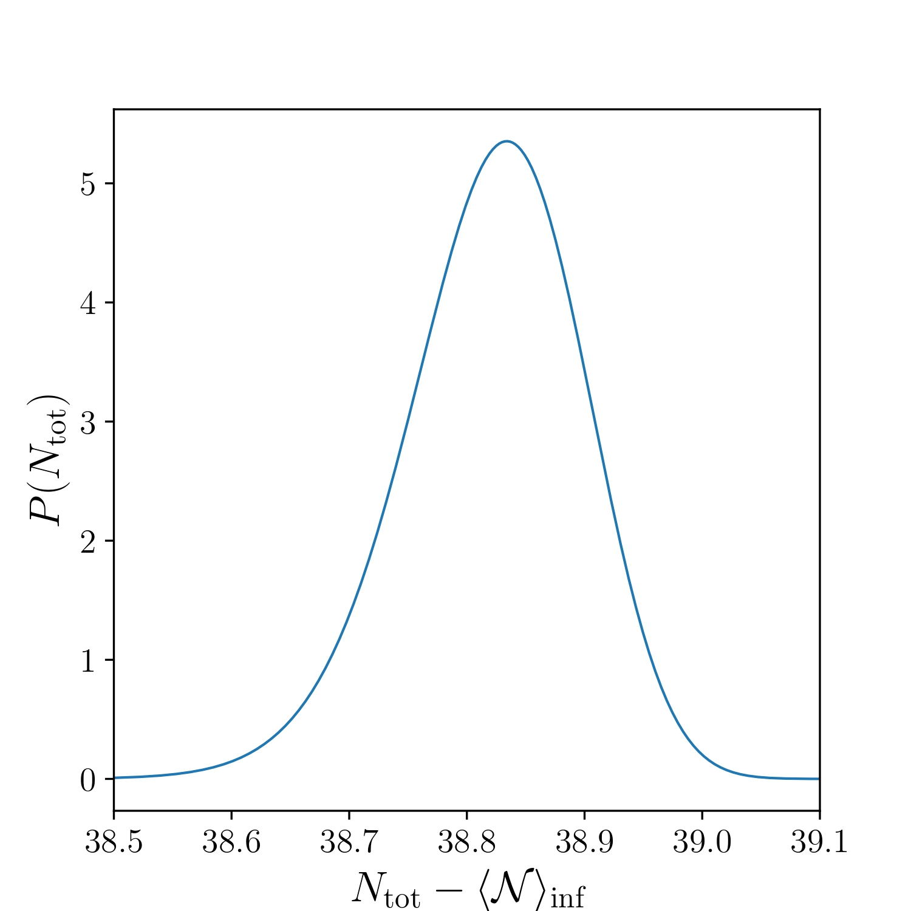
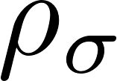
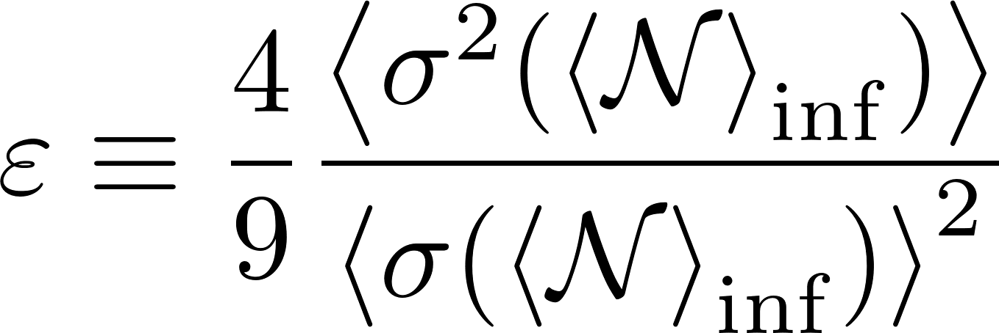
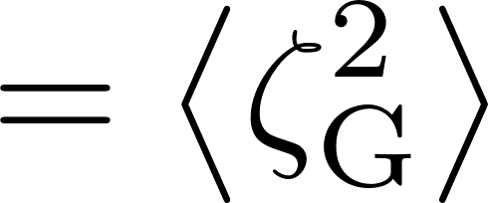
Results 1
8/11
:Gaussian
non-perturbativity
[Enqvist, et al. 1205.5446]
When is dominant at ,
reduced to a local-type
non-Gaussian
distribution

Slide 10
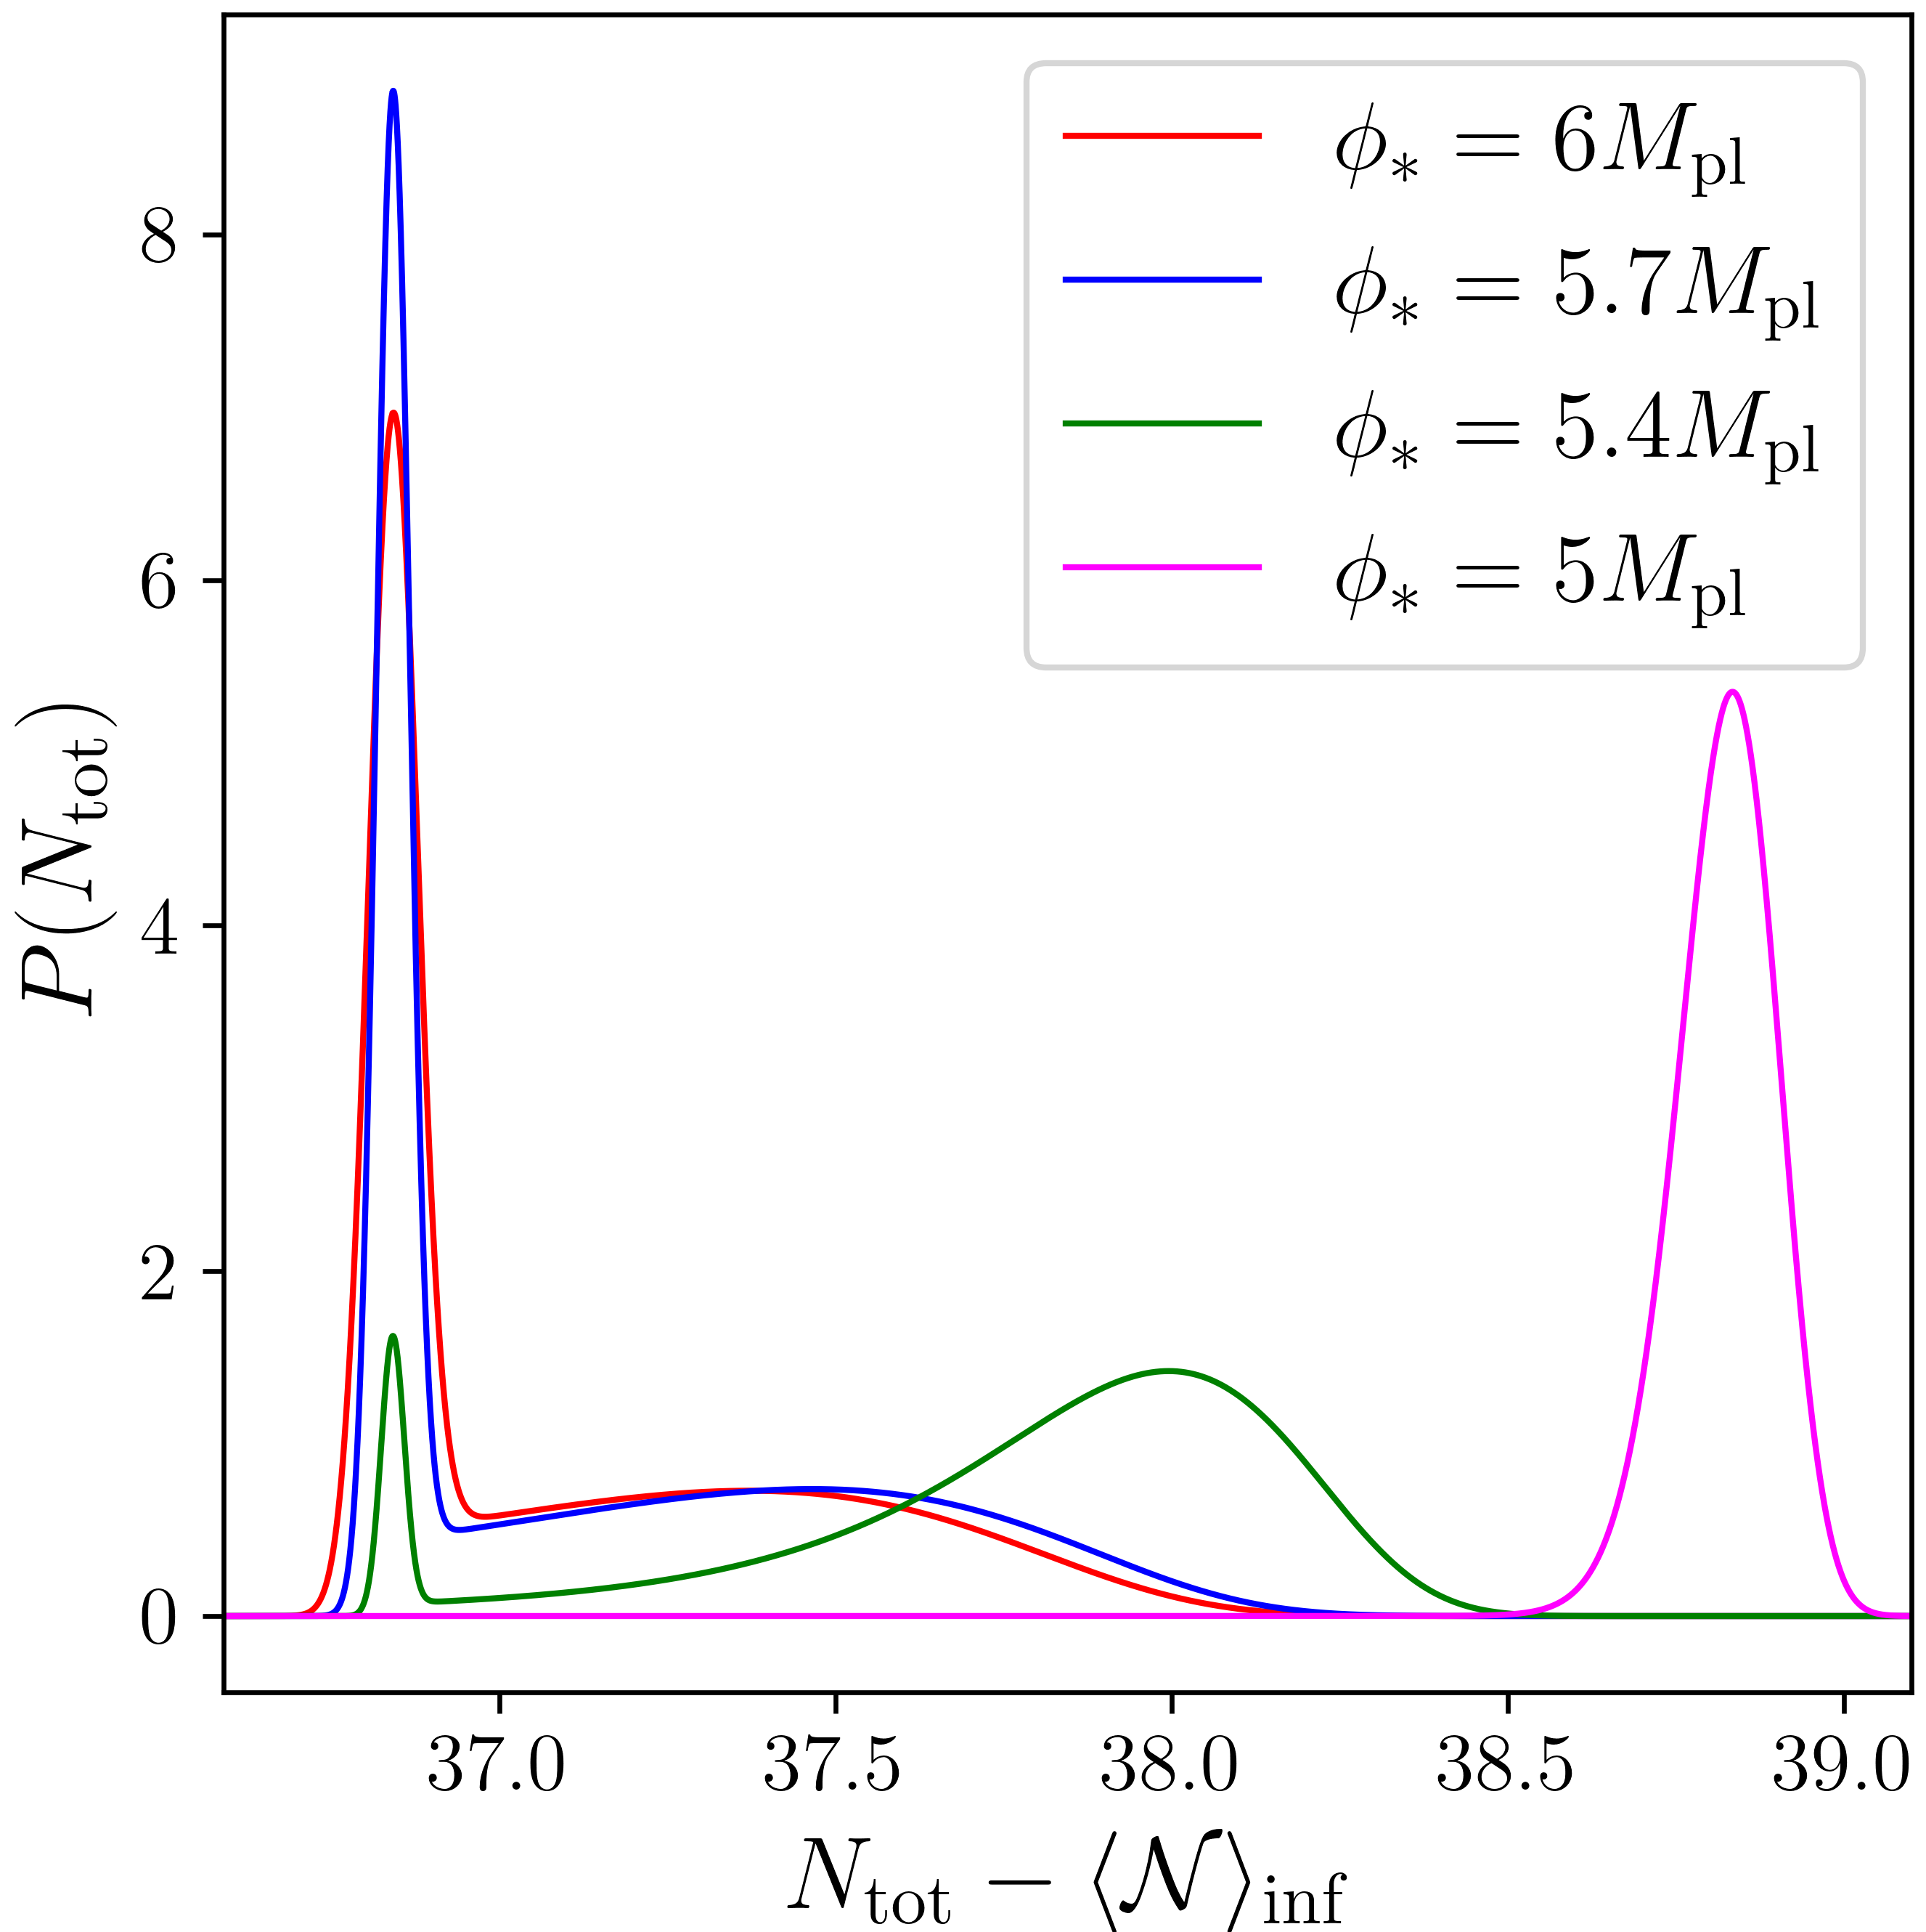
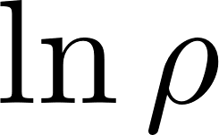
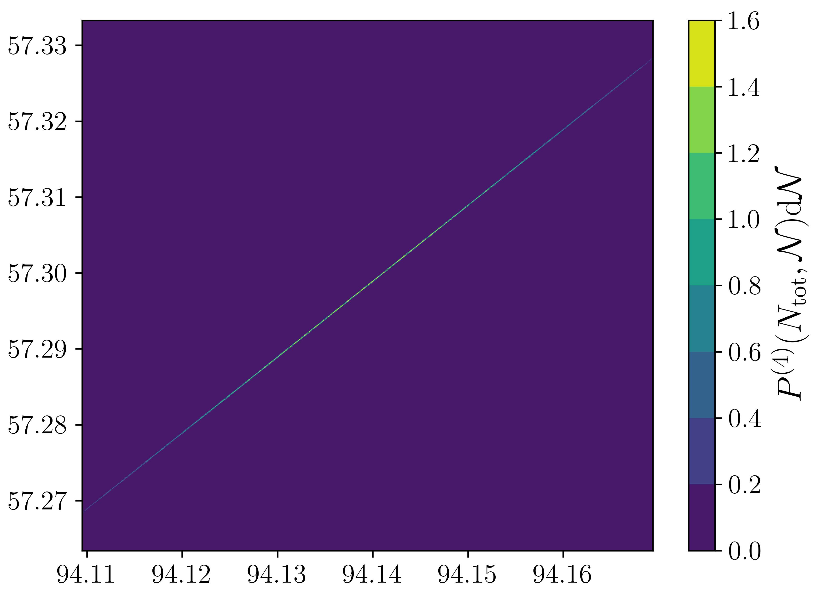
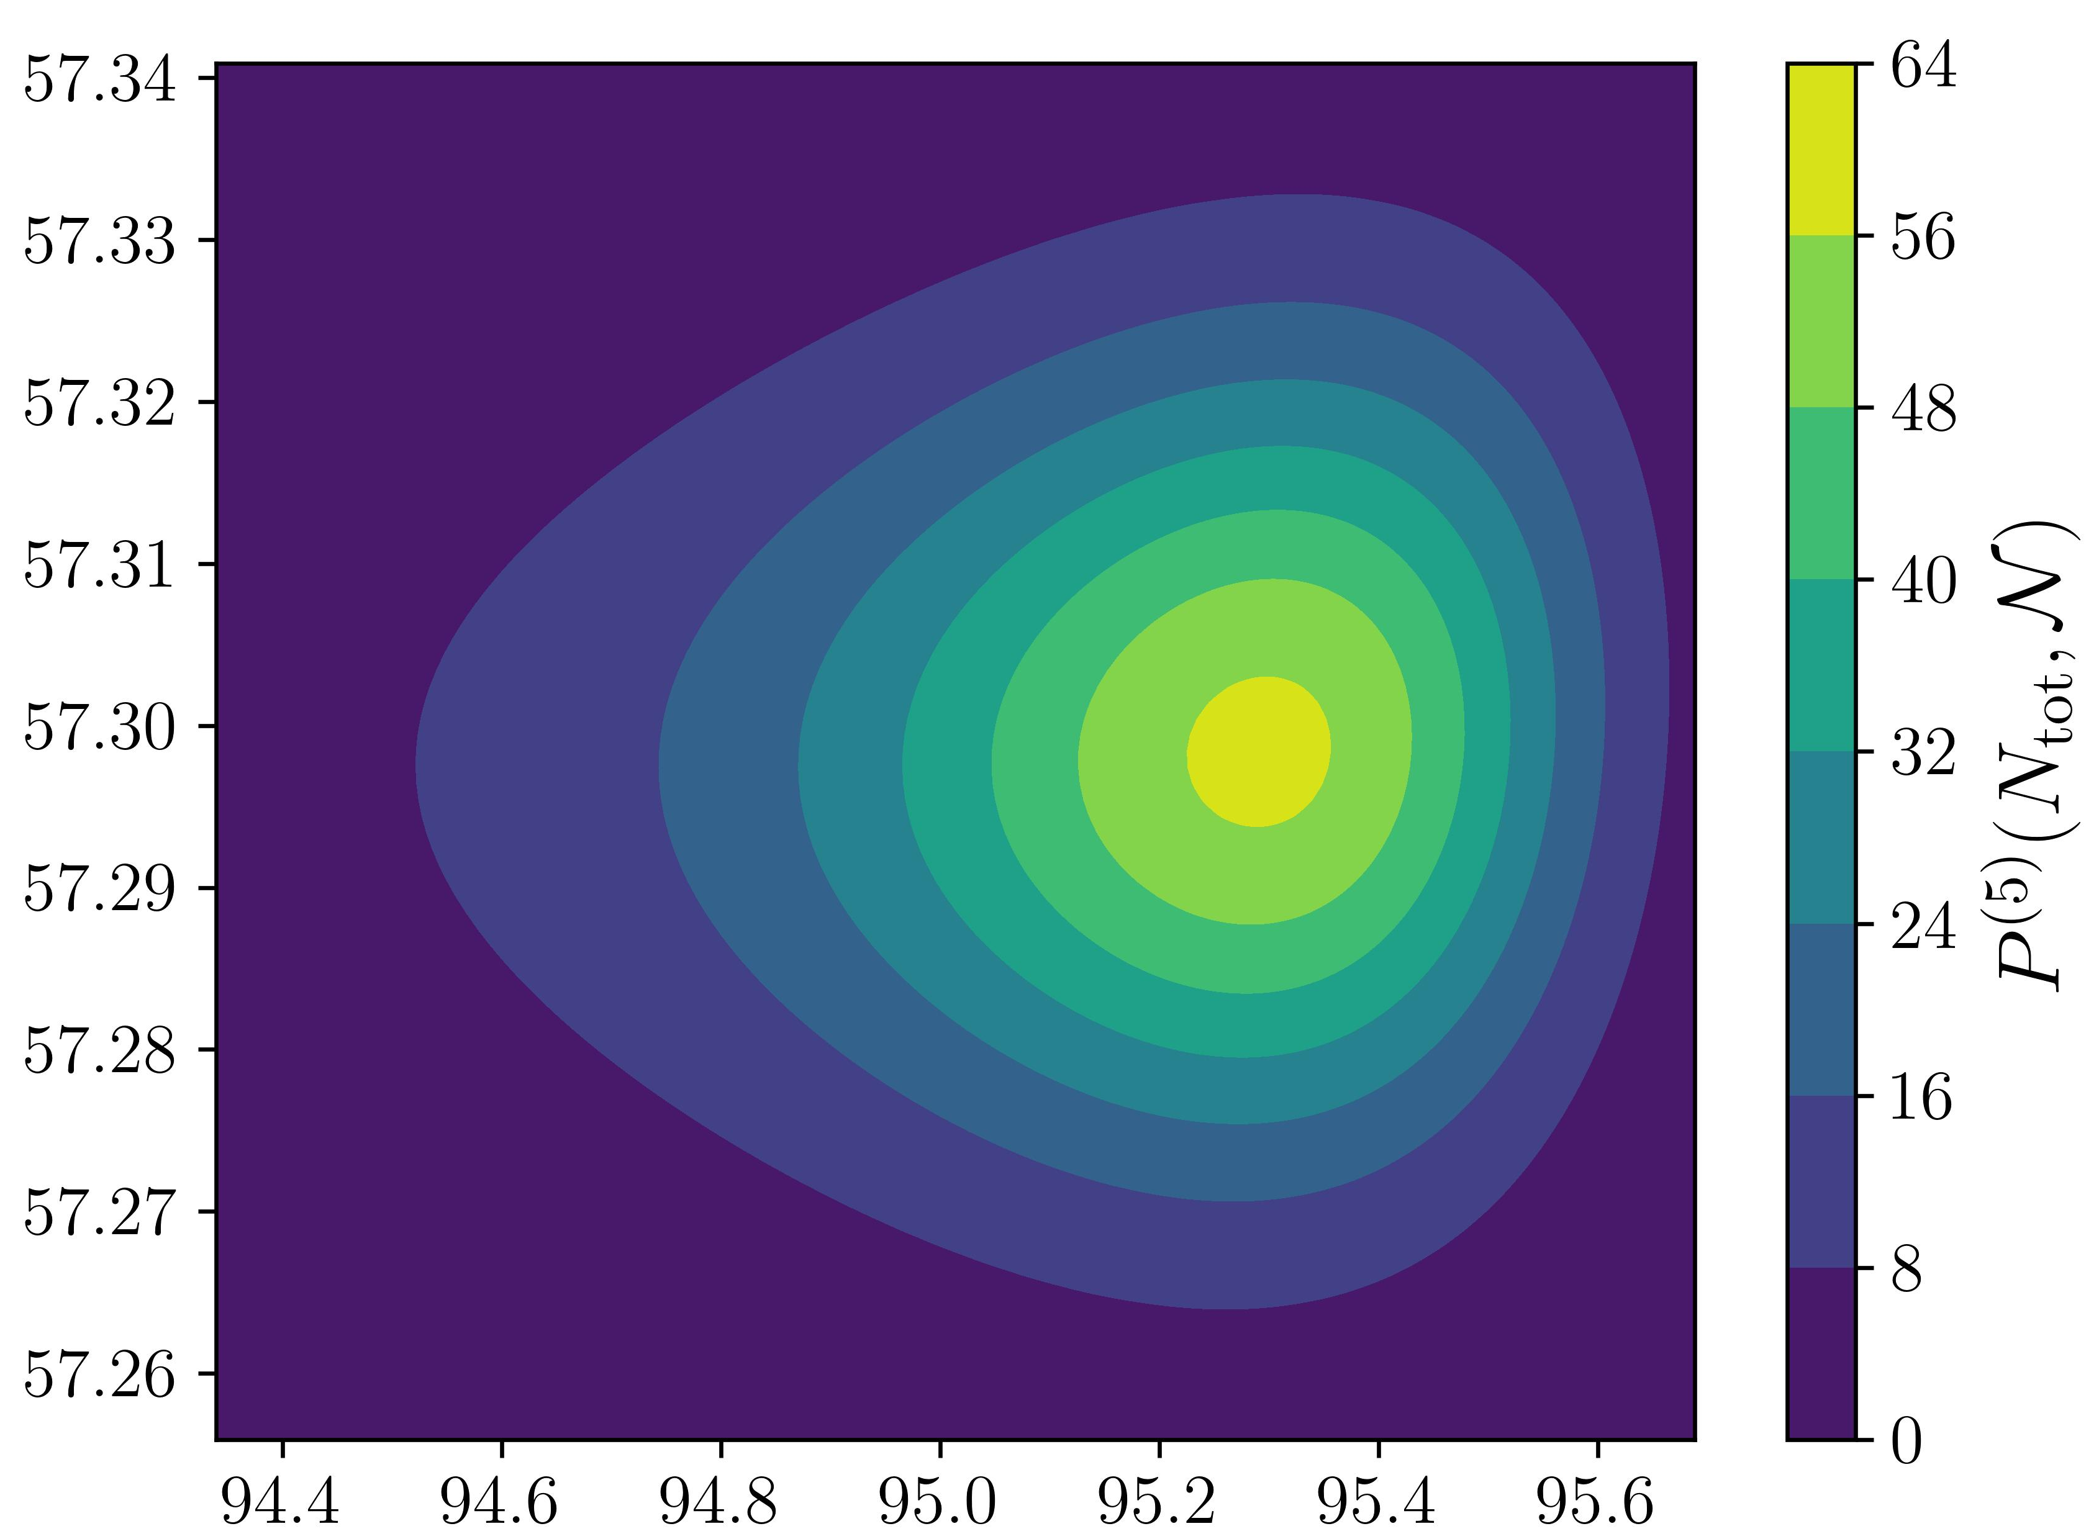
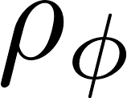
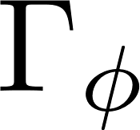
Results 2
9/11
In general case,
(Starobinsky model)
sourced
sourced
from ,
subdominant
dominant
from only
c.f)
dominant
subdominant
correlation

Slide 11
Implication for PBhs
10/11
Gaussian
Possibility
depends on horizon exit scale
large non-Gaussianity at small scale, with
almost Gaussian distribution at large scale
produce PBHs
&
sourced
from
match the CMB results
,
sourced
from
large non-Gaussianity

Slide 12
Conclusion
11/11
PDFs calculated by stochastic-δN formalism include non-perturbativity and are reduced to a local-type non-Gaussian distribution in an appropriate limit (perturbative, no-inflaton), as expected.
There exist a set of parameters where observational results of CMB is realized at large scale (sourced from ) , while PBHs might be produced at small scale (sourced from , ).

Slide 13
Back up slides

Slide 14
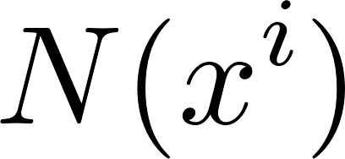
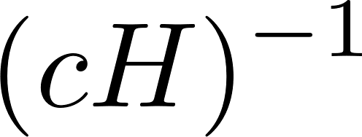
Separate universe
5/21
At super-horizon scale,
[Lyth, et al. astro-ph/0411220]
non-linear relationship
our universe
an ensemble of patches,
independent FLRW universes
curvature
perturbation
fluctuations
of e-folds
[Sasaki, et al. astro-ph/9507001]
[Wands, et al. astro-ph/0003278]
uniform density
flat
flat
time
space

Slide 15
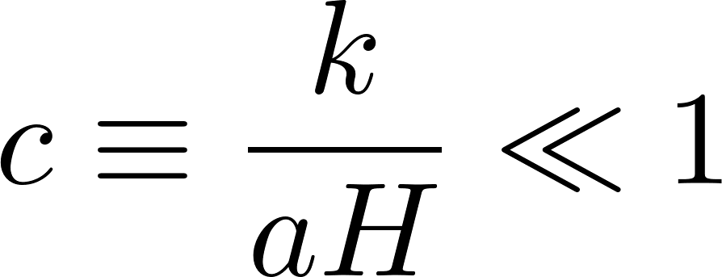
N formalism
22/21
δ
⇒
gradient expansion
choosing following slices
In the case of adiabatic fluctuation ,
uniform density
flat
flat
generalization for non-linear perturbation
gauge independent
conserved (time independent)

Slide 16
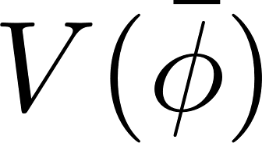
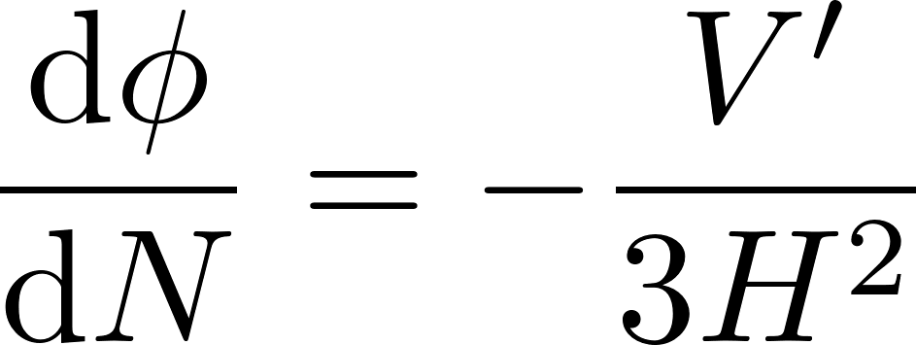
Stochastic inflation
6/21
As an Effective Field Theory for long wavelength (super-horizon) modes of inflaton(s)
Focused, Classical
[Starobinsky (1986)]
stochastic!!
Quantum, linear
: Langevin eq.
non-linear evolution
c.f) SR
the end of inflation
sub-horizon
s u p e r - h o r i z o n
from sub-horizon to super-horizon at
as Gaussian noise

Slide 17
How to separate ir & UV
23/21
:step function
EoM
Langevin equations
EOM for as free field
gradient expansion
quantum to classical
one-patch
leading order in slow roll

Slide 18
Stochastic- N formalism
7/21
δ
Stochastic inflation
+
How long?
→
different results
for each realization
δN formalism
Stochastic-δN formalism
Inflation
for each patch
time
[Fujita, et al 1308.4754]
[Vennin, et al 1506.04732]
space

Slide 19
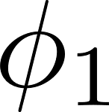
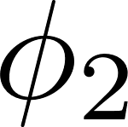
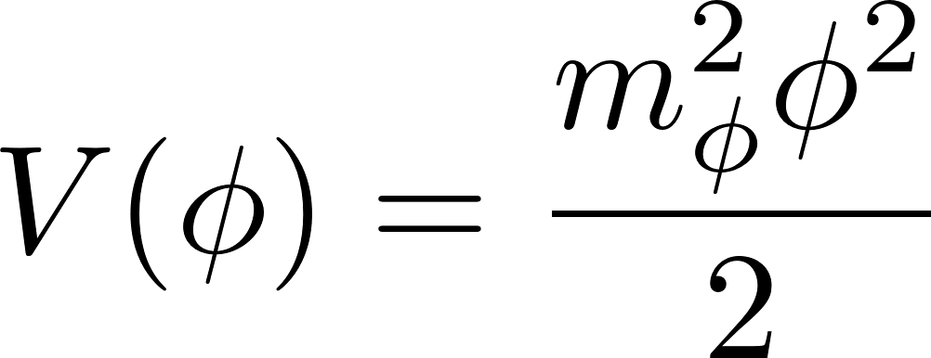
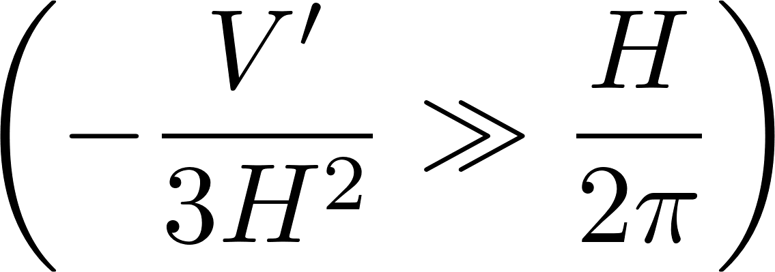
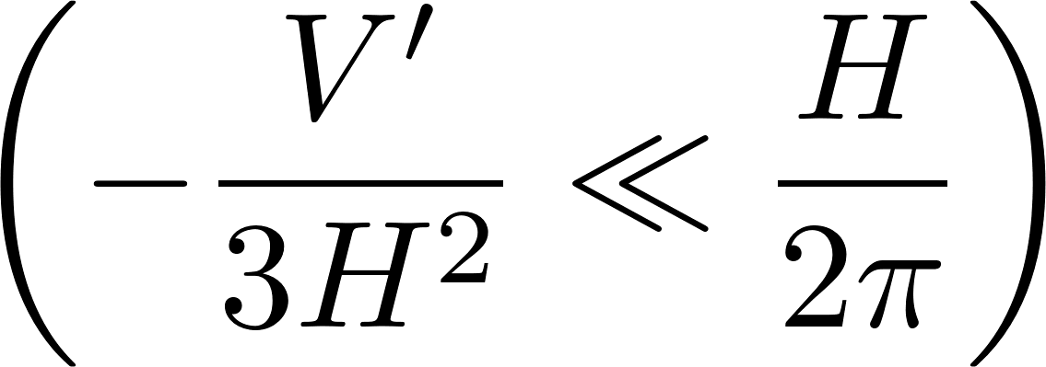
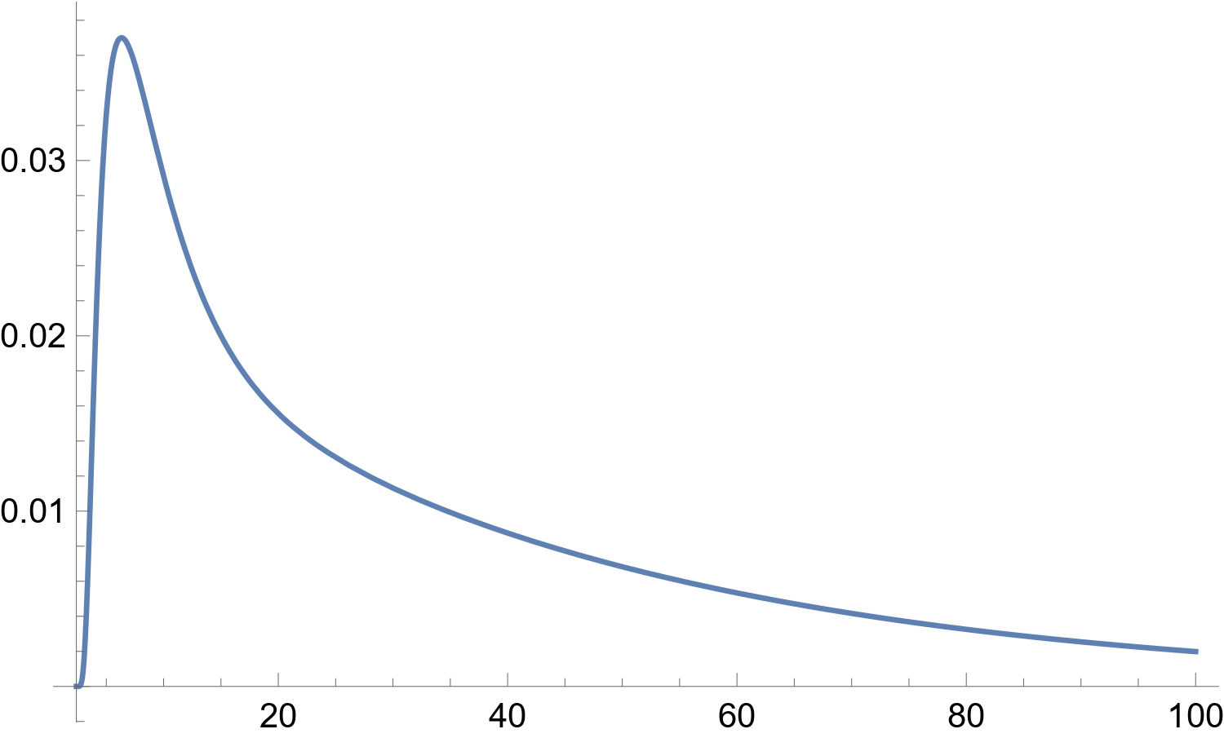
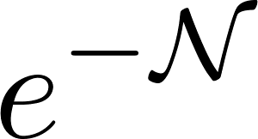
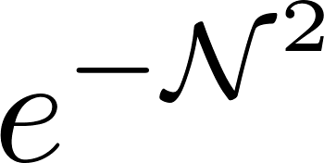
Probability distributions
e.g.)
8/21
Langevin eq.
for
[Assadullahi, et al. 1604.045027]
[Pattison, et al. 1707.00537]
for the field value at time
(⇐ Fokker-Planck eq.)
(⇐ Adjoint FP eq.)
for e-folds from an initial set to the end
Fokker-Planck eq
start
Adjoint Fokker-Planck eq
goal
passes the end surface for the first time
with some initial or boundary conditions
For spectator field with ,
For large ,
reach an equilibrium state
classical limit
stochastic limit
exp decay
Gaussian

Slide 20
Solution for FP eq
24/21
For spectator field with ,
where
~
~
~
~
~
~
~
~

Slide 21
Solution for AFP eq
25/21
with boundary conditions,
classical limit
stochastic limit
e.g)
LO:
NLO:
Exponential decay!

Slide 22
Probability distributions
Fokker-Planck eq
Adjoint Fokker-Planck eq
with some initial or boundary conditions
9/21
Langevin eq.
for
[Assadullahi, et al. 1604.045027]
[Pattison, et al. 1707.00537]
for the field value at time
(⇐ Fokker-Planck eq.)
(⇐ Adjoint FP eq.)
for e-folds from an initial set to the end
For spectator field with ,
[Enqvist, et al. 1205.5446]
e.g.)
For large ,
reach an equilibrium state
start
goal
classical limit
stochastic limit
passes the end surface for the first time
exp decay
Gaussian

Slide 23
Probability distributions
Fokker-Planck eq
Adjoint Fokker-Planck eq
with some initial or boundary conditions
For spectator field with ,
For large ,
reach an equilibrium state
10/21
Langevin eq.
for
[Assadullahi, et al. 1604.045027]
[Pattison, et al. 1707.00537]
for the field value at time
(⇐ Fokker-Planck eq.)
(⇐ Adjoint FP eq.)
for e-folds from an initial set to the end
classical limit
stochastic limit
exp decay
Gaussian
e.g.)
start
goal
passes the end surface for the first time

Slide 24
What is curvaton
3/11
[Moroi, et al. hep-ph/0110096]
[Lyth, et al. hep-ph/0110002]
[Enquivst, et al. hep-ph/0109214]
very light scalar field (spectator field)
local-type:
⇒
generate which grew at super-horizon for each pacth
I
II
III
IV
V
II
III,IV
V
Inflation
still slow-rolling
oscillation as dust
dominant
subdominant
decay to radiation
⇒
⇒

Slide 25
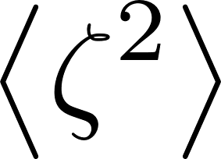
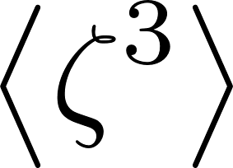
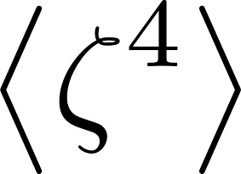
Non-gaussianity
26/21
Bunch-Davis vac
linear perturbations
⇒
Gaussian statics characterized by only
c.f) CMB
higher orders
Non-Gaussianity
…
,
e.g) local-type non-Gaussianity
: obeying Gaussian statics

Slide 26
Curvaton scenario
27/21
In the following,
Considering duration of each phase and summing up all,
case A: curvaton dominates
contributions from ,
case B: curvaton subdominant
contributions from

Slide 27
Complicated expressions
28/21
perturbatively
+ more terms

Slide 28
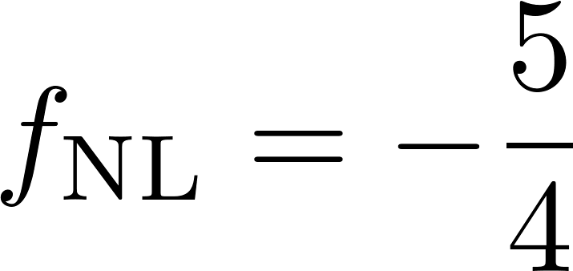
Comparison
29/21
result:
correspondence
substituting
into Gaussian distribution,

Slide 29
Cosmic inflation
1/12
[ESA and the Planck Collaboration]
accelerated expansion
before Big-bang universe
Inflation =
inhomogeneity and anisotropy
time
inflation
space
Laboratory for very high energy physics

Slide 30
Stochastic- N formalism
5/12
δ
Focusing long wavelength modes of inflaton(s) ,
[Starobinsky (1986)]
How long?→
Focused, Classical
Quantum, linear
: Langevin eq.
Inflation
c.f) SR
[Fujita, et al (2013) 1308.4754]
[Vennin, et al (2015) 1506.04732]
sub-horizon
non-linear evolution
time
s u p e r - h o r i z o n
space

Slide 31
Probability distributions
6/12
For spectator field with ,
(⇐ Fokker-Planck eq.)
for the field value at time
e.g.)
In classical limit
(⇐ Adjoint FP eq.)
Gaussian
for e-folds from an initial set to the end
[Assadullahi, et al (2016) 1604.045027]
[Pattison, et al (2017) 1707.00537]

Slide 32
Motivation
7/12
theoretical & phenomenological aspects ⇒ multifield inflation
inflaton
curvaton
+
stochastic δN
very light scalar field (spectator field)
generate which grew at super-horizon
⇒
local-type
theory
non-perturbatively
including both fields with detail analysis
phenomenology
large non-Gaussianity ⇒ PBHs

Slide 33
What is curvaton
3/11
[Moroi, et al. hep-ph/0110096]
[Lyth, et al. hep-ph/0110002]
[Enquivst, et al. hep-ph/0109214]
very light scalar field during inflation
local-type:
⇒
generate which grew at super-horizon for each pacth
I) inflation
depends on
I
II
III
IV
V
II)~IV) reheating
generated
; oscillate
⇒
decay to rad.
; slow-roll
⇒
oscillate
⇒
decay to rad.
dominant
subdominant
⇒
⇒

Slide 34
Conclusion
11/11
Curvaton can generate large non-Gaussianities.
PDFs calculated by stochastic-δN formalism include non-perturbativity.
They are reduced to local-type non-Gaussian distribution in an appropriate limit (perturbative, no-inflaton), as expected.
There are a set of parameters where observational results of CMB is realized at large scale (sourced from ) , while PBHs might be produced at small scale (sourced from , ).
Thank you for your attention!

