Slide 1
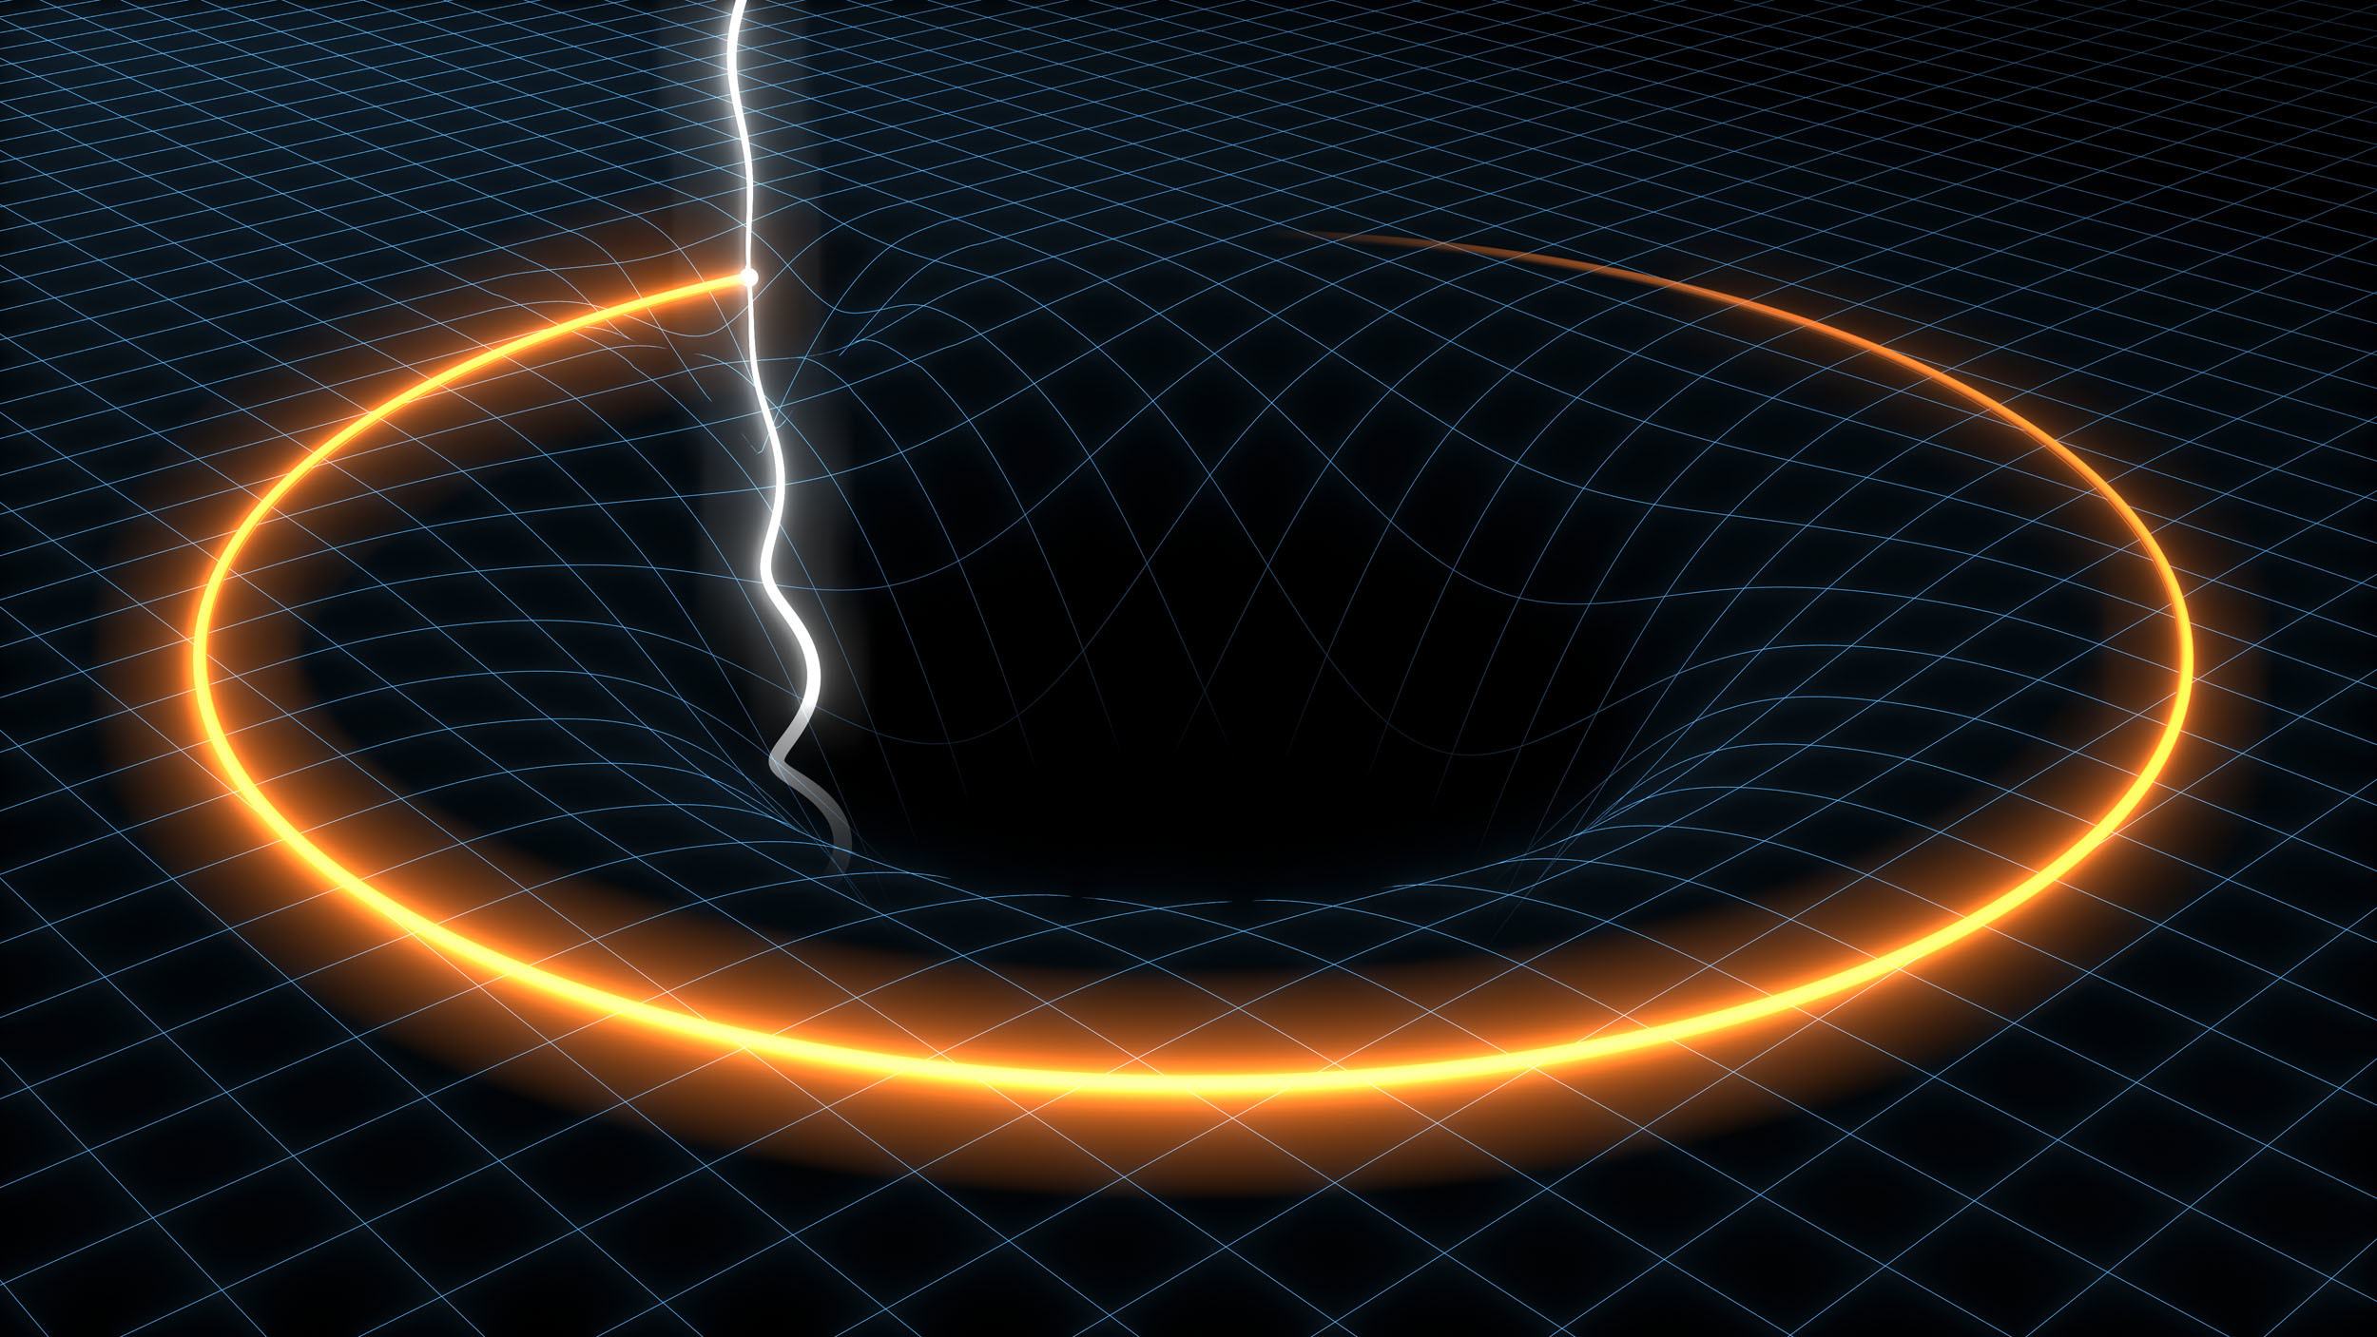
Strong-field Tests of Gravity with Gravitational Waves
Kent Yagi
University of Virginia
PASCOS 2024, Quy Nhon, Vietnam
July 9th 2024

Slide 2

This morning with my family
Kent Yagi

Slide 3
Strong-field Tests of Gravity with Gravitational Waves
Kent Yagi
University of Virginia
PASCOS 2024, Quy Nhon, Vietnam
July 9th 2024

Slide 4
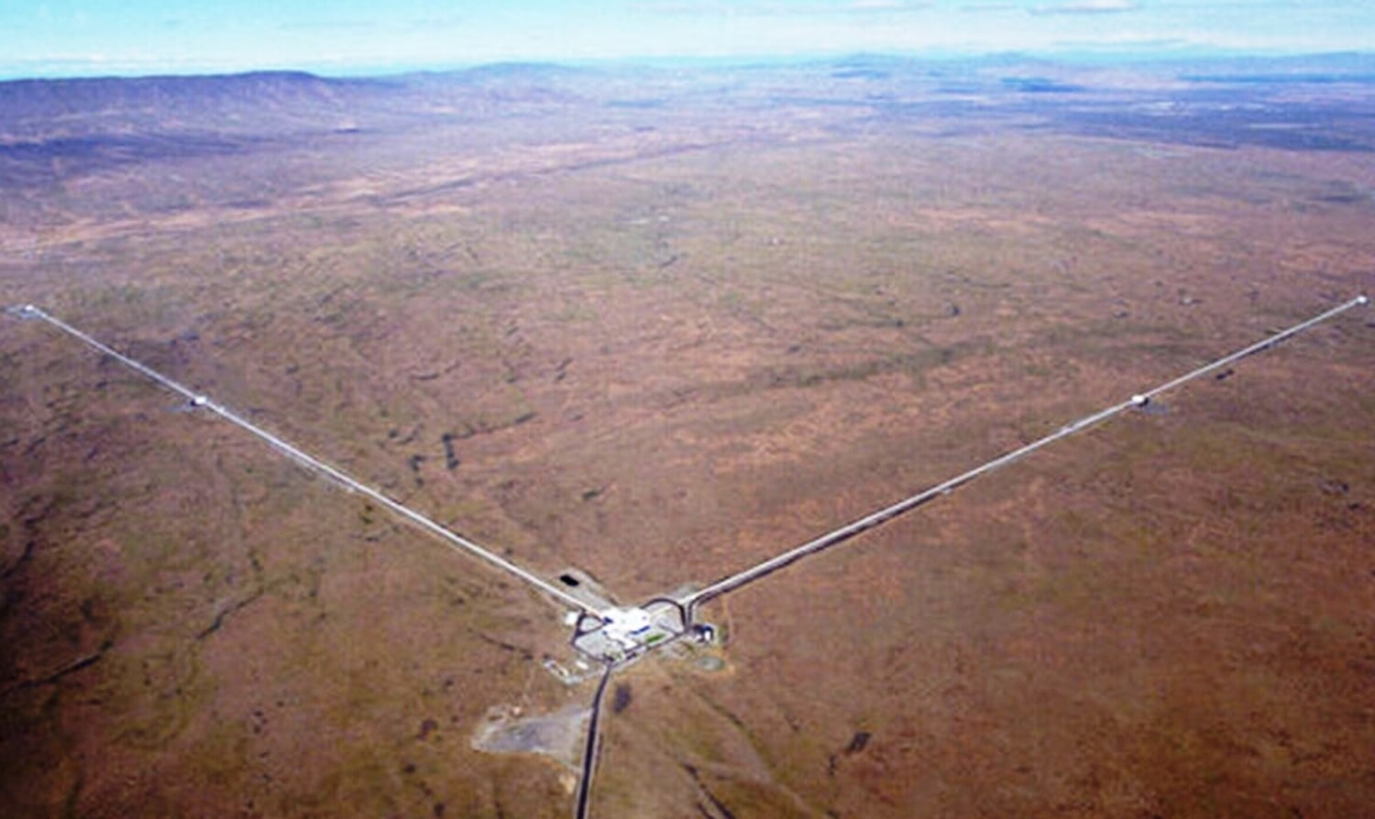
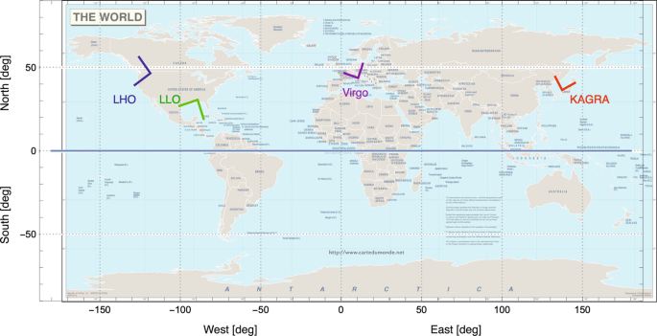
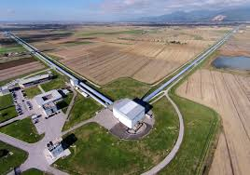
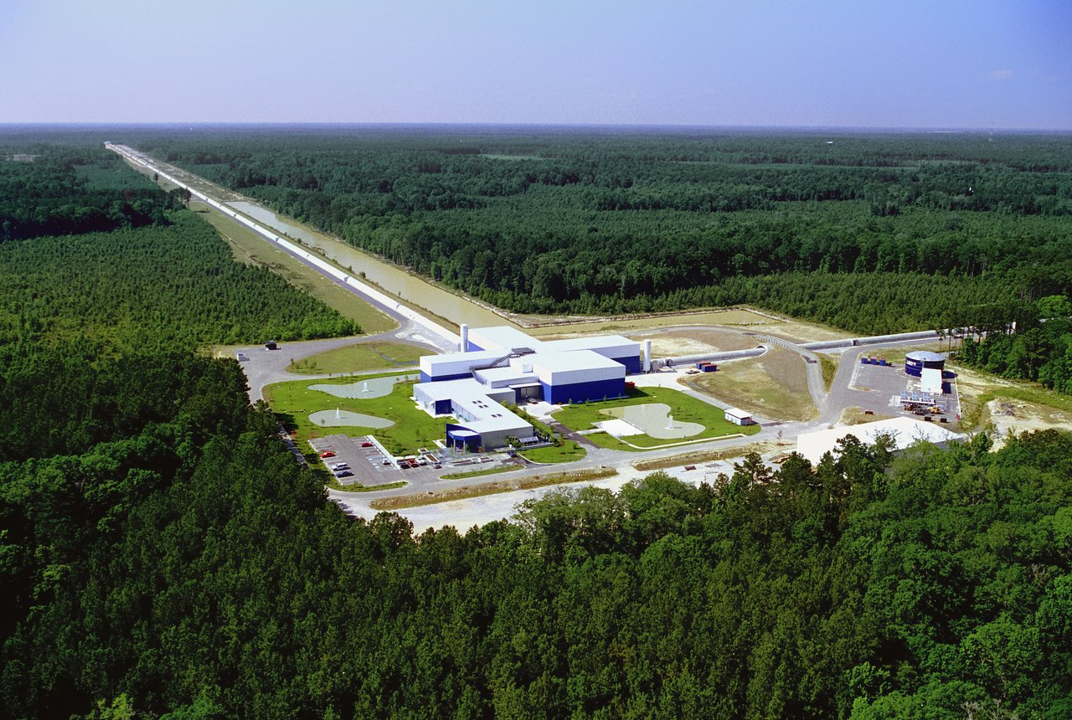
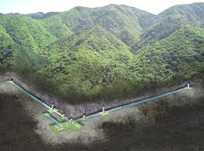
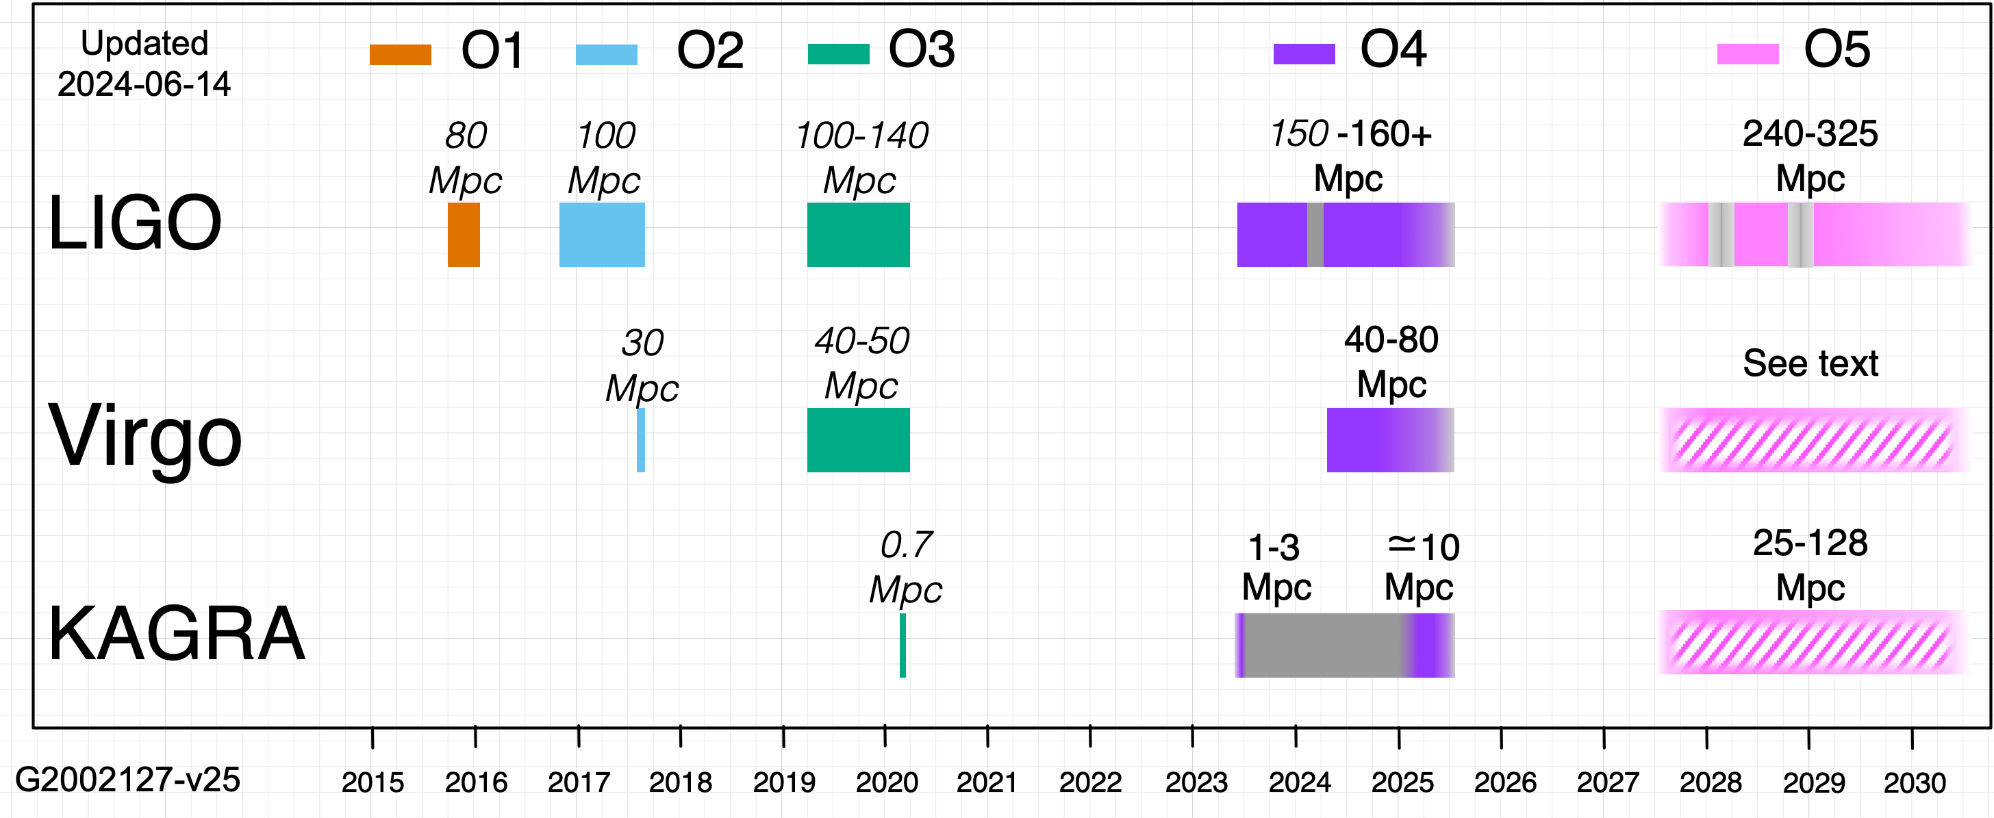
Gravitational-Wave Detector Network
[Brady et al. (2022)]
GW200105 / GW200115
Kent Yagi

Slide 5
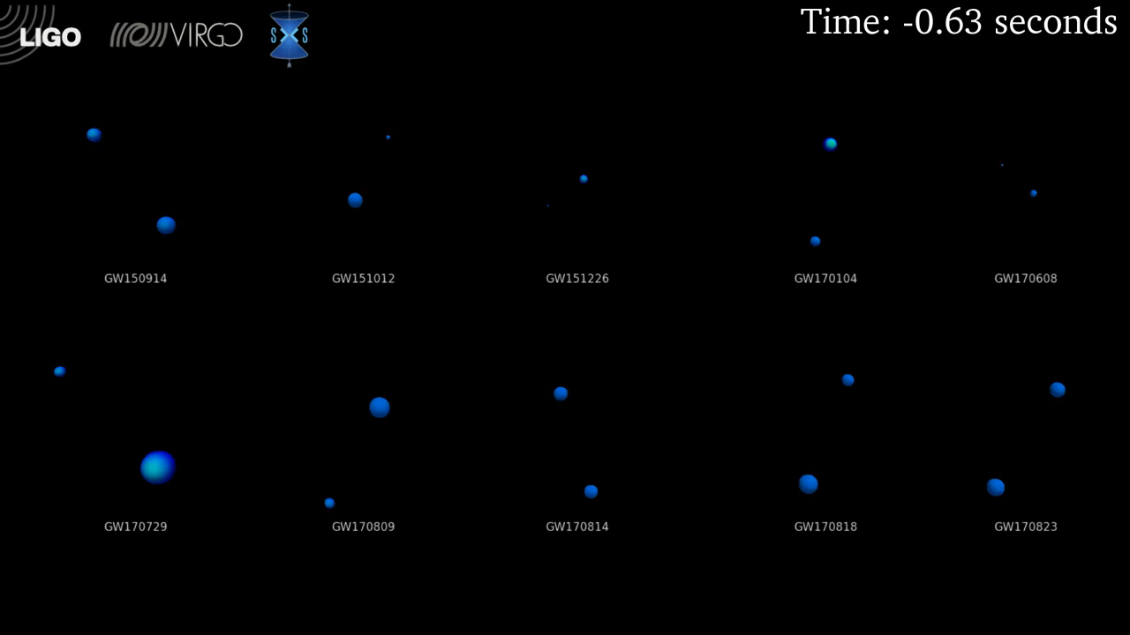
Binary Black Hole Merger Events
[LIGO]

Slide 6
Gravitational-Wave Events
11 events
+44 events
+117 candidates
GWTC-1
GWTC-2.1
GraceDB
+35 events
GWTC-3
Kent Yagi

Slide 7
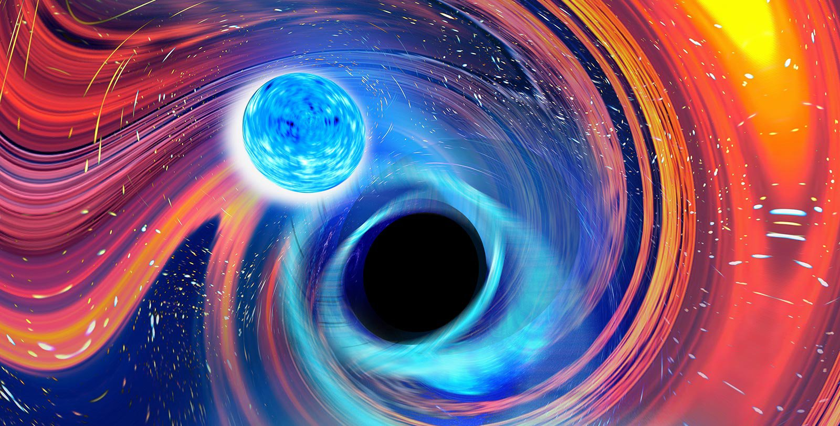
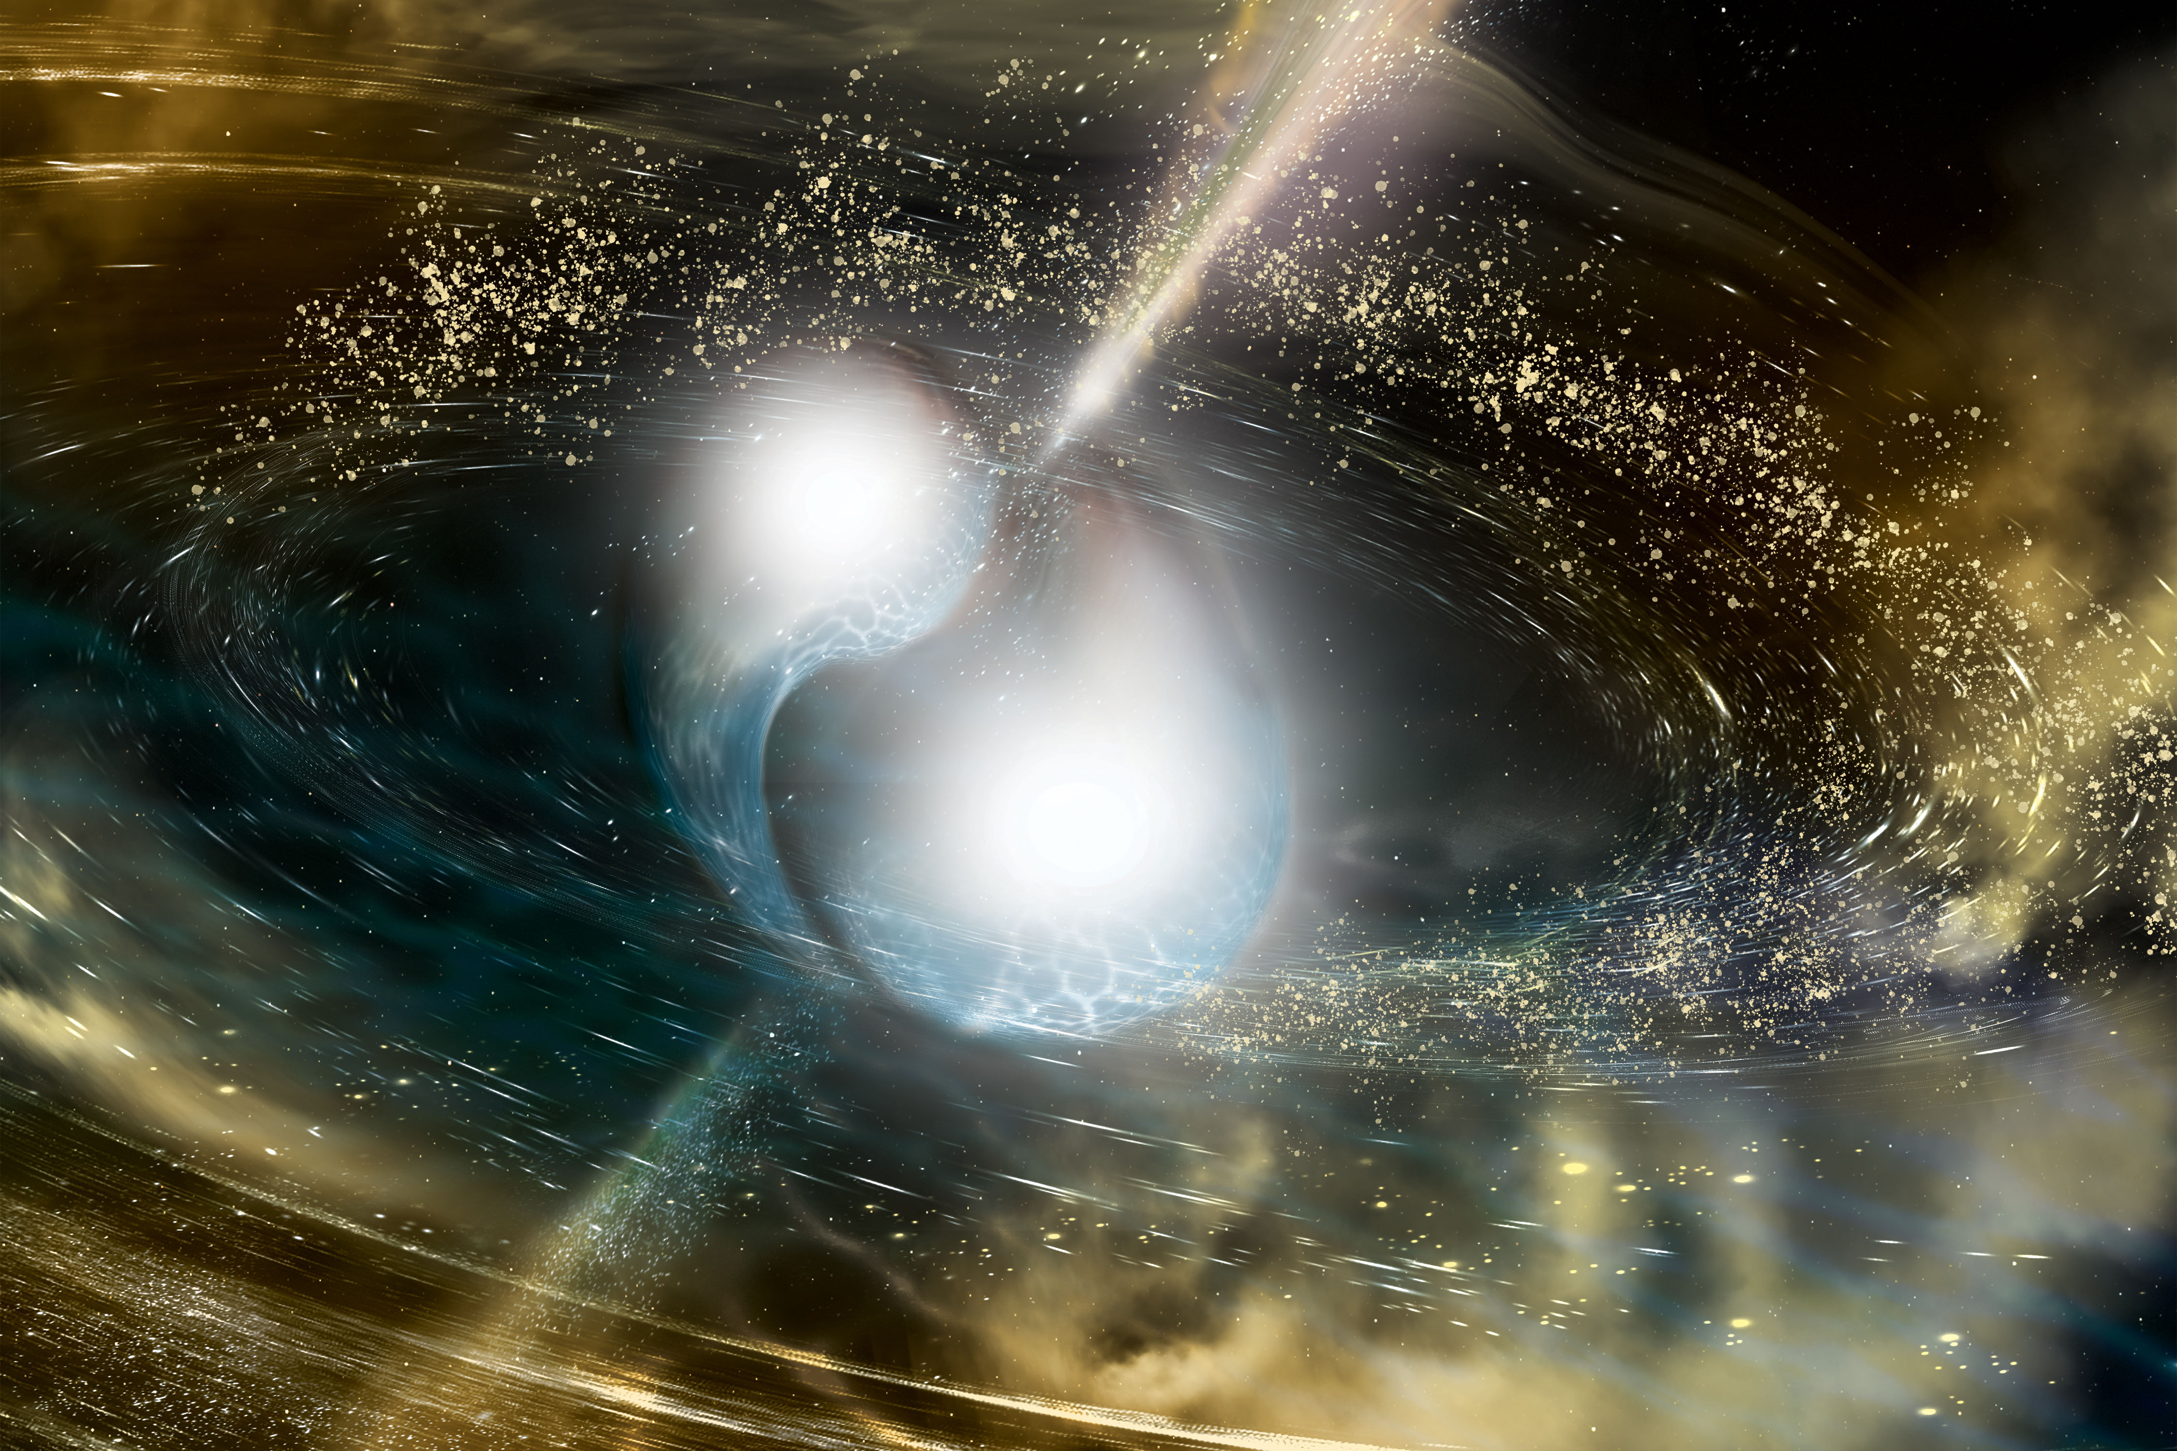
Binary Neutron Stars & Neutron Star-Black Holes
BH-??
??-NS
BH-NS
BH-NS
NS-NS
NS-NS
[LVK arXiv:2404.04248]
GW200105 / GW200115
Kent Yagi

Slide 8
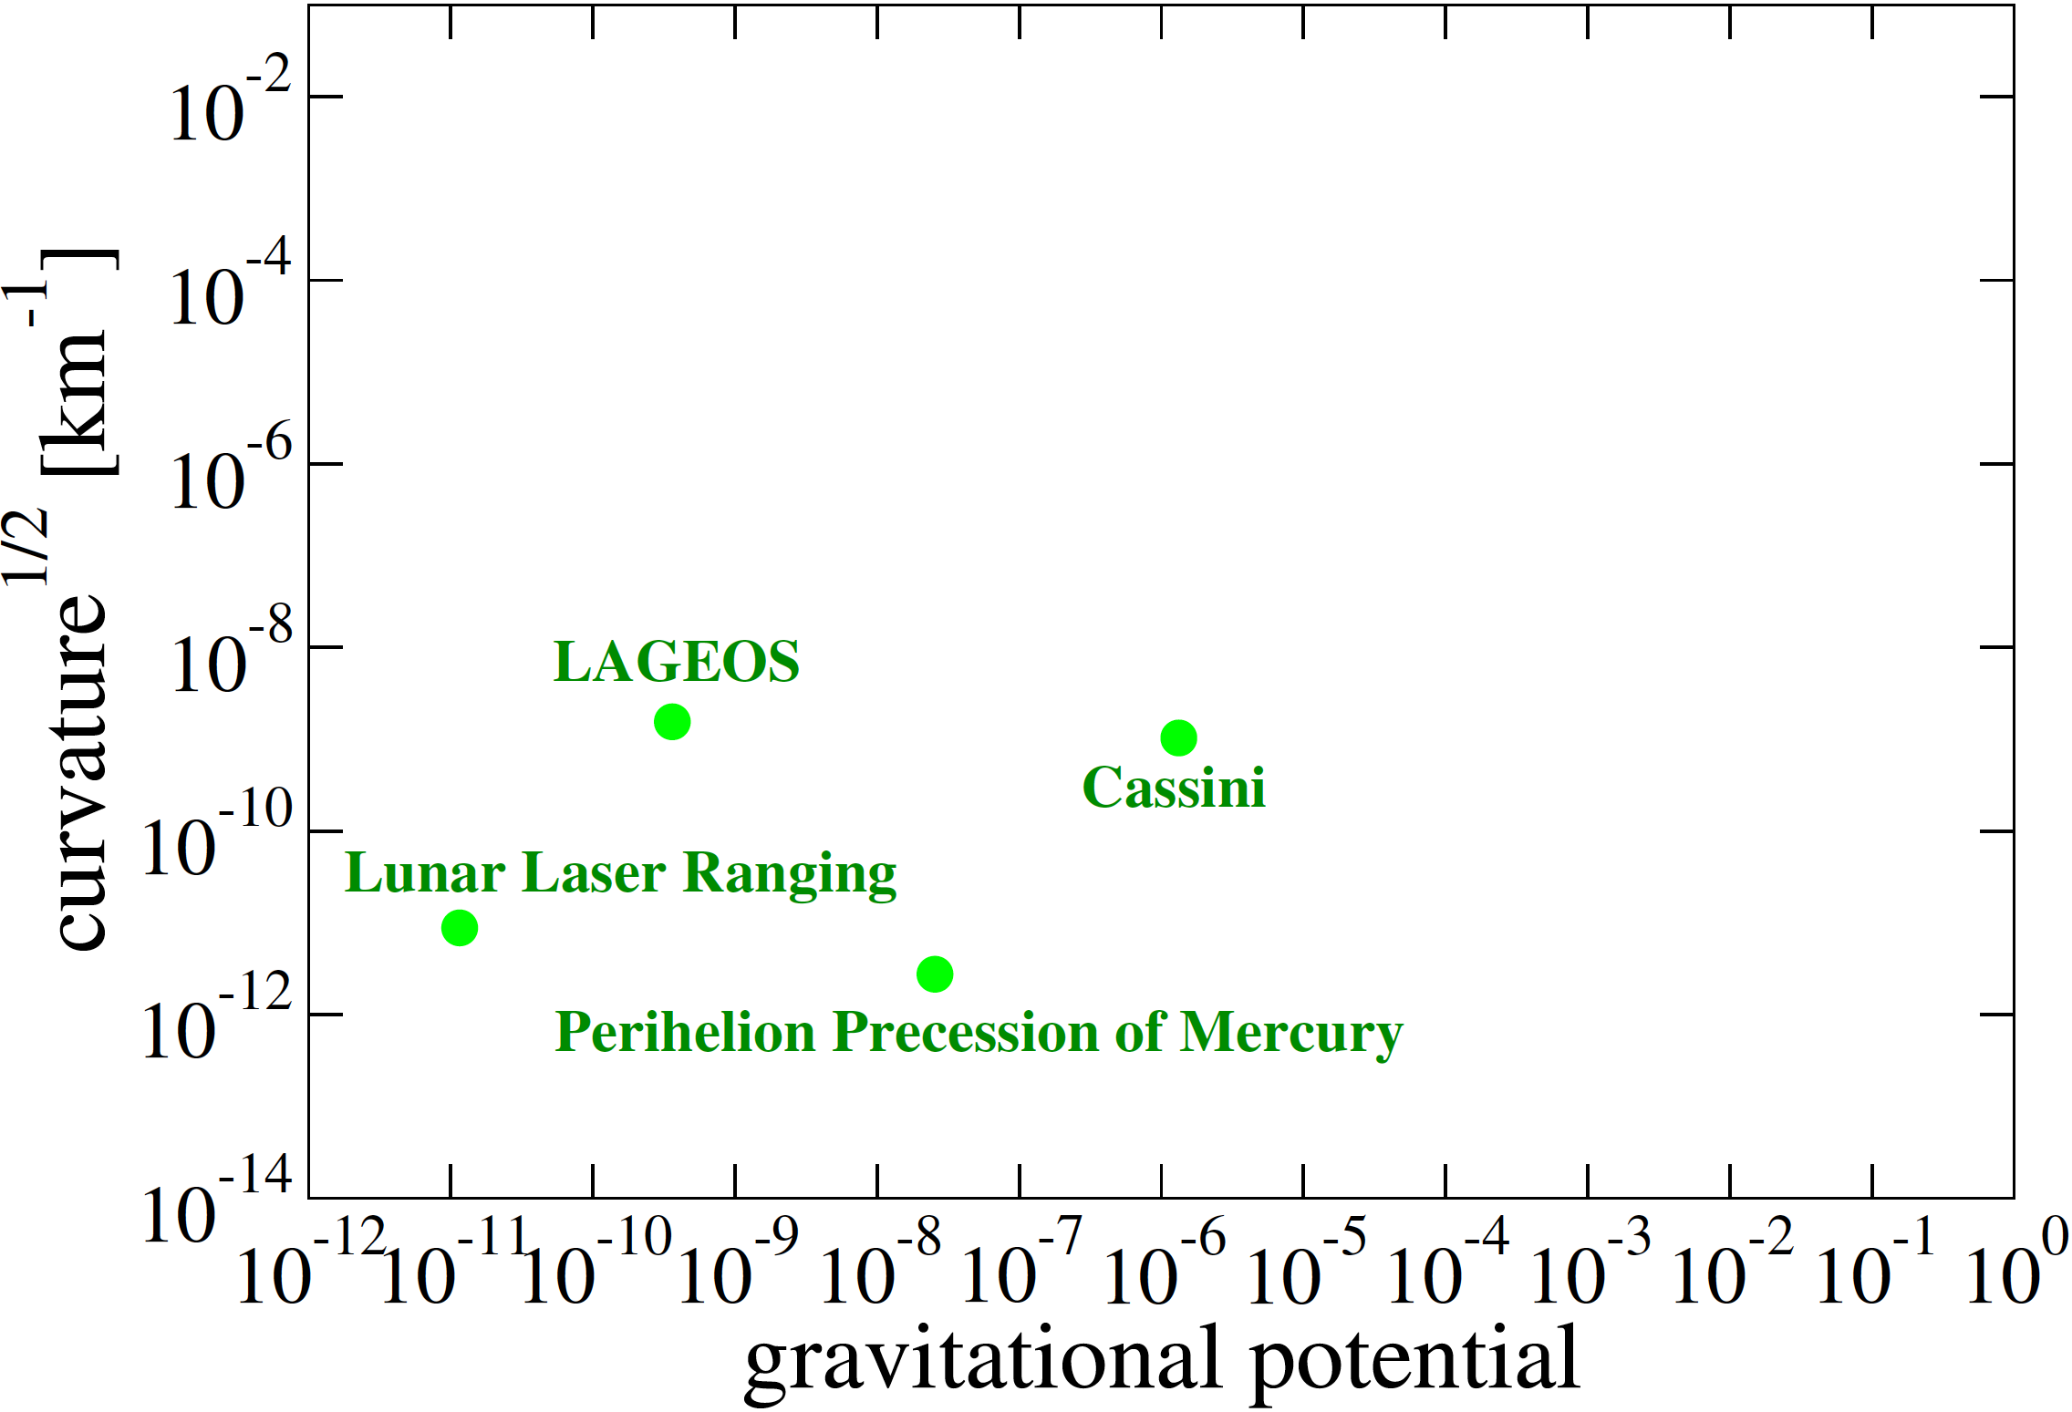
Various Tests of Gravity
strong
strong gravity
weak gravity
[Yunes, KY & Pretorius PRD (2016)]
large
Kent Yagi

Slide 9
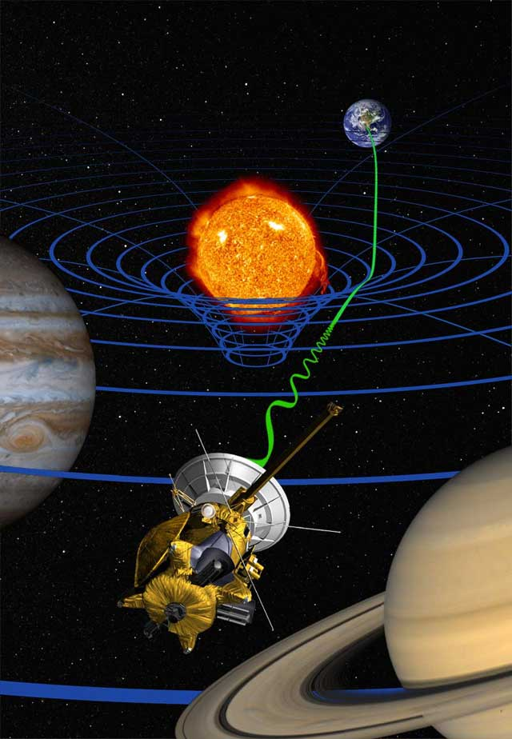
Various Tests of Gravity
strong
Solar System Exp.
[Yunes, KY & Pretorius PRD (2016)]
large
black hole
Kent Yagi
Kent Yagi

Slide 10
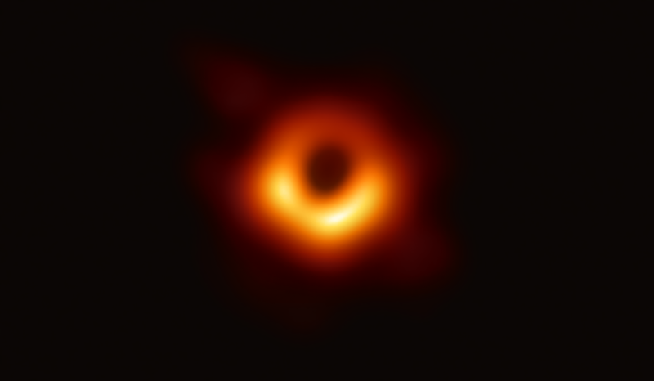
Various Tests of Gravity
strong
Sgr A*
M87
Solar System Exp.
Sgr A*
M87
[Yunes, KY & Pretorius PRD (2016)]
large
black hole
Kent Yagi
Kent Yagi

Slide 11
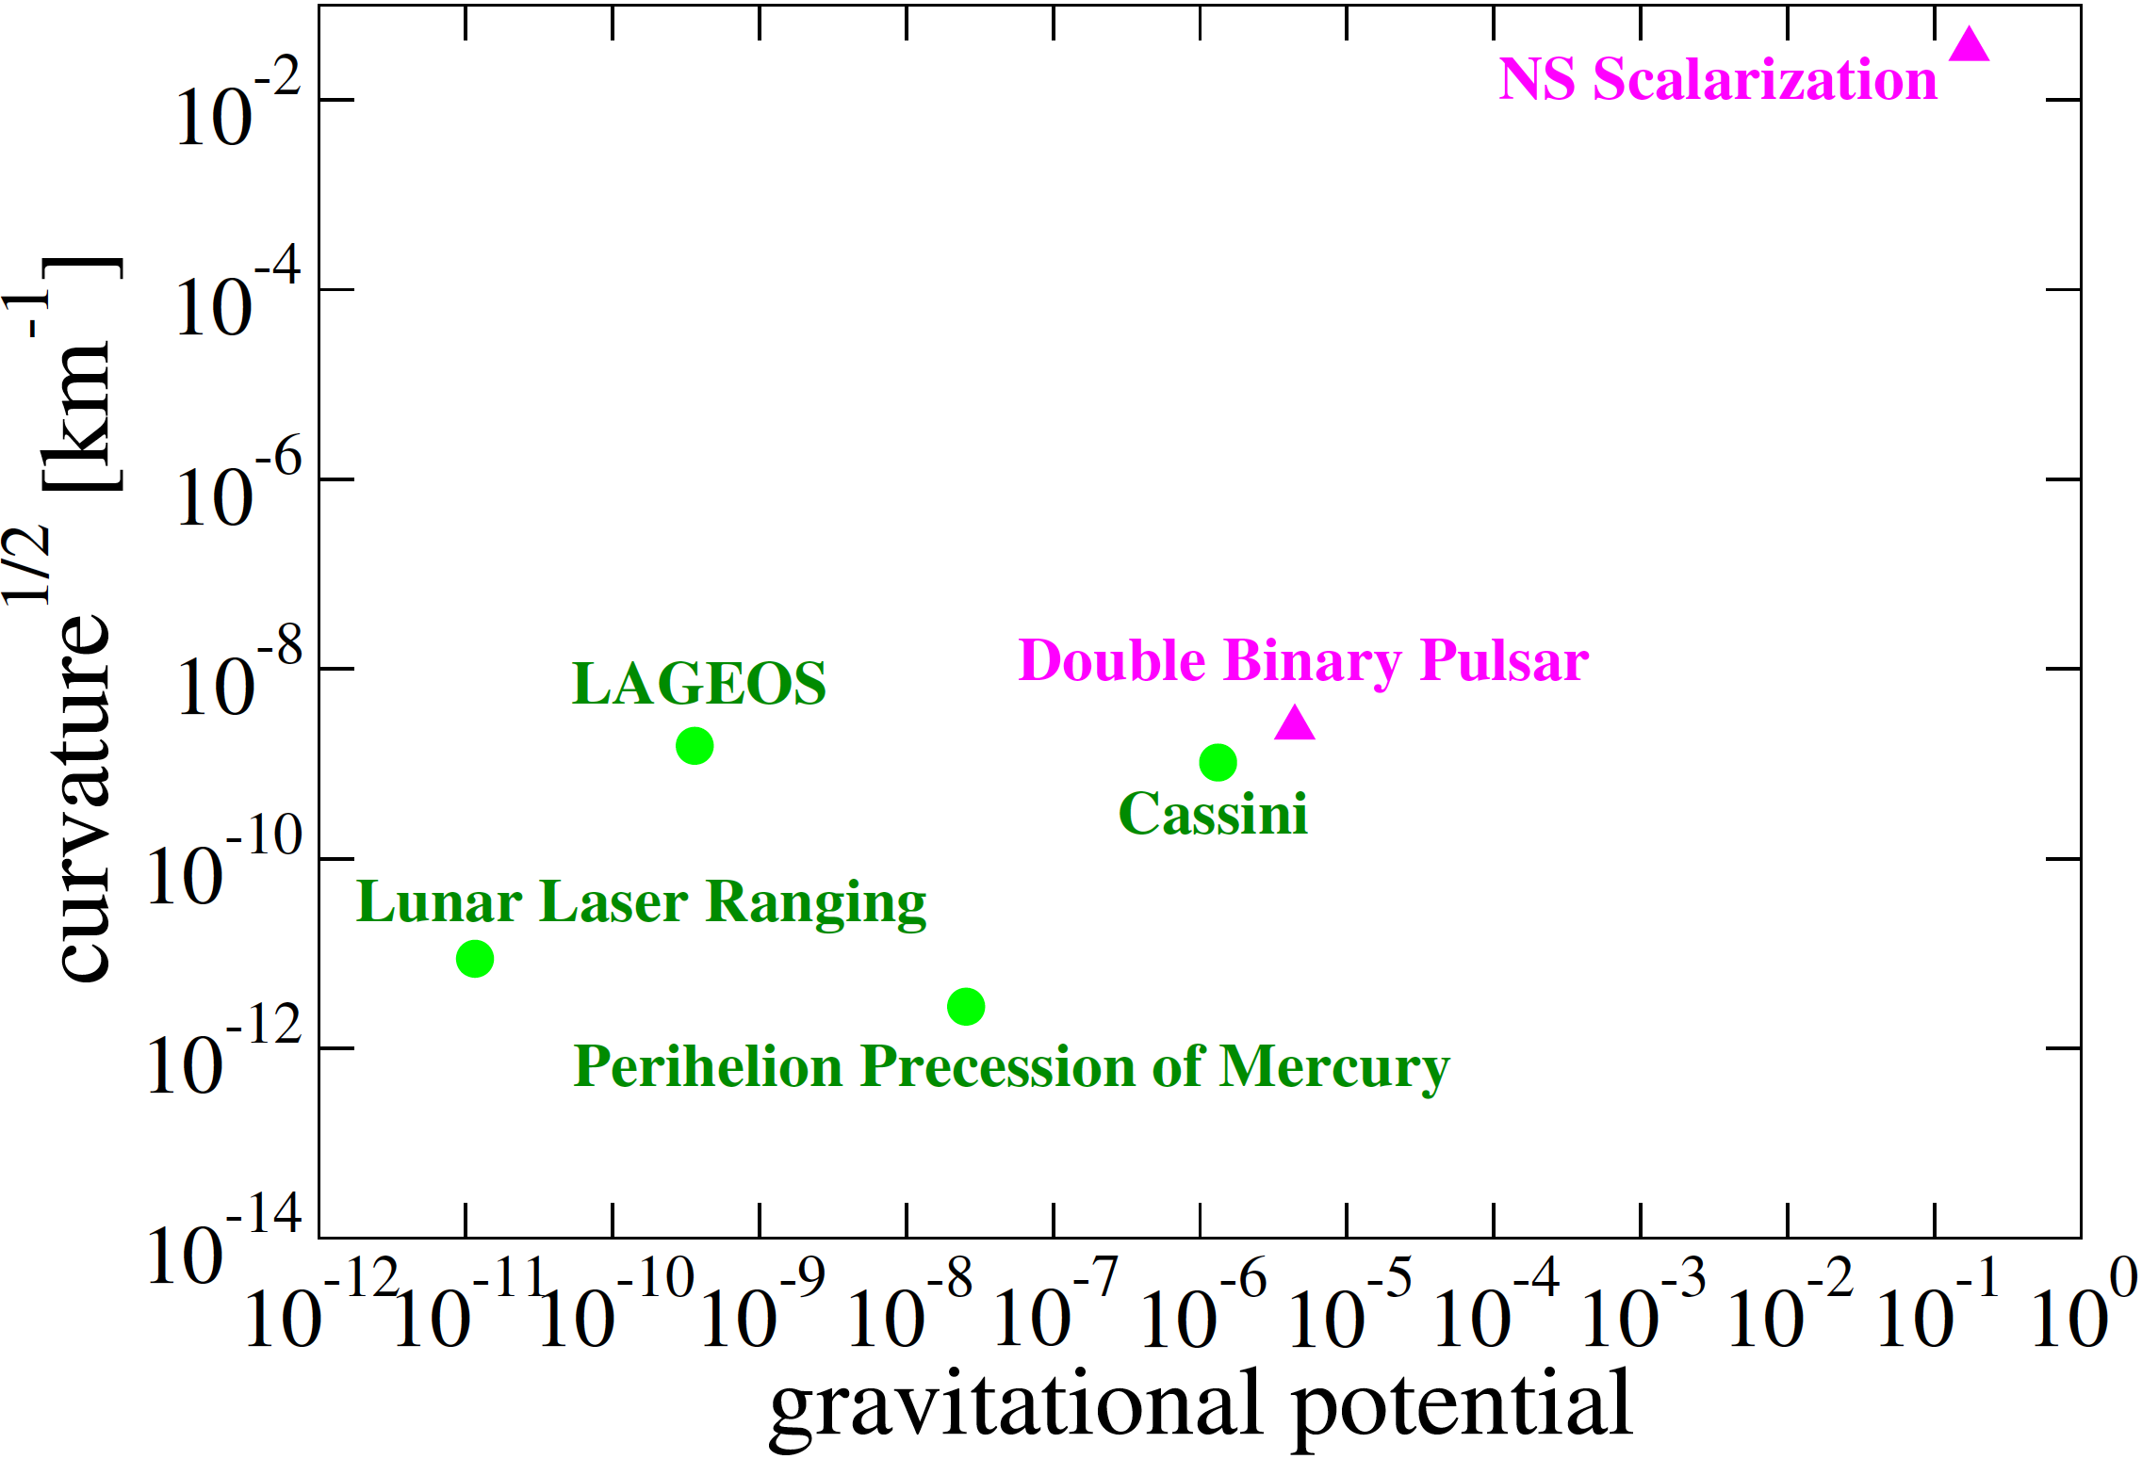
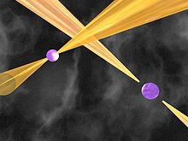
Various Tests of Gravity
strong
neutron star
Solar System Exp.
Sgr A*
M87
[Yunes, KY & Pretorius PRD (2016)]
large
Kent Yagi

Slide 12
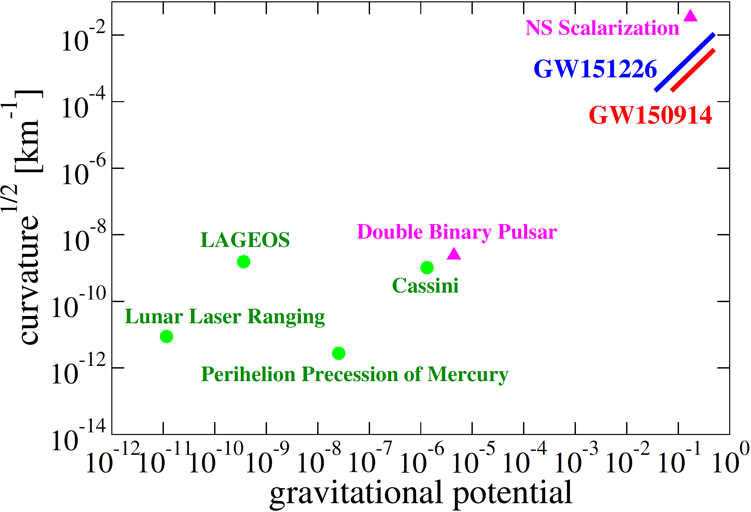
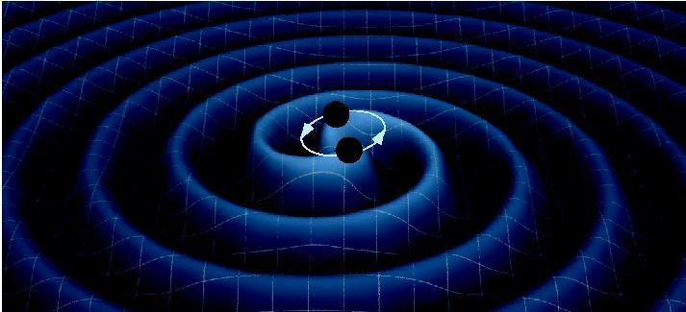
Various Tests of Gravity
strong
Strong & Dynamical Gravity
neutron star
Solar System Exp.
Sgr A*
M87
[Yunes, KY & Pretorius PRD (2016)]
large
black hole
neutron star
Kent Yagi
Kent Yagi

Slide 13
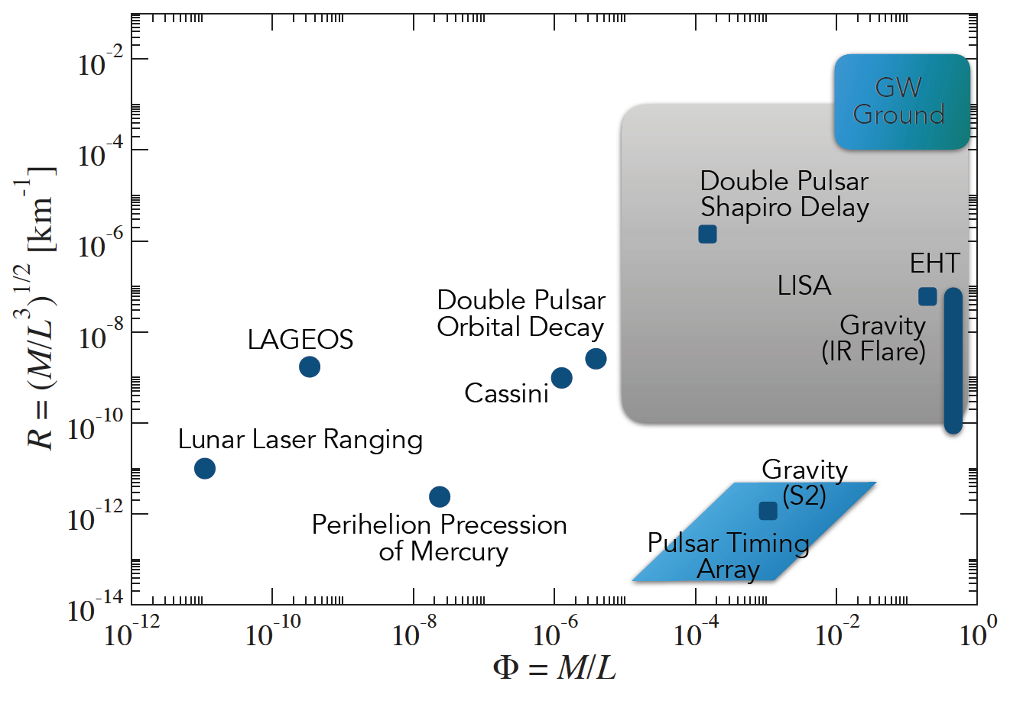
Strong-field Tests of Gravity
curvature
solar system
[Maggiore et al. 1912.02622]
potential
[Yunes, KY & Pretorius 1603.08955]
Kent Yagi
Kent Yagi

Slide 14

Fundamental Pillars in General Relativity
GR
4 Dimensions
Equivalence Principle
Kent Yagi

Slide 15
Equivalence Principle Tests
Kent Yagi
Kent Yagi

Slide 16
Equivalence Principle Tests
EP violation
Kent Yagi
Kent Yagi

Slide 17
Fundamental Pillars in General Relativity
GR
4 Dimensions
Equivalence Principle
Lorentz Invariance
Parity Invariance
Massless Graviton
Tensor Polarization
Kent Yagi

Slide 18

Gravitational-wave Polarizations
General Relativity
beyond GR
tensor
scalar
+ mode
x mode
vector
[Will (2014)]
Kent Yagi

Slide 19
Tests of GR with GWs (based on LVK’s work)
[PRL 116, 221101 (2016); PRX 6, 041015 (2016); PRL 118, 221101 (2017);
PRL 119, 141101 (2017); ApJL 848, L13 (2017); arXiv:1811.00364; arXiv:1903.04467; arXiv:2112.06861; … ]
Non-GR polarization
GW170817
Bayesian Model Selection:
[Will (2014)]
Kent Yagi

Slide 20
Tests of GR with GWs (based on LVK’s work)
[PRL 116, 221101 (2016); PRX 6, 041015 (2016); PRL 118, 221101 (2017);
PRL 119, 141101 (2017); ApJL 848, L13 (2017); arXiv:1811.00364; arXiv:1903.04467; arXiv:2112.06861; … ]
Non-GR polarization
Propagation speed of GWs
dispersion relation of gravitons
Kent Yagi

Slide 21
Propagation Speed of Gravitational Waves
General Relativity
40 Mpc
GW170817
gravitational waves
electromagnetic waves
time of arrival difference: 1.7s
[Abbott et al., ApJL (2017)]
Kent Yagi
Kent Yagi

Slide 22
Tests of GR with GWs (based on LVK’s work)
[PRL 116, 221101 (2016); PRX 6, 041015 (2016); PRL 118, 221101 (2017);
PRL 119, 141101 (2017); ApJL 848, L13 (2017); arXiv:1811.00364; arXiv:1903.04467; arXiv:2112.06861; … ]
Non-GR polarization
Propagation speed of GWs
dispersion relation of gravitons
Number of spacetime dimension
Kent Yagi

Slide 23
# of Spacetime Dimension
[Pardo, Fishbach, Holz & Spergel, arXiv:1801.08160]
luminosity distance
spacetime dimension
[see also Du, KY et al. arXiv: 2004.03051
for bounds on compact extra dimensions from BBHs]
Kent Yagi
Kent Yagi

Slide 24
Tests of GR with GWs (based on LVK’s work)
[PRL 116, 221101 (2016); PRX 6, 041015 (2016); PRL 118, 221101 (2017);
PRL 119, 141101 (2017); ApJL 848, L13 (2017); arXiv:1811.00364; arXiv:1903.04467; arXiv:2112.06861; … ]
Non-GR polarization
Propagation speed of GWs
dispersion relation of gravitons
Number of spacetime dimension
Lorentz violation
Equivalence principle
Black hole no-hair test
Parameterized deviation from GR
Kent Yagi

Slide 25
Zoo of Modified Gravity
model-independent tests of GR!
[Ezquiaga & Zumalacarregui arXiv: 1807.09241]
Kent Yagi

Slide 26
parameterized post-Einsteinian (ppE) Formalism
[Yunes & Pretorius (2009)]
[LVC, PRL 116, 221101 (2016)]
beyond GR
relative velocity
waveform phase:
ppE parameter
nth post-Newton (PN) correction
PN approximation:
Kent Yagi

Slide 27
Example: GR
Kent Yagi

Slide 28
Example: Scalar-tensor Theory
scalar charge
scalar waves
dipolar
quadrupolar
non-GR correction at -1PN
Kent Yagi

Slide 29
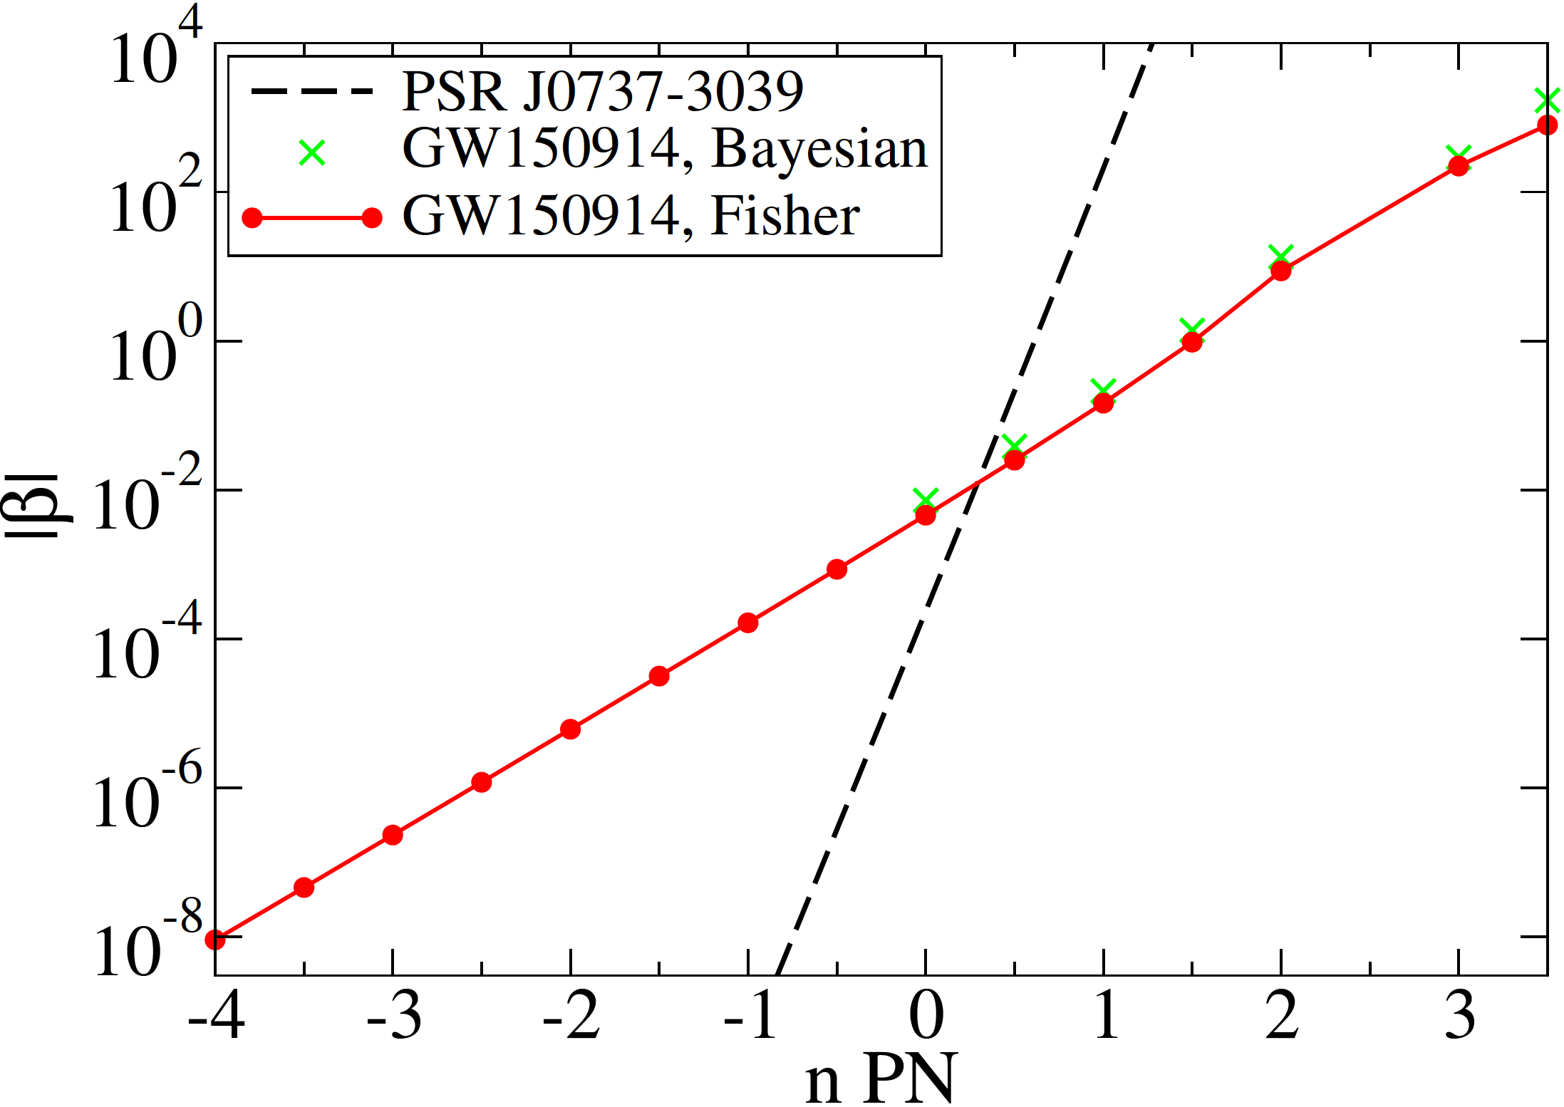
Constraining GR Fundamental Pillars
[Yunes & Hughes (2010)]
double pulsar
[LIGO-Virgo
Collaboration (2016)]
[Yunes, KY & Pretorius (2016)]
ppE
binary black hole
binary pulsars
extra dimension
time varying G
scalar monopole activation
vector field activation
scalar dipole activation
equivalence principle
equivalence principle
Lorentz invariance
parity invariance
4D
Kent Yagi

Slide 30
Parameterized tests from GWTC-3
related to PPE
[LVK, arXiv:2010.14529]
Kent Yagi

Slide 31
Parameterized tests from GWTC-3
related to PPE
[LVC, arXiv:2010.14529]
Kent Yagi

Slide 32
Specific Example: EdGB
Exponent
Einstein-dilaton Gauss-Bonnet
dynamical
Chern-Simons
[Tahura & KY 1809.00259]
Kent Yagi

Slide 33
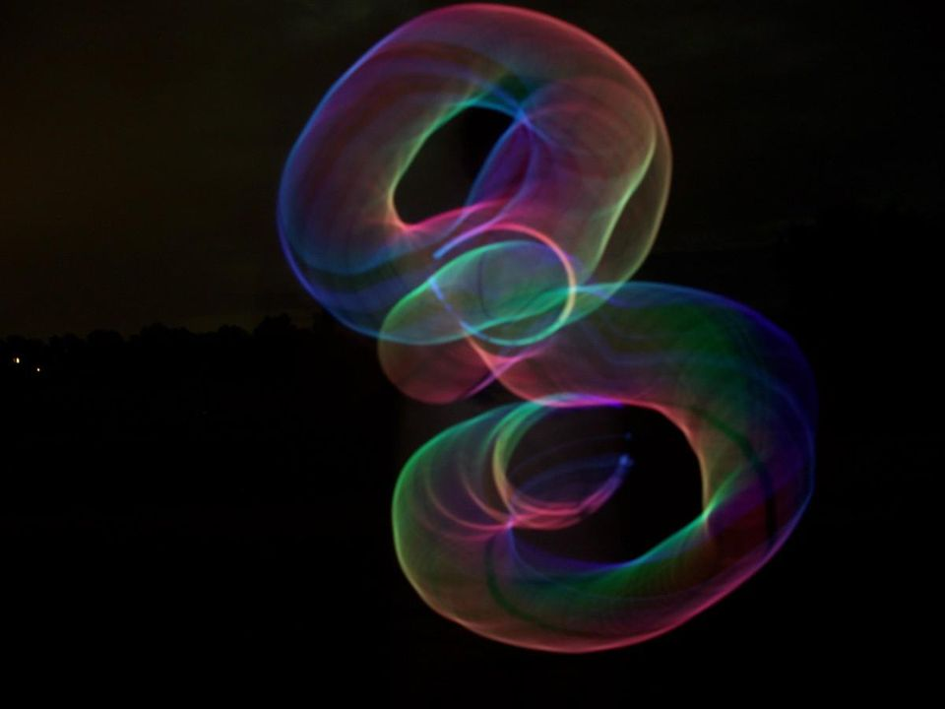
Einstein-dilaton Gauss-Bonnet (EdGB) Gravity
motivated by string theory
coupling constant
dilaton (scalar) field
Kent Yagi

Slide 34
Specific Example: Einstein-dilaton Gauss-Bonnet
coupling constant
dilaton field
Exponent
Einstein-dilaton Gauss-Bonnet
dynamical
Chern-Simons
[KY et al. arXiv:1110.5950]
[Tahura & KY 1809.00259]
Kent Yagi

Slide 35
Gravitational Waveform in sGB Gravity
Phase:
[KY et al. arXiv:1110.5950]
Einstein-dilaton Gauss-Bonnet
[Carson arXiv: 2010.04745]
Kent Yagi

Slide 36
GW Bounds (BBH)
GW bounds
binary black hole (BBH)
[Perkins et al. 2104.11189]
[Yamada et al. 1905.11859]
[Wang et al. 2104.07590]
[km]
several BBH events combined
Kent Yagi
Kent Yagi

Slide 37
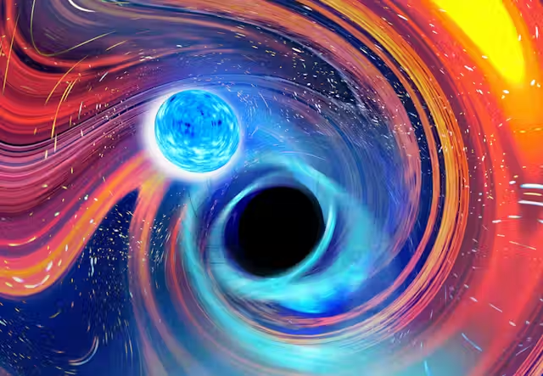
GW Bounds on EdGB Gravity
GW bounds
GW bound:
BBH + NSBH
much more stringent with solar system exp. or binary pulsar obs.!
binary black hole (BBH)
coupling constant
[km]
[Lyu, Jiang & KY arXiv:2201.02543]
[Perkins et al. 2104.11189]
Kent Yagi
Kent Yagi
Notes:
PhenomXPHM
f_high = 0.018/M (insp -> intermediate in Phenom model, below which the waveform is not calibrated with NR)

Slide 38
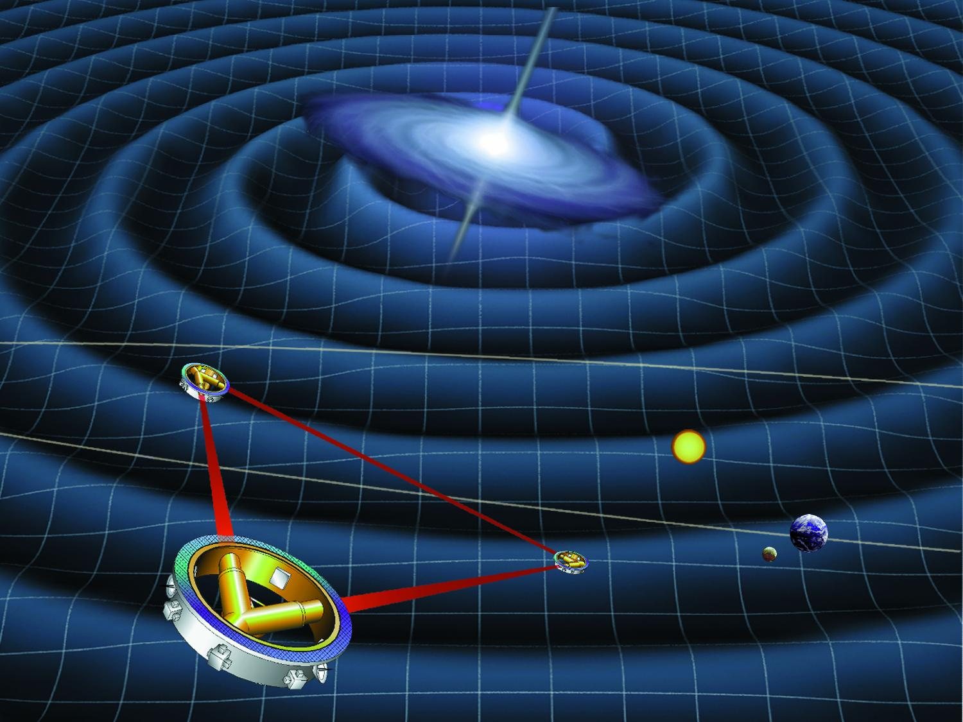
Future Prospects: LISA
[Chamberlain & Yunes (2017)]
Kent Yagi

Slide 39
Summary
[PRL 116, 221101 (2016); PRX 6, 041015 (2016); PRL 118, 221101 (2017);
PRL 119, 141101 (2017); ApJL 848, L13 (2017); arXiv:1811.00364; arXiv:1903.04467; arXiv:2112.06861; … ]
Non-GR polarization
Propagation speed of GWs
dispersion relation of gravitons
Number of spacetime dimension
Lorentz violation
Equivalence principle
Black hole no-hair test
Parameterized deviation from GR
application to specific theories
Kent Yagi

Slide 40
Summary
[PRL 116, 221101 (2016); PRX 6, 041015 (2016); PRL 118, 221101 (2017);
PRL 119, 141101 (2017); ApJL 848, L13 (2017); arXiv:1811.00364; arXiv:1903.04467; arXiv:2112.06861; … ]
Non-GR polarization
Propagation speed of GWs
dispersion relation of gravitons
Number of spacetime dimension
Lorentz violation
Equivalence principle
Black hole no-hair test
Parameterized deviation from GR
application to specific theories
Thank You!
Kent Yagi

