Slide 1
Status and Physics Reach of Next Gen
ν Experiments; DUNE & Hyper–K
PASCOS2024
ICISE, Quy-Nhon, Vietnam
July 7 - 13, 2024
Jaehoon Yu
Department of Physics
University of Texas at Arlington
  Outline
Introduction
Hyper – K & DUNE, next gen. ν experiments
Potential Physics Reach
Timeline of the experiments
Conclusions

Slide 2
In the Past Quarter Century in HEP
Observation of The Top Quark
Higgs-like Scalar Boson Discovery
Neutrino oscillation discovery
Yeah, I know, I am missing the two recent astrophysical discoveries…

Slide 3
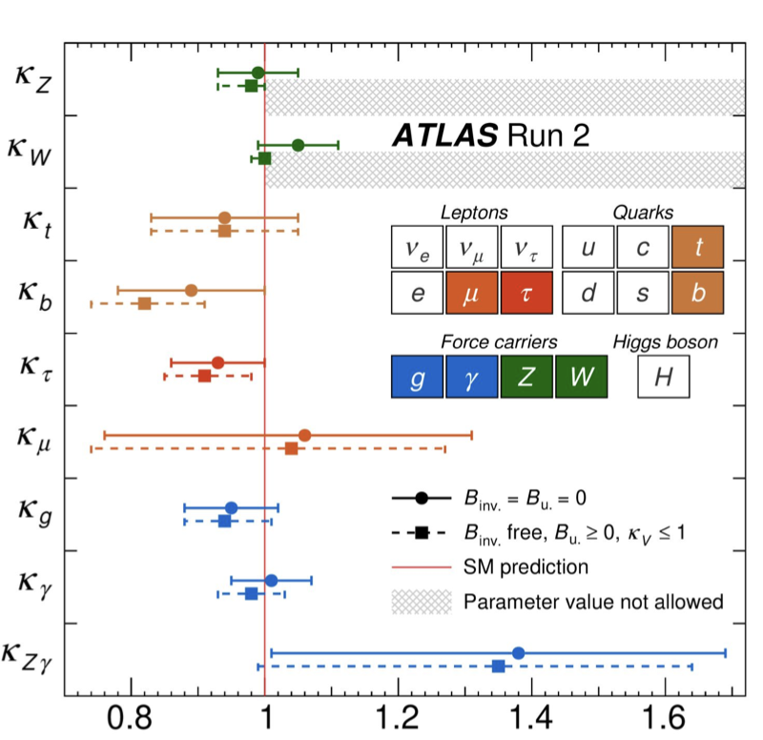
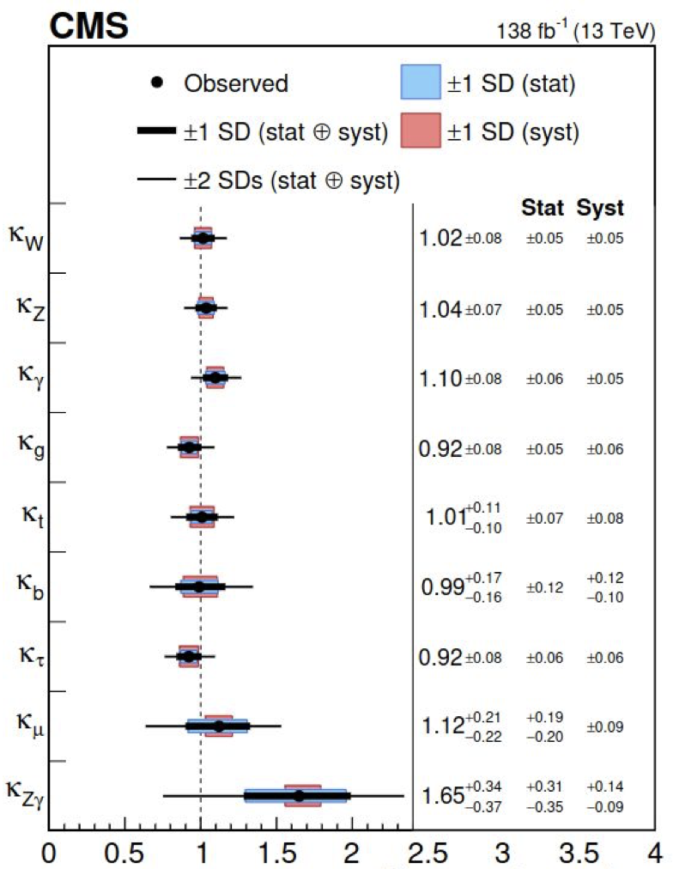
LHC Exp. Combined Higgs Coupling
ATLAS
Nature 607 (2022) 52
Nature 607 (2022) 60
SM
SM

Slide 4
In the Past Quarter Century in HEP
Observation of The Top Quark
Higgs-like Scalar Boson Discovery
Neutrino oscillation discovery

Slide 7
Key Elements or Next Gen. ν Exp.
High statistics samples w/ an excellent systematic uncertainty control essential for precision neutrino property measurements
To accomplish the necessary precision measurements
  For high statistics samples
    High flux ν beams ➔ High power proton beams essential to produce large number of secondary mesons for ν production
    Large ν interaction target mass ➔ large mass far detectors (FD)
  For excellent systematic uncertainty control
    Powerful near detector (ND) system w/ the same tech. as FD
    Excellent understanding of ν-N interactions

Slide 8
Current Understanding of ν Oscillation
θ₂₃ & ΔM²₂₃ measurements
  Atm. ν: SK, IceCube, Km³NET, etc
  Long Baseline: K2K, MINOS, Opera, NOvA, etc
θ₁₂ & ΔM²₁₂ measurements
  Solar ν: SNO, SK, Borexino, etc
  Reactor: KamLAND
θ₁₃ measurements
  Long Baseline: MINOS, T2K, NOvA, etc
  Reactor: Daya Bay, RENO, Double Chooz
NH
I H
Apologies if any missing

Slide 9
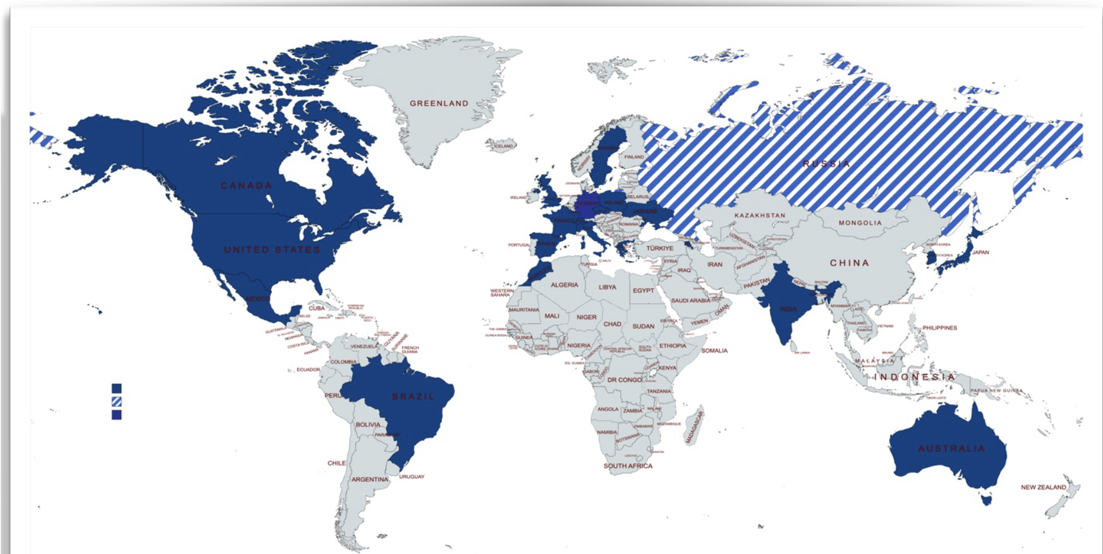
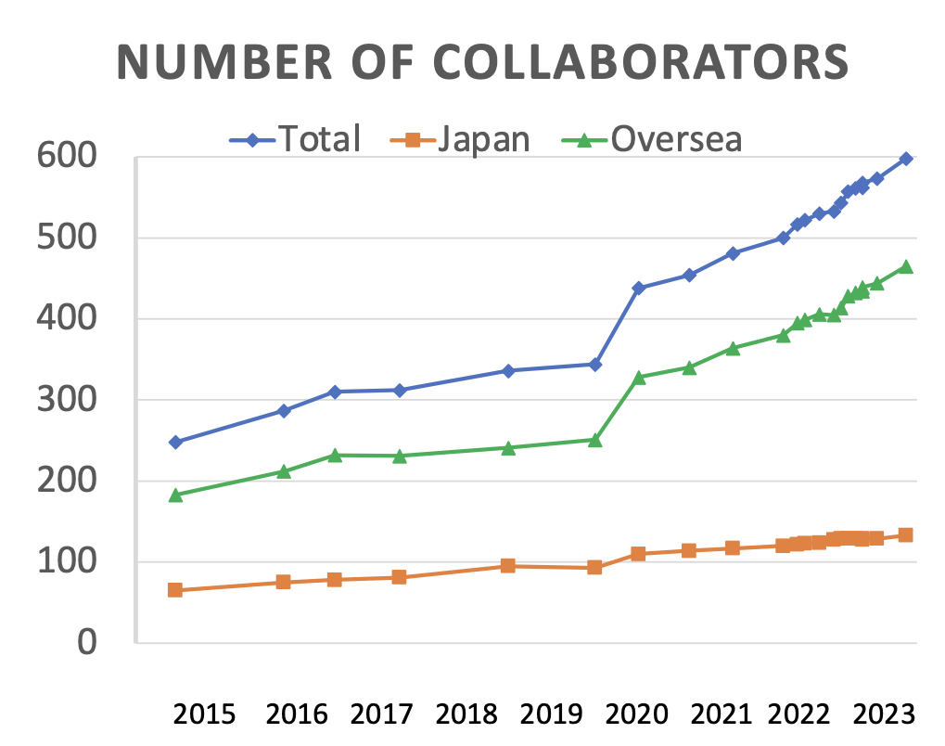
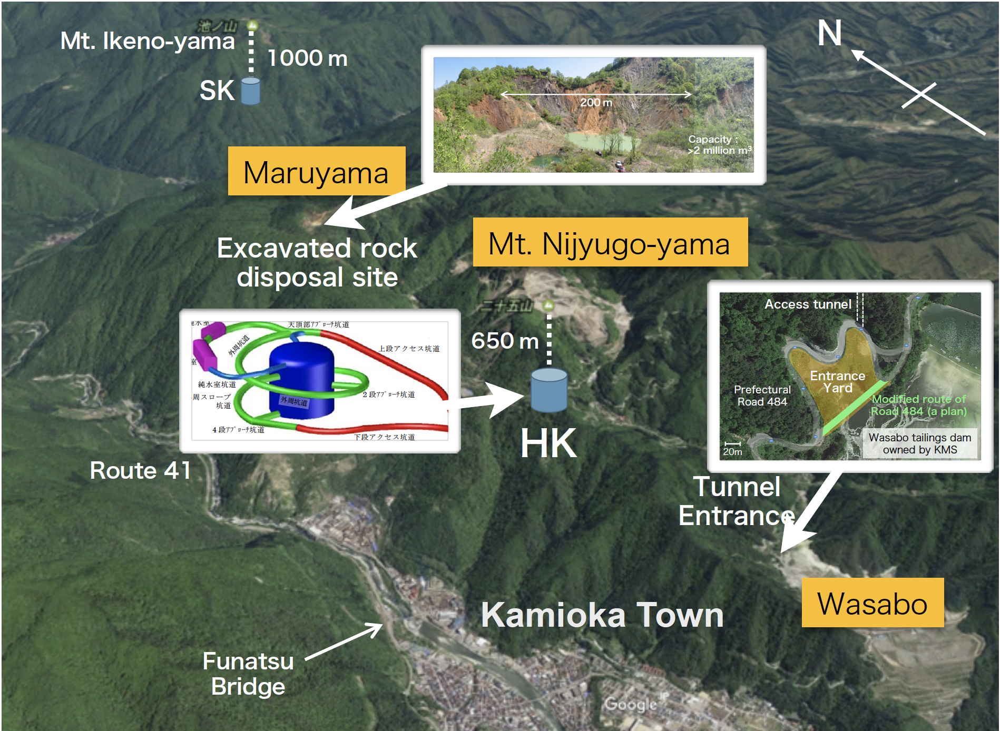
The Next Gen. ν Experiment – I
With the 2013 strategic planning of the community in the three regions, the efforts of building two large scale neutrino experiments progressing in earnest
The Hyper Kamiokande, T2HK and T2HKK
  Joint efforts of the teams from all three regions at Kamioka
  Water Cerenkov ➔ Proven technology! Operating exp.
  583 members, 104 institutions from 22 countries in the proto-collaboration
  Approved by Japanese Government
  Construction in full swing
    arXiv:1805.04163, 1611.06118

Slide 10
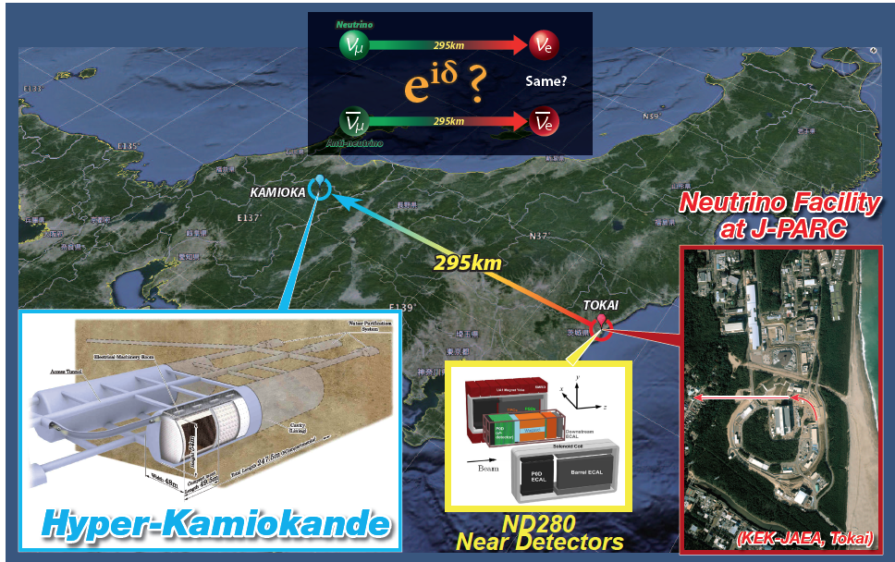
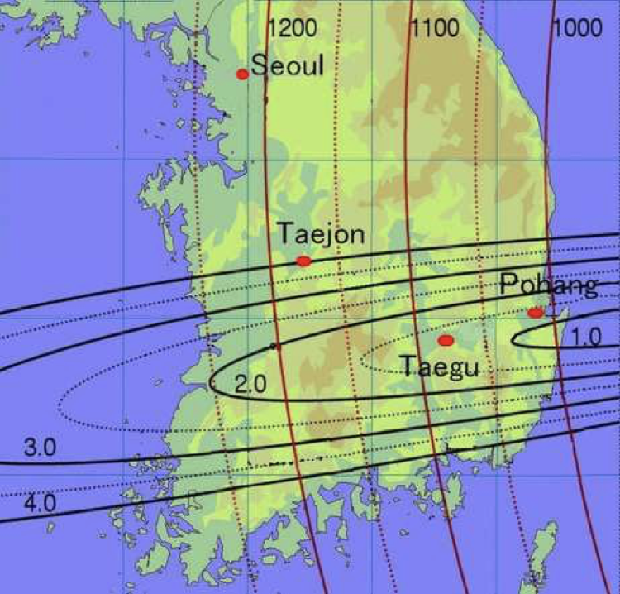
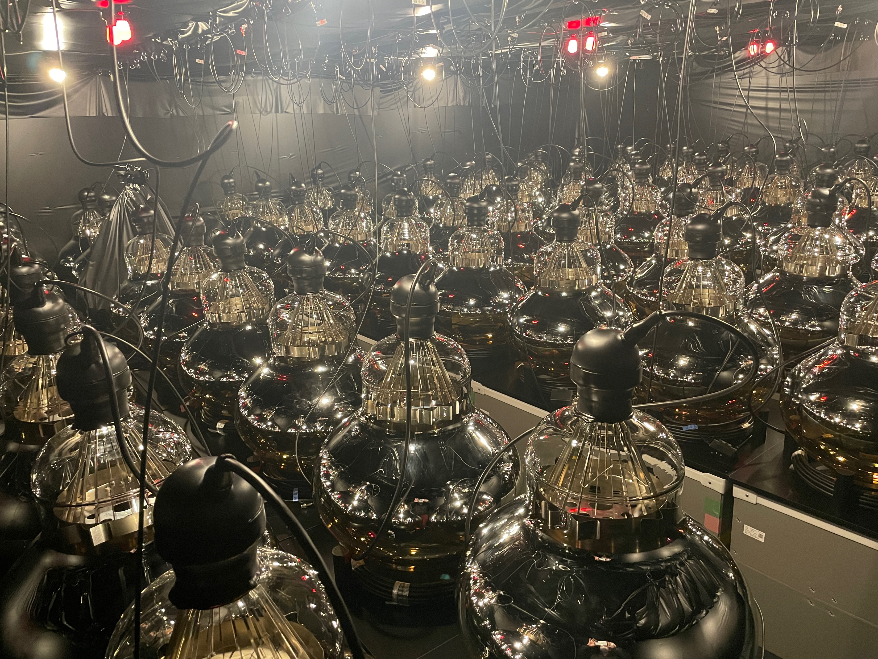
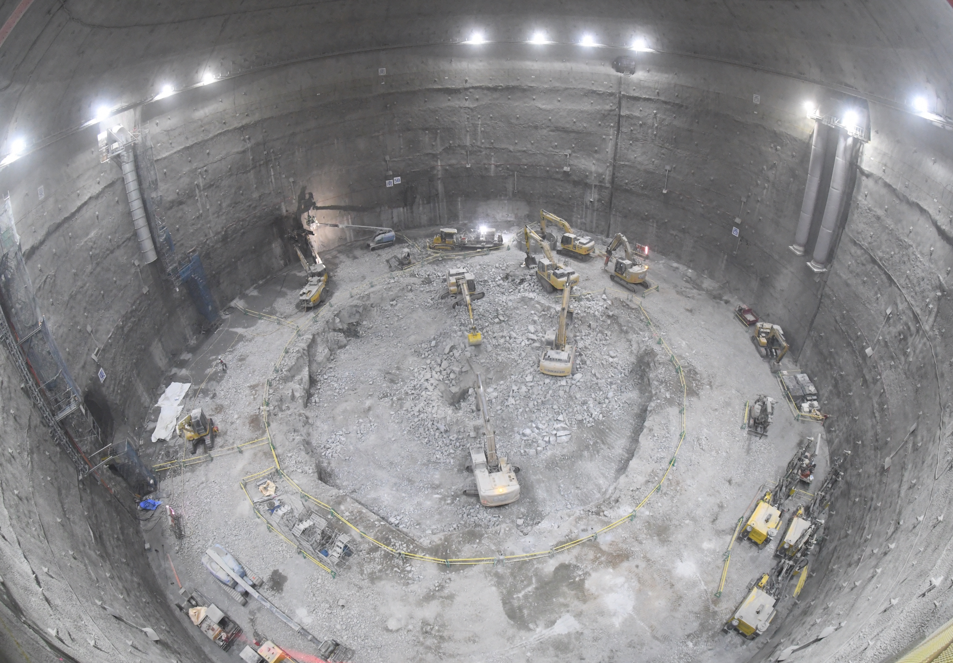
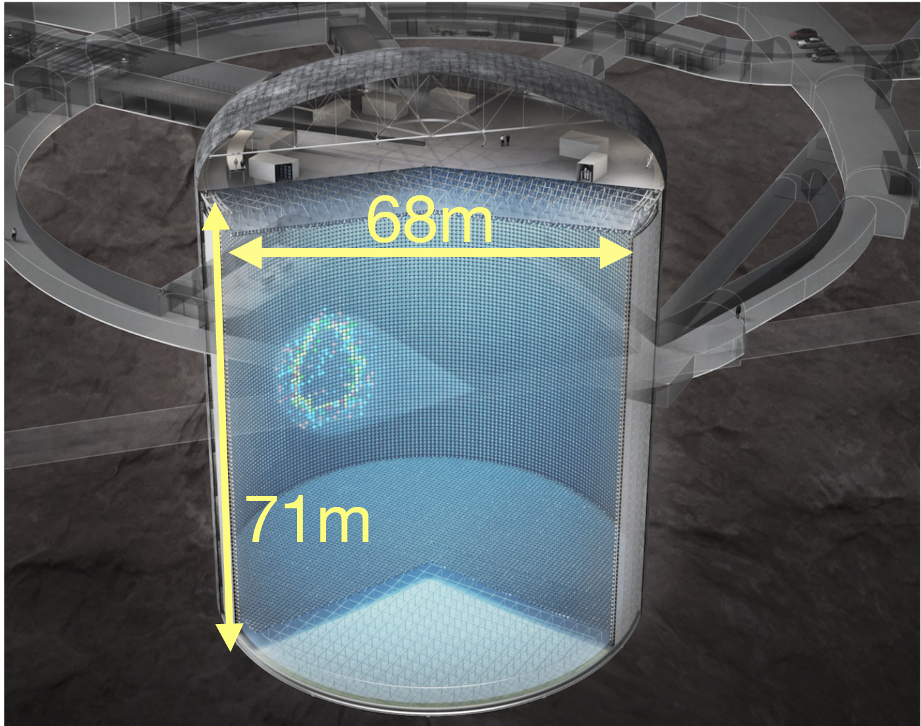
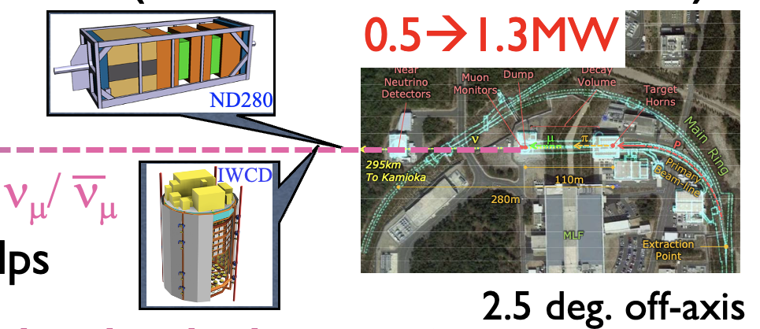
2.5º off-axis narrowband ν beam
P_{Beam}~1.3MW,
d~650m
1 cavern, 1 Water Cerenkov, active mass
m_{A}~ 187kt H₂O
~8xSK
High sing γ QE 50cm PMTs: >10k/20k delivered
High Single γ QE 50cm PMT production ongoing, >10k/20k delivered.
Excavation of the HK cavern to complete by the end of 2024!
Shiozawa

Slide 11

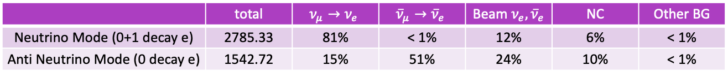
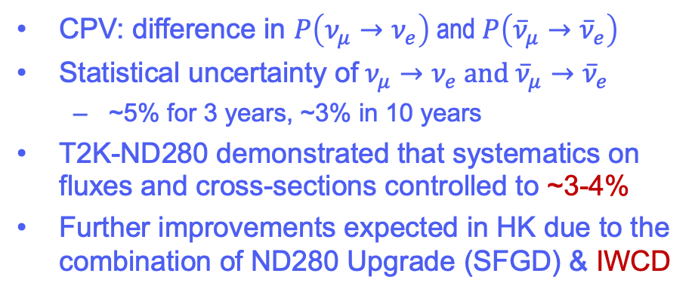
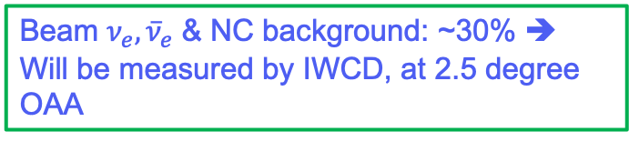
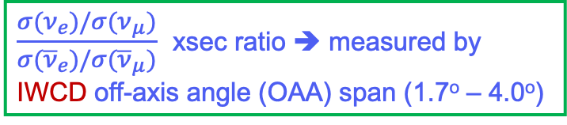


HK Near Detectors: ND280 and IWCD
CPV: difference in $P\left(ν_{μ}→ν_{e}\right)$and $P\left({\overline{ν}}_{μ}→{\overline{ν}}_{e}\right)$
Statistical uncertainty of $ν_{μ}→ν_{e} and$ ${\overline{ν}}_{μ}→{\overline{ν}}_{e}$
  ~5% for 3 years, ~3% in 10 years
T2K-ND280 demonstrated that systematics on fluxes and cross-sections controlled to ~3-4%
Further improvements expected in HK due to the combination of ND280 Upgrade (SFGD) & IWCD
$$\sim 50\text{m}$$
Number of single ring e-like events in 10 years（$ν:\overline{ν}=1:3$, $δ_{CP}=−90°$）
 | total |  |  | Beam | NC | Other BG
Neutrino Mode (0+1 decay e) | 2785.33 | 81% | < 1% | 12% | 6% | < 1%
Anti Neutrino Mode (0 decay e) | 1542.72 | 15% | 51% | 24% | 10% | < 1%
Wrong sign component: 15% ➔
Will be measured by magnetized ND280 det.
Beam $ν_{e},{\overline{ν}}_{e}$ & NC background: ~30% ➔
Will be measured by IWCD, at 2.5 degree OAA
Successful upgrade for T2K: large acceptance & short tracks by hadrons to reduce systematic errors. → Super-FGD, High-angle TPC
Full operation started in the current T2K run!
$\frac{σ(ν_{e})/σ(ν_{μ})}{σ({\overline{ν}}_{e})/σ({\overline{ν}}_{μ})}$ xsec ratio ➔ measured by IWCD off-axis angle (OAA) span (1.7º – 4.0º)
$$\sim 800\text{m} \text{from} \text{the} \text{target}$$

Slide 12
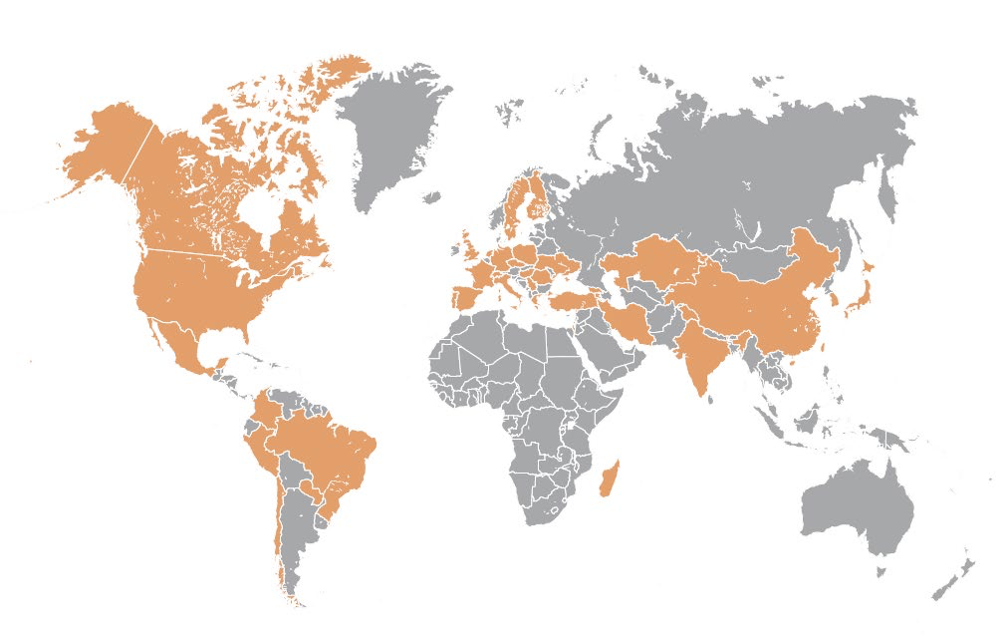

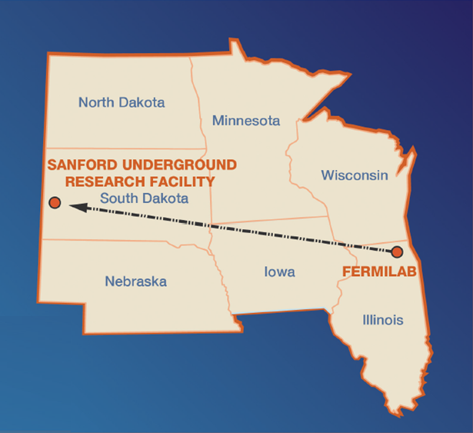
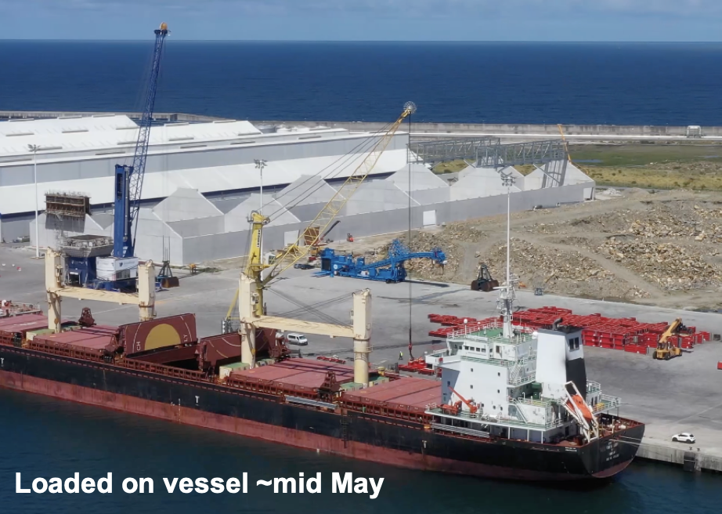
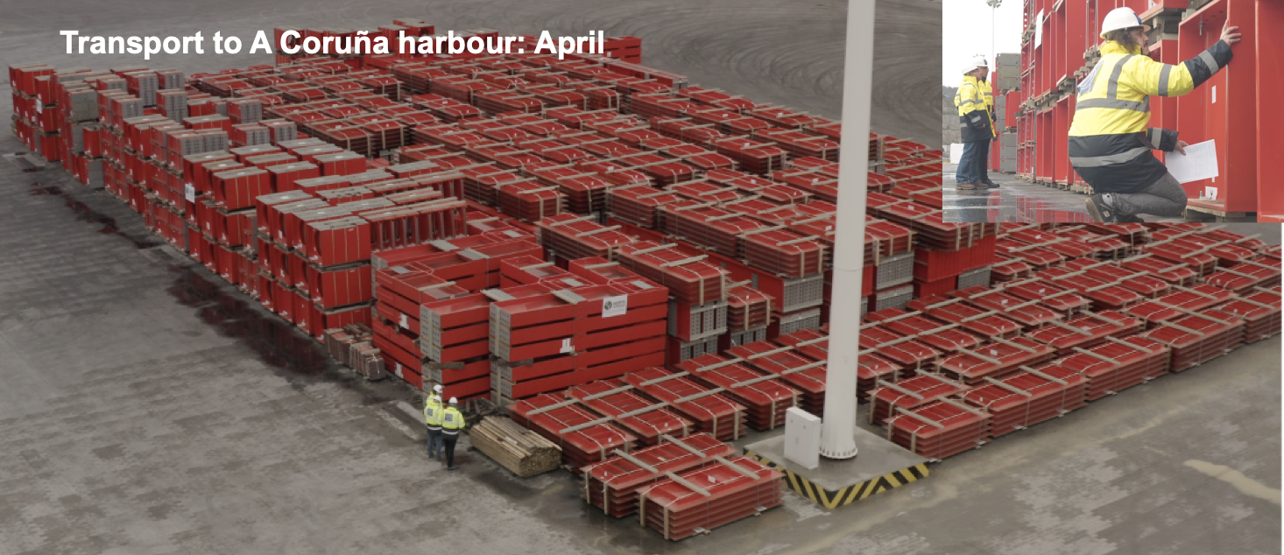
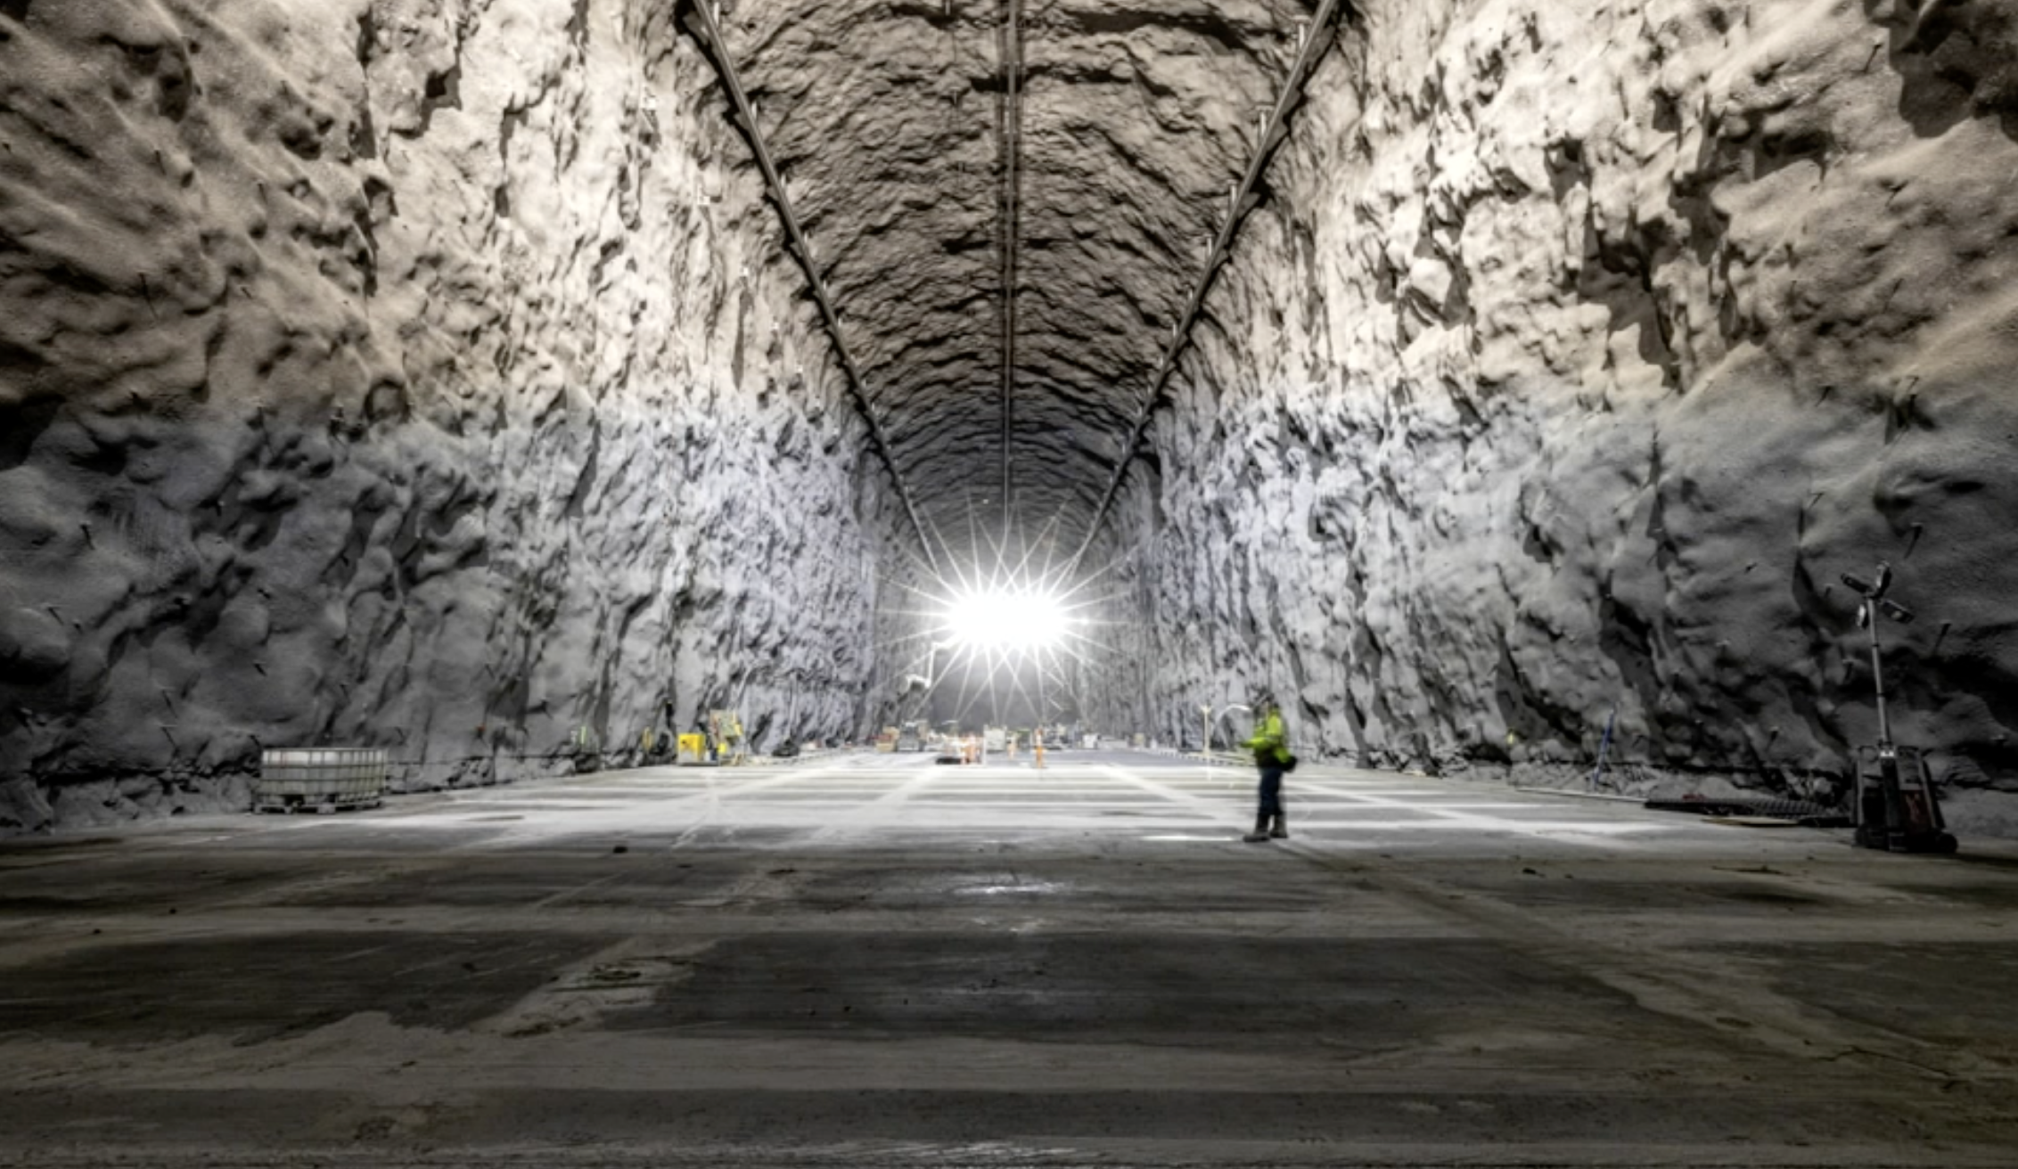
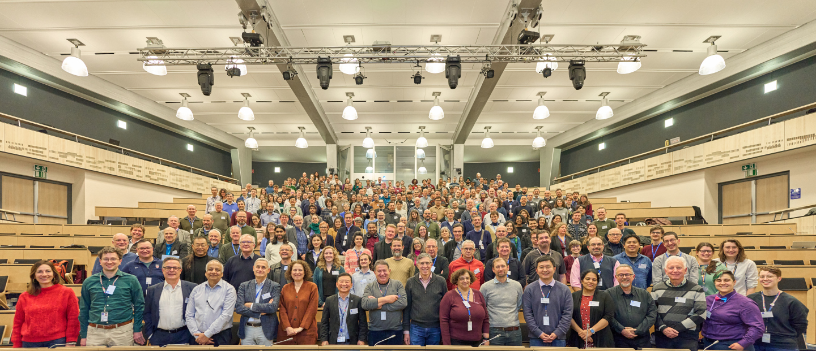

The Next Gen. ν Experiment – II
The Deep Underground Neutrino Experiment (DUNE)
  Joint efforts of teams from all three regions – Americas, Europe and Asia – hosted by Fermilab in the US
  >1500 members, >209 institutions, 36 countries +CERN
  LAr TPC ➔ Employ two readout technologies (HD/VD) within one experiment, systematic x-check
  LBNF (Long Baseline Neutrino Facility) far site facility construction approved by US DOE in Sept. 2016 ➔ Cavern excavation completed 1/25/24
  Exp. Infra work in progress
1300km
>1500 collaborators
>209 institutions
>36 countries + CERN
https://www.dunescience.org/about-the-collaboration/
CM@CERN, CH/Jan. 2024

Slide 13
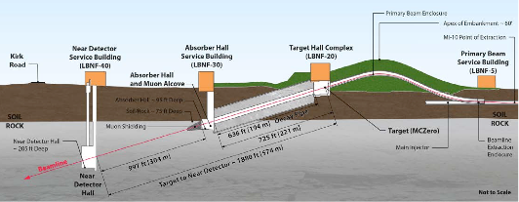
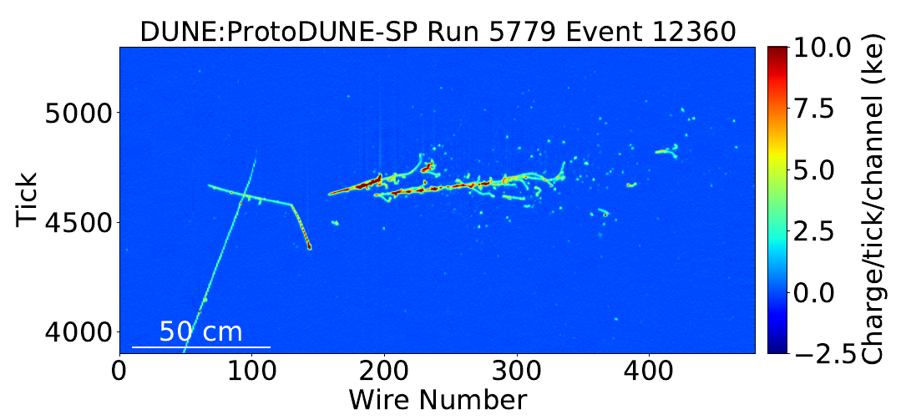
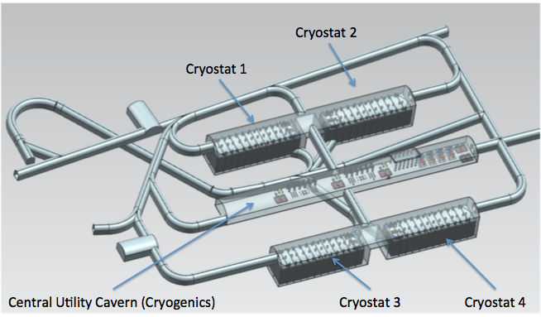
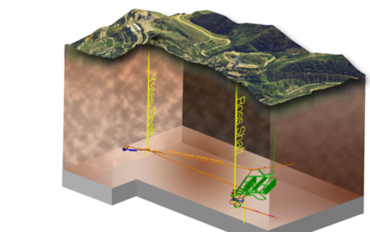
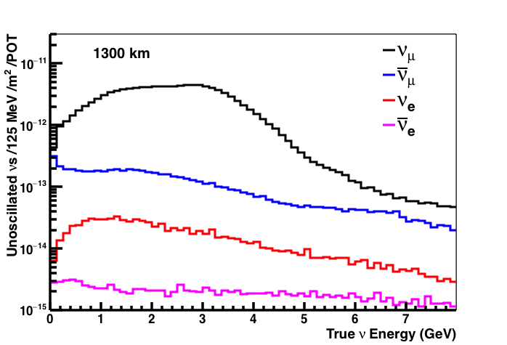
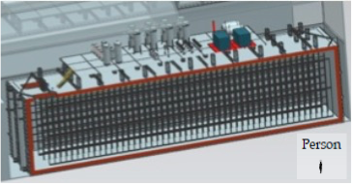
Anatomy of DUNE
Broadband ν from 60 – 120GeV p
LBNF ν Beam
P_{Beam} :1.2MW →2.4MW
Tgt
1300km (800 miles)
π⁺ n→π⁰ p
570m
ND
Long Baseline
3 GeV π⁺
π⁰ →γγ
4 caverns w/ active V_{A}~ 10kt LAr each
cosmic muon
stopping proton
LBNF Far Detector Site, SURF
1500m underground
18m
18m
66m

Slide 14
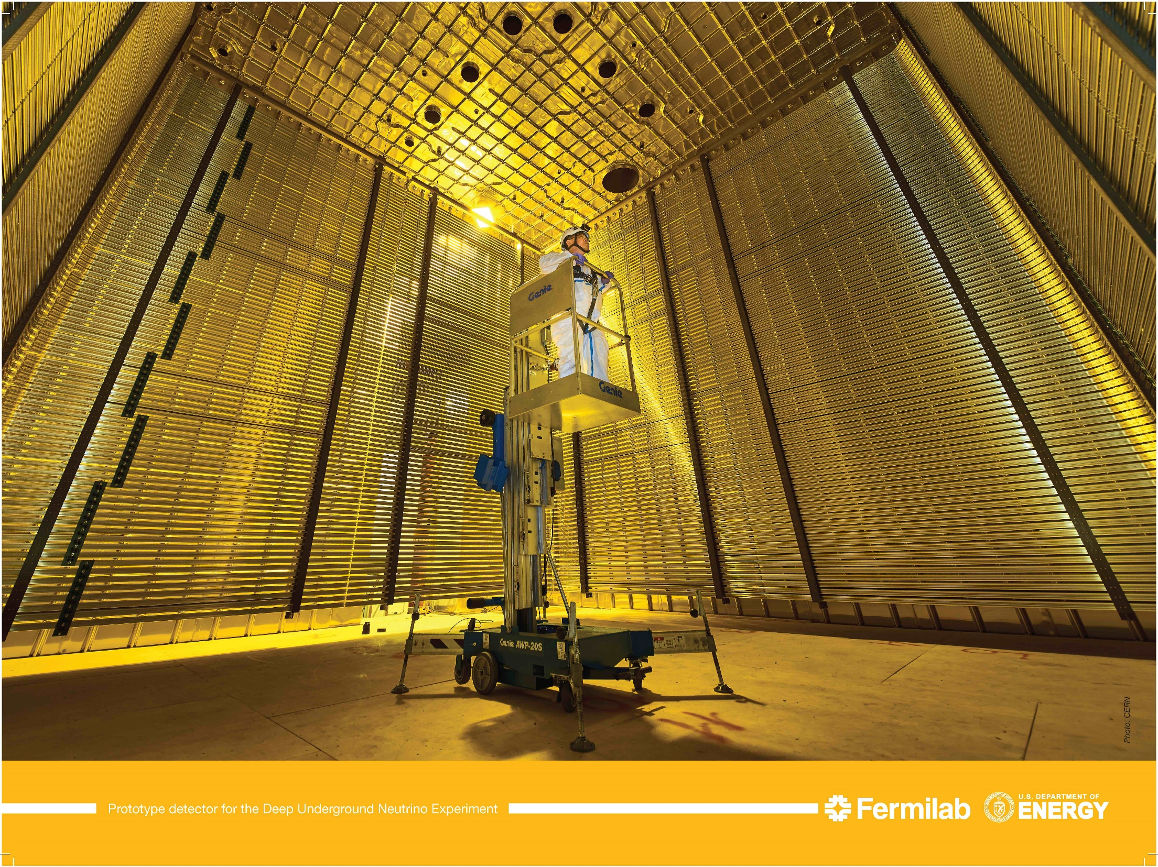
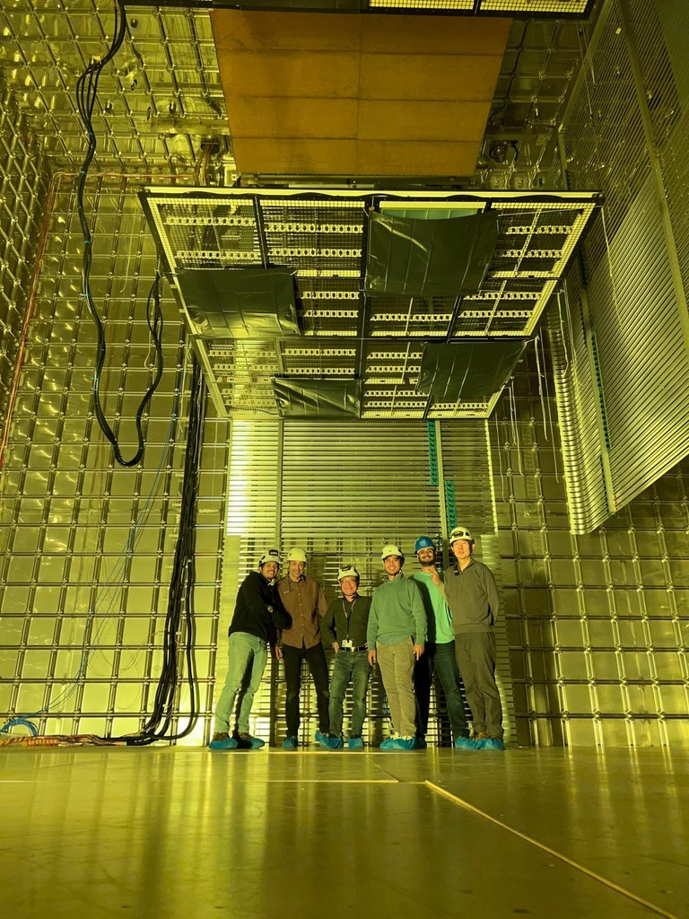
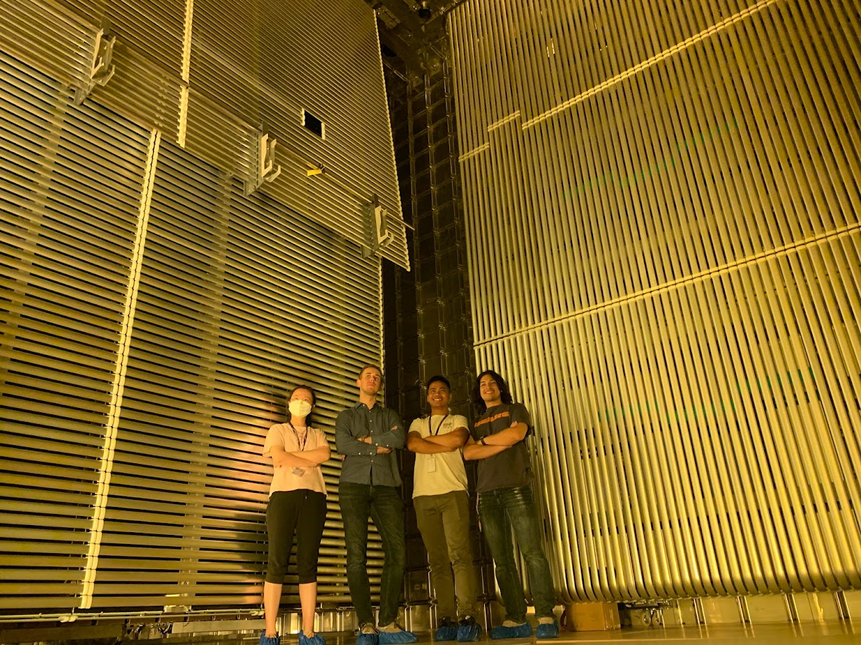
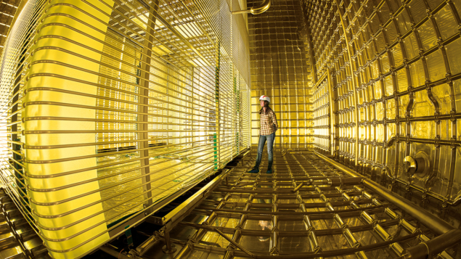
ProtoDUNE HD @ CERN, June 2022
DUNE Prototypes @ CERN ν-Platform
ProtoDUNE VD @ CERN, March 2023
LAr Filled and taking beam data at present
April 2018
6m
6m
6m
LAr will be x-fered from PD-HD later 2024 and taking beam data early 2025
V_{PD}=1/30 V_{FD}

Slide 15
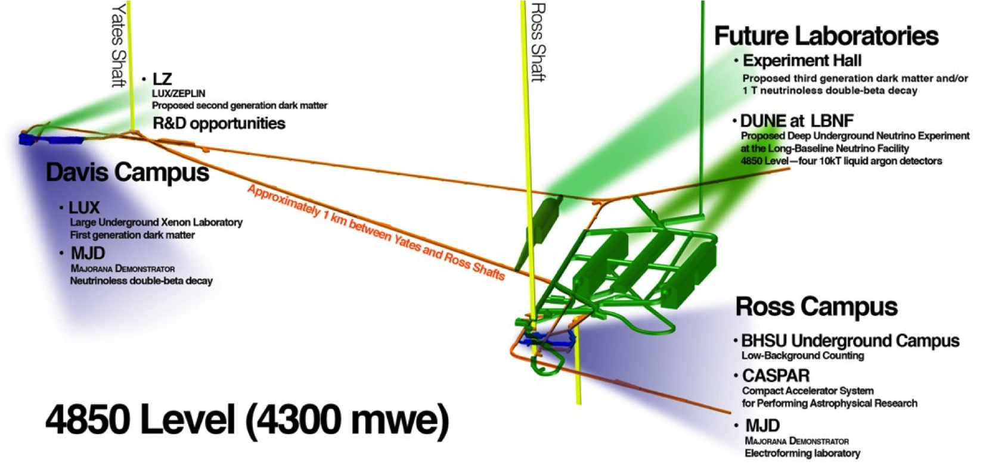
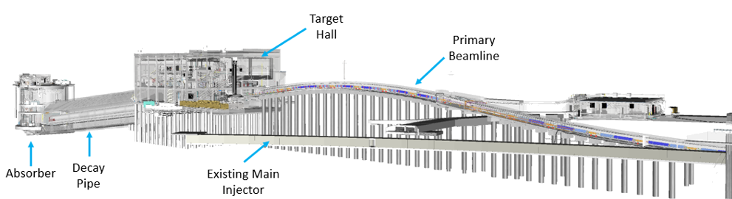
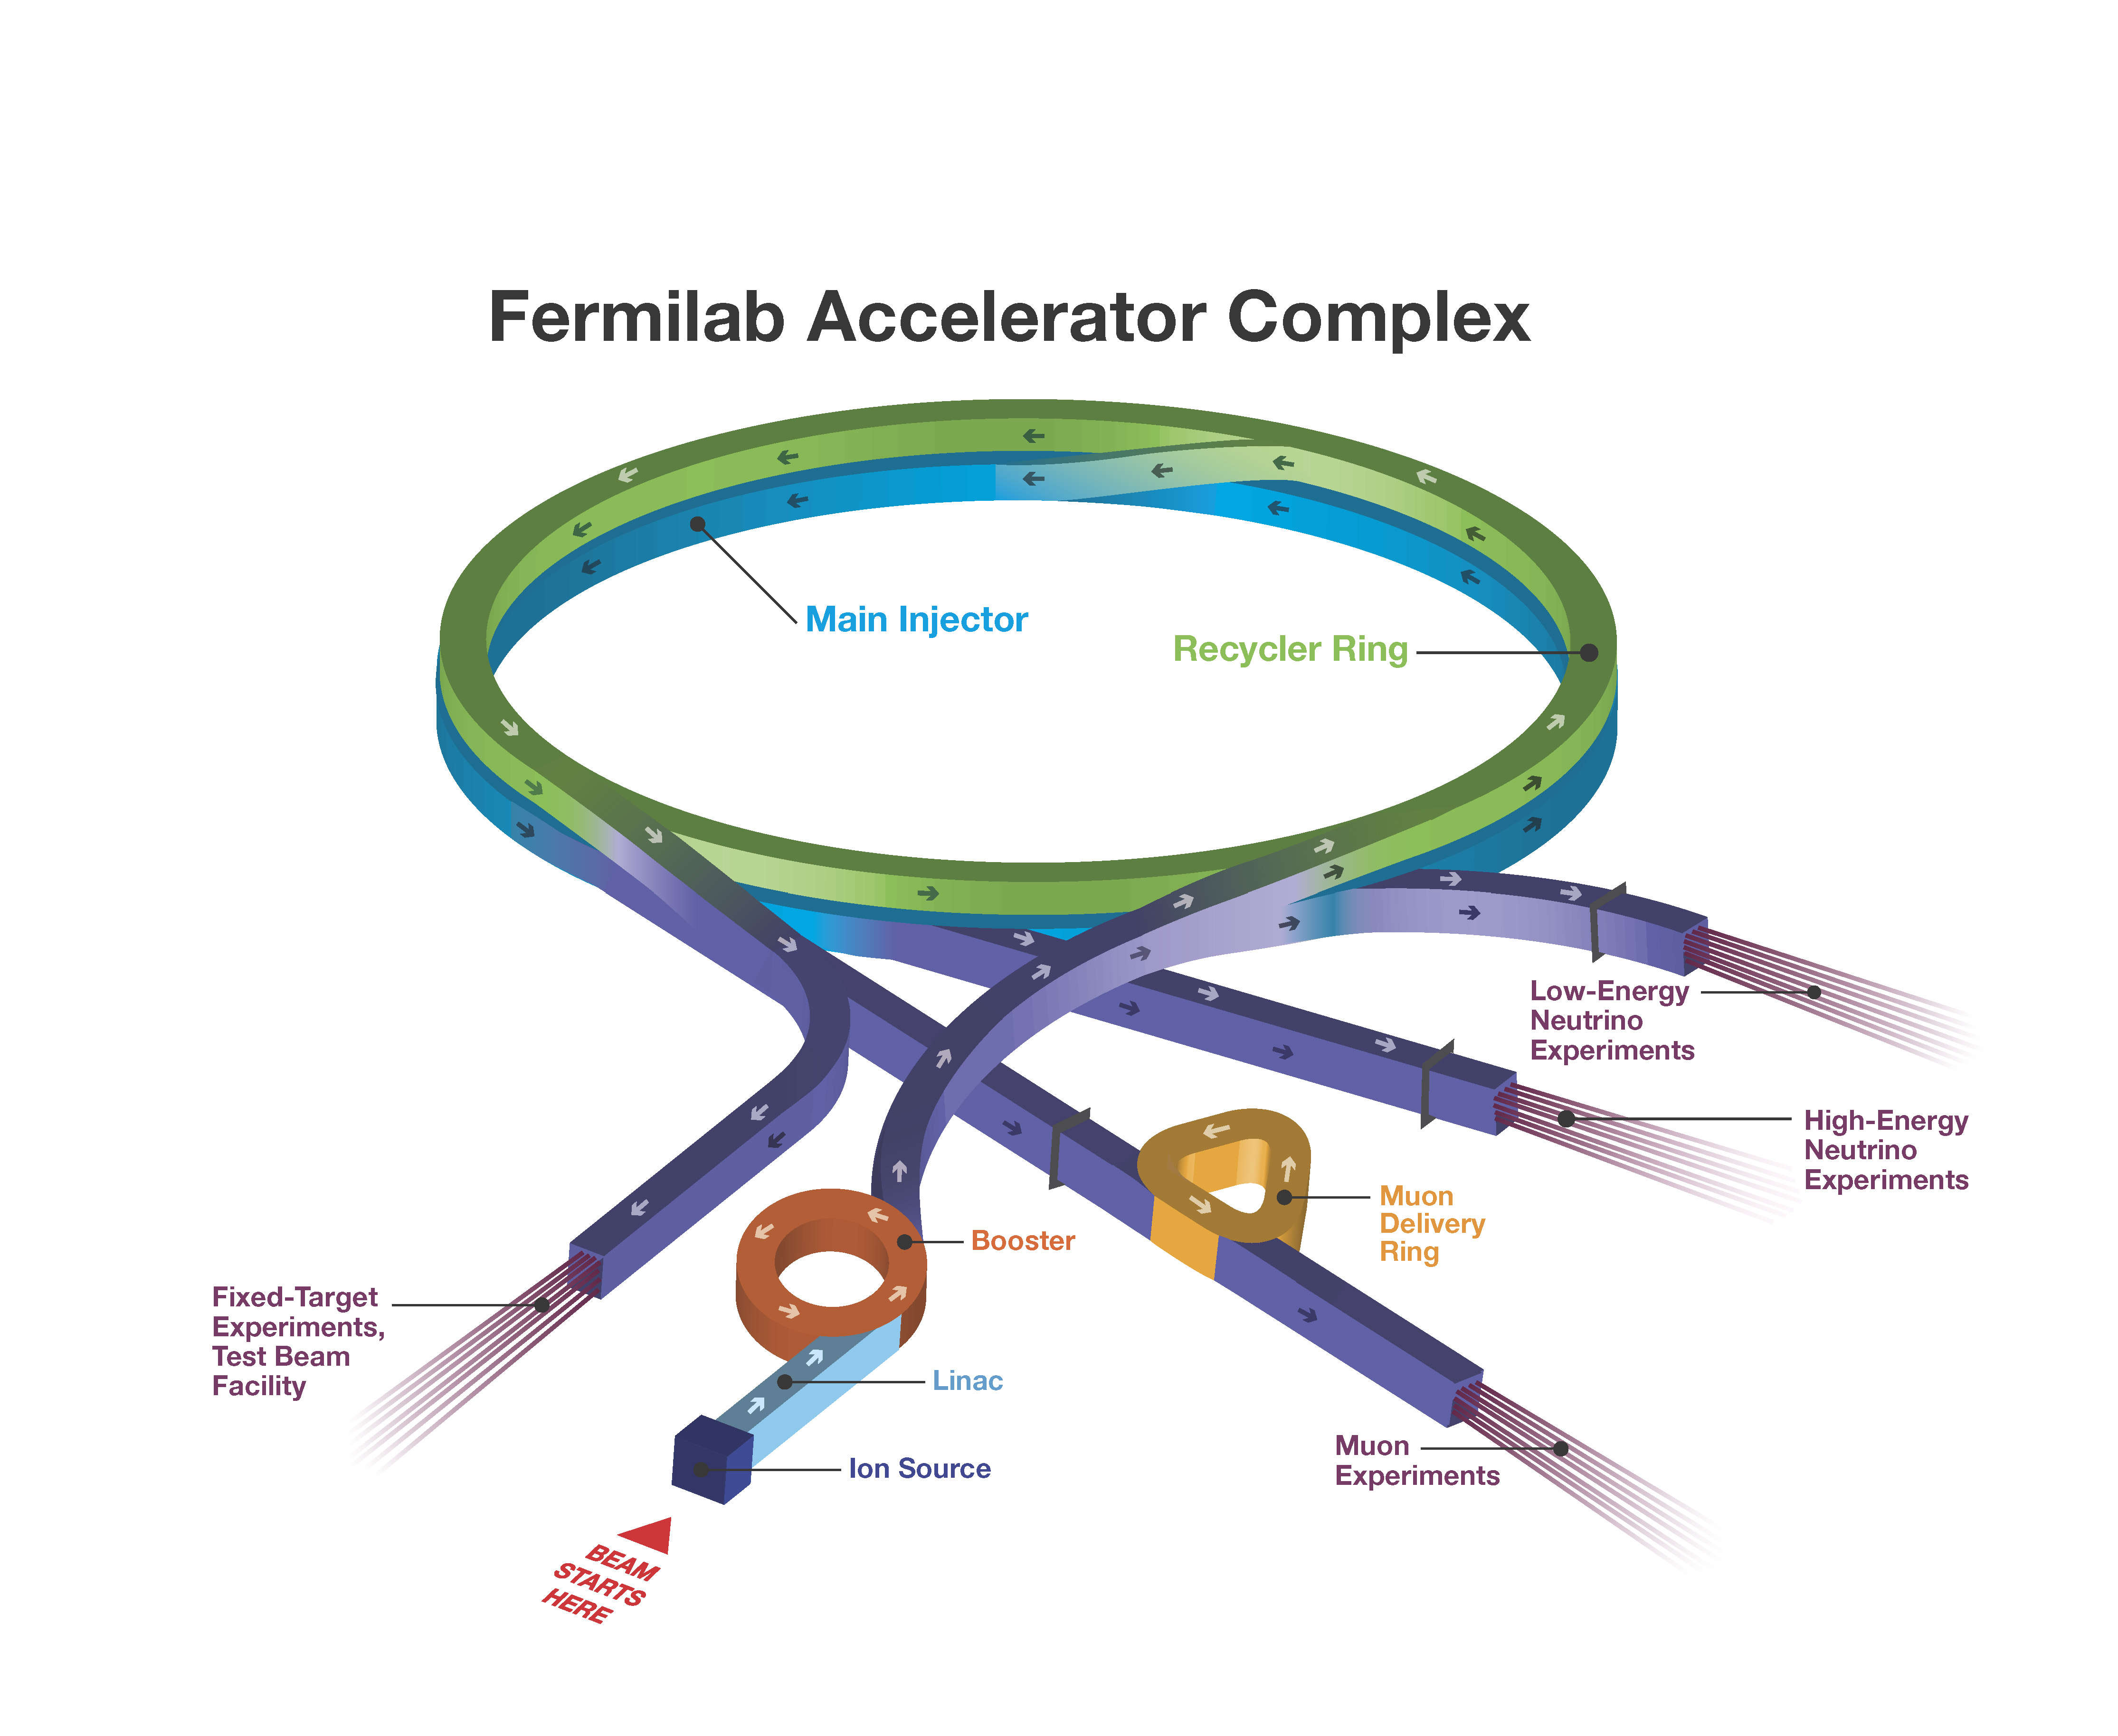
Long Baseline Neutrino Facility (LBNF)
LBNF Consists of 3 elements
  FD site: Sanford Underground Research Facility (SURF), SD
  ND site at Fermilab
  Neutrino Beam Line at Fermilab
    E_{p}=60 – 120 GeV
    1.2MW upgradable to 2.4MW
    Horn focused broadband beams optimized for CPV studies ➔ access to two oscillation maxima
800MeV PIP-II LINAC (I_{P}=2mA) under construction
To complete by 2029

Slide 16
DUNE Phased Approach
Recent P5 report recommends phased approach to DUNE, depending on funding scenario favorability
Phase I (Baseline)
  Two 17kt LArTPC FD (1 HD + 1VD) – Cryostats supported by CERN
  One 150t LArTPC Near Detector + 1 TMS on prism system for off-axis ν flux measurements
  One on-axis stationary, physics capable beam monitor
  ν beam w/ 1.2MW → 2MW ACE-MIRT (accelerator timing)
Phase II
  3rd 17kt LArTPC FD (vertical drift, VD readout)
  2.4MW ν beam upgrade
  More capable ND (MCND), potentially the GArTPC
R&D on the 4th 17kt LArTPC FD (VD)

Slide 17
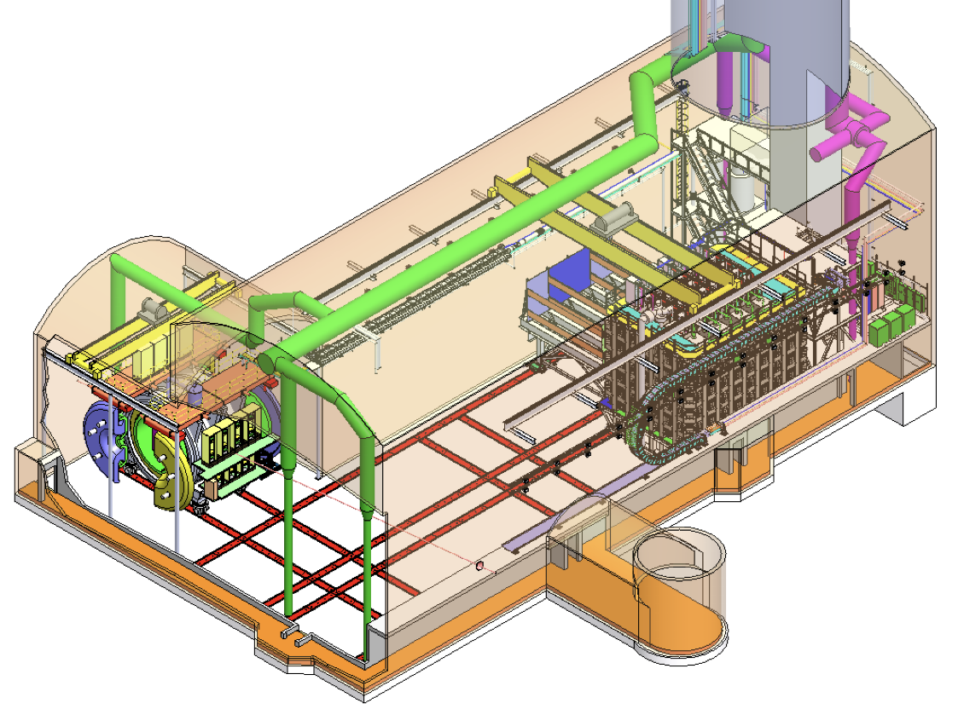
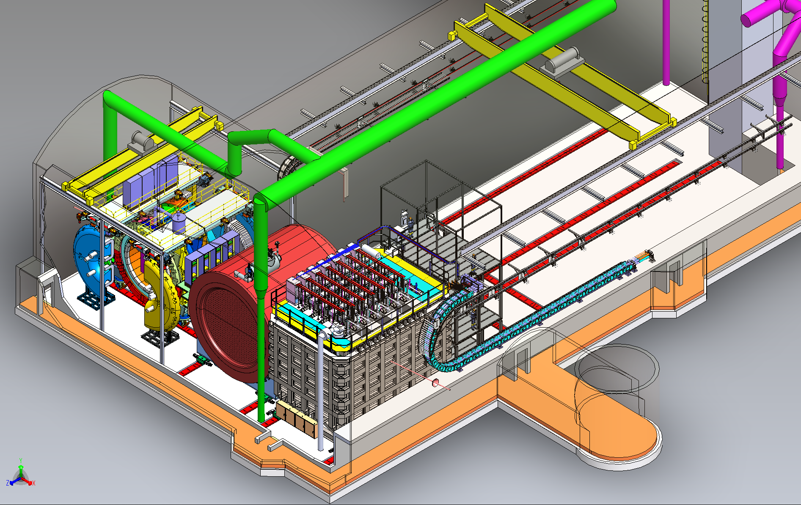
DUNE Near Detector Complex
Phase – I
Phase – II
TMS
DUNE-PRISM
LAr TPC
SAND
GAr
28.5m
SAND
28.5m
LAr TPC
ν beam
ν beam
LAr TPC: The same technology as the FD ➔ reduce systematics from different nuclear effects than FD; ν-Ar interactions (M_{A}=150t, V_{A}=105m³ ) ➔ 1x10⁸ ν_{μ} CC/year on-axis (~1Hz)
TMS: Spectrometer to provide momenta of the μ from LAr
DUNE-PRISM: Off-axis ν spectrum for systematics; takes ND-LAr and TMS (ND-Gar) from on axis up to 28.5m off-axis (~53mrad or 3º)
SAND(System for On-Axis neutrino Detection): Monitors on-axis ν beam flux to the FD; Consists of a straw tube tracker + ECAL equipped with a 0.6T magnet
MCND: Magnetized (0.5T) large volume HPGAr TPC (10atm) w/ ECAL: ν-Ar events with low-threshold tracking; p_{μ} measurements (M_{A}=1t, V_{A}=108m³ ) ➔ 1x10⁶ ν_{μ} CC/year on-axis

Slide 18
DUNE and Hyper-K Facility
 | DUNE | HK/T2HK
FD Technology & Active Mass | LArTPC (2+1+1) x10kt | Water Cerenkov 1 x187kt
Proton Beam power (MW) | 1.2 → 2 → 2.4 | 1.3
Proton Energy (GeV) | 120 | 30
Baseline (km) | 1300 | 295
FD Depth/overburden (m) | 1500 | 650
ND from ν target (m) | 575 | 280
Hyper-K Design Report: arXiv:1805.04163
DUNE TDR V1, 3&4: IoJ 15, N08, T08008 – 10 (2020)

Slide 19
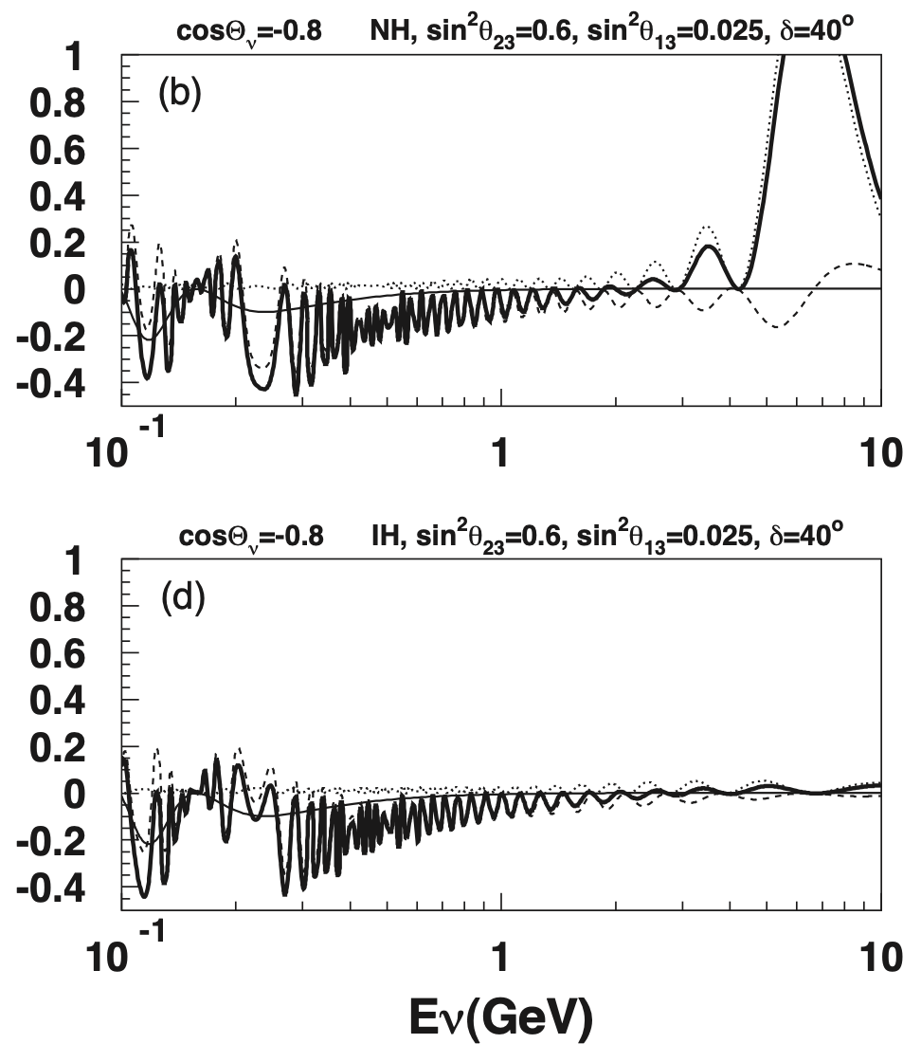

T2HK CPV & MO w/ ν_{e} Appearance
ν mode
ν_{atm}
NO
2nd octant. δ_{CP}=40º
δ_{CP}=+90
ν_{e}
δ_{CP}=+90
IO
ν mode
ν_{e}

Slide 20
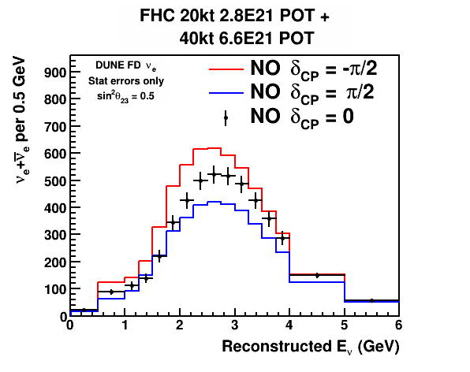
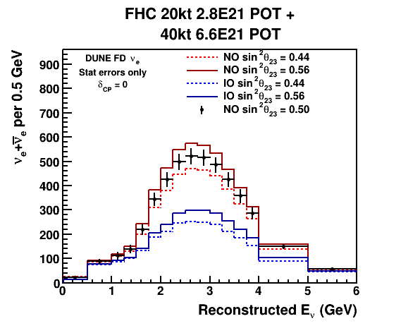
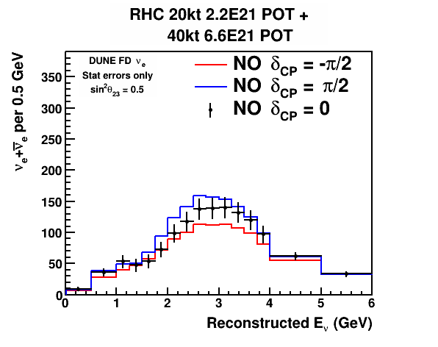
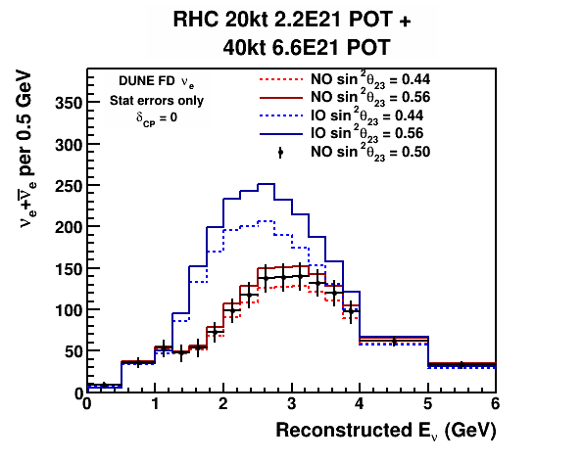
DUNE CPV & MO w/ ν_{e} Appearance
12 years
12 years
ν_{e}
ν
ν mode
ν_{e}
δ_{CP}=+90
12 years
12 years
ν_{e}
ν
ν_{e}
ν mode
ν_{μ}
δ_{CP}=+90
Simultaneous fit could provide info on MO and θ₂₃

Slide 21
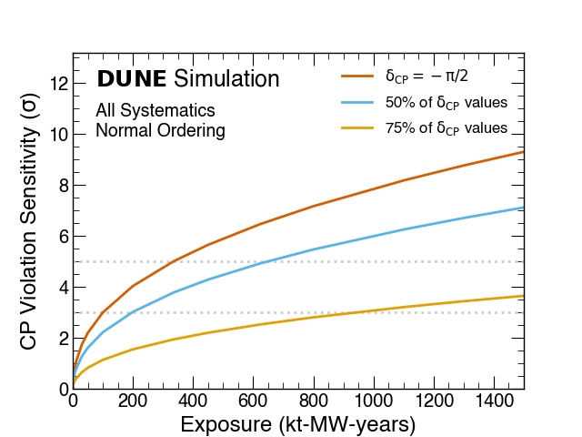
CPV Discovery Potential
Impact of syst. after 10yr
DUNE
5σ
5σ
HK
Hyper-K Design Report arXiv:1805.04163
DUNE Conceptual Design Report (CDR) arXiv:1512.06148
5σ CPV discovery possible in about a decade of the start of operation!

Slide 22
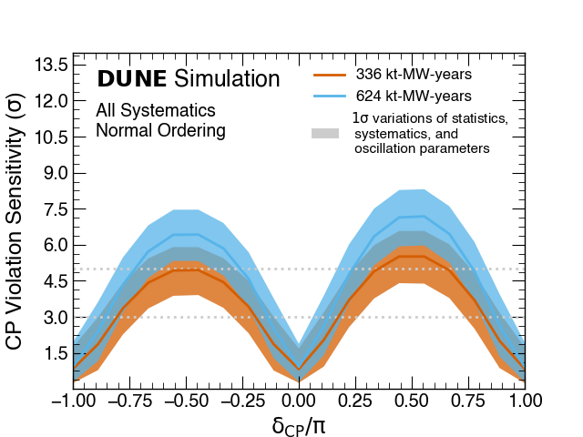
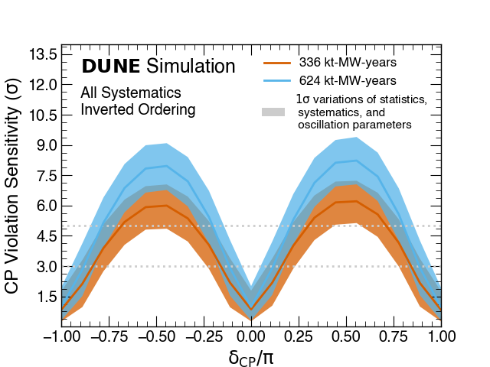
Physics Reach, δ_{CP} Determination
HK
NO
IO
Δδ_{cp} <10º at δ_{cp} =0!
Band:variation of θ₂₃
Δδ_{CP} ~20º @ δ_{CP}=π/2 & <10º@ δ_{CP}= 0 in about a decade of operation

Slide 23
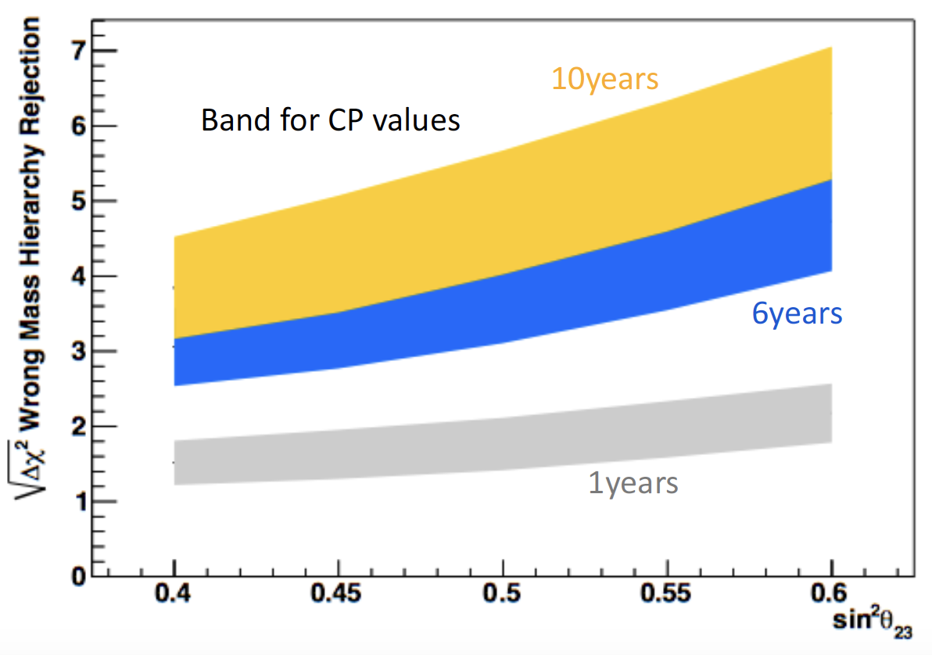
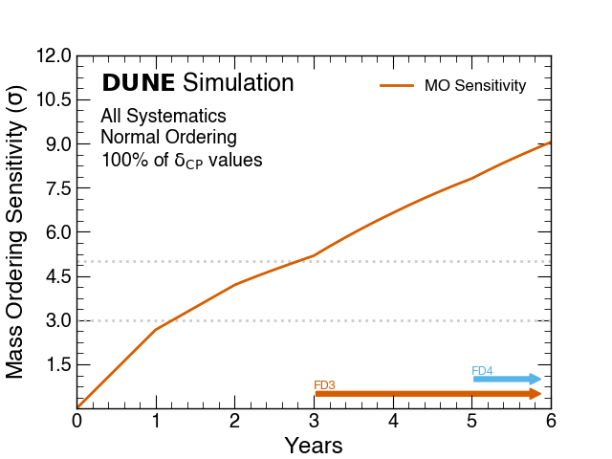
Physics Reach, Mass Hierarchy
HK
5σ
HK Design Report arXiv:1805.04163
DUNE: Eur. Phys. J. C 80, 978 (2020)
5σ MO determination possible in about half decade of operation!

Slide 24
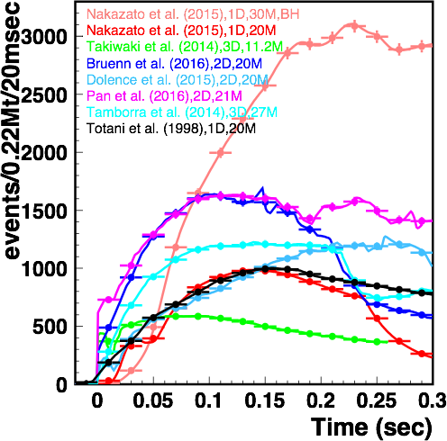
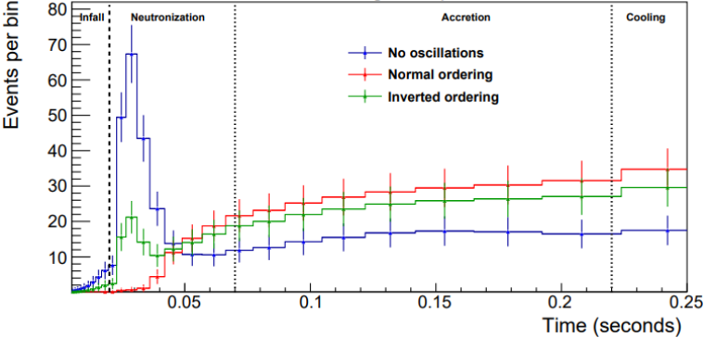
SNB Electron Neutrino Interactions
Ap. J. 916 15 (2021)
Eur. Phys. J. C 81, 423 (2021)
DUNE
HK
In LArTPC, SNB signal dominated by ν_{e}
ν_{e} + ⁴⁰Ar → e⁻ + ⁴⁰K*
Observation of early time development yields sensitivity to neutrino mass ordering and details of SNB model.
Notes:
No collective effects

Slide 25
BSM@ν Signature Categories
BSM physics accessible in next gen. ν experiments
Direct Observation Signatures
  Requires high beam flux
  Sufficiently large mass for scattering signatures
  Sufficiently large volume for decay signatures
Inferred Observation Signatures from both beam and cosmogenic sources
  Leverage oscillatory behaviors
  Large target mass, large volume FD for interactions
What do we need to know?
  Signal flux and realistic behaviors in the detector
  Neutrino flux and their interactions in the detector as backgrounds

Slide 26
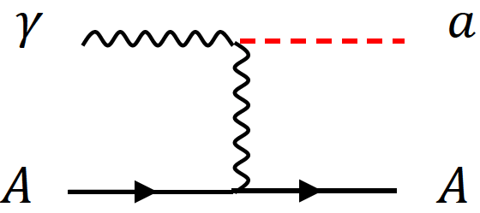
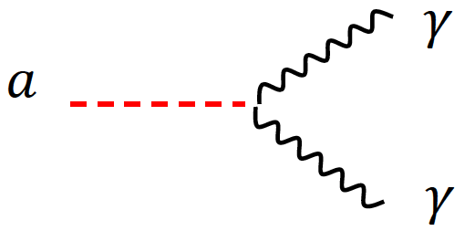

BSM Physics at a ν Experiment?
High beam power, large detector mass + highly capable detectors make BSM physics possible [See DUNE TDR publication, EPJC 81, 322(2021)]
  Direct Observation Signature, ND+Beam power
    Low mass Dark Matter (LDM)
    Heavy Neutral Leptons (HNL)
    Axion-like Particles (ALP)
    Dark Photons (A’→e+e-)
    Milli-charge Particles (mCP)
    Neutrino Trident
  Brdar, Yu, et al., PRL126, 201801 (2021)
  Inferred observation, FD+beam power
    Sterile neutrino searches
    Non-standard Interactions, Non-Unitarity, CPT violation
    Large Extra Dimensions (LED)
    Boosted Dark Matter (BDM) / Inelastic Boosted Dark Matter (iBDM)
  Significant development in last dec.

Slide 27
DUNE and Hyper-K Timeline
 | DUNE | Hyper-K
Cavern Excavation Completion | Jan. 25, 2024 | End of 2024
FD Construction | 2025 – 2027 | 2024 – 2025
FD Fill | 2027 – 2028 (10+10kt V_{A}) | 2025 – 2026 (187kt V_{A})
Data Taking | 2028 (cosmic) / 2031 (ν beam) | 2027
Beam & ND Ready | 2031 | 2027

Slide 28
Conclusions!
The SM needs to reflect non-zero m_{ν}
Precise understanding of neutrino properties and discovery of CPV in lepton sector are essential
Two complementary next generation LBN experiments (HK & DUNE) with large ν target mass, high power beams and highly capable ND are under construction
  HK cavern exc. end 2024 & aims to start beam ops in 2027
    Efforts on KNO for T2HKK possibility still ongoing
  DUNE FD site cavern exc. done Jan. 2024 & FD construction to complete by 2028, followed by Phase I ND & 1.2MW beam in 2031
Expect results from HK & DUNE, starting later in this decade

Slide 29
In the Next Quarter Century
Discovery of CPV in ν Sector
A new theoretical framework!
Discovery of Supersymmetric Particles
Discovery of Dark Sector Particles & Dark Matter

