Slide 1



Results from 10 Years of NOvA
E
cos$θ$
On behalf of the NOvA Collaboration:
Wilf Shorrock
University of Sussex
PASCOS
8th July 2024
w.shorrock@sussex.ac.uk

Slide 2
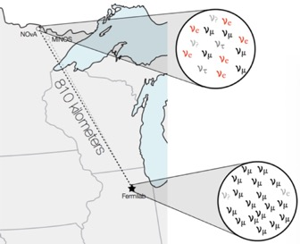
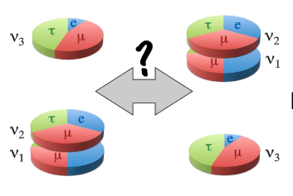

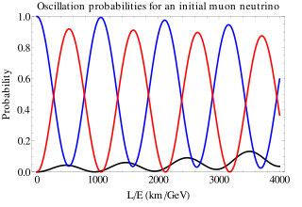
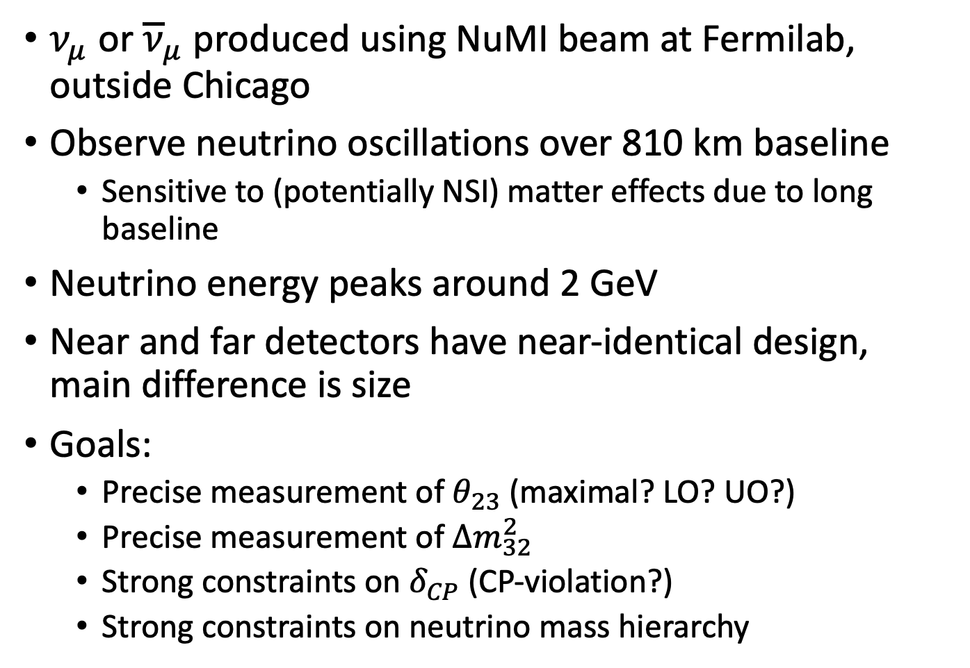
The NOvA Experiment
$ν_{μ}$ or ${\overline{ν}}_{μ}$ produced using NuMI beam at Fermilab, outside Chicago
Observe neutrino oscillations over 810 km baseline
  Sensitive to (potentially NSI) matter effects due to long baseline
Neutrino energy peaks around 2 GeV
Near and far detectors have near-identical design, main difference is size
Goals:
  Precise measurement of $θ_{23}$ (maximal? LO? UO?)
  Precise measurement of $∆m_{32}^{2}$
  Strong constraints on $δ_{CP}$ (CP-violation?)
  Strong constraints on neutrino mass hierarchy
Notes:
Also have sensitivity to theta13
Detect muon neutrinos and electron neutrinos

Slide 3
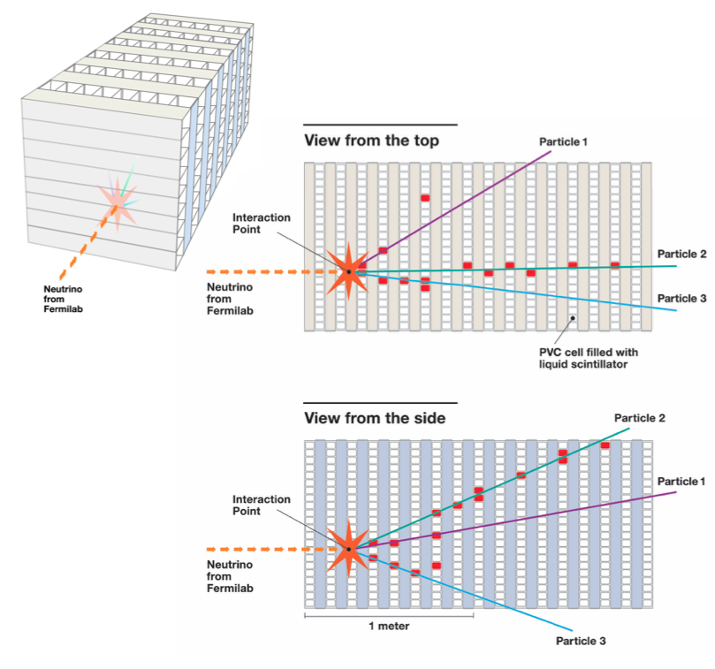
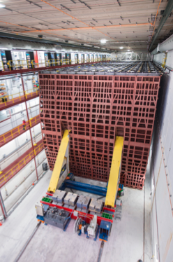
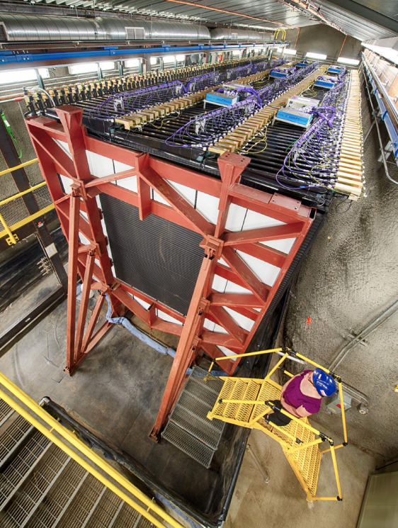
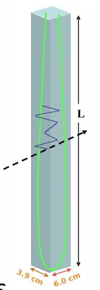
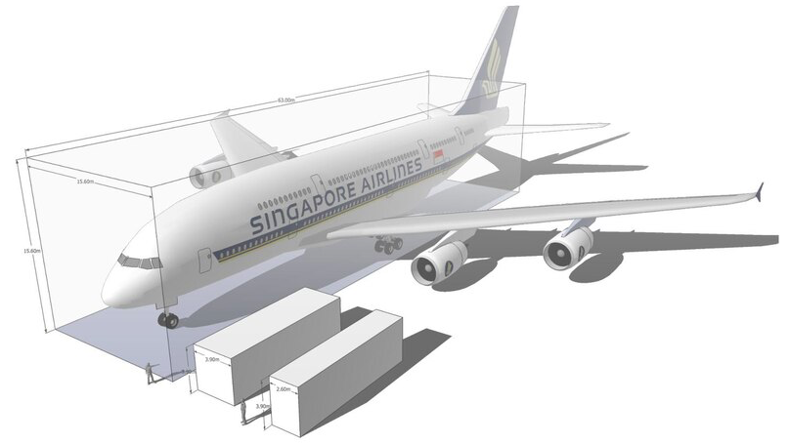
Detectors
Cells of liquid scintillator give tracking information of charged particles
To APD readout
The NOvA far detector
14,000 tons
~16 x 16 x 60 m³
The NOvA near detector
290 tons
~4 x 4 x 16 m³
Wavelength shifting fiber
Scintillation light
FD
Charged particle
ND
Comparing the NOvA detectors with an A380
Notes:
~cm spatial resolution (based on cell size)
~6 cell lengths per radiation length of EM showers
60% active material
Time resolution of a few ns
~350,000

Slide 4
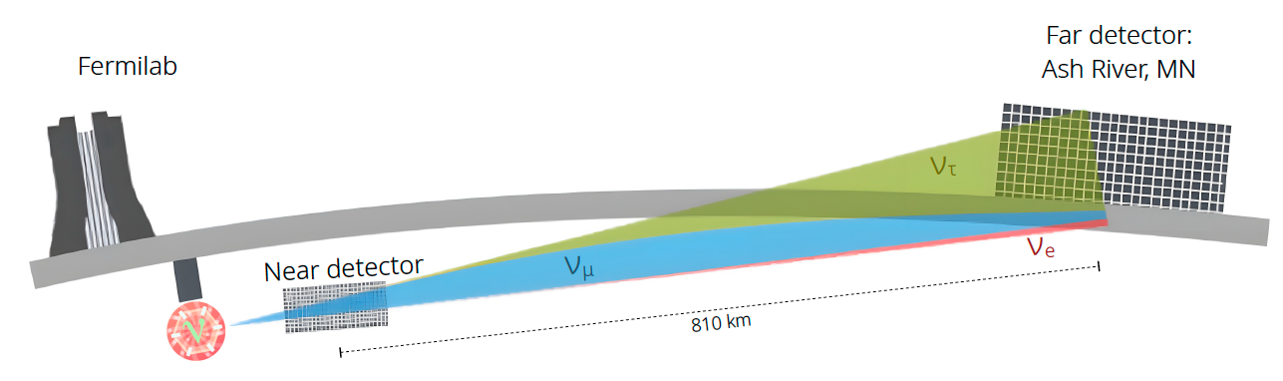
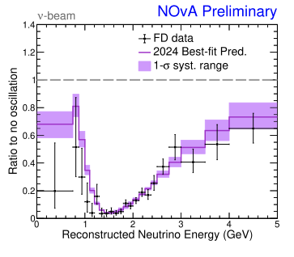
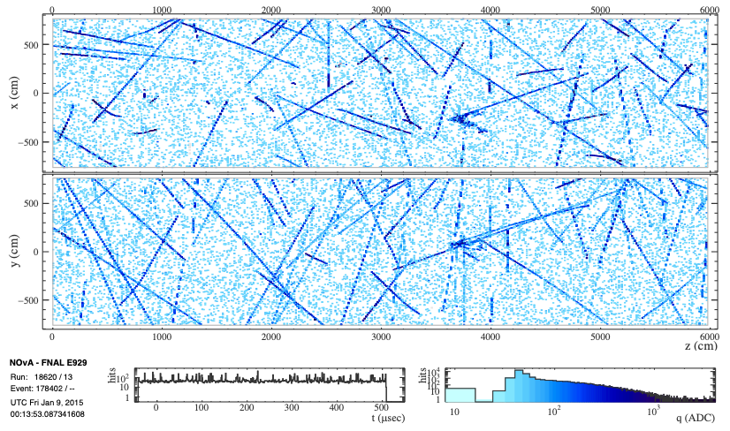
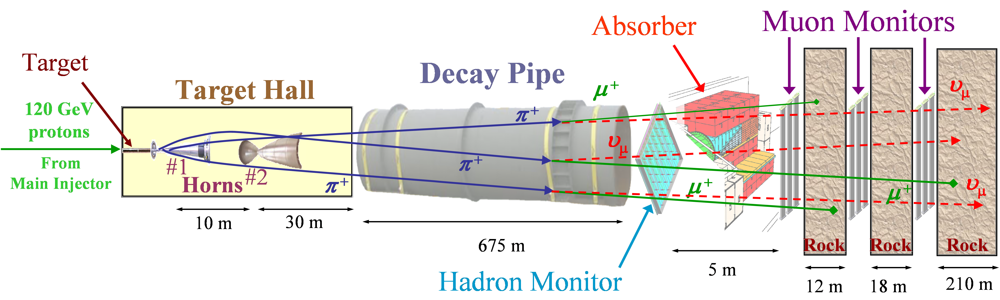
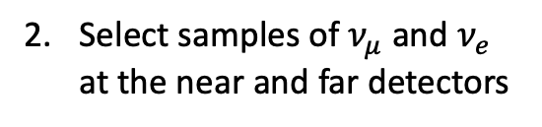
The NOvA Analysis
Constrain simulation and fit neutrino energy spectra
Produce a beam of muon (anti)neutrinos
Select samples of $ν_{μ}$ and $ν_{e}$ at the near and far detectors

Slide 5
The NuMI Beam
Constrain simulation and fit neutrino energy spectra
Produce a beam of muon (anti)neutrinos
Select samples of $ν_{μ}$ and $ν_{e}$ at the near and far detectors

Slide 6
The NuMI Beam
120 GeV protons fired into target
Pions and kaons focussed by horn current
Muon (anti)neutrinos produced in decay of pions and kaons
(Anti)muons absorbed in rock
(Anti)Neutrinos pass through the Earth to the ND and FD
Nearly doubled our neutrino POT this analysis!
Recently achieved 1 MW beam power!

Slide 7
Event Selection
Constrain simulation and fit neutrino energy spectra
Produce a beam of muon (anti)neutrinos
Select samples of $ν_{μ}$ and $ν_{e}$ at the near and far detectors

Slide 8
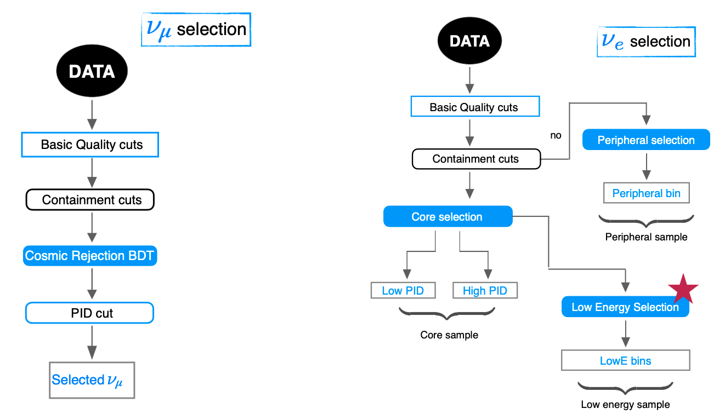
Event Selection
Convolutional neural networks (CNNs) used extensively
  Particle ID
  Cosmic rejection
Used in conjunction with other classifiers, such as Boosted Decision Trees (BDTs)
Notes:
BDTs for cosmic rejection and selection of uncontained nu-es

Slide 9
Constrain Simulation & Fit
Constrain simulation and fit neutrino energy spectra
Produce a beam of muon (anti)neutrinos
Select samples of $ν_{μ}$ and $ν_{e}$ at the near and far detectors

Slide 10
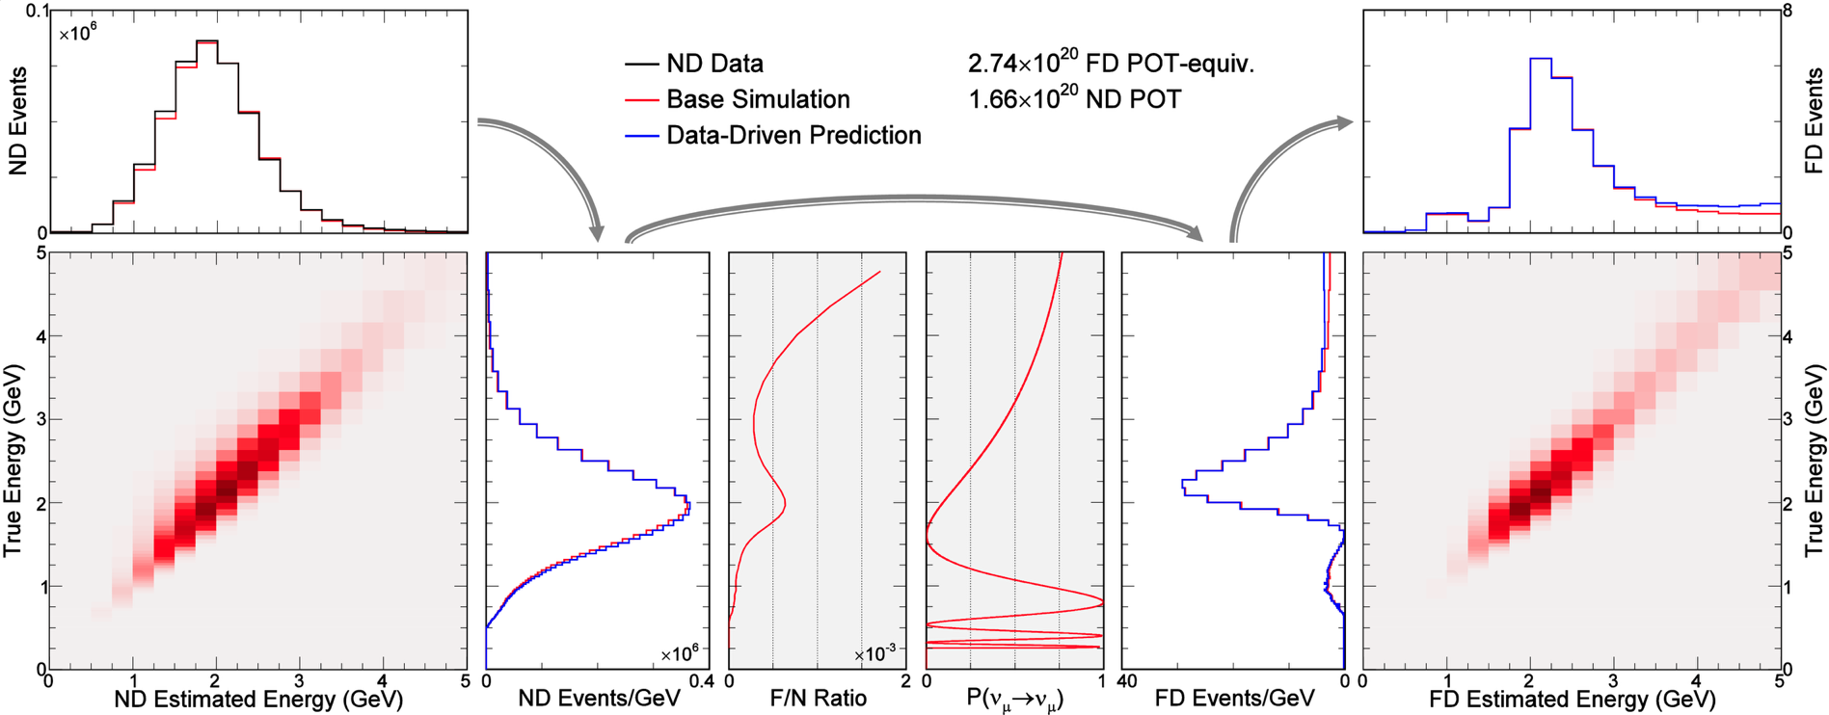
Constrain Simulation
For accurate predictions, we constrain our ND simulations using data and extrapolate to the FD

Slide 11
Constrain Simulation
For accurate predictions, we constrain our ND simulations using data and extrapolate to the FD
Correct ND simulation using ND data
1)

Slide 12
Constrain Simulation
For accurate predictions, we constrain our ND simulations using data and extrapolate to the FD
Convert to true neutrino energy
2)

Slide 13
Constrain Simulation
For accurate predictions, we constrain our ND simulations using data and extrapolate to the FD
Apply ND->FD extrapolation. Accounts for oscillations, beam divergence, detector acceptance etc.
3)

Slide 14
Constrain Simulation
For accurate predictions, we constrain our ND simulations using data and extrapolate to the FD
Convert back to reconstructed neutrino energy
4)
Notes:
numu sample subdivided into hadronic energy and transverse momentum
nue sample subdivided into different backgrounds (nue CC and numu NC)

Slide 15
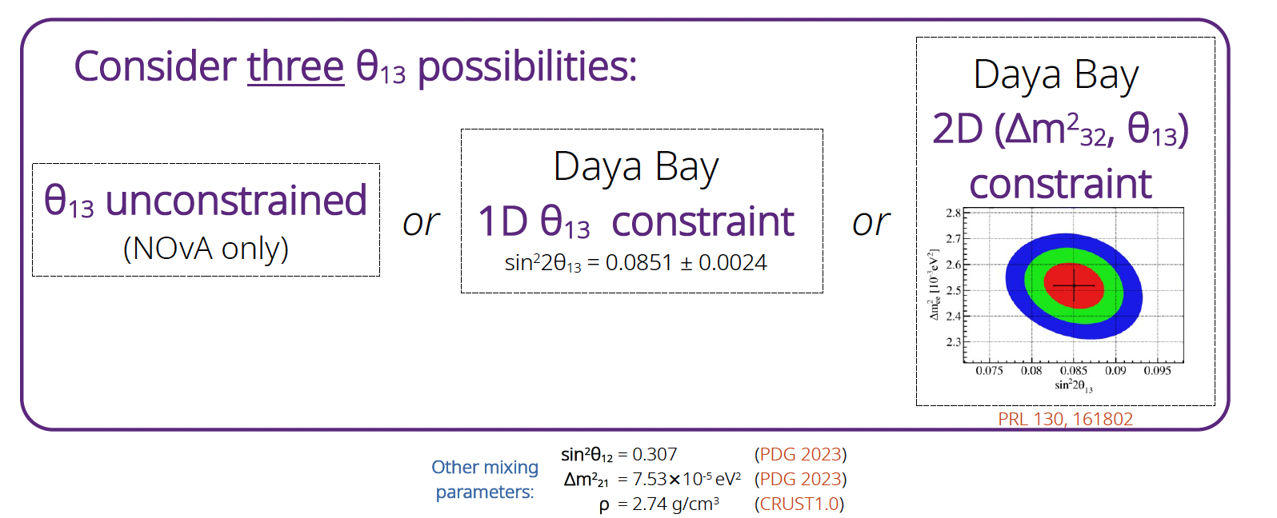

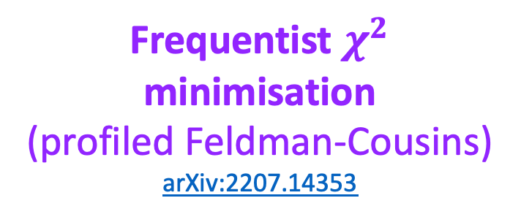
Fits
Bayesian Markov Chain Monte Carlo (marginalisation)
arXiv:2311.07835
Frequentist $χ^{2}$ minimisation
(profiled Feldman-Cousins)
arXiv:2207.14353
Bayesian credible regions
$$Δm_{32}^{2}, \sin^{2}{θ_{23},\sin^{2}{{2θ}_{13}, δ_{CP}}}$$
Frequentist confidence regions

Slide 16
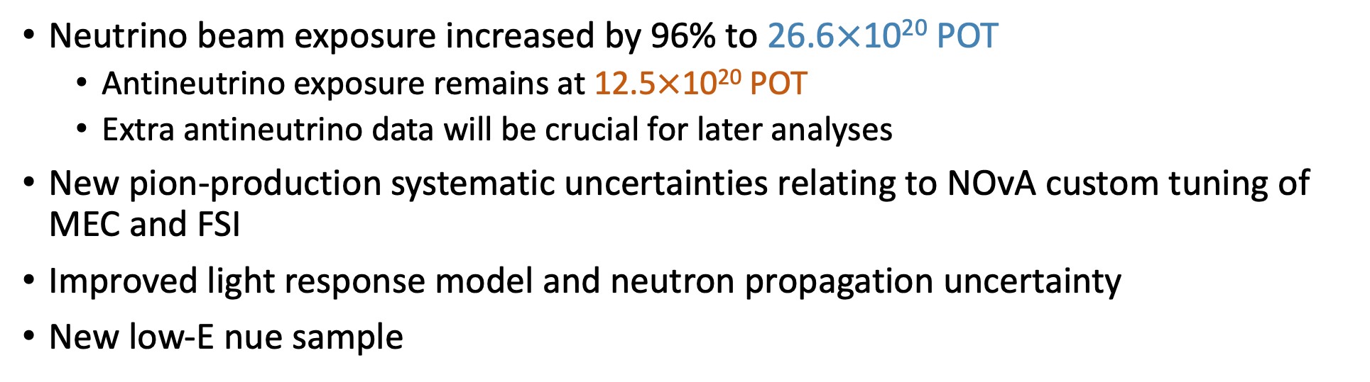
Improvements since 2020
Neutrino beam exposure increased by 96% to 26.6$×$10²⁰ POT
  Antineutrino exposure remains at 12.5$×$10²⁰ POT
  Extra antineutrino data will be crucial for later analyses
New pion-production systematic uncertainties relating to NOvA custom tuning of MEC and FSI
Improved light response model and neutron propagation uncertainty
New low-E nue sample
2024 analysis dataset
2020 analysis dataset

Slide 17
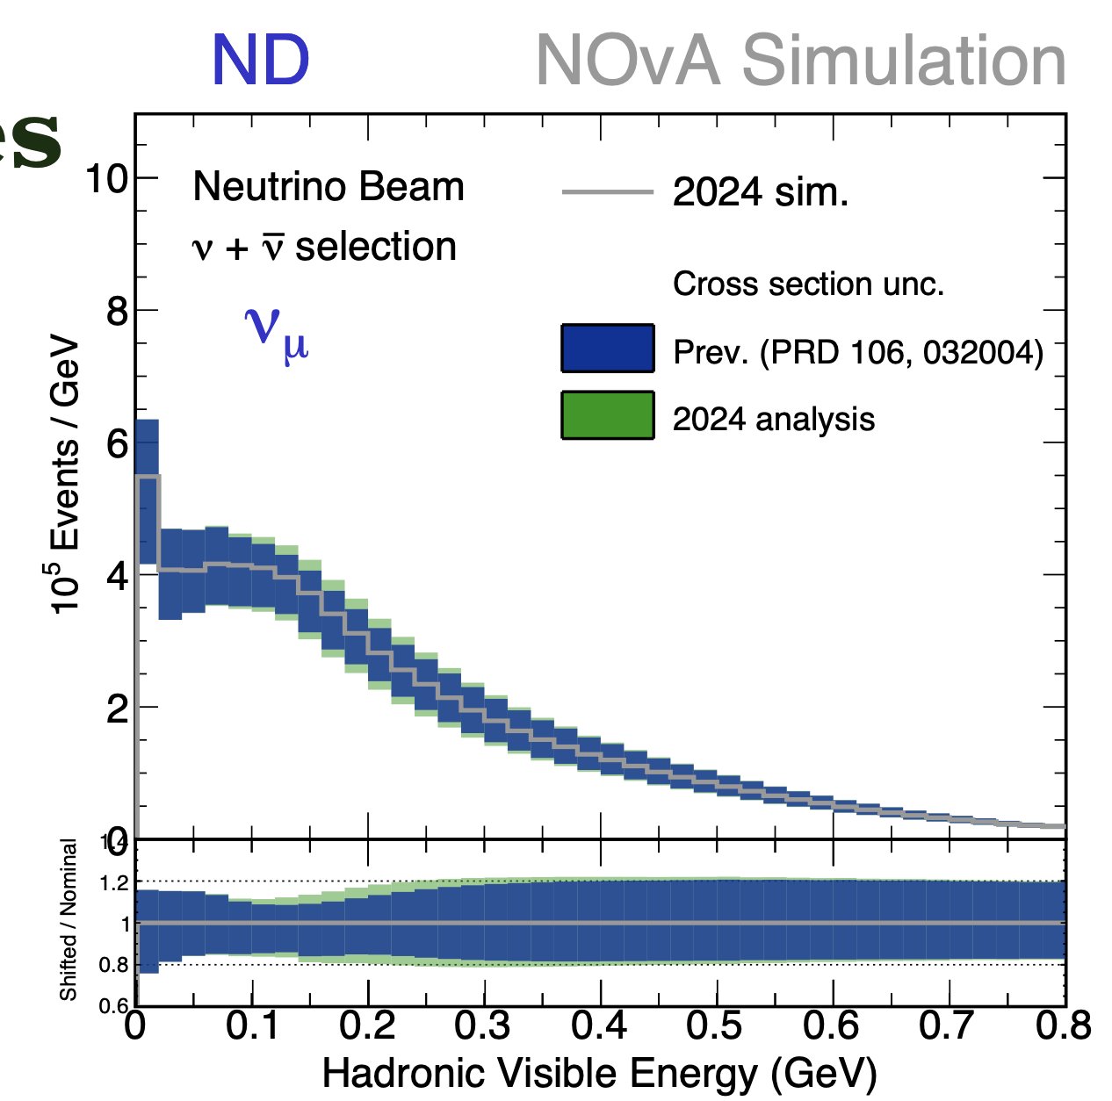
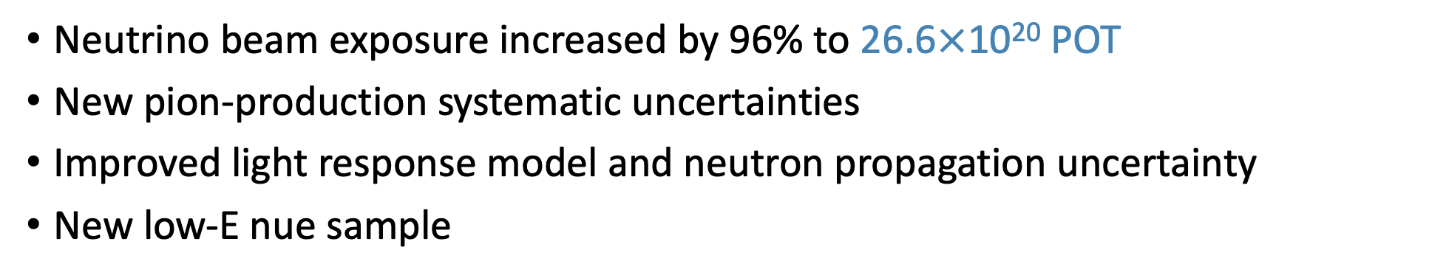
Improvements since 2020
Neutrino beam exposure increased by 96% to 26.6$×$10²⁰ POT
New pion-production systematic uncertainties
Improved light response model and neutron propagation uncertainty
New low-E nue sample
A comparison of the cross-section uncertainties for the 2024 and 2020 analyses.
Overall effect of extra uncertainty shifts is small.
Notes:
MEC = meson exchange currents
Shift delta and non-delta resonances independently (in default GENIE they are shifted together)
Shift ratio of RES delta-channel for proton and neutron final states
Shift composition of proton/neutron final states in DIS

Slide 18
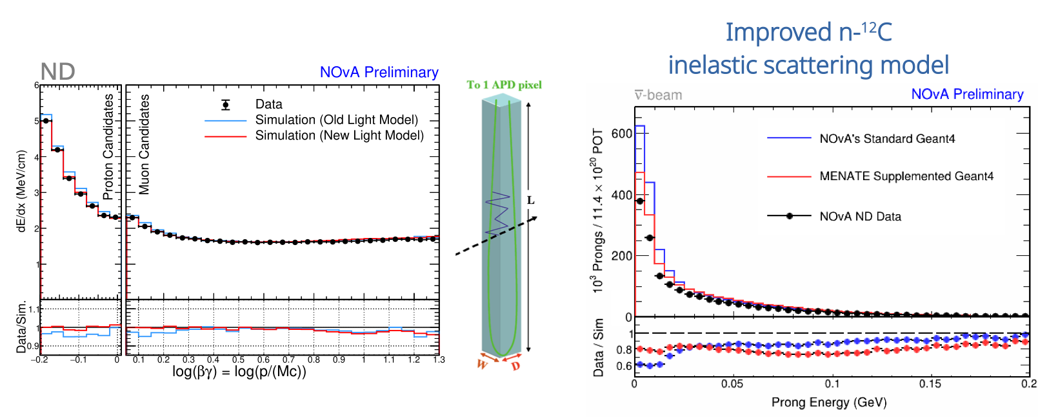
Improvements since 2020
Neutrino beam exposure increased by 96% to 26.6$×$10²⁰ POT
New pion-production systematic uncertainties
Improved light response model and neutron propagation uncertainty
New low-E nue sample
Neutron Candidate Visible Energy (GeV)
Cherenkov and scintillation light model improved using experimental measurements
Improved n-¹²C inelastic scattering uncertainty. Difference between MENATE_R* and default Geant4.10.4 informs systematic uncertainty
*P. Désesquelles, et al., NIM A307 366-373 (1991), Z. Kohley, et al., NIM A682 59-65 (2012)
Notes:
Utilised in-situ ND neutron data and compared to MENATE_R and Genie simulations
Difference between simulations used as systematic uncertainty
Using MENATE “flattens” our data/sim ratios
GEANT models inelastic scattering as individual particle-nucleon processes followed by statistical de-excitation process (tuned to total inelastic cross-section)
MENATE uses channel-by-channel cross-section measurements

Slide 19
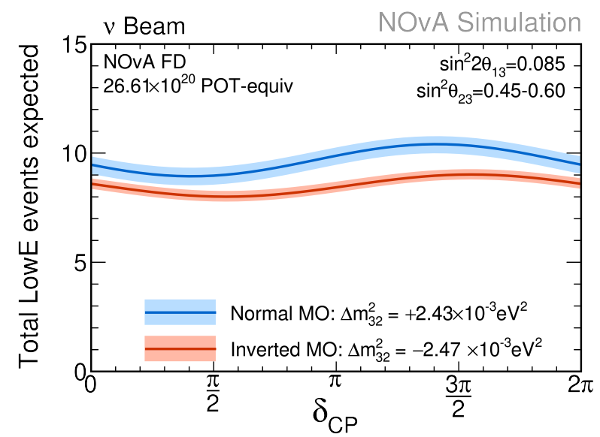
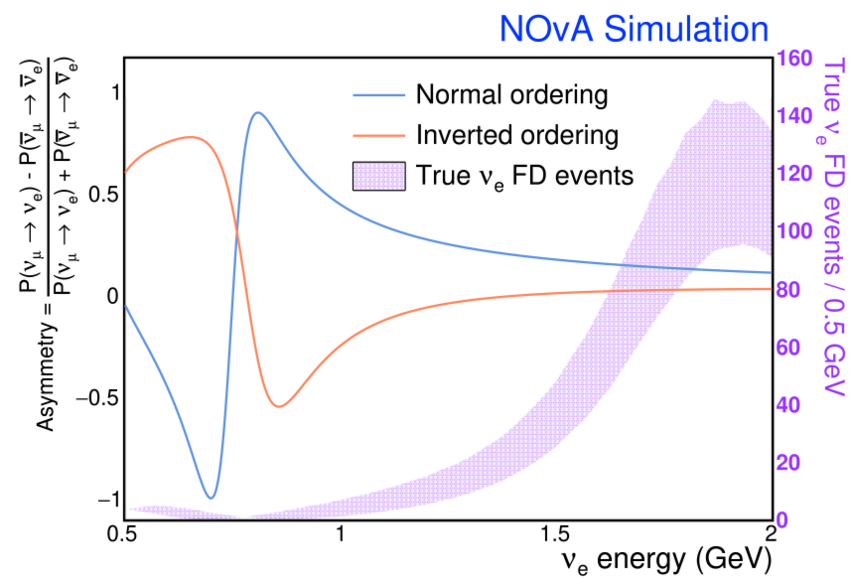

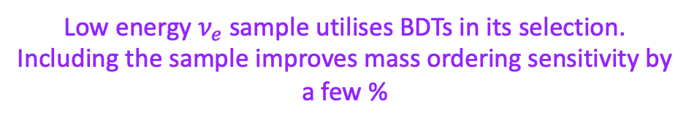
Improvements since 2020
Neutrino beam exposure increased by 96% to 26.6$×$10²⁰ POT
New pion-production systematic uncertainties
Improved light response model and neutron propagation uncertainty
New low-E $ν_{e}$ sample
Previously excluded
Low energy $ν_{e}$sample utilises BDTs in its selection. Including the sample improves mass ordering sensitivity by a few %
Expect ~10 events depending on oscillation parameters and mass ordering

Slide 20

Results
E
cos$θ$
Questions to keep in mind…
Do neutrinos violate CP conservation?
What is the ordering of neutrino mass states?
Is $θ_{23}$ maximally mixing (45º)?
What is the precise value of $Δm_{32}^{2}$?

Slide 21
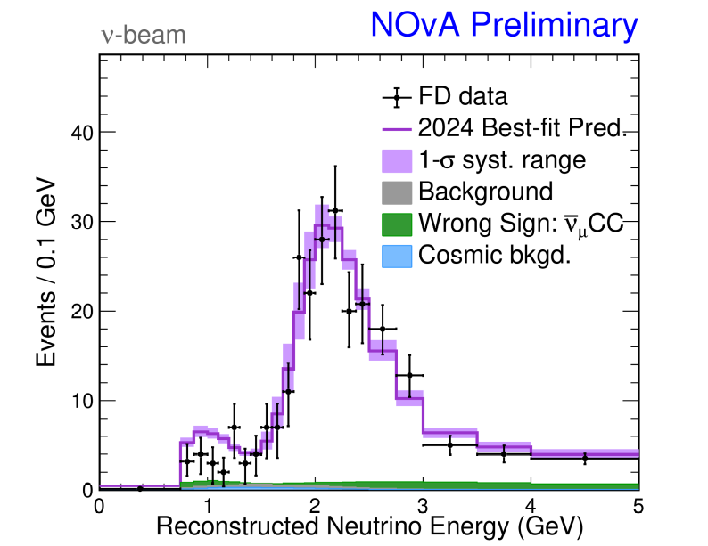
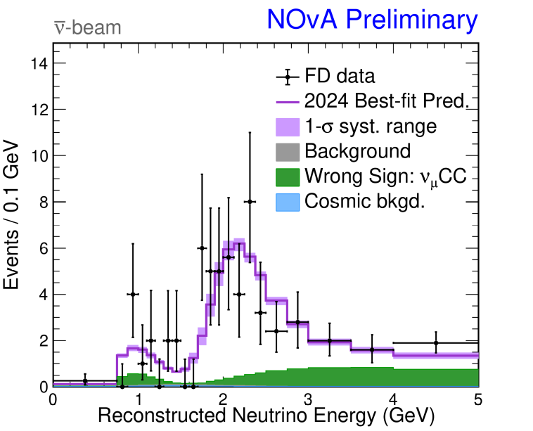



Results: $ν_{μ}$ observations
384 $ν_{μ}$ candidates
106 ${\overline{ν}}_{μ}$ candidates
Notes:
Data shape described well by 3-flavor oscillations. Bayesian posterior predictive p-value = 0.54 for all data
2020 analysis: 211 numu and 105 numunb
Would expect ~2100 and ~500 events respectively for no-oscillation hypothesis.
Refer back to extrapolation process

Slide 22
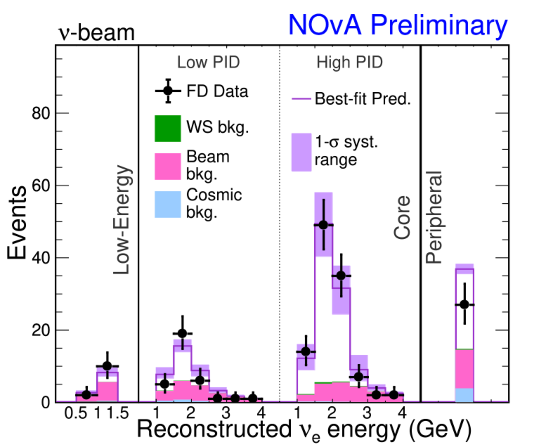
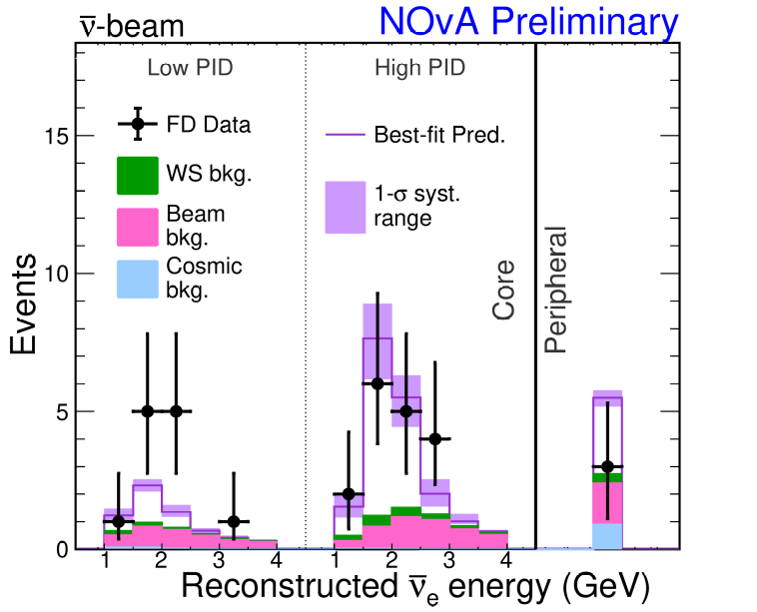



Results: $ν_{e}$ observations
181 $ν_{e}$ candidates
32 ${\overline{ν}}_{e}$candidates
Notes:
2020 analysis: 82 nue and 33 nueb

Slide 23

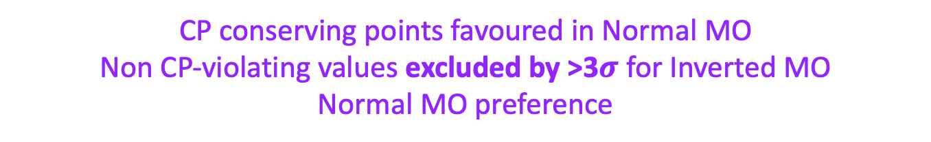
Results: $δ_{CP}$
CP conserving points favoured in Normal MO
Non CP-violating values excluded by >3$σ$ for Inverted MO
Normal MO preference

Slide 24
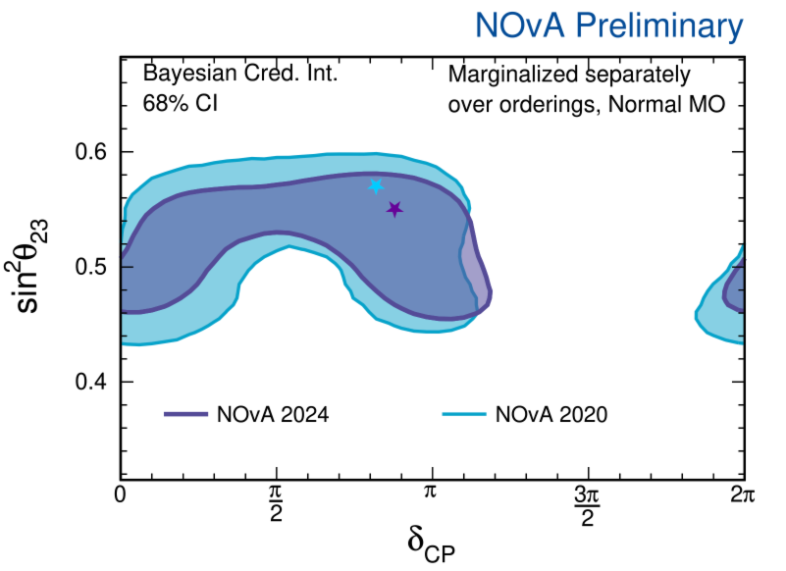
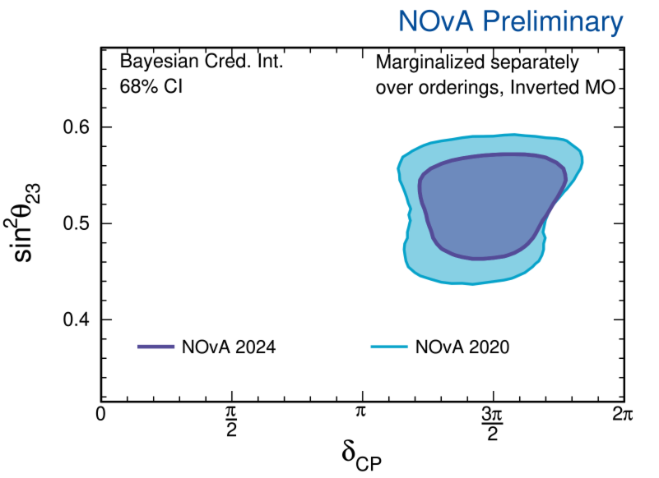

Results: $\sin^{2}{θ_{23}}$ vs. $δ_{CP}$
New results are consistent with 2020 results, with tighter constraints.
Note: 2020 results use 2019 PDG average for $θ_{13}$, 2024 results use Daya Bay 2023 1D constraints on $θ_{13}$

Slide 25

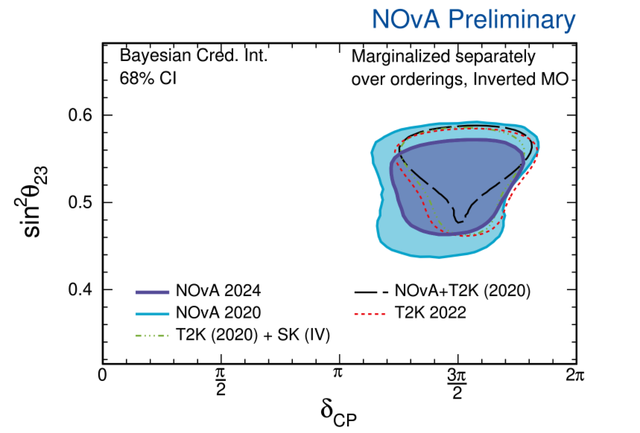


Results: $\sin^{2}{θ_{23}}$ vs. $δ_{CP}$
NOvA prefers different regions to other experiments in Normal MO
In Inverted MO it is consistent with other experiments.
Maybe difference is due to Non-Standard Interactions?

Slide 26
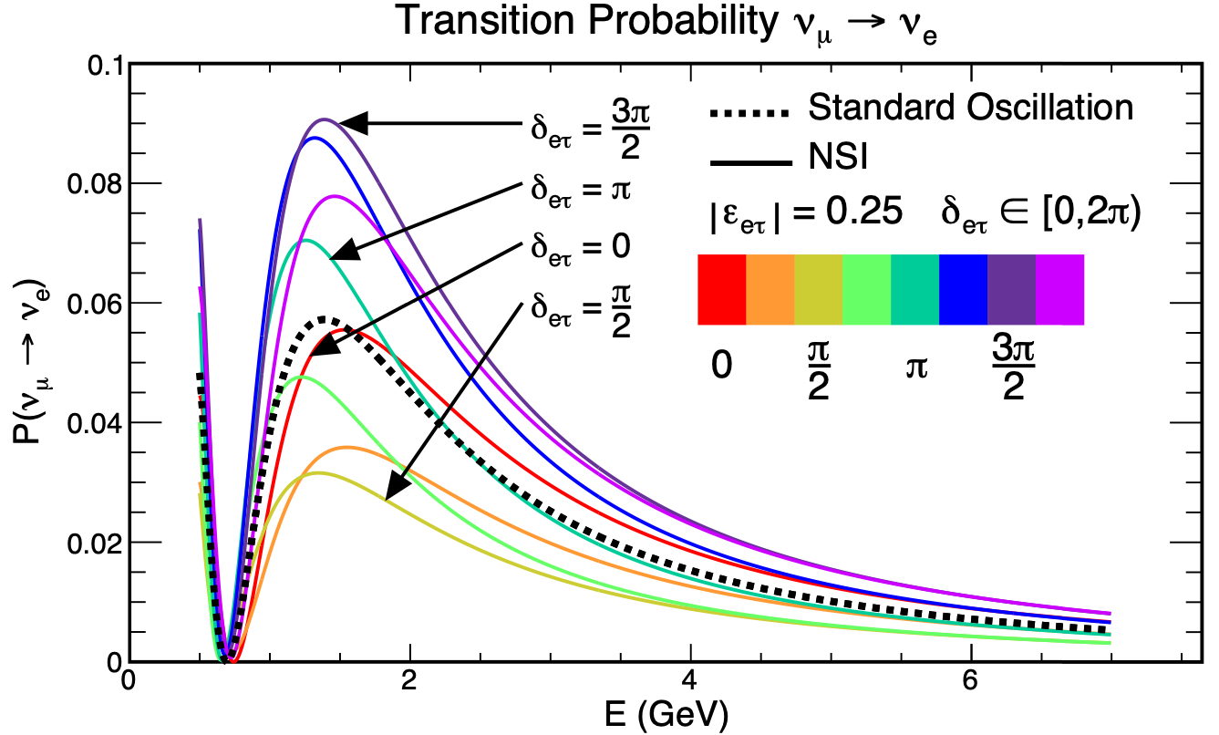
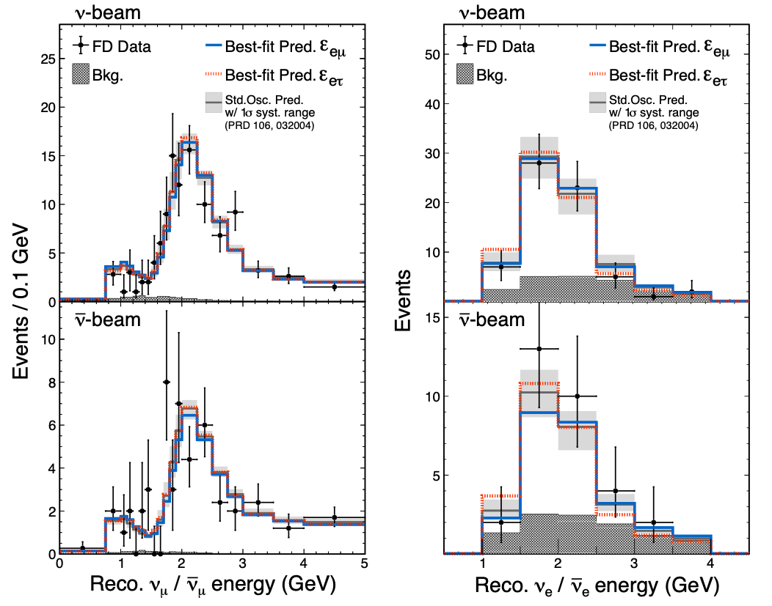

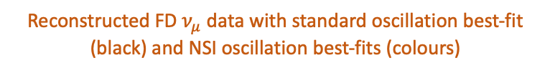
Search For Non-Standard Interactions (NSI)
Potential sub-leading neutrino interactions with matter
Could affect oscillation probability, enhanced by NOvA’s long baseline
Possible explanation of NOvA’s different favoured region of $δ_{CP}$ compared to T2K
NOvA’s 2022 NSI analysis probed for NC-NSI using the 2020 dataset and systematics (arXiv:2403.07266)
NC-NSI described by effective four-fermion $ℒ$ with couplings
$$ε_{αβ}=|ε_{αβ}|e^{iδ_{αβ}}$$
Impact of NSI $δ_{eτ}$ phase on $ν_{e}$ appearance at NOvA
Reconstructed FD $ν_{μ}$ data with standard oscillation best-fit (black) and NSI oscillation best-fits (colours)

Slide 27
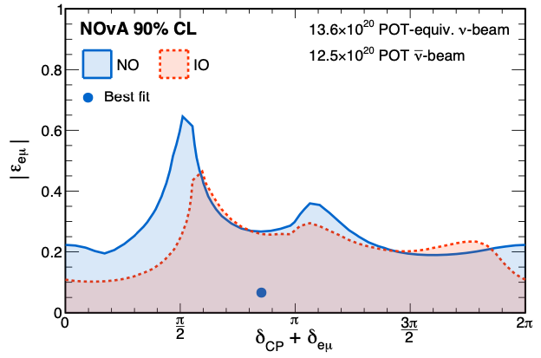
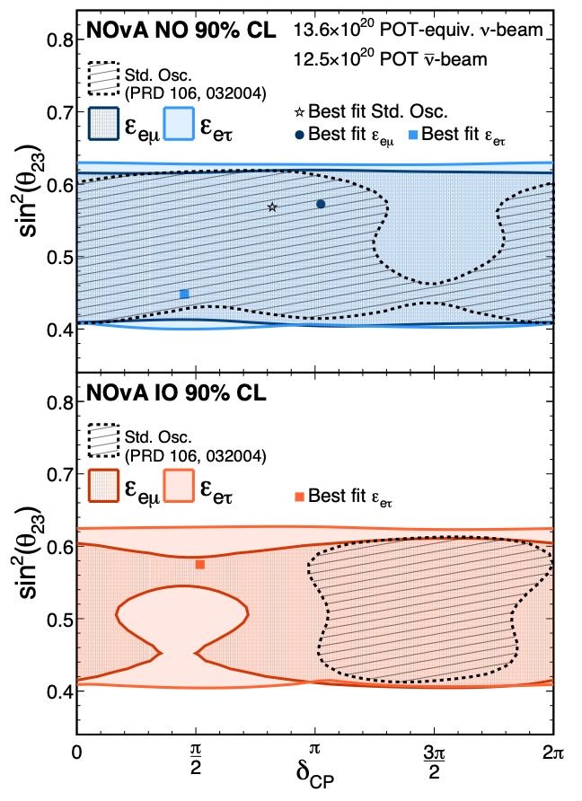
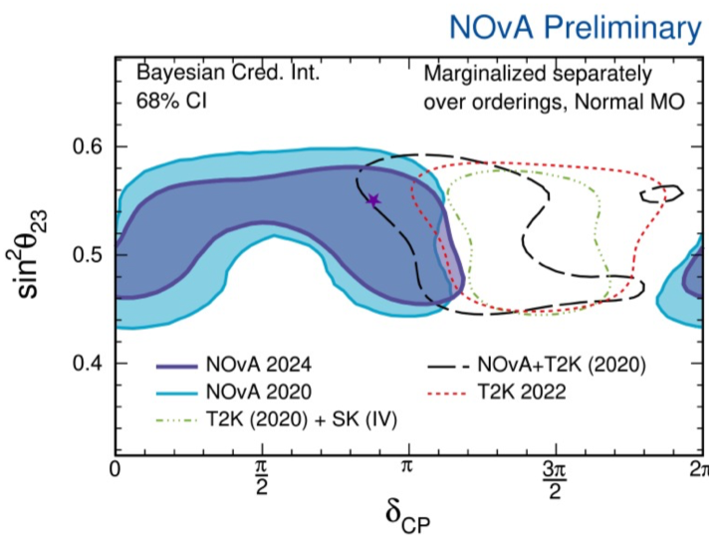
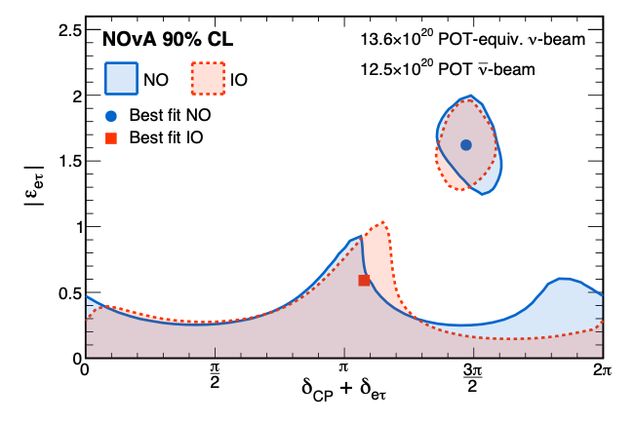


NSI Results
Top plot has global best-fit in Normal MO (NO)
Bottom plot has degenerate best-fit between Normal MO and Inverted MO (IO)
$|ε_{eμ}|\text{≲ }\text{0.3}$
$|ε_{eτ}|\text{≲ }\text{0.4}$
Including possible NSI significantly loosens constraints on $δ_{CP}$

Slide 28
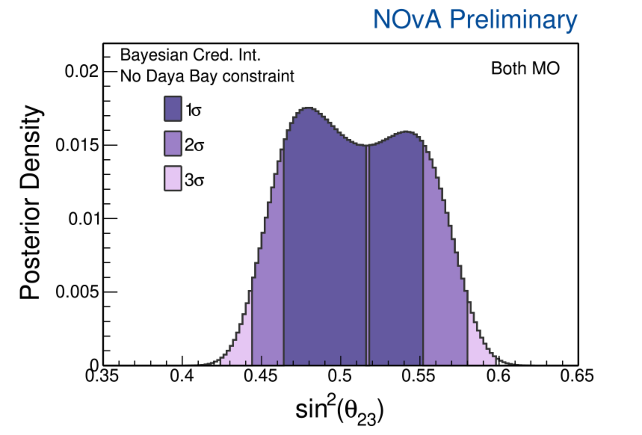
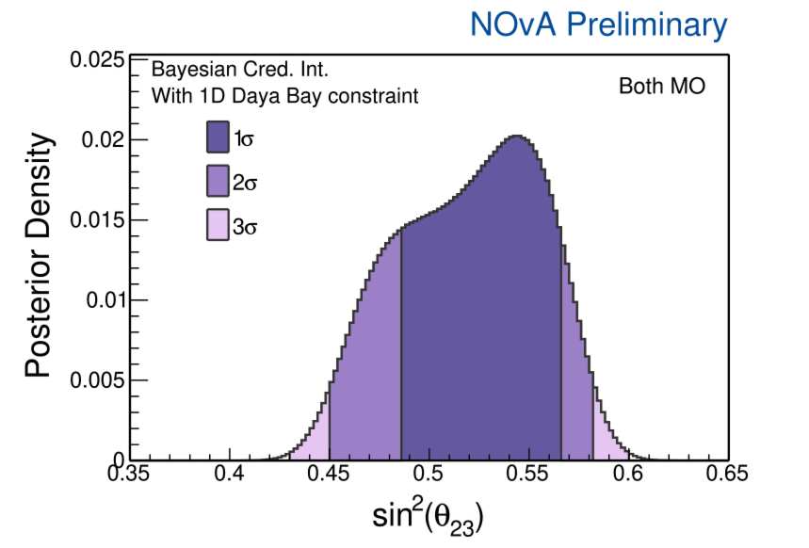
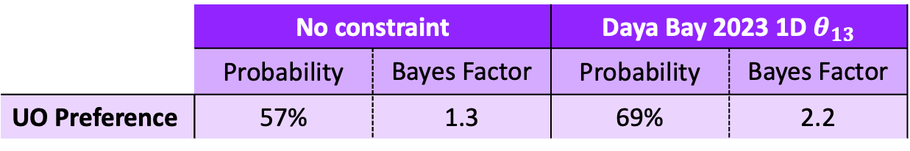

Results: $ν_{2}$ - $ν_{3}$ sector
 | No constraint |  | Daya Bay 2023 1D
 | Probability | Bayes Factor | Probability | Bayes Factor
UO Preference | 57% | 1.3 | 69% | 2.2
UO preferred with 1D Daya Bay constraint
Peak flips from LO to UO with and without constraint
Notes:
Peak of credible interval changes octant when constraint applied.

Slide 29
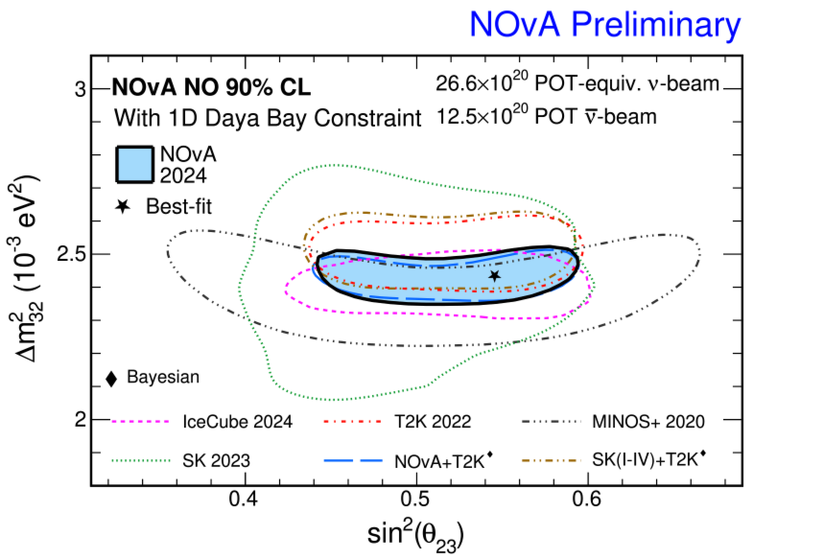
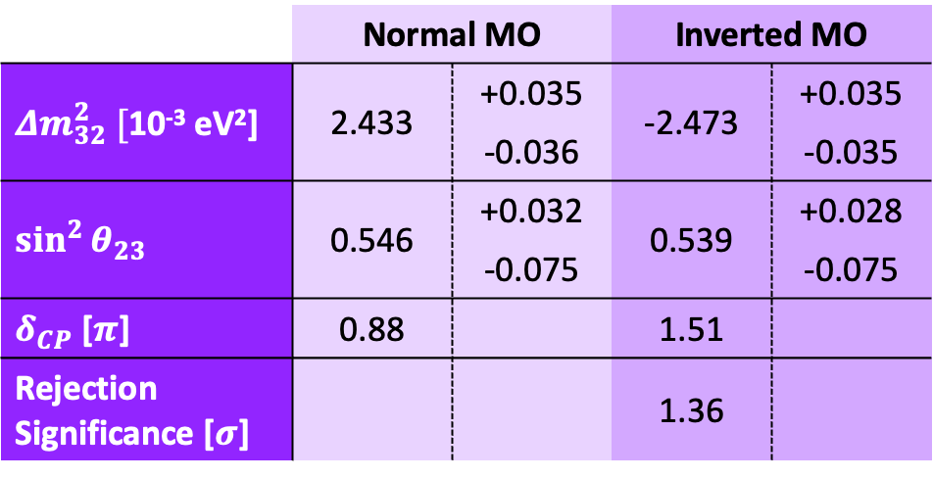
Results: $ν_{2}$ - $ν_{3}$ sector
 | Normal MO |  | Inverted MO
10⁻³ eV²] | 2.433 | +0.035 | -2.473 | +0.035
 |  | -0.036 |  | -0.035
 | 0.546 | +0.032 | 0.539 | +0.028
 |  | -0.075 |  | -0.075
[] | 0.88 |  | 1.51
Rejection Significance [] |  |  | 1.36
Frequentist results with Daya Bay 1D $θ_{13}$ constraint
IceCube 2024: arXiv:2405.02163
T2K 2022: 10.5281/zenodo.6683821
MINOS+ 2020: Phys. Rev. Lett. 125, 131802
SK 2023: Phys. Rev. D109, 072014
NOvA + T2K 2024: KEK IPNS seminar, FNAL JETP seminar
T2K + SK 2024: arXiv:2405.12488
The latest NOvA results are consistent with results from other experiments, including non-accelerator experiments

Slide 30
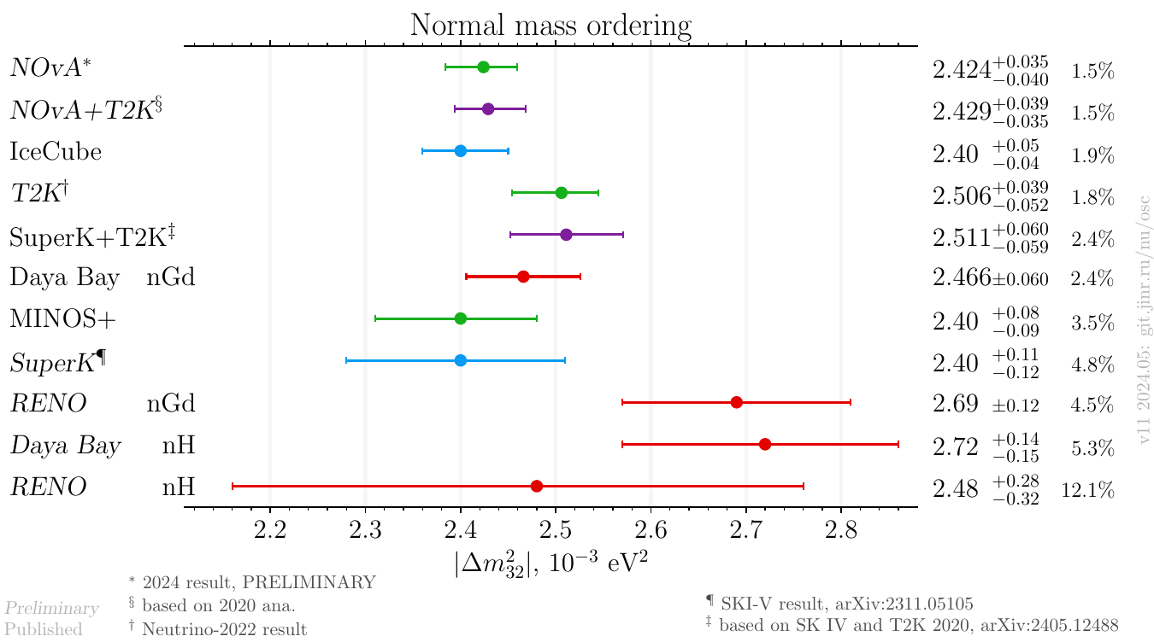

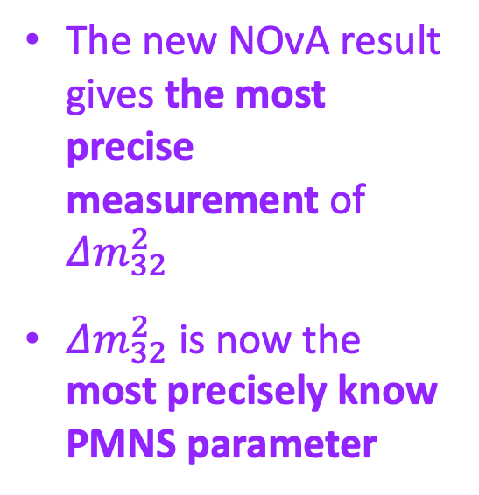
Results: $Δm_{32}^{2}$
The new NOvA result gives the most precise measurement of $Δm_{32}^{2}$
$Δm_{32}^{2}$ is now the most precisely know PMNS parameter

Slide 31
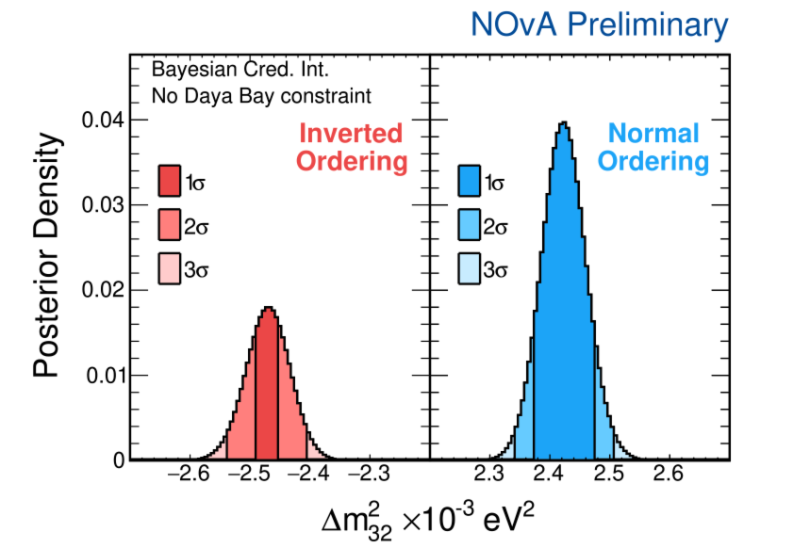



Results: Mass Ordering
 | No constraint |  | Daya Bay 2023 1D |  | Daya Bay 2023 2D
 | Probability | Bayes Factor | Probability | Bayes Factor | Probability | Bayes Factor
NO Preference | 69% | 2.2 | 76% | 3.2 | 87% | 6.8
Normal MO preference increases with reactor constraints
87% odds of Normal MO of neutrinos with 2D constraint

Slide 32



E
cos$θ$
Summary
First standalone oscillation analysis since 2020
10 years of data-taking
Neutrino-mode dataset doubled
Updated simulation and physics models
New low-E electron neutrino sample
Results
Most precise single-experiment measurement of $∆m_{32}^{2}$ (1.5%)
Favour regions where matter and CP violation effects are degenerate
With reactor constraints
Upper octant preference with $θ_{13}$ constraint
Normal ordering preference with constraint on $∆m_{32}^{2}$
NSI
Including NSI parameters significantly loosens $δ_{CP}$ constraints
Future
Will continue taking data until 2027
Aim to double antineutrino dataset
Test beam results can help reduce our largest systematic
1 MW beam recently achieved!
Thank you!
w.shorrock@sussex.ac.uk

