Slide 1
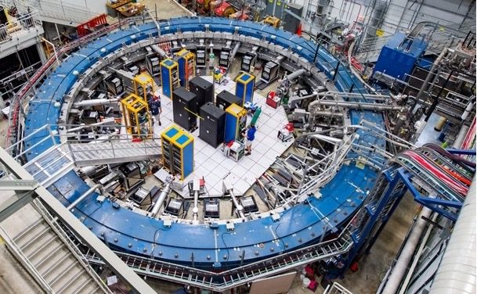
A New Measurement
of Muon g-2
to 0.2 ppm
Hogan Nguyen
Fermilab
Rencontres du
Vietnam 30th
Anniversary

Slide 2
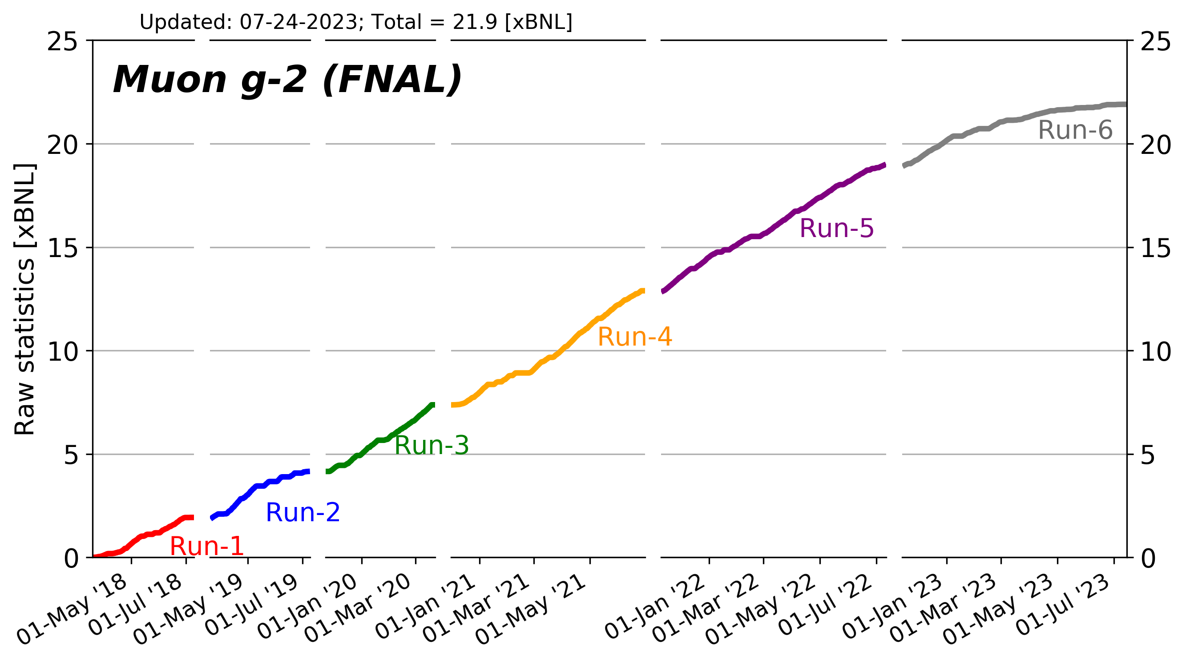
Today’s
Result
FNAL
2021

Slide 3
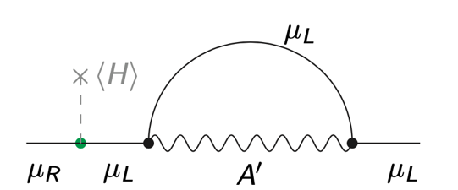

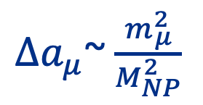
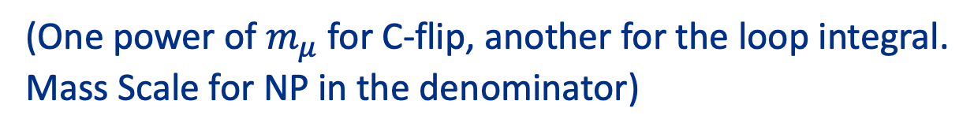
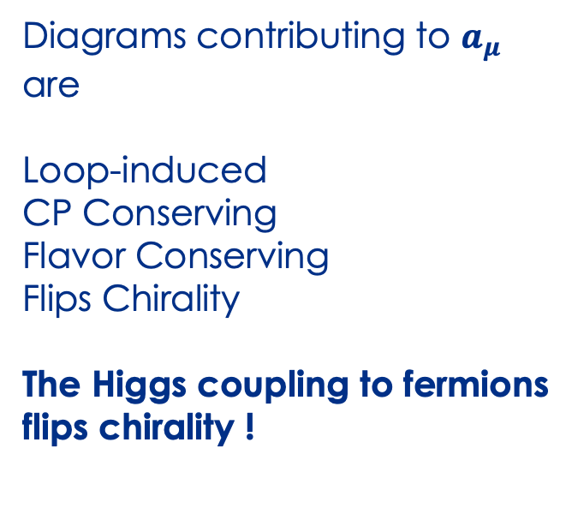
Window into BSM Physics
Example: Dark Photon
Diagrams contributing to $a_{μ}$
are
Loop-induced
CP Conserving
Flavor Conserving
Flips Chirality
The Higgs coupling to fermions
flips chirality !
$$γ$$
$Δa_{μ}$~ $\frac{m_{μ}^{2}}{M_{NP}^{2}}$
(One power of $m_{μ}$ for C-flip, another for the loop integral.
Mass Scale for NP in the denominator)

Slide 4
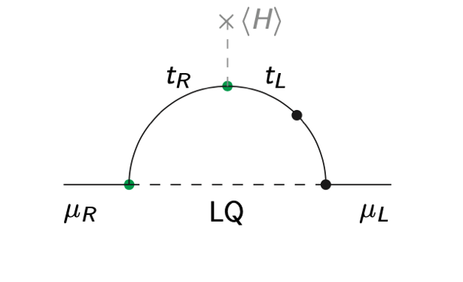
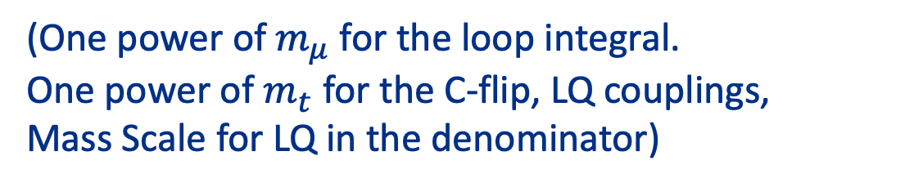
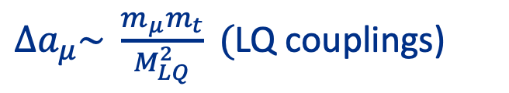
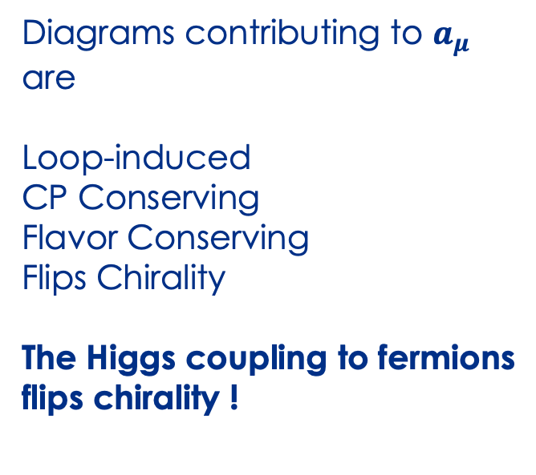
Window into BSM Physics
Example: Lepto Quark
$$γ$$
Diagrams contributing to $a_{μ}$
are
Loop-induced
CP Conserving
Flavor Conserving
Flips Chirality
The Higgs coupling to fermions
flips chirality !
$Δa_{μ}\sim \frac{m_{μ}m_{t}}{M_{LQ}^{2}} ($LQ couplings)
(One power of $m_{μ}$ for the loop integral.
One power of $m_{t}$ for the C-flip, LQ couplings,
Mass Scale for LQ in the denominator)

Slide 5
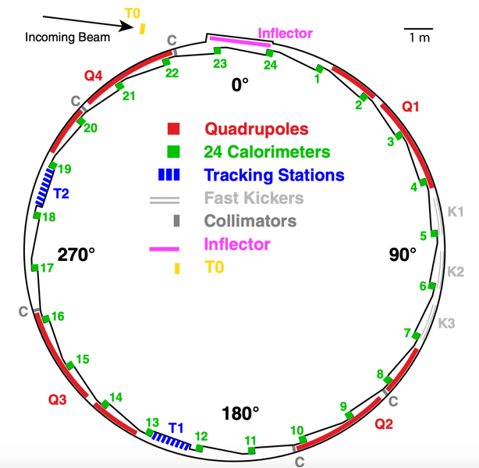
Ring Anatomy
1.45 Tesla Magnet
14.2 meter Diameter Ring
~5 cm diameter beam
in an evacuated volume

Slide 6

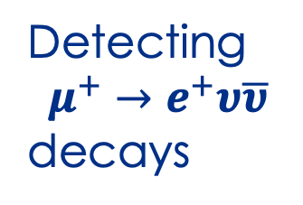
NMR Metrology
Experts
Detecting
$$μ^{+}→e^{+}υ\overline{υ}$$
decays
Determination
of the B field
$$a_{μ}$$
Tradition HEP
Experimentalists
Collaboration wide
effort taking ~ 2 years
of Analysis
Understanding
the Stored Beam
Accelerator Physicists

Slide 7
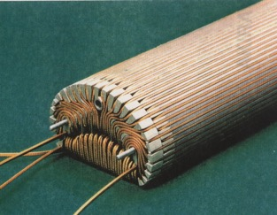
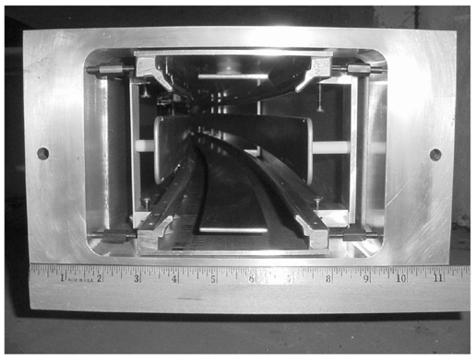
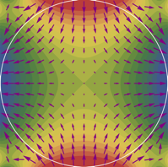
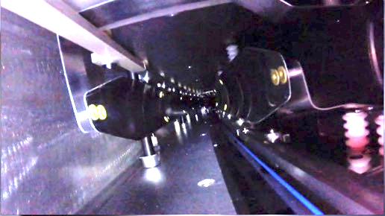
Superconducting Inflector
Beam Storage Components
Quadrupole Electric Field for
vertical focusing (43% Azimuthal Coverage)
Magnetic Kicker (10 mrad kick)

Slide 8
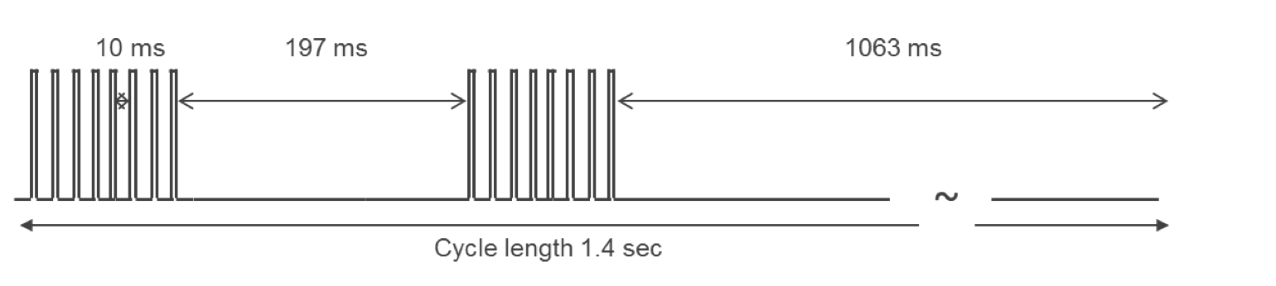

The Stored Beam
Muon Injection
Ideal
Stored
Orbit
~200 Gauss Kick (~ 10 mrad)
~ 5000 Amps
~ 200 nsec pulse

Slide 9
“Horizontal Betatron
Oscillation”
The Stored Beam
Actual
Orbit
~ 4 cm
Ideal
Stored
Orbit
In Run 1, the kick was
not strong enough

Slide 10
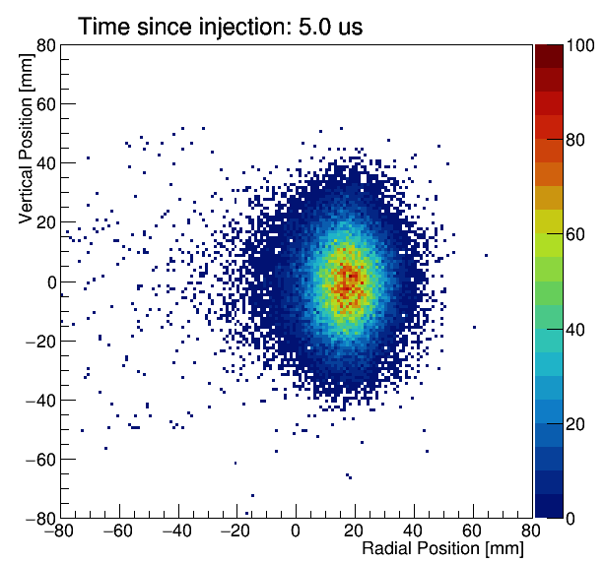
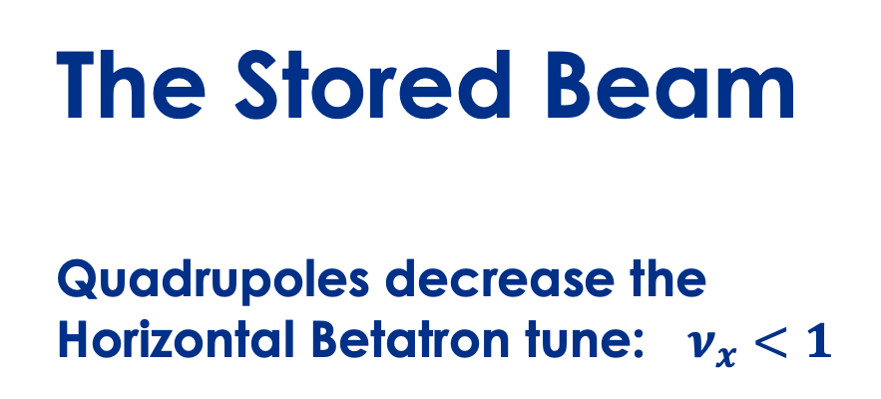
The Stored Beam
Quadrupoles decrease the
Horizontal Betatron tune: $ν_{x}<1$
Beam viewed
by a detector

Slide 11
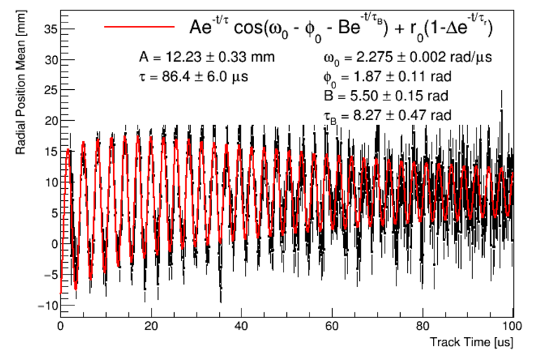
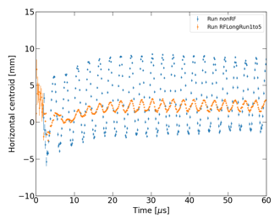
Huge Effort Went Into
Improving the Stored Beam Radial Motion
2018 Data (1st publication)
~ 10 mm
amplitude
2019-2020 Data (This Result)
2021-2023
data
(Upcoming
Result)

Slide 12
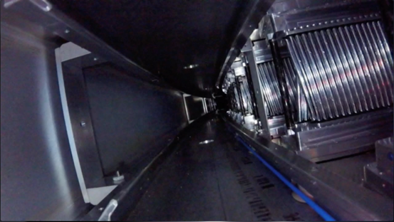
Main Positron Detectors
24 stations of
PbFl2 crystals
2 in-vacuum non-destructive
positron tracking stations

Slide 13
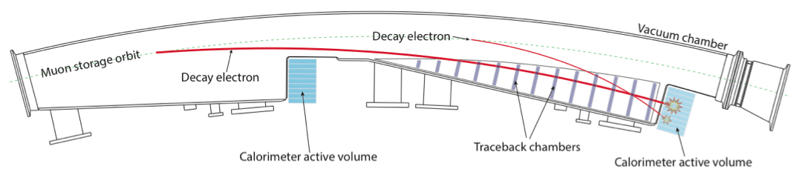
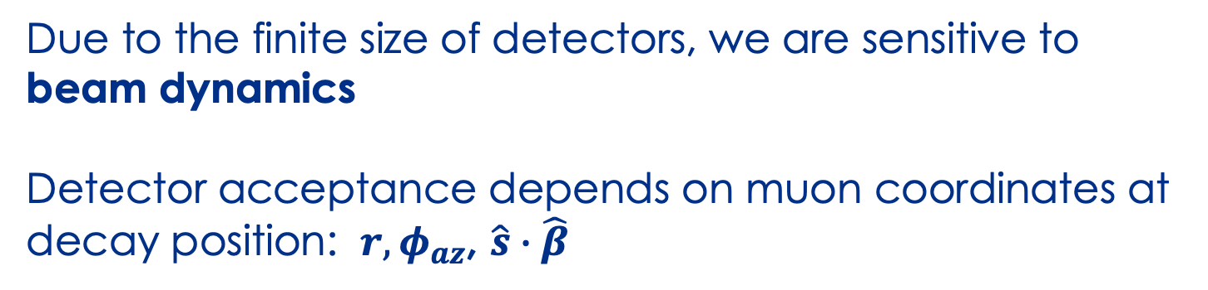
1/12 of Ring
Due to the finite size of detectors, we are sensitive to
beam dynamics
Detector acceptance depends on muon coordinates at
decay position: $r, φ_{az}$, $\hat{s}∙\hat{β}$
Great Effort went into modelling the acceptance using GEANT
and accelerator physics codes (BMAD, COSY)

Slide 14
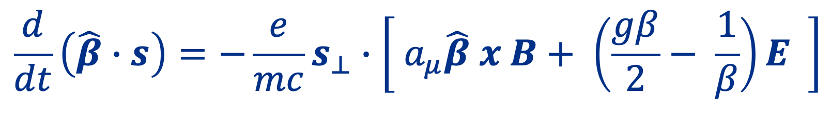
Spin and Momentum Precession in an E/B Field
$$\frac{d}{dt}\left(\hat{β}∙s\right)=−\frac{e}{mc}s_{⊥}∙\left[ a_{μ}\hat{β} x B+ \left(\frac{gβ}{2}− \frac{1}{β}\right)E \right]$$
Our Experimental
Observable
We
want
this
Must measure and subtract
out these terms
Bargmann-Michel-Telegdi

Slide 15
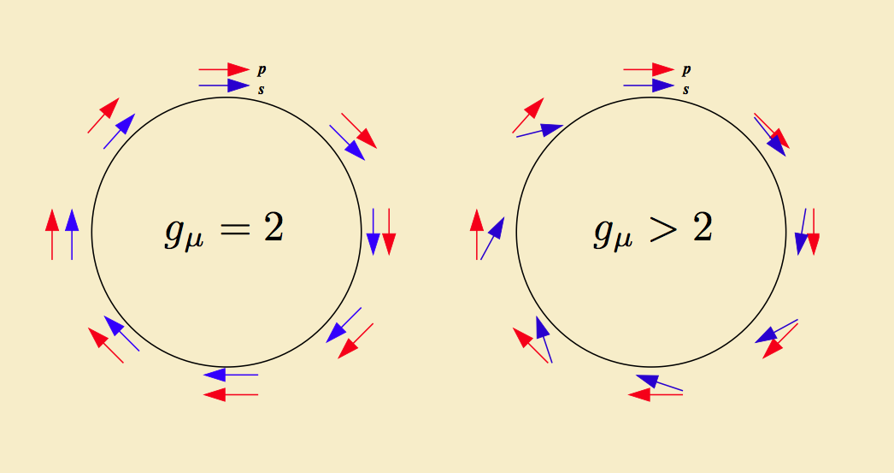
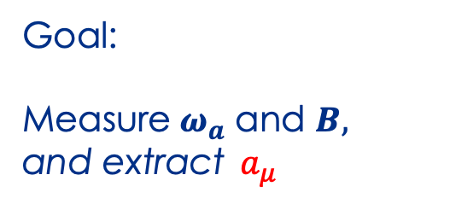
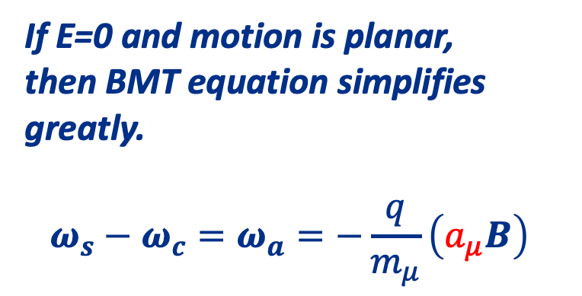
Spin and Momentum Precession in a Storage Ring
If E=0 and motion is planar,
then BMT equation simplifies
greatly.
$$ω_{s}−ω_{c}=ω_{a}={−\frac{q}{m_{μ}}\left(a_{μ}B\right) }_{ }$$
Goal:
Measure $ω_{a}$ and $B,$
and extract${ a}_{μ }$

Slide 16
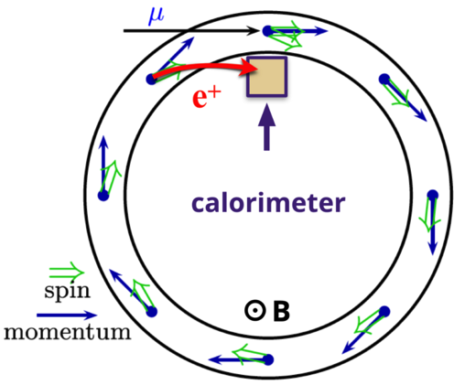
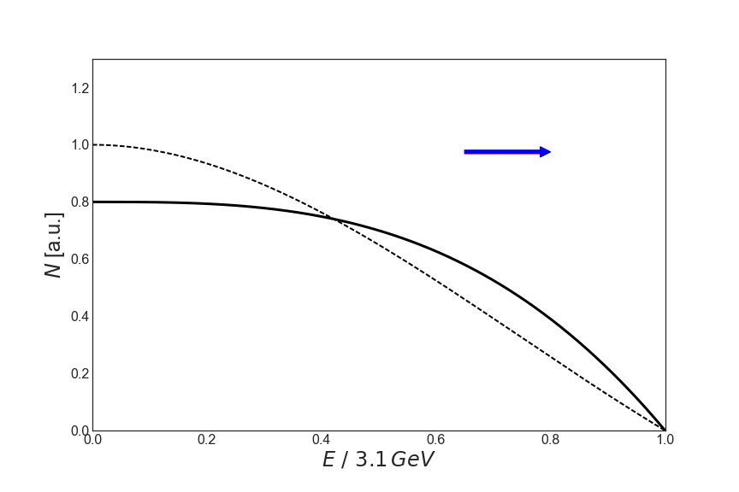

Measuring $ω_{a}$ (rate of change of longitudinal polarization)
Tagging high energy positrons
Select

Slide 17
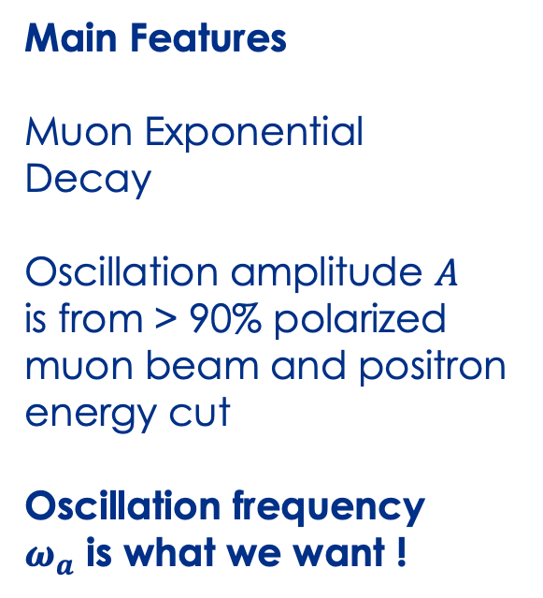

Final Event Sample: 32.6B $μ^{+}→e^{+}υ\overline{υ}$
Main Features
Muon Exponential
Decay
Oscillation amplitude $A$
is from > 90% polarized
muon beam and positron
energy cut
Oscillation frequency
$ω_{a}$ is what we want !
Nearly described by a 5-parameter fit: N, $τ_{μ}, A, ω_{a}, φ_{a}$

Slide 18
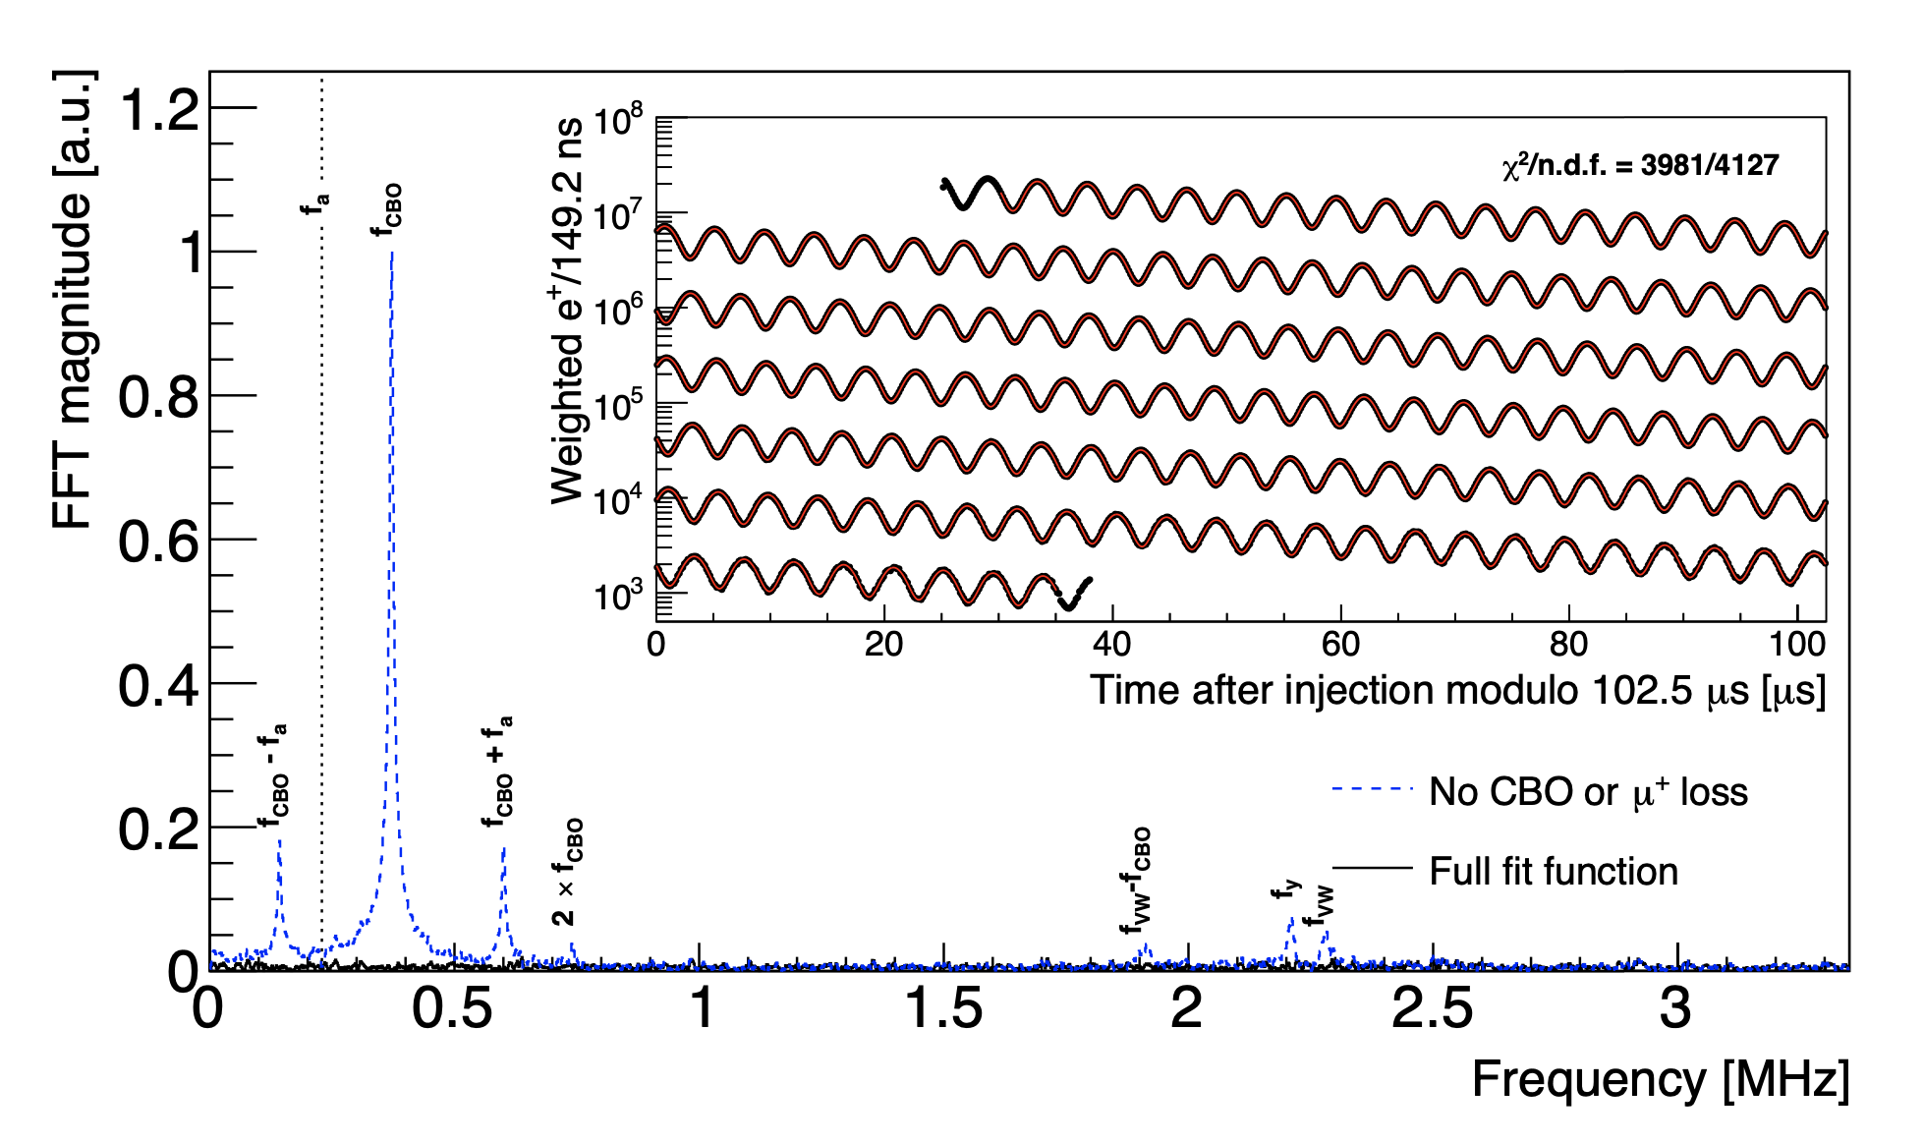
Detailed Fit Function (18-30 parameters)
Accounts for Complicated Beam Dynamics

Slide 19
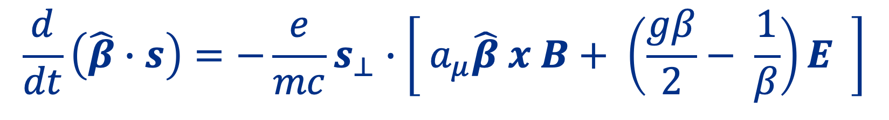
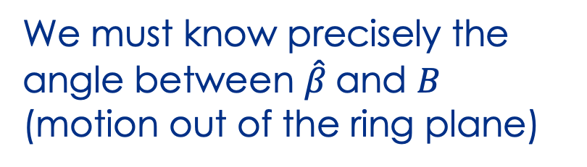
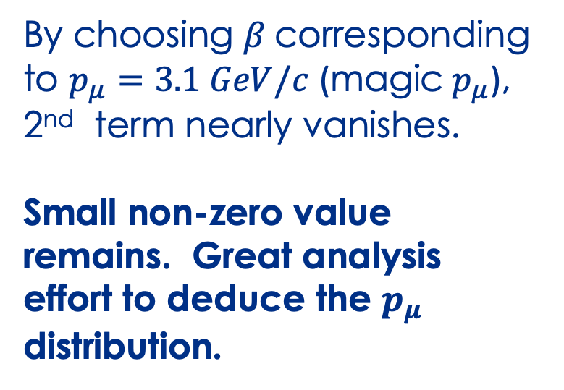
Two Main Challenges with the Storage Ring Technique
$$\frac{d}{dt}\left(\hat{β}∙s\right)=−\frac{e}{mc}s_{⊥}∙\left[ a_{μ}\hat{β} x B+ \left(\frac{gβ}{2}− \frac{1}{β}\right)E \right]$$
By choosing $β$corresponding to $p_{μ}=3.1 GeV/c$ (magic $p_{μ}$), 2nd term nearly vanishes.
Small non-zero value remains. Great analysis effort to deduce the $p_{μ}$ distribution.
We must know precisely the angle between $\hat{β}$and $B$
(motion out of the ring plane)

Slide 20
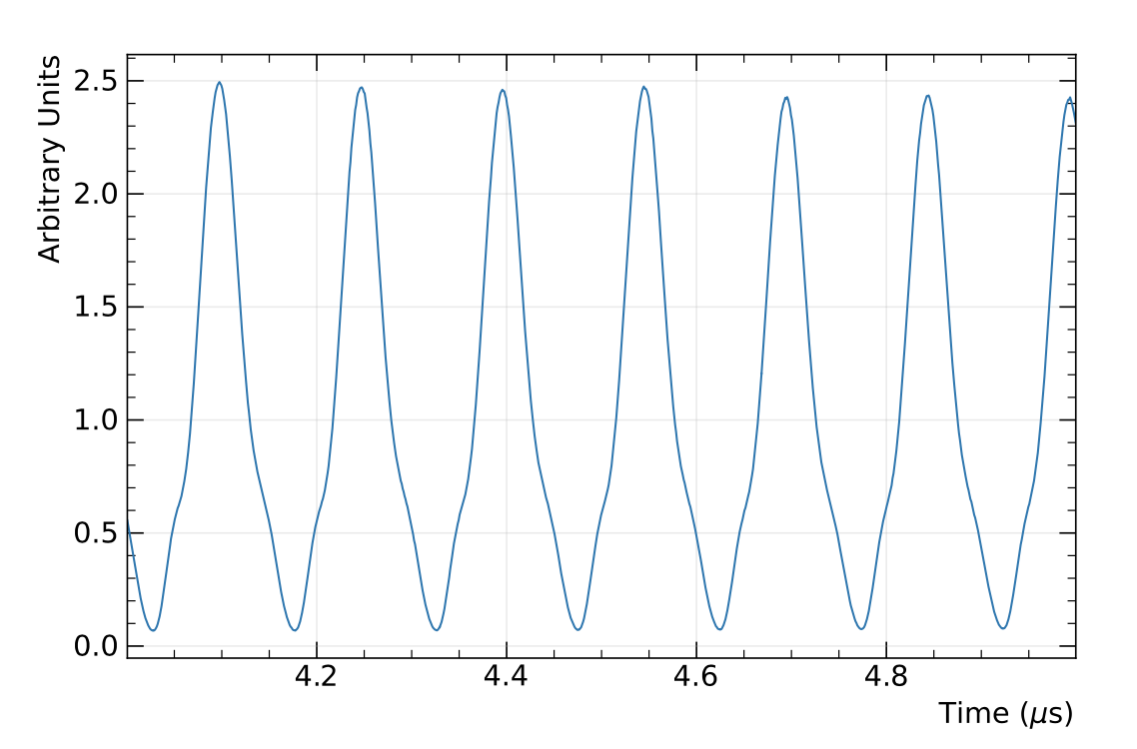
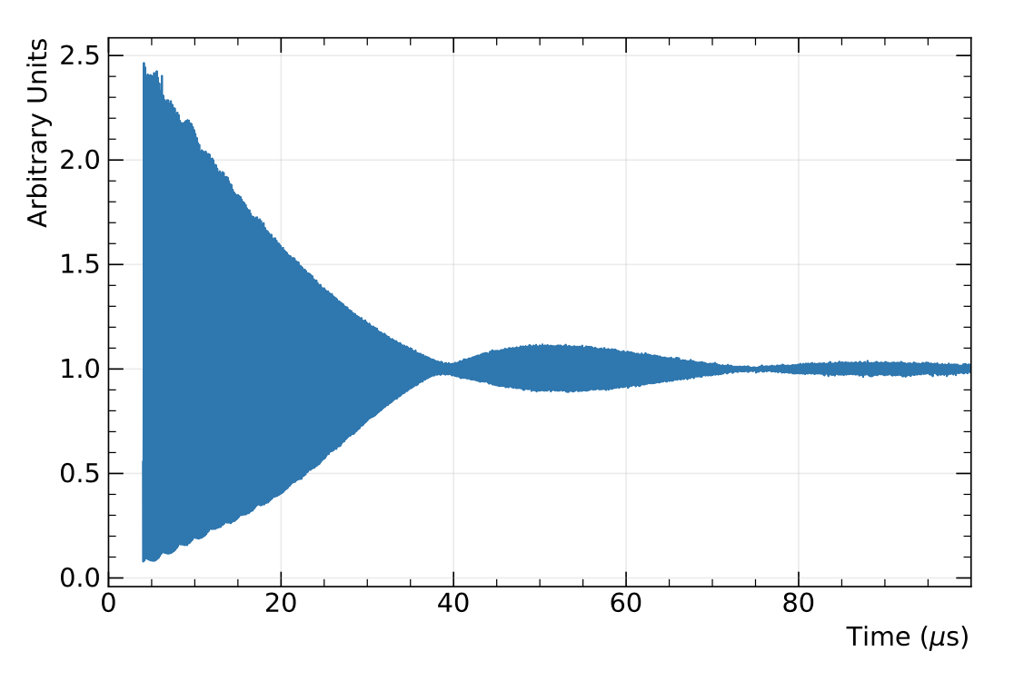
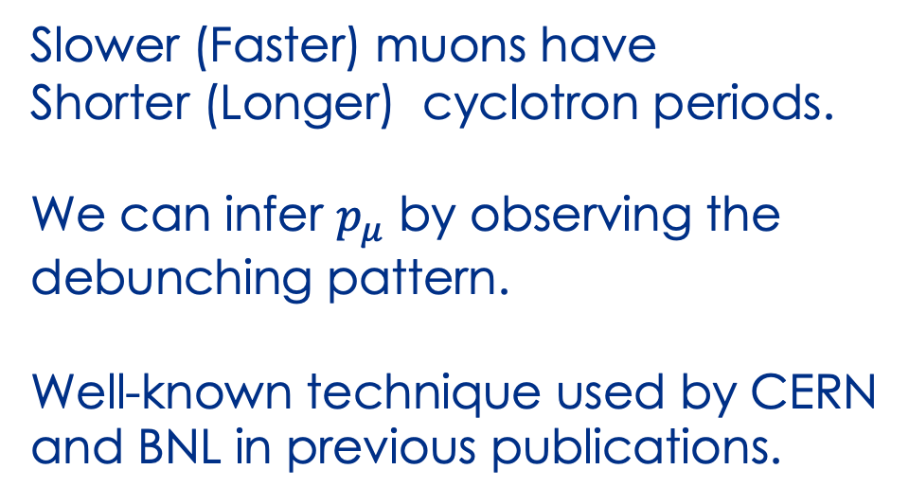
~ 150 nsec cyclotron period
Determining Momentum
Distribution by Observing Beam Debunching
Slower (Faster) muons have
Shorter (Longer) cyclotron periods.
We can infer $p_{μ}$ by observing the
debunching pattern.
Well-known technique used by CERN
and BNL in previous publications.

Slide 21
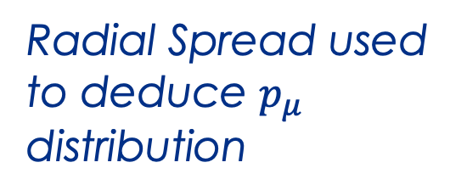


Determining Momentum Distribution by Observing Beam Position Spreading
New Technique !
$$X_{0}$$
$$X_{f}$$
Injected Beam was focused
before entering the ring.
This pattern is imprinted into the stored beam.
Beam relaxes and refocuses.
Radial Spread used to deduce $p_{μ}$ distribution

Slide 22
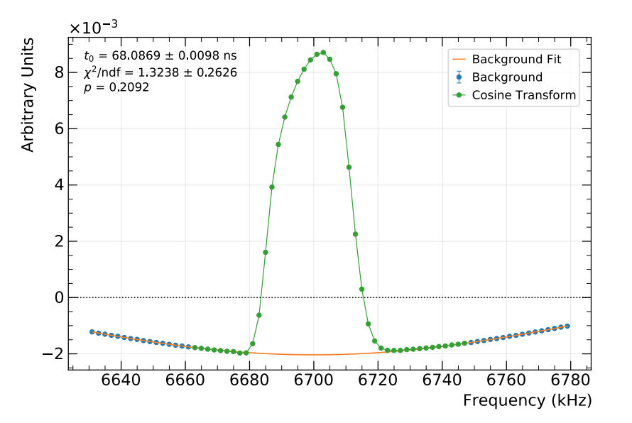
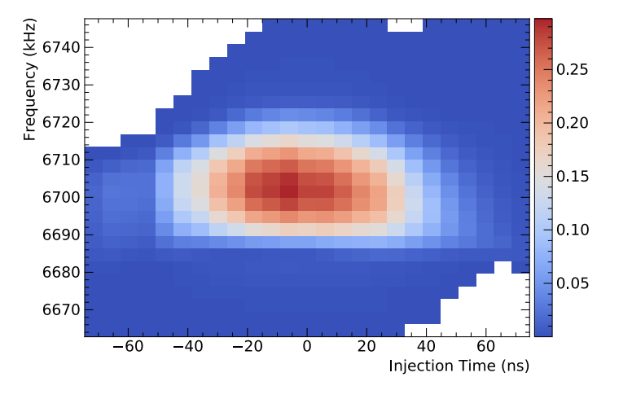
The Momentum Distribution
Correction due to $p_{μ}$ $≠3.1 Gev/c$: $426 ±32 ppb$

Slide 23

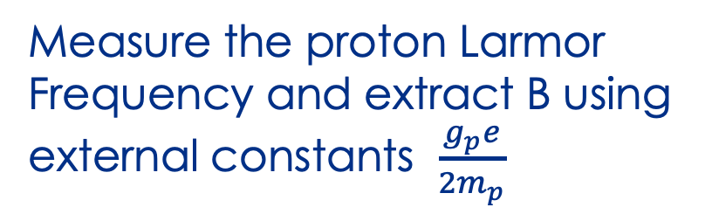
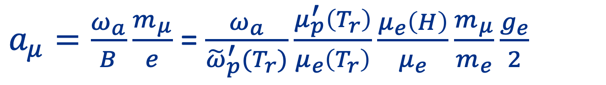
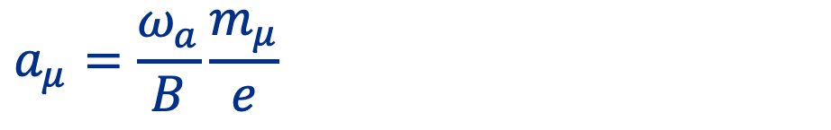
Measure the B Field with Proton NMR
$$ω_{p}=\frac{g_{p}e}{2m_{p}}B$$
Measure the proton Larmor Frequency and extract B using external constants $\frac{g_{p}e}{2m_{p}}$
$$a_{μ}=\frac{ω_{a}}{B}\frac{m_{μ}}{e}$$
$a_{μ}=\frac{ω_{a}}{B}\frac{m_{μ}}{e}$ = $\frac{ω_{a}}{{\tilde{ω}}_{p}^{′}(T_{r})}\frac{μ_{p}^{′}\left(T_{r}\right)}{μ_{e}\left(T_{r}\right)}\frac{μ_{e}\left(H\right)}{μ_{e}}\frac{m_{μ}}{m_{e}}\frac{g_{e}}{2}$
In practice, we use protons in water/jelly and external constants from :
H-maser, Muonium HFS, and Penning Trap experiments, and QED Theory.
Known to ~ 24 ppb
Larmor frequency of protons in
jelly/water

Slide 24

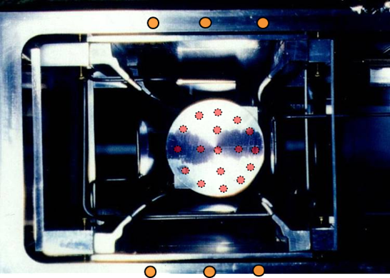
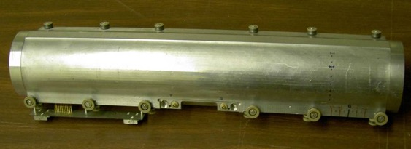
NMR Probes containing
protons in water or
petroleum jelly
“Fixed” NMR probes
(monitors B during muon storage)
"Trolley” measures 3D profile of B
(must turn OFF beam)
Must also correct for shape of proton sample and material effects ....

Slide 25
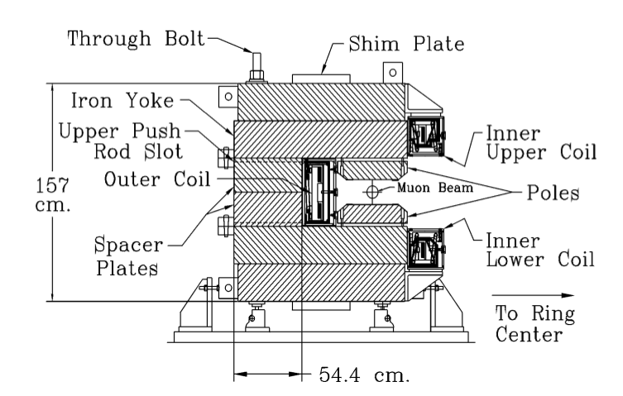

Magnet Inherited from BNL 821
Super Conducting Technology allowed
for low heat load
Thermal Expansion/
Contraction of Iron
changes the B-field.
$$Dipole changes by$$
$$20 ppm/℃$$
We dynamically adjust the current
to keep the dipole constant

Slide 26
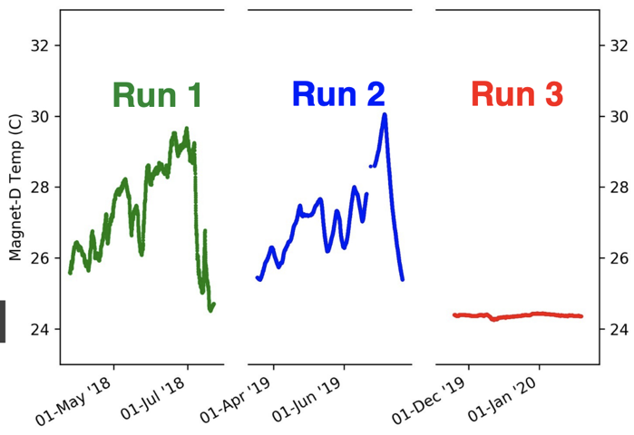
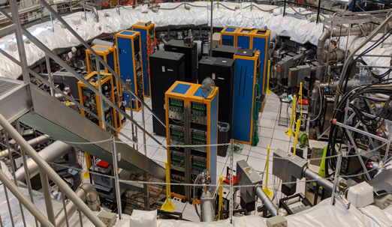
Magnet Iron
Temperature Control
2019
publication
This Result
Stabilizes the magnetic field
Magnet
Insulation
Improved
Hall HVAC

Slide 27

B Field and Beam Convolution
Smoother and more constant
field due to better
Iron Temperature Control
More Centered Beam due to
a Stronger Kick
Muons ”see” a better B field

Slide 28

Combining Everything
Hardware
Blinded Clock
Beam Dynamics Corrections
Absolute
Field
Calibration
Spatial
Convolution
with muon
beam
Magnetic Transient
Corrections

Slide 29


Corrections and Error Estimates after
2 years of analysis
Statistical Uncertainty: 201 ppb
Systematic Uncertainty:
68 (internal) $⨁$ 25 (external)
ppb

Slide 30


The New Result
Excellent
Agreement
with previous $a_{μ}$

Slide 31




The SM Prediction Needs More Time to Clarify
Tension between $a_{μ}^{HVP,Window}$
determination by Lattice QCD
and R-ratio determination of $a_{μ}^{HVP}$
New tension in $a_{μ}^{HVP}$between previous
R-ratio determination and recent CMD3 result
Work is underway to analyze new data:
BaBar, KLOE, SND, BESIII, Belle-II
Future facilities and techniques:
future $τ−c$factories (STCF), MuonE (CERN)
Ignatov et. al. https://arxiv.org/abs/2302.08834

Slide 32


Experiment vs Theory Comparison
Theory prediction is less clear, nevertheless for demonstration purposes:
Following A. Keshavarzi at Lattice 2023…
Substitute CMD-3 data for HVP below 1 GeV
SND2k cannot be processed in this way, but would fall closer to WP (2020).
Disclaimer from Lattice 2023 talk:

Slide 33



Conclusion
$a_{μ}$ versus Magnetic Fields
New Result is in
excellent agreement with
previous $a_{μ}$determinations
(all using magic $p_{μ}$)*
We have ~3x more data
to analyze, with best beam
systematics ever achieved.
Extremely Active
HEP-wide effort to clarify the SM prediction
Fermilab
(2021)
BNL
(2004)
Fermilab
(2023)
* Upcoming JPARC g-2 will
not use magic momentum muons
(no E field, no kicker).

Slide 34

Thank you

