Slide 1
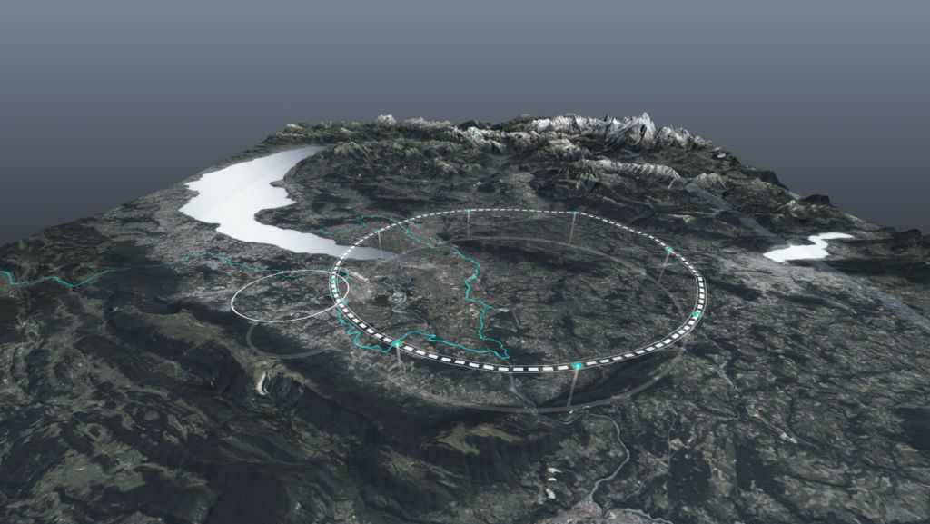










FCC Feasibility Study and CERN Plans*
30th Rencontres du Vietnam, Windows on the Universe,
Quy Nhon, 11 August 2023
Michael Benedikt, Frank Zimmermann, CERN
on behalf of FCC collaboration & FCCIS DS team
*also borrowing from Mike Lamont’s talk “CERN's Collider Options:
The Path Forward” PAB 2023 Strathclyde
http://cern.ch/fcc
Work supported by the European Commission under the HORIZON 2020 projects EuroCirCol, grant agreement 654305; EASITrain, grant agreement no. 764879; iFAST, grant agreement 101004730, FCCIS, grant agreement 951754; E-JADE, contract no. 645479; EAJADE, contract number 101086276; and by the Swiss CHART program
photo: J. Wenninger

Slide 2
European Strategy for Particle Physics 2020 Update
The successful completion of the high-luminosity upgrade of the machine and detectors should remain the focal point of European particle physics, together with continued innovation in experimental techniques.
The full physics potential of the LHC and the HL-LHC, including the study of flavour physics and the quark-gluon plasma, should be exploited.
2022 Snowmass Energy Frontier Summary
Our highest immediate priority accelerator and project is the HL-LHC, the successful completion of the detector upgrades, operations of the detectors at the HL-LHC, data taking and analysis, including the construction of auxiliary experiments that extend the reach of HL-LHC in kinematic regions uncovered by the detector upgrades.

Slide 3
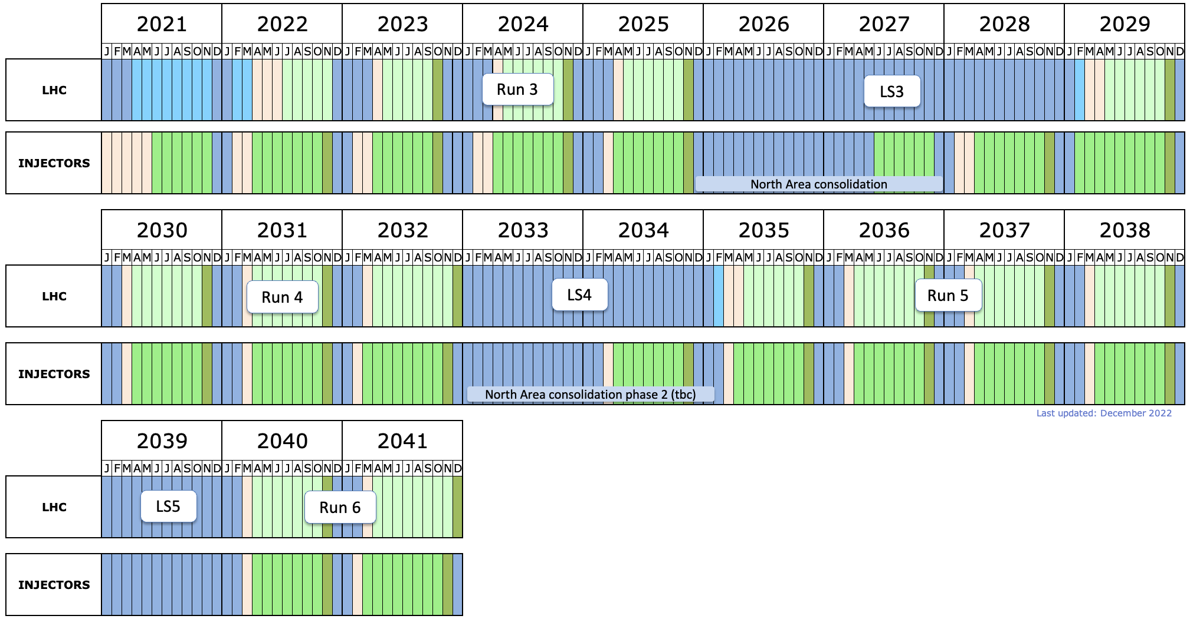
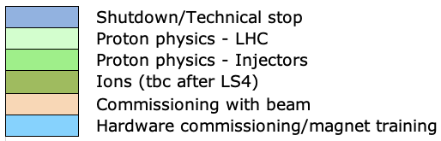
HL-LHC – the medium-term future
LHCb-II prep (tbc)
LHCb-II, ALICE3 upgrades (tbc)

Slide 4
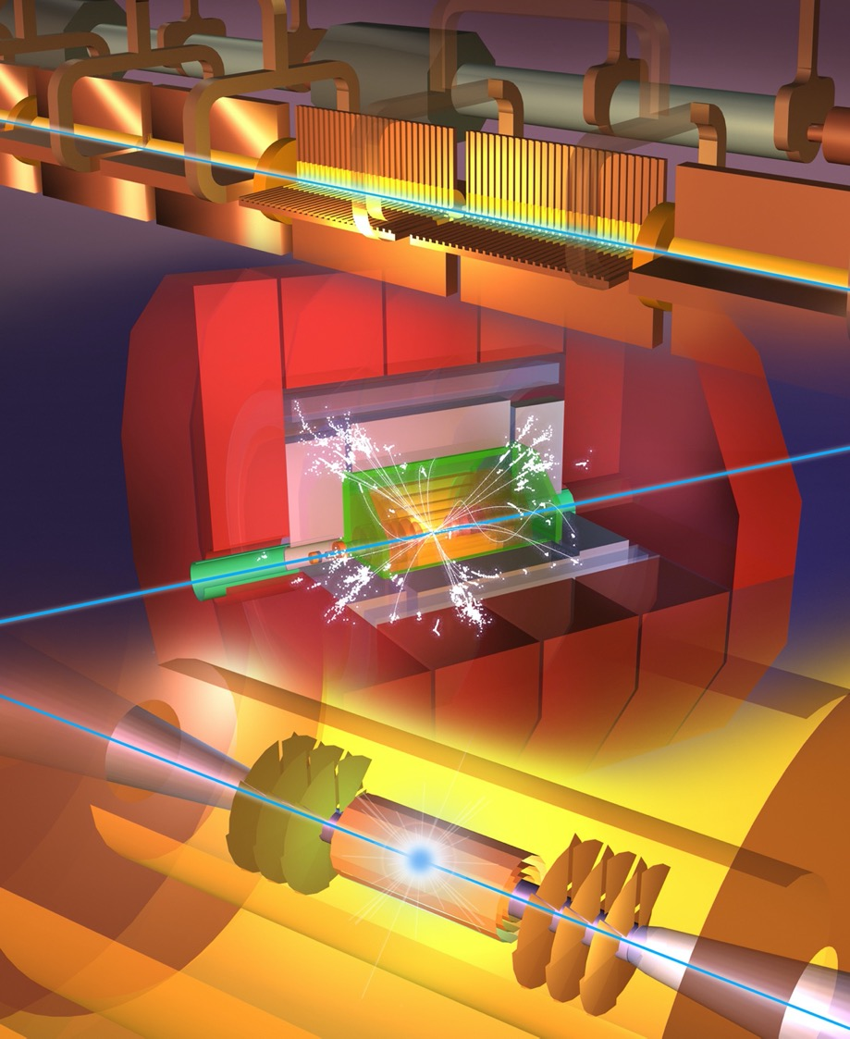
Future Collider options
Mike Lamont
Higgs factory
  Plan A1: FCC-ee
  Plan A2: ILC in Japan
  Plan B: CLIC
  Plan C: CepC in China, C³ in US
Multi-TeV
  e+e- : CLIC, C³
  muons: Muon Collider
  protons: FCC-hh, SppC
Options under consideration at CERN given by European Strategy for Particle Physics Update 2020

Slide 5
Context
Mike Lamont
HL-LHC baseline schedule foresees operation until end 2041.
CERN/European Physics Community are positioning themselves to be able to start operating a new major facility in the second half of the forties (2045 - 2050).
That major new facility should be an e⁺e⁻ Higgs factory.
Next ESPP update: ~2026-2027 – confirmation of priorities – down-selection
This could imply approval and resource commitment in the 2028 – 2030 timeframe, with subsequent project preparation and execution in the following decade.
There are clear implications for the necessity to bring to maturity any requisite technology. Given the projected large scale component production in the thirties, associated accelerator and detector technologies would need to be relatively mature as one moves into that phase.

Slide 6
Options at CERN
Mike Lamont
Options within specified timeframe
Options outside specified timeframe
FCC-ee
CLIC-380
(ILC-250)
(LEP3, LHeC, HE-LHC)
Muon Collider
FCC-hh (natural follow-on to FCC-ee)
++
Options possibly in timeframe not at CERN: ILC, CEPC, C³

Slide 7
ESPPU2020 also said…
“An electron-positron Higgs factory is the highest-priority next collider.
For the longer term, the European particle physics community has the ambition to operate a proton-proton collider at the highest achievable energy.”
“Europe, together with its international partners, should investigate the technical and financial feasibility of a future hadron collider at CERN with a centre-of-mass energy of at least 100 TeV and with an electron-positron Higgs and electroweak factory as a possible first stage.”
“Such a feasibility study of the colliders and related infrastructure should be established as a global endeavour and be completed on the timescale of the next Strategy update.”
→ 2021 Launch of FCC Feasibility Study (FCC FS) by CERN Council

Slide 8

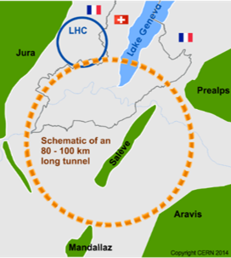
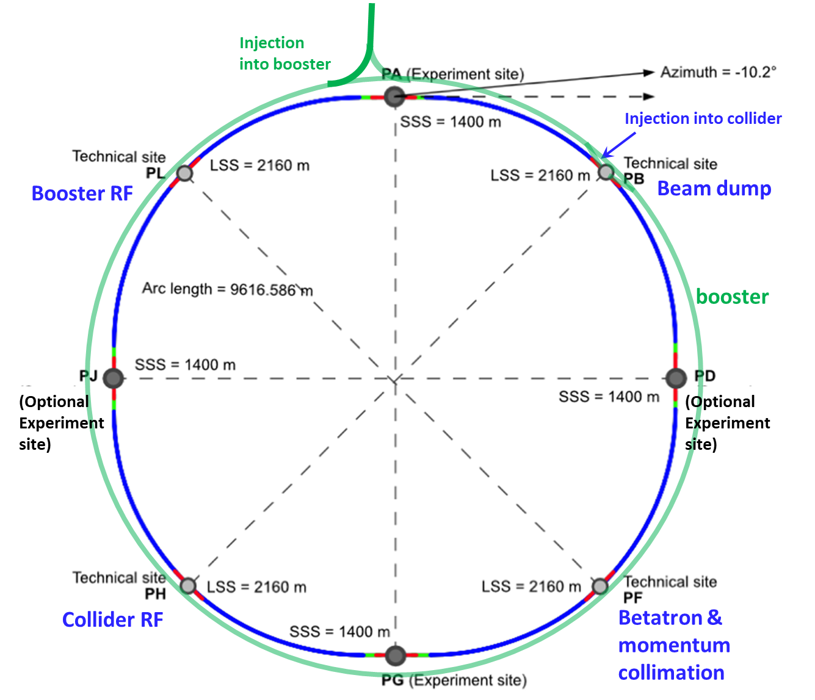
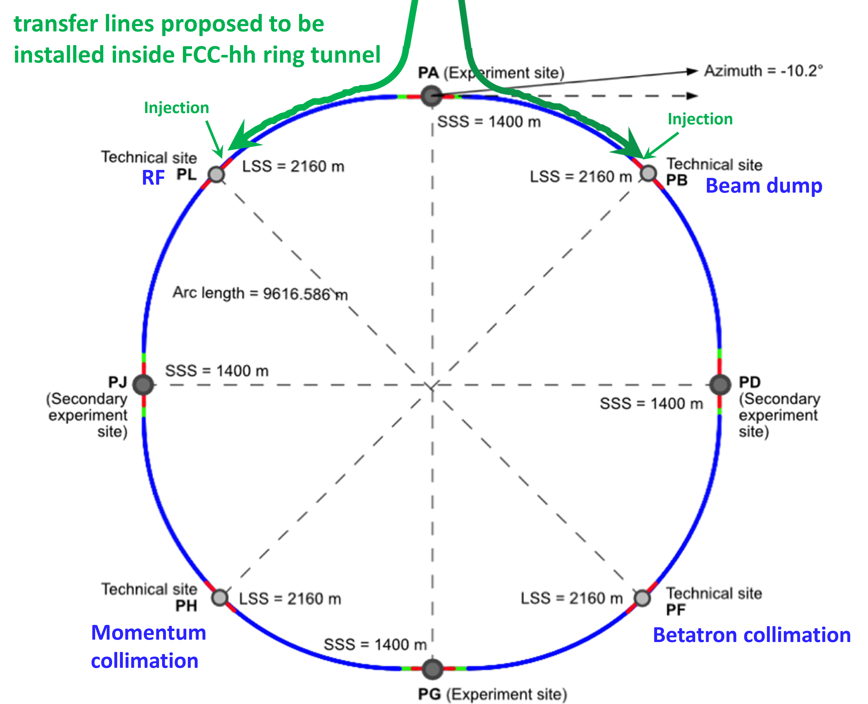
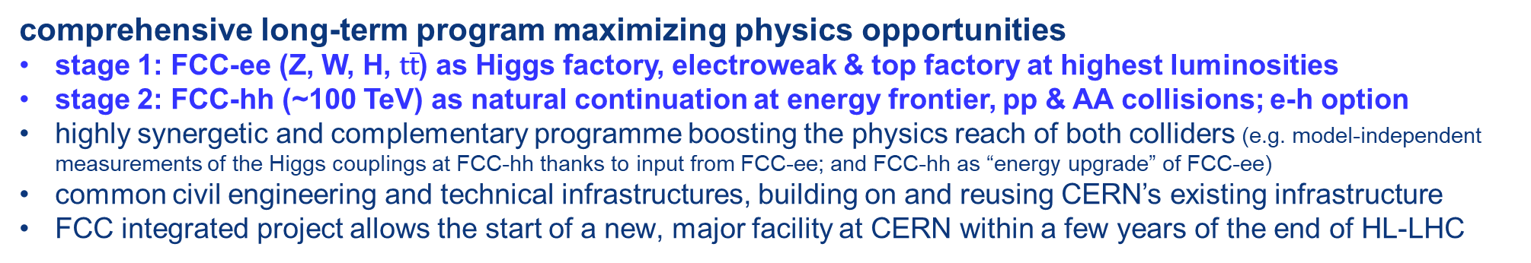
FCC integrated program
comprehensive long-term program maximizing physics opportunities
stage 1: FCC-ee (Z, W, H, $\text{t}\overline{\text{t}}$) as Higgs factory, electroweak & top factory at highest luminosities
stage 2: FCC-hh (~100 TeV) as natural continuation at energy frontier, pp & AA collisions; e-h option
highly synergetic and complementary programme boosting the physics reach of both colliders (e.g. model-independent measurements of the Higgs couplings at FCC-hh thanks to input from FCC-ee; and FCC-hh as “energy upgrade” of FCC-ee)
common civil engineering and technical infrastructures, building on and reusing CERN’s existing infrastructure
FCC integrated project allows the start of a new, major facility at CERN within a few years of the end of HL-LHC
FCC-ee
FCC-hh
2020 - 2040
2045 - 2063
2070 - 2095
a similar two-stage project CEPC/SPPC is under study in China

Slide 9



Feasibility Study Timeline and main activities/milestones
2021 | 2021 |  | 2022 |  |  |  | 2023 |  |  |  | 2024 |  |  |  | 2025
Q2 | Q3 | Q4 | Q1 | Q2 | Q3 | Q4 | Q1 | Q2 | Q3 | Q4 | Q1 | Q2 | Q3 | Q4 | Q1 | Q2 | Q3 | Q4
CDR baseline design adaptations for
new implementation scenario
FCC Week
study planning
FCC Week & Review : implementation, baseline design, organisation, communication
environmental studies, site investigation authorisation with host states, site investigations: drillings and seismics
FCCW & mid-term review:
study progress & CDR cost update
detailed design towards FSR: refine surface sites layout,
technical implementation and coherence
FCC Week & review: technical coherence
FS Report
FCC Week
FSR progress
Release FSR
Project review

Slide 10
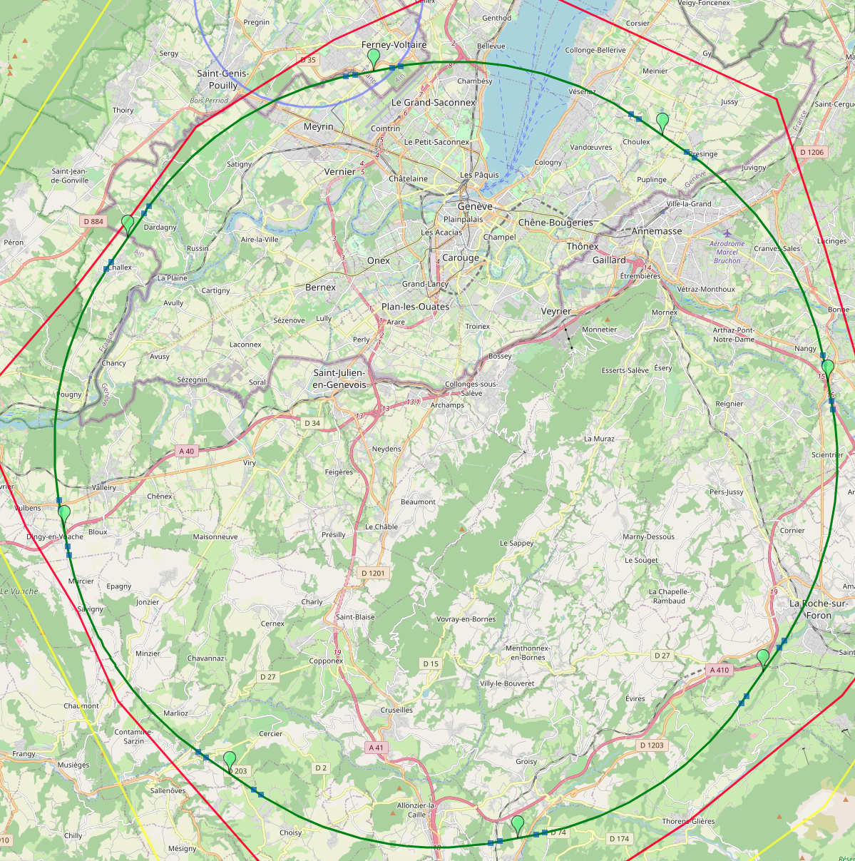
Optimized placement and layout for feasibility study
Major achievement: optimization of the ring placement
Layout chosen out of ~ 100 initial variants, based on geology and
surface constraints (land availability, access to roads, etc.), environment
(protected zones), infrastructure (water, electricity, transport), etc.
“Éviter, reduire, compenser” principle of EU and French regulations
V. Mertens,
J. Gutleber
PA: Experiment
PB: technical
Lowest-risk baseline: 90.7 km ring, 8 surface points,
4-fold superperiodicity, possibility of 2 or 4 IPs
Whole project now adapted to this placement
PL: technical
PD: experiment
Number of surface sites | 8
LSS@IP (PA, PD, PG, PJ) | 1400 m
LSS@TECH (PB, PF, PH, PL) | 2032 m
Arc length | 9.6 km
Sum of arc lengths | 76.9 km
Total length | 90.7 km
PJ: experiment
PF: technical
PH: technical
10
PG: experiment

Slide 11
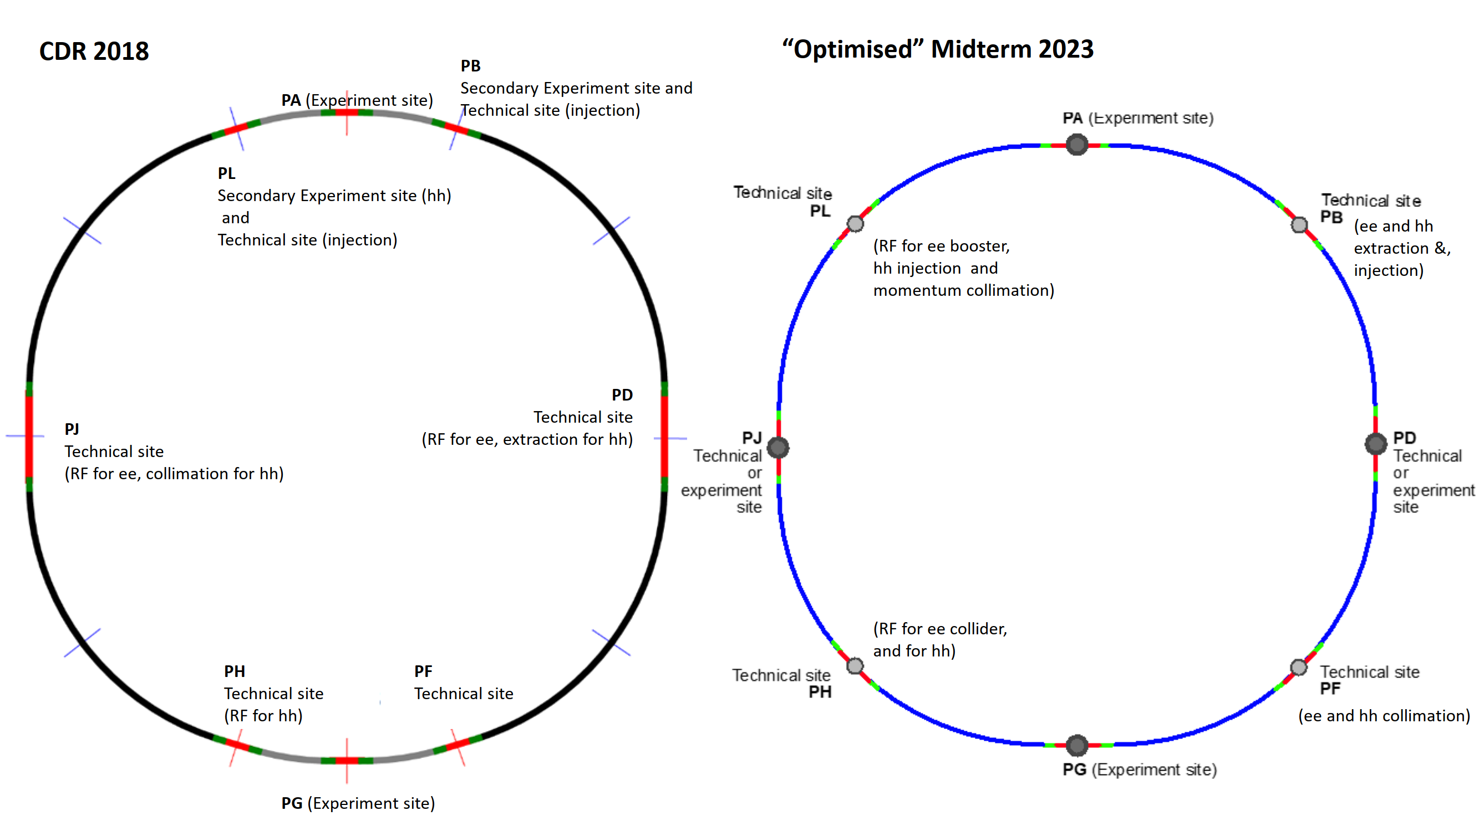
Revised layout and geometry
K. Oide, M. Hofer, et al.

Slide 12
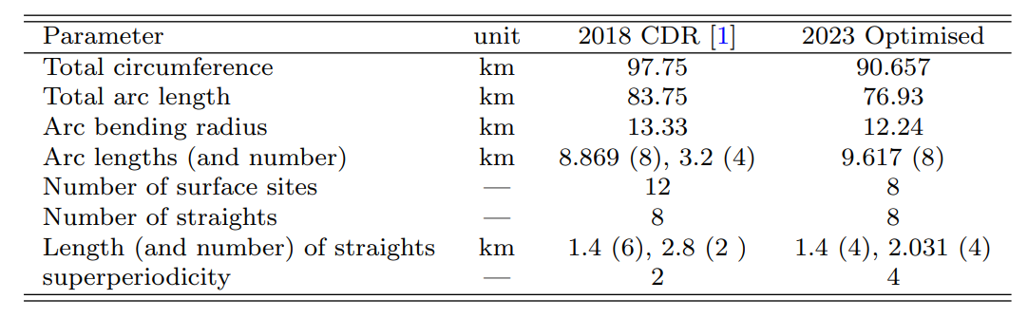
Main geometrical parameters
Main changes
# access points reduced from 12 to 8
facilitating placement and reducing the overall surface area required
circumference has shrunk from 97.75 km to 90.657 km
new layout with 4-fold superperiodicity, enabling FCC-ee operation with either 2 or 4 collision points
hadron collider RF system now shares a klystron gallery tunnel with lepton collider
new circumference matched to both LHC and the SPS tunnels, corresponding to 400 MHz harmonic ratios of h_{FCC}/h_{LHC}=1010/297 & h_{FCC}/h_{SPS}=1010/77, allowing for hadron beam injection from either the LHC or from a new superconducting SPS, with bunch spacings of 2.5, 5.0, 7.5, 10, 12.5, 15, 20, and 25 ns

Slide 13
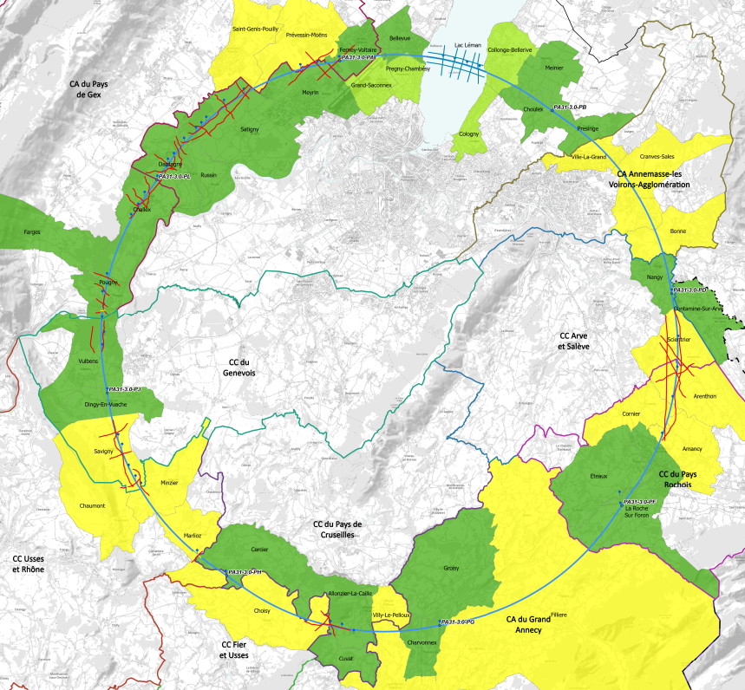
implementation baseline PA31 90.7 km
Meetings with municipalities concerned
in France (31) and Switzerland (10)
PA – Ferney Voltaire (FR) – site experimental
PB – Présinge/Choulex (CH) – site technique
PD – Nangy (FR) – site experimental
PF – Roche sur Foron/Etaux (FR) – site technique
PG – Charvonnex/Groisy (FR) – site experimental
PH – Cercier (FR) – site technique
PJ – Vulbens/Dingy en Vuache (FR) site experimental
PL – Challex (FR) – site technique
Rencontrée individuellement
Rendez-vous proposé / programmé
Rencontre collective
Environmental studies and preparation of geological investigations (drillings and seismics) ongoing since February 2023

Slide 14
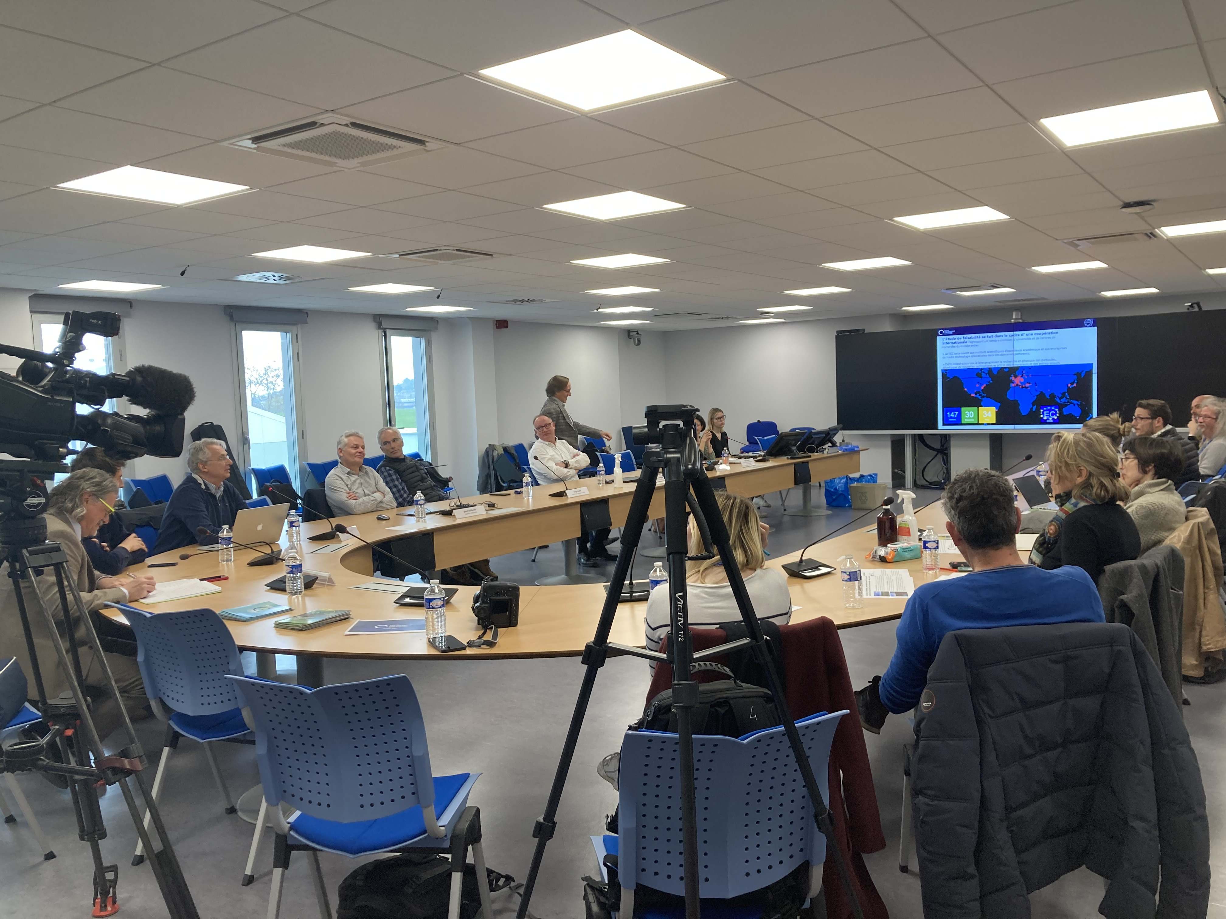
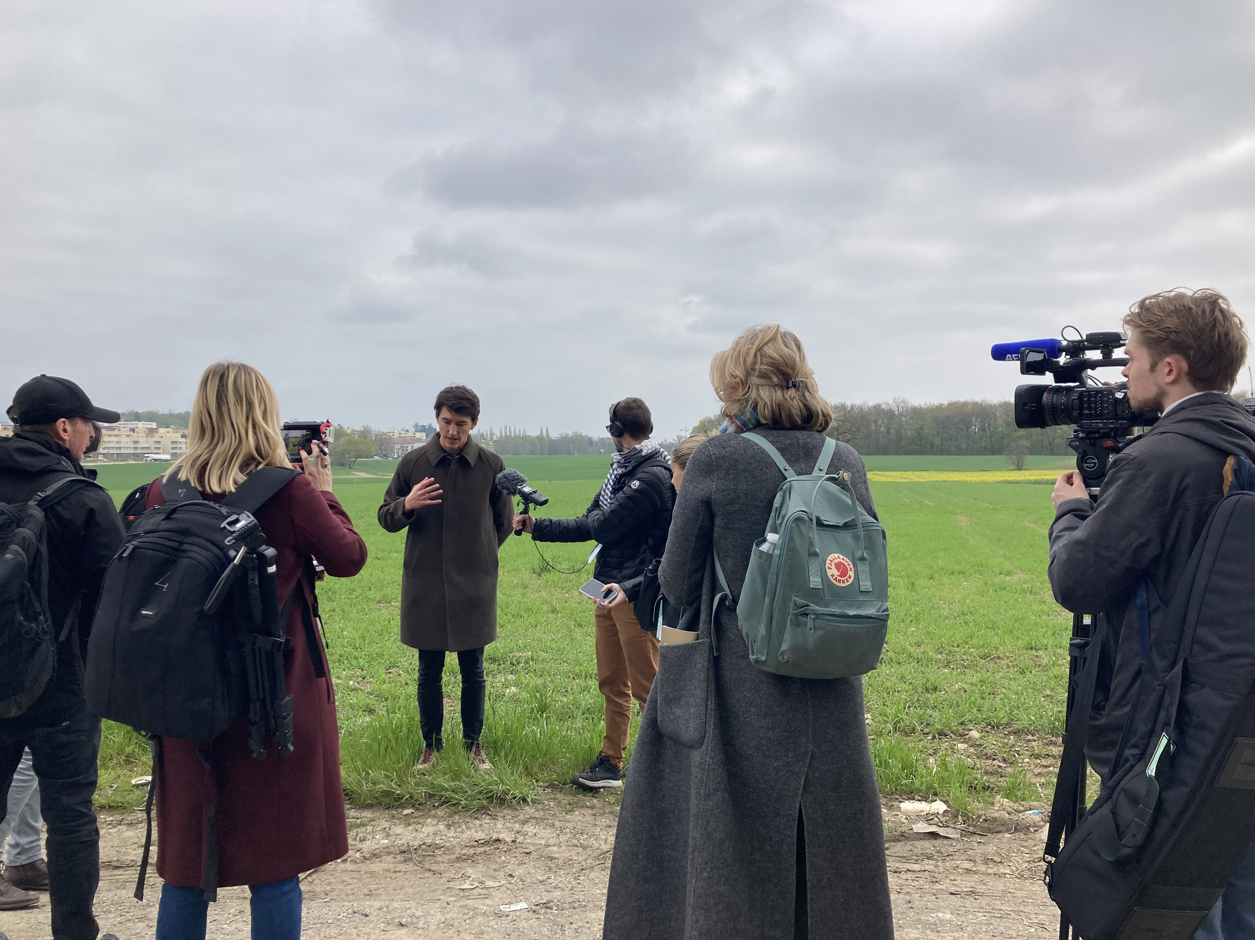
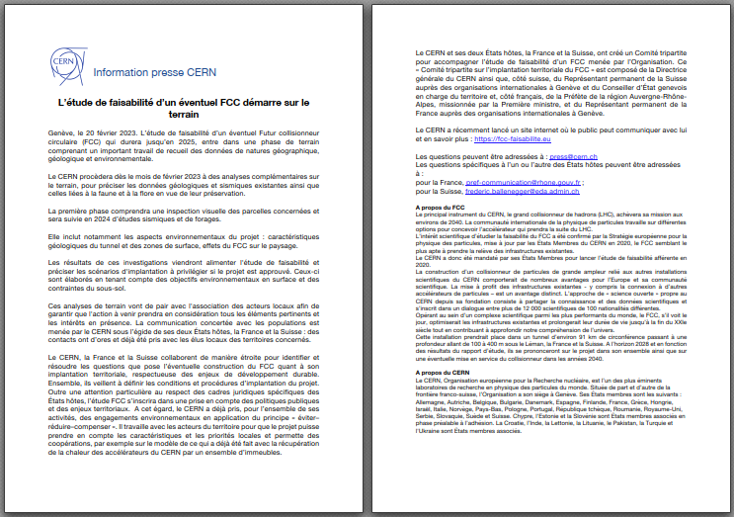
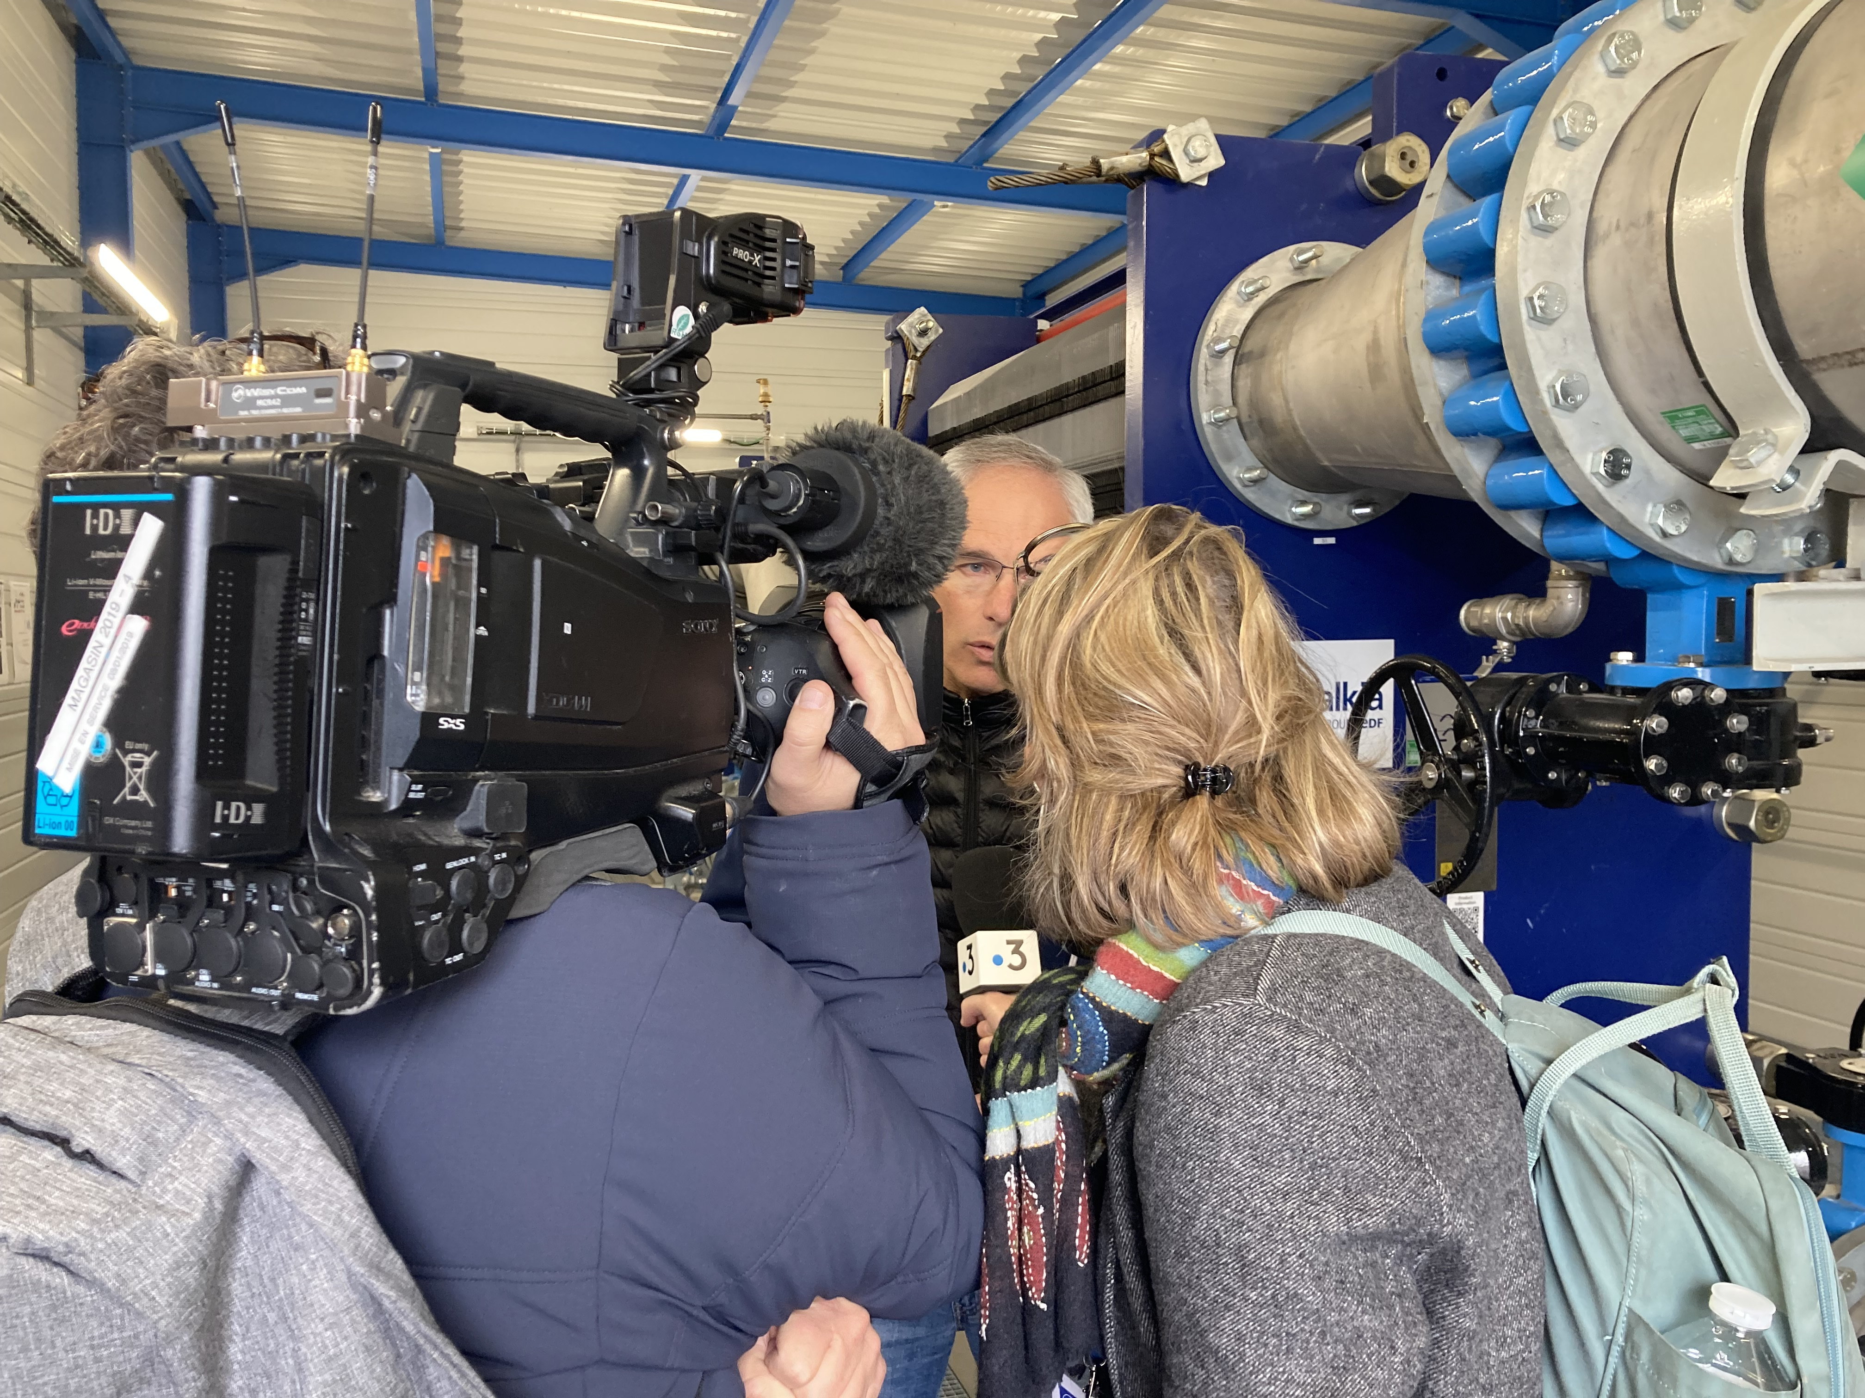
Communication aspects
CERN press release in February 2023 to inform about FS and organisation
Prepared with France and Switzerland « groupe de dialogue territoriale »
Press visit at CERN for local medias in April 2023
11 journalistes
90 press clippings
31 countries

Slide 15
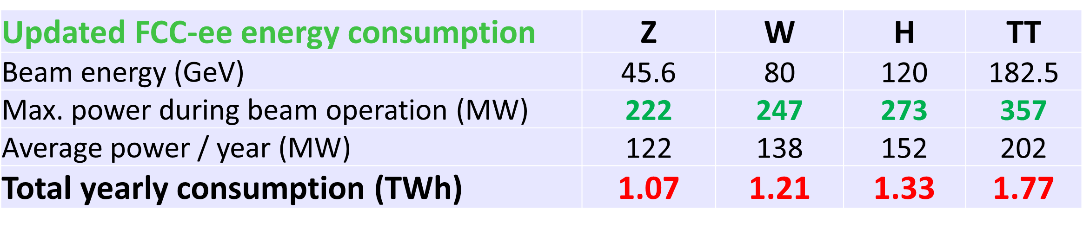
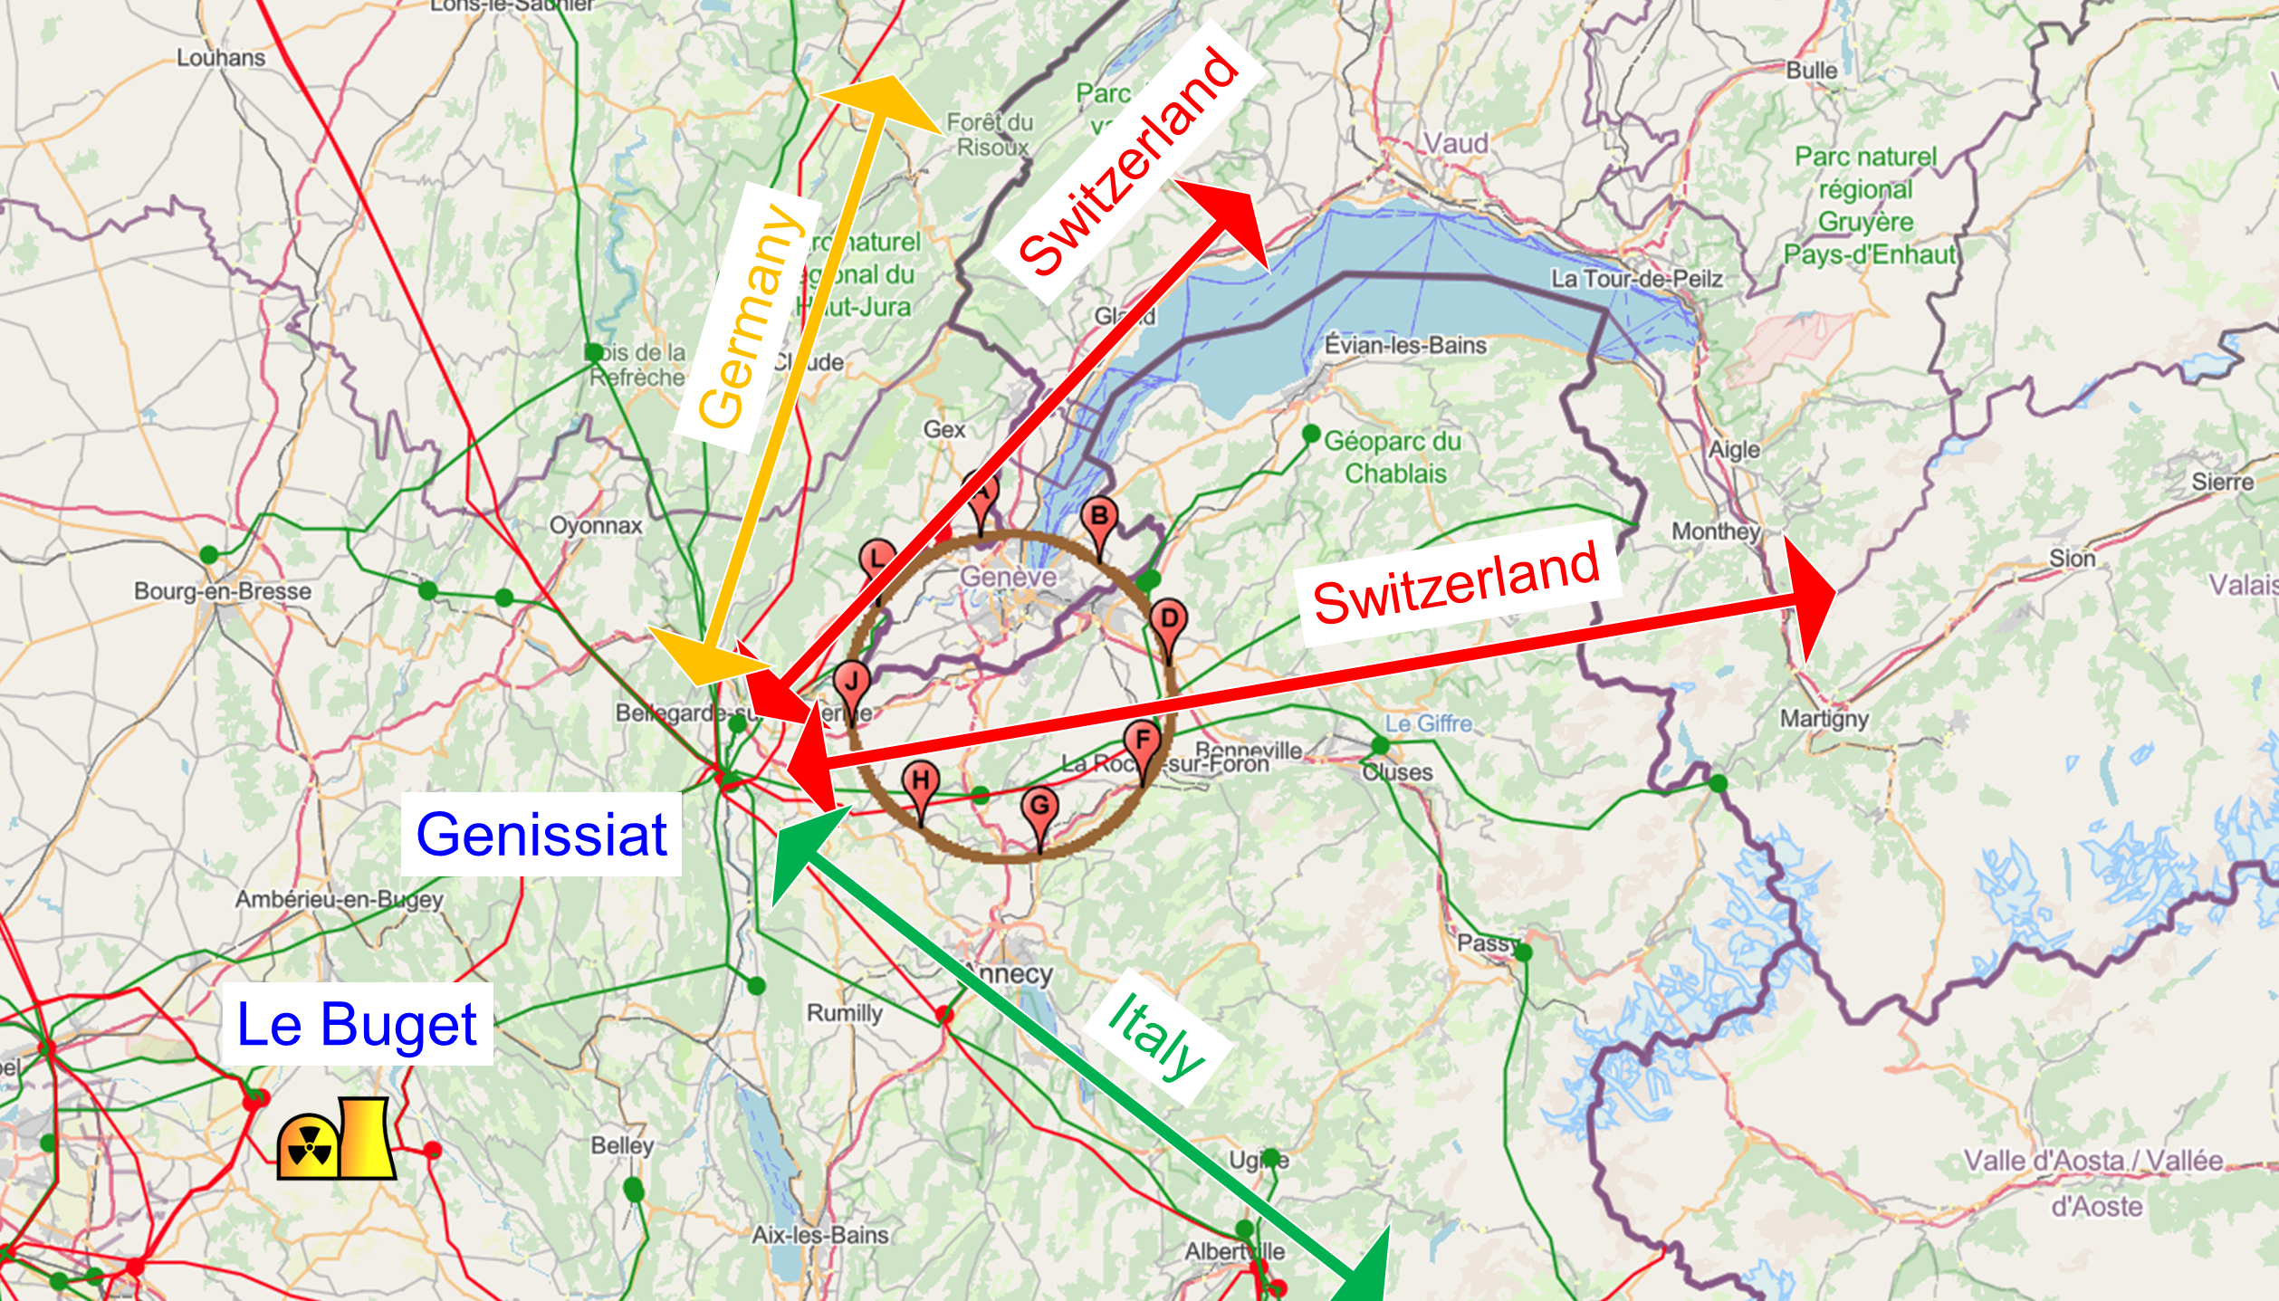
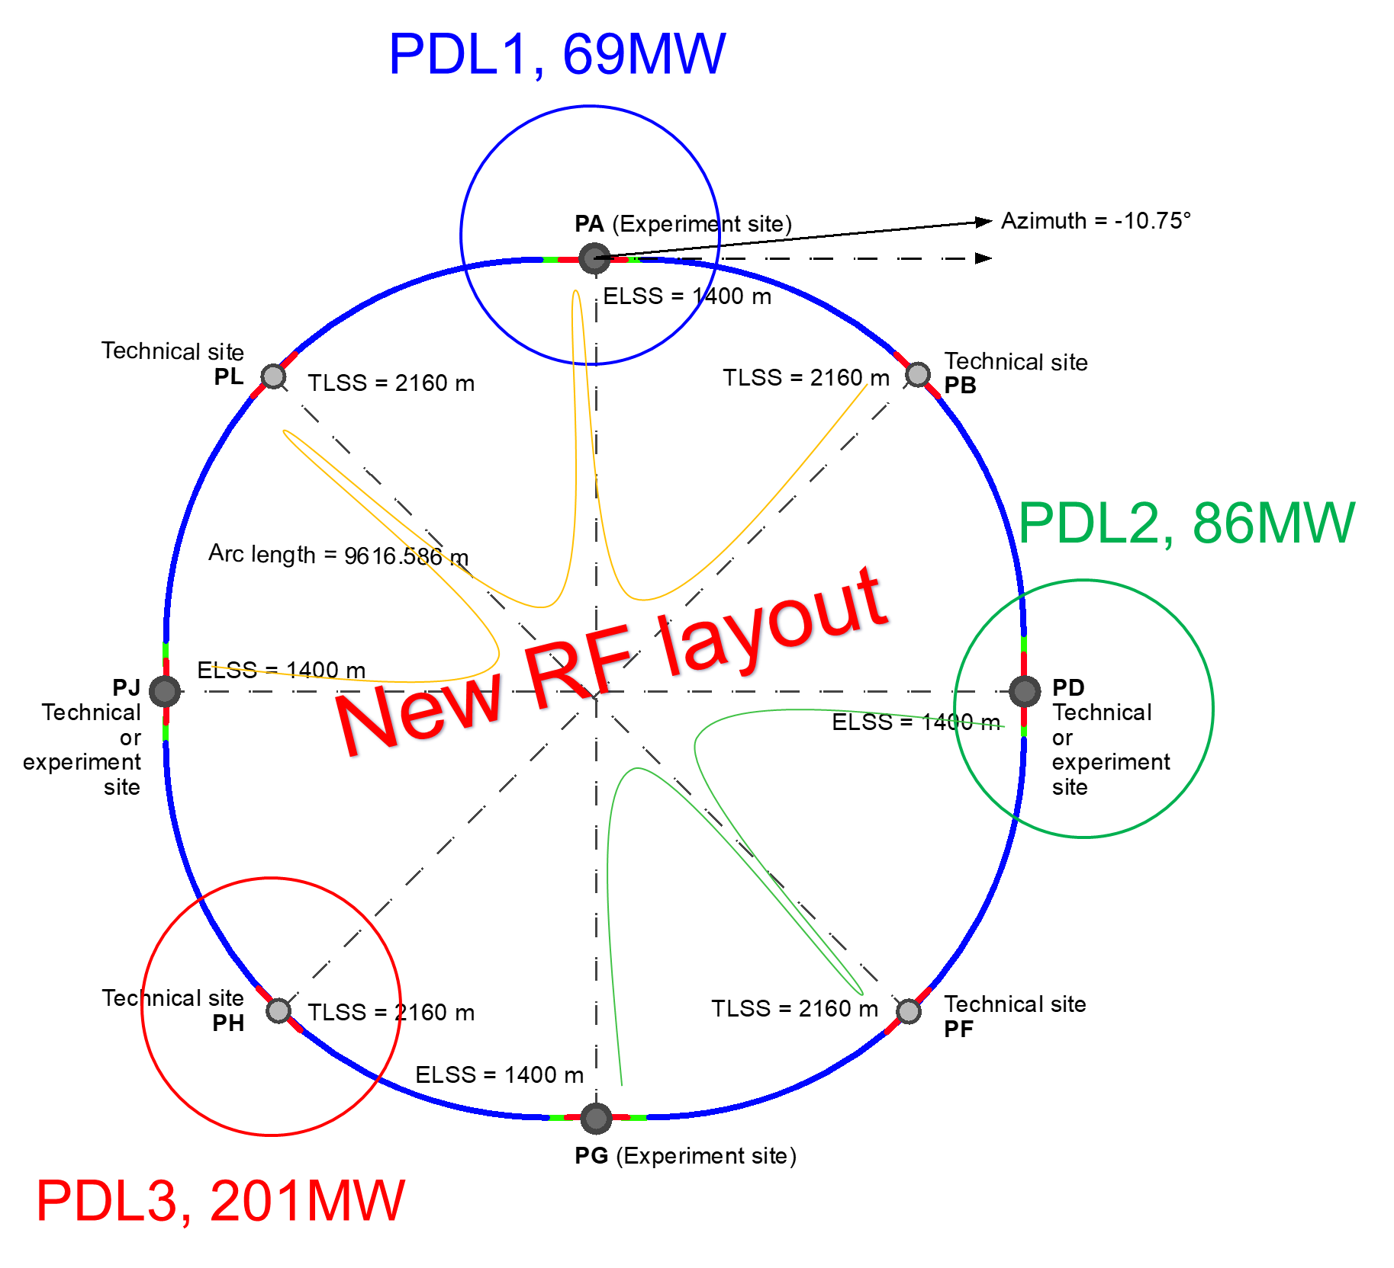

Connections to electrical grid infrastructure
Powering concept and max power load by sub-stations:
The loads could be charged on three sub-stations (optimally connected to existing regional HV grid):
Point D, with a new sub-station covering PB – PD – PF – PG
Point H with a new dedicated sub-station for collider RF
Point L, with a sub-station covering PJ – PL – PA
→ Alternative to new sub-station at Point L is connecting the existing CERN Prevessin station to PA
All options pursued with RTE
Powering concept and max. power rating of the three sub-stations compatible with FCC-hh

Slide 16
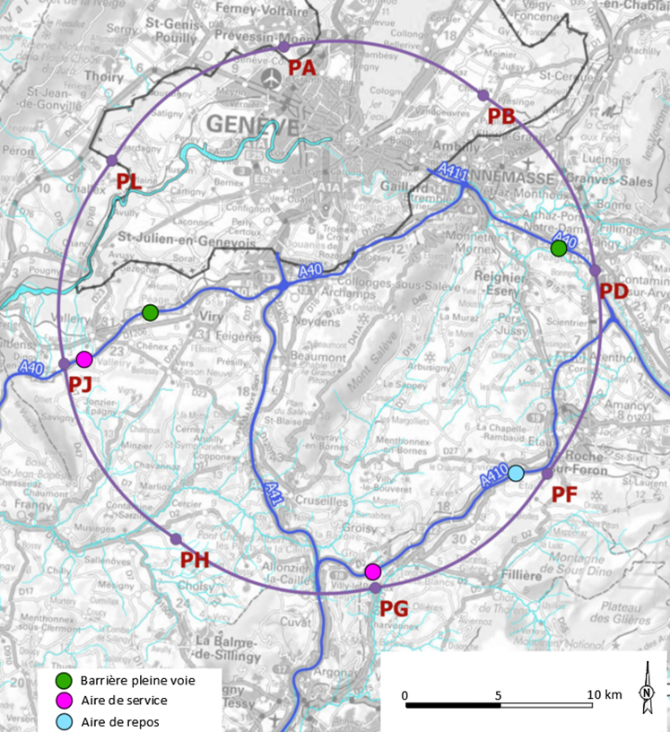
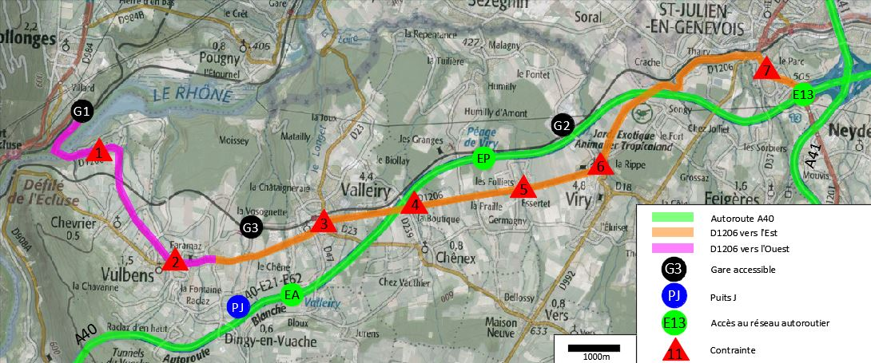
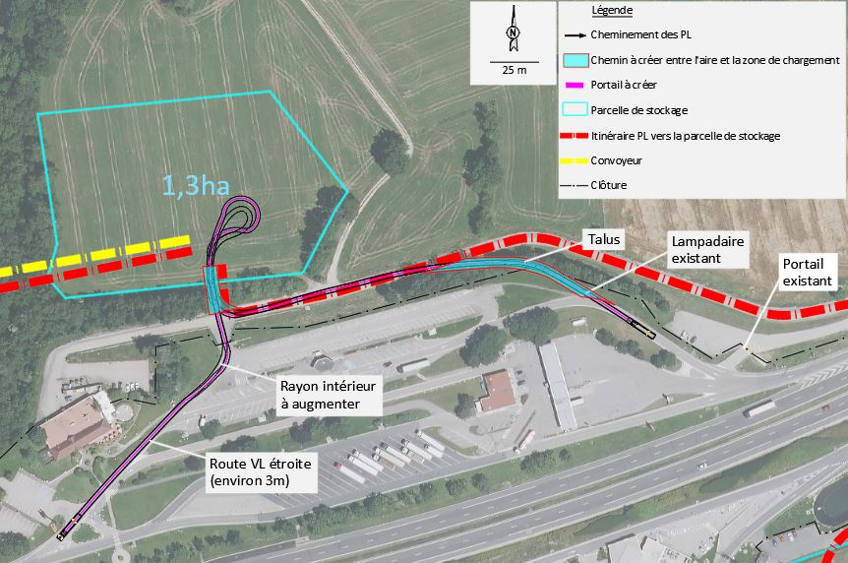
Connections to transport infrastructure
Road accesses identified and documented for all 8 surface sites
Four possible highway connections defined (materials transport)
Total amount of new roads required < 4 km (at departmental road level)
Detailed road access scenarios & highway access creation
study carried out by Cerema including regulatory requirements in France
E.g. Valleiry Nord

Slide 17
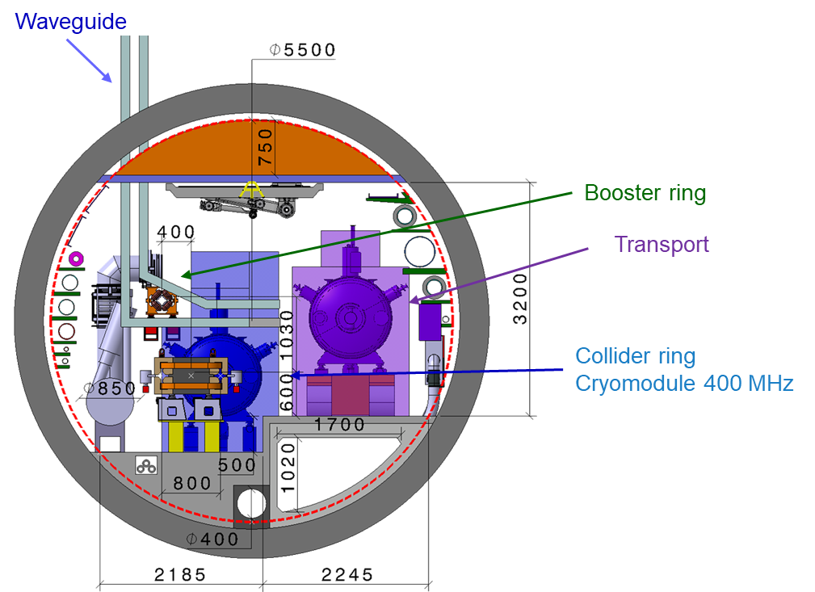
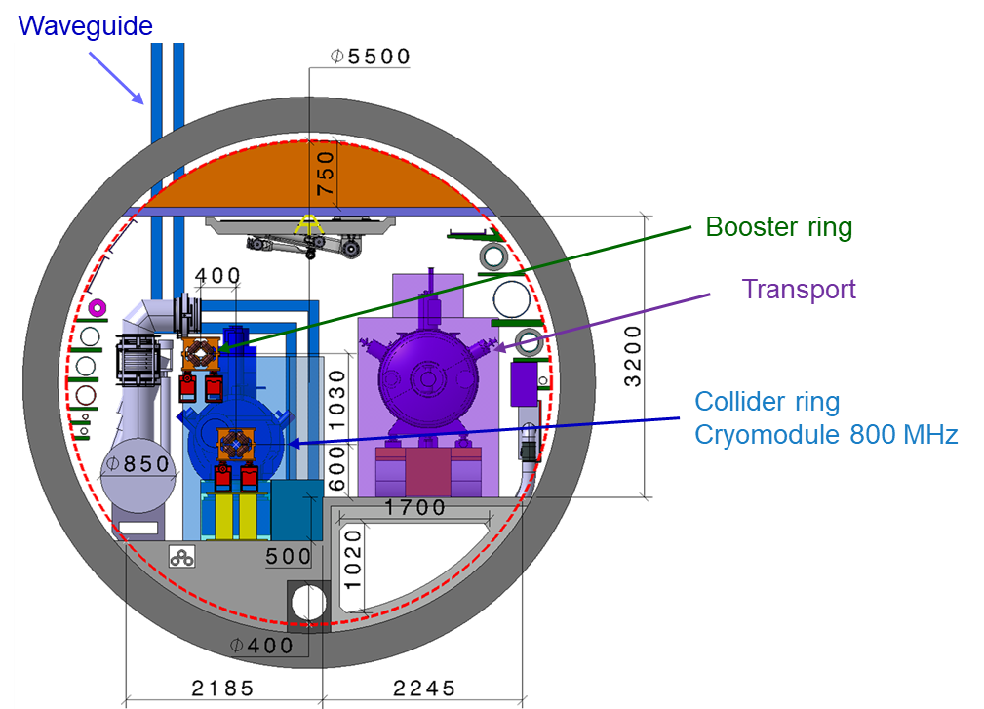
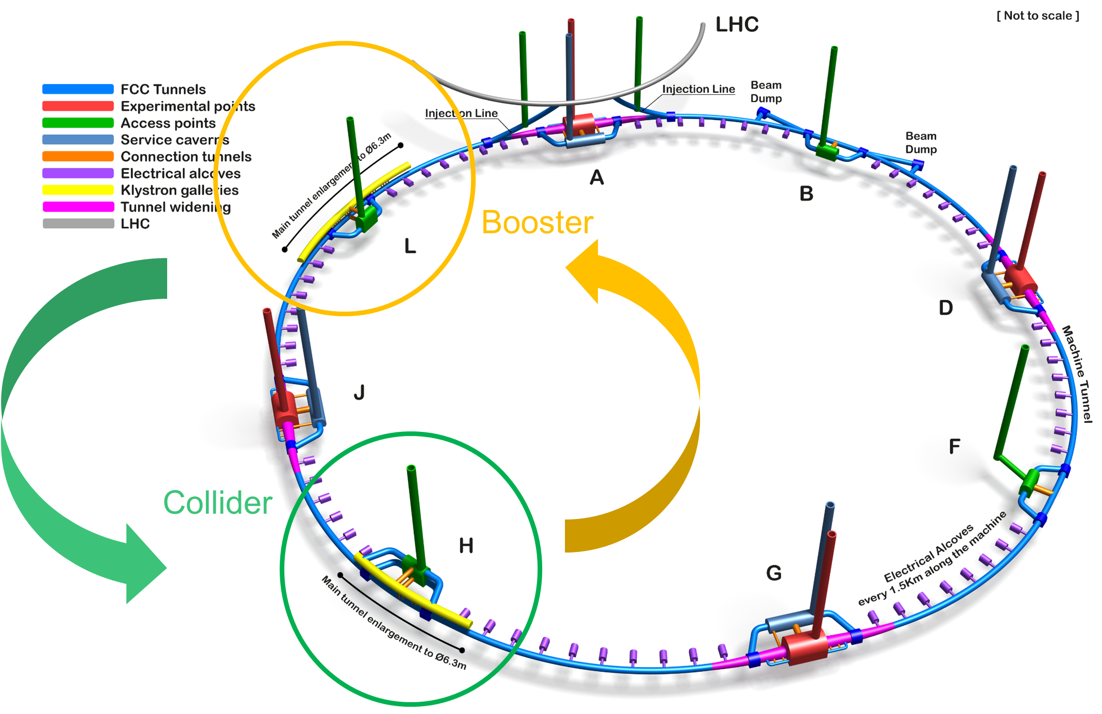
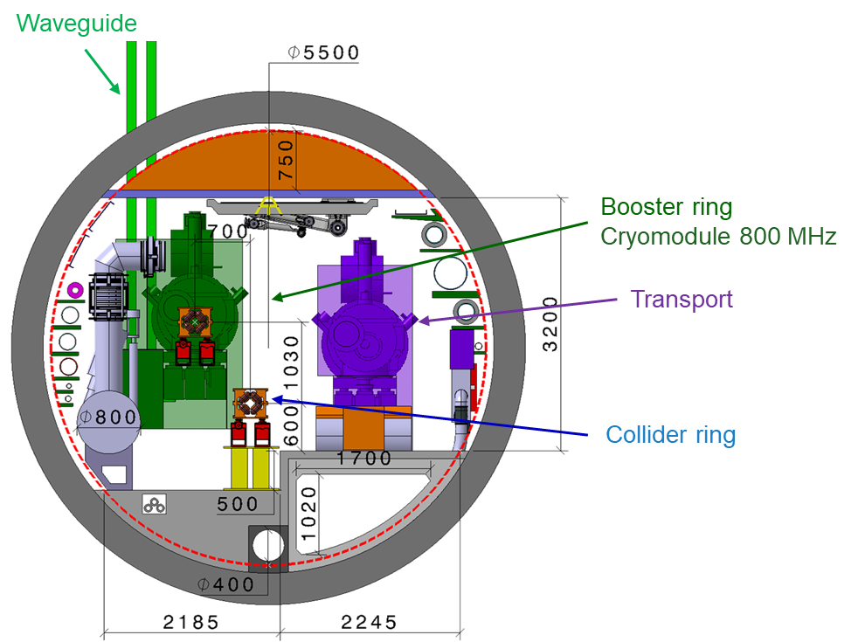
modified FCC-ee RF layout
RF for collider and booster in separate straight sections H and L.
fully separated technical infrastructure systems (cryogenics)
collider RF (highest power demand) in point H with optimum connection to existing 400 kV grid line and better suited surface site
Collider RF - Point H (400 and 800 MHz)
Booster RF - Point L
(800 MHz only)
J.-P. Burnet
F. Valchkova, F. Peauger

Slide 18
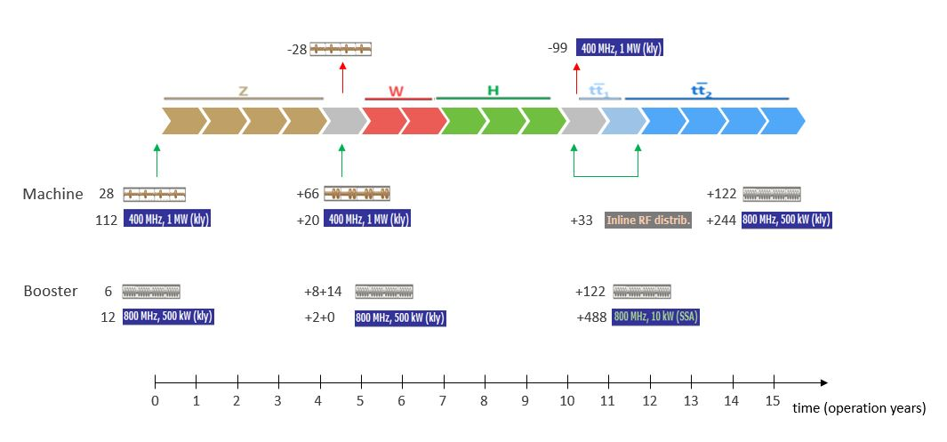
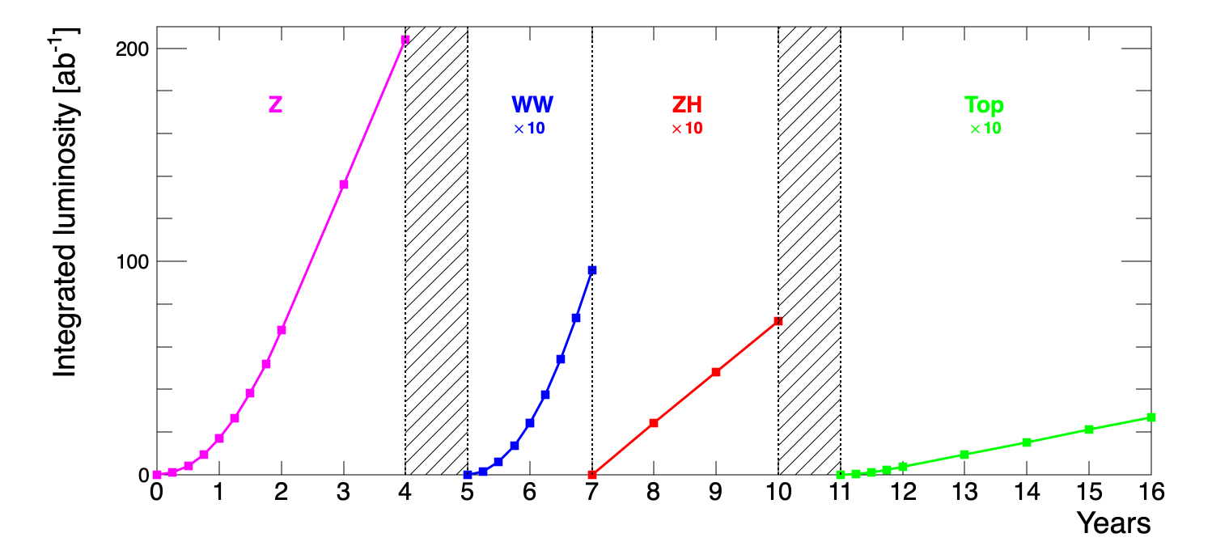
baseline operational sequence starting from Z
O. Brunner, F. Peauger
P. Janot

Slide 19
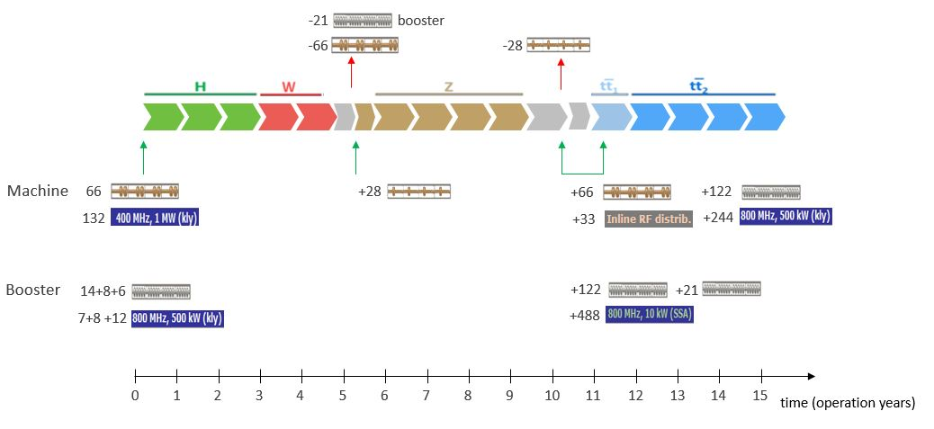
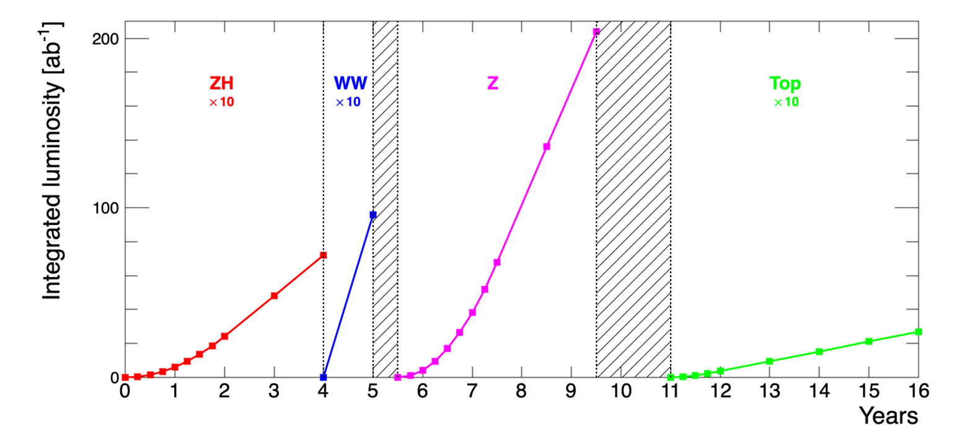
alternative operational sequence starting from ZH
O. Brunner, F. Peauger
P. Janot

Slide 20
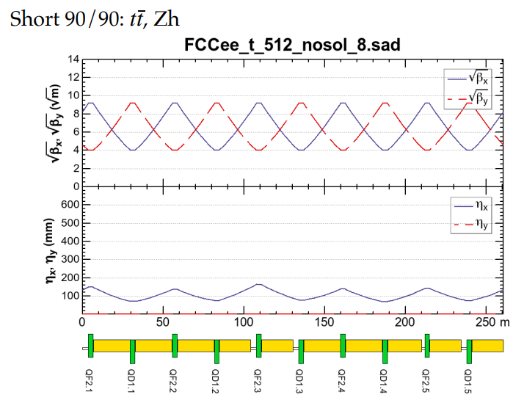
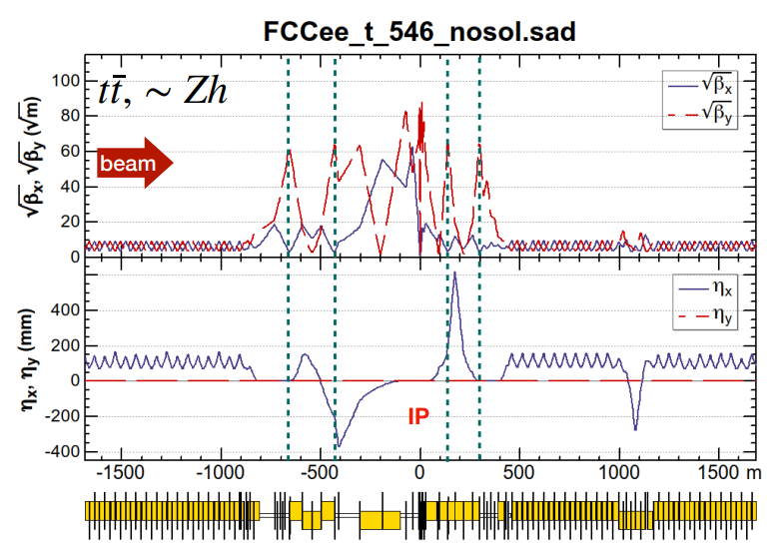
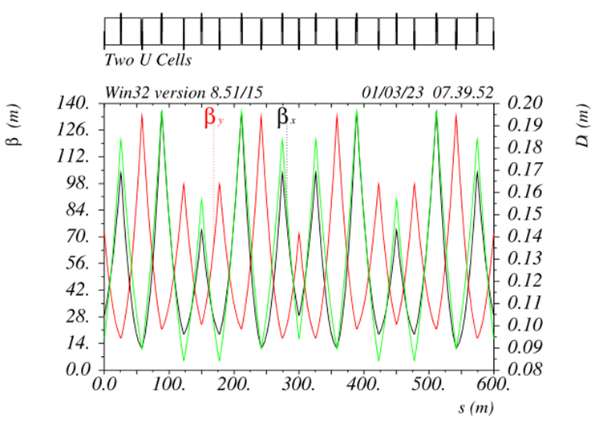
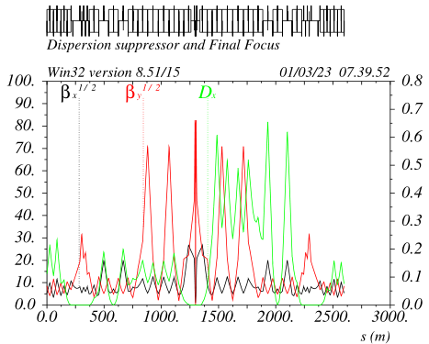
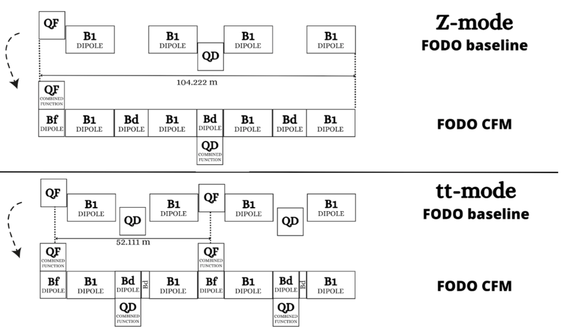
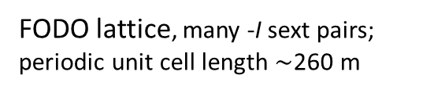
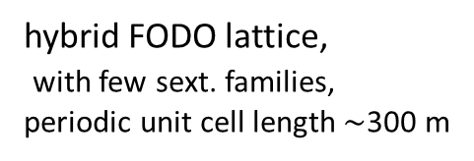
FCC-ee optics baseline & further evolution(s)
regular arc
K. Oide
interaction region
K. Oide
optimisation goals:
reduced power consumption
lower SR energy loss
increased momentum acceptance
relaxed tolerances
larger dynamic aperture
simplified powering schemes
FODO lattice, many -I sext pairs; periodic unit cell length $\sim$260 m
“1.5” sext.s per final focus,
asymmetric
P. Raimondi
P. Raimondi
hybrid FODO lattice,
with few sext. families,
periodic unit cell length$\sim$300 m
5 sext.s per final focus, modular
C. Garcia,
R. Tomas, et al.

Slide 21
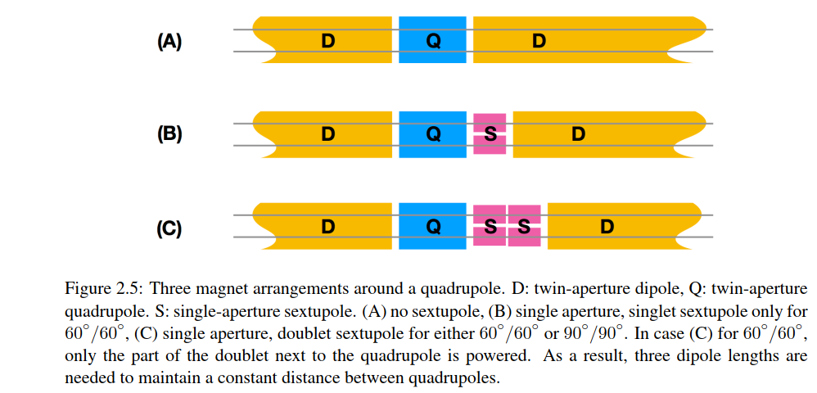
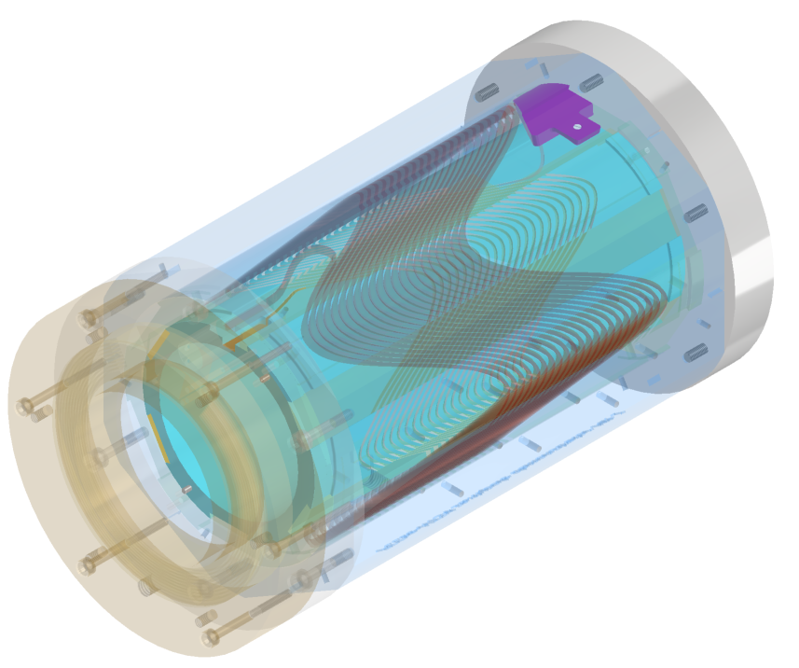
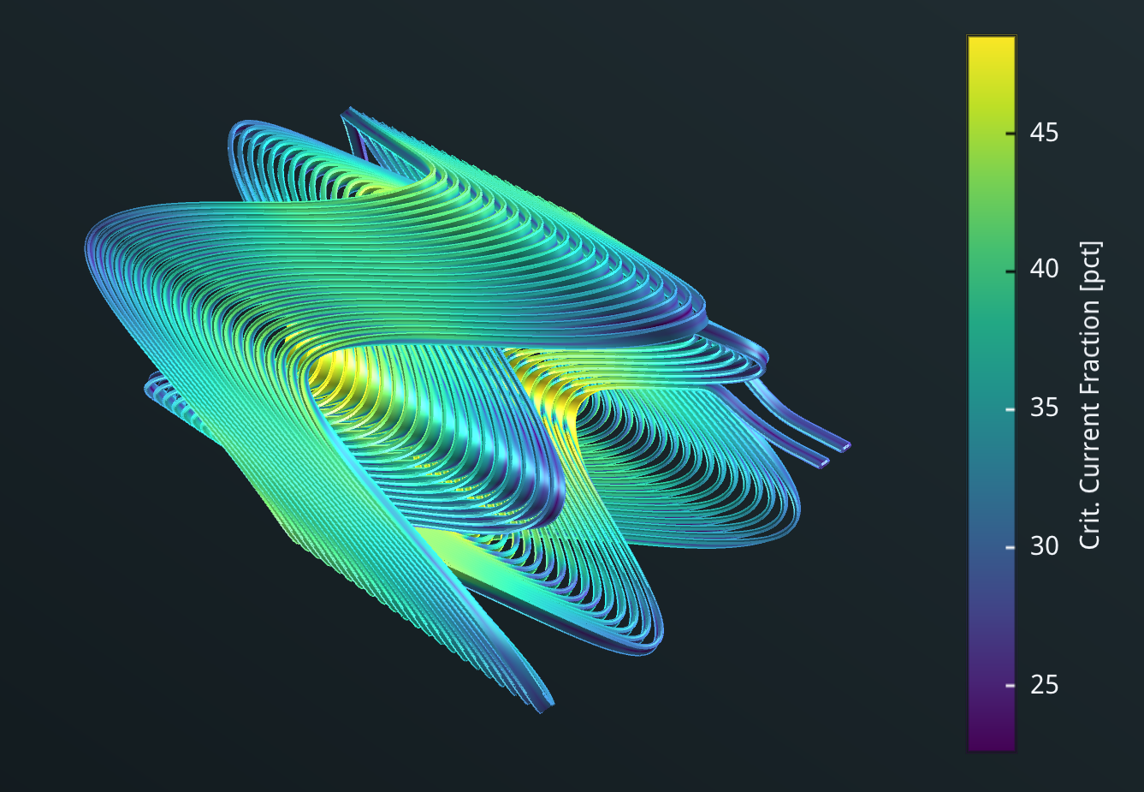
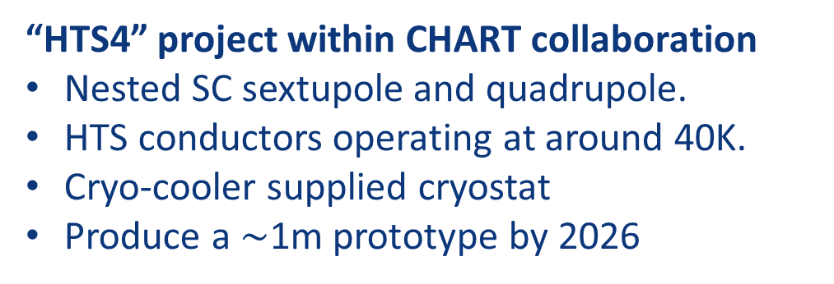
R&D on HTS option for FCC-ee arc quads and sextupoles
CDR: 2900 quads & 4700 sextupoles
Normal conducting, ~50 MW @ ttbar
3 different types of short straight sections
“HTS4” project within CHART collaboration
Nested SC sextupole and quadrupole.
HTS conductors operating at around 40K.
Cryo-cooler supplied cryostat
Produce a $\sim$1m prototype by 2026
CDR arc lattice
CAD design of HTS short
sextupole demonstrator based on CCT coils
HTS option proposal
“HTS4” potential
Power saving
Reduced length and increased dipole filling factor
Optics flexibility
M. Koratzinos, B. Auchmann

Slide 22
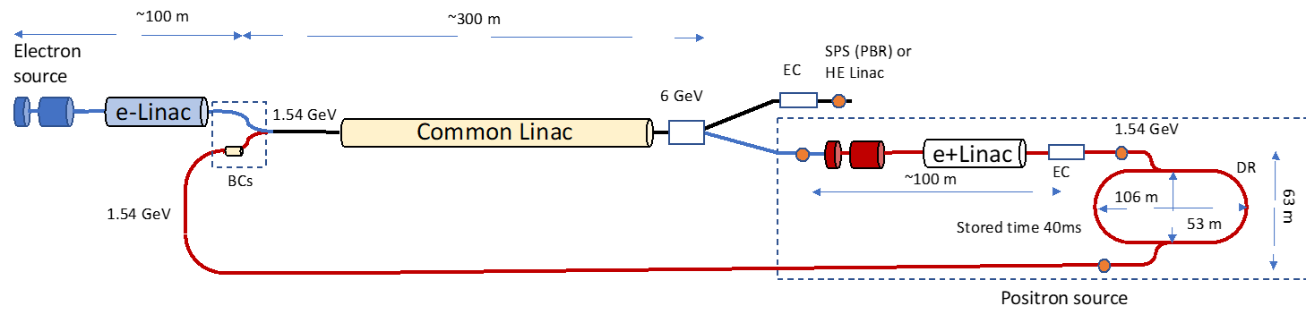
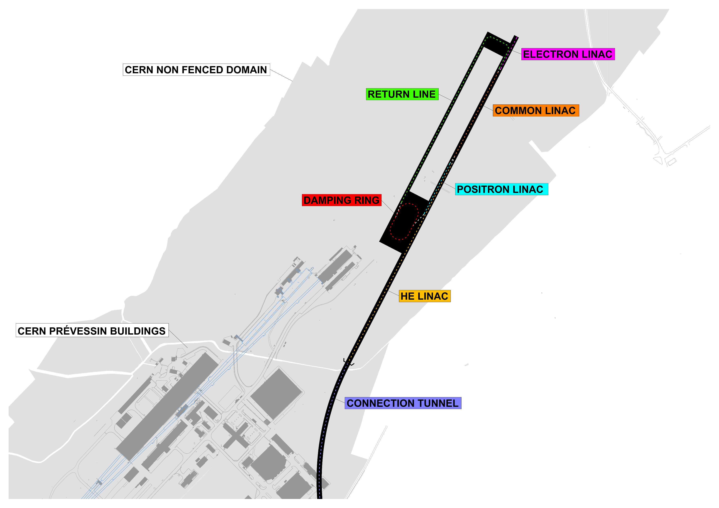
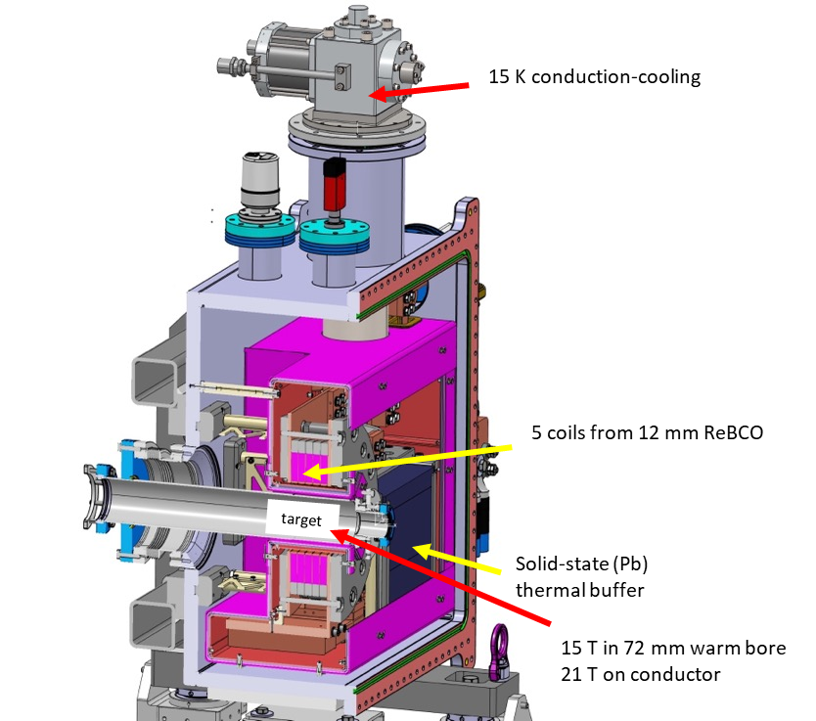
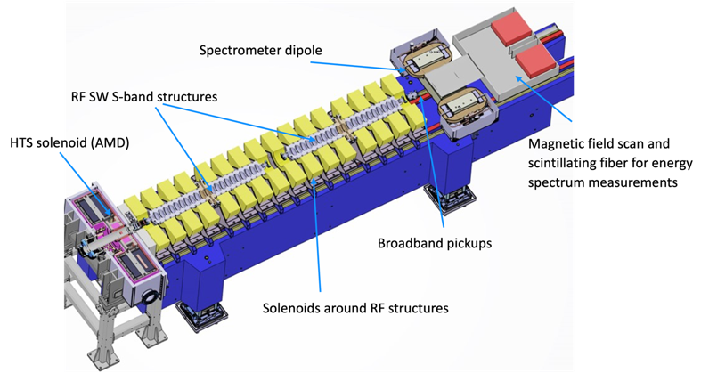
new FCC-ee injector layout & implementation
P. Craievich, I. Chaikovska, A. Grudiev, C. Milardi, et al
implementation study on Prevessin site
“Positron production experiment” at PSI’s SwissFEL,
beam tests from 2025/26
6 GeV linac
→20 GeV linac
HTS NI target solenoid
T. Watson
J. Kosse, T. Michlmayr, H. Rodrigues

Slide 23
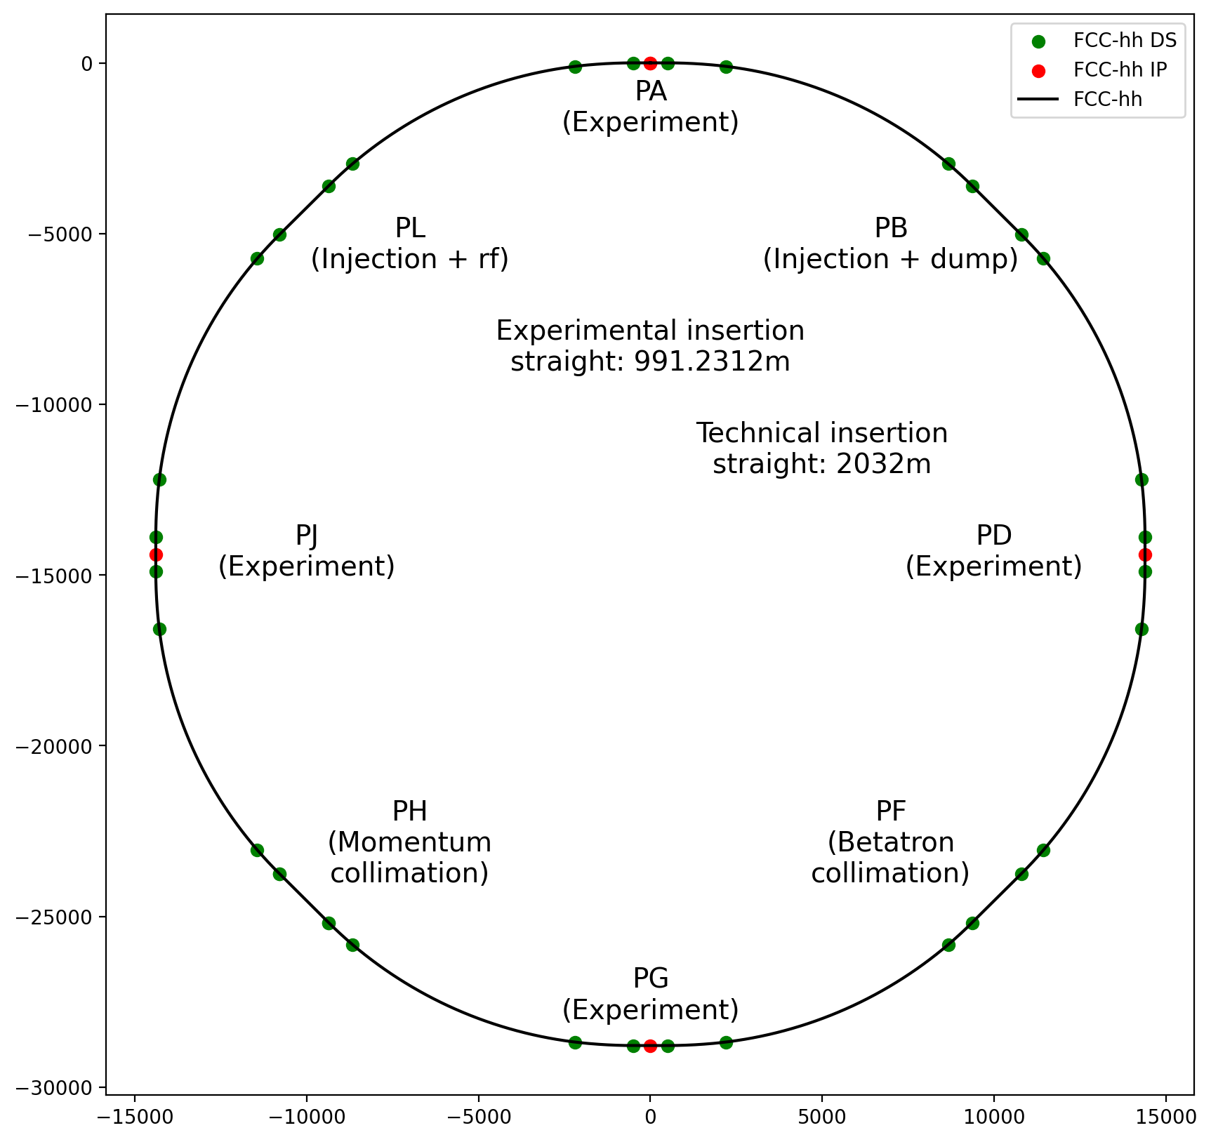
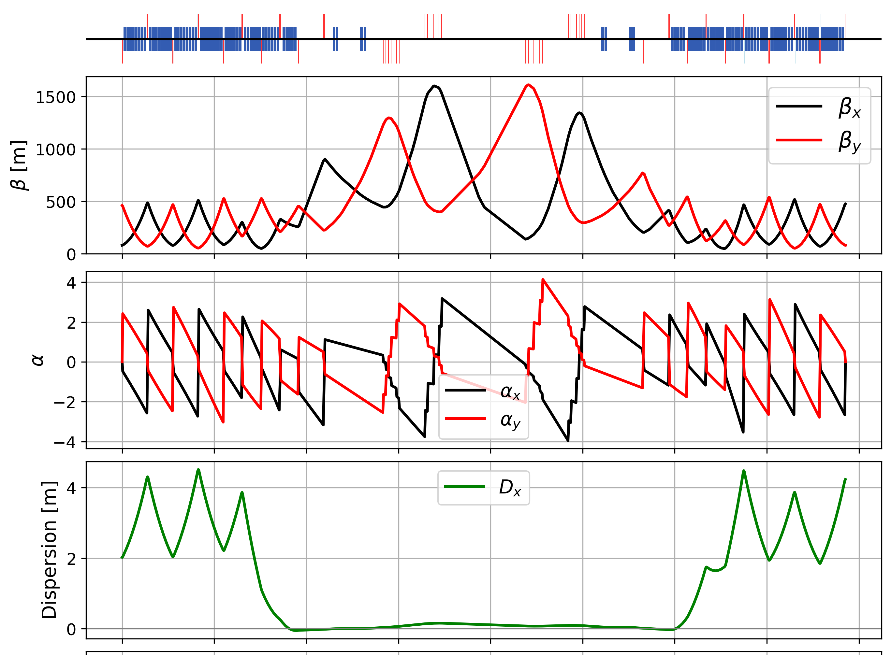
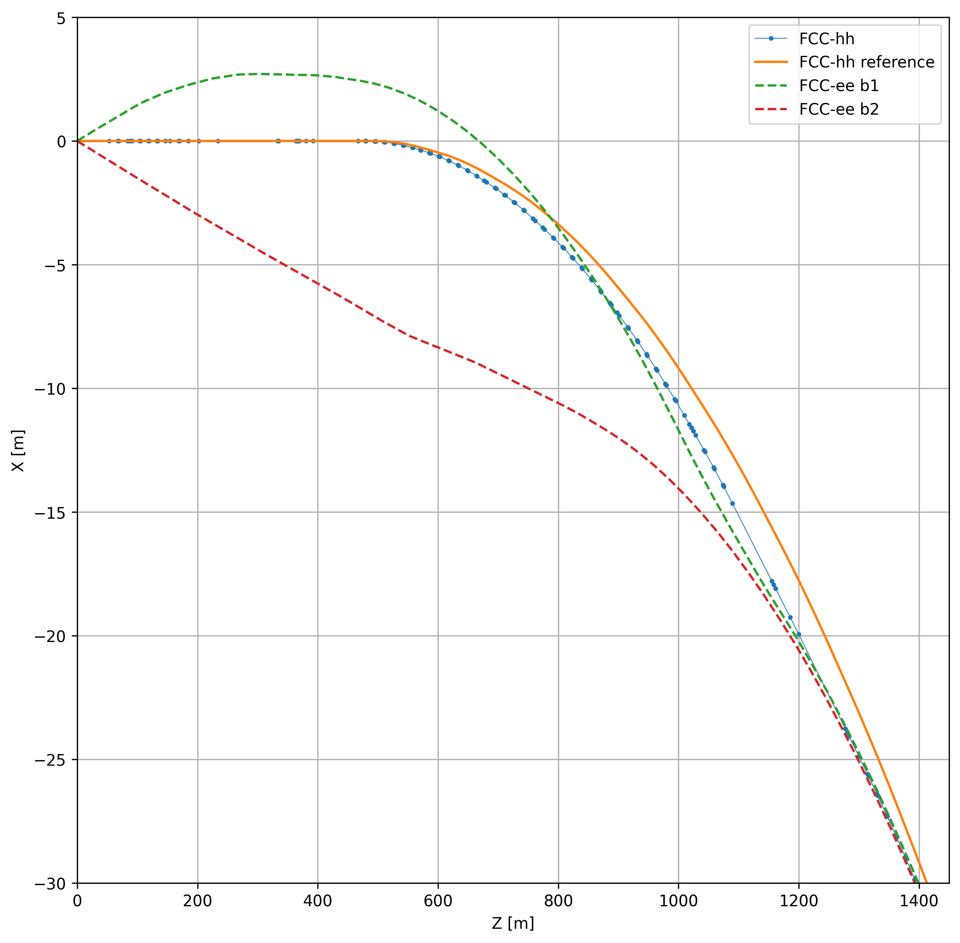
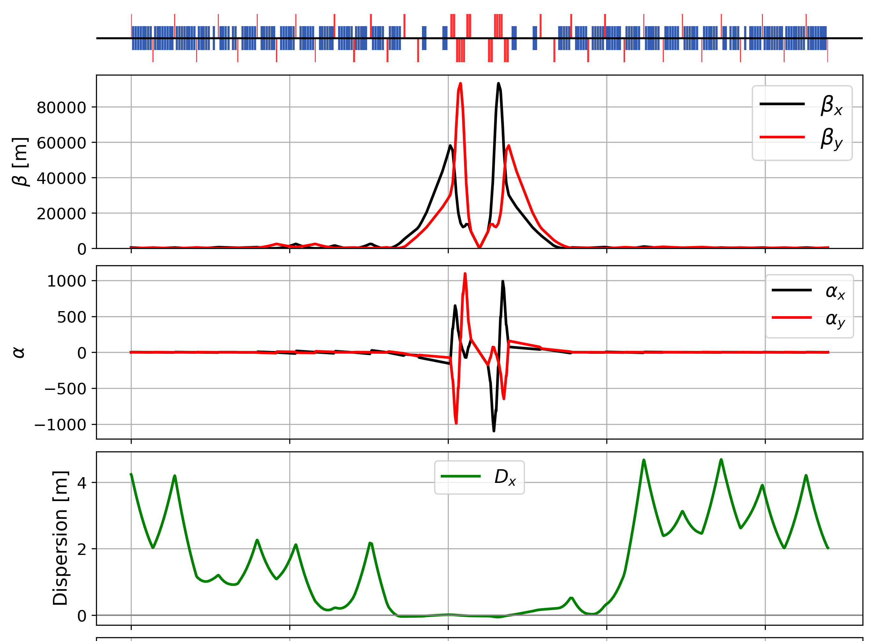
FCC-hh layout, optics work, geom. integration
betatron collimation straight
3 - beam footprint
at interaction point
ee – beam 1
from IP
IP
hh
new
hh – earlier
reference
ee – beam 2
towards IP
experimental straight
adaptation to new layout and geometry
shrink β collimation & extraction by ~30%
optics optimisation (filling factor etc.)
move hh IPs on top of ee IP to optimise tunnel and cavern widths.
M. Giovannozzi, T. Risselada, G. Perez Segurana, M. Hofer, K. Oide

Slide 24
FCC-ee: main machine parameters
Parameter | Z | WW | H (ZH) | ttbar
beam energy [GeV] | 45.6 | 80 | 120 | 182.5
beam current [mA] | 1270 | 137 | 26.7 | 4.9
number bunches/beam | 11200 | 1780 | 440 | 60
bunch intensity [10¹¹] | 2.14 | 1.45 | 1.15 | 1.55
SR energy loss / turn [GeV] | 0.0394 | 0.374 | 1.89 | 10.4
total RF voltage 400/800 MHz [GV] | 0.120/0 | 1.0/0 | 2.1/0 | 2.1/9.4
long. damping time [turns] | 1158 | 215 | 64 | 18
horizontal beta* [m] | 0.11 | 0.2 | 0.24 | 1.0
vertical beta* [mm] | 0.7 | 1.0 | 1.0 | 1.6
horizontal geometric emittance [nm] | 0.71 | 2.17 | 0.71 | 1.59
vertical geom. emittance [pm] | 1.9 | 2.2 | 1.4 | 1.6
horizontal rms IP spot size [μm] | 9 | 21 | 13 | 40
vertical rms IP spot size [nm] | 36 | 47 | 40 | 51
beam-beam parameter ξ_{x} / ξ_{y} | 0.002/0.0973 | 0.013/0.128 | 0.010/0.088 | 0.073/0.134
rms bunch length with SR / BS [mm] | 5.6 / 15.5 | 3.5 / 5.4 | 3.4 / 4.7 | 1.8 / 2.2
luminosity per IP [10³⁴ cm⁻²s⁻¹] | 140 | 20 | 5.0 | 1.25
total integrated luminosity / IP / year [ab⁻¹/yr] | 17 | 2.4 | 0.6 | 0.15
beam lifetime rad Bhabha + BS [min] | 15 | 12 | 12 | 11
currently assessing
technical feasibility
of changing operation
sequences
(e.g. starting at ZH energy)
4 years
5 x 10¹² Z
LEP x 10⁵
2 years
> 10⁸ WW
LEP x 10⁴
3 years
2 x 10⁶ H
5 years
2 x 10⁶ tt pairs
x 10-50 improvements on all EW observables
up to x 10 improvement on Higgs coupling (model-indep.) measurements over HL-LHC
x10 Belle II statistics for b, c, τ
indirect discovery potential up to ~ 70 TeV
direct discovery potential for feebly-interacting particles over 5-100 GeV mass range
Up to 4 interaction points → robustness,
statistics, possibility of specialised detectors
to maximise physics output
F. Gianotti

Slide 25
FCC-hh: main machine parameters
parameter | FCC-hh | HL-LHC | LHC
collision energy cms [TeV] | 81 - 115 | 14 | 14
dipole field [T] | 14 - 20 | 8.33 | 8.33
circumference [km] | 90.7 | 26.7 | 26.7
arc length [km] | 76.9 | 22.5
beam current [A] | 0.5 | 1.1 | 0.58
bunch intensity [10¹¹] | 1 | 2.2 | 1.15
bunch spacing [ns] | 25 | 25 | 25
synchr. rad. power / ring [kW] | 1020 - 4250 | 7.3 | 3.6
SR power / length [W/m/ap.] | 13 - 54 | 0.33 | 0.17
long. emit. damping time [h] | 0.77 – 0.26 | 12.9 | 12.9
peak luminosity [10³⁴ cm⁻²s⁻¹] | ~30 | 5 (lev.) | 1
events/bunch crossing | ~1000 | 132 | 27
stored energy/beam [GJ] | 6.1 - 8.9 | 0.7 | 0.36
If FCC-hh after FCC-ee: significantly
more time for high-field magnet R&D
aiming at highest possible energies
Formidable challenges:
high-field superconducting magnets: 14 - 20 T
power load in arcs from synchrotron radiation: 4 MW → cryogenics, vacuum
stored beam energy: ~ 9 GJ → machine protection
pile-up in the detectors: ~1000 events/xing
energy consumption: 4 TWh/year → R&D on cryo, HTS, beam current, …
Formidable physics reach, including:
Direct discovery potential up to ~ 40 TeV
Measurement of Higgs self to ~ 5% and ttH to ~ 1%
High-precision and model-indep (with FCC-ee input)
measurements of rare Higgs decays (𝛄𝛄, Z𝛄, µµ)
Final word about WIMP dark matter
F. Gianotti

Slide 26

Status of FCC global collaboration
collaboration members in Asia
Japan: KEK, The University of Tokyo, Tokyo Int’l University
South Korea: PAL, KIAS, KAIST, Gangneung-Wonju Natl U.,
Yonsei University, Kyungpook Nat’l. U., Kyung Hee U., Hanyang U., Busan Nat’l U., Korea University
Iran: IPM, University of Tehran
Pakistan: PAEC
Thailand: Chiang Mai U.
Türkiye : IYTE, Izmir University of Economics, Kirikkale University, Istanbul University, Istanbul Aydin U, Piri Reis Üniversitesi, Isik University, Giresun University, Ege University, TOBB University of Economics and Technology, AIBU, Ankara U, İstinye University
increasing international collaboration as a prerequisite for success
150
Institutes
32
Companies
34
Countries
EC
H2020
FCC Feasibility Study: Aim is to increase further the collaboration, on all aspects,
in particular, on Accelerator and Particle/Experiments/Detectors (PED).

Slide 27
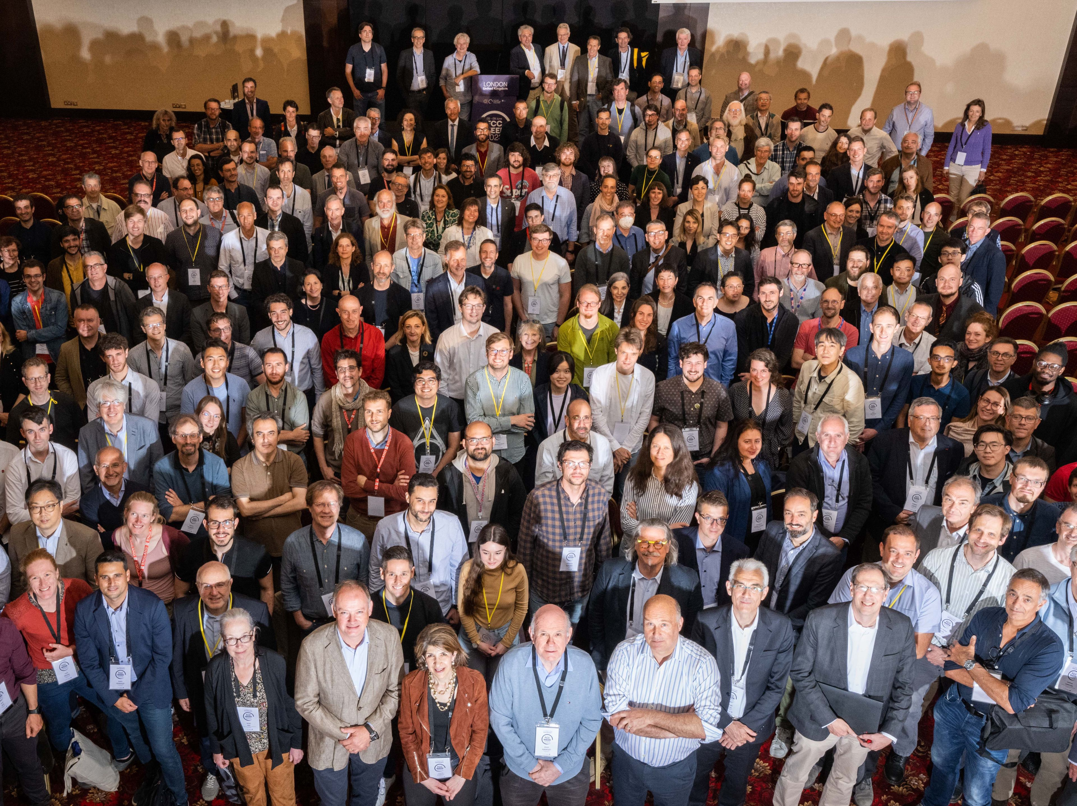
FCC Week 2023
473 participants
362 in person and 111 remote
Courtesy P. Charitos

Slide 28
FCC Feasibility Study – status summary
The first half of the FCC Feasibility Study will soon be completed with the mid-term review
Topics addressed: Infrastructure & placement, Technical Infrastructure, Accelerator design FCC-ee and FCC-hh, Physics, experiments, detectors, Organisation and financing, Environmental impact, socio-economic impact
End October 2023: SAC and CRP reports available to Scientific Policy Committee and Finance Committee
20 – 22 November 2023: SPC and FC review meetings on mid-term review
2 February 2024: Council meeting on mid-term review
Focus so far: identifying best placement & layout and adapting entire project to new placement
  3D underground civil engineering model, siting study for implementation of FCC-ee pre-injector on CERN Prevessin site
  FCC-ee 4 IP variant, significant effort in FCC-ee lattice design with two complete optics solutions, major progress towards full performance simulations including beam-beam, impedance etc.
  FCC-ee SRF configuration and layout further optimized.
  FCC powering concept defined in cooperation with French network operator RTE.
Fruitful collaboration between all scientific & technical actors and in close cooperation with the host state services concerned; at departmental/cantonal and local level. Direct exchange with communes concerned by surface sites. Environmental studies ongoing.

Slide 29
Tentative timeline
FCC-ee physics run
2047 –
2046 –
2045 –
2044 –
2043 –
2042 –
2041 –
2040 –
2039 –
2038 –
2037 –
2036 –
2035 –
2034 –
2033 –
2032 –
2031 –
2030 –
2029 –
2028 –
2027 –
2026 –
2025 –
– 2047
– 2046
– 2045
– 2044
– 2043
– 2042
– 2041
– 2040
– 2039
– 2038
– 2037
– 2036
– 2035
– 2034
– 2033
– 2032
– 2031
– 2030
– 2029
– 2028
– 2027
– 2026
– 2025
Start accelerator commissioning
Start detector commissioning
End of HL-LHC operation
Start detector installation
Start accelerator installation
Start accelerator component production
Technical design & prototyping completed
Start detector component production
Four detector TDRs completed
Ground-breaking and start civil engineering
Start engineering design
Detector CDRs (>4) submitted to FC³
Completion of HL-LHC: more ATS personnel available .
Completion of HL-LHC upgrade: more detector experts available
FCC Approval, R&D, start prototyping .
FC³ formation, call for CDRs, collaboration forming
European Strategy Update
European Strategy Update
FCC Feasibility Study Report
Detector EoI submission by the community
FCC-ee Accelerator
Key dates
FCC-ee Detectors

Slide 30
The path forward for CERN
HL-LHC - flagship machine at the energy frontier out to end ~2041
The vision is for another major project commensurate with the laboratory’s capabilities, communities, and resources to assure the future of CERN for the next 50+ years
    Engine for continued investment, innovation, R&D and scientific engagement
    CERN remains a world leading Research Infrastructure
    CERN remains a prestigious symbol of worldwide collaboration, scientific excellence at the leading edge
    Geopolitical implications
The preferred direction for a future collider at CERN is the FCC
    As mandated by the European Strategy for Particle Physics
    Feasibility Study results to be delivered end 2025 – expect full and detailed scrutiny
Thank you for your attention !
    “This a big, hairy, audacious goal – but then so was LEP, so was the LHC !”
    - Mike Lamont

