Slide 1
Optical Properties and Biomarkers of Rogue Planets in the Solar Vicinity
Eduardo L Martín & Jerry Jun-Yan Zhang
30th anniversary Rencontres du Vietnam
WINDOWS ON THE UNIVERSE
11 August 2023

Slide 2
Ultracool dwarfs
Spectral type
Late-M 2700 – 2200 K Oxides (TiO)
L 2200 – 1200 K Hydrides (FeH, CrH), Alkali
T 1000 – 500 K Methane
Y < 500 K Ammonia
Low-Mass Stars, Brown Dwarfs, Planetary Mass Objects

Slide 3
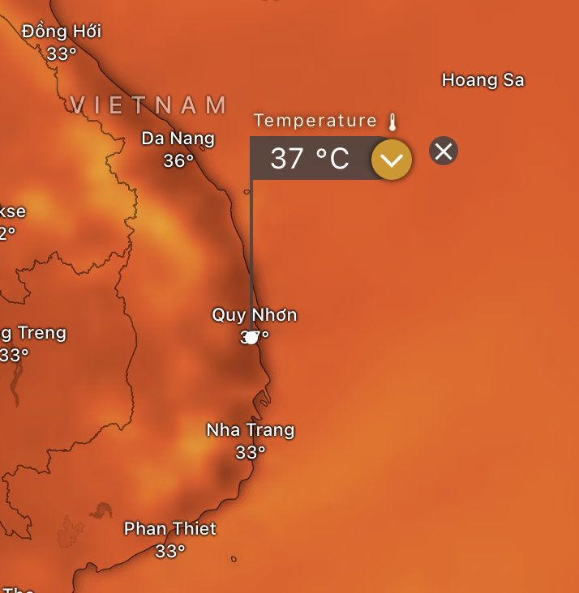
Cold worlds
Y dwarfs were first found in 2008 (Delorme et al. 2008) ~ 30 objects till today
NH₃ Absorption in NIR (Cushing et al. 2011, Martín et al. 2021)
T < 500K
Coldest WISE J0855-0714 ~ 250K !
Abundant in water
Life?
Large Atmospheric Life Zones in the upper atmosphere (McKay 2014, Yates et al. 2017)
310K

Slide 4
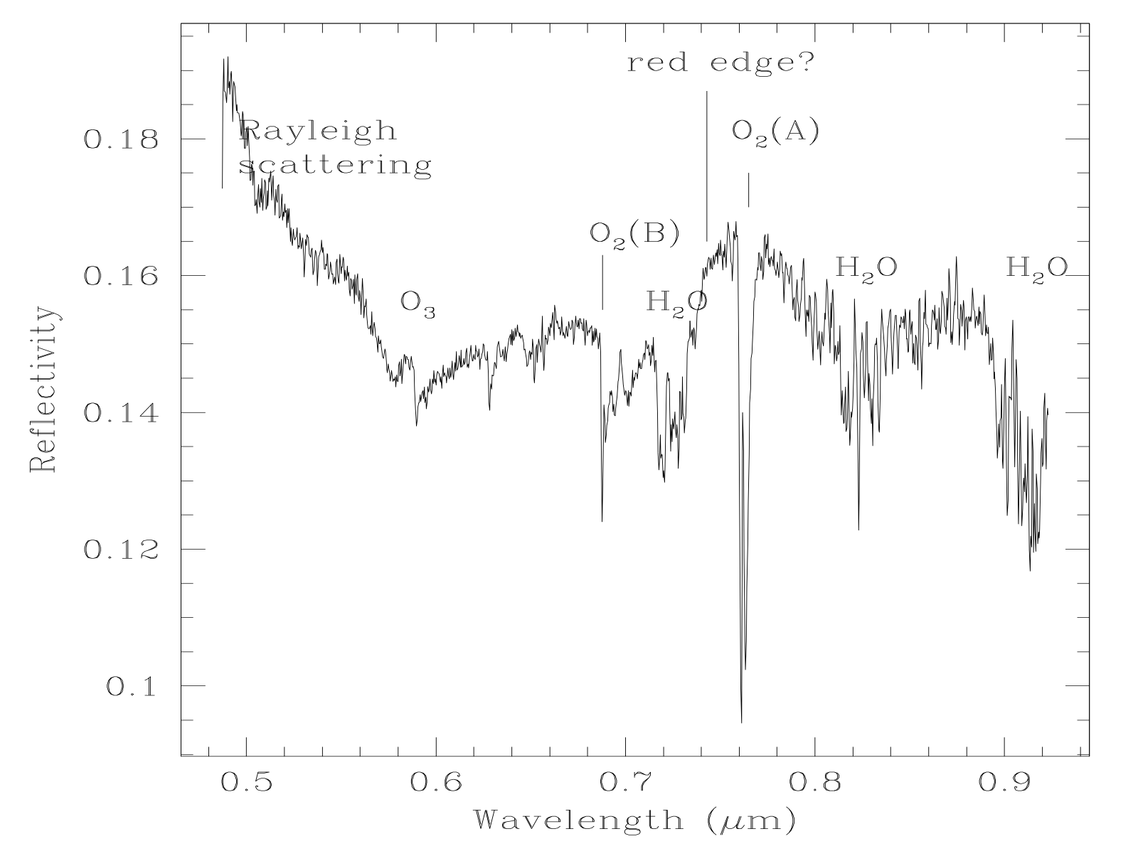
biomarkers
Vegetation red edge …
O₂, O₃, N₂O absorption …
(CH₄, NH₃?)
Bioluminescence in optical, NIR
(Maisch et al. 2007; Poinar Jr et al. 1980)
Earthshine spectrum (Woolf et al. 2002)

Slide 5
EXOPLANET bioluminescence

Slide 6
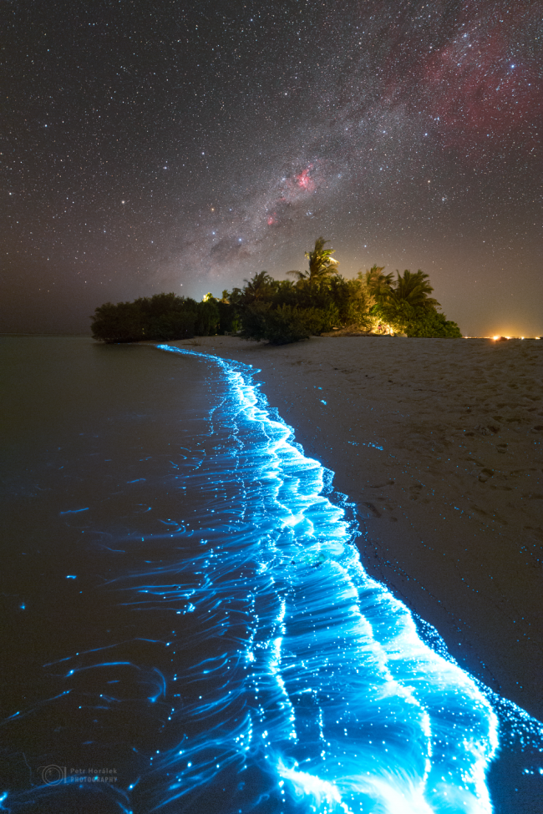
unique window
Unlike exoplanets, Y dwarfs are isolated
Bioluminiscence normally shines in the optical
Y dwarfs are dark in the optical !!!
If not detected, we can still set constrains to the Y dwarf atmosopheric models
Petr Horálek 2023

Slide 7
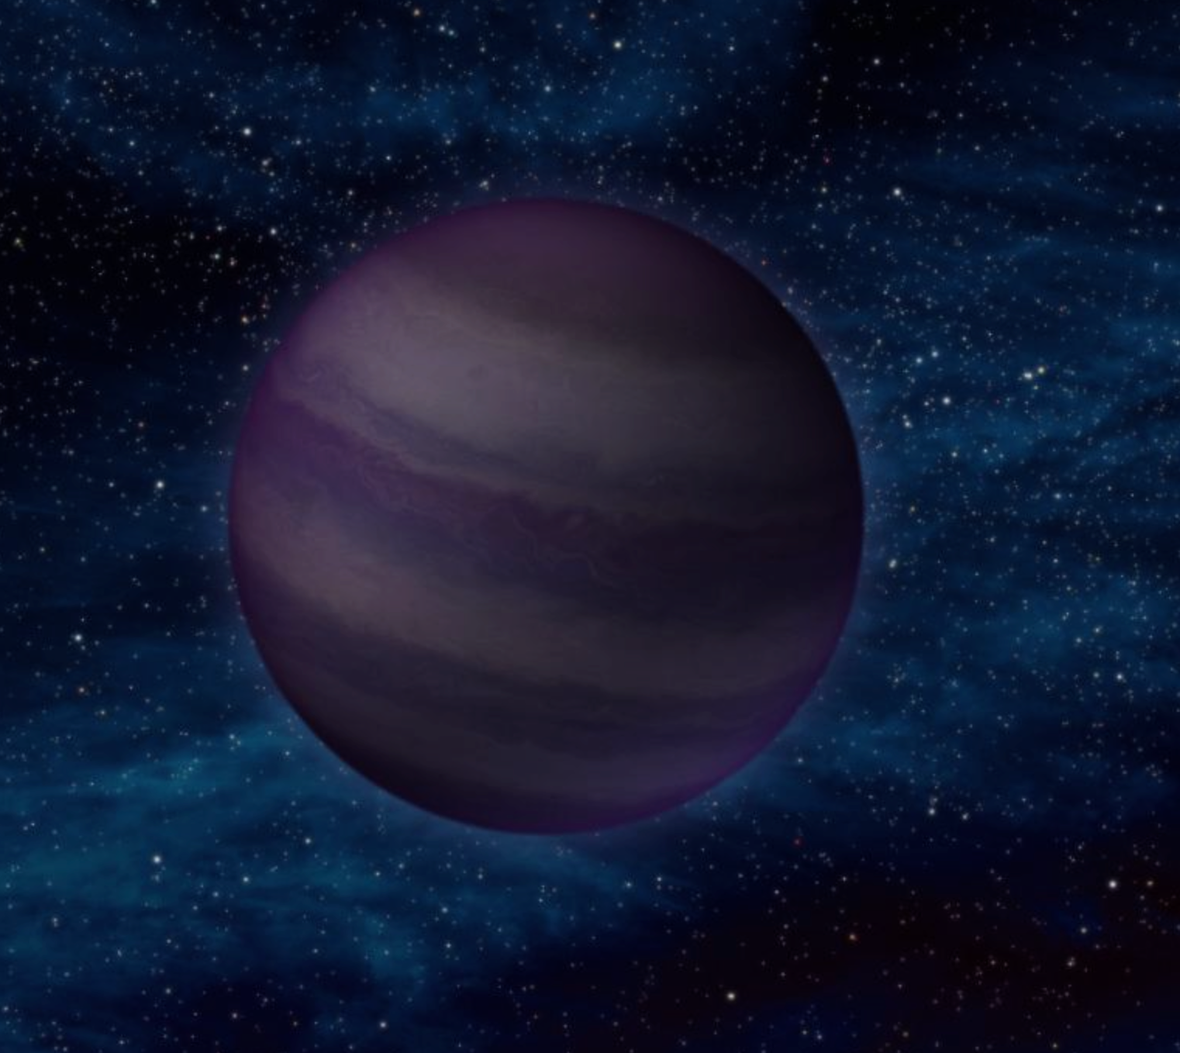
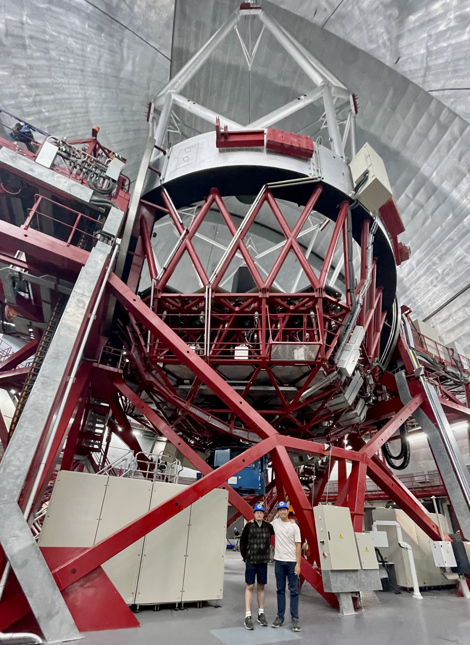
Problems
Y dwarfs are intrinsically extremely faint
We need big telescopes!
10.4-m Gran Telescopio Canarias
in La Palma island 🇮🇨 Spain 🇪🇸

Slide 8
observations
5 brightest Y dwarfs
OSIRIS optical photometry & low-resolution spectroscopy
EMIR NIR photometry & low-resolution spectroscopy
HiPERCAM ugriz multi-band photometry

Slide 9
Optical photometry
1h exposure
1.3 1.1 0.9 0.75 0.65 0.55 0.4 μm
NOTE: Pluto magnitude 14 mag, 100 times / 5 mag

Slide 10
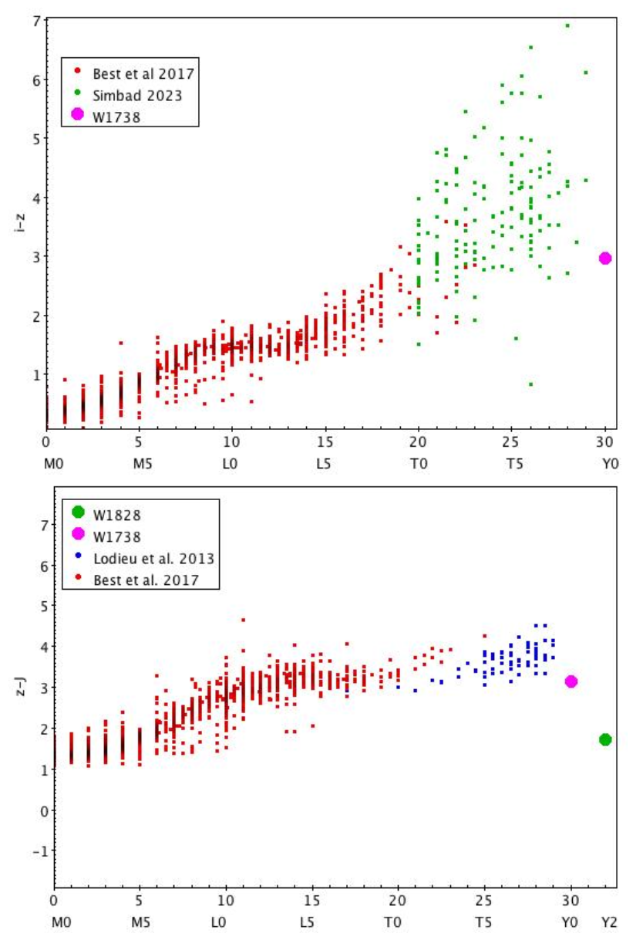
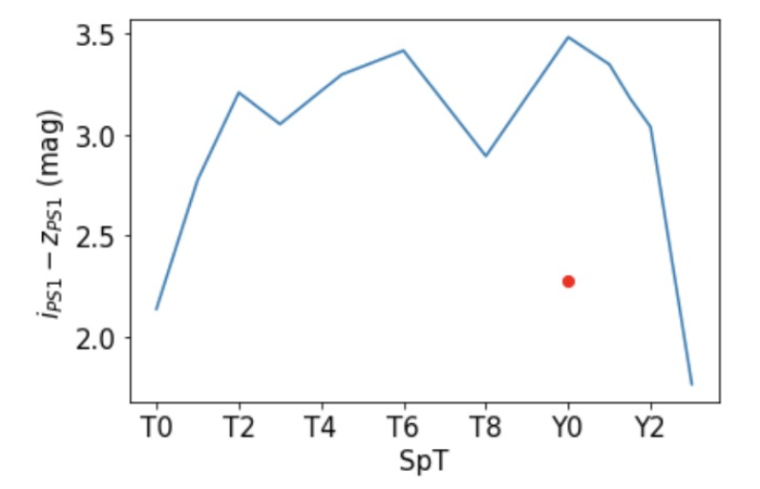
Bluer?
Condensation of alkali
Weaker Na I and K I absorption

Slide 11
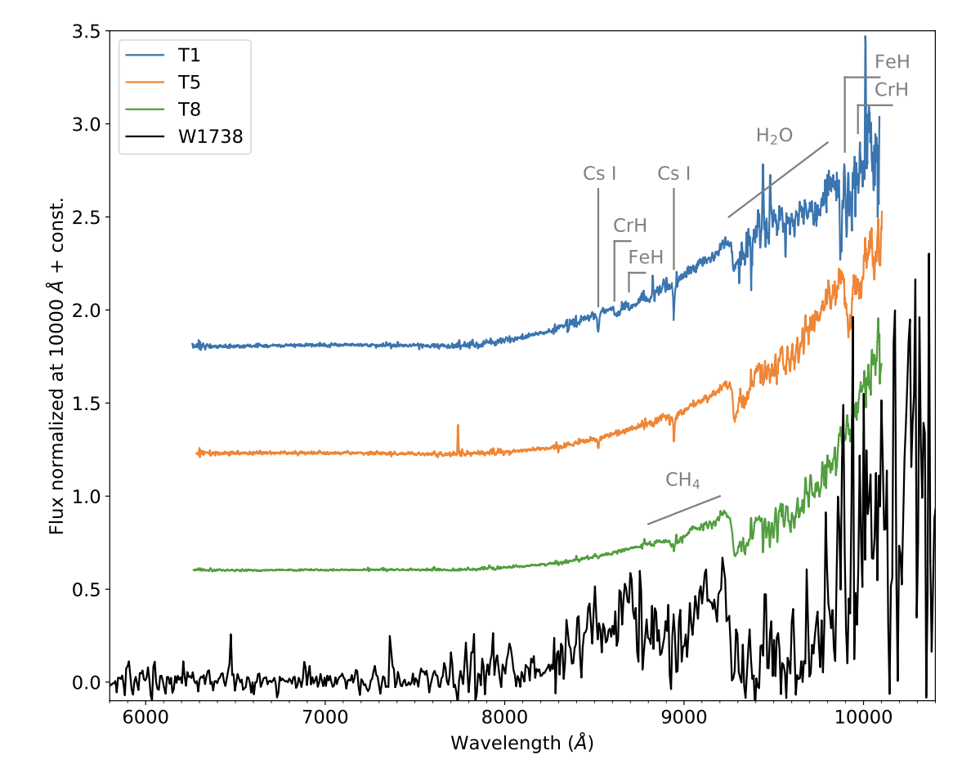
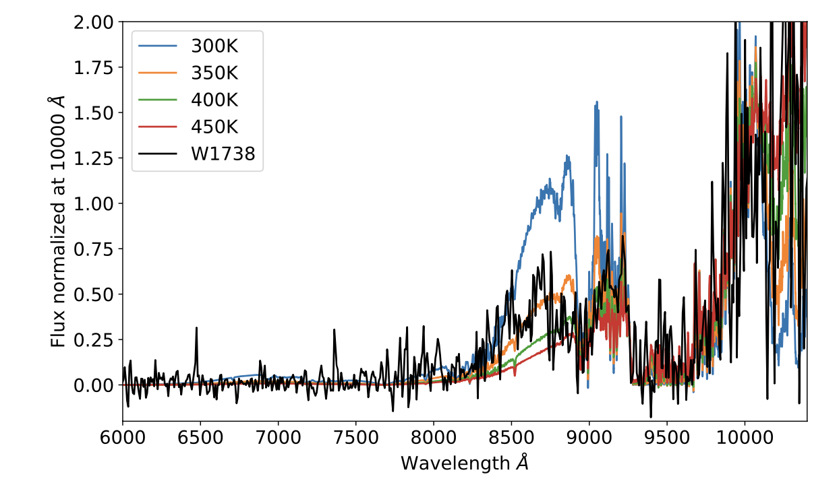
Optical spectroscopy
WISE J1738+2732, Y0 standard (Cushing et al. 2011)
Strong water
350K

Slide 12
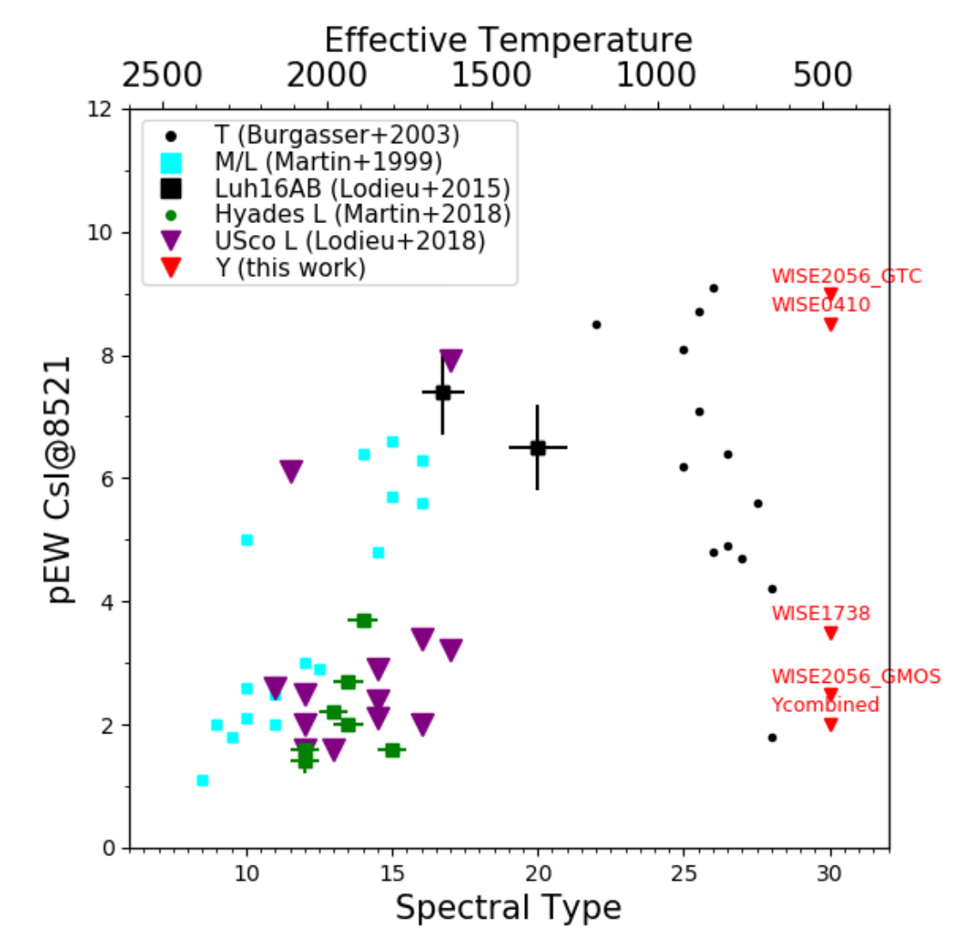
Optical spectroscopy
Cs Equivalent Width upper limits
Alkali metals depositing in dust grains

Slide 13
variability
No significe

Slide 14
Bioluminescence strength
For the brightest WISE1738, g-z > 3.6
< 0.01% of its surface is covered by biolumiscent biota emitting at wavelengths around 500 nm
Earth ?

Slide 15
Conclusion
No evidence for the presence of non-thermal optical emission
Future
ELT, TMT, GMT
JWST

