Slide 1





Substellar Science in the Wake of
the ESA EUCLID Space Program
Eduardo L Martín & Jerry Jun-Yan Zhang
30th anniversary Rencontres du Vietnam
WINDOWS ON THE UNIVERSE
11 August 2023

Slide 2
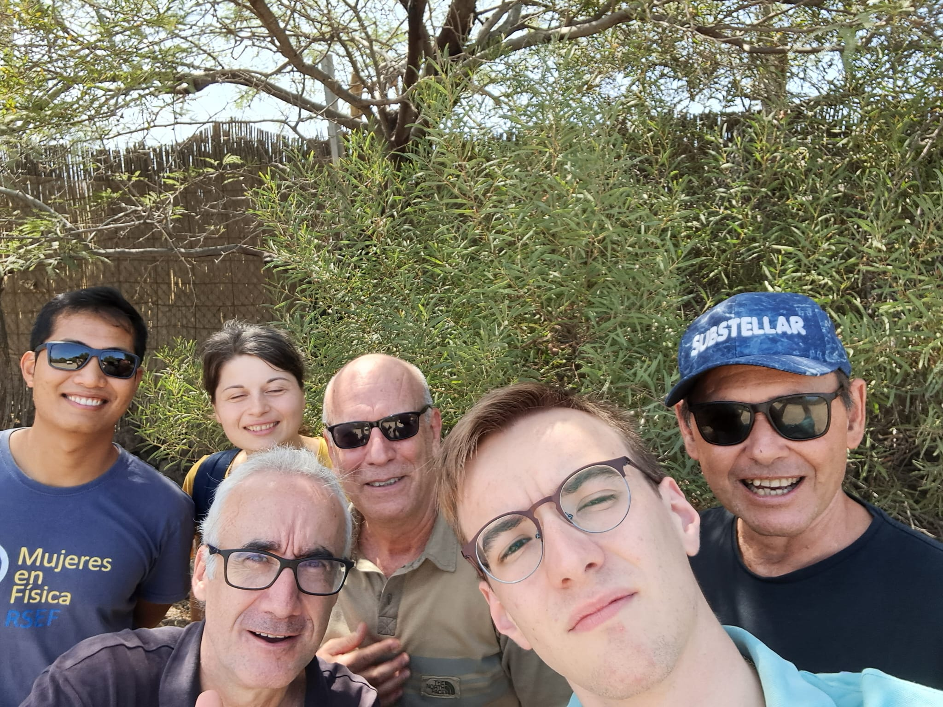
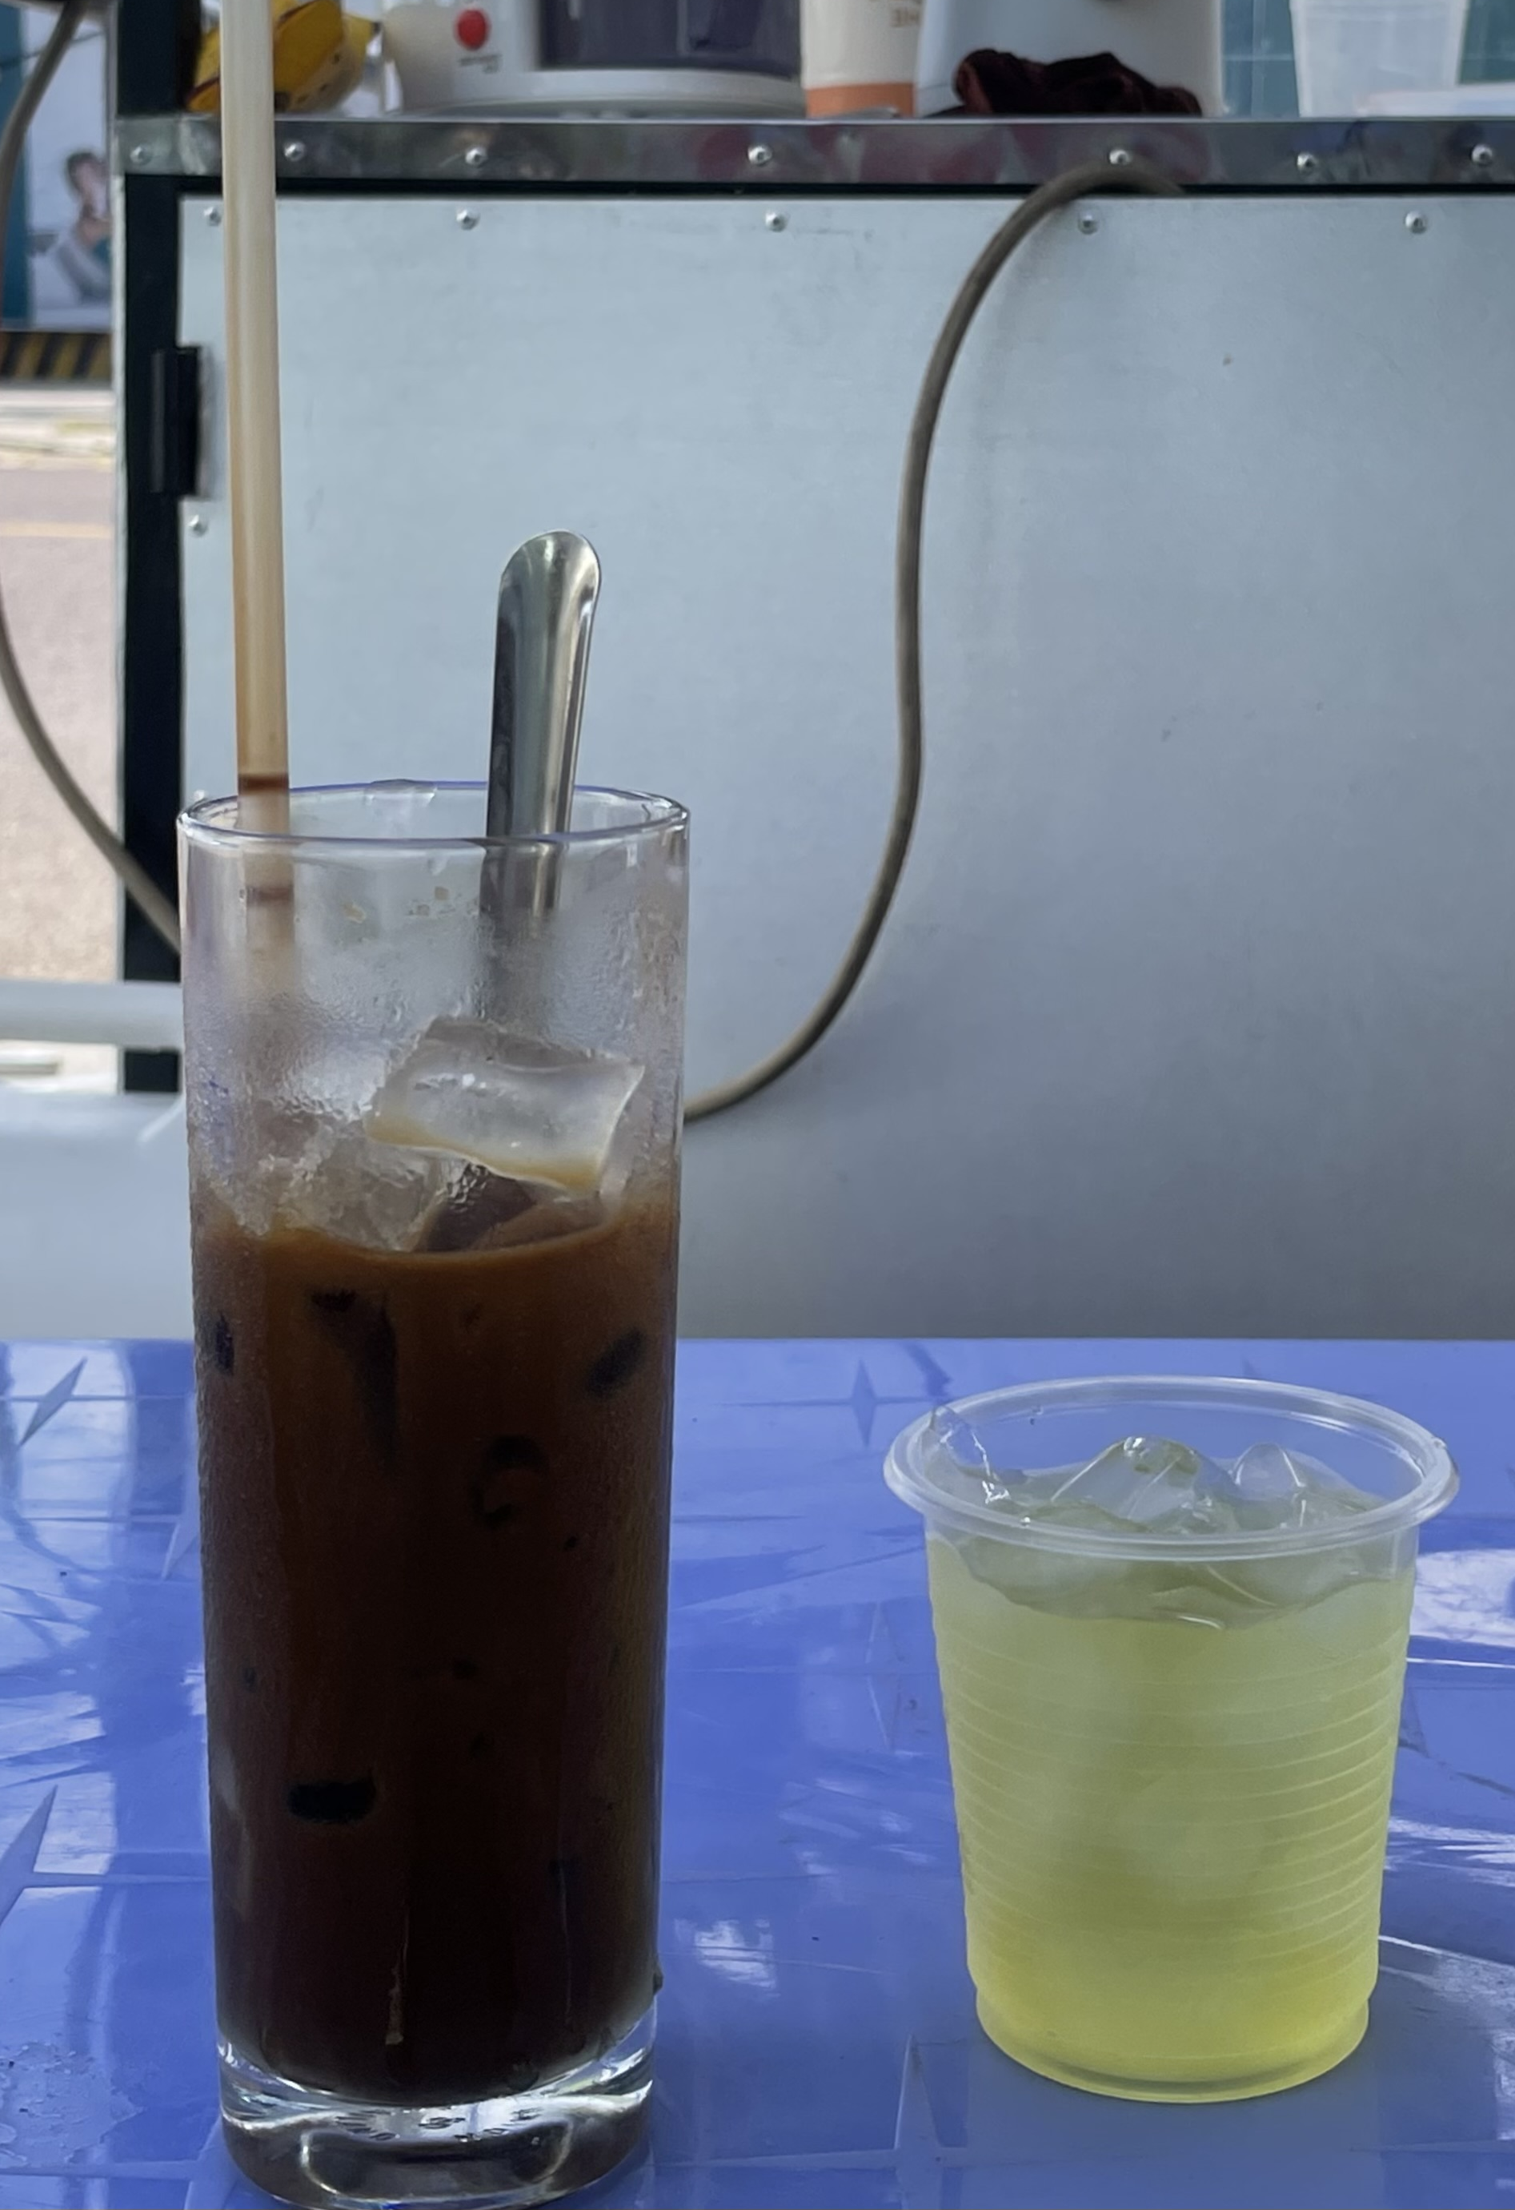
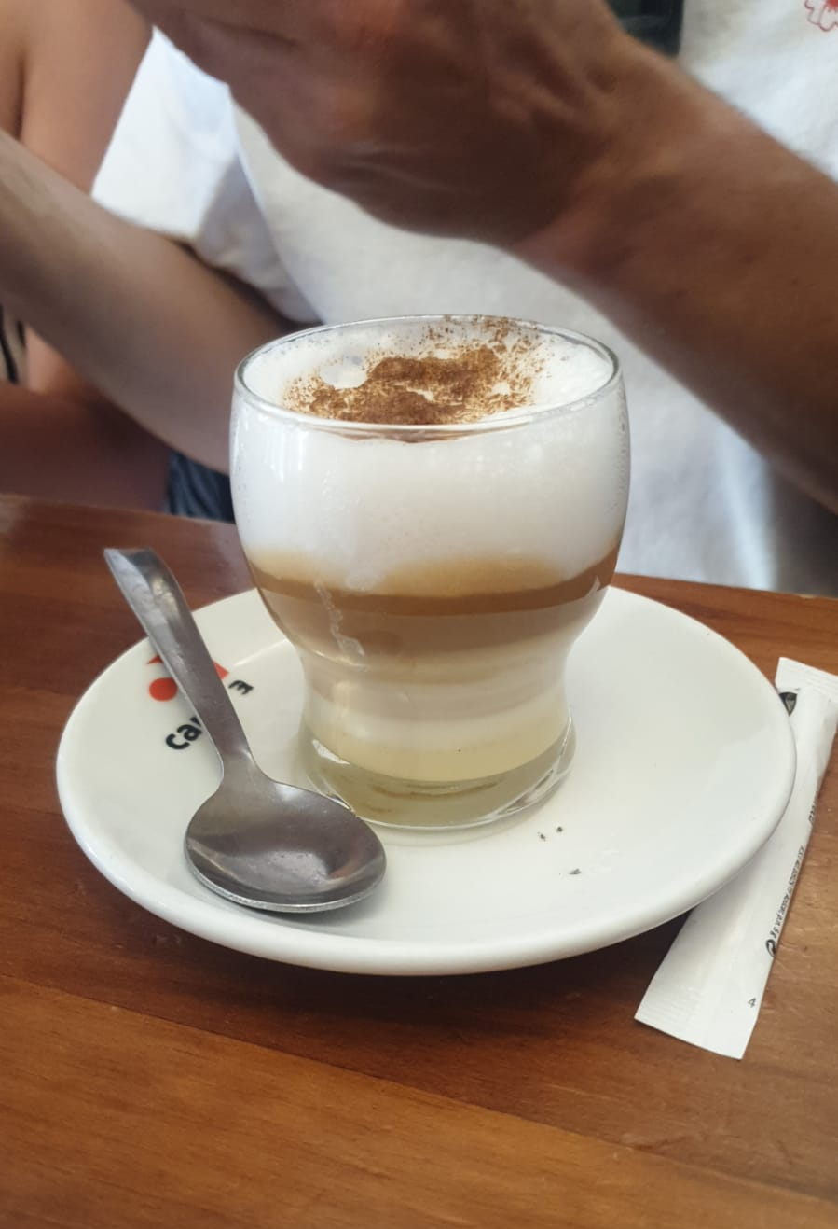
ERC team
Marusa Zerjal (advanced postdoc)
Alberto Escobar Rodríguez (project manager)
Jerry Zhang (IAC resident PhD student)
Diego Martín (IAC summer student)
Three PhD students (fall 2023)
Three postdocs (2023-24)
Eduardo Martín (PI)
Collaborators: IAC BD group & Euclid ILS team
🇻🇳 cà phê đá
🇮🇨 barraquito

Slide 3
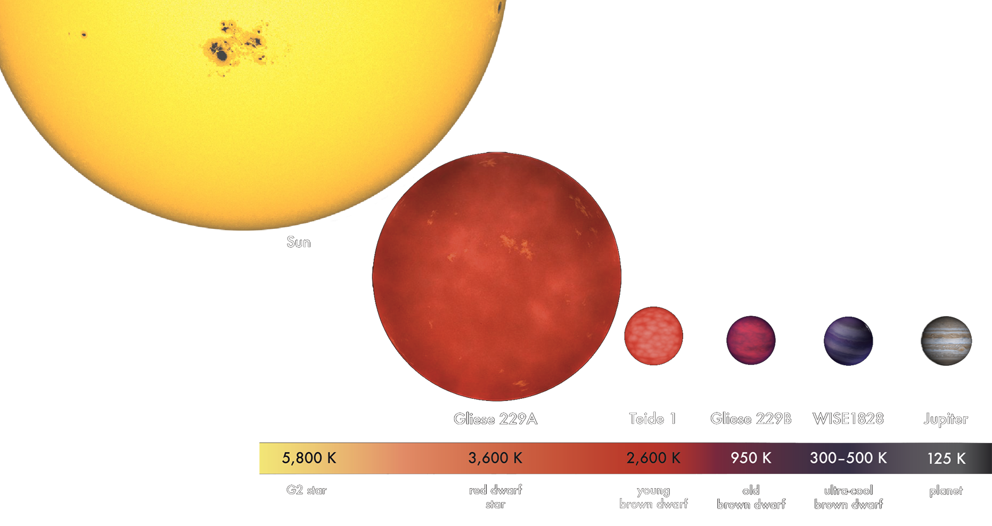

Substellar science
OBAFGKMLTY
Ultracool Infrared
Small Faint
M8
T5
Y0
STELLAR DOMAIN
H-fusion
SUBSTELLAR DOMAIN
NO H-fusion
Brown dwarf
Planetary mass objects

Slide 4
Our interests
Substellar Evolution
Ultracool Atmospheres
History of the Milky Way Galaxy
Low-mass tail of the Initial Mass Function
Cosmological Li Problem
…

Slide 5
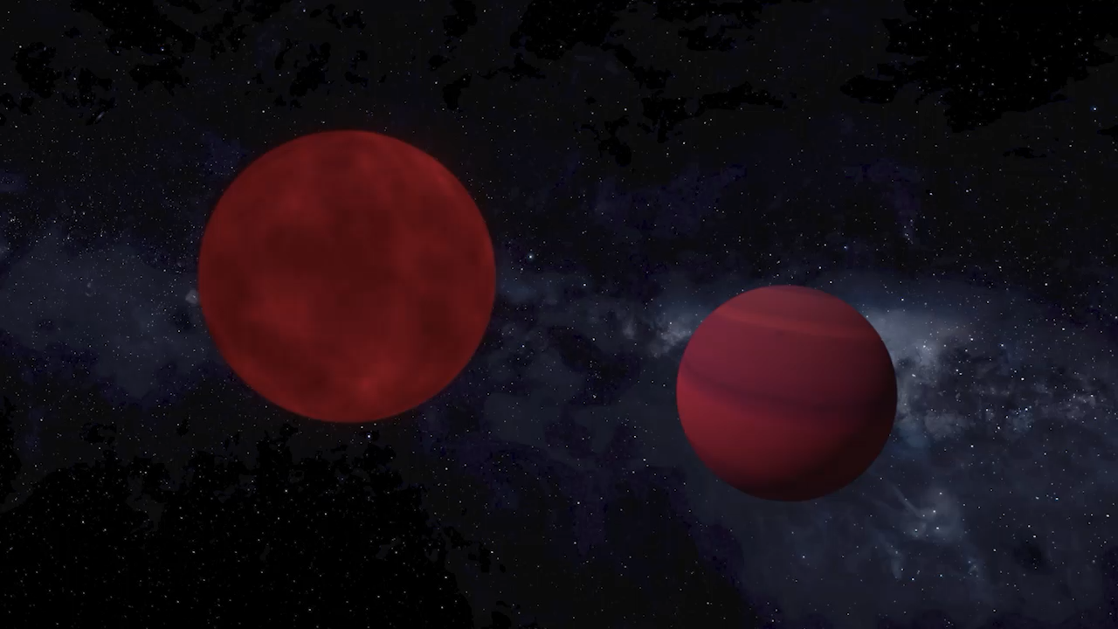
Dynamical masses of substellar objects
Martín, Lodieu & del Burgo 2022 MNRAS, 510, 2841-2850

Slide 6
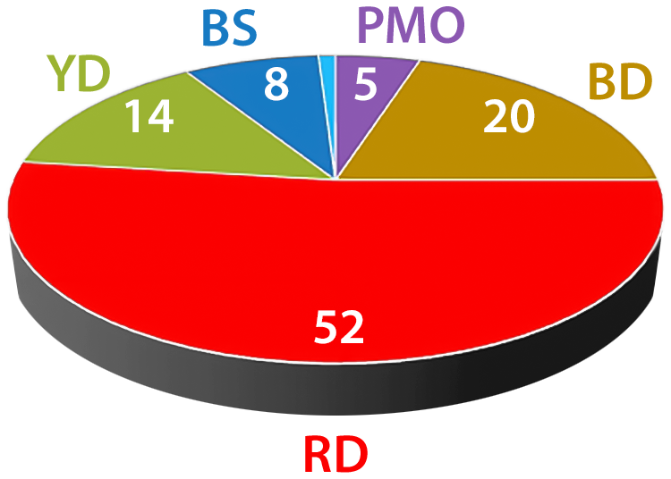
SOLAR VICINITY CENSUS
substellar objects
1994: 0 %
2022: 25 %
$<$ 100 pc: Red Dwarfs 52%, Brown Dwarfs 20%, Planetary Mass Objects 5%,
Yellow dwarfs 14%, Blue Stars 8%, Evolved Stars 1%

Slide 7
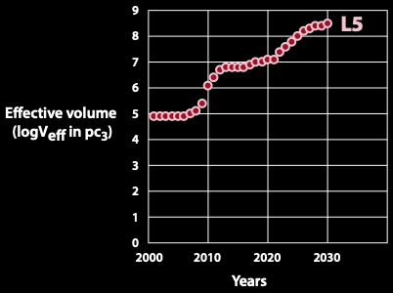
The SUBSTELLAR REVOLUTION

Slide 8
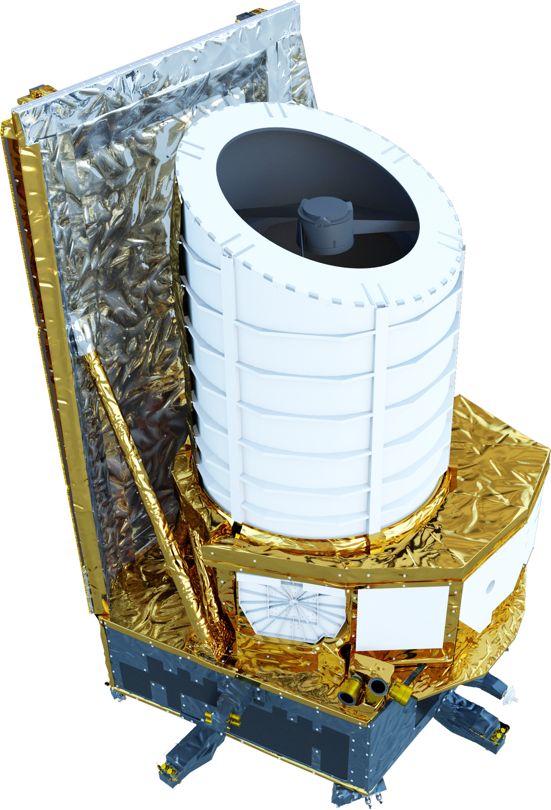
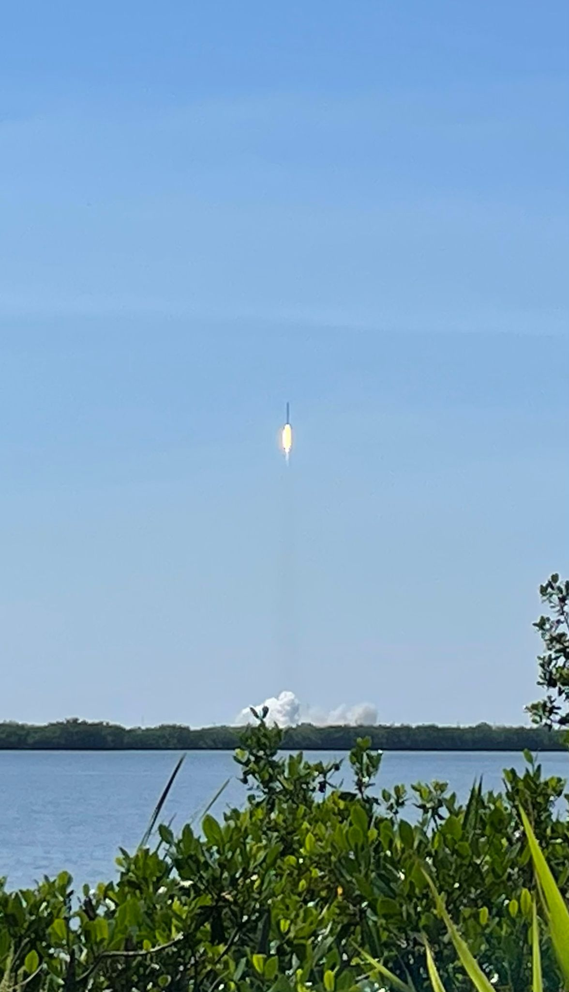
Euclid has arrived to L2
LAUNCHED
July 1ST 2023
6 year nominal survey
EUCLID
15000 deg²
Wide-field 10 deg² / day
1.2-m primary mirror
Diffraction limited
Optical
Imager 0.55 - 0.9 μm band
Near-Infrared
Slitless Spectrograph 1.25 - 1.85 μm
Photometric Imager Y, J, H bands
1.1 1.3 1.5 μm

Slide 9
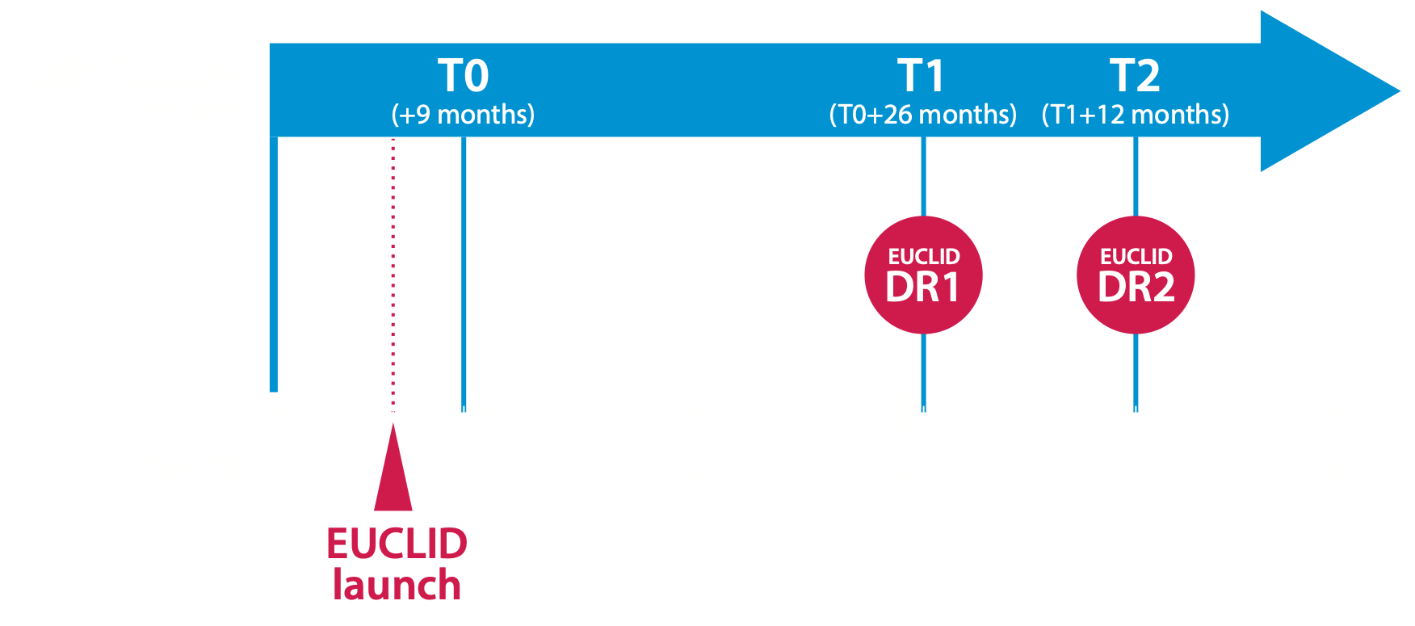
ESA Euclid SPACE MISSION SCHEDULE

Slide 10
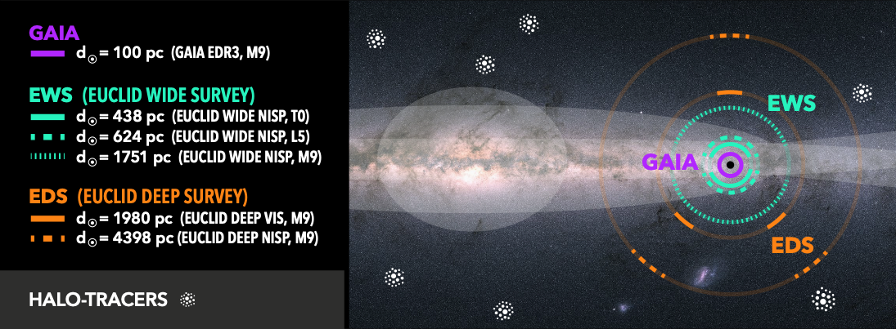
The Euclid advantage
Reach deeper, further & wider than ever before
M
L

Slide 11

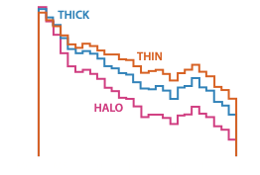
Leveraging EUCLID to identify substellar objects
NISP J imaging: optimal sensitivity
Output: $>$ 5 x 10⁵ substellar objects (1 of each 20,000 sources)
E. Solano et al. 2021 MNRAS 501, 281

Slide 12
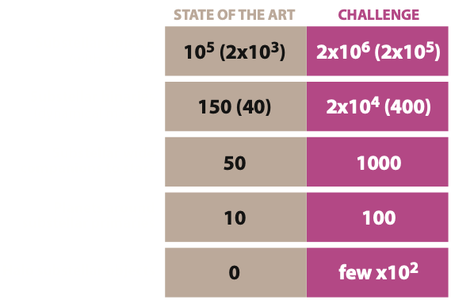
STATE OF THE ART / CHALLENGE
Euclid => Large Telescope follow-up

Slide 13
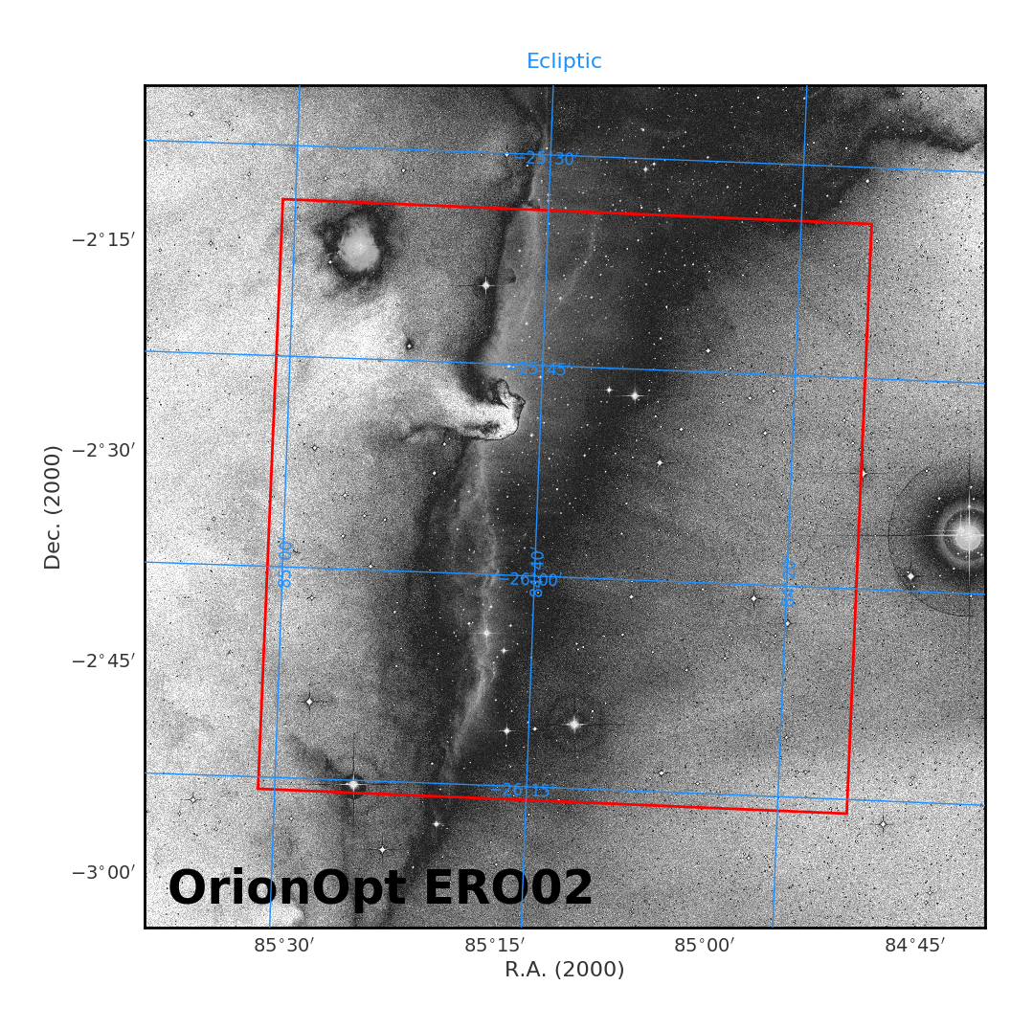
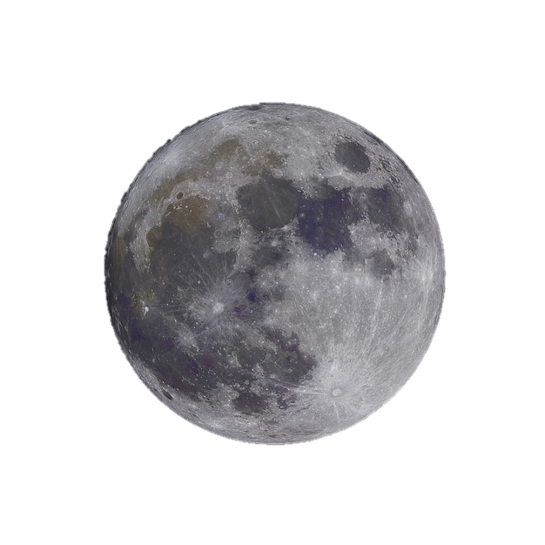
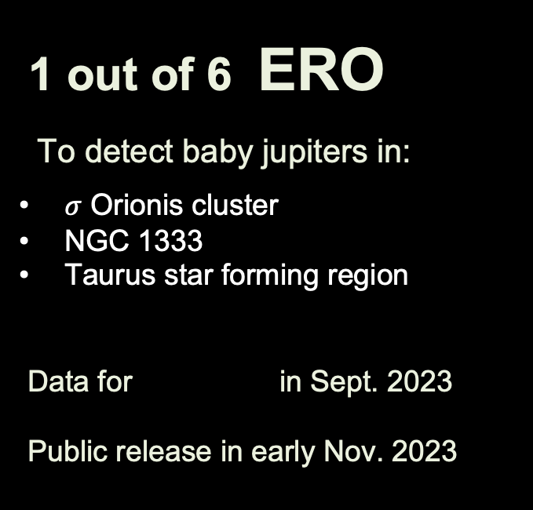
1 out of 6 ERO
To detect baby jupiters in:
$σ$ Orionis cluster
NGC 1333
Taurus star forming region
Data for in Sept. 2023
Public release in early Nov. 2023
JWST NIRCAM

Slide 14
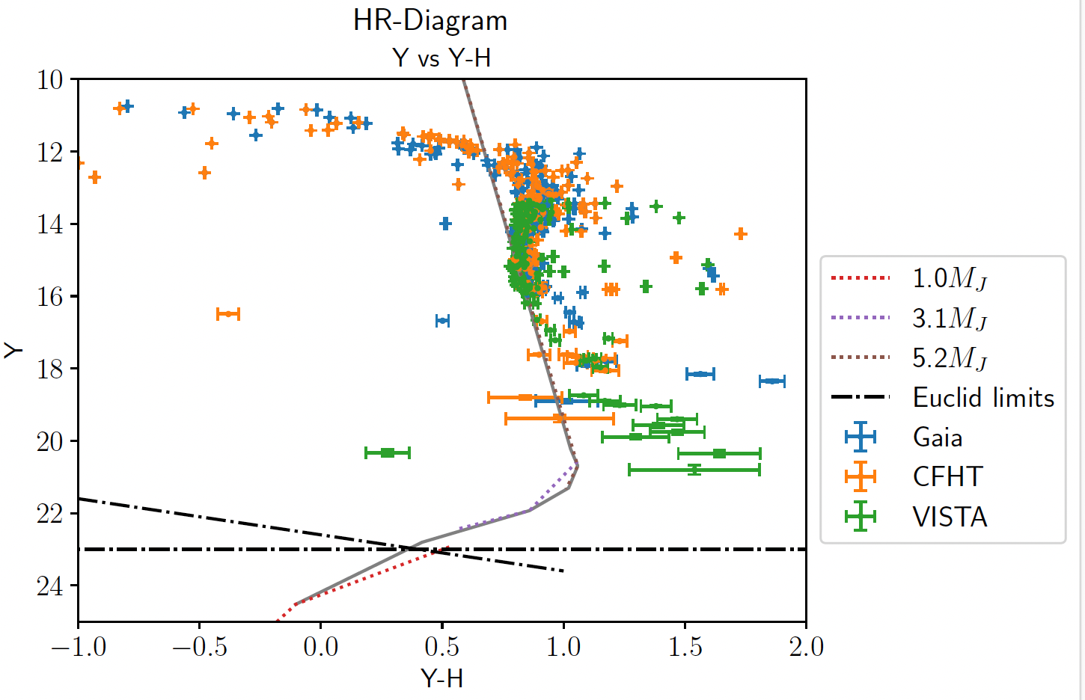


$σ$ Orionis
Cluster
$3 Myr$

Slide 15

Taurus
Star
Forming
Region
$1 Myr$

Slide 16
3 EUCLID DEEP FIELDS
North 20 deg² × 40 visits
Fornax 10 deg² × 52 visits
South 23 deg² × 45 visits
~ 1 month / visit
2 mag deeper coadded (2.5 × distance or 15 x effective volume)
Proper motion search, > 50 mili-arcsec / yr (with only 3 epochs)
Reconnaissance spectroscopic templates of ultracool dwarfs in 3 deep fields, obtained by 🇮🇨 10.4-m Gran Telescopio Canarias
& 2023B proposal on 🇨🇱 8.4-m Very Large Telescope approved.

Slide 17
Connecting substellar with galactic, stellar & exoplanet science
(bridging and extending the IMF across wide range in mass)
IMPACT
Transforming substellar science
(➔ order of magnitude leap in detections & spectra)
Creating new standards
(➔ order of magnitude leap in substellar binaries & new types of objects)

