Slide 1
Hadronisation in dense
(and not-so-dense) environments
Jan Fiete Grosse-Oetringhaus (CERN)
Windows of the Universe
10.08.2023
Notes:
20’

Slide 2

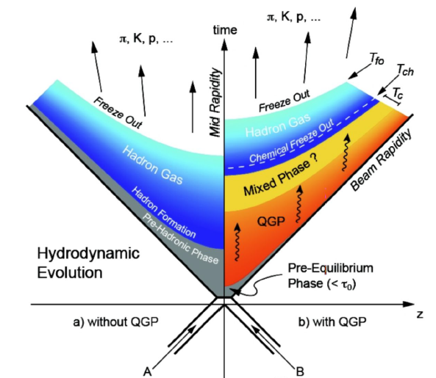

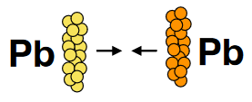

Hadronization
h
h
q
h
h
q
h
Hadronization is a non-perturbative process
  No first-principle description
  Λ_{QCD}… but when does it begin exactly?
  Understanding is very important, as a fundamental element of QCD
    Affects all observables which measure hadrons
    Needed for background estimates, including in searches
  Experiment guides the way hand-in-hand
  with theory-inspired phenomenological models
What is different in a denser environment (pp, pPb, PbPb)?
What can we learn from comparing systems about hadronization?
q
h
h
q
h
h
h
q
h
q
h
h
e
e
Cartoons: Boris Hippolyte, Katarina Gajdosova
Notes:
Scope of hadronization somewhat subjective. E.g. perturbative to non-perturbative transition, Q2 at which this happens, …

Slide 3
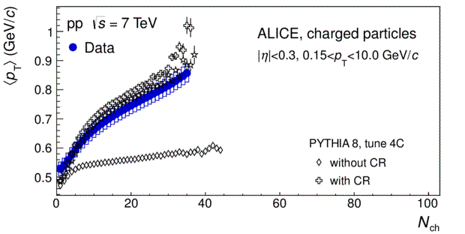

Independent Fragmentation
Factorized description of hadron production
  Parton distribution functions, partonic cross-section
  Fragmentation functions encoding non-perturbative part
    Transition from perturbative shower evolution to non-perturbative hadronization
    model depends on event generator or model, tunable
Multiple interactions within the same collision combined incoherently
  Picture does not hold in pp collisions when multiplicity increases
  Addition of e.g. colour reconnection (Pythia) needed
<p_{T}> vs. multiplicity
Colour reconnection!
PLB 727 (2013) 371
Illustration: J.R.Christiansen
Notes:
TODO: F. Prino for equation
TODO: check transition Pythia, Herwig, EPOS

Slide 4
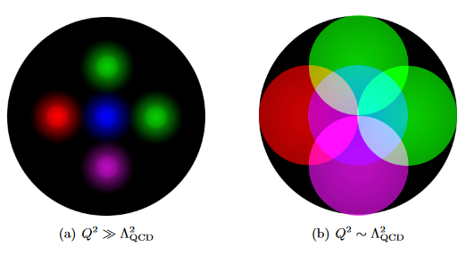
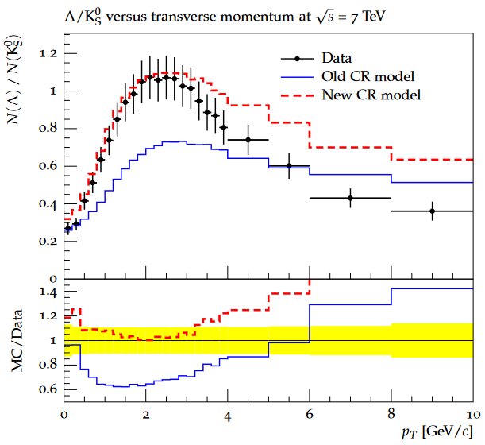
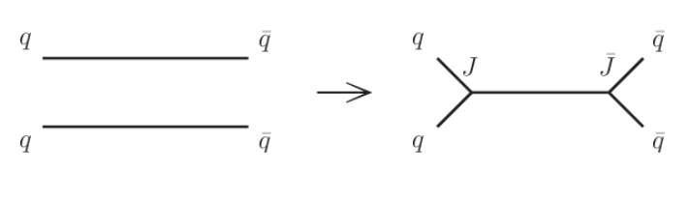
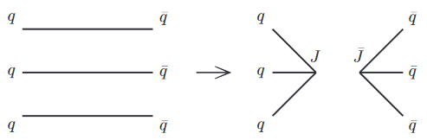
Colour Reconnection
Baryon production (e.g. Λ) not described by basic CR
Reconnections beyond leading colour needed
  Introduction of more complex topologies like junctions
  Introduces ambiguities which strings can resolve each other (and hence reconnect), new tuning parameter
Λ/K⁰ vs. p_{T}
Data
Basic CR
New CR
Christiansen, Skands, JHEP 08 (2015) 003
Independent fragmentation picture violated in pp collisions at low Q² where there are several color sources
JHEP 08(2015)003
and others…
Notes:
https://arxiv.org/pdf/1505.01681.pdf

Slide 5
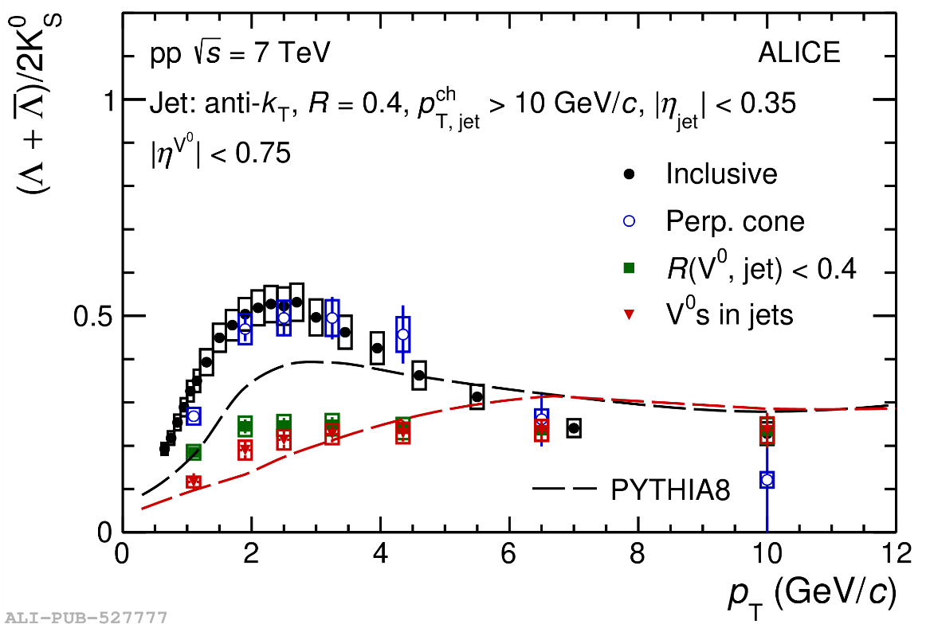
Λ/K⁰: jets vs. bulk
The Λ/K⁰ ratio can also be studied in jets
  Here charged jets with p_{T} > 10 GeV/c
Baryon enhancement not visible for jet constituents
  Fragmentation remains independent of other activity in the event
Observation valid for pp, p-Pb and Pb-Pb
Λ/K⁰ vs. p_{T}
inclusive
PLB 827(2022)136984
within jet
Fragmentation within jets unaltered (e⁺e⁻ like).
Independent and “higher-order” fragmentation present in same collision

Slide 6
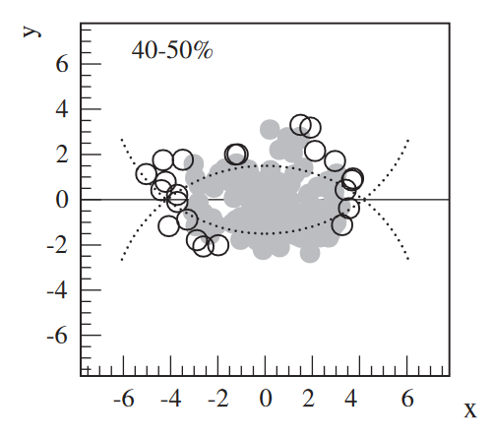
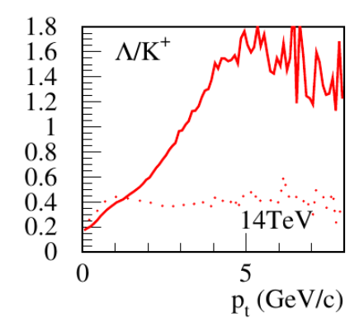
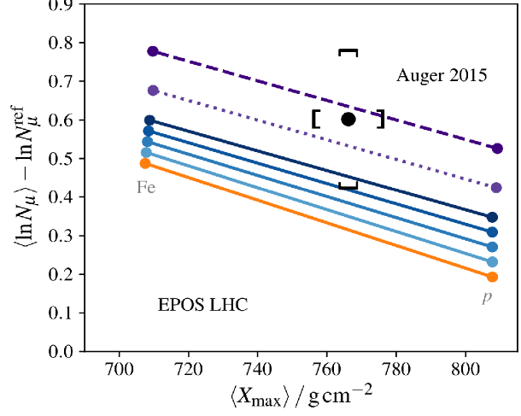
Core-Corona Models
Impact parameter plane
Independent and “higher-order” fragmentation present in same collision
Reflected in core-corona models, e.g., EPOS
  Each fragmentation universal but fraction density dependent
Mechanism also applied to cosmic-ray physics
  Muon excess in CR showers compared to models (“muon puzzle”)
Werner, PRL 98, 152301 (2007)
Core
Corona
#μ vs. shower maximum
Increase of core fraction
QGP formation and hadronization in cosmic-ray shower?
Λ/K vs. p_{T}

Slide 7
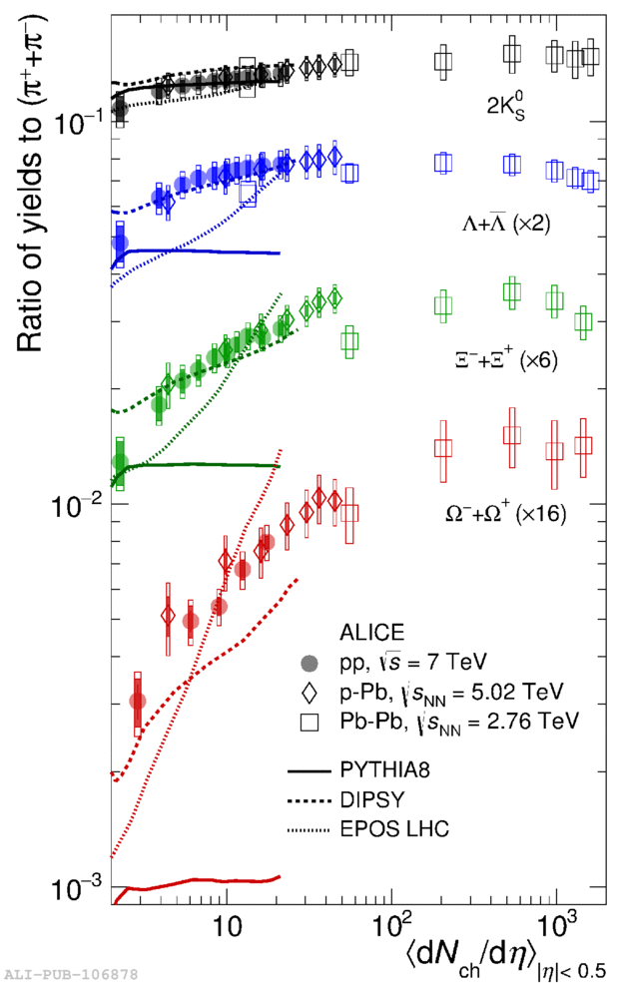

Strangeness Enhancement
Strange/π vs. dN_{ch}/dη
(Strange = K, Λ, Ξ, Ω)
Hadronization for strange particles density-dependent
Strange particle production increases with multiplicity
  K/π, Λ/π, Ξ/π, Ω/π
  from pp, over p-Pb, to Pb-Pb
❌ Independent fragmentation
✅ EPOS (core-corona)
✅ Colour rope mechanism
(DIPSY)
Nature Phys. 13 (2017) 535
Pb-Pb
p-Pb
pp

Slide 8
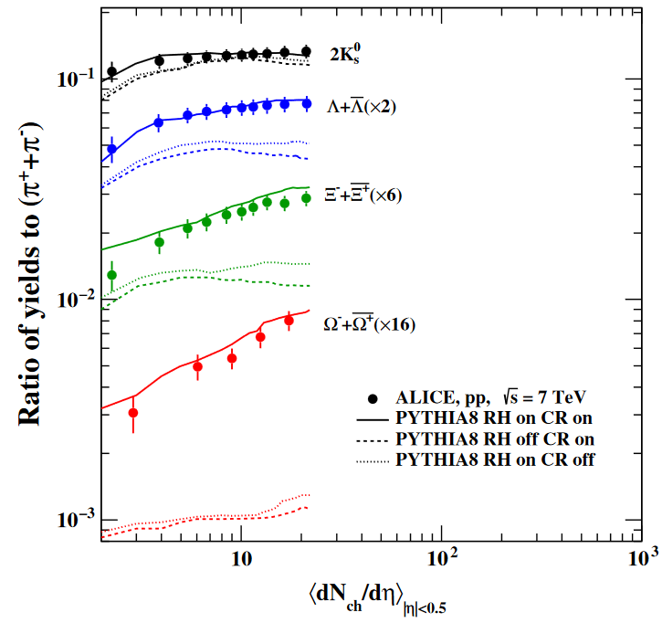
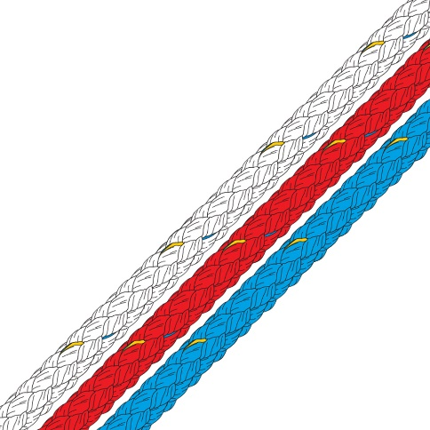

Coulour Ropes
Strange/π vs. dN_{ch}/dη
(Strange = K, Λ, Ξ, Ω)
Strings close in phase space hadronize together
  Outwards pressure gradient
  → momentum perpendicular to the strings
K Λ Ξ Ω
Nayak, Pal, Dash, Phys. Rev. D 100, 074023
AI queried for
“colour rope hadronization”
❌ Colour reconnection
❌ Rope hadronization
✅ Both
Both colour reconnection and ropes are needed

Slide 9
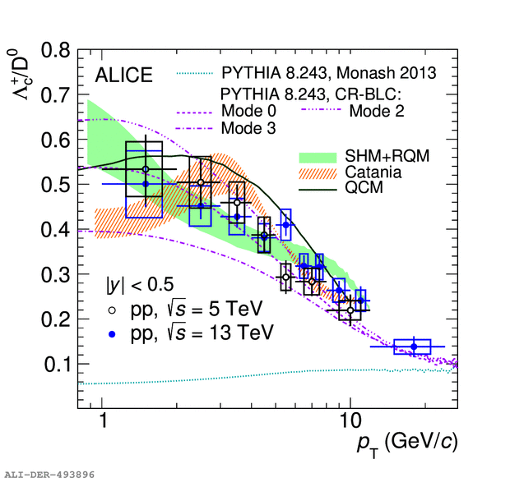
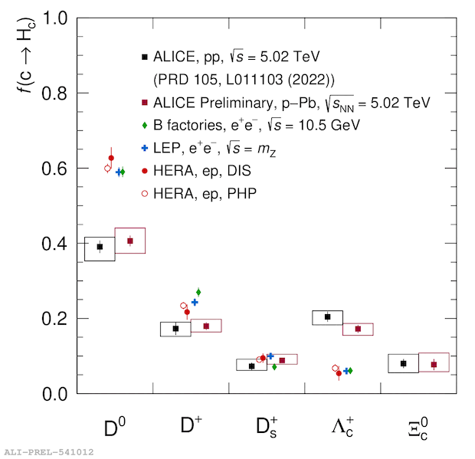
Charm Sector
Λ_{c}/D⁰ vs. p_{T}
Charm and beauty produced in hard scattering, rarely in string fragmentation
  Initial production calculable perturbatively
  In HI: undergo the entire medium evolution
Baryon enhancement also in charm sector
  Λ_{c}/D significantly larger than e⁺e⁻ expectation
Pythia with reconnections beyond leading colour works well
Significant effect on fragmentation fractions
  Less D⁰ in pp than in e⁺e⁻ and ep
  More Λ_{c} in pp than e⁺e⁻ and ep
PRL128 (2022) 012001
e⁺e⁻ expectation
(including LO CR)
Chong KIM – Wednesday 12:10
Notes:
flavour is conserved
“even more striking”, e+e- here already includes LO CR

Slide 10
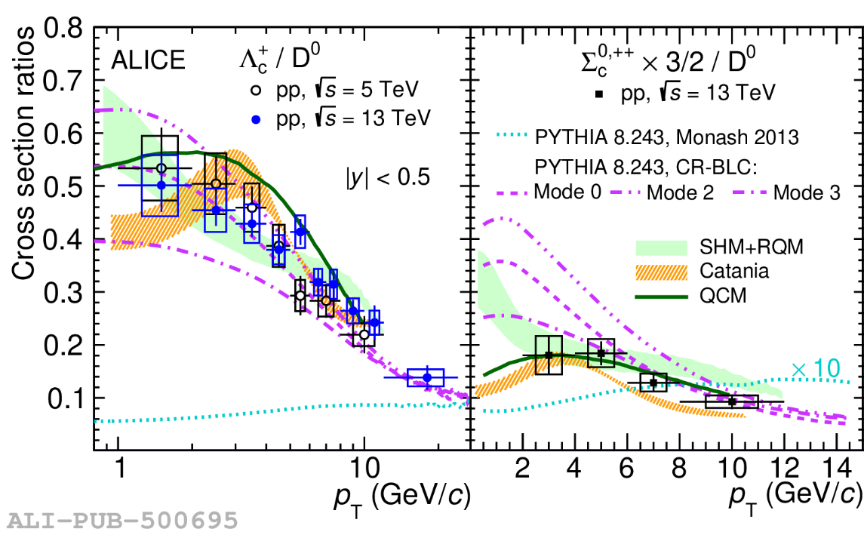
Charm Sector (2)
Baryon enhancement also in charm sector
  Λ_{c}/D and Σ_{c}/D⁰ significantly larger than e⁺e⁻ expectation
Pythia with colour reconnection works well for Λ_{c}/D but not for Σ_{c}/D⁰
Quark coalescence model reproduces both
Λ_{c}/D⁰ vs. p_{T}
PRL128 (2022) 012001

Slide 11
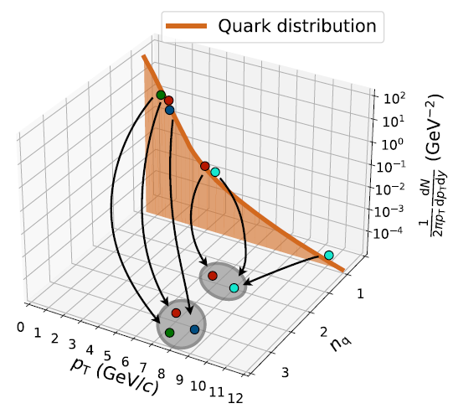
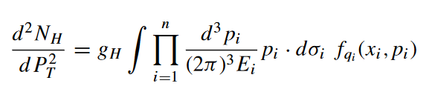
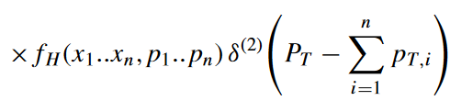
Quark Coalescence
(sometimes referred to as quark recombination)
Sufficiently filled phase space
  Quarks: effective degrees of freedom
  Gluons: dynamic degrees of freedom (→ qqbar)
Partons close in momentum and position space can coalesce to hadrons
  Probability is p_{T} dependent
Cartoon: F. Grosa
hadron
spectrum
quark distribution
in phase space
Wigner function
quark within hadron
Minissale, Scardina, Greco, Phys. Rev. C 92 054904
11
Notes:
gH: stat. factor to form colorless hadron
dsigma_i: spacelike hypersurface

Slide 12
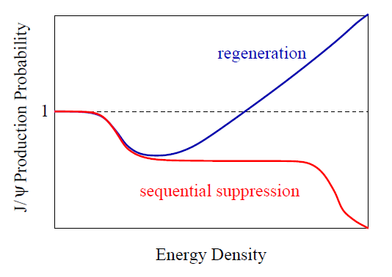

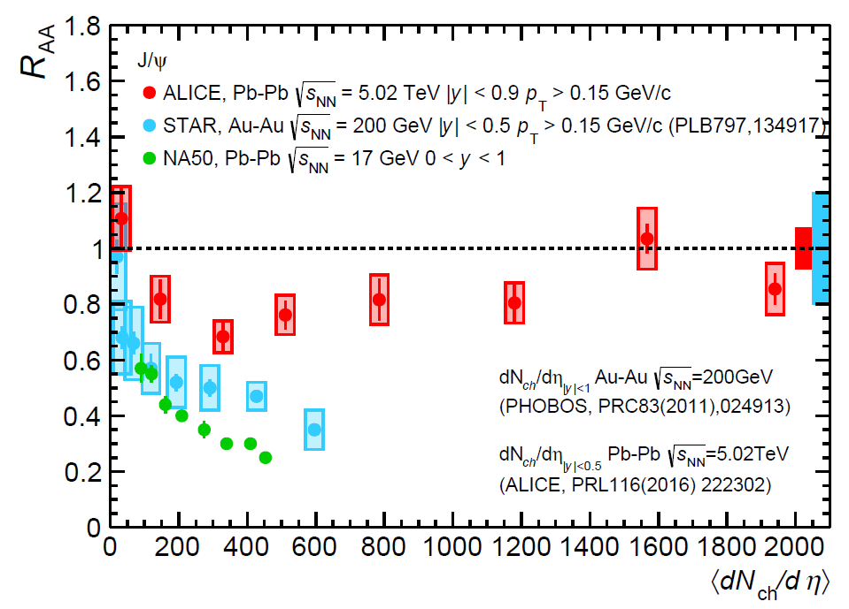
Coalescence at work: J/ψ
J/ψ modification vs. energy density
H. Satz
J/ψ production in heavy-ion collision modified due to deconfined medium (“charmonia melting”)
  Depends on local energy density
Effect countered by coalescence of melted c
c from one c-cbar may combine with cbar from another c-cbar at hadronization to form a J/ψ
In a central event
  SPS √s_{NN} = 17 GeV ~0.1 c-cbar
  RHIC √s_{NN} = 200 GeV ~10 c-cbar
  LHC √s_{NN} = 5020 GeV ~100 c-cbar
R_{AA} vs. multiplicity
R_{AA} = 1 (“pp-like”)
LHC
R_{AA} = 1 → no modification
R_{AA} != 1 → medium effects
RHIC
SPS
Dong Ho MOON – Wednesday 11:30

Slide 13
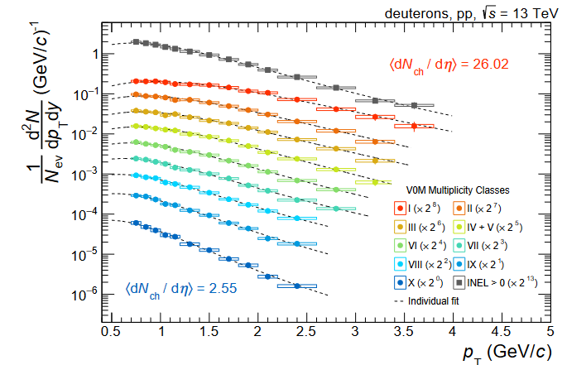
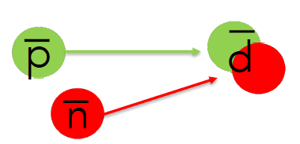
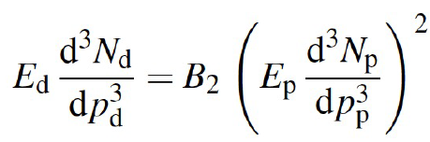
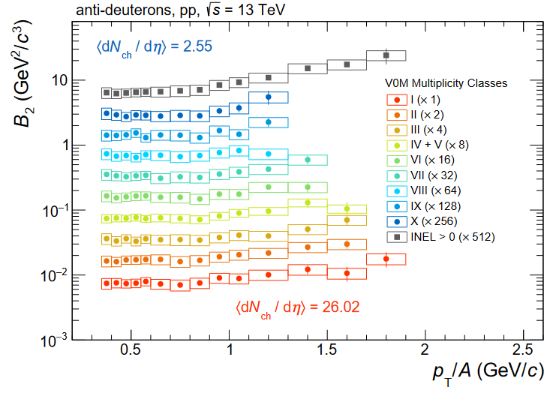
Coalescence at work: Nuclei
dN/dp_{T} vs p_{T}
Nuclei have a small binding energy and are formed late in the hadronization process
Coalesce p and n to d
Measure p_{T} distribution of p and d
  B₂ parameter flat with p_{T} → uniform description
  Magnitude depends on multiplicity → source volume
Coalescence describes d and ³He production
  ⁴He is being studied (LHC Run 3 data)
B₂ vs p_{T}
EPJC 80 (2020) 889
Coalescence concept can also be applied to “large” objects
Cartoon: A. Kalweit

Slide 14
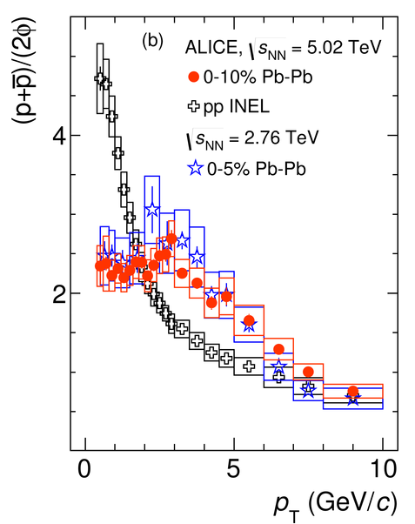

φ Meson: Coalescence vs. Fragmentation
p/φ vs. p_{T}
p(1007) and φ(1020)
  Similar mass
  Different quark content and baryon number
p/φ ratio
  Exhibits large differences pp vs. Pb-Pb
  Pb-Pb: p_{T} independent below 4 GeV
    Understood of dominance of coalescence
    Additional collective radial flow effects
pp
Pb-Pb
PLB 802 (2020) 135225
coalescence fragmentation
Notes:
Review paper, page 79

Slide 15
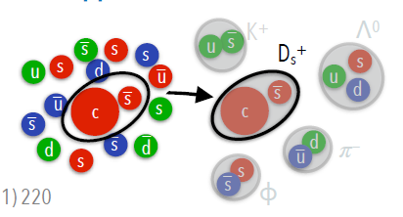
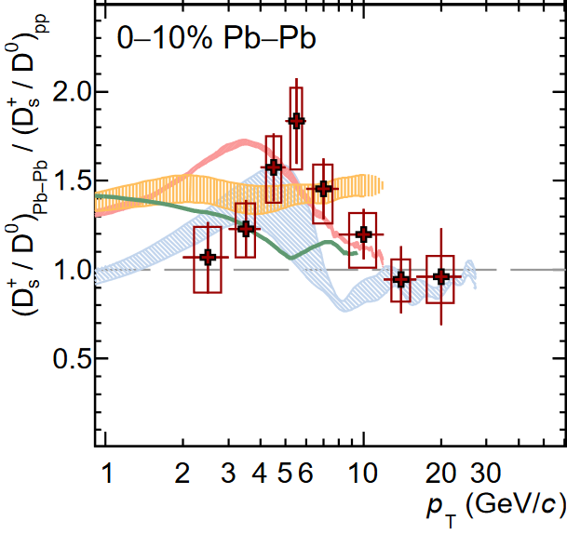
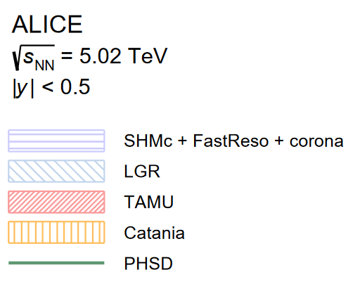
Charm and Strange
Cartoon: F. Grosa
Abundant thermal production of strange quarks in Quark-Gluon Plasma (T_{QGP} > m_{s})
  Coalescence with thermal strange quarks
  → strange hadron fraction increases
D_{s}/D⁰ ratio larger in PbPb than in pp
Roughly described by state-of-the-art coalescence models
D_{s}/D⁰ Pb-Pb over pp vs. p_{T}
Phys. Lett. B 827 (2022) 136986
Hadronization by coalescence in dense heavy-ion collisions
Notes:
TODO check with Fabrizio if 13 TeV paper is out for a new plot
TODO review Paper page 82 ff
Also influence of radial flow, in principle needs fully integrated yield

Slide 16
Statistical Hadronization Model (SHM)
Relativistic ideal quantum gas of hadrons in thermal and chemical equilibrium
  For particle i (out of π, K, p, …, all known particles)
3 free parameters: V, T, μ_{B}
  Particle ratios → V cancels
  Baryochemical potential μ_{B} fixed by pbar/p ratio
  → one remaining parameter T
Temperature
Volume
Chemical potential (conserved
quantities: baryons, strangeness, …)
E.g. Andronic, Braun-Munzinger, Stachel, Nucl. Phys. A 772 (2006) 167
Thermal origin of particle production without “history” → macroscopic description

Slide 17
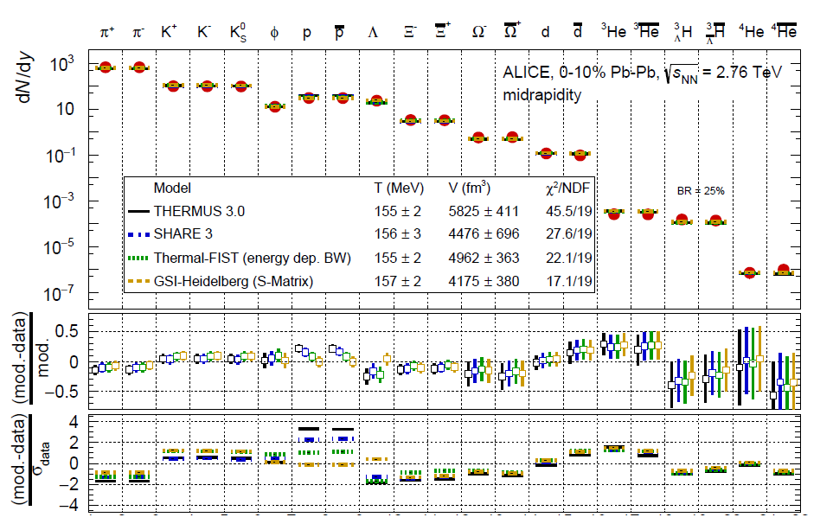
SHM at work
12 different particles
Central Pb-Pb
T = 156 ± 2 MeV
V ~ 5000 ± 500 fm³
10 orders of magnitude
Remarkable agreement
arXiv:2211.04384
Notes:
No contradiction between SHM and coalescence: one could be the microscopic implementation of the macroscopic successful model

Slide 18
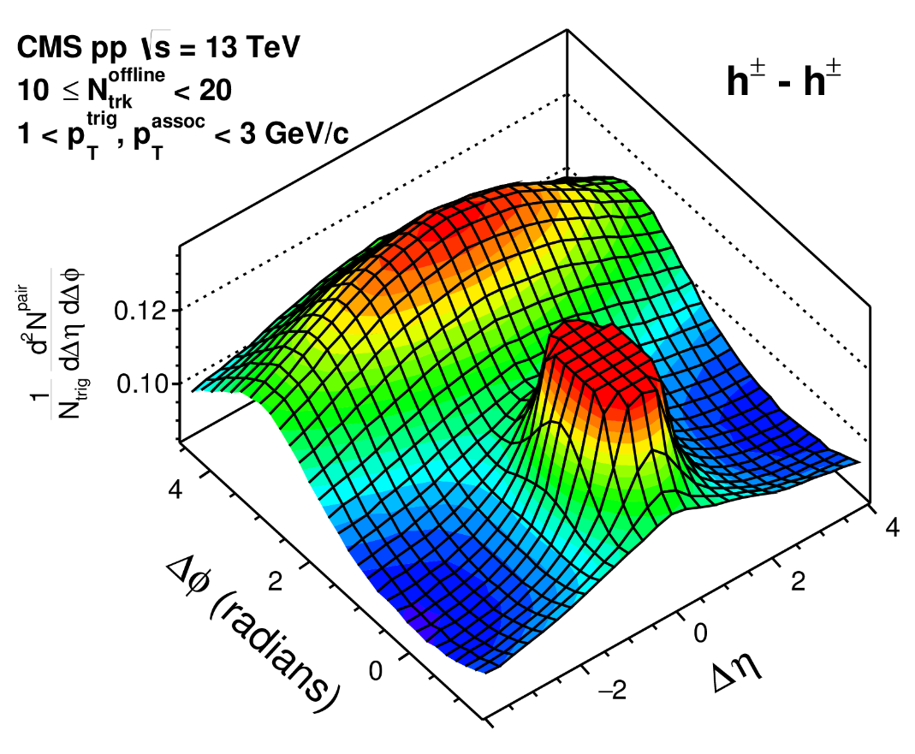
Collective Phenomena
Imprint of hadronization can involve many particles
  Studied in two-particle correlations
  “Probably density” to find second particle
Δϕ
Δη
Away-side jet
Near-side jet
Resonance decays
Δϕ (rad)
Δη
PLB 765 (2017) 193

Slide 19
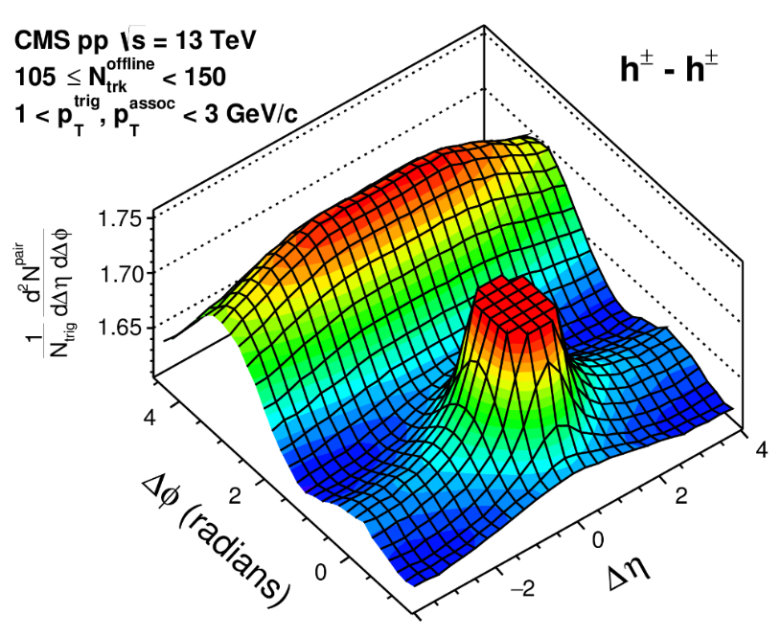
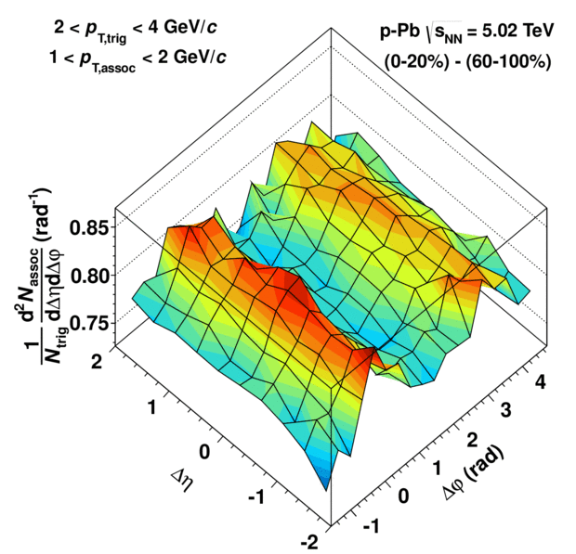

Collective Phenomena
0.0002% of MB
Imprint of hadronization can involve many particles
  Studied in two-particle correlations
  “Probably density” to find second particle
Striking observation of long-range ridge structures
Initially seen in high-multiplicity in pp and p-Pb
  Jet subtraction procedure revealed
  almost symmetric away-side component
CMS, PLB 765 (2017) 193
Δϕ (rad)
Δη
ALICE, PLB719 (2013) 29
Intriguing interpretations involving QGP in small systems
Δη
Δϕ (rad)

Slide 20
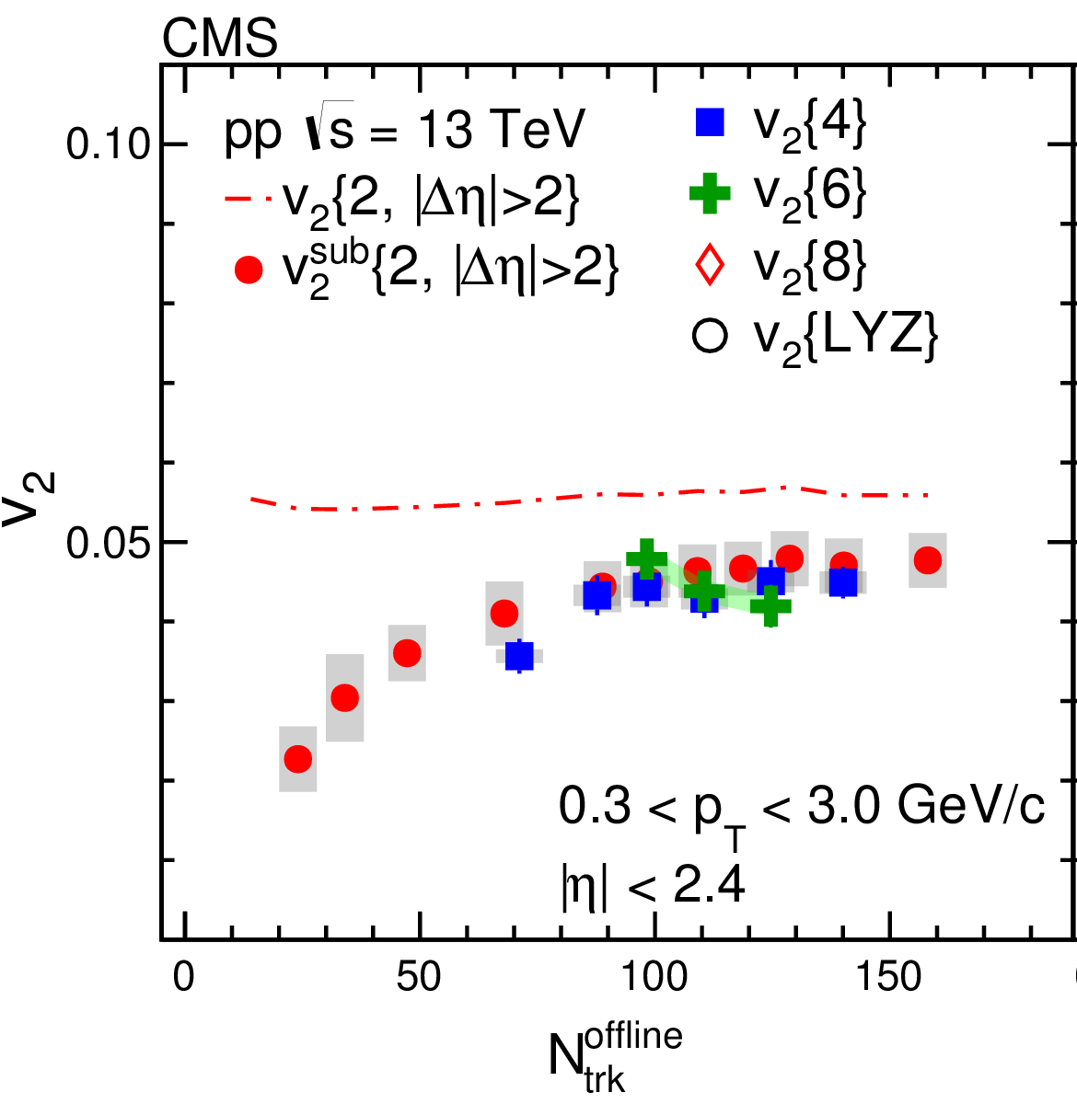
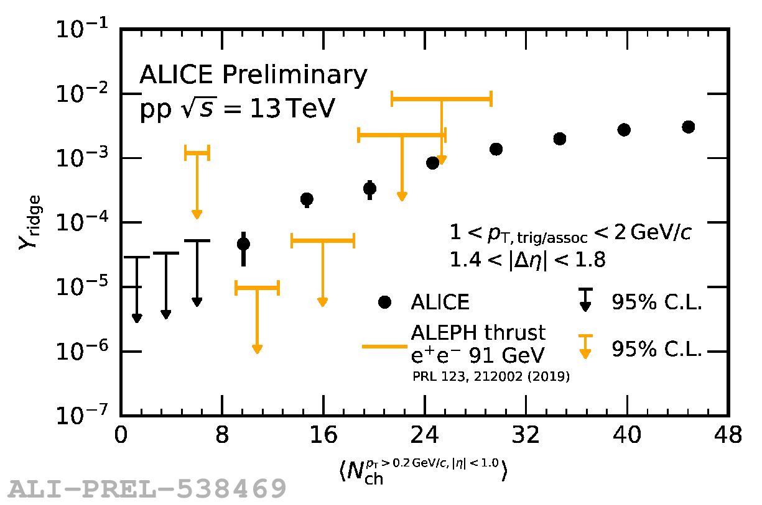
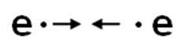
Collective Phenomena (2)
v₂ vs. N_{ch}
Observed hadronization phenomena involve many particles
  Measured up to 6th order (6-particle correlations for v₂)
No ridge observed in elementary e⁺e⁻ collisions
(archived ALEPH data)
But in pp at the same multiplicity
  Not so dense system needed
  for multi-particle effects
Phys. Lett. B 765 (2017) 193
Y_{ridge} vs. N_{ch}
Universal hadronization model must include complex multi-correlation phenomena
MB
Notes:
TODO mention ep (ZEUS)?
MB is 11.3 in pp

Slide 21
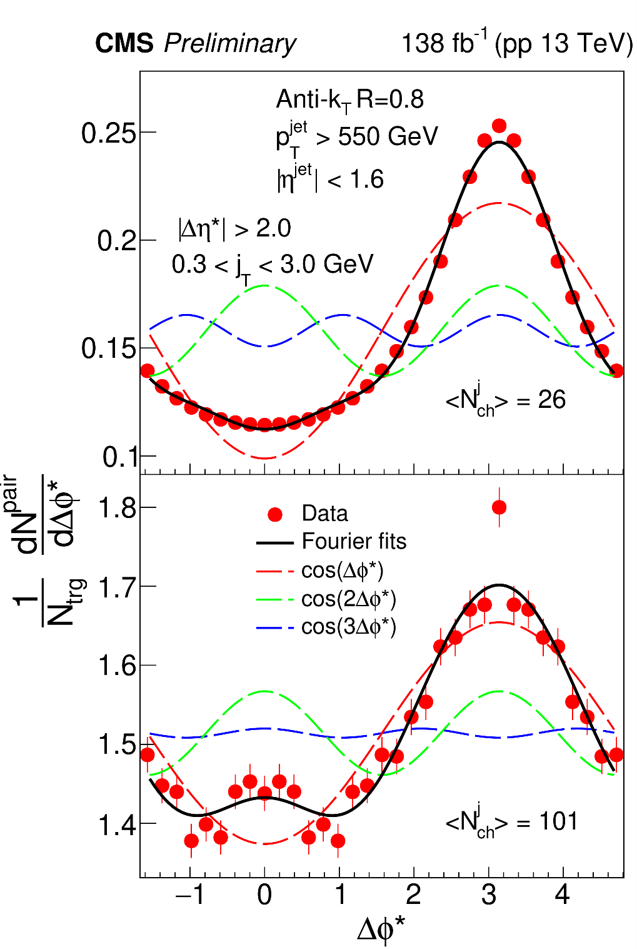
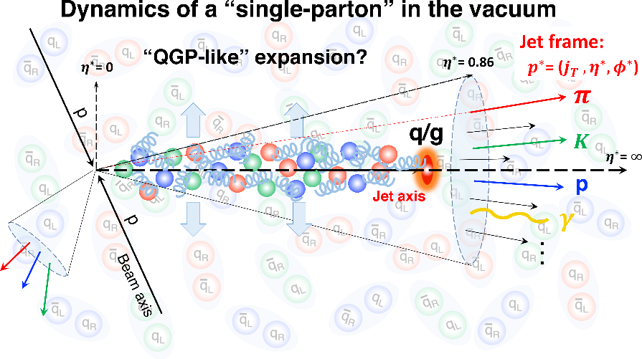
Very High Multiplicity Jets
Particles in very dense jets
  p_{T} > 550 GeV/c <N_{ch}> = 101
Rotation of jet “into” beam axis
Ridge-like contribution
CMS-PAS-HIN-21-013
Can a single parton hadronization develop its own dense environment or is it a fundamental QCD (“not QGP”) property?

Slide 22
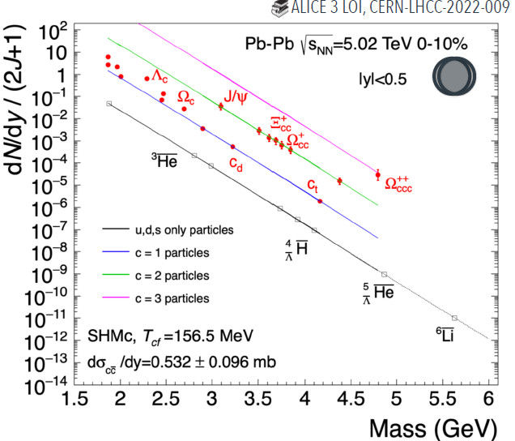


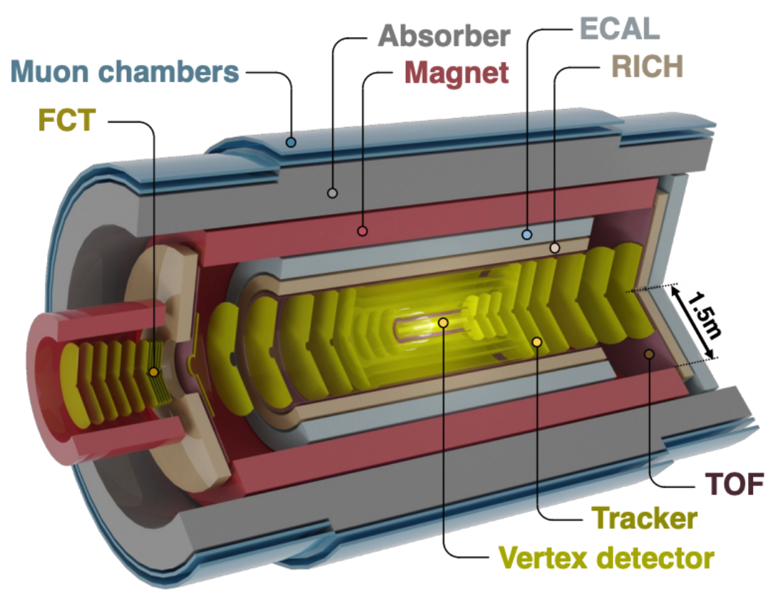

Outlook on Multi-Charm
States with multiple charm ideal test bed for hadronization models
  Largely enhanced in heavy ions (e.g. 100 for Ξ_{cc})
  Measurement of Ξ_{cc}, Ω_{cc}, possibly Ω_{ccc}
  Testing coalescence picture on quark level
Detector proposal for LHC Run 5 (2035): ALICE3
  Retractable vertex detector 5 mm from beam
    Pointing resolution 3-4 μm @ 1 GeV
    X/X₀ ~ 0.1% per layer
  All-silicon tracker (p_{T} resolution 1% @ 1 GeV)
  Continues readout and online processing
  Pb-Pb: 35 nb⁻¹ | pp 18 fb⁻¹
arXiv:2211.02491
Notes:
bg info: J/Psi: we already don’t know how produced in pp; other mechanism to produce it within the hard coll., while multi-charm has to be produced later; 3 order of magnitude enhancement for “free” production (to study hadronization by coalescence), sensitivity to level of equilibrium
[TODO Salvatore Plumari ALICE week, coalescence]

Slide 23
Summary
Hadronization is a non-perturbative process without first-principle description
Evolution from e⁺e⁻ over pp and p-Pb to Pb-Pb allows new insights
  Baryon/meson ratios, fragmentation fractions, strange & charm, multi-particle correlations
Different hadronization concepts describe different observations
  From colour reconnection over coalescence to statistical hadronization
  Various mechanisms “active” in the same collision
Challenge to find universal hadronization model for these complex phenomena
Thank you for your attention!
Thanks for input & discussions to: Federico Antinori, Fabrizio Grosa, Alexander Kalweit, Andrea Rossi
Notes:
Microscopic to macroscopic descriptions: No contradiction: one could be the microscopic implementation of the macroscopic successful model
Mention fluctuations?

