Slide 1
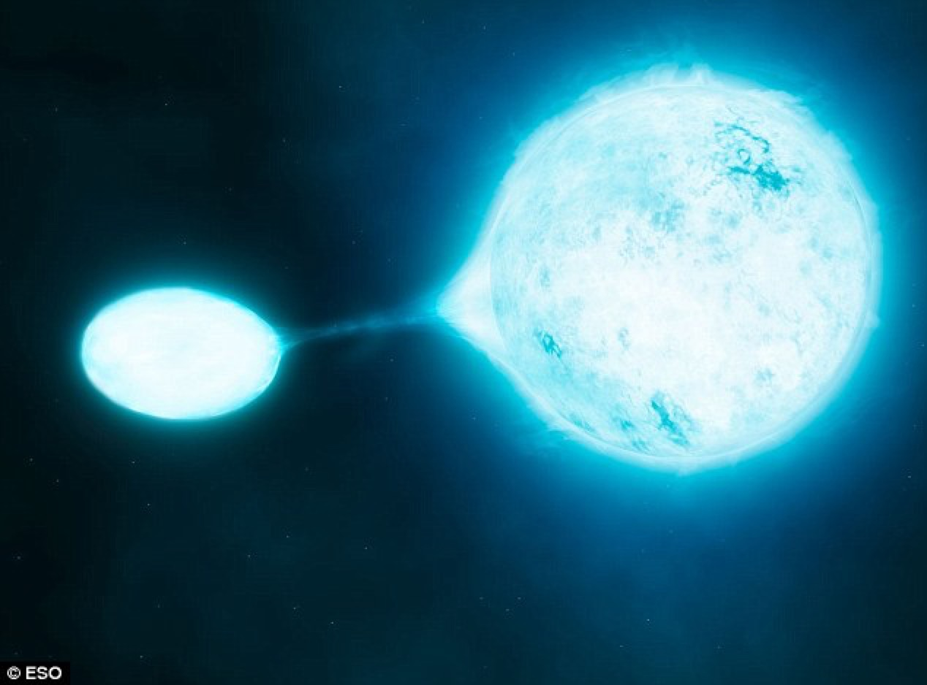

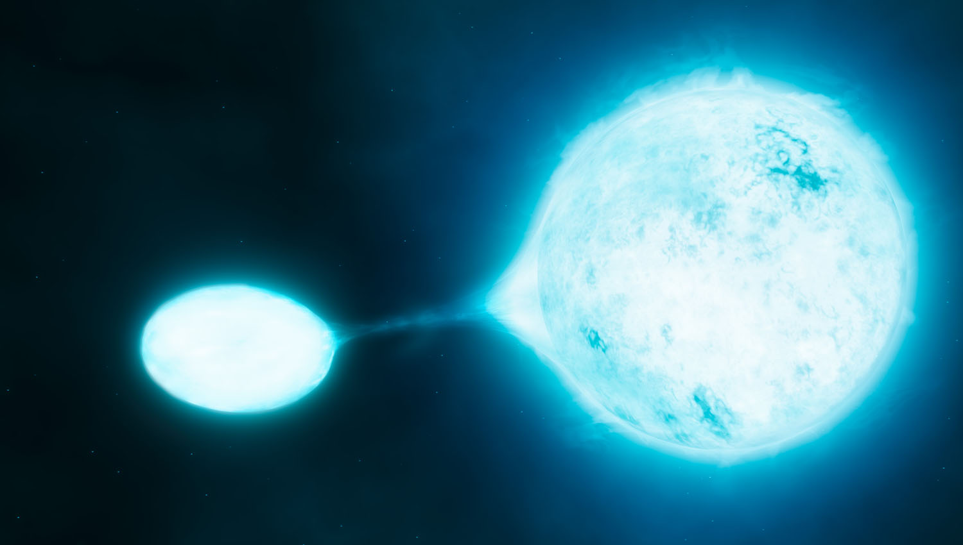
Binary massive stars and their impact to their environment!
Emmanouil (Manos) Zapartas
Rencontres du Vietnam
Notes:
Thanks the organizers for the honor to give this talk about binary massive stars.

Slide 2
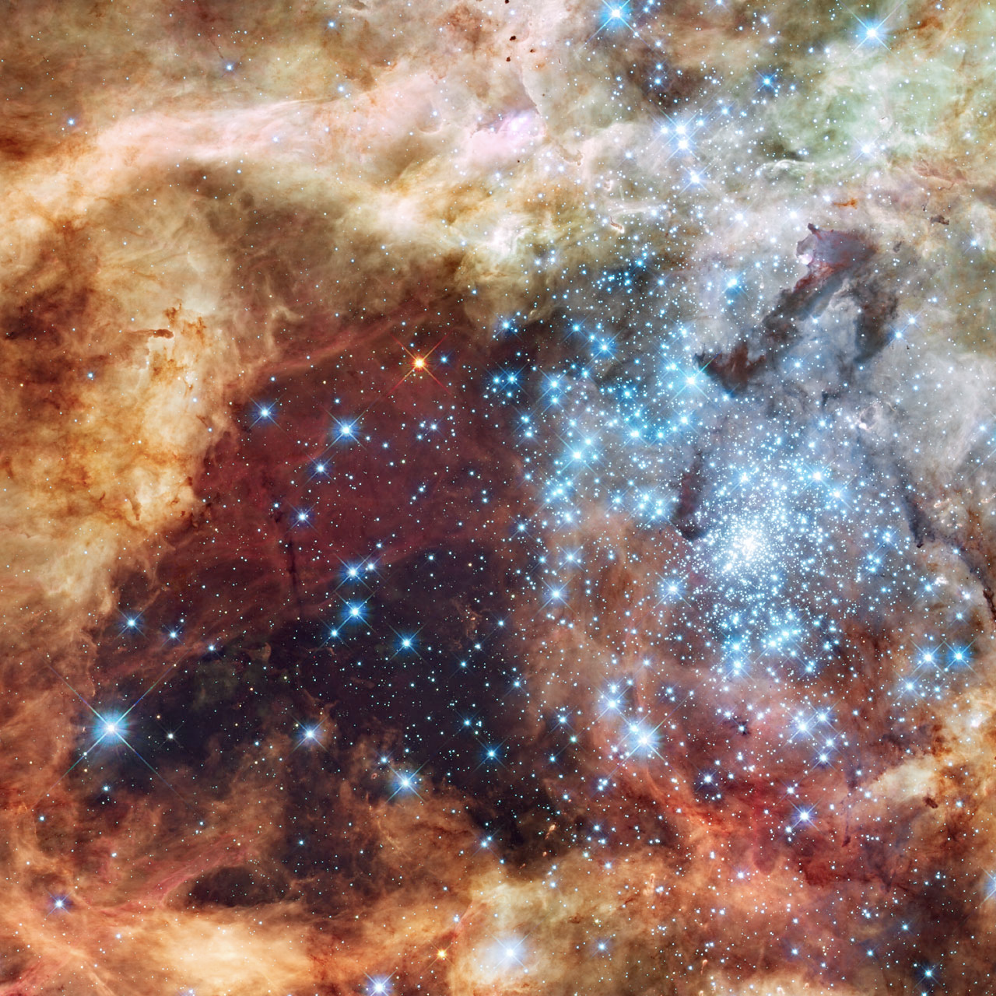
b
Impact of massive stars
Chemical enrichment:
nuclear burning
Mechanical feedback:
  Winds
  Eruptions
Energetic feedback:
  (Ionizing) radiation
  heating
Credit: NASA, ESA, and E. Sabbi (ESA/STScI)
Notes:
#Ιnfluense
Driving engines of their environments
copious amounts of mass loss, stably or episodic in eruptions etc
ionizing radiation, shape evolution, how they look like
above CO, made of stardust

Slide 3
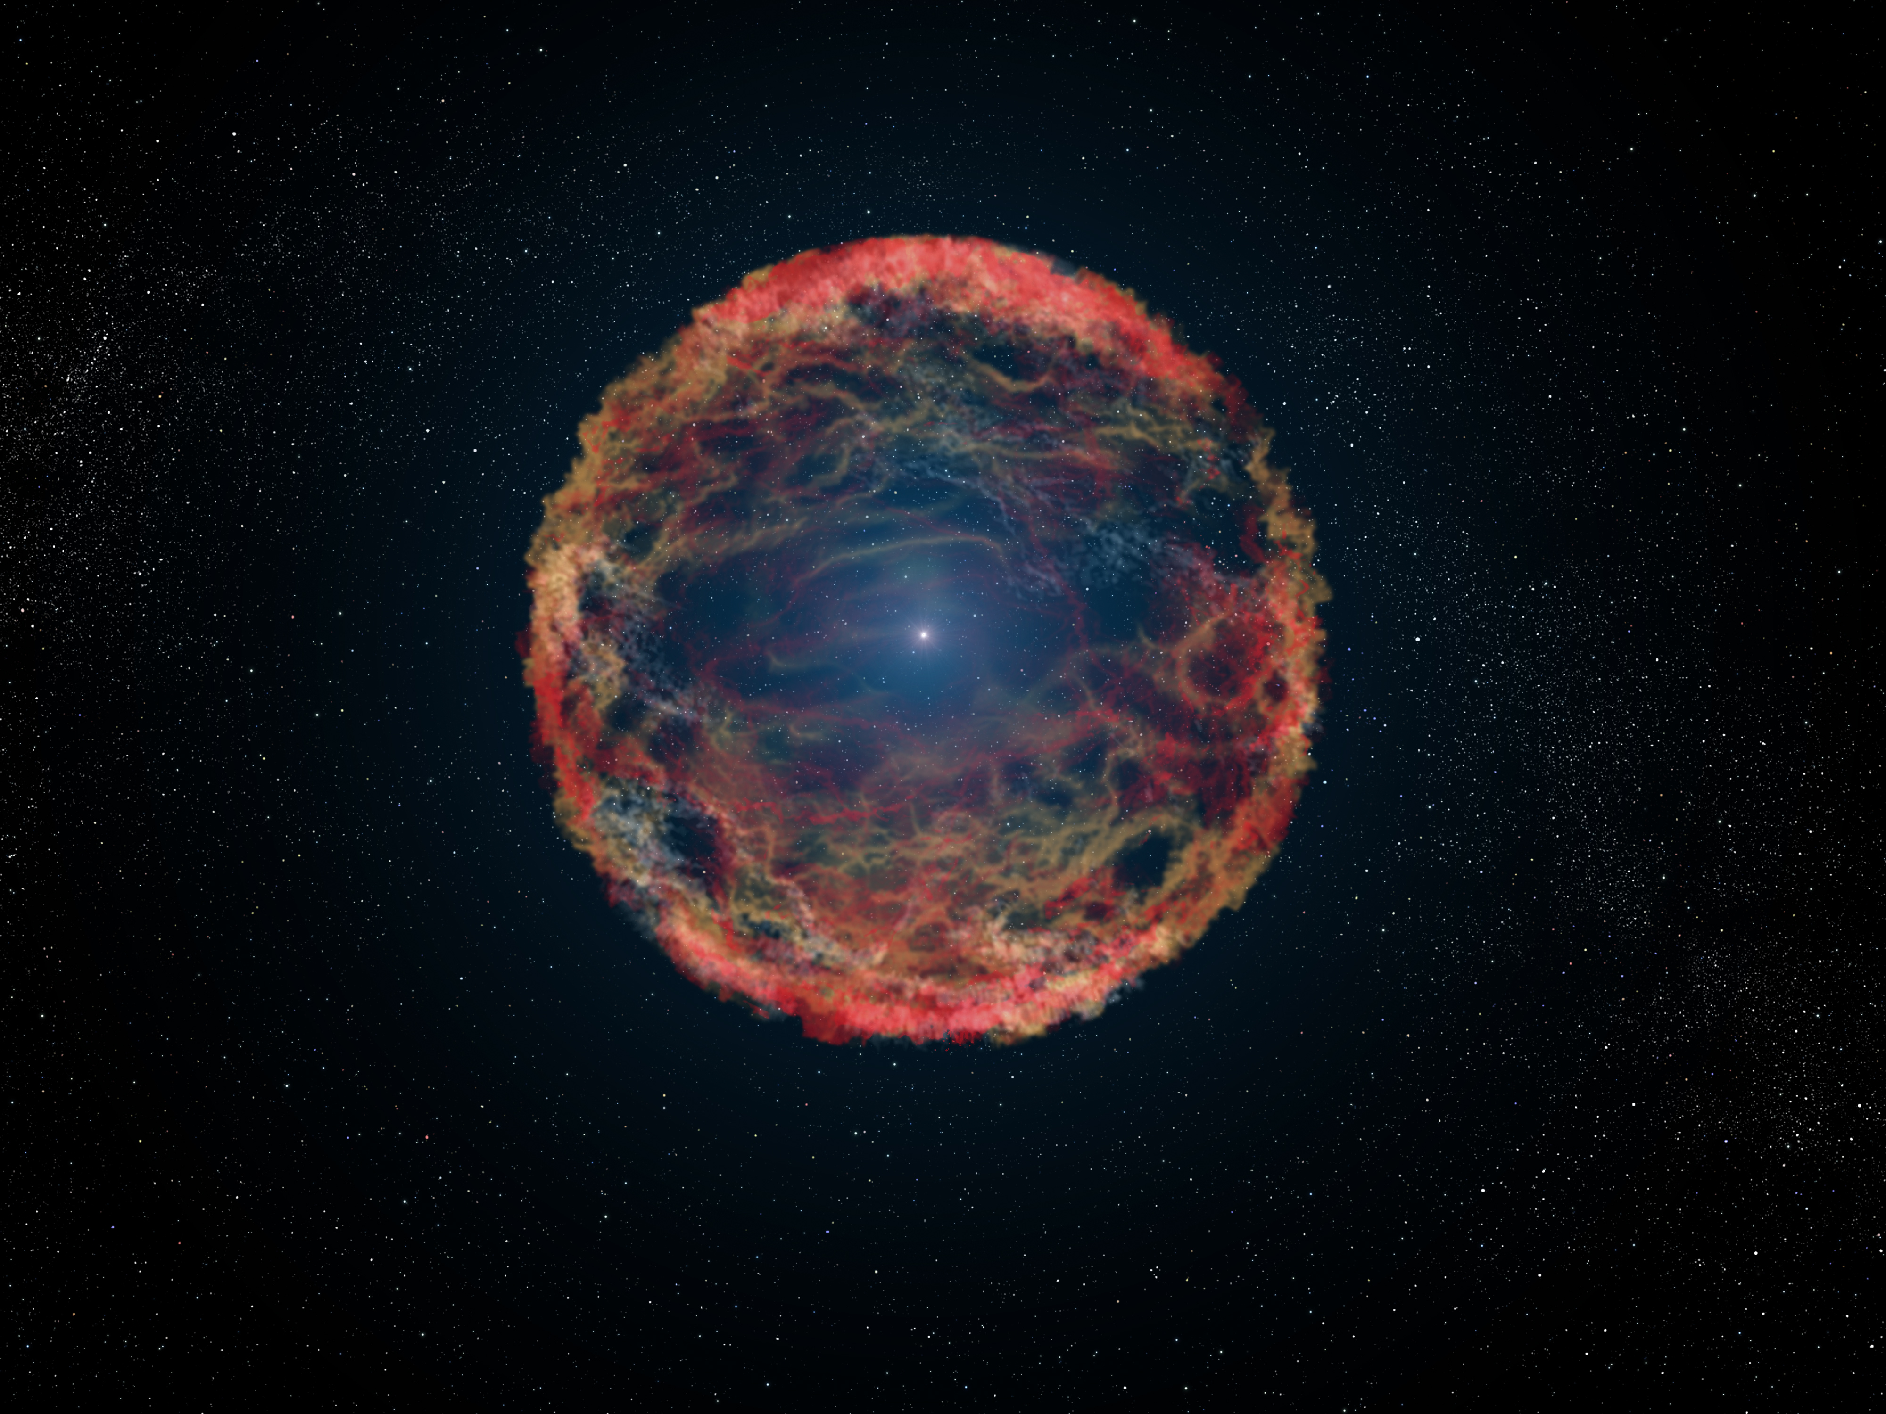
Massive stars explode in supernovae!
Chemical enrichment:
explosive nucleosynthesis
dust?
Mechanical feedback:
  superbubbles
  trigger new star formation?
Energetic feedback:
  kinetic energy
e.g. Maeder+Meynet2000, Heger+2003, Langer2012
Notes:
shape their envornments
also remnant BH , NS, cosmic rays (Prof Fragos will talk about them in even more detail)

Slide 4
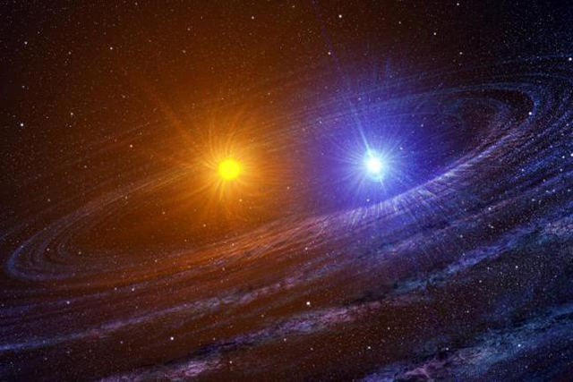
Most young massive stars are found in binary systems!
Notes:
Key properties of these stars massive stars

Slide 5
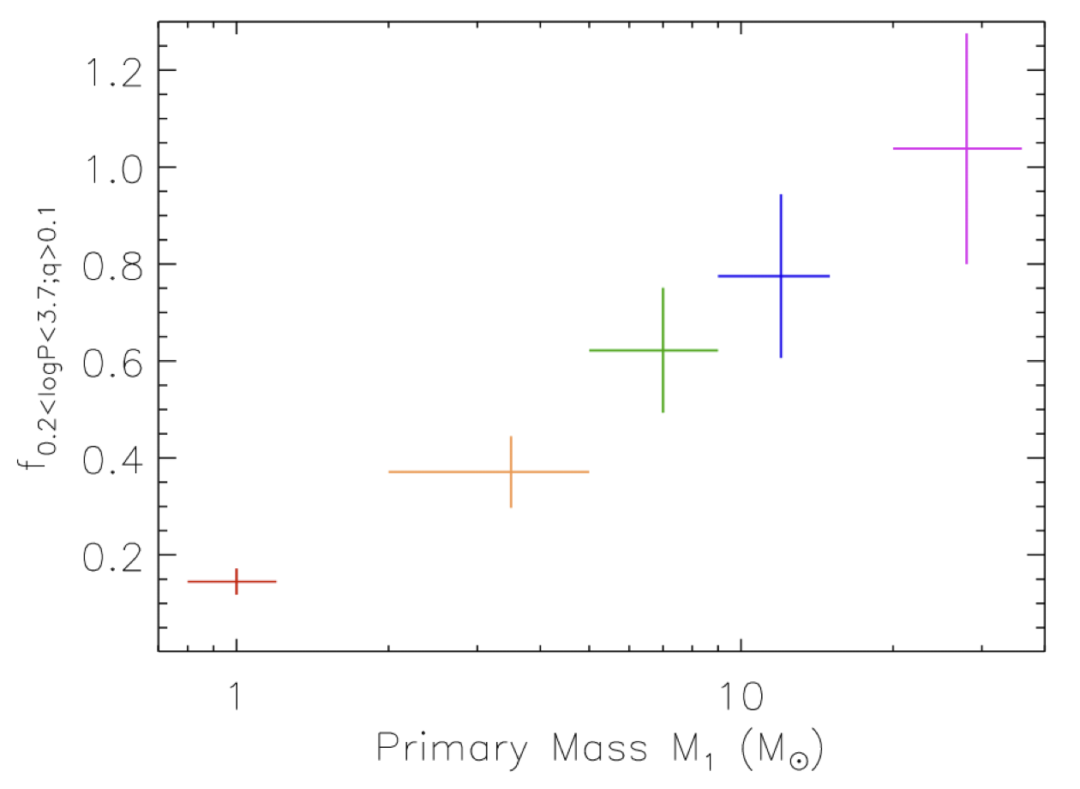
Most (massive) stars are in close binary systems!
see also Kobulnicky+Fryer 2007; Eggleton+Tokovinin2008; Chini +2012; Kiminki+Kobulnicky 2012; Sana+2012; Dunstall +2015; Moe+DiStefano 2017; Almeida+al. 2017
Moe+diStefano2017
Notes:
after statistical correction for completenes etc:
mass dependent
ALL masive stars will interact with a companion during their life, triples
3.7

Slide 6
Mass transfer
Notes:
Progenitors are massive stars
key property. Found in binary interactions

Slide 7
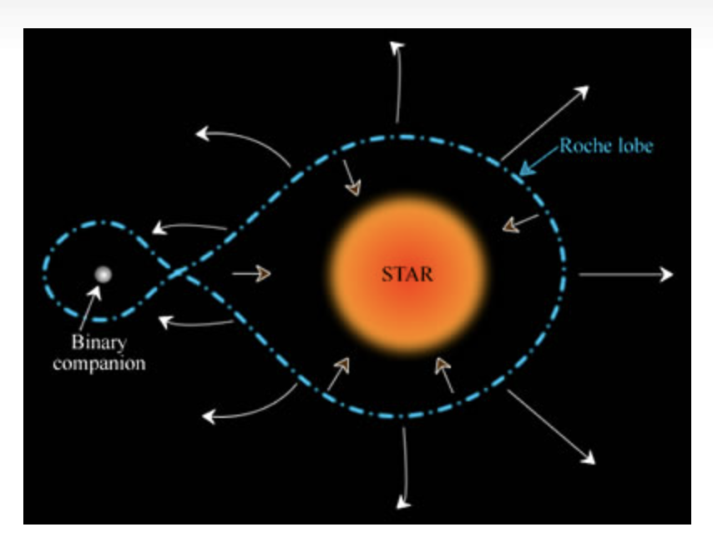

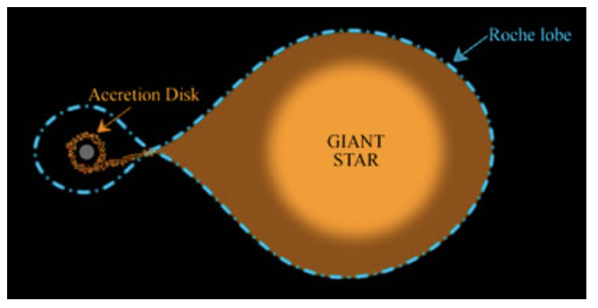
Roche lobe
for
Eggleton 1983
Notes:
Not able to do 3D binary. Not even 3D star.
Notion of Roche lobe
Equation
Which of the two stars is the most massive?
Which star do we expect to lose its mass first, fill its RL?

Slide 8
mass stripping
Mass transfer
Notes:
lose mass

Slide 9
mass stripping
Mass transfer
mass
gaining
Notes:
stable or unstable

Slide 10
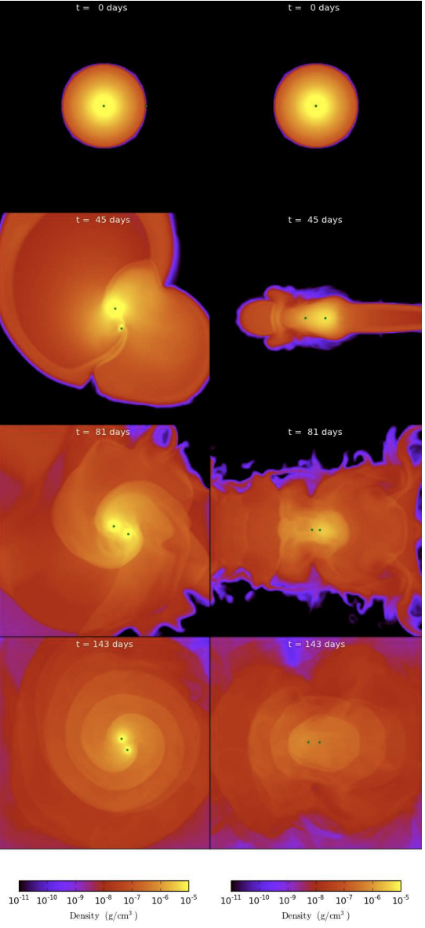
Common envelope evolution
Looking the binary face-on (from above the orbit)
Looking the binary edge-on (from the orbital plane)
Ivanova+2013
Figure from Ivanova et al (2013)
Notes:
Very fast dynamical process. Uncertain
3D simultions: Lot’s of mass ejected and envelope sripping
2 outcomes

Slide 11
Common envelope evolution
Succesful envelope ejection:
short orbit binary
Merging of the two stars in one
Notes:
Oveflowing of mass onto the companion star: Formation of a commone envelope around both “stars” (or cores)
Spiral in due to gravitational drag
Shrikage of orbit. Energy from the orbit heats up the envelope and can lead to its ejection
Two outcomes
Very close orbit
Merging: unknow process, mixing, rotation, re-adjustment

Slide 12
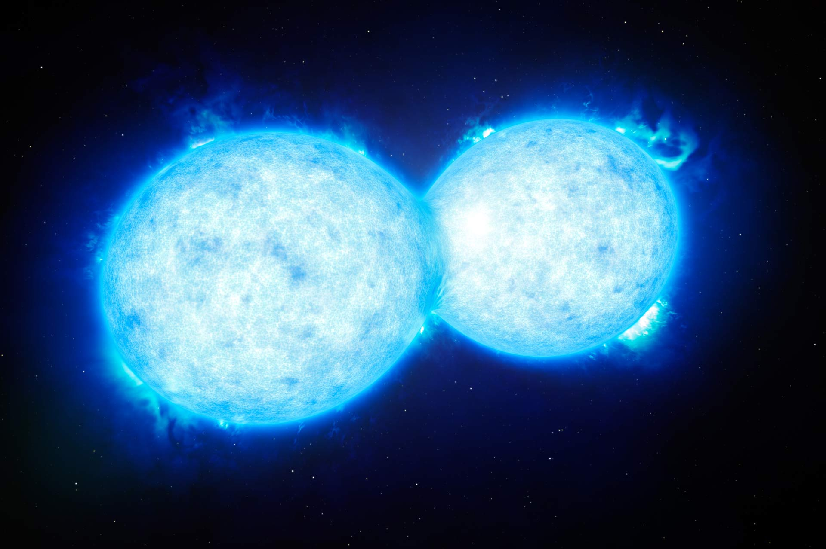
mass gaining
Merging
Credits: (ESO) / L. Calçada
Notes:
merging of the two stars
Merging: unknow process, mixing, rotation, re-adjustment. Magnetic
Many sinlge stars that we see may be binary mergers.

Slide 13
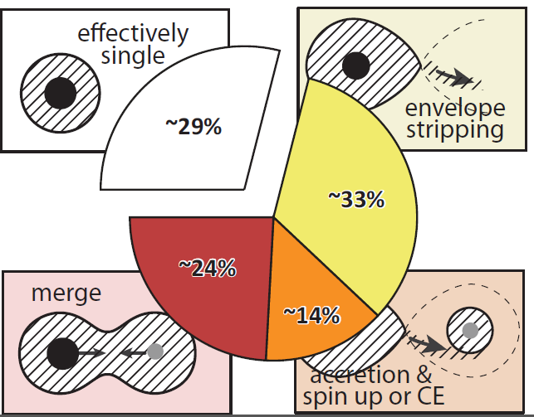
Most young massive stars are found in close enough binaries to interact
Fig. from De Mink (Sana+2012)
Notes:
normality for massive stars.
cannot neglect this scenarios

Slide 14
mass stripping
Mass transfer
Notes:
common scenarios
commonly lose almost all of its H-rich envelope. (stable MT or unstable/common envelope)

Slide 15
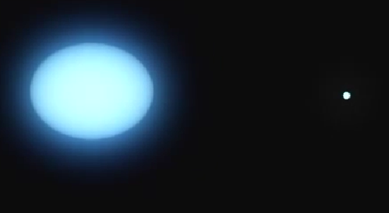
Stripped star
Notes:
Donor usually stripped up to the (He-rich) core
mass ejected, not all accreted (non-conservative) to the environment.
Uncertain how much mass will be lost

Slide 16
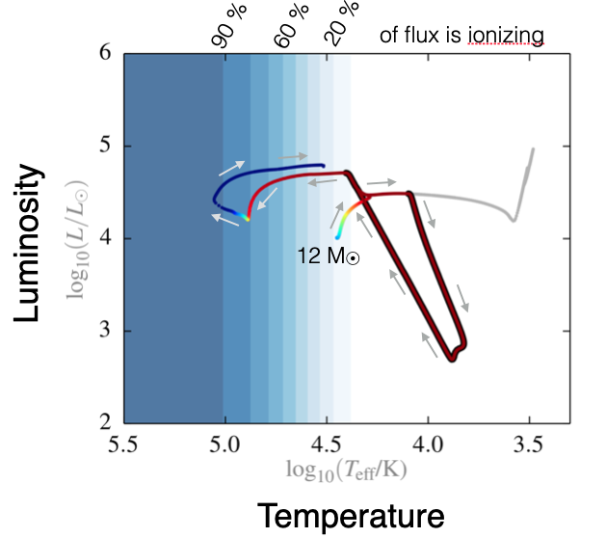

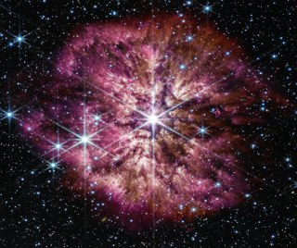

Ionizing radiation from stripped stars
Wolf-Rayet star
binary stripped star
Götberg+2017
Notes:
effectively singles (tides may play a role)
instead of RSG Goes to the blue (hot).
He core burning there (10% of its MS)
common outcome of binary evolution
Ionizing radiation
different masses compared to WR stars (shed their envelopes due to winds)

Slide 17
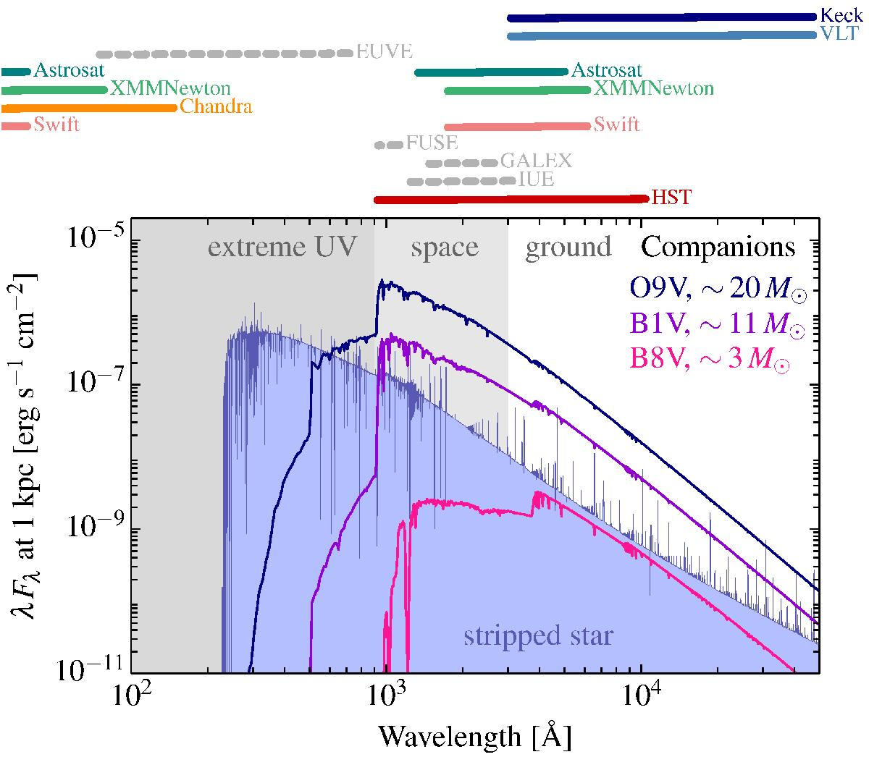
Götberg+2017
Notes:
what are the system’s masses, confiuration etc???
UV and ionzing
hidden most of the times from their most common MS companion

Slide 18
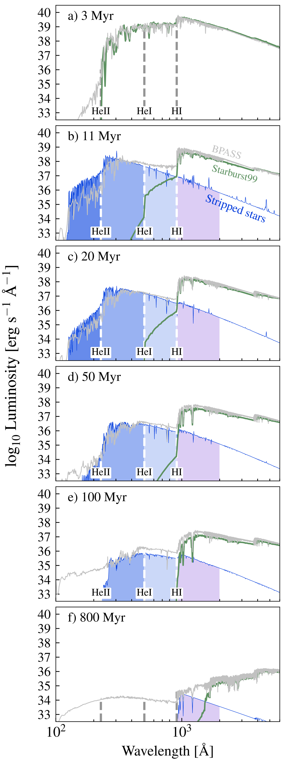
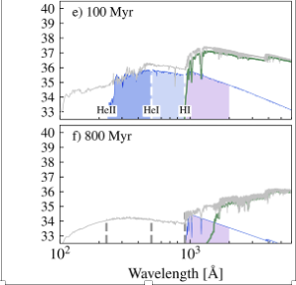

Extra source of ionizing radiation
later than WR stars
time
Götberg+2019
Notes:
population, synthetic population.
commonly used.
pioneered
harder SED, last longer
stripped stars: only 5% of HI-rate in rate (but 20% in reionization, due to escape fraction??)

Slide 19
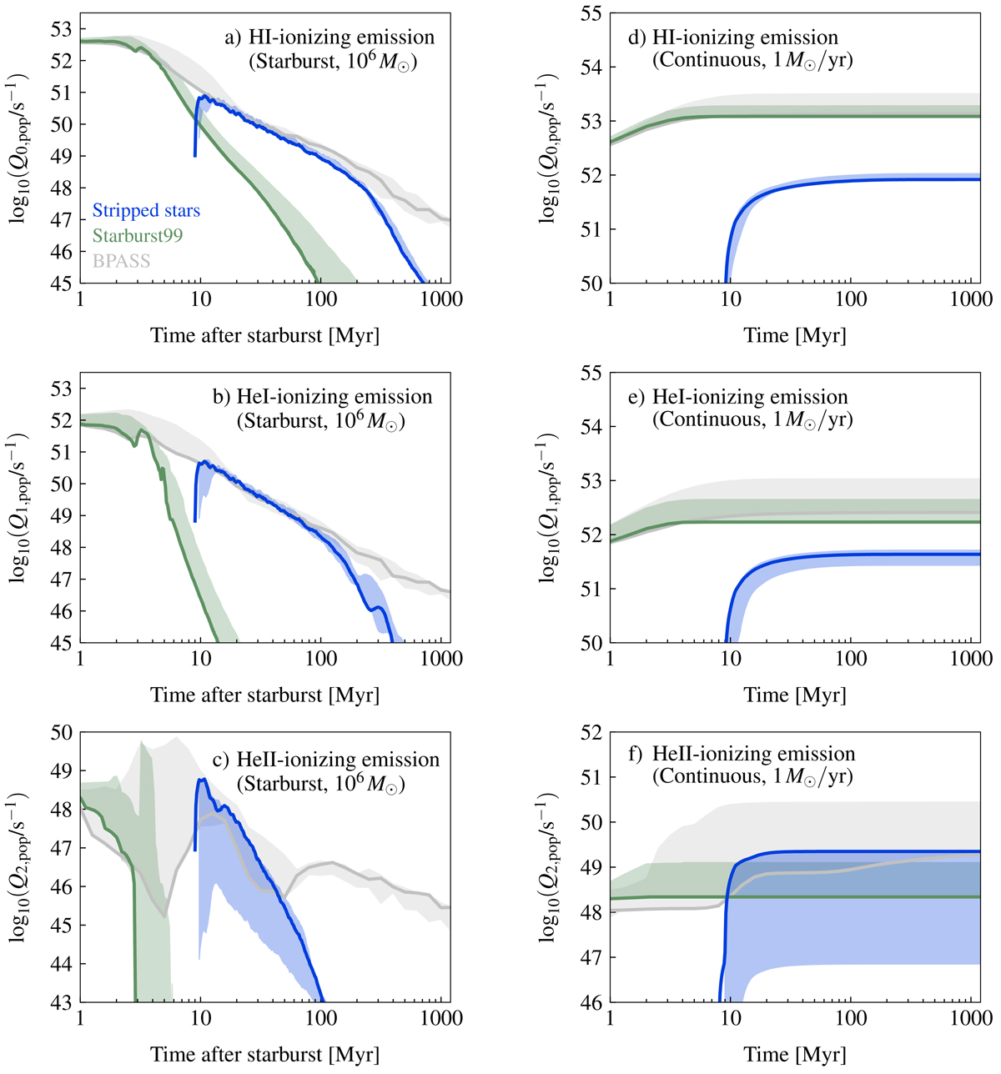
Stripped stars are late!
Götberg+2019
Notes:
late due to their initial low mass, long evolutionary timescales.
Keep this point for later, SNe!

Slide 20
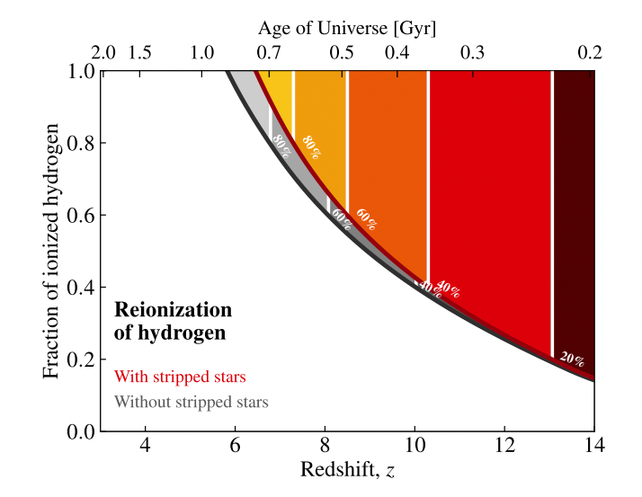
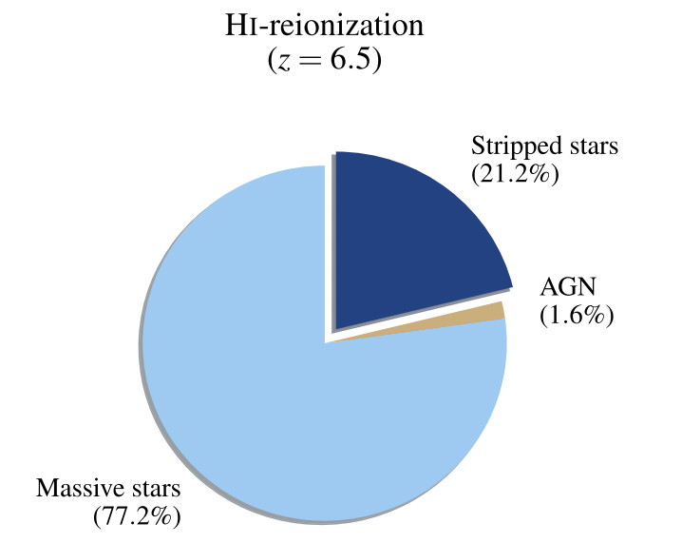
Reionization of the universe
Götberg+2020
see also Stanway+Eldridge+2016

Slide 21
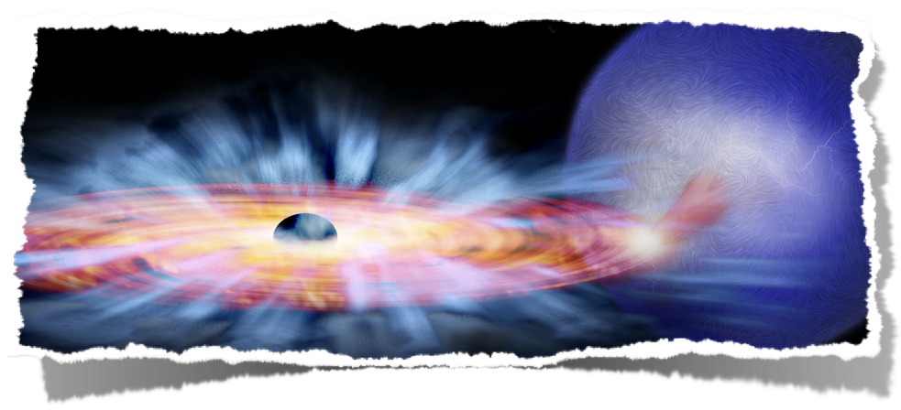
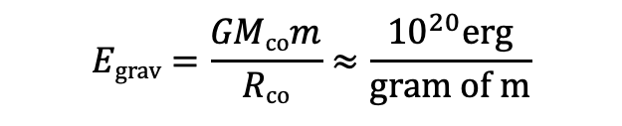
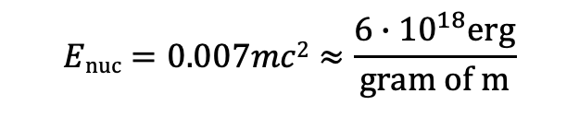
X-ray binaries:
Extra source of ionizing radiation
$$Egrav=\frac{GMcom}{Rco}≈\frac{{10}^{20}erg}{gram of m}$$
$$Enuc=0.007mc2≈\frac{{6∙10}^{18}erg}{gram of m}$$
Notes:
Secondary star (prev. accretor re-expands). Feeds material the compact object
Accretion onto compact object
Come very close: Release of high gravitational energy ->
Big part of if in radiation. Not all, kinetic
Very hot accretion disk, radiation peaks at X-ray wavelengths
Much higher than nuclear budget

Slide 22
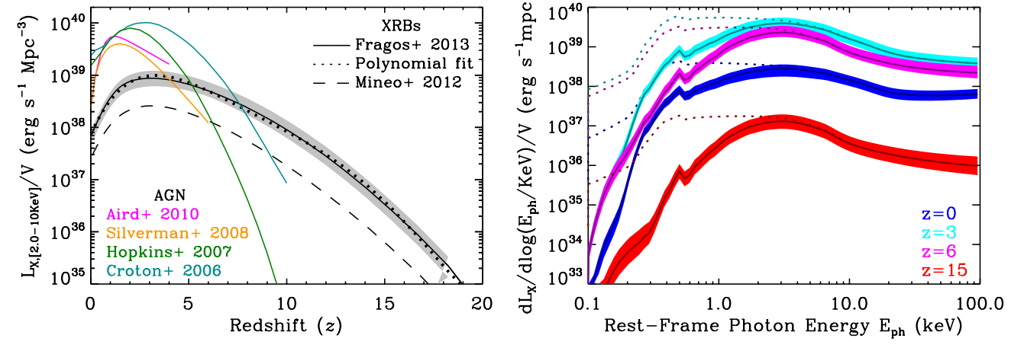
Reionization/reheating of the universe from X-ray binaries!
Fragos+2013
Notes:
Reheating,
escape the galaxy, interact further away to the IGM
change the signature 21cm
kink artificial of the phenomenological spectral libraries used

Slide 23
How binary interaction affects the eventual core-collapse supernovae?
Notes:
also remnant BH , NS, cosmic rays

Slide 24
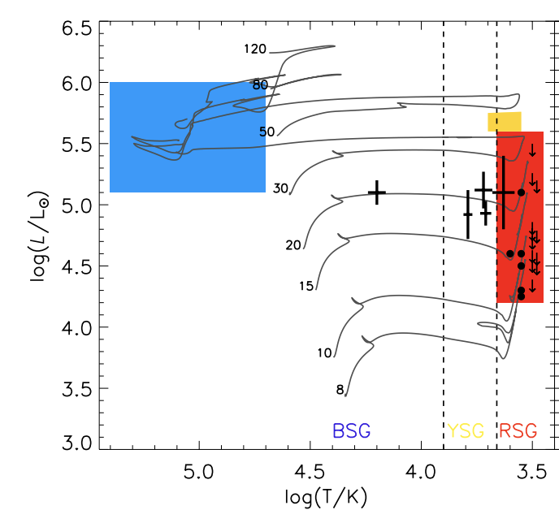
Supernovae progenitor position in
Hertzsprung-Russell diagrams
H
Wolf-Rayet star
Type Ib/c SNe
(H-poor)
Type II SNe
(H-rich)
Figure from Eldridge+2013

Slide 25
Stripped star
Notes:
Donor usually stripped up to the (He-rich) core
mass ejected, not all accreted (non-conservative)

Slide 26
Also different supernova!
H-poor
Type Ib, Ic SN

Slide 27
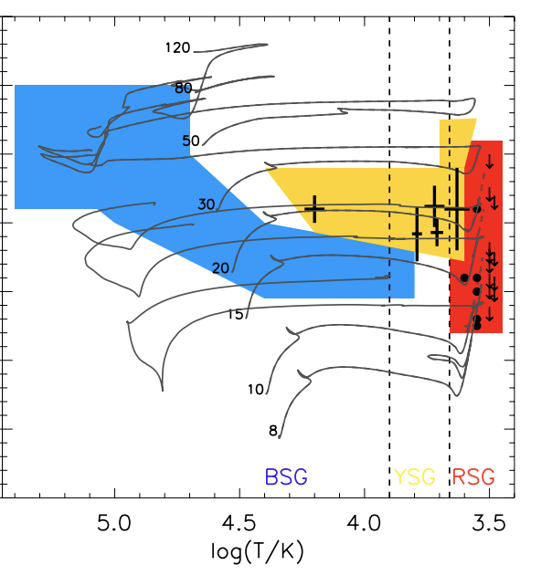
Stripped stars in binaries as progenitors or H-poor Type Ib/c supernovae!
core
H
Wolf-Rayet star
core
Type II SN
(H-rich)
Binaries help explain:
Difficulty to detect the nearby progenitors
Low ejecta masses
High rates
Figure from Eldridge+2013
Notes:
Type II SNe, single --> No!

Slide 28
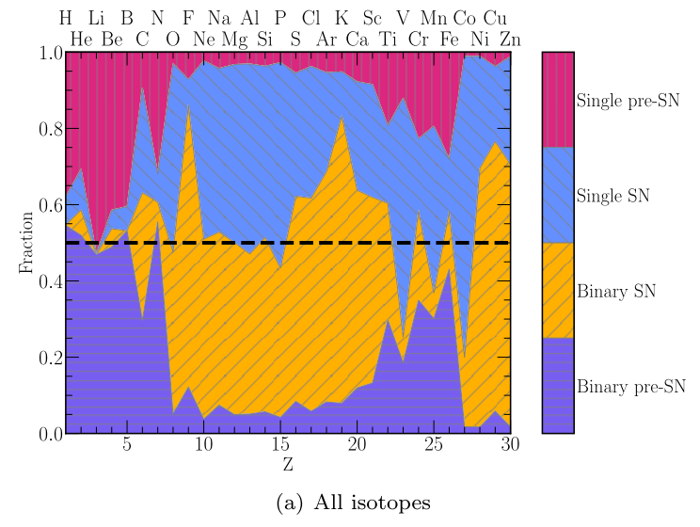
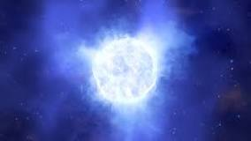

Different elements ejected
Farmer+2023, 2021
Notes:
Different SN ejecta
IMF-weighted
SINLGES VS BINARIES

Slide 29
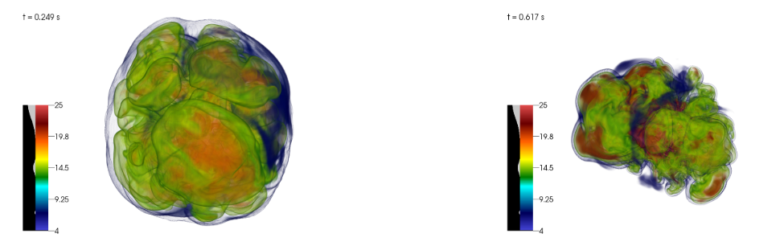
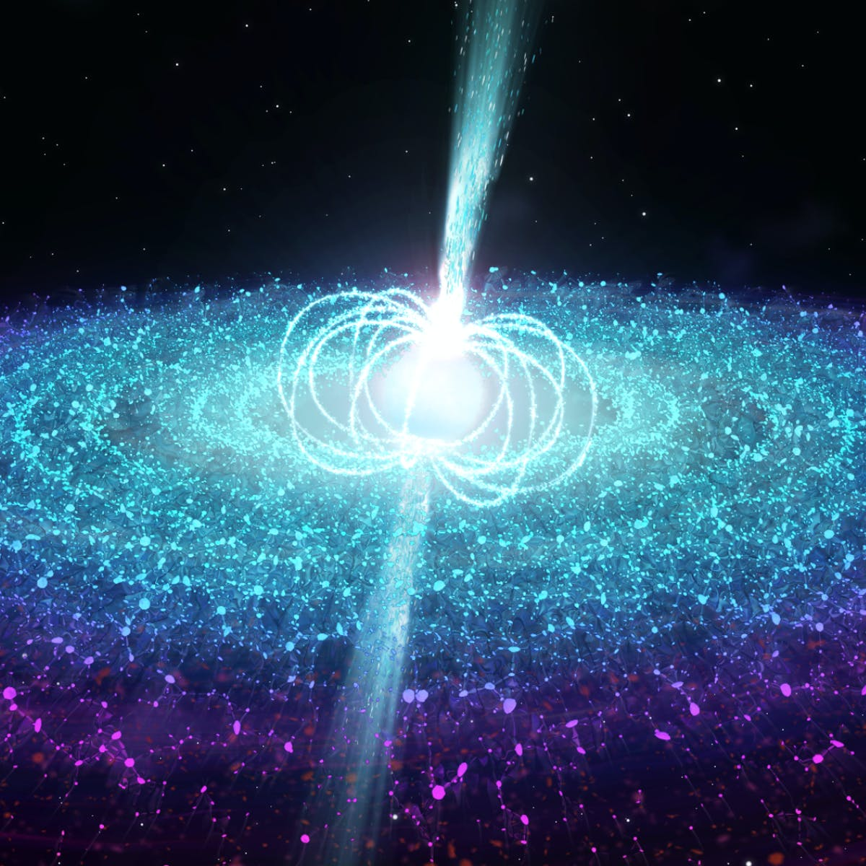
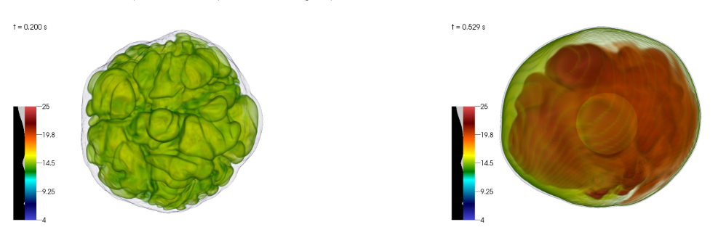
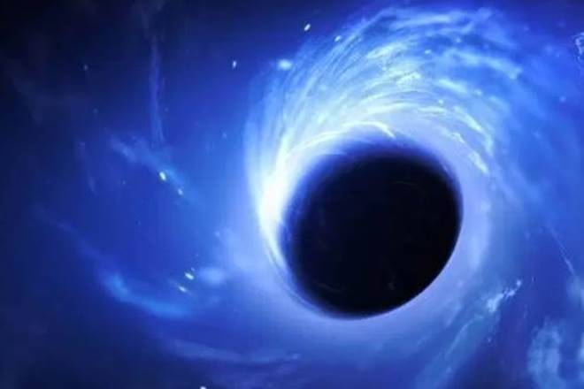
Some massive stars will implode into a black hole!
Neutron Star
Black Hole
Burrows+2019
Notes:
milisecond
MHD, GR, 3D, neutrino transport
computationally heavy

Slide 30
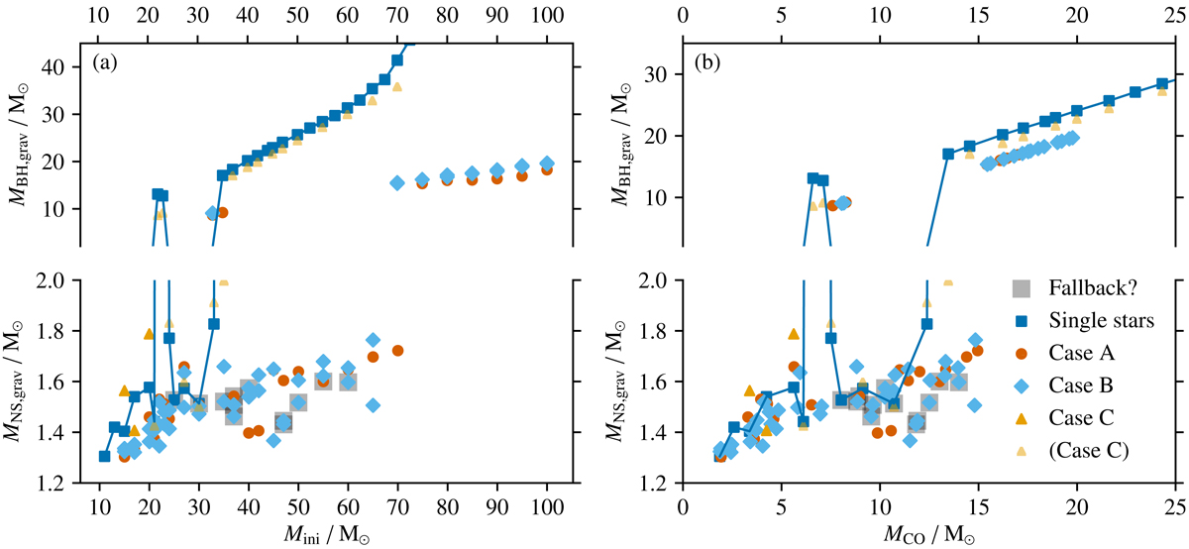
Stars stripped in binaries seem to be “easier” to explode
Schneider+2021
see also Laplace+2021
Notes:
Not only their explodability

Slide 31


Do massive Wolf-Rayet stars explode as core-collapse SNe at all?
Ib, Ic
IIb
Exploding
Type II SN
Fryer+12 Rapid
Fryer+12 Delayed
Sukhbold+16 – N20
Sukhbold+16 – S19.8
Patton+20Ertl+16 – N20
Zapartas+2021b
Notes:
Ads to the tension that Type Ib/c SN should come from other sources

Slide 32
Do massive Wolf-Rayet stars explode as core-collapse SNe at all?
core
?
Wolf-Rayet star
Figure from Eldridge+2013
Notes:
Type II SNe, single --> No!

Slide 33
What about H-rich type II core-collapse SNe?
core
H
?
Wolf-Rayet star
Type II SN
(H-rich)
Figure from Eldridge+2013
Notes:
Type II SNe, single --> No!

Slide 34
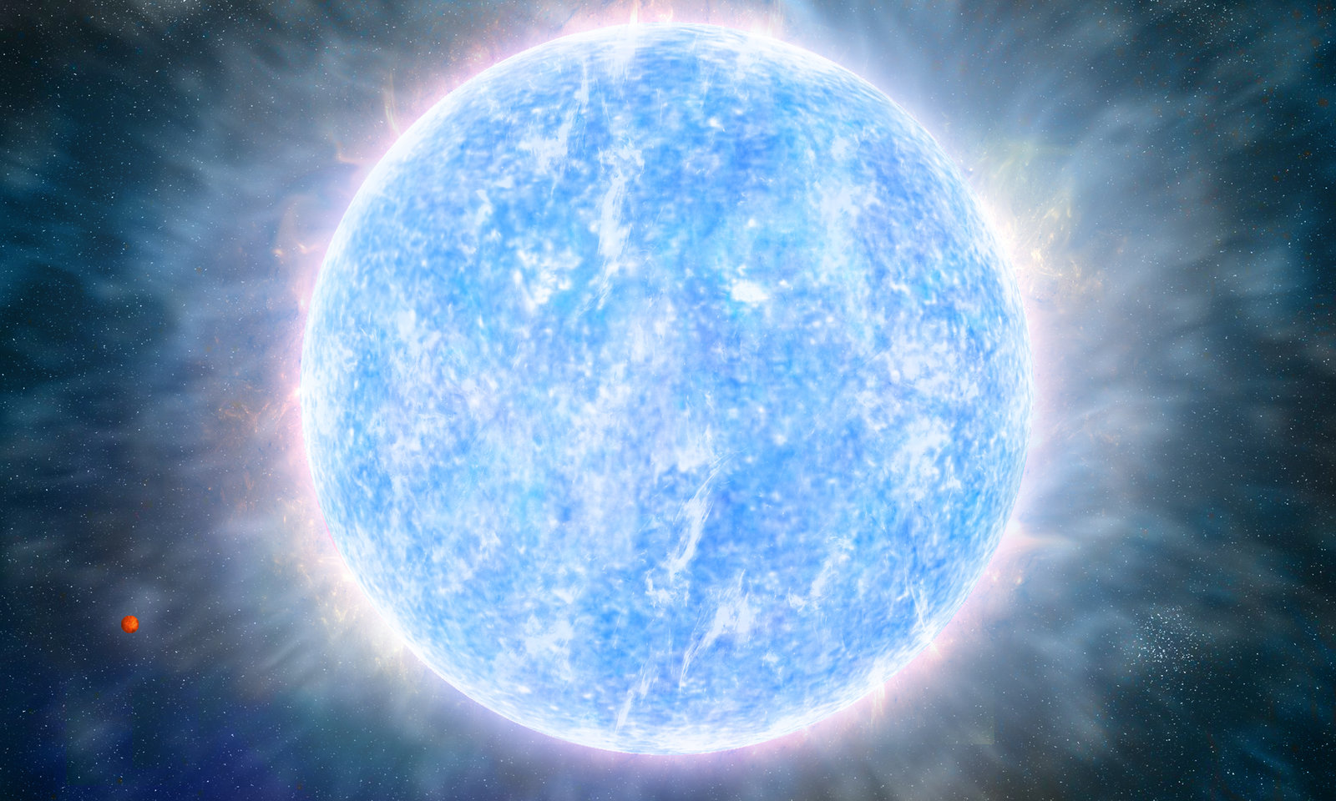
Many Type II (H-rich) supernova progenitors
Mass
gaining
merging
31%
(16-49)
H
single stars
Zapartas+2019
Notes:
Opposite of stripping: Accrete mass or merge!
Some kind of mergers
Exact numbers for each channel can vary with assumptions, but it is difficult to have at least 1/3 of type II progenitors
(check models sensitivity)!

Slide 35
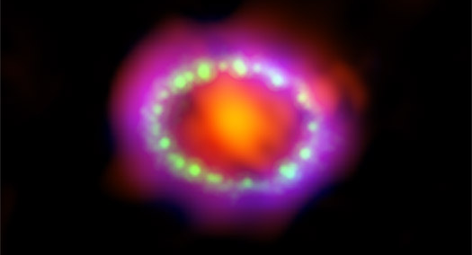
SN 1987A
e.g., Podsiadlowski+1990; Podsiadlowski1992; Menon+Heger2017, Urushibata+2018
(although see e.g., Saio+1988, Weiss+1988, Langer+1989)
Notes:
https://chandra.harvard.edu/photo/2017/sn1987a/
most well studied, SN1987A in LMC
BSG progenitors.
CSM rings around it.

Slide 36
Time of explosion
H
“Supernova rate”
Wolf-Rayet star
Time after starburst (Myr)
Fig. adapted from Zapartas+17a;
see also DeDonder+ Vanbeveren+2003
Notes:
- slope

Slide 37
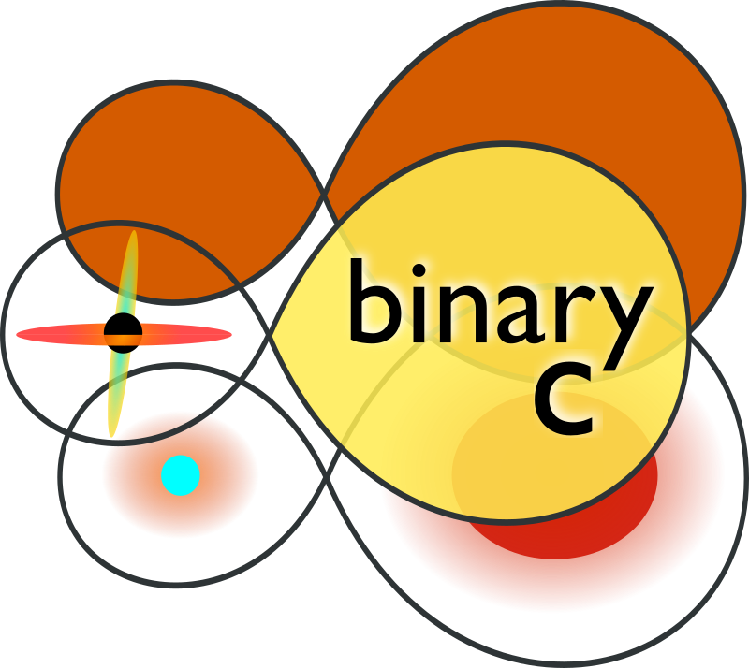
Including binaries
“Supernova rate”
Time after starburst (Myr)
Fig. adapted from Zapartas+17a;
see also DeDonder+ Vanbeveren+2003
Notes:
Binary progenitors elongate the time deposition of these binaries
predominantly below 8 Msun violates

Slide 38
More spread-out time deposition of SN energy and ejecta
“Supernova rate”
Time after starburst (Myr)
Fig. adapted from Zapartas+17a;
see also DeDonder+ Vanbeveren+2003
Notes:
Binary progenitors elongate the time deposition of these binaries
predominantly below 8 Msun violates

Slide 39
More spread-out time deposition of SN energy and ejecta
5M
6 M
“Late” SNe in “older” populations (M_initial < 8 Msun)!
“Supernova rate”
Time after starburst (Myr)
Fig. adapted from Zapartas+17a;
see also DeDonder+ Vanbeveren+2003
Notes:
Binary progenitors elongate the time deposition of these binaries
predominantly below 8 Msun violates

Slide 40
Core-collapse supernovae from below the mass limit!
~10 M
merging
5M
6 M
~10 M
time
Notes:
Binarity seems to violate the minimum mass threshold for core-collapse
longer evolutionary timescale until interaction. They start MT when all massive stars have already exploded.

Slide 41
Possible observational signature of late ccSNe
ccSNe
?
late ccSNe
+
prompt Ia?
Leitherer+’99, Schaller+92
Totani+’08, Maoz+’10
Maoz+Badenes’10
“Supernova rate”
SNe Ia
Time after starburst (Myr)
Zapartas+2017a

Slide 42
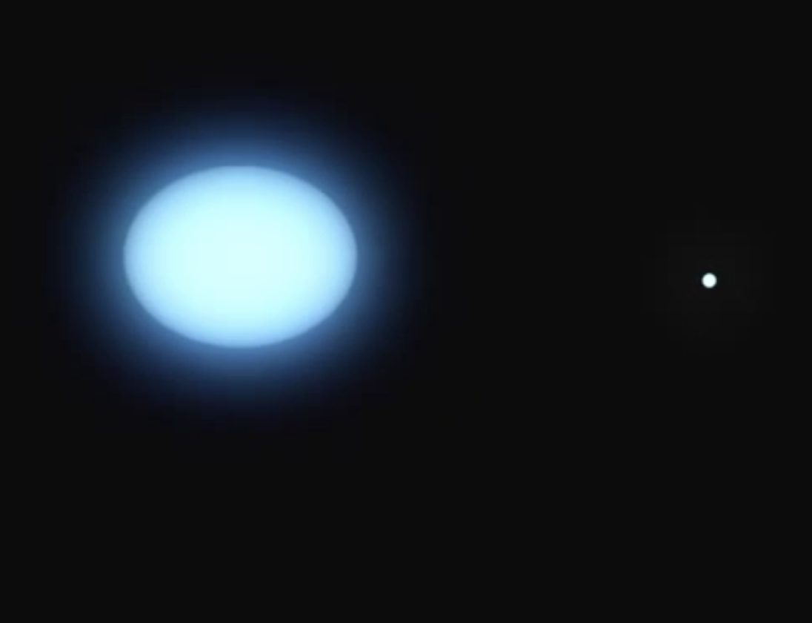
Companion ejections after a prior SN:
“Polluting” the nearby populations with stars
Mass gainer companion
Notes:
rule of thump: 4/5
mass accretor, travel to disances

Slide 43
Ejected “runaway” companions
Type Ib, Ic, IIb SN
Mass gainer companion
Notes:
rule of thump: 4/5
mass accretor, travel to disances

Slide 44
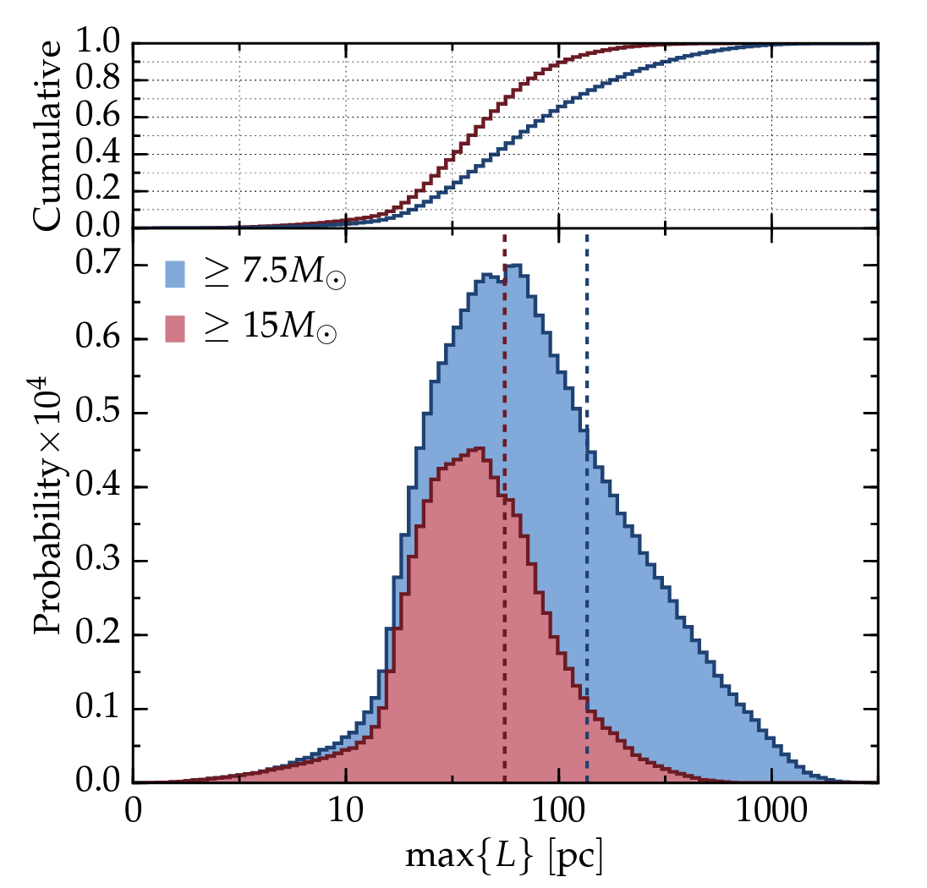
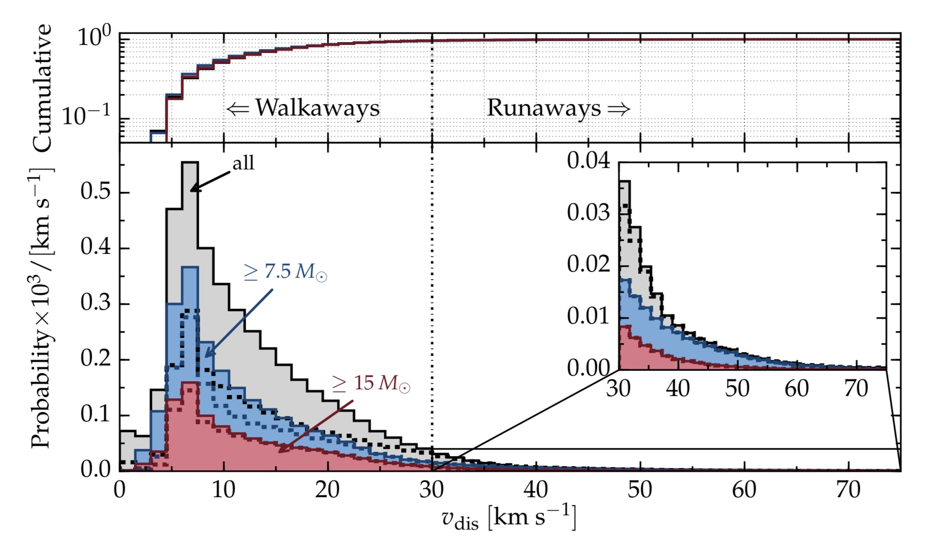
Ejected “runaway” companions
Renzo+2019
see also Eldridge+2011

Slide 45

Companion ejections after a prior SN:
“Polluting” the nearby populations with stars
Far-away, older population
star-forming region
(Eldridge+2011, Renzo+2019)
Notes:
Type II progenitors that had binary history are on average expected to explode further away from their birth region.
Two reasons: 1) because some of them will be ejected from their binary system and subsequently from their birth place, be observed runaway stars

Slide 46
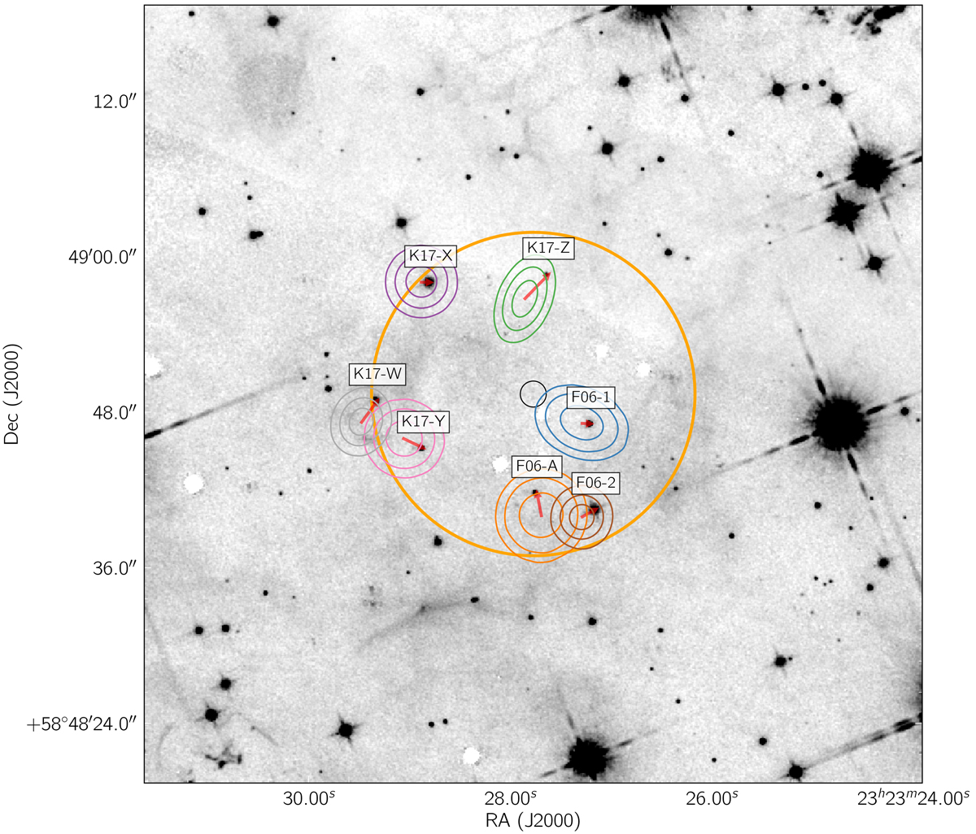
Companion search at nearby SN sites or SN Remnants
Kerzendorf+, Fox+ , Maund+

Slide 47

Observational sample of companion detections (or limits)!
Zapartas+2022 in prep.
Notes:
population
statistical perspective
steep. We are trying to apply reanalyze the values for each detection (or upper limit) and do a more in depth statistical comparison

Slide 48
Summary
Binary stripped stars are an extra source of ionizing radiation
  reionization of the universe?
Binarity mass transfer affects which stars explode in SNe, of which type, what chemical elements are ejected
SNe later in time
SNe in binaries “pollute” surrounding regions with
ejected companion stars

Slide 49
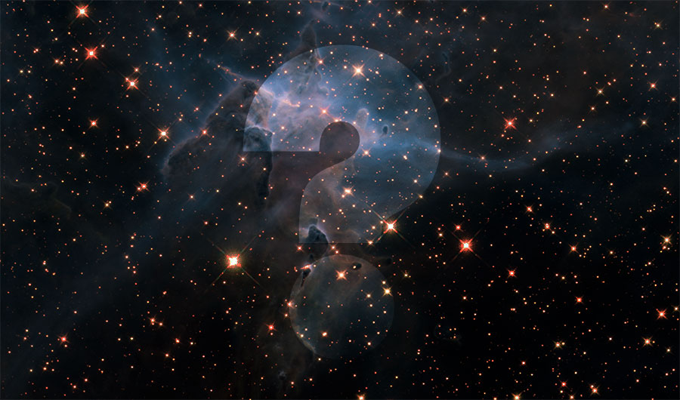
Notes:
Great.
Interestingly, many open questions
cc: which make NS/BH, which explode?
Ia; main mechanism (sd vs dd)
- zoo of observed classification (superluminous, associated with GRBs, sub-luminous, ) -> which progenitors

