Slide 1
Neutrinos in cosmology: A match made in the Heavens
Yvonne Y. Y. Wong, UNSW Sydney
Rencontres du Vietnam “Windows on the Universe”, Quy Nhon, August 6– 12, 2023

Slide 2
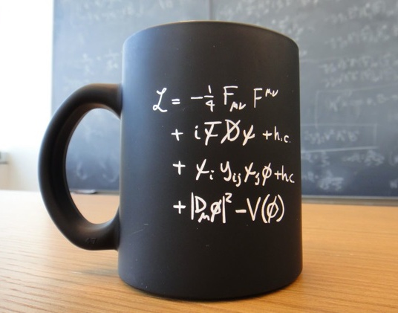
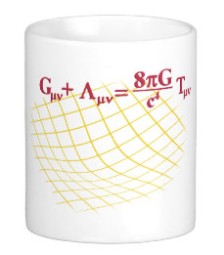
An unlikely partnership?
Neutrino = one of the lightest and most weakly-interacting known particles
Cosmology = gravitation on the largest observable scales
Standard model of particle physics
General relativity

Slide 3
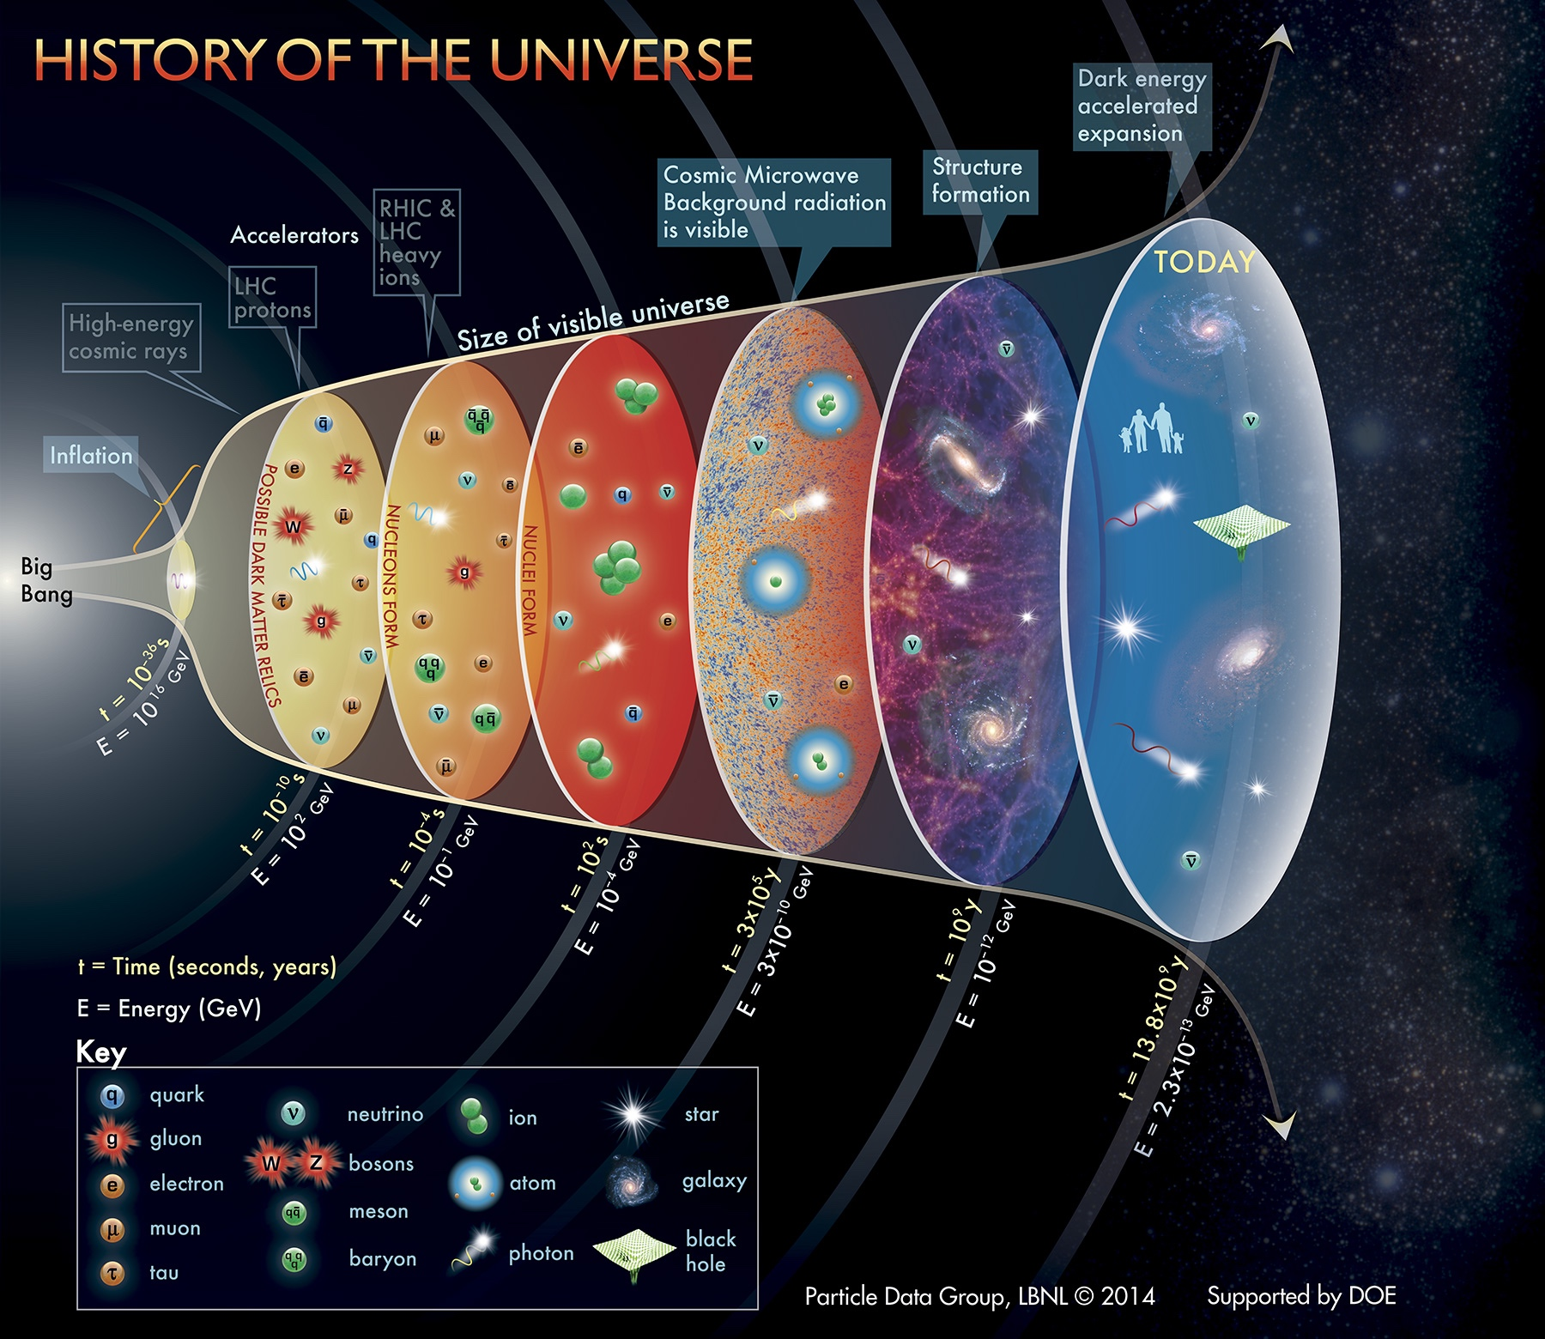
Primordial nucleo-synthesis
Cosmic neutrino background $t \sim 1s$, $T \sim 1 MeV$

Slide 4
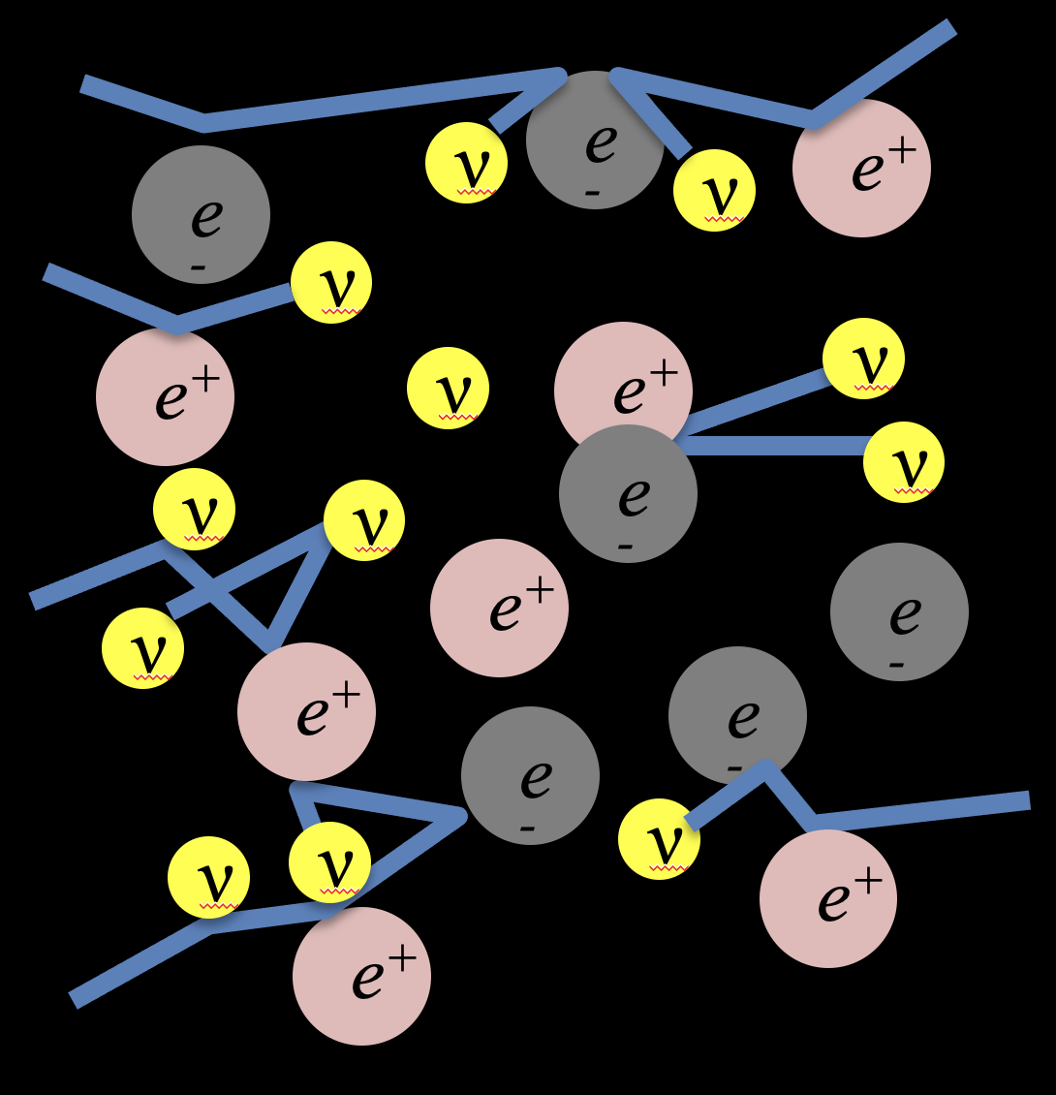
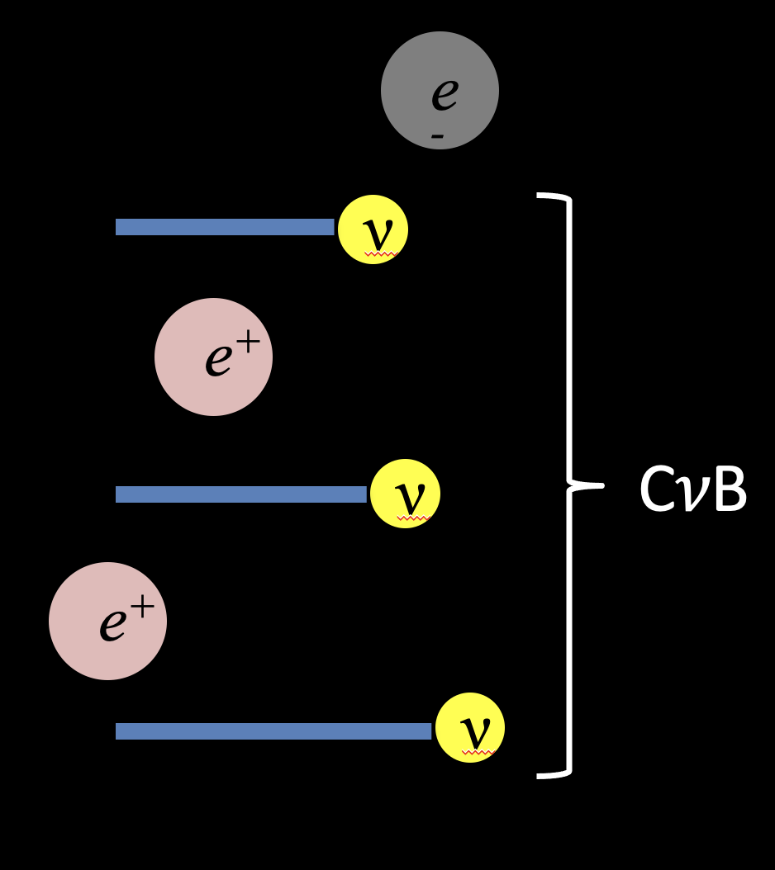
Formation of the C𝜈B…
Interaction rate:
$$Γ_{weak}\sim G_{F}^{2}T^{5}$$
Expansion rate:
$$H\sim M_{pl}^{−2}T^{2}$$
The C𝜈B is formed when neutrinos decouple from the cosmic plasma.
Neutrinos
“free-stream”
to infinity.
($T_{⊙core}\sim 1 keV$)
Above$T \sim 1 MeV$, even weakly-interacting neutrinos can be produced, scatter off $e^{+}e^{−}$and other neutrinos, and attain thermodynamic equilibrium
Below $T \sim 1 MeV$, expansion dilutes plasma, and reduces interaction rate: the universe becomes transparent to neutrinos.

Slide 5
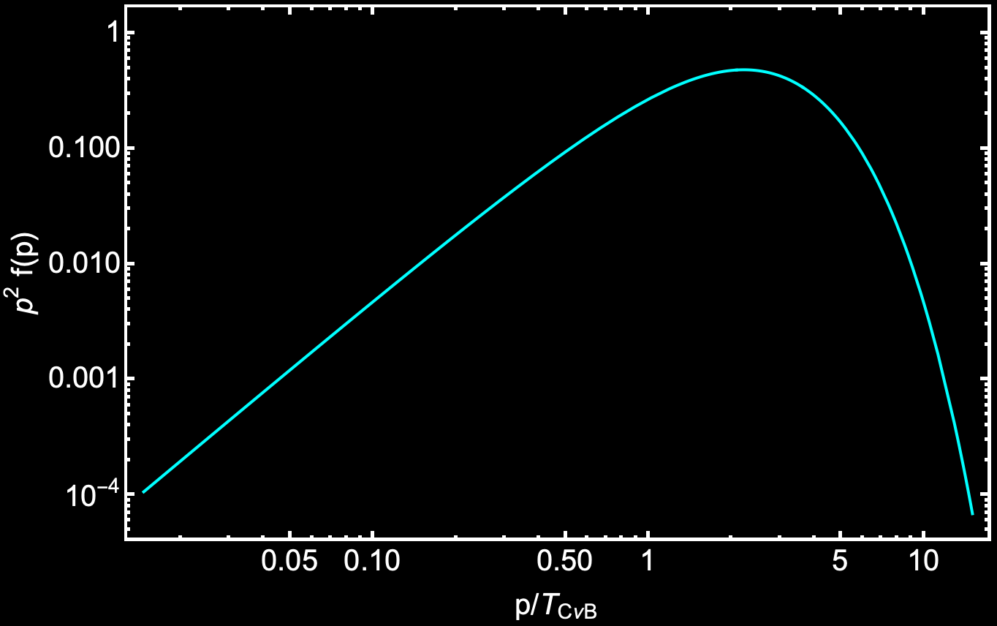
The cosmic neutrino background…
Standard model predictions
Per family of
neutrinos
+antineutrinos
Number density:
Energy density:
Relativistic (if $T_{CνB}≫m_{ν}$):
Non-rel (if $T_{CνB}≪m_{ν}$):
Relativistic Fermi-Dirac
distribution
$$nCνB≃110 {cm}^{−3}$$
$$ρ_{CνB}≃\frac{7}{8}{\left(\frac{4}{11}\right)}^{4/3} ρ_{CMB}$$
Temperature:
$$TCνB={\left(\frac{4}{11}\right)}^{1/3}TCMB$$
$$Ω_{CνB}≃\frac{m_{ν}}{93 h^{2} eV}$$
Neutrino dark matter

Slide 6
Primordial nucleo-synthesis
Cosmic neutrino background $t \sim 1s$, $T \sim 1 MeV$

Slide 7
What can cosmology do for neutrino physics?
Precision cosmological observations allow us to infer the properties of the cosmic neutrino background, from which to determine :
Absolute neutrino mass scale,
Number of neutrino families,
Deviations from SM prediction of
e.g., test for the existence of light sterile states
Neutrino decay/lifetime,
Non-standard neutrino interactions
Self, neutrino-dark matter, neutrino-dark energy
…
“Standard” tests
More exotic, but of growing interest

Slide 8
1. What can cosmology do for neutrino physics?

Slide 9
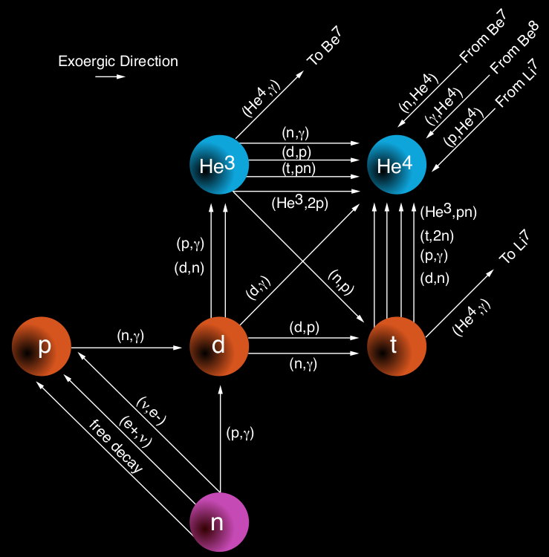
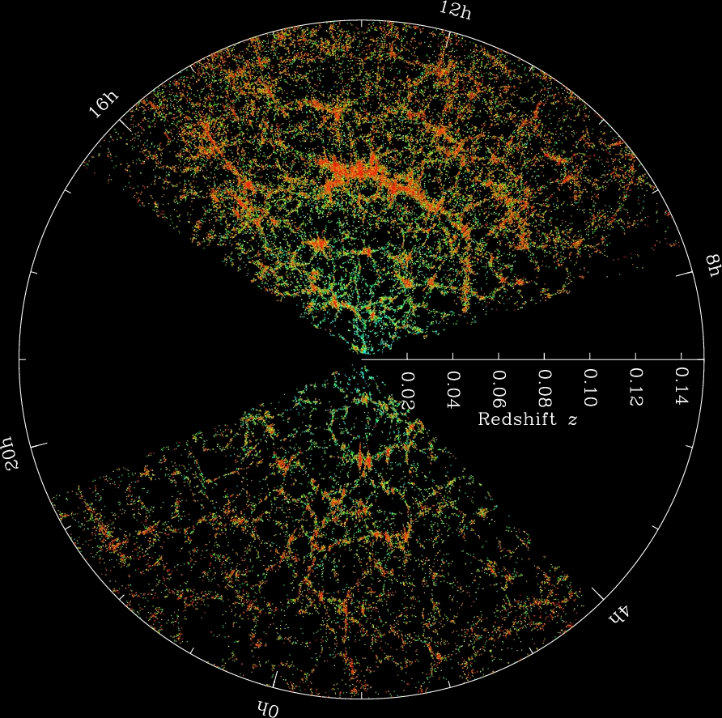
Cosmological observables…
+ Supernova Ia, local H₀, etc.
(No direct neutrino effects)
Light element abundances from primordial nucleosynthesis
Cosmic microwave background anisotropies
Large-scale matter distribution
$${He}^{3}$$
$${He}^{4}$$
$$p$$
$$d$$
$$t$$
$$n$$
$N_{eff}$ (expansion rate)
Interactions (free-streaming)
Lifetime (free-streaming)
$N_{eff}$ (expansion rate)
$\sum{m_{ν}}$ (perturbation growth)

Slide 10
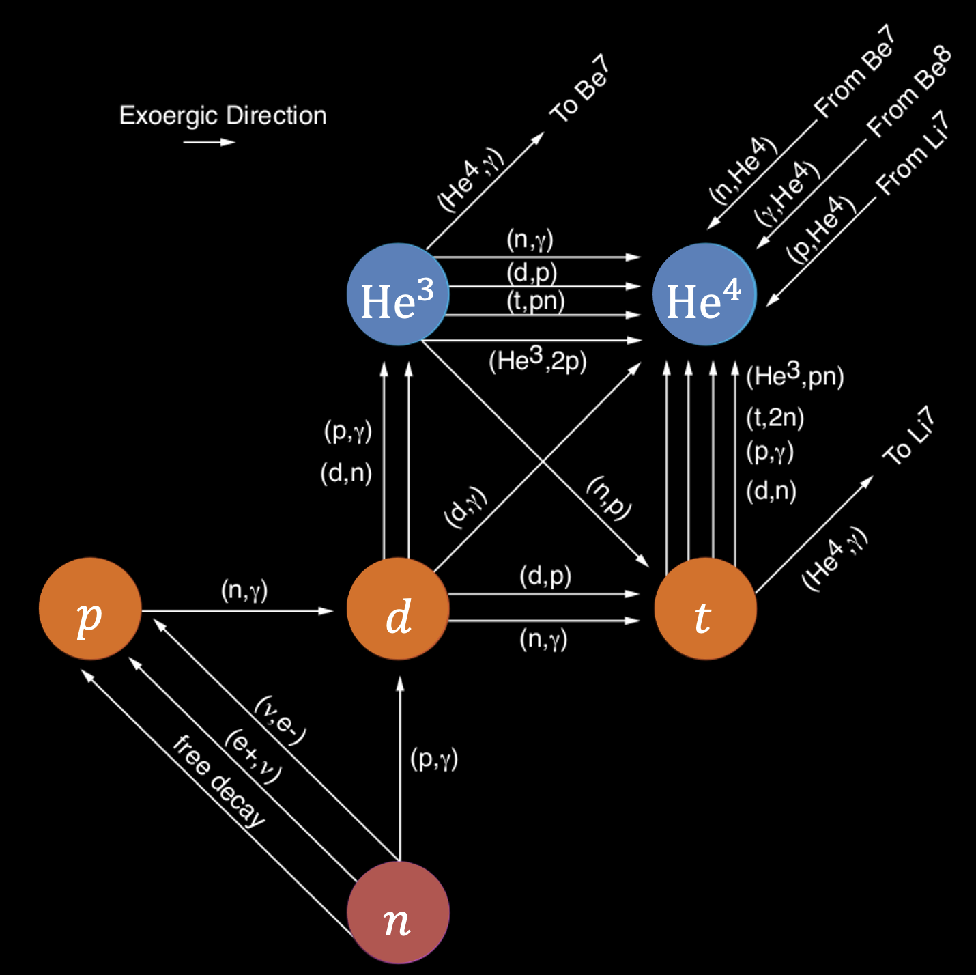
What do these probes really probe?
They may look different, but ultimately the information contained is
Universal expansion rate at different times
How much matter, radiation, “in-between” (e.g., neutrinos), vacuum energy, etc.
Growth of fluctuations under gravity
Kinematic properties and interactions of the various types of stuff in the universe; good for neutrino physics
Distance measurements
Spatial geometry, dark energy; not directly relevant for neutrino physics but has indirect effects on inference

Slide 11
Neutrinos & the expansion rate…
The Hubble expansion rate depends on the energy content of the universe:
$$H^{2}\left(a(t)\right)=H_{0}^{2}\left(Ω_{m}a^{−3}+Ω_{r}a^{−4}+Ω_{Λ}+Ω_{k}a^{−2}+…\right)$$
Scale factor
Matter
Radiation
Cosmological constant
Spatial curvature
Neutrinos = radiation at early times
= matter at late times

Slide 12
Neutrinos & the expansion rate…
The Hubble expansion rate depends on the energy content of the universe:
$$H^{2}\left(a(t)\right)=H_{0}^{2}\left(Ω_{m}a^{−3}+Ω_{r}a^{−4}+Ω_{Λ}+Ω_{k}a^{−2}+…\right)$$
Scale factor
Matter
Radiation
Cosmological constant
Spatial curvature
Standard cosmology
$$ρ_{other}+ρ_{CMB}+\sum{ρ_{CνB}}=\left[1+N_{eff}×\frac{7}{8}{\left(\frac{4}{11}\right)}^{4/3}\right] ρ_{CMB}$$
$$N_{eff}^{SM}=3.0440±0.0002$$
For 3 SM families, includes $m_{e}/T$ corrections, non-instantaneous decoupling, finite-temperature QED, and neutrino oscillations.
Bennett et al, 2020, 2021;
Froustey, Pitrou & Volpe, 2020

Slide 13
Neutrinos & the expansion rate…
The Hubble expansion rate depends on the energy content of the universe:
$$H^{2}\left(a(t)\right)=H_{0}^{2}\left(Ω_{m}a^{−3}+Ω_{r}a^{−4}+Ω_{Λ}+Ω_{k}a^{−2}+…\right)$$
Scale factor
Matter
Radiation
Cosmological constant
Spatial curvature
$$ρ_{other}+ρ_{CMB}+\sum{ρ_{CνB}}=\left[1+N_{eff}×\frac{7}{8}{\left(\frac{4}{11}\right)}^{4/3}\right] ρ_{CMB}$$
Any ultra-relativistic, feebly-interacting, particle species produced in some abundance in the early universe will look like a neutrino cosmologically, e.g., light sterile neutrinos, thermal axions, etc.
$$N_{eff}^{SM}=3.0440±0.0002$$
For 3 SM families, includes $m_{e}/T$ corrections, non-instantaneous decoupling, finite-temperature QED, and neutrino oscillations.
Bennett et al, 2020, 2021;
Froustey, Pitrou & Volpe, 2020

Slide 14
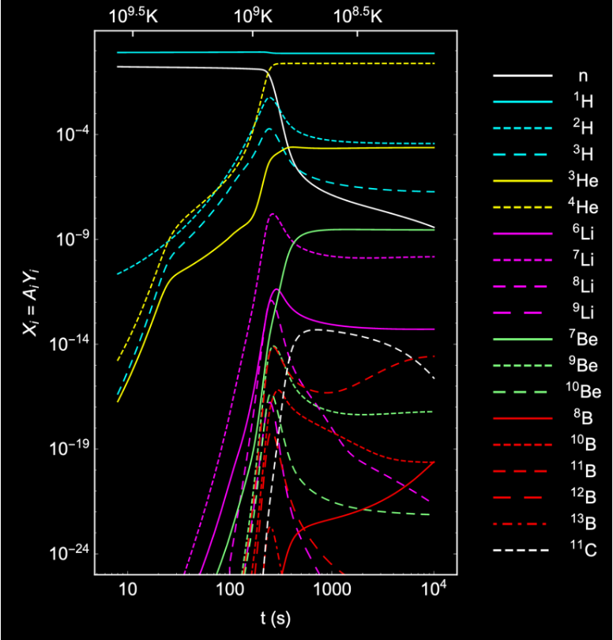
Nucleosynthesis & N_{eff}…
Constraining $N_{eff}$ with the primordial elemental abundances has a long history.
Abundance
Pitrou, Coc, Uzan & Vangioni 2018
Time after big bang [s]
How much of these elements is produced depends on how fast the universe expands.
$$N_{eff}<5$$

Slide 15
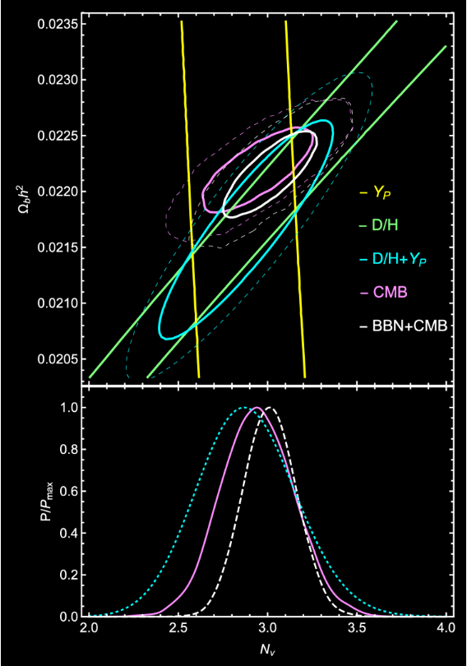
Nucleosynthesis & N_{eff}…
Constraining $N_{eff}$ with the primordial elemental abundances has a long history.
D/H = Deuterium
Y_{p} = Helium-4
Pitrou, Coc, Uzan & Vangioni 2018
$$N_{eff}=2.88±0.27 (68\% CL)$$
$$N_{eff}<5$$
Consistent with Standard Model prediction $N_{eff}≈3$

Slide 16
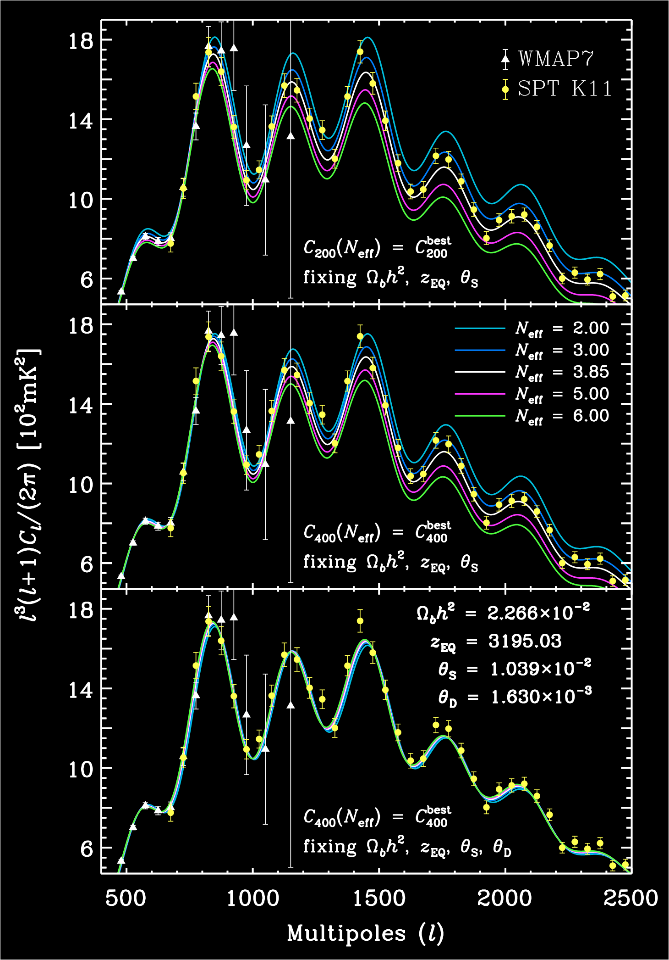
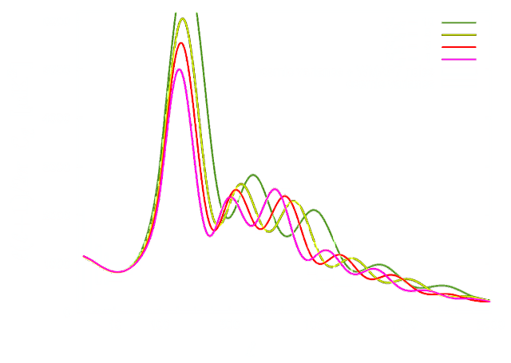
CMB anisotropies & N_{eff}…
Hou, Keisler, Knox, Millea & Reichardt 2013
$N_{eff}$ also affects the expansion rate at recombination.
Observable in the CMB temperature power spectrum
“Naïve” signature
“Irreducible” signature is in the CMB damping tail
Consistent with Standard Model prediction $N_{eff}≈3$
Planck TTTEEE+lowE
+lensing+BAO;
7-parameters
$$N_{eff}=2.99±0.34 (95\% CL)$$
Aghanim et al. [Planck] 2021

Slide 17
BSM physics constrainable by N_{eff} …
Light sterile neutrinos
Thermal axions and ALPs
Massless dark photons
Gravitational waves
Generic dark radiation
Neutrino NSI
Time-varying gravitational constant
…

Slide 18
What do these probes really probe?
They may look different, but ultimately the information contained is
Universal expansion rate at different times
How much matter, radiation, “in-between” (e.g., neutrinos), vacuum energy, etc.
Growth of fluctuations under gravity
Kinematic properties and interactions of the various types of stuff in the universe; good for neutrino physics
Distance measurements
Spatial geometry, dark energy; not directly relevant for neutrino physics but has indirect effects on inference
Neutrino masses, $\sum{m_{ν}}$ (large-scale structure)
Neutrino decay/lifetime, $τ_{0}$ (CMB)
Non-standard neutrino interactions (CMB)

Slide 19
Neutrino masses & large-scale structure...
Cold dark matter only
Cold dark matter + neutrinos ($\sum{m_{ν}=6.9}eV$)
$$Ω_{CDM}≈10\%$$
$$Ω_{ν}=\frac{\sum{m_{ν}}}{93 h^{2}}≈15\%$$
$$Ω_{CDM}≈25\%$$
$$256 h^{−1}\text{Mpc}$$
~ 3% of largest observable distance
Simulations by Troels Haugbølle

Slide 20
Matter power spectrum…
Replace some CDM with neutrino DM
Large-scale matter
power spectrum, P(k)
.$\frac{∆P}{P}∝\frac{Ω_{ν}}{Ω_{m}}∝\sum{m_{ν}}$

Slide 21
Matter power spectrum…
Galaxy clustering
/BAO
Cosmic
shear
CMB lensing
potential
(z~3-4)
Large-scale matter
power spectrum, P(k)
CMB “primary” (z~1000)
Cluster
abundance
Lyman-α
(z~2-4)
.$\frac{∆P}{P}∝\frac{Ω_{ν}}{Ω_{m}}∝\sum{m_{ν}}$

Slide 22
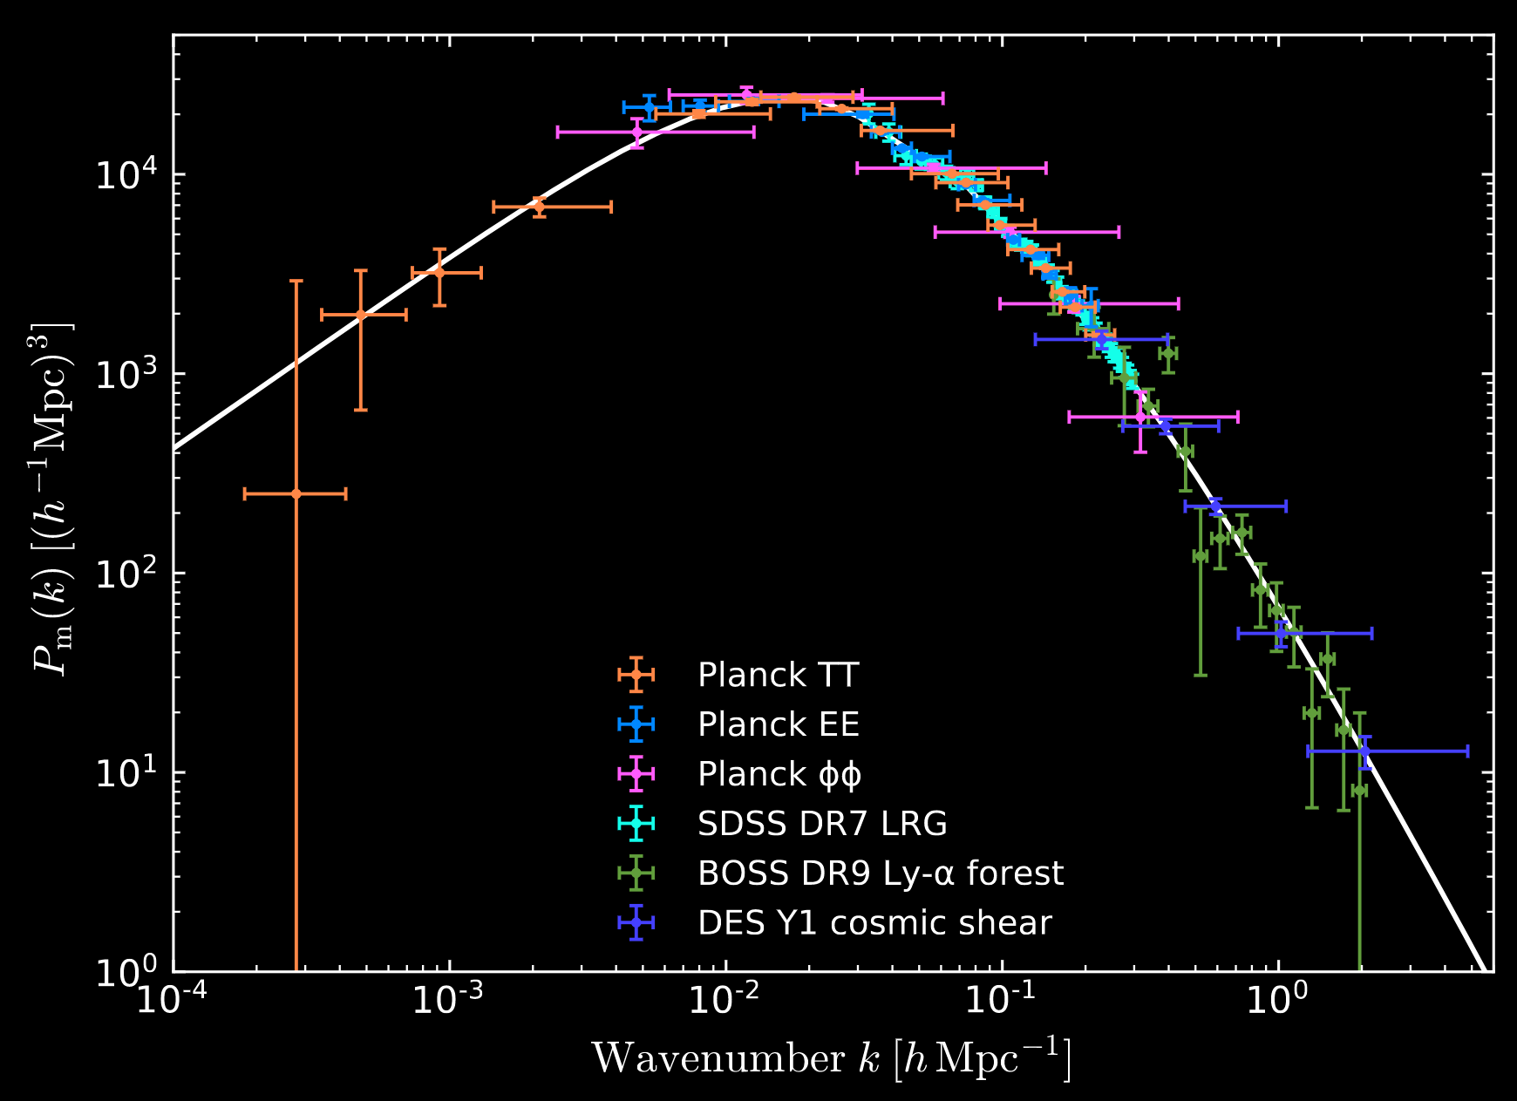
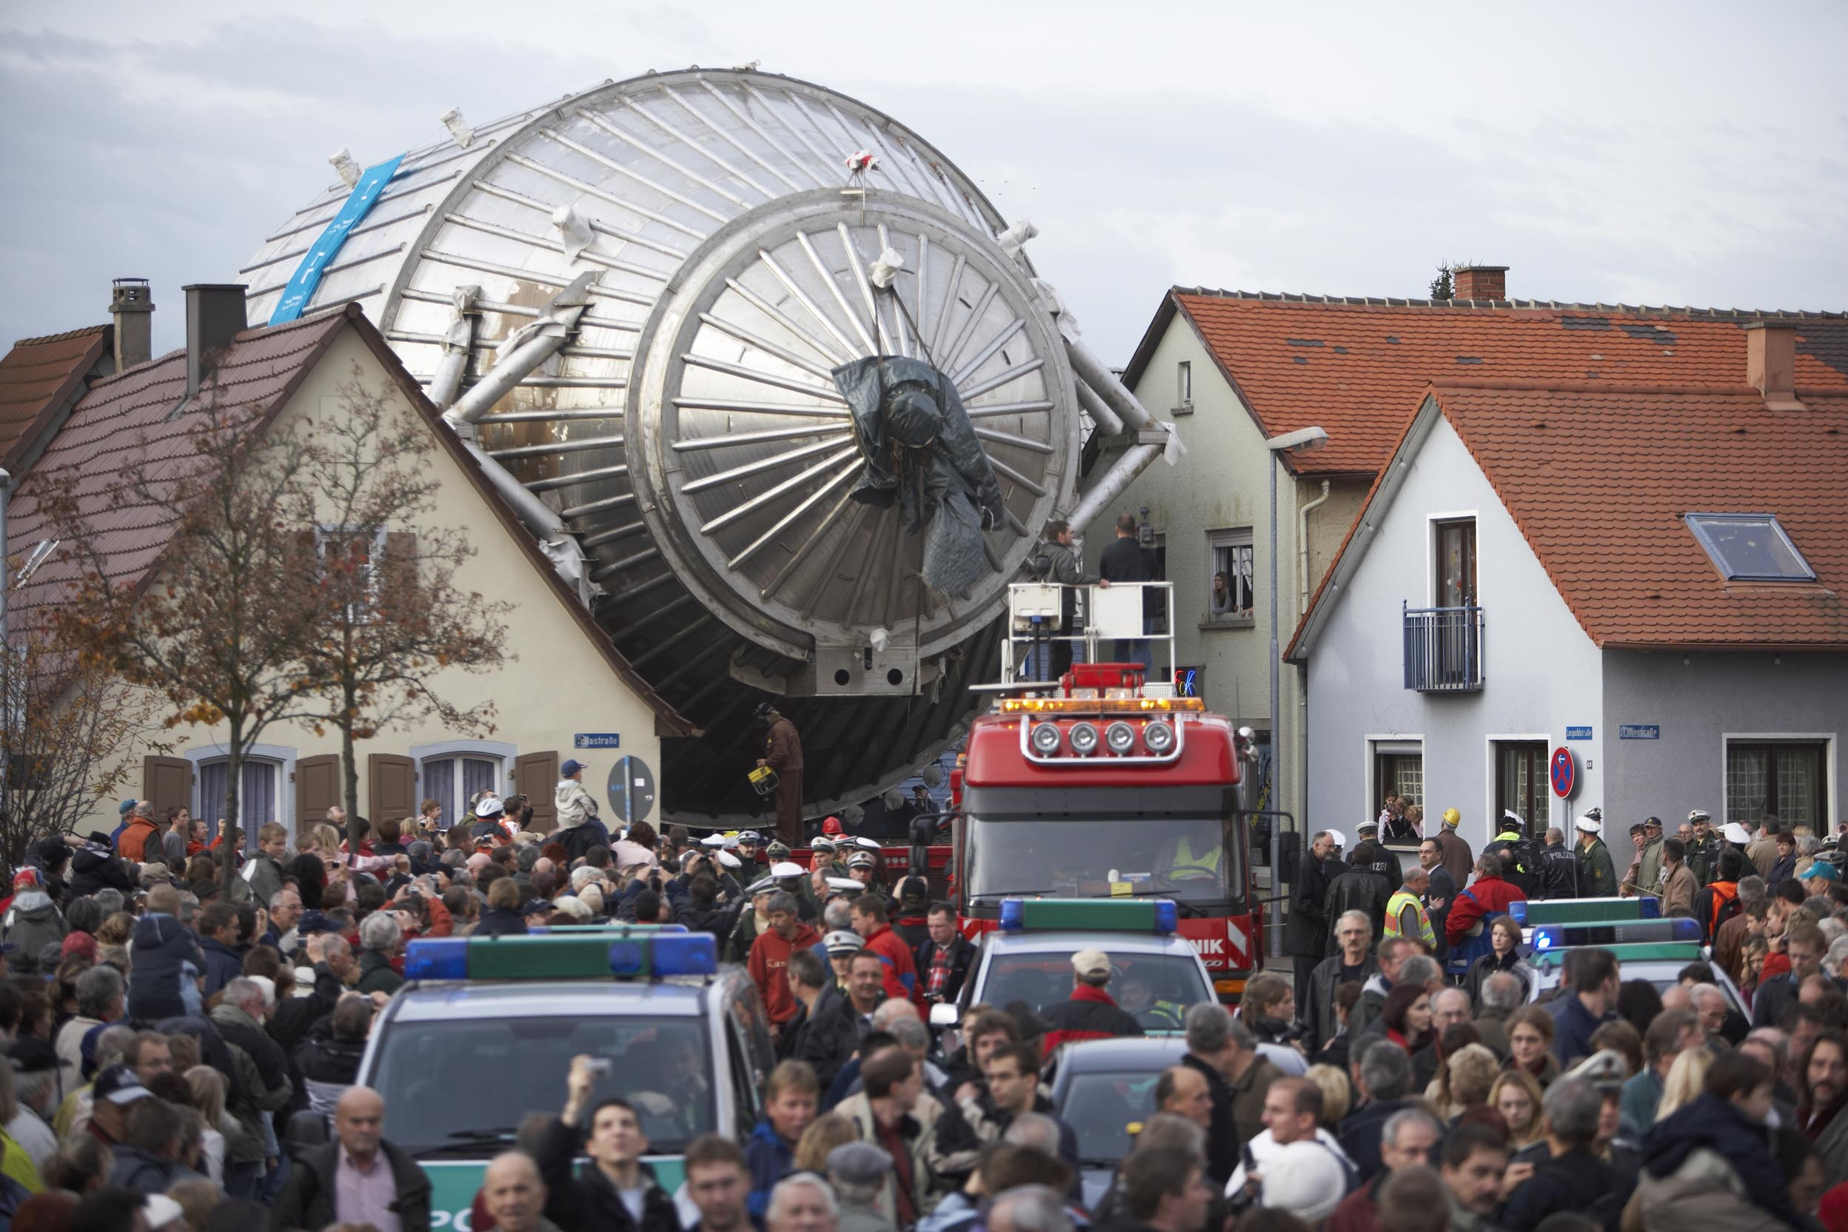
Neutrino mass from cosmology…
Large-scale matter power spectrum measurement ca. 2018
Current cosmological limits on the neutrino mass sum typically fall in the range, depending on assumptions:
.$\sum{m_{ν}}<O(0.1 −0.5)eV (95\% CL)$
Aghanim et al. [Planck] 2021
At face value a factor of 6 tighter than current lab bound from KATRIN, $\sum{m_{ν}}<3 eV$.
Aker et al. [KATRIN] 2019
p
n
ν
n
³H
e
p
n
p
³He
Ade et al. [Planck] 2018

Slide 23
The mandatory cautionary note…
$\sum{m_{ν}}<O\left(0.1 −0.5\right) eV \left(95\% CL\right)$ is a pretty conservative range.
Encompasses most “reasonable” variations in how the limit is extracted (e.g., assumptions about the background cosmology.)
But it’s not entirely impossible to get around these limits if you’re willing to introduce some non-standard neutrino physics, e.g.,
Late-time 𝜈 mass generation: $\sum{m_{ν}}<1.5 eV$
𝜈 spectral distortions (from new interactions): $\sum{m_{ν}}<3 eV$
Cf KATRIN sensitivity: $\sum{m_{ν}}<0.6 eV$
Dvali & Funcke 2016; Lorenz, Funcke, Löffler & Calabrese 2021
Alvey, Escudero & Sabti 2022

Slide 24
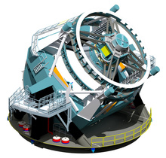
Future cosmological probes…
$1σ$ sensitivity to $\sum{m_{ν}}$
$1σ$ sensitivity to $N_{eff}$
ESA Euclid
2023
$$0.011 −0.02 eV$$
$$0.05$$
LSST
2024
$$0.015 eV$$
$$0.05$$
CMB-S4
>2027
$$0.015 eV$$
$$0.02 −0.04$$
Minimum $\sum{m_{ν}=0.06 eV}$
A $3σ−4σ$ detection of the neutrino mass sum may be possible!
From neutrino oscillations
(assuming normal mass ordering)

Slide 25
What do these probes really probe?
They may look different, but ultimately the information contained is
Universal expansion rate at different times
How much matter, radiation, “in-between” (e.g., neutrinos), vacuum energy, etc.
Growth of fluctuations under gravity
Kinematic properties and interactions of the various types of stuff in the universe; good for neutrino physics
Distance measurements
Spatial geometry, dark energy; not directly relevant for neutrino physics but has indirect effects on inference
Neutrino masses, $\sum{m_{ν}}$ (large-scale structure)
Neutrino decay/lifetime, $τ_{0}$ (CMB)
Non-standard neutrino interactions (CMB)

Slide 26
Formation of the C𝜈B…
Interaction rate:
$$Γ_{weak}\sim G_{F}^{2}T^{5}$$
Expansion rate:
$$H\sim M_{pl}^{−2}T^{2}$$
The C𝜈B is formed when neutrinos decouple from the cosmic plasma.
Neutrinos
“free-stream”
to infinity.
($T_{⊙core}\sim 1 keV$)
Above$T \sim 1 MeV$, even weakly-interacting neutrinos can be produced, scatter off $e^{+}e^{−}$and other neutrinos, and attain thermodynamic equilibrium
Below $T \sim 1 MeV$, expansion dilutes plasma, and reduces interaction rate: the universe becomes transparent to neutrinos.

Slide 27
Neutrino free-streaming & the CMB…
Standard neutrinos free-stream.
Free-streaming in an inhomogeneous background induces shear stress/momentum anisotropy.
Conversely, interactions transfer momentum and wipe to out shear.
Free-streaming case
Interacting case
Peak
Scattering transfers
momentum and
wipes out shear
Trough
Sinusoidal
gravitational
potential
Peak
Trough
Peak
Neutrino shear stress (or lack thereof) leave distinct imprints on the spacetime metric.
Affects the evolution of CMB perturbations; observable in the TT spectrum.

Slide 28
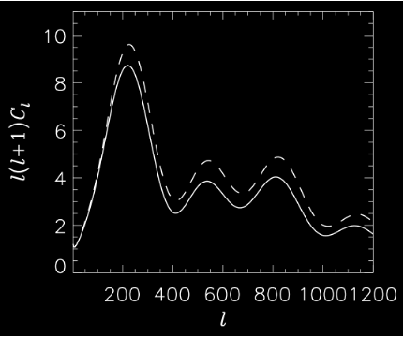
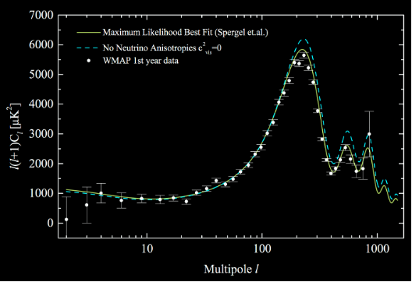
Neutrino free-streaming & the CMB…
That CMB prefers neutrino shear stress to no shear stress is well known.
No neutrino shear stress
Standard neutrino shear stress
Hannestad 2005
Melchiorri & Trotta 2005
The trick is in translating this preference to constraints on the fundamental parameters of a non-standard neutrino interaction → What is the isotropisation timescale?
Isotropisation timescale should be longer than the CMB timescale (400k years).

Slide 29
Isotropisation from 𝜈 self-interaction…
Consider a 2-to-2 scattering event $ν_{i}+ν_{i}→ν_{f}+ν_{f}.$
$$ν_{f}$$
→ Particles in two head-on $ν_{i}$beams need only scatter once to transfer their momenta equally in all directions.
$$ν_{f}$$
$$ν_{i}$$
$$θ$$
$$ν_{i}$$
$$ν_{f}$$
Isotropisation timescale
$$ν_{f}$$
The probability of $ν_{f}$ emitted at any angle $θ$ is the same for all $θ∈[0,π]$.
Scattering rate
$$T_{isotropise} \sim 1/Γ_{scattering}$$
$$≳400 kyr$$
Cyr-Racine & Sigurdson 2014; Oldengott, Rampf & Y³W 2015;
Lancaster, Cyr-Racine, Knox & Pan 2017; Oldengott, Tram, Rampf & Y³W 2017;
Kreisch, Cyr-Racine & Dore 2019; Forastieri et al. 2019; etc.
→ Upper limit on $Γ_{scattering}$ and hence coupling.

Slide 30
𝜈 self-interaction and the $H_{0}$ tension…
Kreisch, Cyr-Racine & Dore 2019
Recent claim that self-interaction alleviates the Hubble tension.
Local/late time: Cepheid-calibrated SNIa (SH0ES) and strong-lensing time delays (H0liCOW); $H_{0}=(73.5 ± 1.4) km/s/Mpc$
Global/early time: Statistical inference from CMB anisotropies (Planck), weak lensing, BAO; $H_{0}= (67.4 ± 0.5) km/s/Mpc$
Global
Local
This island:
$$G_{eff} \sim { 10}^{10}G_{F}$$
Disclaimer: I am not endorsing this result…

Slide 31
Isotropisation from relativistic 𝜈 decay…
How long does it take $ν_{H}→ν_{l}+φ$ and its inverse process to wipe out momentum anisotropies? (Hint: it’s not the rest-frame lifetime of $ν_{H}$.)
$$φ$$
Assuming a massless $φ$
$$ν_{H}$$
$$θ_{φ}≈{m_{νH}}/{E_{νH}}$$
Isotropisation timescale
$θ_{νl}≈$ $\left(\frac{Δm_{ν}^{2}}{m_{νH}^{2}}\right)θ_{φ}$
$$ν_{l}$$
In relativistic decay, the decay products are beamed.
Inverse decay can also only happen when the daughter particles satisfy strict momentum/angular requirements.
Boost
Rest-frame lifetime
→Isotropisation is a looooong process:
$$T_{isotropise} \sim {\left(θ_{φ}θ_{νl}\right)}^{−2} γ_{νH} τ_{rest}$$
$$≳400 kyr$$
Barenboim, Chen, Hannestad, Oldengott, Tram & Y³W 2021
Chen, Oldengott, Pierobon & Y³W 2022
→ Lower bound on $τ_{rest}$ as a function of $m_{νH}$ and $m_{νl}$.

Slide 32
CMB lower bounds on the neutrino lifetime…
CMB currently offers the best limits on non-radiative neutrino decay $ν_{H}→ν_{l}+φ.$
$$ν_{3}→ν_{2+1}(NO)$$
$$ν_{2+1}→ν_{3}(IO)$$
$$ν_{3}→ν_{2or1}(NO)$$
$$ν_{2or1}→ν_{3}(IO)$$
IceCube & future 𝜈 telescope forecasts
$$ν_{2}→ν_{1} (NO)$$
$$ν_{2}→ν_{1} (IO)$$
IceCube constraints
IceCube constraints
SN 1987A constraints
SN 1987A constraints
Chen, Oldengott, Pierobon & Y³W 2022
* IceCube constraints & forecasts from Song et al. 2021

Slide 33
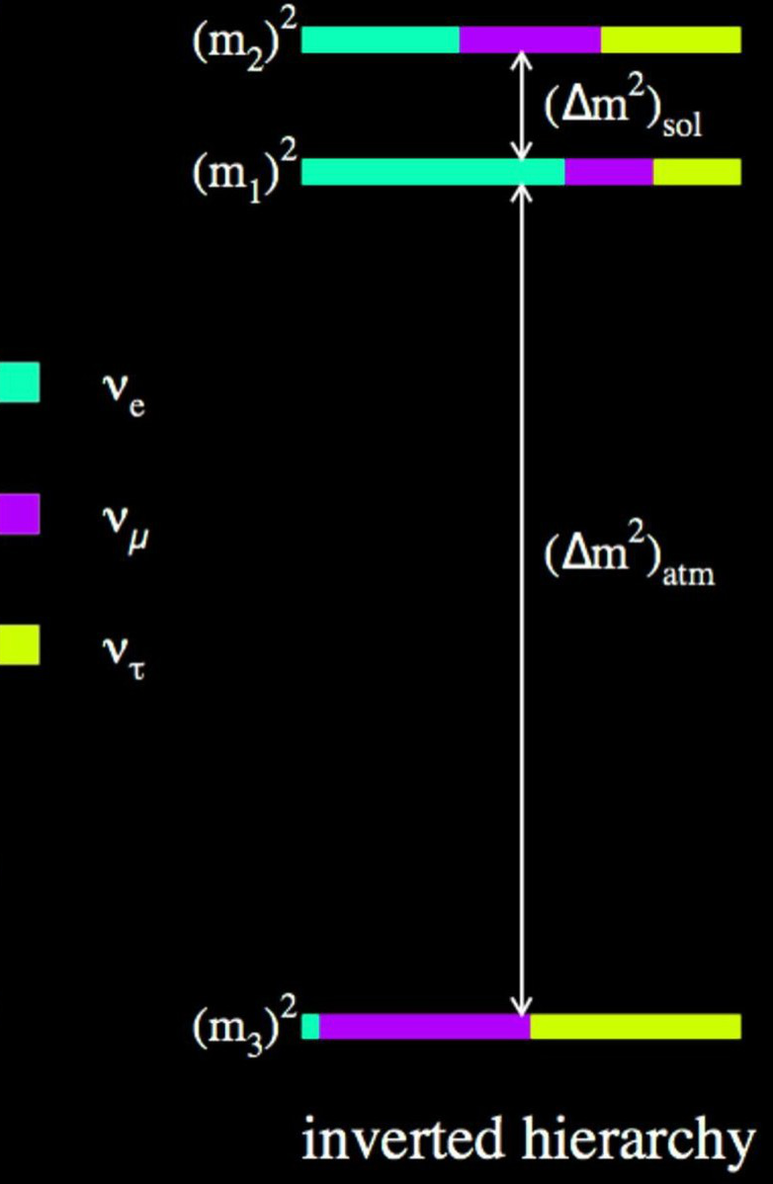
CMB lower bounds on the neutrino lifetime…
CMB currently offers the best limits on non-radiative neutrino decay $ν_{H}→ν_{l}+φ.$
$$ν_{2}$$
However, depending on the exact decay scenario, neutrino telescopes may become competitive in the future! Watch this space!
$$ν_{1}$$
Allowed
IceCube & future 𝜈 telescope forecasts
CMB limit
$$ν_{2}→ν_{1} (IO)$$
Ruled out
IceCube constraints
SN 1987A constraints
BBN:
Solar 𝜈:
Lab 𝜈:
$$τ_{0}≳{10}^{−2}→{10}^{−1} s$$
$$τ_{0}≳{10}^{−5}→{10}^{−4} s$$
Chen, Oldengott, Pierobon & Y³W 2022
$$τ_{0}≳{10}^{−13}→{10}^{−11} s$$
* IceCube constraints & forecasts from Song et al. 2021

Slide 34
2. What can neutrino physics do for cosmology?

Slide 35
What can neutrino physics do for cosmology?
From the theoretical perspective:
Origin of dark matter = keV sterile neutrinos as a dark matter candidate
Origin of the matter-antimatter asymmetry = leptogenesis linked to neutrino mass generation
More directly, neutrino experiments can also help to pin down parameters of the C𝜈B and hence allow us to gain more precise and accurate information about the other stuff in the universe.

Slide 36
What can neutrino physics do for cosmology?
Parameter estimation from cosmological observations is based on statistical inference.
Observations don’t actually measure the dark matter density or the dark energy equation of state, and much less anything about inflation.
Inference always assumes a model:
The less the model uncertainty, the more precise and accurate the parameter estimates.
Neutrinos are unique in that they are the only cosmologically significant component that has a precise prediction within the Standard Model and whose properties can be independently measured in a laboratory.
Eliminating uncertainty in the neutrino sector will help us pin down other cosmological parameter inaccessible in the laboratory.

Slide 37
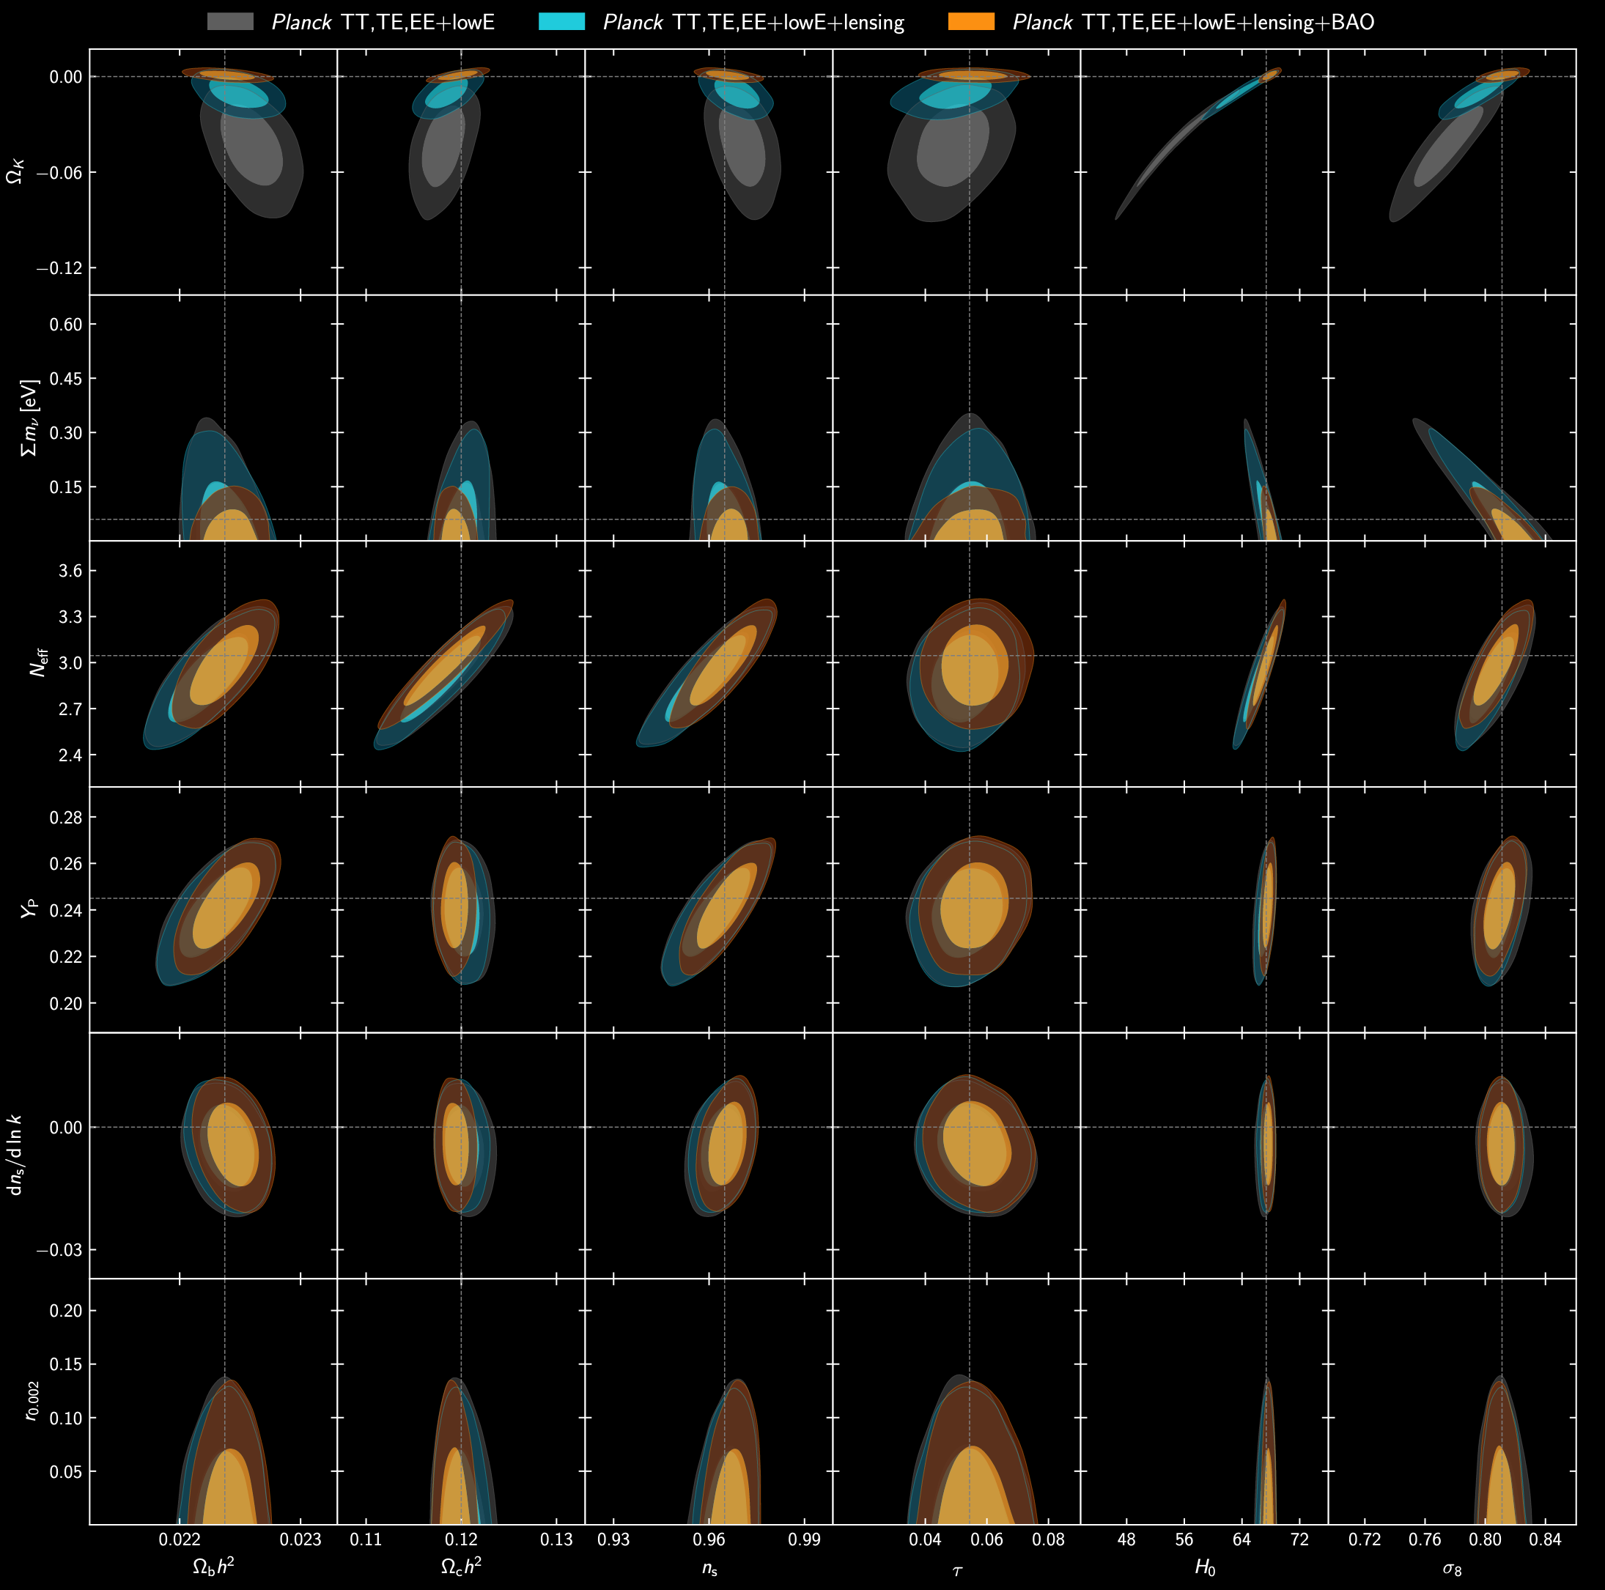
A direct neutrino mass measurement or even a confirmation of the inverted mass ordering (minimum $\sum{m_{ν}}=0.11 eV$) by oscillation experiments would help to shrink these ellipses.
Neutrino mass
Effective number
of neutrinos
Establishing the existence (or not) of light sterile neutrino states through oscillation experiments would shrink the uncertainty in $N_{eff}$ from the neutrino sector.
More accurate estimates of parameters inaccessible in the lab.
Aghanim et al. [Planck] 2021
Dark matter density
Spectral index
Hubble parameter
Fluctuation amplitude

Slide 38
What can neutrino physics do for cosmology?
Ultimate prize = Direct detection of the C𝜈B itself
Best idea uses the 𝛽-decay end-point spectrum → Goes hand-in-hand with direct neutrino mass detection.
Weinberg 1962
Cocco, Mangano & Messina 2007
$$N→N^{′}+e^{−}+{\overline{ν}}_{e}$$
$$ν_{e}^{CνB}N→N^{′}+e^{−}$$
$Rate\sim 7.5/year$ $/(100 g tritium)$
Electron energy spectrum (end point)
Monochromatic signal from relic neutrino capture
KATRIN source:
~ 0.1 mg tritium
$$2m_{ν}$$
$$Q_{β}−m_{ν}$$
$$Q_{β}≡m_{N}−m_{N′}$$
$$Q_{β}+m_{ν}$$

Slide 39
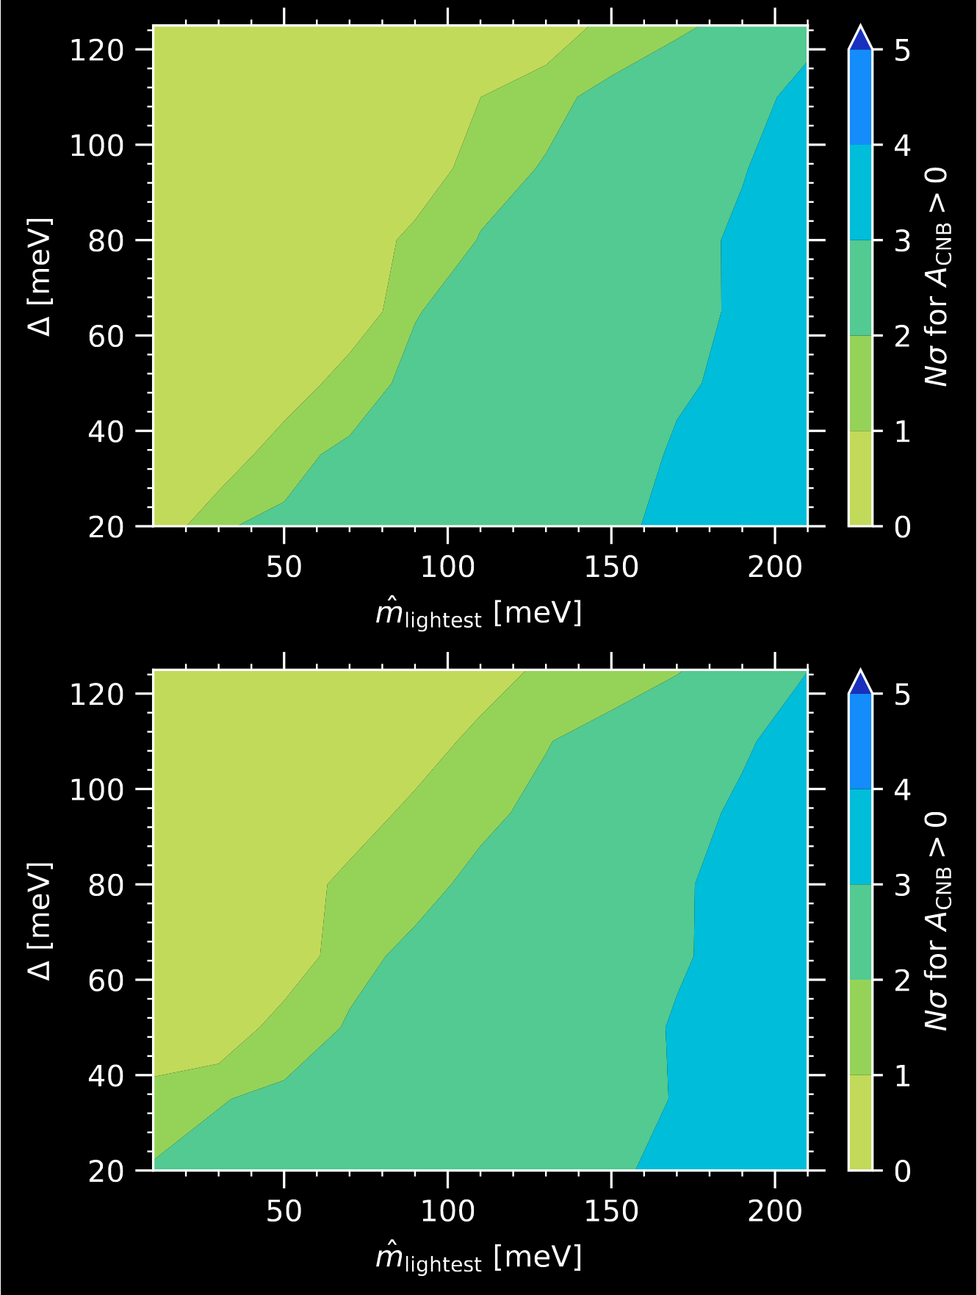
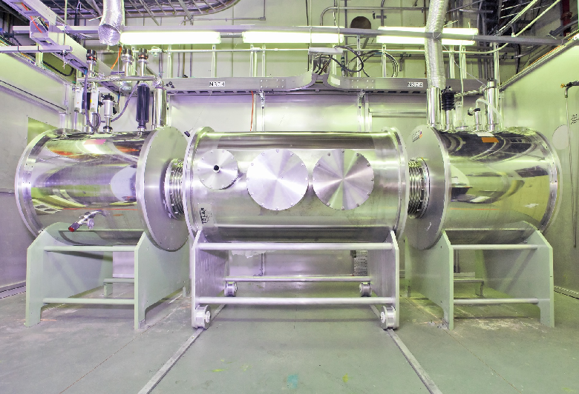
What can neutrino physics do for cosmology?
Ultimate prize = Direct detection of the C𝜈B itself
Best idea uses the 𝛽-decay end-point spectrum → Goes hand-in-hand with direct neutrino mass detection.
Ptolemy Experiment
Normal mass ordering
Energy resolution
Statistical significance of the detection (100 g yr)
Inverted mass ordering
The PTOLEMY prototype at the Princeton Plasma Physics Laboratory
Betti et al. [PTOLEMY] 2019

Slide 40
Summary…
The existence of a cosmic neutrino background is a fundamental prediction of SM+FLRW cosmology.
Precision cosmological observations have allowed us to infer the properties of this background, from which to determine neutrino properties.
e.g., masses, effective number of neutrinos, non-standard interactions, lifetime.
Conversely, better determination of neutrino properties in laboratory experiments will allow us to eliminate some model uncertainty in the cosmological parameter inference exercise.
More precise and accurate constraints on the dark matter density, dark energy properties, inflationary physics, and other cosmological physics inaccessible in the laboratory.

