Slide 1
The CMB-S4 Project
Hogan Nguyen (he/him), Fermilab
for the CMB-S4 Collaboration
08/08/23

Slide 2
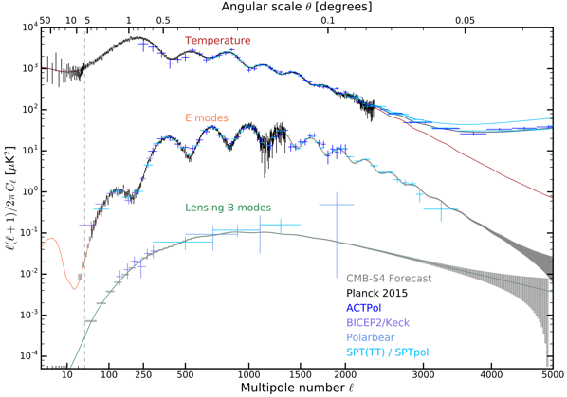
CMB-S4 Science Themes
Time-variable millimeter-wave sky
light relics
Matter mapping and neutrino mass
inflation

Slide 3
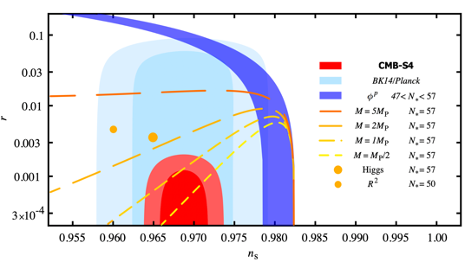
Critical Thresholds on Inflation
Inflation would have
left a unique imprint in the
polarization of the
CMB in the form of B-modes.
CMB-S4 will reach 𝝈(r)<0.0005
Two orders of magnitude lower than current constraints!
Discover or rule out a large class of inflationary models
CMB-S4 Science Book, 2016
Notes:
r=0 scenario
The Starobinsky model and Higgs inflation are shown as small and large filled orange circles. The lines show the classes of models discussed in Section 2.5 that naturally explain the observed value of the scalar spectral index for different characteristic scales in the potential (see eq. (2.28)), M = MP/2, M = MP, M = 2 MP, and M = 5 MP

Slide 4




Probing Light Relics
Any light relics would modify the radiation density: sound horizon and damping scale of the CMB power spectra
Probe extensions to the Standard Model: Axions, sterile neutrinos, dark photons, gravitinos
Broad, model-independent capability to discover or rule out new light relics that freeze out during and after QCD phase transition
Planck (current):
CMB-S4:

Slide 5
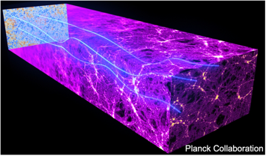
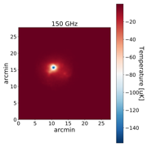
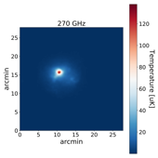
Matter Mapping
Map matter through gravitational lensing of the CMB: galaxy clusters would deflect CMB photons by ~ 1 arcmin and change its statistical properties.
Detect Large # of Galaxy clusters (z > 2) via the Sunyaev-Zel’dovich effect
Probe the growth of matter structure:
  Sensitive to dark matter, dark energy, sum of the neutrino masses
  Complementary to neutrino oscillation experiments and to supernovae and large-scale structure surveys
Notes:
~1300 ish, 21,000 clusters

Slide 6
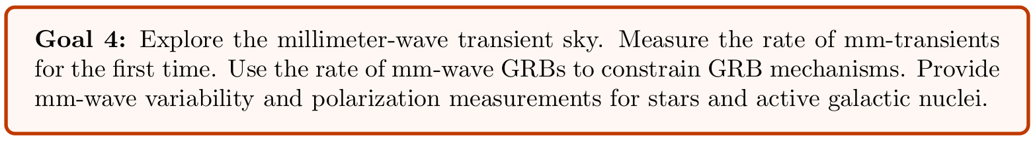
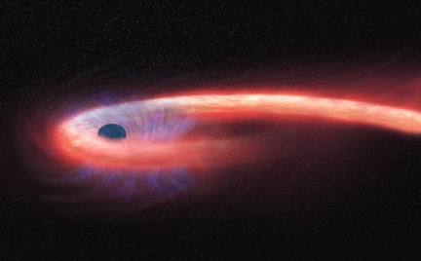
The Time-Variable Millimeter-Wave Sky
CMB S4 maps made on few hour timescales
  Early detection
  Follow up at other wavelengths → moving into age of multi-messenger astronomy
NASA / CXC / M. Weiss.
Notes:
gamma ray bursts, supernovae, tidal disruption events, and active galactic nuclei

Slide 7
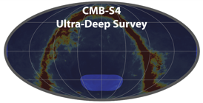
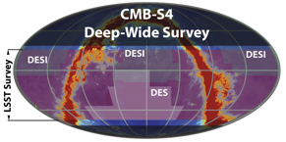
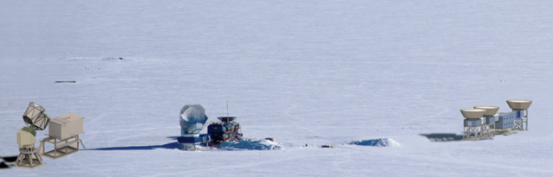
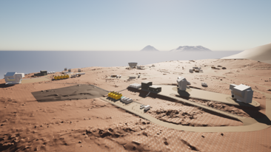
CMB-S4 Design
Ultra-Deep Survey from the South Pole and Deep-Wide Survey from Chile with arcmin angular resolution
7 frequency bands (20-300 GHz) for foreground subtraction
Uses mature technology successfully demonstrated in current experiments (ACT, Polar Bear, SPT, BK Array, etc ..)
Exceeds current generation by ~10x in channel count
South Pole
Chile
CHLATs
SATs
SPLAT

Slide 8
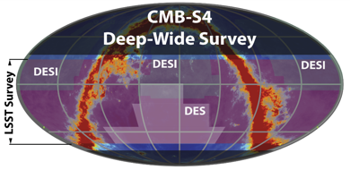

Two Large Aperture Telescopes in Chile
Chile
Deep and Wide field survey optimized for
matter mapping via CMB lensing,
neutrino mass, light relics, and
transient mm-wave phenomenon.
Overlaps with other optical surveys (DES, DESI, LSST) for cross-correlation
Two 6-m Large Area Telescopes

Slide 9
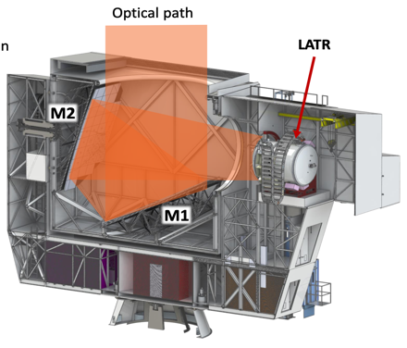
Two Large Aperture Telescopes in Chile
6-meter primary diameter
Crossed-Dragone Design
1.4’ angular resolution at 150 GHz
Design based on experience from
CCAT-Prime and the upcoming
Simon’s Observatory
Gallardo et. al. https://arxiv.org/abs/2207.10012

Slide 10


South Pole Large and Small Area Telescopes
South Pole
Large Area Telescope for B-mode Delensing
3 Small Area Telescopes for B-mode
survey
SPT and Bicep/Keck Array

Slide 11
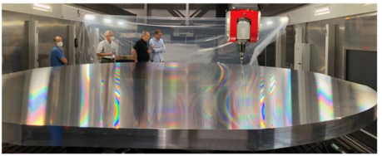
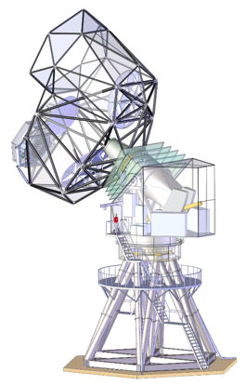
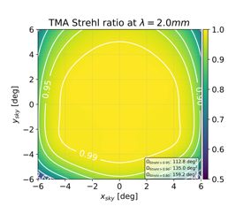
South Pole Large Aperture Telescope
Three Mirror
Anastigmat
(TMA) Design
5-meter gapless mirror fabricated
Optimized for the B-mode Delensing Survey
  Optimal beam over FOV
  Gapless mirrors to prevent B-mode contamination
  Boresight rotation to cancel polarization systematics

Slide 12
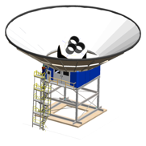
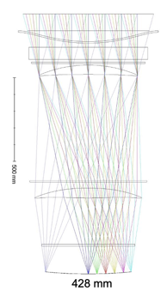
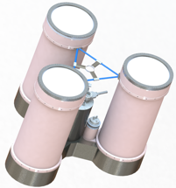
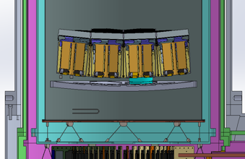
South Pole Small Area Telescopes
Cryostat
Support Tower and
Ground shield
Focal Plane
Cold Refractor Optics
Builds upon proven Bicep/Keck Array Design

Slide 13
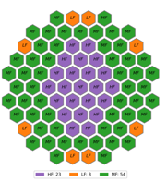
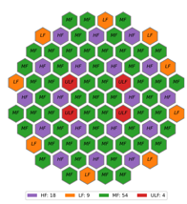

Telescope Focal Plane
South Pole LAT
Focal Plane
~ 130K detectors
South Pole SAT Focal Plane
~ 100K detectors (LF detectors shown for illustration)
Chilean LAT Focal Plane
~ 270K detectors

Slide 14
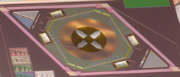
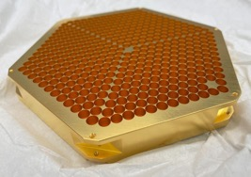
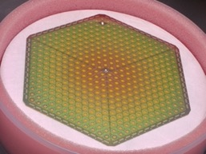
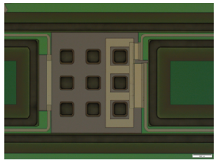
CMB-S4 will be the most sensitive CMB experiment to date
Polarization-sensitive
orthomode transducers
Horn antenna array for best
beam optics
100 mK Super conducting
Circuits on 6” Nb Si wafers
Detector Noise practically limited
only by Photon Statistics
Transition Edge Sensors read out
with 80-to-1 Multiplexing in the
time domain (i.e. sequential readout).
(90 GHz design shown for illustration)

Slide 15
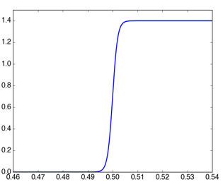

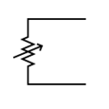



Transition-Edge Sensor Bolometers
$$I_{Optical}$$
Mature technology adopted by practically all
ground-based experiments: BK Array, SPT,
Polar bear, ACT, Simons Array ...
$$I_{Elec}$$
antenna
current
Current from
a constant
voltage source
resistance varies
with sky power
$$I_{Elec}$$
Electronics
detect change
in current
resistance [Ohm]
voltage bias
Optical Photon
heats up the TES,
changing its R
Thermal Coupling
100 mK Temperature Bath
temperature [K]

Slide 16
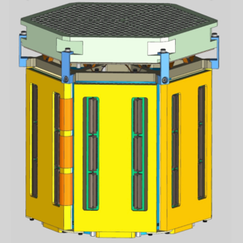
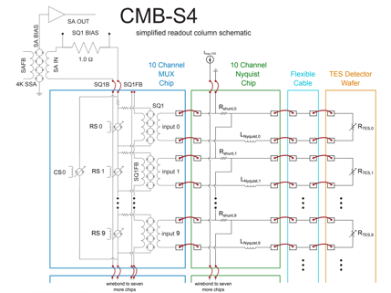
CMB-S4 Detector Module
Horn
Antennas
Silicon Nb
Detector
Wafer
Readout
and 80-1
MUX
electronics

Slide 17
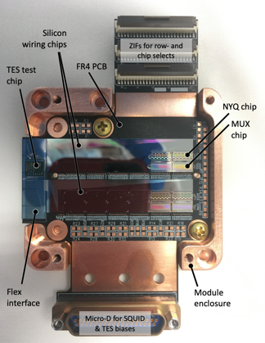
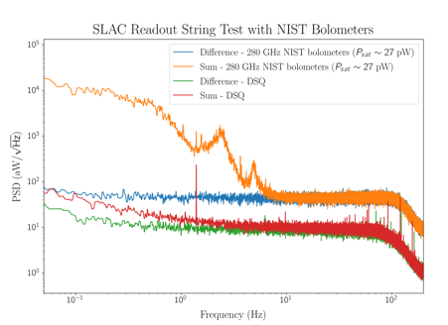
CMB-S4 Detector R&D
Readout
and 80-1
MUX
electronics
Barron et. al. https://arxiv.org/pdf/2208.02284.pdf

Slide 18
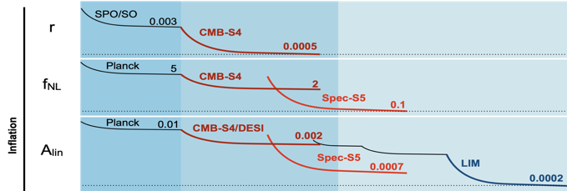
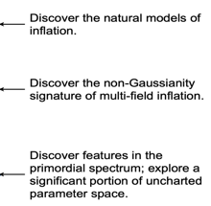
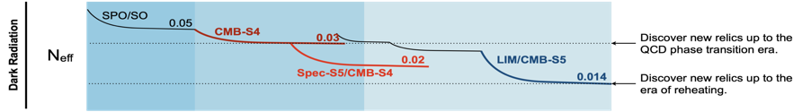
CMB-S4 Science Goals in 7-9 years
Notes:
—ESAAB: Rubber stamp for the CD review
—OPA (Office of Program Assessment) review: “One of the primary functions of the OPA (Appendix A) is to conduct independent technical, cost, schedule, and management reviews of construction projects, experimental equipment, and facilities. OPA conducts IPRs prior to Critical Decisions 2 and 3 (Approve Performance Baseline and Approve Start of Construction, respectively); however, OPA typically reviews larger projects semiannually, in addition to other Critical Decision reviews.
—TEC = “total estimate costs”
—OPC = “other project costs”

Slide 19
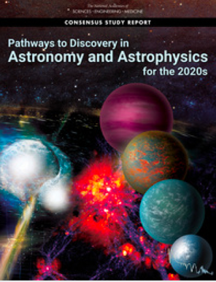
CMB-S4 Concept Endorsement by US Community
CMB community has united around “Stage 4” experiment concept, CMB-S4:
  Designed to make transformational discoveries in fundamental physics, cosmology, astrophysics & astronomy
  Recommended by 2014 P5 under all budget scenarios
  Recommended by 2015 NAS report A Strategic Vision for
  NSF Investments in Antarctic and Southern Ocean Research
  Strongly recommended by Astro2020: “NSF & DOE should jointly pursue the design and implementation of CMB-S4”
  Prominently featured in recent Snowmass process / ongoing 2023 P5

Slide 20
Summary
The next generation of CMB observations are poised to make tremendous discoveries
  r : Observe gravity operating on quantum scales
  N_{eff} : Probe for light particles beyond the standard model
  ∑m_{ν} : Constrain the masses of neutrinos
  New insights into dark energy, dark matter, structure formation
  New discovery space for transients in the millimeter sky
CMB-S4 offers a unique opportunity to study fundamental physics of the universe that cannot be practically be done with the current generation of experiments
CMB-S4 will impact many fields: HEP, Cosmology, and Traditional Astronomy
Notes:
OPA and CDR reviews later this year, observing beginning in ~2032

Slide 21
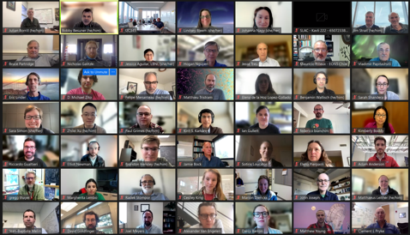
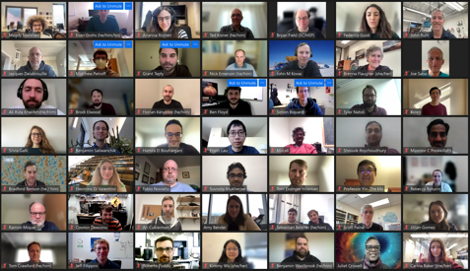
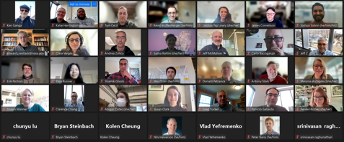



Thank you!

