Slide 1

Axion cosmology with post-Newtonian corrections
J. Hwang (IBS) & H. Noh (KASI)
08 Jan. 2023

Slide 2
Linear density perturbation for dust:
cosmic scale factor
Lifshitz (1946) synchronous gauge
Bonnor (1957) Newtonian
Bardeen (1980) comoving gauge
Include Λ and Κ
relative density perturbation
background density
Perturbation theory:
Expansions in
Fully relativistic but weakly nonlinear
Post-Newtonian approximation:
Expansions in
gravitational strength
For axion
Fully nonlinear but weakly relativistic
c → ∞ : Newtonian limit!

Slide 3
Axion as a CDM (FDM) candidate, proofs:
Background order:
Abbott-Sikivie (1983)
Dine-Fischler (1983)
Preskill-Wise-Wilczek (1983)
Khlopov-Malomed-Zel’dovich (1985)
Sikivie-Yang (2009) zero-shear gauge
JH-Noh (2009) axion comoving gauge
Noh-Park-JH (2017) axion comoving gauge
JH-Noh 2211.02197 naturally gauge-invariant
Madelung (1927)
Newtonian:
Linear perturbation order:
Fully nonlinear and exact order:
Post-Newtonian correction:
From Schrödinger equation:

Slide 4
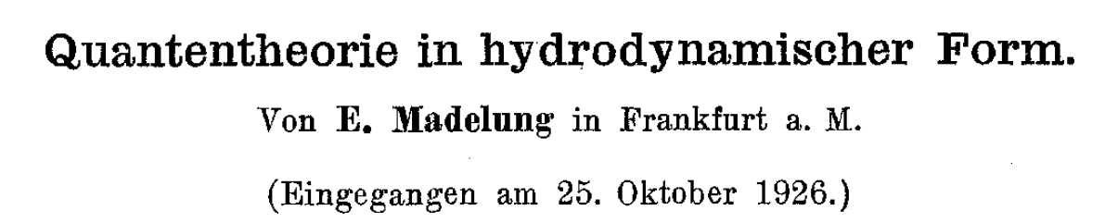
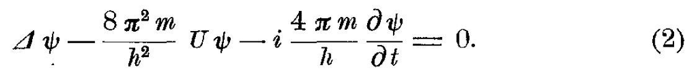

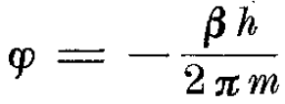

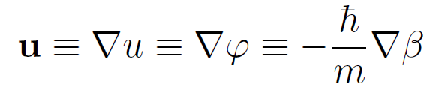


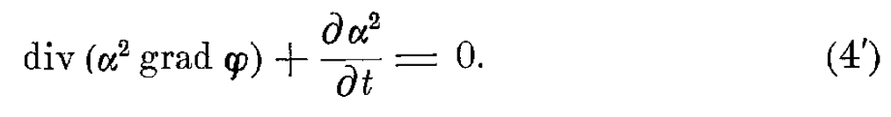
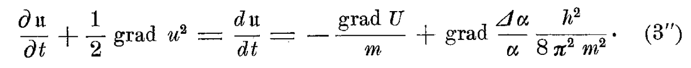
Identify:
Im → Continuity:
Re → Momentum conservation:
Quantum stress
Madelung (1927)

Slide 5
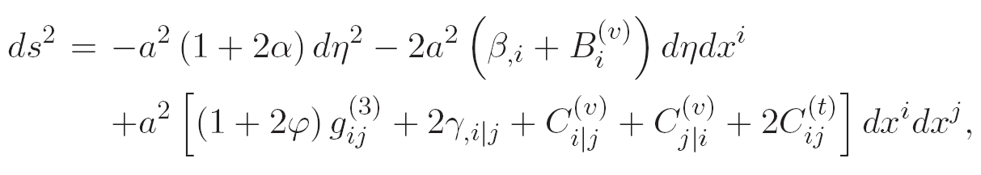
FNLE
Fully nonlinear and exact perturbation formulation
arbitrary amplitude
Friedmann background
transverse
transverse-tracefree
JH-Noh (2013); Gong-JH-Noh-Wu-Yoo (2017)

Slide 6
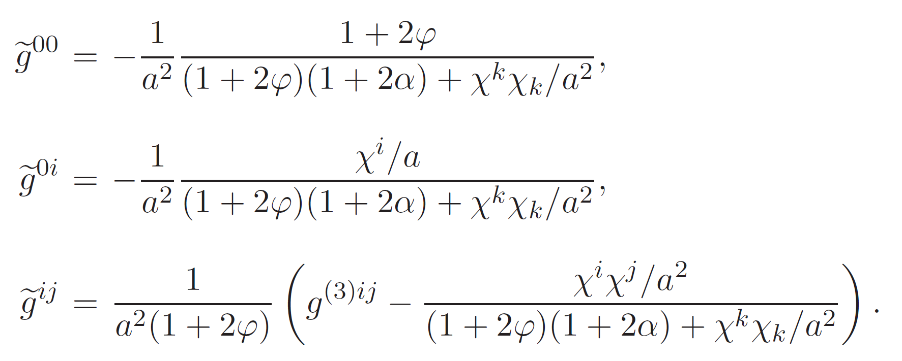
FNLE metric convention
Decomposition, possible
to nonlinear order
Spatial gauge condition
Ignore TT
Inverse metric:
Exact!
FNLE formulation: Fully nonlinear and exact perturbation equations
without imposing temporal gauge condition
JH-Noh (2013)

Slide 7
Zero-pressure
irrotational fluid
Comoving gauge

Slide 8
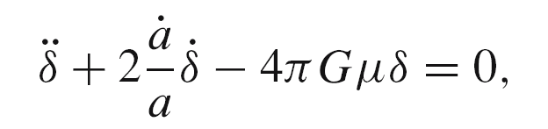
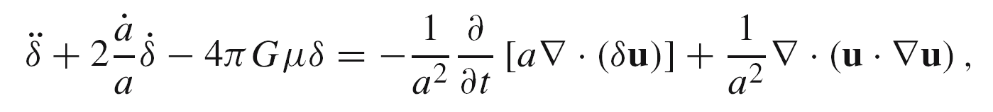
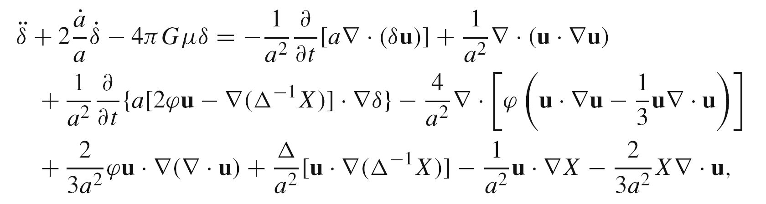
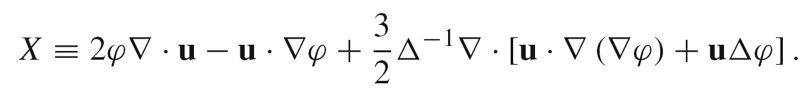
Linear-order: Lifshitz (1946) synchronous gauge = comoving gauge; Bonnor (1957)
Only for dust to linear order!
Second-order: Noh-JH (2004) comoving gauge
Relativistic/Newtonian correspondence to second-order. Valid to fully nonlinear order in Newtonian theory.
Third-order: JH-Noh (2005) comoving gauge
Pure relativistic corrections appear in the third-order.
All terms involve φ ~ 10⁻⁵

Slide 9
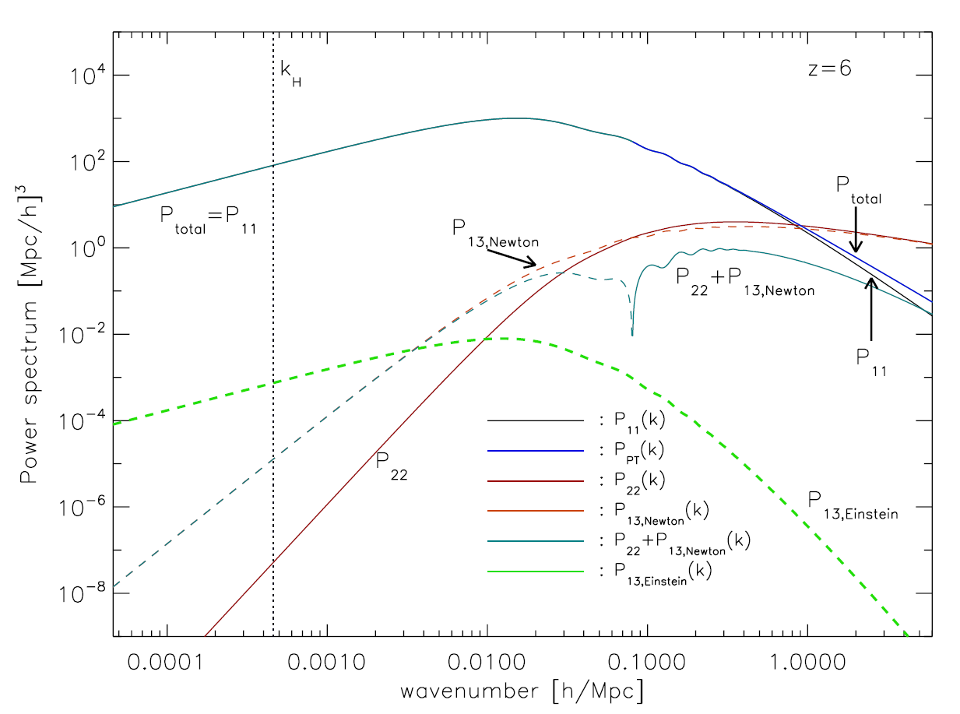
Leading nonlinear density power-spectrum in comoving gauge
Vishniac 1983
Pure Einstein
Jeong et al 2011
Unreasonable effectiveness of Newton’s gravity in cosmology!
Jeong-Gong-Noh-JH (2011)

Slide 10
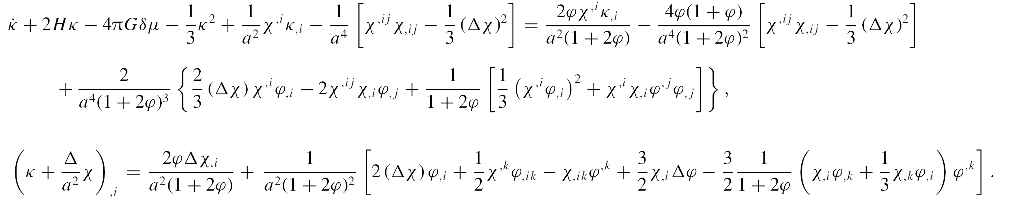
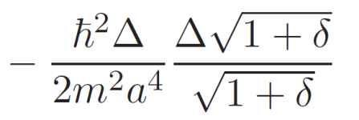

Fully nonlinear and exact order
Comoving gauge:
RHS = pure Einstein’s gravity corrections,
starting from the third-order, all involving φ
Axion!
Identify:
Nonrelativistic ⸪ ignored
Madelung (1927)
Khlopov-Malomed-Zeldovich (1985)
Noh-JH-Park (2017)
Perturbed part of the trace of extrinsic curvature
JH-Noh (2013)

Slide 11
Axion
Massive scalar field

Slide 12
Scalar field
Popular in cosmology: steady-state theory, inflation, dark energy, dark matter
Action:
Einstein eq:
Klein-Gordon eq:
EOM

Slide 13
Axion
As a massive scalar field
Axion:
Klein transformation:
(1926)
Klein-Gordon eq. → Schrödinger eq. in nonrelativistic limit
Madelung transformation:
(1927)
Schrödinger eq. → Hydrodynamic eqs.
Equivalently,
or

Slide 14
Klein tr →
0PN (Newtonian)
1PN
Post-Newtonian metric:
Post-Newtonian Schrödinger eq:
1PN
Nonrelativistic limit:
JH-Noh 2211.02197

Slide 15
Nonrelativistic perturbation, fully nonlinear:
Madelung tr →
Quantum stress:
Uncertainty principle, quantum tunneling, interference, …
Pilot wave theory (de Broglie 1927)
Bohmian mechanics (Bohm 1952)
Not identical to Schrödinger eq. ⸪ at ρ = 0 → quantized vortex
Bose-Einstein condensate
Superfluid
Quantum turbulence
Perturbation:
subtracting BG
Quantum stress
⇒
Without imposing temporal gauge, ⸫ naturally gauge-invariant
JH-Noh JCAP (2022)

Slide 16
Relativistic perturbation to linear order in axion-comoving gauge:
Strictly ignore:
⸫ nonrelativistic
Axion-comoving gauge:
Energy conservation:
Raychaudhury eq:
EOM:
⇒
Assumption violated, but somehow recovers correct behavior in the sub-Compton scale
Jeans scale:
⸫ CDM
⸫ FDM
JH-Noh (2009)

Slide 17
Ultralight axion
Fuzzy dark matter

Slide 18
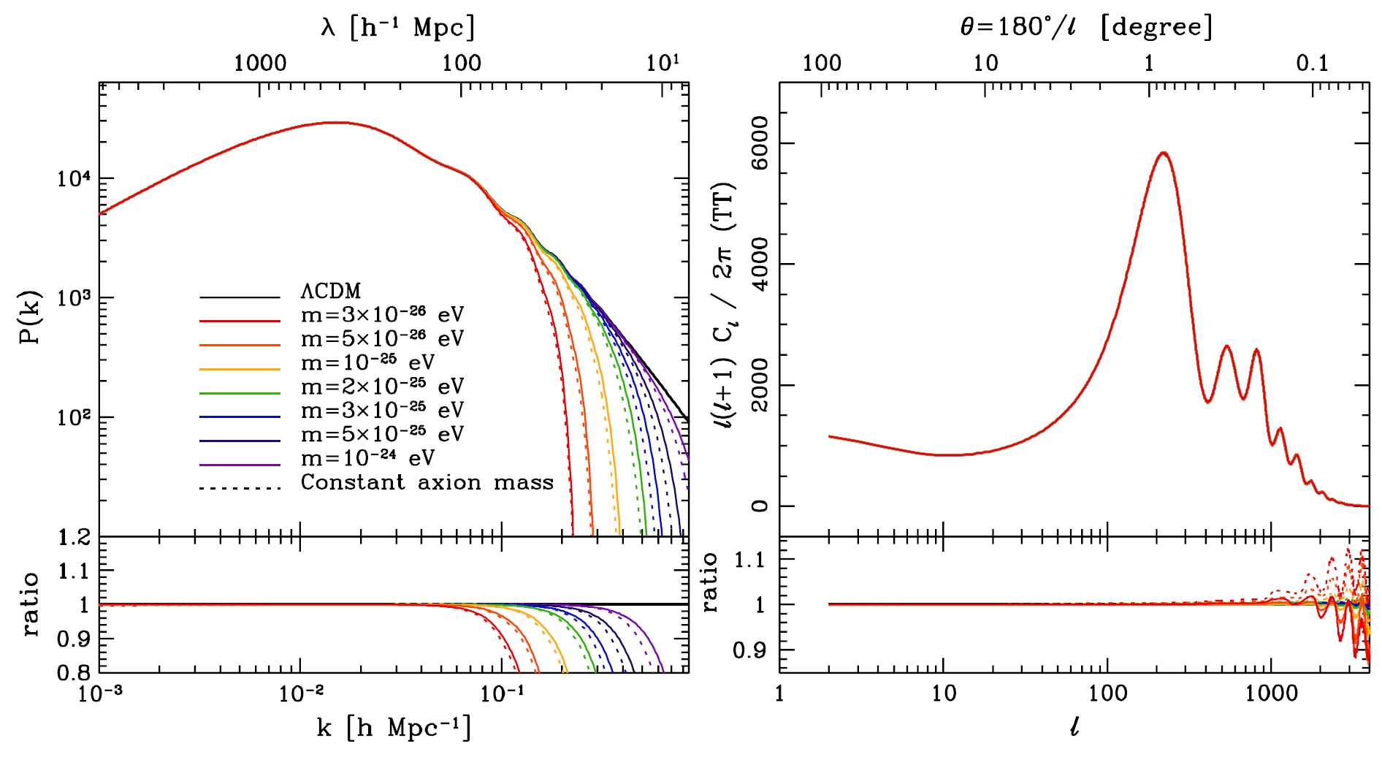
Ultralight axion as a fuzzy (wave) DM
Hui-Ostriker-Tremaine-Witten (2017)
Park-JH-Noh (2012)

Slide 19
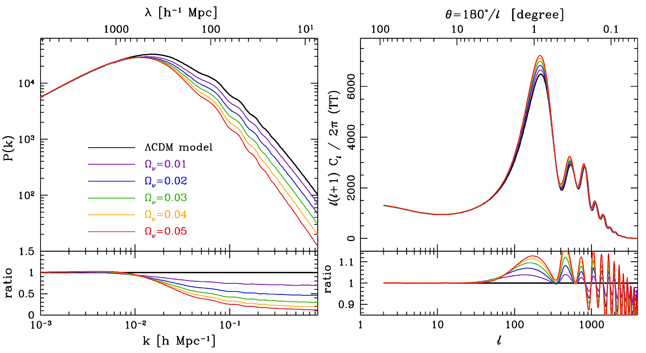
Neutrino as a hot DM
Park-JH-Noh (2012)

Slide 20
Post-Newtonian corrections
0PN (Newtonian)
1PN
1PN
Expansions in
For axion
Chandrasekhar (1965); JH-Noh-Puetzfeld (2008)

Slide 21
Gravitational instability, to linear order
1PN correction
Continuity:
Momentum:
Poisson:
⇒
1PN correction
Jeans scale:
1PN correction
Without imposing temporal gauge, ⸫ naturally gauge-invariant
JH-Noh 2211.02197

Slide 22
Thank you !

