Slide 1
Search for neutrinoless quadruple β decay of ¹³⁶Xe in XMASS-I
2205.05231,
submitted for PLB
Kentaro Miuchi (Kobe University)
for the XMASS collaboration
2022 July 21st

Slide 2
Contents
Introduction
Experiment
Quadruple β decay search
Summary

Slide 3
Introduction

Slide 4
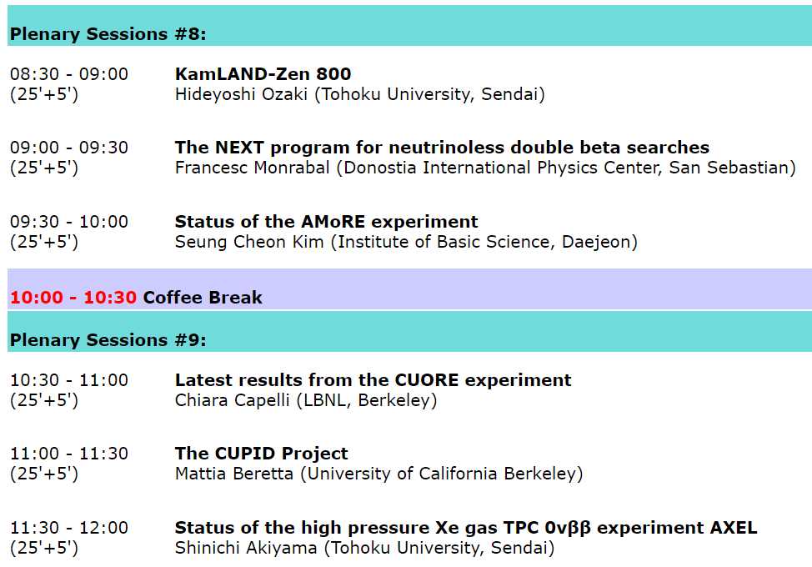
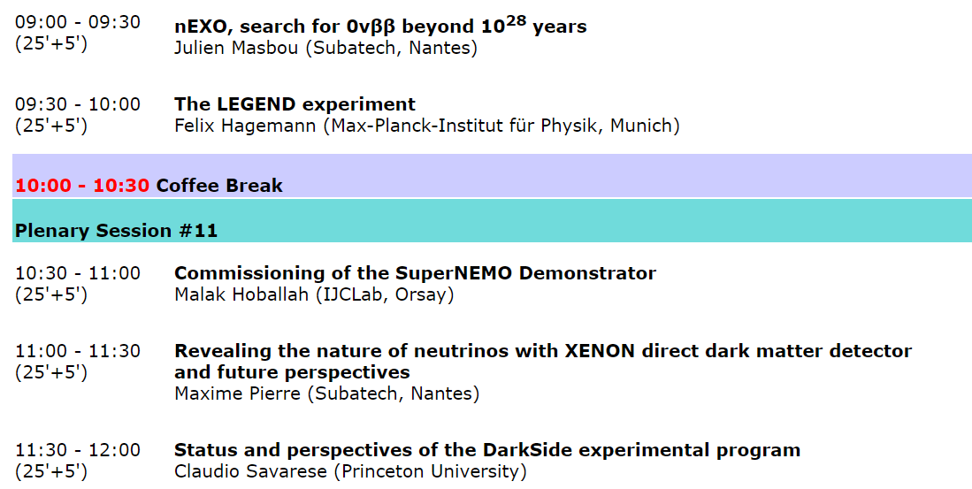
Introduction: neutrinoless quadruple decay (0ν4β)
Bunch of 0ν2β searches.
KamLAND-Zen paper
2203.02139v1
Discoveries may be around the corner,
in case neutrinos are Majorana particles...

Slide 5
What is neutrinos are Dirac particles?
Discoveries may be around the corner,
in case neutrinos are Majorana particles...

Slide 6
What is neutrinos are Dirac particles?
lepton flavor violating
0ν2β doesn’t happen, but 0ν4βstill can.
Neutrinoless Quadruple Beta Decay
Julian Heeck, Werner Rodejohann
EPL 103 (2013) 32001, 1306.0580
Discoveries may be around the corner,
in case neutrinos are Majorana particles...

Slide 7
diagrams, mass levels
energy level example
⊿L=4 scattering diagrams
EPL, 103 (2013) 32001
0ν4β decay diagram
EPL, 103 (2013) 32001
⊿L = 4 linked to
  Naturally light Dirac mass terms of neutrinos
    Chen, Ratz,Staudt,Vaudrevange, Nucl.Phys.B 866 157 (2013)
  CP violation
    Chuli,Srivastava,Valle, Phys.Lett.B 761,431 (2016)
  Dark Matter candidates
    Chuli,Ma,Srivastava,Valle, Phys.Lett.B 767 209 (2017)
  Leptogenesis
    Heeck, Phys.Rev.D 88, 076004 (2013)
EPL, 103 (2013) 32001

Slide 8
⊿L=4 candidates
natural abundance
EPL, 103 (2013) 32001

Slide 9
⊿L=4 candidates
natural abundance
150Nd: T_{1/2} > (1.1–3.2) × 10²¹
by NEMO-3 (PRL 119, 041801 (2017))
EPL, 103 (2013) 32001

Slide 10
⊿L=4 candidates
natural abundance
136Xe:
Q value was updated in
Chinese Physics C 41 (3) (2017) 030003, 41 (3)
150Nd: T_{1/2} > (1.1–3.2) × 10²¹
by NEMO-3 (PRL 119, 041801 (2017))
⇒ search for a 79keV peak
EPL, 103 (2013) 32001

Slide 11
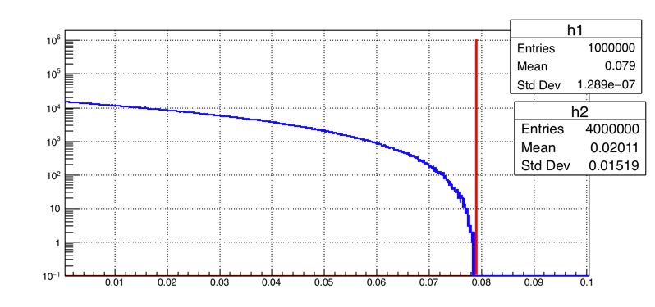
136Xe 0ν4β signal
  Energy of each electron was calculated by Decay0/GENBB for
can handle:
96Zr, 136Xe and 150Nd (4β) 124Xe, 130Ba (4EC)
E1,E2,E3,E4
Nevents
⇒ input for our Geant4 MC
E [MeV]
E1+E2+E3+E4(peak@79 keV)

Slide 12
Experiment

Slide 13
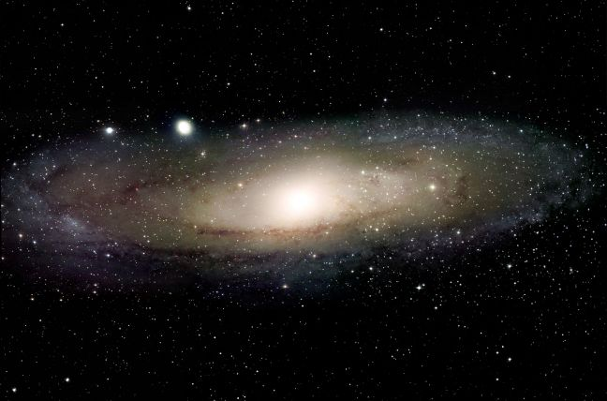
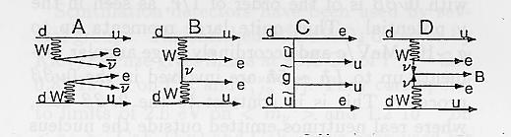
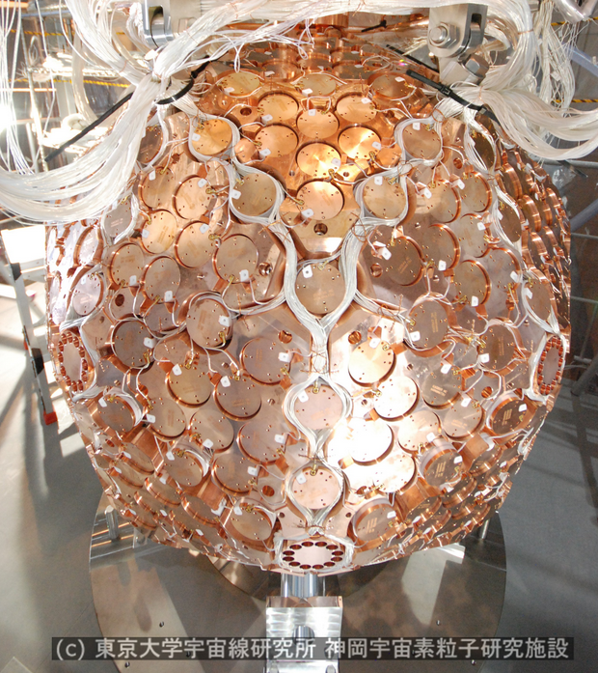
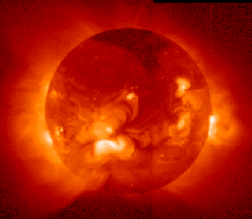
XMASS-I experiment
Unique experiment
  Single phase (use scintillation photon only) liquid xenon detector.
  Long stable observation period, 5 years
    2013/11~2019/2
  large light yield ~14pe/keV and low threshold ~1keVee
Variety of rare events search with large amount of xenon ( ~1 ton)
  Dark matter, modulation, low mass, inelastic, hidden photon
  solar axion, 2νECEC, GW, exotic neutrino interaction
Wide variety results are quite important for present dark matter search
Neutrino-less double beta decay
Dark matter
& quadruple
Solar neutrino
2010 | 2011 | 2012 | 2013 | 2014 | 2015 | 2016 | 2017 | 2018 | 2019
Detector construction
Commissioning run data taking
Detector refurbishment
Data taking (-Feb.2019)
>5yrs continues operation
Notes:
two neutrino double electron capture
貴重なデータ

Slide 14
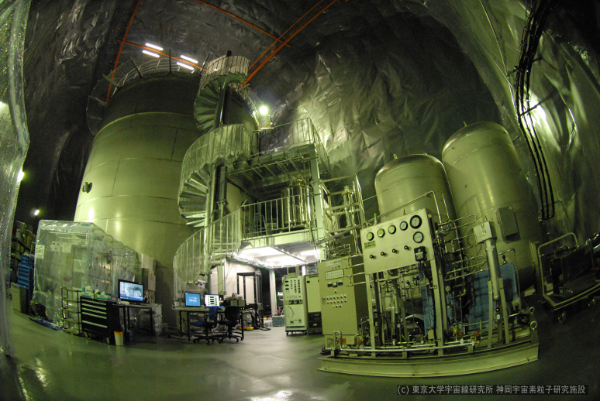
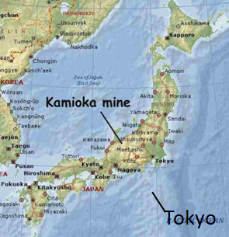
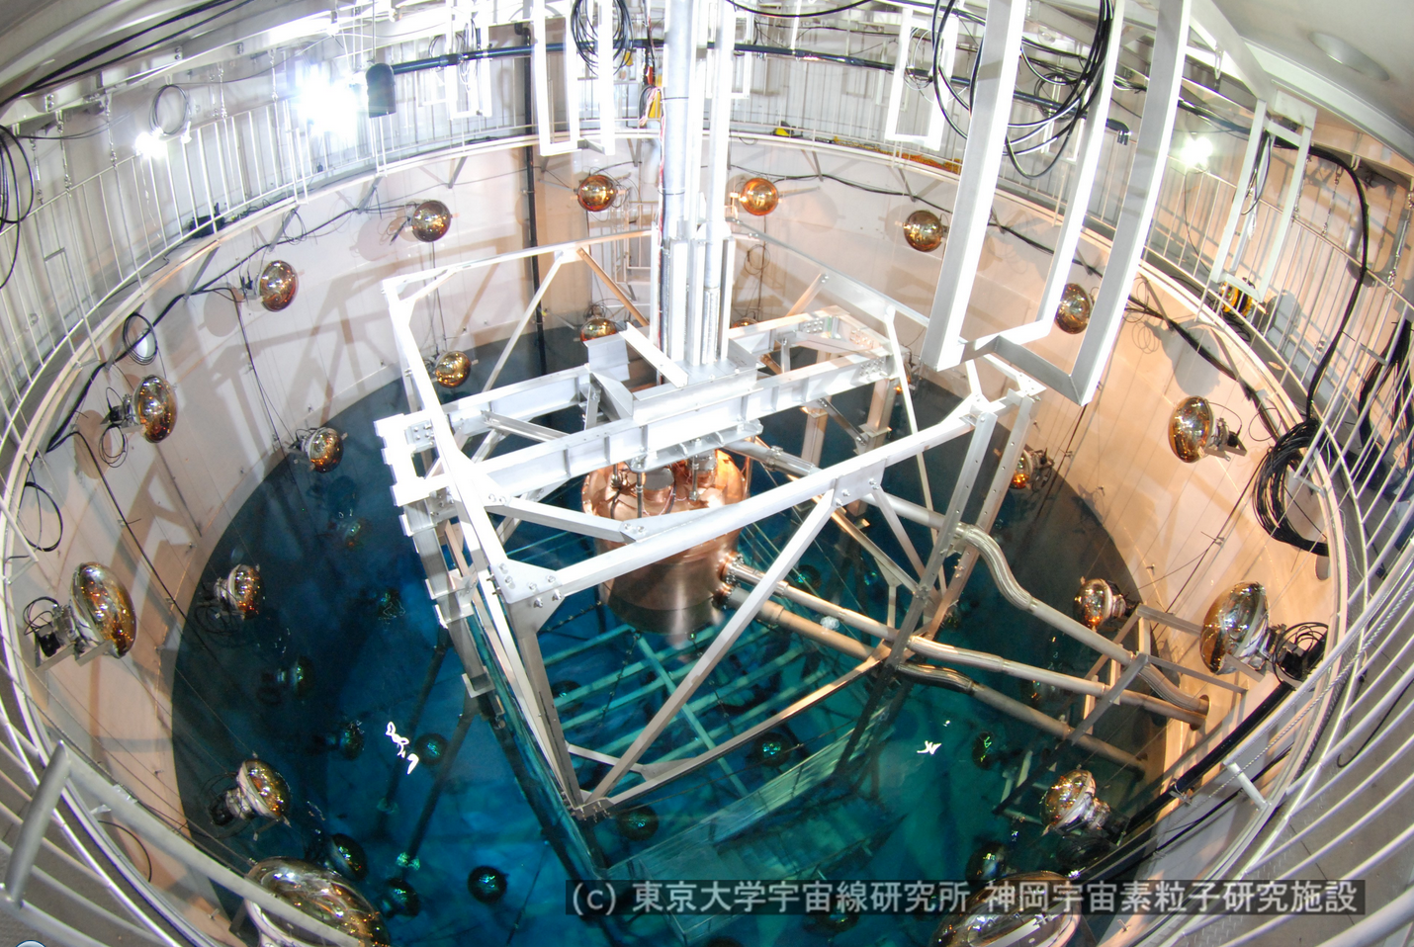
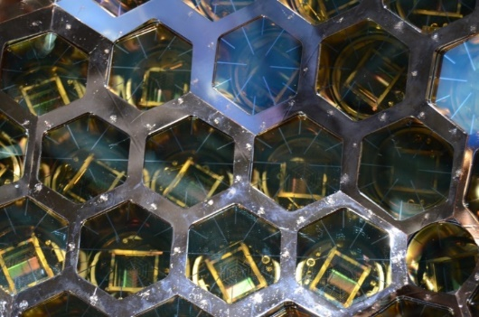
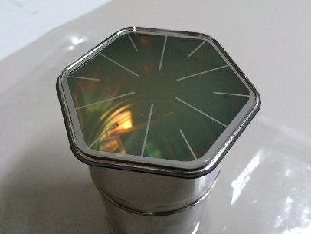
XMASS detector
Japan
NIM A 716 (2012) 78
Kamioka Observatory (~2700m.w.e.), Japan.
832kg (Φ~80cm) liquid xenon for active volume.
~2inch PMT (hex and round shape) ×642 : 62% photo-coverage
10x10m water tank for muon veto with 20 inch PMT×70.
Kamioka Mine
Tokyo
~80cm

Slide 15
XMASS pioneered...
“water tank” veto
water-tank style veto
many physics channels
PTEP(2017) 103C01
PLB 809 (2020) 135741
neutrino magnetic moment < 1.8 ×10⁻¹⁰μ_{B}
dark photon coupling
(U(1)B-L symmetry)

Slide 16
PTEP(2018) 053D03
T_{1/2}>2.1×10²² years (90%C.L.)
T_{1/2}=1.8×10²² years

Slide 17
Quadruple β decay search

Slide 18
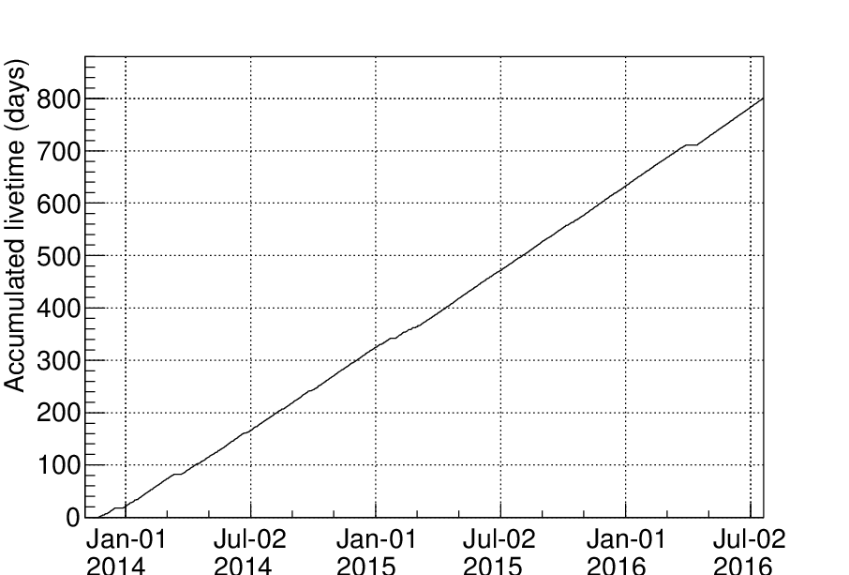
Data set
  Data acquisition: November 2013 to July 2016
    first half of the “full data”
    4 periods
  Fiducial volume: r<30cm
  Exposure: 327kg(LXe）×800days (136Xe, 29kg)
Period1
Period2
Period3
Period4
124.0
240.0
338.1
88.0days
Lxe extraction/filling
LXe extraction/filling
²⁵²Cf
Calib.
LXe filling
Gas circulation 1.5L/min

Slide 19
Event selection
selection flow
raw
Fiducial volume
(R<30cm)
Passed
²¹⁴Bi rejection
(dT_{post}>1ms)
Rejected
Passed
214Bi sample
fiducial volume
214Bi, αrejection
α-ray rejection
(Pulse shape)
Passed
PID (next slide)

Slide 20

PID (4βselection by “βCL”)
  Decay time depends on the electron energy
  ⇒ discriminate β(one electron) and γ(multiple electrons of lower energies )
  by “βCL”
Scintillation decay time
NIM A834 (2016) 192
N: number of PMTs with pulses
tk: timing of k-th pulse
CDF: cumulative distribution function for a β-ray of energy E to find a pulse at t
single β: uniform in 0-1
others(including 0ν4β) : peak at 0
γ/βseparation by βCL
β-ray events
(30-200keV)
γ-ray events
(59.5keV)
βCL>0.05:
β-enriched (BG) sample
βCL<0.05 :
β-depleted (signal) sample
PTEP (2018) 053D03
PTEP (2018) 053D03

Slide 21
“Samples“
raw
fiducial
214Bi, α rejection
214Bi sample
PID (βCL<0.05)
β-enriched(BG) sample
β-depleted(signal) sample

Slide 22
Selected events and signal shape
expected signal (MC)
raw
PID (βCL<0.05)
fiducial
214Bi, α rejection
ROI
PID (βCL<0.05)
efficiencies:
0ν4β 53±16 % remain
β(214Bi) 94±2 % rejection
S/N enhancement ~9

Slide 23
results
  data(black): count rate ～10⁻⁴ counts/day/kg/keVee
  BG(color): will be discussed in the following slides.
data
136Xe 0ν4β
(90% C.L. upper limit)
126Xe 2e capture (hatched)
125I
133Xe (hatched)
14C
39Ar
85Kr (filled)
214Pb
136Xe 2νββ
external gamma

Slide 24
signal+BG fitting
expected
constrained and free parameters
parameter uncertainties
measured
i :sample ID (β-depleted, β-enriched, 214Bi )
j: period (1-4)
k: energy bin (1-85)

Slide 25
Period
1 | 252Cf calibrations
2 | started 60 days after the 252Cf calibration
3 | gas circulation (w/ hot getter) started
Xenon purification
4
BG interpretation with gas conditions
data
136Xe 0ν4β
(90% C.L. upper limit)
126Xe 2e capture (hatched)
125I
133Xe (hatched)
14C
39Ar
85Kr (filled)
214Pb
136Xe 2νββ
external gamma
39 Ar increased by emanation
14C was decreased by gas circulation

Slide 26
Period
1 | 252Cf calibrations
2 | started 60 days after the 252Cf calibration
3 | gas circulation (w/ hot getter) started
Xenon purification
4
BG interpretation with activations
125I, 133Xe increase by activation
data
136Xe 0ν4β
(90% C.L. upper limit)
126Xe 2e capture (hatched)
125I
133Xe (hatched)
14C
39Ar
85Kr (filled)
214Pb
136Xe 2νββ
external gamma

Slide 27
results
best fit for null signal of 136Xe 0ν4β
data
136Xe 0ν4β
(90% C.L. upper limit)
126Xe 2e capture (hatched)
125I
133Xe (hatched)
14C
39Ar
85Kr (filled)
214Pb
136Xe 2νββ
external gamma
136Xe 0ν4β (90% C.L. upper limit)
  T_{1/2} > 3.7 ×10²⁴years (90% CL)
  first 136Xe limit

Slide 28
Summary
  First experimental search for 0ν4β of 136Xe
  327kg×800days XMASS data
  consistent with null signal
  T_{1/2} > 3.7 ×10²⁴years (90% CL) first 136Xe limit
  submitted for PLB (arXiv: 2205.05231)

Slide 29
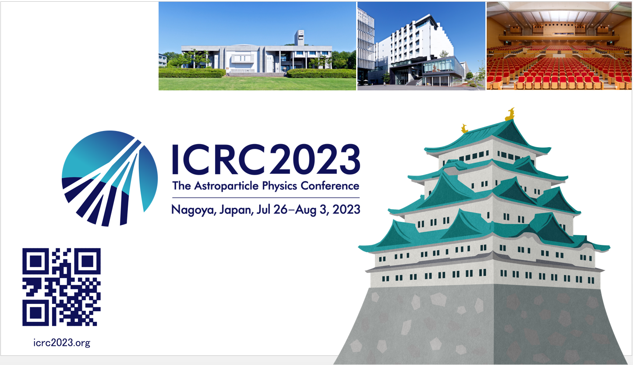
Thank you, and see you in Japan...

