Slide 1
Status of the JUNO detector
Cong Guo
Institute of High Energy Physics (IHEP)
On Behalf of JUNO

Slide 2
Outline
An overview of JUNO
The project status of JUNO
Liquid scintillator
Central detector
PMT
Veto detector
Calibration system
Near detector
Conclusion

Slide 3
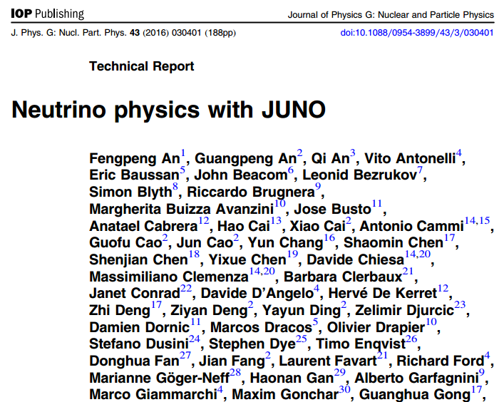
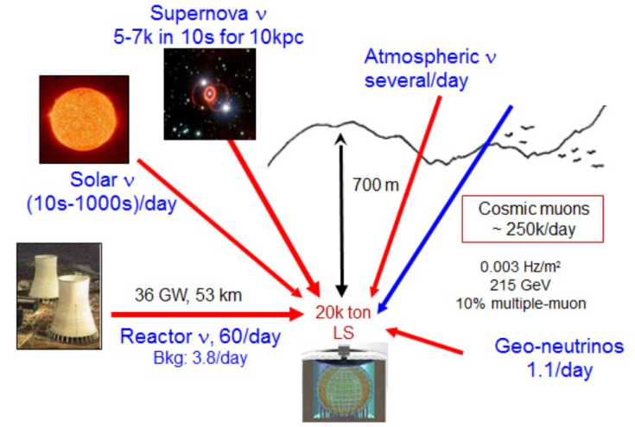
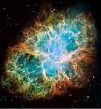
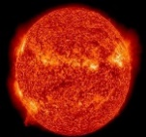
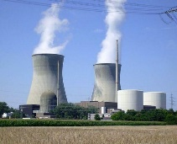
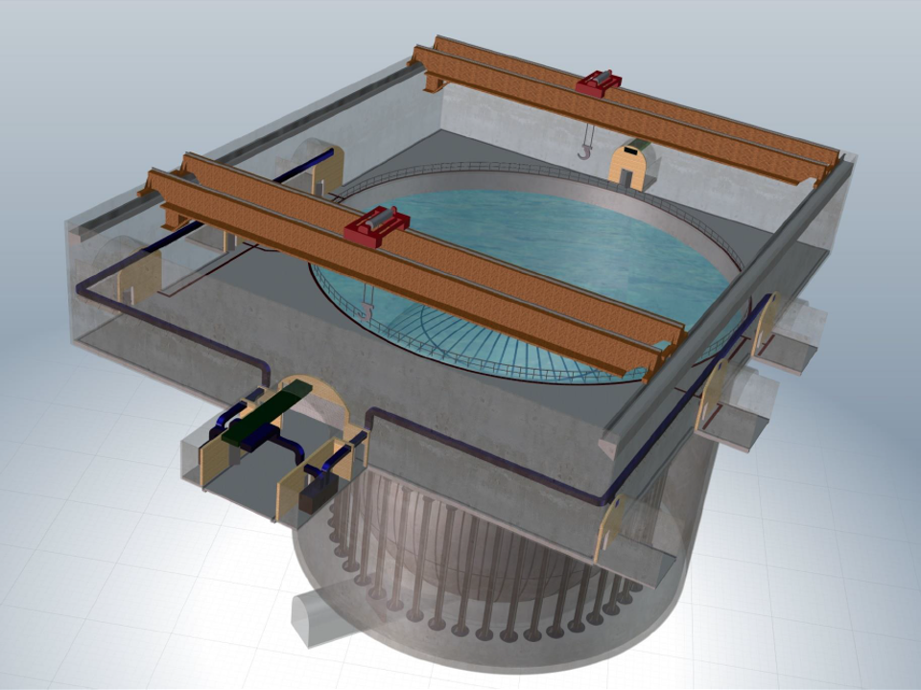
Jiangmen Underground Neutrino Observatory
JUNO：A multipurpose neutrino experiment
Project:
Target: 20 kton liquid scintillator ;
Source : Reactor neutrino;
Location: 700m underground;
Approved in 2013, Construction since 2015, operation in 2021;
Phyiscs:
Determine mass hierarchy;
Precisely measure oscillation parameters;
Observe Supernova neutrinos, study solar neutrino, atmospheric neutrinos and geo-neutrinos;
Exotic searches, proton decay;
Physics yellow book:
J. Phys. G. 43 (2016) 030401

Slide 4
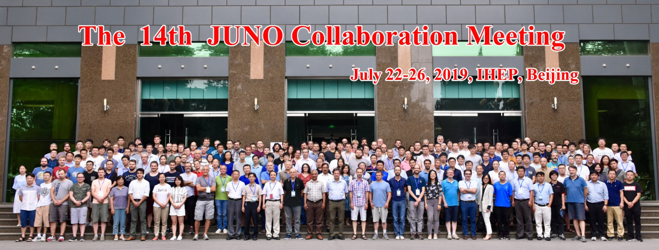
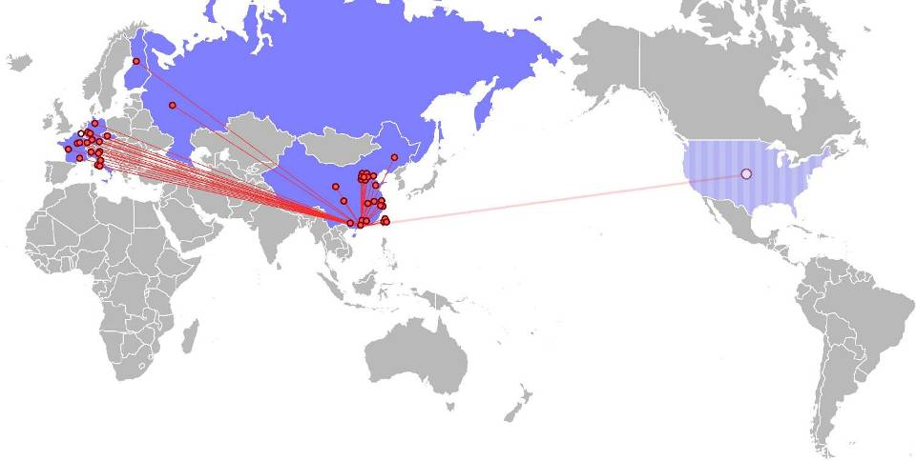
JUNO Collaboration
17 countries/regions，77 institutions，618 members
Europe (28)
Belgium(1)
ULB
Czech(1)
Charles U
Latvia(1)
IECS
Finland(1)
U. Jyvaskyla
France(5)
APC Paris
CPPM Marseille
IPHC Strasbourg
Subatech Nantes
CENBG-IN2P3
America(6)
US(2)
UMD
UMD-Geo
Chile(2)
PCUC
UTFSM
Brazil（2） PUC-Rio
UEL
Asia (38)
BJ Nor. U.
CAGS
Chongqing U.
Shanghai JT U.
DGUT
ECUST
Guangxi U.
HIT
IHEP
U. Of South China
Ninan U.
Nanjing U.
Natl. Chiao-Tung U.
Natl. Taiwan U.
Natl. United U.
Italy(8)
INFN-Catania
INFN-Frascati
INFN-Ferrara
INFN-Milano
INFN-Mi-Bicocca
INFN-Padova
INFN-Perugia
INFN-Roma 3
Germany(7)
FZ Jülich
RWTH Aachen
TUM
U.Hamburg
IKP FZI Jülich
U.Mainz
U.Tuebingen
Russia(3)
INR Moscow
JINR
MSU
China（33）
Armenia(1)
Yerevan Phys.
Inst.
Thailand(3)
SUT
PPRLCU
NARIT
Parkistan(1)
PINSTECH
Nankai U.
NCEPU
Pekin U.
SDU
Sichuan U.
CIAE
SYSU
Tsinghua U.
UCAS
USTC
Jilin U.
Wuhan U.
Wuyi U.
Xi'an JT U.
Xiamen U.
NUU.
Slovakia (1)
FMPICU

Slide 5
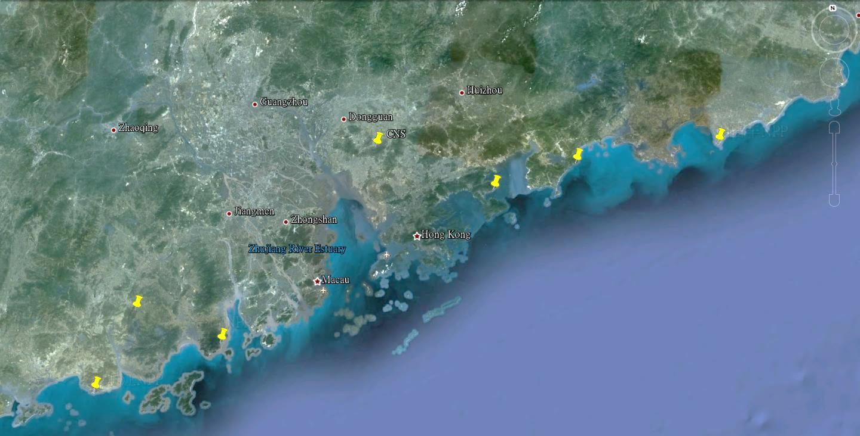
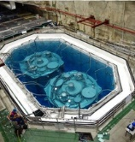
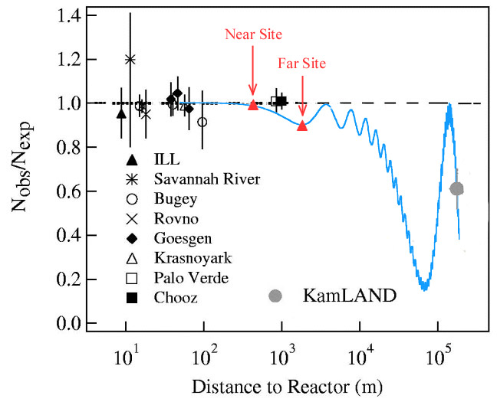
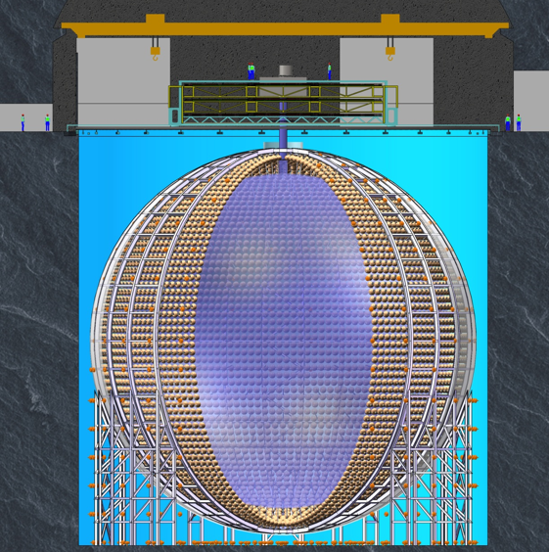
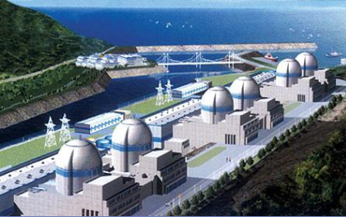
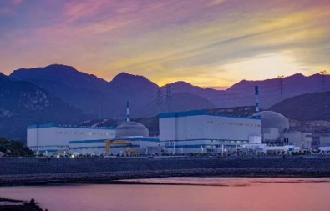
JUNO Location
NPP | Daya Bay | Huizhou | Lufeng | Yangjiang | Taishan
Status | Operational | Planned | Planned | Under construction | Under construction
Power | 17.4 GW | 17.4 GW | 17.4 GW | 17.4 GW | 18.4 GW
by 2020: 26.6 GW
Overburden ~ 700 m
Lufeng NPP
Kaiping,
Jiang Men city,
Guangdong Province
Guang Zhou
Huizhou NPP
2.5 h drive
Shen Zhen
Daya Bay NPP
JUNO
Zhu Hai
Hong Kong
Daya Bay
53 km
Macau
53 km
Yangjiang NPP
Taishan NPP
Taishan NPP
Yangjiang NPP
Notes:
Distance: selects “oscillation regime”
JUNO placed at Δm²₂₁ minimum；
First experiment to see both Δm² ;

Slide 6
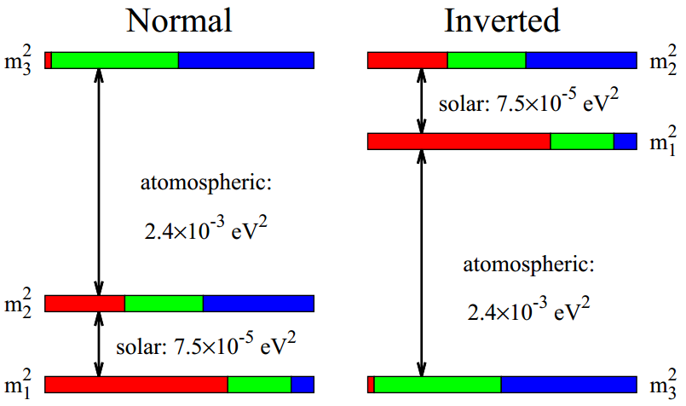
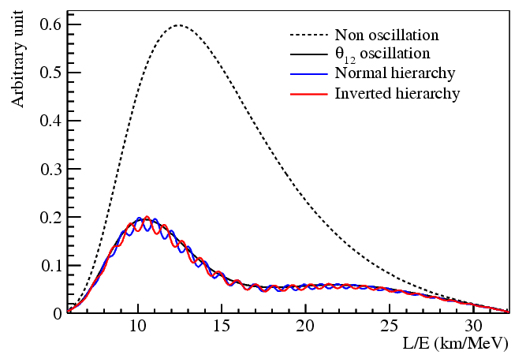
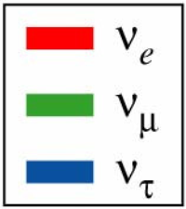
Neutrino Mass Hierarchy
JUNO is designed to resolve the neutrino MH using precision spectral measurements of reactor antineutrino oscillations；
Key: Energy resolution(3%@1MeV);
Notes:
The relative shape difference of the reactor antineutrino flux for different neutrino MHs.
Disappearance of reactor electron antineutrinos at 53km: interference between Δm²₃₁ and Δm²₃₂ ;
Very unique approach, independent on θ₂₃ and CP phase;

Slide 7
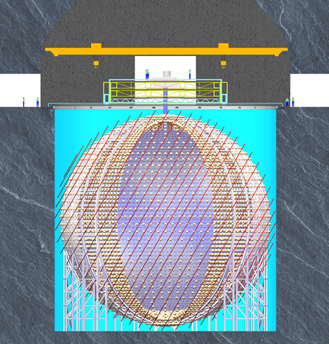
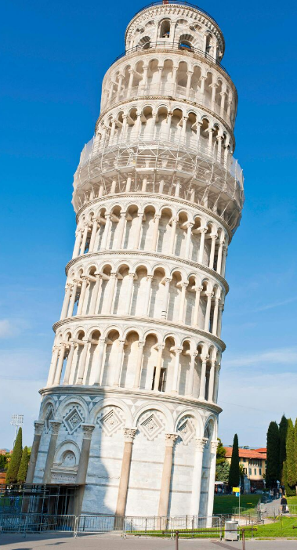
JUNO Detector
Top Tracker
Calibration Room
Pure water Room
LS-Filling Room
Earth Magnetic Field shielding coils
Central detector:
Steel structure
Acrylic Sphere
20kton LS
Acrylic Sphere : Φ 35.4m
PMT:
17600 20’’ PMTs
25000 3’’ PMTs
77.5% Coverage
Stainless steel lattice shell: Φ 40.1m
Pool Depth: 44m
VETO:
40 kton Pure water
2400 20’’ PMTs
Water Pool: Φ 43.5m

Slide 8
Parts of the Requirements of JNUO
Center Detector(CD): 3%@1MeV
Liquid Scintillator
Light yield >1100P.E./MeV;
Attenuation length > 22m@430mn;
PMT
Full coverage；
High quantum & collection efficiency；
Acrylic sphere
High Transparency ;
Good mechanical strength for >20 years;
Low radioactivity
²³⁸U,²³²Th≤10⁻¹⁵g/g, ⁴⁰K<10⁻¹⁶g/g for LS in reactor neutrino measurement ;
²³⁸U,²³²Th, ⁴⁰K ≤ 1ppt for acrylic;
Veto Detector: Muon tagging and radioactive shielding
Top tracker from OPERA;
New electronics;
Earth magnetic field shielding system
To improve the collecting efficiency for 20’’ PMTs;
Water Cherenkov Detector
Attenuation length > 30m @430nm;
Keep the temperature of CD within 21±1℃;
Keep radon concentration <0.2Bq/m³;
Calibration system: Study the non-uniformity of the
detector response;
Keep energy scale uncertainty < 1%
Deploy multiple sources to a wide range of positions inside the detector;

Slide 9
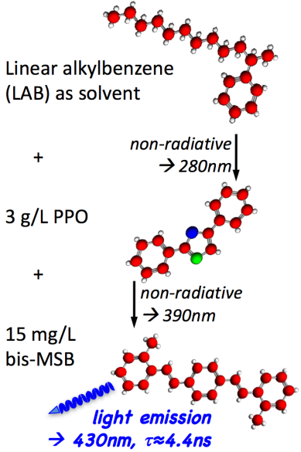
R&D status : Liquid Scintillator
Using a recipe optimized from Daya Bay’s experience;
Tested and changed to be more suitable for JUNO;
Higher light yield and more transparent;
2.5g/L PPO;
3mg/L Bis-MSB;
Filtration with Al₂O₃ column(Based on the “absorption” technique to remove the impurities and increase the attenuation length of LAB);
Low background;
Distillation: Remove heavy metal and improve transparency ;
Water extraction: Remove U/Th/K;
Gas stripping: Remove Ar/Kr/Rn;
Linear alkylbenzene (LAB) as solvent
+
3 g/L PPO
+
15 mg/L Bis-MSB
The recipe of Daya Bay LS

Slide 10
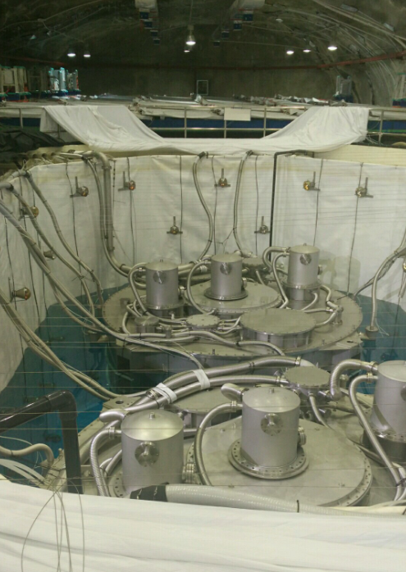
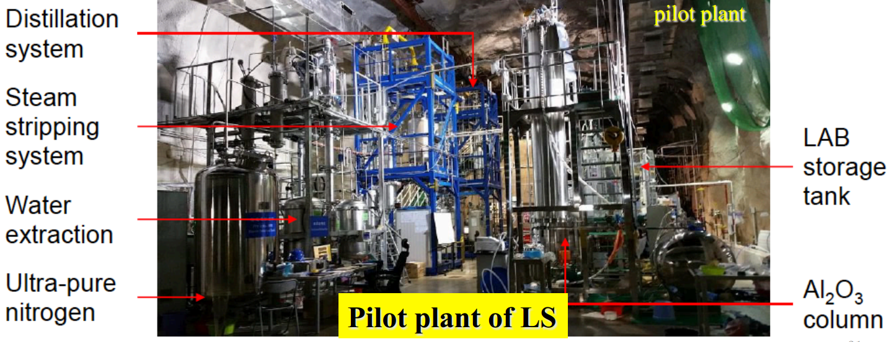
R&D status : Liquid Scintillator
Use one of the Daya Bay detectors through replacing the target LS with the produced LS from the pilot plant;
LS components mixing and online purification has been performed;
²²²Rn suppression efficiency >94%;
Attenuation length is > 20m@430nm ;
Since 2017 a pilot LS purification system installed at Daya Bay EH1

Slide 11
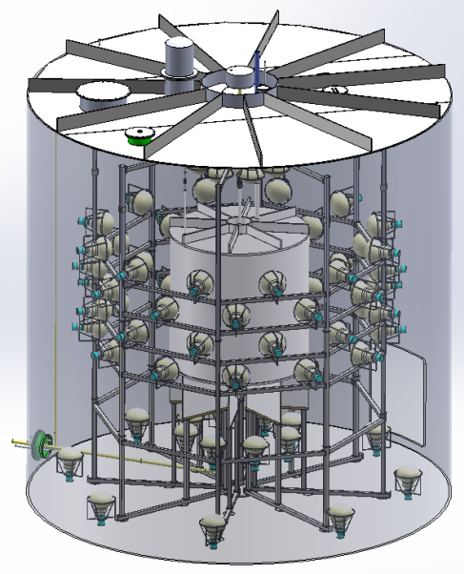
R&D status : OSIRIS
Online Scintillator Internal Radioactivity Investigation System (OSIRIS);
Measure the radioactive contamination of LS before filling into JUNO detector;
Sensitivity: 10⁻¹⁶g/g for U/Th within 24h measurement;
Measure ~19t LS per day;
Detector:
Φ3m*H3m Acrylic tank;
81 20’’ PMTs for photon detection;
2.5m water shielding + 12 20’’ PMTs;
The OSIRIS facility

Slide 12
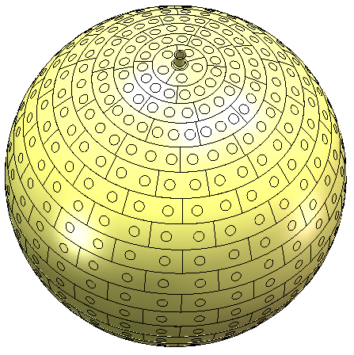
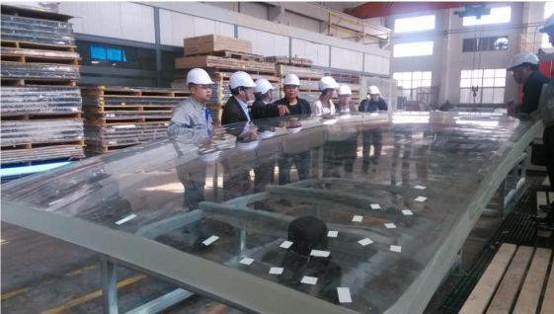
R&D status : CD Acrylic
Central Detector(CD): Acrylic Sphere + Stainless Steel Support ;
The acrylic sphere is composed of 265 pieces of spherical panels;
Thickness:120mm, Net weight: ~600 tons;
Transparency > 96% in pure water;
DonChamp won the bid at 2017.02 and a new production line special for JUNO has been finished;
Process control for low radiation background:
Filter in MMA material & Special reaction kettle/pipe;
Moulding: pure water/clean room;
Thermoforming: film or placket to shield the dust and radon;
Bonding: filled with clean air or N₂;
Shield Rn: plastic film on the surface of the acrylic;
Clean the inner surfaces of the acrylic sphere:
The Acrylic Sphere
The samples for acrylic has met the 1ppt requirement for U/Th/K;
Thermoforming of spherical panel 3m x 8m x 120mm

Slide 13
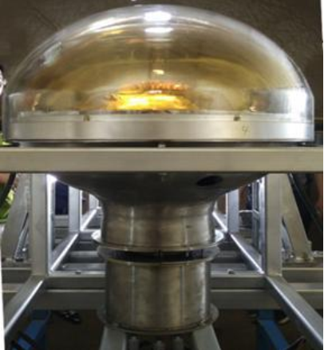
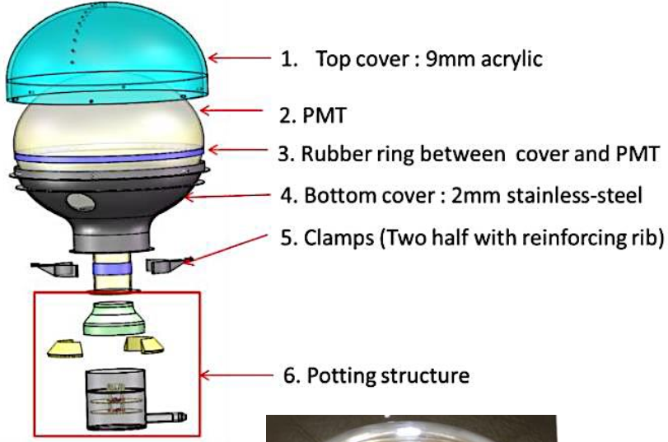
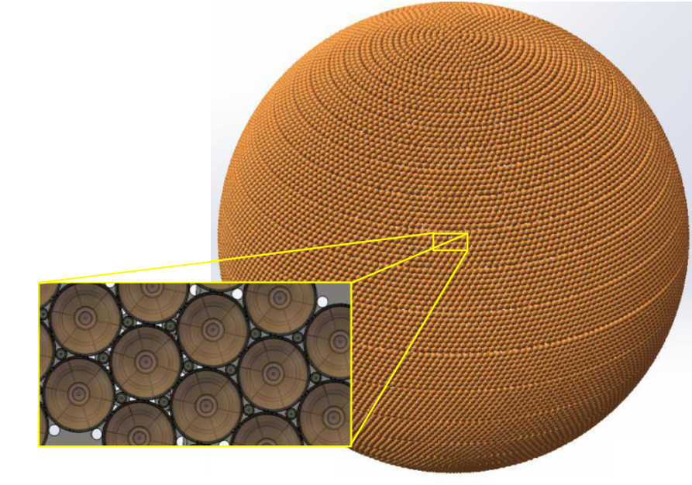
R&D status : JUNO PMTs
Two sizes of PMTs will be used to fully(~78%) cover CD;
17600 20’’ PMTs for CD (~75%) + 2400 20’’ PMTs for Veto;
25000 3’’ PMTs(~2.5%);
Implosion protection;
Waterproof potting;
Custom-made divider and electronics;
Stringent quality control;
6. Potting
structure

Slide 14
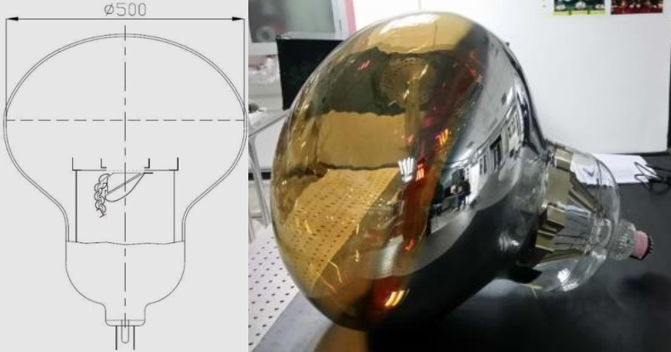
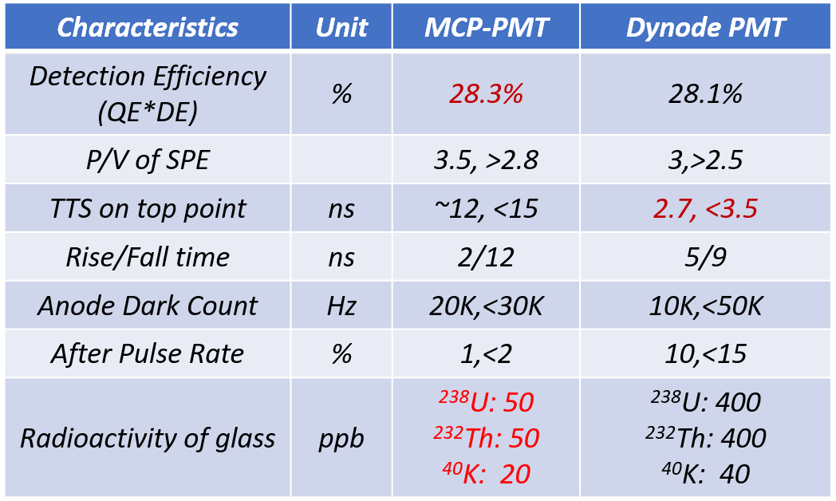
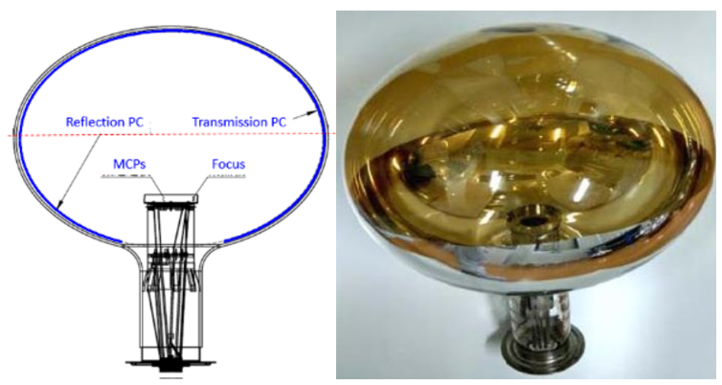
R&D status : Large PMT
Two types of 20‘‘ PMTs will be used: • 15,000 Micro-channel plates PMTs (MCP-PMT,NNVT); • 5,000 Dynode PMTs (Hamamatsu, R12860HQE) ;
MCP-PMTs are custom designed and manufactured for JUNO ;
>10000 20’’ PMTs has been delivered and tested;

Slide 15
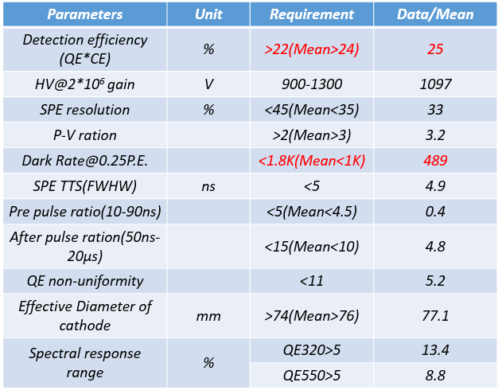
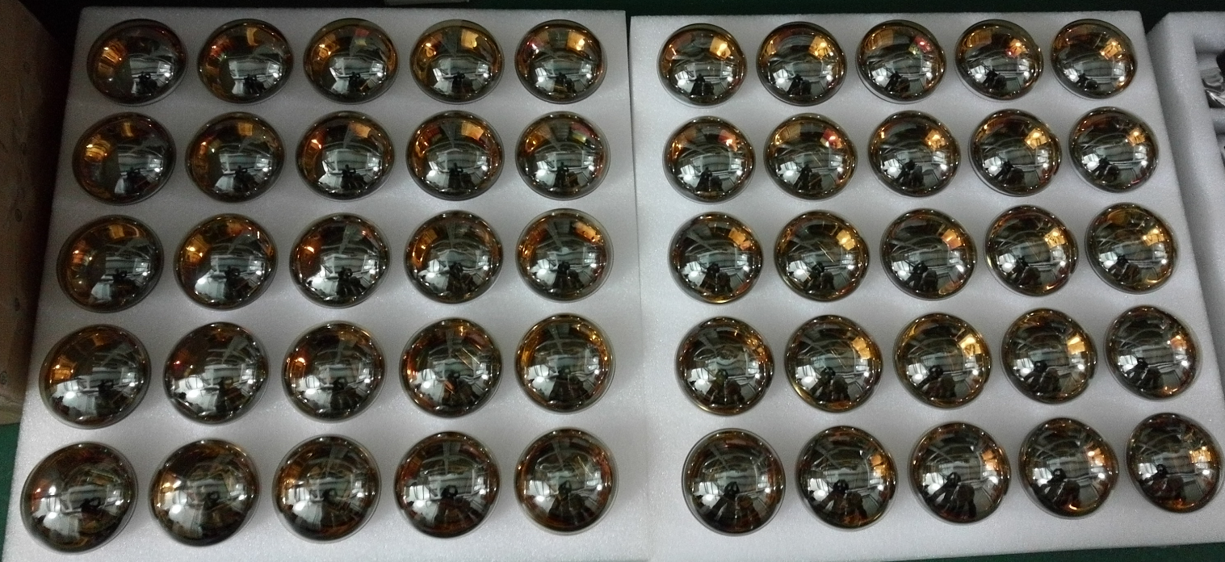
R&D status : Small PMT
Improve the energy scale precision, in particular, the coupling of non-linearity and non-uniformity.
SPMTs almost always work at SPE mode for IBD events and are expected to have almost zero dynamic range, hence virtually no non-linearity, thus providing a linear reference to LPMT;
25000 3’’ PMTs contracted to HZC, ~19000 produced, ~15000 tested and accepted;
3’’ PMTs

Slide 16
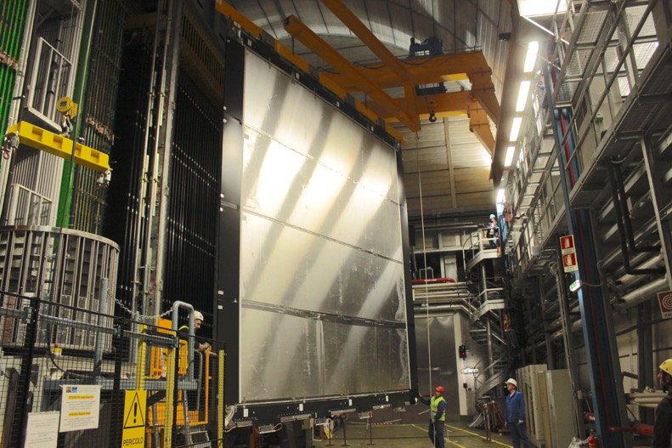
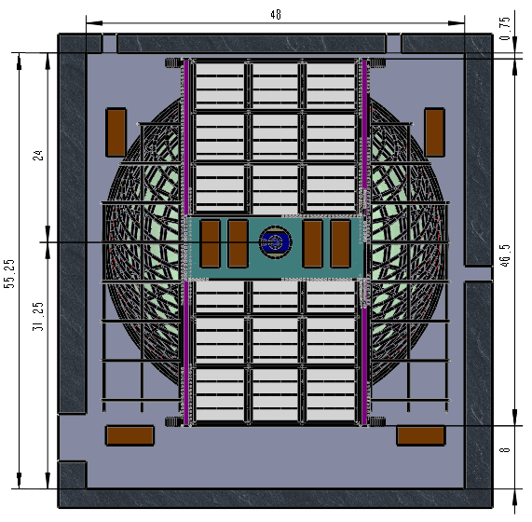
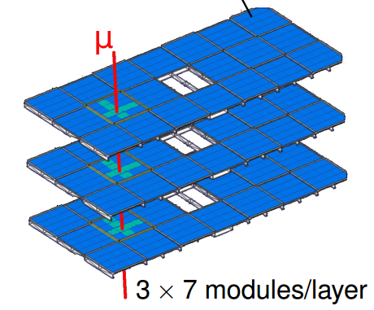
R&D status : Top Tracker
The top tracker(TT) precisely measure the muon tracking and provide valuable information for cosmic muon induced background study;
Reusing the plastic scintillators from OPERA Target Tracker ;
62 modules covered half of the top area;
3 TT layers spaced by 1.7 m ,each layer have x,y readout;
6.8 m
6.8 m
New electronics cards being designed to account for 100× higher radioactivity from rock in JUNO site ;
The plastic modules are already at JUNO site;
No significant aging observed;
1.7m
Top View
JUNO Site (Mar 2019)

Slide 17
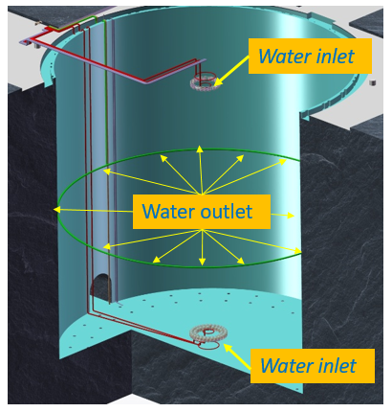
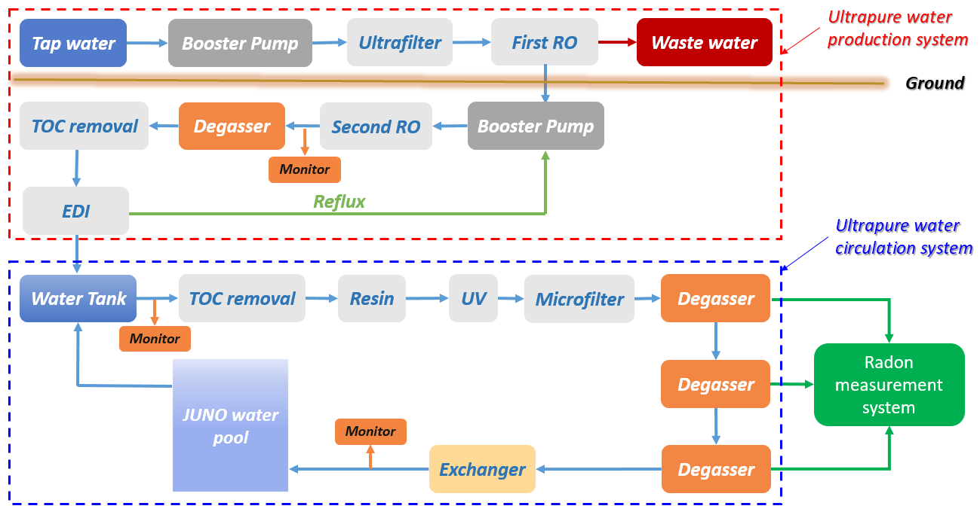
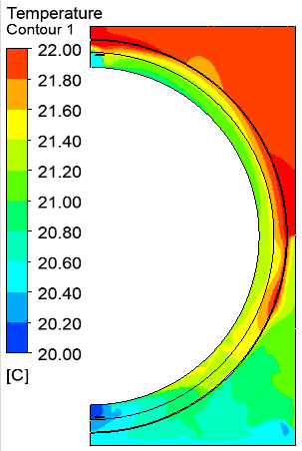
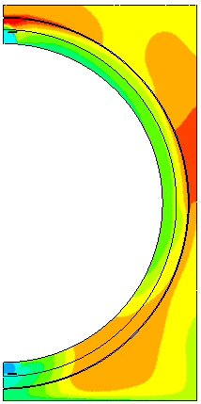
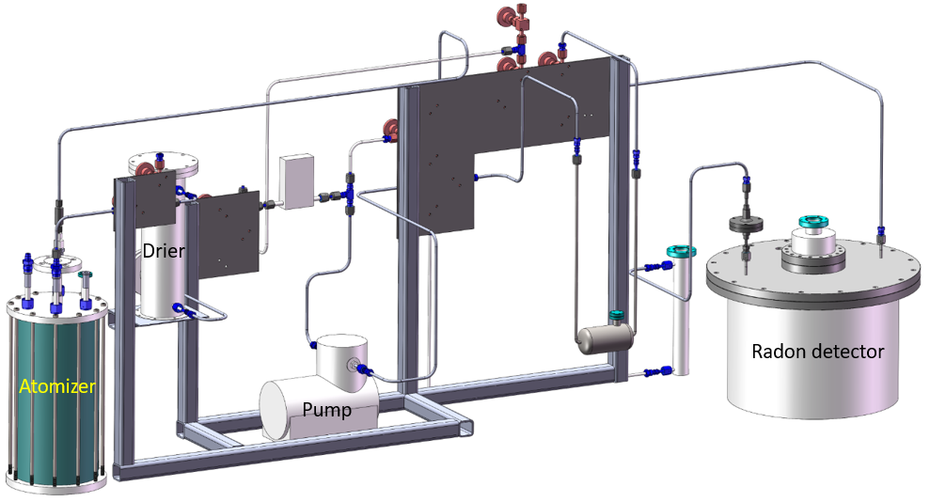
R&D status : Water Cherenkov Detector
A pool filled with 40ktons of ultrapure water and instrumented with 2400 MCP-PMTs to form the water Cherenkov detector;
Detector efficiency requirement is expect to be>95%;
Fast neutron background ~0.1/day;
Water System:
A water system in running with the JUNO-prototype in IHEP;
The radon concentration in water:< 10mBq/m³;
Calculation results show 20℃<T_{water}<22℃；
Radon measurement system
Temperature distribution

Slide 18
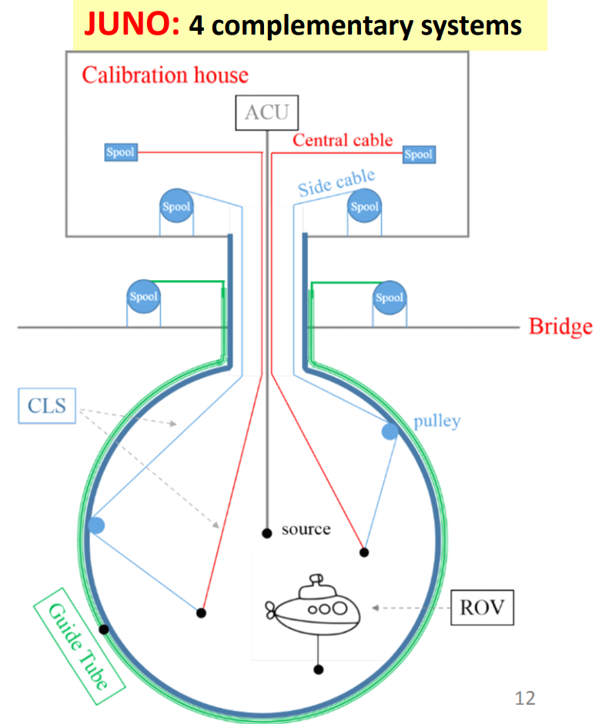
R&D status : Calibration system
The calibration system need to accurately address both the non-uniformity and non-linearity in the detector energy response ;
Energy scale uncertainty < 1%;
Four complementary subsystems:
1-D: Automated calibration unit(ACU);
Scan the central axis;
2-D: Cable loop system(CLS);
Scan vertical planes;
Guide tube calibration system(GTCS);
Scan CD outer surface;
3-D: Remotely operated vehicle(ROV);
Full detector scan;
Radioactive Sources:
γ、e+、n sources
⁴⁰K、⁵⁴Mn、⁶⁰Co、¹³⁷Cs、²²Na、⁶⁸Ge、²⁴¹Am-Be，²⁴¹Am-¹³C or ²⁴¹Pu-¹³C、²⁵²Cf ;

Slide 19
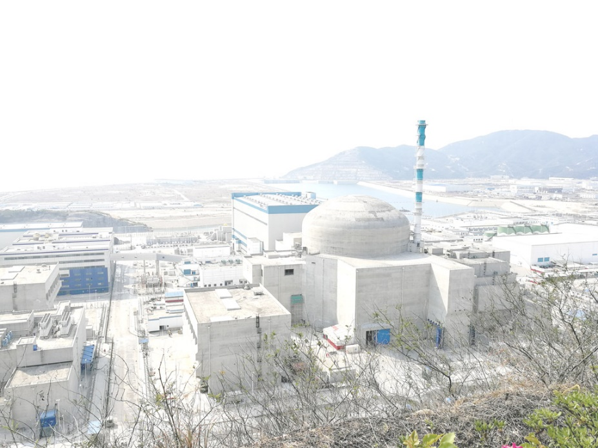
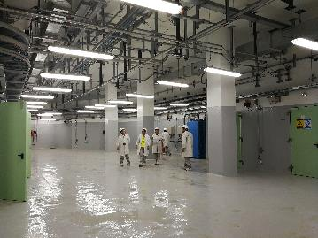
R&D status : TAO
Taishan Antineutrino Observatory (TAO), a ton-level, high energy resolution LS detector at 30m from the core, a satellite experiment of JUNO;
To measure the fine structure of the reactor neutrino spectrum, and eliminate the model dependence of JUNO MH determination;
TAO will be located at Taishan nuclear power plant;
4.6 GW, in operation;
Spacious room at 10 m underground;
~30m horizontally from core;
Event rate: ~2000 IBD/day;
Energy resolution: 1.7%@1MeV；

Slide 20
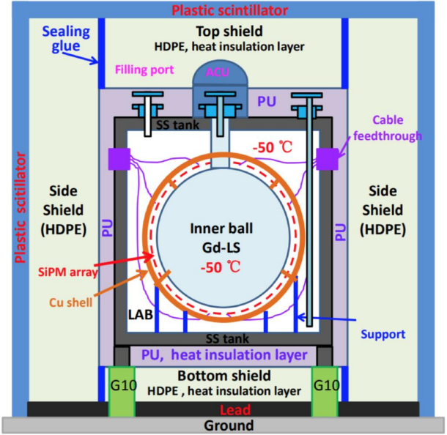
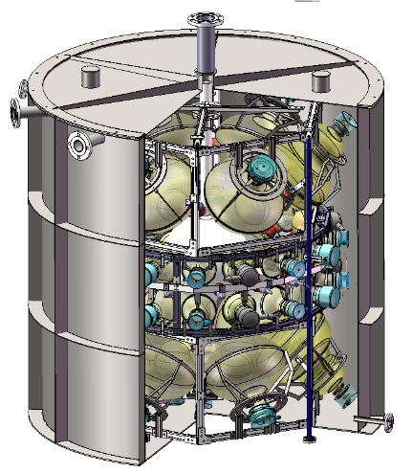
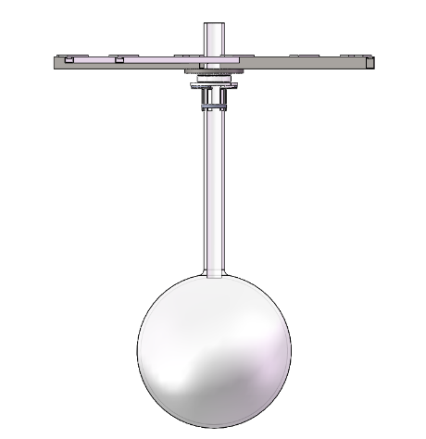
R&D status : TAO
Target:
Gd-LS, 2.6 ton in total and 1 ton fiducial volume;
Detector:
Gd-LS + Balloon + Acrylic + LAB + SiPM;
Full coverage with SiPMs, PDE>50%
Operated at -50 Centigrade (SiPM dark noise);
Light yield: 4500 P.E./MeV;
To verify the cooling system and study the LS properties at low temperature;
The JUNO prototype will be retrofitted to JUNO-TAO prototype;
The SS tank, PMTs and the cryogenic system should be updated;
JUNO Prototype CD
JUNO Prototype

Slide 21
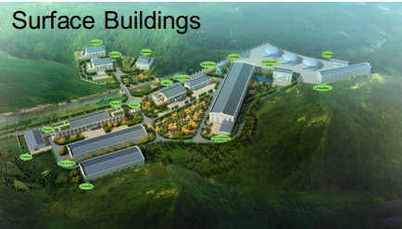
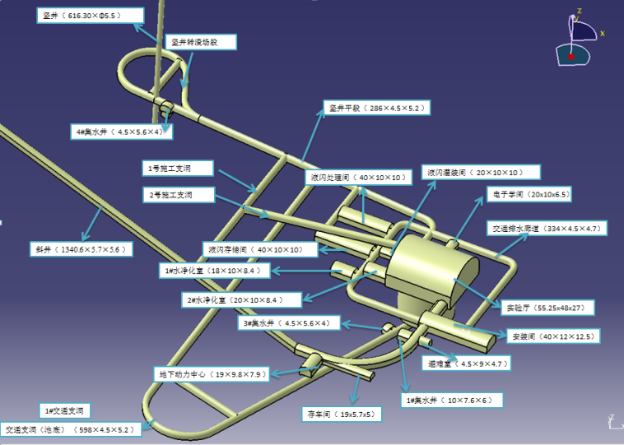
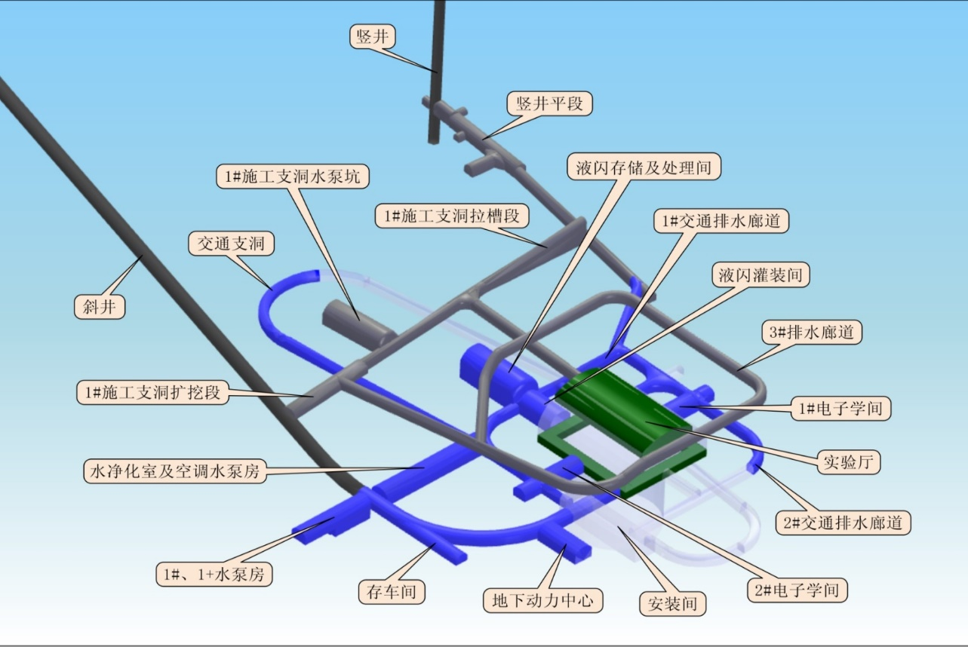
R&D status : Civil construction
2 access tunnels are finished;
Main hall under construction;
Surface buildings under construction;
Slope tunnel: 1340m
Vertical Shaft: 581m

Slide 22
Milestones & Schedule
2021
Detector ready for data taking
Neutrino detected
2019-2020
Electronics production starts
Civil construction and lab preparation completed
Detector construction
2018
PMT potting
Start delivery of surface building
Start production of acrylic sphere
Collaboration 2014
2017
PMT testing start
TT arrived
2016
PMT production start
CD parts production start
Yellow book published
2015
PMT production line setup
CD parts R&D
Civil construction start
2014
International collaboration established;

Slide 23
Summary
JUNO: Rich neutrino physics prospects
Determine MH with 3-4σ with 6 years data;
Precisely measure oscillation parameters with 1% accuracy;
Study the neutrinos from supernova、sun、earth;
…..;
The detector: A massive LS detector with excellent energy resolution
The largest acrylic sphere ever constructed;
20 ktons of highly transparent LS;
Instrumented with 20000 20’’ PMTs and 25000 3’’ PMTs;
4 calibration subsystems;
Reference measurement of reactor neutrino energy spectrum with TAO;
Civil construction & R&D works are on-going, data taking expected in 2021 .

