Slide 1

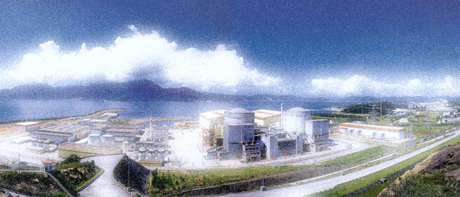
Daya Bay review of sterile neutrino search and Isotope-dependent fluxes
Ming-chung Chu
The Chinese University of Hong Kong, Hong Kong
On behalf of the Daya Bay Collaboration
Partial support: CUHK VC Discretionary Fund, RGC CUHK3/CRF/10R
15th Rencontres du Vietnam
August 4 – 10, 2019, Quy Nhon, Vietnam

Slide 2
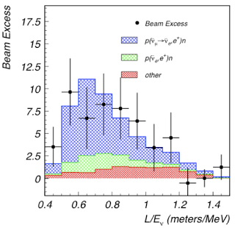
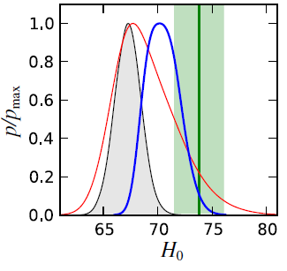


Sterile Neutrinos
- right-handed neutrinos (no weak interactions) in many Beyond Standard Model theories
- May explain some experimental anomalies: LSND, MiniBooNE (m_{s} ~ eV)
Dark matter candidate (m_{s} ~ keV)
May alleviate tension in Hubble parameter between Planck and local measurement (m_{s} ~ eV)
MiniBooNE
LSND
ΛCDM + sterile ν@all data
4.5σ excess of ν_{e} in ν_{μ} beam
local
ΛCDM@CMB
3.8σ excess of in beam
PRL 112, 051302 (2014).
PRD 64, 112007 (2001).
arXiv:1805.12028v2

Slide 3
Daya Bay review of sterile neutrino search and Isotope-dependent fluxes
The Daya Bay Reactor Neutrino Experiment
Constraining sterile neutrino mixing
Absolute reactor antineutrino flux, spectrum, and fuel evolution

Slide 4

The Daya Bay Reactor Neutrino Experiment
F. P. An et al., Daya Bay Collaboration, NIM A 811, 133 (2016); PRD 95, 072006 (2017).

Slide 5
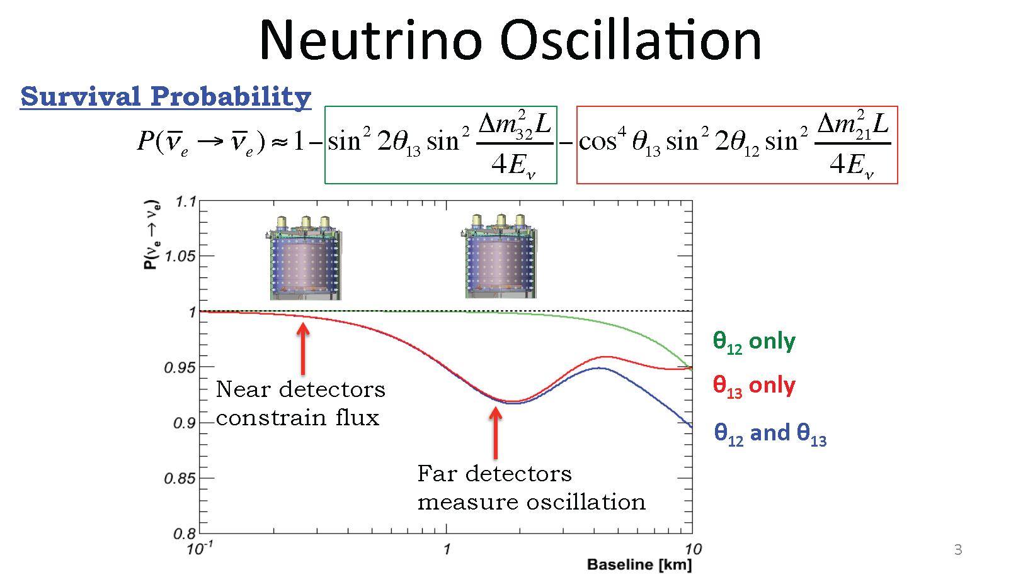
Reactor expt.: a clean way to measure θ₁₃
ee
-
- Reactor: abundant, free, pure source of ν_{e}
- disappearance of ν_{e} at small L depends only on θ₁₃
Near-far configuration
θ₁₂ only
θ₁₃ only
Near detectors: ν_{e} flux and spectrum for normalization
θ₁₂ and θ₁₃
Far detectors: near oscillation maximum for best sensitivity
Relative measurement: cancel out most systematics
L

Slide 6
Near/far Configuration
Minimize systematic uncertainties:
reactor-related: cancelled by near-far ratio
detector-related: use ‘identical’ detectors, careful calibration
R_{Far}
L_{Near}
2
N_{Far}
ε_{Far}
P_{surv}(L_{Far})
R_{Near}
=
L_{Far}
N_{Near}
ε_{Near}
P_{surv}(L_{Near})
number of protons
detector efficiency
Survival prob. → sin²(2θ₁₃)
ν_{e} detection ratio
1/r²
Parameter | CHOOZ error | Near/far configuration
Reaction cross section | 1.9 % | Cancelled out
Number of protons | 0.8 % | Reduced to ~ 0.03%
Detection efficiency | 1.5 % | Reduced to ~ 0.2%
Reactor power | 0.7 % | Reduced to ~ 0.04%
Energy released per fission | 0.6 % | Cancelled out
CHOOZ Combined | 2.7 % | ~ 0.21%

Slide 7
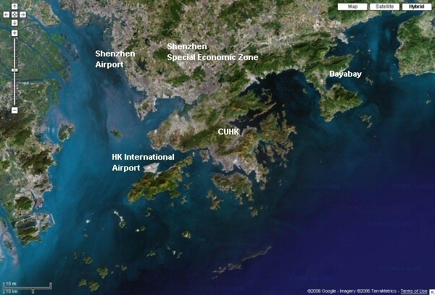
Daya Bay (China)
~40 km

Slide 8
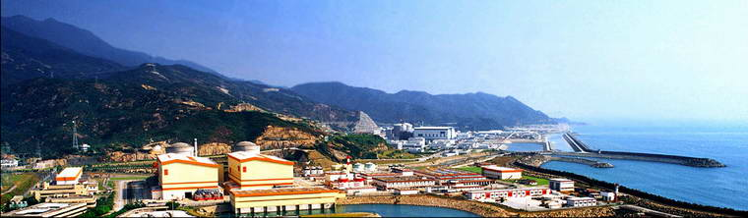
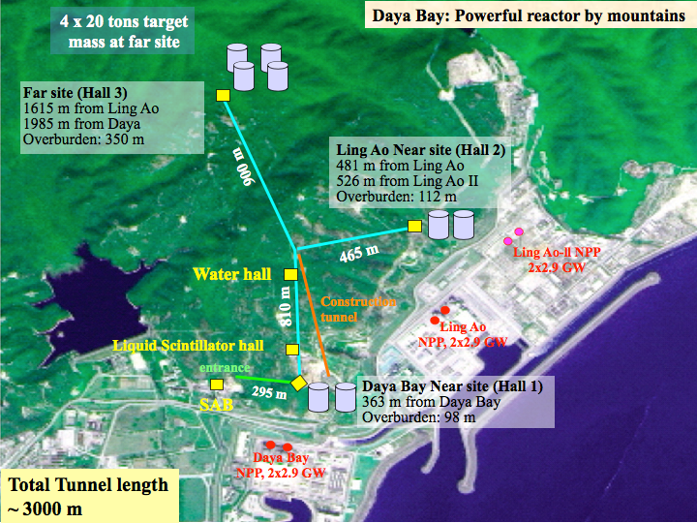
Daya Bay Experiment
- Top five most powerful nuclear plants (17.4 GW_{th})
→ large number of ν_{e} (3x10²¹/s)
- Adjacent mountains shield cosmic rays
Far Hall (EH3)
860 m.w.e., Target: 80 t
<L> ~ 1580 m
Ling Ao Near Hall (EH2)
265 m.w.e., Target: 40 t
<L> ~ 560 m
Daya Bay Near Hall (EH1)
265 m.w.e., Target: 40 t
<L> ~ 510 m

Slide 9

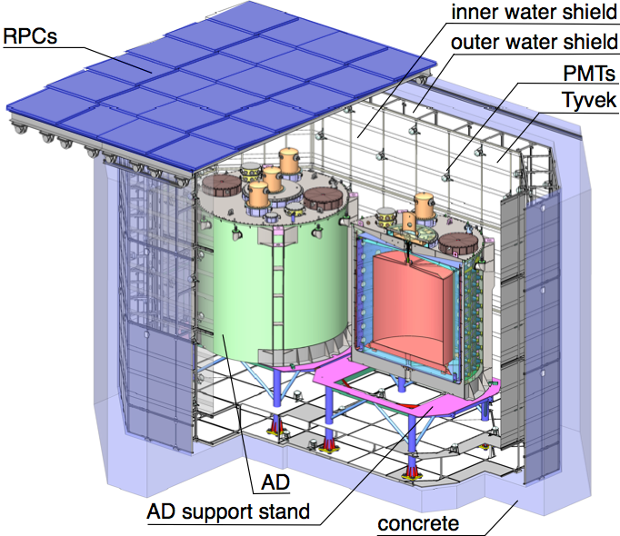
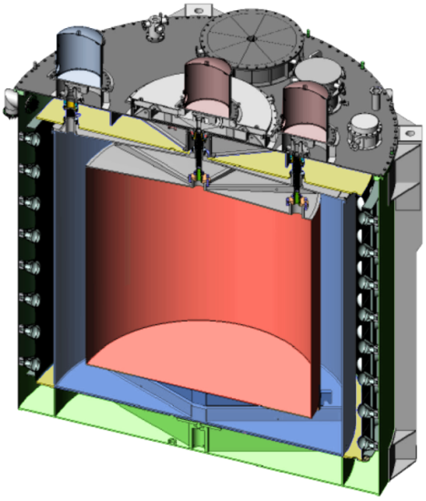
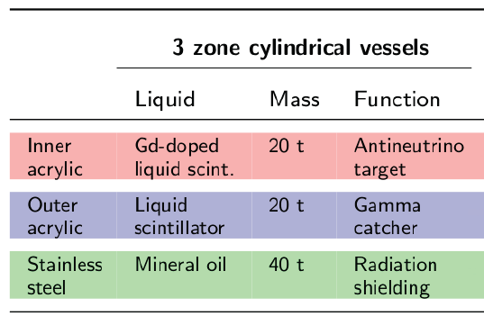
Daya Bay detectors
RPC : muon veto
Water pool: muon veto + shielding from environmental radiations (2.5m water)
8 functionally identical anti-neutrino detectors (AD) to suppress systematic uncertainties
Calibration units
192 8” PMTs
5m
Top and bottom reflectors: more light, more uniform detector response
5m

Slide 10
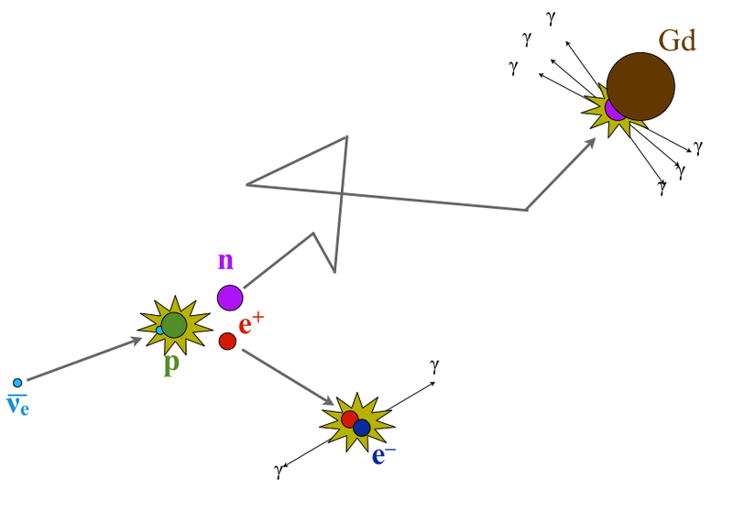
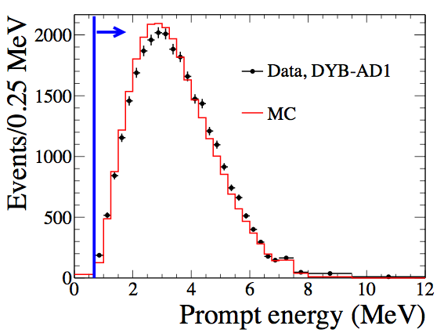
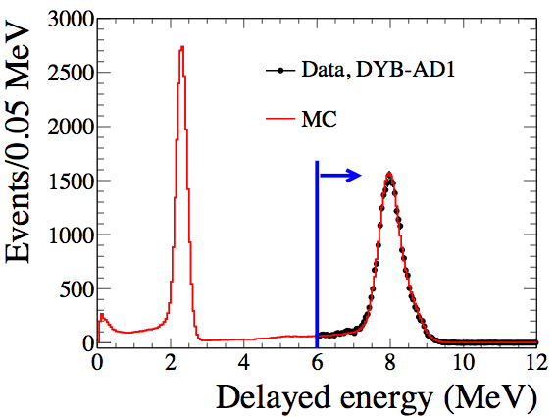
Antineutrino detection
ν_{e} detected via inverse beta-decay (IBD):
Prompt Signal
γ → visible photons in liq. scintillator
ν_{e} + p → e⁺ + n (prompt signal)
~180μs
Delayed Signal
→ + p → D + γ (2.2 MeV)
nH
(delayed signal)
+ Gd → Gd*
→ Gd + γ’s (8 MeV)
~30μs
for 0.1% Gd
nGd
Powerful background rejection!
E_{ν} ≈ T_{e+} + T_{n} + (m_{n} - m_{p}) + m_{e+} ≈ T_{e+} + 1.8 MeV

Slide 11
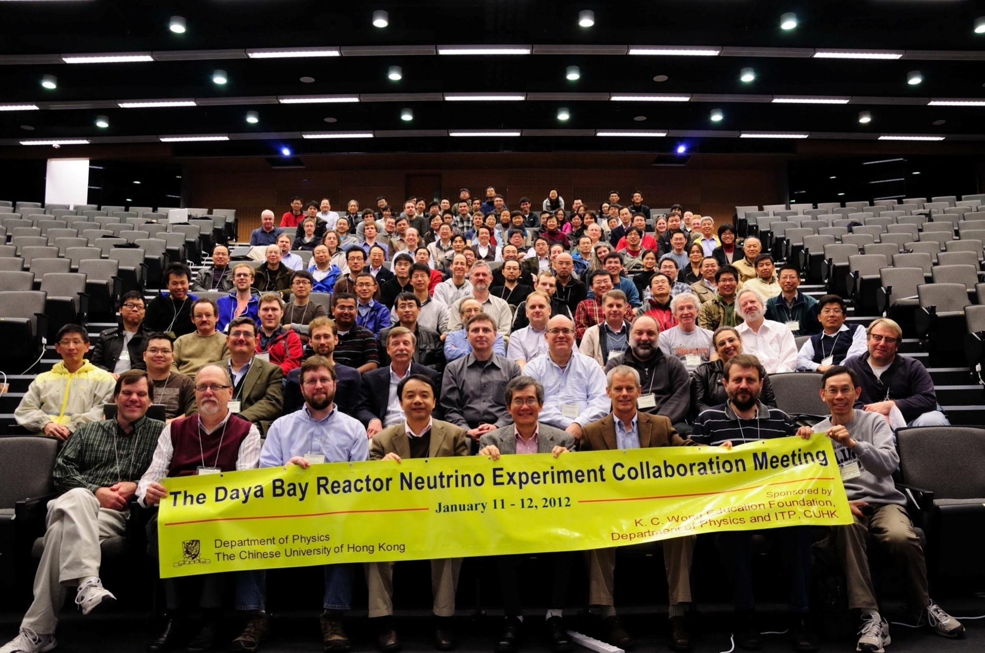
The Daya Bay Collaboration
42 Institutes, ~ 203 collaborators from China, USA, Hong Kong, Taiwan, Chile, Czech Republic and Russia

Slide 12
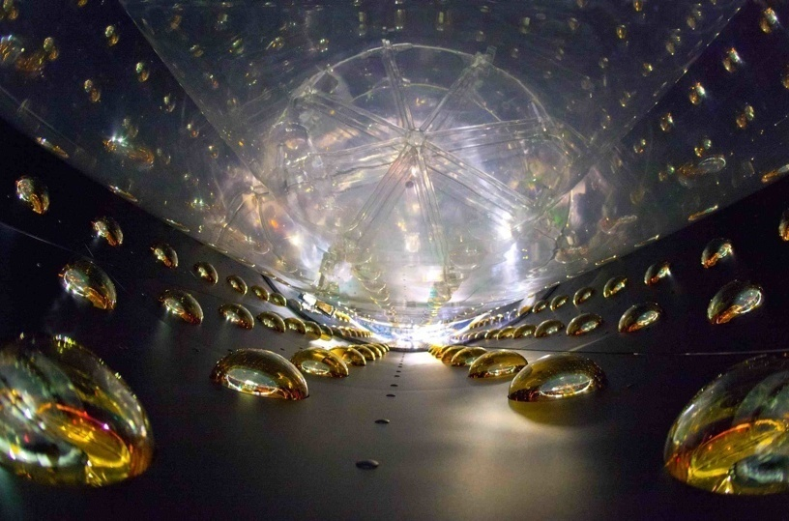
Interior of an AD

Slide 13
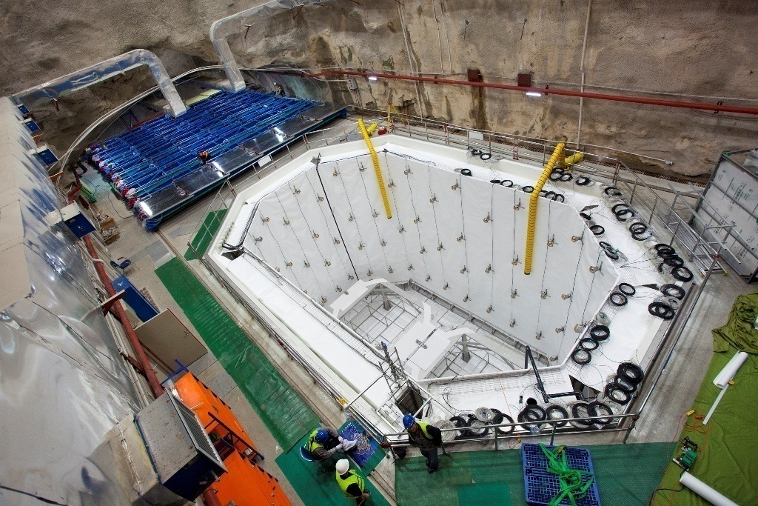
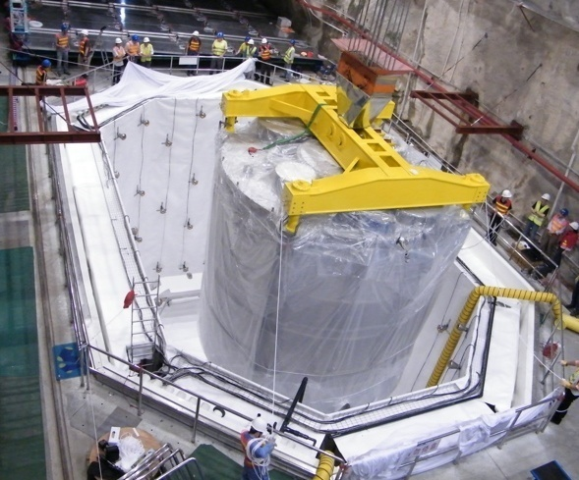
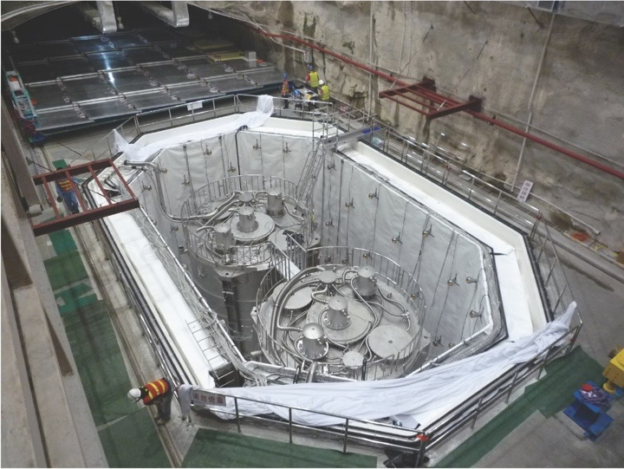
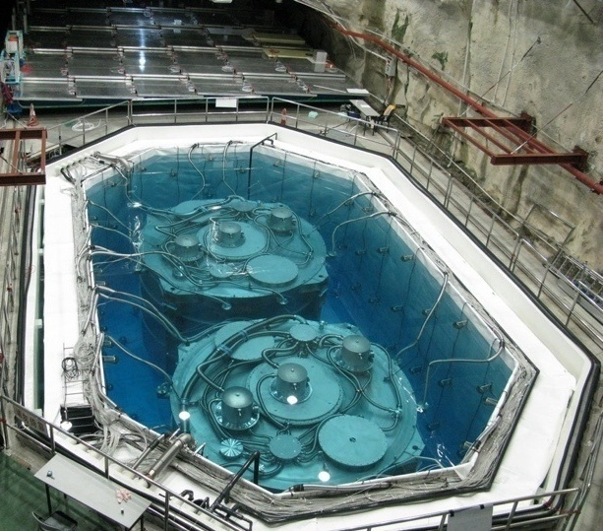
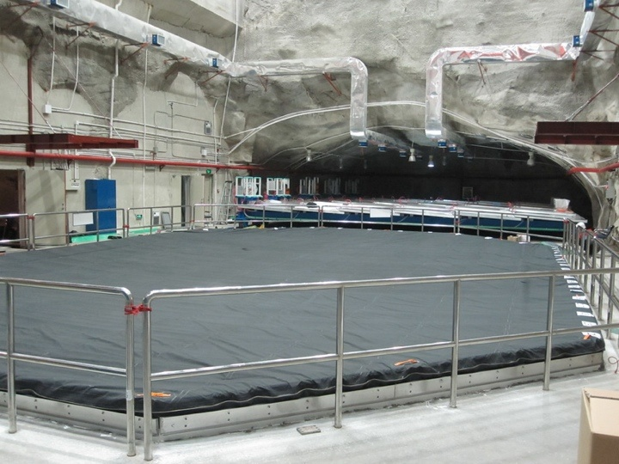
AD Installation - Near Hall

Slide 14
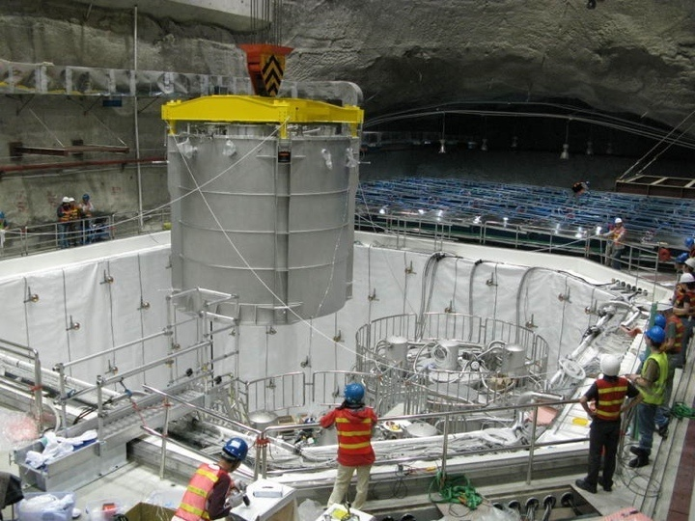
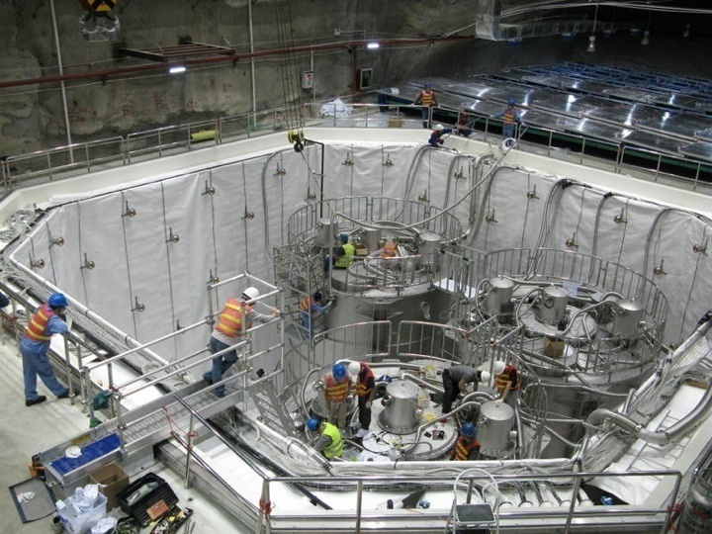
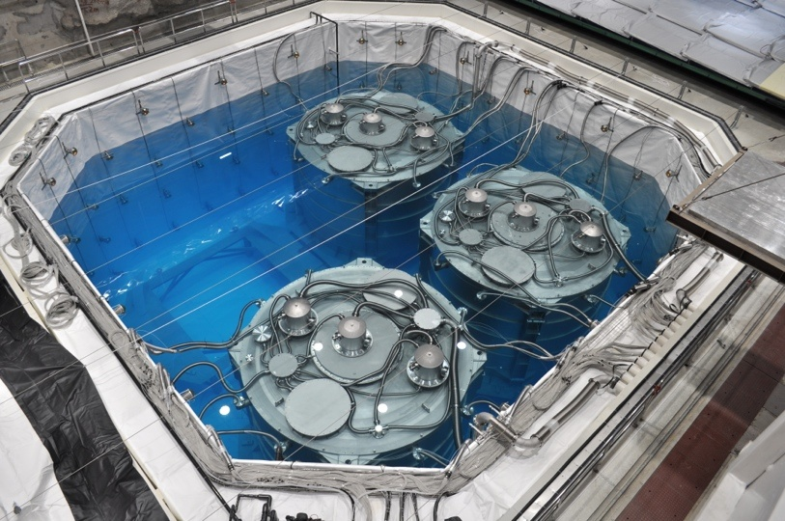
AD Installation - Far Hall

Slide 15
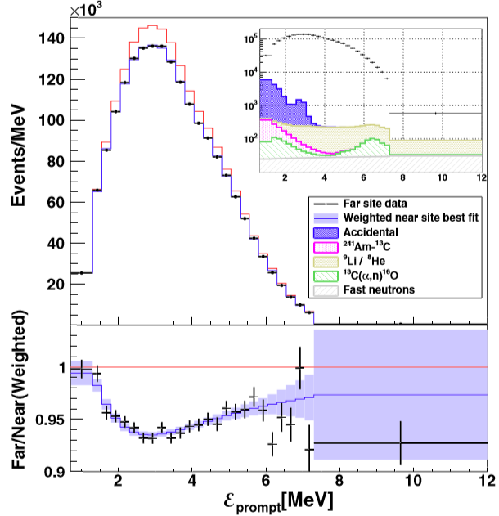
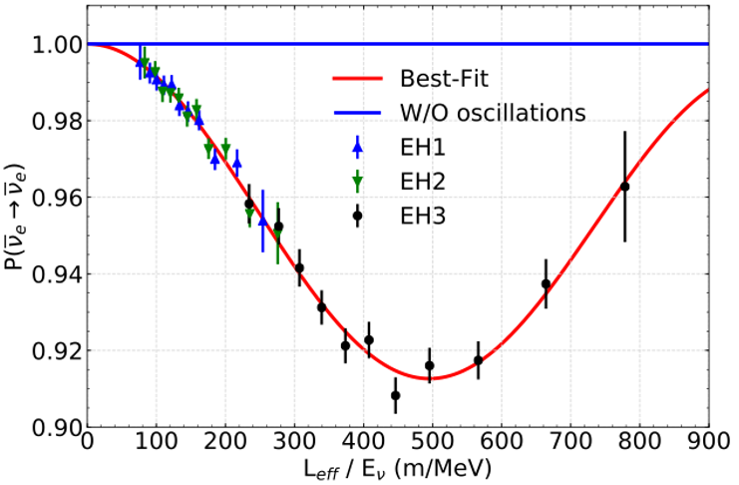
Oscillation results
P_{ee} ≈ 1 – sin²2θ₁₃sin²(Δm_{ee}²L/4E_{ν}) – sin²2θ₁₂cos⁴θ₁₃sin²(Δm₂₁²L/4E_{ν})
Far/near relative measurement, 1958 days of data
Oscillation parameters measured with rate + spectral distortion
Both consistent with neutrino oscillation interpretation
PRL 121, 241805 (2018).
F. P. An et al., Daya Bay Collaboration,

Slide 16
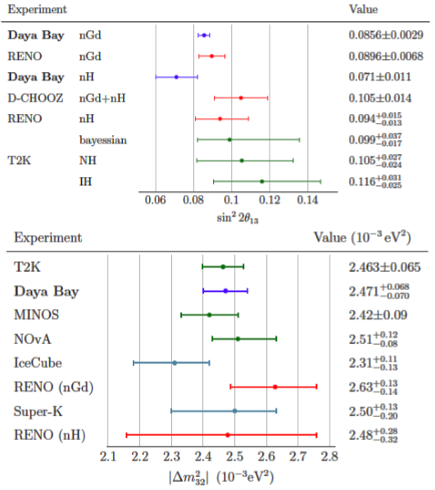
Oscillation results
PRL 121, 241805 (2018).
sin²2θ₁₃ = 0.0856 ± 0.0029
N.H.
I.H.

Slide 17
Constraining sterile neutrino mixing
F. P. An et al., Daya Bay Collaboration, PRL 117, 151802 (2016); PRL 113, 141802 (2014).
Daya Bay and MINOS Collaborations, PRL 117, 151801 (2016).

Slide 18
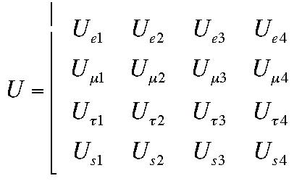

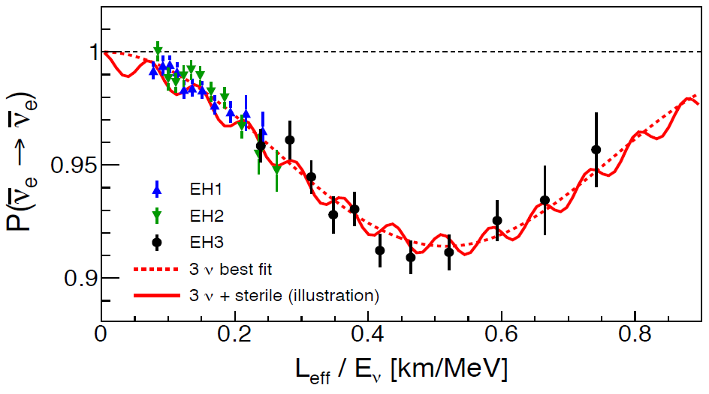
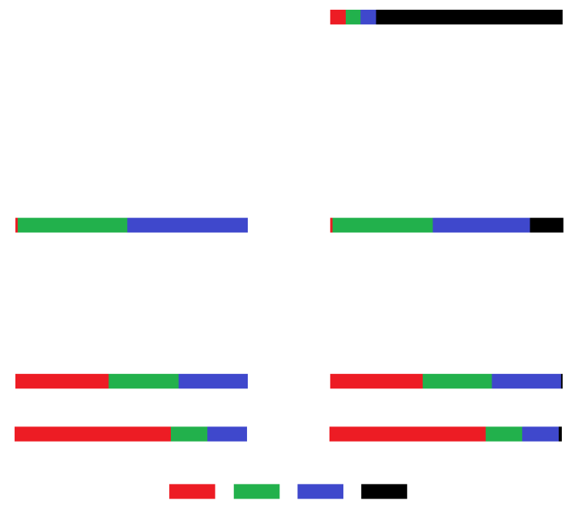




3+1 Neutrino Oscillations
Simplest extension:
ν_{e}
ν₁
ν_{μ}
ν₂
= U
ν_{τ}
ν₃
ν_{s}
ν₄
P_{ee} ≈ 1 – sin²2θ₁₃sin²(Δm²₃₁L/E_{ν})
– sin²2θ₁₄sin²(Δm²₄₁L/E_{ν}) for Daya Bay baselines
Standard
3ν mixing
(NH)
3+1ν mixing
L_{eff}/E_{ν}

Slide 19
Search for a light sterile neutrino
PRL 117, 151802 (2016)
Daya Bay IBD data (217 days of 6 ADs + 404 days of 8 ADs):
Full 4-flavor oscillation formula for P_{ee}; free variables: sin²2θ₁₃, sin²2θ₁₄, |Δm²₄₁|
Method A: predict prompt energy spectrum at far hall from measured spectra in near halls.
Minimize
Covariance matrix (sys. + stat.)
Weighting factors calculated from baselines and reactor power profiles
Energy bin
Method B: fit spectra from all ADs simultaneously using a binned log likelihood constructed with nuisance parameters for various systematics. Reactor ν_{e} flux constrained using Huber-Mueller with enlarged uncertainties.

Slide 20
Search for a light sterile neutrino
PRL 117, 151802 (2016)
Results:
Minimum χ²_{4ν} /NDF = 129.1/145
Method A:
p-value (using MC) = 0.41
Minimum χ²_{3ν} /NDF = 134.7/147
Minimum χ²_{4ν} /NDF = 179.74/205
Method B:
p-value (using MC) = 0.42
Minimum χ²_{3ν} /NDF = 183.87/207
No apparent signature for sterile neutrino mixing is observed.
Setting constraints on η = (|Δm²₄₁| , sin²2θ₁₄):
Feldman-Cousins – using large no. of pseudo-experiments to determine C.L. according to Δχ²
CL_{s} method -
p-value for 4ν
Exclusion region at α C. L. if CL_{s} ≤ 1- α
p-value for 3ν

Slide 21
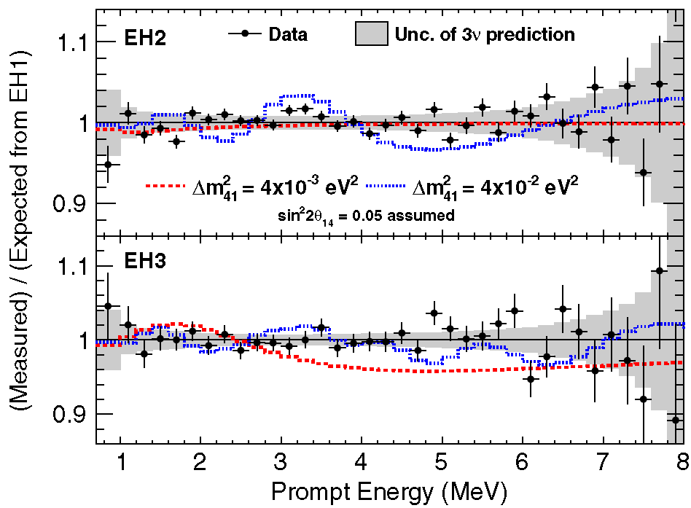
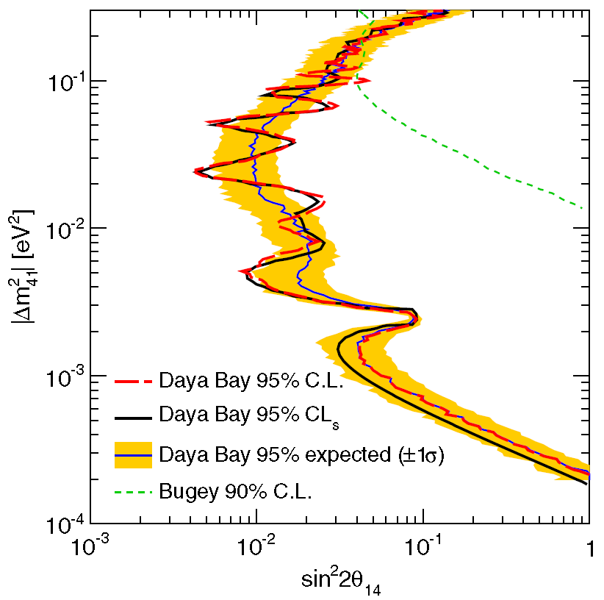
Search for a light sterile neutrino
PRL 117, 151802 (2016).
Sterile neutrino: additional oscillation mode:
3 expt. halls → multiple baselines
  Relative measurement at EH1 (~350 m), EH2 (~500 m), EH3 (~1600 m)
  Unique sensitivity at 10⁻³ eV² < Δm²₄₁ < 0.1 eV²
  most stringent limit on sin²2θ₁₄ for 2x10⁻⁴ eV² < Δm²₄₁ < 0.2 eV²
P_{ee} ≈ 1 – sin²2θ₁₃sin²(Δm²₃₁L/E_{ν}) – sin²2θ₁₄sin²(Δm²₄₁L/E_{ν}) for Daya Bay baselines
Excluded

Slide 22
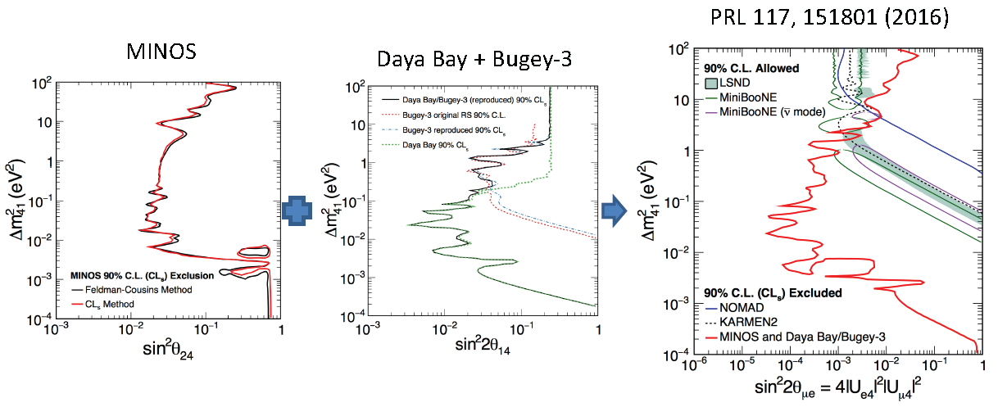
Daya Bay + Bugey-3 + MINOS
Updated results with MINOS/MINOS+ will be released soon!
- Constrain ν_{μ} → ν_{e} by combining constraints on sin²2θ₁₄ from ν_{e} disappearance in Daya Bay and Bugey with constraints on sin²θ₂₄ from ν_{μ} disappearance in MINOS
- Set constraints over 6 orders of magnitude in Δm²₄₁.
- Exclude MiniBooNE and LSND parameters for Δm²₄₁ < 0.8 eV².

Slide 23
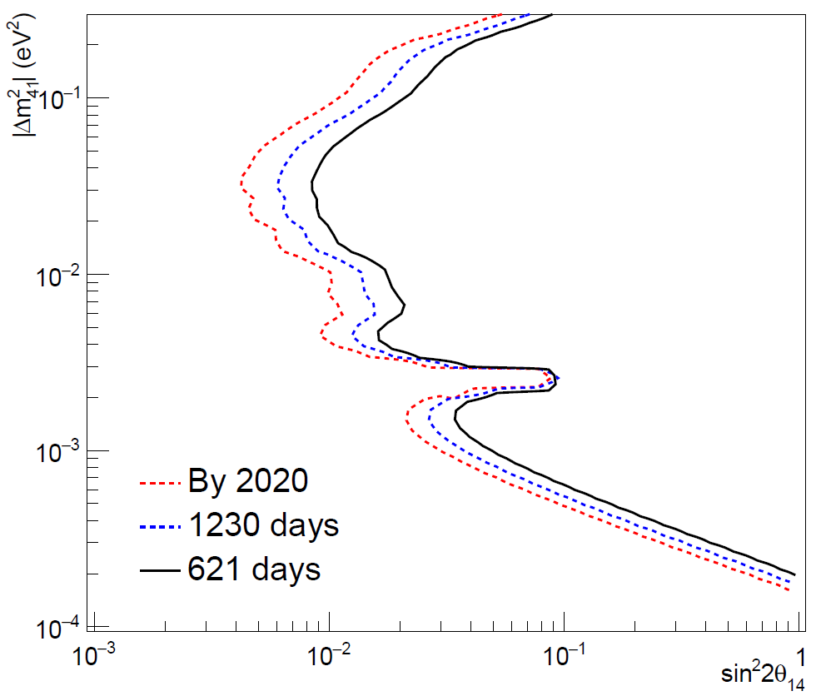
Better Limits to come
Expect ~2 improvement by 2020

Slide 24
Absolute reactor antineutrino flux, spectrum, and fuel evolution
F. P. An et al., Daya Bay Collaboration, PRL 116, 061801 (2016); Chinese Physics C 41(1), 13002 (2017); PRL 118, 251801 (2017); arXiv:1808.10836v1; arXiv:1904.07812v1.

Slide 25
Reactor antineutrino flux
arXiv:1808.10836; PRL 118, 251801 (2017); Chin. Phys. C41, 0130002 (2017).
Precise measurement of reactor antineutrino flux using 2.2 M inverse beta decay (IBD) events collected with the Daya Bay near detectors in 1230 days
IBD yield = (5.91±0.09)x 10⁻⁴³ cm²/fission
Measured antineutrino yield = 0.952 ±0.014 ±0.023 of Huber-Mueller model prediction: confirm Reactor Antineutrino Anomaly
Mean fission fractions:
²³⁵U | ²³⁸U | ²³⁹Pu | ²⁴¹Pu
0.564 | 0.076 | 0.304 | 0.056
Data/Prediction (Huber+Mueller)

Slide 26
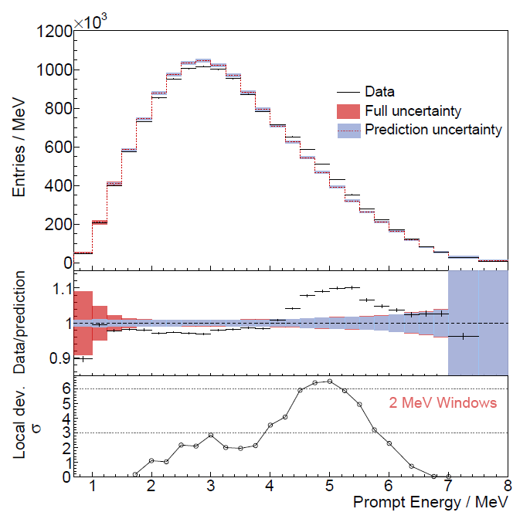
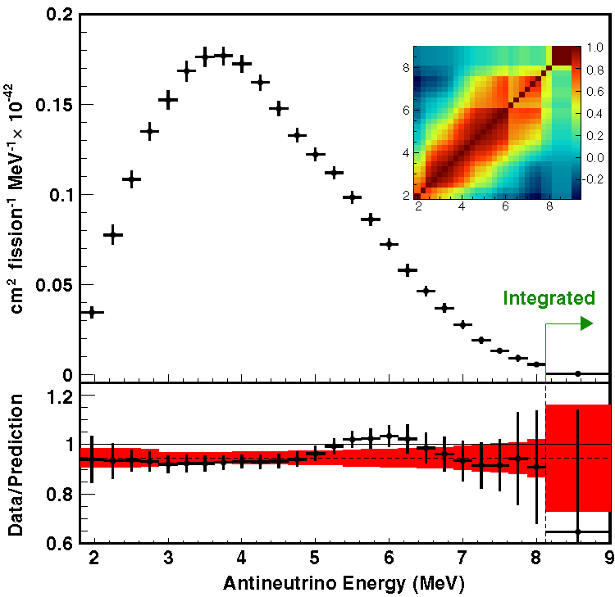
Reactor antineutrino spectrum
arXiv:1904.07812 (2019).
1958 days of data, 3.5M IBD events
Measured prompt spectrum vs. Huber+Mueller:
Global discrepancy at 5.3 σ
Local deviation in 4-6 MeV region: 6.3 σ
Extracted a generic observable reactor antineutrino spectrum by removing the detector response

Slide 27

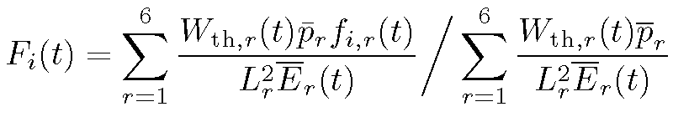
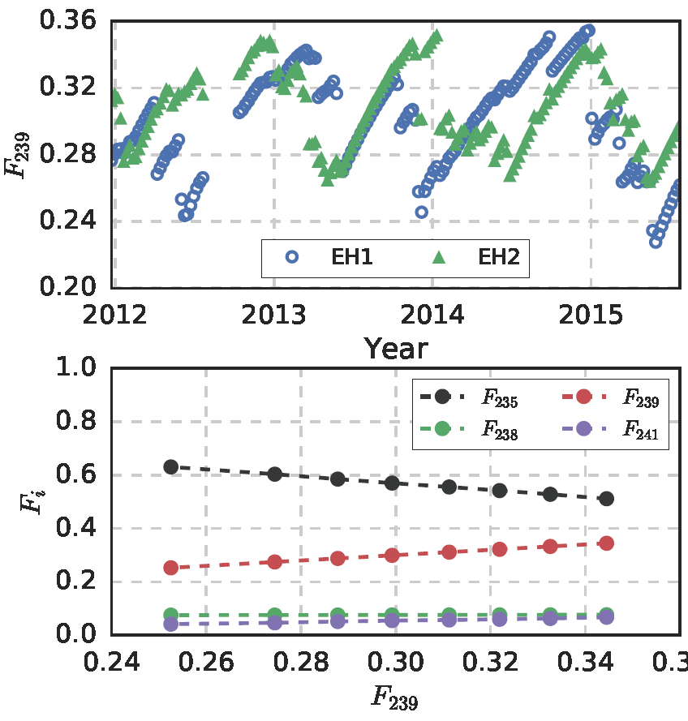
Reactor antineutrino flux evolution
(
Effective fission fraction for i^{th} isotope changes in time as fuel evolves:
f_{i,r}(t) (fission fraction for i^{th} isotope in reactor r) and W_{th,r}(t) (thermal power) obtained from reactor data, validated with MC.
p_{r} = survival probability
L_{r} = baseline
E_{r} = average energy per fission
σ_{f}(t) = Σ_{i} σ_{i}F_{i}(t) also evolves
IBD yield
i^{th} isotope
PRL 118, 251801 (2017)

Slide 28
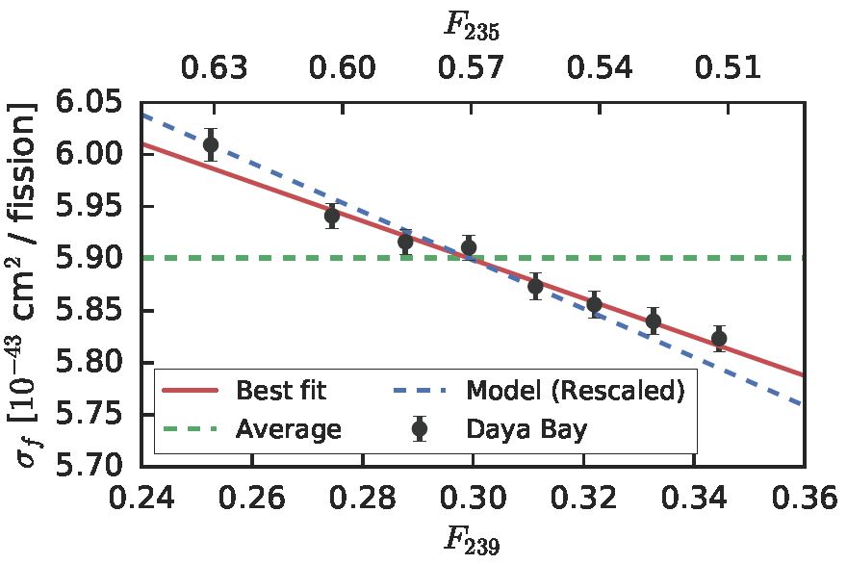
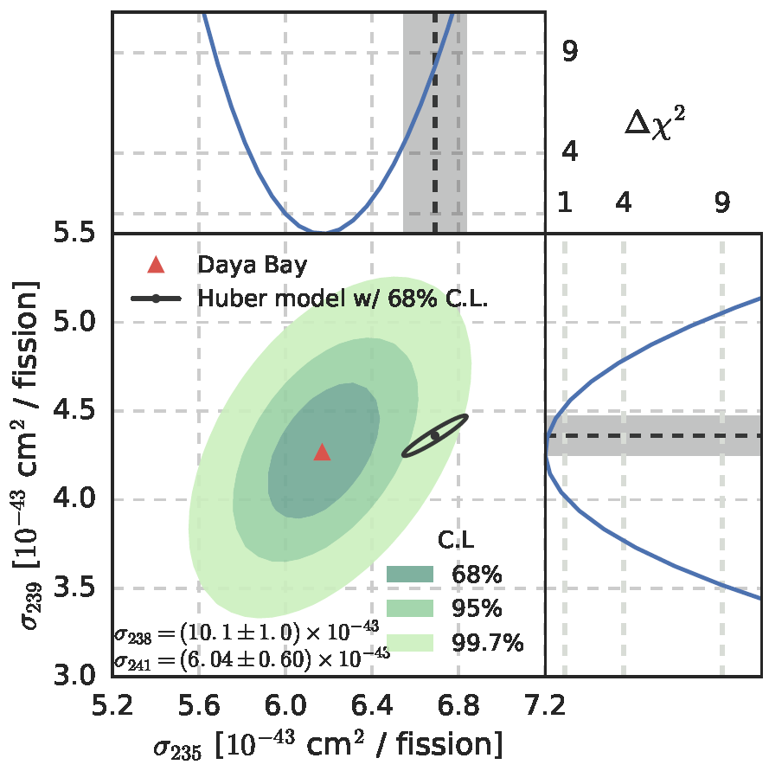
Reactor antineutrino flux and spectrum evolution
PRL 118, 251801 (2017).
σ_{f}(t) = Σ_{i} σ_{i}F_{i}(t) also evolves
Best fit of σ_{f}(t) = Σ_{i} σ_{i}F_{i}(t) to get σ_{i}
Favors: overestimation of ²³⁵U yield
IBD yield
i^{th} isotope
Slope differs from theory by 3.1σ
Sterile ν only ⇒ same fractional flux deficit for all isotopes:
(dσ_{f}/dF₂₃₉)/<σ_{f}> = theory
incompatible with data at 2.6σ

Slide 29
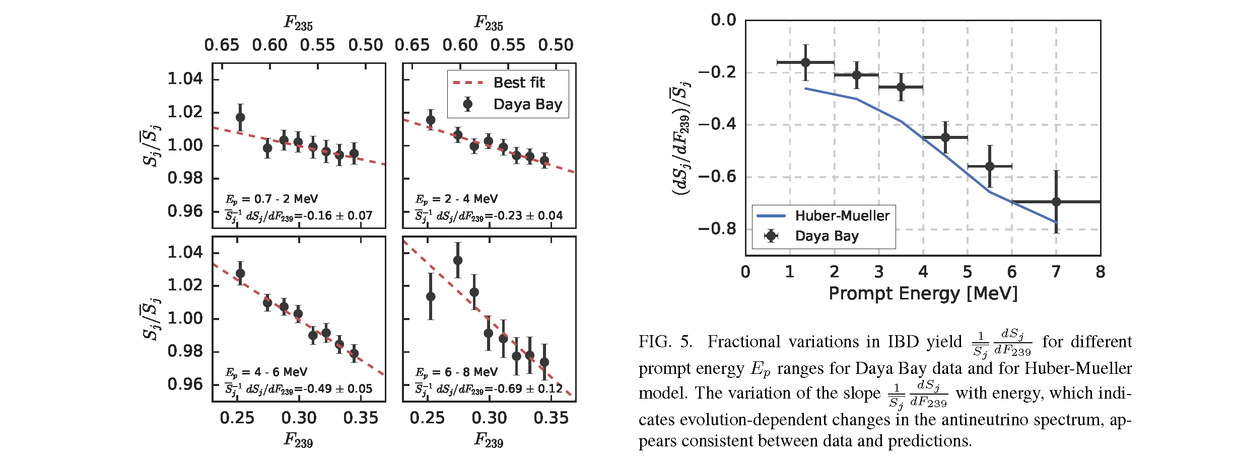
Reactor antineutrino spectrum evolution
S_{j} = observed IBD per fission in j^{th} energy bin
PRL 118, 251801 (2017).
- First observation of change in IBD spectrum with F₂₃₉ at 5.1σ
- Shape ~ theory
- Demonstration of neutrino monitoring of reactors

Slide 30
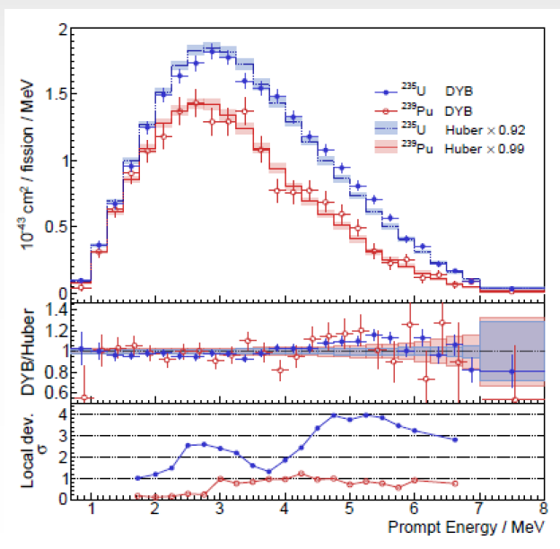
²³⁵U and ²³⁹Pu Spectra
arXiv:1904.07812(2019)
Fuel evolution allows to extract ²³⁵U and ²³⁹Pu spectra
Ordered by ²³⁹Pu fission fraction into 20 data groups
Fit the ²³⁵U and ²³⁹Pu spectra, as two dominant components
Not sensitive to ²³⁸U and ²⁴¹Pu
1958 days data
Compare spectra, yield with Huber-Mueller:
  - Similar excess in 4—6 MeV
  - Significance of local deviations:
    4σ for ²³⁵U
    1.2σ for ²³⁹Pu
- IBD yield comparison:
²³⁵U: 0.92 ±0.023(exp.)±0.021(model)
²³⁹Pu: 0.99 ±0.057(exp.) ±0.025(model)

Slide 31
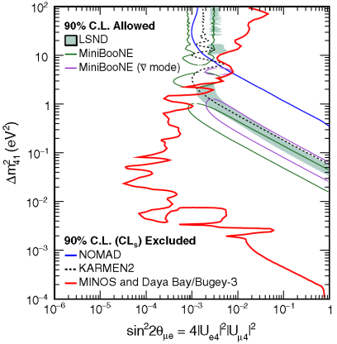
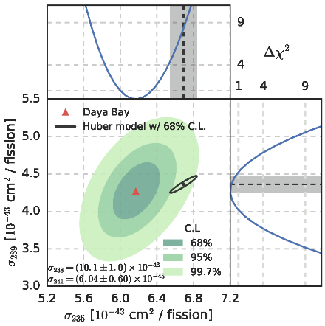
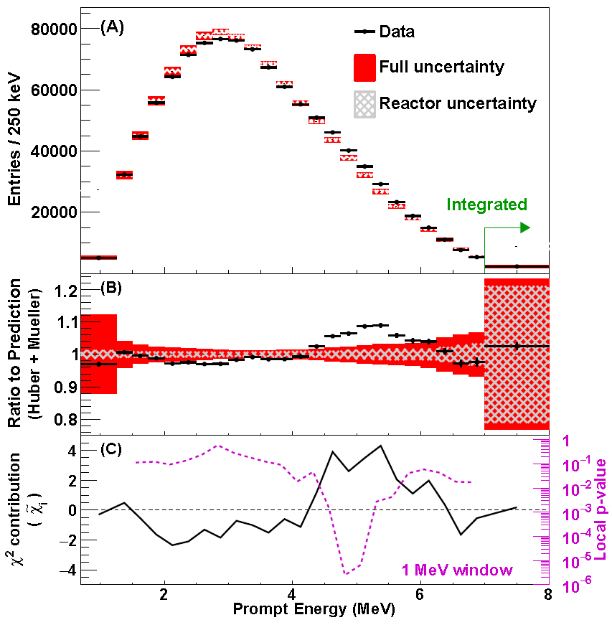
Summary
Daya Bay Expt.
  Most precision measurement of : 3.4%
  Most precision measurement of : 2.8%
Direct search for sterile neutrino mixing
- fit Daya Bay spectra with additional oscillation due to sin²2θ₁₄
  - most stringent limit on sin²2θ₁₄ for 2x10⁻⁴ eV² < Δm²₄₁ < 0.2 eV²
Reactor antineutrino flux, spectrum and evolution
  Flux : consistent with previous short baseline expt.s, 0.952±0.014±0.023 of Huber-Mueller
  Prompt Spectrum: 6.3σ deviation from prediction in [4, 6] MeV
  Evolution observed. Favors σ₂₃₅ wrong; disfavors sterile neutrino mixing at 2.6σ
  ²³⁵U and ²³⁹Pu spectra extracted
Will continue till 2020

