Slide 1
Axion Dark Matter Search at IBS/CAPP
New Physics with Exotic and Long-Lived Particles
A Joint ICISE-CBPF Workshop
01−06 July 2019 ICISE, Quy Nhon, Vietnam
SungWoo YOUN
Center for Axion and Precision Physics Research (CAPP)
Institute for Basic Science (IBS)

Slide 2
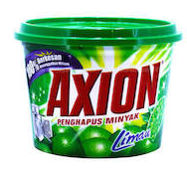
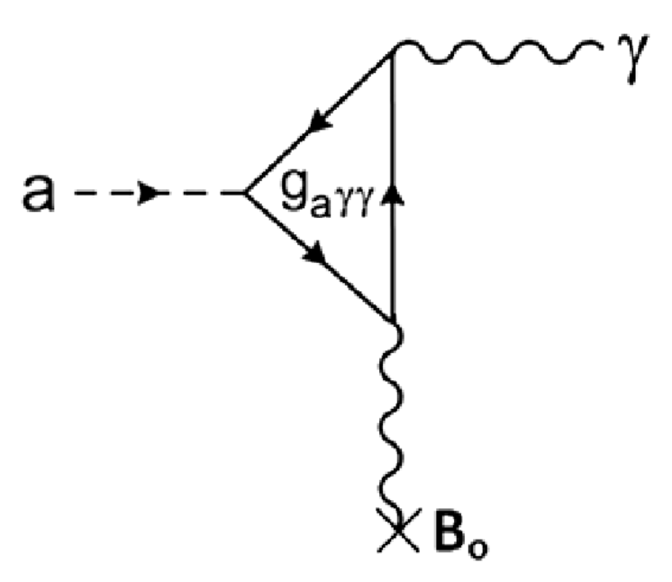
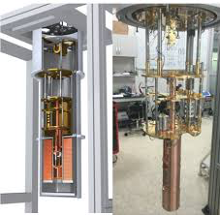
Outline
Axion
Dark matter ?
Detection principle
Experimental parameters
Axion research at IBS/CAPP
Facilities and equipment
R&D effort
(Multiple) experiments
Projected sensitivities
Summary

Slide 3
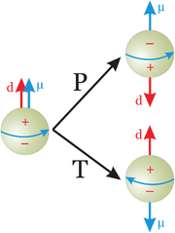
Strong CP problem
QCD vacuum structure adds an extra terms to L_{QCD}
Violates CP symmetry proportionally to θ
Not predictable by theory, must be measured
CP-violation term induces charge separation
Neutron electric dipole moment (nEDM)
Experimental value is very tiny
d_{n} < 10⁻²⁶ ecm => θ < 10⁻¹⁰
Theoretically, θ = 0 if a quark is massless (X)
Strong CP problem
Naturalness problem (0 < θ_{the} < 2π vs. θ_{exp} ~ 0)

Slide 4
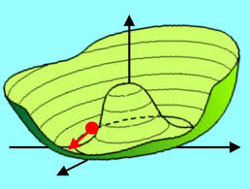
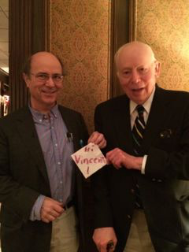
PQ mechanism and axion
Peccei & Quinn (1977)
New global symmetry U_{PQ}(1) with a scalar a(x)
Spontaneously broken at an energy scale f_{a}
Induces a potential for a(x) with minimum at a(x) = θ×f_{a}
Dynamic solution to the strong CP problem
Wilczek & Weinberg (1978)
Pseudoscalar Goldstone boson => Axion
Axion mass depends on symmetry breaking scale f_{a}
For f_{a} of the order of the EW scale => m_{a} ~ 100 keV (PQWW axion excluded by collider experiments)
R. Peccei & H. Quinn
F. Wilczek &
S. Weinberg

Slide 5
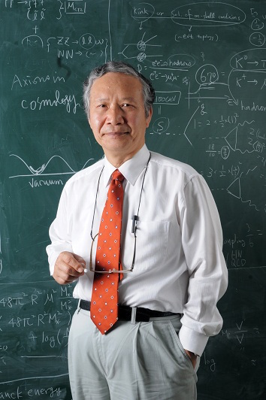
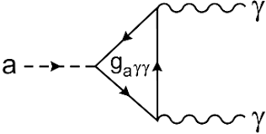
Invisible axion
J.E. Kim (1979)
Proposed a very light axion with a very large f_{a} (in early universe)
Spanned axion mass by many orders of magnitude
J. E. Kim
Energy scale
Axion mass
Axion interactions
Quarks, gluons, photons, leptons,…
Model dependent on PQ charge assignment
KSVZ – Heavy quark (ex. g_{γ} = −0.97)
DFSZ – Higgs doublet (ex. g_{γ} = 0.36)

Slide 6
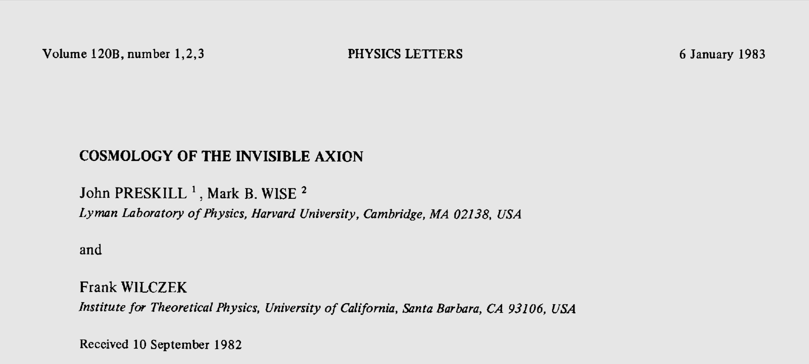
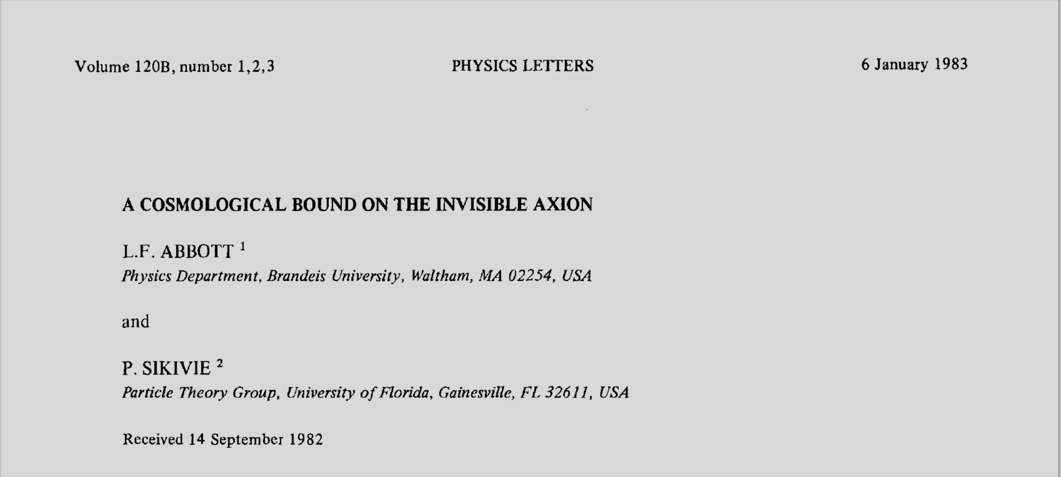
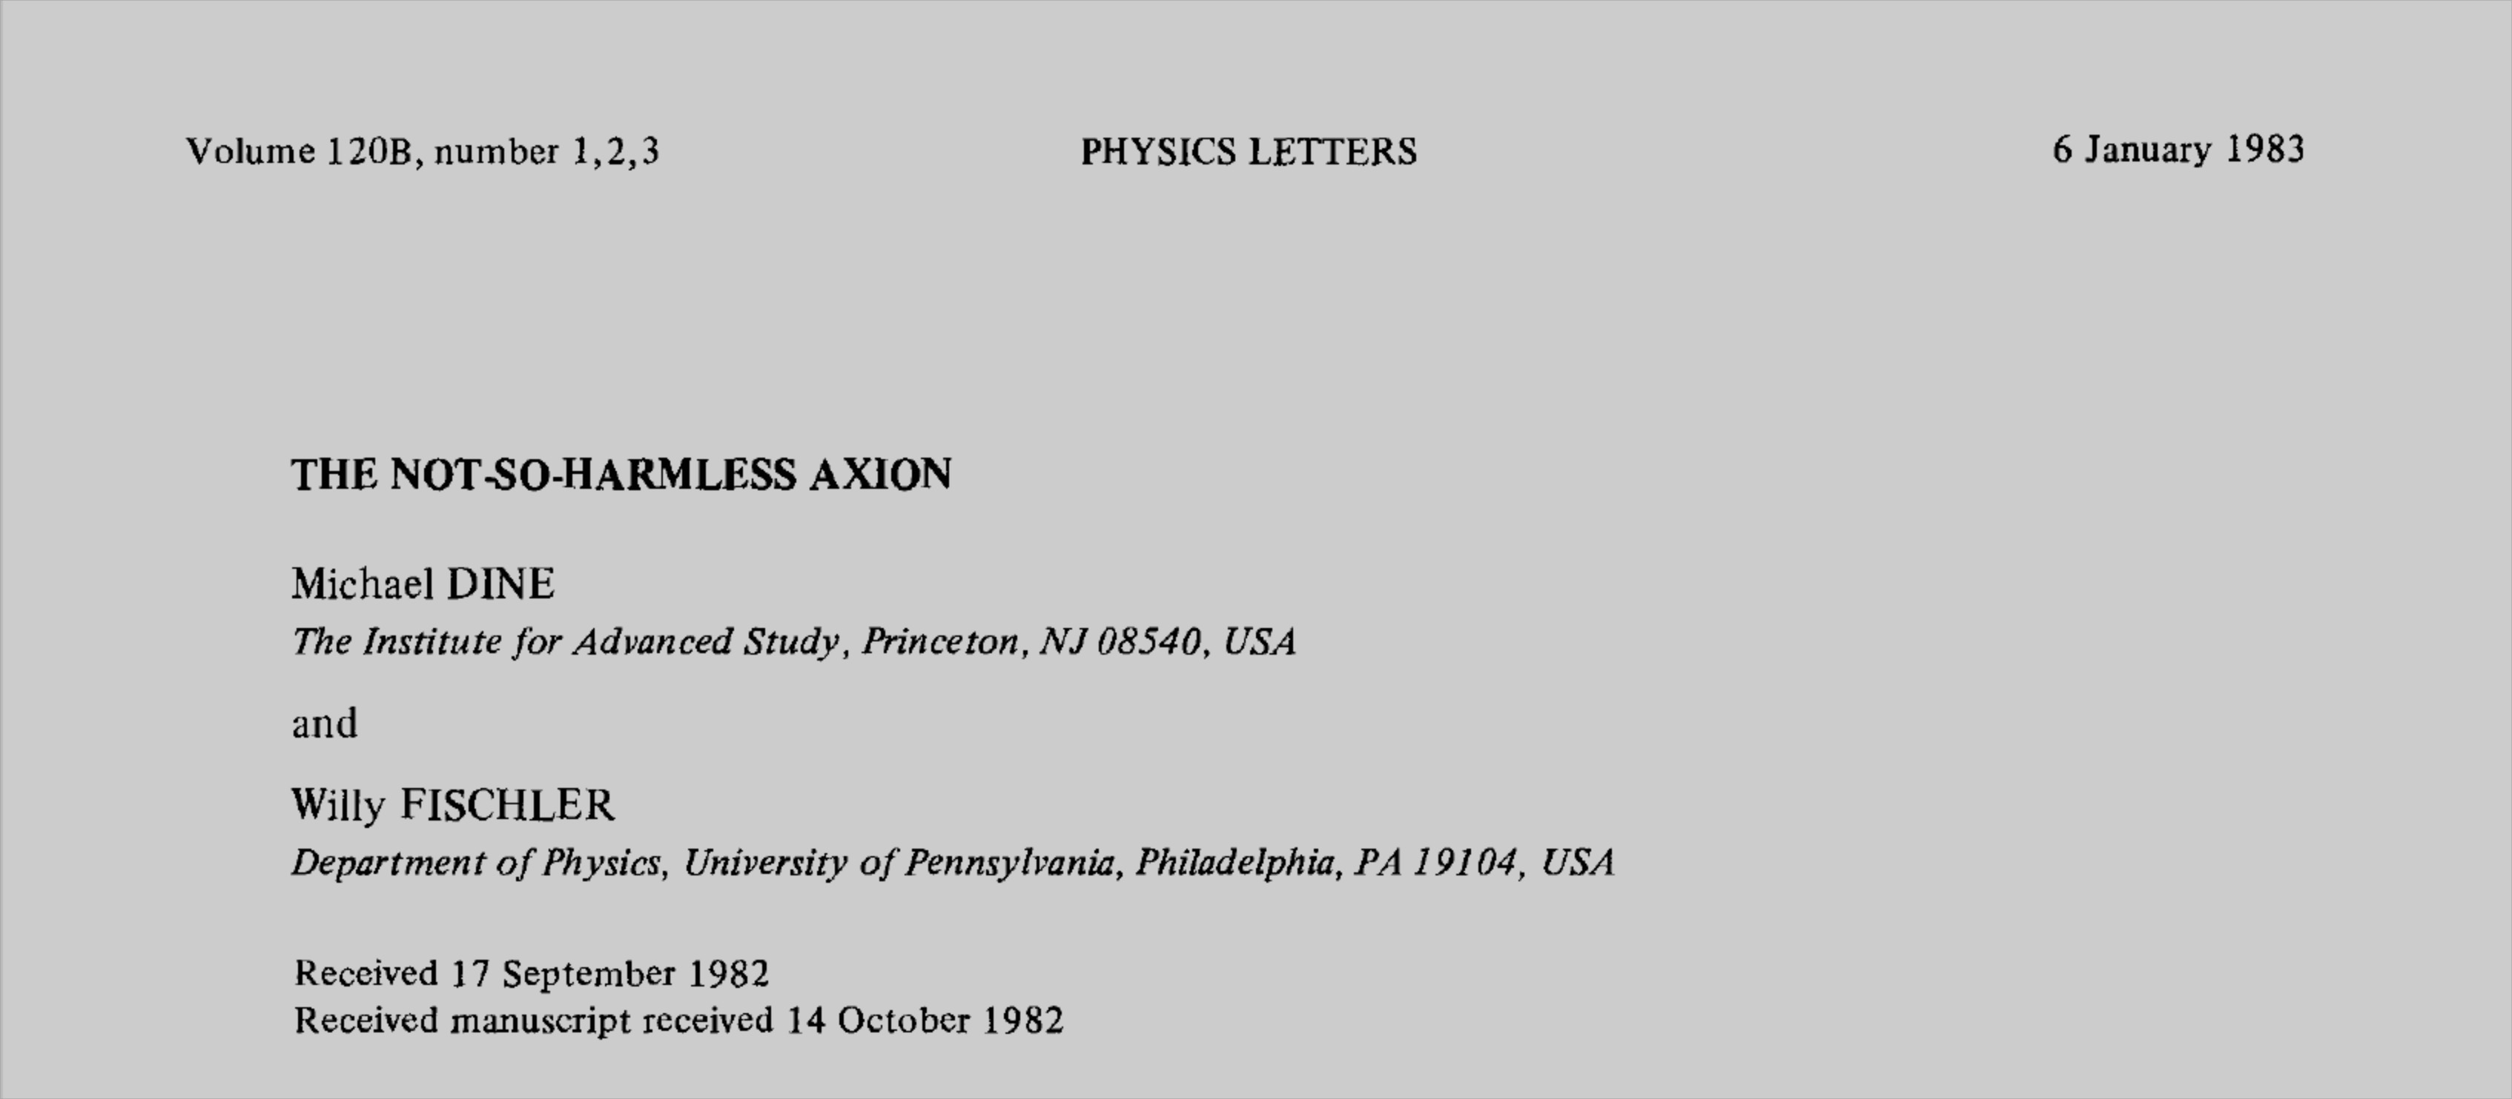
Axion dark matter
Cosmic axion (1983)
Very light axions would be overproduced in early universe
f_{a} < 10¹² GeV (m_{a} > 10⁻⁶ eV) is excluded
Axion may account for dark matter
10⁻⁶ eV < m_{a} < 10⁻³ eV
Dark matter axion ?

Slide 7
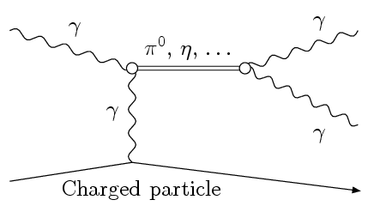
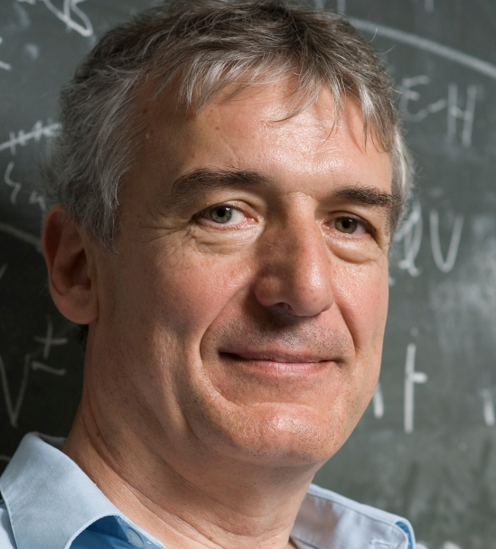
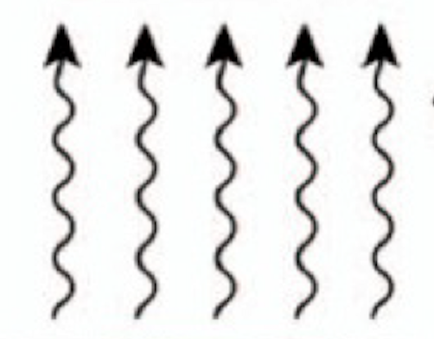
Detection principle
Coupling with photons
Primakoff effect
Energetic photons + EM of nuclei
=> pseudoscalar
Conversion of axions to photons in a magnetic field (1983)
Axions “borrow” virtual photons from the magnetic field to turn into real photons
Principle of axion search experiments
B
ϒ*
a
ϒ
Magnet
Classical EM field
Sea of
virtual photons
Primakoff effect
P. Sikivie

Slide 8
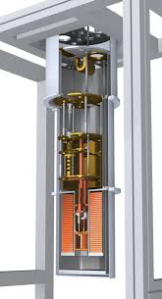
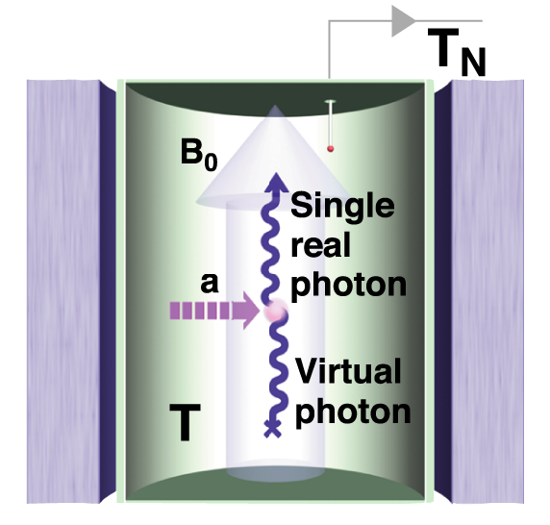
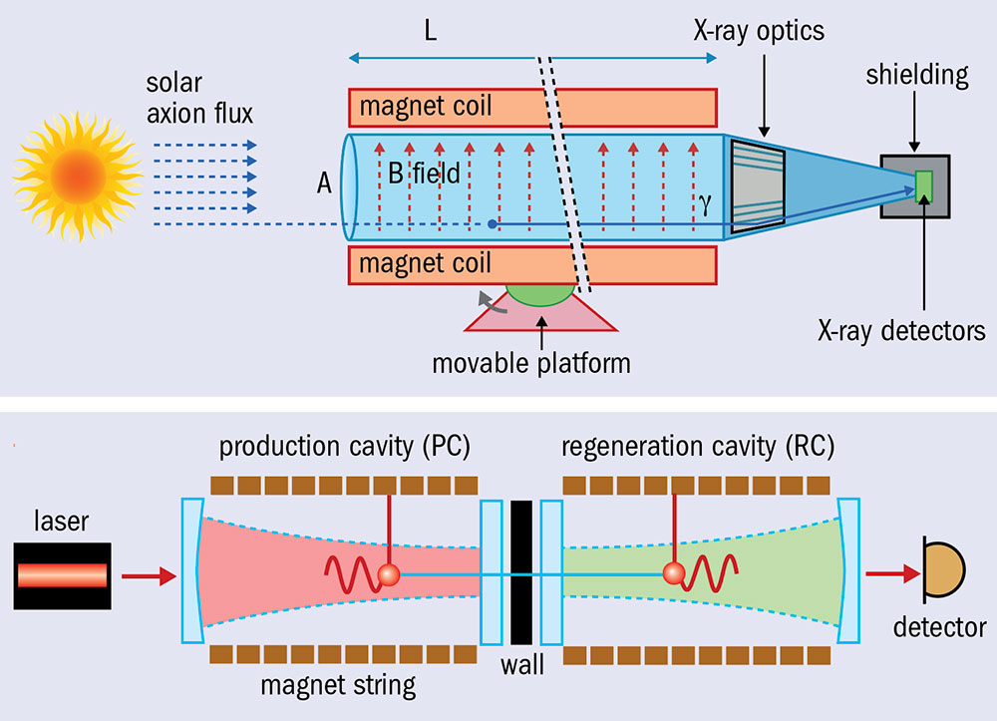
Main approaches
Haloscope
DM axions in our galactic halo
Microwave resonators
ADMX, HASTAC, CULTASK,…
Helioscope
Solar axions
Emitted by the solar core
CAST, IAXO,…
Photon regeneration
Light Shining through Wall
Axions at the lab
ALPS,…

Slide 9
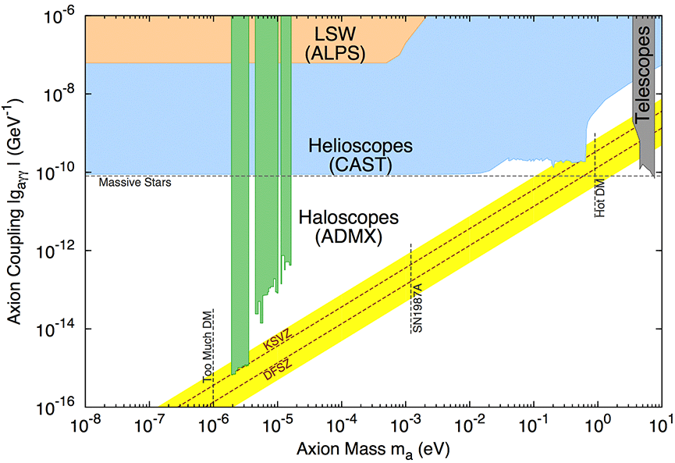
Axion parameter space
1 μeV ≈ 0.24 GHz

Slide 10
Physical Quantities
- theoretical parameters
- experimental parameters
Conversion power (a→γγ)
Signal-to-noise ratio (SNR)
Scan rate (F.O.M.)
Cavity Q factor
Axion Q factor
Coupling constant
Effective volume
Axion number density
Magnetic field
Integration time
Axion bandwidth (~10⁻⁶ f)
System noise temperature
Cavity Q_{L},V,C
γ
g_{aγγ},ρ_{a},m_{a},Q_{a}
Strong B₀

Slide 11
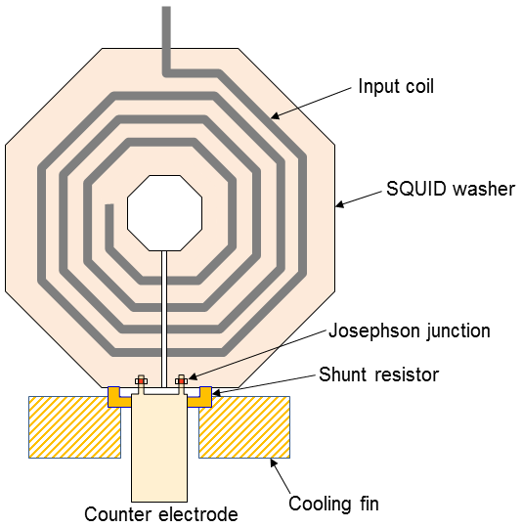
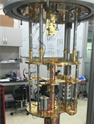
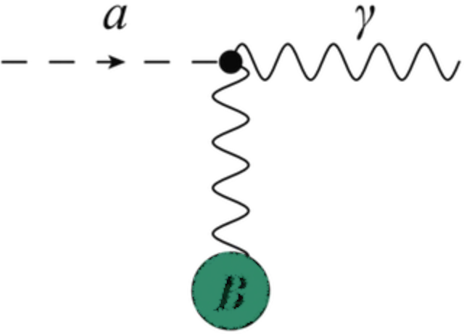
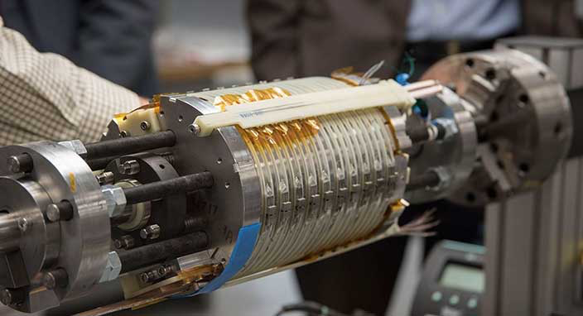
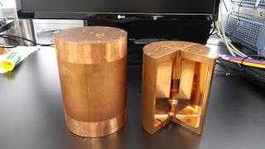
Haloscope in a Nutshell
Enhancing the scan rate
Quantum noise limited amplifier T
Cryogenics T
RF readout chain
Signal amplification w/ minimal noise added
Lowering thermal noise
Tunable High Q resonator
V, Q, C, Δf
High field HTS Magnet B
Axion-photon conversion
(Sikivie effect)
Boosting a→γγ conversion rate
Resonant frequency tuning

Slide 12
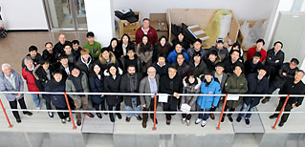
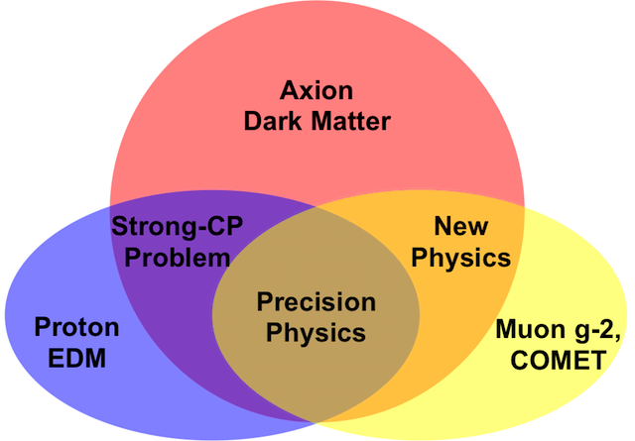
IBS/CAPP
Center for Axion and Precision Physics Research
A research center of the Institute for Basic Science
Established in Oct. 2013 at KAIST, Daejeon, South Korea
Organization
20 researchers / 20 students / 10 staffs
Visiting scholars
Mission
Axion physics
CULTASK
CAST-CAPP
GNOME / ARIADNE
Precision physics
pEDM / g-2 experiments / COMET

Slide 13
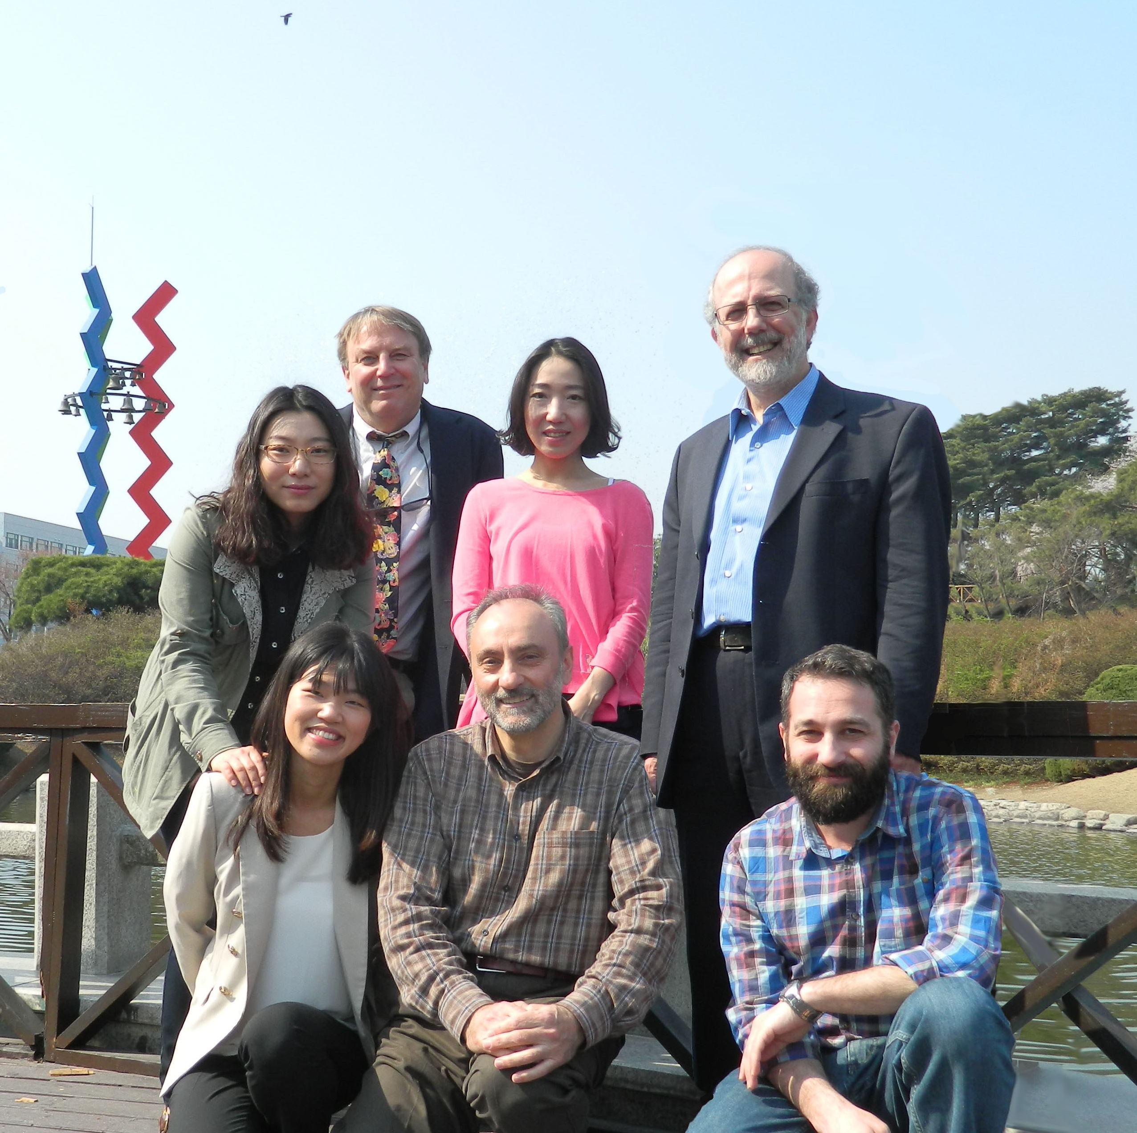
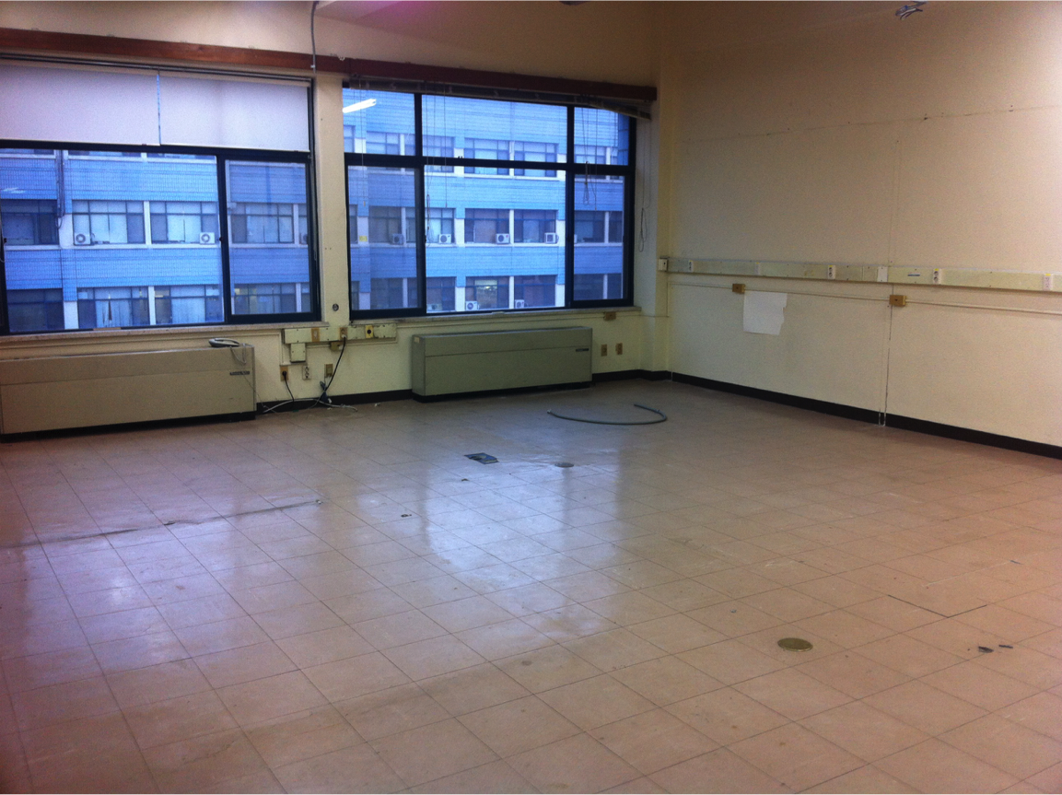
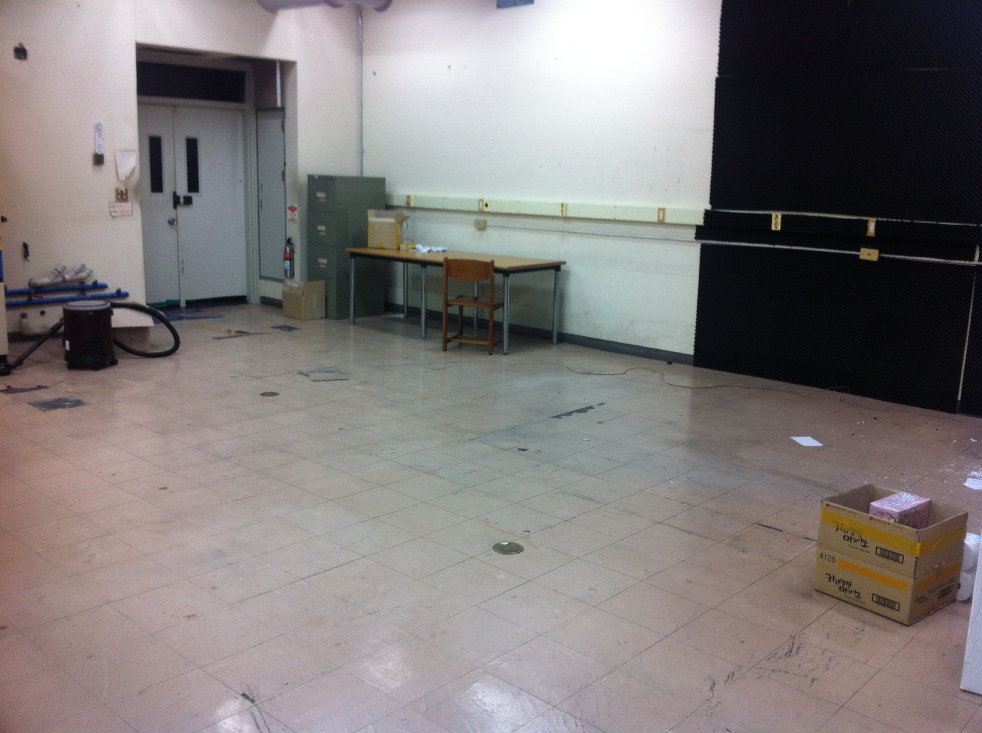
CAPP in Oct. 2013

Slide 14
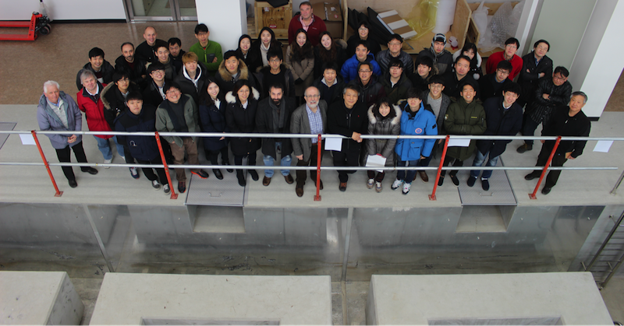
CAPP in Jan. 2017

Slide 15
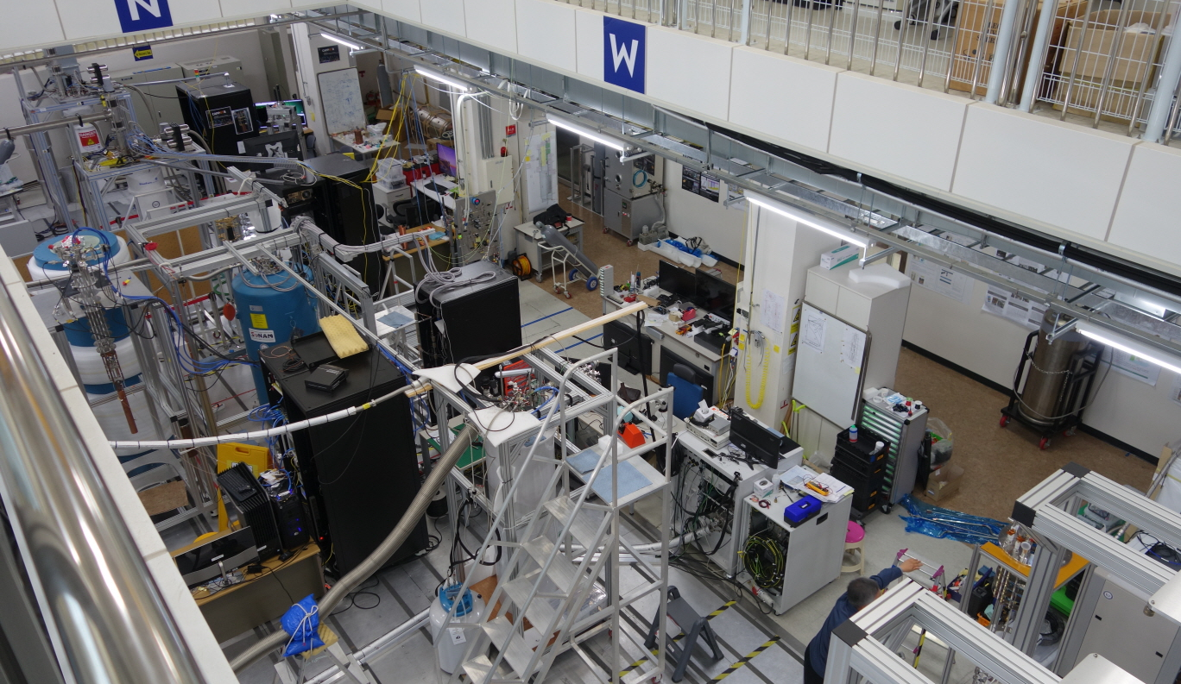
CAPP in Oct. 2018

Slide 16
Major equipment
Refrigerators
Magnets
Manufacture | Model | T_{B} [mK] | Cool. Power [μW@mK] | Install-ation
BlueFors (BF3) | LD400 | 10 | 18 @ 20 580 @ 100 | 2016
BlueFors (BF4) | LD400 | 10 | 18 @ 20 580 @ 100 | 2016
Janis | HE-3-SSV | 300 | 25 @ 300 | 2016
BlueFors (BF5) | LD400 | 10 | 18 @ 20 580 @ 100 | 2017
BlueFors (BF6) | LD400 | 10 | 18 @ 20 580 @ 100 | 2017
Oxford | Kelvinox | 30 | 400 @ 120 | 2017
Leiden | DRS1000 | 10 | 1000 @100 | 2019
Manufacture | B_{max} [T] | Bore [mm] | Delivery
Cryo Magnetics | 9 | 125 | 2016
AMI | 8 | 125 | 2017
AMI | 8 | 165 | 2017
SuNAM | 18 | 70 | 2017
Oxford | 12 | 320 | 2019
IBS/BNL | 25 | 100 | 2022
Notes:
Start, describe, discuss, make a few wards

Slide 17
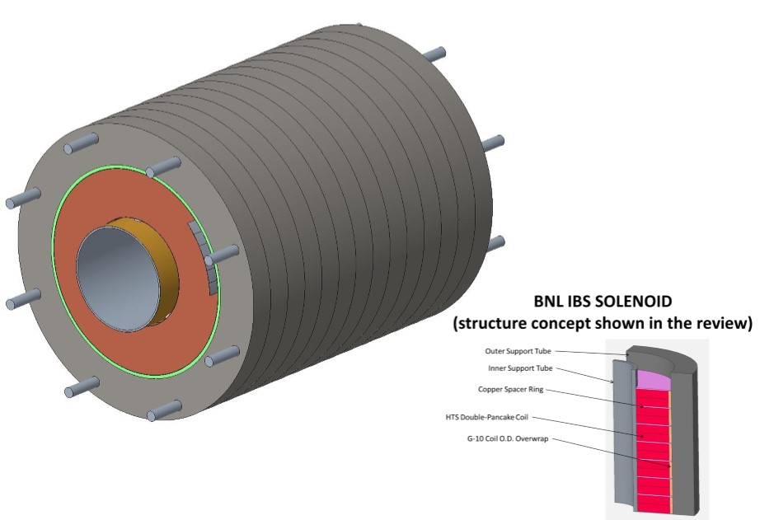
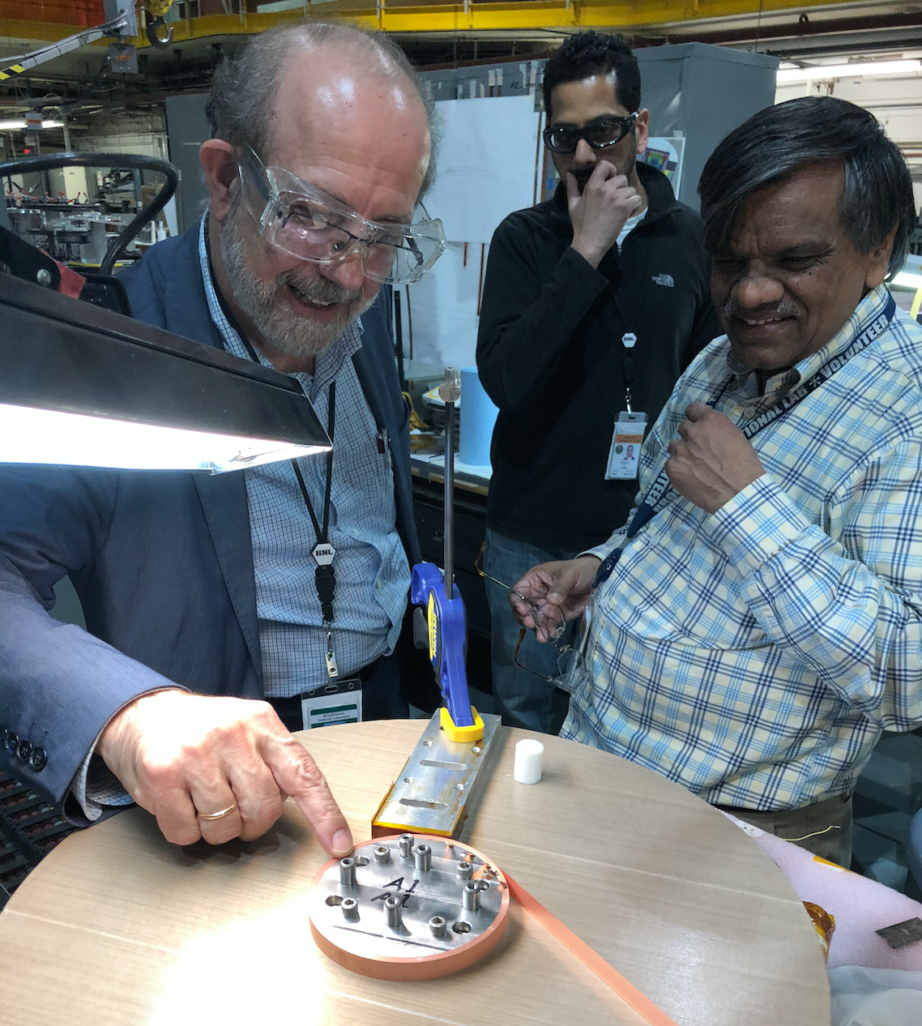
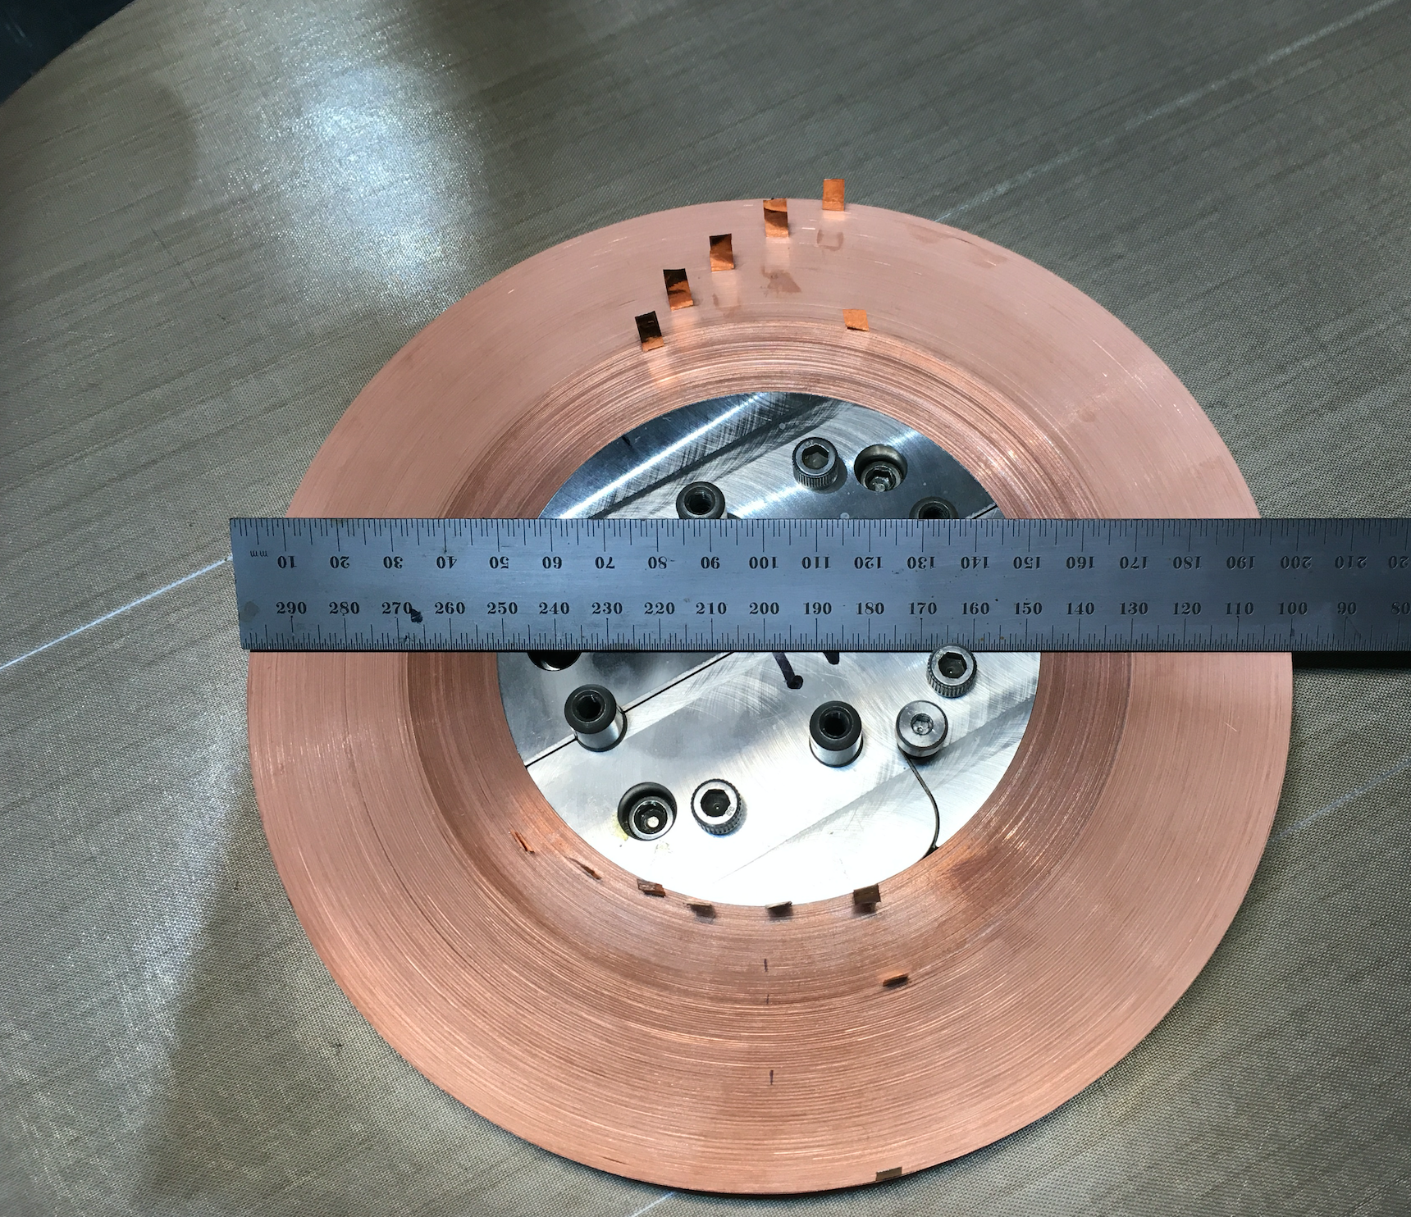
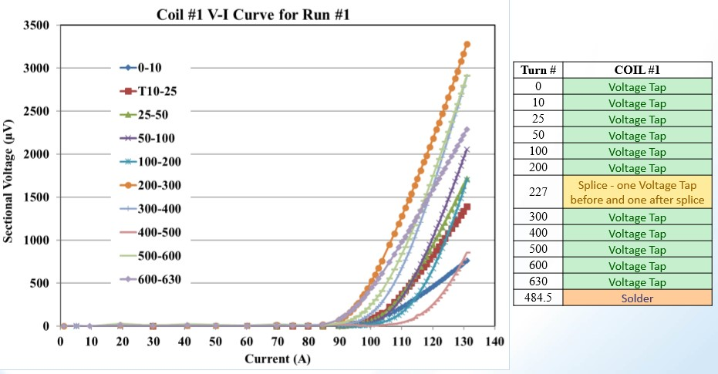
High field magnet
25 T / 100 mm
B_{max} (z=0) @ 4 K | 25 T
Uniformity | 90% (± 100 mm)
Bore (clear) | 100 mm
# of D.P. | 14
Type | No Insulation
Current | 450 A
Stored energy | 1.3 MJ
Stress | < 684 MPa
Delivery | 2020
Winning game !
SC material | HTS (ReBCO)
Width | 12 mm
Thickness | 75 μm
Current Density | 500 A/mm²
Conductor / S.P. | 303 m
Total conductor | 8.5 km

Slide 18
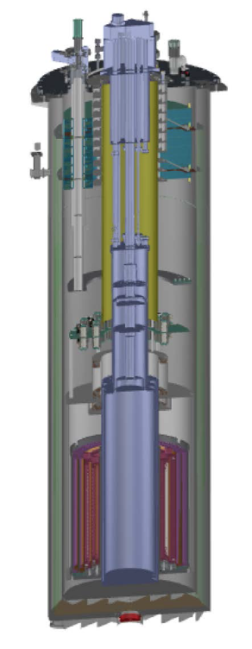
Lager bore magnet
12 T / 320 mm
Large aperture with a strong field
Sensitive to low mass axions
Cavity volume ~ 40 liters
Installed in a DR (Leiden, 10 mK)
Will allow for DFSZ physics
0.7 < f_{a} < 3.0 GHz within 5 years
Manufacturer | Oxford
B_{max} (z=0) @ 4 K | 12 T
Bore (clear) | 320 mm
SC material | LTS (Nb₃Sn)
Delivery | 2019. 12
Notes:
Start, describe, discuss, make a few wards

Slide 19
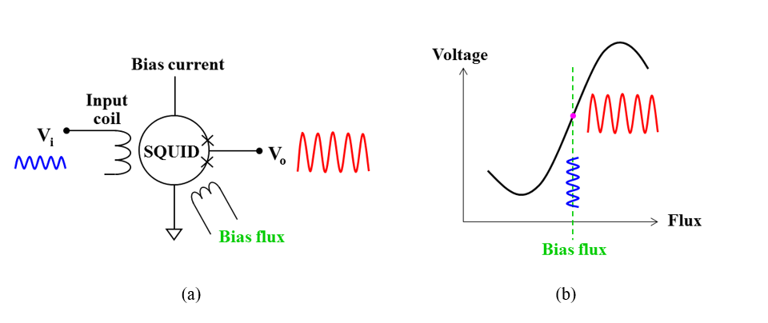
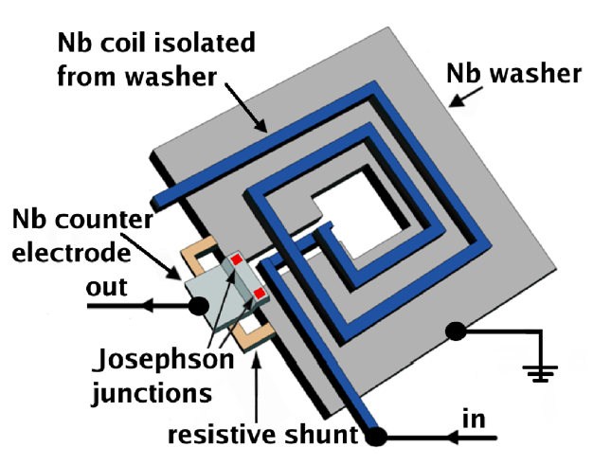
SQUID amplifier
Superconducting Quantum Interference Device
Most sensitive magnetic sensor
Josephson effect and flux quantization
Quantum limited noise: T_{SQL} ≈ 50 mK × f [GHz]
Two types of SQUID-based amplifiers
Microstrip SQUID Amplifier (MSA)
Josephson Parametric Amplifier (JPA)
Developing units for our application from various resources
Working Point: I_{W} and Ф_{DC}
RF_{OUT}
RF_{IN}
RF input signal couples with a SQUID via L_{m} and modulated

Slide 20
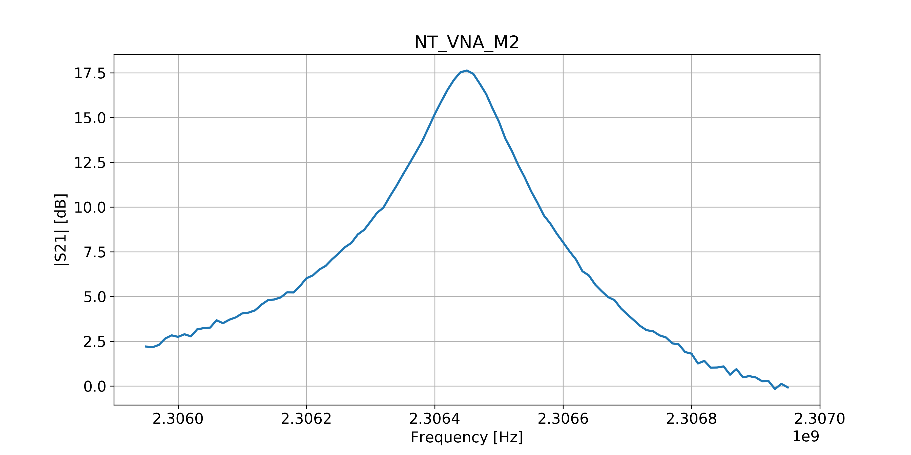
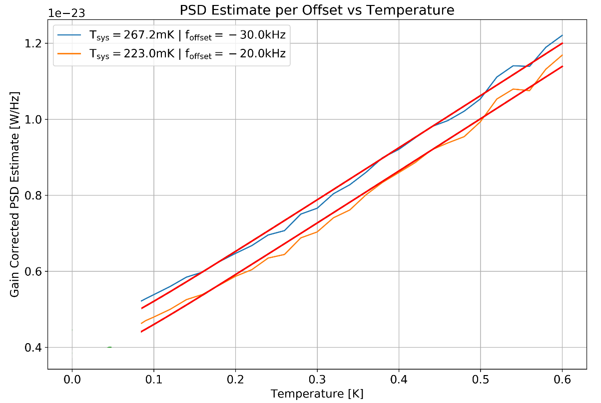
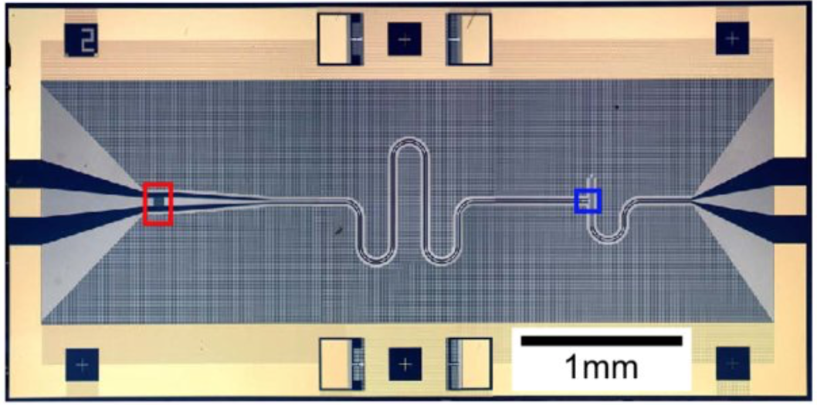
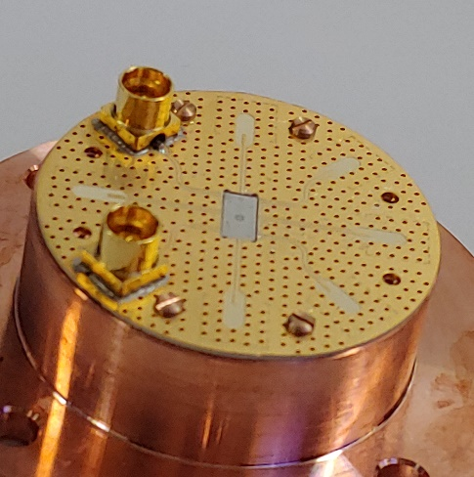
Josephson Parametric Amplifier
Gain [dB] vs. freq [GHz]
Critical component
Collaboration w/ RCAST (Tokyo)
Chips for 2.3, 4.0, 6.9 GHz
Reasonable G and T_{N}
G > 15 dB
T_{N} < 300 mK (cf. HEMT ~ 2 K)
Lots of room for improvement
T_{SQL} ≈ 50 mK × f [GHz]
PD [W/Hz] vs. temp [K]

Slide 21
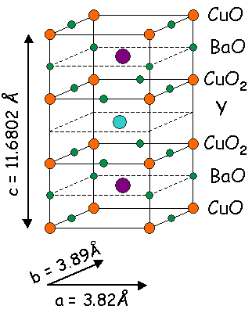
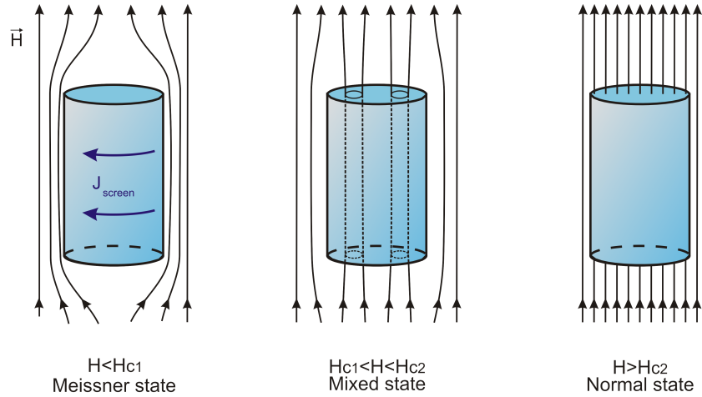
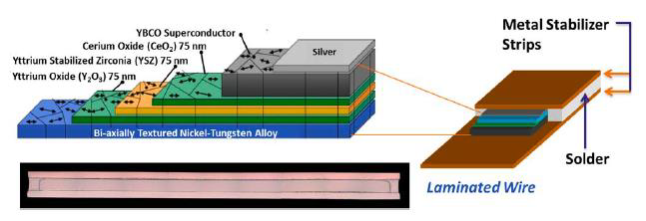
Superconducting cavity
Type II SC
Bi-axially textured film (grains well aligned) for low R_{s}
Implementation in 3D structure
High-T_{c} / high-H_{c} SC materials
YBCO HTSC tapes
Commercially available (AMSC)
RABiTS method

Slide 22
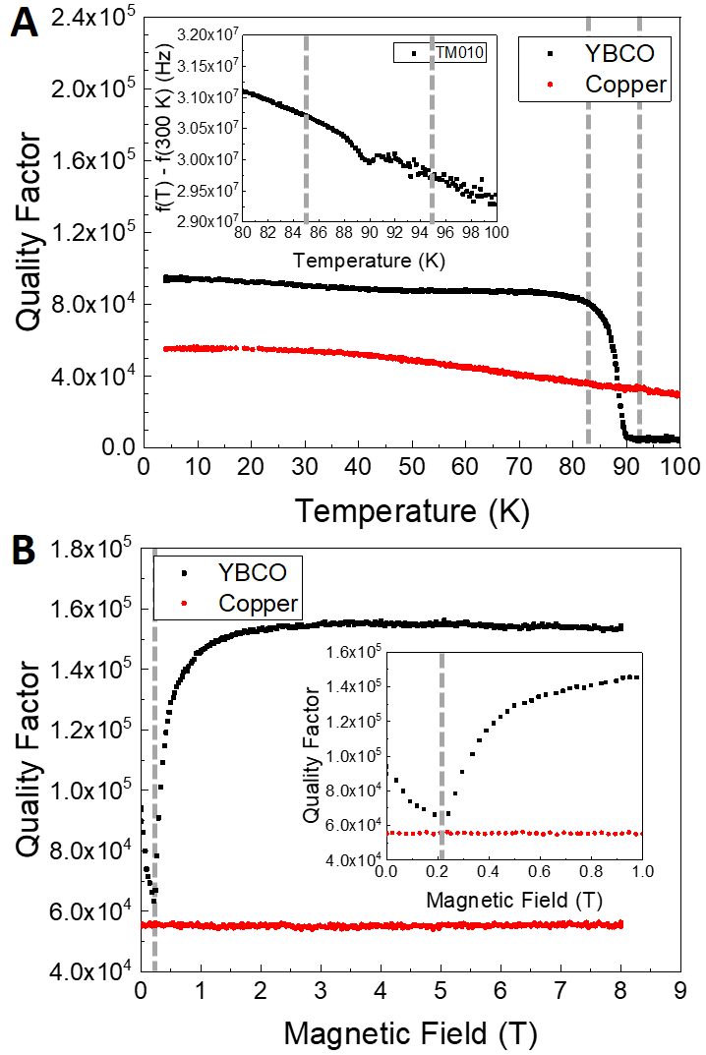
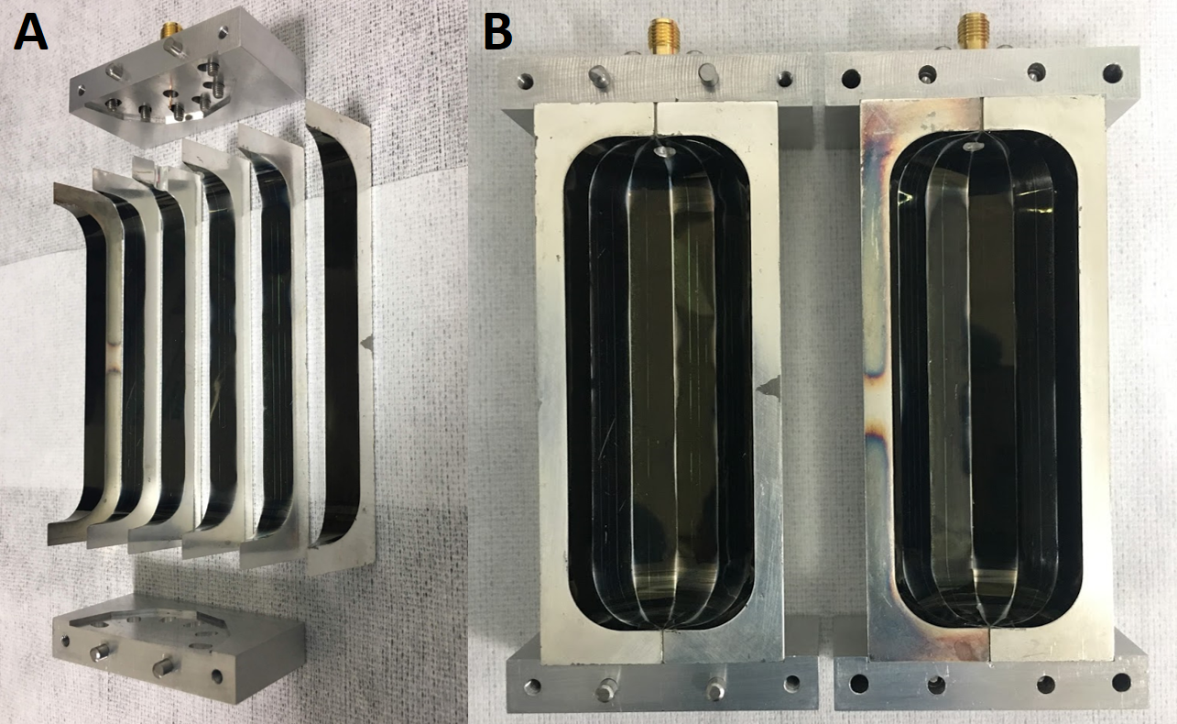
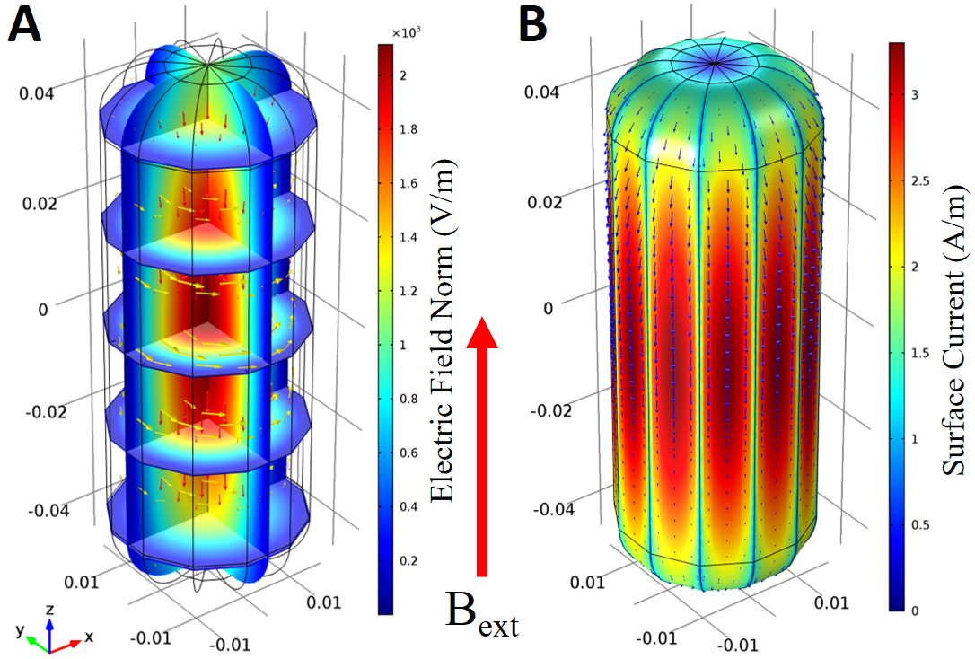
Superconducting cavity
arXiv:1904.05111
Attaching SC tapes on inner surface
Polygon-shaped cavity - 12 pieces

Slide 23
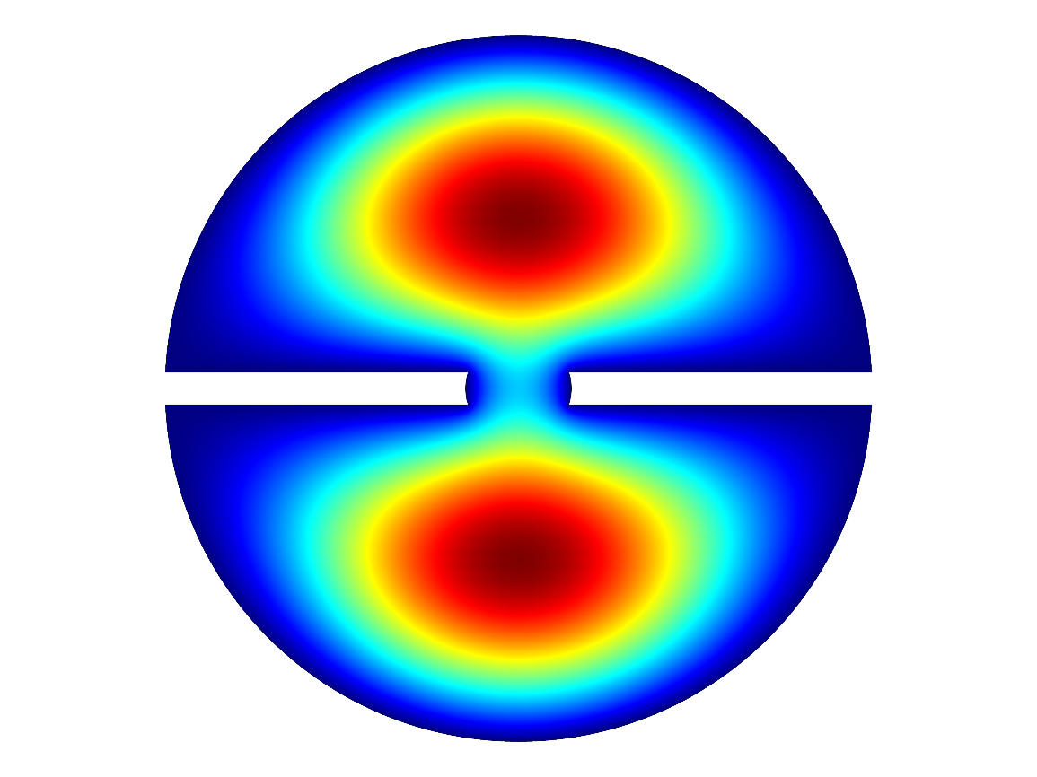
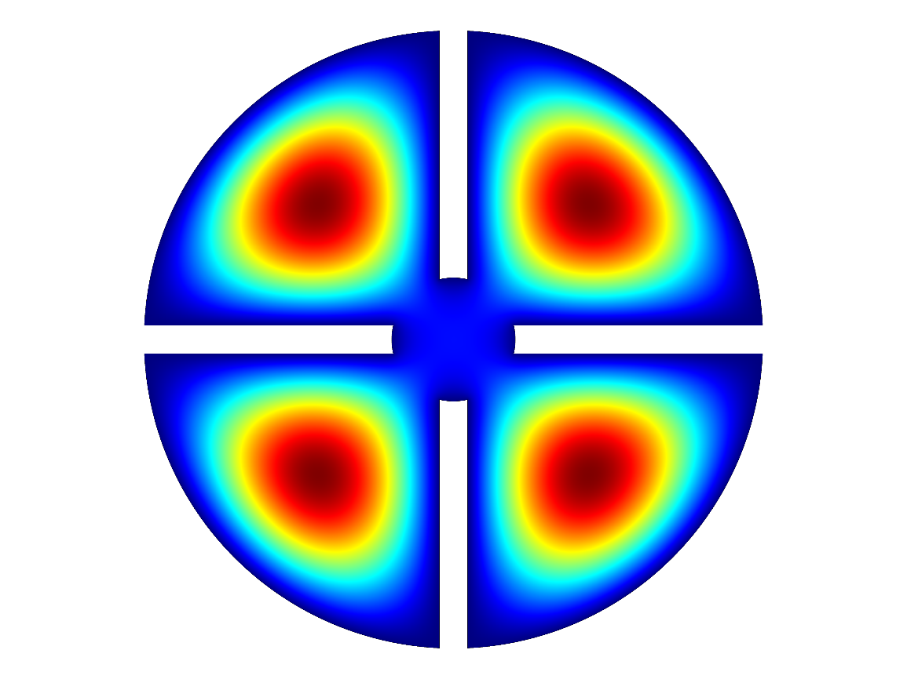
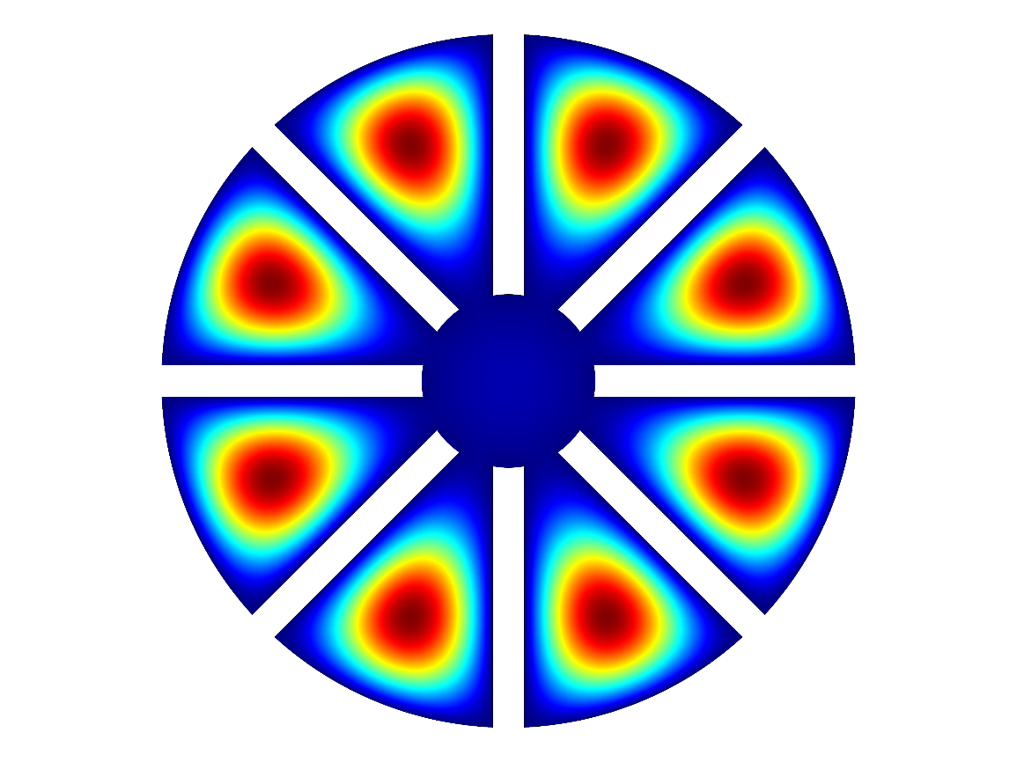
High frequency approach
: Magnet bore
: Cavity
Single large cavity
Multiple small cavities
Multiple cells
in a single cavity
Multiple cells
w/ a hole
Larger volume
Higher sensitivity
2 times better than multiple-cavity
Single antenna
Easier experimental setup
cf) N antennae for N-cavity systems
Easier phase-matching mechanism
Experimental demonstration
Stability and negligible dead time
Pizza cavity
Notes:
Start, describe, discuss, make a few wards

Slide 24
CAPP experiments
Refrigerators
Magnets
Experiments
Manufacture | Model | T_{B} [mK]
BlueFors (BF3) | LD400 | 10
BlueFors (BF4) | LD400 | 10
Janis | HE-3-SSV | 300
BlueFors (BF5) | LD400 | 10
BlueFors (BF6) | LD400 | 10
Oxford | Kelvinox | 30
Leiden | DRS1000 | 10
Oxford | Kelvinox | 30
Manufacture | B_{max} [T] | Bore [mm]
Cryo Magnetics | 9 | 125
AMI | 8 | 125
AMI | 8 | 165
SuNAM | 18 | 70
Oxford | 12 | 320
IBS/BNL | 25 | 100
Name
CAPP-9T MC
CAPP-8T (PACE)
CAPP-8TB
CAPP-18T
CAPP-12TB
CAPP-25T
Operating parallel experiments
targeting at different mass ranges!
Notes:
Start, describe, discuss, make a few wards

Slide 25
CAPP-PACE
Pilot Axion Cavity Experiment
8 T / 125 mm magnet
DAQ mode since Jan. 2018
Currently targeting at KSVZ
JPA near future
Split cavity
Parameter | Value
Δf | 2.45 – 2.76 GHz
B_{max} | 8 T
T_{phy} | < 50 mK
T_{amp} | 1 - 1.5 K
V_{cav} | 1.1 litter
Q₀ | 120,000
C₀₁₀ | 0.55
Q₀
JINST 12 (2017) no.10, P10023

Slide 26
CAPP-PACE
First result by CAPP
Preliminary
JPA (~200 mK) will make a significant improvement!

Slide 27
CAPP-8TB
Utilizing a 8 T Big bore magnet
B_{max} (B_{avg}) | 8 T (7.3 T)
Magnet bore | 165 mm
V_{cav} | 3.5 L
Q₀ | > 100,000
T_{phy} | ~40 mK
Target search region | 1.6~1.7 GHz (6.6 ~7.0 μeV)
Frequency map
Gain
Noise temperature
Preliminary
Preliminary
G ~ 33 dB
Preliminary
TN < 2 K
Notes:
Start, describe, discuss, make a few wards

Slide 28
CAPP-8TB
Two stage experiment
1st stage: w/ HEMT-based amplifier (~3 months of operation)
Touching the QCD axion band
2nd stage: w/ SQUID/JPA-based amplifier
Achieving the KSVZ sensitivity
Notes:
Start, describe, discuss, make a few wards

Slide 29
CAPP-9T MC
JANIS He-3 system
w/ 9T magnet
Charcoal sorption pump
Test operation confirmed the desired specifications
Operation in continuous mode
Condens. = Evapor.
T_{physica}l < 2 K
Re-liquefier installed
80 L/day => No LHe loss
1K pot
He-3 pot
HEMT amps
T_{N}: 1~2 K
Amps ~ 4.9 K
Charcoal ~ 36.0 K
1K plate ~ 2.0 K
He-3 plate ~ 1.7 K
Cavity ~ 1.8 K
Linear actuator
Frequency
tuning rotator
(single)
Cu 2-cell cavity
I.D. = 110 mm
I.H. = 220 mm
Q₀ ~ 60,000
Proof-of-concept experiment for pizza cavity design (He-3 fridge w/ 9T SC)

Slide 30
CAPP-9T MC
Experimental parameters
 | 2-cell | 4-cell | 8-cell
Geometry
F₀₁₀ [GHz] | [2.8,3.3] | [3.8,4.5] | [5.8,7.0]
B_{avg} [T] | 7.8
V [L] | 2.0 | 1.9 | 1.7
P_{sig} [10⁻²¹ W] | 0.51 | 0.56 | 0.68
T_{sys} [K] | 2.0+2.0 | 2.0+3.0 | 2.0+4.0
SNR | 5
DAQ efficiency | 0.5
df/dt [GHz/year] (KSVZ×10) | 5.4 | 4.8 | 5.0
Scan time (month) | 1.1 | 1.8 | 2.9
Timeline
Year | 2019 |  |  |  | 2020
Quarter | 1 | 2 | 3 | 4 | 1 | 2 | 3 | 4
Double-cell
Quad-cell
Octuple-cell

Slide 31
CAPP-18T
Magnet test
Frequency map
Uniformity: 93% (±100 mm)
Stability: <0.05% for 2 weeks
SuNAM Co.
GdBCO HTS
B_{max} = 18 T
I.D. = 70 mm
No-insulation
3.6~4.2 GHz at KSVZ
JPC from QCI

Slide 32
Projected sensitivity – 2 year
CAPP Projected Sensitivity
CAPP-8TB
CAPP-PACE
CAPP-18T
CAP-9T MC
Notes:
Start, describe, discuss, make a few wards

Slide 33
Projected sensitivity – beyond
CAPP Projected Sensitivity
+
+
12 T / 320 mm
25 T / 100 mm
Notes:
Start, describe, discuss, make a few wards

Slide 34
Summary
Axion is a dynamic solution to the strong CP problem
Well-motivated dark matter candidate
Detection scheme relies on Sikivie effect
IBS/CAPP is searching for galactic halo axions
Major R&D focuses
High field / large volume magnets
Development of quantum noise limited amplifiers
Cavity design for higher masses
Parallel experiments are on going
Targeting at different mass ranges
Probing a large mass range (< 40 μeV) with sensitivity of the QCD axion in five years

