Slide 1
An overview of the activities for promoting the astronomical observatory construction project at Tay Nguyen University, Vietnam
Le Minh Tan¹, Tran Quoc Lam¹, Nguyen Luong Quang²
¹Department of Physics, Faculty of Natural Science and Technology, Tay Nguyen University, Vietnam
²IBM Canada and visiting researcher at Nagoya City University
Qui Nhon, August 2018

Slide 2
Outline
Introduction
Our project and initial activities
Future plan
Challenges

Slide 3
Introduction

Slide 4
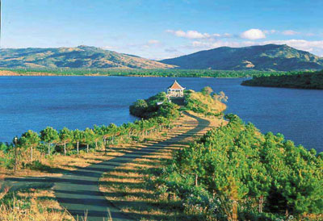
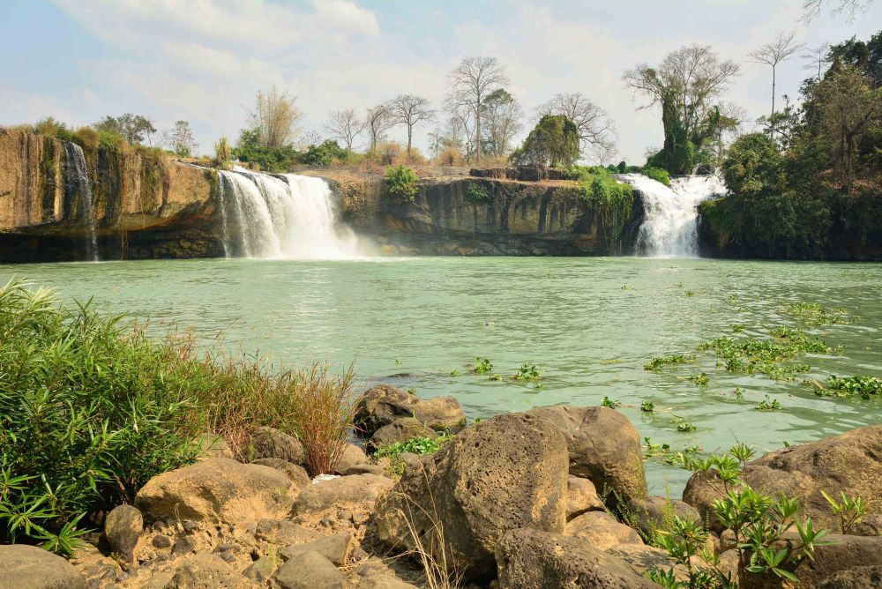
Why do we need an astronomical observatory in Tay Nguyen University, Vietnam ?

Slide 5
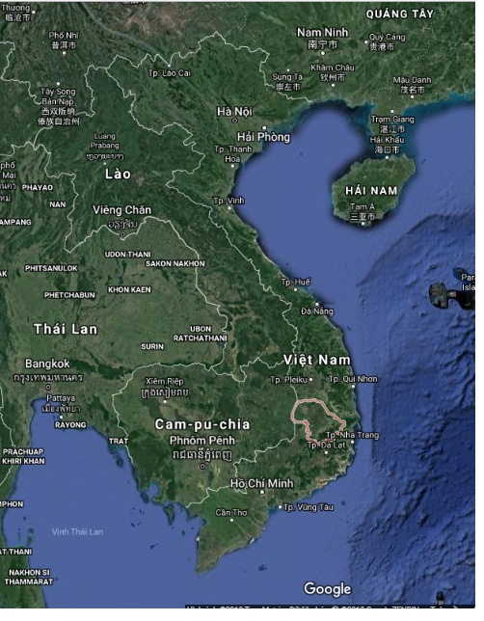
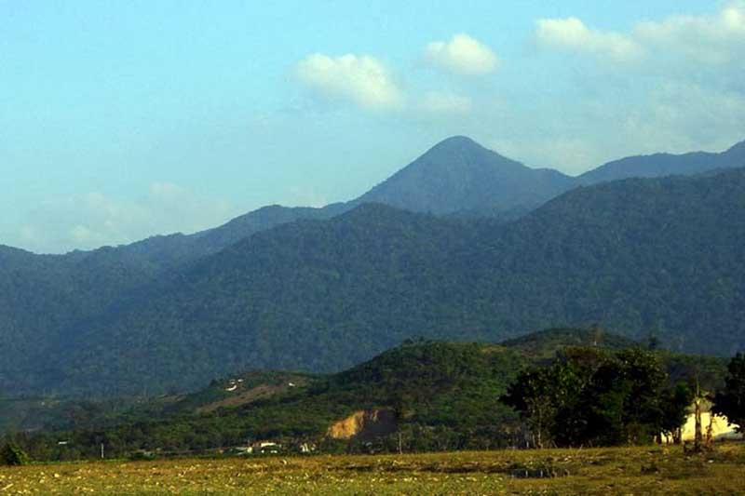
Chu Yang Sin mountain
http://gody.vn/diadiem/dak-lak/vuon-quoc-gia-chu-yang-sin
Dak Lak province: The largest province in the HighLand region in Vietnam (∼ 400 - 800 m high above sea level)
Has high mountain: Chu Yang Sin (2442 m high)
Dak Lak is ∼200 km far from the sea
Largest university in the region: Tay Nguyen university (TNU).
TNU has ∼ 17000 students (1200 students are in Faculty of Natural Science and Technology and ∼160 students in Physics at Department of Physics).

Slide 6
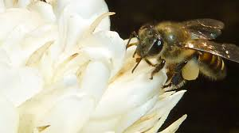
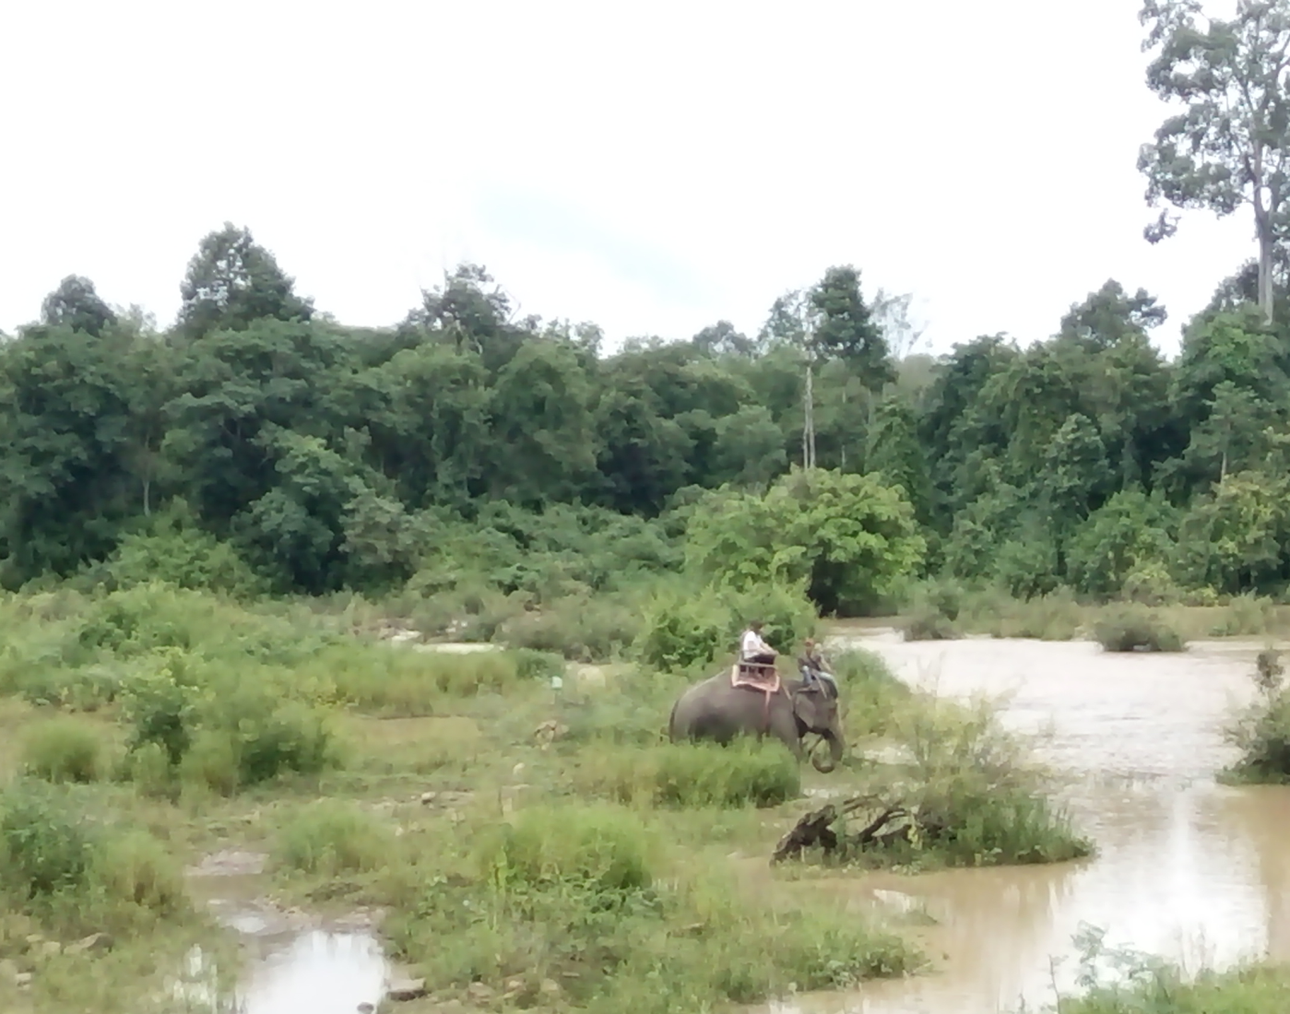
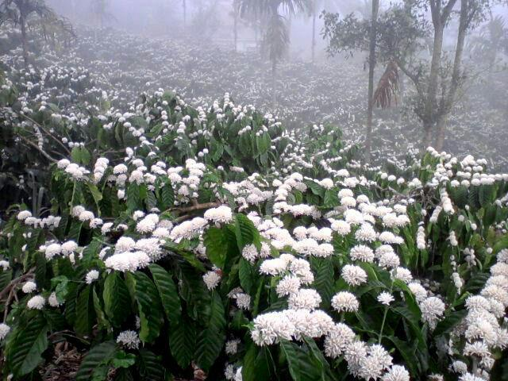
Dry season: November – April each year
Quite dry weather + many clear nights
Bee
SrePok River
Coffee blossom

Slide 7
Astronomy in Tay Nguyen
Has two lecturers in Astronomy
Astronomy subject is for third-year students (25 hours for lecture and 3 days for observational practice)
A night-sky observation is still a big gap
Astronomical observation brings the passion/creativity for students and promote the researching and teaching activities in Astronomy
For research: exoplanet discovery planet formation, asteroids, etc.

Slide 8
Our project and Initial activities

Slide 9
Our goal
Construct an astronomical observatory for education by 2023
Build an astronomy hub in Tay Nguyen for local researchers to meet and exchange continuously
Nurture young enthusiasts and encourage students to follow higher degree in astronomy

Slide 10
Status
Astronomical observatory
We received a 21 cm hydrogen line radio telescope built by Le Quang Thuy and Nguyen Anh Tuan (ICISE ExploraSciene Center)
We built a very low frequency telescope
1. Le Minh Tan (2015), Development of TNU-SuperSID Teaching Module for Observing the Effects of Solar Activities on the Lower Ionosphere, Journal of Physical Science and Application, 5(2), 116 – 122.
2. Le Minh Tan (2015), Study of the effects of solar activities on the ionosphere as observed by VLF signals recorded at TNU station, Vietnam, Sun and Geosphere, Bulgaria, 10(2), 101 – 106.
Future plan for a two-storey observatory that include an 30 cm optical telescope, control room, museum and exhibition room for the public

Slide 11
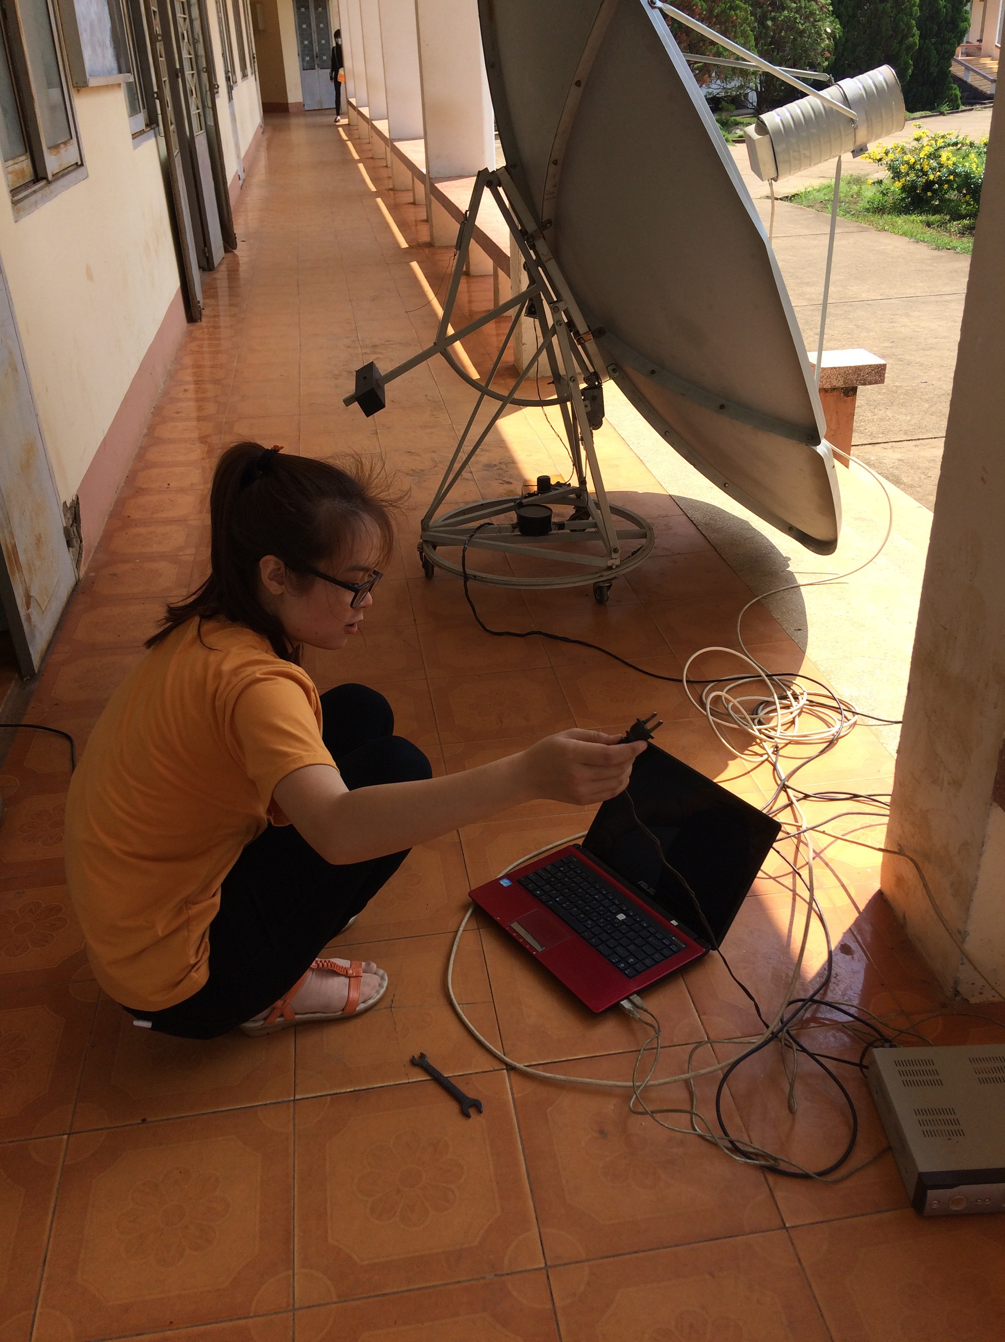
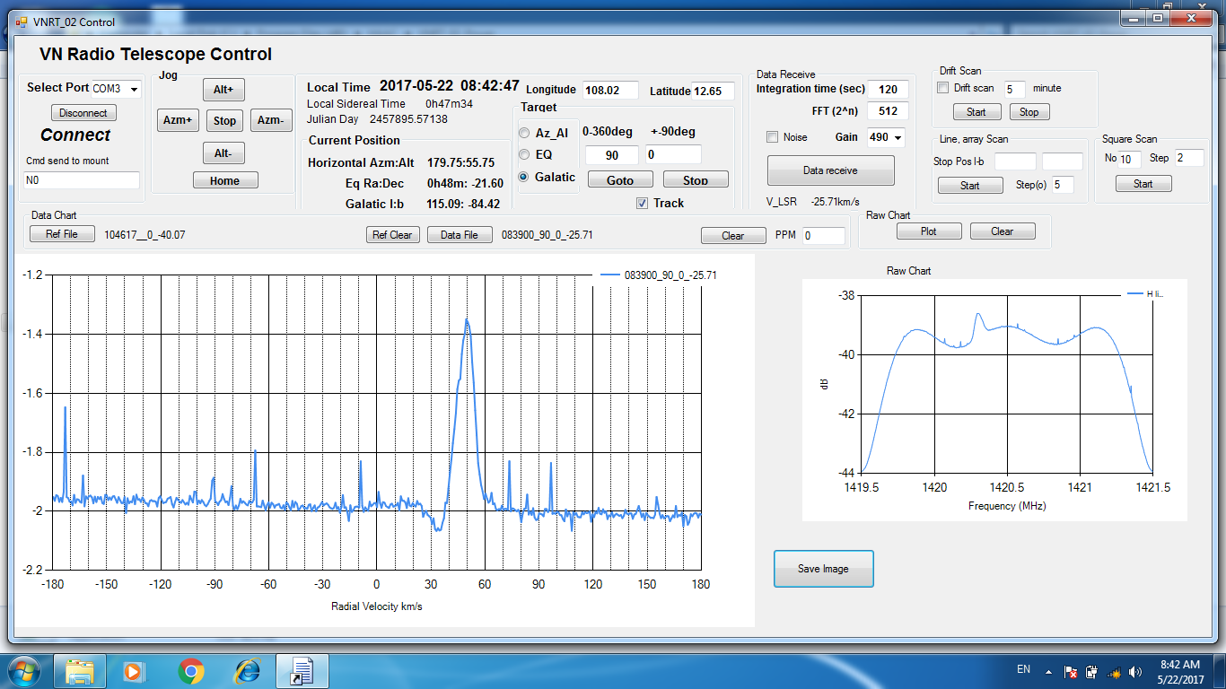
21 cm hydrogen line radio telescope
Our project

Slide 12
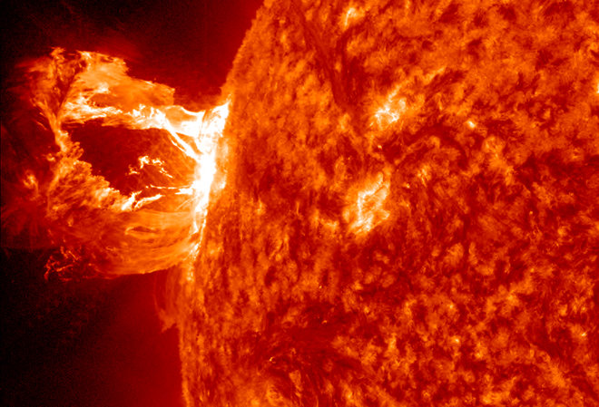
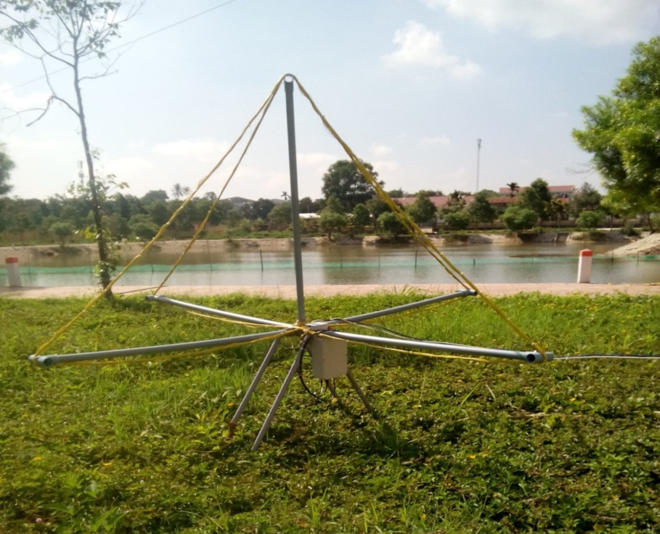
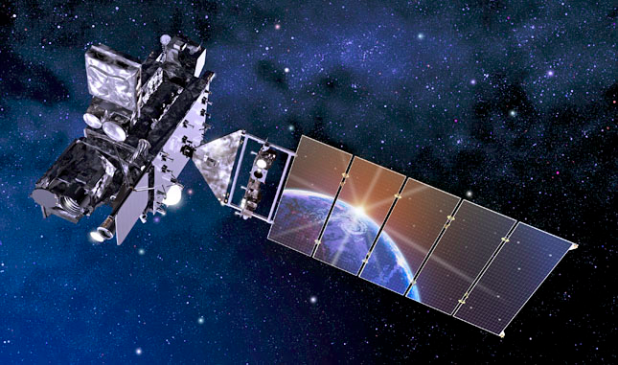
Standford SuperSID
GOES
Very Low Frequency Telescope
22.2 kHz
19.8 kHz

Slide 13
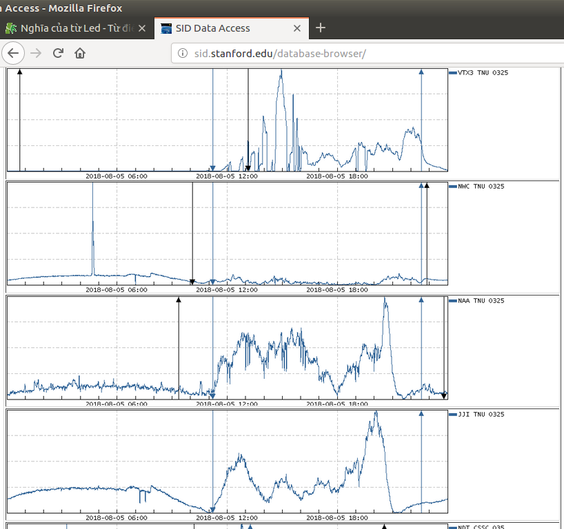
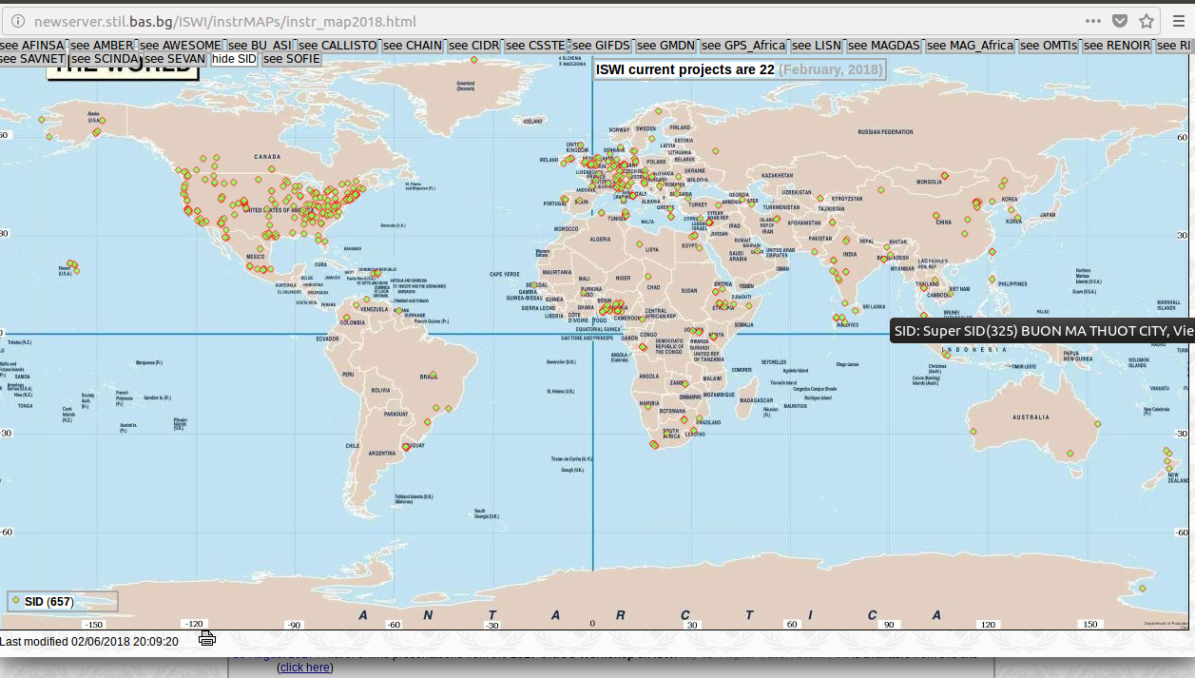
Since 2012: Jointed the International Space Weather Initiative (ISWI) program

Slide 14
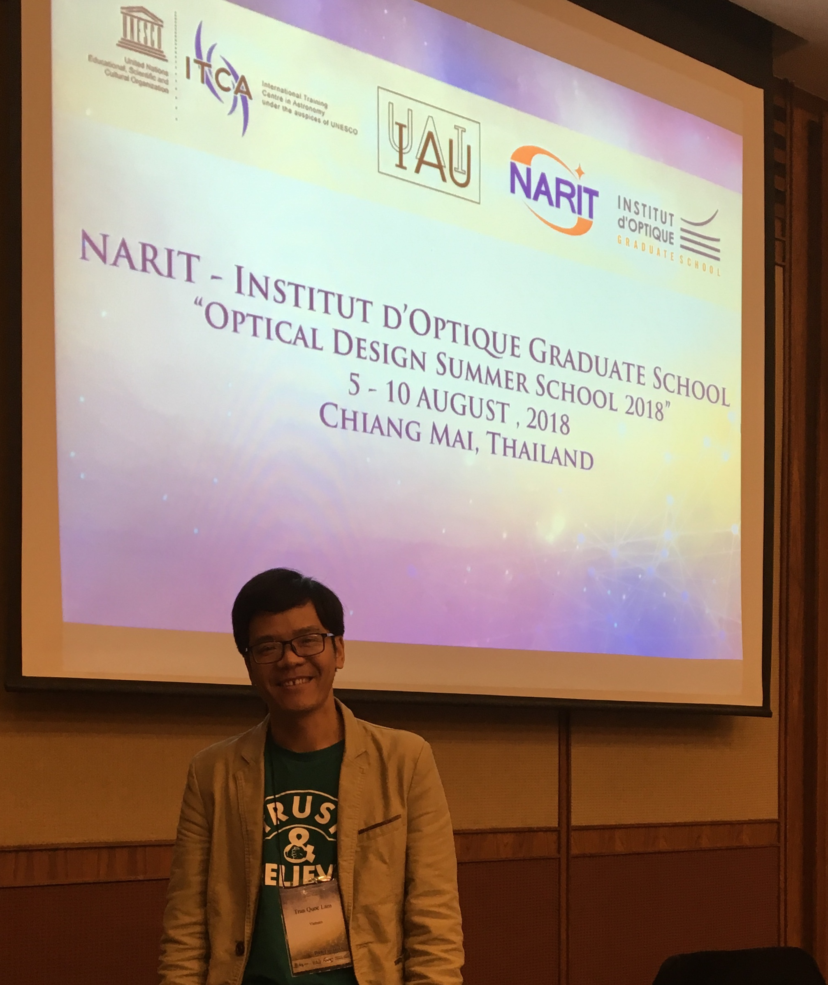
Astronomical observatory: telescopes and equipment
We signed an MOU with NAOJ to ask for support in constructing the observatory
The new telescope tube design is led and donated by the astronomy lab from Kyoto university, CCD is supported by NHAO
A staff of TNU, Tran Quoc Lam, is joining the NARIT Optical Design Summer School 2018 at Chiang Mai, Thai Land
He will join a scientific group at Kyoto University to design a new telescope
We are actively looking for financial supports for other parts of the observatory (dome, rotator, mount)

Slide 15
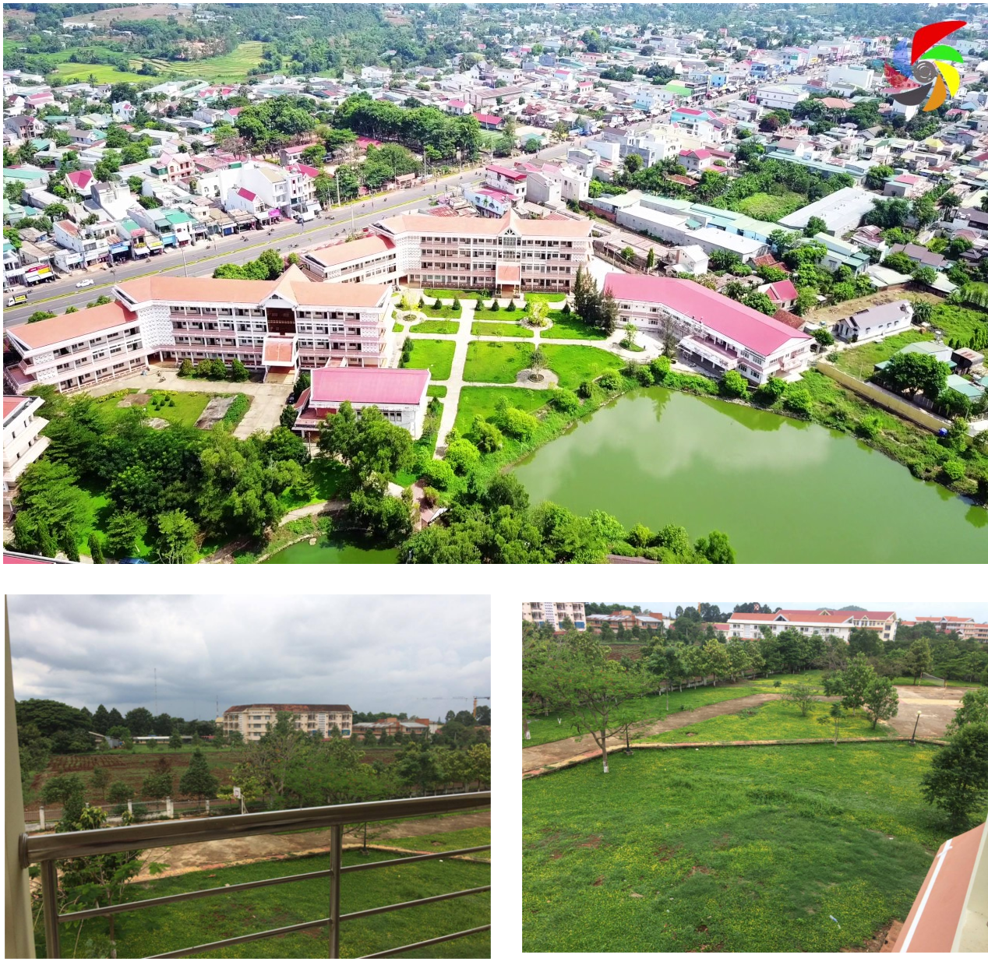
Astronomical Observatory: site
Inside Tay Nguyen university campus
Land is granted by TNU
Construction fund is granted by TNU
Observatory

Slide 16
Past relevant activities
First visit of Nguyen Luong Quang to TNU, 2015
Visit of Le Minh Tan to NAOJ, Nobeyama, 2015
Visit of Professor Masatoshi Ohishi (NAOJ) to TNU, July 2016
Visit of Nguyen Dang Thanh Nhan to NHAO, University of Hyogo, July 2016
Visit of Professor Neal Evans to TNU, July 2017
Tropical school for undergraduate astronomy 2017
Exploration Program in Astrophysics Research (EPAR), 2 – 13 July, 2018

Slide 17
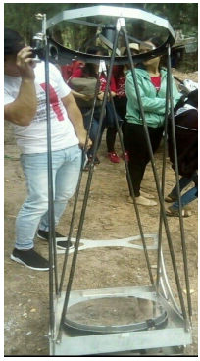
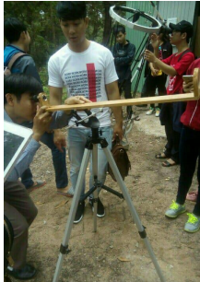
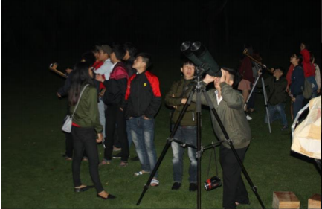
Educational activities: First tropical school in astronomy in Quy Nhon,
We were the fist university to partner with ICISE to bring students to ICISE and organize the first hands-on event in ICISE (April, 2017)
We are looking to strengthen this partnership and creating a good model for unviersity and ICISE collaboration
We created a tropical school series in astronomy with lectures from ICISE conference attendants: lectures in English, 60 attendants

Slide 18
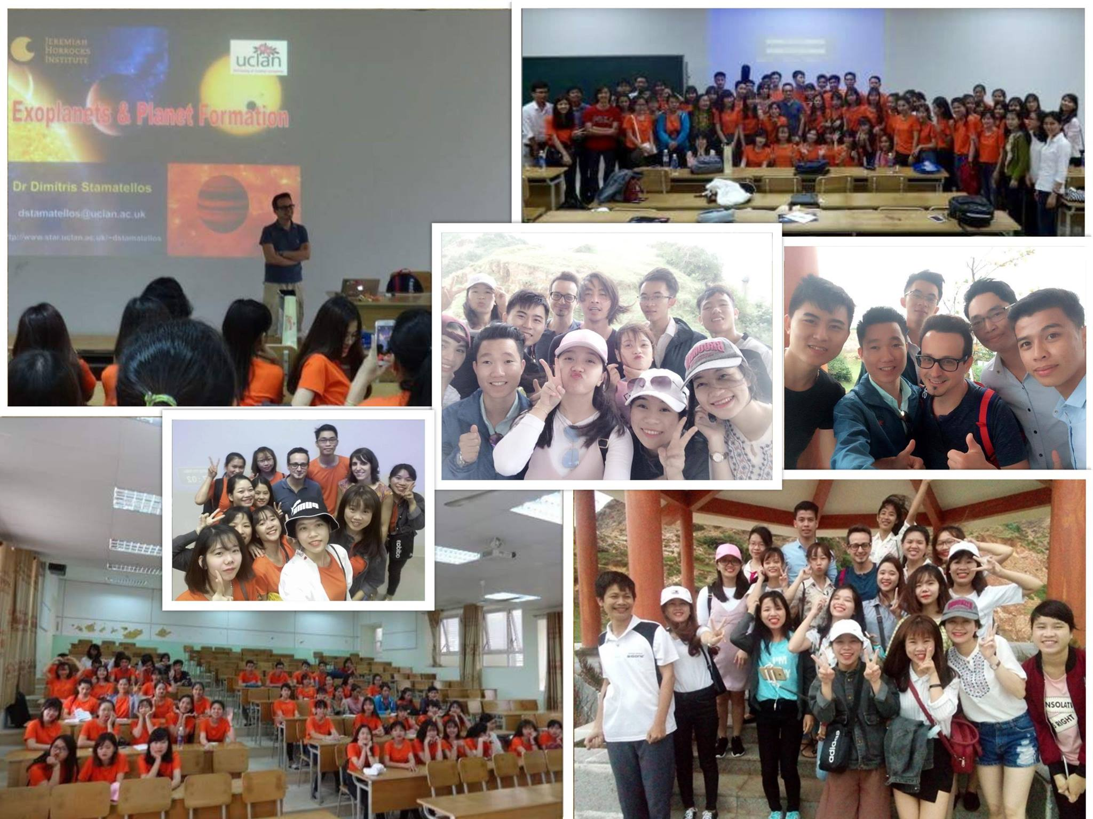
Educational activities: First tropical school in astronomy

Slide 19
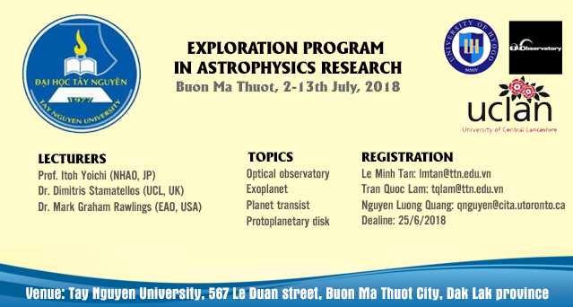
Educational activities: EPAR
We designed and created a first research schools for remote students with little English communication skills, good physics background and zero astronomy knowledge

Slide 20
EPAR 2018 (two weeks)
Scientists gave students lectures in the morning (20 participants)
In the afternoon, 3 visiting scientists and 9 students to team up and conduct common research projects.
Each week, one or two scientists are responsible for the scientific theme and student supervision.
Students presented their topics in two Friday's afternoon.

Slide 21
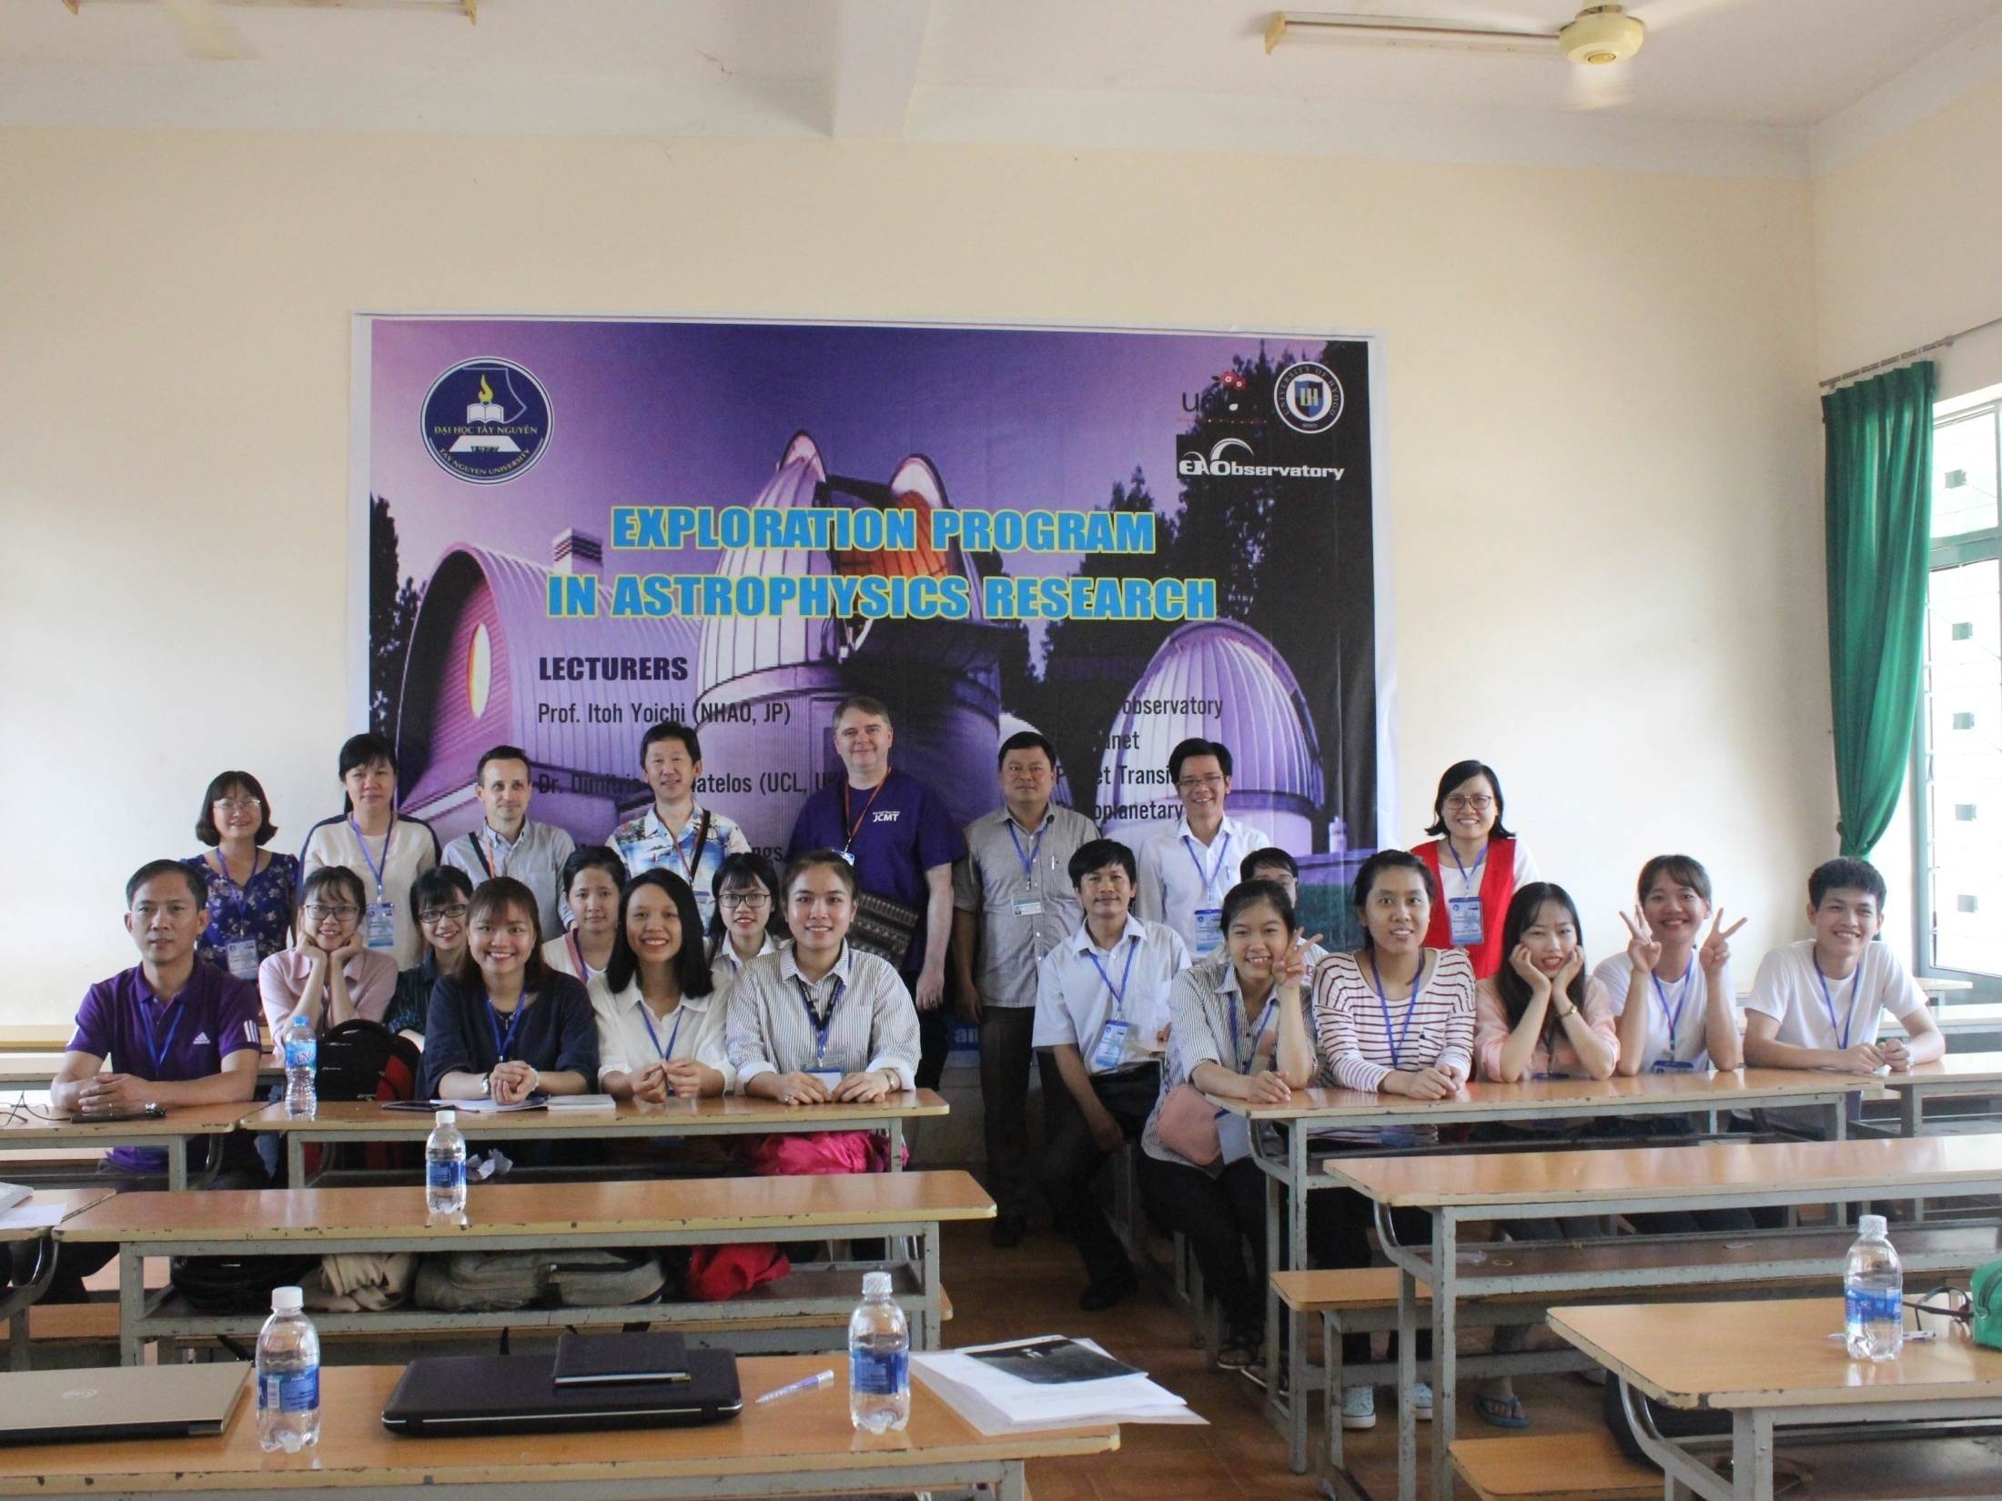
EPAR 2018

Slide 22
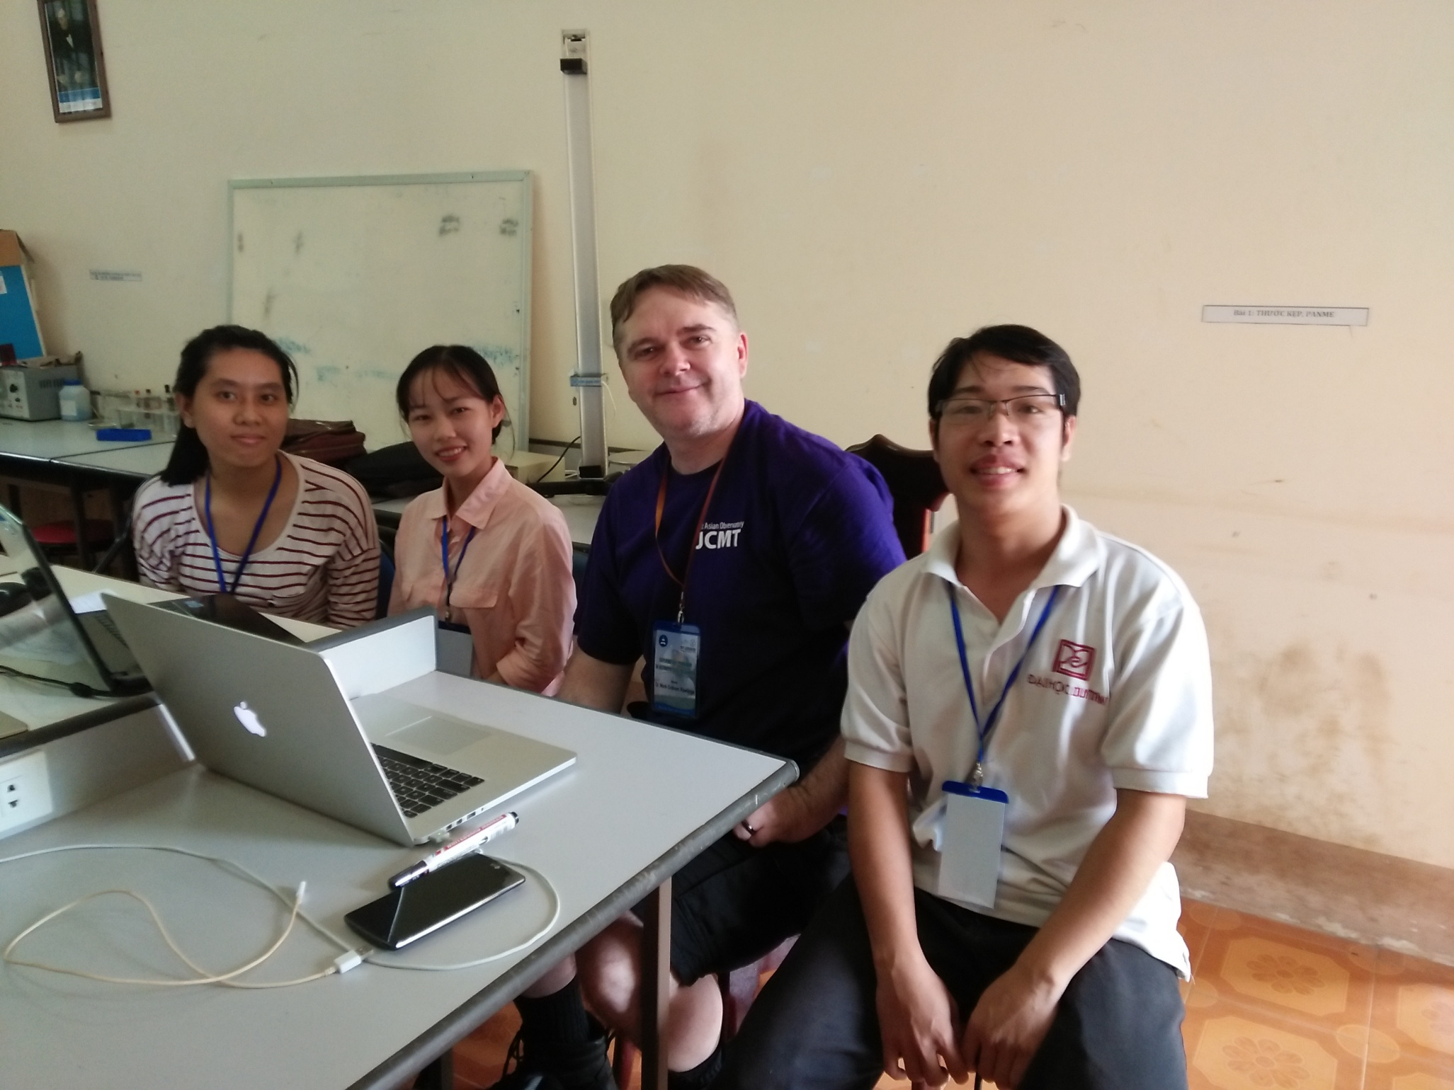
Project 1: Observing Gamma Ray Burst with JCMT (supervisor: Dr. Mark Rawlings)

Slide 23
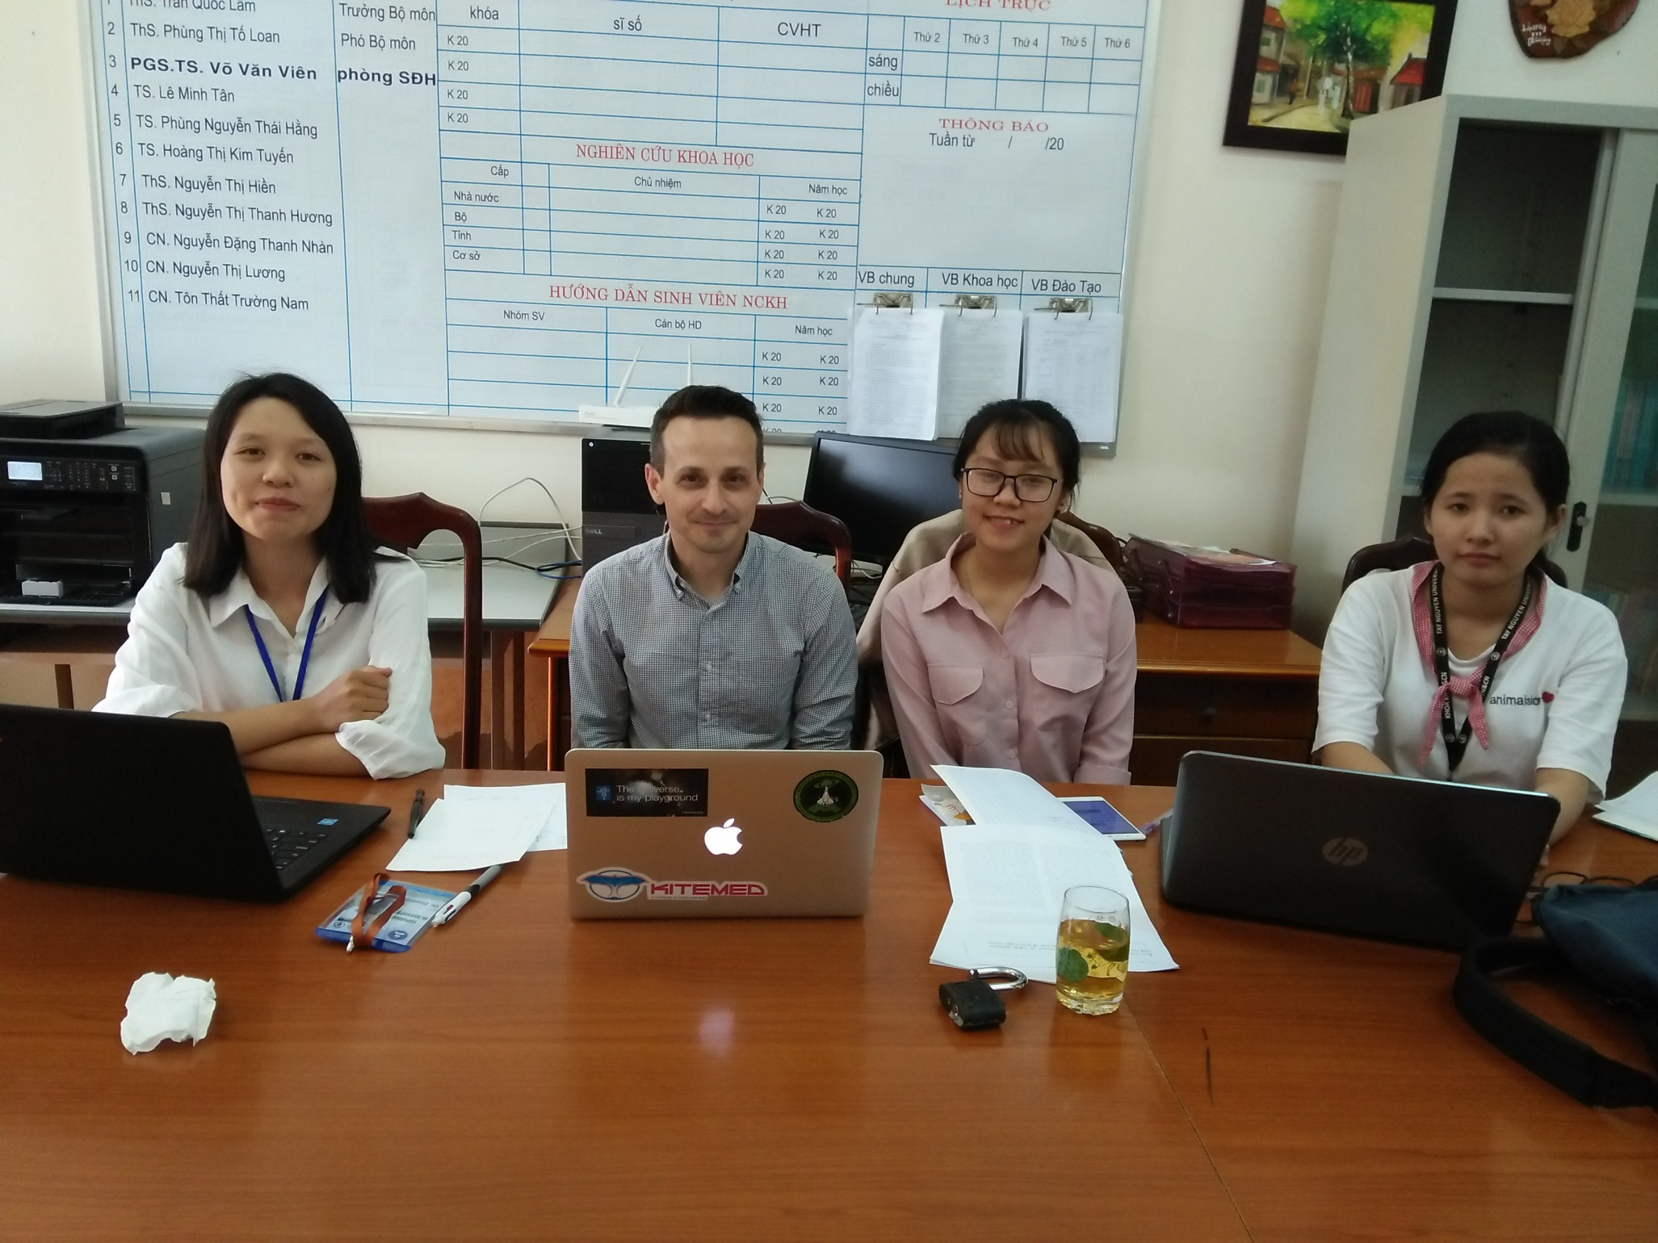
Project 2: Radiative Transfer modelling of planet forming core (supervisor: Dr. Dimitris Stamatellos)

Slide 24
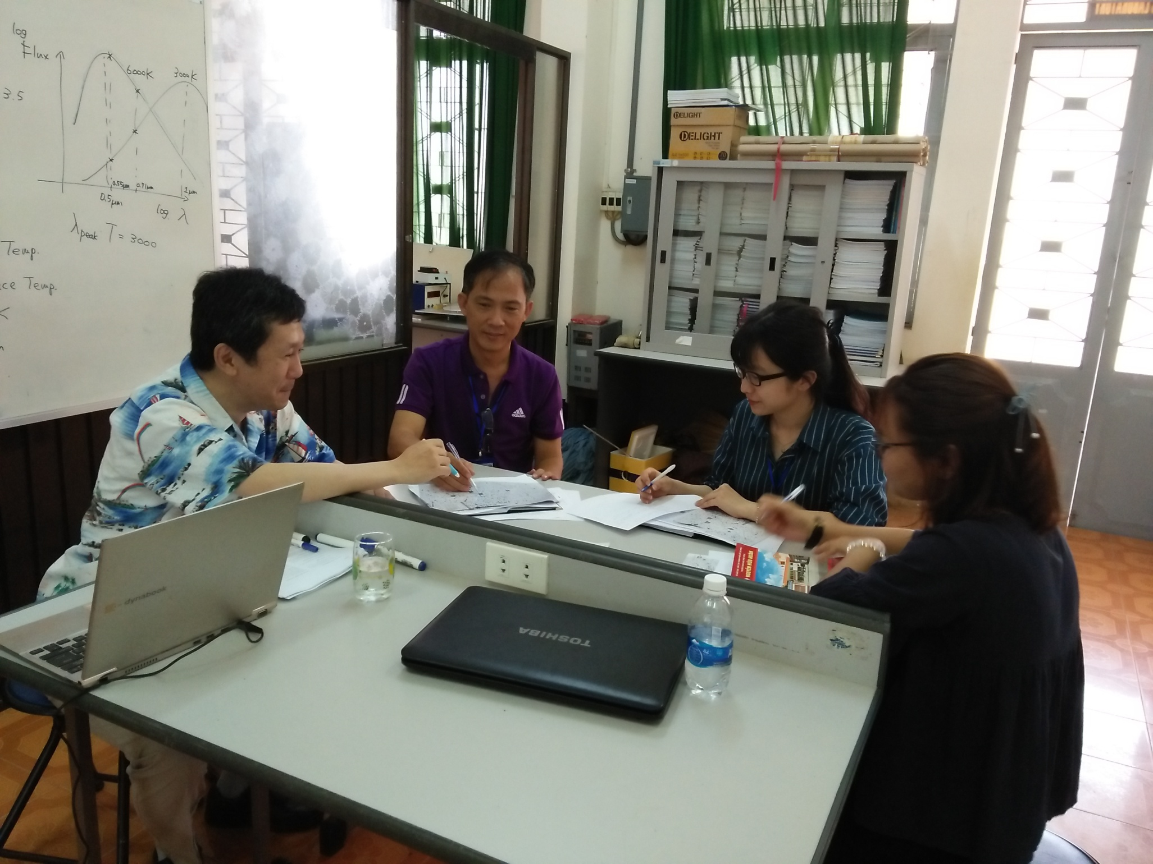
Project 3: Sciences with sub-1m optical telescopes: stellar evolution and HR diagram, asteroid light curve (supervisor: Prof. Itoh)

Slide 25
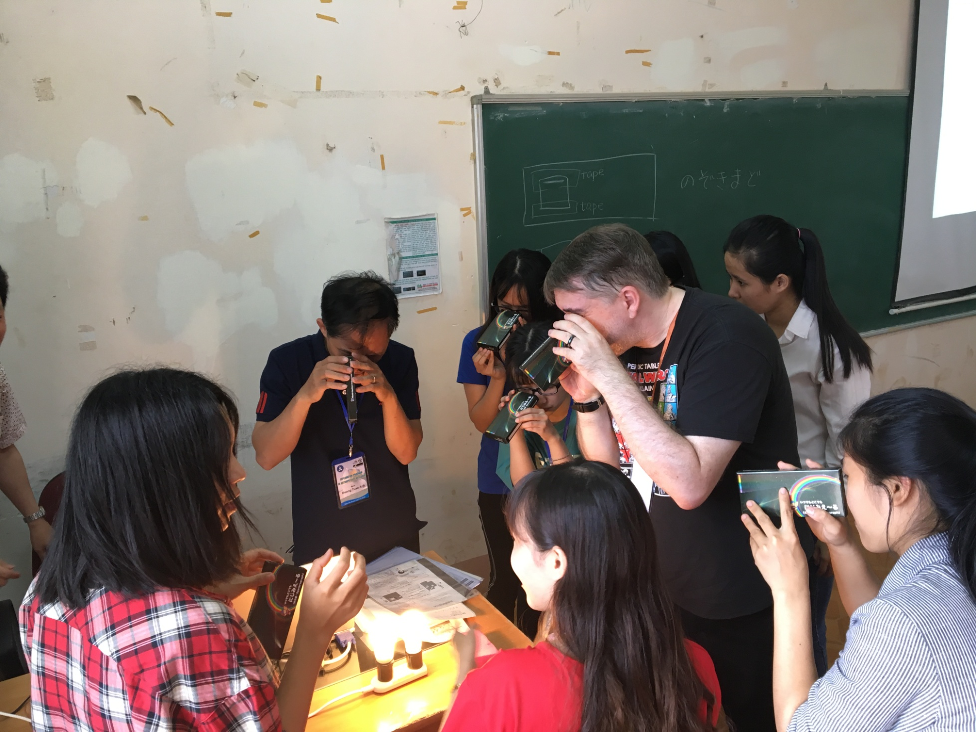
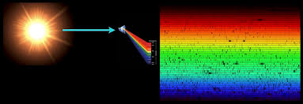
Spectroscopy practising

Slide 26
Students’ presentations

Slide 27
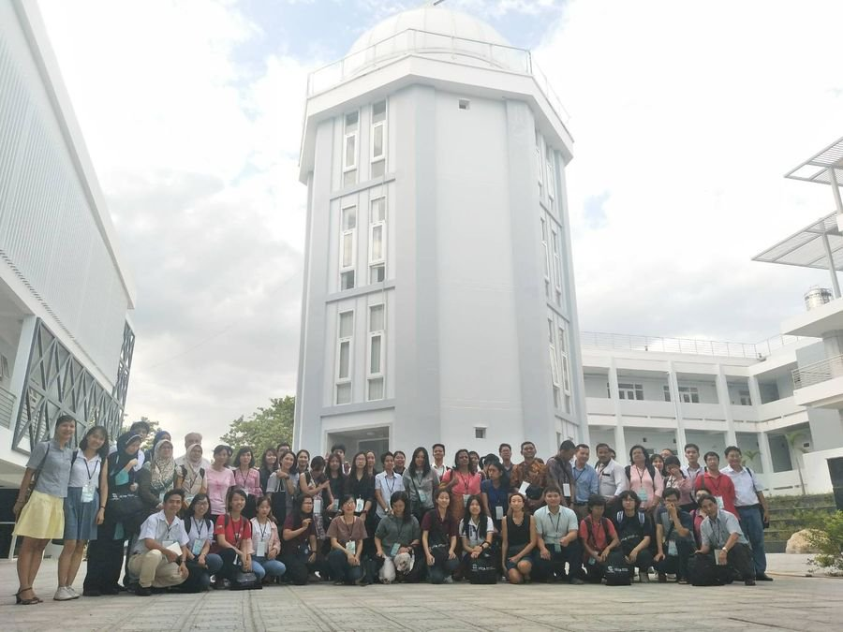
Some staffs of TNU joined the ITCA Colloquium 2018 “NARIT-VNSC Astronomy and Astrophysics Workshop”, Nha Trang Observatory, 22 – 27, July, 2018

Slide 28
Future plan
2018
Observational event at Nha Trang Observatory, VNSC (20 third-year students) (Sep. 2018)
2019 - 2020
EPAR will be held at Tay Nguyen University and Nha Trang Observatory, July 2019
Design the new telescope at Kyoto University
Build the observatory
2021
Join the optical telescope network in Vietnam (VNSC has two observatories)

Slide 29
Challenges
Human sources: There is a lack of experts in Astronomy in Central Highland, Vietnam
Buon Ma Thuot city: Large number of motivated people who are purely interested in science and discovering new knowledge
Budget: We are actively looking for financial support to purchase parts of the observatory and send staffs to visit foreign institutes
Collaboration: We actively need support from scientific community to come to Daklak to teach and exchange. We are also looking for support to receive our students for internship or exchange.

Slide 30
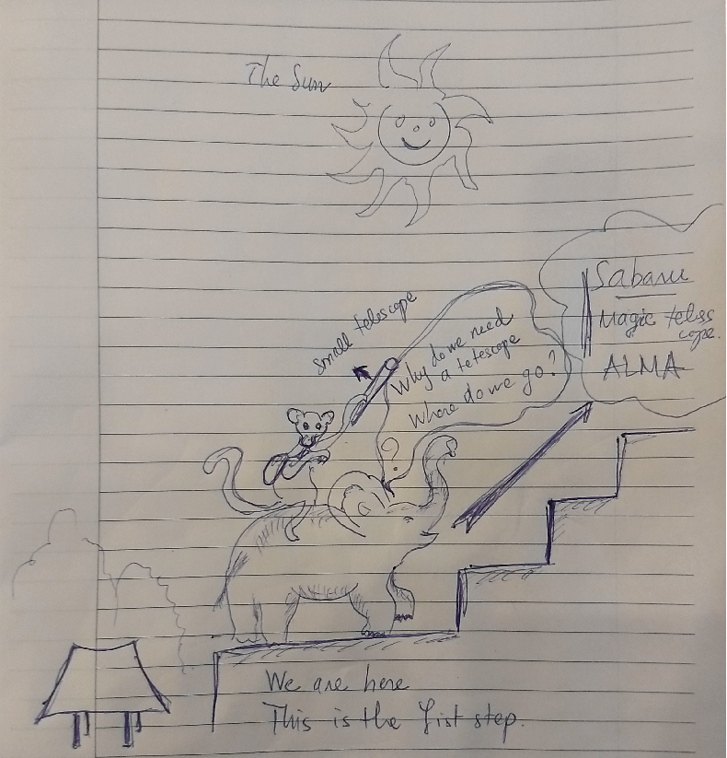
We need your help, talk to me about it

Slide 31
Thank you for
your attention !

