Slide 1
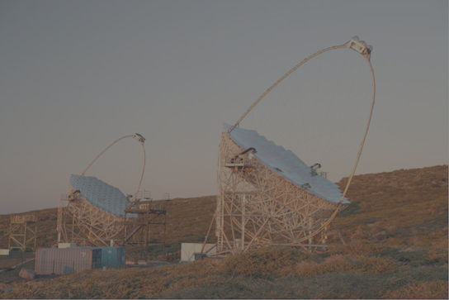
Multiwavelength observation of FRB121102 with the MAGIC Telescopes
John Hoang on behalf of the MAGIC Collaboration
Partners in crime: T. Hassan, M. López, S. Inoue
J. A. Barrio, J. Cortina, D. Fink, L. A.Tejedor, M. Will
Rencontres du Vietnam
12-18 August
Quy Nhơn - Việt Nam

Slide 2
OUTLINE
The FRB story so far…
Overview
Repeater FRB121102
Instrumentation and search strategies
The MAGIC telescope
γ-ray & Optical strategies
Observations & Results
Radio
Optical
γ-ray
1
John Hoang | The MAGIC Collaboration | Rencontres du Vietnam | Windows August 2018

Slide 3
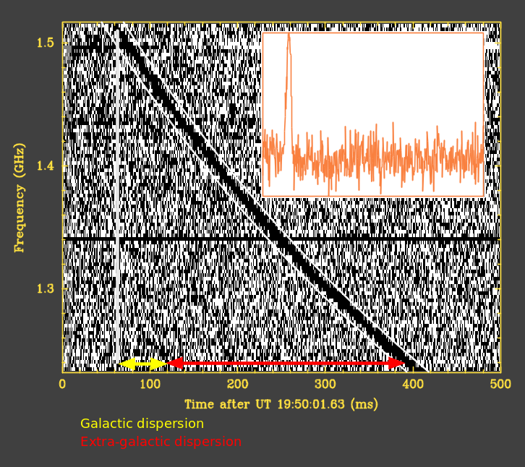
THE FRB STORY SO FAR: Overview
FRBs in short:
First discovered by Duncan Lorimer in 2007
Millisecond bursts of radio waves.
“Dispersed” – earlier at higher frequencies, later at lower.
Excess dispersion => origin outside our Galaxy
One-off events (mostly)
Reminiscent the early days of GRBs:
Expected thousands of bursts per sky per day.
More models than detected bursts.
Tell us about the intergalactic medium.
Where are the nearby sources in our galaxy?
S. Chatterjee et al.
Credit: S. Chatterjee 2017
2
John Hoang | The MAGIC Collaboration | Rencontres du Vietnam | Windows August 2018

Slide 4
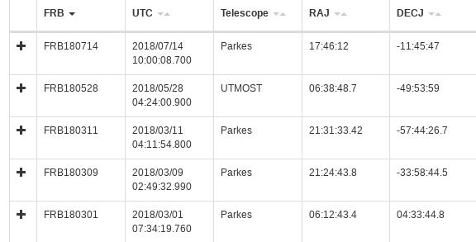
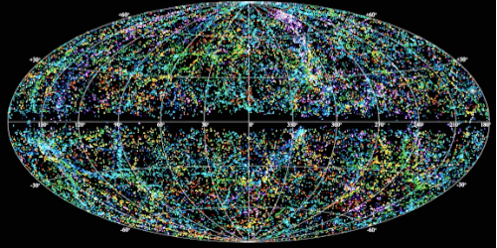
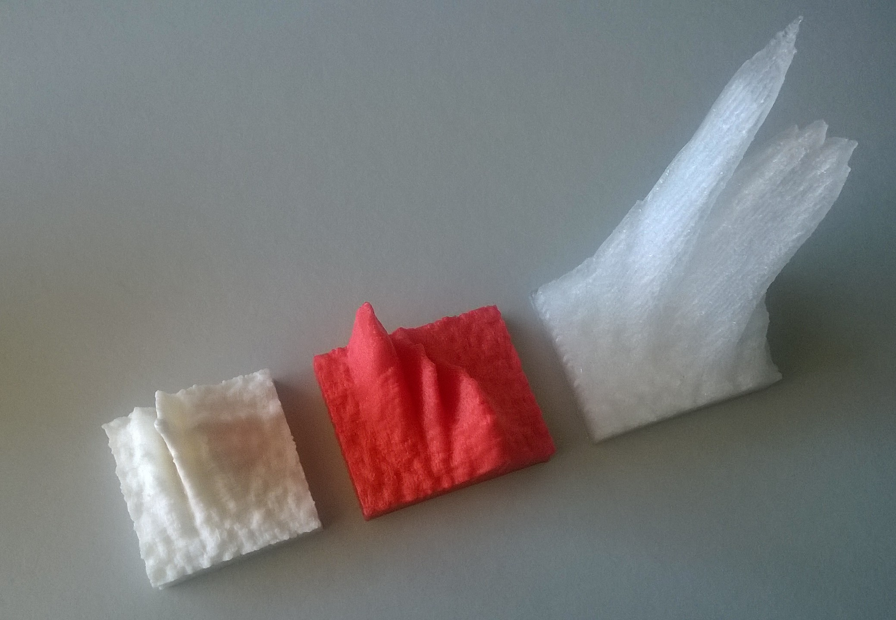
THE FRB STORY SO FAR: Repeater FRB121102
FRB121102 a.k.a. The Repeater
35 FRBs as of July 2018: http://frbcat.org/
Credit: NRAO
A. Archibald on Thingiverse
flux
frequency
Time
3
John Hoang | The MAGIC Collaboration | Rencontres du Vietnam | Windows August 2018

Slide 5
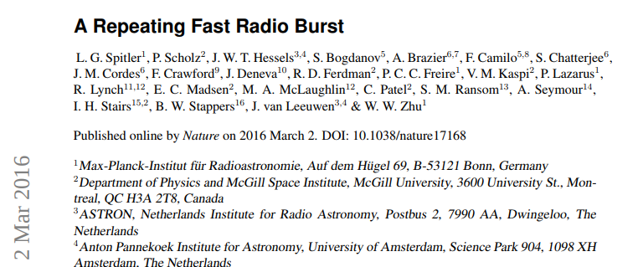
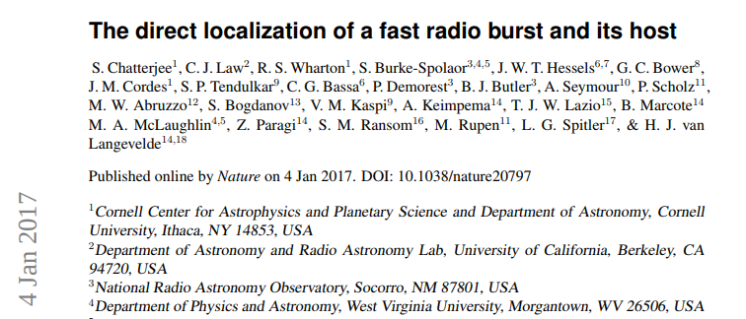
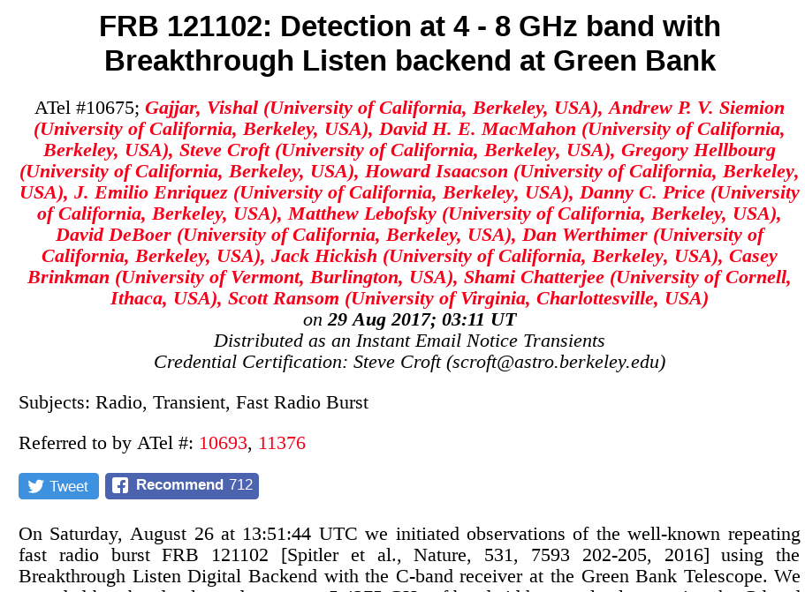
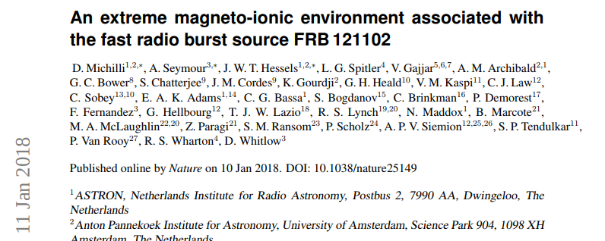
THE FRB STORY SO FAR: FRB121102 breakthrough
4
John Hoang | The MAGIC Collaboration | Rencontres du Vietnam | Windows August 2018

Slide 6
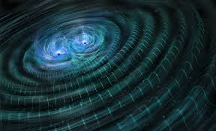
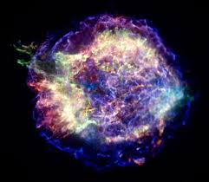
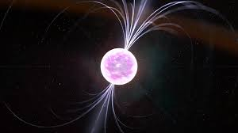
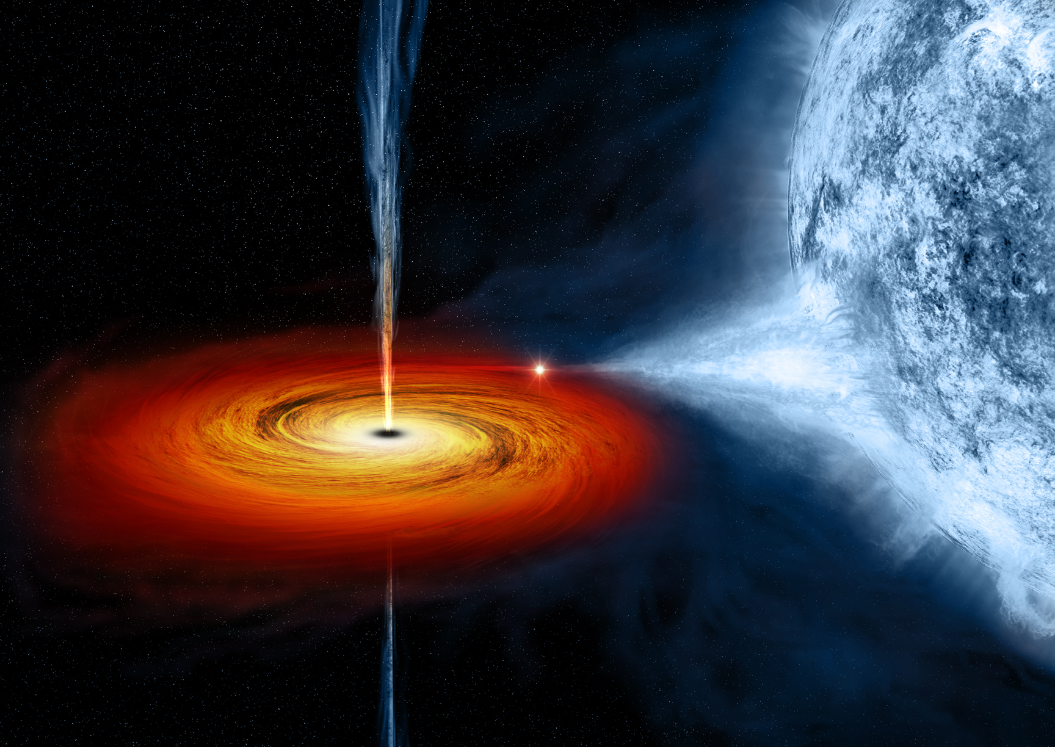
THE FRB STORY SO FAR: MAGIC MOTIVATION
No!
What if counterparts detected in other wavelengths?
Magnetar? Rotation frequency? Spectrum? Brightness?
Accreting black hole? Jet spectrum? Disc luminosity?
What if counterpart not detected in other wavelengths?
Constraint on models.
Which wavelength to look at next.
Build more sensitive instrument!
Maybe no...
Maybe?
Could be?
5
John Hoang | The MAGIC Collaboration | Rencontres du Vietnam | Windows August 2018

Slide 7
THE MAGIC TELESCOPES
At Roque de los Muchachos Observatory in La Palma (Spain)
System of two Imaging Atmospheric Cherenkov Telescopes (IACTs)
17 m diameter reflector, fast imaging camera with field of view of 3.5 deg
Sensitive to γ-rays between 50 GeV and 50 TeV
Detectors (PMTs) sensitive to Cherenkov photons in the U-band (365 nm)
6
John Hoang | The MAGIC Collaboration | Rencontres du Vietnam | Windows August 2018

Slide 8
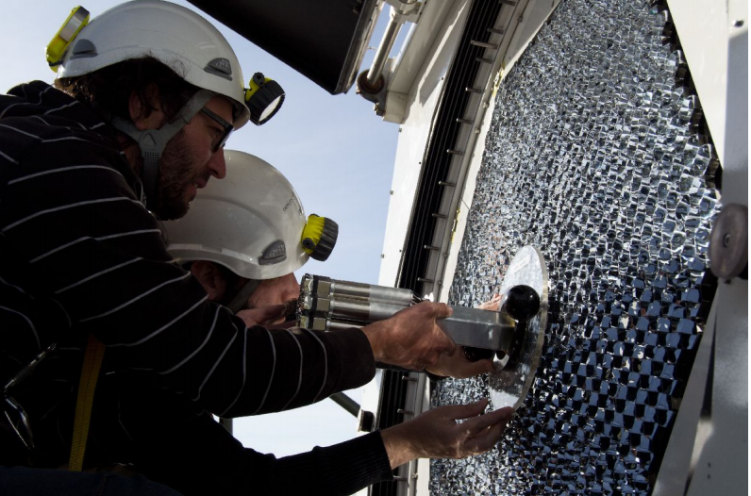
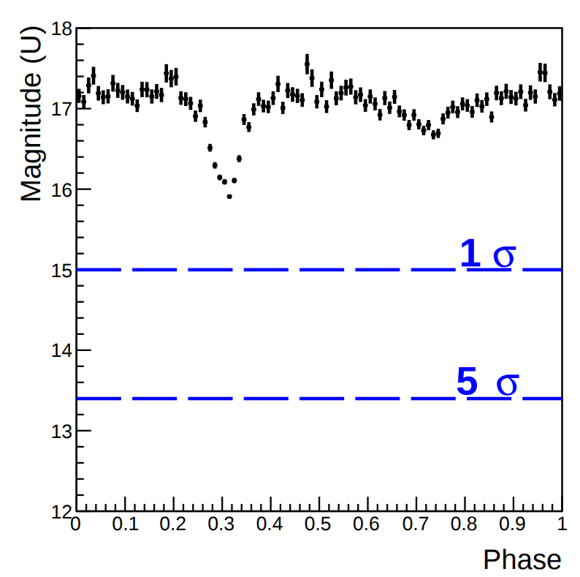
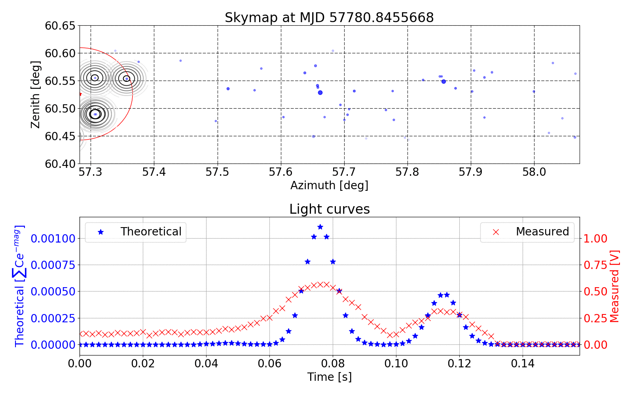
MAGIC TELESCOPES: Central Pixel
The PMT at the camera center was modified to read out simultaneously optical signal at 10 kHz rate
Can detect Crab’s pulsation after ~10 s using phase-folding
Sensitive to isolated ms optical pulses (tested with meteors and sky scan)
Credit: T. Hassan et al arXiv:1708.07698
7
John Hoang | The MAGIC Collaboration | Rencontres du Vietnam | Windows August 2018

Slide 9
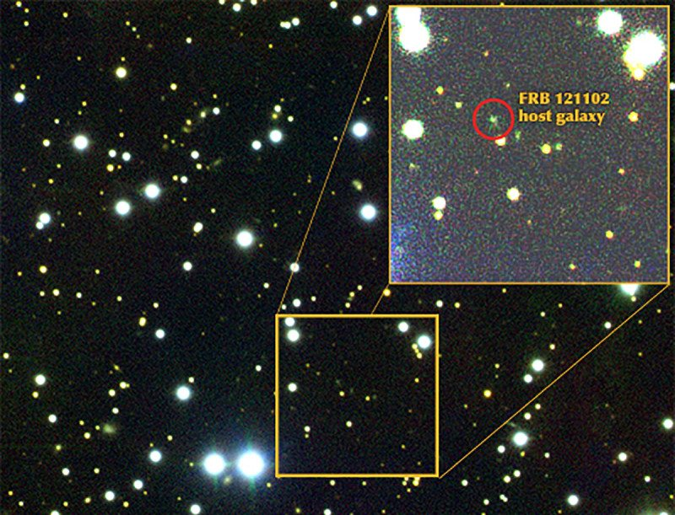
MAGIC FRB optical search strategy
Time-domain search:
Bursty: expect few background pulses/hour => optical pulses coincident with radio bursts strongly hint at optical counterpart to FRB
Persistent: Not possible: host galaxy identified at 25 magnitude while MAGIC’s pixel is only sensitive up to 13.5 magnitude
Credit: SP. Tendulkar et al.
Search windows:
Targeted: 10 ms around the Time of Arrival (ToA) of radio bursts (from radio observatories)
Blind: During the entire observation campaign
8
John Hoang | The MAGIC Collaboration | Rencontres du Vietnam | Windows August 2018

Slide 10
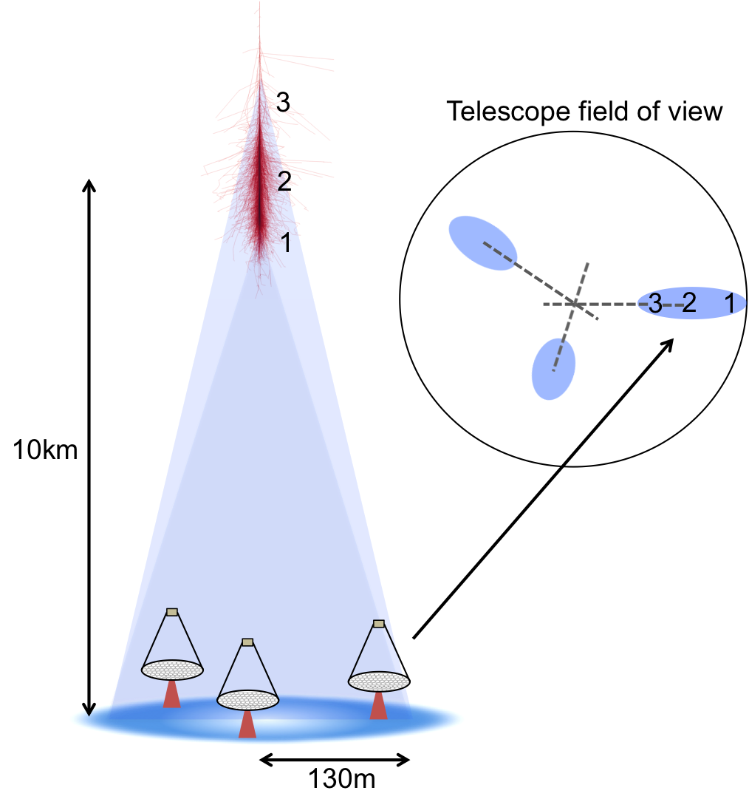
MAGIC FRB γ-ray search strategy
Time-domain search:
Bursty: expect virtually no events in the ms scale => few events/ms can hint a γ-ray counterpart to FRB
Persistent: Assuming power-law spectrum => Estimation of Flux and Spectral Energy Distribution
Telescope FoV
3 2 1
10km
Search windows:
Targeted: 10 ms around the arrival time of radio bursts (from radio observatories)
Blind: During the entire observation campaign
130m
9
John Hoang | The MAGIC Collaboration | Rencontres du Vietnam | Windows August 2018

Slide 11
MULTIWAVELENGTH OBSERVATIONS
More than 10 nights of observation between 2016 and 2017:
Concurrent observation with Arecibo and Effelsberg radio telescopes between November 2016 and March 2017
Concurrent observation during MWL campaign led by INTEGRAL (X-ray), Effelsberg, GBT and Nançay (radio) during September 2017
MAGIC observations carried out in ON mode (source located at the camera center) to allow simultaneous optical observation
Background estimation obtained via separate observations
Zenith angle up to 60 deg
Good weather conditions during several MWL observation nights
10
John Hoang | The MAGIC Collaboration | Rencontres du Vietnam | Windows August 2018

Slide 12
RESULTS: Radio
Arecibo ToA (MJD) | UTC | Peak brightness (Jy) | Significance (σ)
57799.98317566 | 2017-02-15 23:35:46.377 | 1.4 | 32.17
57806.96425078 | 2017-02-22 23:08:31.268 | 1.6 | 38.59
57806.98472905 | 2017-02-22 23:38:00.590 | 1.5 | 35.21
57808.00278585 | 2017-02-24 00:04:00.697 | 0.79 | 18.73
57814.94698520 | 2017-03-02 22:43:39.521 | 0.47 | 11.13
5 radio bursts detected by Arecibo during the Winter 2016-2017 campaign
FRB121102 seems to have “episodic” periods of bursting and then goes silent for months
No radio bursts detected during the September 2017 campaign
11
John Hoang | The MAGIC Collaboration | Rencontres du Vietnam | Windows August 2018

Slide 13
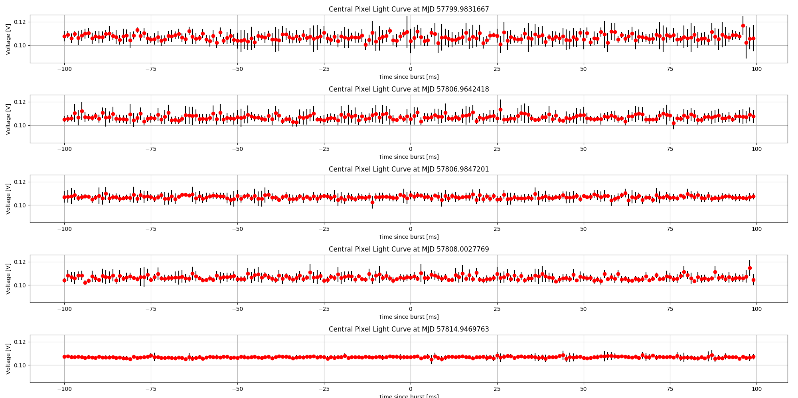
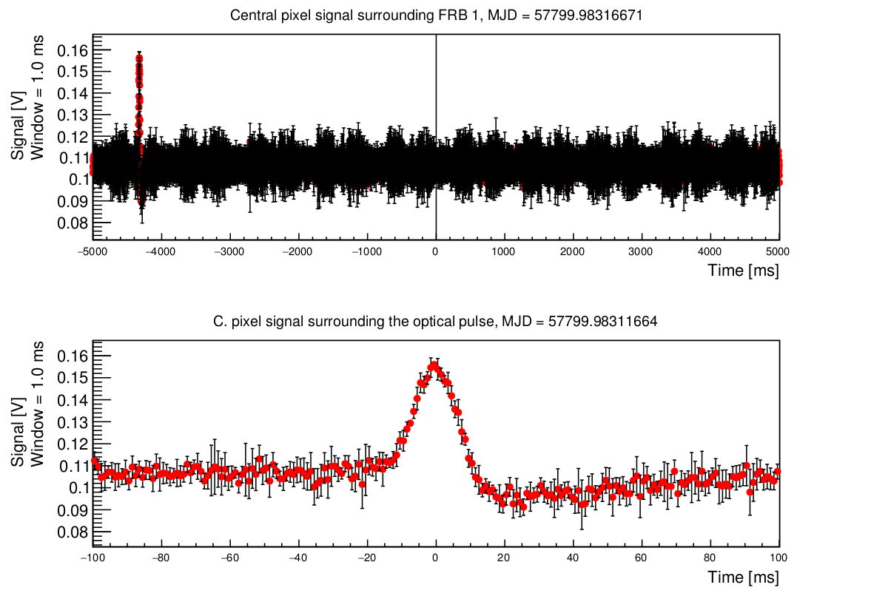
RESULTS: Optical
200ms
Credit: T. Hassan et al 2018
No optical bursts detected 100 ms before & after the 5 FRBs
During the first radio burst, there was 1 optical flash ~4 s before the radio burst
Most likely a background event due to meteor within FoV
12
John Hoang | The MAGIC Collaboration | Rencontres du Vietnam | Windows August 2018

Slide 14
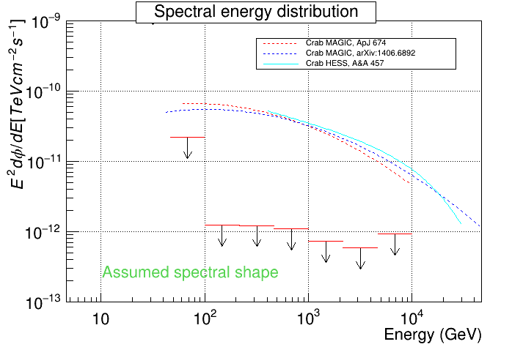
RESULTS: γ-ray
No persistent source of VHE γ-ray detected
Upper limit on the SEDs
1 order of magnitude less constraining than Sgr A*
No γ-like events above 100 GeV are found within 10 ms time window around these radio bursts
VHE radiation energy per burst roughly estimated ~10⁴⁷ erg
Can be more constraining with more bursts observed
13
John Hoang | The MAGIC Collaboration | Rencontres du Vietnam | Windows August 2018

Slide 15
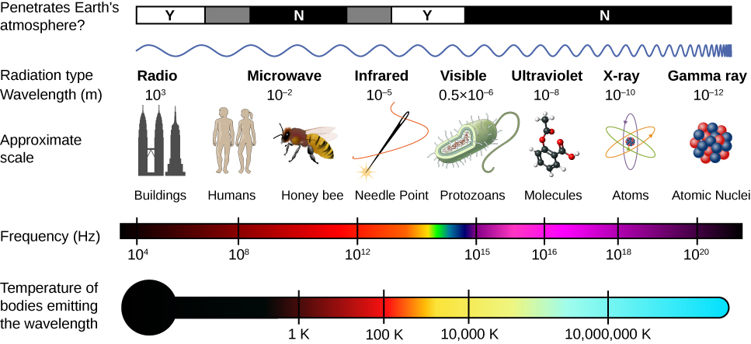
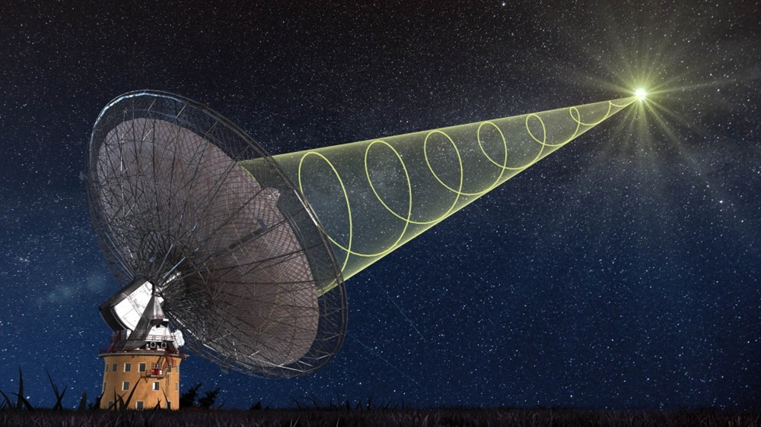
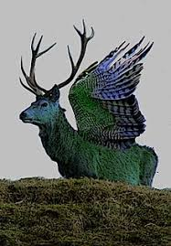
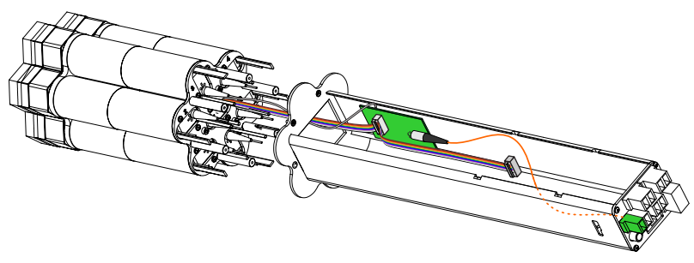
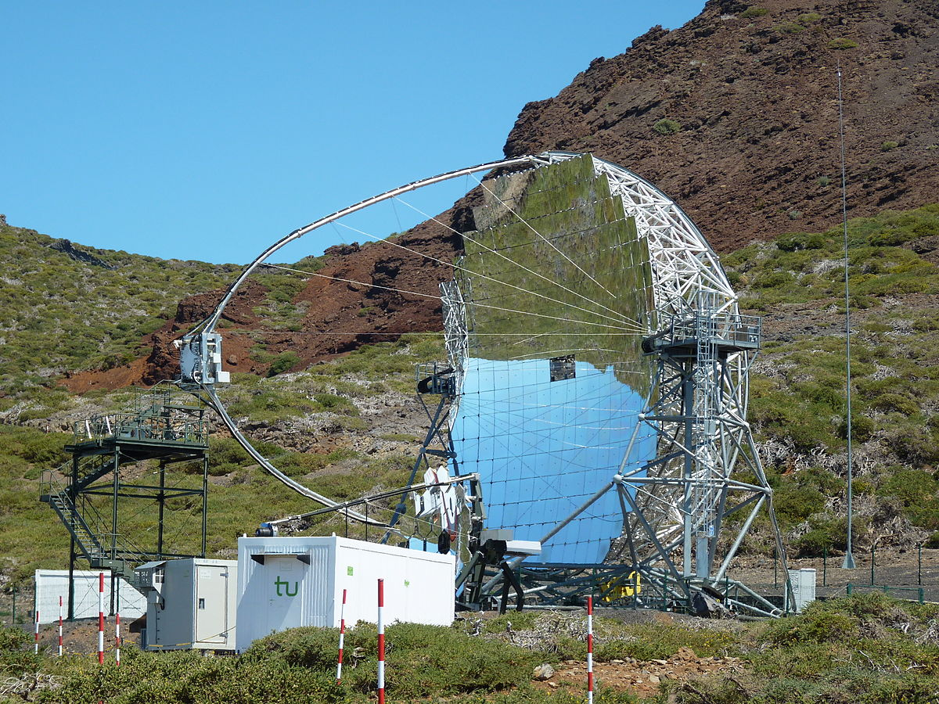
SUMMARIES & CONCLUSIONS
Exciting time for FRBs => MWL counterparts will be beneficial to understanding FRB’s nature.
MAGIC is sensitive to ms bursts in both optical and gamma-ray regimes
Publication submitted to MNRAS:
5 bursts were detected in radio band
No persistent γ-ray source detected in the 50 GeV - 50 TeV range
No ms counterparts in detected optical & γ regime
Additional 20h more allocated for 2018 => Open to MWL collaboration
14
John Hoang | The MAGIC Collaboration | Rencontres du Vietnam | Windows August 2018

Slide 16
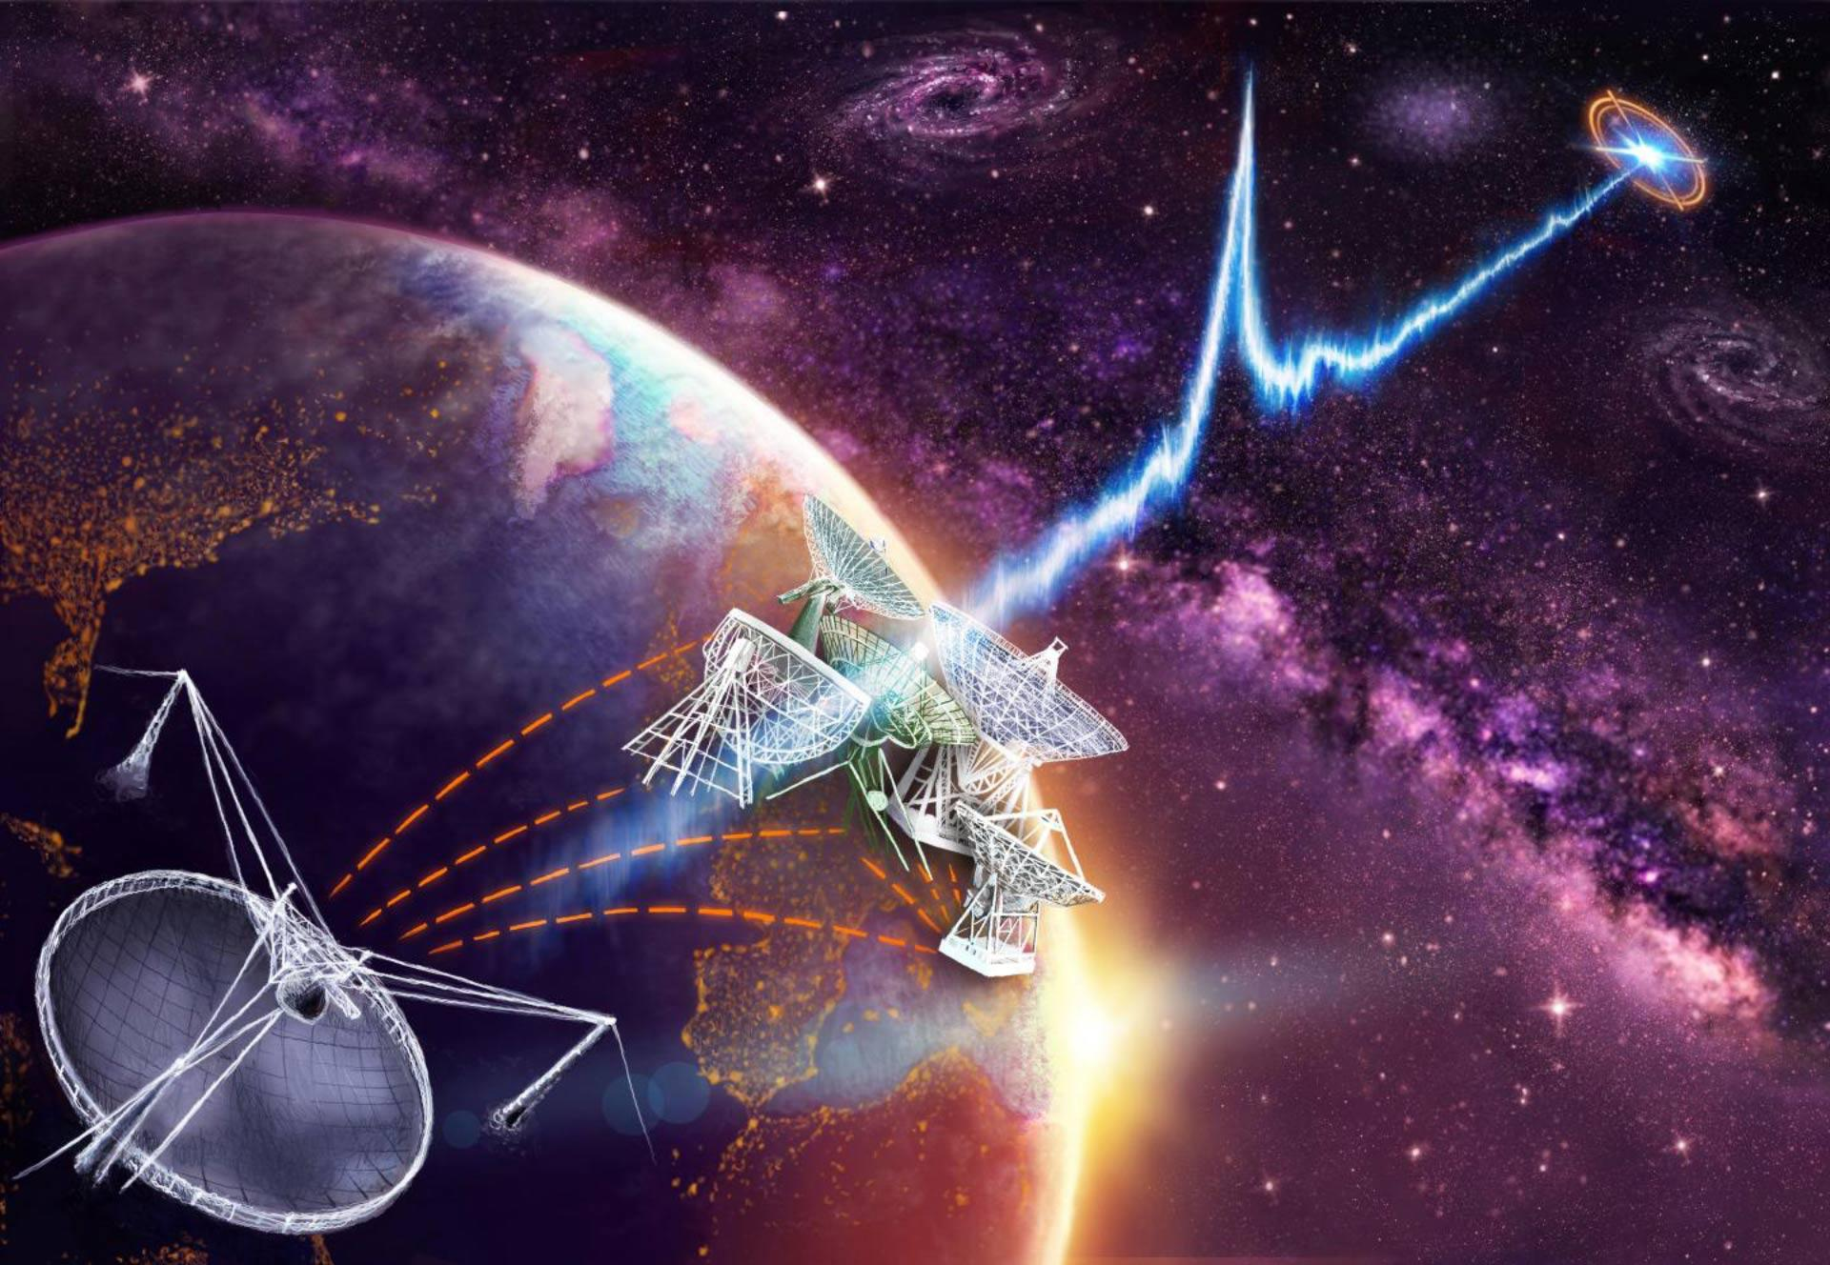
Q&A
Thank you for the contact.
Keep listening!
15
John Hoang | The MAGIC Collaboration | Rencontres du Vietnam | Windows August 2018

Slide 17
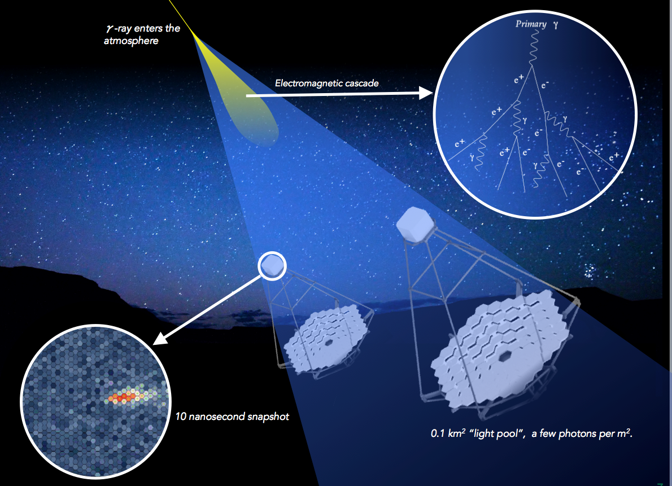
Backup: IACT
primary particle collides with atmosphere molecules
⇓
production of Extensive Air Shower (electromagnetic or hadronic)
⇓
secondary particles move with v > c_{air}
⇓
production of Cherenkov light
⇓
large mirrors focus on pixelated (PMTs) camera
⇓
record image of the Cherenkov flash on camera
⇓
reconstruction of primary particle properties (nature, energy, direction)
Credit: CTA
16
John Hoang | The MAGIC Collaboration | Rencontres du Vietnam | Windows August 2018

Slide 18
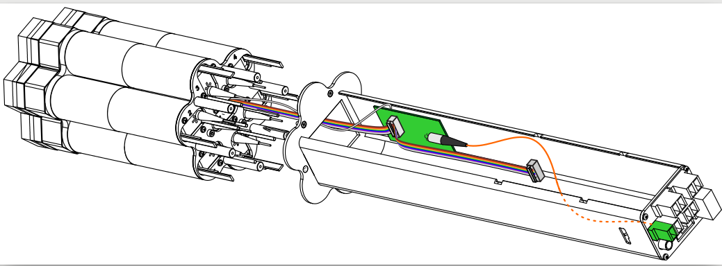
Backup: MAGIC’s Central Pixel
Central cluster with 7 PMTs, mechanical housing and CPix optical transmitter, each pixel has 0.1 deg FoV and a light concentrator (Winston cone) in front
Block diagram of CPix. Cherenkov AC branch not shown
PMT of CPix showing several electronic boards
17
John Hoang | The MAGIC Collaboration | Rencontres du Vietnam | Windows August 2018

Slide 19
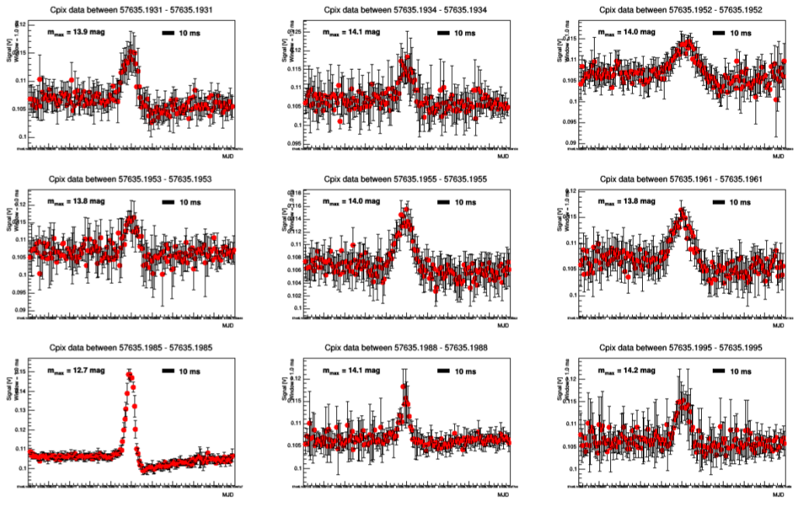
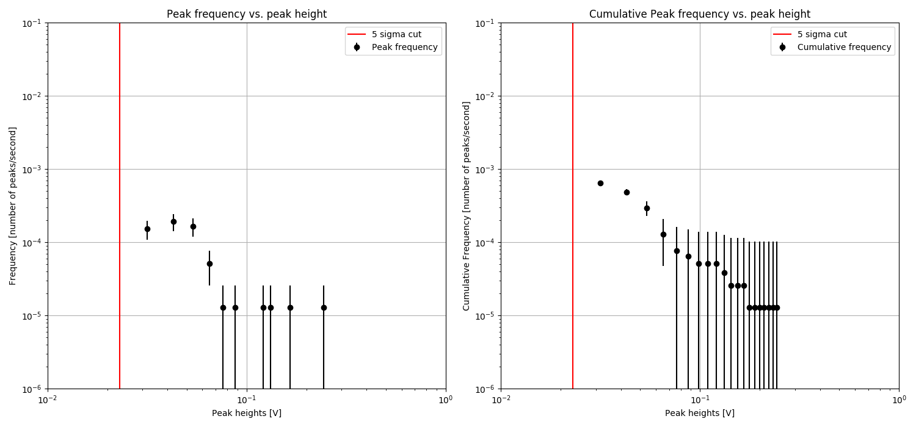
Backup: Central Pixel background
Credit: T. Hassan
Frequency of pulses vs their brightness => expected only a few bright pulses per hours
Some examples of bright isolated optical pulses due to meteors
18
John Hoang | The MAGIC Collaboration | Rencontres du Vietnam | Windows August 2018

Slide 20
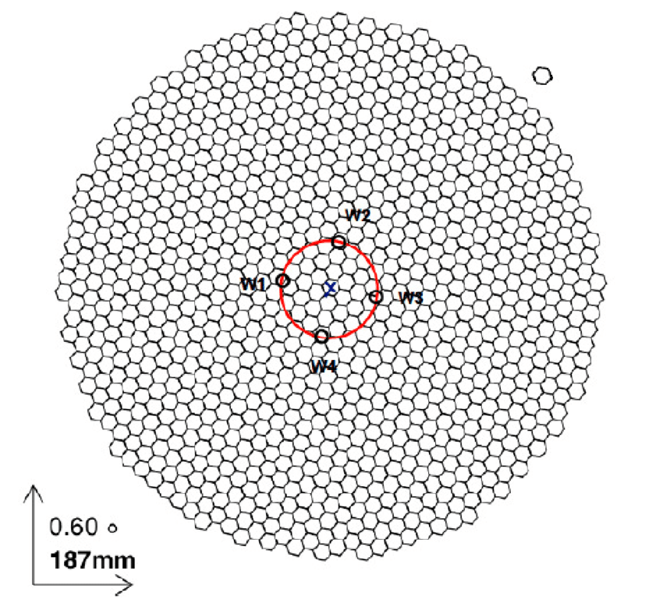
Backup: MAGIC ON vs WOBBLE observation
WOBBLE observations:
Source location 0.4 deg away from the camera center
Simultaneous source & background observations
ON observations:
Source in the camera center
Separated background observation
Credit: A. López Oramas
19
John Hoang | The MAGIC Collaboration | Rencontres du Vietnam | Windows August 2018

Slide 21
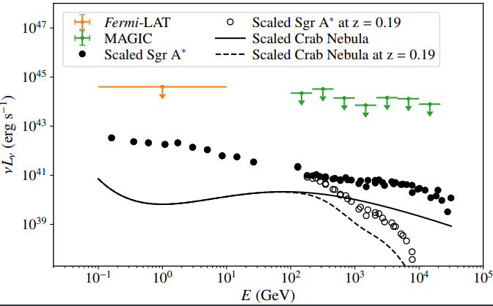
Backup: Scaled SED
Credit:T.Hasan
20
John Hoang | The MAGIC Collaboration | Rencontres du Vietnam | Windows August 2018

