Slide 1
The Smoking Guns Of Neutron Stars Mergers
Arnon Dar*
Technion, Haifa, Israel
* Based on:
- The Smoking Guns Of Short Hard Gamma Ray Bursts,
Dado and Dar, arXiv:1708.04603
- Cannonball model diagnosis of the short gamma ray burst 170817A,
Dado, Dar and De R`ujula, arXiv:1712.09970
- Universal Afterglow Of Supernova-Less Gamma Ray Bursts
Dado and Dar, arXiv:1807.08726
*a

Slide 2


The Long Road Towards The Solution of the GRB Puzzles
Discovery of GRBs : USA Vela Spy Satellites , July 2, 1967, published by
Klebesadel , Strong , Olson, 1973, ApJ, 182, L35.
Discovery of the first pulsar, Bell & Hewish, 1967, Nature 213, 1214.
Discovery of the first binary pulsar PSR 1913+16: Hulse & Taylor , 1975, ApJ, 195, L51
Evidence GW emission leading to their merger: Taylor, Weisberg, 1982, ApJ, 253, 908
EG n*n* mergers and SNe produce GRBs : Goodman, Dar, Nussinov, 1987, ApJ, 314, L7
Large cosmic distances of GRBs indicated by CGRO: Meegan et al. 1992, Nature, 355, 143
Two types GRBs, long and short-hard (LGRBs, SHBs): Kouveliotou et al. 1993, ApJ, 413, L101
GRBs are produced by ICS of photons by highly relativistic jets : Shaviv, & Dar, 1995, ApJ, 447, 863
Discovery of the X-ray afterglow of GRBs with BeppoSAX: Costa et al. 1997, Nature, 387, 783,
led to discovery (1997-2018) of their host galaxies, their redshifts, the SN-GRB ,
SN-less GRBs, and the detailed properties of their prompt and afterglow emissions, over the entire electromagnetic spectrum mainly due to the BeppoSAX , Swift, Konus-Wind , Fermi , CXO, and XMM-Newton satellites + ground based telescopes, but, the origin and production mechanism of SHBs remained unsolved puzzles until after SHB170817A.
1974
1993

Slide 3
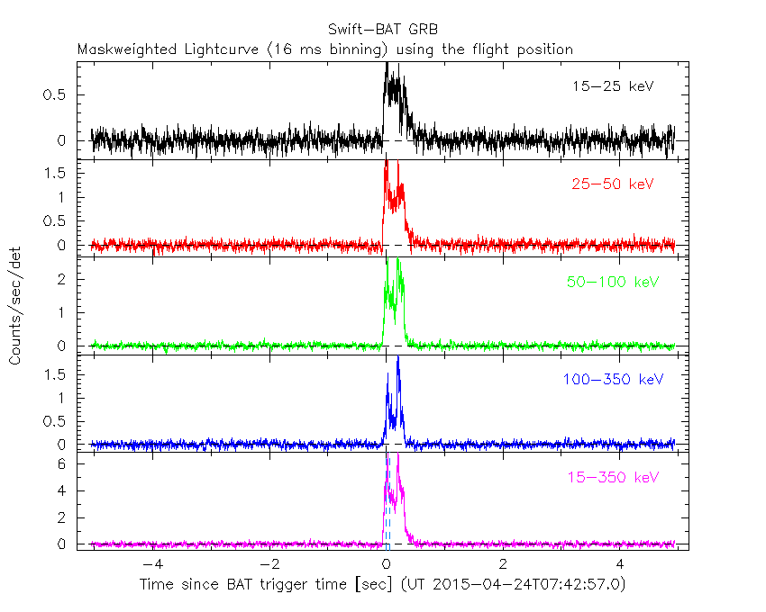
The Light Curve of an Ordinary SHB, 150424A
SHB Puzzles: Progenitors ? Production Mechanism?

Slide 4
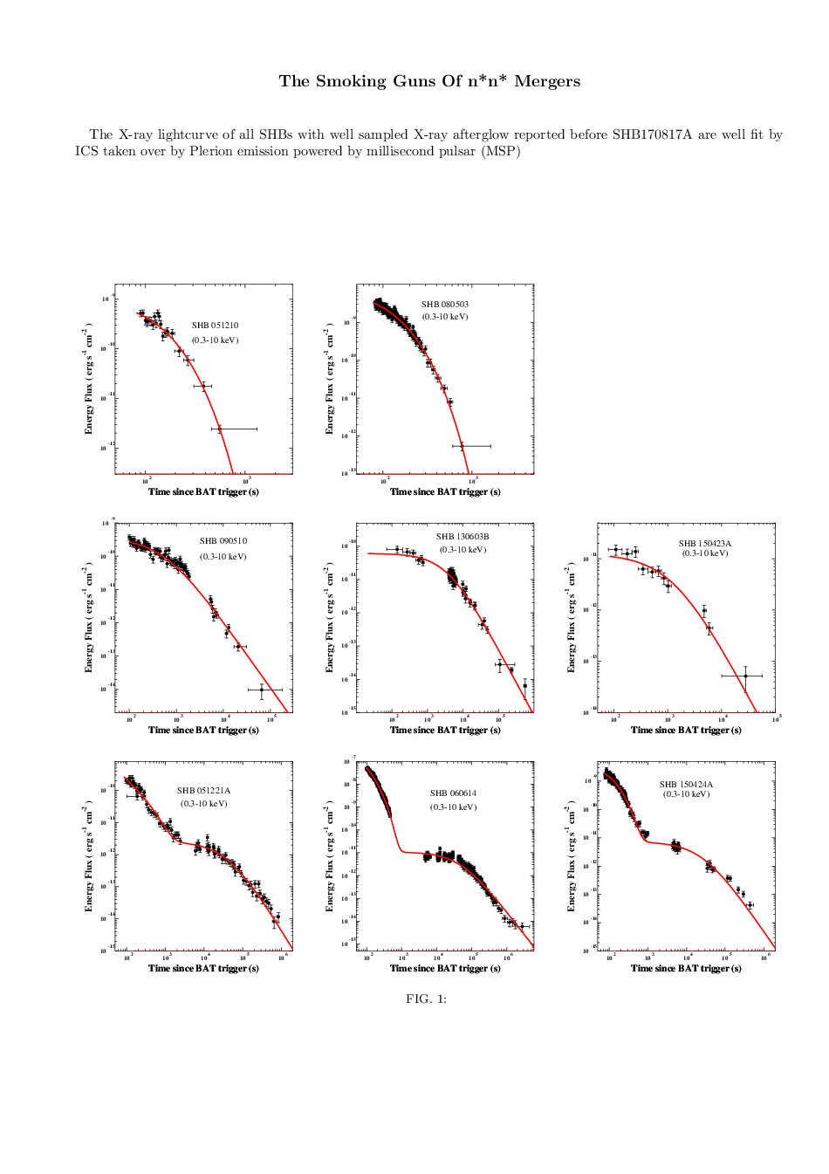
Are SHBs the Smoking Guns of n*n* Mergers ?
All the well-sampled X-ray afterglow of SHBs are well fit by PWN emission powered by millisecond pulsar (MSP), or by ICS of PWN light
by highly relativistic jet = extended emission (EE) , or by EE+MSP
EE+MSP

Slide 5
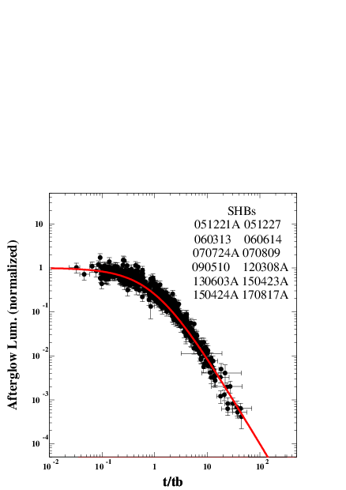
Universal Shape of AG of All SHBs With Well Sampled Late AG
Can be explained by
PWN Powered by
Millisecond Pulsar:
evidence for remnant n*, (no bh, no associated SN)
P(0) around 30 ms

Slide 6
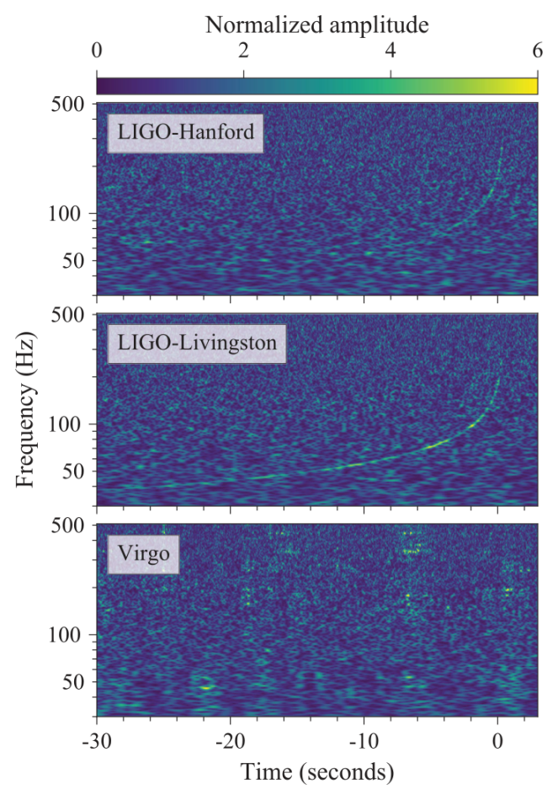
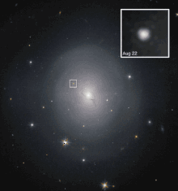

On 17/8/2017: Evidence for n*n* merger origin of SHBs
GW170817 as measured by
the LIGO and Virgo GW detectors
Hubble picture of NGC 4993
at 40 Mpc, 5 days after SHB
170817A. Its site lies on the near side of the galaxy. (Levan et al. 2017, ApJL, 848, L48)
SHB170817A began 1.7s after GW170817 (produced by fall-back ejecta?) and lasted 2s
Superluminal Motion Measured!
Mooley et al. arXiv180609693
SHB170817A was an ordinary SHB viewed from Far Off-Axis

Slide 7
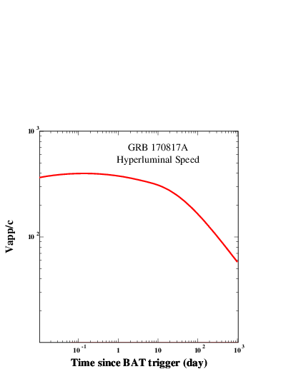
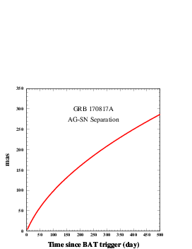


“superluminal” speed of the CB which produced SHB170817A
Mooley et al. arXiv:1806.09693 (VLBI +VLBA)
75d→250d after burst
10 keV accretion disk glory

Slide 8





The Cannonball (CB) Model OF GRBs
Inverse Compton scattering of glory light by highly relativistic jets of plasmoids
(CBs) of ordinary matter launched in core-collapse supernovae of Type Ic,
in n*n* or n*bh mergers in close binaries, and in n*→q* phase transition
due to mass accretion in high mass X-ray binaries (HMXBs).
(Shaviv, Dar 1994; Dar 1997; Dado, Dar, De R`ujula 2000 - 2018)
SHBs from n*n* mergers:
Prompt Emission :
ICS of glory light
by Jet of HR CBs
Afterglow:
MSP=>PWN isotropic Brem.
CBs: beamed Synchrotron
.
Glory
CB
CB

Slide 9
CB Model Prompt Emission: ICS OF Photons
(DD 2000) By a Jet of Highly Relativistic CBs
Doppler boost:
Relativistic beaming:
ICS of glory:
+ Beaming:
Most probable GRB viewing
Far off-axis GRBs (XRFs/LLGRBs)
Amati et al. empirical Relation (2002 A&A, 390, 81):

Slide 10
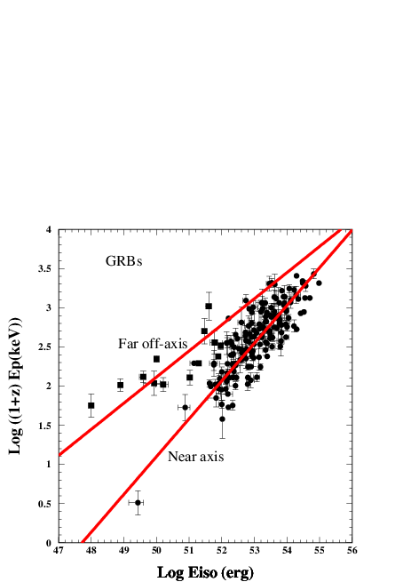
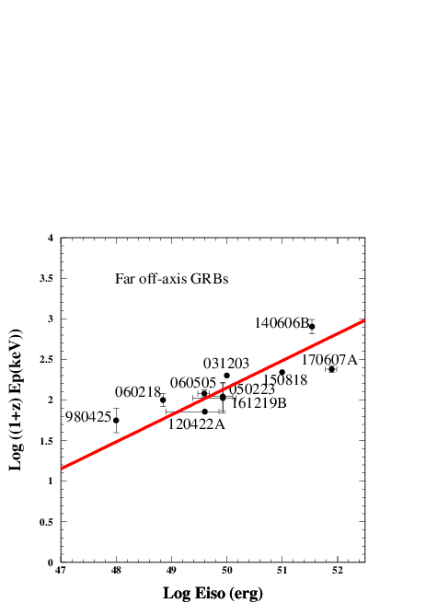
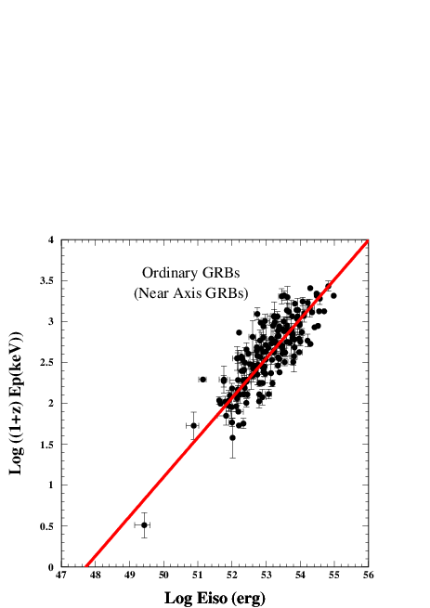
Long GRBs
Far Off-Axis GRBs
Near Axis GRBs

Slide 11
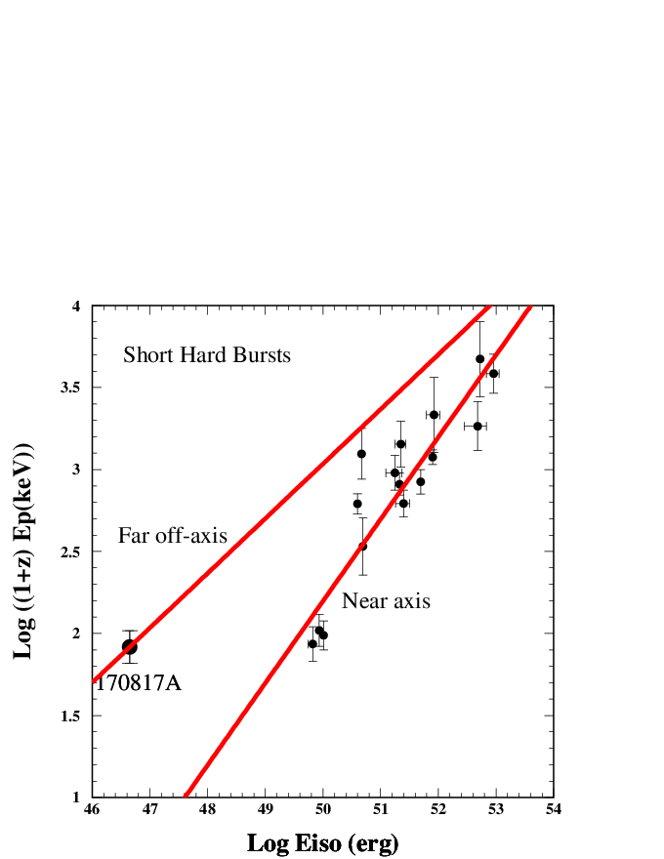
Short Hard Bursts
Far Off-Axis
Near Axis
=10 KeV

Slide 12
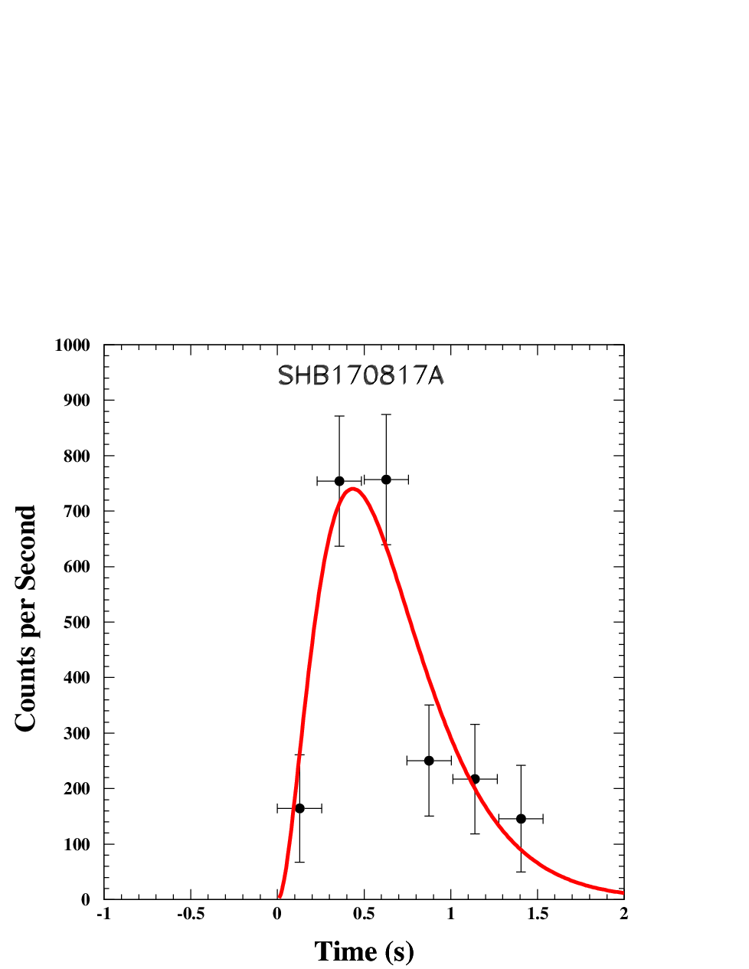
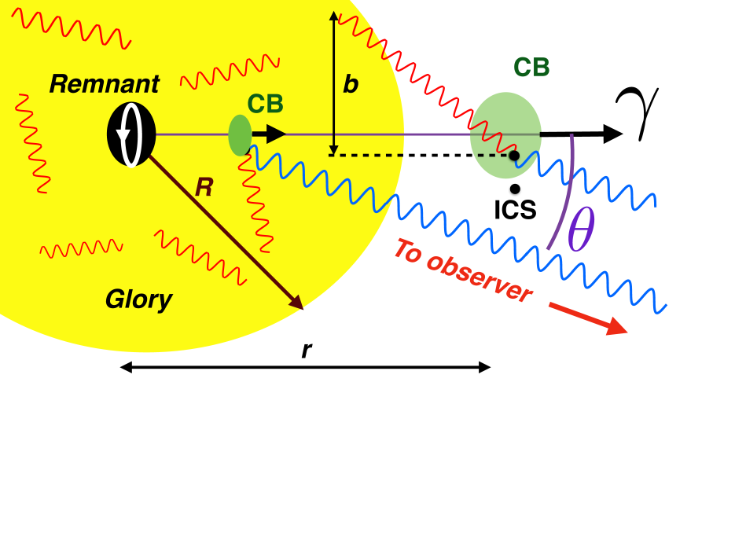
CB Model Pulse Shape
(ICS of glory photons)
FRED=Fast Rise Exp. Decay
Data: Goldstein et al. Fermi GBM 2017

Slide 13
n*n* merger within a PWN/accretion disk ?
1.7s time delay ? Fall-Back Matter ?
Peak time Crossing Time Through Accretion Disk’s X-ray Glory?
CB
R
EARTH
n*n* merger
R cos
GW

Slide 14
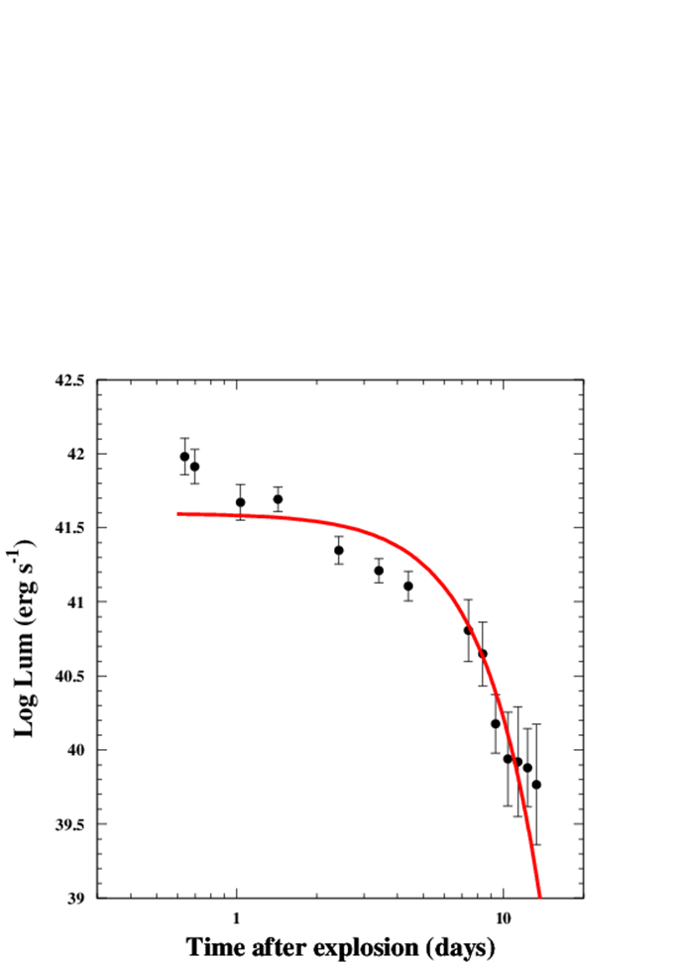
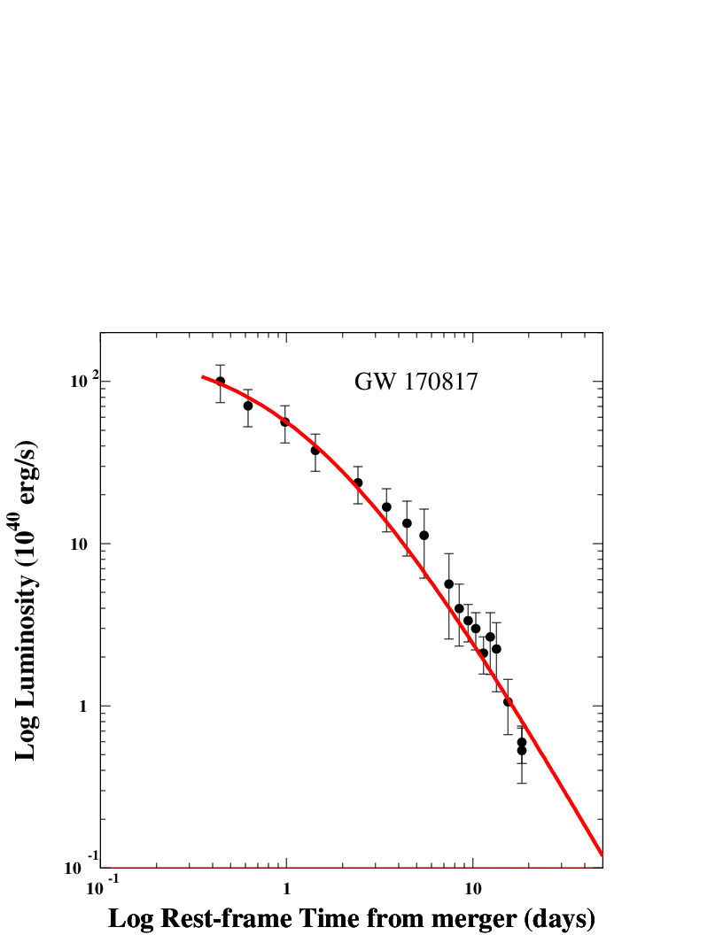


Origin of “Early-Time Afterglow” : PWN or Kilonova ?
PWN powered by
newly born MSP
BH remnant inside
a fireball/kilonova
Data: Drout et al. 2017
Data:Smartt et al. 2017
DDD:
DDD:
V

Slide 15
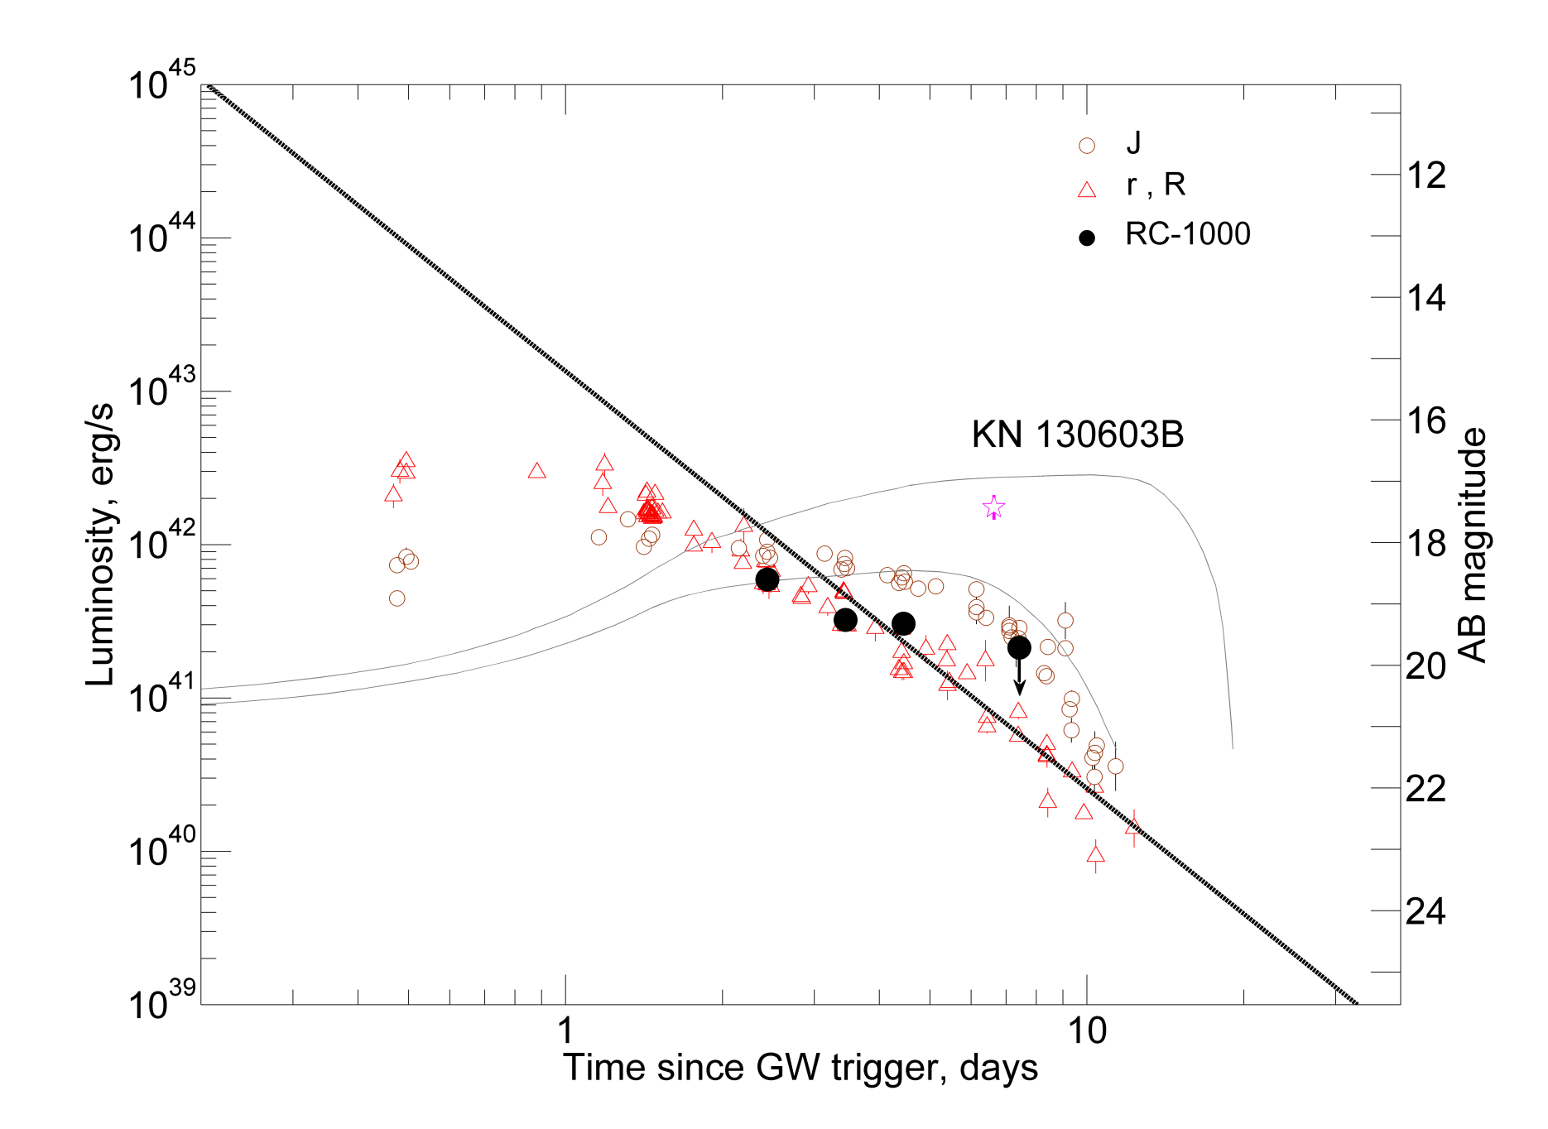

Data: Andreoni et al. 2017; Arcavi et al. 2017; Coulter et al. 2017; Cowperthwaite et al. 2017; Díaz et al. 2017; Drout et al. 2017; Evans et al. 2017; Hu et al. 2017; Kasliwal et al. 2017; Lipunov et al. 2017; Pian et al. 2017; Pozanenko et al. 2017; Shappee et al. 2017; Smartt et al. 2017; Tanvir et al. 2017; Troja et al. 2017; Utsumi et al. 2017;
Valenti et al. 2017.
KN 170817A
Previously claimed kilonova

Slide 16
(Fermi GBM)
Priors:
(From Superluminal V)
SHB170817B: best fit ts = 0.167 d ➔ tb=113—172 d

Slide 17
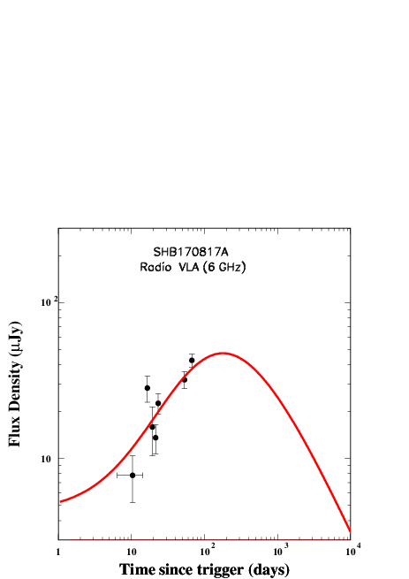
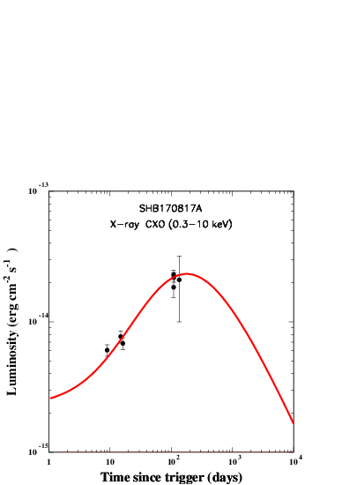

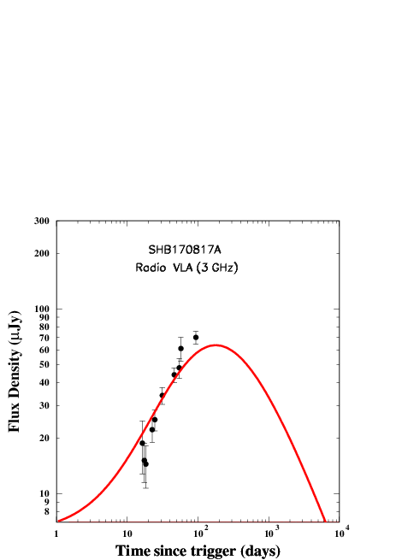

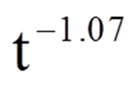


Radio data: Hallinan
et al. ; Mooley et al.
CB Model AG light curves of
SHB170817B : (for a prior
and a best fit value t_s =113 d) :
X-ray data: CXO -- Troja et al.,
Margutti et al., Haggard et al.
XMM Newton -- D’Avanzo et al.
Radio 6 GHz
X-ray 0.3-10 keV
Radio 3 GHz

Slide 18
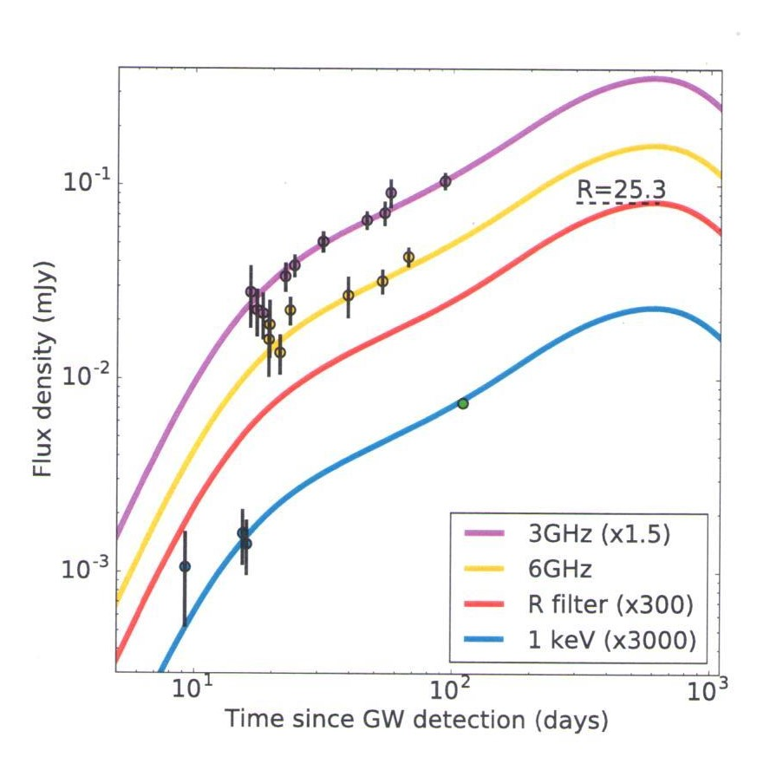
To be compared to the new party lines: structured jet with a highly
relativistic core viewed from 20 degree off-axis (8 free adjustable parameters !) or cocoon with energy injection (9 free parameters)...
Lazzati et al. arXiv:1712.03237
structured jet (8 free param)

Slide 19
arXiv:1711.11573 :A mildly relativistic wide-angle outflow in the neutron star merger GW170817
K. P. Mooley (1,2,3,19), E. Nakar (4), K. Hotokezaka (5), G. Hallinan (3), A. Corsi (6), D.A. Frail (2), A. Horesh (7), T. Murphy (8,9), E. Lenc (8,9), D.L. Kaplan (10), K. De (3), D. Dobie (8,9,11), P. Chandra (12,13), A. Deller (14), O. Gottlieb (4), M.M. Kasliwal (3), S. R. Kulkarni (3), S.T. Myers (2), S. Nissanke (15), T. Piran (7), C. Lynch (8,9), V. Bhalerao (16), S. Bourke (17), K.W. Bannister (11), L.P. Singer (18)
7 wrong attempts by the blue/white indicated authors to postdict this AG in progress, so far.

Slide 20
Conclusions : The CB model diagnosis of SHB170817A:
1. The observed properties of SHB170817A are very different from those of ordinary SHBs,
but , they are those expected for an ordinary SHB viewed far off- axis (28 +/- 3 deg
from its superluminal AG, and 26 +/-5 deg from GW170817A). They suggest that:
2. The n*n* binary was produced by fission in core collapse SN.
3. The remnant of the n*n* merger GW170817 was n* and not bh .
4. The n*n* merger took place inside a PWN.
5. The GRB probably was produced by fall back ejecta on the newly born n*.
6. The optical AG of SHB170817A in the first 20d was that of a PWN powered by an MSP.
7. The late-time radio to X -ray AG is SR from a decelerating far off–axis HR jet.
8. SHB170817A does not provide compelling evidence that GW170817 produced a kilonova
9. Most Ligo-Virgo detections of n*n* mergers will not be accompanied by a detectable SHB
10. All n*n* mergers detected by Ligo-Virgo will produce visible isotropic MSP powered AG.

Slide 21
THE END

Slide 22
Rewriten history in volunteered reviews
where reviewers credit themselves for ideas which they knew were suggested before by others):
The GRB -- SN association
Woosley (1993) : GRBs are produced in “Failed Supernovae“ – direct collapse of massive stars to black hole without a supernova- and not in stripped envelope SNe ,“as suggested by Goodman Dar and Nussinov, 1987, Dar et al 1992.”
Woosley (1998) : SN1998bw – GRB980425 is a sky coincidence or an association between a rare type of GRB and a rare type supernova.
Bloom & Woosely (2006) Review : The SN-GRB Association: GRBs are produced by collapsars – direct colllapse of massive stars to a bh (not proven) with an hypernova,
but without any reference to GDN 1987, Dar et al. 1992, Dar 1998 ,DD 2000, DDD 2001-2005
---------------------------------------------------------------------------------------------------------------------------
Shaviv & Dar 1994: GRBs are produced by highly relativistic jets of plasmoids
Dar 1977: GRBs afterglows are also produced by the relativistic jets of plasmoids
Meszaros, Rees, Piran, Waxman, Sari, … (1997) : GRBs are produced by of e+e- gamma
spherical fireballs, not by narrow jets,, BUT:
Sari , Piran, Halpern (1999) : GRBs+AGs are produced by jets (no reference to SD 1994, Dar 1997) neither in Reviews by Piran, Mezaros and Rees, Zhang et al. etc. 1999-2018
--------------------------------------------------------------------------------------------------------------------------
Goodman, Dar Nussinov (1987): n*n* merger can produce cosmological GRBs.
Eichler, Livio, Piran, Schram (1989): n*n* mergers produce GRBs (with no reference to GDN 1987). Plagiarism by Piran who misled his collaborators and the entire GRB community.

Slide 23
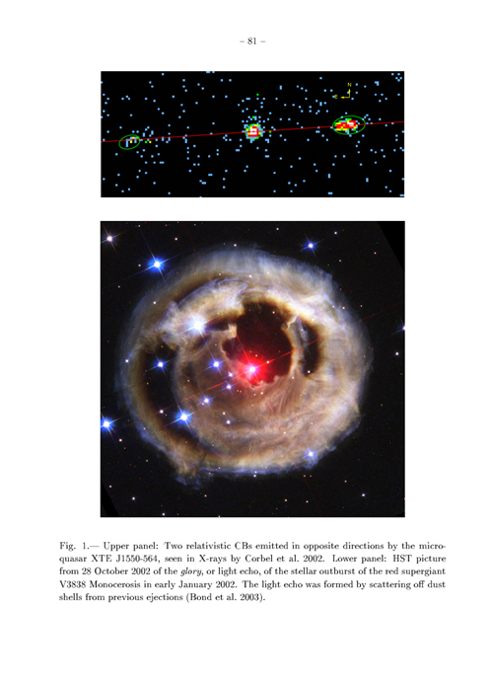
CB MODEL of GRBs -- Motivation:

Slide 24
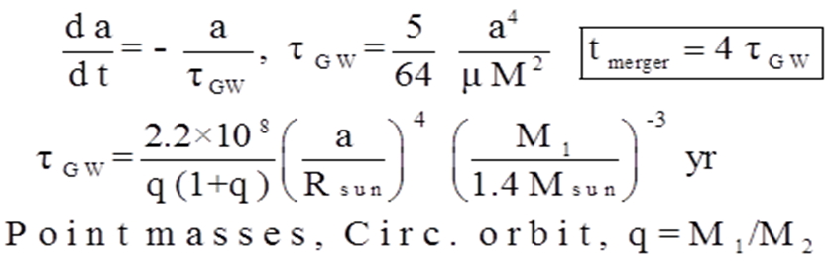
Life time of n*n* binary

Slide 25
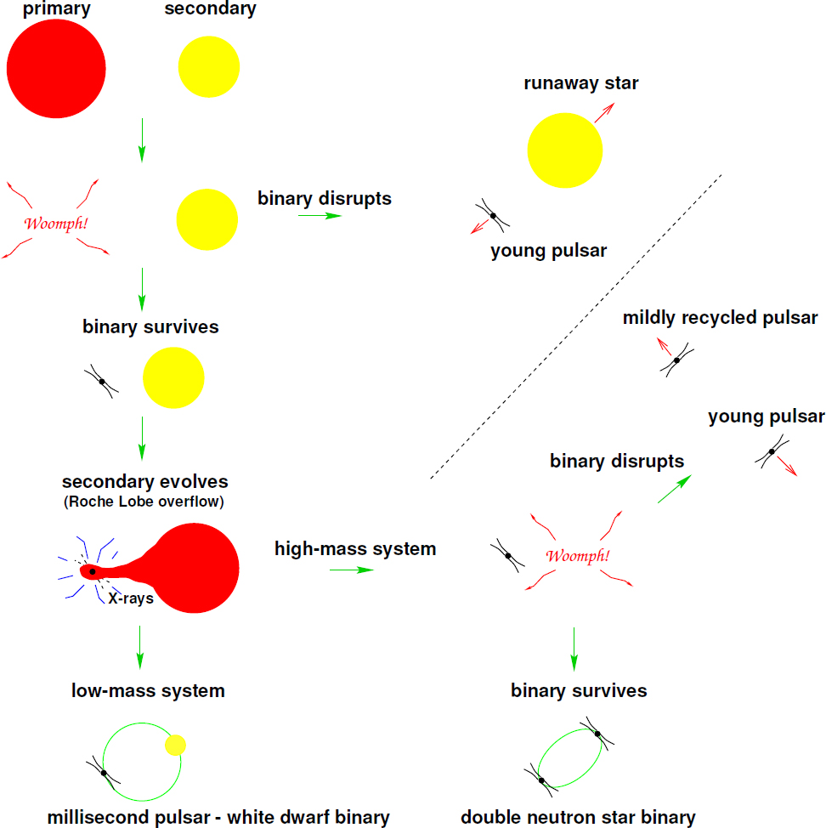
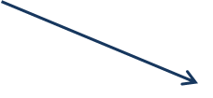








Formation of n*n* binaries
My belief:
?
Massive
with Large L
CC SN
SN
SN
Core Fission
During CC ?
?
HMXB
SN
SN
SN
Compact n*n*
binary in SNR
LMXB
MSP –WD Binary
n*n* Binary
GWs -->MERGER→ SHB
+ BH / n* ?
GWs → MERGER→ SHB + BH/n* ?

Slide 26
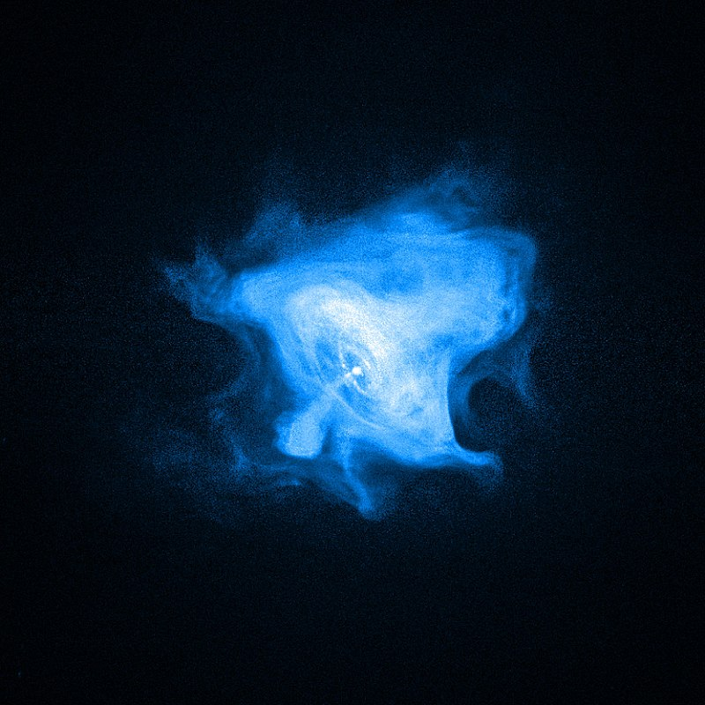
The Crab Pulsar Wind Nebula (CXO)

Slide 27
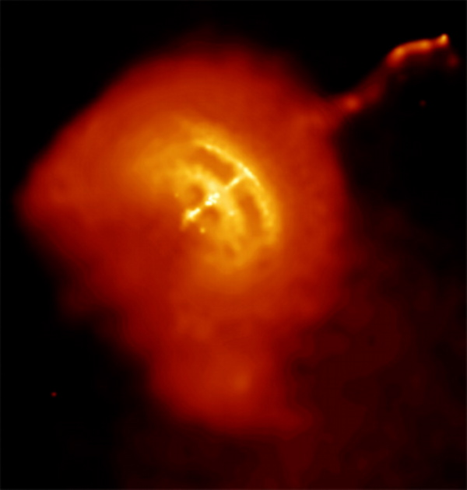
The Vela Pulsar Wind Nebula

Slide 28
Radio lobes and X-ray hot spots in the microquasar S26
Roberto Soria et al. 2010, MNRAS , 409, 541

Slide 29
:
The outflow structure of GW170817 from late time broadband observations
Troja et al. 19 Jan 2018, arXiv:1801.06516v1
The off-axis structured jet models [of the late time afterglow considered] are fully determined by the set of eight parameters.
The isotropic cocoon with a power law velocity distribution, on the other hand, requires nine parameters.
Our modeling of the latest broad band data confirms that a jetted outflow seen
off-axis and parameters within the observed range of sGRBs is consistent with the data (Troja et al. 2017). The late-time data favor a Gaussian shaped jet profile while homogeneous and a power law [conical] jets are ruled out. A simple spherical cocoon model also fails to reproduce the observed behavior and, to be successful, a cocoon
with energy injection from earlier shells catching up with the shock is required.
A Gaussian jet and a re-energized cocoon are presently indistinguishable but
we predict a different behavior in their post-break evolution once the broadband
signal begins to decay, with for the cocoon and for
a re-energized cocoon, and intermediate values indicating a combination of directed outflow plus cocoon.
While the cocoon model resorts to a new class of previously unobserved phenomena,
the Gaussian jet provides a self-consistent model for both the afterglow and the prompt emission and explains the observed properties of GW170817 with a rather normal sGRB seen off-axis.

