Slide 1
The protoDUNE Detectors at the CERN Neutrino Platform
Matthew Worcester (BNL) for the DUNE Collaboration
Windows on the Universe, 25th Anniversary of the Rencontres du Vietnam
August 7, 2018, Quy Nhon, Vietnam

Slide 2
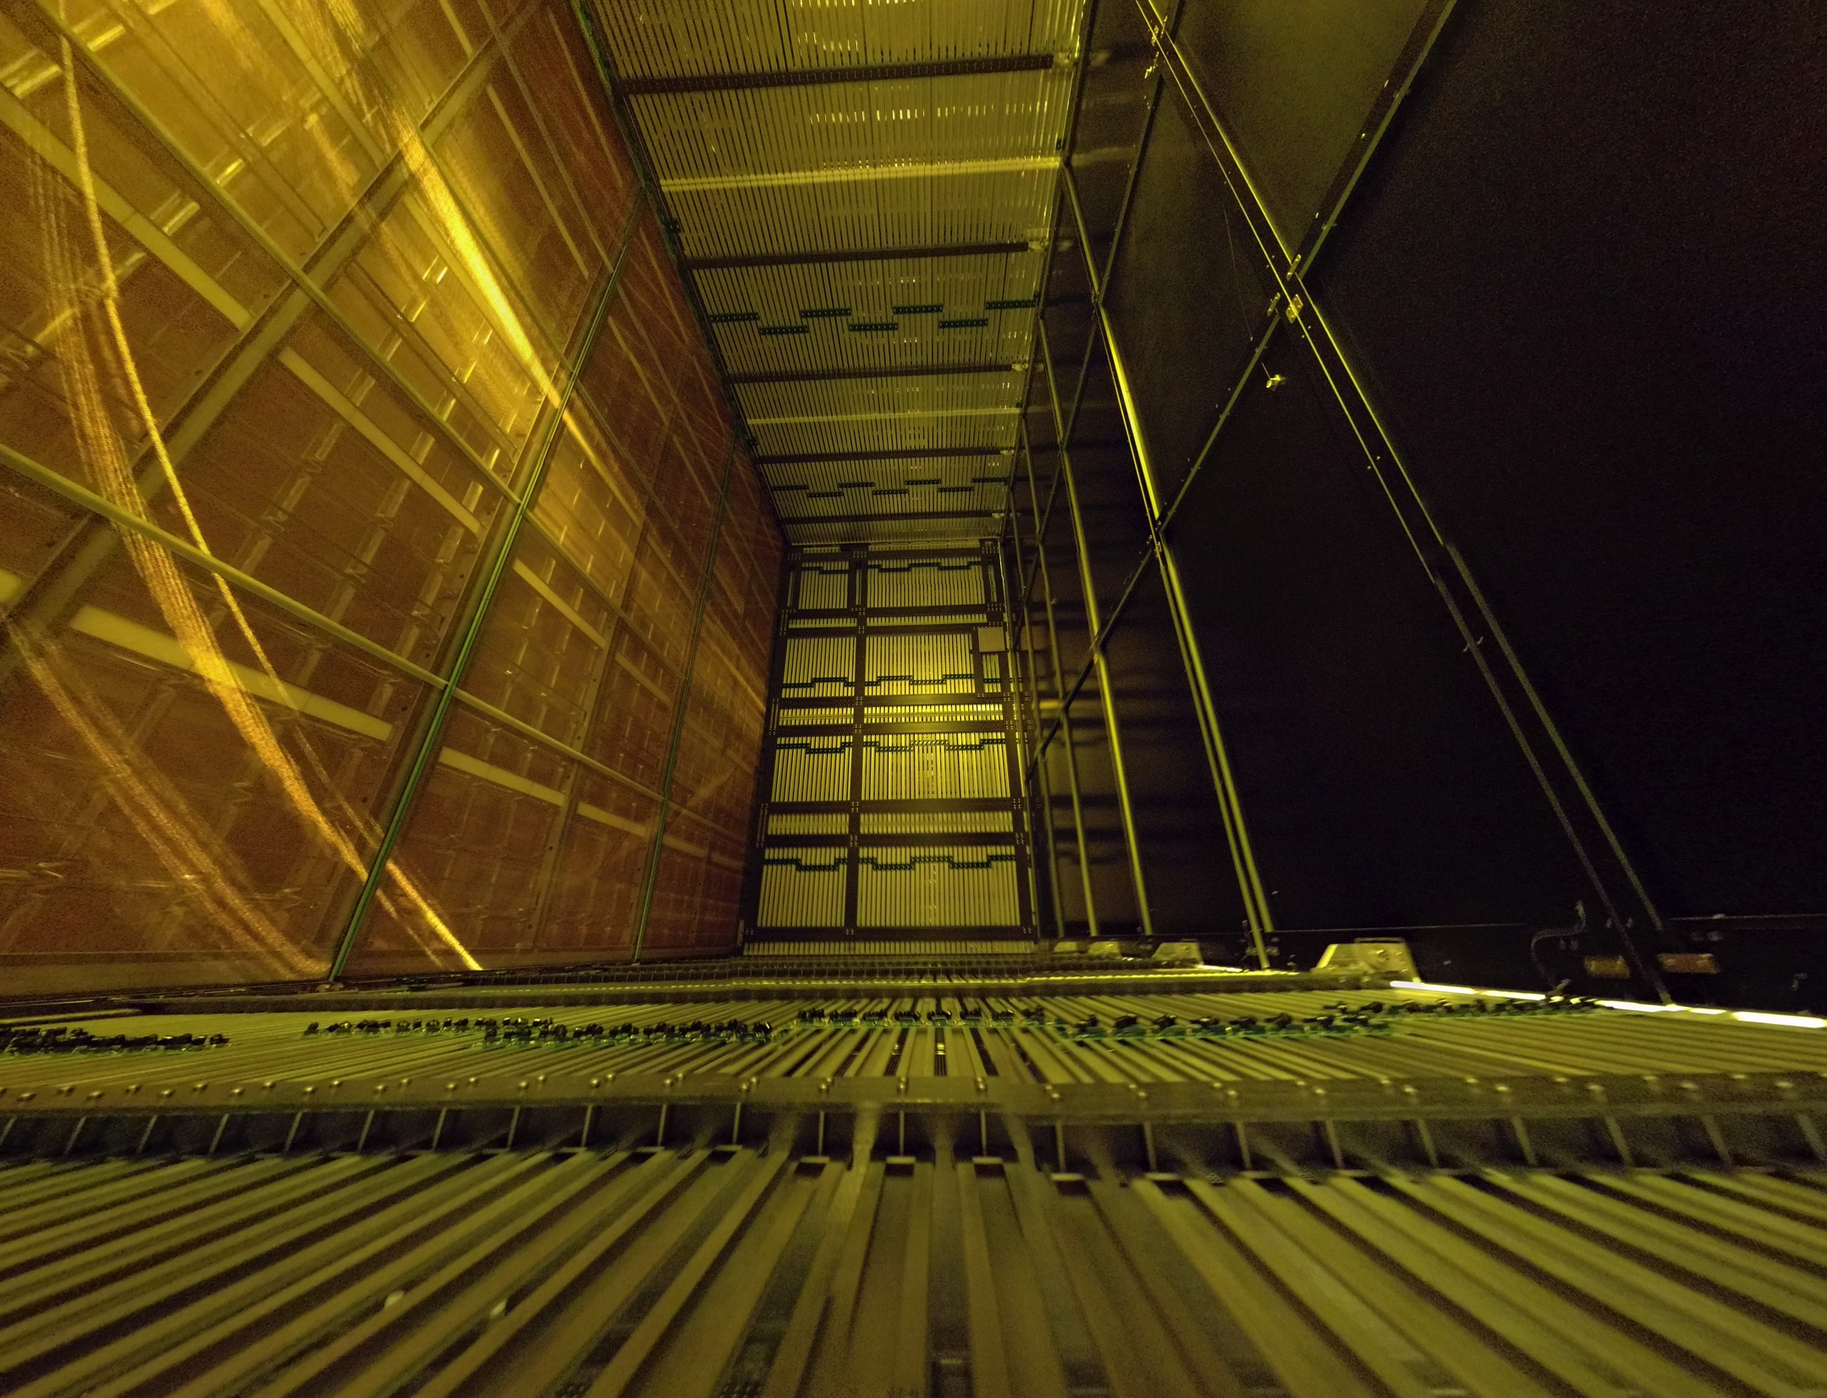
Outline
Deep Underground Neutrino Experiment
The protoDUNE detectors at CERN
Dual-phase protoDUNE
Single-phase protoDUNE
Conclusions
Single-phase field cage

Slide 3
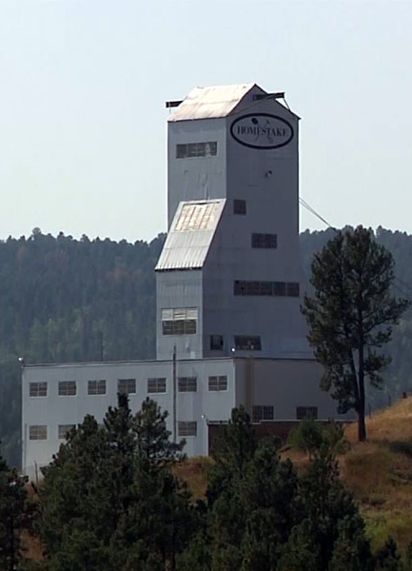
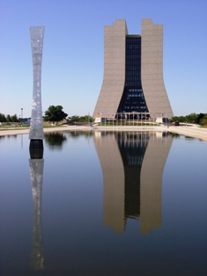
DUNE
See Antonio’s plenary talk for more details
DUNE Interim Design Report: arXiv: physics.ins-det/1807.10334
New mega-watt power neutrino beam
with 1300km baseline from Fermilab
(Illinois) to SURF (South Dakota)
Far detectors at 1.5 km underground
4x10 kton Liquid Argon Time
Projection Chambers (LArTPCs)
Notes:
Important idea is unprecedented scale of 10 kton LAr detectors

Slide 4
protoDUNE Detectors
Enabled by the CERN Neutrino Platform
Single Phase:
Dual Phase:
LAr drift volume 6.9 x 7.2 x 6 m³
TPC readout ”cold” electronics submerged in LAr
LAr drift volume: 6 x 6 x 6 m³
TPC readout electronics in GAr phase
Notes:
~770 tons, key concepts 1. drift field in V/cm 2. number of electron arriving at the wires

Slide 5
protoDUNE Detectors
Enabled by the CERN Neutrino Platform
Single Phase:
Dual Phase:
electron drift
LAr drift volume 6.9 x 7.2 x 6 m³
TPC readout ”cold” electronics submerged in LAr
LAr drift volume: 6 x 6 x 6 m³
TPC readout electronics in GAr phase
Notes:
~770 tons, key concepts 1. drift field in V/cm 2. number of electron arriving at the wires

Slide 6
3x1x1 Dual Phase Prototype
3x1x1 m³ prototype ran from June to November 2017
Successful demonstration of dual phase LArTPC concept
Signal to noise (S/N) ~100 for a minimum ionizing particle (MIP) in LAr
Led to improved designs for protoDUNE dual phase
Notes:
4 ton, 2 key features: x/y segmented anode, large gain ~20 in Gar, 5x10^5 events

Slide 7
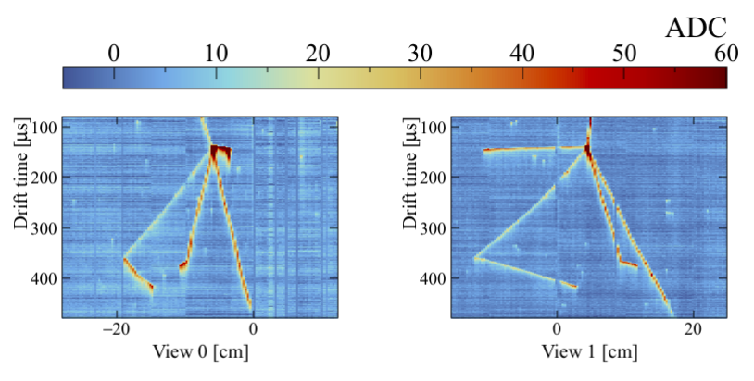
3x1x1 Performance
First time charge extraction over a 3 m squared area and amplification inside 50x50 cm² Large Electron Multipliers (LEMs)
Would cover ~10% of protoDUNE-DP drift volume
Stable liquid surface as required for detector operation, good performance of the cryogenic system and excellent LAr purity
Compatible with ms electron lifetime (next slide)
Stable drift field of 500 V/cm
Observation of scintillation light in liquid and gas
Tracks and vertex with ~3 mm granularity!
Notes:
2 views x/y on anode collection plane with 3.125mm pitch, level sigma 0.05mm, drift field sustained ~4 mo, raw images, triggered by PMT, no noise removal, color in ADC counts

Slide 8
3x1x1 Electron Lifetime
Dual phase DUNE far detector 10 kiloton design has 12m drift
Requires few ms electron lifetime
protoDUNE-DP is a ½ scale test of 12m drift performance
3x1x1 achieved few ms lifetime extracting charge from tracks which cross the entire drift volume
“A 4-tonne demonstrator for large-scale dual-phase liquid argon time projection
chamber” arXiv: physics.ins-det/1806.03317, submitted to JINST
Notes:
300kV, 4 ms ~ 75ppt O2 contamination, black markers are average for 62.5 usec or ~10 cm

Slide 9
protoDUNEs at CERN
Dual phase cryostat
Single phase
beamline
Single phase cryostat
Single-Phase TDR: arXiv: physics.ins-det/1706.07081

Slide 10
protoDUNE-DP Charge Readout Plane
First 3x3 m square LEM and readout
module complete (25% of entire cryostat)
and tested in dedicated GN₂ cold box
CRP
LEM operation was stable at nominal voltage for > 48 hours!
Notes:
33kV/cm, gain = 20, LEMs = 0.5x0.5m

Slide 11
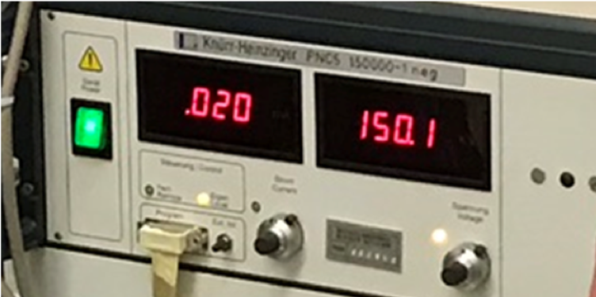
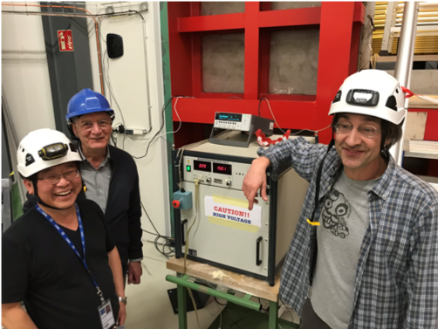
protoDUNE-DP Field Cage
Completed installation and successful test at 150 kV!

Slide 12
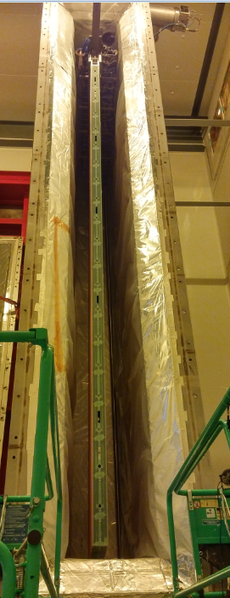
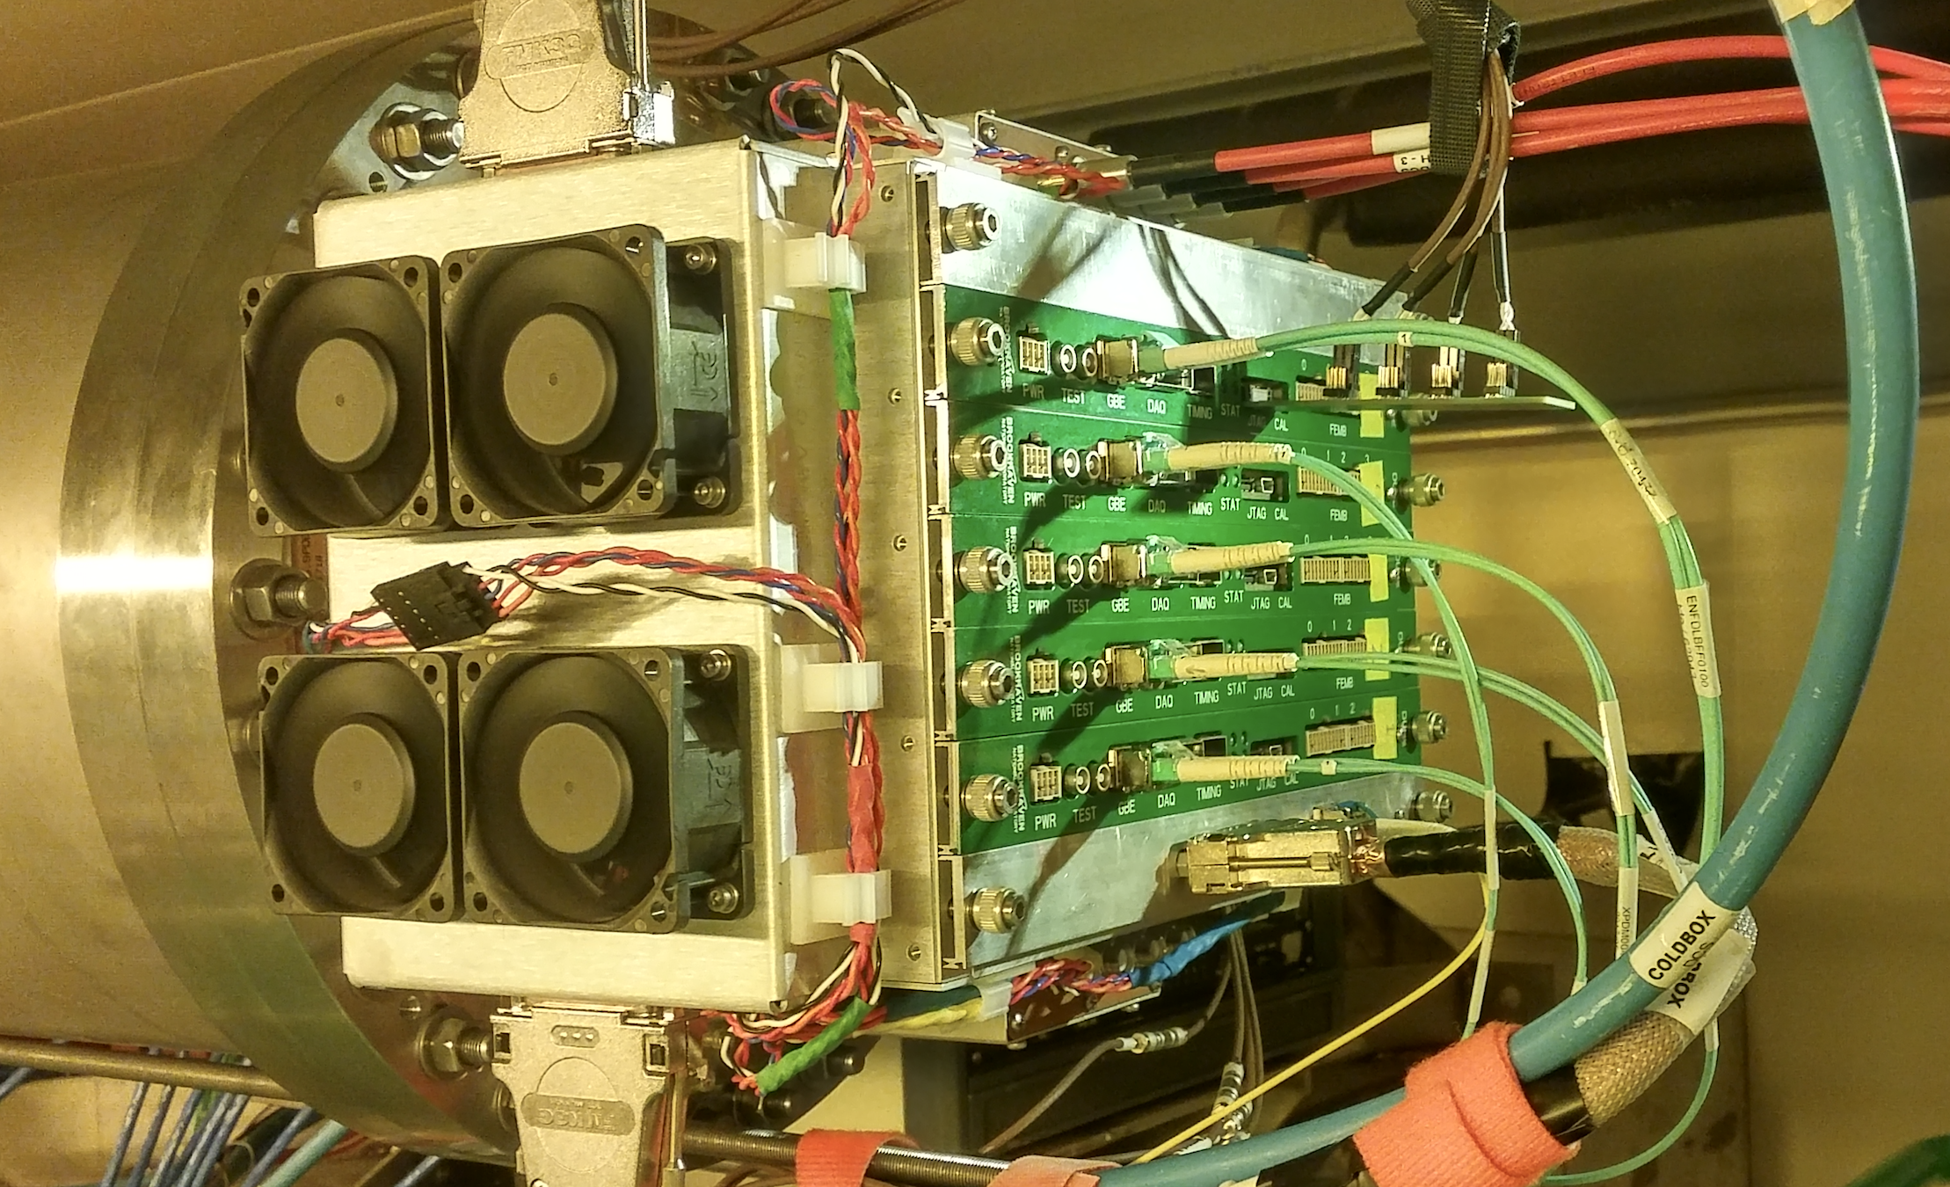
protoDUNE-SP Cold Box
Allows testing of assembled APA and electronics immediately before installation into protoDUNE-SP cryostat
Incorporates feed-thru, cabling, and readout system identical to protoDUNE-SP
Filled with cold nitrogen gas for testing at “cool” temperature (~160 K)
Successful demonstration of required noise levels at cryogenic temperature
APA = Anode Plane Assembly: 2,560 total sense wires
6m collection wires (X); 7.4 m induction wires (U/V)
Cold electronics
Cold Box
APA

Slide 13
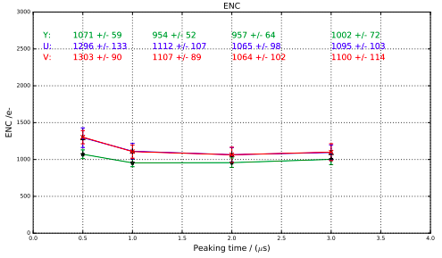
ENC in Cold Box at RT
ENC (Equivalent Noise Charge) is charge (in e⁻) injected across the detector capacitance which produces at the output of the shaping amplifier a signal whose amplitude equals the output RMS noise
At 1 usec peaking time, the ENC on induction wires is measured at ~1100 e⁻, for comparison, the smallest charge on a DUNE wire from a MIP is ~11,000 e⁻
Room Temperature
ENC (electrons)
Front end gain = 25 mV/fC
Amplifier Shaping Time (usec)

Slide 14
protoDUNE-SP Cold Box Results
APA2
ENC and Temperature vs. Time
ENC at 159K
U plane: 481 e⁻
V plane: 481 e⁻
X plane: 398 e⁻
ENC (electrons)
Temperature (K)
Front end gain = 25 mV/fC
Time (hours)
Notes:
25 mV/fC, 2 us

Slide 15
APA Wire Noise Summary
APA | Minimum Temperature (Kelvin) | Cold Box wire ENC (electrons)
 |  | X plane average | U plane average | V plane average
1 | 180 | 436 | 528 | 526
2 | 160 | 398 | 481 | 481
3 | 150 | 381 | 463 | 455
4 | 160 | 406 | 488 | 488
5 | 170 | 415 | 486 | 487
Cold box lowest temperature improved due to upgrades to cryo system
APA6 not tested due to lack of time in the schedule
Noise levels comparable to previous SP detectors: e.g. MicroBooNE
Consistent between all tested APAs

Slide 16
APA Wire Noise Summary
APA | Minimum Temperature (Kelvin) | Cold Box wire ENC (electrons)
 |  | X plane average | U plane average | V plane average
1 | 180 | 436 | 528 | 526
2 | 160 | 398 | 481 | 481
3 | 150 | 381 | 463 | 455
4 | 160 | 406 | 488 | 488
5 | 170 | 415 | 486 | 487
Preliminary S/N >15 for a MIP!
Cold box lowest temperature improved due to upgrades to cryo system
APA6 not tested due to lack of time in the schedule
Noise levels comparable to previous SP detectors: e.g. MicroBooNE
Consistent between all tested APAs
To achieve DUNE physics goals requires ENC < 700 e⁻

Slide 17
Abnormal Channels (18 of 15,360)
Noise (e-) vs APA Channel
APA2 at 160K as an example
Front end gain = 25 mV/fC
ENC (electrons)
Missing wire connections
ENC $\sim$250 e⁻ $→$consistent with the front-end amplifier
being disconnected (open) from the wire on the APA

Slide 18
Abnormal Channels (18 of 15,360)
Noise (e-) vs APA Channel
APA2 at 160K as an example
Front end gain = 25 mV/fC
Found 2 abnormal V wires where a wire was cut
(low noise) and joined to its neighbor (high noise)
ENC (electrons)
Missing wire connections
ENC $\sim$250 e⁻ $→$consistent with the front-end amplifier
being disconnected (open) from the wire on the APA

Slide 19
Conclusions
The protoDUNE program at CERN has made enormous progress in the last 2 years
Preliminary results from both Dual-phase and Single-phase programs is very promising
Beam coming in the next months!
Dual-phase membrane

