Slide 1
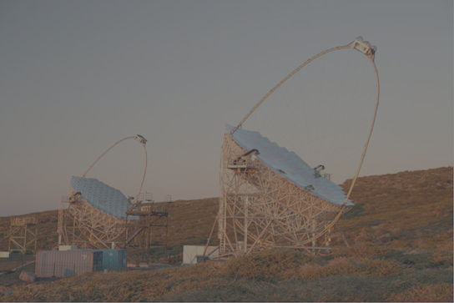
The MAGIC telescope as a multiwavelength instrument for astrophysical observations
John Hoang on behalf of the GAE group
Partners in crime: T. Hassan, M. López, J. A. Barrio, L. A.Tejedor
Rencontres du Vietnam
5-11 August
Quy Nhơn - Việt Nam

Slide 2
OUTLINE
The MAGIC Telescope:
Overview
IACT techniques
The Central Pixel:
Modifications for optical observation
Sensitivity
Physics Cases:
Meteors
Microquasar
Pulsar
Fast Radio Burst
Vietnam’s Participation:
Weeks ~ Months
Months ~ Years
Years ~ Decades
1
John Hoang | The MAGIC Collaboration | Rencontres du Vietnam | Windows August 2018

Slide 3
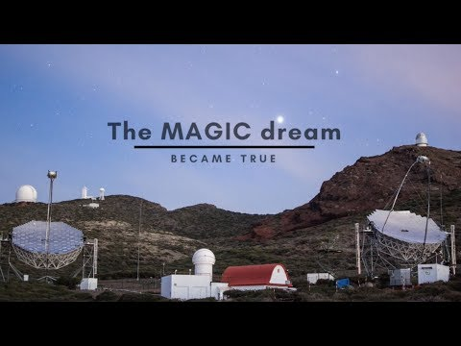
THE MAGIC TELESCOPES
If a picture speaks a thousand words...
1
John Hoang | The MAGIC Collaboration | Rencontres du Vietnam | Windows August 2018

Slide 4
THE MAGIC TELESCOPES
At Roque de los Muchachos Observatory in La Palma (Spain)
System of two Imaging Atmospheric Cherenkov Telescopes (IACTs)
17 m diameter reflector, fast imaging camera with field of view of 3.5 deg
Sensitive to γ-rays between 50 GeV and 50 TeV
Detectors (PMTs) sensitive to Cherenkov photons in the U-band (365 nm)
2
John Hoang | The MAGIC Collaboration | Rencontres du Vietnam | Windows August 2018

Slide 5
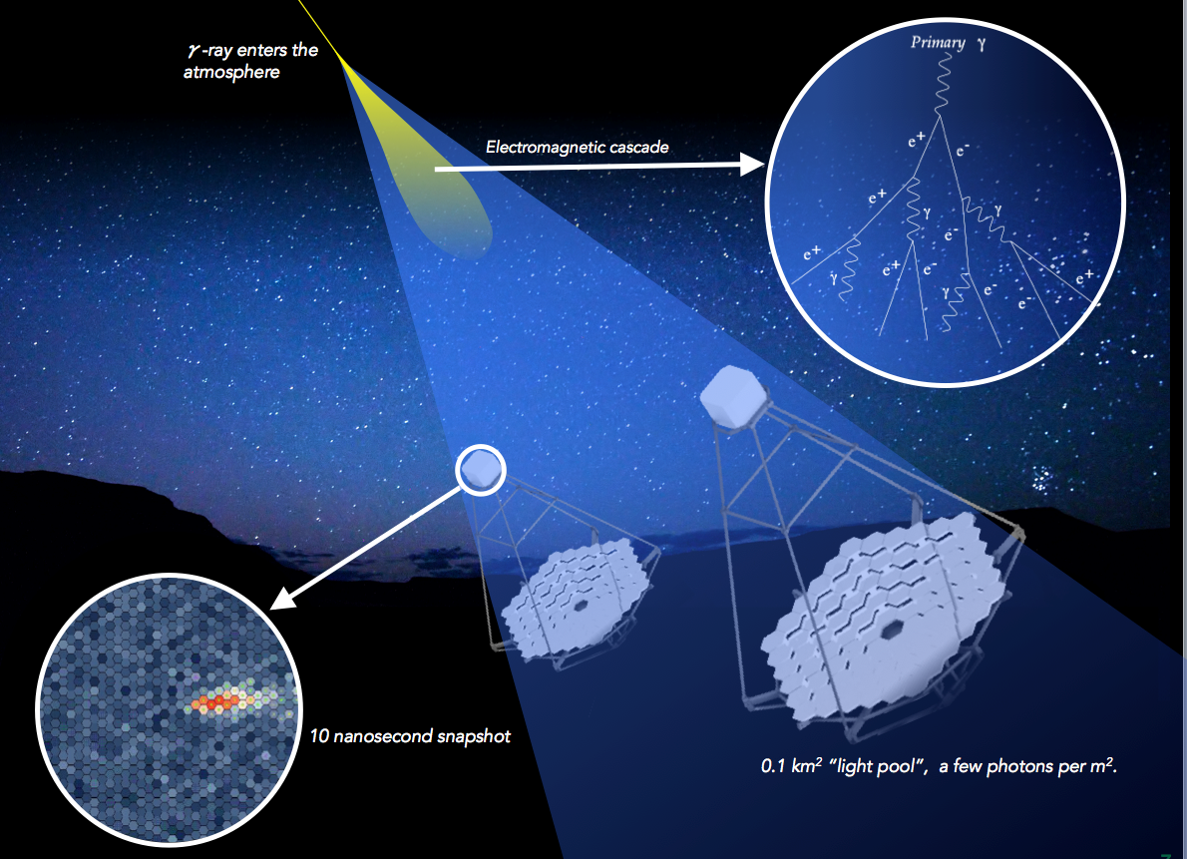
IACT TECHNIQUE
primary particle collides with atmosphere molecules
⇓
production of Extensive Air Shower (electromagnetic or hadronic)
⇓
secondary particles move with v > c_{air}
⇓
production of Cherenkov light
⇓
large mirrors focus on pixelated (PMTs) camera
⇓
record image of the Cherenkov flash on camera
⇓
reconstruction of primary particle properties (nature, energy, direction)
Credit: CTA
3
John Hoang | The MAGIC Collaboration | Rencontres du Vietnam | Windows August 2018

Slide 6
MAGIC TELESCOPES: Central Pixel
MAGIC can operate under moderate moonlight
Each PMT electronics has 2 ADC branches:
AC (Fast rate 2 GHz) Branch: processing Cherenkov
DC (Slow rate 8 Hz) Branch: monitoring to prevent burning from accidental car flashes or strong moonlight
Modified DC branch to read out at 1 kHz
Advantages over conventional optical telescopes:
Large mirror (17m diameter) => collect more photons
High rate, low data volume > better than CCDs in the millisecond regime
4
John Hoang | The MAGIC Collaboration | Rencontres du Vietnam | Windows August 2018

Slide 7
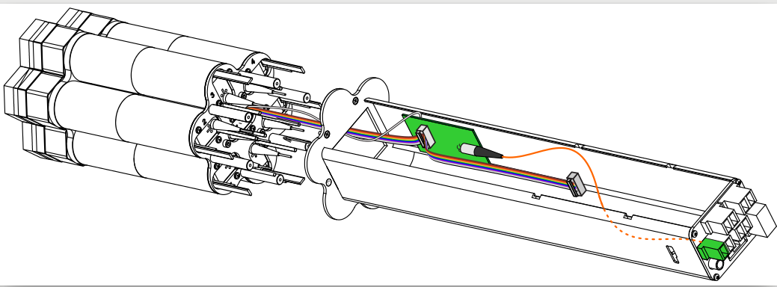
MAGIC’s Central Pixel
Central cluster with 7 PMTs, mechanical housing and CPix optical transmitter, each pixel has 0.1 deg FoV and a light concentrator (Winston cone) in front
Block diagram of CPix. Cherenkov AC branch not shown
Central Pixel’s PMT and electronics
5
John Hoang | The MAGIC Collaboration | Rencontres du Vietnam | Windows August 2018

Slide 8
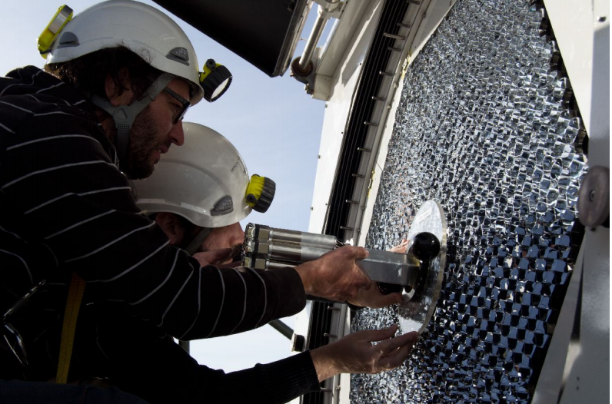
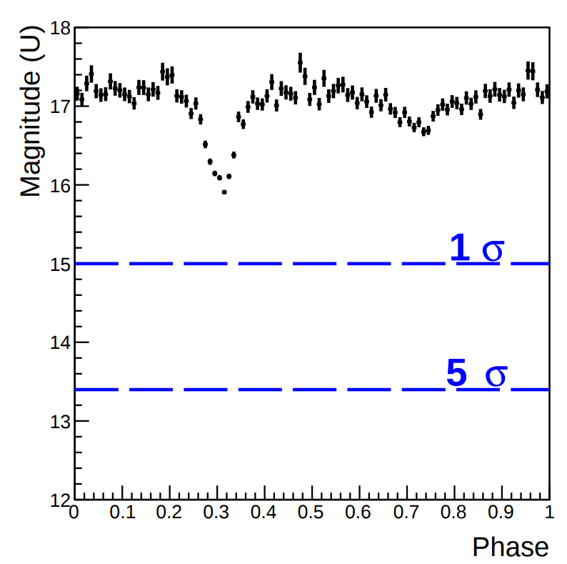
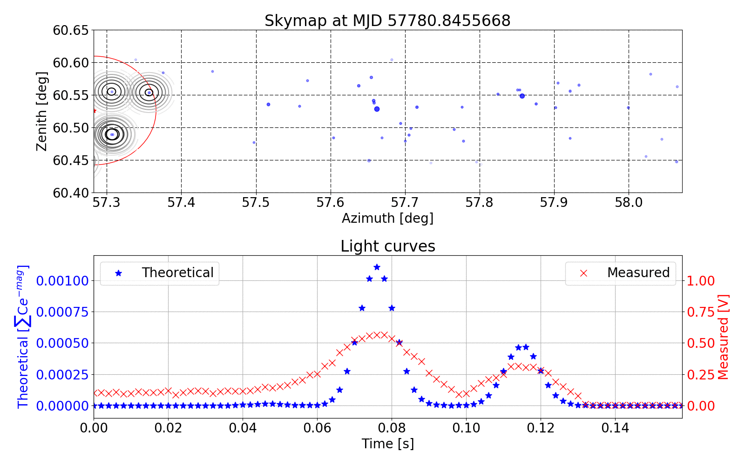
Sensitivity
Periodic regime: Can detect Crab’s pulsation after ~10 s using phase-folding
Isolated regime: Sensitive to isolated ms optical pulses (tested with meteors and sky scan)
6
John Hoang | The MAGIC Collaboration | Rencontres du Vietnam | Windows August 2018

Slide 9
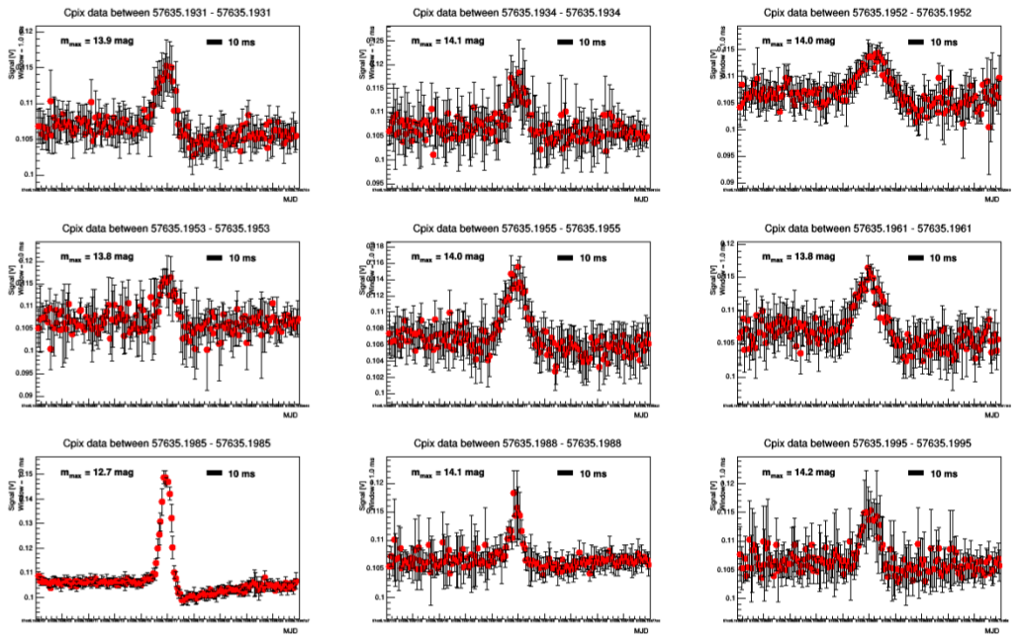
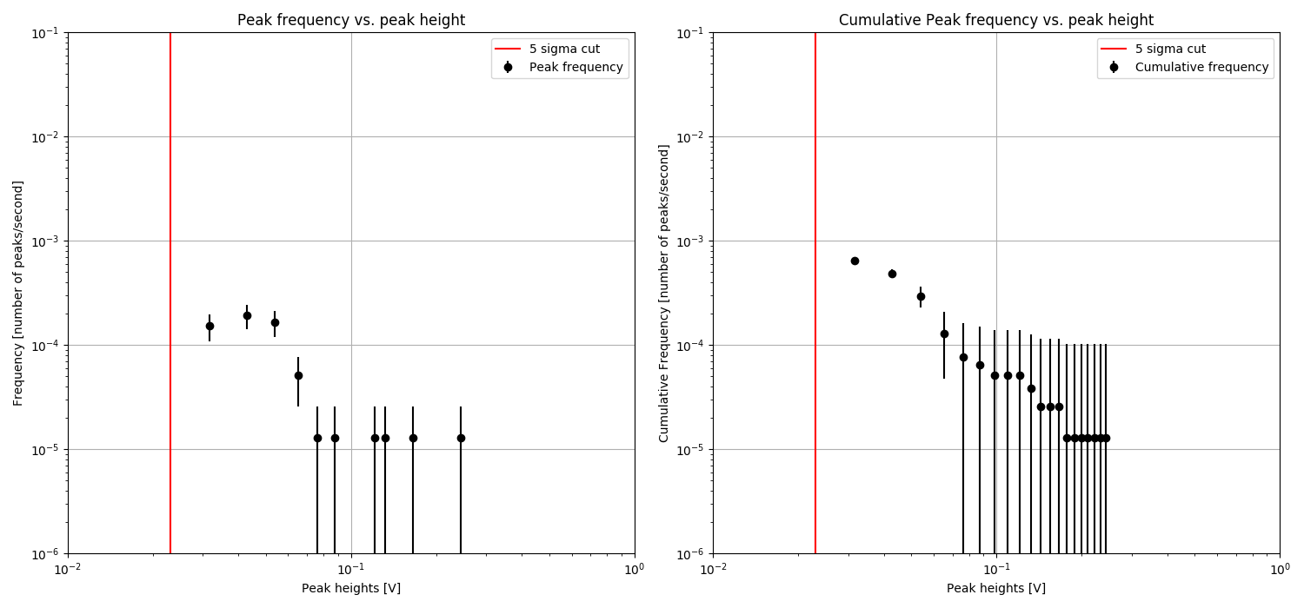
PHYSICS CASE: Meteors study
Credit: T. Hassan
Frequency of pulses vs their brightness => expected only a few bright pulses per hours
Some examples of bright isolated optical pulses due to meteors
7
John Hoang | The MAGIC Collaboration | Rencontres du Vietnam | Windows August 2018

Slide 10
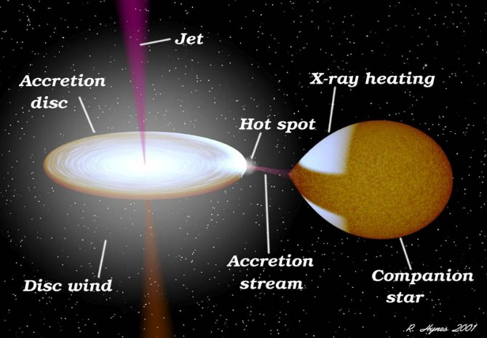
PHYSICS CASE: Microquasar
Low Mass X-ray Binary (LMXB) candidate
Excellent candidate for MWL studies
MAXI J1820+070 (d<20kpc)
Showing quasi-periodic oscillation in the optical
MAGIC observation
> 10h of 𝛾 and > 5h of optical
MWL with HESS
Extensive MWL monitoring is still ongoing in the community
8
John Hoang | The MAGIC Collaboration | Rencontres du Vietnam | Windows August 2018

Slide 11
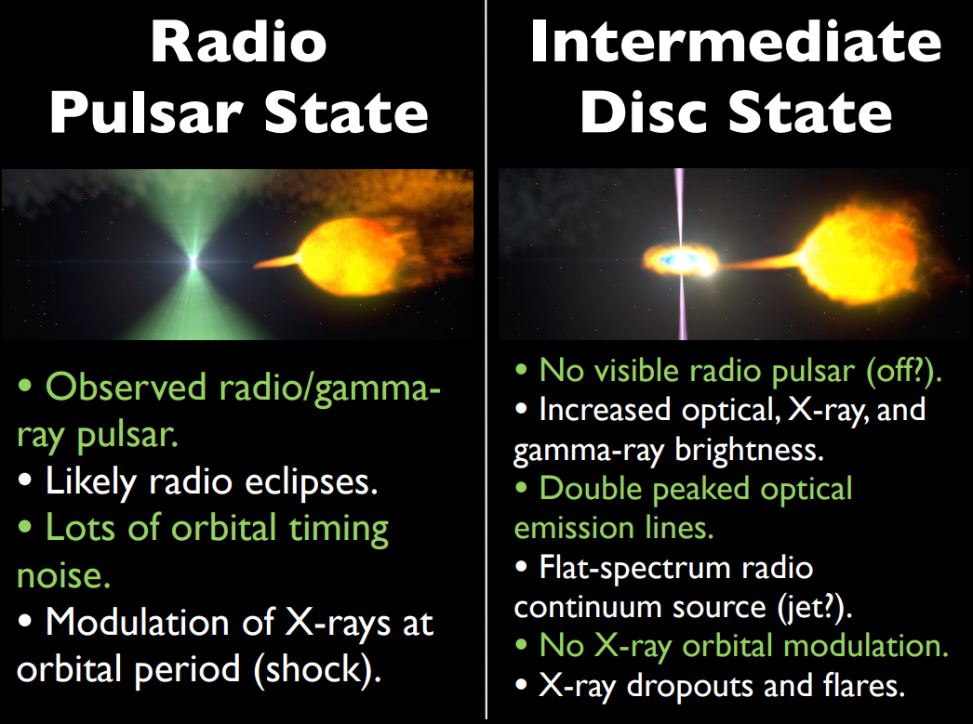
PHYSICS CASE: Transitional Millisecond Pulsars
Except for Crab, known VHE 𝛾-ray pulsars such as Geminga and Vela are too optically faint for MAGIC observations
However, a new class of optical pulsars can produce gamma-ray:
Transition between rotating and acreeting
PSR J1023+0038 (d = 1.3 kpc)
Already detected by optical instruments with similar performance
MAGIC proposed observation in Fall 2018
Credit: J. Hessels
9
John Hoang | The MAGIC Collaboration | Rencontres du Vietnam | Windows August 2018

Slide 12
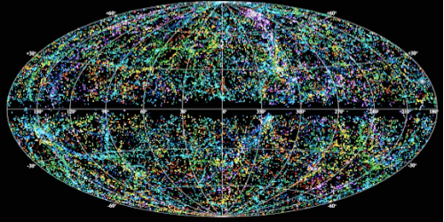
PHYSICS CASE: Fast Radio Burst
FRB121102 a.k.a. The Repeater
Reminiscent the early days of GRBs:
Expected thousands of bursts per sky per day.
More models than detected bursts.
Tell us about the intergalactic medium.
Where are the nearby sources in our galaxy?
Credit: NRAO
10
John Hoang | The MAGIC Collaboration | Rencontres du Vietnam | Windows August 2018

Slide 13
MWL OBSERVATIONS of FRB121102 (z=0.19)
More than 10 nights of observation between 2016 and 2017:
Concurrent observation with Arecibo and Effelsberg radio telescopes between November 2016 and March 2017
Concurrent observation during MWL campaign led by INTEGRAL (X-ray), Effelsberg, GBT and Nançay (radio) during September 2017
MAGIC observations carried out in ON mode (source located at the camera center) to allow simultaneous optical observation
Background estimation obtained via separate observations
Zenith angle up to 60 deg
Good weather conditions during several MWL observation nights
Dedicated talk on Thursday.
1 1
John Hoang | The MAGIC Collaboration | Rencontres du Vietnam | Windows August 2018

Slide 14
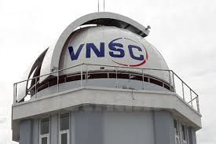
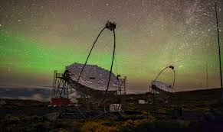
VIETNAM’S PARTICIPATION: WEEKS ~ MONTHS
Concurrent MWL observation between 2 (or more) telescopes:
Via either ATel or SmartNet
Co-sign publications
Limited by the difference between timezones (La Palma is 6h behind)
12
John Hoang | The MAGIC Collaboration | Rencontres du Vietnam | Windows August 2018

Slide 15
VIETNAM’S PARTICIPATION: MONTHS ~ YEARS
MAGIC observations proposed by external scientist:
Individual external scientists to propose observations to be performed with the MAGIC telescopes.
Observation time granted by the Time Allocation Committee based on scientific merit.
The deadline will be between October ~ November 2018 for the observation cycle between January 2019 to February 2020.
Become MAGIC member:
Provide shifter at La Palma.
Full access to data and working groups.
Co-sign all MAGIC publications.
13
John Hoang | The MAGIC Collaboration | Rencontres du Vietnam | Windows August 2018

Slide 16
POST-MAGIC ERA (YEARS ~ DECADES)
14
John Hoang | The MAGIC Collaboration | Rencontres du Vietnam | Windows August 2018

Slide 17
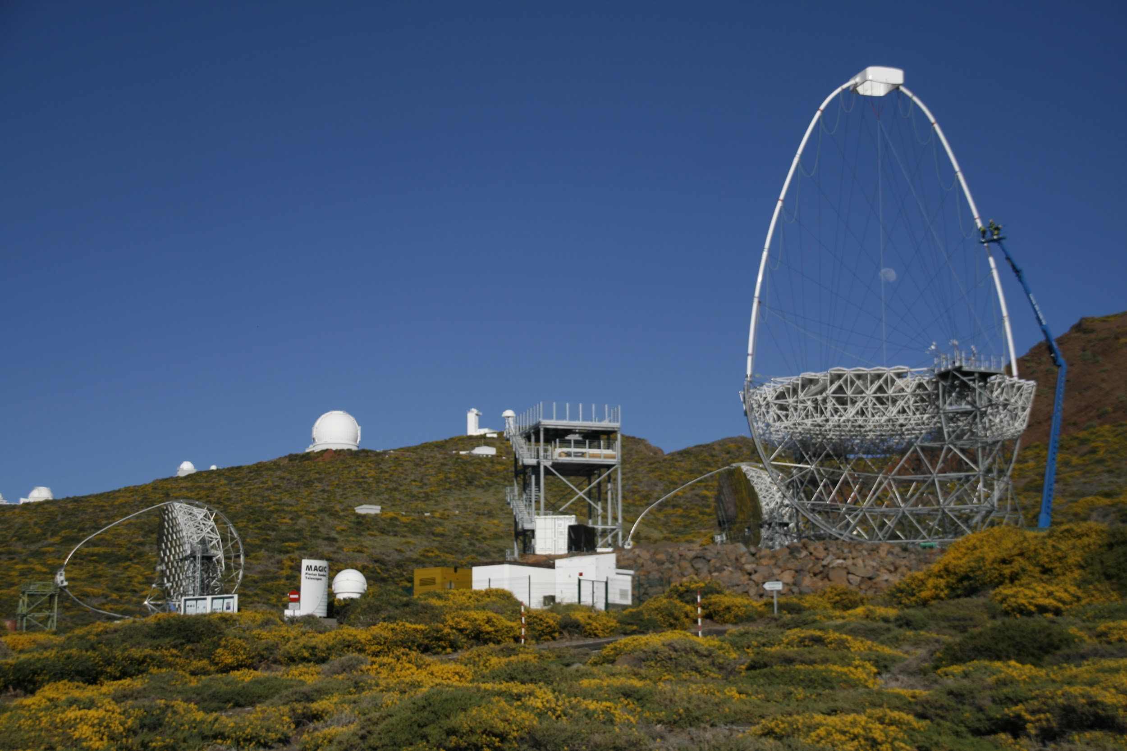
POST-MAGIC ERA (YEARS ~ DECADES)
Spanish law: dismantle the telescopes after decommissioning (aka clean up your own mess)
Cost: >1 million € + 40 tons of scrap material per telescope
Solutions:
Robotized operation => not possible.
Integrated into CTA => difficult due to hardware differences.
Remain as a “teaching instrument”.
LST I (CTA)
MAGIC II
MAGIC I
15
John Hoang | The MAGIC Collaboration | Rencontres du Vietnam | Windows August 2018

Slide 18
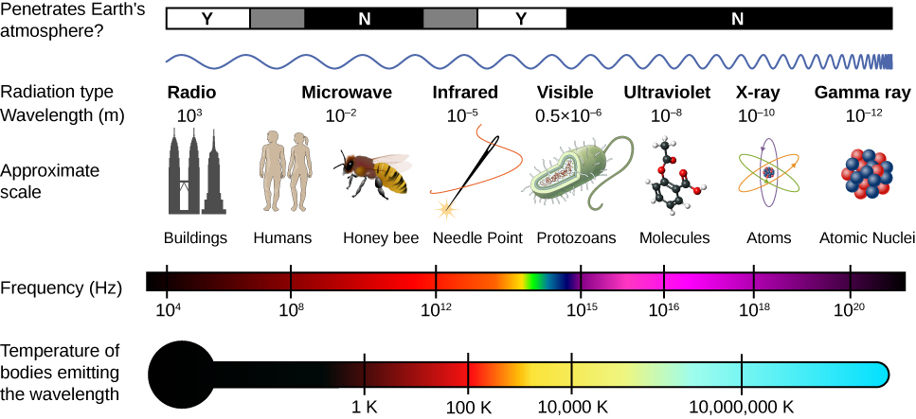
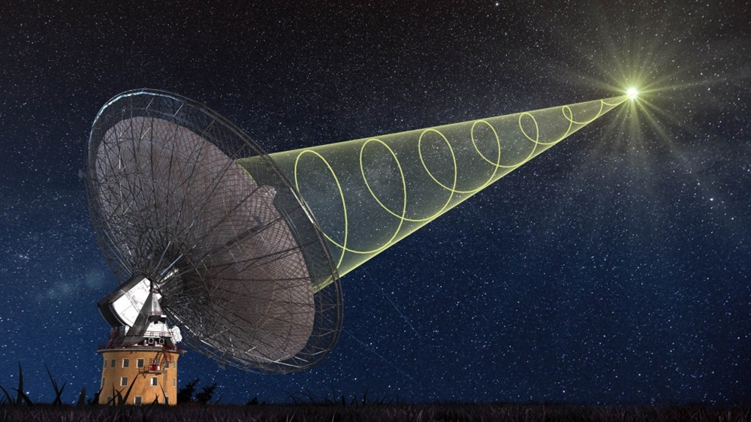
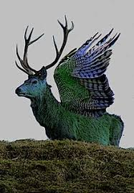
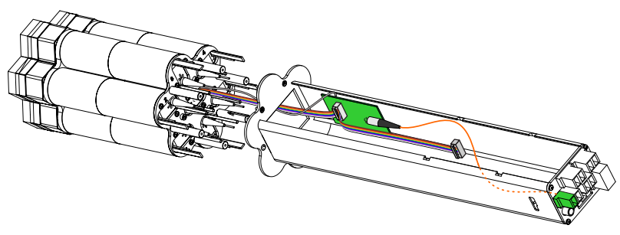
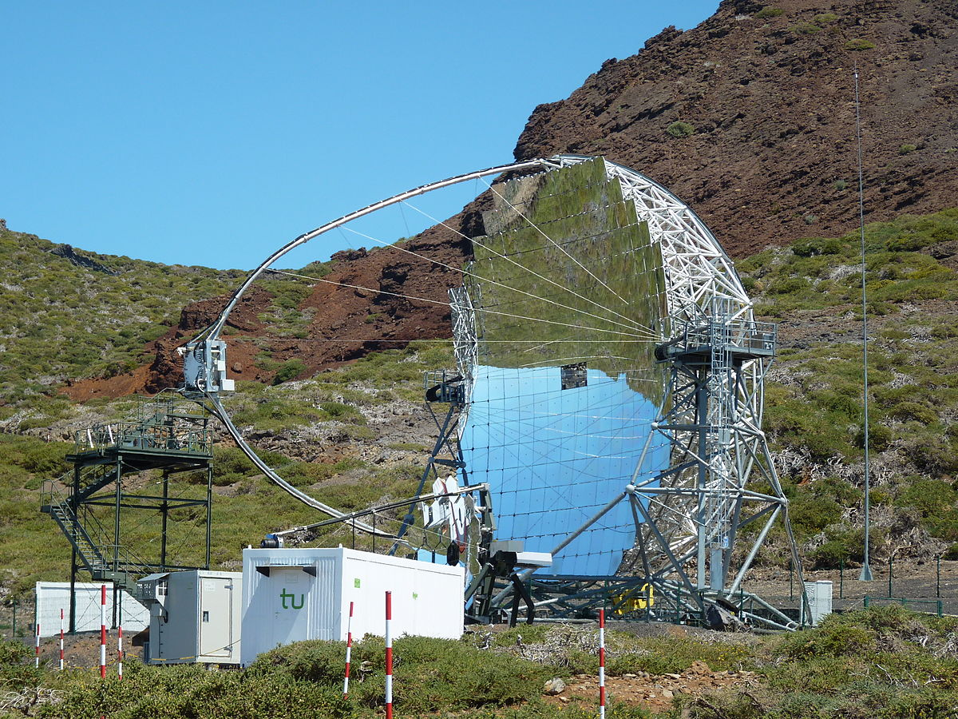
SUMMARIES & CONCLUSIONS
Modified Central Pixel to read out optical signal at 10kHz
MAGIC is sensitive to ms signal in both optical and gamma-ray regimes
Several interesting Physics cases: meteors, FRB, tmp, LMXB
Opened to opportunities for international MWL collaboration
16
John Hoang | The MAGIC Collaboration | Rencontres du Vietnam | Windows August 2018

Slide 19
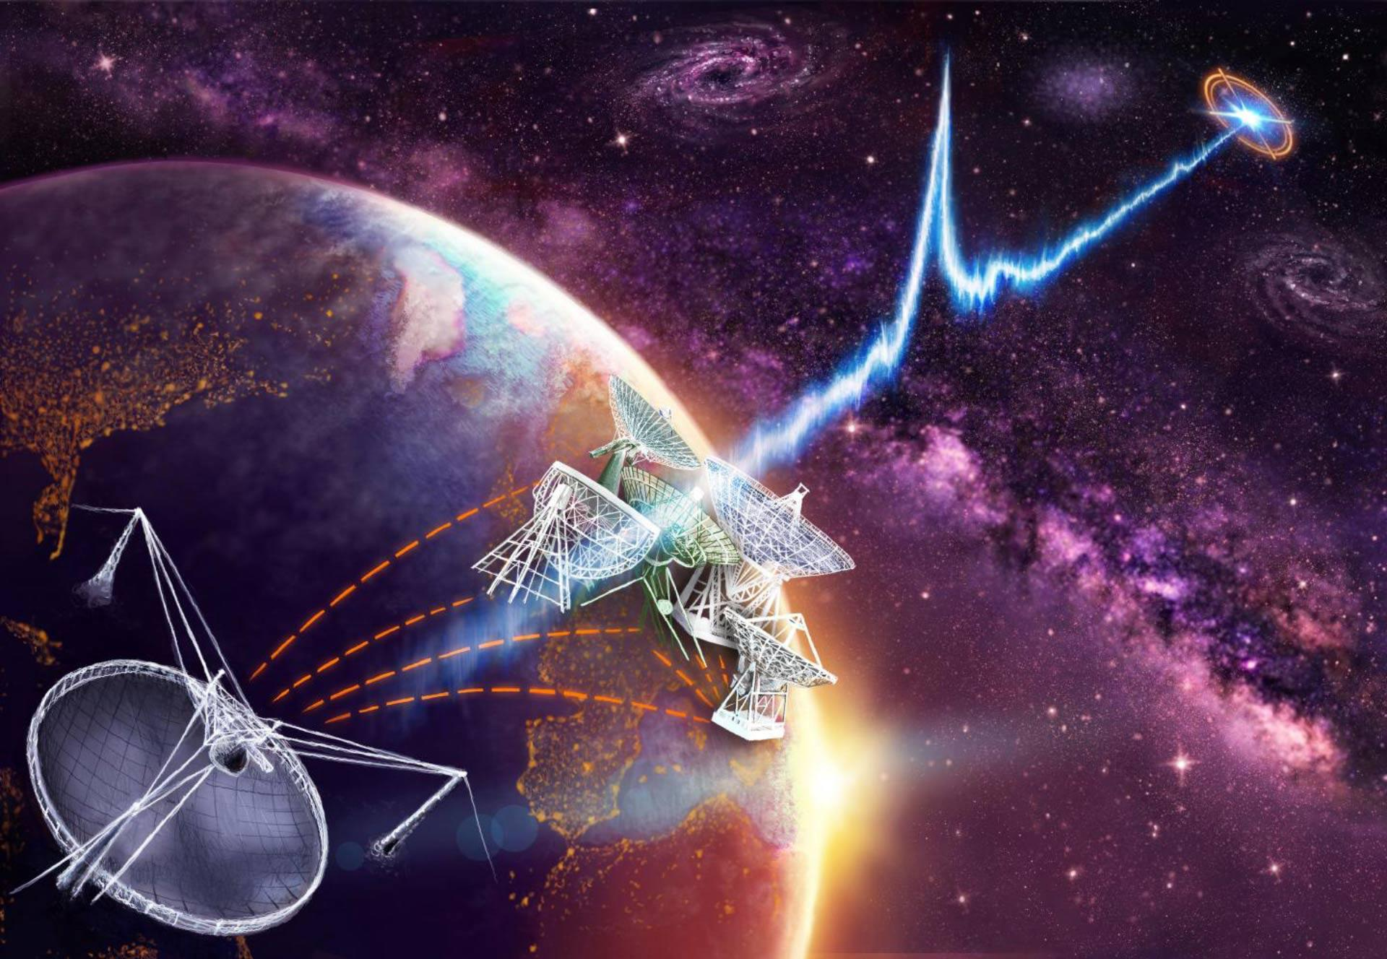
Q&A
Thank you for the contact.
Keep listening!
17
John Hoang | The MAGIC Collaboration | Rencontres du Vietnam | Windows August 2018

Slide 20
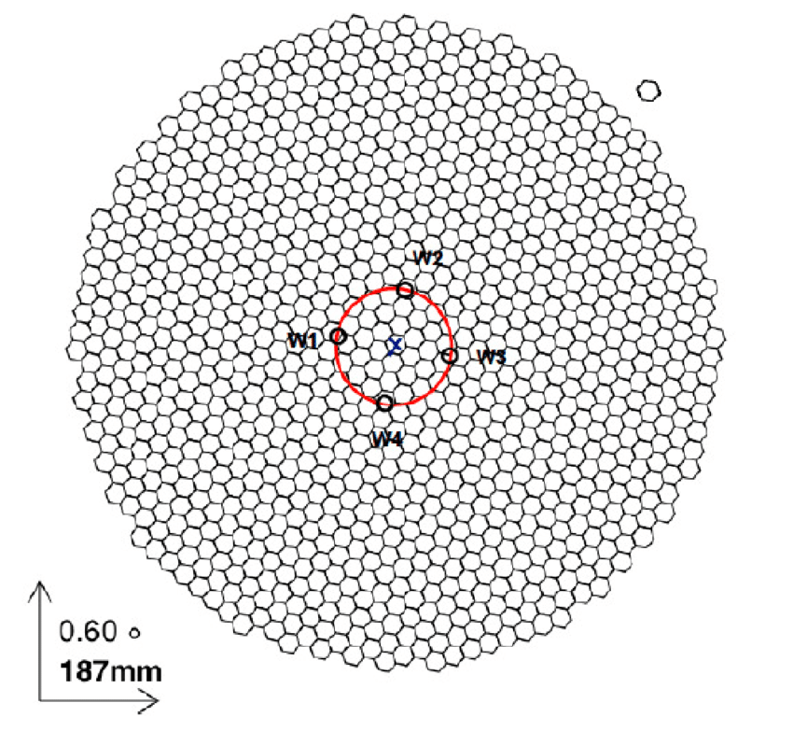
Backup: MAGIC ON vs WOBBLE observation
WOBBLE observations:
Source location 0.4 deg away from the camera center
Simultaneous source & background observations
ON observations:
Source in the camera center
Separated background observation
Credit: A. López Oramas
18
John Hoang | The MAGIC Collaboration | Rencontres du Vietnam | Windows August 2018

Slide 21
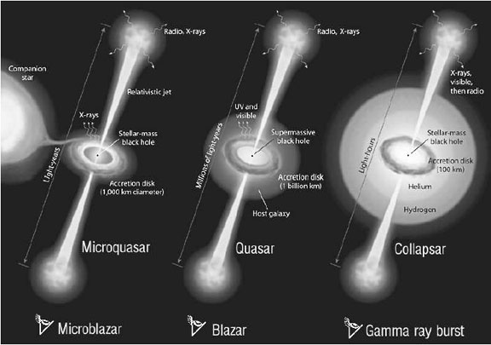
Backup: Quasar, Microquasar, GRB
19
John Hoang | The MAGIC Collaboration | Rencontres du Vietnam | Windows August 2018

Slide 22
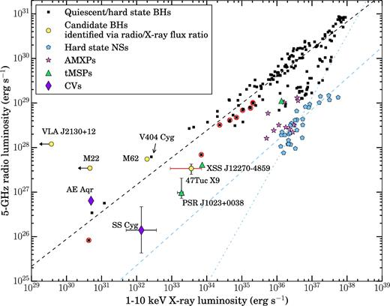
Backup: Correlation plot Radio - X-ray
20
John Hoang | The MAGIC Collaboration | Rencontres du Vietnam | Windows August 2018

Slide 23
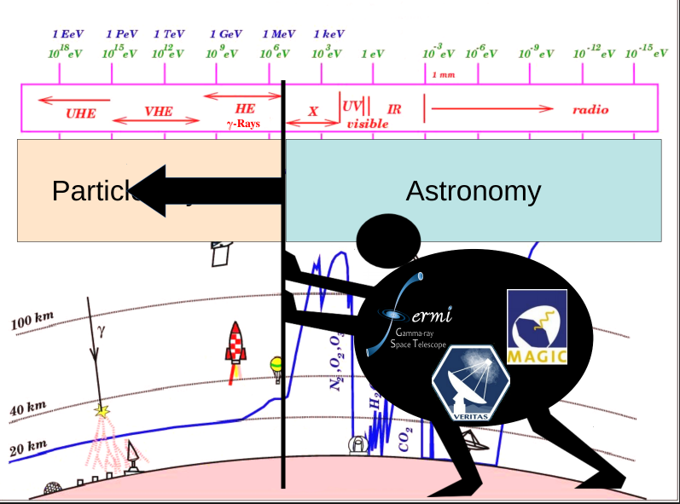
Backup: Pushing the Astronomy - Particle boundary
21
John Hoang | The MAGIC Collaboration | Rencontres du Vietnam | Windows August 2018

