Slide 1
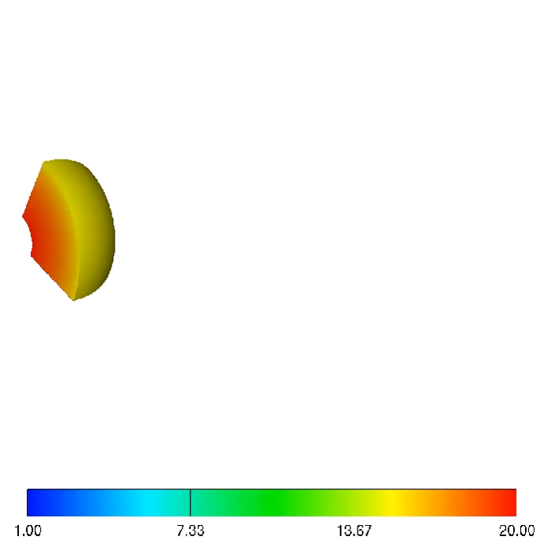
Prompt Emission of Gamma-ray Bursts
Hirotaka Ito RIKEN
Collaborators
Jin Matsumoto (Leeds Univ.)
Shigehiro Nagataki (RIKEN)
Don Warren (RIKEN)
Maxim Barkov (Perdue Univ.)
Daisuke Yonetoku (Kanazawa Univ.)
＠ Windows on the Universe, ICISE, Vietnam 2018/8/7

Slide 2
Plan of this talk
Introduction
・Brief overview of GRBs
・Observed properties, correlation (Yonetoku Relation)
・Theoretical model (Internal Shock .vs. Photospheric emissions)
Numerical simulation of photospheric emission
Summary

Slide 3
Plan of this talk
Introduction
・Brief overview of GRBs
・Observed properties, correlation (Yonetoku Relation)
・Theoretical model (Internal Shock .vs. Photospheric emissions)
Numerical simulation of photospheric emission
Summary

Slide 4
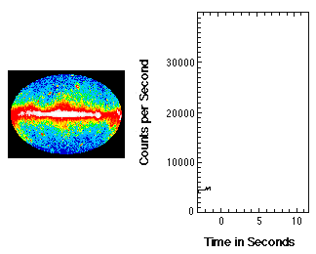
Gamma-Ray Burst (GRB)
Most luminous explosion in the universe
L_{γ,iso} ~ 10⁵² - 10⁵⁴ erg/s
・cosmological distance z~9.4 for furthest event
・event rate ~1000/yr
・duration ~ 10ms ー 1000s
・rapid variability δt ～ ms

Slide 5
2 Classes of GRBs
Long GRB: Collapse of a massive star
GRB980425/SN1998bw,GRB030329/SN2003dh
Short GRB: Merger of Compact binary
GRB170817A/GW170817
Emission mechanism unestablished

Slide 6
Prompt Emission Spectrum
Band function
F_{ν}∝ν^{-α} （hν< E_{p}）
α~ -1
F_{ν}∝ν^{-β} （hν> E_{p}）
β~ -2.5
Long GRB
< Ep > ~ 160 keV
<α>~ -0.9
ν^(-0.5)
Short GRB
ν
< Ep > ~ 490 keV
E_{p}
<α>~ -0.5
<β>~ -2.3
Nava + 2011
Gruber + 2014
Briggs + 1999

Slide 7
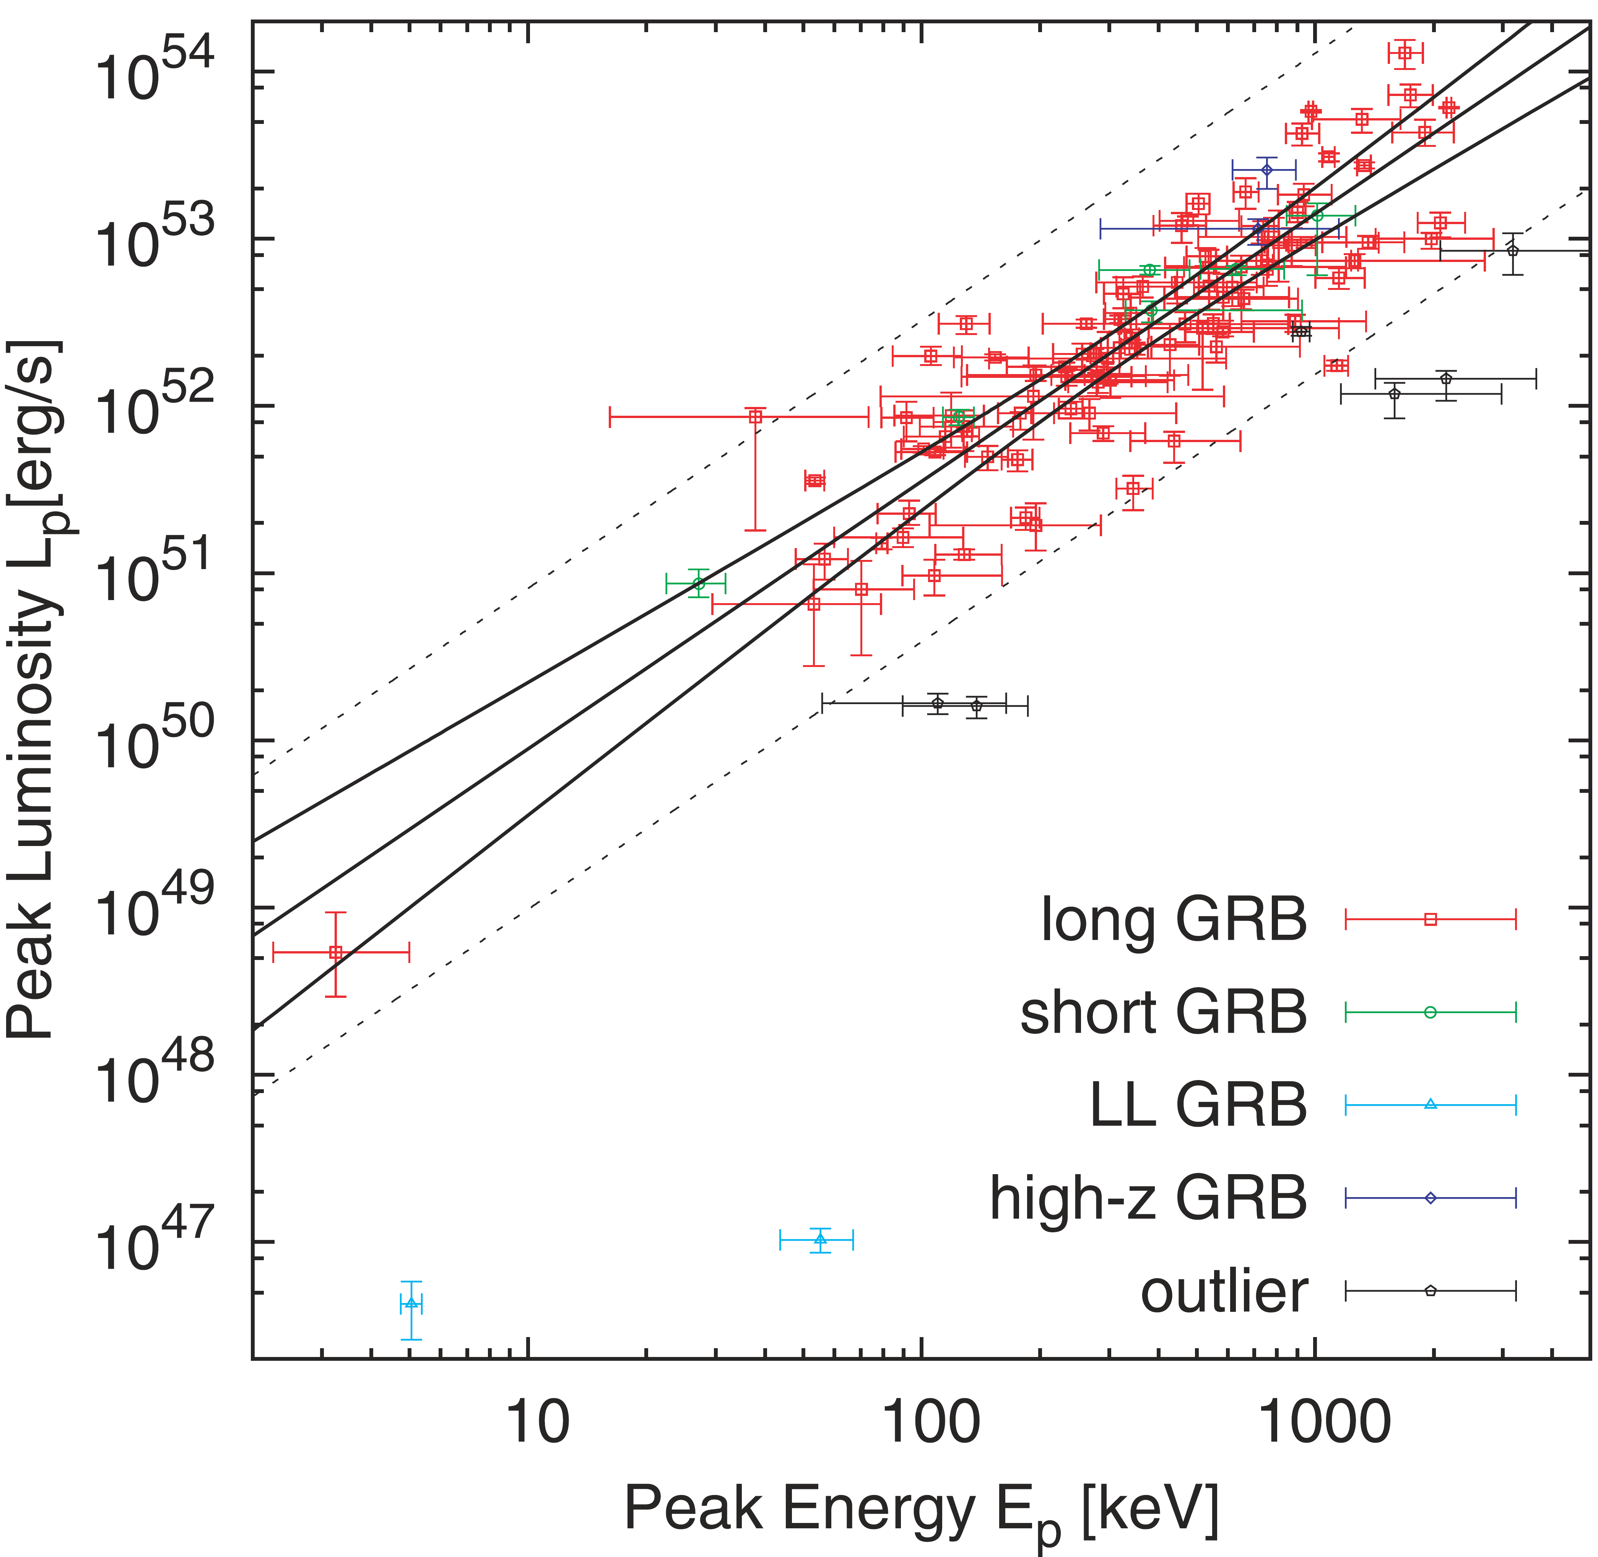
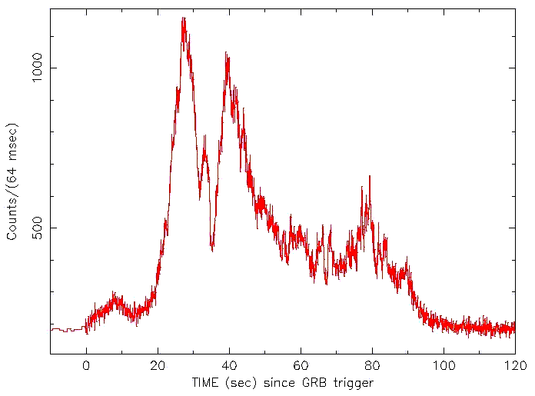
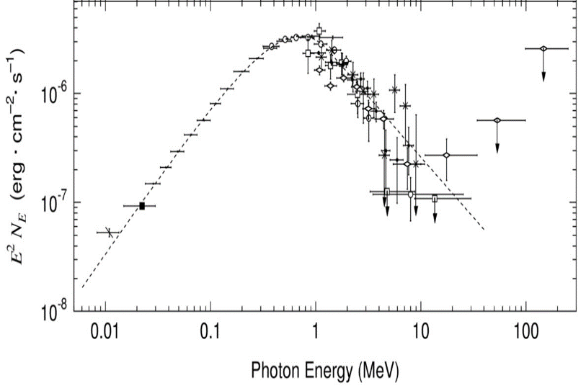
Yonetoku Relation
Tight correlation between E_{p} - L_{p}
Yonetoku + 2004；2010
L_{p}
E_{p}
Powerful diagnostic for emission mechanism
Notes:
放射メカニズムは分かっていないが、EpとLpには次のような強い相関関係がある

Slide 8
Model for Emission Mechanism
Internal Shock Model
・Low efficiency for gamma-ray production
flaw
・Difficulty in reproducing spectral shape
(hard spectra at low energy, narrowly peaked spectra)
Photospheric Emission Model
(e.g., Rees & Meszaros 2005, Pe’er et al.2005, Thompson 2007)
・High radiation efficiency
・Clustering of peak energy ~ 1MeV
γ
γ
photosphere
Internal shock
External shock

Slide 9
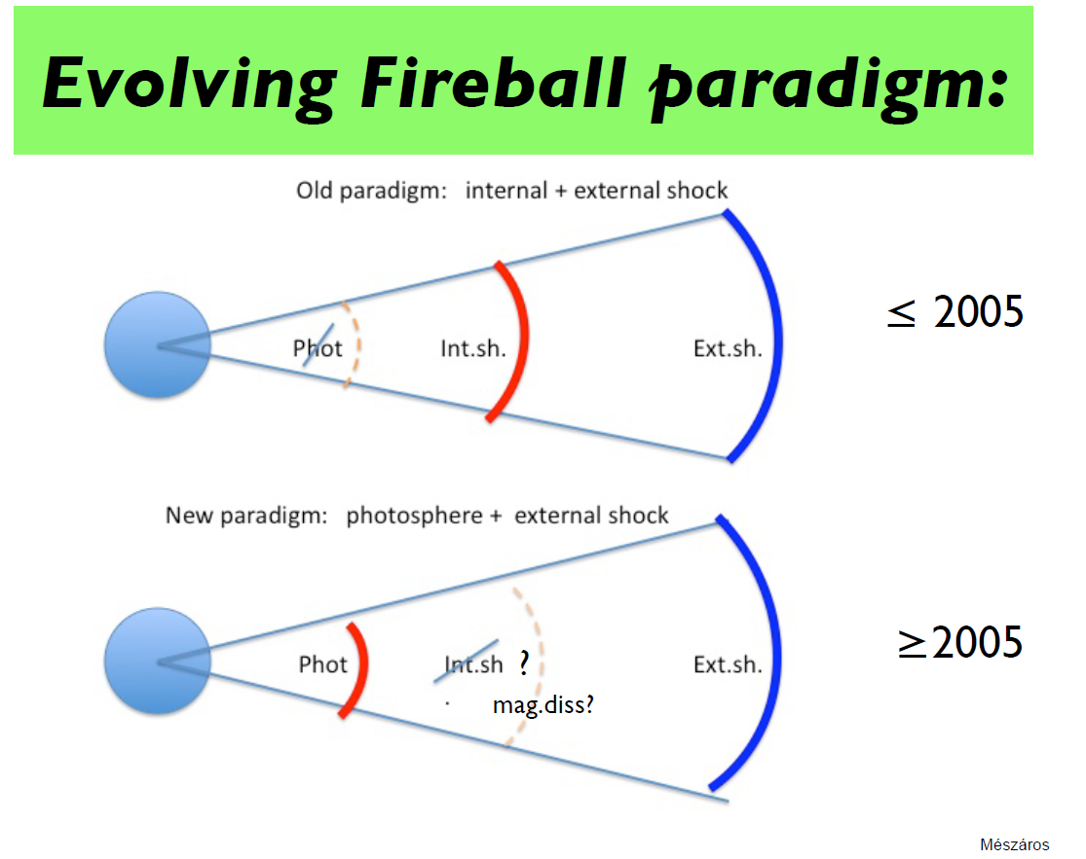
Slide from P.Meszaros @ SNGRB in Kyoto 2013

Slide 10
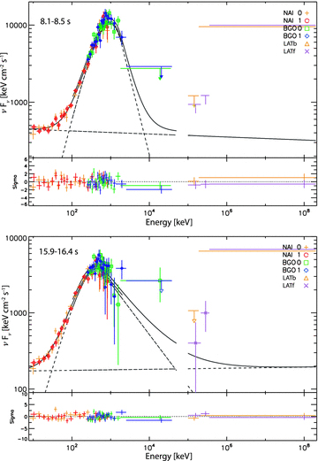
GRB 090902B
Slide from P.Meszaros @ SNGRB in Kyoto 2013
Strong evidence for photospheric emission
Ryde + 2011

Slide 11
Short Summary
・ IS model is not viable in fraction of GRBs
・ PH emission is dominant mechanism at least in
some GRBs (e.g., GRB090902B, 110920A)
Question tackled in this Study
Is PH emission the dominant emission mechanism
for vast majority of GRBs ?
Is there contribution from IS model or other mechanism ?
hybrid models necessary ?

Slide 12
E_{p} - L_{p}
Yonetoku relation can give important clue
Can photospheric emission reproduce this relation ?
Question tackled in this Study
Is PH emission the dominant emission mechanism
for vast majority of GRBs ?
Is there contribution from IS model or other mechanism ?
hybrid models necessary ?

Slide 13
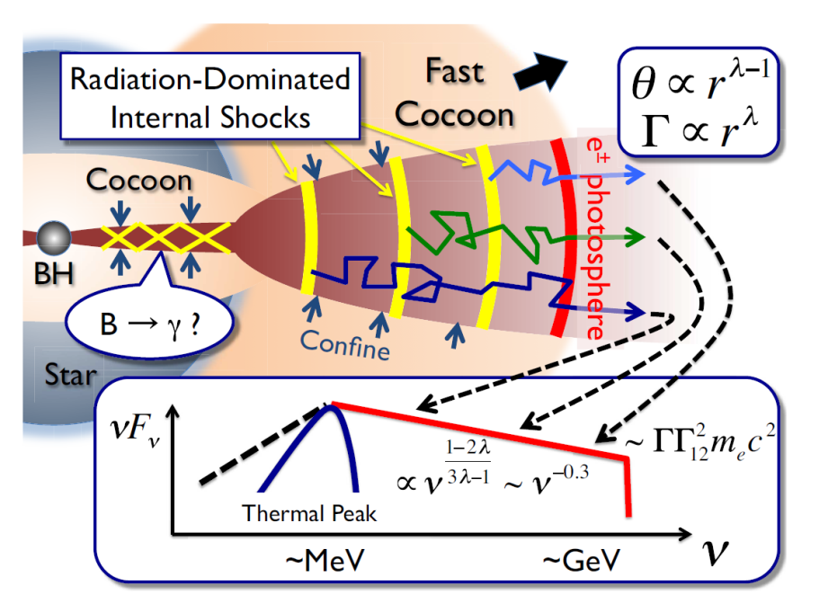
Photospheric Emission in GRB jet
Dynamics of Jet and
Radiation transfer must be solved
Previous Studies
steady outflow or 1D model
Pe’er +2005,2006,2011; Giannios 2008; Beloborodov 2010,2011; Begue + 2013; Vurm+2011,2016; Lundman+2013,2014, Ito+2013,2014, Chhotray 2015
approximated treatment for radiation
Ioka+2011
Lazzati+2009,2011,2013; Mizuta+2011;Nagakura+2011;
Lopez-Camara+2014
This Study
MC Radiation transfer calculation based on 3D hydrodynamical simulation => Ep - Lp
See also Lazzati 2016, Parsotan & Lazzatil 2018, Parsotan, Lopez-Camara, Lazzati 2018
Notes:
これまで多次元の計算もやられてきたが、信頼性、精度はあまりよくない。

Slide 14
Plan of this talk
Introduction
・Brief overview of GRBs
・Observed properties, correlation (Yonetoku Relation)
・Theoretical model (Internal Shock .vs. Photospheric emissions)
Numerical simulation of photospheric emission
Summary

Slide 15
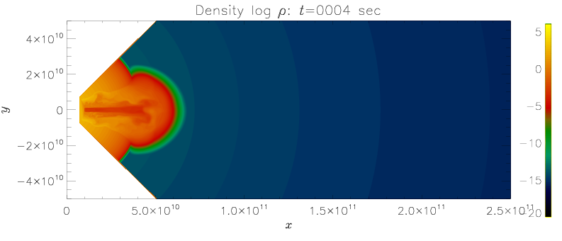
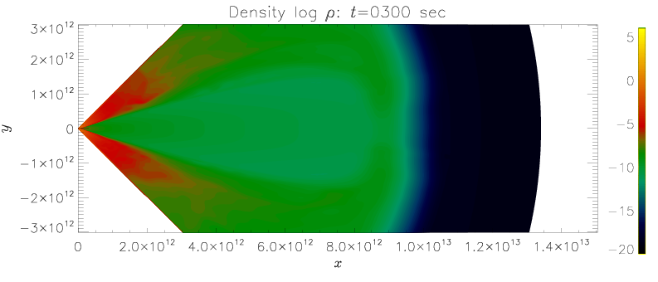
3D relativisitic hydrodymaical simulation
Calculation of relativistic jet breaking out of massive progenitor star
Progenitor star
t=4s
16TI （Woosley & Heger 2006）
M* ~14Msun
R* ~ 4×10¹⁰ cm
@presupernova phase
Jet parameter
L_{j} = 10⁴⁹, 10⁵⁰ ,10⁵¹ erg/s
t=300s
θ_{j} = 5°
Γ_{j} = 5
Γｈ = 500, 900
Ｒ_{inj} = 10¹⁰ cm
3models with different power
Notes:
流体計算の設定（親星、ジェットパラメター）

Slide 16
3D relativisitic hydrodymaical simulation
Calculation of relativistic jet breaking out of massive progenitor star
Progenitor star
t=4s
16TI （Woosley & Heger 2006）
γ
M* ~14Msun
R* ~ 4×10¹⁰ cm
@presupernova phase
γ
Jet parameter
L_{j} = 10⁴⁹, 10⁵⁰ ,10⁵¹ erg/s
τ_{inj} >> 1
τ= 1
t=300s
θ_{j} = 5°
γ
Γ_{j} = 5
γ
Γｈ = 500, 900
Ｒ_{inj} = 10¹⁰ cm
3models with different power
Radiative transfer calculation
Propagation of photons are calculated until they reach optically thin region
Notes:
流体計算の設定（親星、ジェットパラメター）

Slide 17
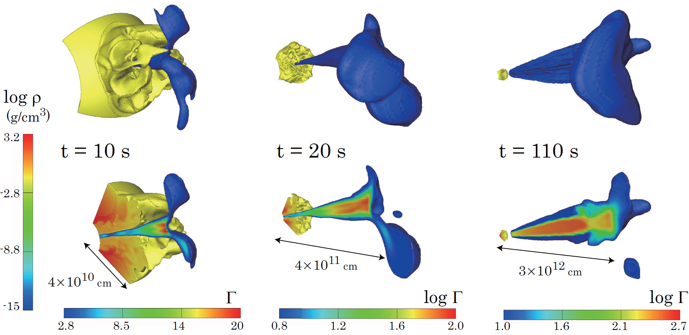
fiducial model L_{j} = 10⁵⁰ erg/s
log Γ
Ito + 2015

Slide 18
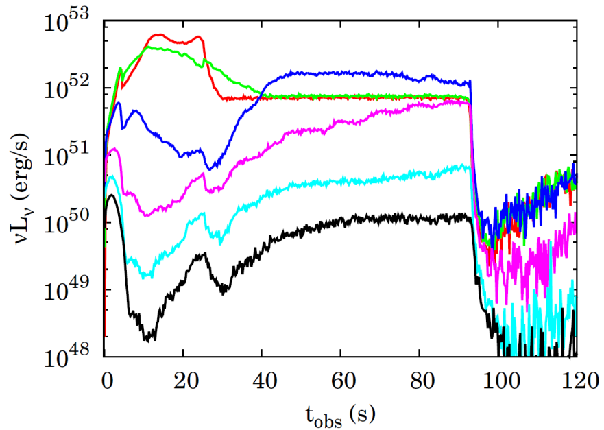
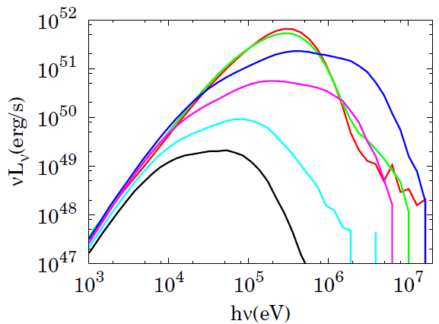
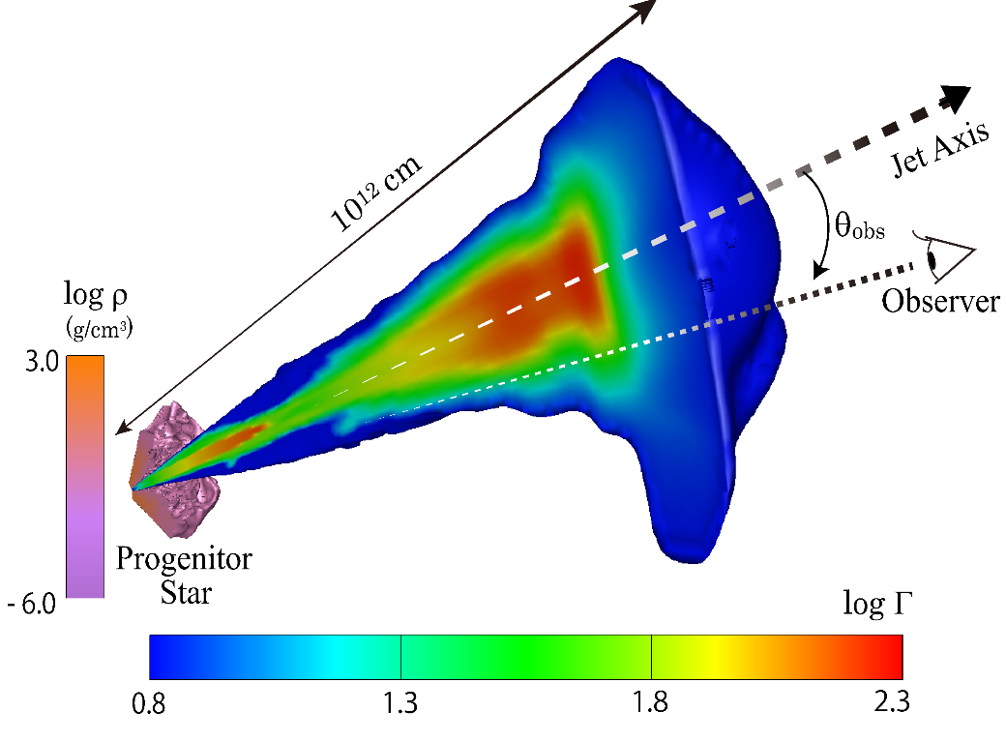
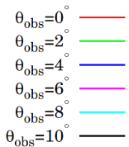
fiducial model L_{j} = 10⁵⁰ erg/s
log Γ

Slide 19
fiducial model L_{j} = 10⁵⁰ erg/s
log Γ
Θ_{obs}
Θ_{obs}
E_{p} & L_{p} decline as Θ_{obs} increases

Slide 20
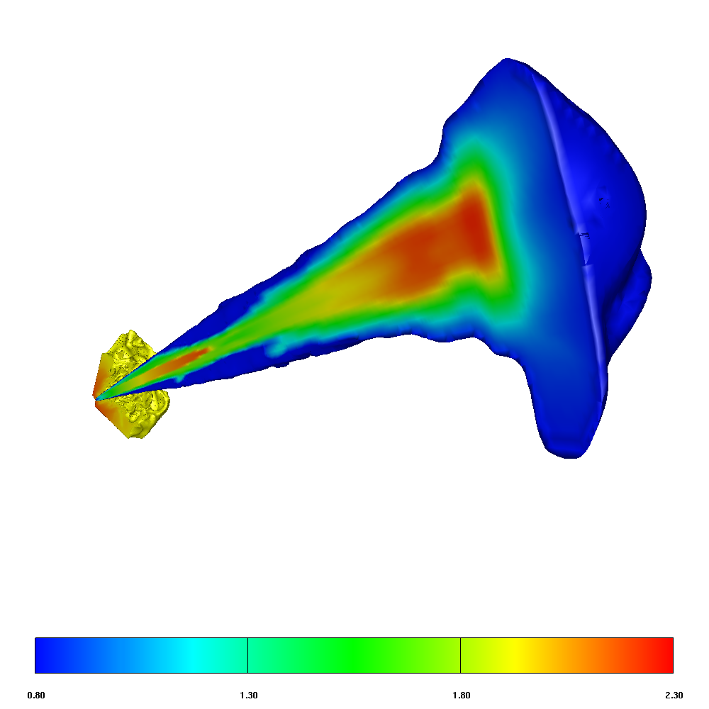
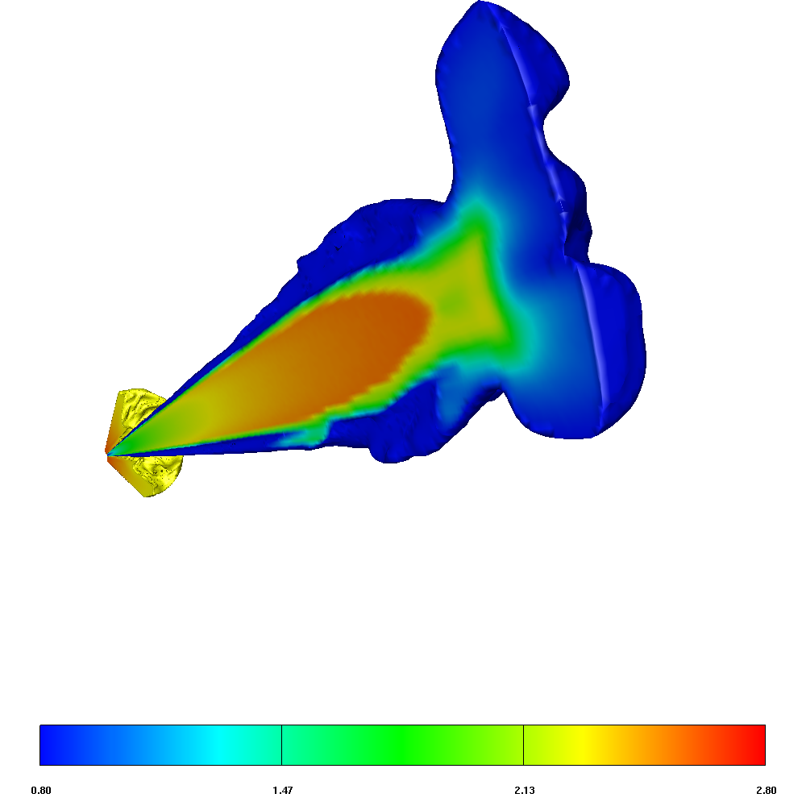
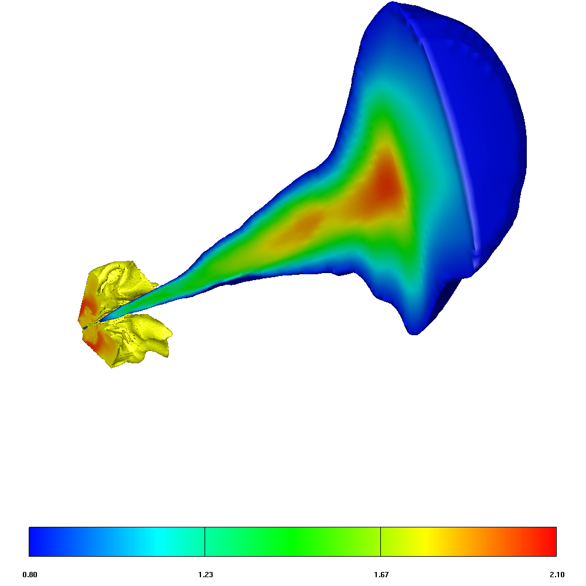
Dependence on jet power
L_{j} = 10⁴⁹ erg/s
L_{j} = 10⁵⁰ erg/s
L_{j} = 10⁵¹ erg/s
t=40s
Ito + 2018, submitted

Slide 21
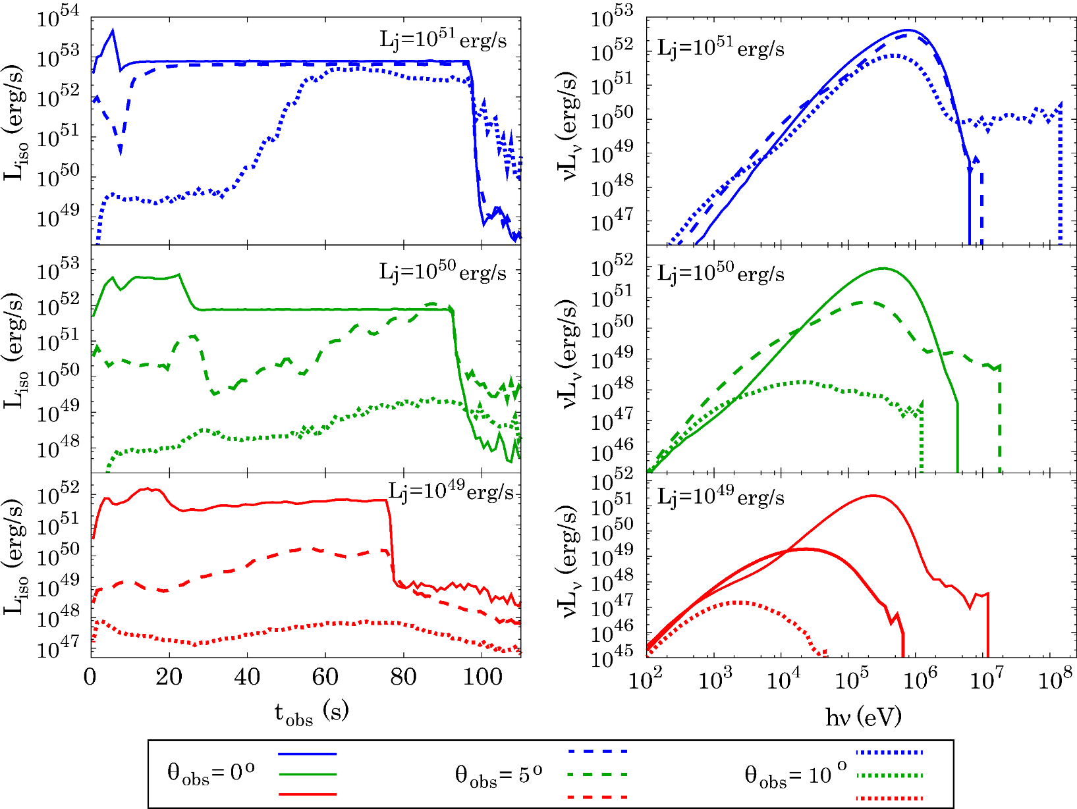
Dependence on jet power
L_{j}= 10⁵¹ erg/s
L_{j}= 10⁵¹ erg/s
L_{j}= 10⁵⁰ erg/s
L_{j}= 10⁵⁰ erg/s
L_{j}= 10⁴⁹ erg/s
L_{j}= 10⁴⁹ erg/s
Θ_{obs} = 0°
Θ_{obs} = 5°
Θ_{obs} = 10°
L_{p} & E_{p} are systematically higher for higher L_{j}

Slide 22
Dependence on jet power
Θ_{obs}
Θ_{obs}
L_{j}= 10⁵¹ erg/s
L_{j}= 10⁵¹ erg/s
Θ_{obs}
Θ_{obs}
L_{j}= 10⁵⁰ erg/s
L_{j}= 10⁵⁰ erg/s
L_{j}= 10⁴⁹ erg/s
L_{j}= 10⁴⁹ erg/s
Θ_{obs}
Θ_{obs}
Θ_{obs} = 0°
Θ_{obs} = 5°
Θ_{obs} = 10°
E_{p} & L_{p} decline as Θ_{obs} increases
lateral structure of jet induces the viewing angle dependence

Slide 23
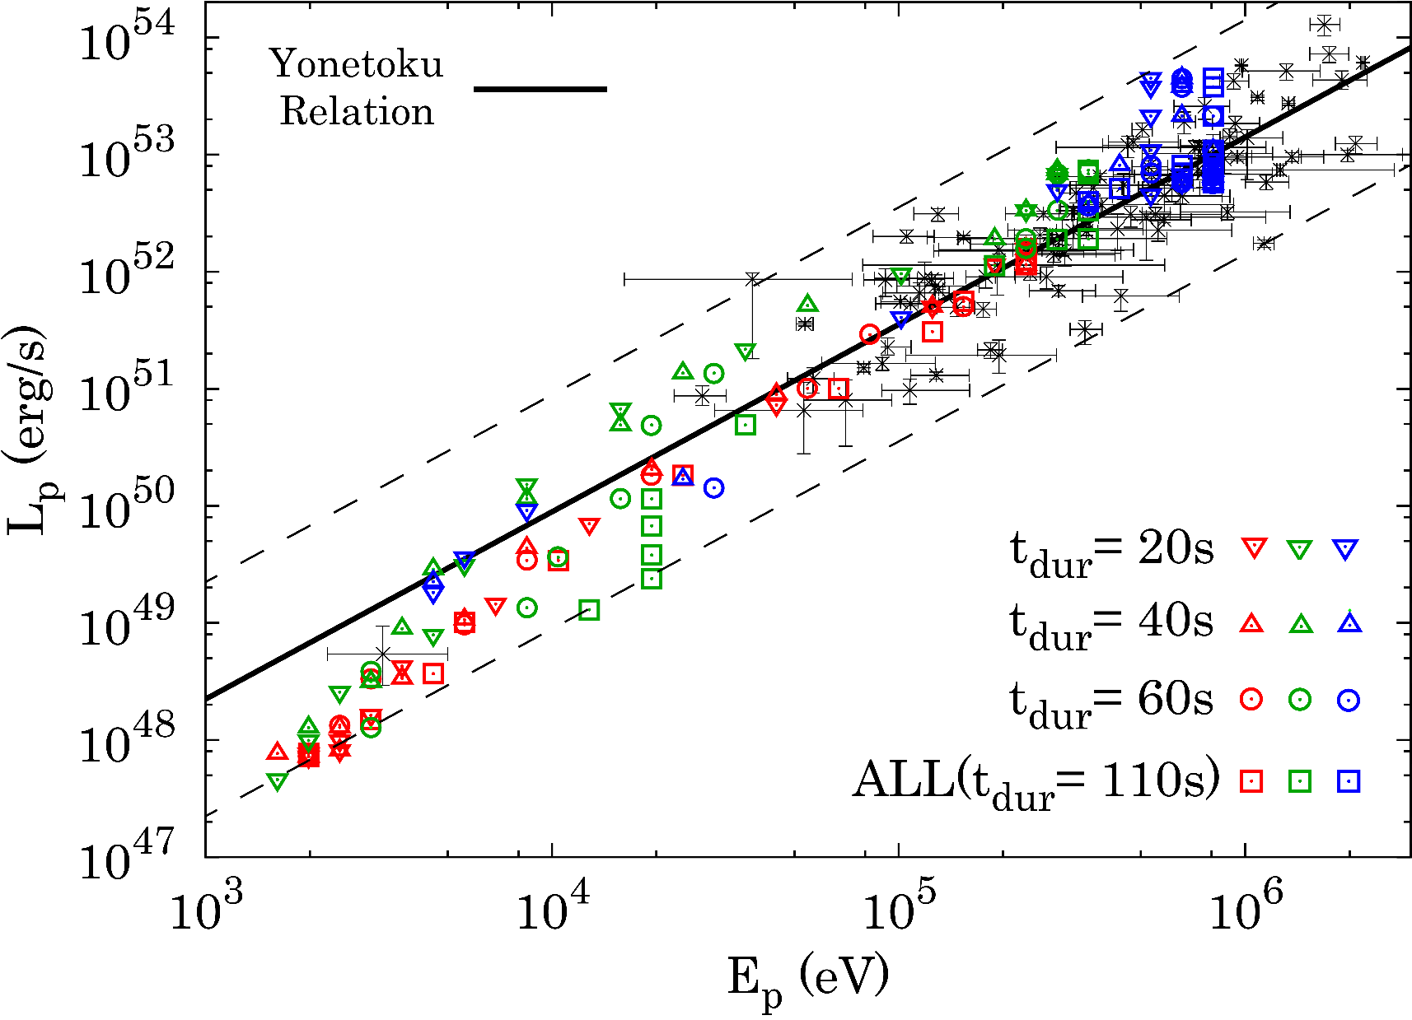
Yonetoku relation
Blue : L_{j}= 10⁵¹ erg/s
Green : L_{j}= 10⁵⁰ erg/s
Red : L_{j}= 10⁴⁹ erg/s
Remarkable match with observations

Slide 24
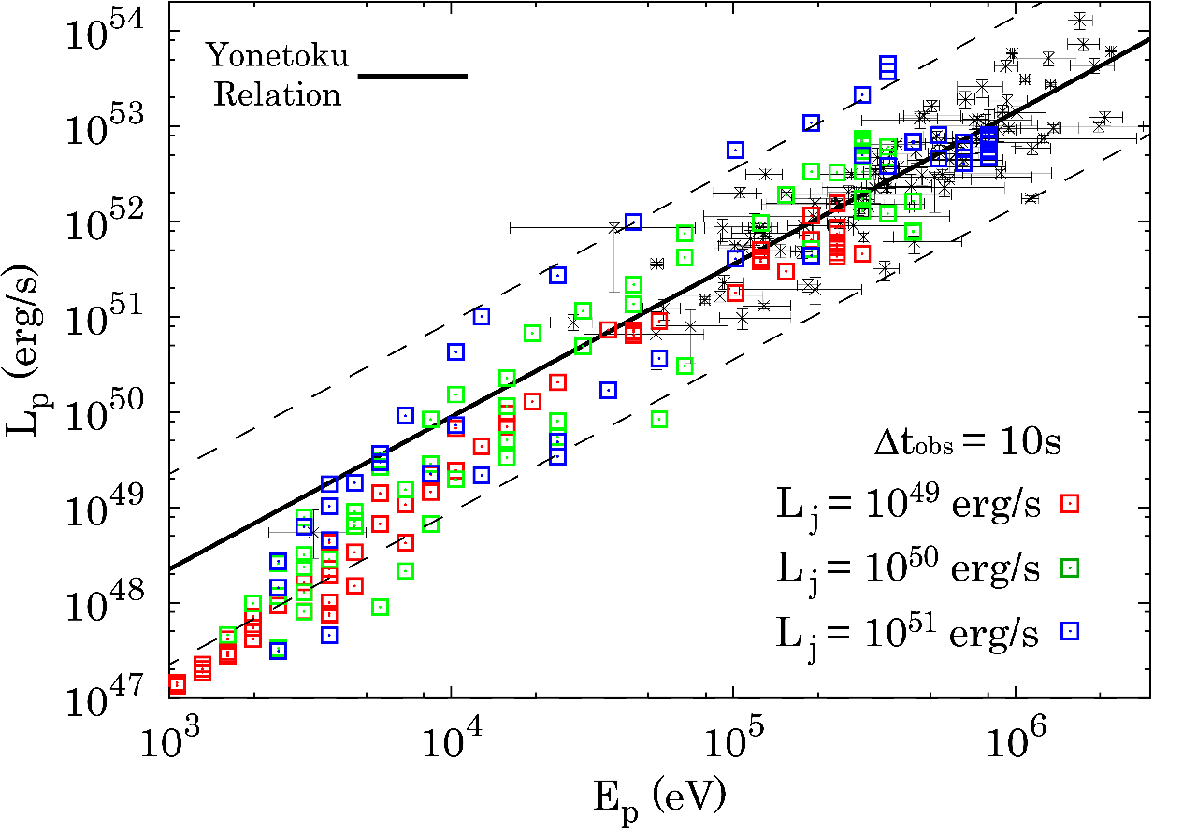
Time resolved Yonetoku relation
Lu + 2012
15 GRBs with time resolved
Ep and redshift
Yonetoku Relation holds regardless of the time interval

Slide 25

polarization
s
20%
Jet axis
15%
DOP（％）＝(I₊ - I₋) / (I₊ + I₋)
10%
Preliminary
5%
0%
-15° -10° -5° 0° 5° 10° 15°
Θobs
High polarization (>10%) at large Θ_{obs}
Notes:
Effective edge emission

Slide 26
Summary
Yonetoku relation is an inherent feature of photospheric emission
Lateral structure of jet developed during propagation is an origin of the correlation between Eｐ & Lp
This relation holds regardless of the jet power
Evidence of photospheric emission as a dominant radiation mechanism for GRBs
Prediction of high polarization at large viewing angle

