Slide 1
Critical Tests Of GRB Theories*
Arnon Dar
.
Windows On The Universe , Quy Nhon, Viet Nam, Augus 7, 2018
Scientific theories must be falsifiable (K. M. Popper 1959). Only confrontations of their main predictions, which do not depend on free adjustable parameters, with observational
data rather than prejudices or concensus, can serve as their critical tests.
Due to time limitation, in my talk, critical tests will be limited to the Fireball (FB) and Cannonball (CB) models of GRBs, the only models that have been applied in the past two decades to analyze the bulk of the mounting observational data on GRBs.
* Based on research work done in collaboration with Nir Shaviv (1994/5)
Rainer Plaga (1998/9), Shlomo Dado and Alvaro De Rujula (2000-2017).

Slide 4
The Fireball Model
In the original fireball model (Goodman 1986; Goodman, Dar & Nussinov 1987; Rees & Meszaros 1992-1999) GRBs were isotropic. But, the evidence from CGRO in 1992 of a cosmological origin of GRBs led to GRB energy crisis, which could be solved only if GRBs are jetted (Shaviv & Dar 1994). In 1999, after the observation of GRB980425/SN1998bw and GRB broken PL aftergows,
(e.g., GRB990510) the spherical fireball was replaced by a conical jet of thin e+e- shells whose overtaking collisions produce GRB pulses, and a shock driven into the circumstellar medium produces the GRB afterglow (Sari, Piran, Waxman, Rees & Meszaros, and followers). Such models were called ‘conical fireball models’. Later the jets of e+e- shells were replaced by conical flows of ordinary plasma from SNeIc explosions, and the completely revised model was declared to be
“the fireball model”…. And later (2015):

Slide 5
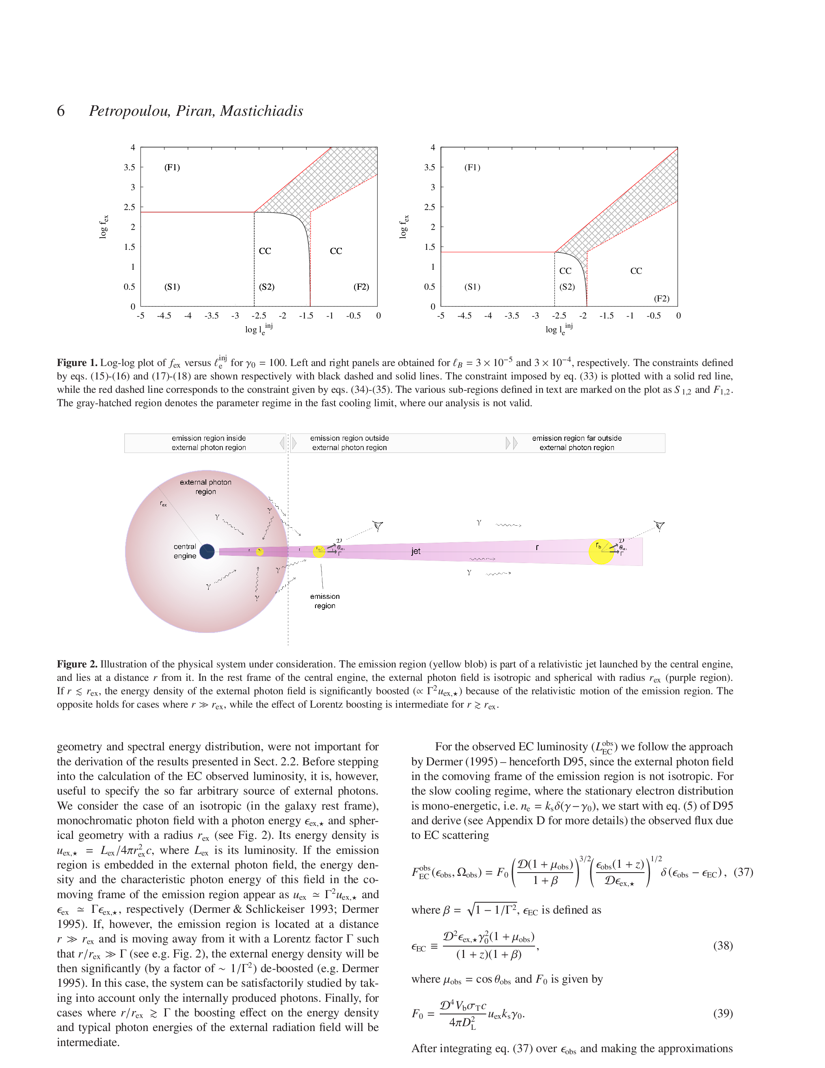
Step by step the Fireball Model is becoming more and more similar to the CB model, e.g.
Additional key assumptions of the FB model were later replaced
by assumptions underlying the CB model (with no much
ceremony, proper references , and acknowledgement), e.g.,
Maria Petropoulou, Tsvi Piran, Apostolos Mastichiadis,
(MNRAS 452 , 3226 (2015) [arXiv:1507.02710]):
CB Model Present FB model ?
Glory became “External Photon Region”
CBs became “Emission Regions”
ICS became “Prompt Emission Mechanism”

Slide 6
Remaining Main Differences between the CB and FB Models
CB FB
Power Source: jet of plasmoids (CBs) fired by MSP jet fired by bh/magnetar in
in SNeIc, n*n* mergers, n*→q* PT hypernovae and macronova
Jet Geometry: discrete plasmoids (CBs) conical flow/shells
Radiations:
Prompt Inverse Compton scattering Synchrotron radiation from
of glory light by CB electrons shell collisions/internal shocks
Afterglow SR from Fermi Accelerated e’s SR from Fermi Accelerated e’s
within the CBs in the shocked ISM
HE SSC + hadronic meson prod. SSC + photo meson prod.
XRFs, LLGRBs Ordinary GRBs viewed far-off axis Different classes of GRBs

Slide 7
Test #1 : Polarization
Prompt Emission Mechanism Afterglow Mechanism
CB: ICS of glory light by jet electrons SR from Fermi accelerated
swept in ISM electrons*
(Shaviv & Dar 1994)
(Dar 1998)
FB: SR from shocked jet SR from shocked ISM
*Turbulent magnetic fields are required for shock acceleration of the HE e’s emitting the SR.
All the a posteriori attempts to explain a large polarization of the prompt emission in the FB model (after measurements) cannot explain why almost all GRBs have large polarization.

Slide 8
Observed polarization of prompt -rays is very large!
CB Prediction (1995) : ICS
FB Expectation SR
GRB Polarization Confidence level Reference Comments
80+\-20 % 5.7 sigma Coburn & Boggs 2003 RHESSI
(controversial)
930131 > 35 % 90 % Willis et al. 2005 BATSE Albedo
Polarimetry
960924 > 50 % 90 % Willis et al. 2005 “
041219A 98 +/-33 % 68 % Kalemci et al. 2007 INTEGRAL-SPI
63 +/-31 % 68 % McGlyn et al. 2007 “
100826A 27 +/-11 % 99.4% Yonetoku et al. 2011 IKARUS-GAP
061122 > 60 % 68 % Gotz et al . 2013 INTEGRAL-IBIS
> 33 % 90 %
110301A 70 +/- 22 % 68 % Yonetoku et al. 2011 IKARUS-GAP
110721 84+16/-28% 68 % Yonetoku et al. 2011 IKARUS-GAP
140206A > 48 % 68 % Gotz et al. 2014 INTEGRAL-IBIS

Slide 9
Test #2: correlations
CB Model (Dar & De Ru`jula, 2000, astro-ph/0012227):
Doppler boost:
Time aberration:
Relativistic beaming:
+ ICS of glory
+ Beaming
Ordinary GRBs
Far off-axis GRBs (XRFs/LLGRBs)
Amati et al. empirical Relation (2002 A&A, 390, 81):

Slide 10
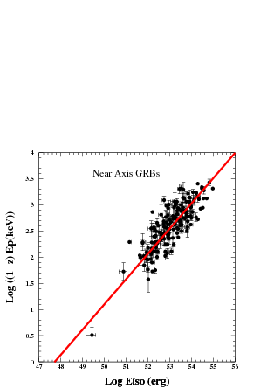
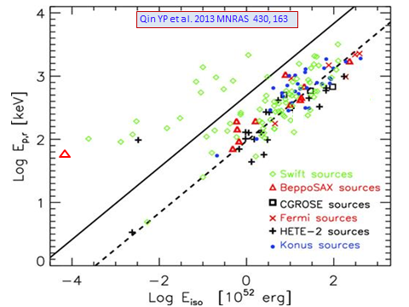
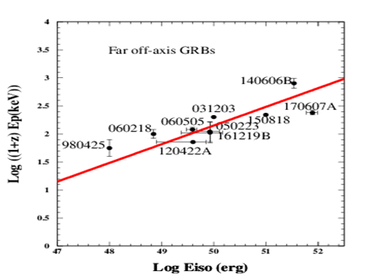
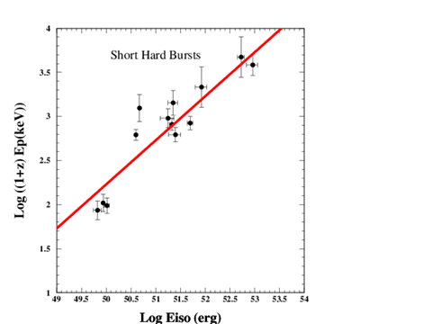

Slide 11
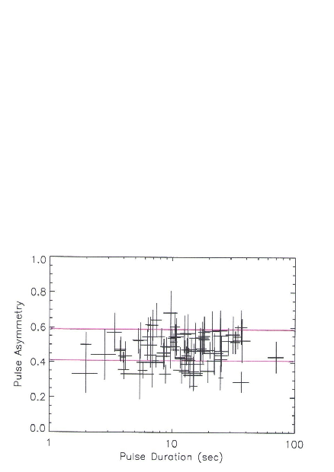
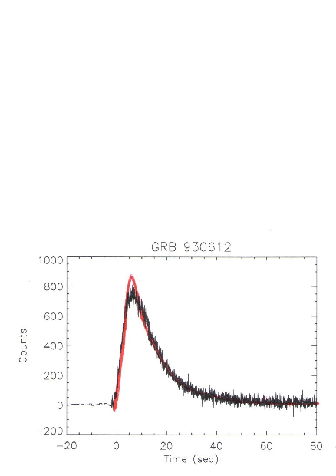
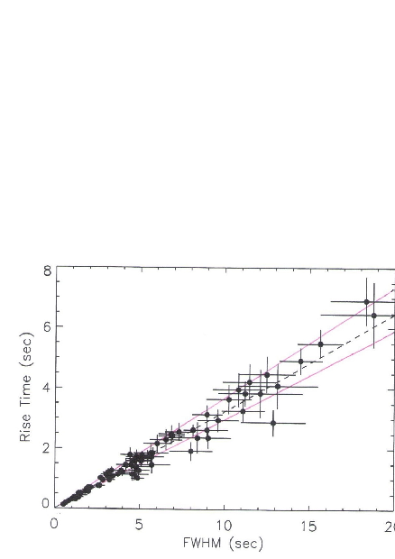
Test # 3: Pulse Shape
RT/DT
GRB 930612
BATSE
Data : Kocevski et al. 2003
CB Model limits :
77 individual GRB pulses
BATSE

Slide 12
Test # 4:
FB:
Overtaking collisions produce the GRB while shocked ISM produces the AG:
Relative velocity of colliding shells is smaller than in shell-ISM collision.
most of the radiation is released in the beam dump (ISM).
The visible area increases with time during the AG due to jet deceleration

Slide 13
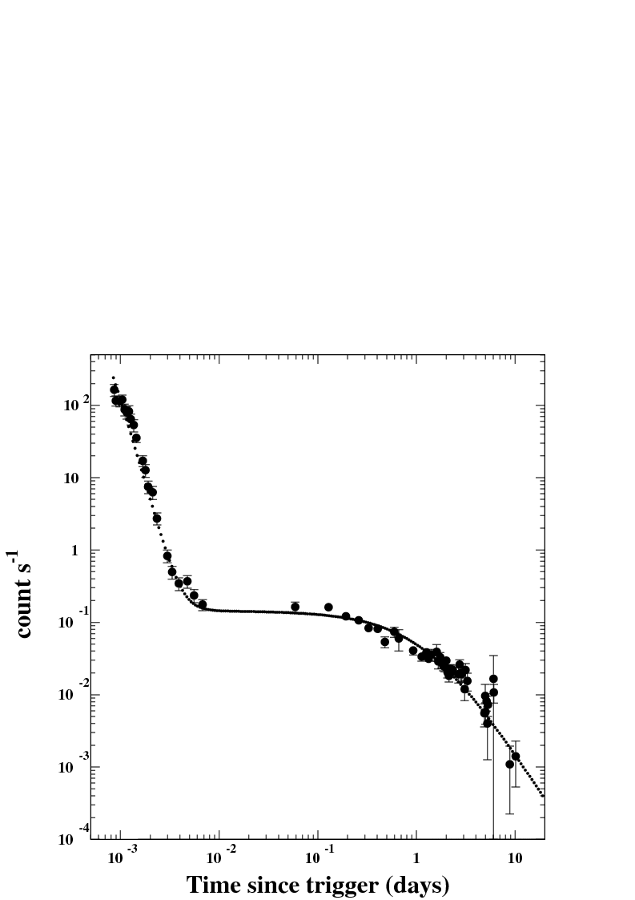
Test #5: The ‘canonical behavior’ of X-ray light curves of SN-GRBs
Neither expected nor predicted/explained by the standard FB models. Predicted by the CB Model (2001) long before it was discovered with Swift:
SN--GRBs
SWIFT: GRB 050315
(Vaughan et al. 2005)
ICS tail
SR
r
CB model: DDD2005

Slide 14
Tests # 5-8: Jet break properties
FB: Jet break in the GRB afterglow when (Sari, Piran, Halpern 1999)
observer
R
energy flux proportional to visible area:

Slide 15
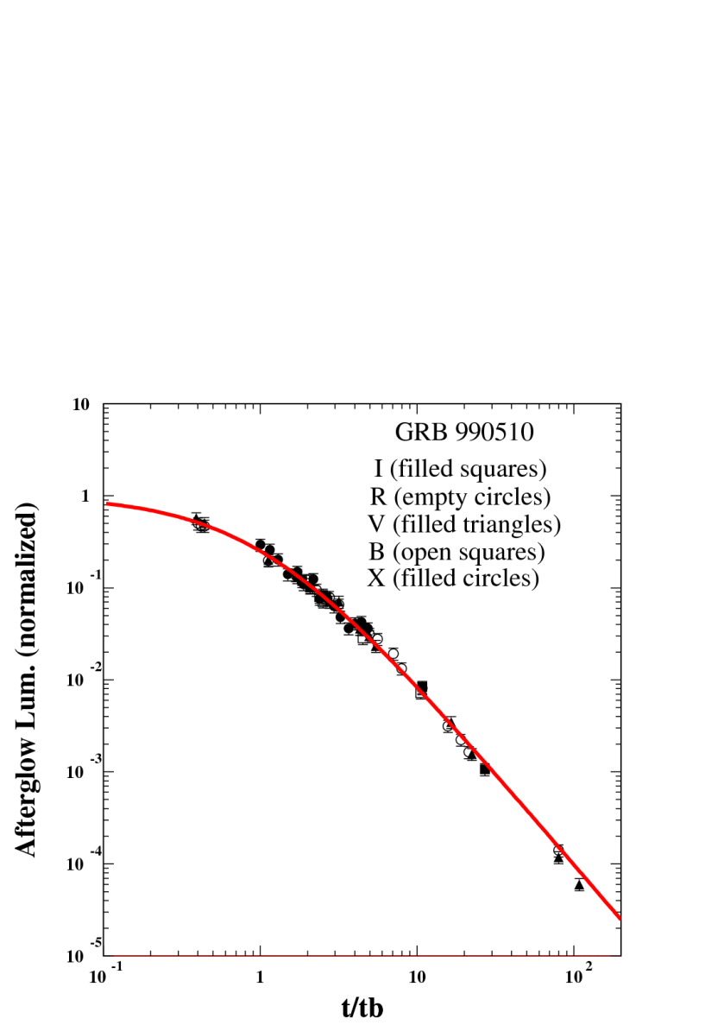
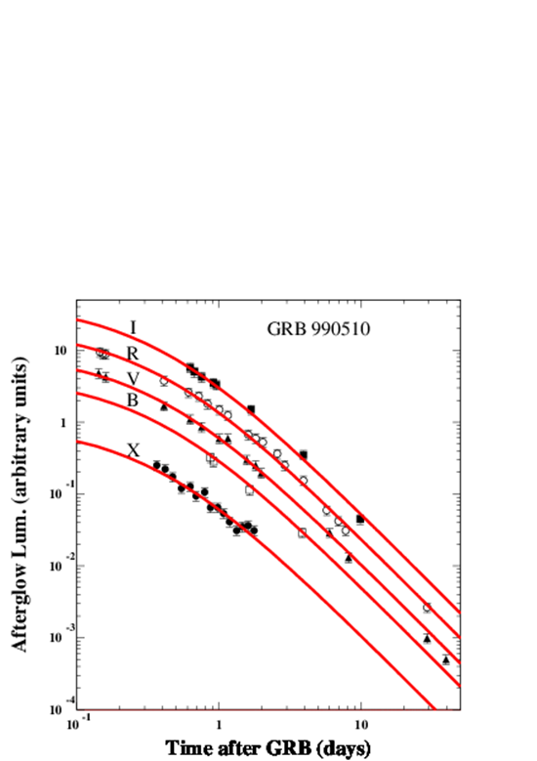
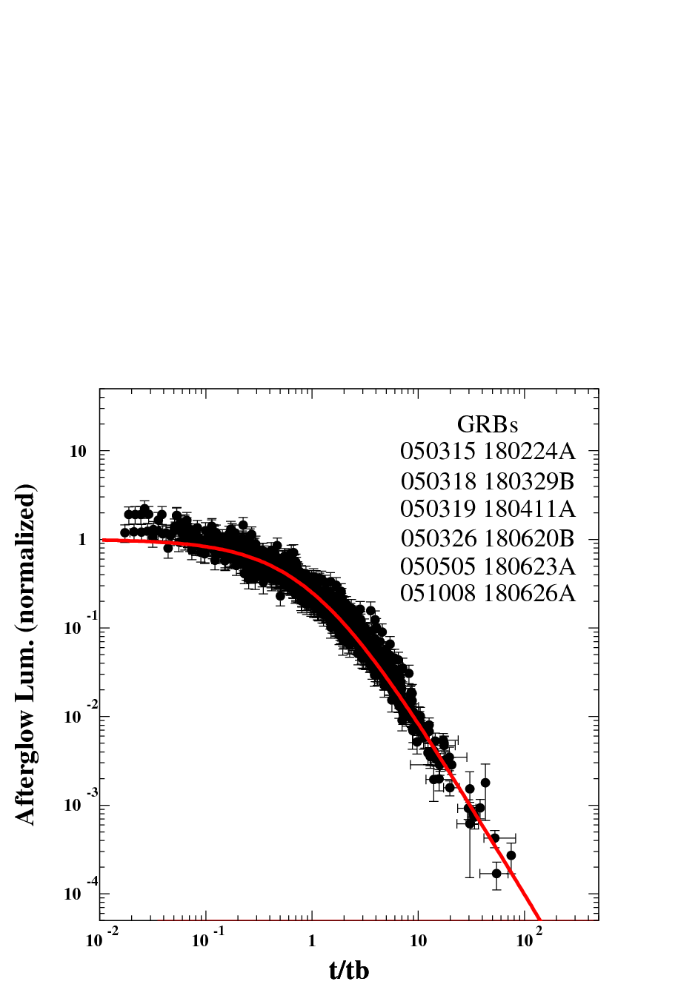
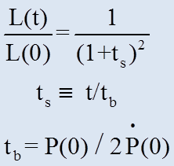
GRB 990510 was the flag ship of the Fireball Model Armada. Papers such as "BeppoSAX confirmation of beamed afterglow emission
from GRB 990510“ [Pian et al. 2001] or "Optical and Radio Observations of the Afterglow from
GRB990510: Evidence for a Jet" [Stanek et al. 1999], were based on heuristic parametrizations and not on formulae properly derived from FBM underlying assumptions. They have misled the entire GRB community into a wrong direction!
PWN powered
by MSP:
Pian et al. 2001
CONICAL JET ?
SN-Less GRBs: PWN powered by MSP
Universal LC:

Slide 16
FB models of GRB afterglows predict:
TEST #
TEST #
TEST #
TEST #
6. Broken power-law light curves
with a slope change at
7. Closure relations between and
8. Achromatic break
But, E. W. Liang, et al. Astrophys. J. 675, L528 (2008) analyzed
the afterglow of 179 GRBs detected by Swift between January 2005
and January 2007 and the optical AG of 57 pre-Swift GRBs.
They did not find any afterglow with a break satisfying 1,2 and 3.
9. Missing Break
(#Dado, Dar & De Rujula (ApJ, 680, 517 (2008)): No observable break
(“hidden break “) in the AG of SN-GRBs with large Eiso) while,
Racusin, et al. Astrophys. J. 698, 43 (2009) : The “jet break” in the AG of GRBS with large Eiso takes place after the observations end.

Slide 17
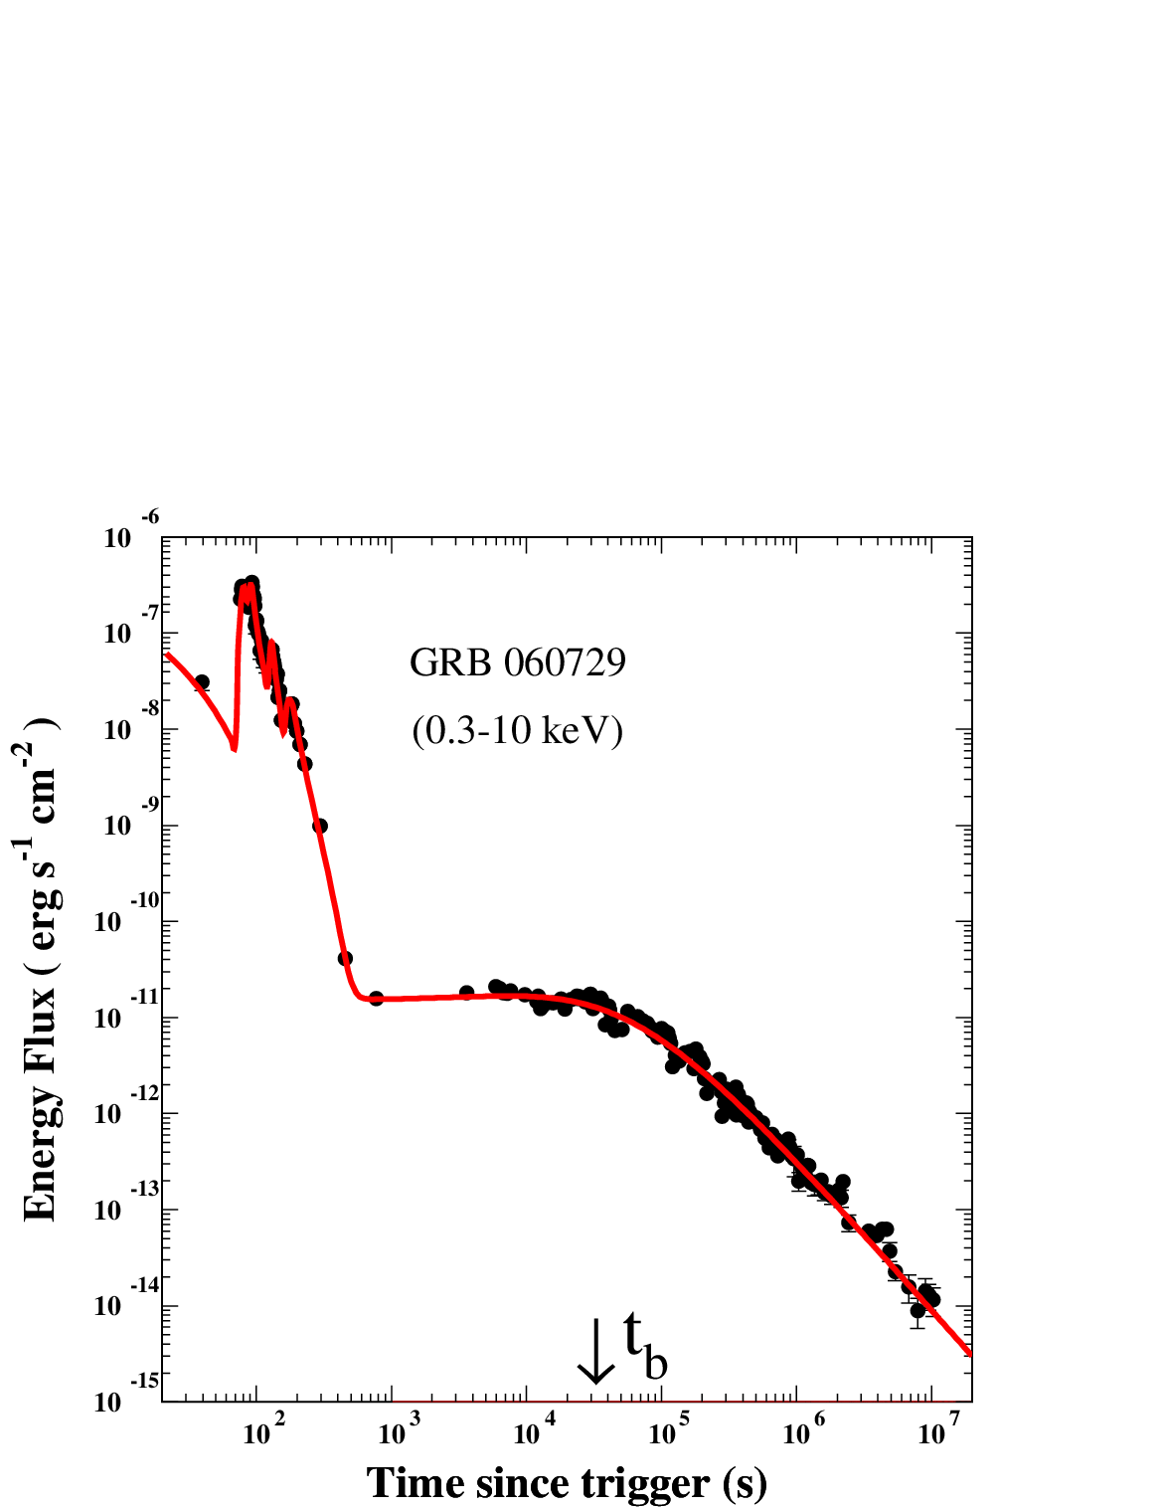
Post-break behavior

Slide 18
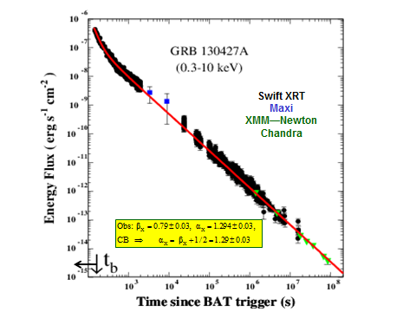
Missing Break
(De Pasquale et al. 2016)
Dado @ Dar, PRD 94, 063007 (2016)

Slide 19
CB Model: A deceleration “break” in SN-GRB afterglows when the swept-in mass/energy the initial CB rest mass, and an exit break*
Plastic collision of a CB (radius R, initial mass with
constant density (n) ISM, viewed from an angle yields
which are practically constant until
where
Missing Break : When is very large, the break is
hidden under the prompt emission tail (DDD 2007)
*in AGs of GRBs in face-on host galaxy when the CB escapes into the halo

Slide 20
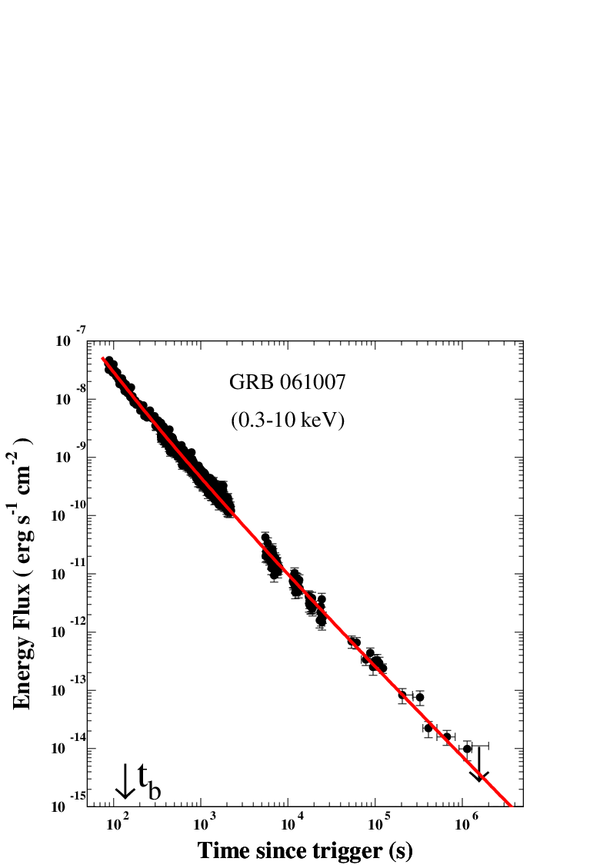
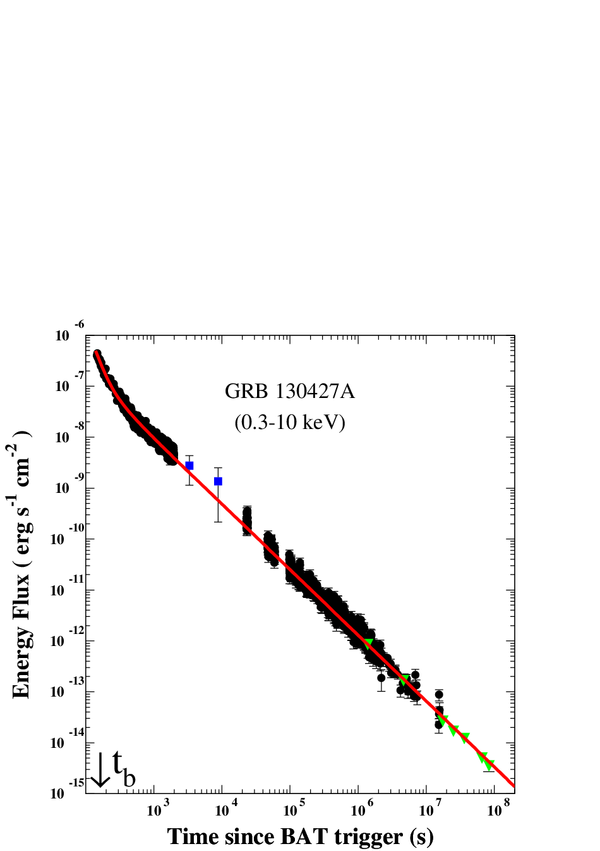
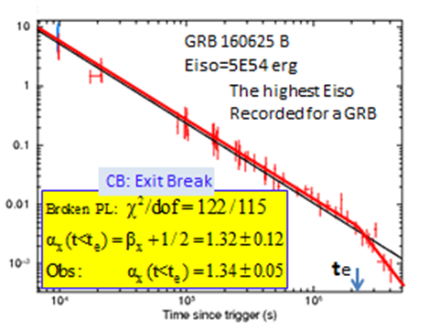
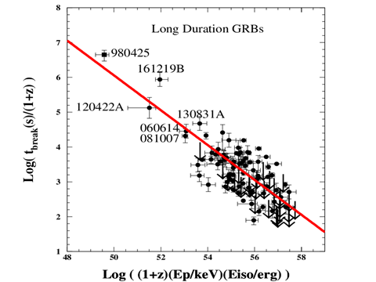
Missing break
Missing break
LGRBs + LLGRBs
CB Model:

Slide 21
Are Low Luminosity (LL) GRBs and Ordinary GRBs Different classes ?
FB: Different, despite their similar parent SNeIc:
FB:
CB: LLGRBs are ordinary GRBs viewed far off-axis:

Slide 22
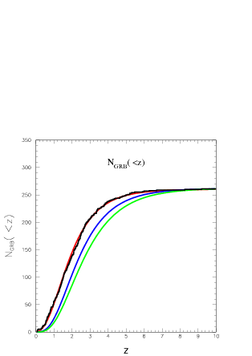
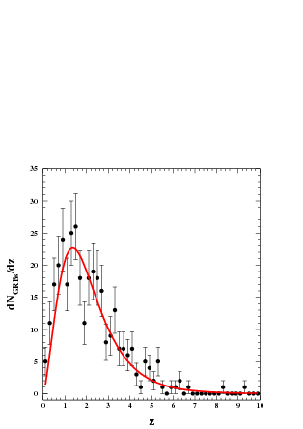
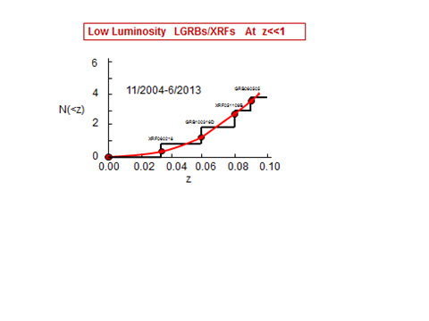
Test # 11 : Rate(GRBS) SFR
CB Model:
LGRBs produced by SNeIc:
Rate(LGRBs*) Rate(SNeIc) SFR
*Observable + non observable
dNobs(LGRB)/dz with known z
CB Model
FB Model
without/with evolution*
* Robertson & Ellis 2012
DD 2017
345 Observed GRBs
DD 2013
CB

Slide 23
Test # 12 : Superluminal Velocity of CBs
CB
b
observer
SN

Slide 24
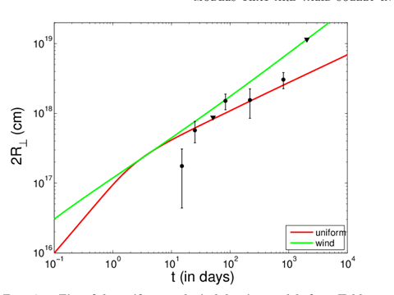
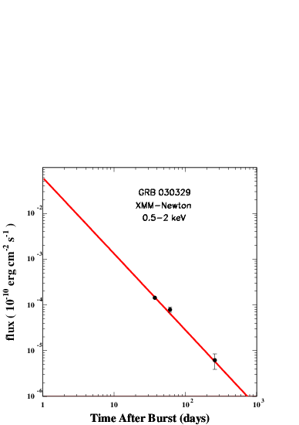
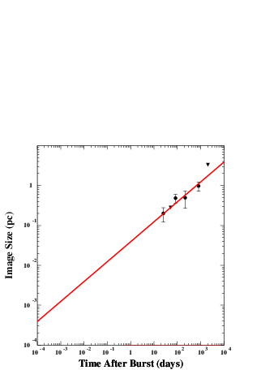
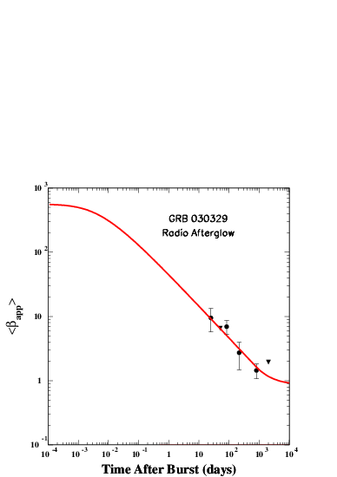
Hyperlumina→superluminal
GRB 030329
FB: Image Expansion (Evolving Interpretation…)
Taylor et al. 2004, ApJ, 609, L1
Taylor et al. 2005, ApJ, 622, 986
Pihlstrom et al. 2007, ApJ, 664
Mesler et al. 2012, ApJ, 759, 4
Mesler et al. 2013, ApJ, 774, 77
CB: Hyperluminal GRB-AG Displacement
GRB 030329 Image Size
GRB 030329
Hyperluminal Speed

Slide 25
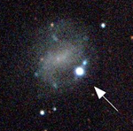
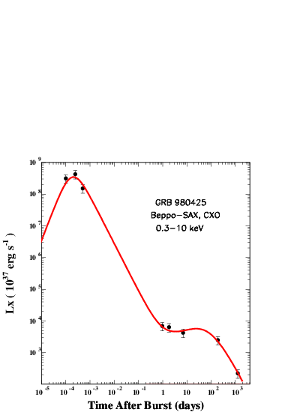
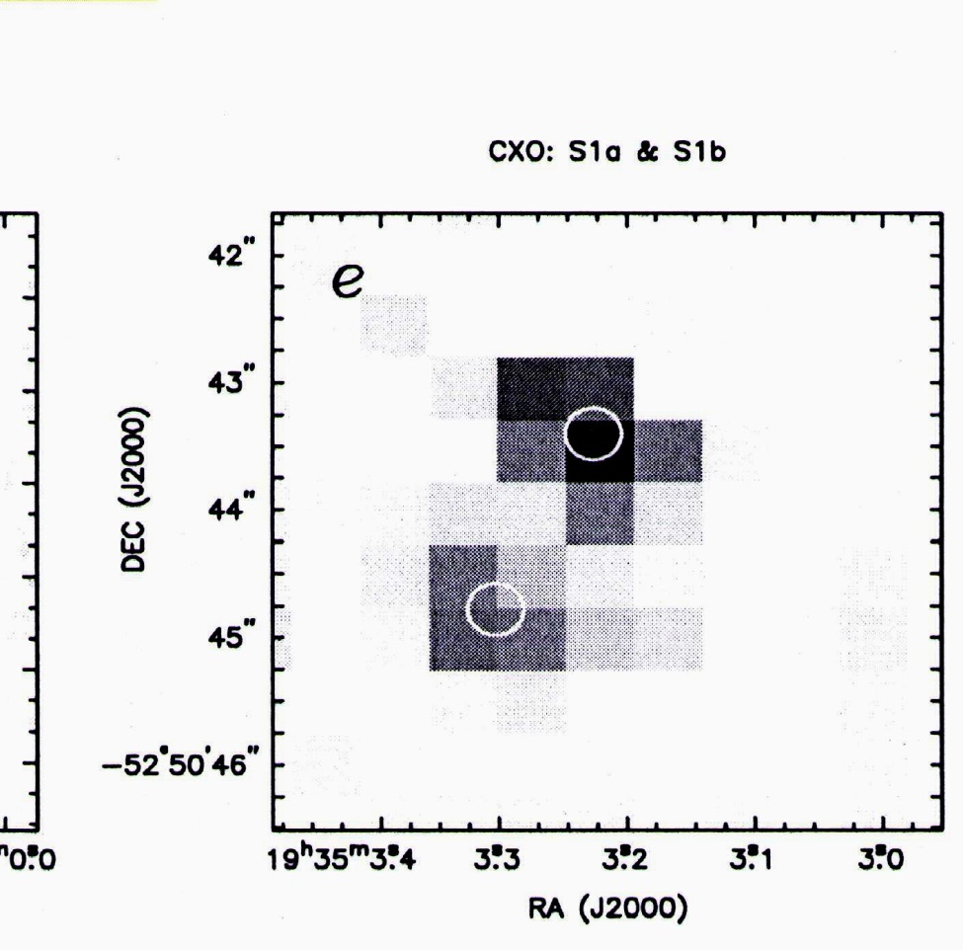
ESO 184-G82 + GRB980425
Test # 12:
Hyperluminal Speed of CB Fired by GRB980425 ?
DD2000: arXiv:astro-ph/0008474
DDD2016: arXiv:1610.01985
12
ATCA D2049
CXO D1281
Not detected by
ATCA on D2049
GRB980425/SN1998bw

Slide 27
THE END

Slide 28
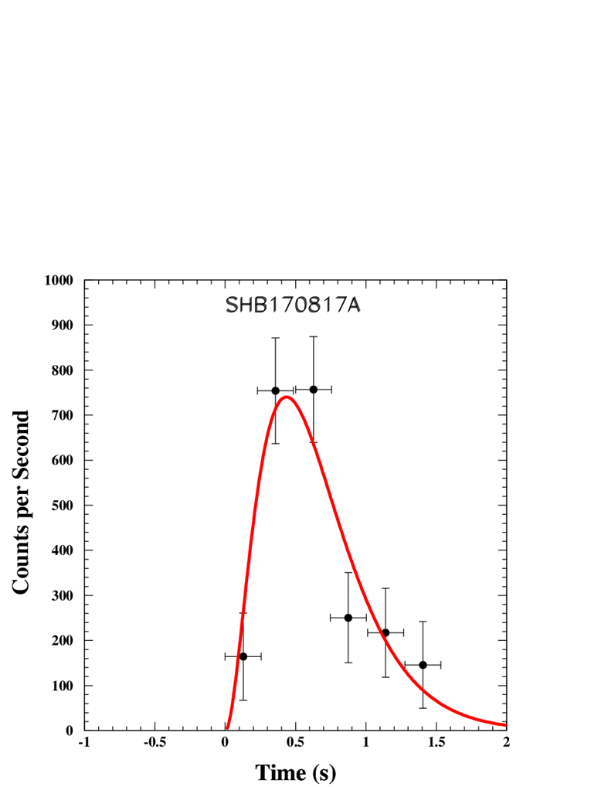
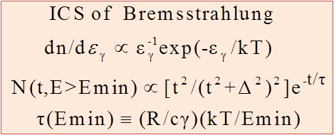
SHB170817A
DATA: Fermi GBM
Theory: CB Model:

Slide 29
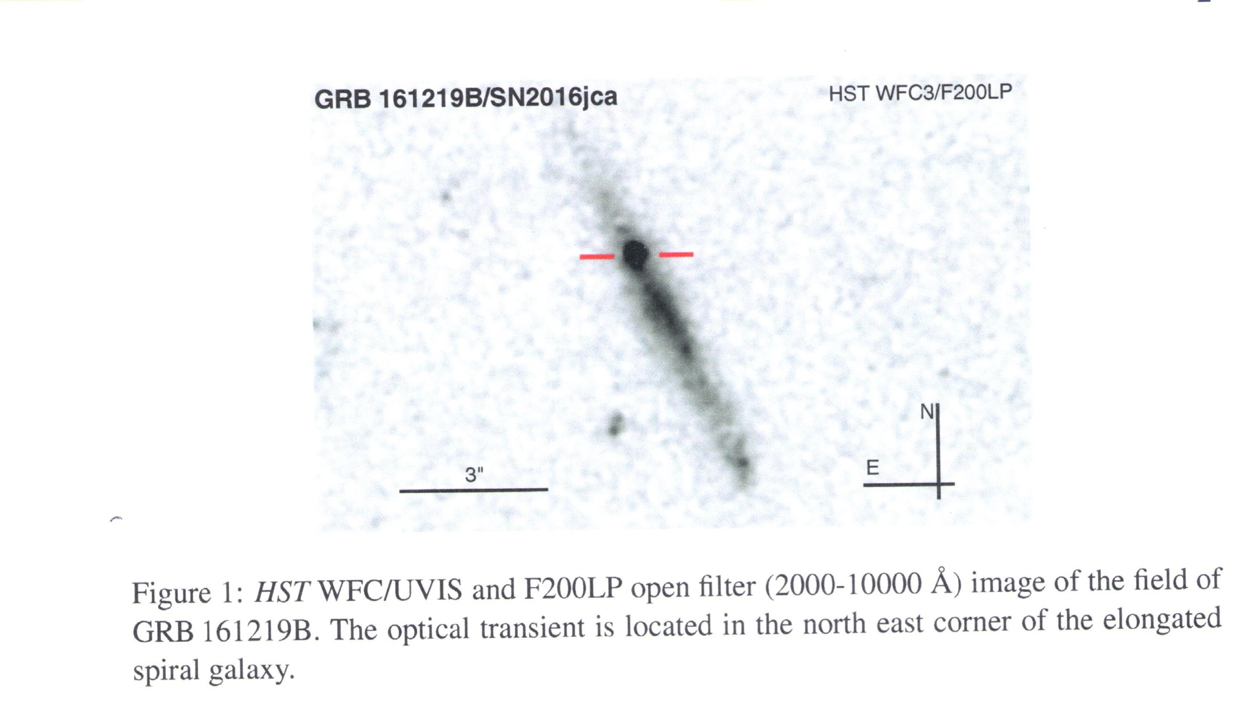
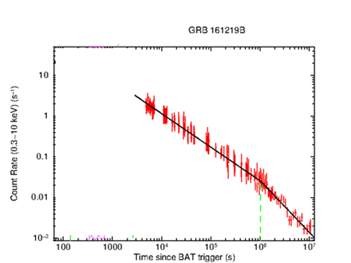
Edge-on host galaxy of 161219B/SN2016jca;
C. Ashall et al. , arXiv:1702.0433
LL
Testable with VLBI and VLA
tb
➔Late -time deceleration break

Slide 30
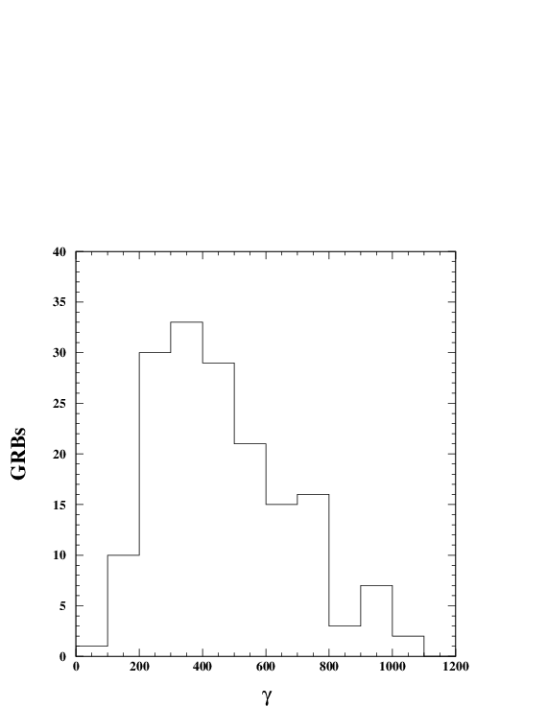
Near axis GRBs with known (1+z)Ep

Slide 31
GRB reviews became promotion campaigns, far from being critical scientifically and accurate historically.
See for instance,
T. Piran , 1999, Phys. Rep. 314, 575–667.
T. Piran, 2000, Phys. Rep. 333, 529-553.
T. Piran , 2005, Rev. Mod. Phys. 76, 1143-
S. Woosley & J. Bloom, 2006, ARA&A, 44, 507–556
T. Piran & Y. Fan, 2007, RSPTA 365, 1151–1162
P. Meszaros, 2002, ARA&A , 40, 137-169
B. Zhang & P. Meszaros, 2004, IJAP A 19, 2385–2472.
P. Meszaros, 2006, Rep. Prog. Phys. 69, 2259–2321
P. Meszaros & M. Rees, 2014, arXiv:1401.3012
P. Kumar & B. Zhang, 2015, Phys. Rep. 561, 1-109
and two examples below from these reviews

Slide 32
Tsvi Piran: Gamma Ray Bursts, the Strongest Explosions in the Universe.
But, HISTORY HIS STORY (2009) http://www.phys.huji.ac.il/~tsvi/Gamma2.pdf
Piran’s Story (alternative facts)
..”Together with David Eichelr from Ben Gurion University, Mario Livio (then at the Technion) and Dave Schramm from the University of Chicago I have suggested in 1989 that extra‐galactic merging neutron stars binaries could produce GRBs. This was the first credible extra‐galactic GRB model.”…
9. Eichler D., Livio M., Piran T., Schramm D. N., Nucleosynthesis, neutrino bursts and gamma rays from coalescing neutron stars, 1989, Nature, 340, 126
But , the model and the underlying calculations in the above paper of Eichler et al.
were published two years before in “Neutrino annihilation in Type II supernovae”, ApJ, 314, L7 (1987) by Goodman, Dar & Nussinov, who concluded there: “We can imagine other circumstances in which the ratio would be sufficiently high that neutrino annihilation should be taken into account : FOR EXAMPLE , MERGING OF NEUTRON STARS, AND THE ‘BARE’ COLLAPSE OF AN IRON WHITE DWARF. SUCH EVENTS COULD PRODUCE A RELATIVISTIC e+e- WIND AND EXPLAIN GAMMA RAY BURSTS” … The paper was written by GDN at the IAS.
Piran who were there was well aware of the above published paper of GDN (1987) , as can be seen from the acknowledgement there: “ We would like to thank John Bahcall, Robert Duncan, Bohadan Paczynsky , Tsvi Piran, Ed Salpeter, and James Sexton for helpful comments and stimulating discussions. “ But, no reference to GDN in 9 ,
and in his published papers and reviews where he credit himself for the GDN model.

Slide 33
Piran’s Story (alternative facts)
“The detection of the afterglow enabled redshift determinations. With those precise estimates of the distances and of the corresponding energies followed. As the energy implied in some cases was unreasonably large it became clear that the emission is not uniformed and it is beamed towards us. James Rhoads (1999) from the Kitt Peak National Observatory and independently together with Re’em Sari, Jules Halpern (from Columbia University) we (1999) have predicted that jets would have a clear signature on the afterglow, known today as a “jet break”.
BUT the correct history is: The BATSE measurements that provided in 1992 the first clear evidence that GRBs are at large cosmological distances, created a ‘GRB energy crisis’ (implausible large energies emitted from small volumes). This ‘crisis’ led Shaviv & Dar in 1994 (astro-ph/9407039; ApJ, 447, 863: Gamma-Ray Bursts from Jets) to suggest that GRBs are produced by highly relativistic jets whose emission is narrowly beamed and are observed only from those that are pointing in our direction , like in blazars and microblazers . Right after the discovery of the afterglow of GRB 97228, Dar argued in ‘Can Fireball Models Explain Gamma-Ray Bursts?’ (astro-ph/9709231, ApJ, 500, 93L) that also the afterglows of GRBs are narrowly beamed, unlike those of the widely accepted spherical fireball models of GRBs. Until 1999, Rees , Mezaros, Piran , Sari, Paczynski, Rhoads, Waxman, and the entire GRB community adopted the spherical fireball model and dismissed the jet geometry . Only in 1999, after the observation of broken power-law GRB afterglows and following Dar’s talk in “GRBs in the afterglow era” in Rome (1998), where he argued that the deceleration and/or expansion of a highly relativistic jet produces the observed break in GRB afterglows, like
those observed for jets from microquasars, Sari, Piran & Halpern “predicted” the jet break.

Slide 34
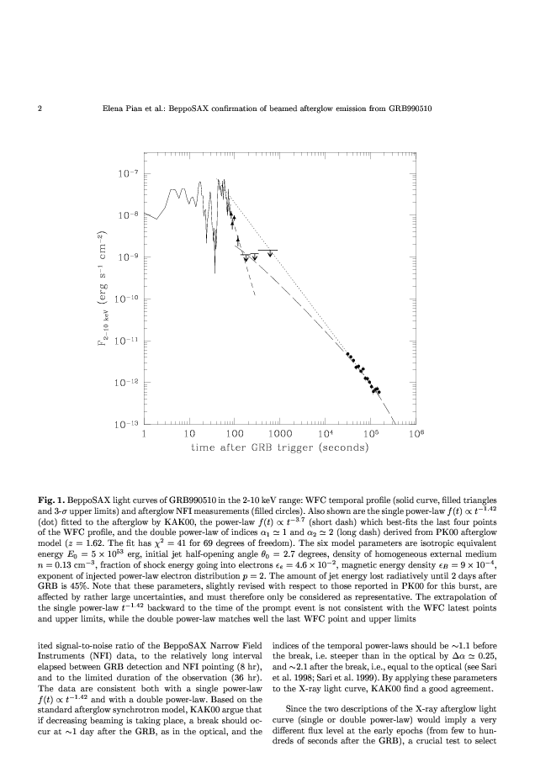

Slide 35
The SN-GRB Association Debate
Woosley , January 1993, AAS, 97, 205 : Neither shock escape From CC supernovae
(Colgate, 1968, Canadian J. Phys. 46, S476; Colgate and Petschek, 1979, ApJ, 229, 682)
nor stripped envelope (bare collapse) supernovae (Goodman, Dar and Nussinov,
1987, ApJL 314, L7; Dar et al. 1992, ApJ, 388, 164), produce GRBs !
Woosley, March 1993, ApJ, 405, 273: Failed SNeIb (CC to BH without visible SN)
produce mildly relativistic jets that produce GRBs , while:
Shaviv and Dar, 1995 ApJL, 447, 863: GRBs are produced by highly relativistic, narrowly
collimated jets of ordinary matter ejected in mass accretion episodes on the compact
objects in stripped envelope SN explosions, in microquasars, and in merger of Neutron Stars.
Dar 1997, ApJL, 500, L93: The Jets produce also a narrowly beamed afterglow.
Galama et al. 1998, Nature , 395, 670; Iwamoto et al. 1998, Nature, 395, 672 :
SN1998bw in the error box of GRB 980425 (Pian et al. 2000, ApJ, 536, 778) ➔
Woosley et al. 1999, ApJ, 516, 788 ; MacFadyen & Woosley, 1999, ApJ, 524, 262, and
the entire GRB community (until GRB130427A-SN 2013cq): The GRB-SN association is only between low-luminosity GRBs and a rare type of very energetic SNeIc (Hypernovae)
But, Dar 1998, Dar & Plaga 1999, Dar 1999, Dado, Dar, De Rujula 2001-2003, Zeh et al. 2004 : Photometric and/or spectroscopic evidence that SNIc akin to SN1998bw was found allmost in every LGRBs/XRFs where it could be seen and was looked for, but absent in all other cases.
By now (2017), the SNIc-LGRB association was confirmed by many more spectroscopic and photometric observations. No evidence yet whether the remnant is BH, n*, or a quark star.

