Slide 1
Progress on the Development of Astrophysics and Space Science at Viet Nam National University HCMC
Phan Bảo Ngọc
Department of Physics
International University – Vietnam National University HCMC
Windows on the Universe ICISE, Quy Nhơn city, 5 August – 11 August 2018

Slide 2
Outline
Why do we need to develop Space Science in Viet Nam?
The undergraduate program of space engineering at IU, VNU-HCMC
Proposal for the development of Space Science in Viet Nam

Slide 3
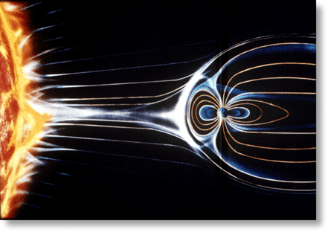
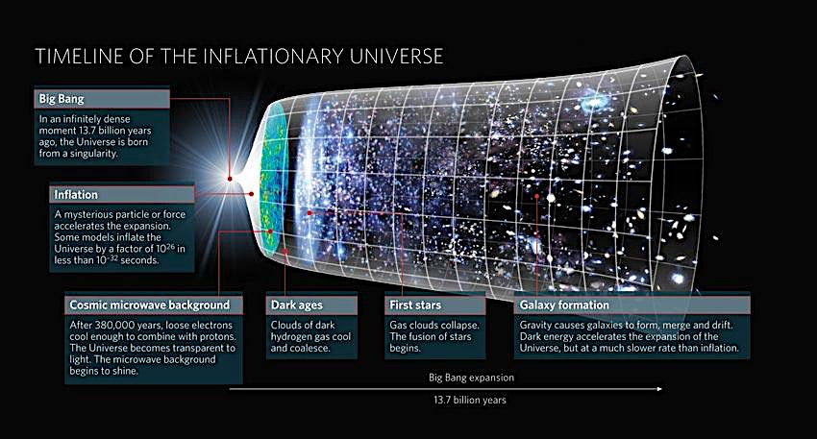
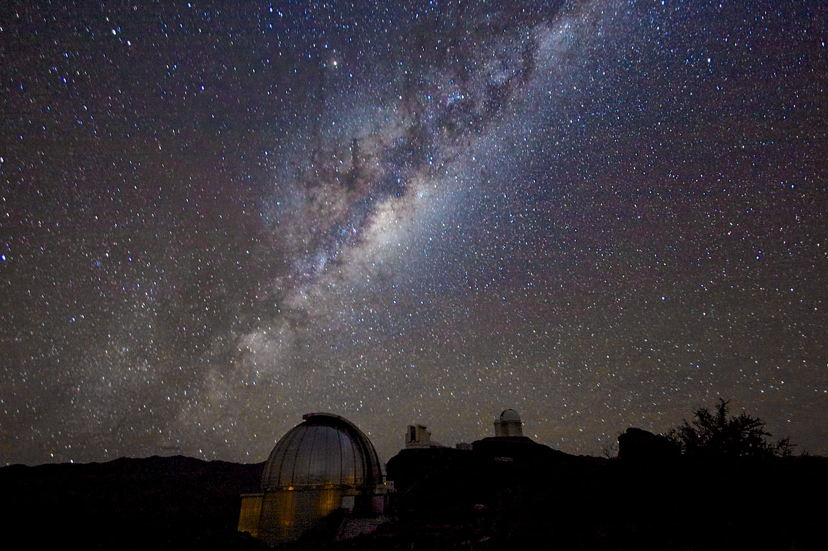
Why do we need to develop Space Science in Viet Nam?
Space science encompasses many scientific areas:, Astrophysics, Space Physics, Planetary Science, Cosmology, Astroparticle physics, Astrochemistry, Astrobiology,...
spacephysics.msfc.nasa.gov
nature.com
ESO.ORG

Slide 4
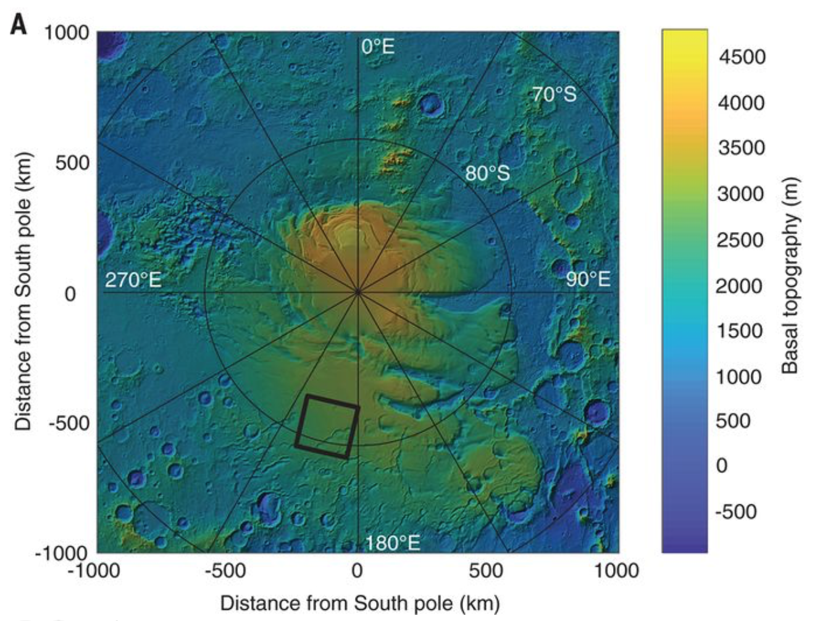
In the 21st century, space science plays a key role in knowledge discovery, technology innovations, and sustainability.
Radar evidence of subglacial liquid water on Mars
(Orosei et al. 2018, Science 10.1126/science.eer7268)

Slide 5
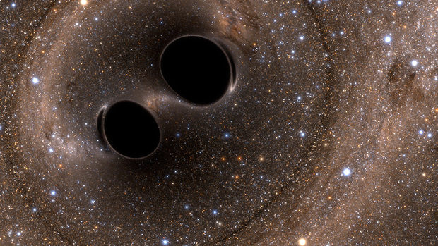
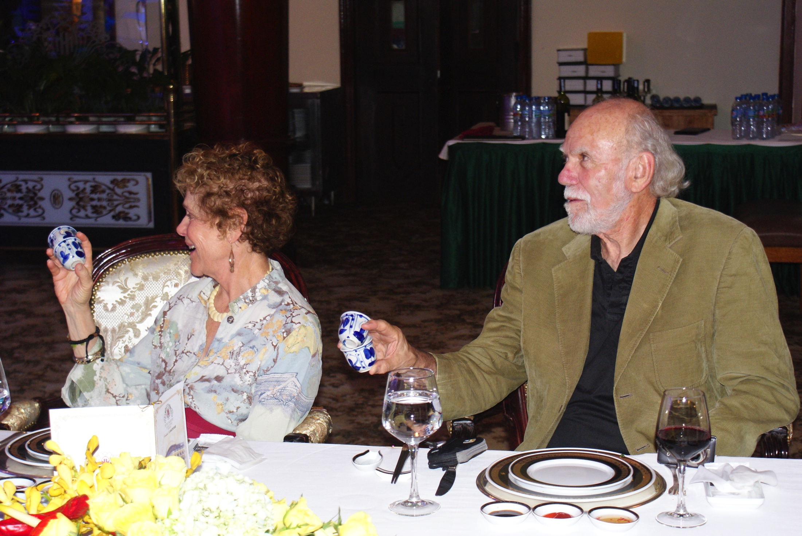
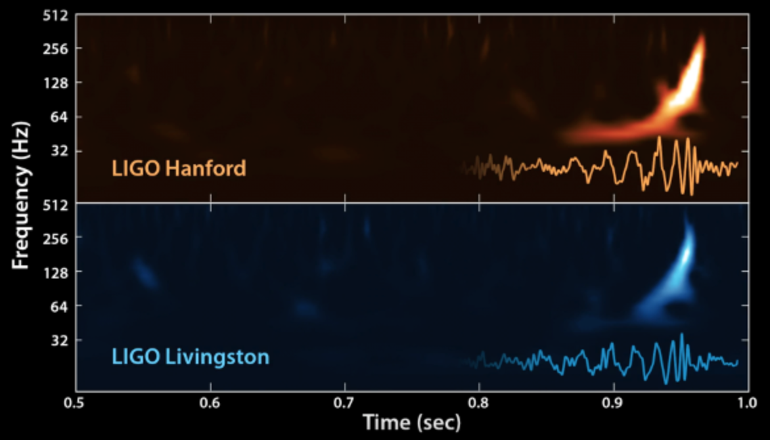
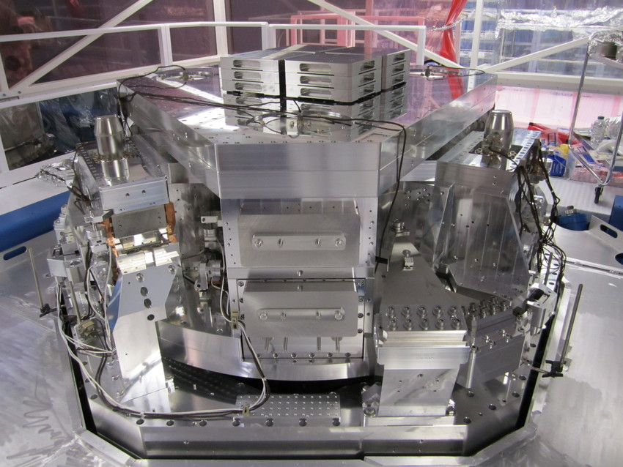
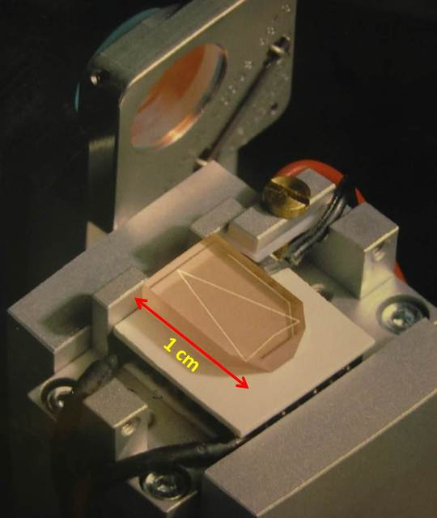
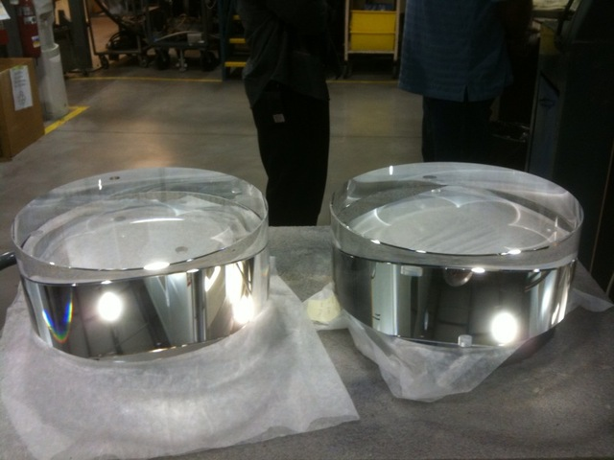
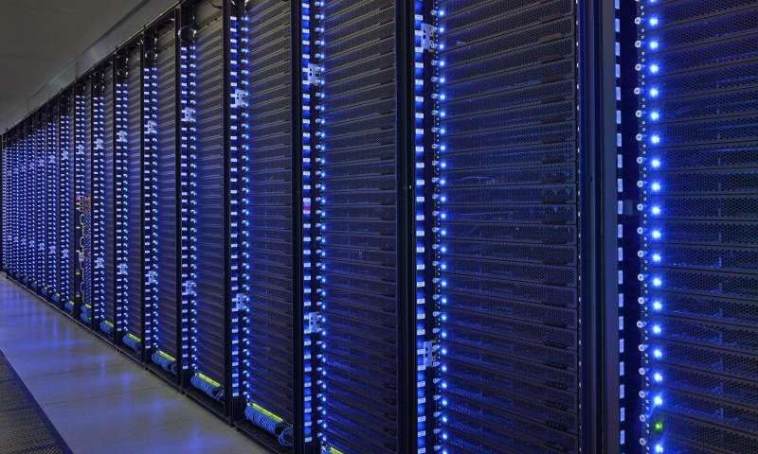
10 August 2013
14 September 2015
Image credits: ligo.caltech.edu, phys.org
LIGO’s Extreme Engineering
(measure a motion 10,000 times smaller than an atomic nucleus)
Seismic isolation
Optics system
Supercomputer

Slide 6
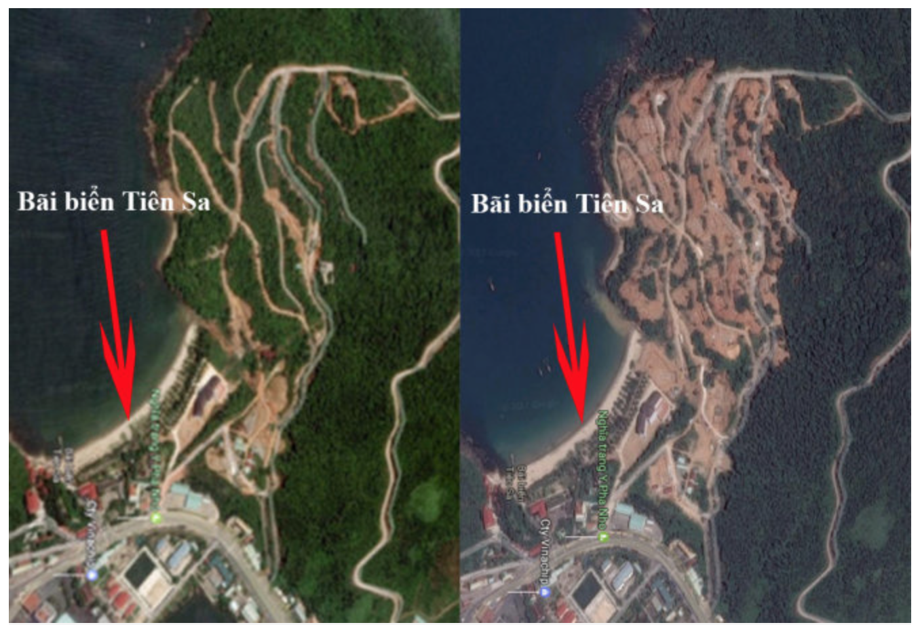
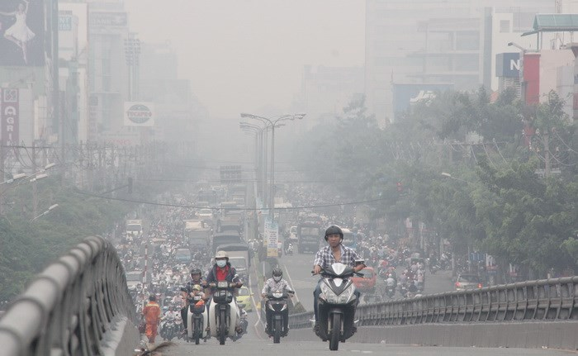
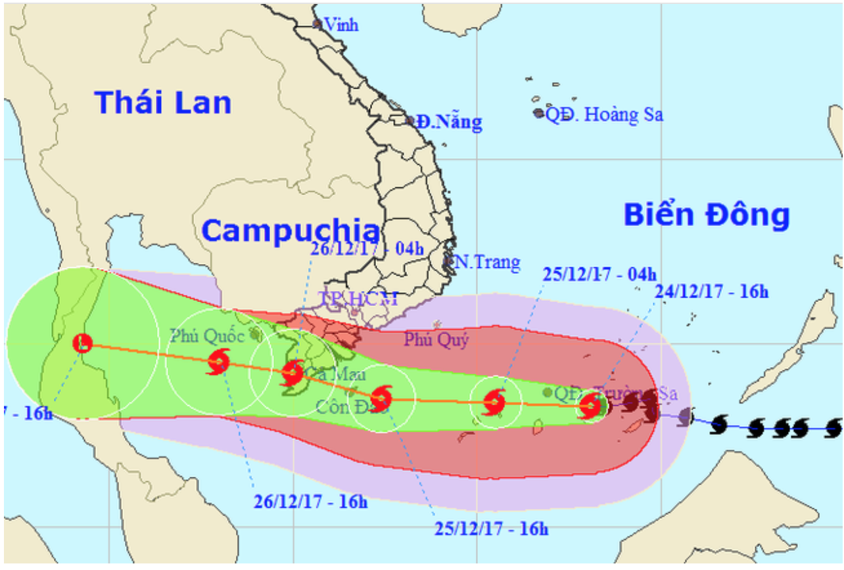
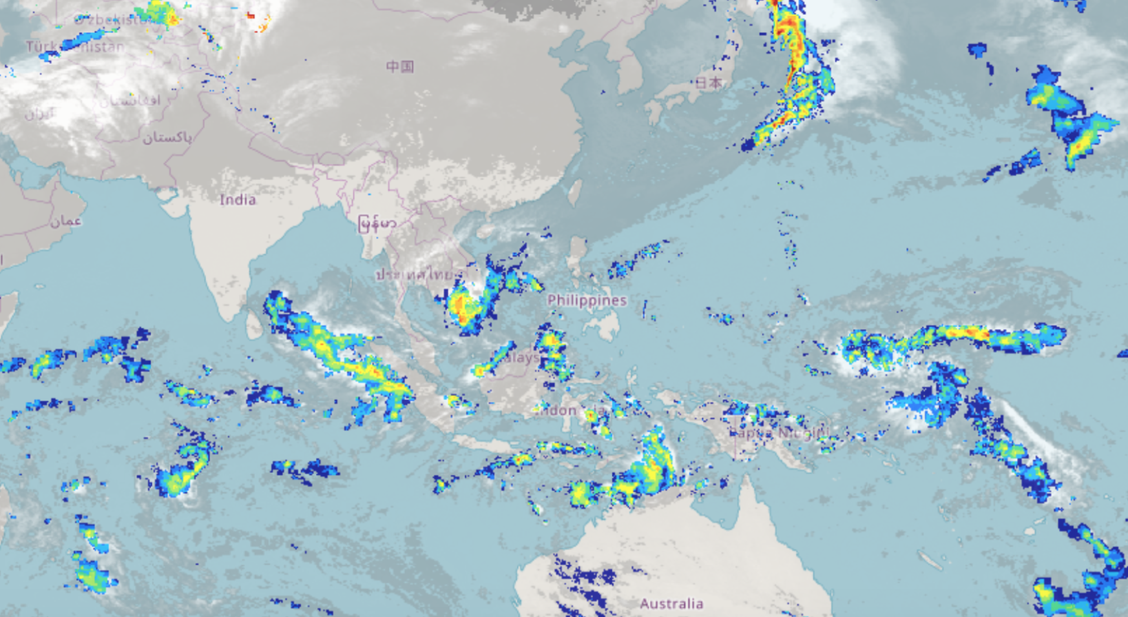
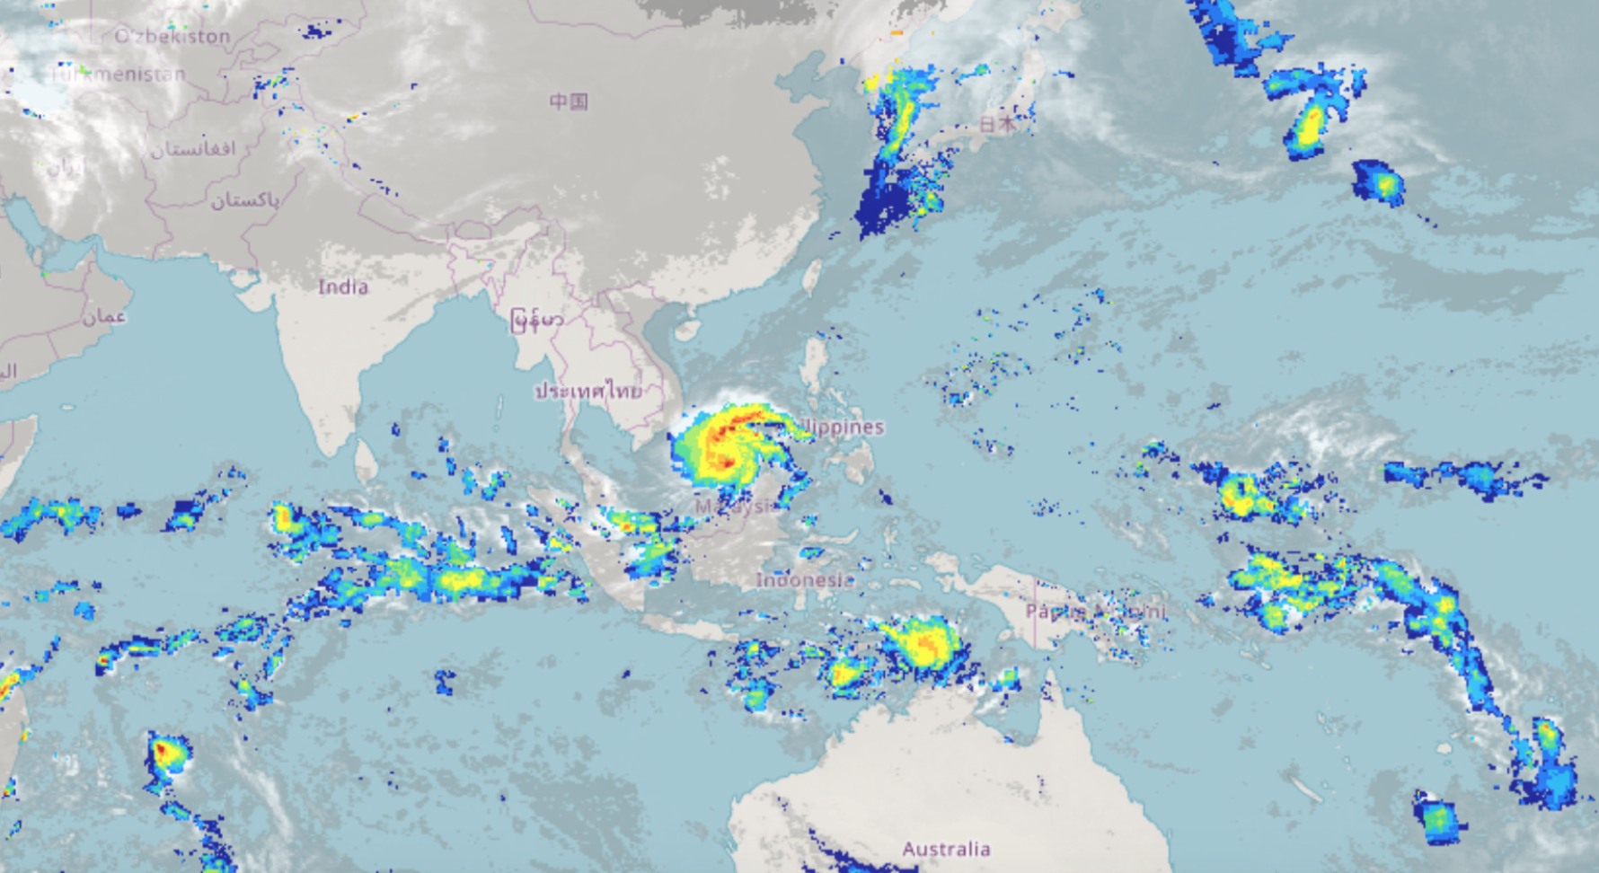
Deforestation
Air pollution
Half day of 25 Dec
and 26 Dec off in HCMC
Tembin hurricane
25 December 2017
24 Dec 2017
24 Dec 2017
source: vtv.vn
Jaxa Global Rainfall Watch

Slide 7
Country | Population (millions) | 2017 GDP (PPP) (billions of USD) | Astronomy
China | 1382.3 | 23,159 | developed
Indonesia | 260.6 | 3,028
Japan | 126.3 | 5,405 | developed
Philippines | 102.3 | 1,023
Viet Nam | 94.4 (14/233) | 595 (32/233)
Thailand | 68.2 | 1,261 | developing
Myanmar | 54.4 | 311
South Korea | 50.5 | 2,029 | developed
Malaysia | 30.8 | 863
Taiwan | 23.4 | 1,177 | developed
Cambodia | 15.8 | 24
Laos | 6.9 | 59
Singapore | 5.7 | 488

Slide 8
Classification of the development of Astronomy of a country (in my opinion):
Developed:
Funding from the government for Astronomy (i.e., national level).
Member of big international projects (i.e., manpower in technology and science, funding)
Developing:
Funding from the government for Astronomy.
With 94 million people, very rapid economic growth,
potential talented scientists (many gold medals in international Olympiads in Mathematics, Physics, Chemistry,...), Viet Nam should consider Japan, South Korea or Taiwan as references for the development of science and technology.

Slide 9
2. The undergraduate program of space engineering at IU, VNU-HCMC
Viet Nam has 235 universities (170 public and 65 private) with 1.76 million students.
However, Astrophysics in Viet Nam has not developed much:
Only three small groups in Astrophysics: VATLY and IOP in Ha Noi and HCMIU in HCMC.
The number of scientists: 10-15.
Annual summer schools/conferences organized in Quy Nhon.

Slide 10
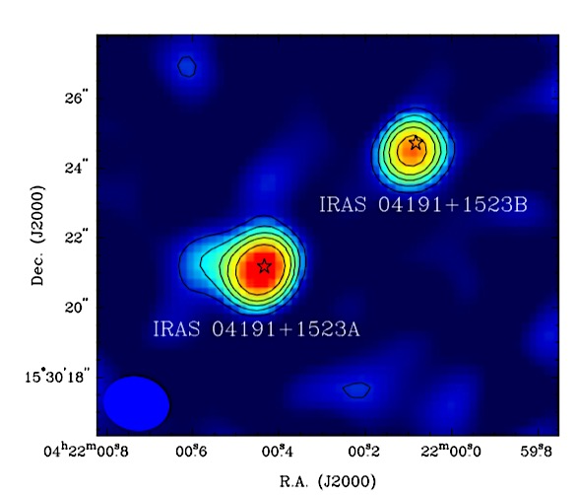
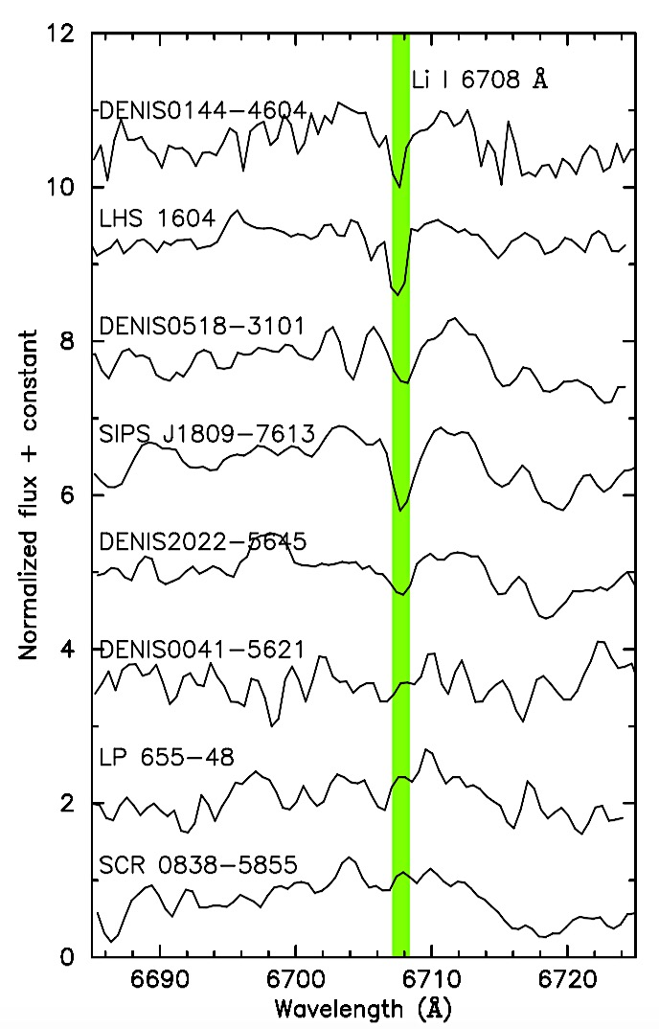
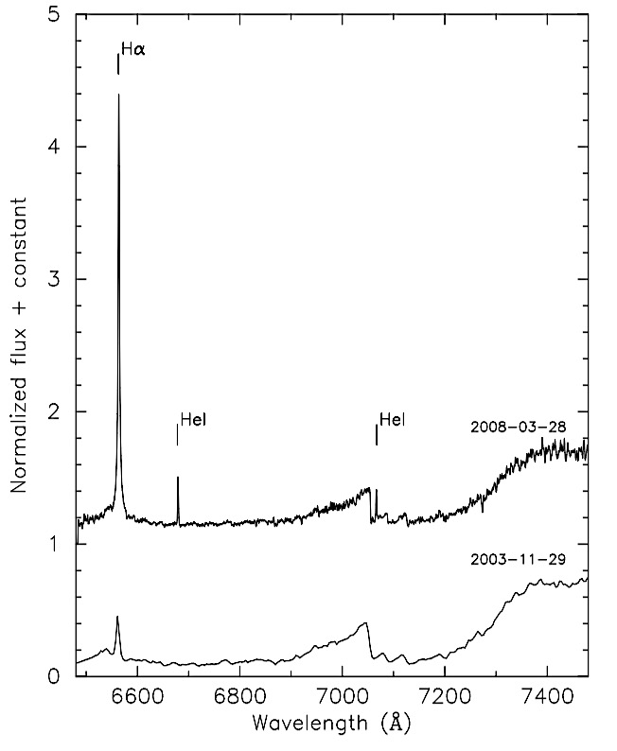
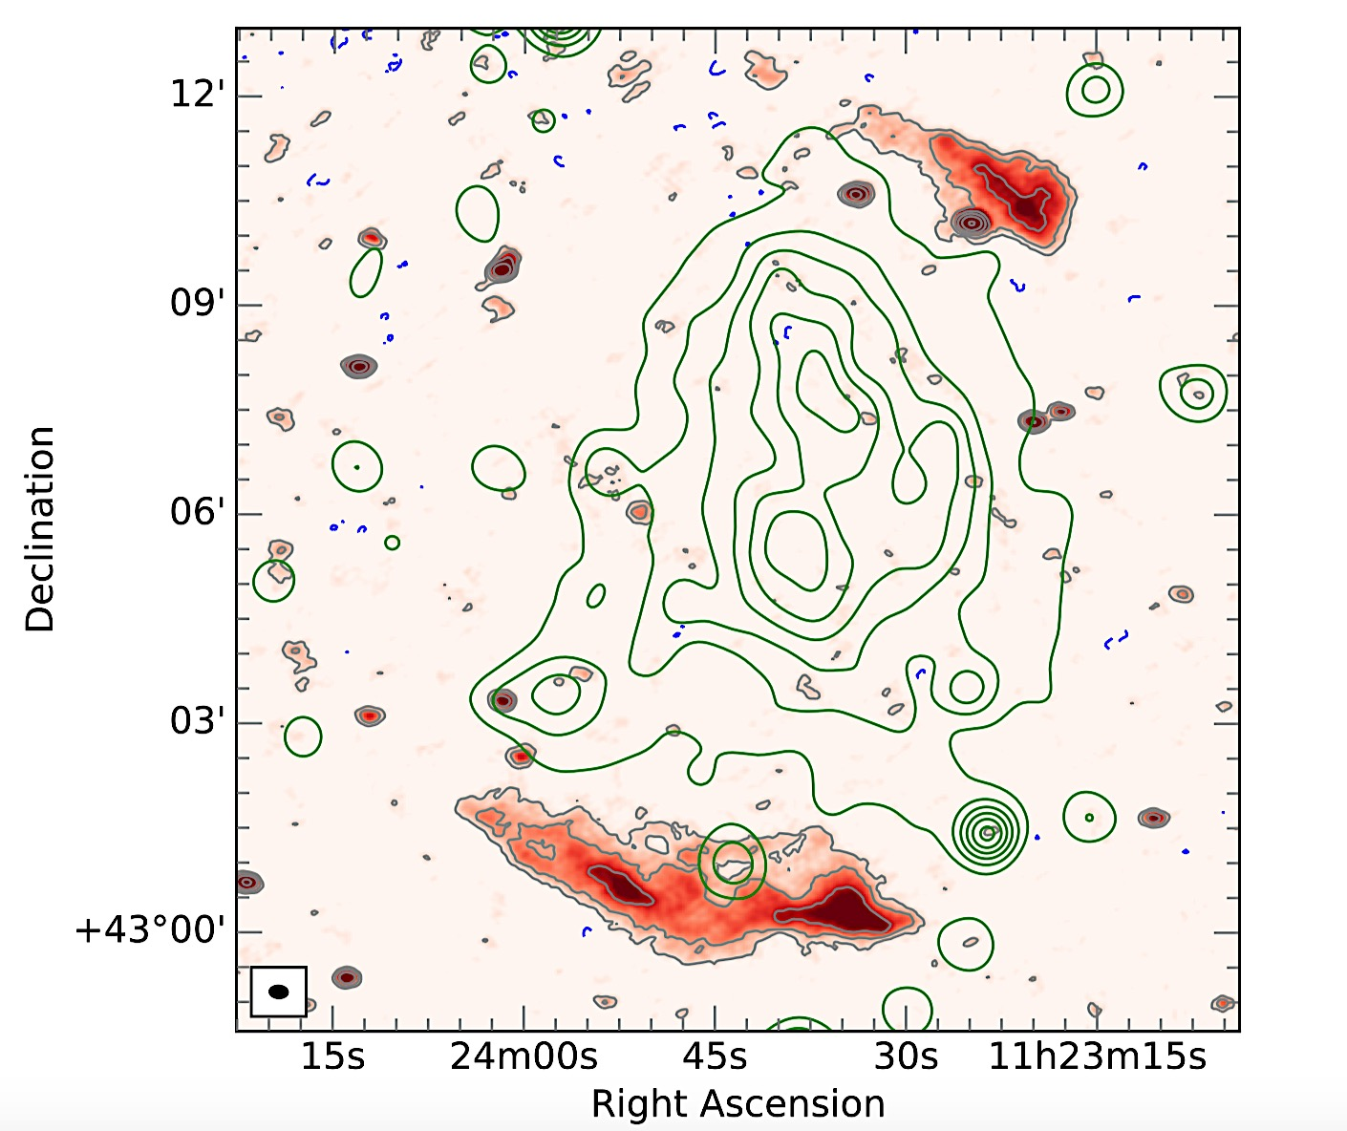
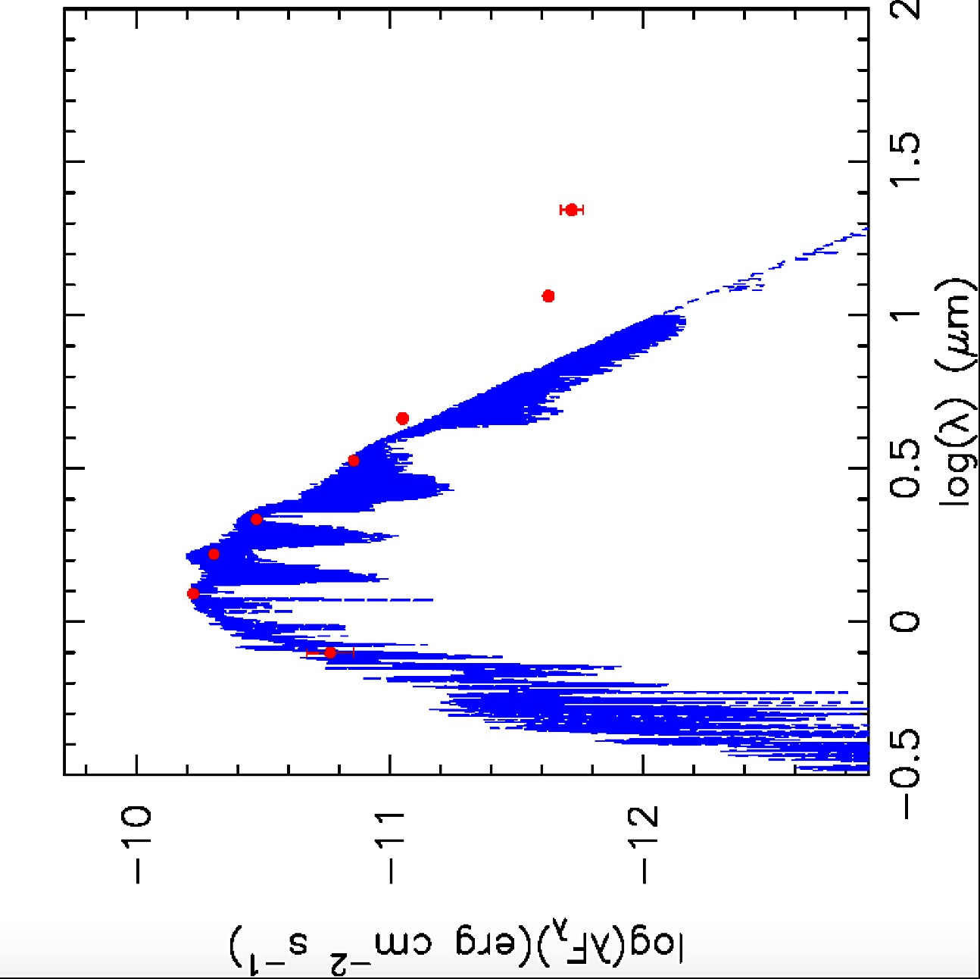
Astrophysics Group at HCMIU
(Dang-Duc et al. 2016, A&A Letters, 588, L2)
(Phan-Bao et al. 2017, A&A, 600, A19)
(Hoang et al. 2018, MNRAS, 478, 2218)
(Nguyen-Thanh et al. 2018, A&A, submitted)

Slide 11
However, Viet Nam need to have a sustainable program that seeks and trains young and excellent scientists for Space Science.
Therefore, we created a 4-year undergraduate program of space engineering (focusing on remote sensing and global navigation satellite system) at IU-VNUHCMC:
Selecting young potential scientists for Space Science (including Astrophysics).
Training engineers in satellite applications.
Viet Nam has two national university systems:
VNU-Hanoi: 31,000 students (21,000 under and 10,000 graduates)
VNU-HCMC: 65,000 students (55,000 under and 10,000 graduates)

Slide 12
VNU-HCM
UNIVERSITY OF SCIENCE
INSTITUTE FOR ENVIRONMENT & RESOURCES
UNIVERSITY OF SOCIAL SCIENCES & HUMANITIES
SCHOOL OF MEDICINE
VNU-IT PARK
UNIVERSITY OF TECHNOLOGY
Center for Information Technology Development
INTERNATIONAL UNIVERSITY (7,500 students)
Center for Testing & Quality Assessment
UNIVERSITY OF INFORMATION TECHNOLOGY
Institute for International Education
UNIVERSITY OF
ECONOMICS AND LAW
John von Neumann Institute Center of Excellence
High school for the Gifted

Slide 13
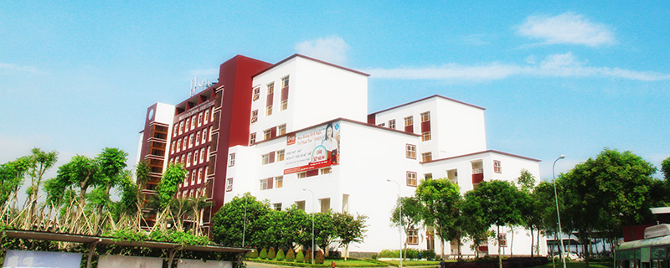
International University:
A member of VNUHCM
A public, financial autonomy university.
4 schools and 7 departments.
7,500 students.
17 under (including Space Engineering) and 12 graduate programs.
All training programs in English.
One of the leading research-oriented universities in Viet Nam.
Annual publication rate: 0.8 ISI paper/lecturer.

Slide 14
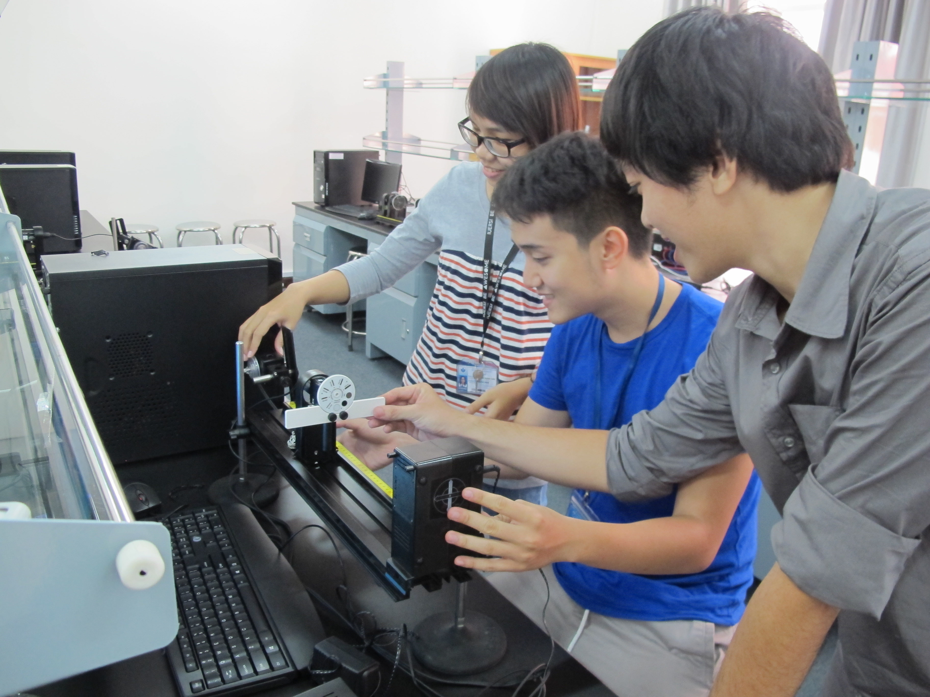
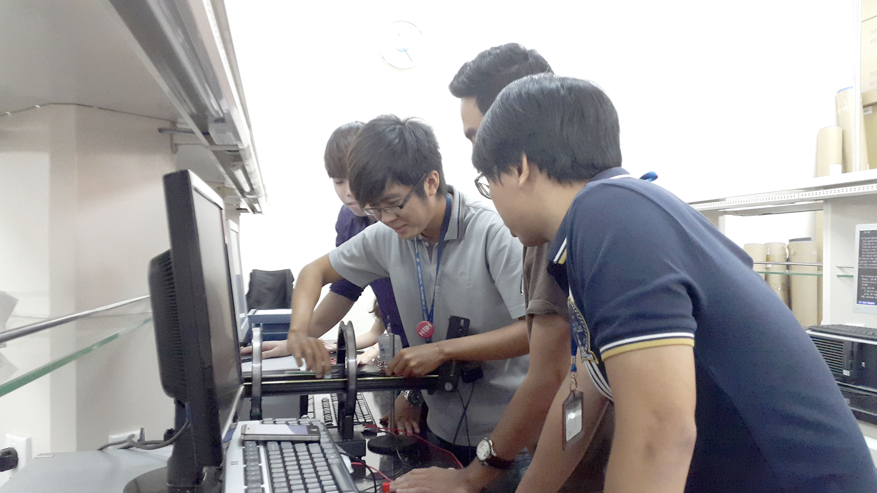
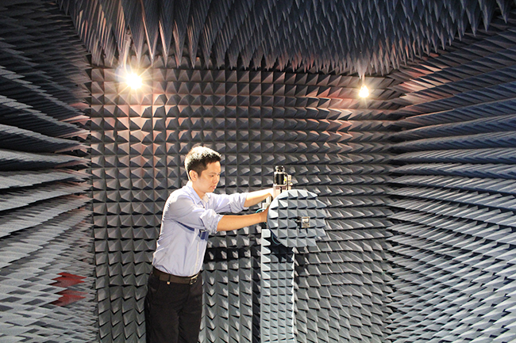
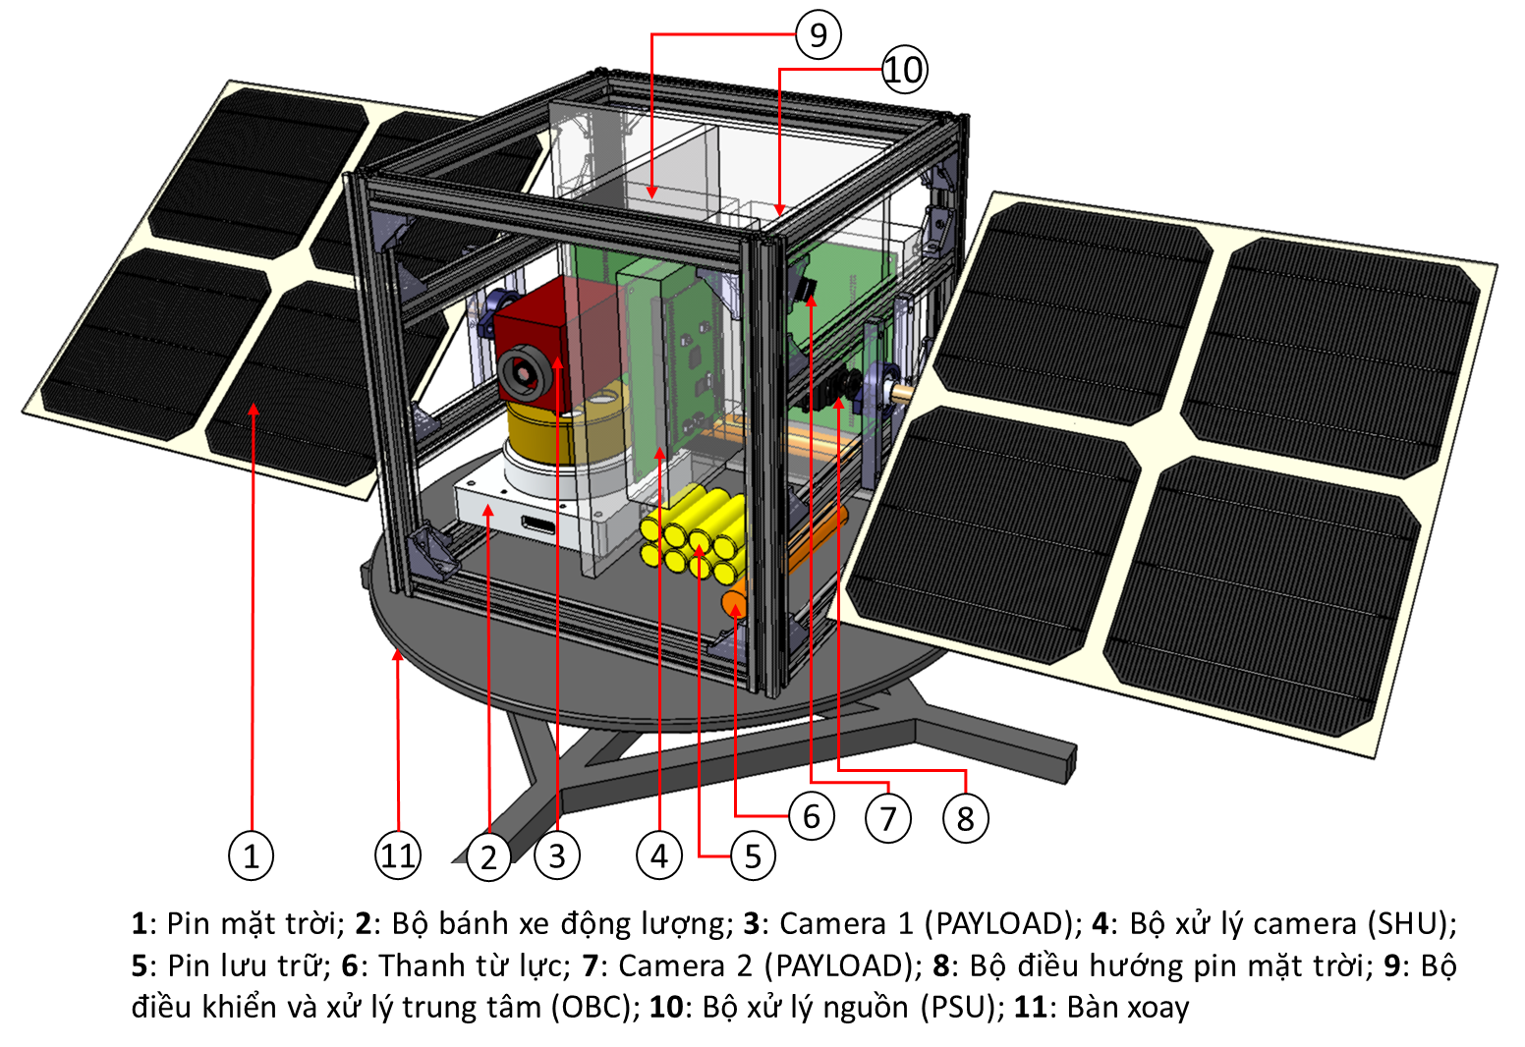
Electricity & Magnetism Lab
Optics Lab
Antenna and Microwave
Engineering Lab
Satellite Signal and Image Processing
Lab

Slide 15
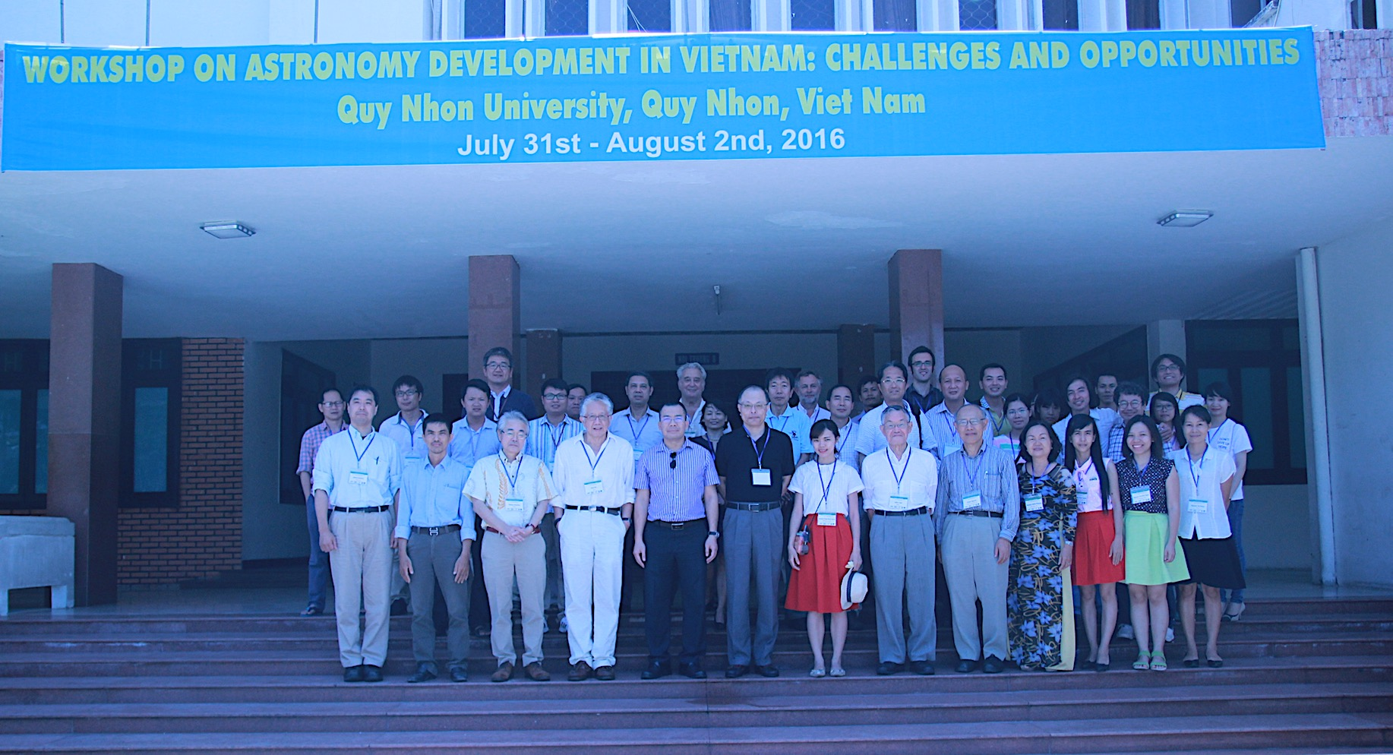
In August 2016, we had a workshop on Astronomy development in Viet Nam: Challenges and Opportunities (many useful comments and discussion).

Slide 16
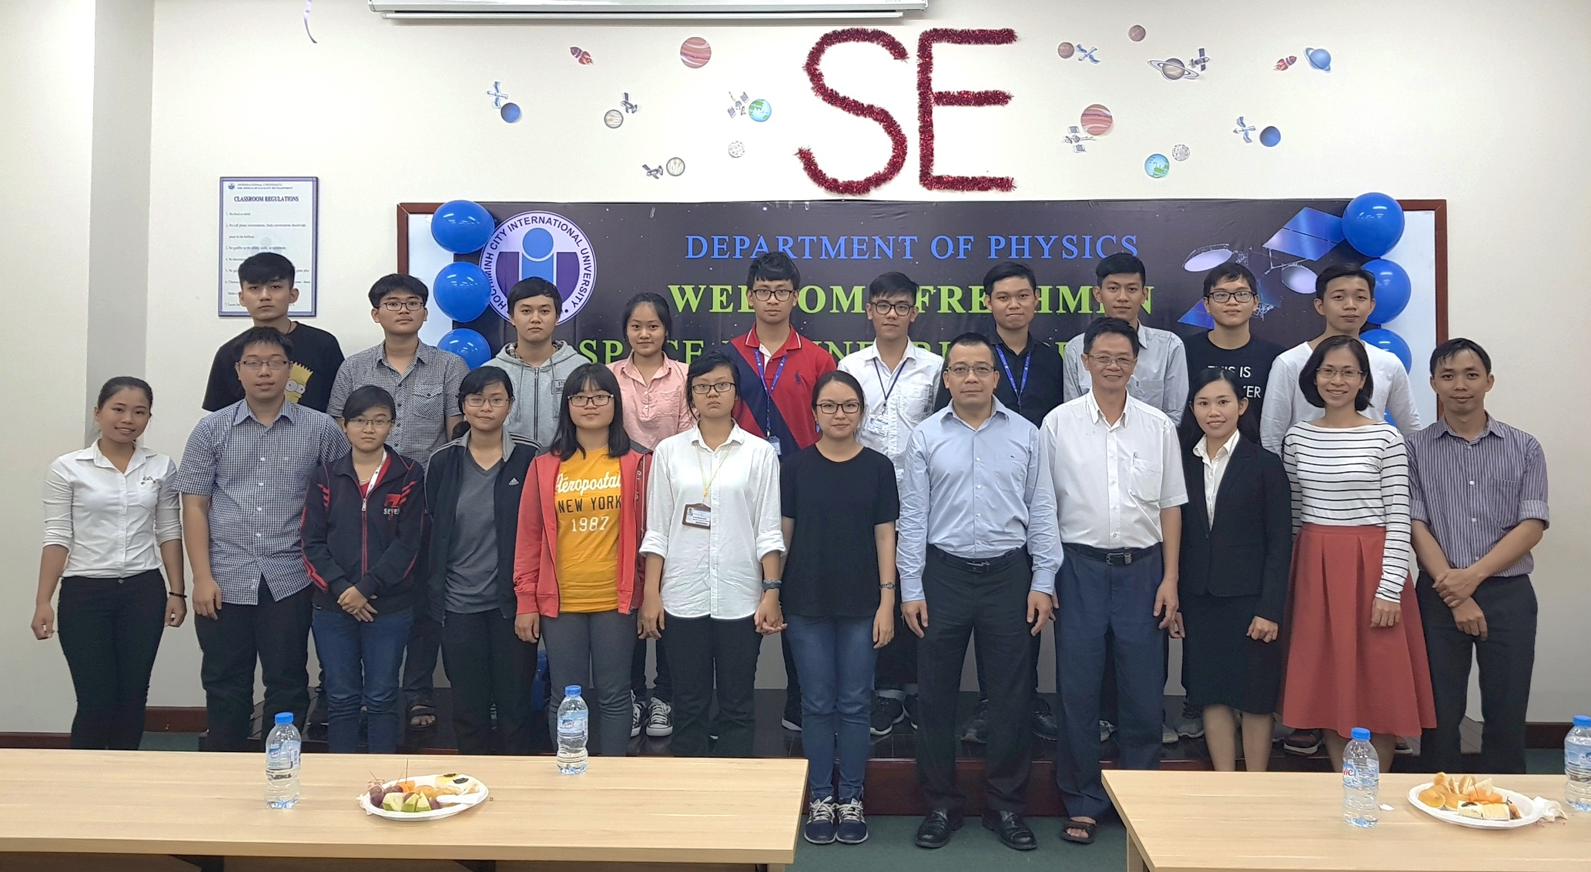
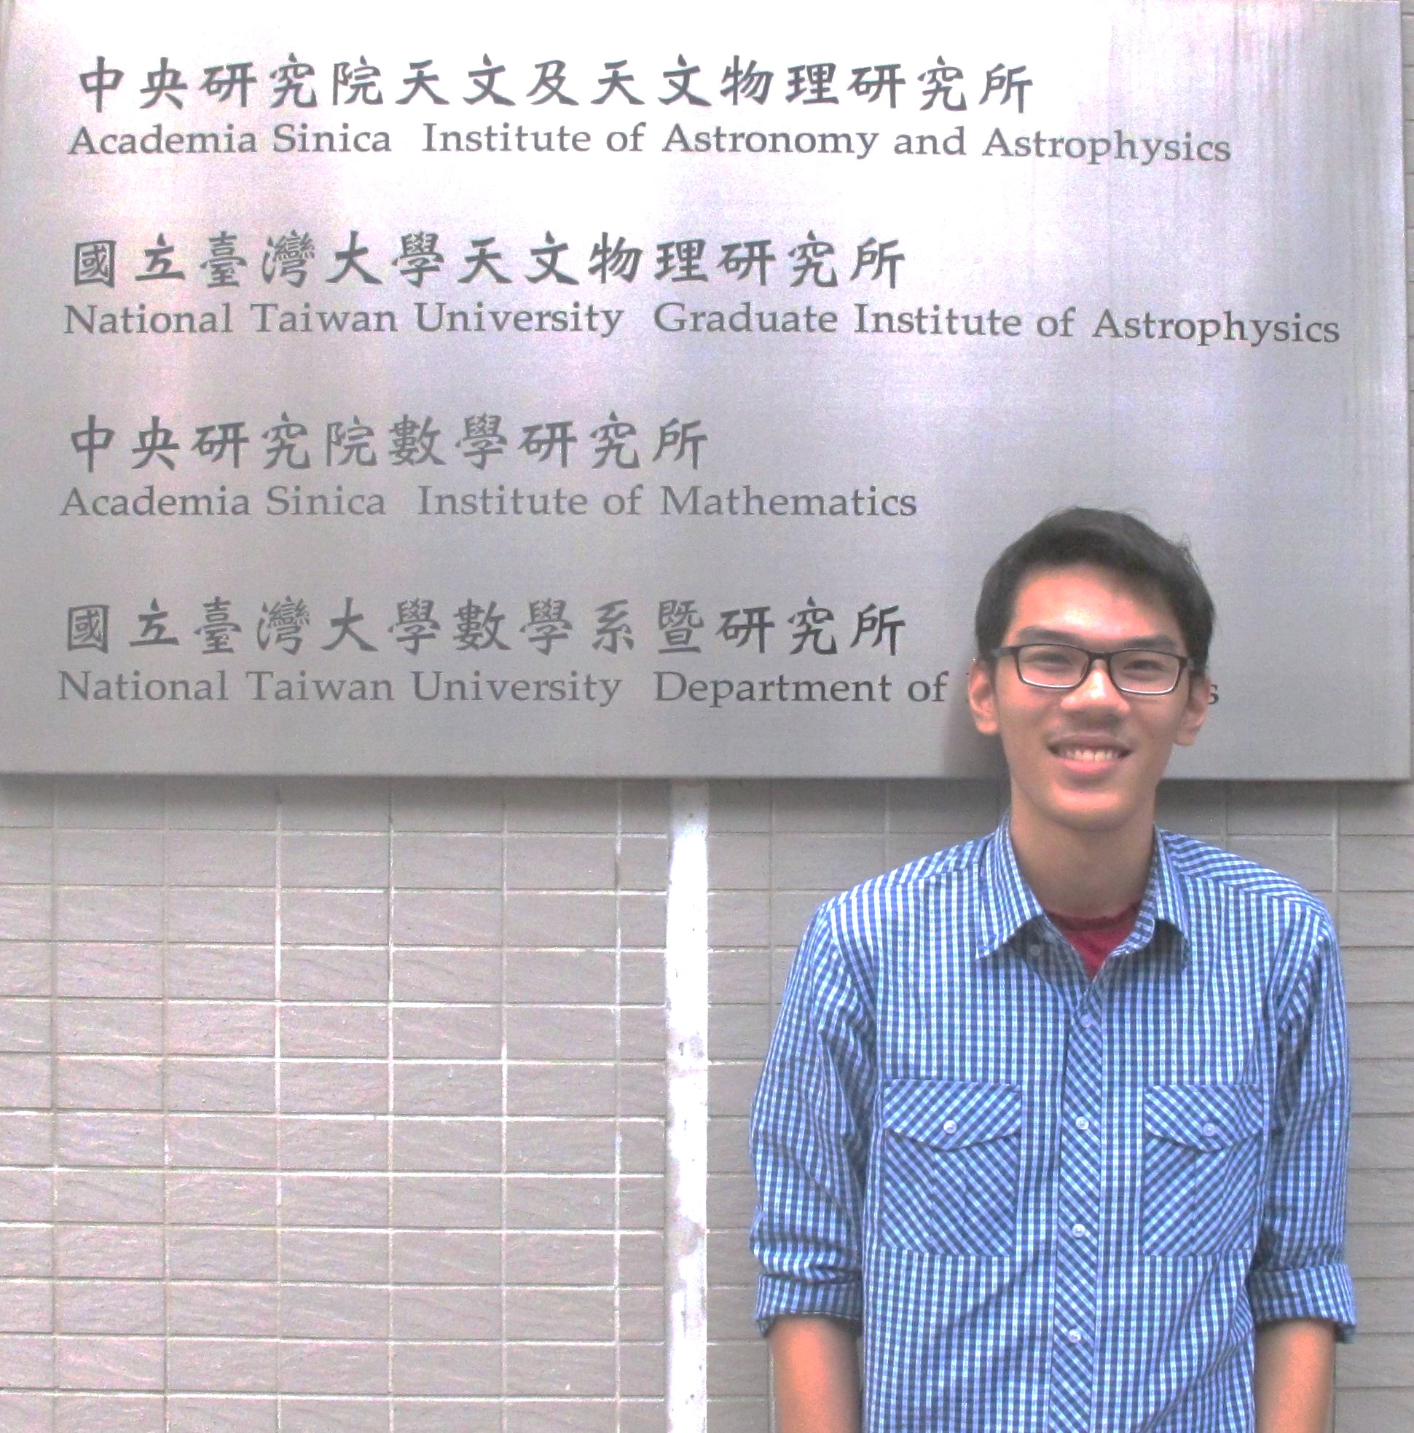
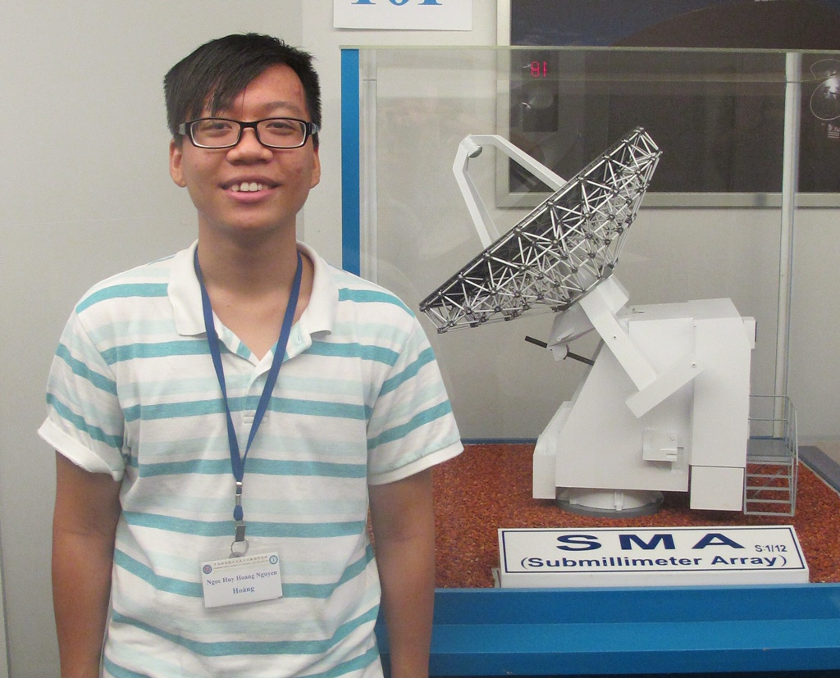
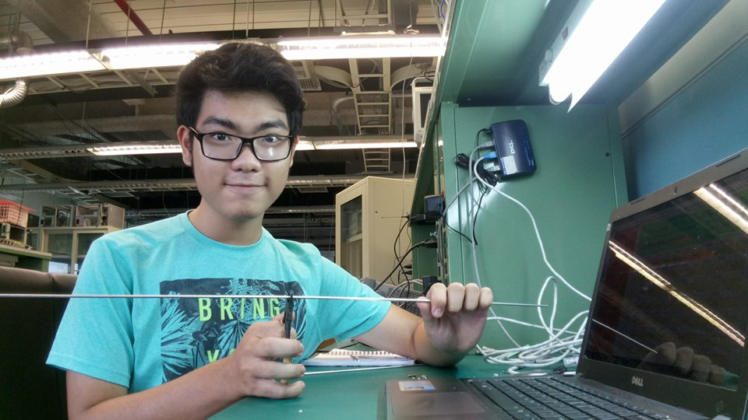
Report on the training program
Batch 2016-2020
Batch 2017-2021
The first three internships in ASIAA, Taiwan
Nguyen Phuc Dat
Nguyen Ngoc Huy Hoang
Le Kim Long
Performance testing of Prime Focus Spectrograph Acquisition and Guide Camera
Performing testing of the cartridge-type multi-pixel receiver at 1.5 THz Based on HEB Mixers
Project on radiation patterns of 2 different types of antenna

Slide 17
Report on the collaboration with East Asian Observatory
and other activities:
In May 2017, East Asian Observatory and Viet Nam National University signed an MOU:
VNUHCM (observer) is a representative of Viet Nam in collaborating with EAO.
All Vietnamese scientists have access to observing time at JCMT, SMA and Subaru telescopes.

Slide 18
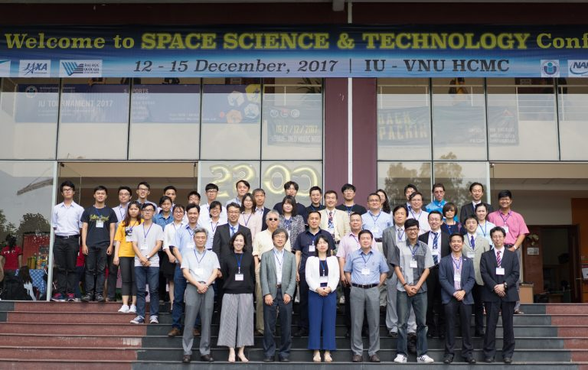
In Dec 2017, we organized the conference on Space Science and Technology in HCMC:

Slide 19
After the conference:
1-2 interns in SOKENDAI, Japan.
Sending 3-4 lecturers on space science and technology to HCMIU.
A possible visit of the president of VNUHCM to ISAS/JAXA and SOKENDAI to promote collaboration.
Working on other possible collaborations.
In March 2018, we established a foundation for basic science VNUHCM - Rencontres du Vietnam to support scientists and graduate students in particle physics, astrophysics and cosmology.

Slide 20
3. Proposal for the development of Space Science in Viet Nam
So far, what have we done?
Created an undergraduate program for Viet Nam.
Established an internship program with ASIAA (Taiwan), Sokendai (Japan).
Created a research group at VNUHCM.
Created a linkage with East Asian Observatory.
Established a foundation for basic science VNUHCM-Rencontres du Viet Nam.
However, we have not received any support from the central government!

Slide 21
Proposal to the government on the development of Space Science (including Astrophysics):
Joining EAO officially:
Having access to optical and radio telescopes (Subaru, JCMT and SMA) at low-cost contribution (8-10 K USD) to do research.
Training young scientists in Astrophysics and Cosmology.
Training engineers in electronics and antenna technology.
This is an important preparation before Viet Nam has its own telescopes.
Funding travel expenses for sending scientists, students and engineers to EAO’s observatory and receiving experts from Japan and Taiwan.
The success of our space science program could be used as a model for particle physics in Viet Nam.

Slide 22
Thank you very much
for your listening and organizing this conference!

