Slide 1
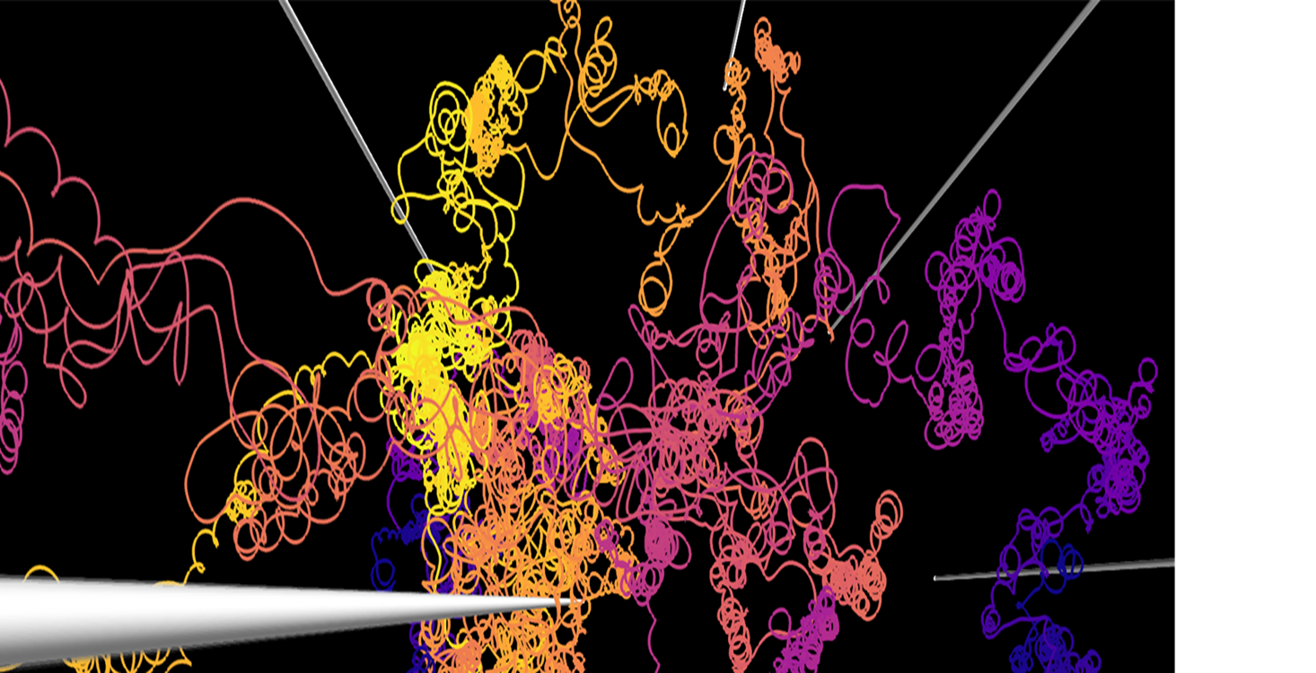

Ruhr Astroparticle and Plasma Physics Center
Cosmic Ray Transport Models
An overview of current simulation frameworks
Lukas Merten, Ruhr-Universität Bochum

Slide 2
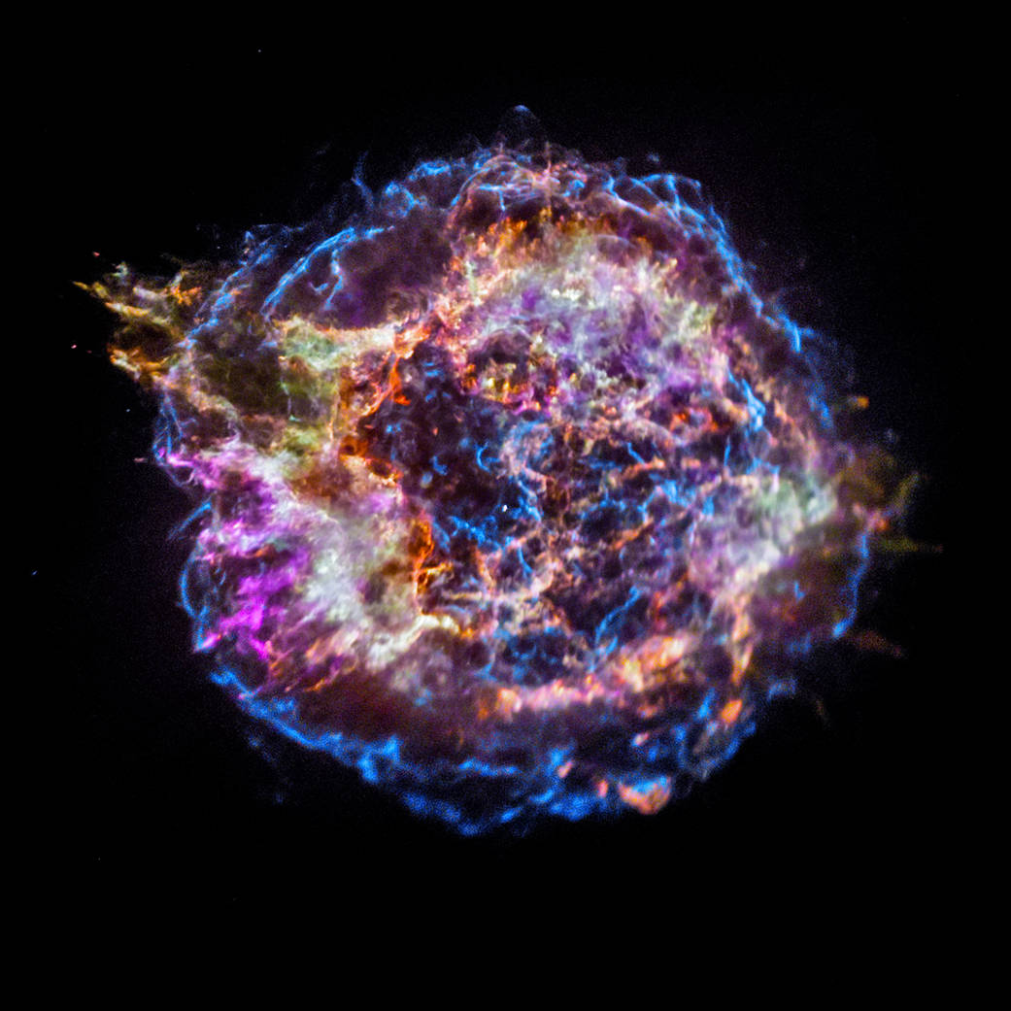


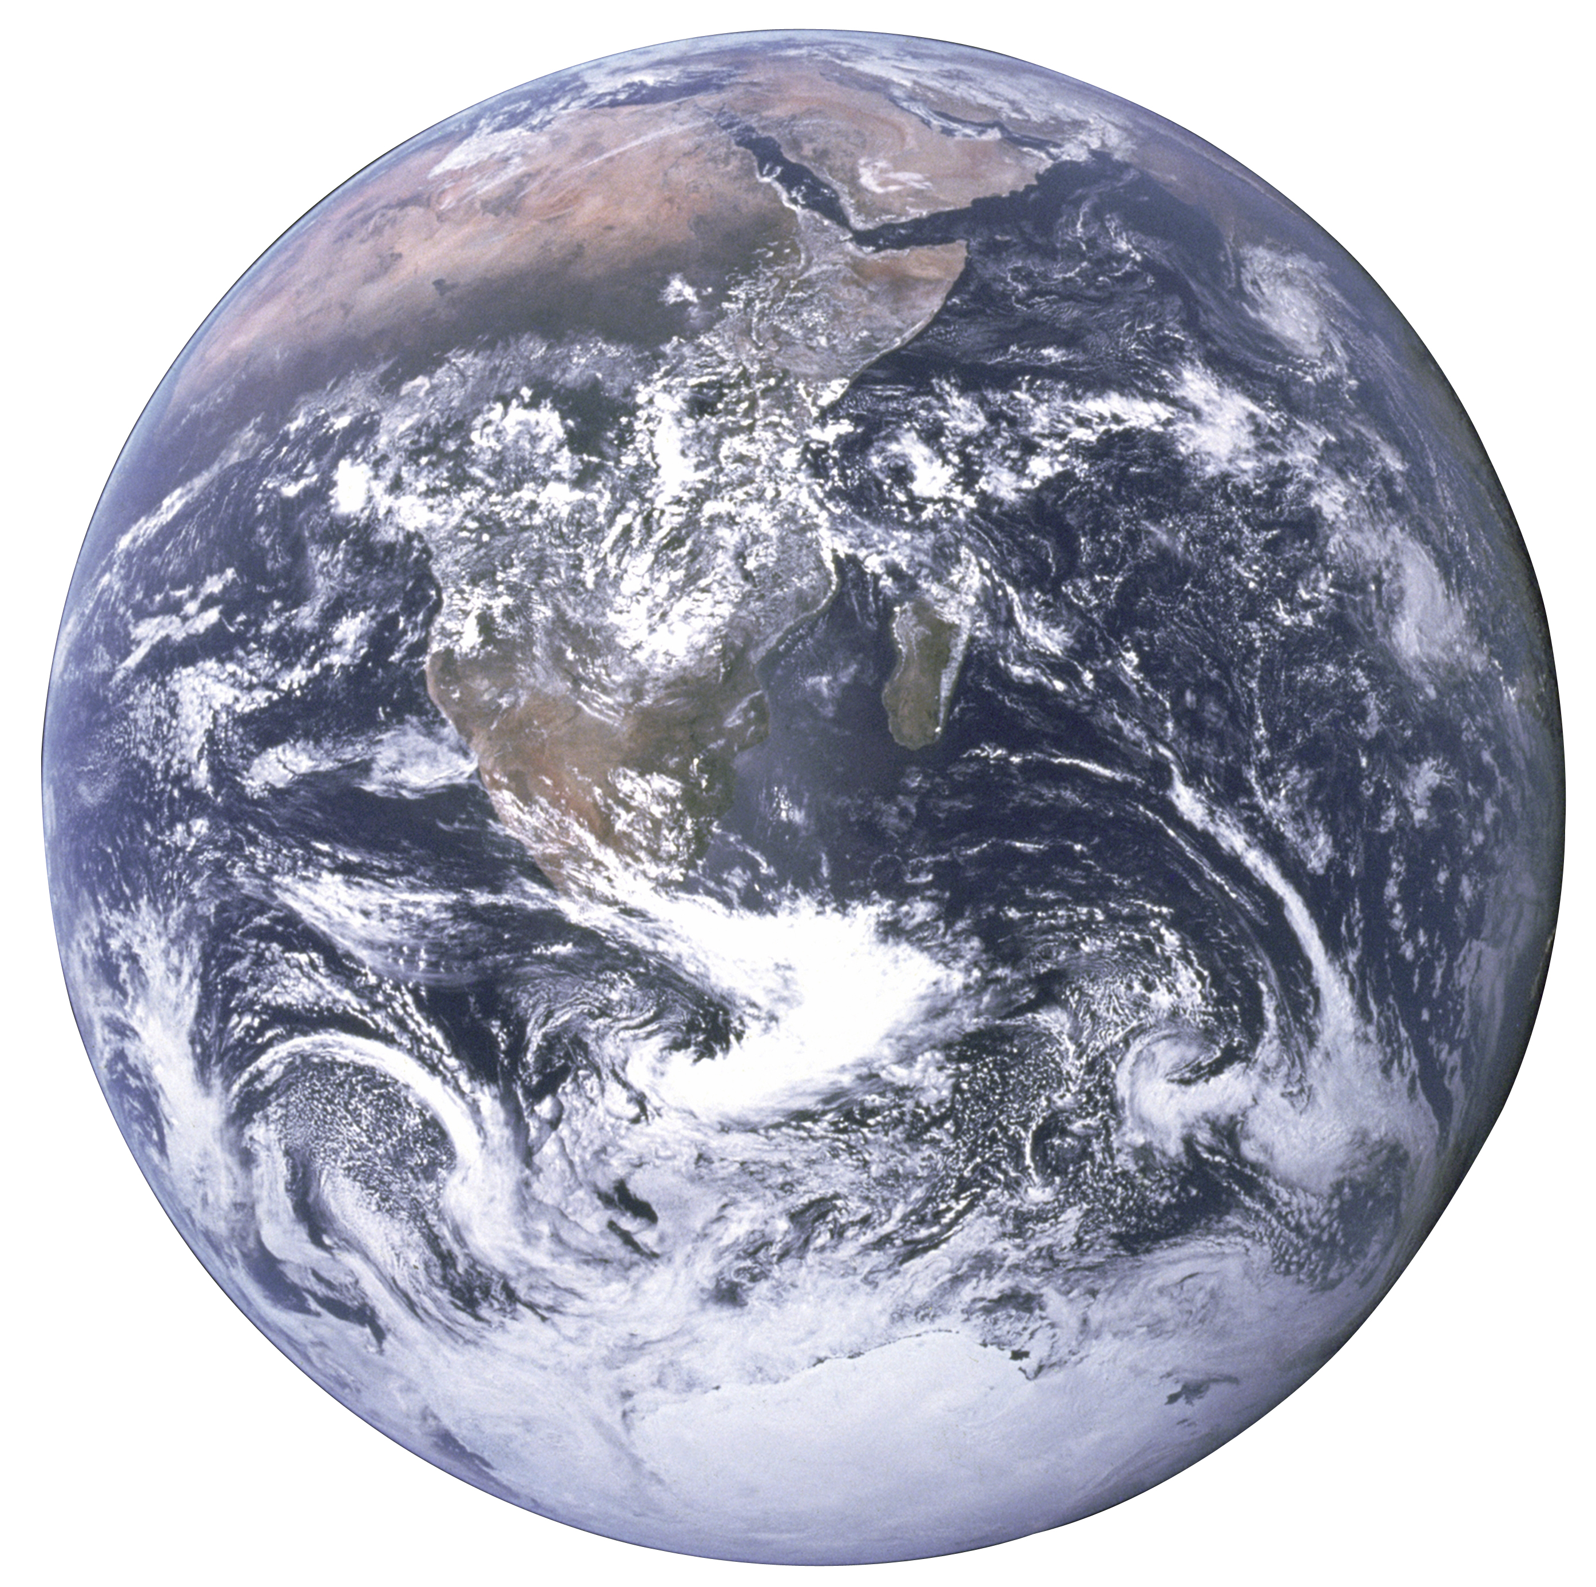

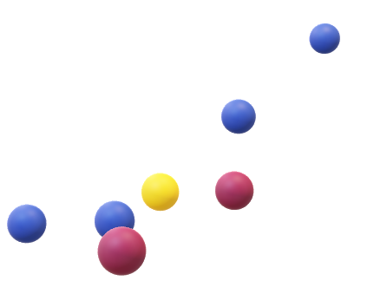
Why transport models?
NASA/CXC/SAO
Where are you from?
Where are they from?
No idea
Maybe from CasA
NASA
Transport model

Slide 3
Contents
Propagation Tools
Examples
Summary / Outlook
Selected transport problems

Slide 4
Selected Problems

Slide 5
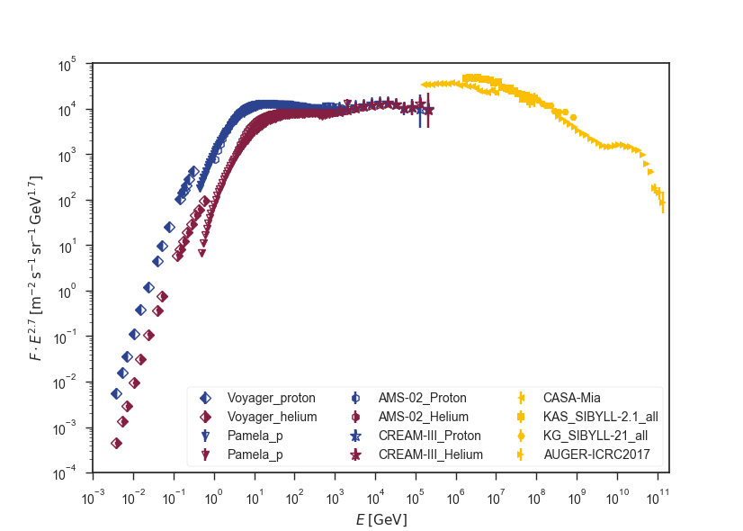
Spectrum
Notes:
Spectrum with line for expected spectrum of diffusive shock acceleration

Slide 6
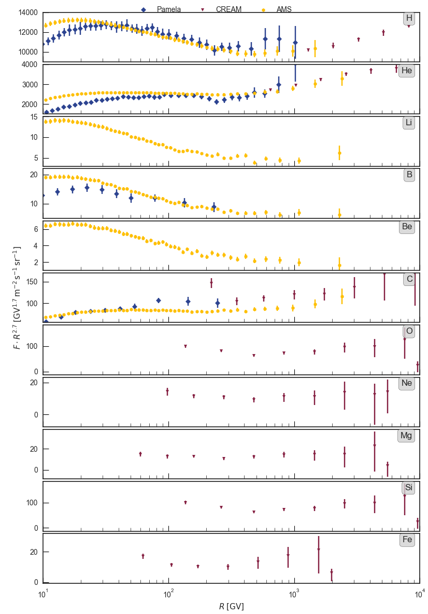
Break @ 300 GV
Derome@CRISM2018
Conclusions:
Break around same rigidity
Visible in primaries and secondaries
More pronounced in secondaries
→ Probably transport related
Notes:
Derome → http://doi.org/10.5281/zenodo.1300409
See e.g. also Genolino, PRL 119,241101 (2017)

Slide 7
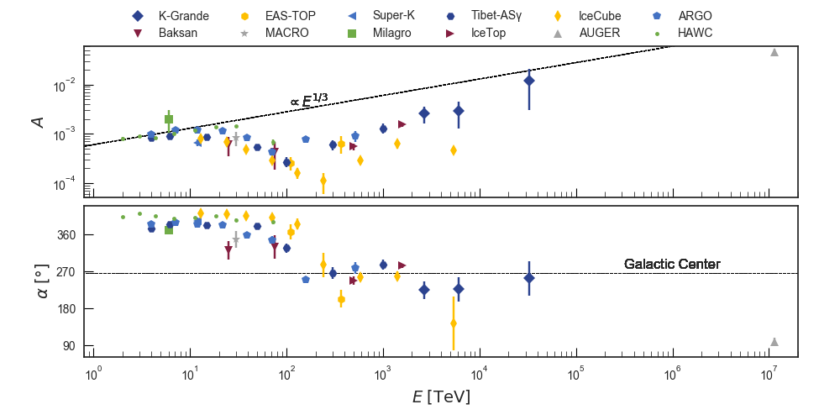
Arrival direction – Dipole
Notes:
Simple diffusion theories lead to A \propto E^1/3

Slide 8
Transport has to account for…
Steepening of the energy spectrum
Enhancement of light elements
Isotropization of arrival directions
DSA and weakly non-linear extensions vs. observation
CR vs. Solar abundances
Many breaks in energy spectrum
Sources? Self-induced turbulence? etc.
Overall low level but significant deviations
Notes:
List of things that have to be changed by the transport process:
-steepen the spectrum
-enhancement of secondary particles
-isotropization of arrival directions
-breaks in spectrum

Slide 9
Propagation Tools

Slide 10
A family tree of simulation tools
Transport models
Stationary
fields
Non-linear
Evoli+
Equation of Motion
CRPropa
SimProp
Timevarying
fields
PIERNIK+CRESP
Moving Mesh
Semi-Analytical
Grid based
Transport Equation
Analytical
Semi-Analytical
USINE
Grid based
GALPROP
DRAGON
PICARD
SDE
Kopp et al.
CRPropa
AREPO
HERMES
TransportCR
Matrix
Feydenowitch+
Notes:
HERMES: https://arxiv.org/pdf/1305.4364.pdf
TransportCR: https://arxiv.org/pdf/1406.0735.pdf

Slide 11
Equation of Motion
Principle: Propagate single CRs → Solve the equation of motion
Use Monte-Carlo sampling to account for losses
Codes: CRPropa (4D), SimProp (3D), TransportCR (1D), HERMES (1D)
Advantages
Real trajectories are available
Scales (in principle) linearly with available processors → Simple to parallelize
Reweighting after simulation is possible
Disadvantages
Slower than grid based methods
Collective behavior not easy to implement
Forward tracking often not effective
Notes:
CRPropa: www.desy.crpropa.de
SimProp: http://augeraq.lngs.infn.it/SimProp/

Slide 12
Magneto-Hydro-Dynamics (MHD+CR)
Principle: Discretize MHD equations (include terms for CRs)
Solve them on a temporally constant grid (Piernik+CRESP)
or Solve them on a moving mesh (AREPO)
Codes: AREPO (+extensions), Piernik + CRESP
Advantages
Evolution of em-fields
Shocks and winds can be implemented
Feedback from CRs on fields can be modelled
Disadvantages
Huge RAM
Often not spezialized on UHECR interactions

Slide 13
Transport Equation I –
Grid Based
Principle: Discretized transport equation
Solve it on a grid (stationary and spatially constant or varying)
Codes: GALPROP (3D), DRAGON (3D), PICARD (3D)
Advantages
Implement collective behavior
Tested and well understood
(nearly) complete
PICARD: Explicit stationary solver
Disadvantages
Huge RAM
Not possible to reweight
No information on single particles
Shocks hard to simulate

Slide 14
Transport Equation II –
Semi-Analytic
Principle: Use analytical solution for simplified problems
Apply MCMC for a full parameter scan
Codes: USINE (1D, 2D)
Advantages
Very fast
Easy to control and understand
Allows for complete parameter scans
Large interaction network implemented
Disadvantages
Does not take complicated symmetries into account
Not three dimensional
No anisotropic diffusion
Notes:
USINE: https://lpsc.in2p3.fr/usine → arXiv: 1807.02968

Slide 15
Transport Equation III –
Stochastic Differential Equations
Principle: Transform Transport Equation into SDEs
Solve SDEs by propagations of pseudo-particles
Codes: CRPropa (Merten+ (2017)), Kopp+ (2013), Miyake+ (2014), Yamazaki+ (2015)
Advantages
Scales linearly with number of processors
Reweighting is possible
Not restricted to grid
Backtracking possible
Discontinuities can be handled
Disadvantages
Averaging of results necessary → Many pseudo particles
Not all interactions implemented yet
Conceptual harder to understand
Notes:
CRPropa DiffusionSDE
Kopp et al. A stochastic differential equation code for multidimensional Fokker-Planck type problems Computer Physics Communication 183 (2012) 530-542
Miyake+ (2014) arXiv:1412.0896
Yamazaki+ (2015) arXiv:1502:05918

Slide 16
Examples

Slide 17

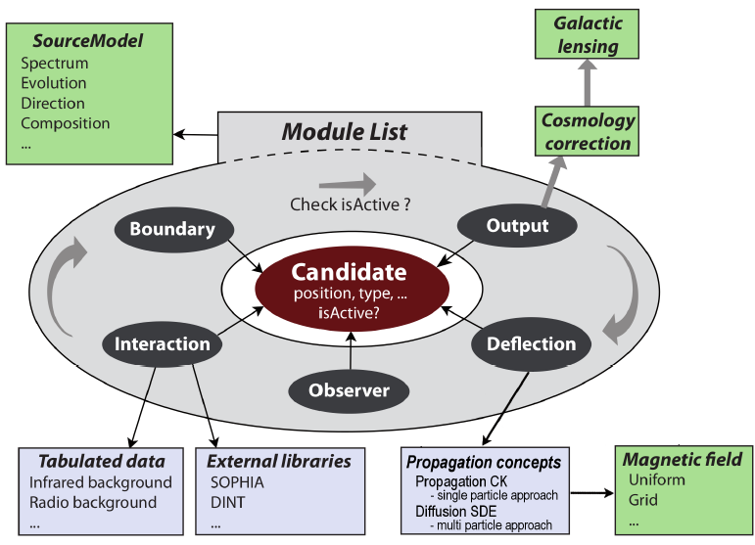
CRPropa – a modular structure

Slide 18
CRPropa – a rich toolbox
Deflection
SimplePropagation
Nucleon-Interacion
ElectronPairProduction
EM-Interactions
EM(Double/Triple)-PairProduction
PropagationCK
DiffusionSDE
PhotoPionProduction
PhotoDisintegration
NuclearDecay
EMInverseCompton-Scattering
General Interactions
Redshift
SynchrotronRadiation
Boundaries/
Thresholds
MaximumTrajectory-Length
MinimumEnergy
CubicBoundary
SphericalBoundary
Observer
ObserverSmallSphere
ObserverTracking
ObserverPoint
ObserverDetectAll
…
Output
ShellOutput
TextOutput
HDF5Output
ParticleCollector
Others
PerformanceModule
…
ObserverTimeEvolution
AdiabaticCooling

Slide 19
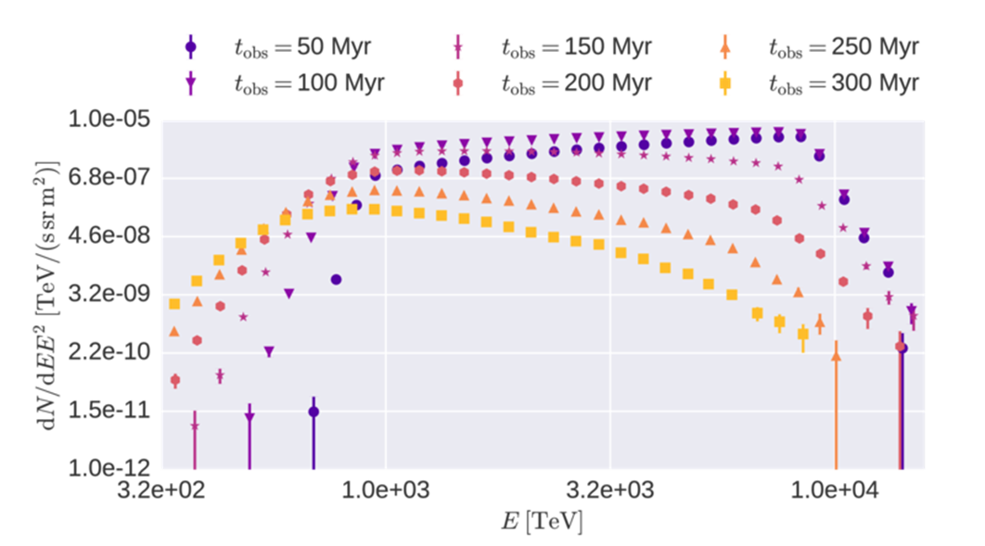
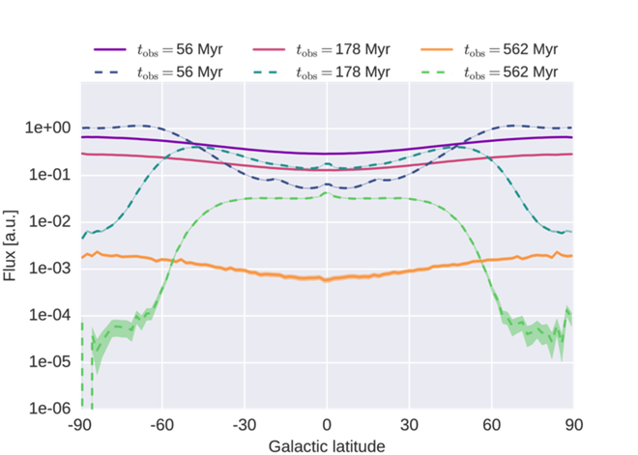
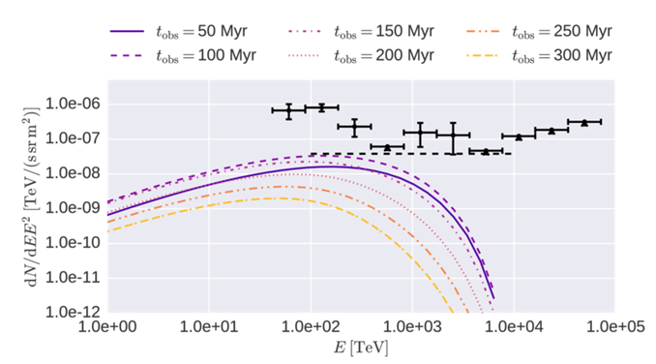
Merten+ (2018) arXiv: 1803.08376
CRs from the Galactic Wind Termination Shock
CR protons are accelerated at the GWTS
Transport equation for CRs is solved to examine the flux at the Galactic boundary
Anisotropic diffusion, advection, adiabatic cooling
Estimate on neutrino production
CRs from the GWTS might account for some of the flux measured in the transition region
Energy spectrum
Arrival direction
Neutrino Flux

Slide 20
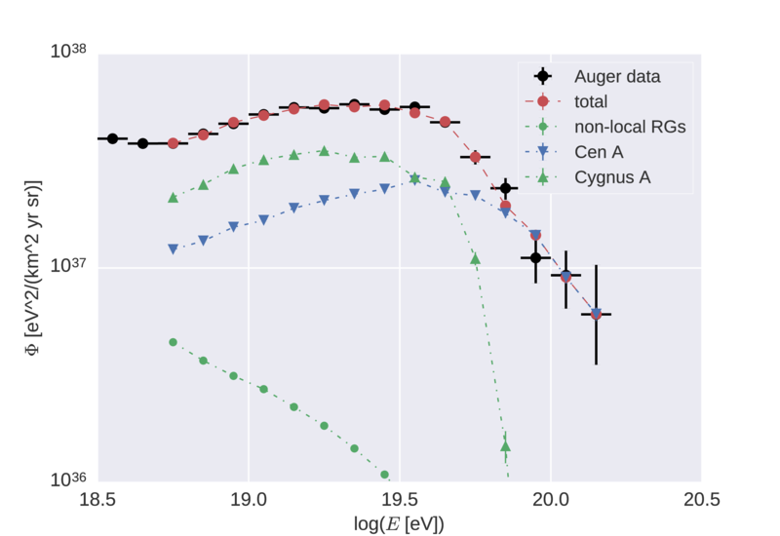
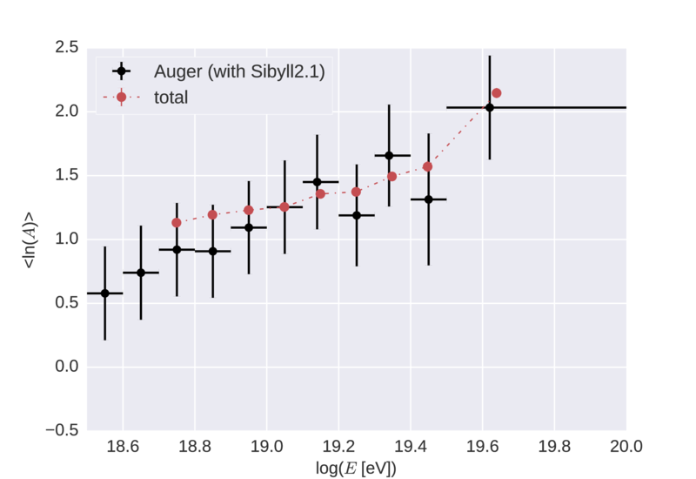
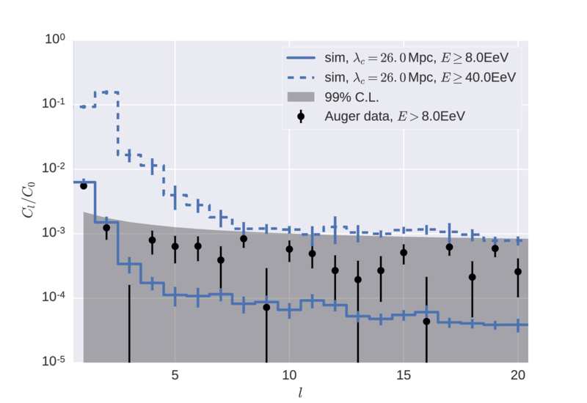
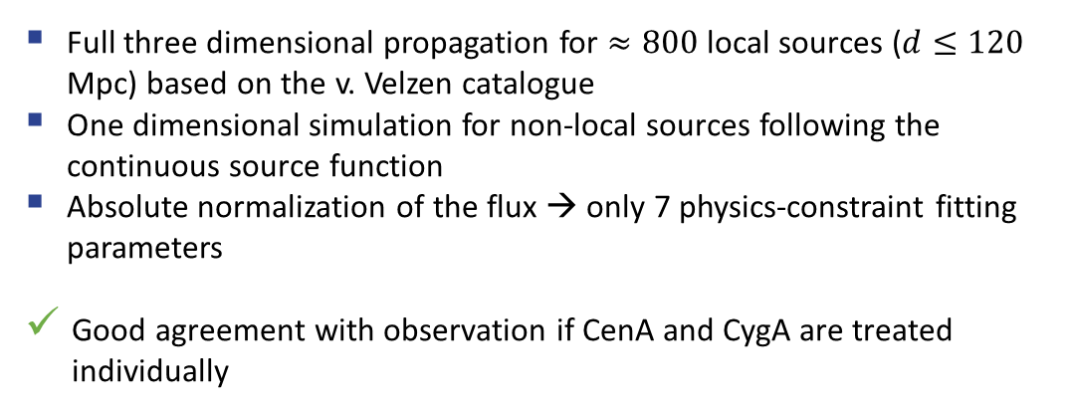
Eichmann+ (2018) arXiv:1701.06792
UHECR from radio galaxies
Full three dimensional propagation for $≈800$ local sources ($d≤120$ Mpc) based on the v. Velzen catalogue
One dimensional simulation for non-local sources following the continuous source function
Absolute normalization of the flux → only 7 physics-constraint fitting parameters
Good agreement with observation if CenA and CygA are treated individually
Energy spectrum
Composition
Arrival direction

Slide 21
Summary

Slide 22
Open problems / Ideas / Solutions
High precision experiments are challenging theory and models
No “One-fits-all”-simulation software
Models have to be chosen depending on the concrete physical set up
A lot of progress in the last years:
Three dimensional an-isotropic diffusion models for the Galaxy
Better Target distributions, etc.
Cross section measurements have to be improved
More features ins spectrum, composition, and arrival direction
Notes:
New diffusion models
Including advection, ….
Lacking precision in ionization cross section at lower energies (Maurin et al.)
Transition between ballistic and diffusive transport
Self consistent treatment of turbulence
Feedback of CRs on em fields

Slide 23
Backup

Slide 24
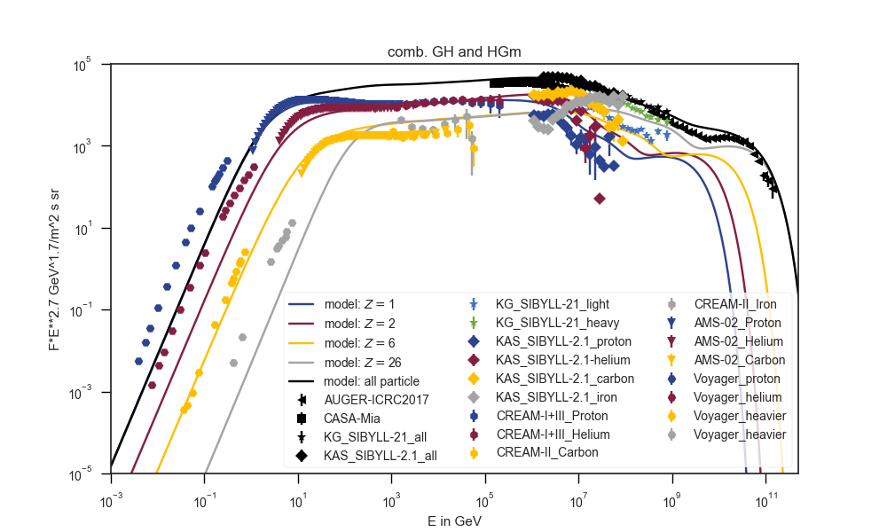
Composition

Slide 25
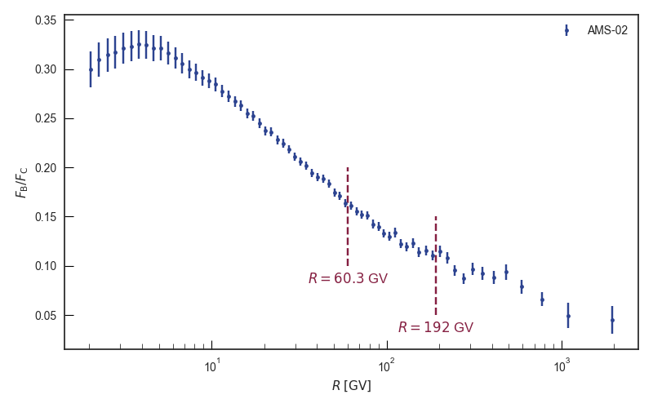
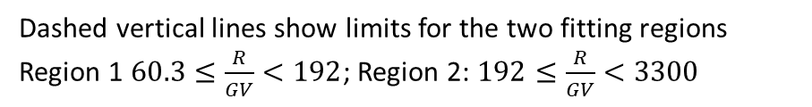
Boron/Carbon ratio
Dashed vertical lines show limits for the two fitting regions
Region 1 $60.3≤\frac{R}{GV}<192$; Region 2: $192≤\frac{R}{GV}<3300$

Slide 26
Whats new in CRPropa 3.2?

Slide 27
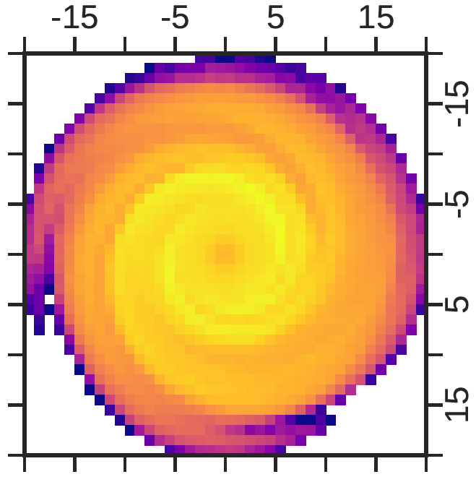
Galactic Cosmic Rays
Propagation of Cosmic Rays using the Transport equation
Taking advantage of the collective behavior of the CRs
$$\frac{∂n}{∂t}+ \vec{u}⋅∇n=∇⋅\left(\hat{κ}∇n\right)+ \frac{1}{p^{2}}\frac{∂}{∂p}\left(p^{2}κ_{pp}\frac{∂n}{∂p}\right)+ \frac{p}{3}∇⋅\vec{u}\frac{∂n}{∂p}+S$$
Anisotropic diffusion in homogeneous background
Including advection
Anisotropic diffusion in galactic JF12 field
kpc
kpc
Merten et al.,
arXiv:1704.07484

Slide 28

Targeting
Reference simulation: p=0.1, $B_{rms}$=1 nG, E=10 EeV,
D=10 Mpc, $R_{obs}$=0.1 Mpc, no interactions
Instead of 4π-emission
Sophisticated targeting method, prioritizing directions towards the observer
Reweight afterwards to again obtain 4π-emission
Van Vliet et al.,
In preperation
Notes:
Speedup is determined as average time per hit

Slide 29
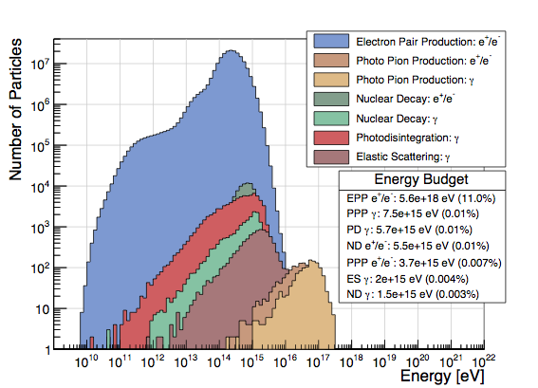
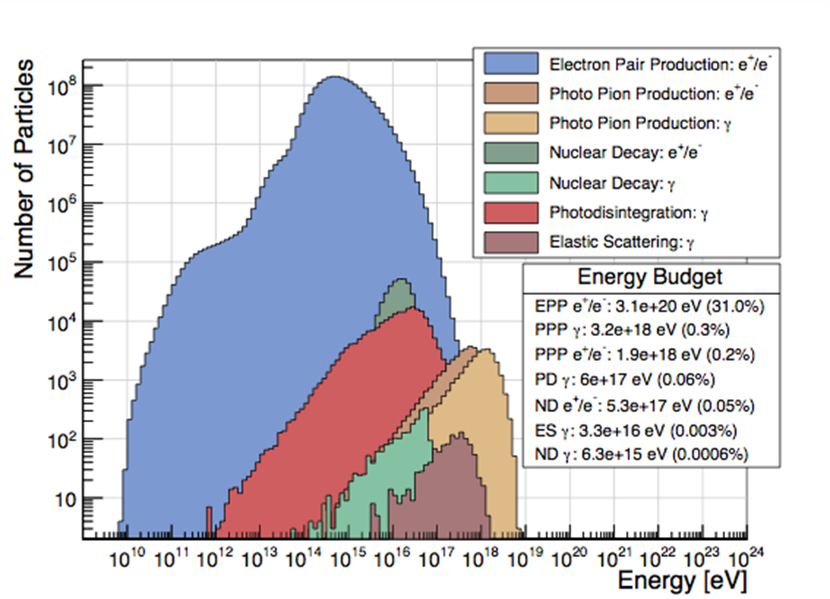
EM production channels
Additional photon production channels relevant for energies below ~1 EeV are implemented
E.g. DoublePairProduction, TripletPairProduction, etc.
50 EeV primary
1000 EeV primary
Heiter et al., arXiv:1710.11406

Slide 30
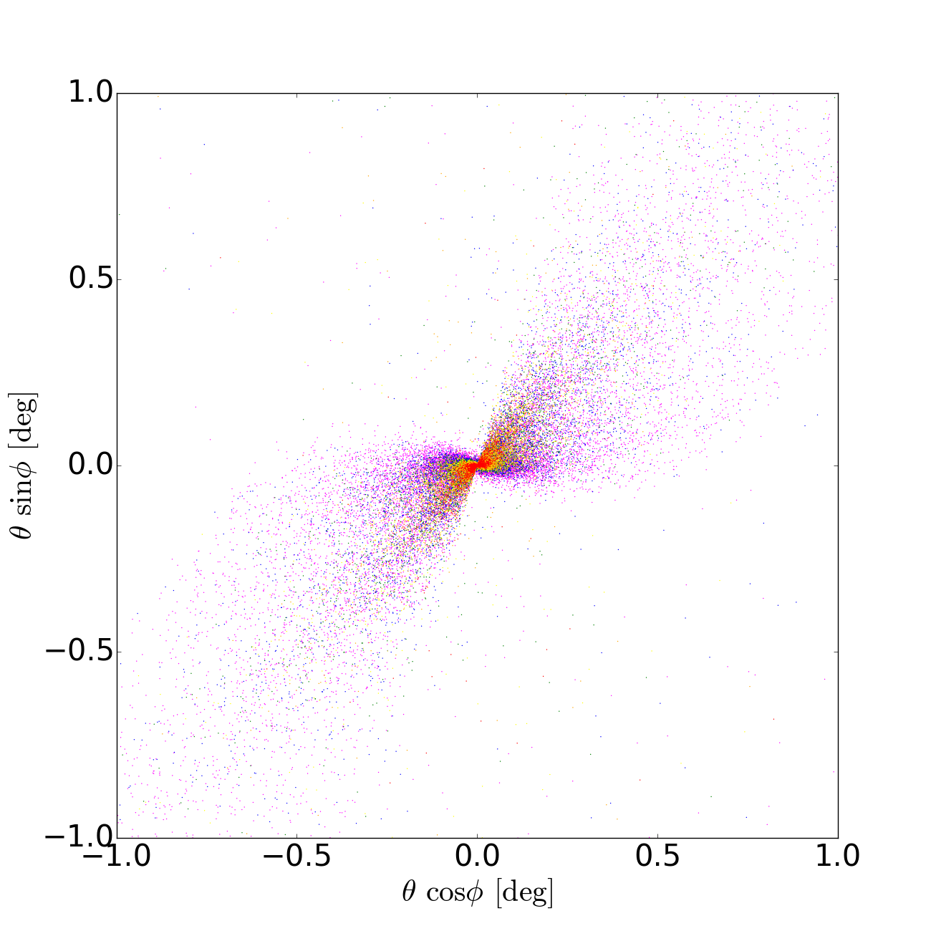
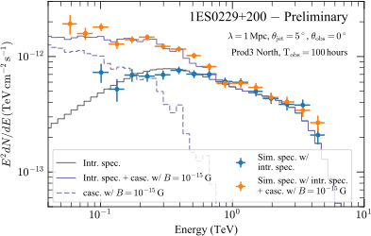
EM cascades
Full 3-dim treatment of electromagnetic cascades
Useful for many studies including blazar pair haloes, time delays due to B fields, etc.
Thinning allows for fast simulations (for now only works for energies below ~ 1 PeV)
Performance: 10^5 initial photons, takes about 4 hours on 12 cores at 2.3 GHz (for B=10^-15 G and z=0.14)
Beta version of the code already used in a number of studies
Cascade spectrum of extreme blazars
Morphology of blazar pair haloes
R. Alves Batista, PRD 2016 arXiv:1607.00320
F. Gaté et al. (CTA Consortium), arXiv:1709.04185
R. Alves Batista, A. Saveliev, G. Sigl, T. Vachaspati. PRD 2016. arXiv:1607.00320

Slide 31
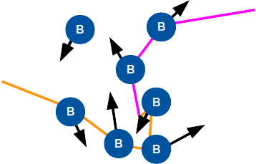
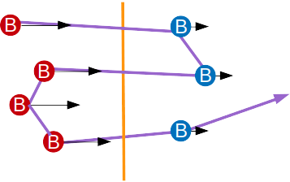
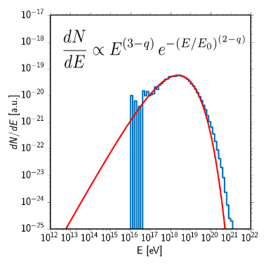
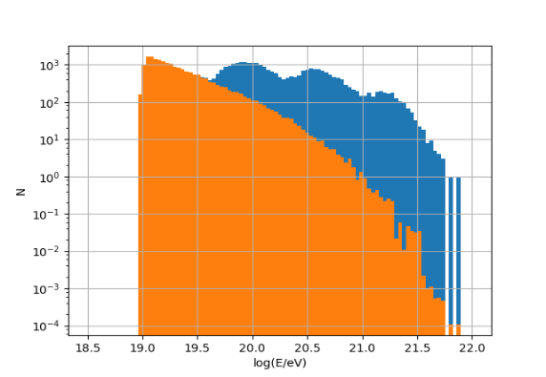
Diffusive Shock Acceleration
Second Order
Acceleration at random scattering centers
First Order
Acceleration at directed scattering centers
Winchen and Buitink,
arXiv:1612.03675
Winchen, Buitink and Rachen
In preperation

Slide 32
How to use CRPropa?

Slide 33
Get started
Instal-lation
Installation guide is completely updated
https://github.com/CRPropa/CRPropa3/wiki/Installation
Intro-duction
Introduction including comments on MC simulations
https://github.com/CRPropa/crpropa-intro-book
Exam-ples
Basic Simulation Setup, Secondaries, 3-, 4-dim Simulation, Diffusion
https://github.com/CRPropa/CRPropa3-notebooks
Support
Use Jupyter notebooks for simulation and analysis
Backtracking, Trajectories, etc.
FAQ: https://github.com/CRPropa/CRPropa3/wiki/FAQ
Documentation: http://crpropa.github.io/CRPropa3/
Wiki: https://github.com/CRPropa/CRPropa3/wiki
Issue tracker: https://github.com/CRPropa/CRPropa3/issues

Slide 34
Propagation of $Fe^{56}$ in turbulent B-field
Simple simulation of a single iron nucleus
Including relevant interactions like photo-pion-production and photo-disintegration
Use CRPropa also to create the turbulent magnetic field
Save the trajectory of the primary and all (hadronic) secondaries
This simulation can be found in a slightly different form on our example page
www.crpropa.desy.de | github.com/crpropa

Slide 35
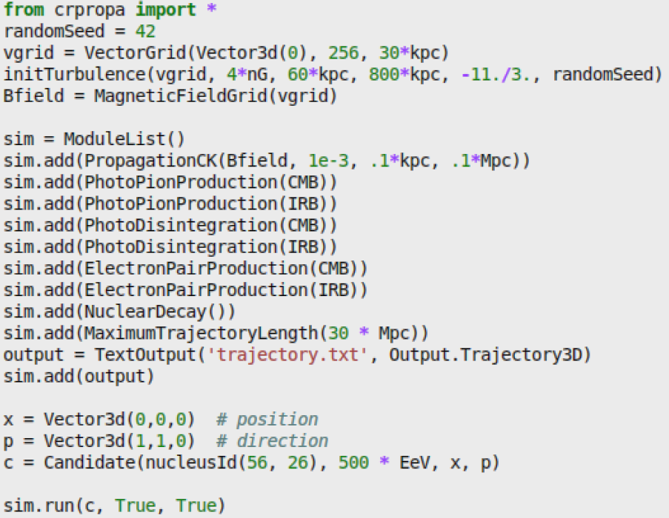
Propagation of $Fe^{56}$ in turbulent field
Magnetic Field settings
Propagation
Interactions
Boundary condition
Output
CR candidate
Run the simulation
www.crpropa.desy.de | github.com/crpropa

Slide 36
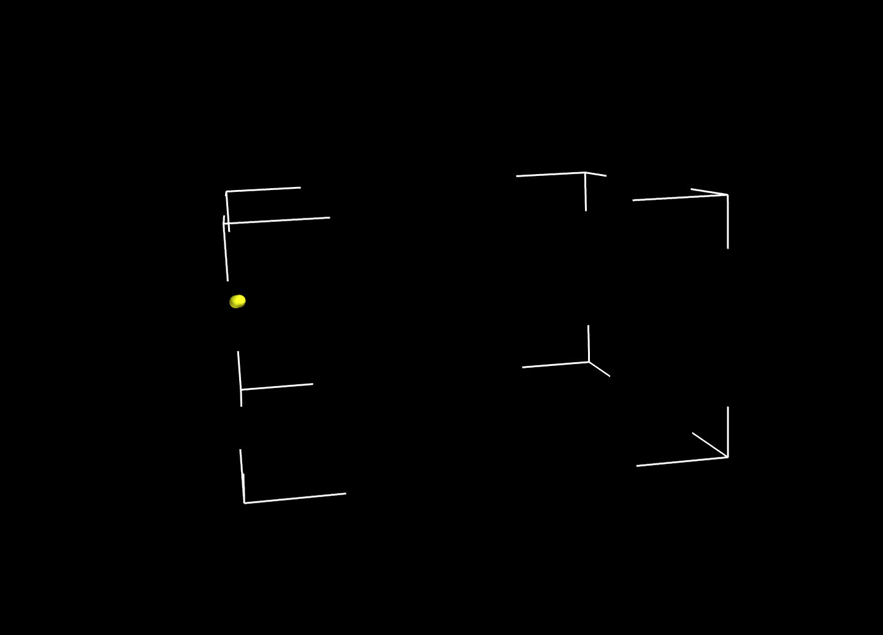

Iron nucleus: $Fe^{56}$
$E$=500 EeV
$B_{rms}$=4 nG
Kolmogorov spectrum
$L_{max}$=30 Mpc

