Slide 1
Massive star clusters as Sources of Galactic Cosmic Rays
(arXiv:1804.02331)
Ruizhi Yang
Max-planck-institute for nuclear physics
In collaboration with Felix Aharonian, Emma de ona Wilhelmi

Slide 2
Galactic Cosmic Rays (GCR)
Current Consensus
Single power law spectrum from 10 GeV up to 1 PeV
Injection rate of ~ 10⁴⁰ erg/s in the Galaxy
Supernova remnants (SNR) as sources?

Slide 3
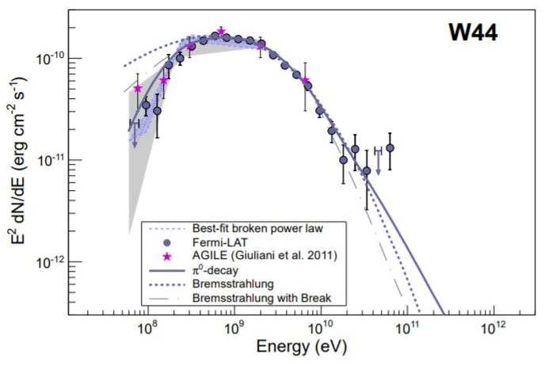
SNRs as CR source
Mid-age SNRs
Clear Pion-decay feature.
Hadronic origin
Break at ~ 10 GeV
Cannot account for all CRs up to PeV
Fermi Collaboration 2013

Slide 4
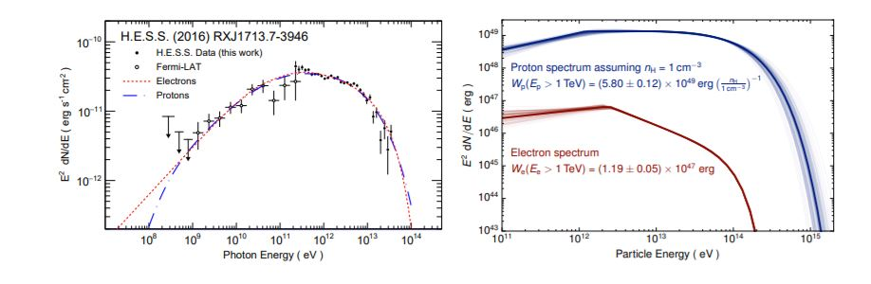
Young SNRs
Hadronic or Leptonic?
The case for RX J1713 (HESS 2017)
Leptonic :
B=15 μG
We ≈3.4 e47 erg
Hadronic :
B=200 μG
Wp ≈2 e50 erg
Cannot give preference, both have attractive features but also serious problems

Slide 5
Gamma-ray observation of Young SNRs
All gamma-ray spectrum young SNRs shows soft spectrum or early cutoff at ~ 10 TeV
corresponding to CR energy of 100 TeV
Hard to address a single power law spectrum of CRs up to PeV

Slide 6
On the hadronic scenario
lack of thermal emission in RXJ 1713.7-3946
almost the entire available energy goes to acceleration?
very low gas density but γ rays are produced in "clumps“ (e.g., inoue 2012)
relatively steep spectra of VHE gamma-rays ( Γ ~ 2.3 - 2.5) in all young SNRs
“early cutoffs” - in all SNRs < 100 TeV
Maybe we can relax and accept that SNRs are the main contributors to GCRs but until
10-100 TeV, and other sources (PeVatrons) responsible for the knee around 1 PeV ?

Slide 7
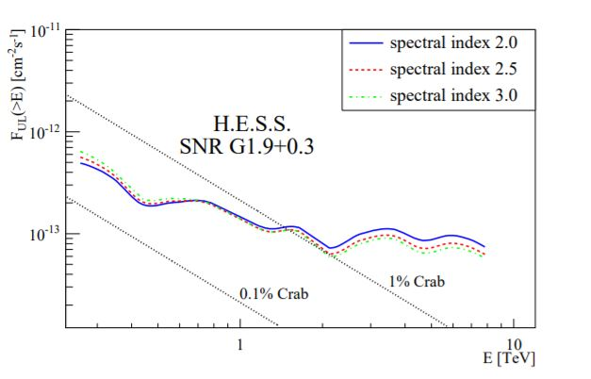
Very young SNRs?
PeVatron phase could be accomplished only during the first years of the explosion (e.g., Bell et.al 2013)
The youngest SNR in the Galaxy:
G1.9+0.3, t~ 100 yr
VHE protons cannot propagate more than 30 pc.
HESS reveals L( >1 TeV) < 1e32 erg/s can be used to set limit on proton energy budget.
Considering a high density in the vinicity (near GC), the total energy on VHE protons are below 1e45 erg. Not enough to account for the CR flux up to the knee.

Slide 8
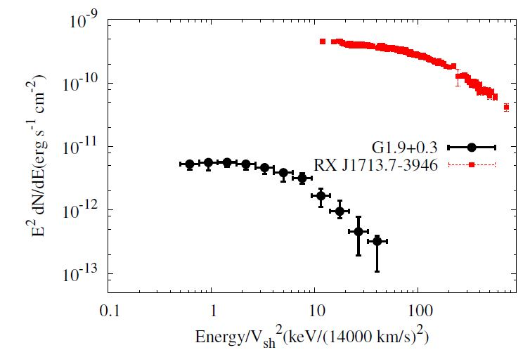
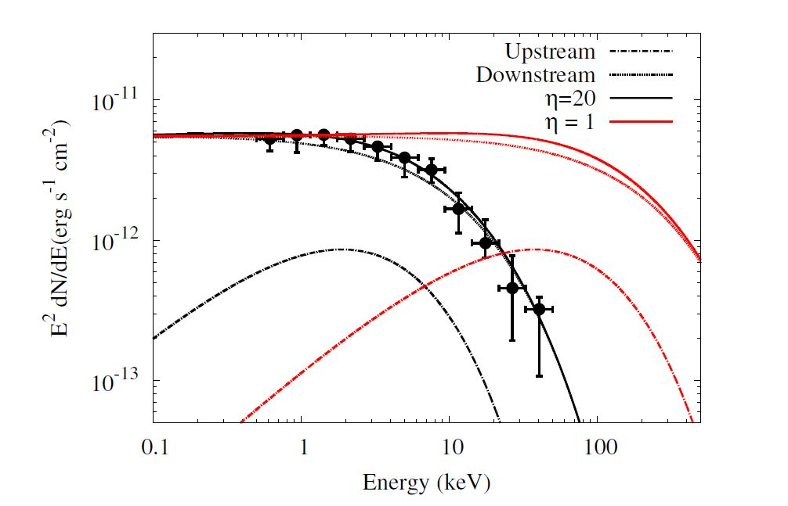
Very young SNRs?
X-ray observations on G1.9+0.3 (Aharonian et.al 2016)
Shock speed ~ 14,000 km/s
in the Bohm diffusion limit the synchrotron peak should be at around 20 keV but is detected at 1 keV
Not efficient accelerator

Slide 9
Massive star clusters: Alternative CR sources?
GCR distribution reveals a similar peak as that for OB stars.
Isotope measurement favor a superbubble origin. (W.R Binns 2016)
Most of OB stars exist in associations or clusters, stellar wind can accelerate CRs (Cesarsky & Montmerle 83).
Efficiency may even better than SNR (high speed wind lasts much longer than SNR shock)
Sufficient wind power (10³⁸ - 10³⁹ erg/s for each cluster, more than -10⁴¹ erg/s in the Galaxy) to account for CRs
Could be visible in gamma-ray due to CR-gas interaction.
.

Slide 10
CR distribution VS Source distributions in the Galaxy
Yang et.al 2016

Slide 11
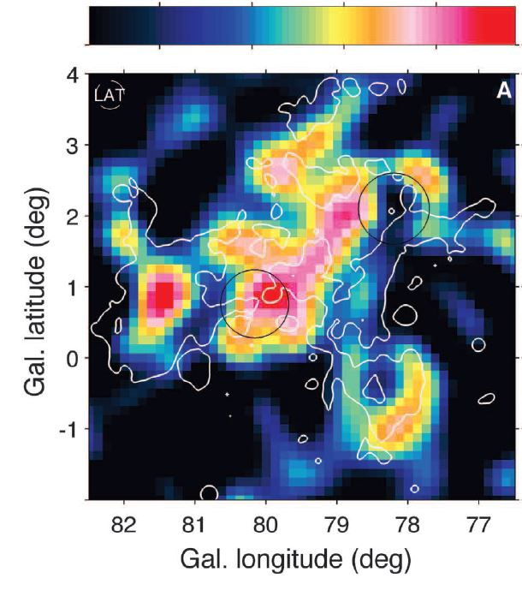
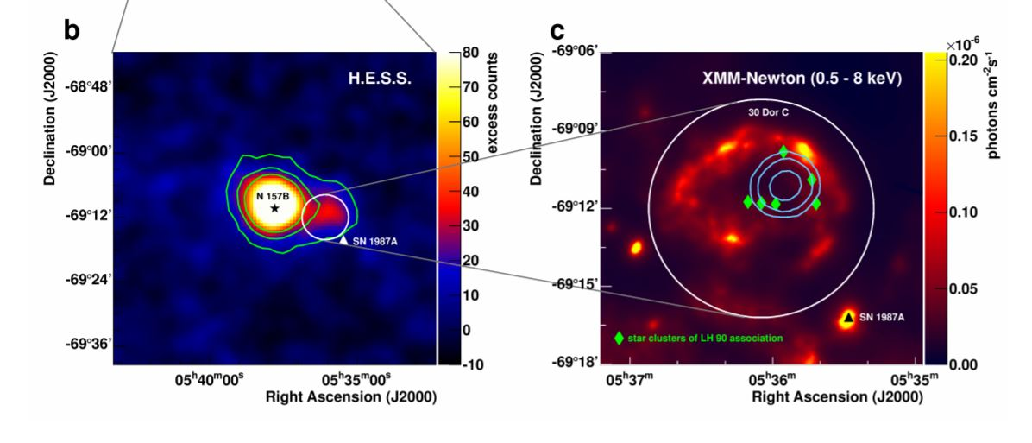
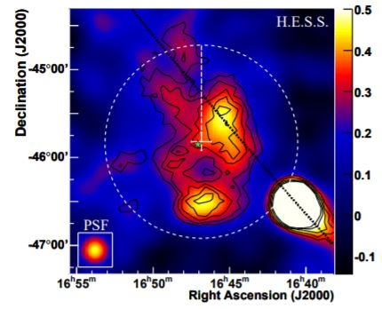
Known candidates
Cygnus Cocoon
(Fermi Collaboration 2012)
30 Doradus C
(H.E.S.S Collaboration 2015)
Westerlund 1
(H.E.S.S Collaboration 2011)

Slide 12
Cygnus cocoon
Spectral Index of -2.2, up to 500 GeV with PASS 8 data.
Fermi LAT counts map (>1 GeV)

Slide 13
NGC 3603 (sky maps)
Residual map (>10 GeV), known source removed
Counts map (>10 GeV)

Slide 14
NGC 3603 (SEDs and CR content)
Gamma-ray SEDs
Index ~ -2.3, up tp 300 GeV
Compared with LIS emissivities

Slide 15
Westerlund 2 (sky maps)
Counts map (>10 GeV)
Residual map (>10 GeV), known source removed

Slide 16
Westerlund 2 (SEDs)
Index ~ -2.1, up tp 300 GeV.
FGES J1023 is the GeV counterpart of HESS J1023, which has a much smaller spatial extension, is believed to be a PWN.

Slide 17
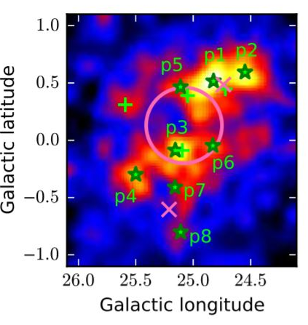
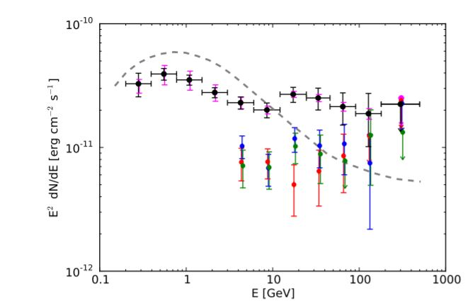
G25.0+0.0
(Katsuta et.al 2017)
Index ~ 2.1, up to more than 500 GeV

Slide 18
Westerlund 1
Extended emission (>1.5 degree)
hard spectrum (index ~ 2.2 above 1 TeV)

Slide 19
Galactic Center (HESS 2016)
Also reveal extended emission and hard spectrum (index ~ 2.2)
GC region harbors Arches, Quintuplet and Nuclear cluster

Slide 20
Summary on Gamma-ray observations
Extended gamma-ray emissions around young star clusters (50 ~ 200 pc), hard to be addressed as SNR/PWNs. Gamma-ray luminosity ~ 1e36 erg/s.
Hard spectrum ( index ~ 2.2, without cutoff)
TeV observations of GC and Westerlund 1 reveal that they are PeVatrons
Crowded region, need to check possible contribution from unknown SNR/PWNs.

Slide 21
Radial distribution of Cosmic Rays
CR distribution derived by gamma-ray profile and gas distributions
All four sources (Wd1, Wd2, Cygnus cocoon, GC) show 1/r distribution of CRs
In diffusion, 1/r profile implies a continuous injection (in the lifetime of clusters)

Slide 22
PeVatrons?
Hard gamma-ray spectrum without cutoff can hardly be addressed in leptonic model (cooling and KN effects).
no-cutoff in the gamma-ray spectrum up to 25 TeV
=> no-cutoff in the parent proton spectrum up to ~ 1 PeV.
GC harbors PeVatron(s).

Slide 23
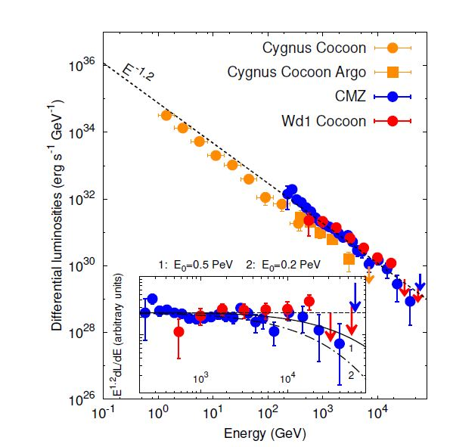
PeVatrons?
Cygnus cocoon, Wd 1 and CMZ all emit multi-TeV gamma-ray.
The spectrum of CMZ and Wd1 put lower limit of cutoff of parent proton spectrum to be several hundred TeV
Promising Pevatron candidate

Slide 24
two-component CR sources?
To fit the locally observed B/C ratio and CR proton spectrum, the acceleration spectra index of the main sources should ~ 2.4.
Assuming a Kolmogolov type turbulence spectrum and continuous CR injection near massive star clusters, the gamma-ray spectrum 2.2 translate into a proton acceleration spectra index of ~2.0.
SNR dominates lower energy (with acceleration index 2.4) and star clusters (with a acceleration index of 2.0) dominate higher energy ?

Slide 25
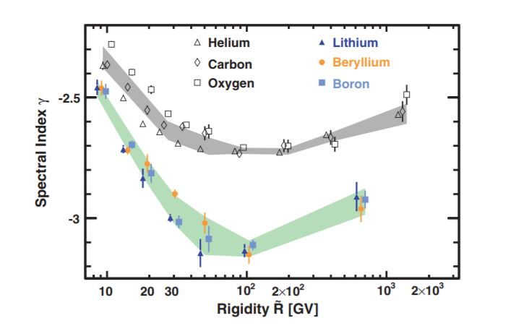
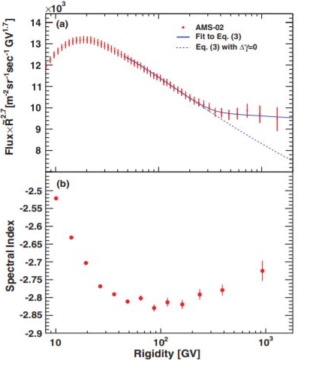
two-component CR sources?
Hint of the second component? A hardening at about 200 GeV for all CR species.
(AMS-02 Collaboration 2015, 2018)
Notes:
s

Slide 26
Conclusion
Extended gamma-ray emission near young star clusters detected.
Best explained as CRs interaction with ambient gas, reveal universal 1/r CR distributions and hard spectra (index ~ -2.2)
Potential CR accelerators (even main accelerators in high energy)
TeV-PeV Neutrinos ?

Slide 27
Thanks!

