Slide 1
Critical Tests Of GRB Theories*
Arnon Dar**
.
Very High Energy Phenomena In the Universe , Quy Nhon, Viet Nam, 14/8/2018
Scientific theories must be falsifiable (K. M. Popper 1959). Only confrontations of their main predictions, which do not depend on free adjustable parameters, with observational
data rather than prejudices or concensus, can serve as their critical tests.
* Due to time limitation, in my talk, critical tests will be limited to the Fireball (FB) and Cannonball (CB) models of GRBs, the only models which have been applied in the past two decades to analyze the bulk of the mounting observational data on GRBs.
.
** Based on research work done in collaboration with Nir Shaviv (1994/5)
Rainer Plaga (1998/9), Shlomo Dado and Alvaro De Rujula (2000-2018).

Slide 3
The Fireball Model
In the original fireball model (Goodman 1986; Goodman, Dar & Nussinov 1987; Rees & Meszaros 1992-1999) GRBs were isotropic. But, evidence from CGRO in 1992 of a cosmological origin of GRBs led to GRB energy crisis, which could be solved only if GRBs are beamed (Shaviv & Dar 1994). In 1999, after the observation of GRB980425/SN1998bw and GRB broken PL aftergows,
(e.g., GRB990510) the spherical fireball was replaced by a conical jet of thin e+e- shells whose overtaking collisions produce GRB pulses, and a shock driven into the circumstellar medium produces the GRB afterglow (Sari, Piran, Waxman, Rees & Meszaros, and followers). Such models were called ‘conical fireball models’. Later the jets of e+e- shells were replaced by conical flows of ordinary plasma from SNeIc explosions, and the completely revised model (a firecone) was declared to be “the fireball model”…

Slide 4
Test #1 : Polarization
Prompt Emission Mechanism Afterglow Mechanism
CB: ICS of glory light by jet electrons SR from Fermi accelerated
swept in ISM electrons*
(Shaviv & Dar 1994)
(Dar 1998)
FB: SR from shocked jet SR from shocked ISM
*Turbulent magnetic fields are required for shock acceleration of the HE e’s emitting the SR.
All the a posteriori attempts to explain a large polarization of the prompt emission in the FB model (after measurements) cannot explain why almost all GRBs have large polarization.

Slide 5
Observed polarization of prompt -rays is very large!
CB Prediction (1995) : ICS
FB Expectation SR
GRB Polarization Confidence level Reference Comments
80+\-20 % 5.7 sigma Coburn & Boggs 2003 RHESSI
(controversial)
930131 > 35 % 90 % Willis et al. 2005 BATSE Albedo
Polarimetry
960924 > 50 % 90 % Willis et al. 2005 “
041219A 98 +/-33 % 68 % Kalemci et al. 2007 INTEGRAL-SPI
63 +/-31 % 68 % McGlyn et al. 2007 “
100826A 27 +/-11 % 99.4% Yonetoku et al. 2011 IKARUS-GAP
061122 > 60 % 68 % Gotz et al . 2013 INTEGRAL-IBIS
> 33 % 90 %
110301A 70 +/- 22 % 68 % Yonetoku et al. 2011 IKARUS-GAP
110721 84+16/-28% 68 % Yonetoku et al. 2011 IKARUS-GAP
140206A > 48 % 68 % Gotz et al. 2014 INTEGRAL-IBIS

Slide 6
Test #2: correlations
CB Model (Dar & De Ru`jula, 2000, astro-ph/0012227):
Doppler boost:
Time aberration:
Relativistic beaming:
+ ICS of glory
+ Beaming
Ordinary GRBs
Far off-axis GRBs (XRFs/LLGRBs)
Amati et al. empirical Relation (2002 A&A, 390, 81):

Slide 7
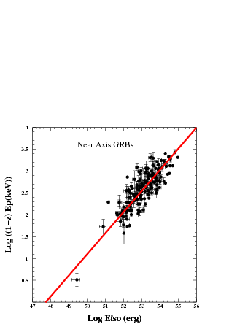
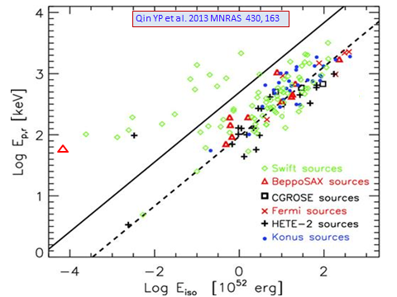
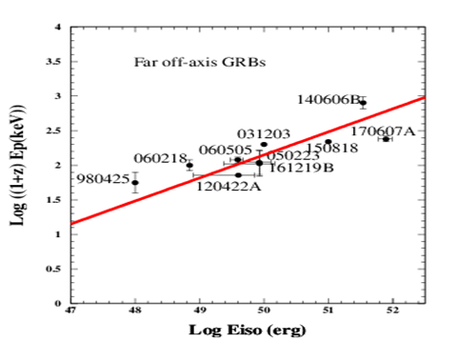
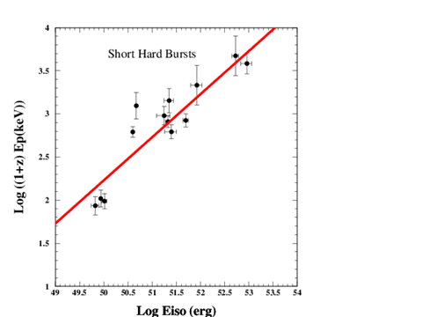

Slide 8
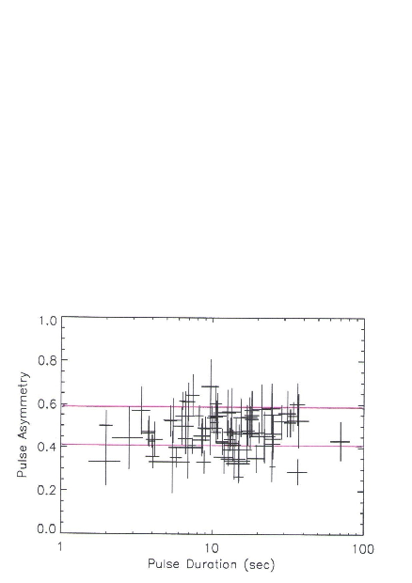
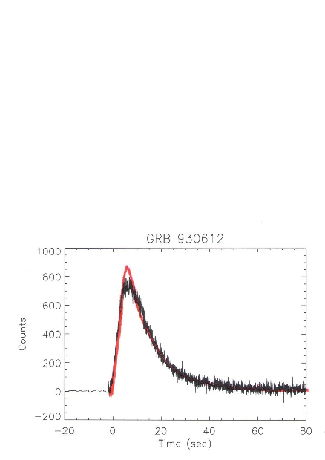
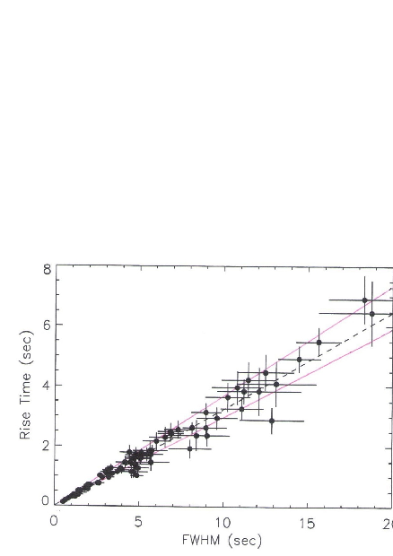
Test # 3: Pulse Shape
RT/DT
GRB 930612
BATSE
Data : Kocevski et al. 2003
CB Model limits :
77 individual GRB pulses
BATSE

Slide 9
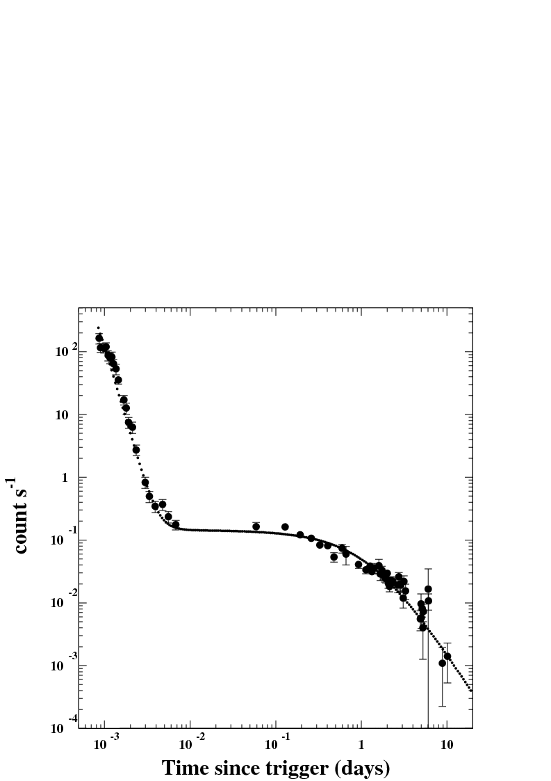
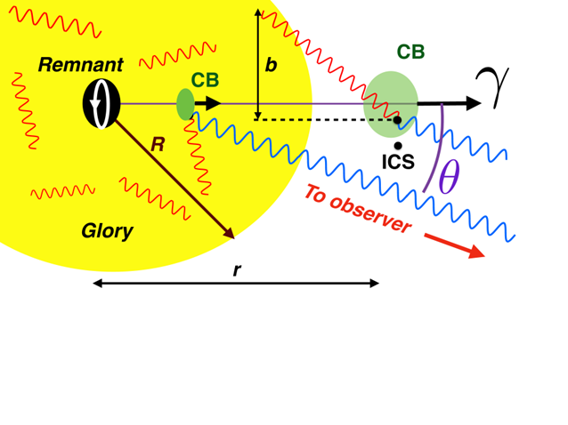
Test #5: The ‘canonical behavior’ of X-ray light curves of SN-GRBs
Neither expected nor predicted/explained by the standard FB models. Predicted by the CB Model (2001) long before it was discovered with Swift:
SN--GRBs
SWIFT: GRB 050315
(Vaughan et al. 2005)
ICS tail
SR
r
CB model: DDD2005
Decreasing density (1/r^2) and
increasing unisotropy of glory photons

Slide 10
Test # 4:
<<
FB:
Overtaking collisions produce the GRB while the shocked ISM produces the AG ➔
Relative velocity between colliding shells is smaller than in
the shell- stationary ISM collision. => most of the radiated
energy is released in the beam dump (ISM).
But,

Slide 11
Tests # 5-8: Jet break properties
FB: Jet break in the GRB afterglow when
(Rhoads 1998, Sari, Piran, Halpern 1999)
observer
R
energy flux proportional to visible area, which increases due to deceleration:

Slide 12
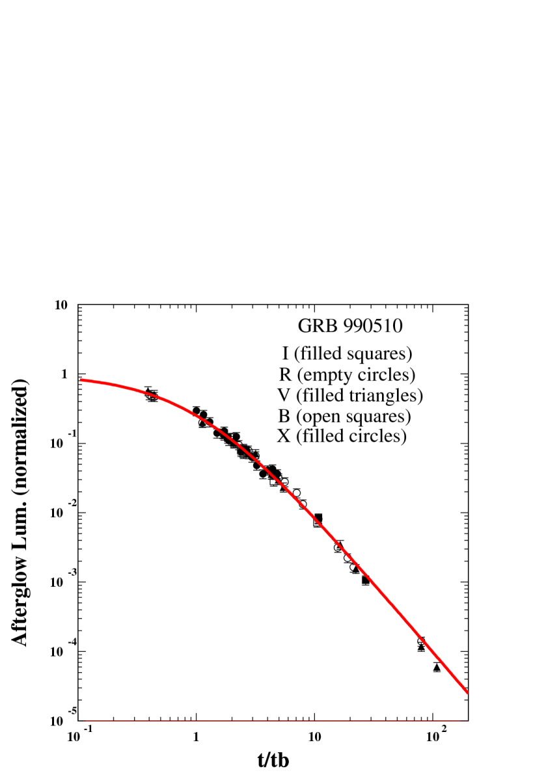
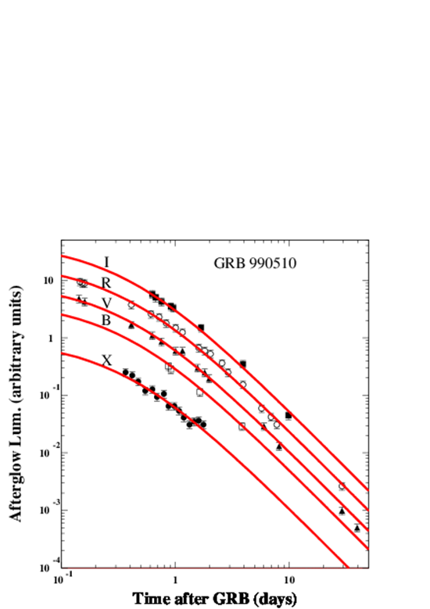
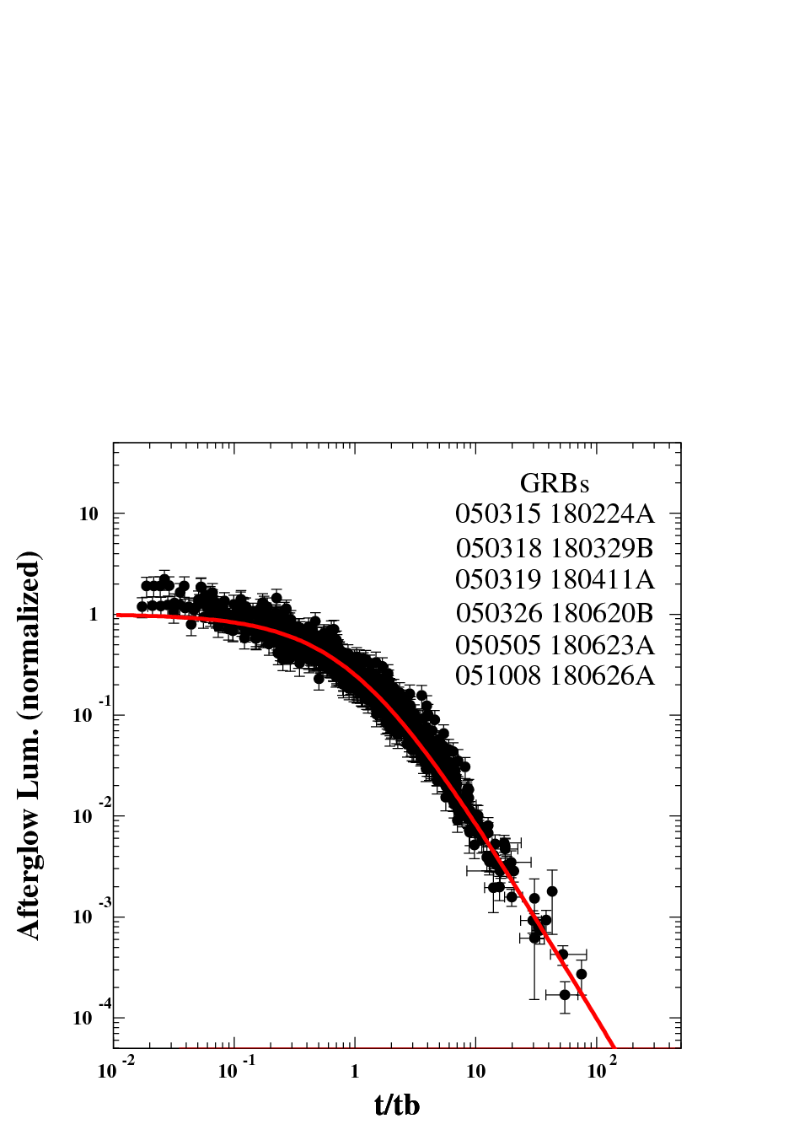
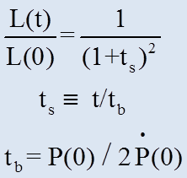
The afterglow of GRB 990510 was the flag ship of the Fireball Model Armada. Papers such as "BeppoSAX confirmation of beamed afterglow emission from GRB 990510“ [Pian et al. 2001] or "Optical and Radio Observations of the Afterglow from GRB990510:
Evidence for a Jet" [Stanek et al. 1999], were based on heuristic parametrizations and not on formulae properly derived from FBM underlying assumptions. They have misled the entire GRB community into a wrong direction!
PWN powered
by MSP:
Pian et al. 2001
CONICAL JET ?
SN-Less GRBs: PWN powered by MSP
<P>=2 ms
Universal LC:

Slide 13
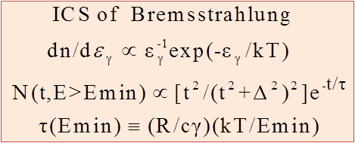
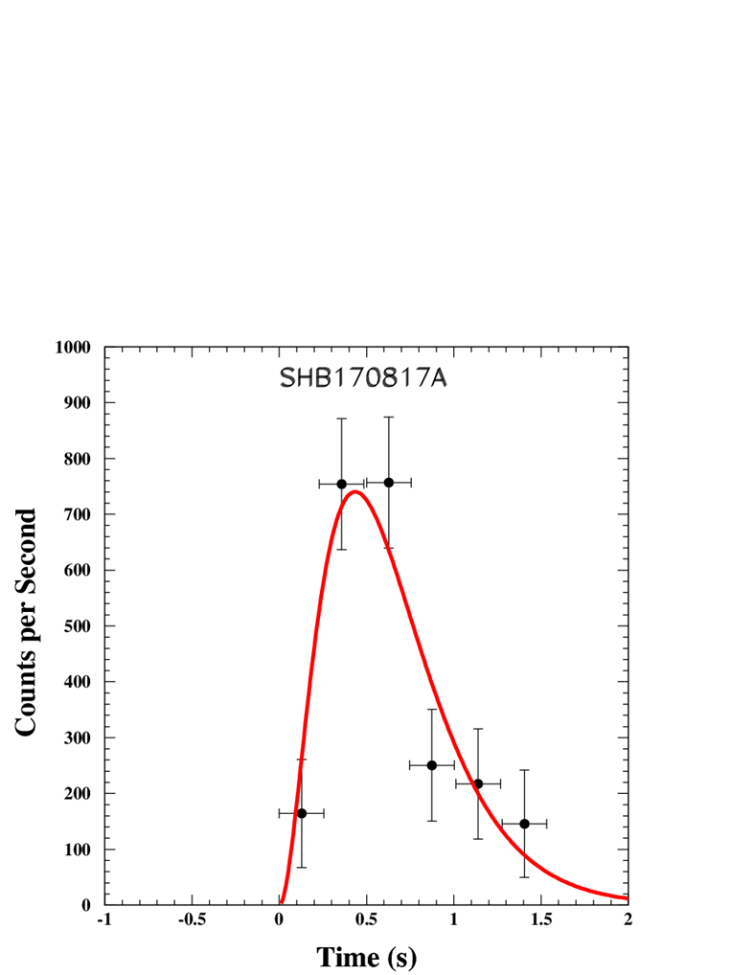
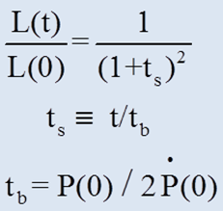
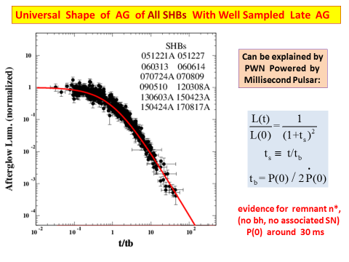
CB Model, Prompt Emission:
CB Model, Universal Afterglow of all SHBs:
SHB170817A
DATA: Fermi GBM

Slide 14
FB models Flag Ship: Jet Break in GRB afterglows. But,
TEST #
TEST #
TEST #
TEST #
6. Broken power-law light curves
with a slope change at
X
7. Achromatic break X
8. Closure relations between and X
But, E. W. Liang, et al. Astrophys. J. 675, L528 (2008) analyzed
the afterglow of 179 GRBs detected by Swift between January 2005
and January 2007 and the optical AG of 57 pre-Swift GRBs.
They did not find any afterglow with a break satisfying 6,7 and 8.
9. Missing Breaks
FB Model: Racusin, et al. Astrophys. J. 698, 43 (2009) : The “jet break” in
AGs of GRBS with large Eiso takes place after the observations end. X
CB Model: (Dado, Dar & De Rujula (ApJ, 680, 517 (2008)):
Hidden early break in the AG of SN-GRBs with large Eiso V

Slide 15
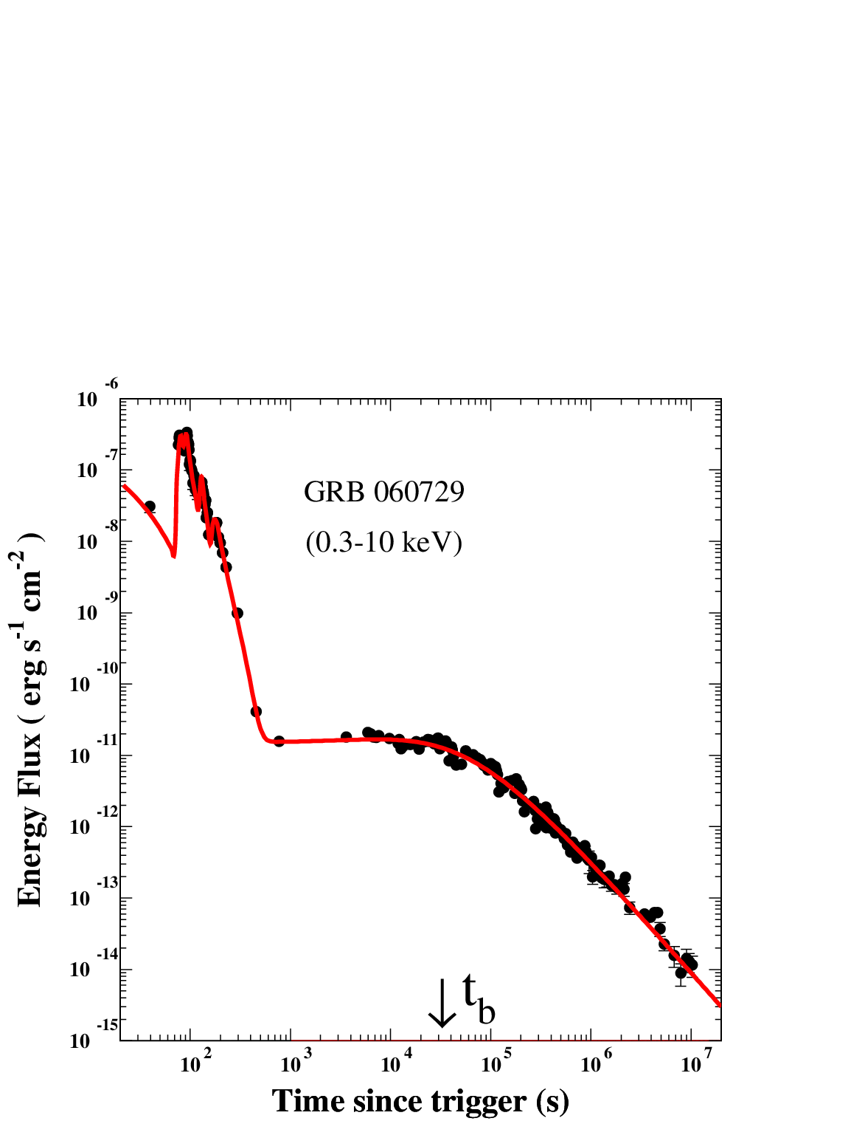
Post-break behavior in SN-GRBs

Slide 16
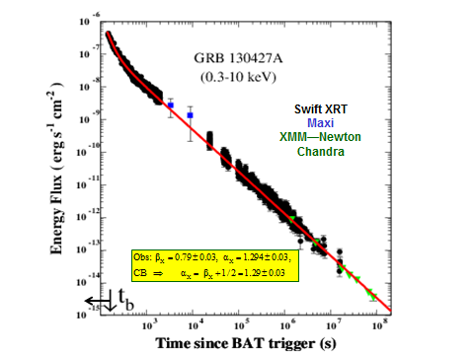
Missing Break
(De Pasquale et al. 2016)
Dado @ Dar, PRD 94, 063007 (2016)

Slide 17
CB Model: A deceleration “break” in SN-GRB afterglows when the swept-in mass/energy the initial CB rest mass, and an exit break*
Plastic collision of a CB (radius R, initial mass with
constant density (n) ISM, viewed from an angle yields
which are practically constant until
where
Missing Break : When is very large, the break is
hidden under the prompt emission tail (DDD 2007)
*in AGs of GRBs in face-on host galaxy when the CB escapes into the halo

Slide 18
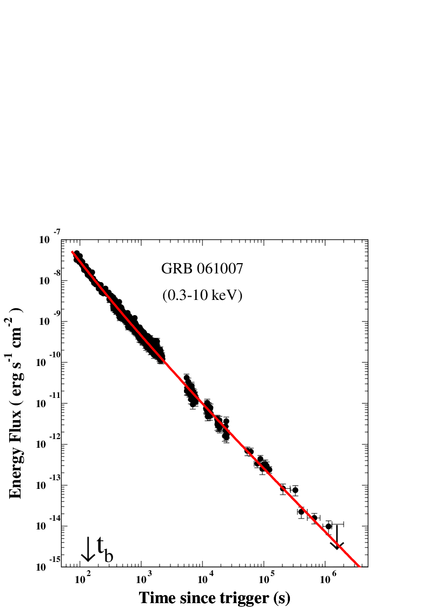
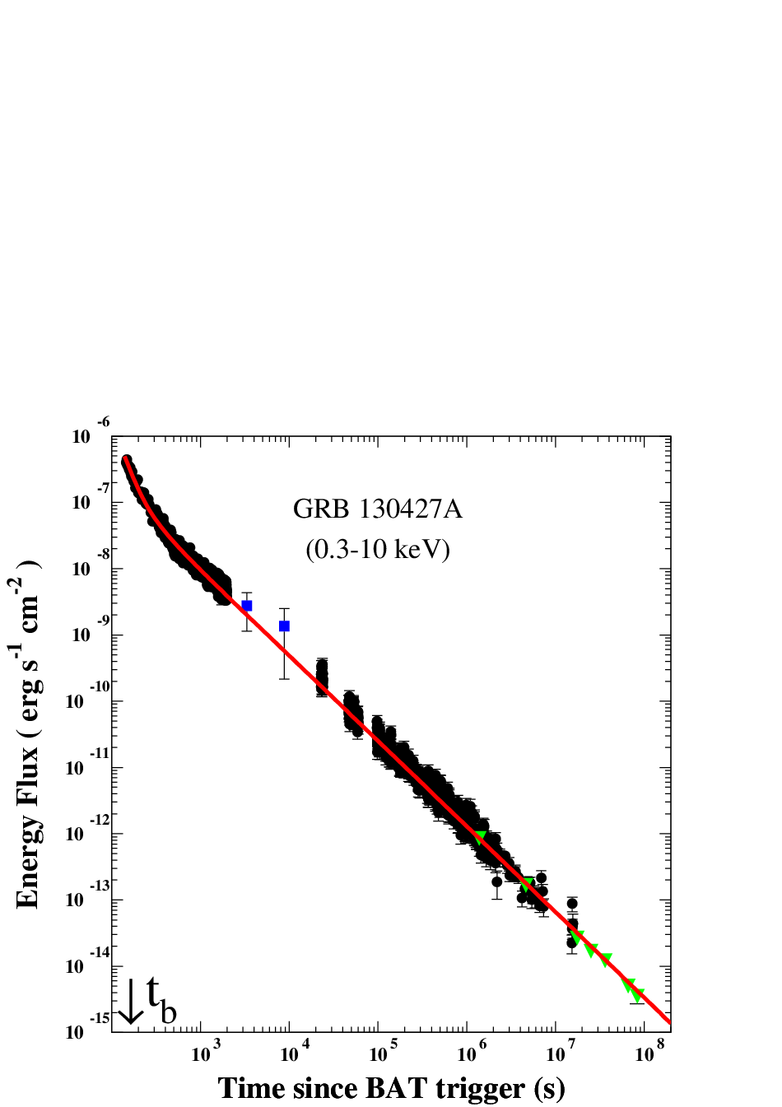
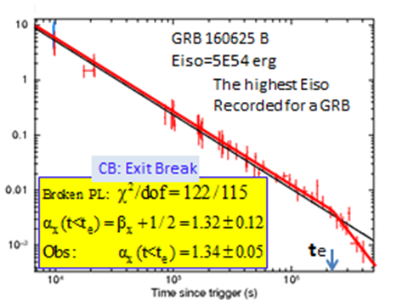
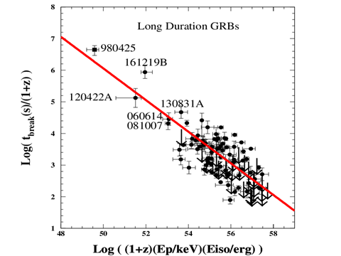
Missing break
Missing break
LGRBs + LLGRBs
CB Model:

Slide 19
Are Low Luminosity (LL) GRBs and Ordinary GRBs Different classes ?
FB: Different, despite their similar parent SNeIc:
FB:
CB: LLGRBs are ordinary GRBs viewed far off-axis:

Slide 20
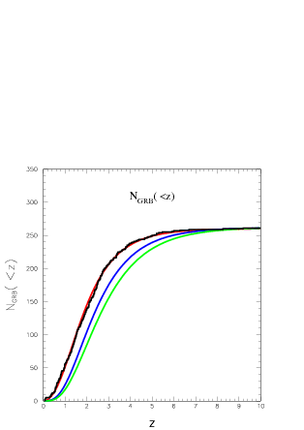
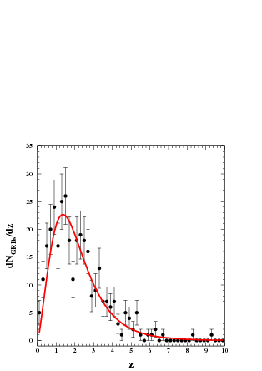
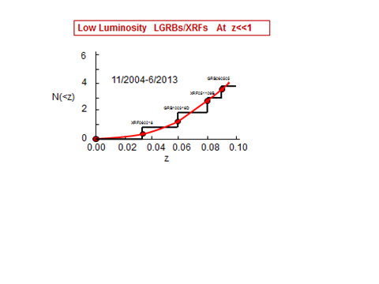
Test # 11 : Rate(GRBS) SFR
CB Model:
LGRBs produced by SNeIc:
Rate(LGRBs*) Rate(SNeIc) SFR
*Observable + non observable
dNobs(LGRB)/dz with known z
CB Model
FB Model
without/with evolution*
* Robertson & Ellis 2012
DD 2017
345 Observed GRBs
DD 2013
CB

Slide 21
Test # 12 : Superluminal Velocity of CBs
CB
b
observer
SN

Slide 22
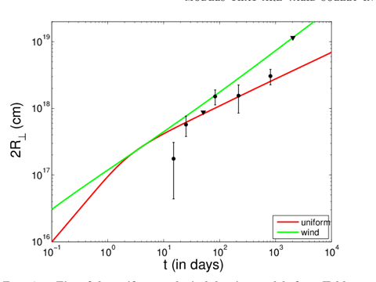
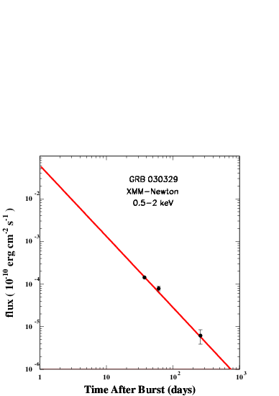
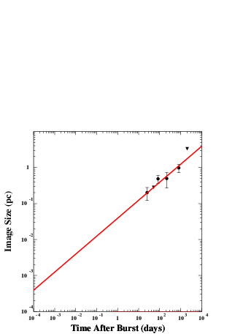
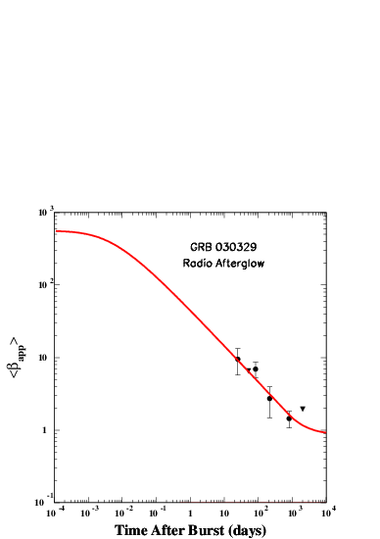
Hyperlumina→superluminal
GRB 030329
FB: Image Expansion (Evolving Interpretation…)
Taylor et al. 2004, ApJ, 609, L1
Taylor et al. 2005, ApJ, 622, 986
Pihlstrom et al. 2007, ApJ, 664
Mesler et al. 2012, ApJ, 759, 4
Mesler et al. 2013, ApJ, 774, 77
CB: Hyperluminal GRB-AG Displacement
GRB 030329 Image Size
GRB 030329
Hyperluminal Speed

Slide 23
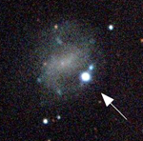
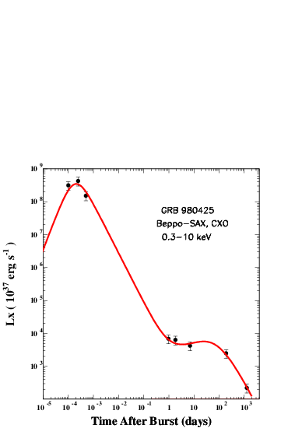
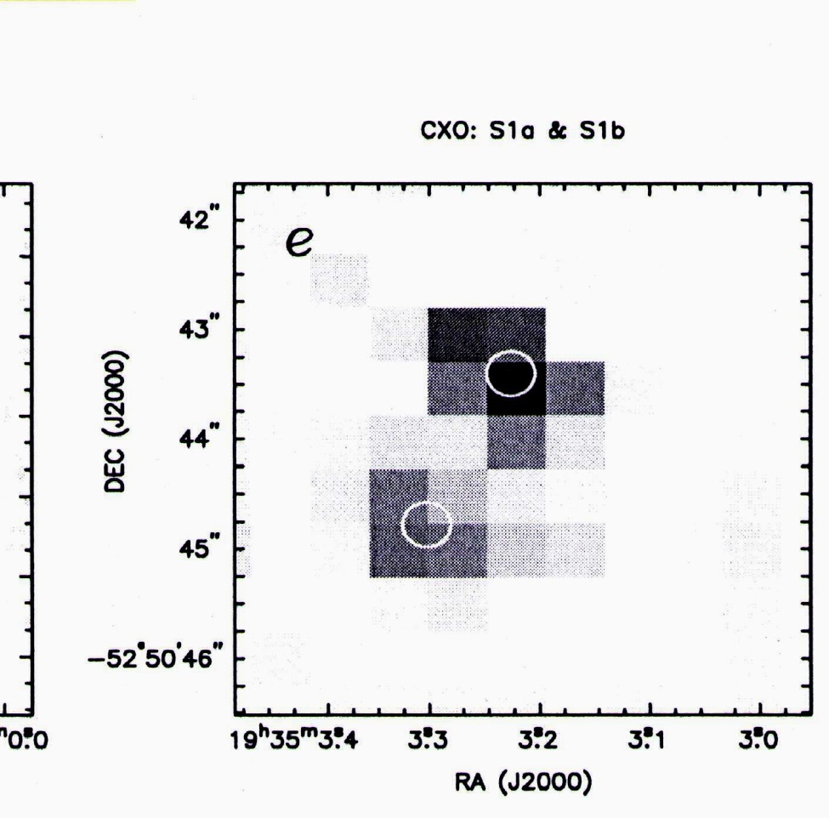
ESO 184-G82 + GRB980425
Test # 12:
Hyperluminal Speed of CB Fired by GRB980425 ?
DD2000: arXiv:astro-ph/0008474
DDD2016: arXiv:1610.01985
12
ATCA D2049
CXO D1281
Not detected by
ATCA on D2049
GRB980425/SN1998bw

Slide 25
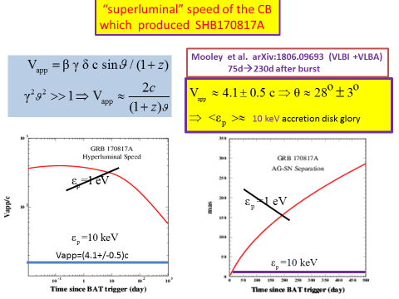

Slide 26
Post
(GRB)
Superluminal Motion (SHB) V Superluminal Motion ?

Slide 27
THE END

