Slide 1
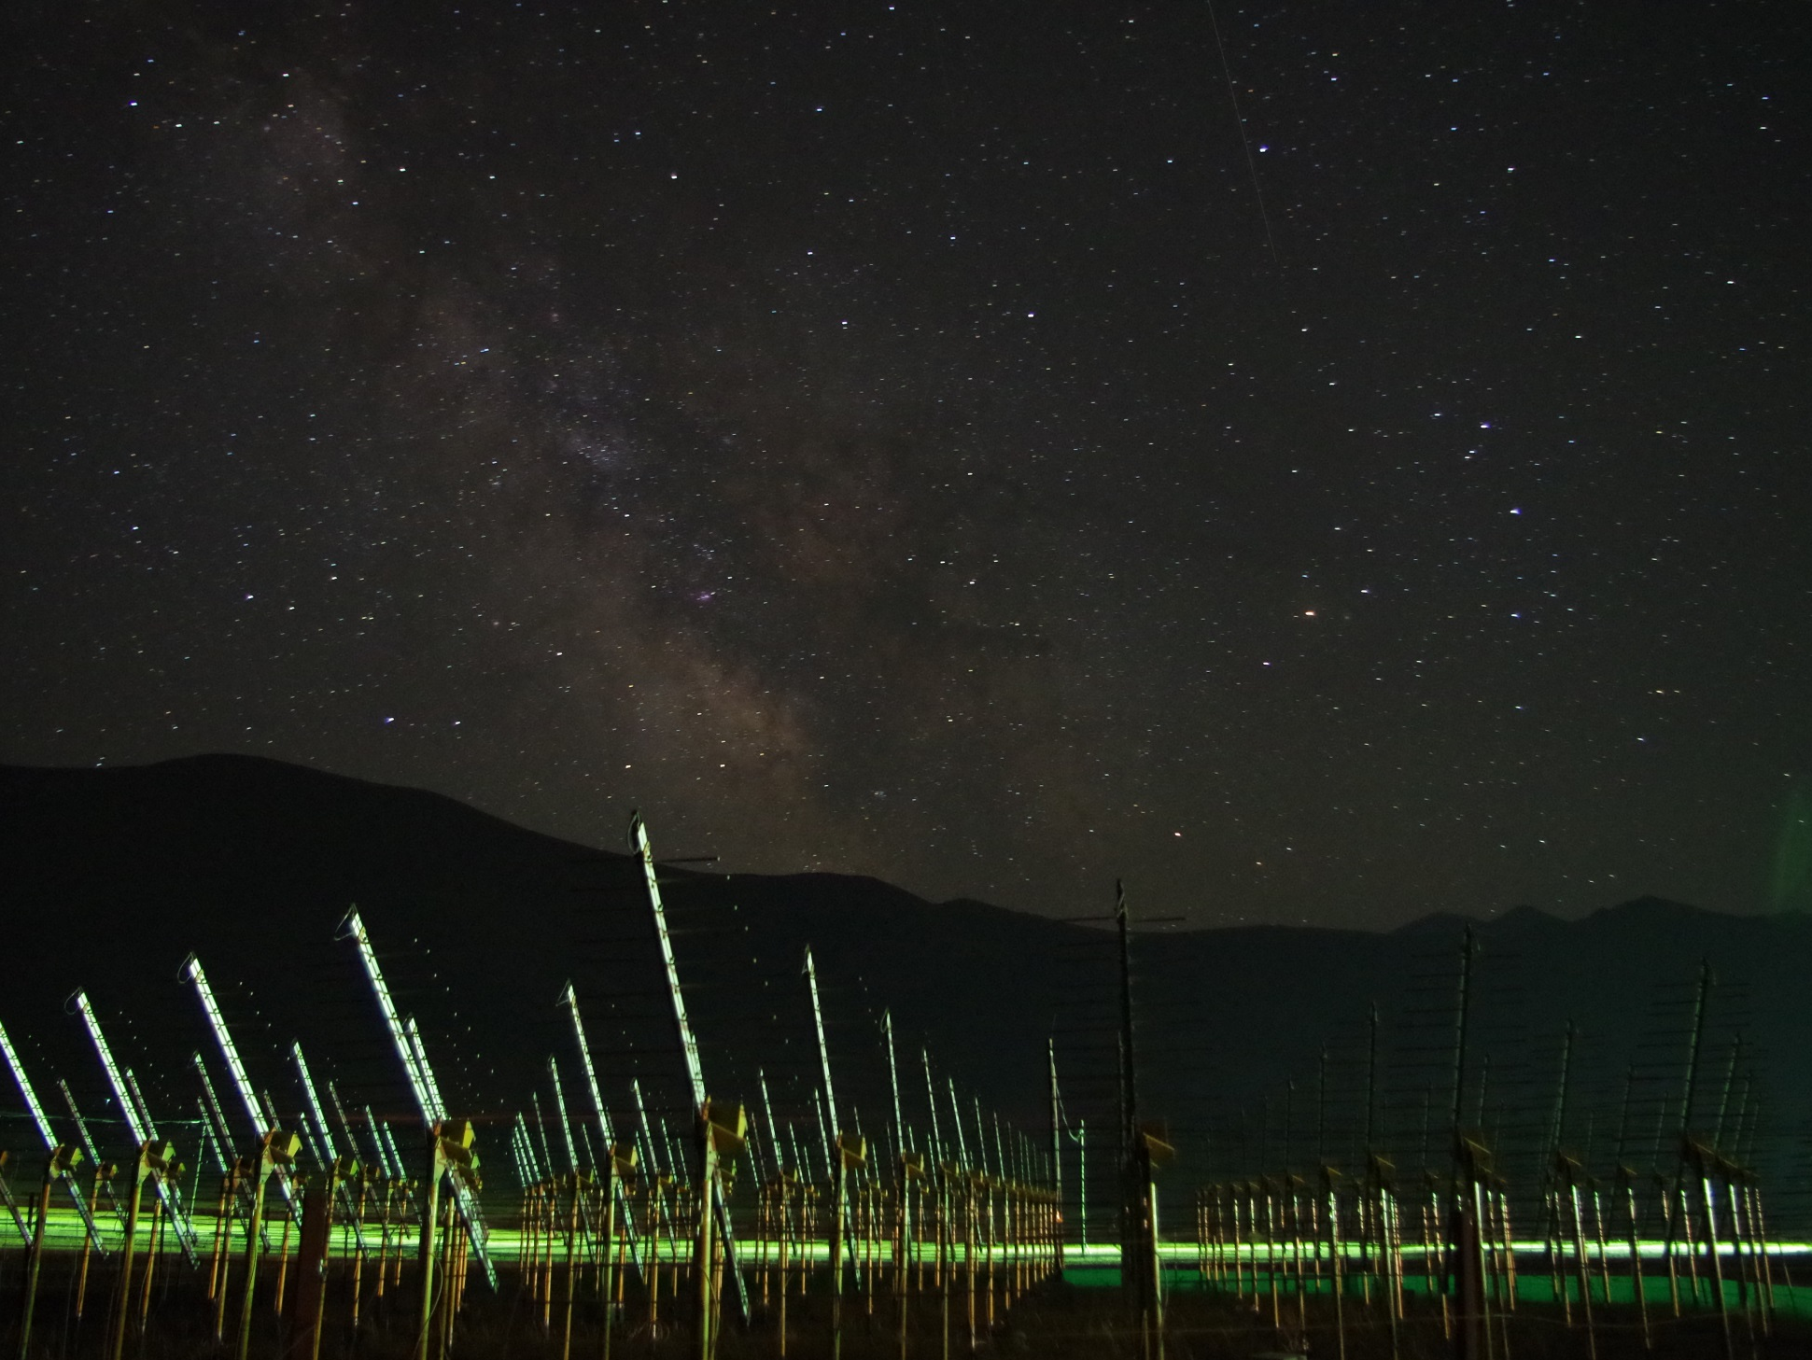
Proposal for a
Giant
Radio
Array for
Neutrino
Detection
http://grand.cnrs.fr/
Olivier Martineau
LPNHE Paris
14th Rencontres du VietNam, Quy Nhon,
August 14, 2018
the 21CM array
site of the GRANDproto35 setup (picture: Gu Junhua)

Slide 2
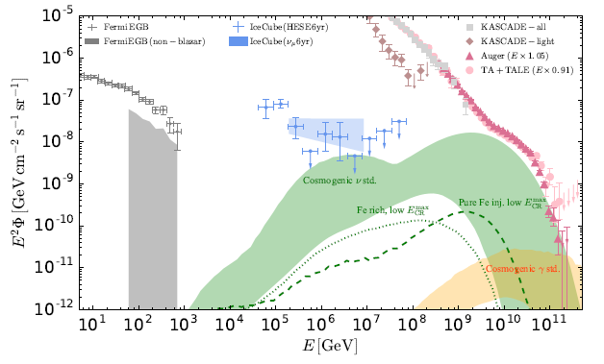
Why UHE neutrinos?
«Cleanest probe» of the Universe (no deflection, no attenuation, hadronic…)
E>10¹⁷eV neutrinos is uncharted territory
Direct link to highest energy CRs (5%/A of primary energy)
5%/A

Slide 3
Kowalski@TeVPA2017

Slide 4
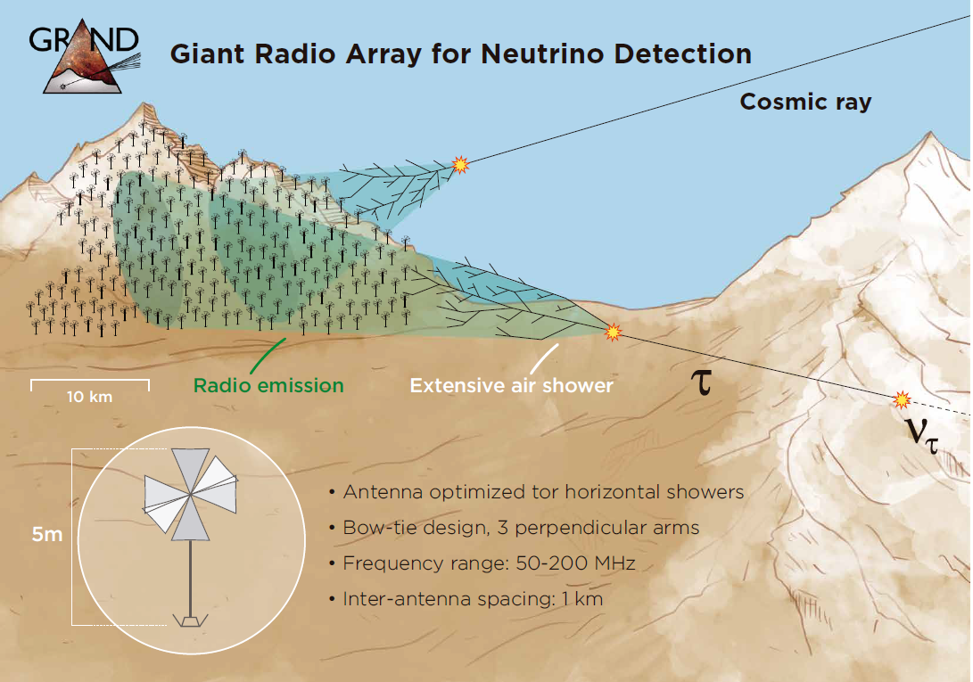
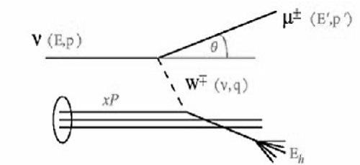
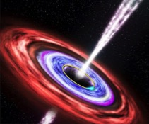
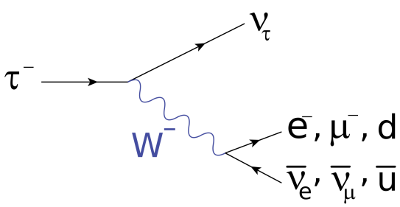
τ±
Detection principle:
ν-induced tau decays in atmosphere generate ~horizontal extensive air showers [Fargion astro-ph/99066450]
Issues:
VERY seldom events ➔ giant detector
Earth-skimming trajectories (λ_{ν} <~1000km)
Radio-detection

Slide 5
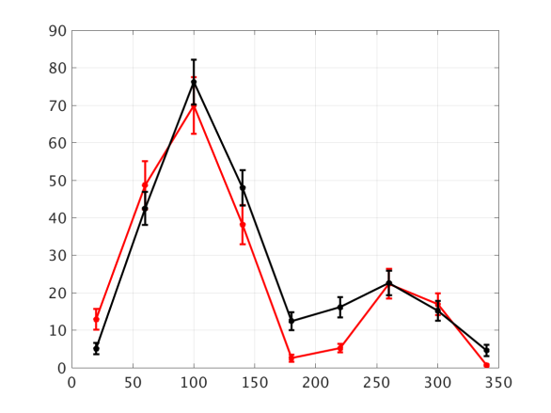
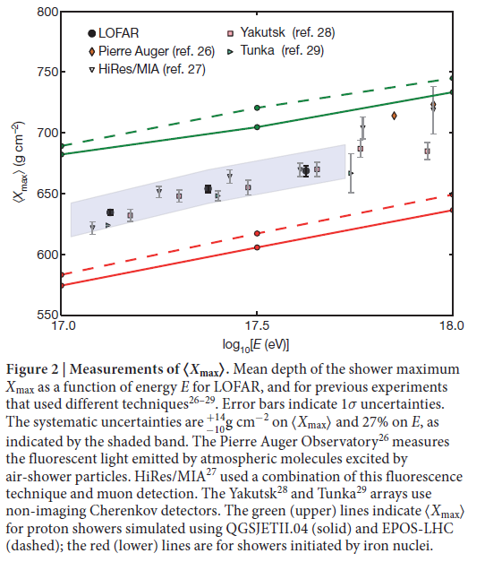
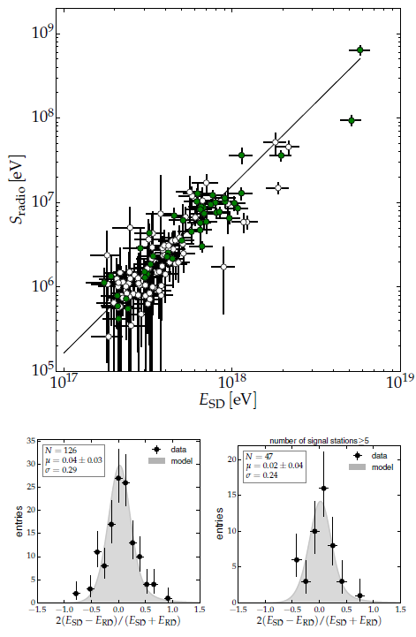
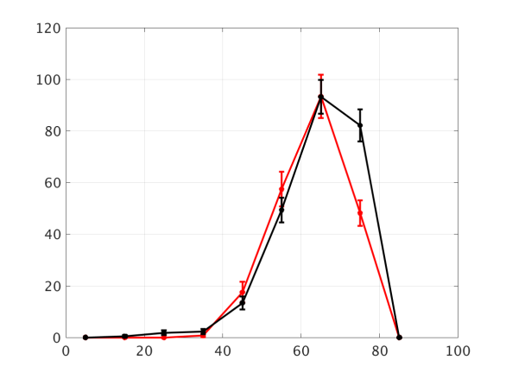
Why radio? Because it works!
MHz radio-detection of air showers becoming a mature technique
σ(Xmax) ~ 20g/cm²
ΔE/E<20%
Autonomous radio-detection & identification of air showers
-- Data
-- EAS simu
Aab et al., AUGER
astro-ph/1508.04267
Le Coz et al., TREND
ICRC2017
+A&A in prep
Azimuth (deg)
-- Data
-- EAS simu
Buitink et al., LOFAR, Nature
Zenith (deg)

Slide 6
Why radio? Because it is perfect for horizontal air showers!
50-200MHz radio emission of a 10^{17.5}eV shower viewed from the side:
~10s of km² detectable footprint @ ~100 km from decay point!!
Use
Elevation (km)
Use mountains as projection screen for radio emission
Background level: 15µV/m

Slide 7
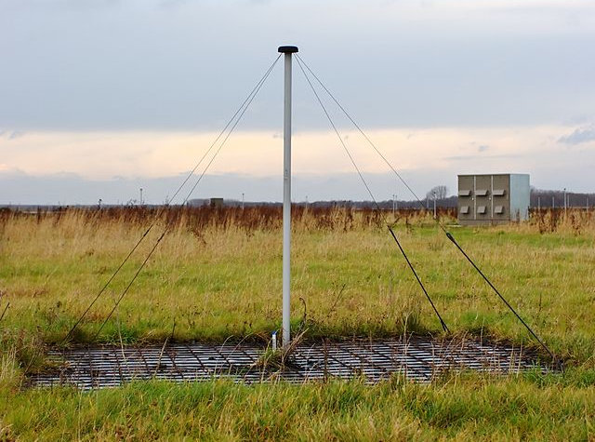
Why radio? Because it is cheap!
a LOFAR antenna
Basic ⬄ cheap
P. Lautridou (2011)

Slide 8
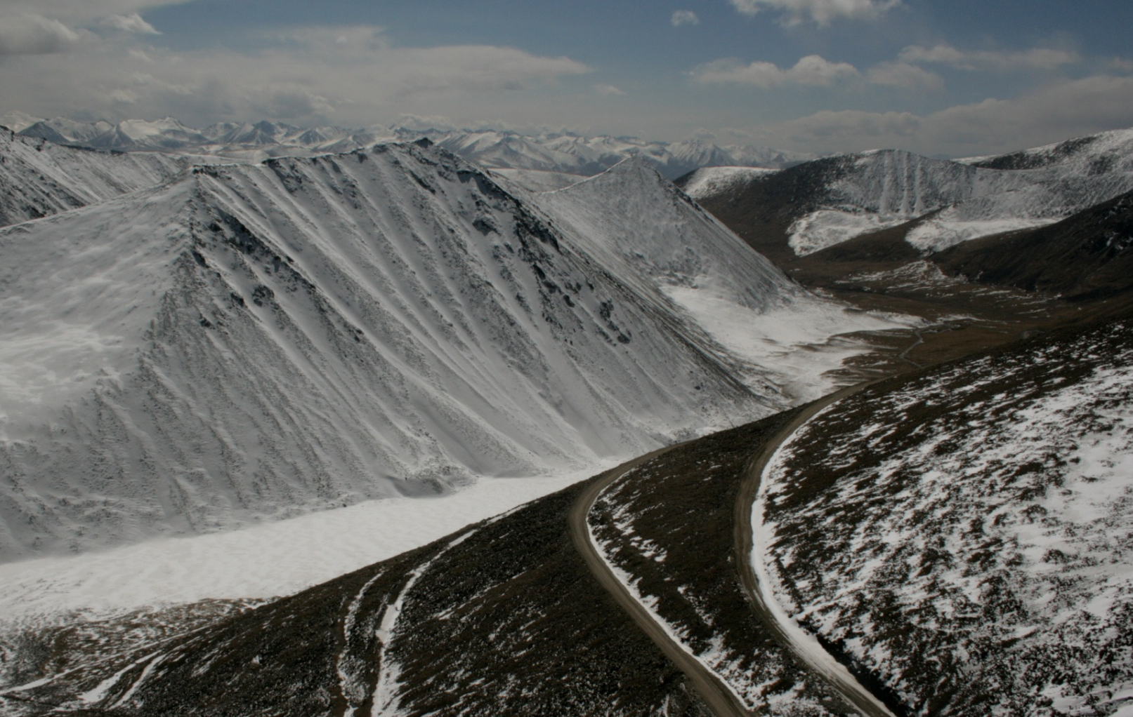
The GRAND project
Size of the neutrino detector is a key parameter.
>10000 km²?
- technical capacity?
- topology?
Ulastai

Slide 9
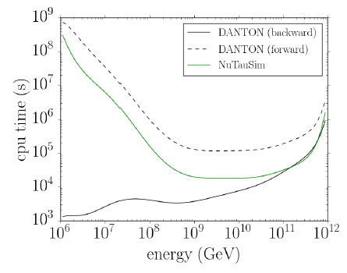
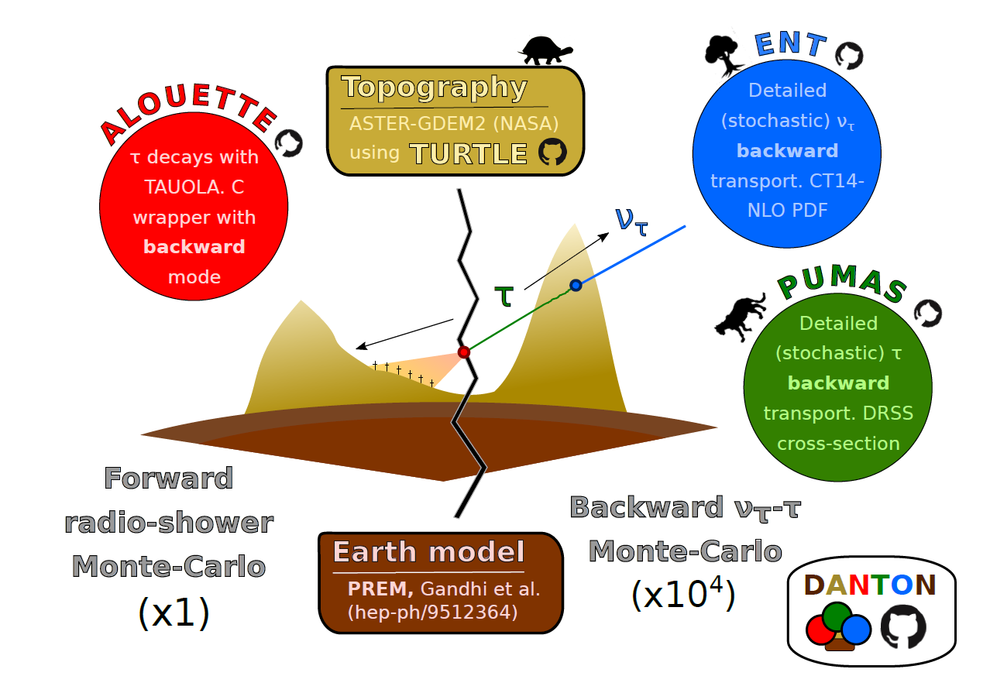
GRAND neutrino sensitivity simulation
End-to-end neutrino simulation chain now complete:
1) ν traj ➔ τ decay through backward simulation.
V. Niess, LPC Clermont-Ferrand

Slide 10
2) radio simulation: home-made cooking
Anne Zilles, IAP, ARENA2018

Slide 11
RadioMorphing:
computation gain ~x100 in CPU time
Resulting radio signal very similar to «true» sim
Anne Zilles, IAP, ARENA2018

Slide 12
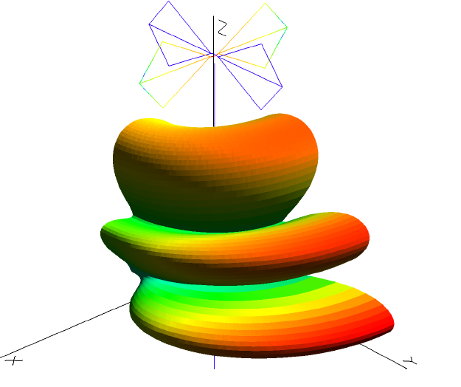
3) Antenna response: a dedicated design
HorizonAntenna proposal (D. Charrier, Subatech)
Active bow-tie antenna (a la CODALEMA)
Dimension optimized for the 50-200MHz frequency range
Antenna height: 4.5m
optimized for ~horizontal waves
3 arms: full polarization measurement
Detailed (stationnary) noise level estimate: 15µV rms

Slide 13
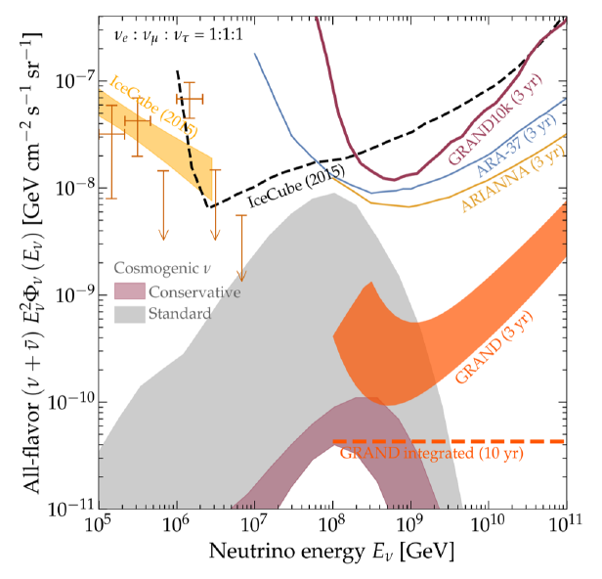
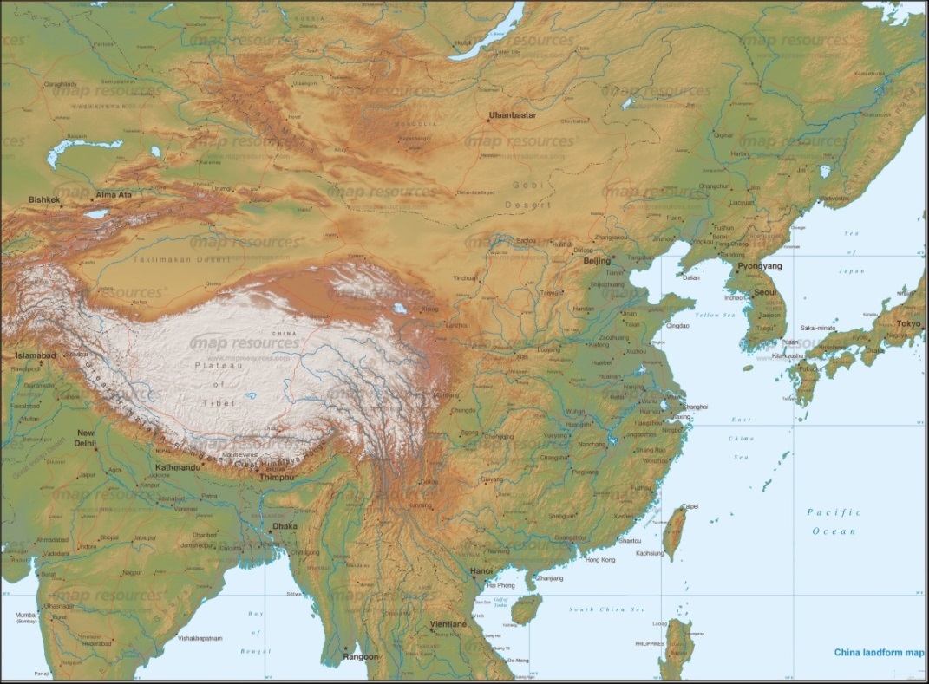
Simulation results
10k antennas over 10000km² competitive with ARA or ARIANNA.
PRELIMINARY
We WANT a detector large enough to GUARANTEE the detection of UHE neutrinos.
o(10-20) hotpsots of o(20-10) kAntennas
deployed over o(20-10’000) km² hotspots with favorable topographies around the world.
➔ total area: 200’000km²

Slide 14
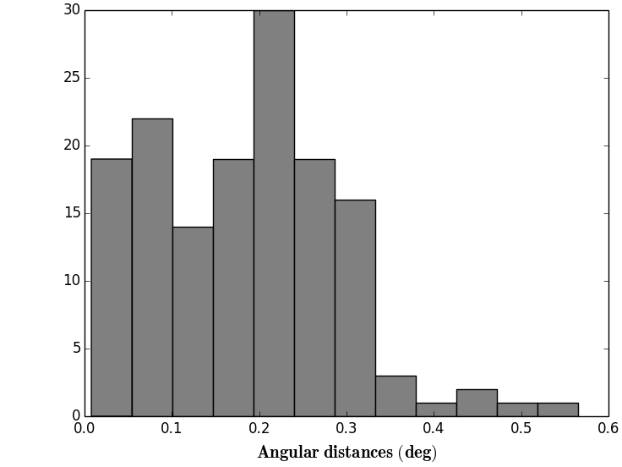
Simulation results
1h observation
Full azimuth coverage allows for large 24h-FoV…
Subarrays deployed at several location in the world would improve instantaneous FoV.
Mountain slopes helps reconstructing direction of origin!
<ψ>= 0.2°
(Plane wave approx)
(V. Decoene)
24h/1yr observation
➔ Astronomy!!!
PRELIMINARY
Assuming 200000km² @ TREND site

Slide 15
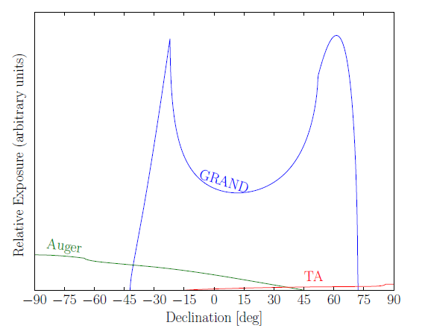
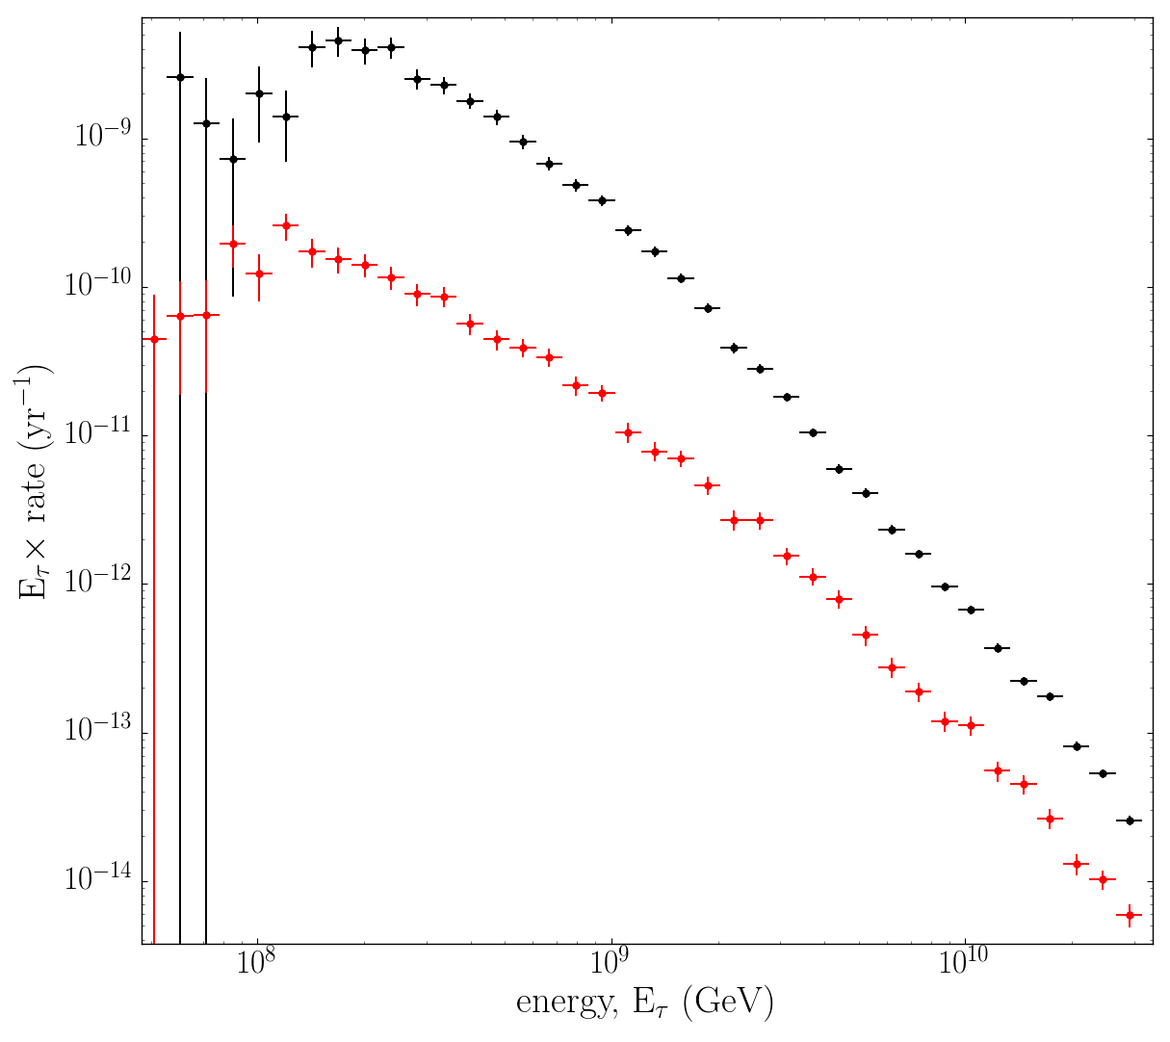
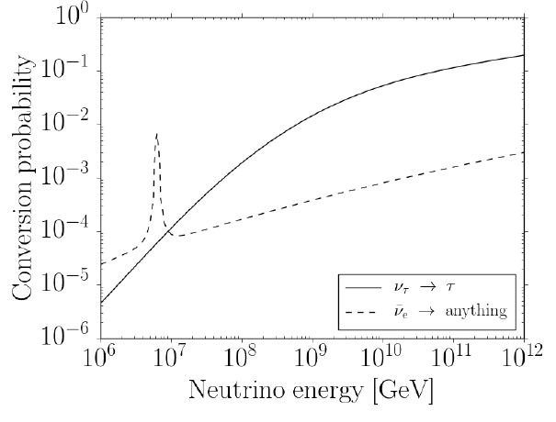
A rich science case
UHECRs & gamma ray :
Huge stat: 15x AUGER aperture: all of AUGER data within a year!
Excellent sky coverage (North/South)
Primary identification ➔ proton astronomy + gamma ray search
Neutrino physics (if stat on atmosphere inter.)
ν-p cross section
flavor study if atmospheric events (all flavors) in addition to ground (ν_{τ}) (?)
Glashow resonnance (??)
FRBs & Epoch of Reionization
Ground interaction
Atmosphere interaction
NuTauSim
For ν_{τ} primaries only:
atmosphere/ground rate~1/20
➔ Estimated overal ratio > 1/10

Slide 16
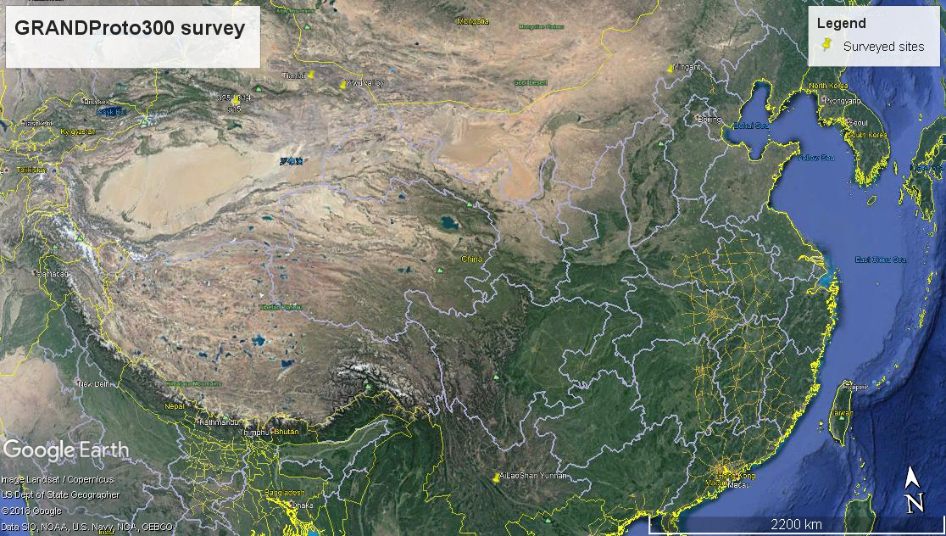
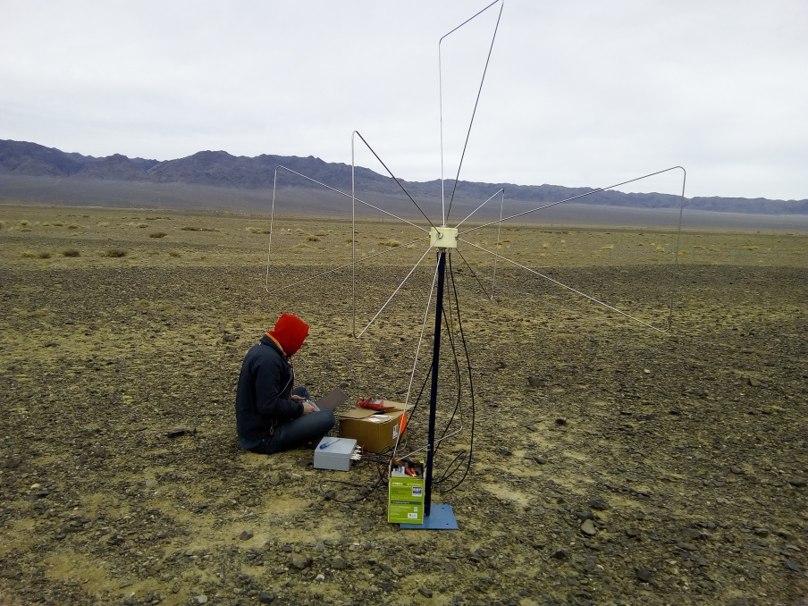
GRAND challenges
How to deal with the HUGE transient event rate ⬄ self-triggering?
How huge? Very limited experimental elements exist…
Site surveys: ~50 measurements@ different locations in China (Aug 2017- Aug 2018)
Usually stationnary noise within factor 2 of (irreductible) Galactic radiation & <1kHz antenna transient rate in 30-80MHz.
Include this constraint in DAQ design (ie 100% livetime up to 1kHz transient rate)

Slide 17
GRAND challenges
How to collect data?
Optimised trigger (machine learning (?), see Führer et al. ARENA2018) to improve selection @ antenna level
Optimised informations to be transmitted to central DAQ
How to identify air showers out of the ultra dominant background ?
Specific signatures of air shower radio signals vs background transients demonstrated
(TREND offline selection algorithm:1 event out 10⁸ pass & final sample background contamination<20%)
Improved setup (GRANDproto35, being deployed) should lead to even better performances
How well can we reconstruct the primary particle information
- Simulations promising (similar performances as for standard showers)
How to deploy and run 200’000 units over 200’000km²?
How much will it cost? Who will pay for it?
-- Data
-- EAS simu
-- Data
-- EAS simu
TREND results:
564 air shower candidates out of 7. 10⁸ triggered events
Zenith (deg)
Need for an exprimental setup to test and optimize technics ➔ GRANDproto300
Azimuth (deg)
Go for industrial approach! Precise answers to be studied at latter stage

Slide 18
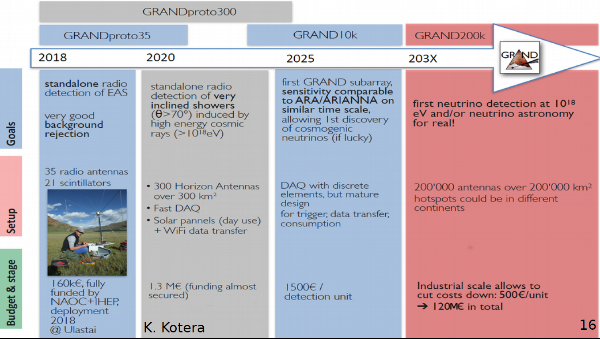

Slide 19
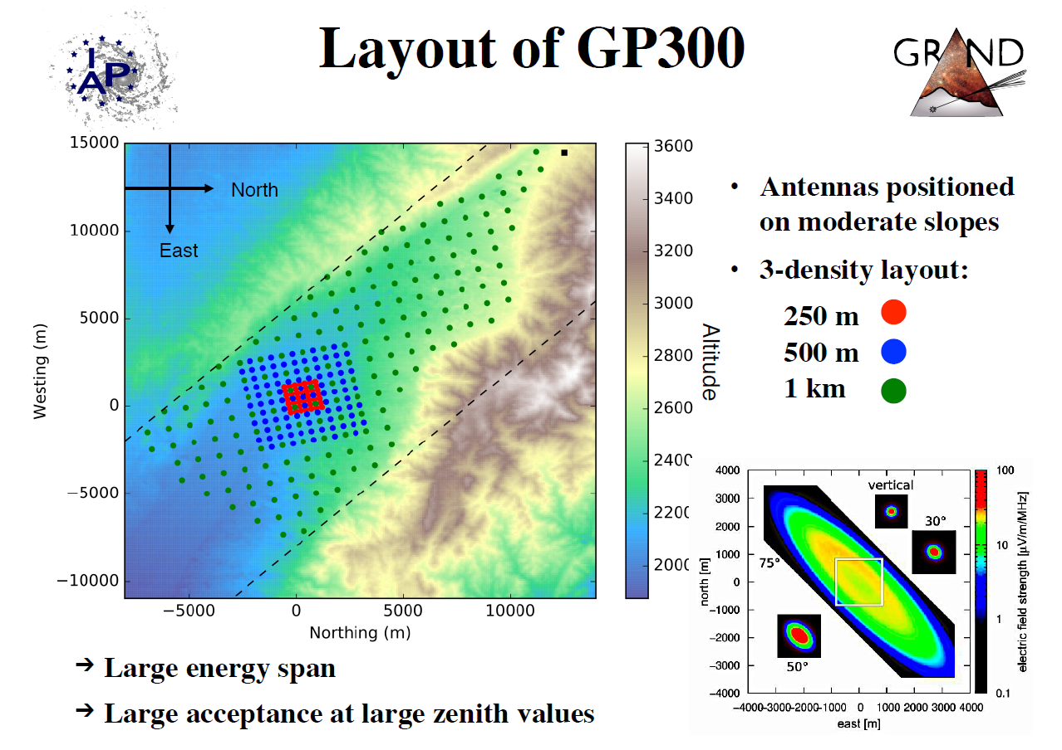
GRANDProto300
49 ants
116 ants
135 ants
Candidate site: Yiwu county, XinJiang
Surveyed Oct 2017 & April 2018
N. Renault-Tinacci, FCPPL2018

Slide 20
GRANDProto300: an engineering array for GRAND
N. Renault-Tinacci, FCPPL2018

Slide 21
Goals of GP300
GRAND engineering array
Measurement of very inclined CRs in 10^{16.5}-10¹⁸eV: reconstructing spectrum, direction of arrival & composition
➔ validation thru comparison to known results
Testbench for further GRAND stages (data selection & collection)
Physics @ GP300
Beautiful physics instrument if complemented by array of particle detector

Slide 22
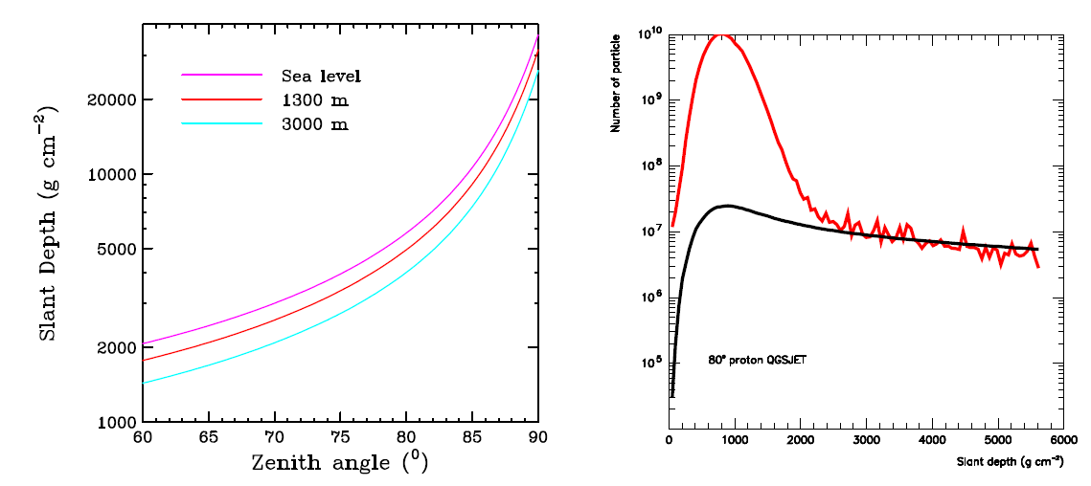
GP300 hybrid array
Very inclined showers
➔only muons at ground
➔ full secondaries discrimination possible:
elm componant (and energy) with radio only
µ componant with surface array
Muons
Electrons

Slide 23
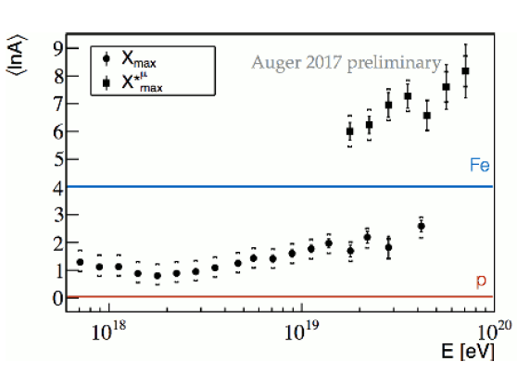
GP300 science case
Air shower physics
Hadronic interaction @ highest energies poorly understood/constrained (lack of accelerator data)
Experimental µ info badly reproduced by simulations
GP300 measurement of E, X_{max} and X_{max}^{µ} should greatly help!
Mallamacci, ICRC2017

Slide 24
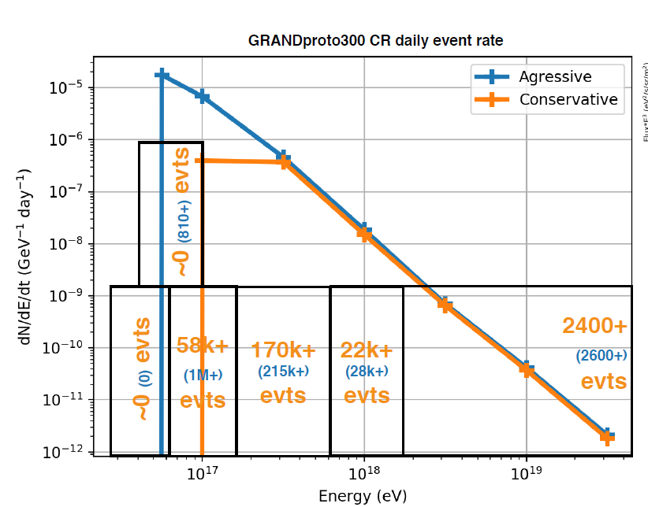
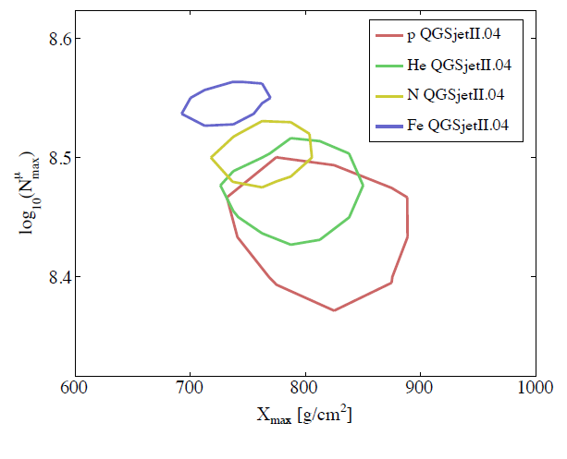
GP300 science case
Improved composition determination
Large stat
➔ Great tool for the study of Galactic-Extragalactic transition
N. Renault-Tinacci
AugerPrime design report

Slide 25
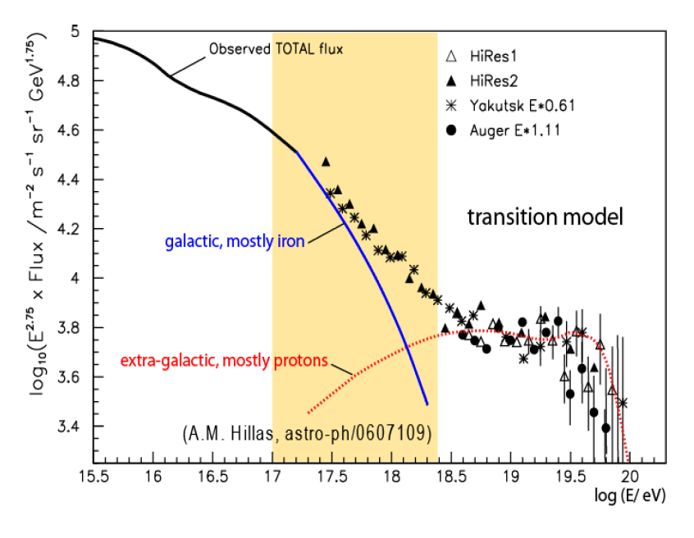
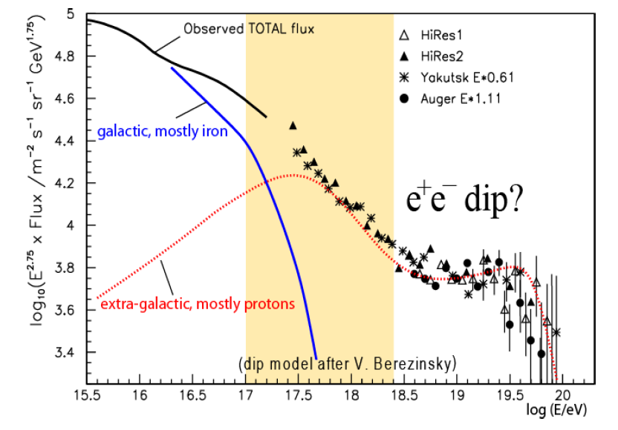
GP300 science case
Improved composition determination
Large stat
➔ Great tool for the study of Galactic-Extragalactic transition
R. Engel, TeVPA2017

Slide 26
Take-home message
GRAND is an ambitious project for a giant array of 200’000 radio antennas deployed at several locations in the world.
Very rich science case centered on UHE cosmic particles.
Huge experimental challenge ➔ staged approach over 10-15 years.
Next step: 300 antennas for the autonomous radio-detection of inclined showers. Exciting science case if complemented by ground array.
We need more people to carry out GRAND’s large tasks list
Want to know more/keep in touch?
Check our webpage: http://grand.cnrs.fr/ (in construction)
Suscribe to our info list GRAND-ALL-L@IN2P3.FR
Join us at our next meeting (IAP Paris, August 22-24, 2018)

