Slide 1
HEAVY NEUTRINOS ?
Rencontres du Vietnam
16-22 July 2017 ICISE-Quy Nhon

Slide 2
Why heavy neutrinos?
Neutrino masses require the existence of right-handed singlet components (absent in MSM)
- They do not couple to W or Z
- They couple to SM through mixing
- PMNS matrix no more unitary
- Their mass is unknown,
U₁₁ U₁₂ U₁₃ U₁₄ …
U₂₁ U₂₂ U₂₃ U₂₄… U = U₃₁ U₃₂ U₃₃ U₃₄ … U₄₁ U₄₂ U₄₃ U₄₄ … …

Slide 3
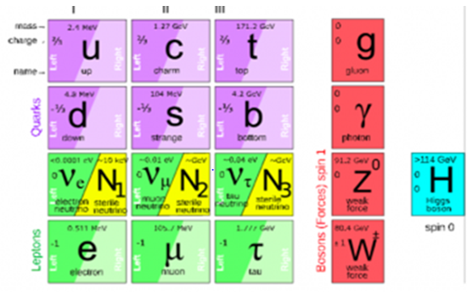
The νMSM model
T. Asaka and M. Shaposhnikov Phys.Lett.B620(2005)17
M.Shaposhnokov Nucl.Phys.B763(2007)49
Minimum extension of the SM to accomodate massive neutrinos
See-saw formula for active neutrinos m_{ν}=-M^{D}(1/M_{I})(M^{D})^{T}
Majorana mass M_{I}
Dirac mass M_{D}=fv v=174 GeV vac exp val of Higgs field
Usual choice : f as in quark sector, M = 10¹⁰-10¹⁵ GeV
Alternative choice : small f

Slide 4
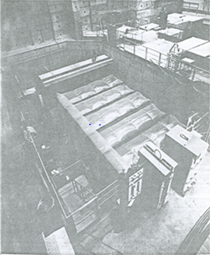
Heavy neutrinos at accelerators
Mixed with active neutrinos
In all weak processes they appear at the level U²_{Nl}
Their mass is limited by kinematics in poduction process
π ⇒ e N m(N) < 130 MeV/ c²
π ⇒ μ N m(N) < 20 MeV/c²
K ⇒ e N m(N) < 450 MeV/c²
K ⇒ μ N m(N) < 350 MeV/c²
…D_{s} ⇒ τ N m(N) < 180 MeV/c²
W ⇒ e N m(N) < 80 GeV/c²
Their decay modes depend on their mass
m(N) > 1.02 MeV/c² N ⇒ e⁺ e⁻ ν_{e}
m(N) > 106 MeV/c² N ⇒ μ⁺ e⁻ ν_{e}
m(N) > 140 MeV/c² N ⇒ π⁺ e⁻
m(N) > 220 MeV/c² N ⇒ μ⁺ μ⁻ ν_{μ}
m(N) < 1.02 MeV/c² N ⇒ γ ν
PS191-CERN 1984

Slide 5
Lifetime
Τ_{H} = Τ_{μ} ( m_{H}/m_{μ})⁻⁵ 1/ U²

Slide 6
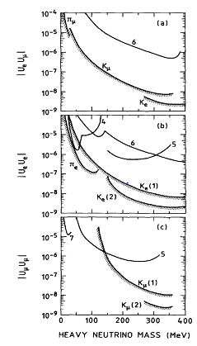
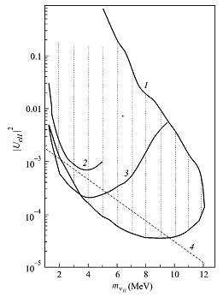
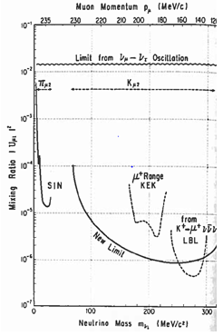
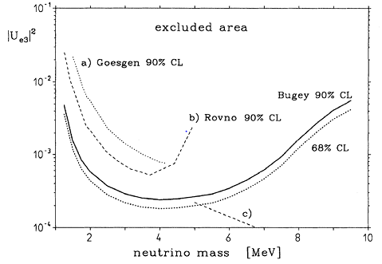
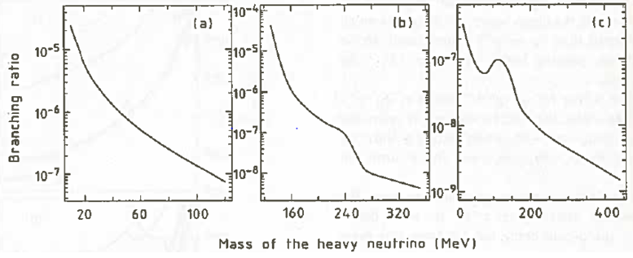
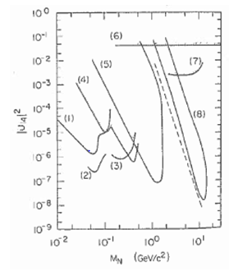
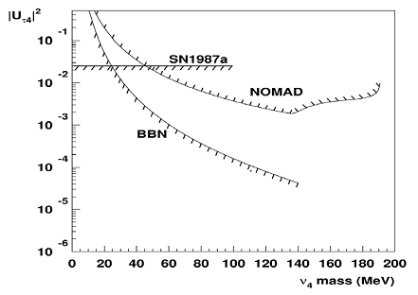
Limits

Slide 7
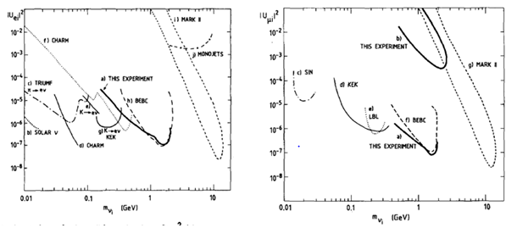
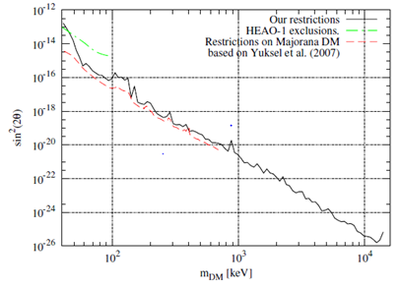
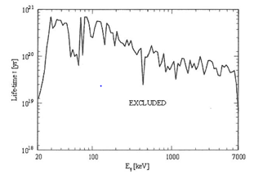
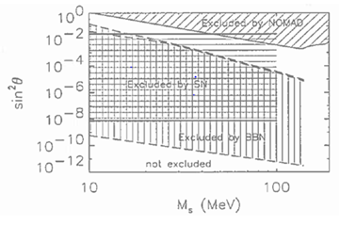
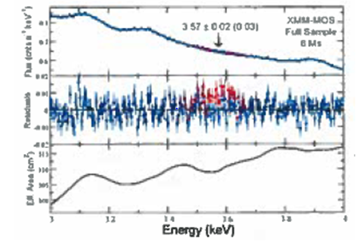
Continued…

Slide 8
A naive consideration
Nucleosynthesis N_{had}/Nγ = 2 10⁻⁹
Nγ = 400/cm³
N_{νe} = 100/cm³
Assume WDM with N of mass m=10 keV
Σm_{N} = 25%
Σm_{had} = 5%
N_{N}/N_{had} = 5 10⁶/m(keV)
N_{N}/N_{νe} = N_{N}/N_{had} N_{had}/Nγ Nγ/N_{νe} = 40 10⁻³ /m
4 10⁻³ = U²

Slide 9
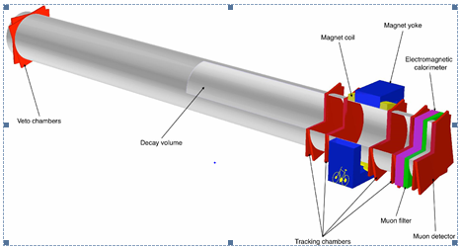
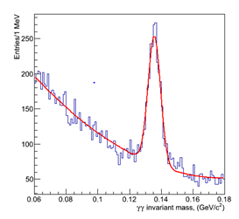
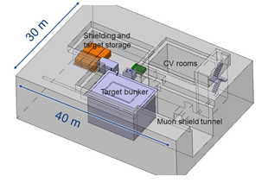
Future at accelerator: NA62 then SHiP (Search for HIdden Particles)

Slide 11
Detector reoptimization
Decay
~30m
~45m
Muon shield
The active muon shield in the SHiP experiment
arXiv:1703.03612v2 [physics.ins-det] 2017_JINST_12_P05011
Pyramidal shape
PID, timing
Technology choices for the subdetectors

Slide 12
Decay

Slide 13
Perspectives
SHiP is a proton beam dump facility
To take data 5 years starting in 2027, assuming approval $≤$ 2020
To reach the best sensivity for many hidden sector particles (MeV-GeV)
with an apparatus currently being reoptimized to search for unknown neutral particle
decays, scattering, also ν_{τ} physics
The SHiP beamline is to be seen as a facility:
τ → 3 μ ?..

Slide 14
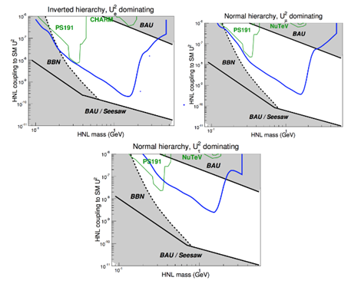
Expected limits

Slide 15
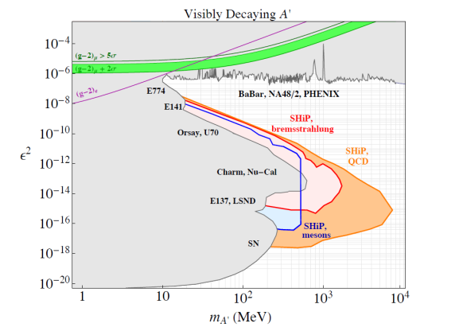
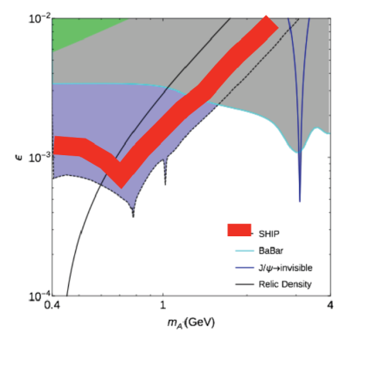
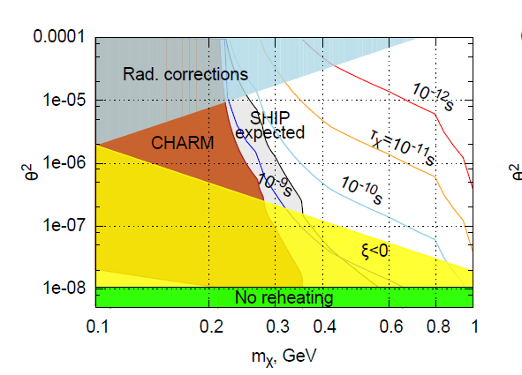
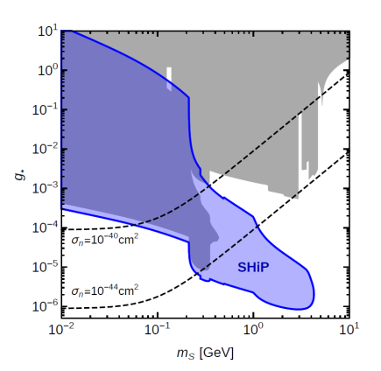
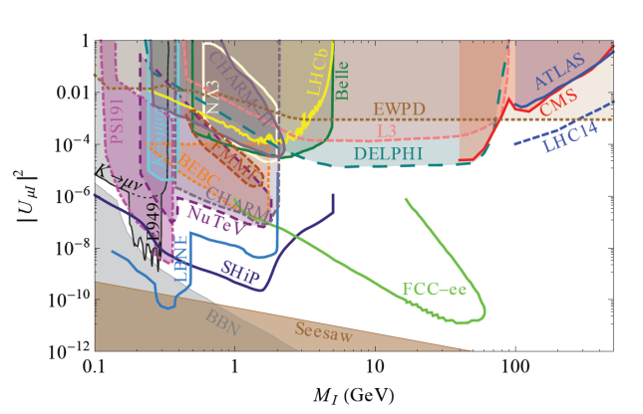
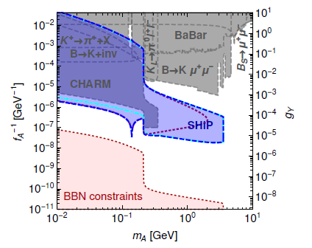
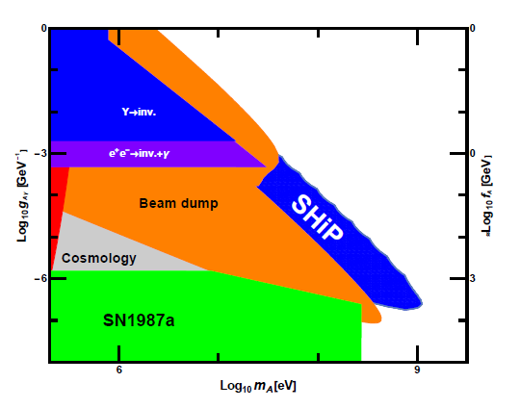
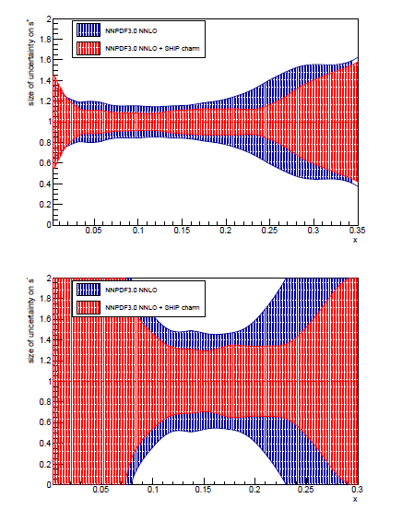
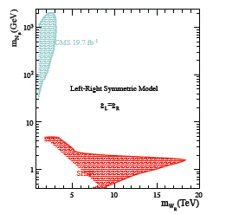
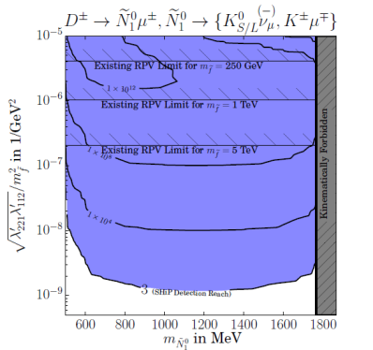
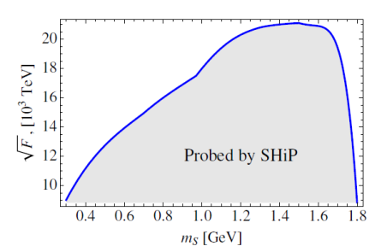
Physics proposal plots
Dark photon
A’→χχ
inflaton
Scalar
HNL
ALP
ν_{τ} DIS
L/R
SUSY

Slide 16
Conclusion
Heavy neutrinos probably exist, but their mass is completely mysterious
Potential candidates for Warm Dark Matter
(… but problematic consistency)
Experimentally, challenging search… but not impossible to be test some mass regions both in the sky (for N₁) and in the laboratory (for N₂ and N₃)

Slide 18
Dump
Vacuum
Timing, PID
>10¹⁸D, >10¹⁶ τ, >10²⁰ γ
for 2×10²⁰ pot (in 5 years)

