Slide 1
Cosmological constraints via the redshfit dependence of galaxy clustering
Xiao-Dong Li (Korea Institute for Advanced Study)
WITH Changbom Park, Juhan Kim (KIAS),
Cristiano G. Sabiu, Hyunbae Park, Arman Shafieloo, Sungwook Hong (KASI),
J. E. Forero-Romero (Univ. de los Andes),
David H. Weinberg (OSU), Donald P. Schneider (Penn State),
Yuting Wang, Gong-bo Zhao (NAOC)
July 11, 2017, Cosmology @ Quy Nhon, Vietnam

Slide 2
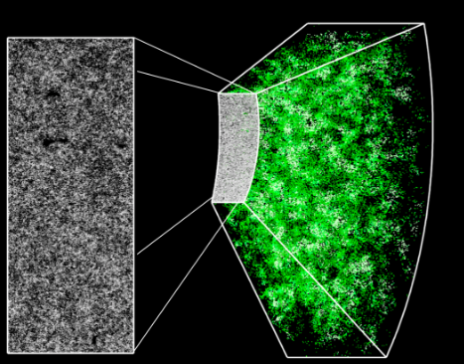
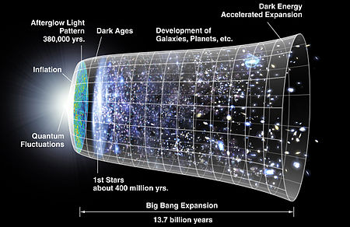
Cosmology from galaxy clustering
Baryon acoustic oscillation
Redshift space distortion
Cosmic expansion history
Growth of structure
Topology
Weak lensing
Cluster
abundance
Alcock-Paczynski test

Slide 3
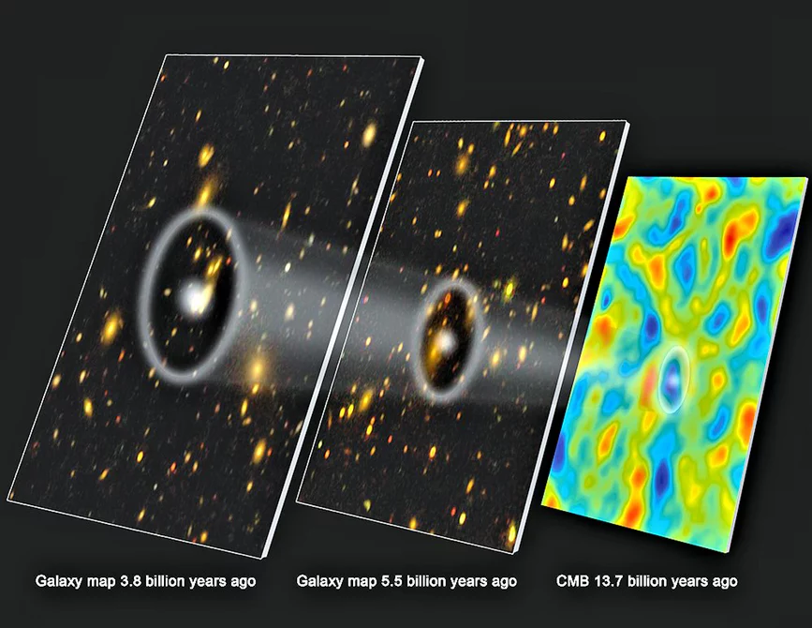
Why using the redshift dependence?
Avoiding the great difficutly and large systematics!
(non-linear clustering, redshift space distortion, galaxy bias, ...)
Small-scale clustering usable!
Tight, robust cosmological constraints from the “redshift invariants”.

Slide 4
Highlights
1. Alcock-Paczynski Test (shape)
2. Volume effect (scale)
3. Summary

Slide 5
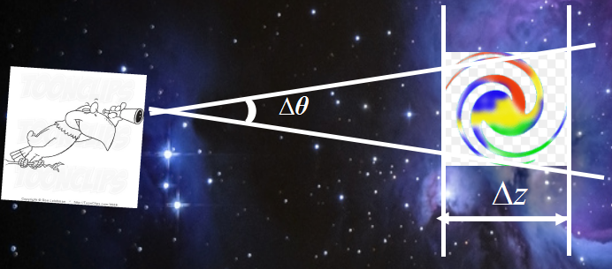
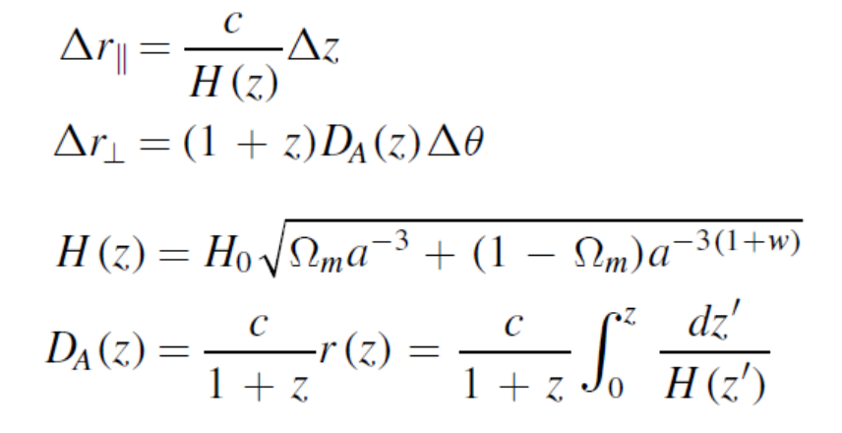

The Alcock-Paczynski test
Alcock & Paczynski, Nature, 1979
Geometric distortion due to wrong r(z).
AP = Apparent shape distortion if H, D_{A} are wrong.

Slide 6



Slide 7

Wrong interpretation of signal → Wrong distribution
Singals are correct. Interpretation is wrong (brain problem...)

Slide 8
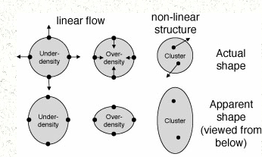
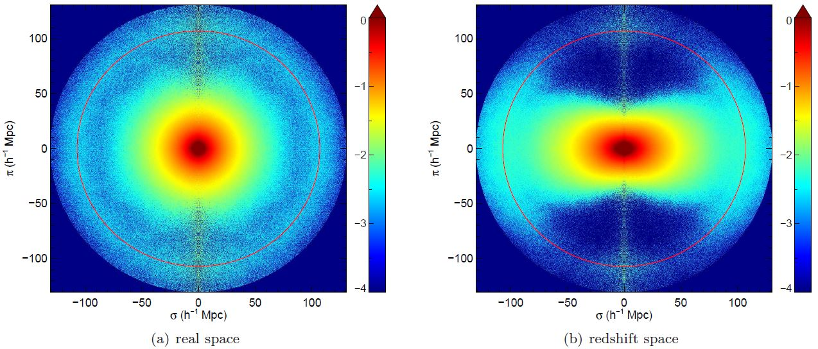
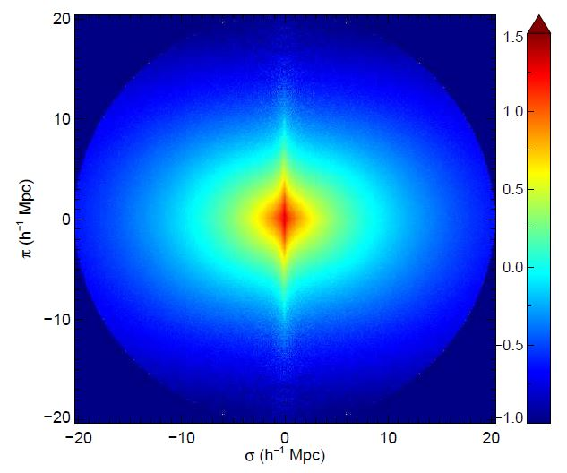
Redshift space distortion (RSD)
RSD produces strong anisotropy.
NL. Not easily to tackle.

Slide 9
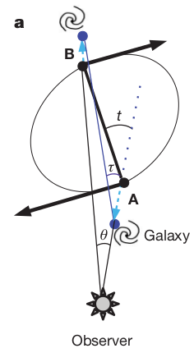
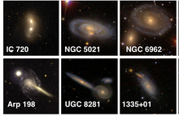
Idea of using Galaxy Pairs
Marinoni & Buzzi 2010
Unfortunately, also limited by RSD.
Distortions of angles due to motion depend on cosmology and redshift, rather difficult to model (Jennings et al. 2011)

Slide 10
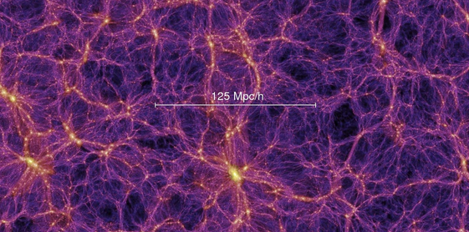
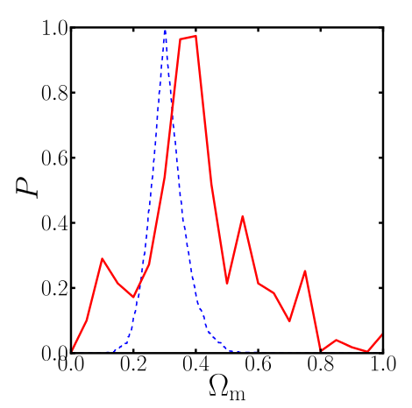
Idea of using Voids
On average, shape of voids is spherical (Ryden 1995; Lavaux & Wandelt 2012).
Voids are easier to model compared with clusters.
Unfortunately so far the constraints are not very strong.
Mao et al., 2016

Slide 11
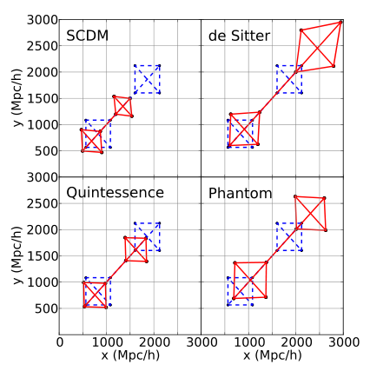
Our Idea: Redshift Evolution
_{Li et al, 2014, ApJ}
Observer in Ω_{m}=0.26 ΛCDM,
located at (0,0).
Degree of anisotropy evolves significantly!

Slide 12
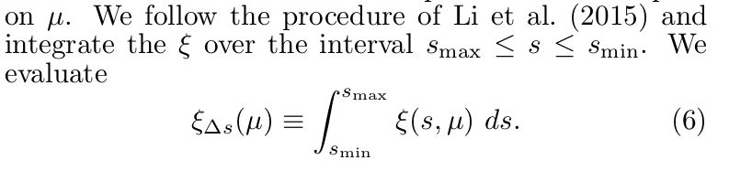
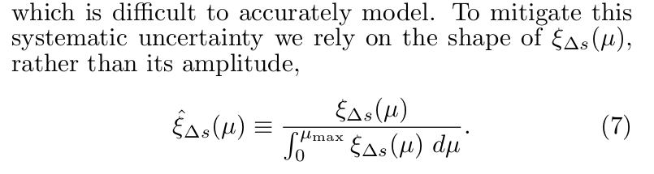
Quantify anisotropy
The redshift evolution is not significant down to 6 Mpc/h, so we can make use of small scale clustering.
This region is usually abondoned in traditional method.
Actually there is quite a lot of clustering information.
6 Mpc/h < s < 40 Mpc/h
Normalizing the amplitude; focus on shape. Galaxy bias removed.

Slide 13
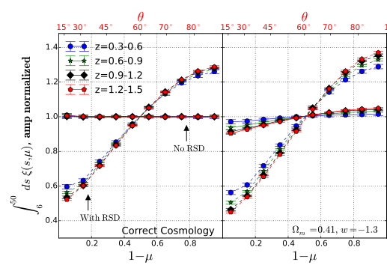
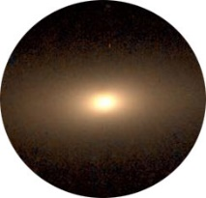
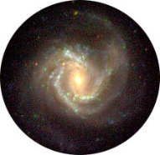

Distinguishing AP & RSD in 2pCF statistics
_{Li et al., 2015, MNRAS}
θ
s
r(z)
μ=cos θ
RSD seriously distorts the isotropy,
but not very evolves with redshift

Slide 14
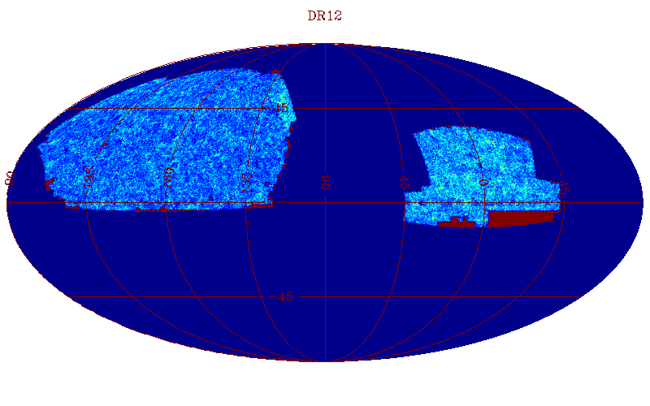
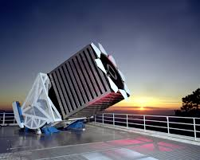
Application to SDSS DR12 BOSS data
_{Li et al., 2016, ApJ}
1/4 sky,
z = 0.15-0.7,
1.3 million galaxies

Slide 15
Application to SDSS DR12 BOSS data
_{Li et al., 2016, ApJ}
1/4 sky,
z = 0.15-0.7,
1.3 million gals
1. Adopt a r(z) [in some cosmology], construct 3D sample
2. Measure ξ(μ) in each bin
3. Quantify the evolution of anisotropy [comparing high-z bins to first bin]
Wrong Cos. → Large redshift evolution → Disfavored
4. Try different cosmologies → Repeat 1-3 → Cosmological Constraints

Slide 16
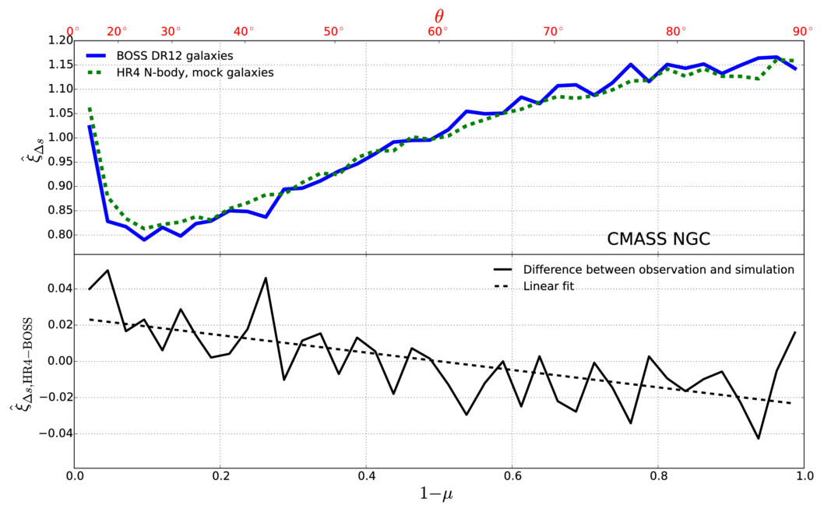
Look at RSD
Kaiser
Finger of God

Slide 17
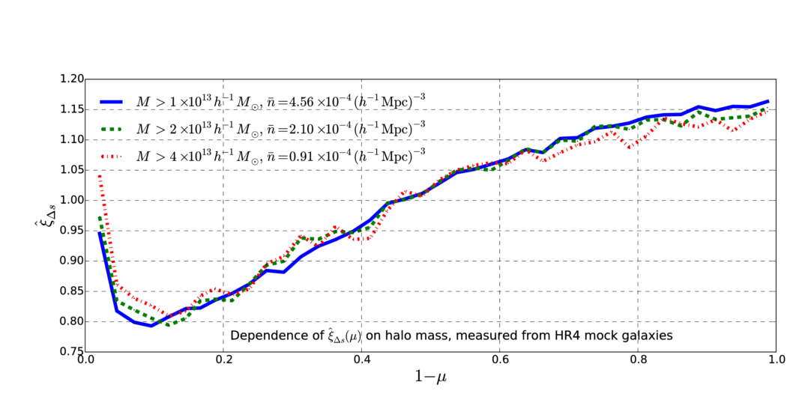
Galaxy bias
Not sensitive

Slide 18
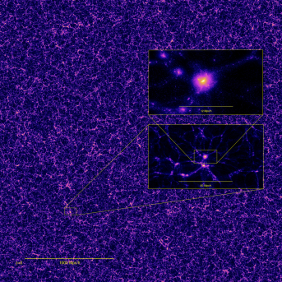
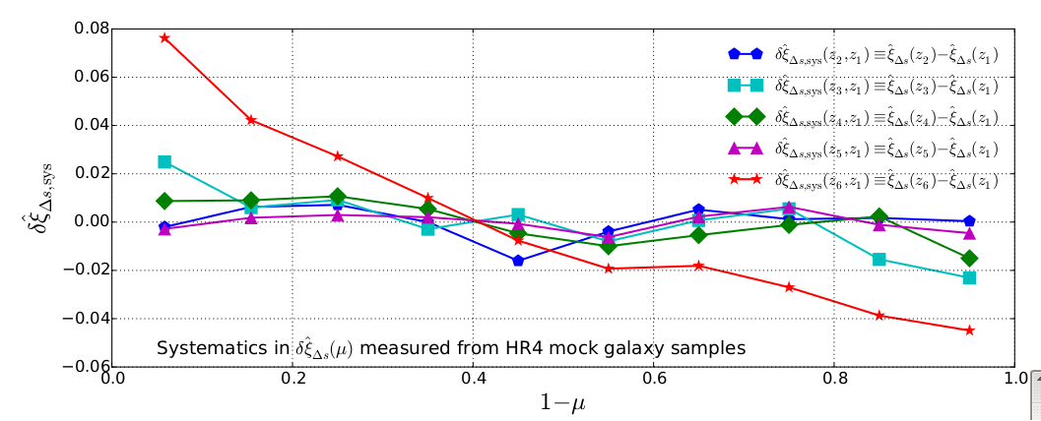
Systematics correction: Horizon Run 4 N-body simulation
Kim et al. 2015. (3.15 Gpc/h)³, 6300³ particles
Mostly < 2%.
Relatively large at the highest redshift bin (0.57<z<0.7);
need check.

Slide 19
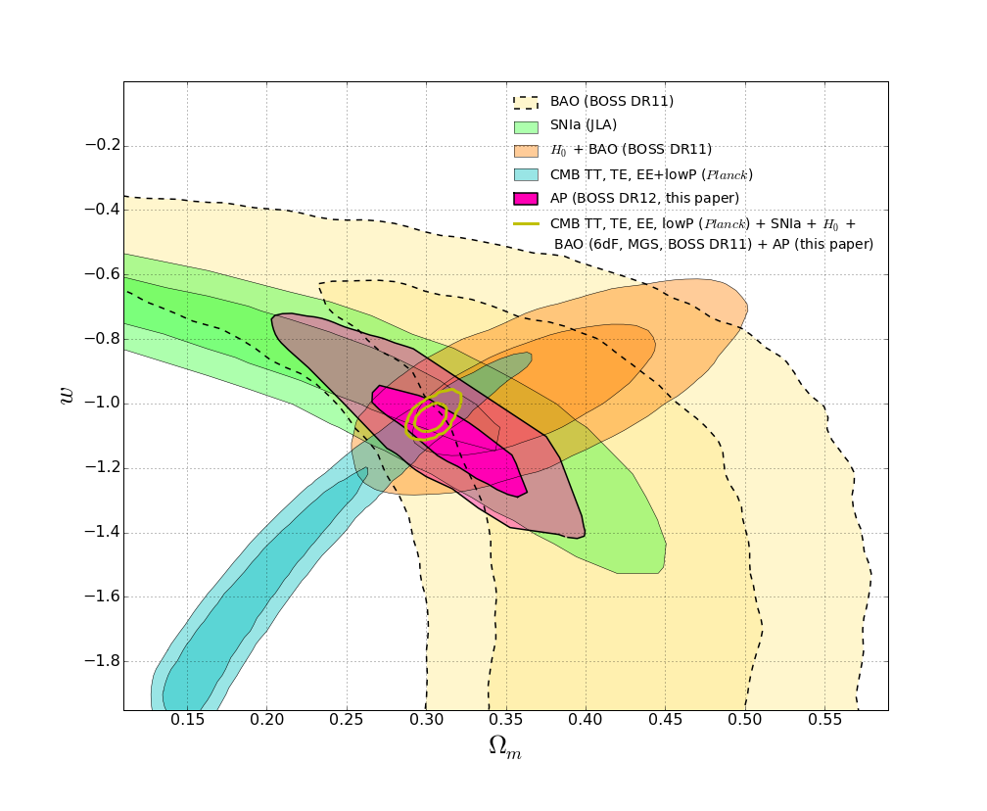
Cosmological constraints
Shape & position similar to SNIa,
but tighter.
Consistent with everything.
Combined results(CMB+SNIa+BAO+H₀+AP):
Ω_{m} = 0.301 ± 0.006
w = -1.054 ± 0.025
Adding our AP method reduces the error bars by 30-40%

Slide 20
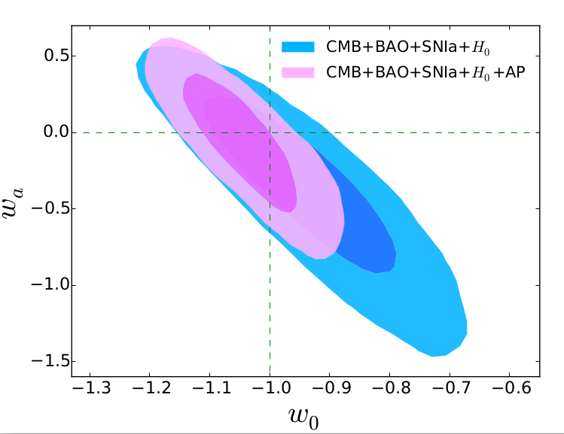
Constraining dynamical dark energy
Based on a fast code written by me, ~ 0.2sec / point. Enable multi-parameters.
“CPL” ansatz:
w = w₀ + w_{a} * (1 - a)
= w₀ + w_{a} * z / (1+z)
All combined:
w₀ = -1.042 ± 0.067
w_{a} = 0.07 ± 0.29
Consistent with cc.
Adding our AP method improves the figure of merit by 100%!

Slide 21
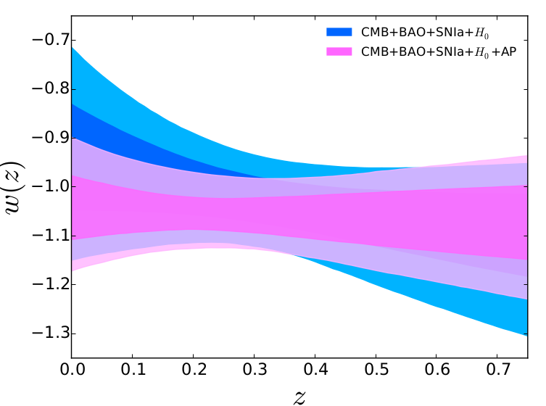
Constraining dynamical dark energy
Consistent with c.c.

Slide 22
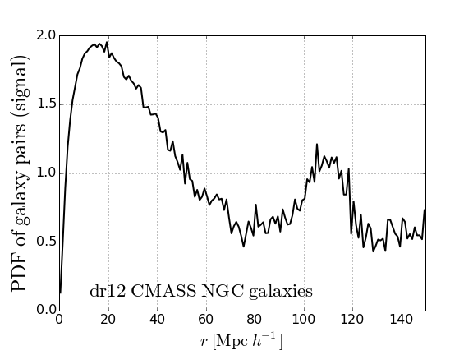
Q: Why so powerful?
A: A lot of information from small-scale clustering!
Our method:
Anisotropy of clustering in 6-40 Mpc/h
BAO:
Peak of over-clustering
around 110Mpc/h

Slide 23

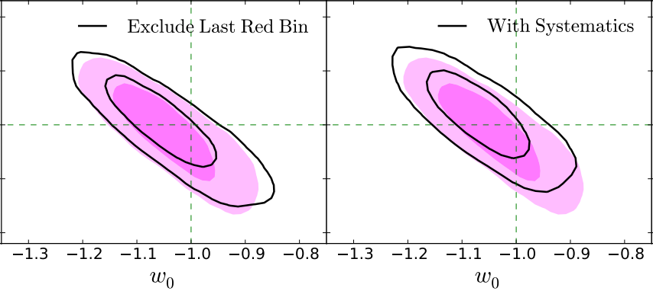
Check systematics
No significant change if discarding the systematics correction or skipping the last red shift bin (having largest systematics)

Slide 24
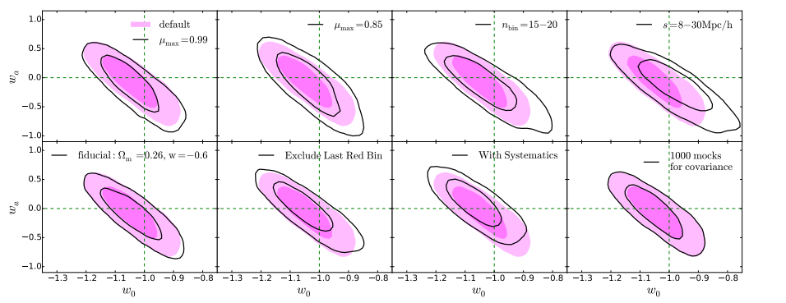
More conservative
binning
More conservative
clusetering scale
Include ~all FoG region
Remove the FoG
Very deviated fiducial cosmology
Number of mocks for covariance

Slide 25
Numerous merits
* Overcoming the great difficulty of RSD in AP
(breakthrough: no good solution for >10yrs!)
* Very tight constraints (powerful)
* Not sensitive systematics (robust)
* No complicated NL clustering & RSD (simple)
* Reliably using clustering on 6-40 Mpc/h (unique)
* Independent information from BAO, RSD, SNIa (extra)
* Can be used in many future spectroscopic surveys! (promising)

Slide 26




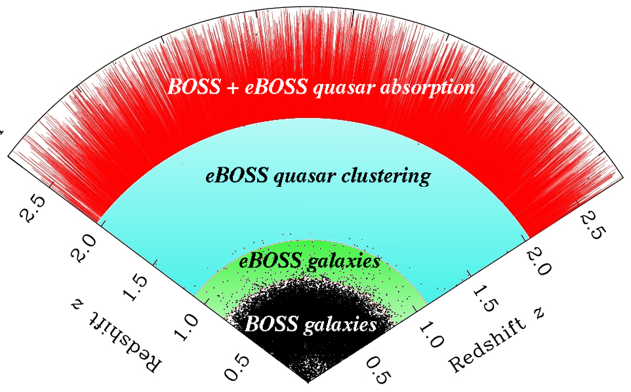

Numerous merits
Commetns from
Prof. Donald Schneider :
“a major advance”
“extremely promising”
“I believe it will indeed be
used in the future”
* Overcoming the great difficulty of RSD
(breakthrough: no good solution for >10yrs!)
* Very tight constraints (powerful)
* Not sensitive systematics (robust)
* No complicated NL clustering & RSD (simple)
* Reliably using clustering on 6-40 Mpc/h (unique)
* Independent information from BAO, RSD, SNIa (extra)
* Can be used in many future spectroscopic surveys! (promising)

Slide 27
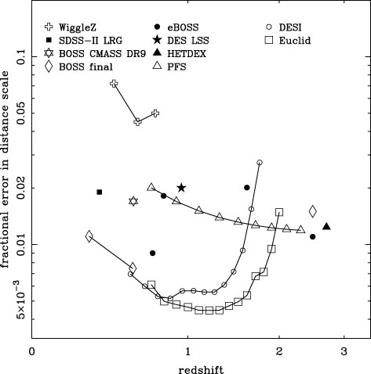

Power ~
sample sizes * redshift span
Statistical Error
Data used in
This analysis

Slide 28
Highlights
1. Alcock-Paczynski Test (shape)
2. Volume effect (scale)
3. Summary

Slide 29

Volume effect
(second piece of the story)
As another consequence of
wrongly adopted cosmology,
the changed comoving-volume size
also has redshift dependence.

Slide 30
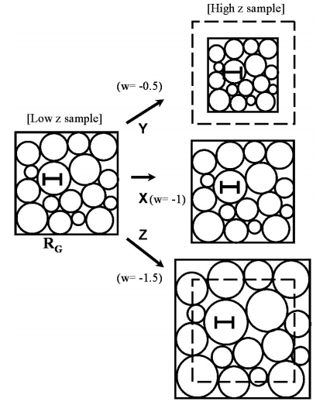
Topology as standard ruler
Park & Kim, 2009
The pattern of galaxy distribution should be
maintained in the course of time on large scales.
By examining the scale-dependence of the pattern in different redshift intervals it is possible to reconstruct the expansion history of the universe.

Slide 31

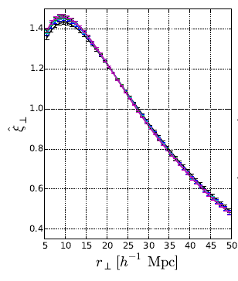
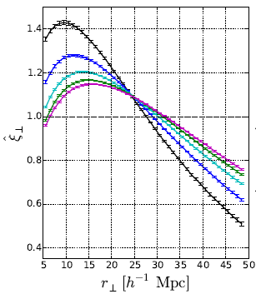
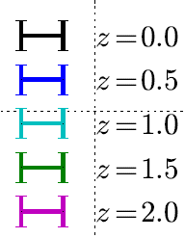

Angular correlation function (Li et al. 2017, ApJ accepted)
_{Q: Why angular CF?}
A: Applicable to photometric data
Volume effect shifts the apparent scale of clustering.
This alters the shape of CF.
Due to the z-dependence,
we see a redshift evolution.
Right panels: angular CF
Correct cosmology

Slide 32
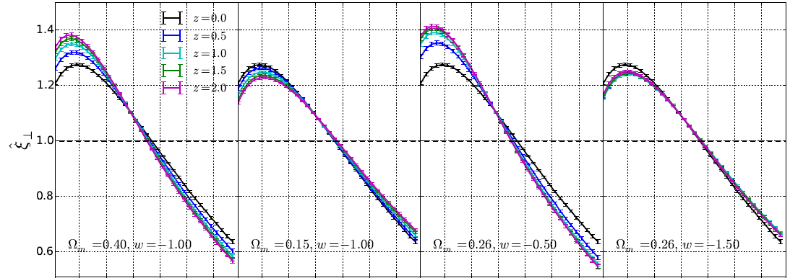
Redshift evolution in wrong cosmologies
Assuming a correct cosmology of 0.26/-1
Horizon Run 4 simulation, z=0-2, 1.75 billion galaxies (10% of LSST)

Slide 33
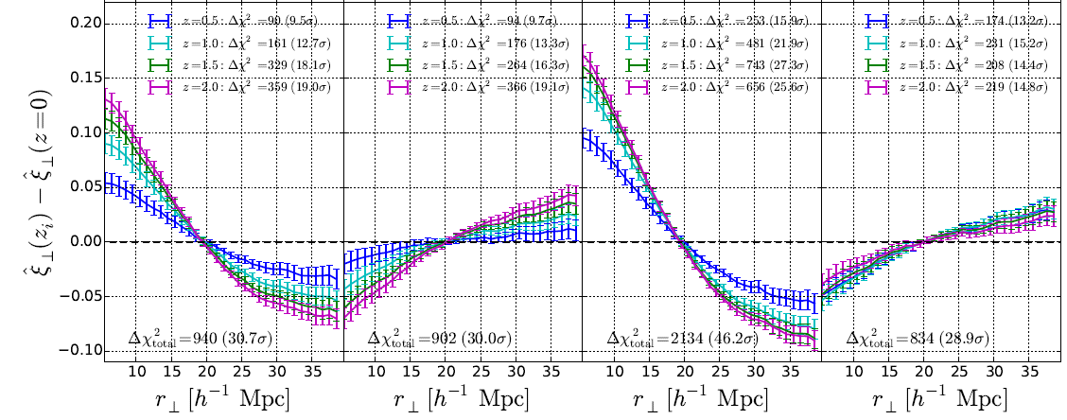
Significant detection
Wrong cosmologies disfavored at very high CL.
Horizon Run 4 simulation, z=0-2, 1.75 billion galaxies (10% of LSST)

Slide 34
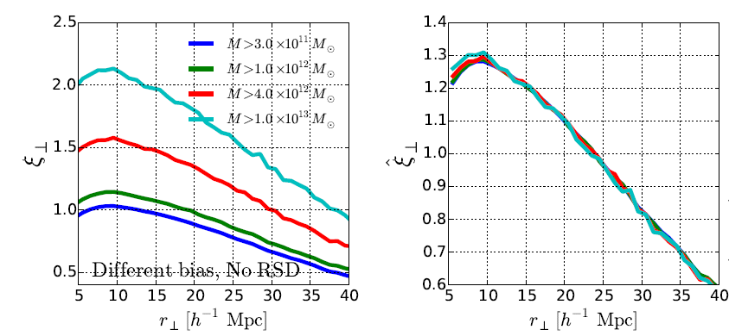
Robust against galaxy bias
Although huge change in the strength of clustering,
almost no change in the shape of CF

Slide 35
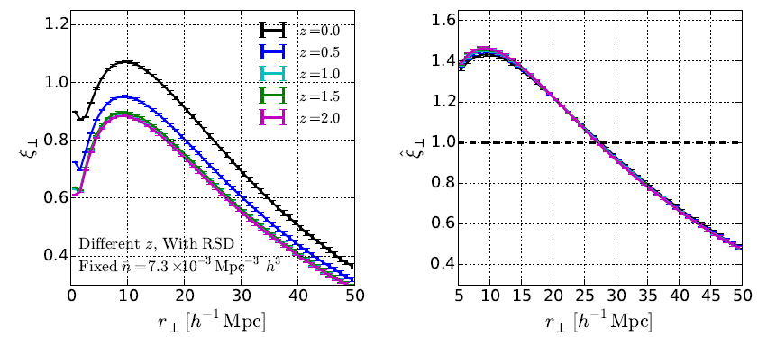
Robust against RSD
Angular CF is less affected by RSD

Slide 36
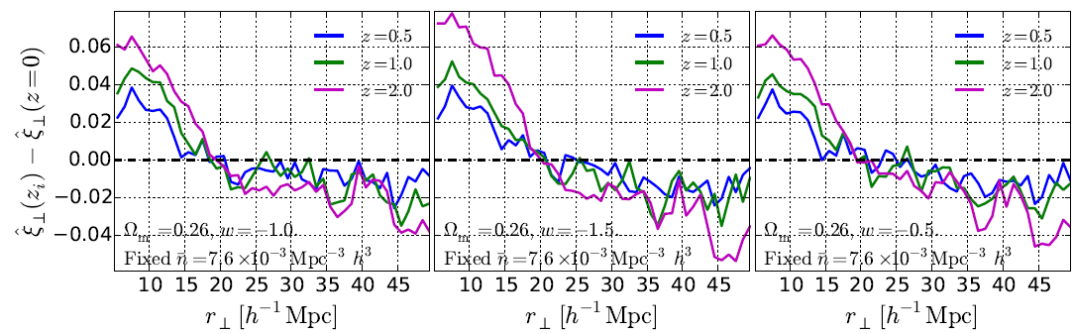
Check cosmological dependence of systematics
Amount of systematics insensitive to cosmology
(can use 1 simulation with representative cosmology to estimate systematics)

Slide 37
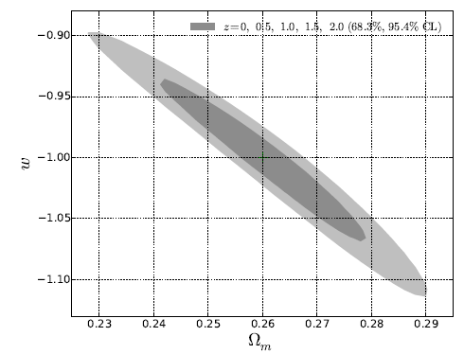
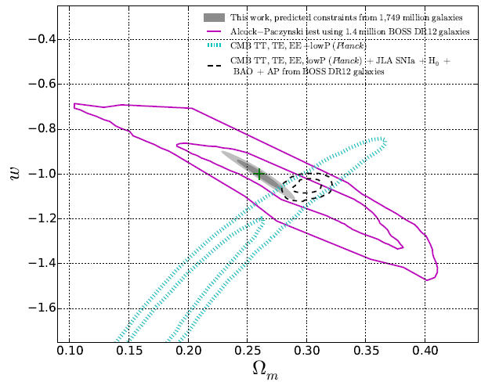
Predicted cosmological constraints from 10% of LSST
AP from BOSS
Angular CF from
10% of LSST
CMB+BAO+SNIa+H0+AP
(current status)
Amazing constraints from LSST (if no serious systematics)

Slide 38
Summary
Redshift dependence of galaxy clustering enables a novel use of
Alcock-Paczynski Test (shape)
Volume effect (size)
...
Overcoming systematics (RSD, galaxy bias)
Small scale clustering usable.
Very tight cosmology constraints!

Slide 39
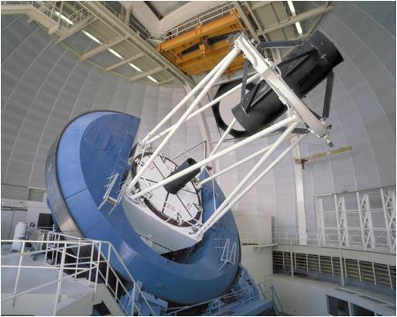
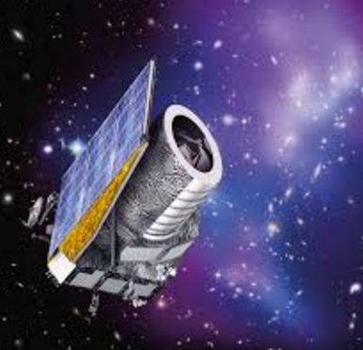

On one hand, it is important to construct powerful experiments...
DESI
EUCLID
On the other hand, a good method extracting physics from data is equally important!

Slide 40
While it is important to build powerful, expensive experiments...
DESI
EUCLID
Having a good method extracting physics
from data is of equal importance!

Slide 41
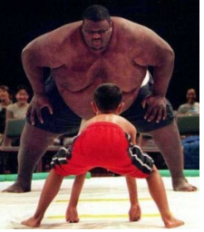
Anyway, it is not easy to
tackle the dark energy!
We should try all our best!

Slide 42

Unveiling the Universe...
Thank you!

Slide 43
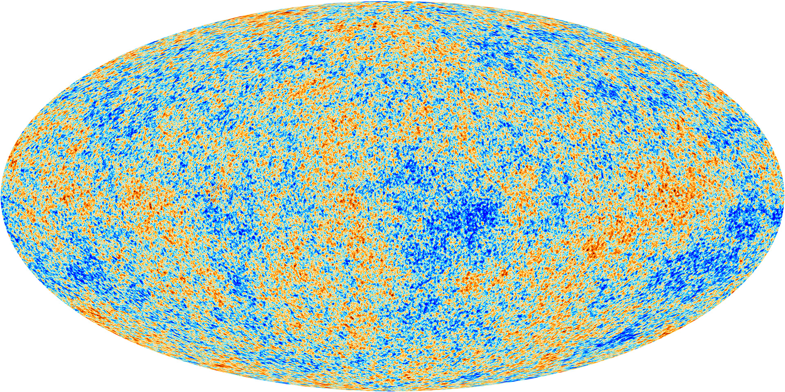
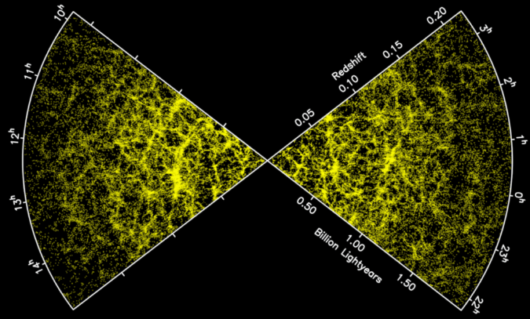
Why redshift dependence?
Avoid the great difficutly in modelling the non-linear clustering, redshift space distortion, galaxy bias, ...
“Redshift invariants”: simple analysis, reliable & tight constraints:

