Slide 1
Focused Stellar wind in Cygnus X-1
Jan Čechura
P. Hadrava (AI CAS), Saku Vrtilek (CfA)
Blowing in the Wind Quy Nhon, Vietnam August 11, 2016

Slide 2
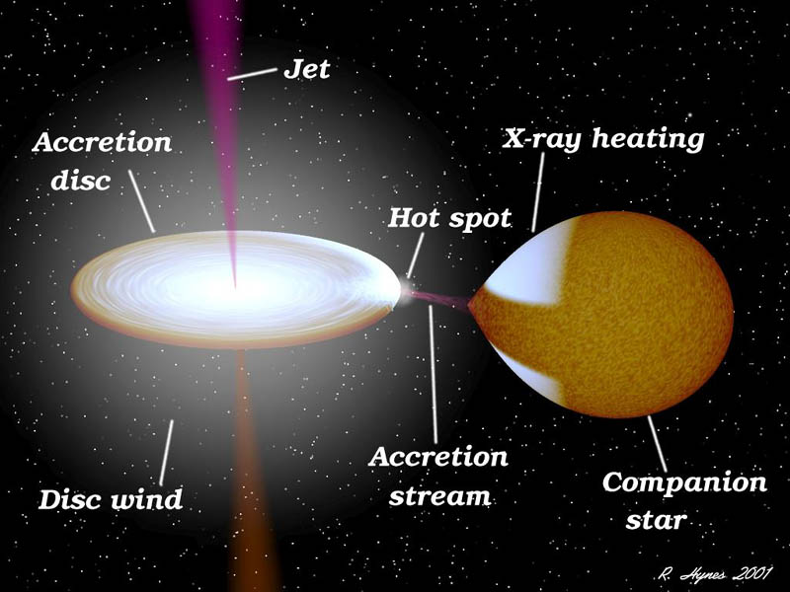
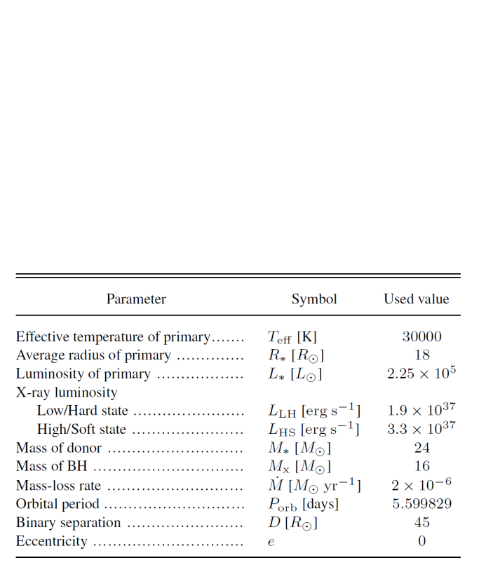
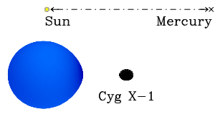
High-mass X-ray binaries

Slide 3
X-ray states
Low/Hard state
hard power-law with a photon index < 2 in
10-100 keV band
High/Soft state
dominated by soft blackbody component with a weak hard power-law component
The X-ray flux in 1-10 keV band varies by approximately an order of magnitude
Physical cause of these transitions remains unclear

Slide 4
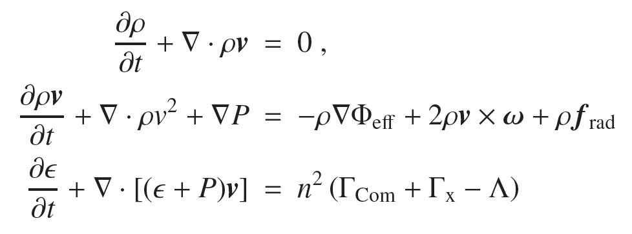
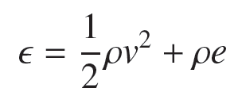
RHM model of stellar wind
Conservation equations
Equation of state
where
Model accounts for gravity of both bodies, centrifugal force, radiation pressure in continuum and lines (CAK mechanism), and Coriolis force.
Radiative force take into account effects of gravity and limb darkening of the stellar surface.

Slide 5
X-ray state transition
Čechura, Hadrava (2015)

Slide 6
Synthetic Doppler tomograms
Averaged values over 1P_{orb}
Low/Hard state
most of the material is fully ionized after going through the shock front
High/Soft state
Wind from the facing hemisphere is completely suppressed.
Shock expands towards the donor and further ionizes the wind medium

Slide 7
Synthetic Doppler tomograms

Slide 8
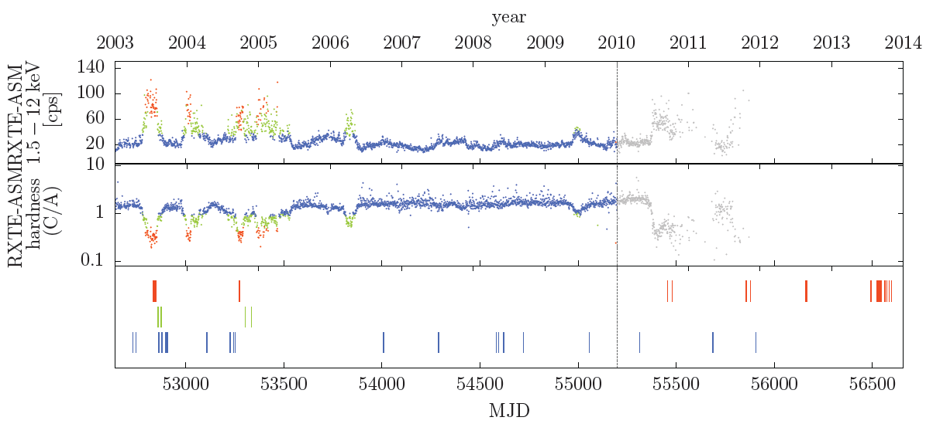
Optical observations
107 spectra in total
clustering problem – phase coverage
is not optimal
we assume the overall structure
of the circumstellar material to
remain stable on larger time scales
and to be defined by the
corresponding X-ray state.
Low/Hard state orbital phase coverage (44 spectra)
High/Soft state orbital phase coverage (44 spectra)

Slide 9
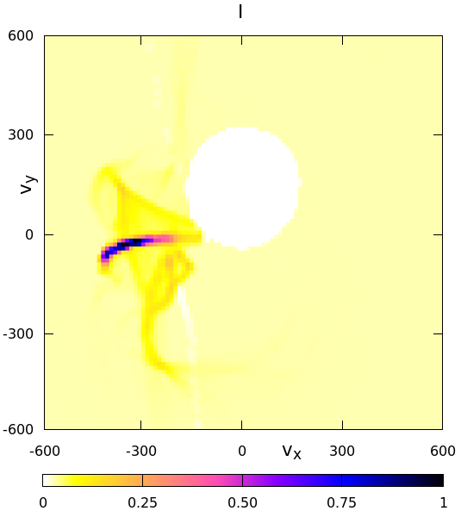
Low/Hard State
Doppler tomogram of H-alpha line
Synthetic tomogram of H-alpha line emission

Slide 10
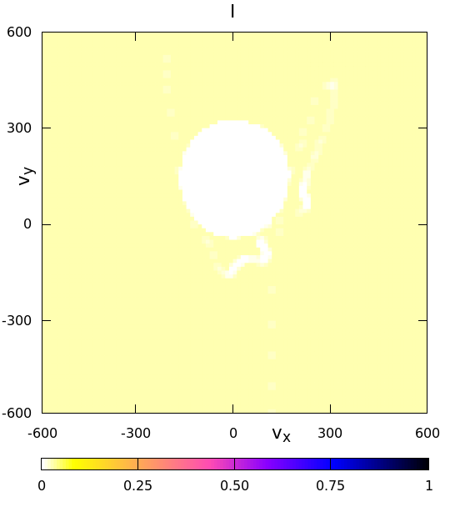
High/Soft State
Doppler tomogram of H-alpha line
Synthetic tomogram of H-alpha line emission

Slide 11
Conclusion
Hydrodynamic simulations can be used for constructing synthetic Doppler tomograms.
Such tomograms are directly comparable with observational data
While Doppler tomograms map emissions in velocity space, comparing the structures with the results of the hydrodynamic model gives us means of interpretation the data in spatial coordinates.

Slide 12
Discussion
Thank you for your attention

Slide 13
X-ray state coverage

Slide 14
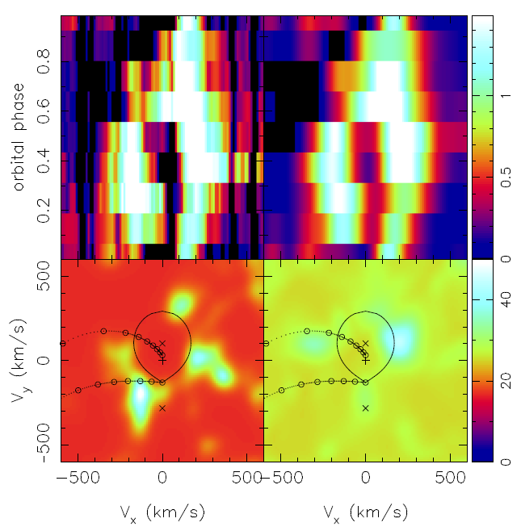
Narrowing observational interval
2003-2013 observations
2003 observations only

Slide 15
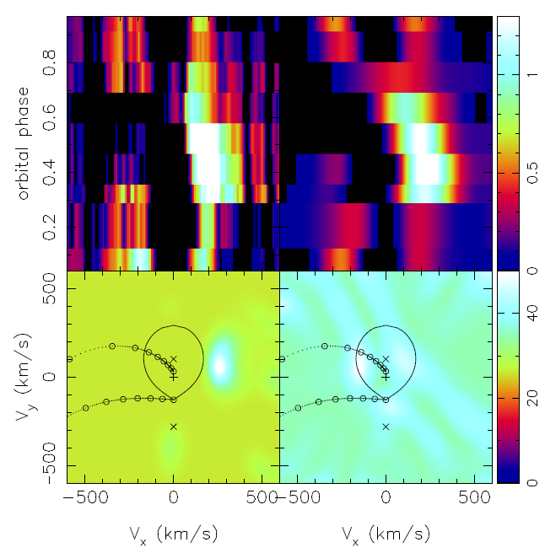
Narrowing observational interval
2003-2013 observations
2013 observations only

Slide 16
X-ray state comparison

Slide 17
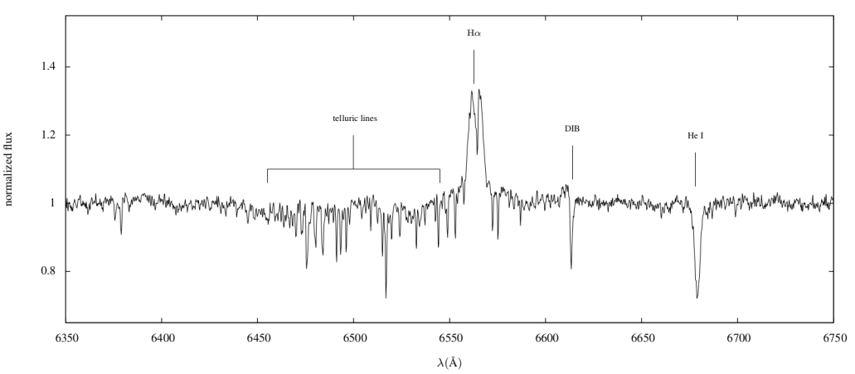
Optical data
Low/Hard state
High/Soft state
a spectra example

