Slide 1
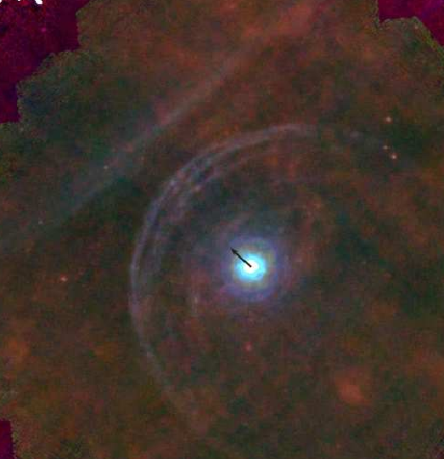
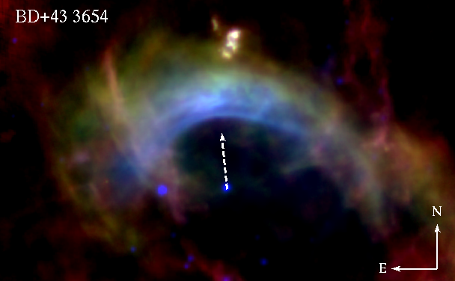
Bow shocks
Stellar-wind ISM interactions around hot & cool stars.
Allard Jan van Marle (Paris Diderot, APC) – Nick Cox (IRAP/CNRS)
Notes:
1

Slide 2

Motivation for studying bow shocks.
Wind-ISM interaction (bow shocks) can
be used as an independent proxy of recent history of stellar winds.
serve as a proxy of the local ambient medium (density, temperature, B-field).
be used to identify runaways / uncover stellar motion.
can provide insight on physics of dust grain-gas coupling and provide inside in dust processing in transition from CSE to ISM.
can affect evolution of (stellar &) planetary systems (protection).
Notes:
2

Slide 3
Outline.
Concept of bow shocks.
Cool old stars.
Hot young stars.
Conclusions / open questions.
Notes:
3

Slide 4
Outline.
Concept of bow shocks.
Cool old stars.
Hot young stars.
Conclusions / open questions.
Notes:
4

Slide 5
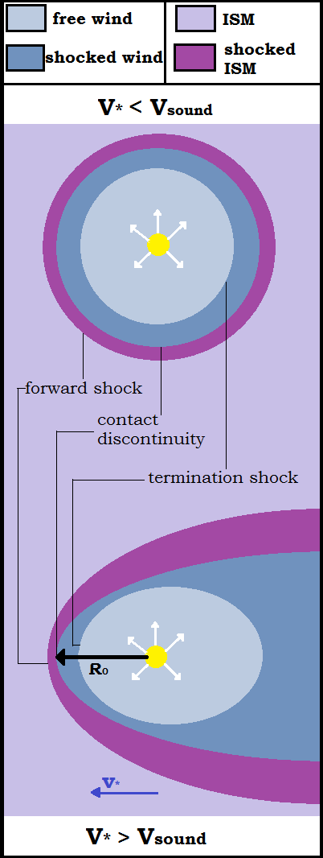
Bow shocks: concept.
Basic idea: Expelled wind (gas and mass loss) interacts and sweeps up the surrounding
interstellar medium. i.e. Wind-ISM interaction.
If the star moves supersonically through the ISM, the standard bubble becomes a bow shock
Unlike any other type of asterosphere, bow shocks can provide information about the wind-ISM conditions TODAY, rather than in the PAST.
bow shock (forward shock):
where v_{ISM} goes from supersonic to subsonic values
asteropause (contact discontinuity):
where P_{ISM} = P_{CMS} [P=pressure]
→ inner (CSM) & outer (ISM) astrosheath
termination shock:
place where v_{wind} goes from supersonic to subsonic values
[Figure credit: Dries Nicolaes]
Notes:
5

Slide 6
Bow shocks: analytical.
Wind-ISM ram pressure balance dictates:
Wilkin 1996, Weaver 1977
A strong, time-independent relationship between the size and the wind/ISM parameters
 | Old cool star | Young hot star | G star
V_{wind} (km/s) | 10-30 | 500-2500 | 400 - 700
M (M₀/yr) | 10⁻⁷ - 10⁻⁵ | 10⁻⁷ - 10⁻⁵ | 10⁻¹⁵ 10⁻¹³
V_{star} (km/s) | 30 | 30 | 15
n(H)_{ISM} (cm⁻³) | 1 | 1 | 0.01
R₀ (pc) | ~ 0.1 – 1 | ~ 0.5 – 10 | ~0.001 (200 AU)
Notes:
6

Slide 7
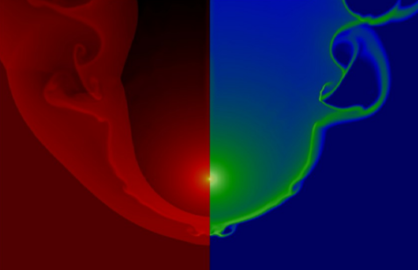
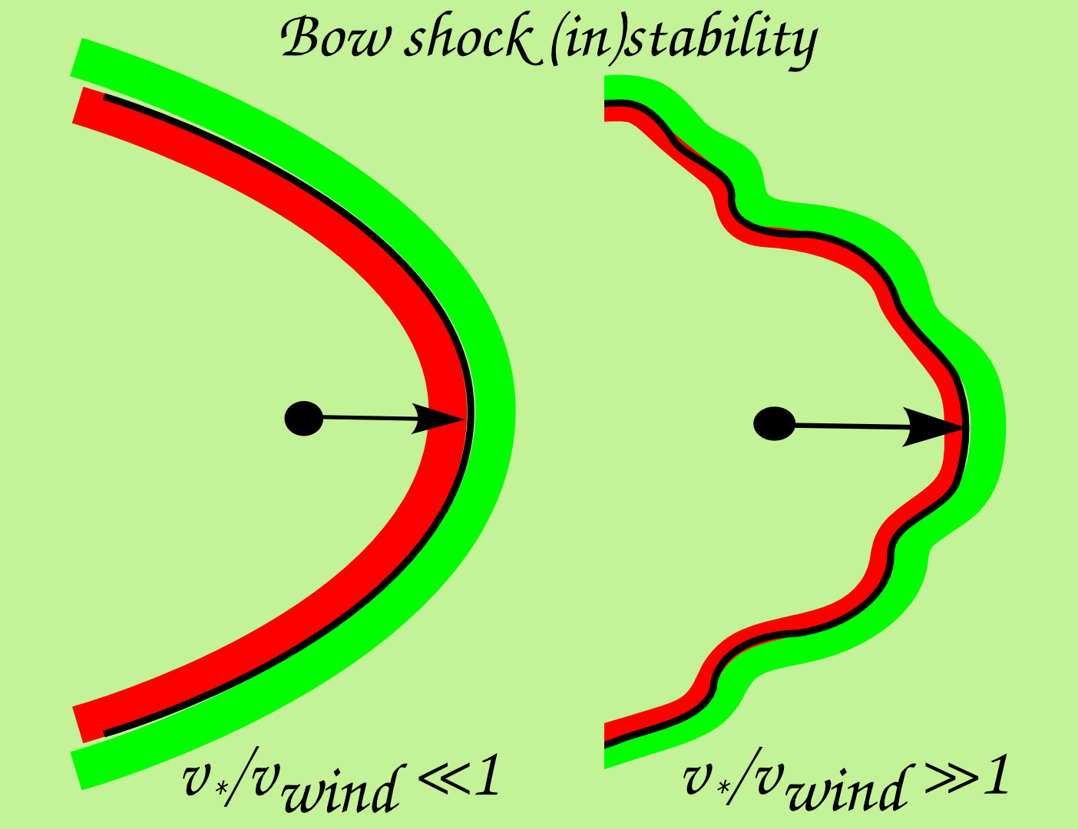
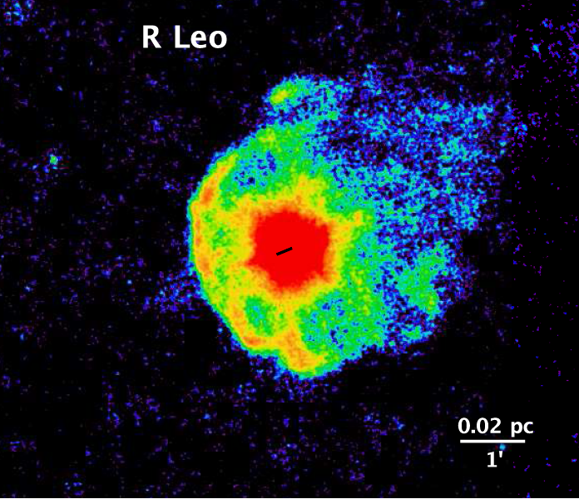
Bow shocks: stability.
Dgani et al. (1996)
Hydrodynamical model
(M=∞, isothermal)
Bow shocks with
v*/v_{w} ≪ 1 → stable
v*/v_{w} ≫ 1 → unstable
Van Marle et al. (2011)
PACS 70mu
Notes:
7

Slide 8
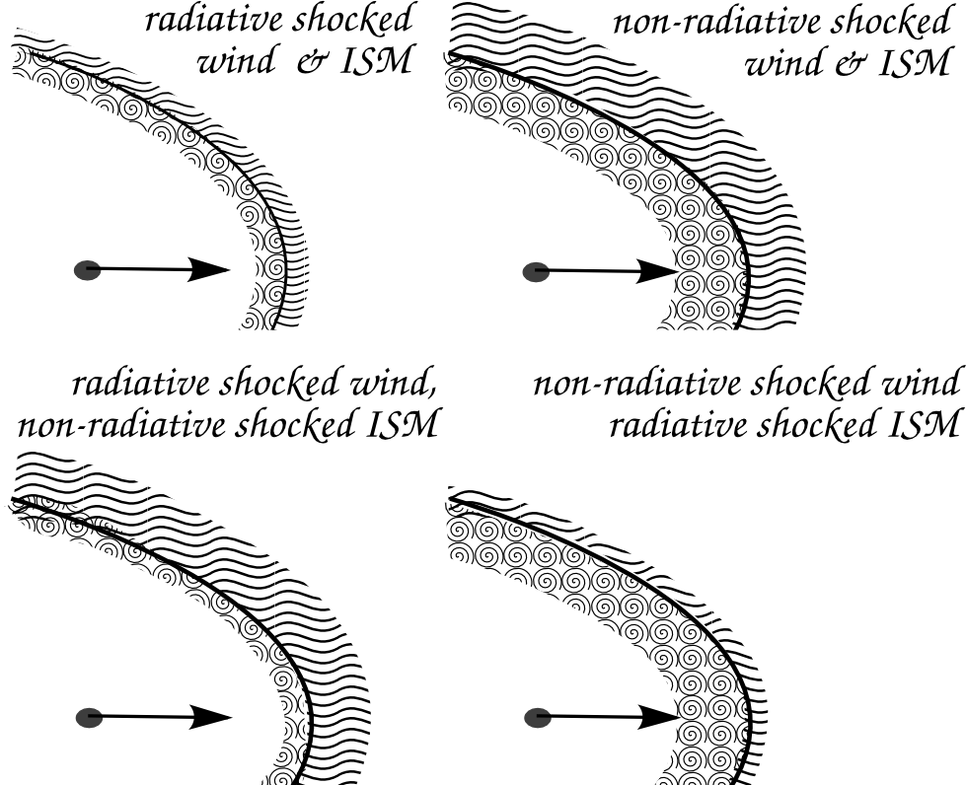
Bow shocks: radiative vs. adiabatic
Hydrodynamical model
Van Marle et al. (2011)
Inspired by Van Buren (1993)
Width interaction region depends on cooling efficiency
and Mach of interacting flows. Efficient (radiative)
cooling → region narrows, higher gas density, ↑ with M².
Width scales as ~ R₀ / M² (Blondin & Koerwer 1998).
PACS 70mu
Notes:
8

Slide 9
Outline.
Concept of bow shocks.
Cool old stars.
Hot young stars.
Conclusions / open questions.
Notes:
9

Slide 10
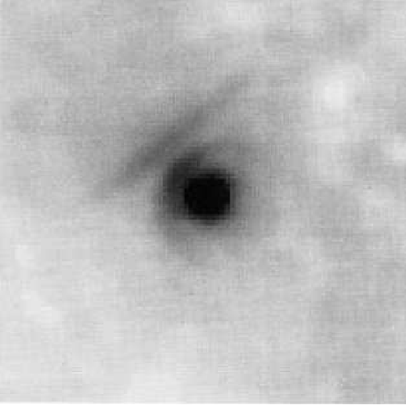
Dust & gas in cool star bow shock regions.
Betelgeuse – IRAS 60mu
Noriega-Crespo et al. 1997
Notes:
10

Slide 11
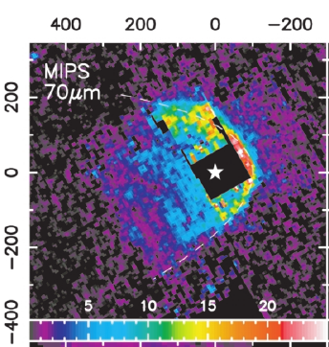
Dust & gas in cool star bow shock regions.
R Hya – MIPS 70mu
Betelgeuse – IRAS 60mu
Noriega-Crespo et al. 1997
Ueta et al. 2006
+ some evidence for R Cas
and Mira (Ueta+ 2009).
Notes:
11

Slide 12
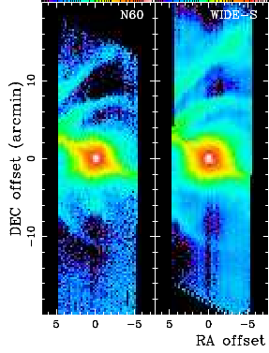
Dust & gas in cool star bow shock regions.
R Hya – MIPS 70mu
Betelgeuse –
AKARI 60+90mu
Betelgeuse – IRAS 60mu
Noriega-Crespo et al. 1997
Ueta et al. 2006
+ some evidence for R Cas
and Mira (Ueta+ 2009).
Ueta et al. 2008
Notes:
12

Slide 13
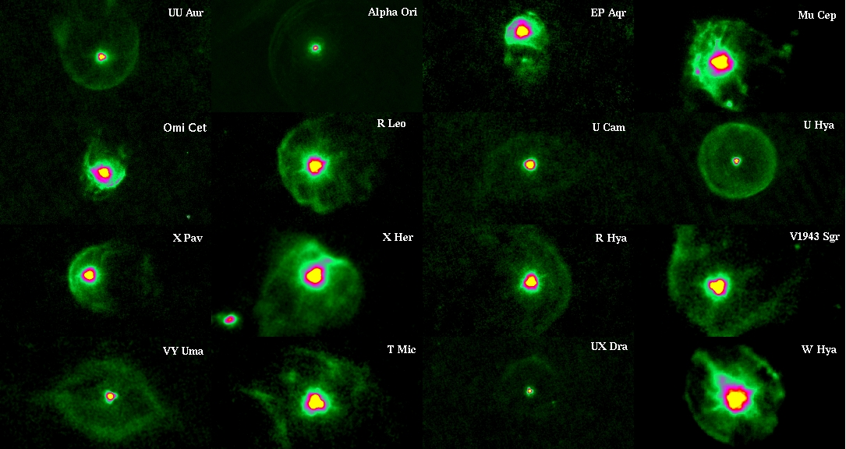
Dust & gas in cool star bow shock regions.
Herschel far-infrared survey of AGB/RSG.
Mass-loss of Evolved StarS:
Groenewegen+2011, Jorissen+2010, Ladjal+2010, Decin+2012, Cox+2012, Mayer+2012, 2013.
Notes:
13

Slide 14
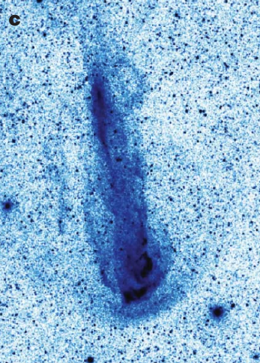
Dust & gas in cool star bow shock regions.
MIRA – GALEX FUV
Martin et al. 2007
Notes:
14

Slide 15
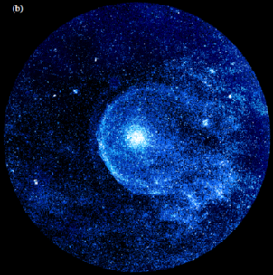
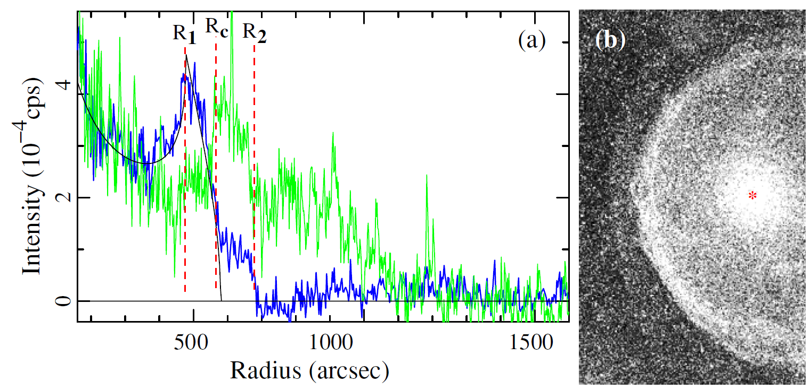
Dust & gas in cool star bow shock regions.
MIRA – GALEX FUV
CW Leo – GALEX FUV
Sahai & Chronopoulos 2010
Presence of extended HI interacting with ISM
inferred from line profiles by e.g. Gerard & Le Bertre (2006).
Martin et al. 2007
Notes:
15

Slide 16
Betelgeuse.
v*/v_{w} > 1
→ unstable bow shock
RT instabilities may
fragment bow shock in
direction of motion.
9'
7'
6'
Magnetic field may
suppress some modes but
accentuate others, leading
to 'RT stripes'
(Dgani & Soker 1998).
Arcs separated by 30” at
distance of 330” yields
(Eq 4 in Dgani 1998).
Alven speed of pre-shock
ISM of ~4 km/s.
For n_{ISM} = 4 cm⁻³ →B = 3 μG.
Notes:
16

Slide 17
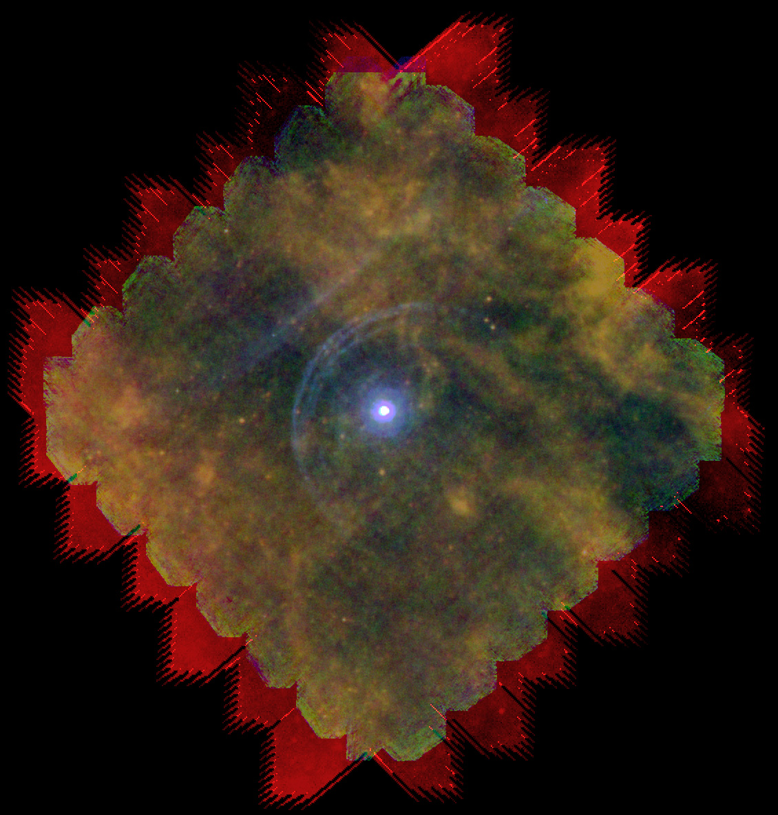
The mystery of the α-Orionis bow shock
Red supergiant interacts with ISM: v_{w} < v_{ӿ}
Bow shock should be unstable. (e.g. Dgani et al. 1996; Brighenti & d’Ercole 1995; van Marle et al. 2011)
But it isn’t!
  Too young? (Mohamed et al. 2012; Mackey et al. 2012)
  Warm ISM? (Decin et al. 2012, Gvaramadze et al. 2014, Meyer et al. 2016)
  Magnetic field?
PACS: 70, 100 & 160 μm
Decin et al. 2012
van Marle et al. 2011

Slide 18
The model.
Ṁ = 3.0x10⁻⁶ M_{ʘ}/yr
v_{wind} = 15 km/s
v_{star} = 28.3 km/s
n_{ISM} = 2 #/cm³
(Ueta et al. 2008, Decin et al. 2012)
ISM B-field near α-Orionis
  B = 1.4 - 5 μG
  (Frick et al. 2001, Heerikhuisen & Pogorelov 2011, Opher et al. 2009)
  Assume 3 μG, parallel with stellar motion (to preserve 2-D symmetry)

Slide 19
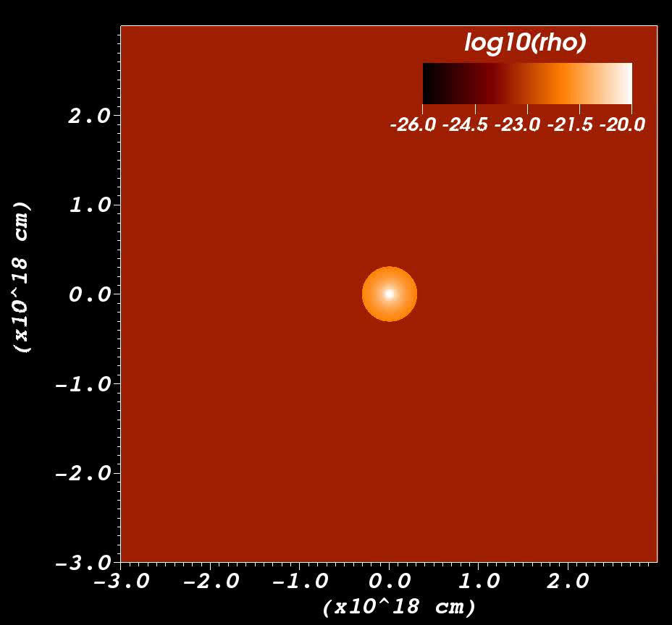
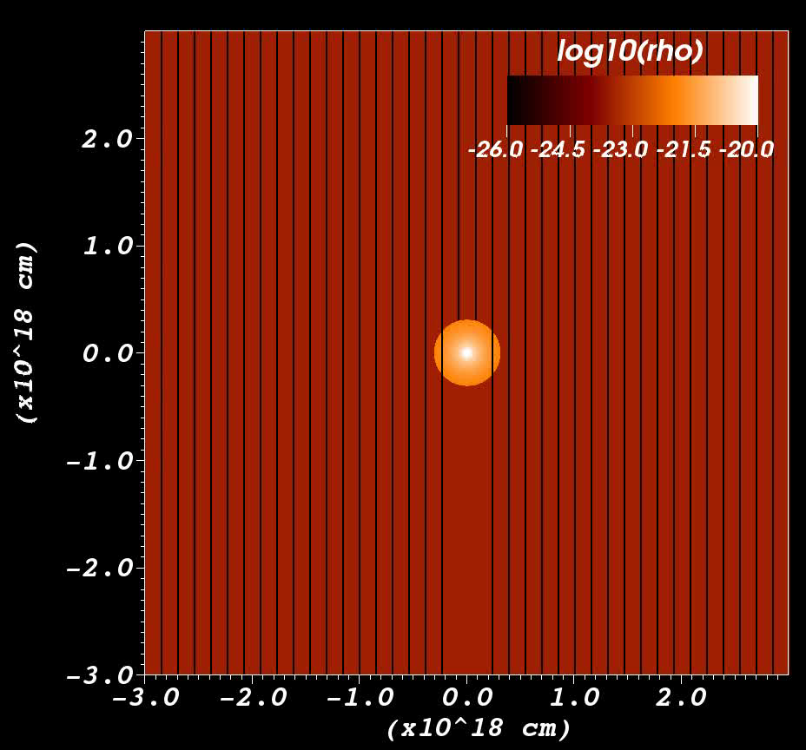
α-Orionis in an interstellar magnetic field.
B = 0 μG
B = 3 μG
van Marle et al. 2014

Slide 20
Outline.
Concept of bow shocks.
Cool old stars.
Hot young stars.
Conclusions / open questions.
Notes:
20

Slide 21
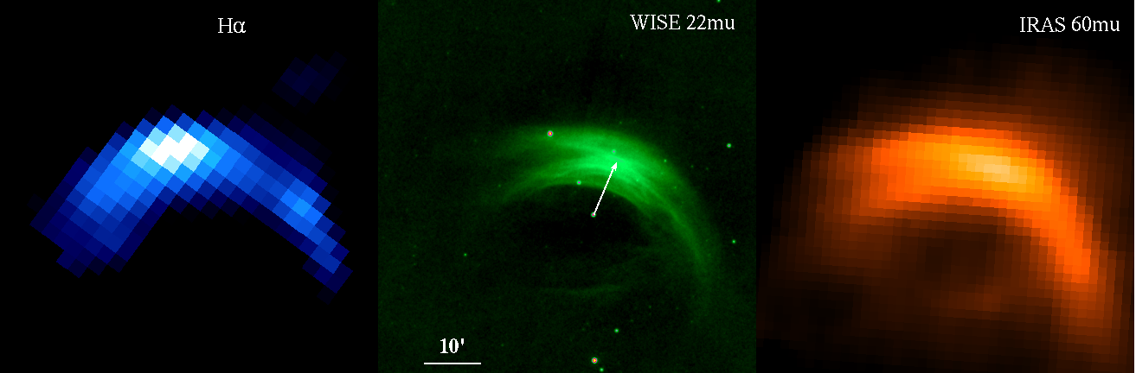
Gas and dust in bow shocks of hot stars.
Previously infrared emission associated with hot luminous stars
(ex. α Cam, ζ Oph, τ Cma) as well as the RSG α Ori
α Cam
Notes:
21

Slide 22
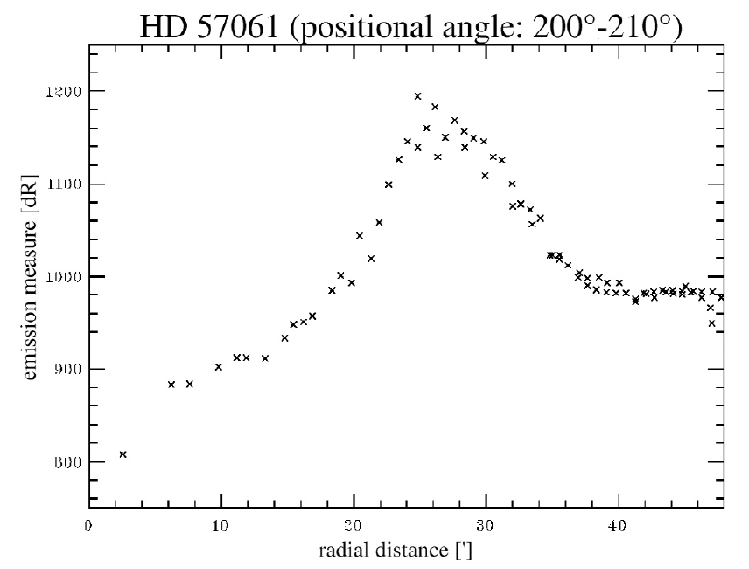
Gas and dust in bow shocks of hot stars.
Previously infrared emission associated with hot luminous stars
(ex. α Cam, ζ Oph, τ Cma) as well as the RSG α Ori
REQUIRED:
supersonic moving star
in diffuse ISM (not too
tenuous) with a (not too
weak) stellar wind.
ISM conditions crucial!
α Cam
SHASSA/VTSS survey by Brown & Bomans (2005)
Notes:
22

Slide 23
Gas and dust in bow shocks of hot stars.
Previously infrared emission associated with hot luminous stars
(ex. α Cam, ζ Oph, τ Cma) as well as the RSG α Ori
REQUIRED:
supersonic moving star
in diffuse ISM (not too
tenuous) with a (not too
weak) stellar wind.
ISM conditions crucial!
α Cam
SHASSA/VTSS survey by Brown & Bomans (2005)
Van Buren & McCray 1998, Van Buren et al. 1995, Noriega-Crespo et al. 1997
New WISE survey of bow shocks (10-15%) runaway stars presented in Peri+2011, 2015
IRAS detected 31 bow shocks and 27 bubbles/resolved emission out of 188 runaways.
Notes:
23

Slide 24
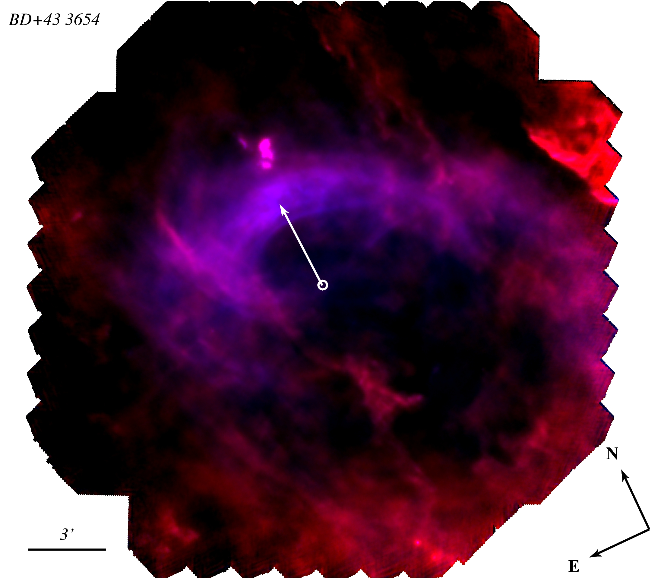
BD+43 3654: Herschel PACS (70 & 160 μm).
O4If, L* = 8.5 10⁵ L_{sun}
D = 1.45 kpc, v* = 77 ± 10 km/s
No Hα?
Thickness bow shock:
δ~0.55 R₀ / M²
Measured: 0.9 pc
→ M ~ 1
→ c_{sound} ~ v*
→ T_{ISM} ~ 10⁴ – 10⁵ K
For v* < 125 km/s → bow shock is isothermal & gas compress by factor Mach²
width of the gas interaction region ~ R₀ / M² (Blondin & Koerwer 1998)
Notes:
24

Slide 25
BD+43 3654: Model parameters
Ṁ = 1.0x10⁻⁵ M_{ʘ}/yr
v_{wind} = 2300 km/s
v_{star} = 77 km/s
n_{ISM} = 2 #/cm³
T_{ISM} = 10,000 K (photo-ionized)
Dust only in ISM (3 species)
Dust treated as pressure-less gas
Dust and Gas linked through the drag-force
Notes:
25

Slide 26
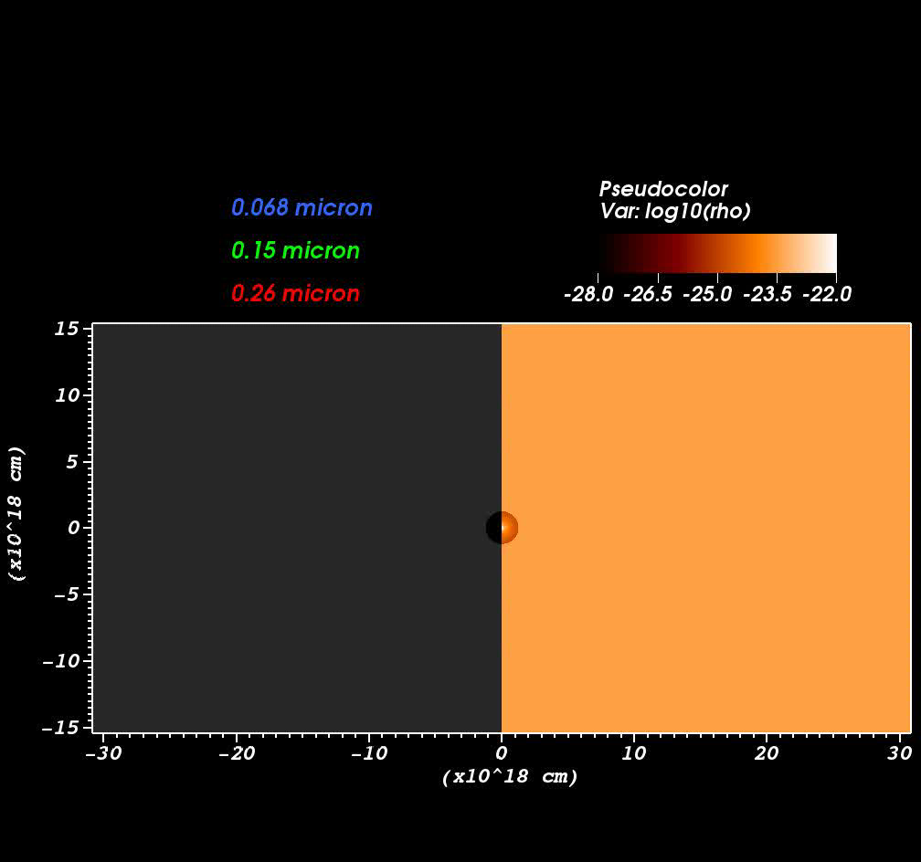
BD+43 3654: Simulation including three dust-species
The ISM is the only source of dust
(the stellar wind is too
hot for dust-formation)
Dust distribution changes over time
Dust layer is much thicker than the gas-shell
Clear “sorting” effect based on grain-size

Slide 27
Outline.
Concept of bow shocks.
Cool old stars.
Hot young stars.
Conclusions / open questions.
Notes:
27

Slide 28

Main conclusions & outlook.
Herschel demonstrated the ubiquitous occurrence of dusty asterospheres around
AGB stars (including resolving KH and RT instabilities!)
→ Independent tools to estimate stellar and/or interstellar parameters.
→ Shape affected by binarity and magnetic field.
→ Shells related to circumstellar chemistry (thermal pulse history).
→ ISM dust mass ~1 to 25 % for evolved stars and ~100% for O/B stars.
AGB/RSG bow shocks primarily detected via their dust (exception: CW Leo).
Hot massive star bow shocks more energetic and (sometimes) visible in Hα.
Weak-wind stars can show dust waves (sigma Ori, zeta Oph) in which the dust and gas are de-coupled.
Combining observations with numerical simulations can help us to analyze and understand the physical processes involved in bow shock formation
Notes:
28

Slide 29
Main conclusions & outlook.
Herschel demonstrated the ubiquitous occurrence of dusty asterospheres around
AGB stars (including resolving KH and RT instabilities!)
AGB/RSG bow shocks primarily detected via their dust (exception: CW Leo).
Hot massive star bow shocks more energetic and (sometimes) visible in Hα.
Multi-wavelength imaging AND spectroscopy of larger sample of asterospheres/bow shocks
to understand bow shock physics, interplay gas and dust, and origin of varying
morphologies.
Work in progress: Introducing dust grains (size distribution,formation/destruction),
chemistry, and magnetic fields in the hydrodynamical simulations. (RADICALS project) Energy loss through cosmic ray acceleration!
Bow shocks around later type (post-AGB/proto-PNe) or solar-type stars → JWST
and a few parting words...
Notes:
29

Slide 30
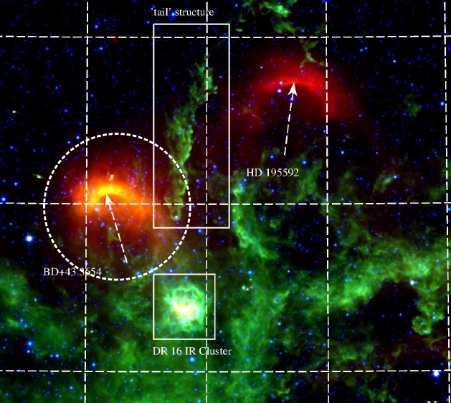
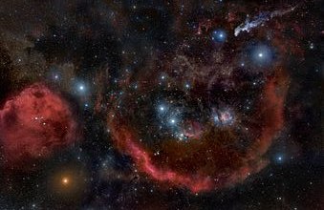
Parting words: Stars do not live in isolation...
1.5 x 1.5 deg
20 x 10 arcmin
15 x 15 arcmin
Notes:
30

Slide 31
Outlook
1. Increase the sample of wind-ISM objects to study the link between host star / circumstellar chemistry and astrosphere morphologies.
2. Why are astrospheres not detected (yet?) around later type (post-AGB/proto-PNe) stars? Dissipated? Low surface brightness wrt cirrus? Specific conditions need to form bright astrospheres? Simulations predict cool extended structures.
3. Composition and physical conditions of gas in the shock interaction regions?
→ ALMA, VLT, SOFIA, SPICA, etc.
4. Direct detection of dust/gas in astrospheres of solar-type stars.
5. Introducing dust grains (size distribution, formation/destruction), chemistry, and magnetic fields in the hydrodynamical simulations to elucidate origin of various shapes... Issue of grain-gas coupling. To reduce mismatch.
6. Introducing energy loss through particle acceleration (Combining grid-based MHD with Particle-in-Cell method)
7. Role of binary companions on shaping of wind-ISM / wind-wind interaction?
Role of CS chemistry, Thermal Pulses, etc.
Notes:
31

Slide 32
Additional slides for Q&A

Slide 33
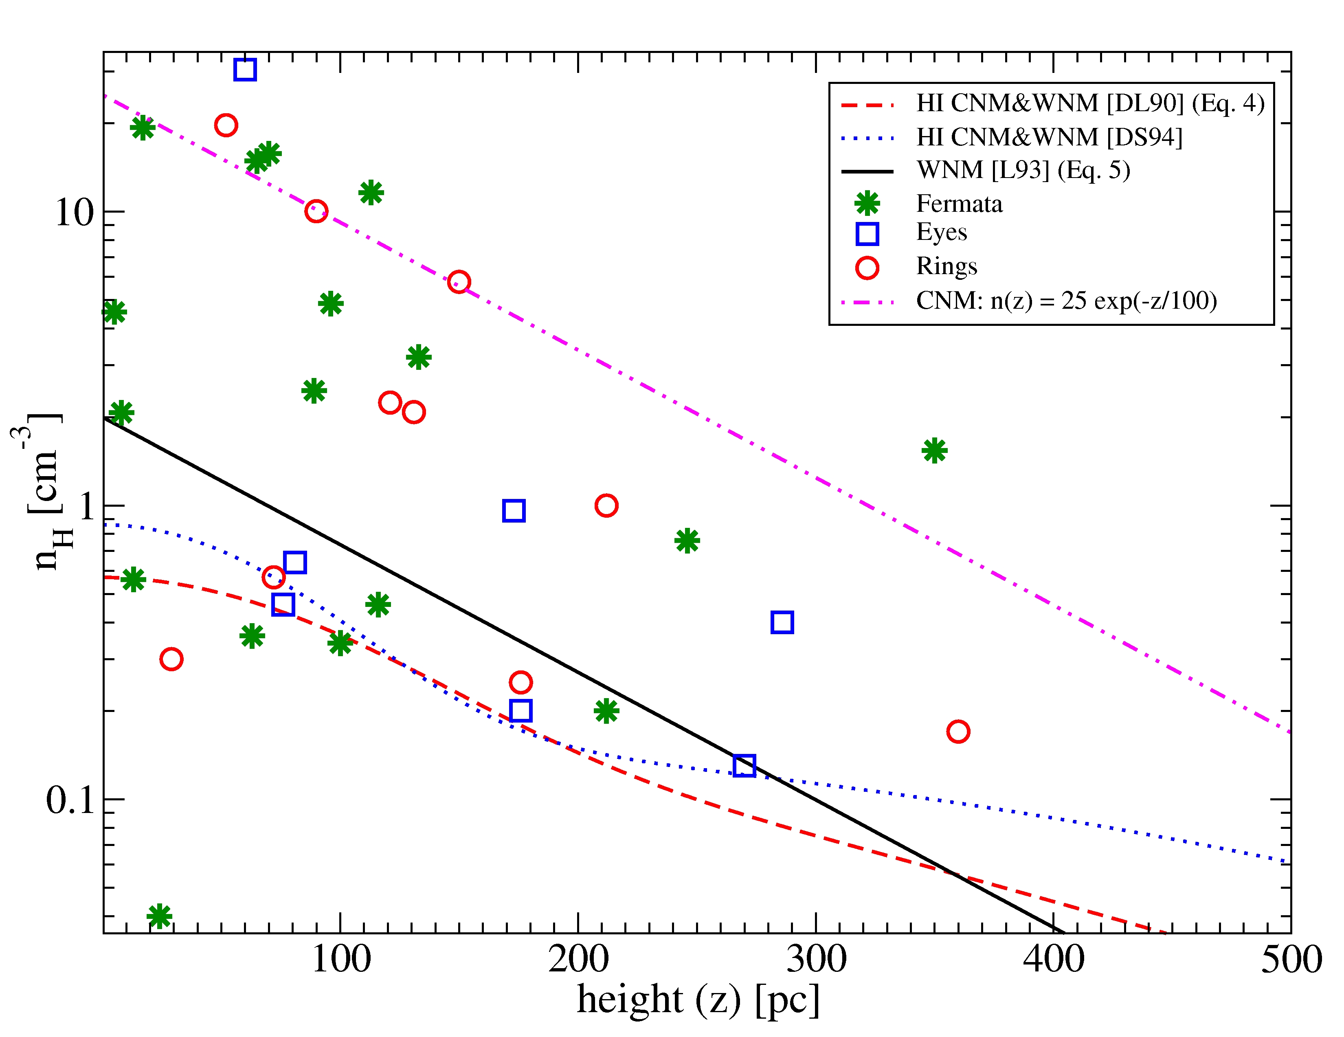
Astrospheres to probe the ISM density.
CNM
WNM
Notes:
33

Slide 34
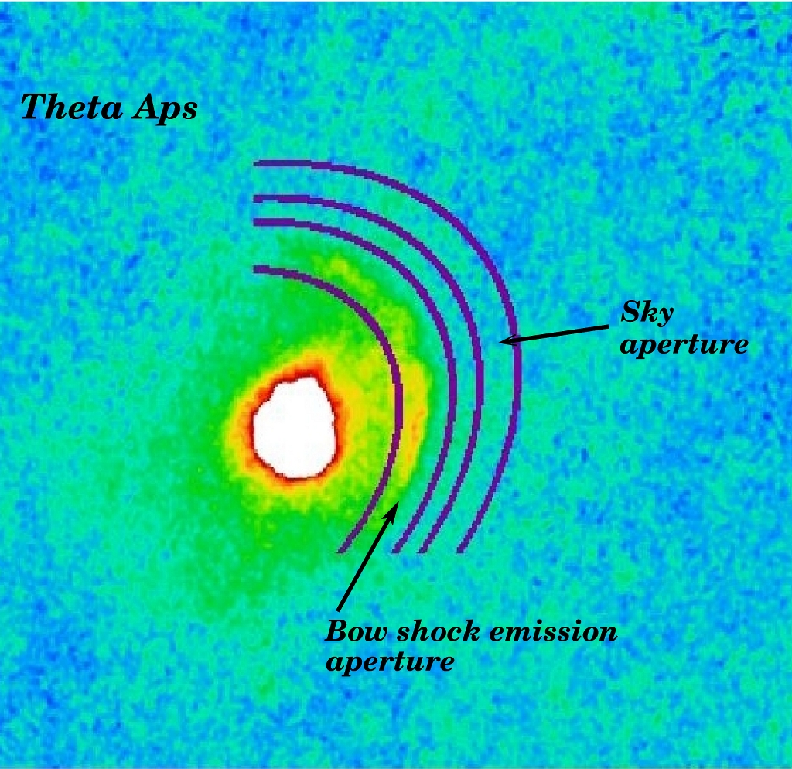
Astrospheres: inferred dust & gas mass
Aperture photometry in ellipses/circles
10⁻² M_{sun}
Assumed T_{dust} = 30 K.
Uncertainties due to emissivity & temperature are at least factor 2.
Notes:
34

Slide 35
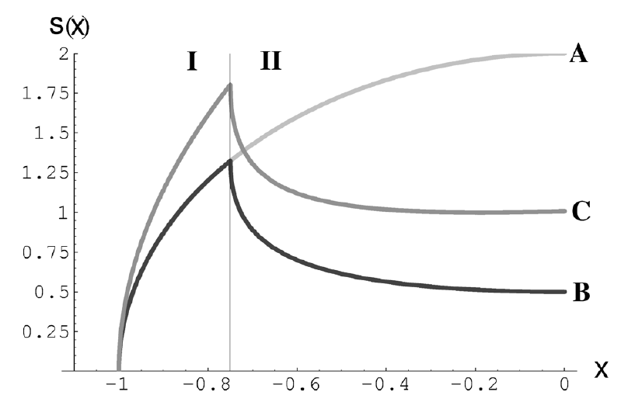
Hα emission from bow shocks
SHASSA/VTSS surveys (Brown & Bomans 2005)
Use thickness of bow shock layer to estimate density (~1 cm⁻³) and maximum
temperature (~10⁴ K) of the ISM (warm ionised medium).
A = sphere
C = bow shock layer
B = spherical shell
O9II at 1.9 kpc – v* = 56 km/s, R₀ ~ 25' / 7.6 pc, n_{ISM}(R₀) ~ 0.1 cm⁻³ / n_{ISM}(Hα width) ~ 1.5 cm⁻³.
Notes:
35

Slide 36
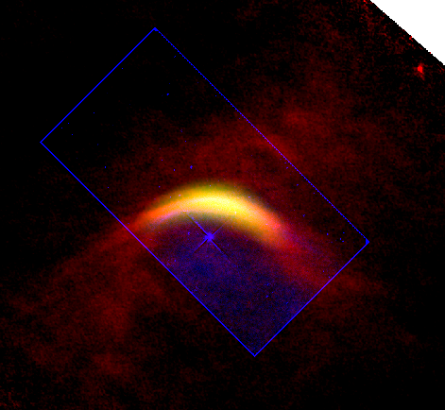
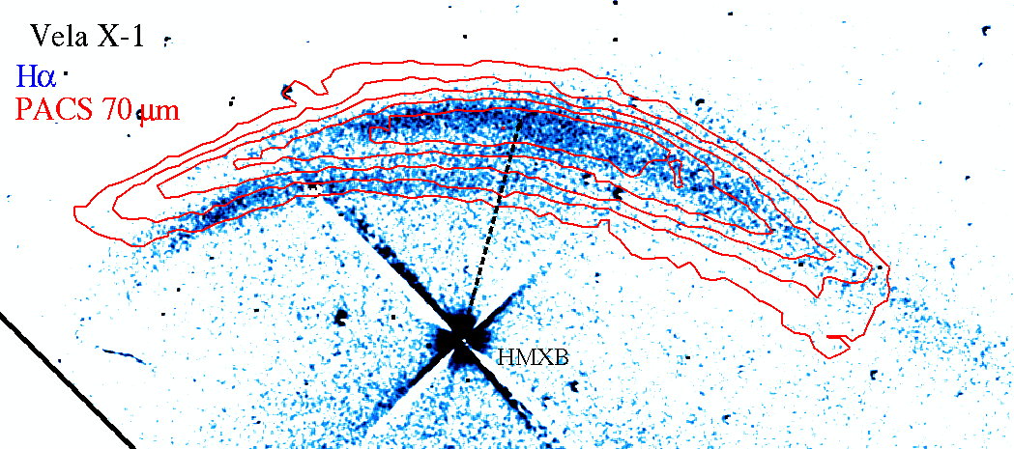
Vela X-1
Hα (Kaper+97) + 70 μm (Cox+in prep.)
2 arcs in Hα,
1 w/ counterpart
at 70μm
R₀
Hα intensity ~ 10⁻¹⁵ erg s⁻¹ cm⁻² arcsec⁻²
R₀ = 0'.9 (0.48 pc)
→ n_{H} = 1 cm⁻³
Radiative outer shock,
Adiabatic inner shock?
Bow shock inside HII region (Strömgren sphere ~0⁰.2 / ~7 pc)
Hα + WISE 22 μm + PACS 70 μm
Notes:
36

Slide 37
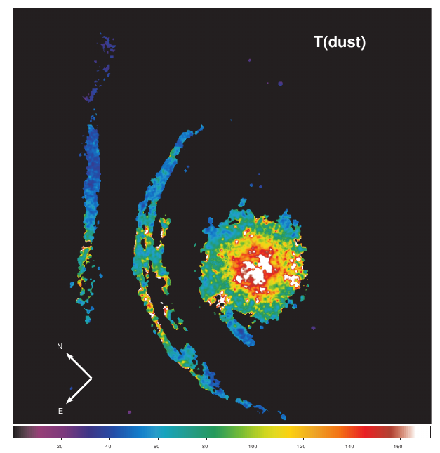
Betelgeuse – dust temperature
Smooth continuous outﬂow:
Silicate heated by the stellar radiation has temperature
~45 –60K at distance of
280–530′′ from the central star.
Arcs:
T_{dust} ~ 80-90 K, β~1
M_{d+g} ~ 10⁻³ M_{sun}
Bar:
T_{dust} ~ 60-70 K, β~1
M_{d+g} ~ 10⁻³ M_{sun}
Decin+2012
Notes:
37

Slide 38
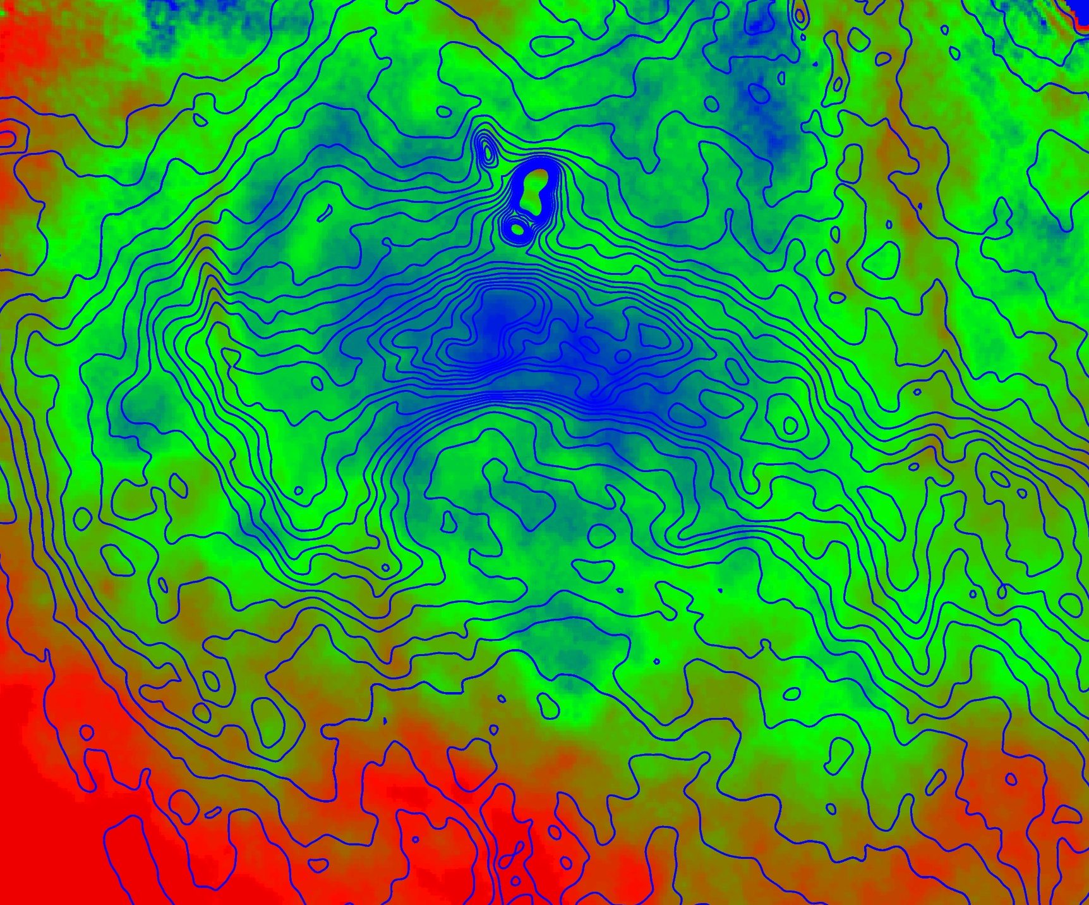
BD+43 3654
Dust colour temperature distribution map
(PACS 70&160 μm)
T_{max(obs)} ~ 45 K
T_{min(obs)} ~ 30 K
Contrary to simulations,
observation suggests
inefficient cooling?
No Hα.
Thickness bow shock:
δ~0.55 M⁻² R₀
Measured: 0.9 pc
→ M ~ 1
→ c_{sound} ~ v*
→ T_{ISM} ~ 10³ – 10⁴ K
T_{dust} ~ 5.7 (1/a)^{0.06} (L*/r²)^{1/6} ~ 50 K [Tielens 2005]
(with grain size a = 0.1 µm)
Notes:
38

Slide 39
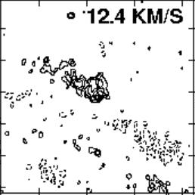
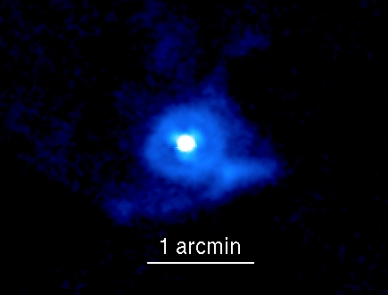
Cool dust versus neutral gas.
~30 arcmin
~4 arcmin
TX Psc
Matthews et al. (2013); Matthews & Reid (2007) present VLA imaging of HI.
Few targets in common with MESS but comparison difficult due to lower spatial resolution of HI maps.
Notes:
39

Slide 40
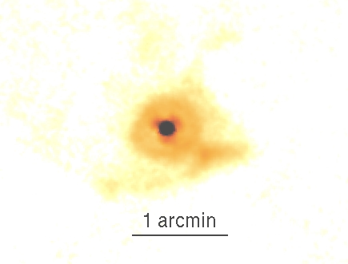
Cool dust versus neutral gas.
~30 arcmin
~4 arcmin
TX Psc
Matthews et al. (2013); Matthews & Reid (2007) present VLA imaging of HI.
Few targets in common with MESS but comparison difficult due to lower spatial resolution of HI maps.
Notes:
40

Slide 41
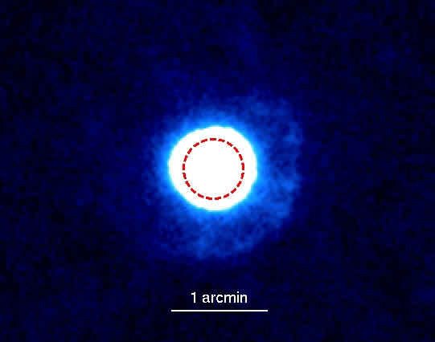
Protection of shells.
Notes:
41

Slide 42
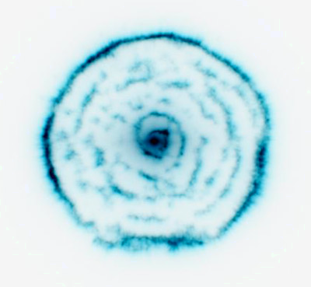
Protection of shells & spirals.
Notes:
42

Slide 43
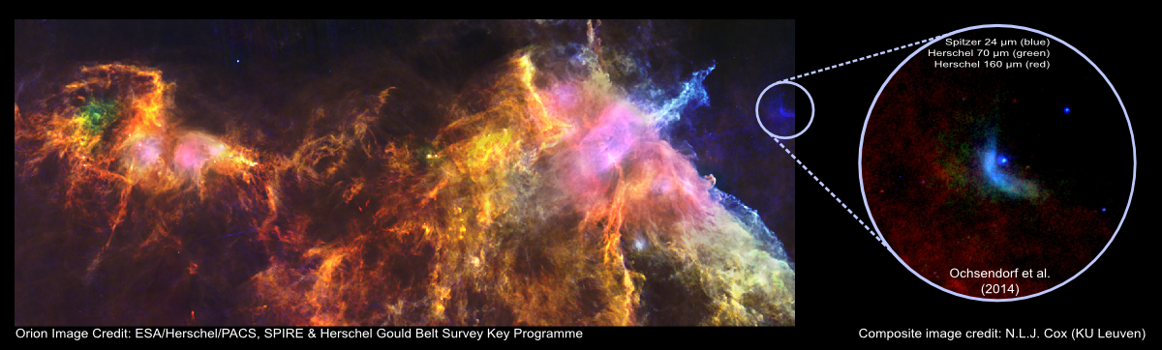
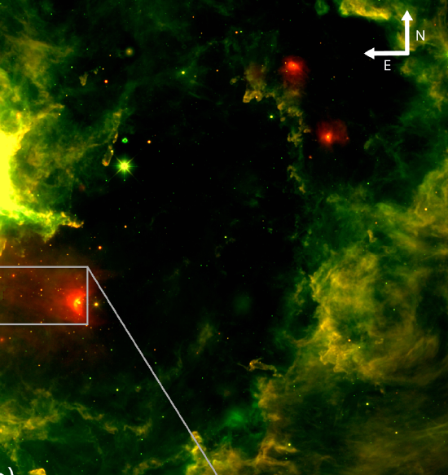
Bow waves in HII regions?
Ochsendorf et al. (2014a)
Notes:
43

Slide 44
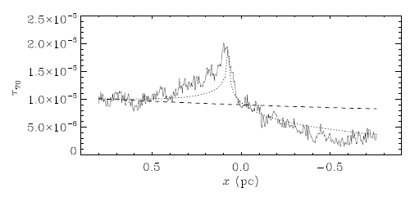
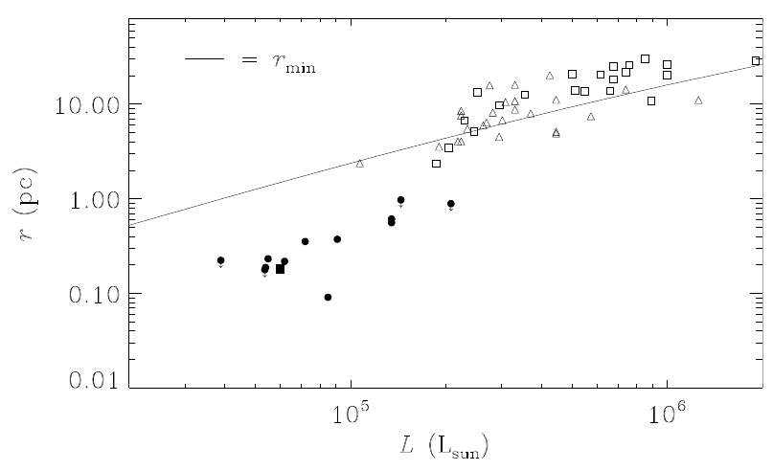
The (dust) bow wave of σ Ori AB.
separating the dust from the gas
(Ochsendorf+2014)
Dust optical depth cross-cut of bow wave
no radiation pressure
with radiation pressure
r_{min}
Notes:
44

Slide 45
Runaway OB stars (1)
These are stars with (Blaauw 1961)
(i) peculiar space motion ~30 – 200 km/s, and
(ii) origin in OB assocation, considered runaway as they wander away.
Origin of runaway OB stars?
* Binary supernova scenario (Blaauw 1961, Zwicky 1957)
- Ejected when member of binary sheds large fraction of its mass (eg type II SN).
* Cluster ejection scenario (Poveda+1967; Gies & Bolton 1986)
- Runaways ejected during close encounters of binary systems.
However, OB stars are (on average) distant and often proper motion poorly determined. Only radial velocity can be determined reasonably accurately....
Signs of runaway OB stars → bow shocks / bow waves
Notes:
45

Slide 46
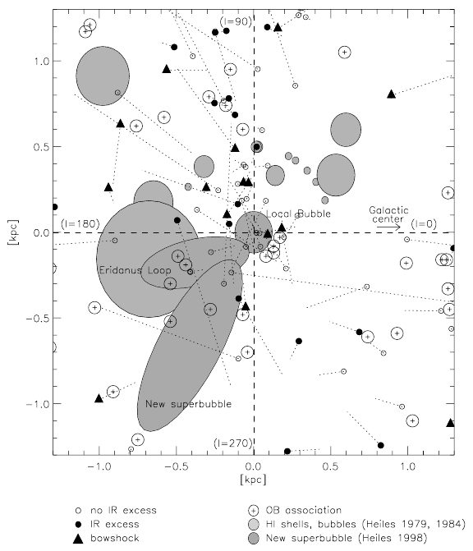
Runaway OB stars (2)
REQUIRED:
supersonic moving star through
diffuse ISM (not too tenuous) with
a (not too weak) stellar wind.
Wind bow shocks are ubiquitous → 10-20% in diffuse ISM, strong winds, high luminosity heating dust (Gull & Sofia 1979; Van Buren & McCray 1988). BUT (Huthoff & Kaper 2002):
→ ISM conditions crucial!
Filling factor of ISM with v_{sound} ≤ 10 km/s
is ~20% + 75% of O stars v* > 10 km/s →
15% of O stars should have bow shocks!
Sound speed ~100 km/s in hot (10⁶ K)
tenuous medium → inside super-bubbles
runaway stars have subsonic velocities!
Huthoff & Kaper 2002
Notes:
46

Slide 47
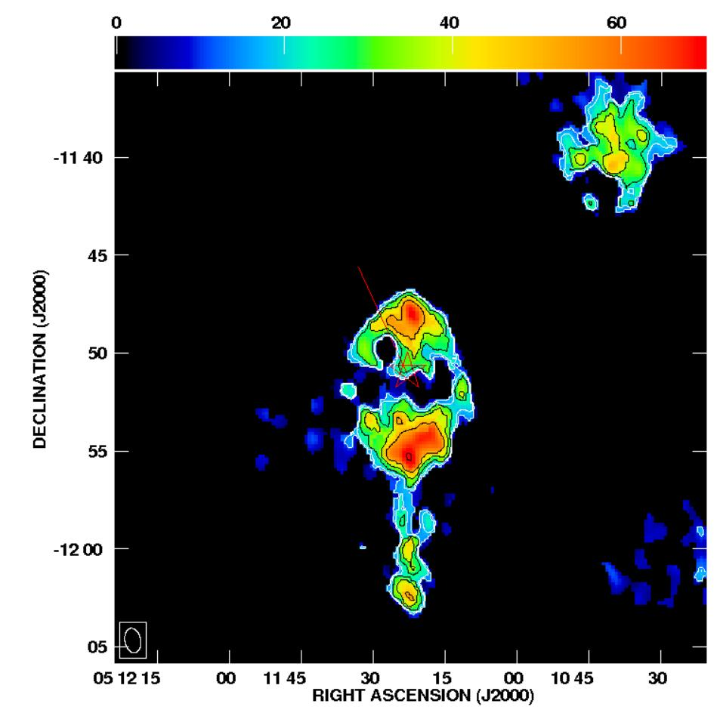
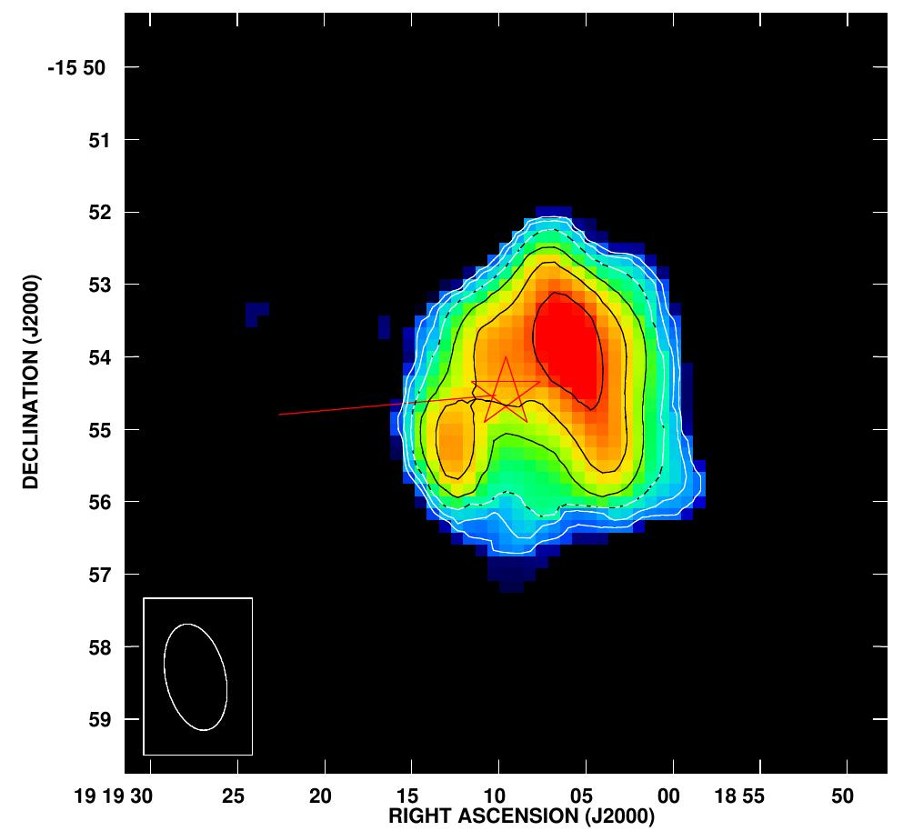
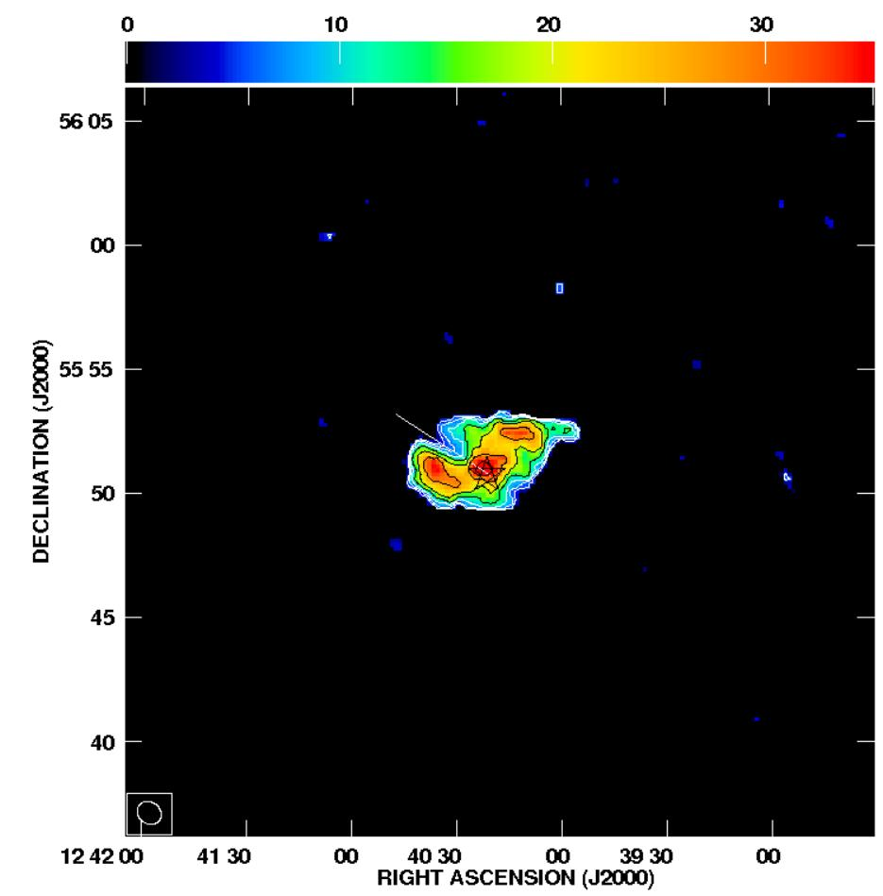
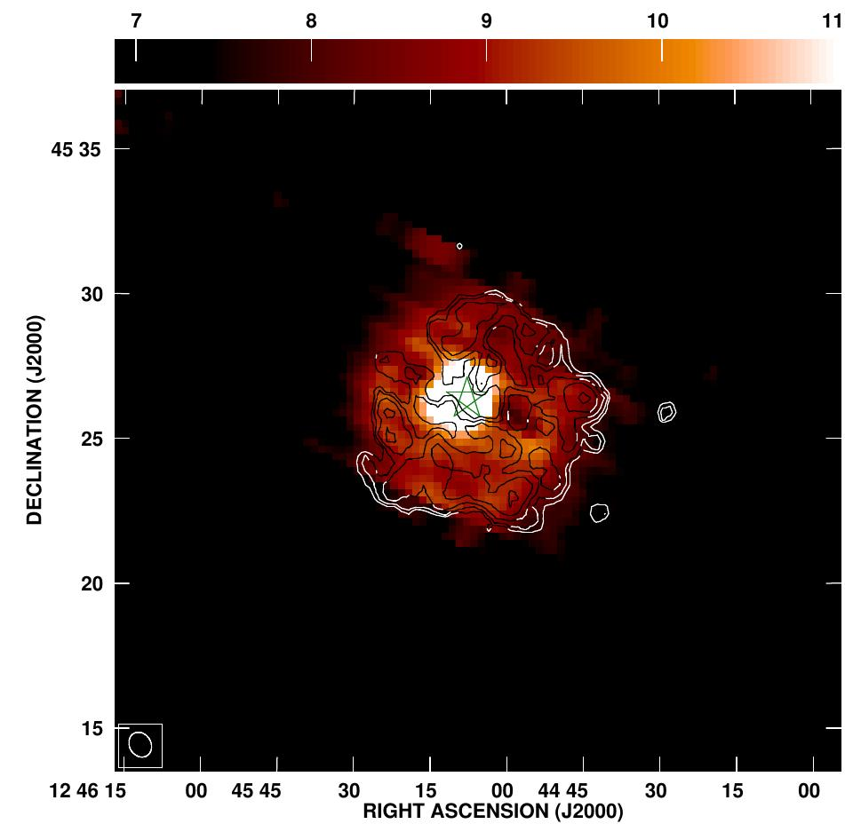
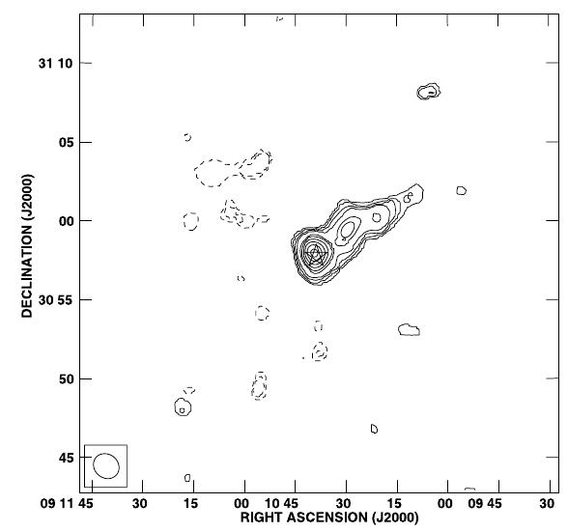
Dust & gas in cool star bow shock regions.
Imaging circumstellar HI gas (Matthews et al. 2013).
RX Lep
V1942 Sgr
Y UMa
TX Psc
Y CVn
RS Cnc
(beam sizes ~1x1 arcmin)
Notes:
47

Slide 48
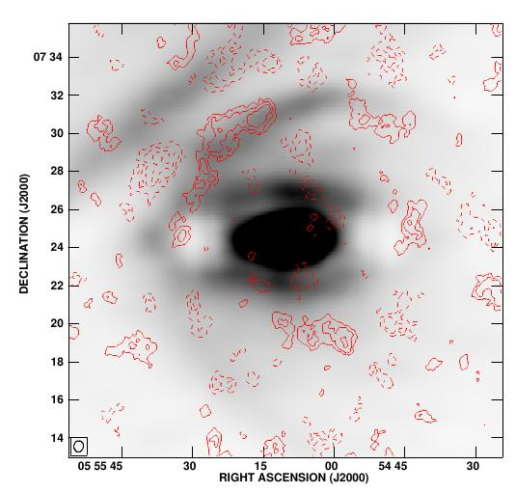
Betelgeuse.
HI gas associate to the
bow shock
9'
7'
6'
Le Bertre et al. (2012)
Notes:
48

