Slide 1
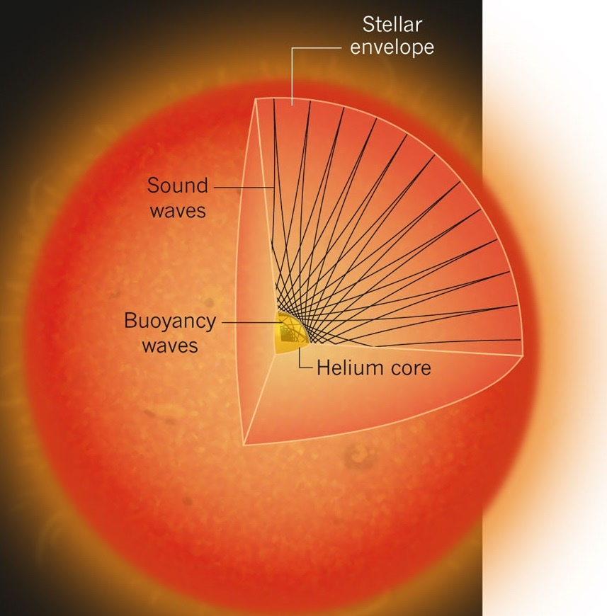
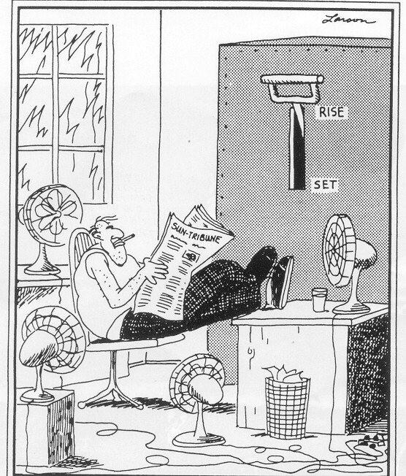
A golden age of asteroseismology with Kepler
Tim Bedding - University of Sydney, Australia
Inside the Sun
Metcalfe (2011)

Slide 2
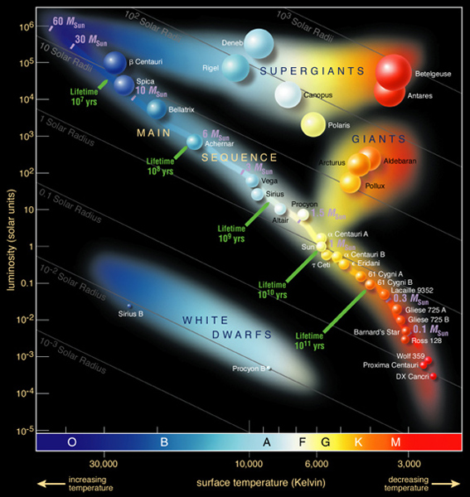
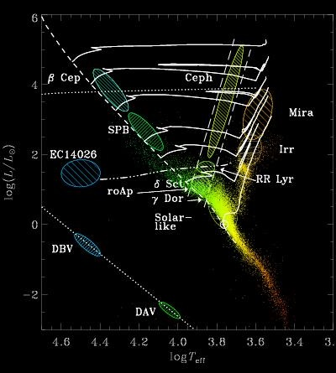
Oscillating stars in the HR diagram

Slide 3
The aims of asteroseismology:
Use the oscillations of stars to measure their properties (mass, radius, age, rotation, etc.)
Improve our understanding of the physics of stars (convection, rotation, magnetic fields, etc.)
Inside the Sun

Slide 4
5-minute oscillations in the Sun (Doppler shift)
BiSON (Birmingham Solar
Oscillations Network)

Slide 5
Convection at the surface of the Sun

Slide 6
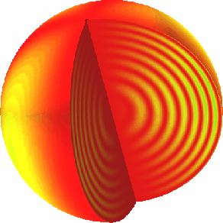
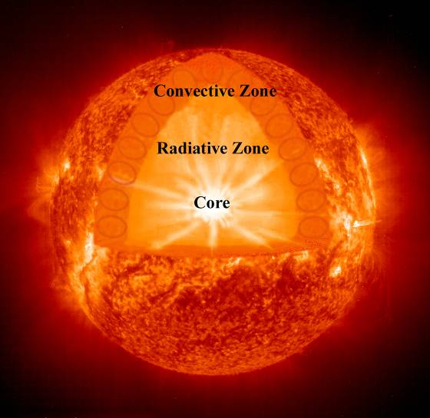
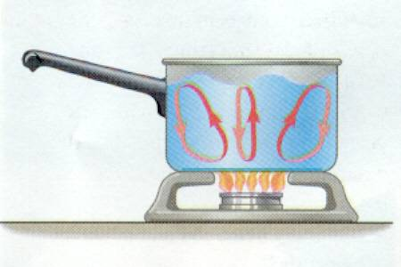
“Solar-like” oscillations
Convection excites the oscillations by shaking the star, creating standing waves

Slide 7
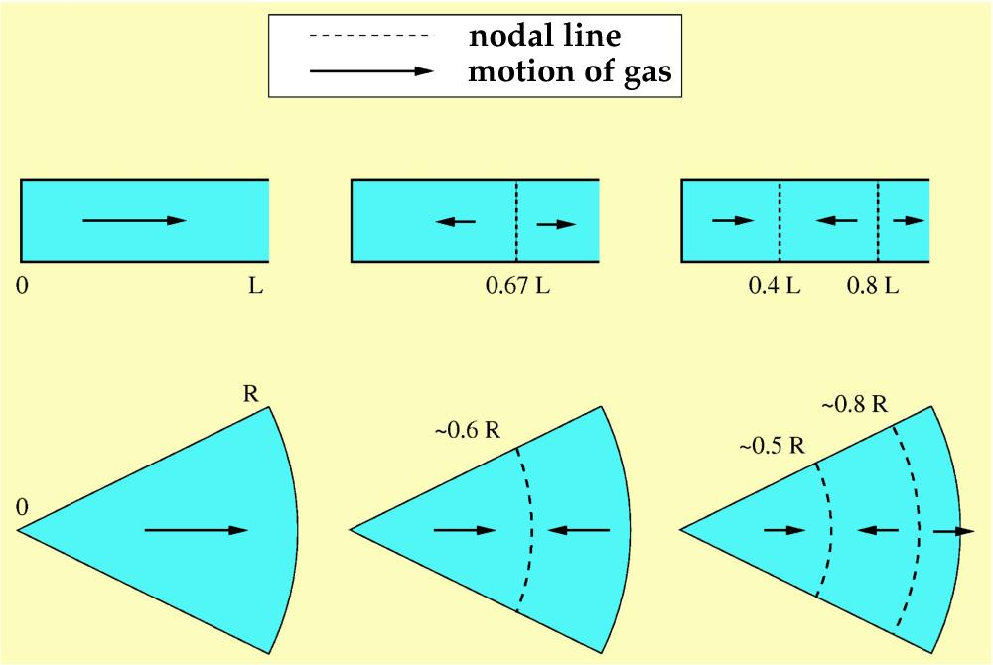
p-mode oscillations are standing sound waves
n =1
n =2
n =3
demonstration
n is called the radial order of the overtone

Slide 8
n =18
oscillation frequency depends on internal sound speed

Slide 9
5-minute oscillations in the Sun (Doppler shift)
BiSON (Birmingham Solar
Oscillations Network)

Slide 10
Fourier power spectrum of solar velocities:
n increases →
Δν
Power
p-mode overtones of a star are approximately regularly spaced in frequency

Slide 11
Building up to the revolution
aided by the exoplanet hunters

Slide 12
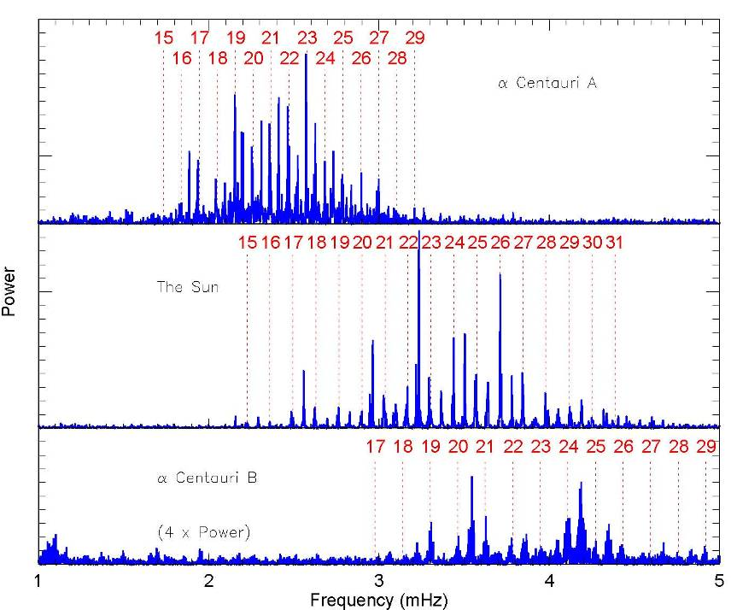
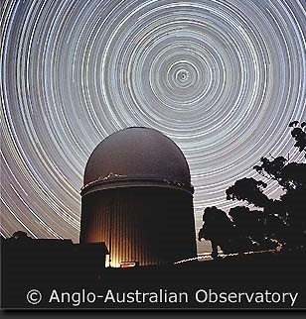
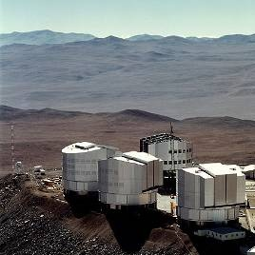
7 minutes
Centauri A
(Bedding et al. 2004)
5 minutes
n increases →
the Sun
Centauri B
(Kjeldsen et al. 2005)
4 minutes

Slide 13
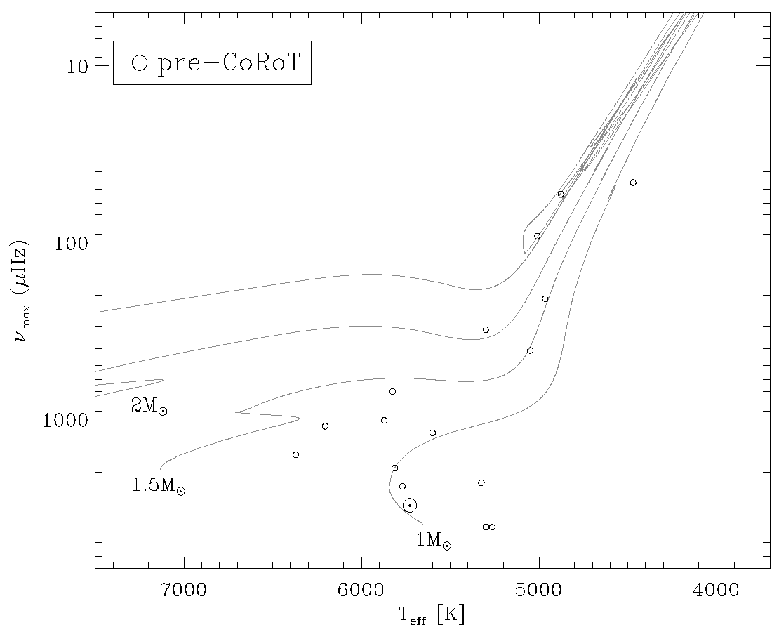
circa 2009
figure by Daniel Huber

Slide 14
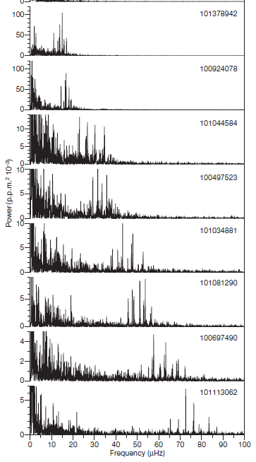
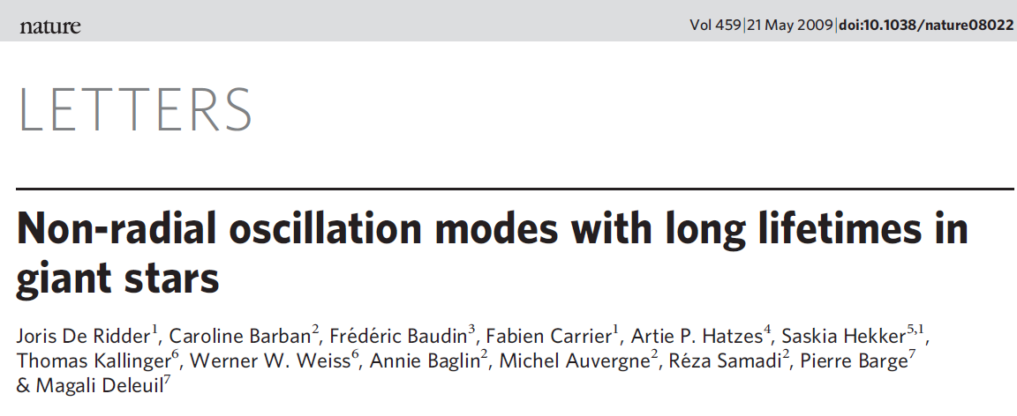
20 hr
Red giants with CoRoT
(De Ridder et al. 2009)
150 days
6 hr
4 hr

Slide 15
figure by Daniel Huber

Slide 16
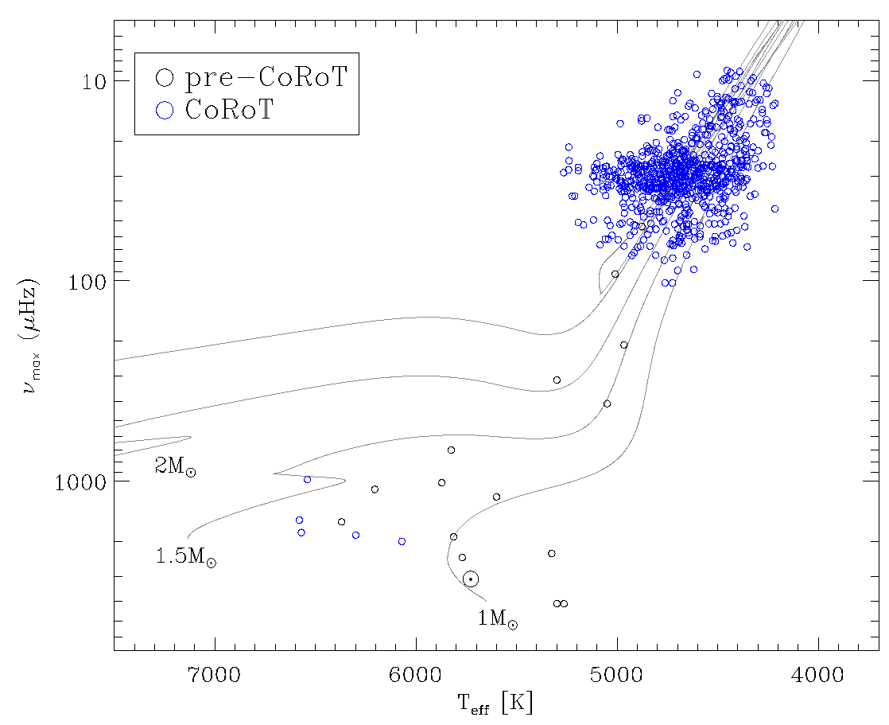
red giants
figure by Daniel Huber

Slide 17
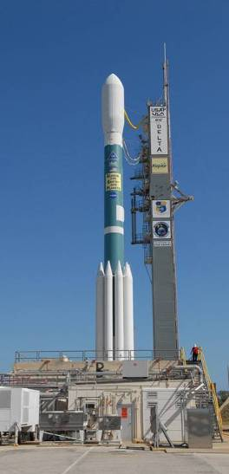
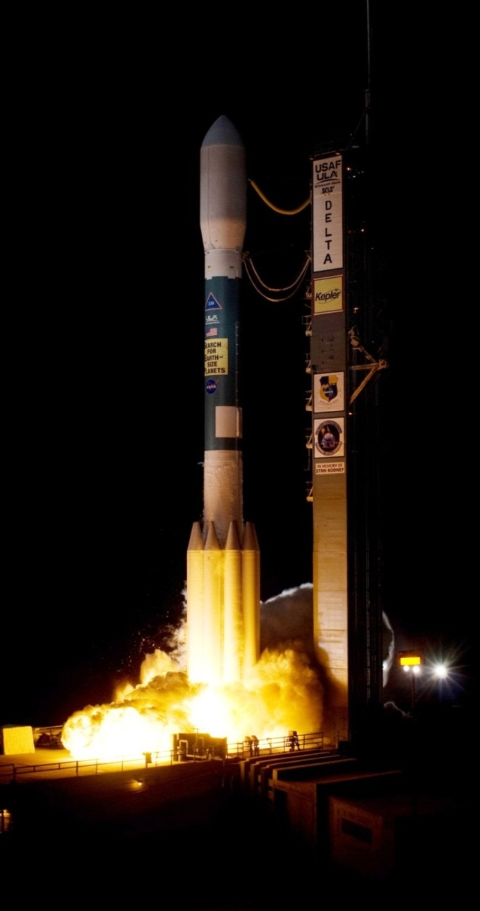
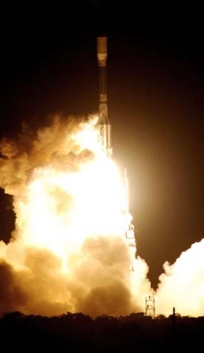
NASA Kepler Mission
launched March 2009

Slide 18
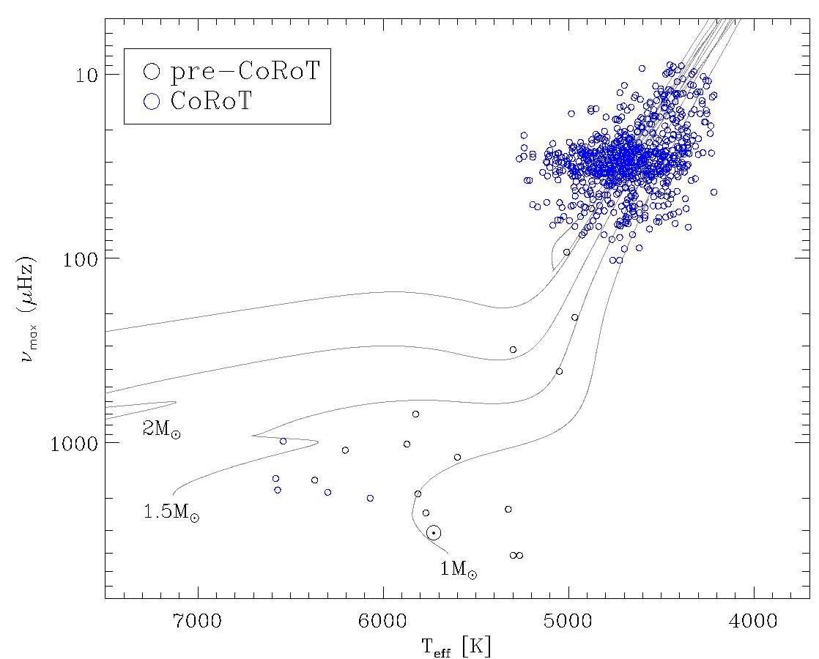
red clump

Slide 19
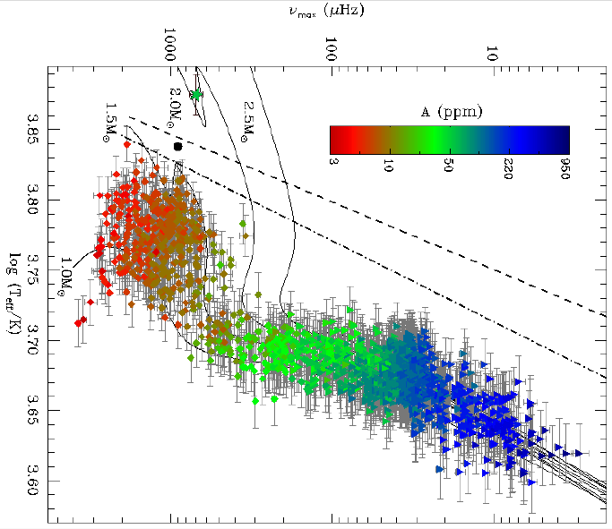
Kepler
red clump
Huber et al. (2011)

Slide 20
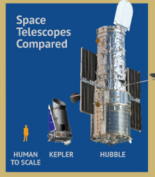
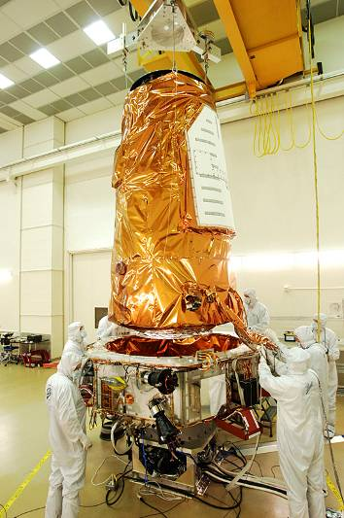
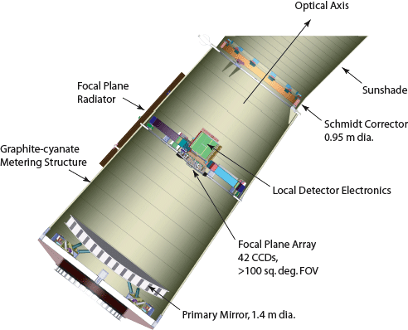
Kepler

Slide 21
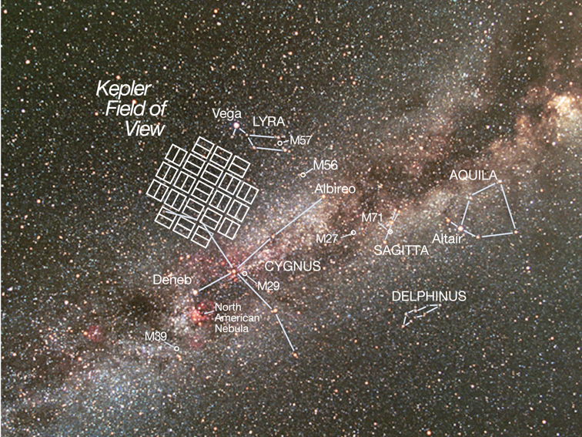
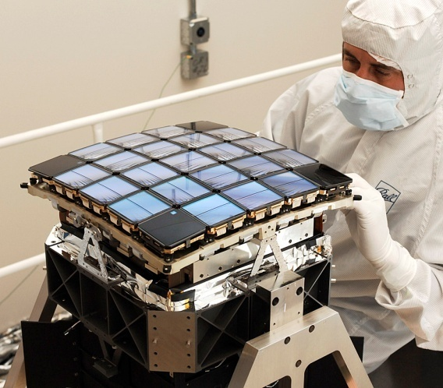
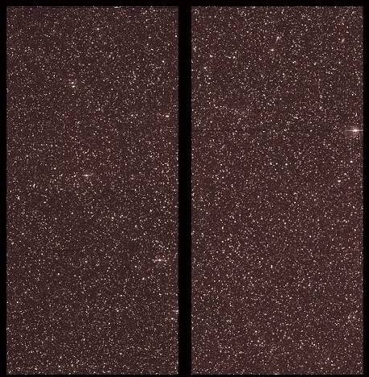

Slide 22
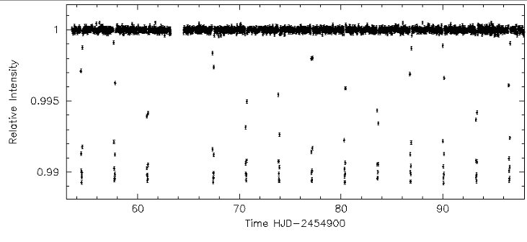
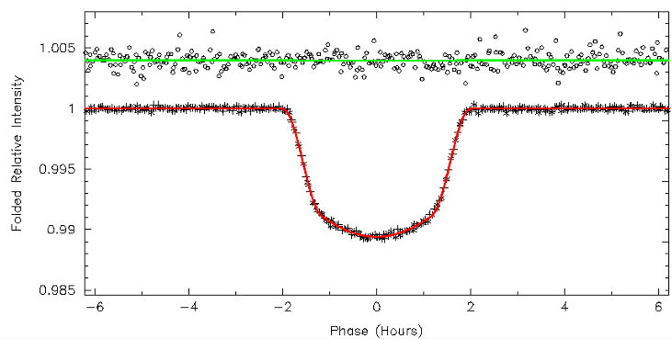
Transiting exoplanets with Kepler

Slide 23
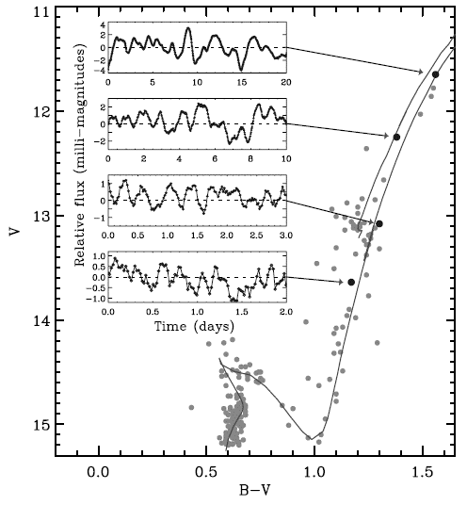
Oscillating stars with Kepler
NGC 6819
Gilliland et al. (2010)

Slide 24
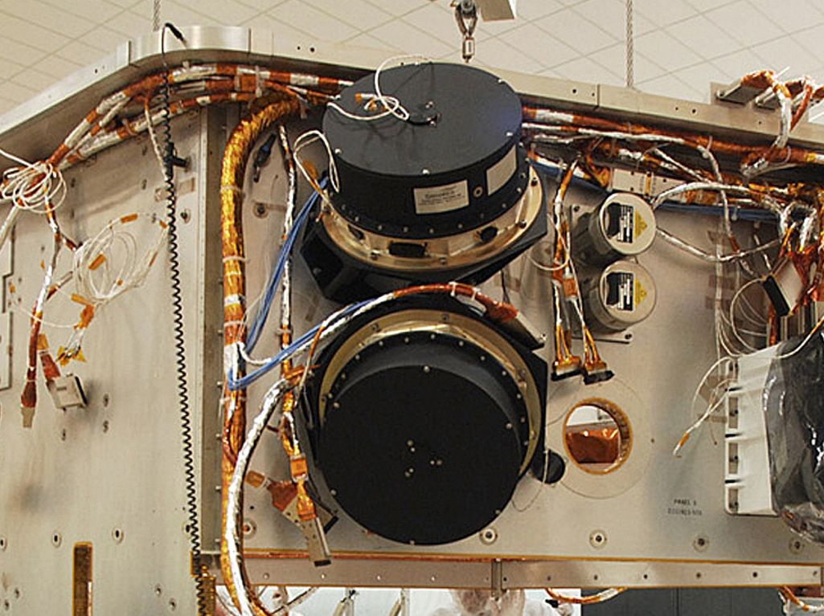
The end of Kepler?
Second reaction wheel failure on 14 May 2013.

Slide 25
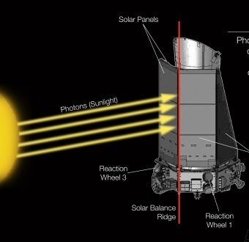
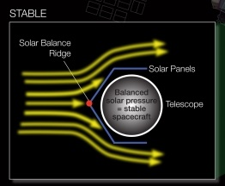

Slide 26
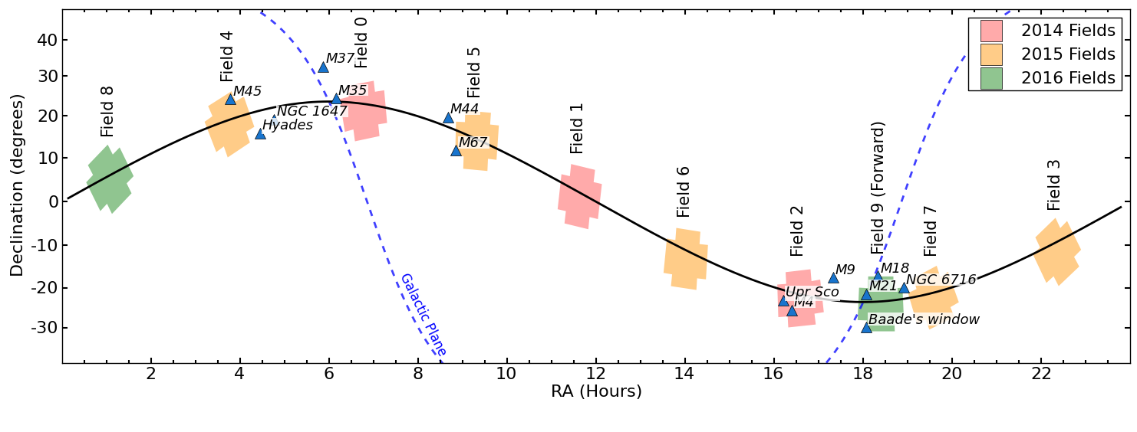
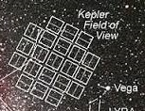
K2 Mission
about 70 days per field along ecliptic plane

Slide 27
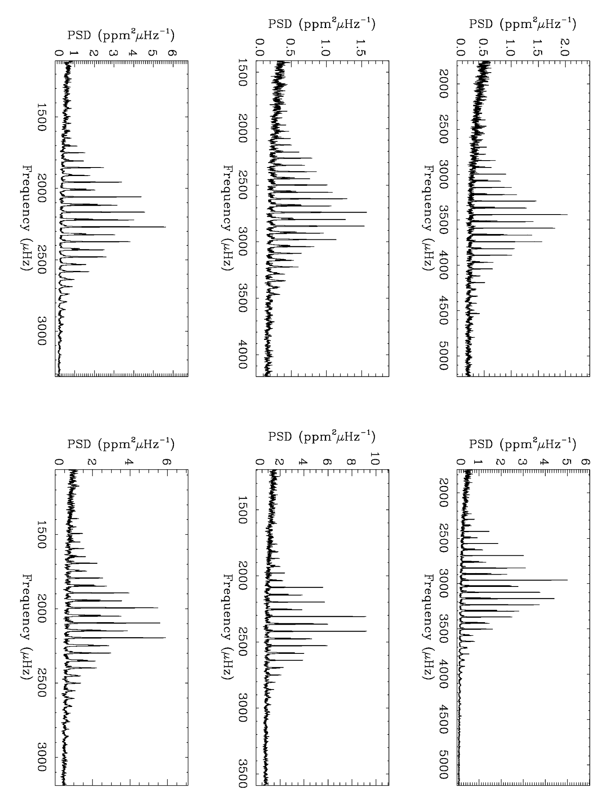
KIC 8006161
Sun
(SOHO)
Δν
Δν
KIC 8379927
KIC 6603624
Δν
Δν
Δν ∝√ρ
KIC 6106415
KIC 6116048
Δν
Δν

Slide 28
νmax
KIC 8006161
νmax
Sun
(SOHO)
νmax
KIC 8379927
νmax
KIC 6603624
νmax
νmax
KIC 6106415
KIC 6116048

Slide 29
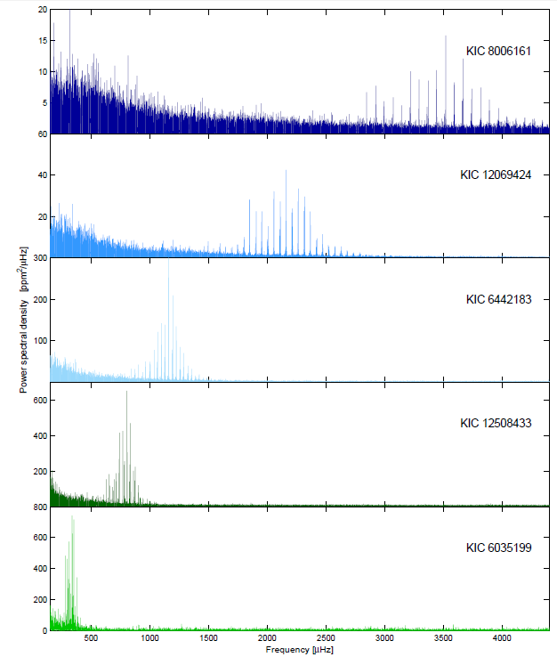
5 minutes
Brown et al. (1991);
Kjeldsen & Bedding (1995)
8 minutes
14 minutes
νmax
21 minutes
70 min
Chaplin & Miglio (2013)

Slide 30
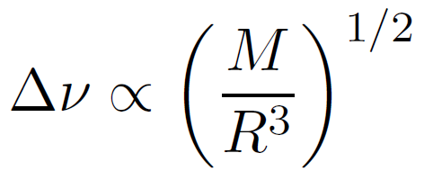
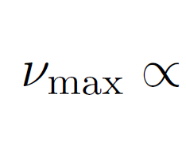
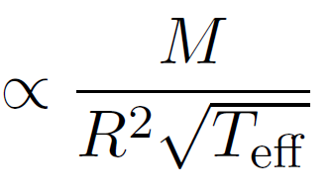
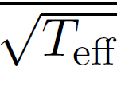
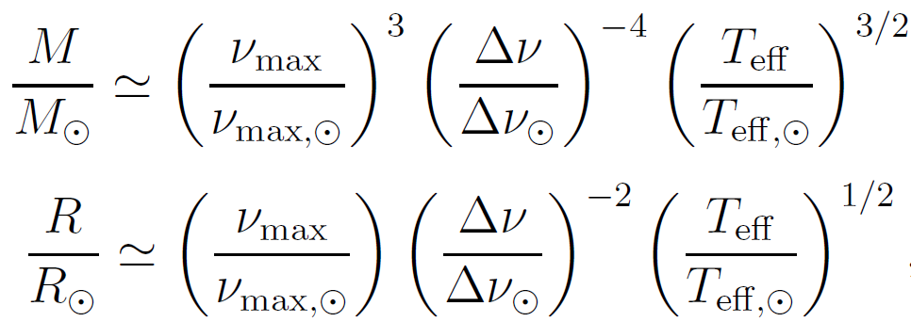
Scaling relations:
Solve to get mass and radius:
(and luminosity)
Much better to fit models to individual frequencies!

Slide 31
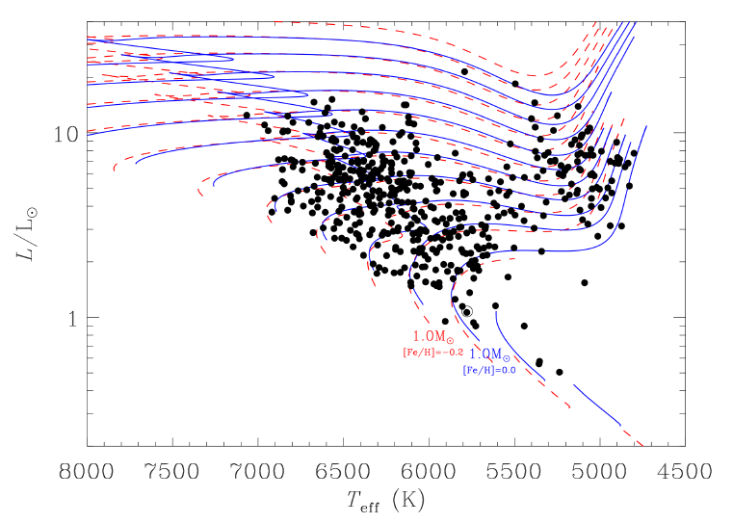
Chaplin et al. (2013, Science; 2014): >500 stars
mass: 5-10%
radius: 2-4%
age: ~20%

Slide 32
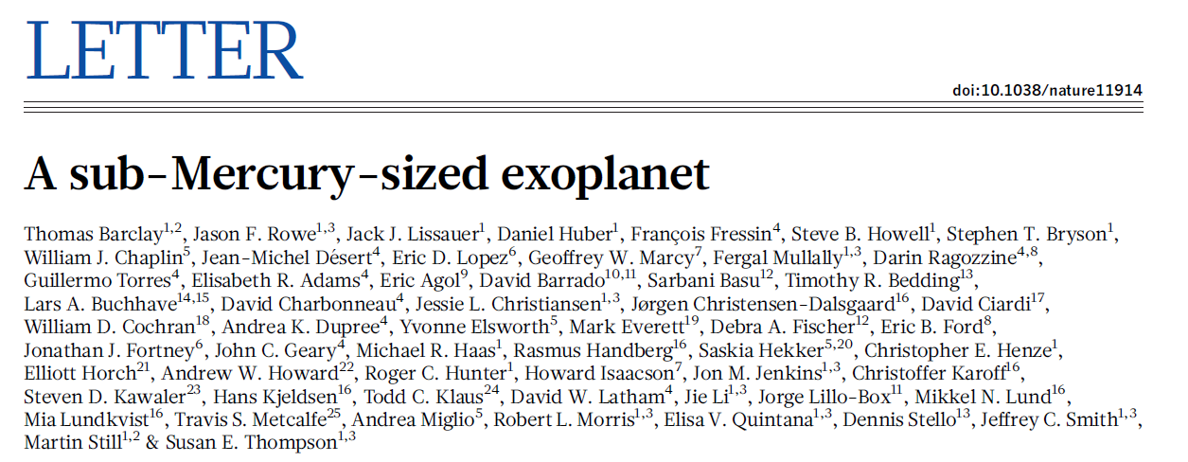
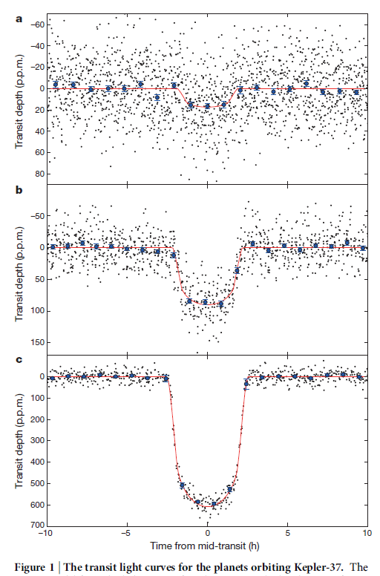
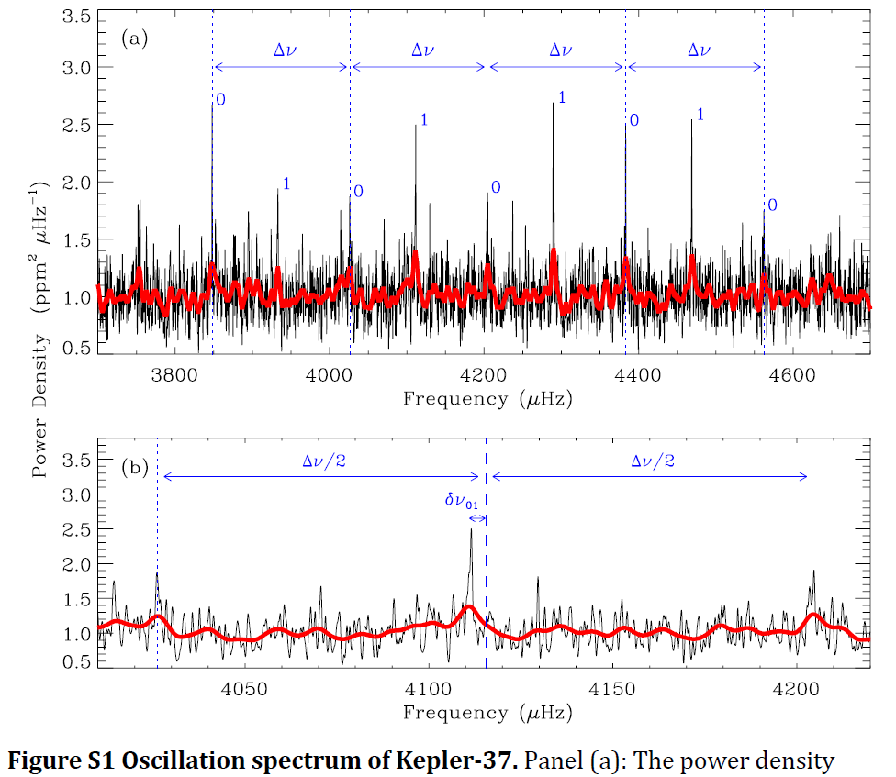
M = 0.80 ± 0.07
R = 0.77 ± 0.03
age = ~6 Gyr
(2013)
4 minutes

Slide 33
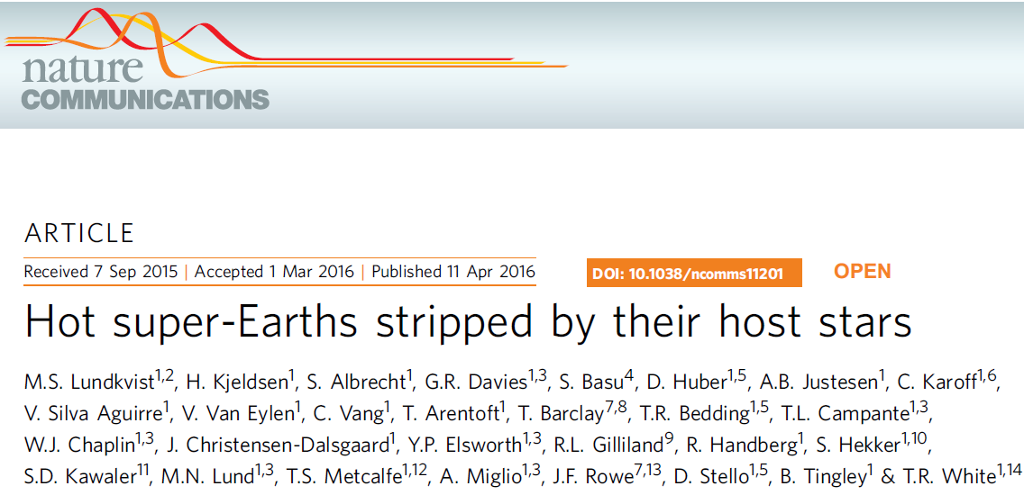

Slide 34
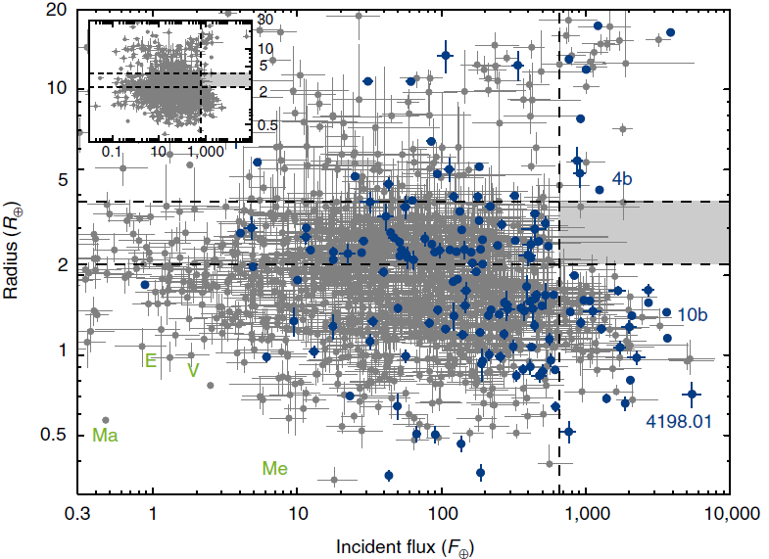
Lundkvist et al. (2016)

Slide 35
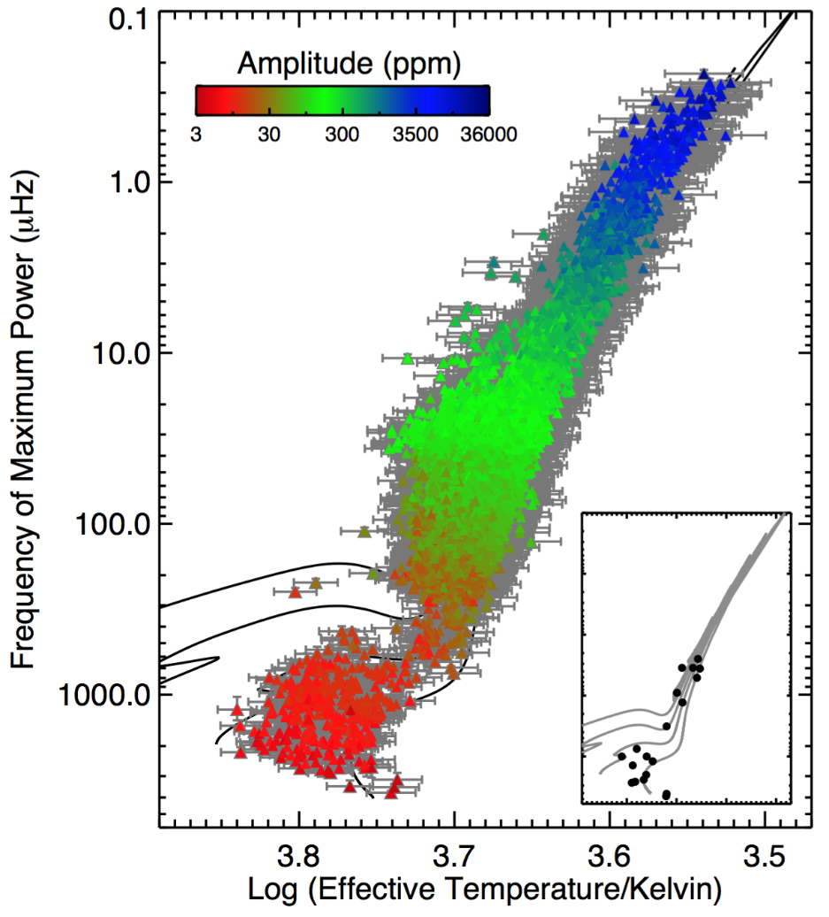
After 4 years of Kepler (Huber 2015)
Red giants
100 d
after 1.4 years of Kepler (Huber et al. 2011)
RGB tip
10 d
1 d
red clump
2 hr
20 min
5 min

Slide 36
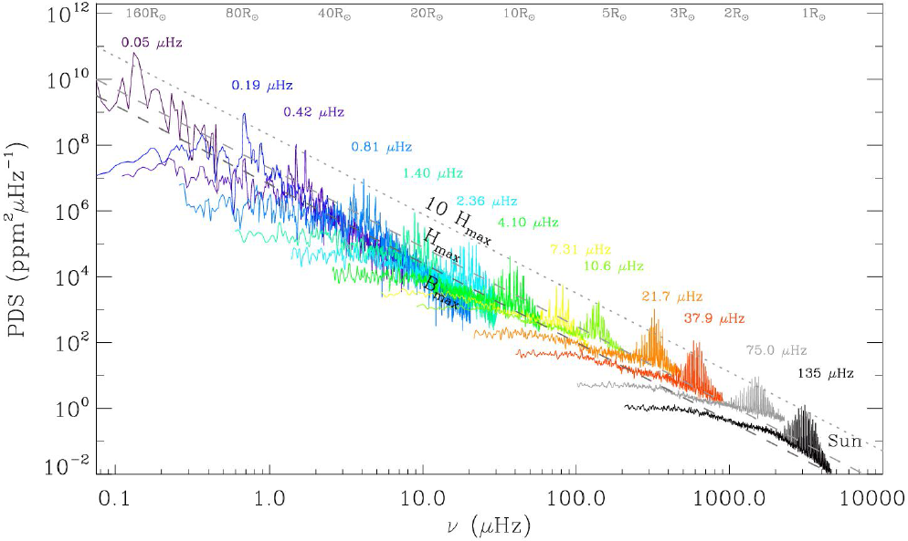
Banyai et al. (2013); Mosser et al. (2013); Stello et al. (2014)
100 d
10 d
1 d
2 hr
20 min
5 min
Mosser et al. (2013)

Slide 37
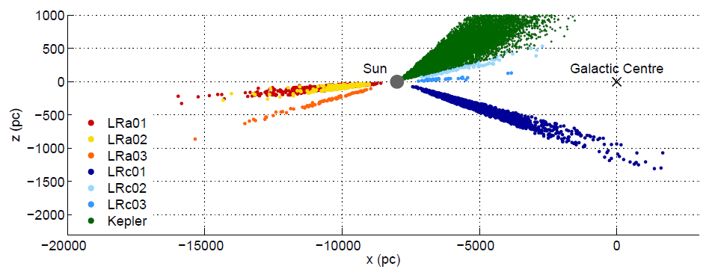
Population studies
(“Galactic archaeology”)
(Miglio et al. 2011)

Slide 38
Kepler
K2
CoRoT

Slide 39
2015

Slide 40
Casagrande et al. (2015)

Slide 42
Open clusters
mass loss
Miglio et al. (2011)

Slide 43
A closer look at the frequency spectra...

Slide 44
Fourier power spectrum of solar velocities:
n increases →
Δν
Power
p-mode overtones of a star are approximately regularly spaced in frequency

Slide 45
The Sun
Δν = 135 μHz
ℓ=1
ℓ=0
ℓ=1
ℓ=0
ℓ=1
ℓ=2
2 0
ℓ=2
3

Slide 46
ℓ =0 (radial modes)
ℓ=1
ℓ= 2

Slide 47
Δν = 135 μHz
Δν measures mean density of the star
ℓ=1
ℓ=0
ℓ=1
ℓ=0
ℓ=1
ℓ=2
2 0
ℓ=2
δν₀₂
sensitive to core (age)
3

Slide 49
Silva Aguirre et al. (2013)
mass=1.15Msun

Slide 50
Appourchaux et al. (2015)
Banyai et al. (2013); Mosser et al. (2013); Stello et al. (2014)

Slide 51
Verma et al. (2014)
Acoustic glitch gives helium abundance

Slide 52
1. Pulsation & mass loss in M giants
30d
100d
300d
1000d
Miras
semiregulars
tip RGB
Feast (1996), Wood & Sebo (1996), Bedding & Zijlstra (1998), Wood et al. (1999), Kiss & Bedding (2003), Ita et al. (2004), Fraser et al. (2005), Derekas et al. (2006), Soszynski et al. (2007), Tabur et al. (2010).

Slide 54
100 d
10 d
1 d
Miras
tip RGB
onset of
Mira-like
excitation?

Slide 55
30d
60d
2.2d
Banyai et al. (2013); Mosser et al. (2013); Stello et al. (2014)

Slide 56
2.2d
4.1d
5.5d
8.3d
25d
60d

Slide 57
dominant modes in M giants are l=1
2 d
10 d
40 d
Stello et al. (2014)

Slide 58
2. Mixed modes in red giants

Slide 59
Kepler red giant (1 month)
Q1
Bedding et al. (2010)

Slide 60
ℓ =0 (radial modes)
ℓ=1
ℓ= 2

Slide 61
2 0
2 0
1
2 0
2 0
2 0
same red giant (46 months)
Q0-Q16

Slide 62
2 0
2 0
1
2 0
2 0
2 0
0
1
2

Slide 63
Mixed modes arise from coupling between p and g modes with the same l
Dupret et al. (2009)
see also Christensen-Dalsgaard (2004)
figures from Metcalfe (2011)

Slide 66
3. Internal rotation of red giants
ℓ= 1, m = -1
ℓ= 1, m = 1

Slide 67
1
1
2 0
1
2 0
2 0
see also Deheuvels et al. (2012)

Slide 68
rotational splitting of ℓ= 1
Gizon & Solanki (2003)

Slide 70
(2012)
Problem: the cores are not rotating as fast as expected
see also Deheuvels et al. (2014)

Slide 71
(2010)
(2013)
(2013)
(2013)
(2013)

Slide 72
(2014)
(2014)
(2015)
(2015)

Slide 73
4. Magnetic fields in red giants
Notes:
fascinating, some of us could study it all day. BTW, some people complain about naming Kepler stars after cats...

Slide 74
Suppression of ℓ=1 modes in red giants
2,0
2,0
2,0
2,0
2,0
2,0
2,0
2,0
Garcia et al. (2014); see also Mosser et al. (2012)
Notes:
fascinating, some of us could study it all day. BTW, some people complain about naming Kepler stars after cats...

Slide 75
(2015)

Slide 76
Stello et al. (2016, Nature)

Slide 77
Stello et al. (2016, Nature)

Slide 78
5. Measuring the inclination of the rotation axis
m = 0
m = -1
m = +1
Gizon & Solanki (2003)
rotational splitting of ℓ= 1 modes

Slide 81
The Future

Slide 82
First node operating in Tenerife, second node under construction in China
μ Her

Slide 83
TESS: 2017-2019+
Large Area Survey of Bright Stars
F, G, K stars: +4 to +12 magnitude
“All sky” observations in 2 years:
> 200,000 target stars at <2 min cadence
> 20,000,000 stars in full frames at 30 min cadence
~500,000 oscillating red giants
Notes:
Launch Aug 2017
Uninterrupted viewing for >95% of time
Orbital Periods:
TESS = 13.7 days➡ 2:1 Resonance➡ 90° Phasing
Aperture 11cm
Obs: ~30,000 deg² for >27 days; ~2800 deg² for >80 days; ~900 deg² for >300 days

Slide 84
PLATO: 2024-2030+
Large Area Survey
4-16 magnitude
50% of entire sky observed in 6 years:
~ 100,000 target stars at 2.5 sec cadence
> 1,000,000 stars at 25 sec cadence
50º
Proposed fields
Notes:
Kepler on steroids
12cm apertures
Fast cam. one in each colour
150.000 stars per pointing (like Kepler)
~100K dwarfs with seismo
Light curves on-board processing (limited stamps go to ground)

Slide 85
Summary
fundamental properties of stars (masses, radii, ages)
probing stellar interiors in detail (convective overshoot, nuclear burning, internal rotation, magnetic fields)
The future: Kepler continues with K2, SONG, then TESS and PLATO, …

