Slide 1
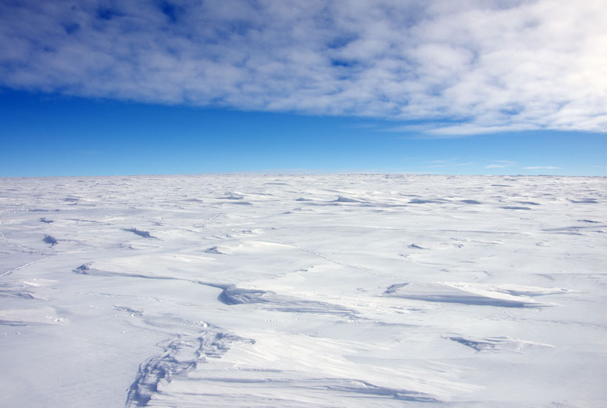


eV-scale Sterile Neutrinos at the IceCube experiment
BEN JONES, UNIVERSITY OF TEXAS AT ARLINGTON

Slide 2
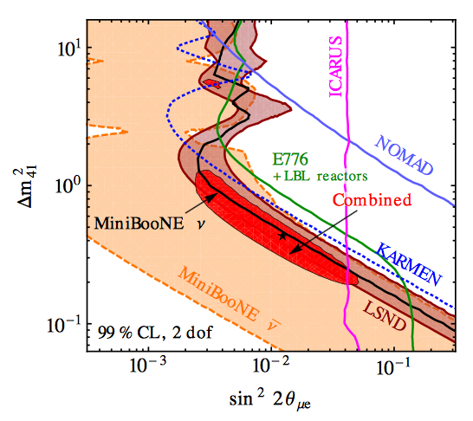
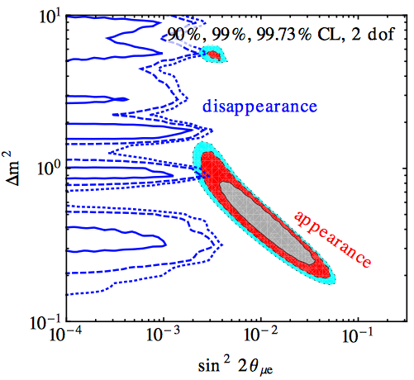
World Data, pre-IceCube
Kopp et al:
JHEP 1305 (2013) 050
Appearance only
Appearance and disappearance

Slide 3
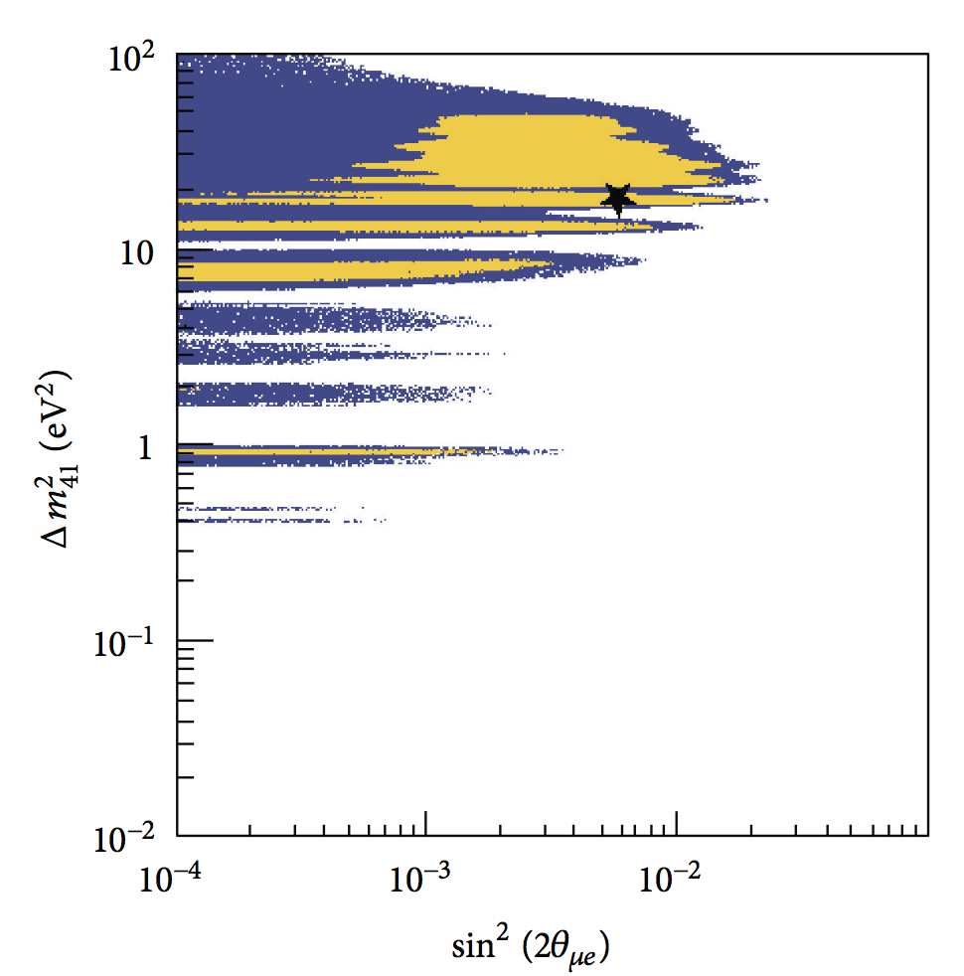
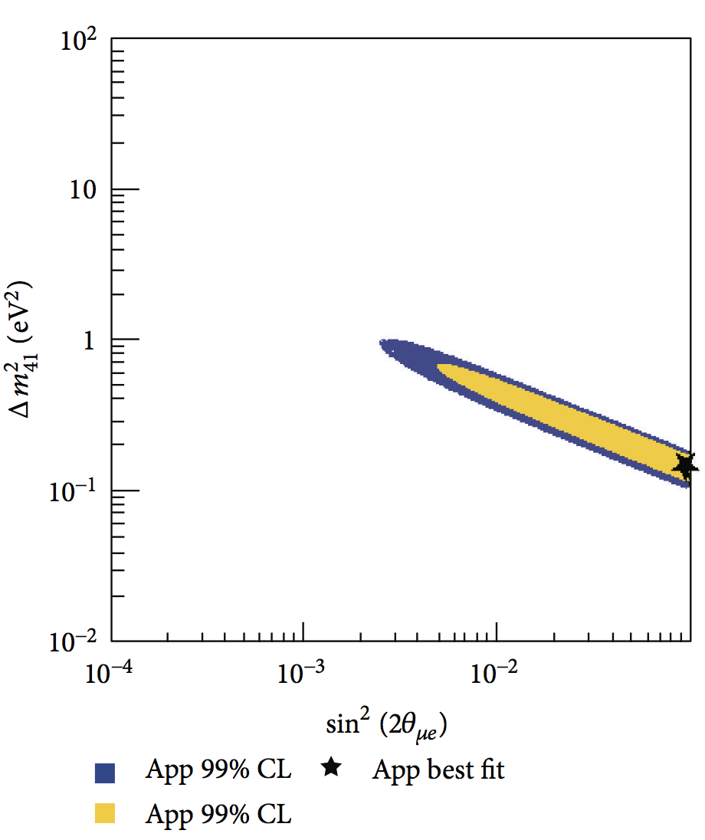
World Data, pre-IceCube
Compare to Conrad et al
Adv.High Energy Phys. 2013 (2013) 163897
Appearance only
Appearance and disappearance

Slide 4
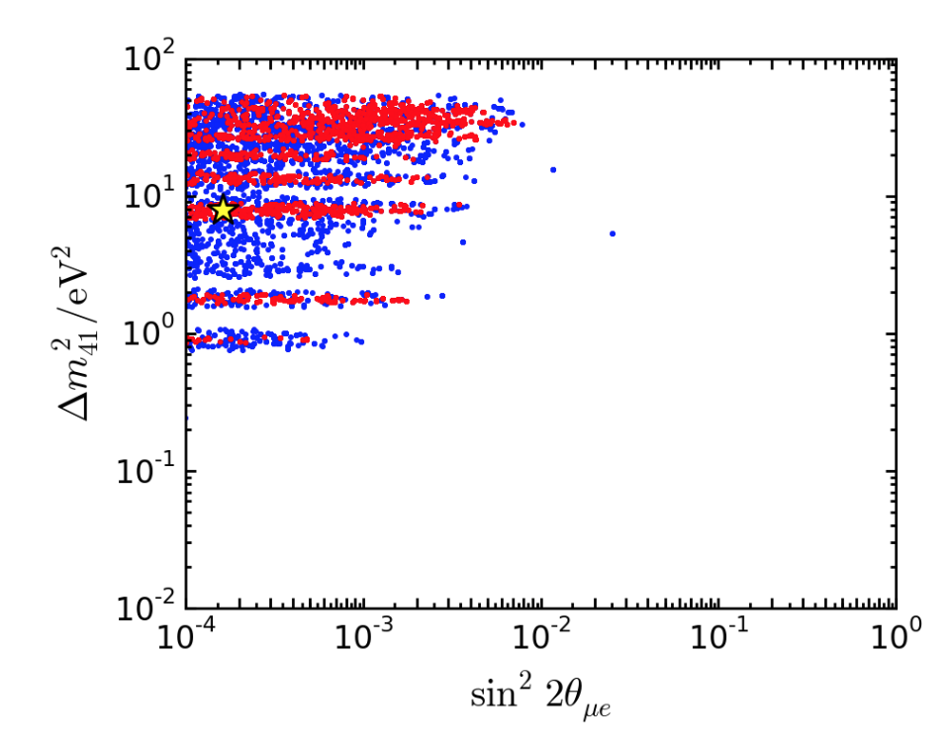
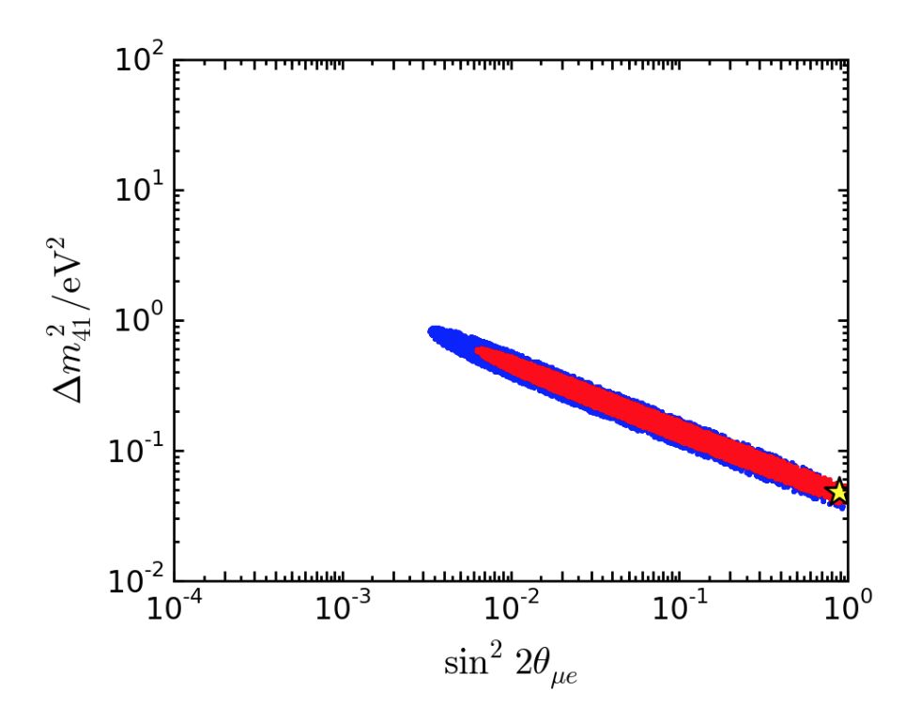
World Data, pre-IceCube-ish
(i.e., data at the time of IceCube publication)
Fits to all SBN data as of Feb 2016
Nucl.Phys. B908 (2016) 354-365
Appearance only
Appearance and disappearance

Slide 5
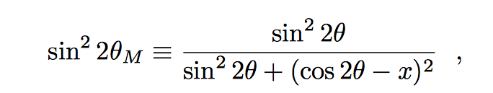
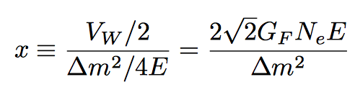
The MSW resonance
It is well established that effective mass and mixing of neutrinos depend on local matter density through the MSW effect
Neutrino energy
Electron density
If x = cos 2θ, maximal mixing → largest possible amplitude of oscillation : MSW resonance.
Happens even if original mixing angle is very tiny.

Slide 6
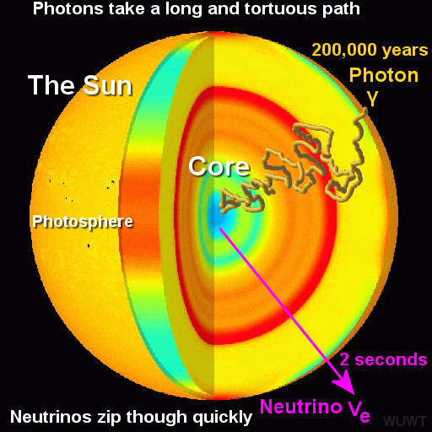
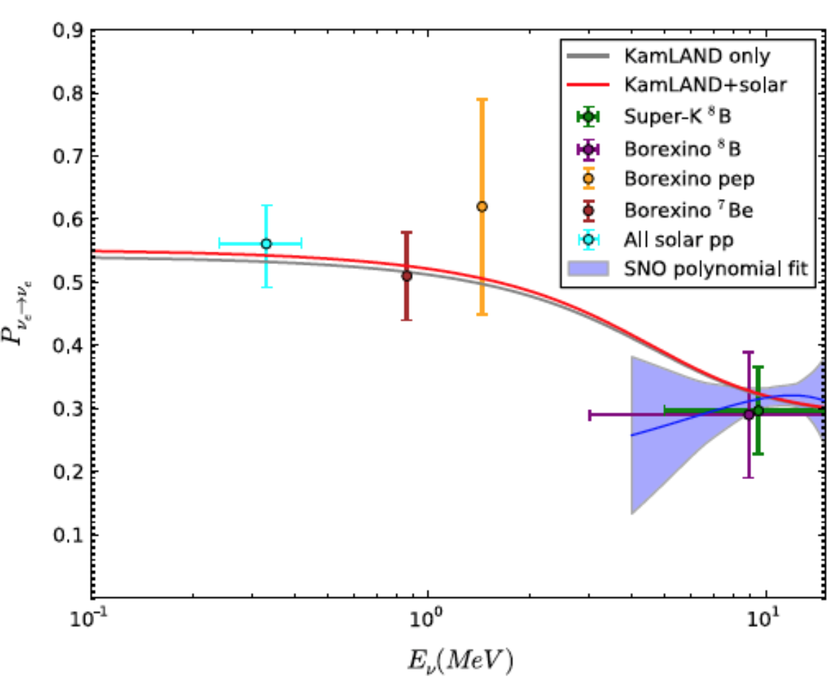
e.g. MSW resonant solar neutrinos
Solar surface
Solar core
10 MeV
neutrino
0.2 MeV
neutrino
Effective mixing angle
No matter effect
RESONANCE ANGLE
Electron density
Matter enhanced oscillations

Slide 7
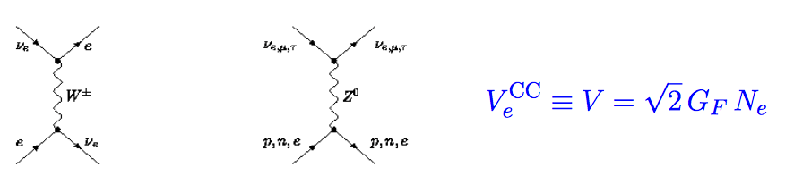
Sterile Neutrino Matter Effects
Sterile neutrinos do not interact with matter at all.
New MSW-type effects are to be expected.
Electron flavor
mu / tau flavor
Sterile flavor
For full phenomenology : Esmali and Smirnov, JHEP 1312 (2013) 014

Slide 8
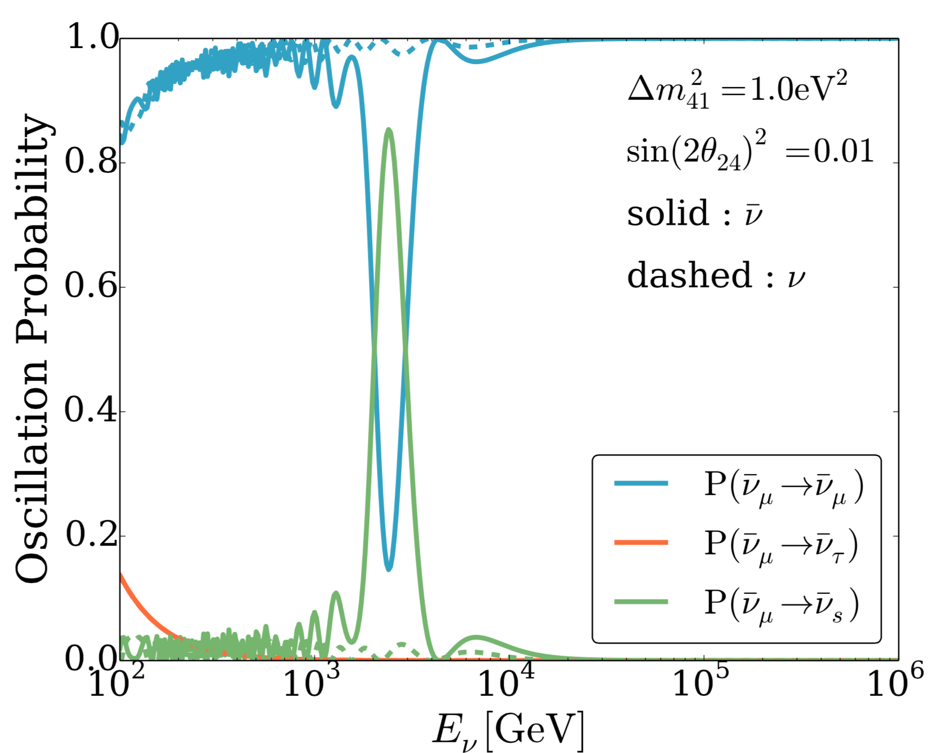
MSW Resonant Atmospheric Neutrinos?
cosmic ray primary
muons
neutrinos
Earth matter
Earth surface
Earth core
detector
3TeV
Effective mixing angle
0.6TeV
RESONANCE ANGLE
Matter density (arb)

Slide 9
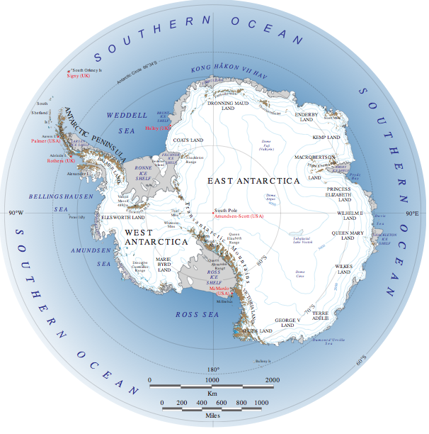
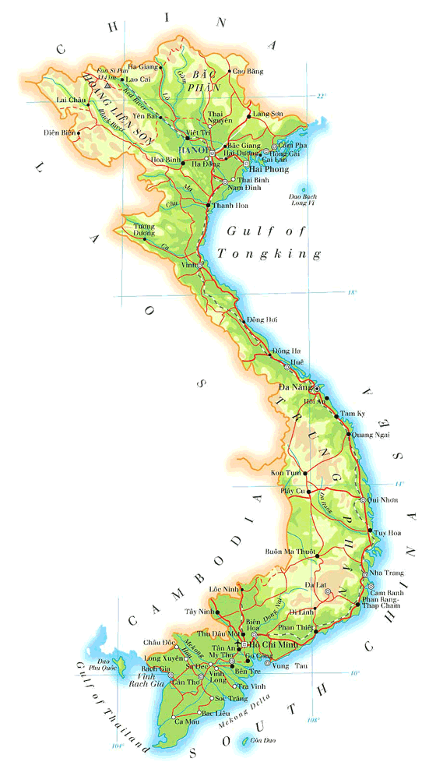
Here
There
(Quy Nhon, Vietnam)

Slide 10
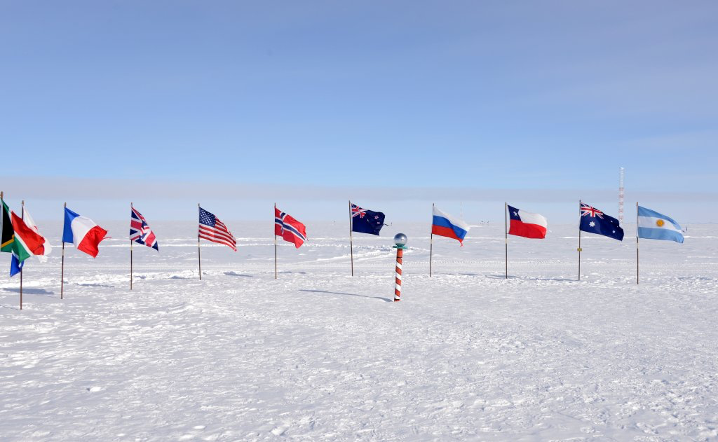

Slide 11
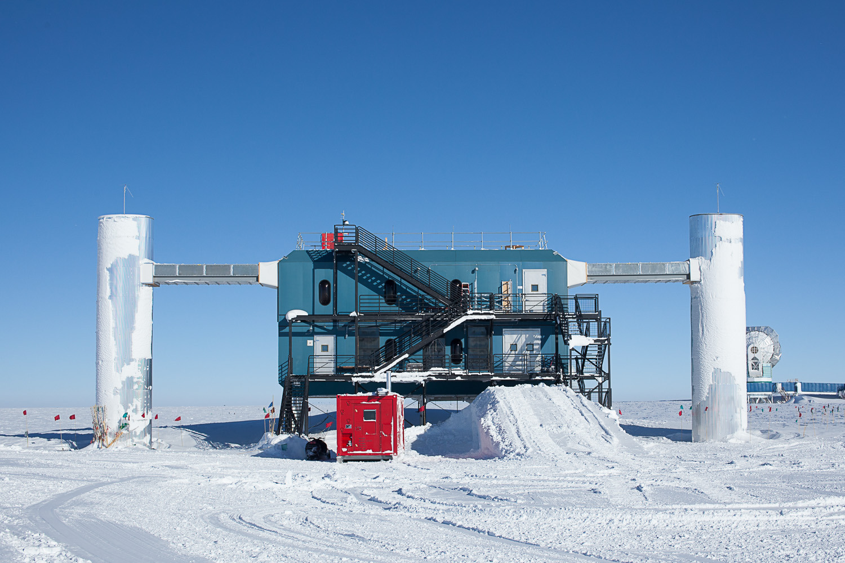

Slide 12
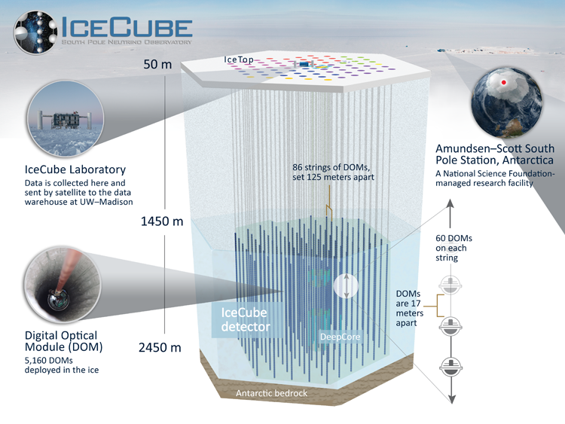

Slide 13
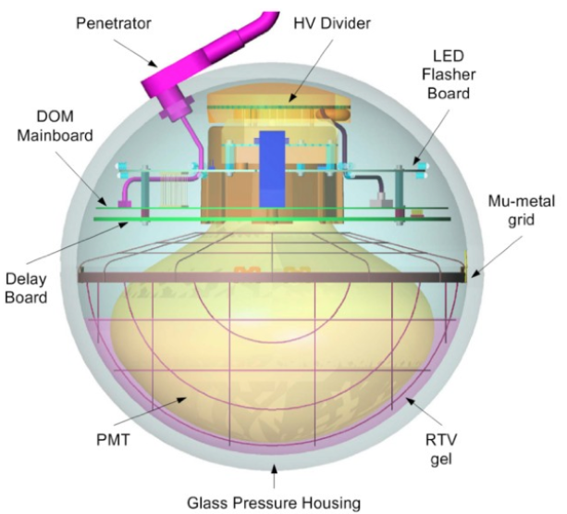
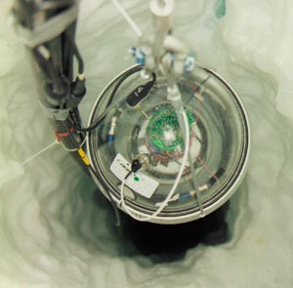
Digital Optical Modules

Slide 14
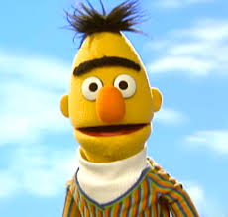
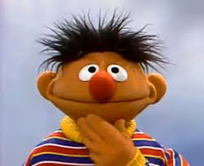
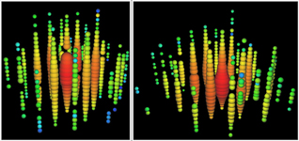
Astrophysical Neutrinos
IceCube observed the flux of ultra-high-energy astrophysical neutrinos in 2013
At present there are 54 astrophysical neutrino candidates
“Bert”
“Ernie”
Phys.Rev.Lett. 113 (2014) 101101
1.0 PeV
1.1 PeV
These are HESE (High Energy Starting Event) cascades

Slide 15
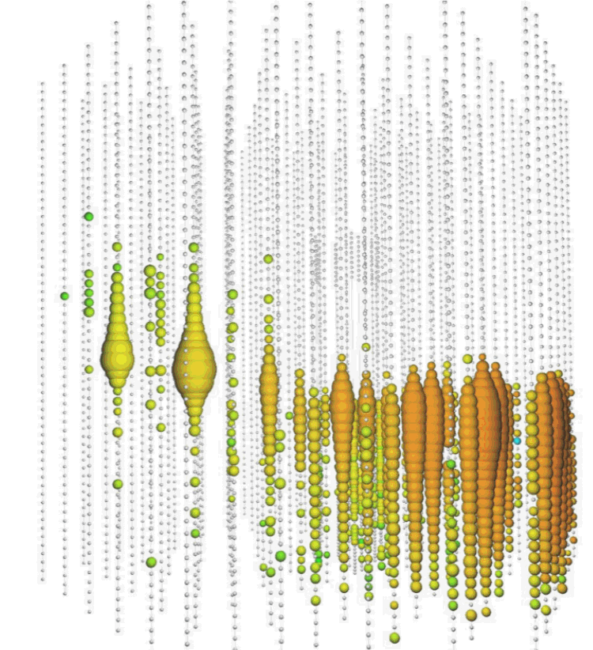
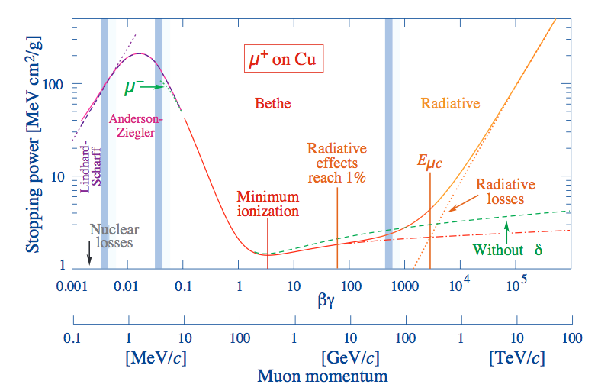
ν_{μ} detection in IceCube
Astro Neutrino
Simulated 4TeV muon event
Highest energy muon neutrino,
~2.6 PeV in detector
Earth
( > 100 times LHC beam energy)
Detected muon
(Muon enegry losses are stochastic in this energy regime)
IceCube events

Slide 16
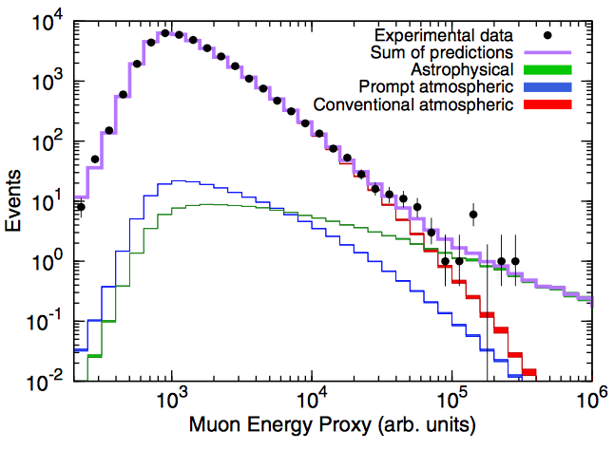
The Muppet Muons
Phys.Rev.Lett. 115 (2015) 8, 081102
Mostly Muppets
(astrophysical)

Slide 17
The Non-Muppet Muons
Phys.Rev.Lett. 115 (2015) 8, 081102
Mostly Muppets
(astrophysical)
Mostly Not Muppets
(atmospheric)

Slide 18
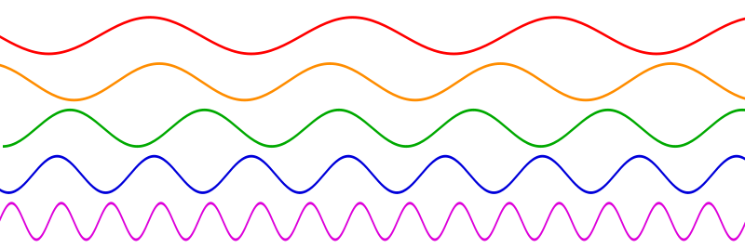
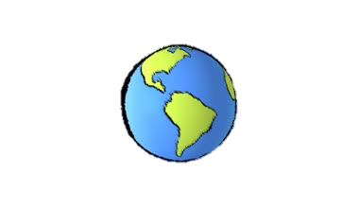
Standard oscillations
Phys.Rev.Lett. 115 (2015) 8, 081102
Higher energy
Dominantly
astrophysical
Lower energy
Osc. length for standard neutrinos >> Earth diameter except at very lowest energies
Energy is too low for resonance, oscillations are vacuum-like
Sensitive to standard oscillations
Dominantly
atmospheric

Slide 19
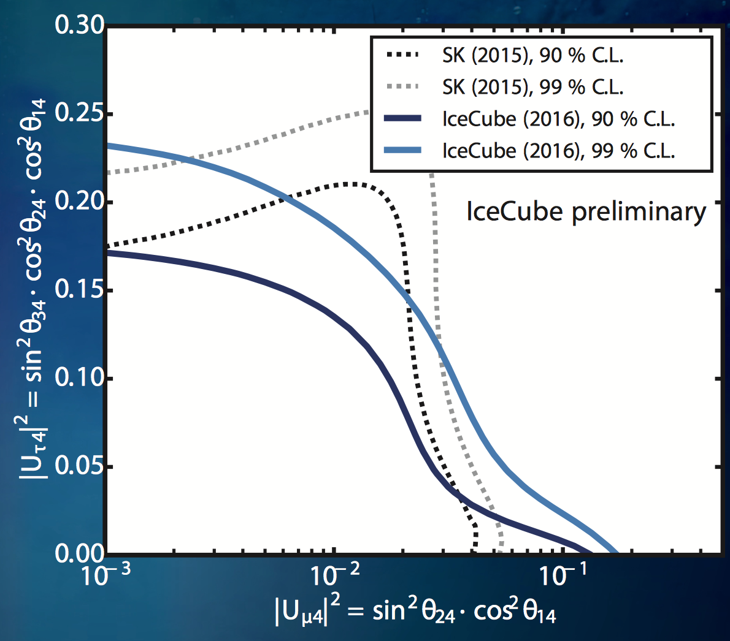
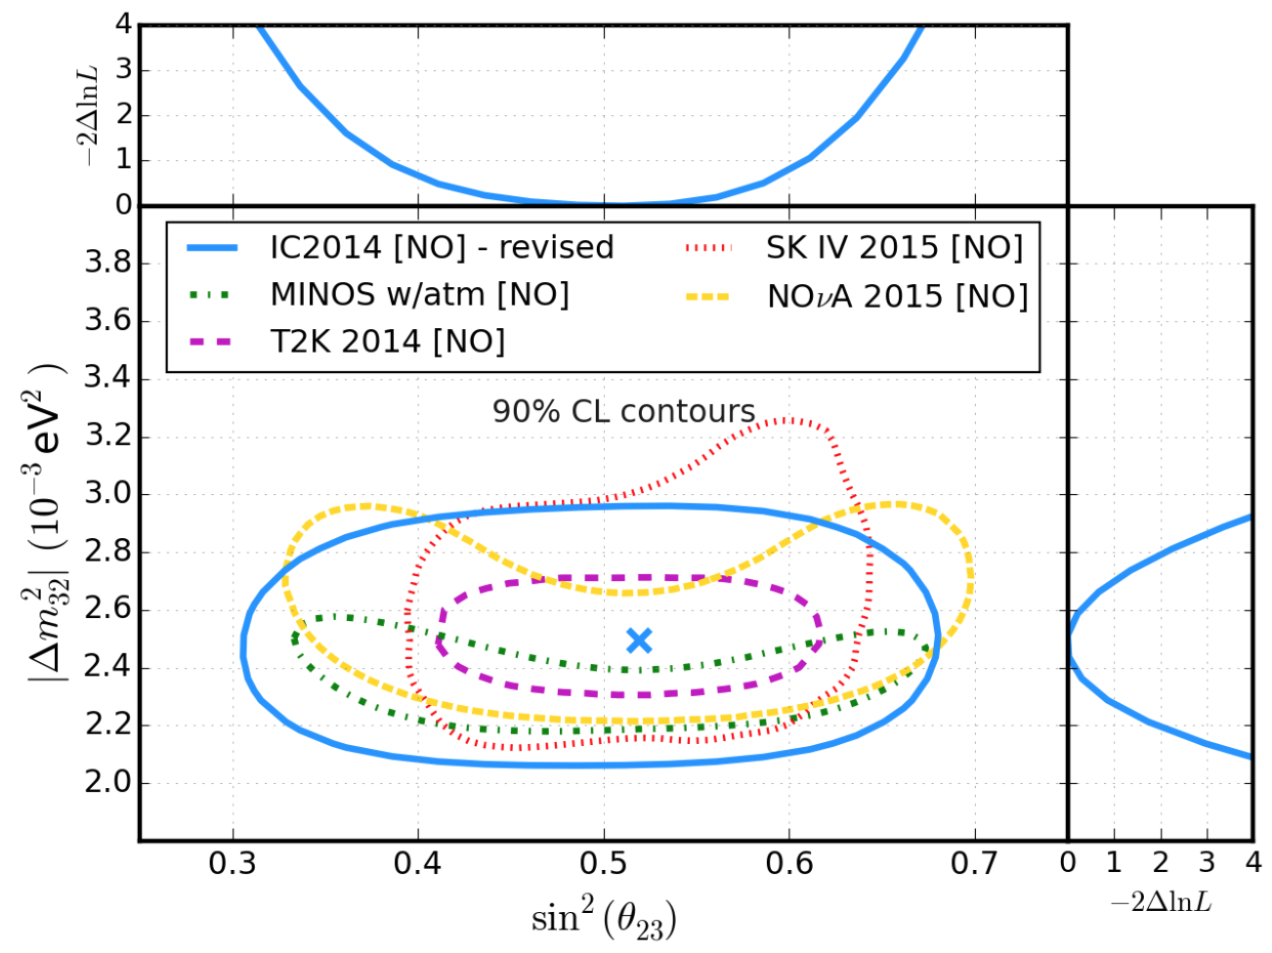
See talk by Philipp Eller
Standard oscillations at IceCube
Low energy sterile search

Slide 20
Where is the MSW resonance?
Island allowed by both appearance and disappearance expts is around Δm² = 1eV2
MSW resonance occurs at:
ADD REFERENCES
For Δm²=1 eV² and Earth matter density:
E_{crit} = 3 TeV

Slide 21
Resonance energy:
Phys.Rev.Lett. 115 (2015) 8, 081102
Right here – big stats in sample!

Slide 22
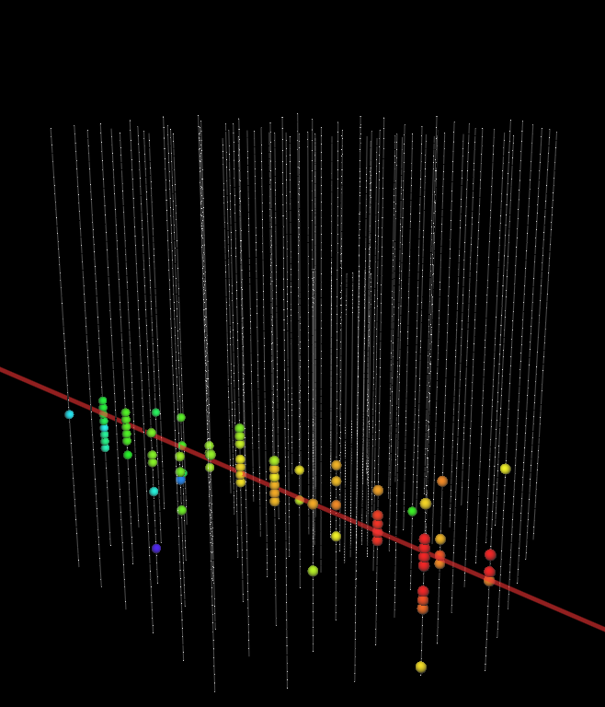
Resonance energy:
Example 4 TeV up-going muon event
Right here – big stats in sample!

Slide 23
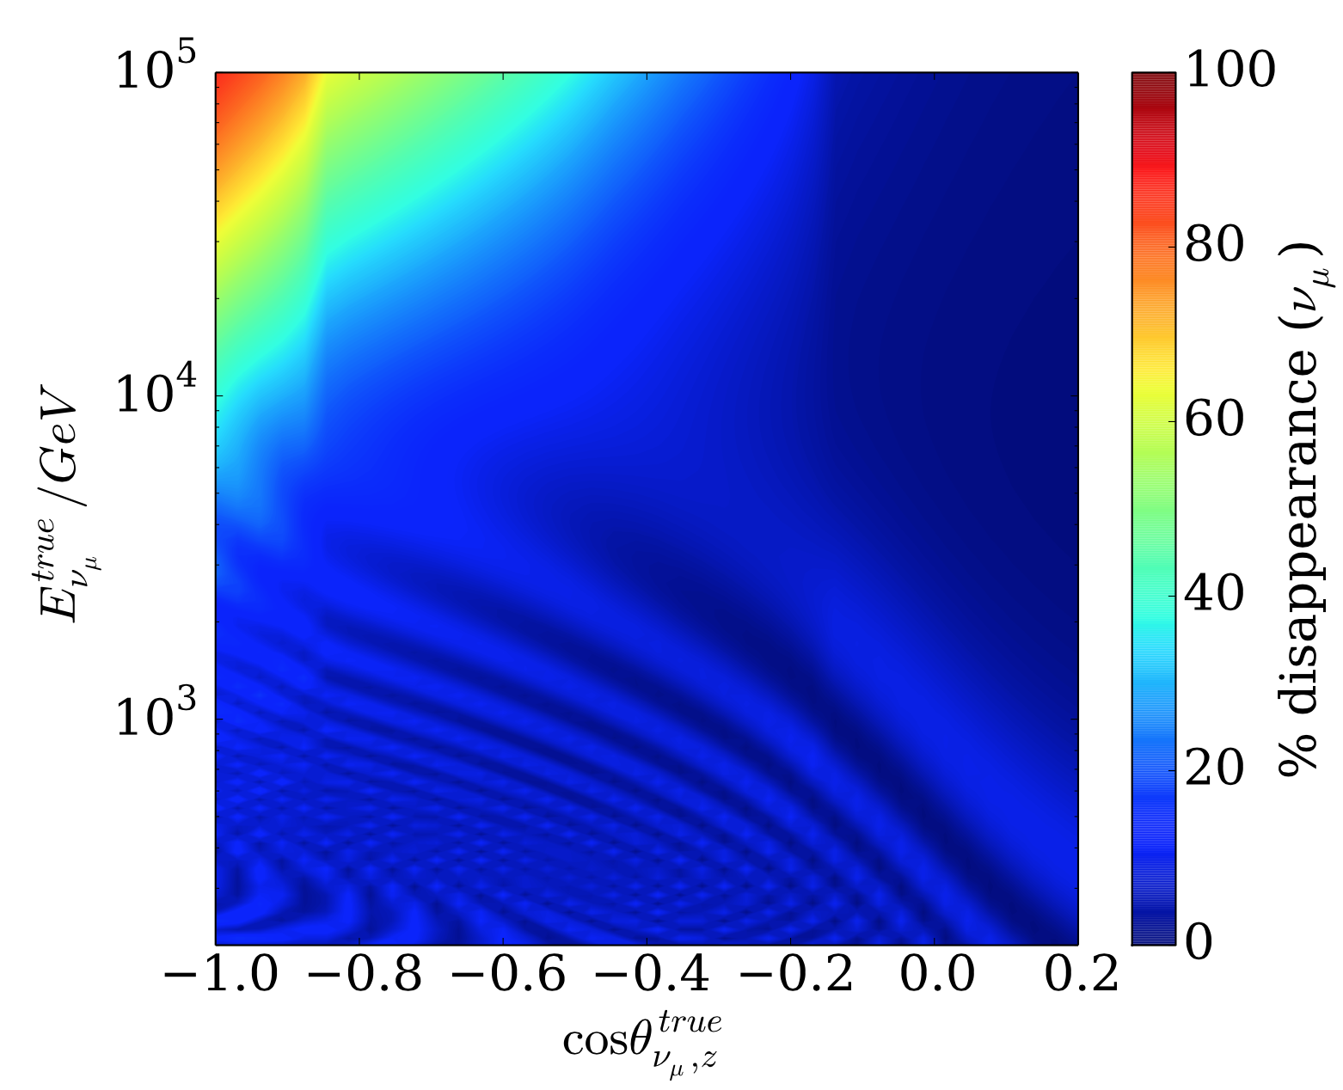
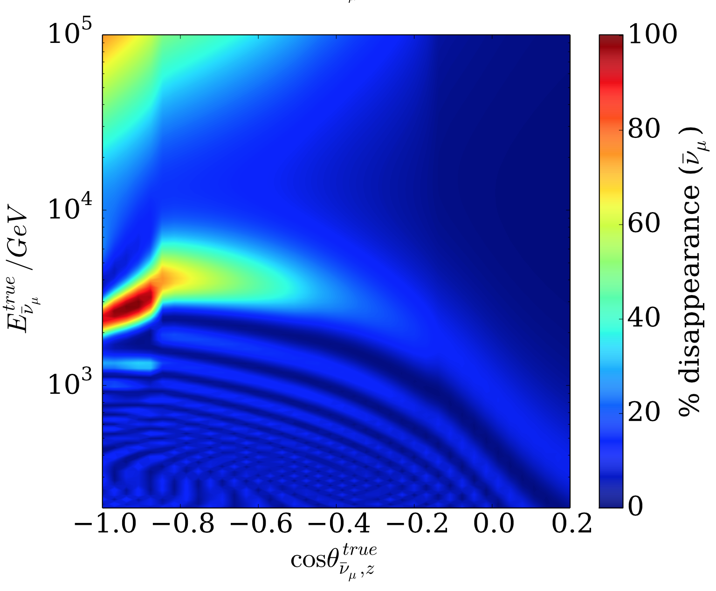
Predicting the MSW oscillation
Neutrinos
At these energies, have refractive (MSW) phenomena, and also significant incoherent scatter cross section.
→ numerically solve flavor evolution master equation through Earth density profile for truth-level oscillation solution.
Antineutrinos
Evaluated at pre-IceCube world best-fit →
nuSQuIDs:
https://github.com/arguelles/nuSQuIDS

Slide 25
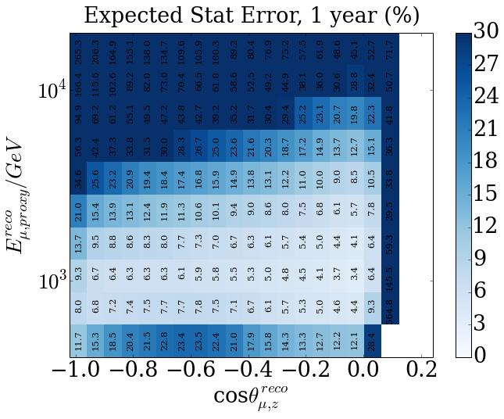
Expected Stat Uncertainty per Bin

Slide 26
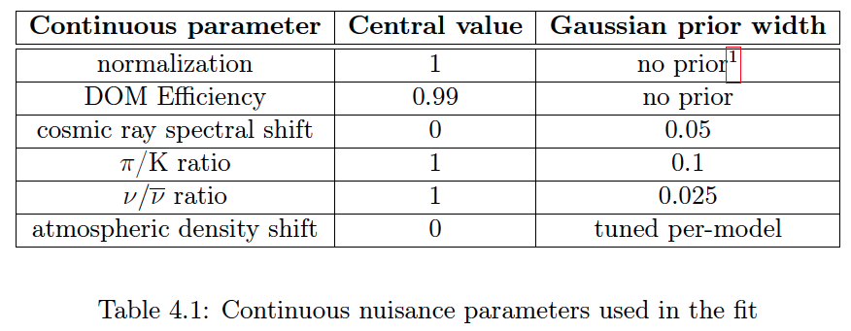
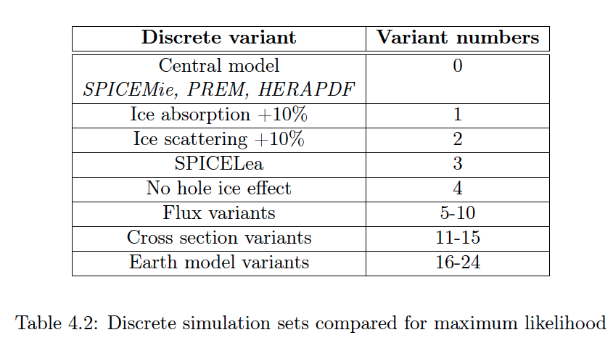
Sources of systematic uncertainty
(anisotropy)

Slide 27
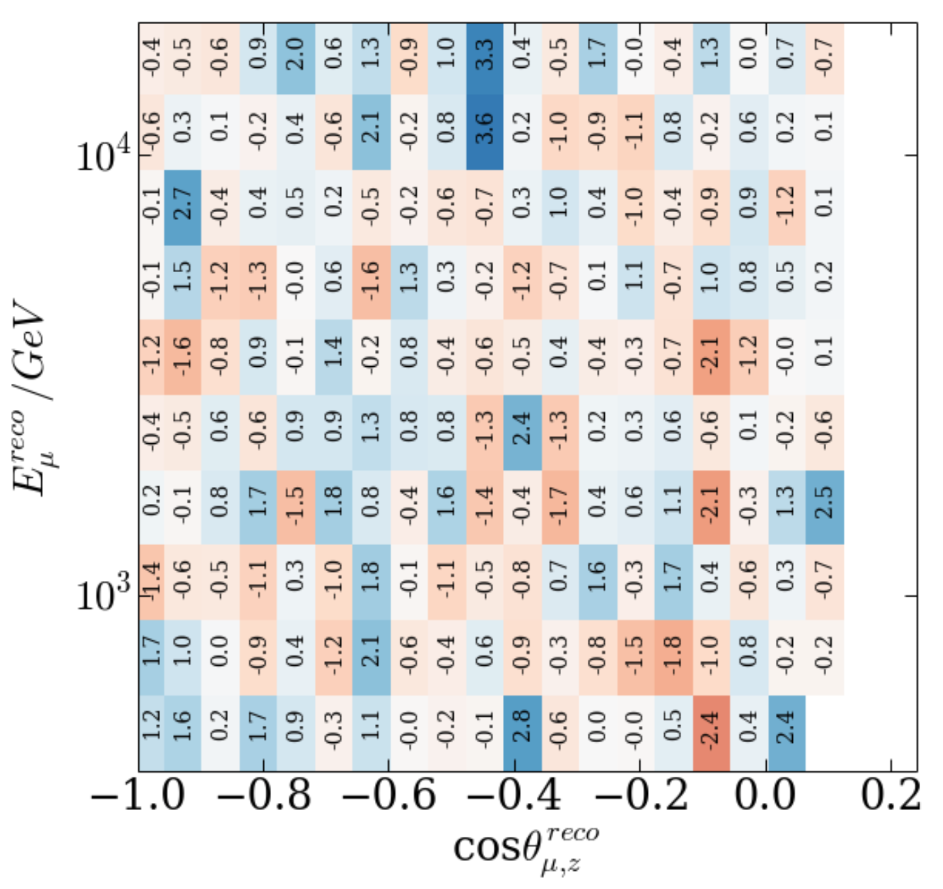
The Data (IC86 1 year)
Comparison of data to no-steriles hypothesis, after accounting for systematics

Slide 28
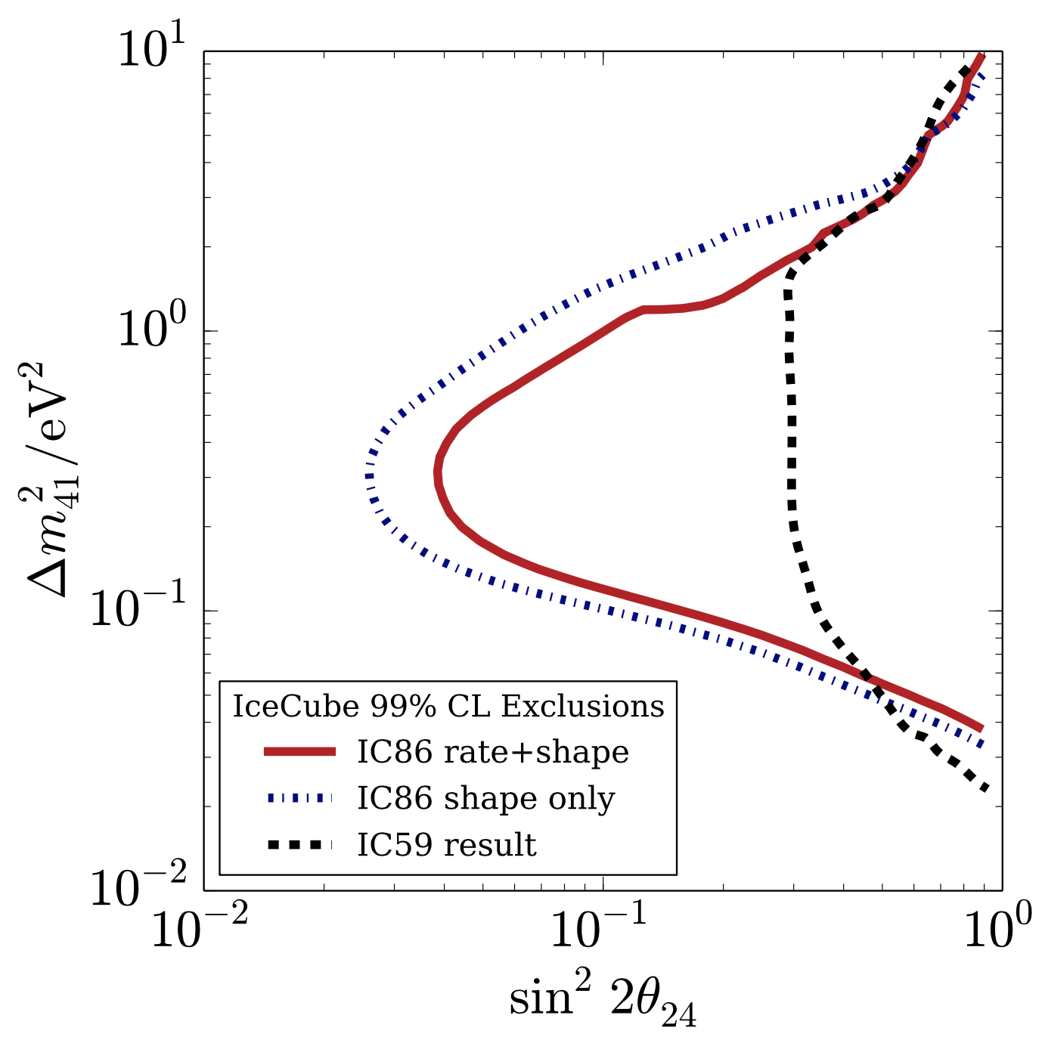
No evidence for sterile neutrinos
The IC86 shape only is result of blind analysis, excluding much parameter space at 99% CL.
Added normalization constraints a-posteriori to obtain IC86 Rate+Shape result, mildly weaker due to small normalization tension at best-fit.
1 year of data from partly-built 59-string detector was also independently analyzed
IC86 Rate + shape reduces degeneracies in fast-oscillation regime and is considered final result.

Slide 29
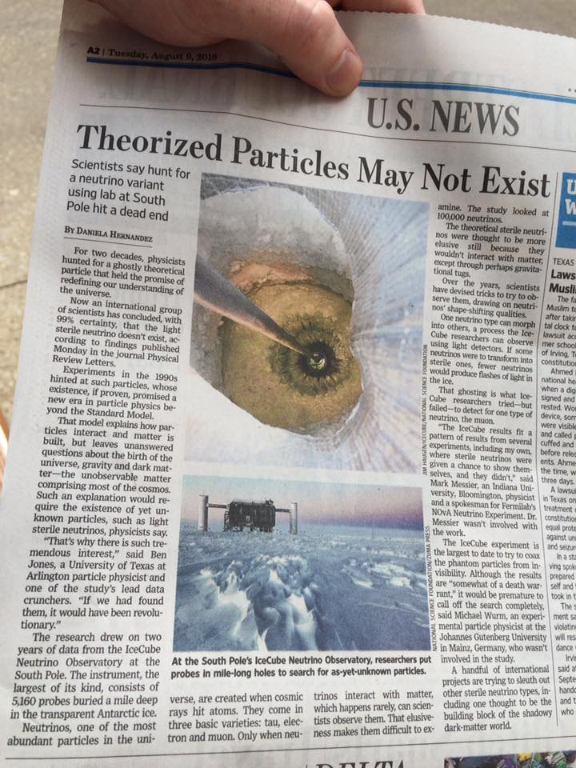
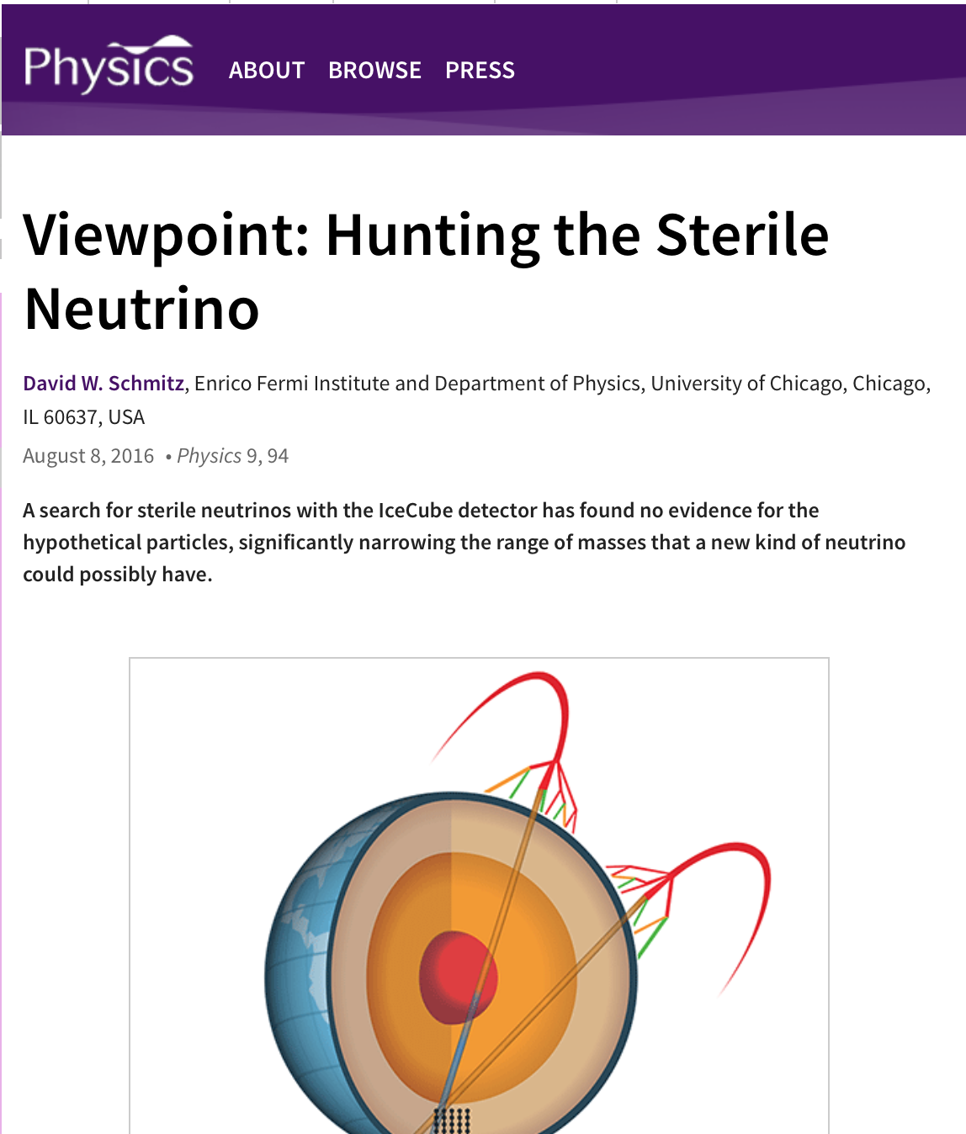
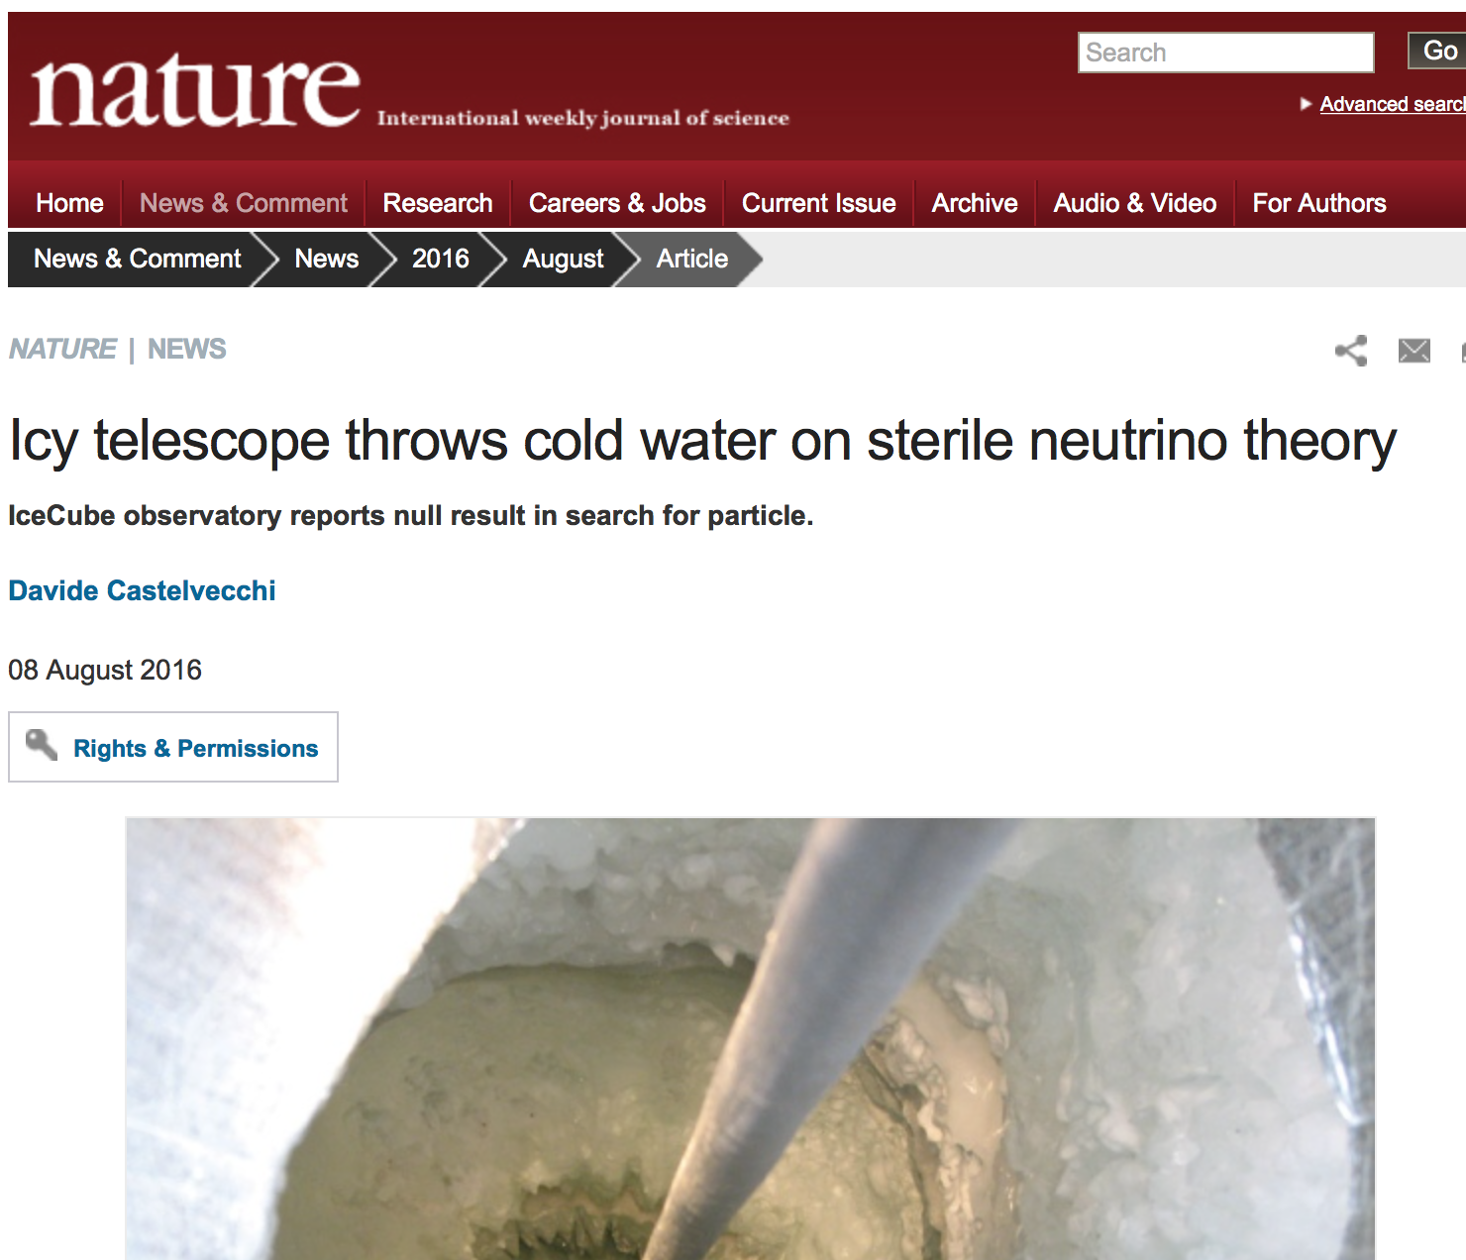
Page 2 of Wall Street Journal
08/09/16
+ Symmetry, New Scientist, The Independent, Wired, LA Times, Physics Today, Scientific American, and more…

Slide 30
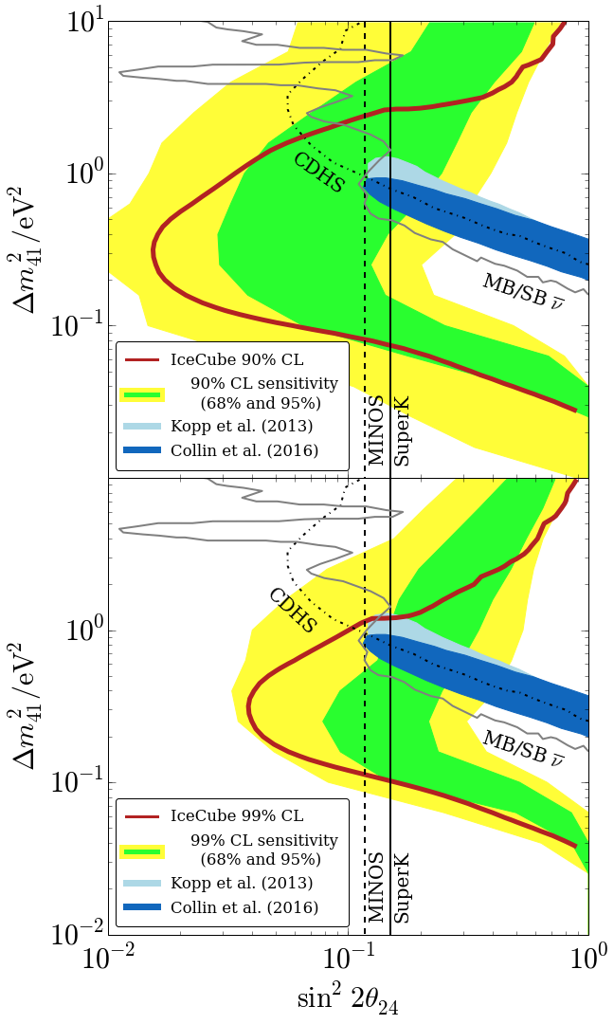
Comparison to world, anomalies, and sensitivity
90%
Realization is strong, but not atypically so:
stronger than median sensitivity in some areas, weaker in others
Within 95% band from pseudo-data trials
Appearance allowed region rejected at 99%CL
99%
Physical Review Letters 117, 071801 (2016).2

Slide 31
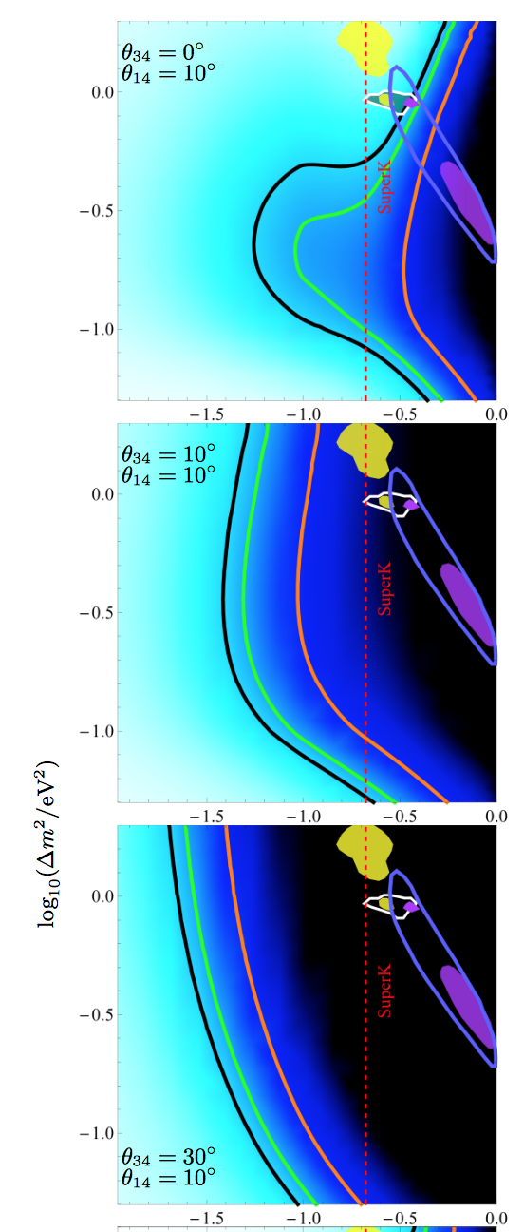
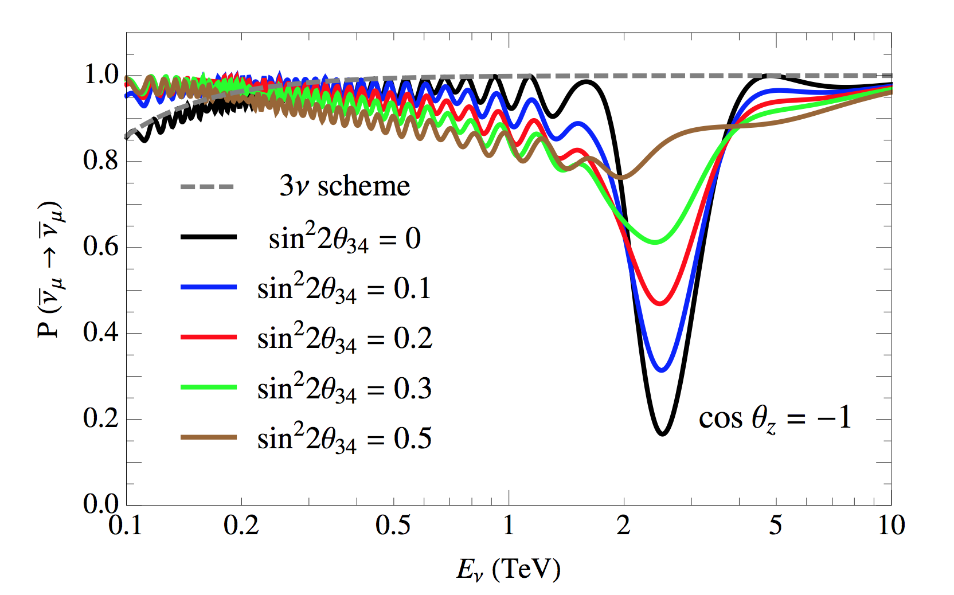
Addressing assumptions: θ₃₄=0
Lindner et al, JHEP 1601 (2016) 124
Esmali and Smirnov, JHEP 1312 (2013) 014
Constraint from Minos data, θ₃₄ < 25 deg at 90%CL
Phys.Rev.Lett. 107 (2011) 011802
θ₃₄=0 gives most conservative limit on θ₂₄ (shown)

Slide 32
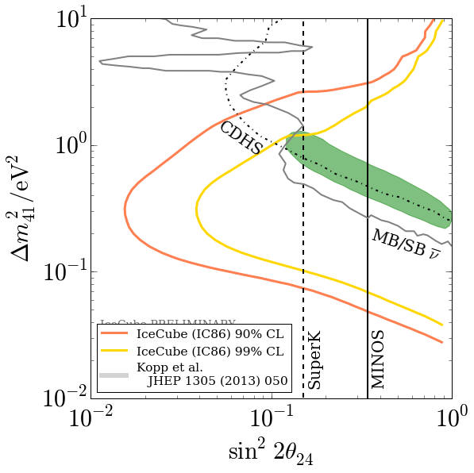
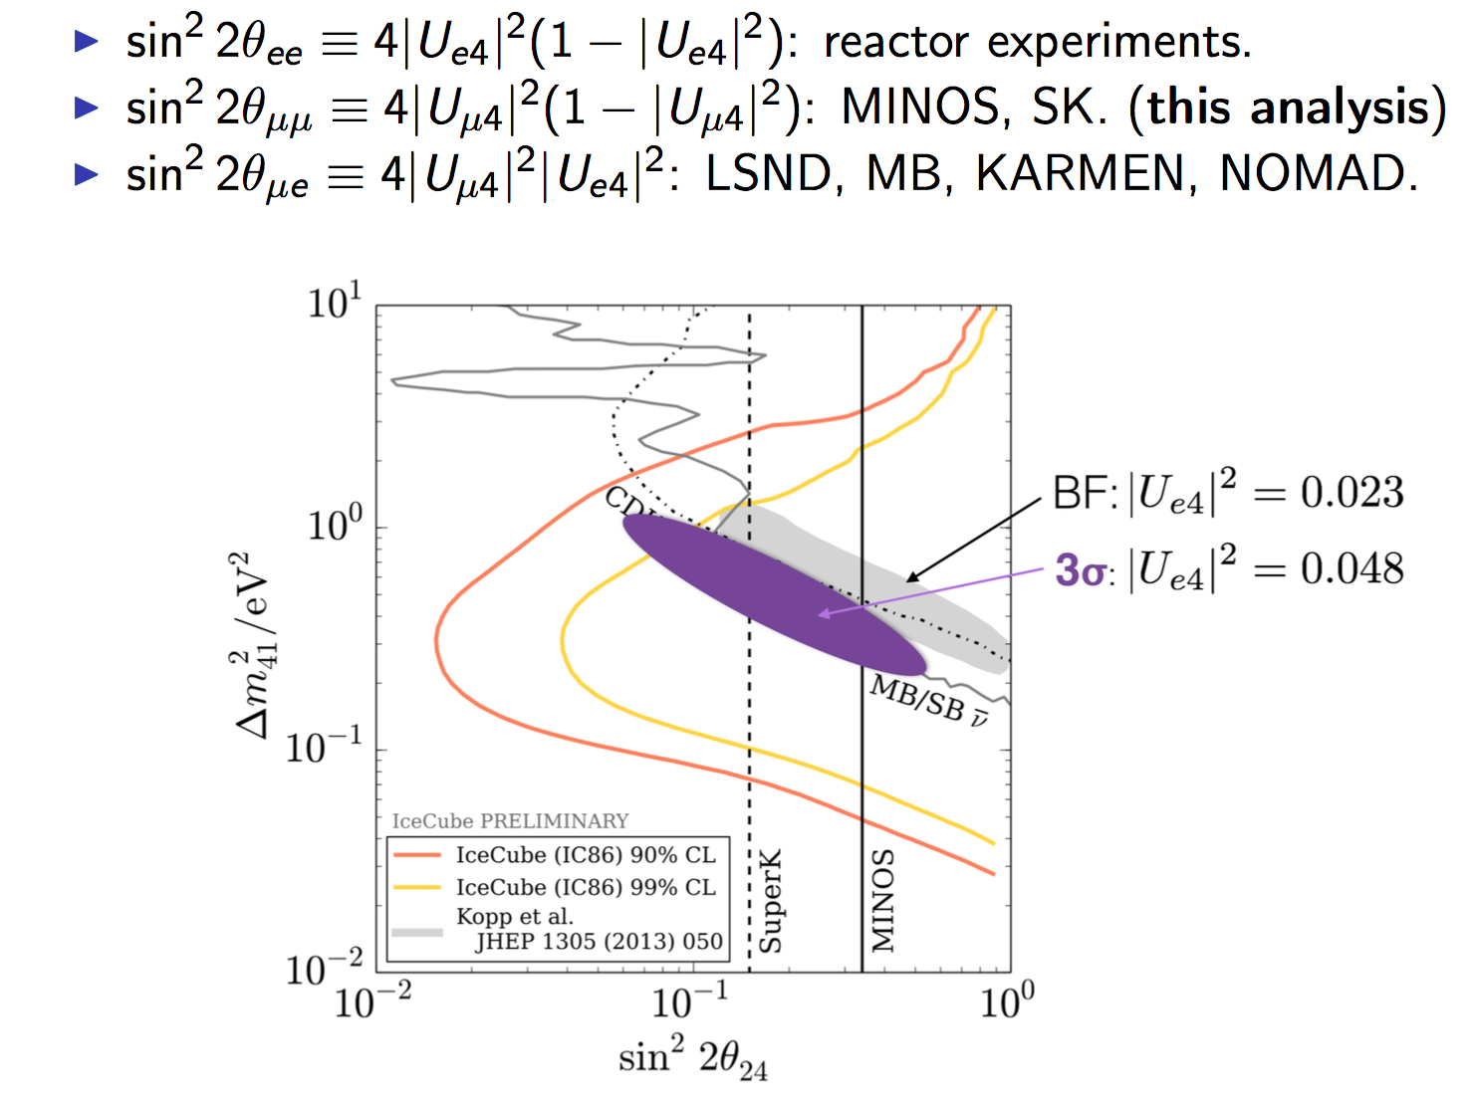
Addressing assumptions:
U_{e4} fixed at world best fit (= constraint on θ₁₄)
Based on other mixing angles, how far can MB /LSND slide?

Slide 33
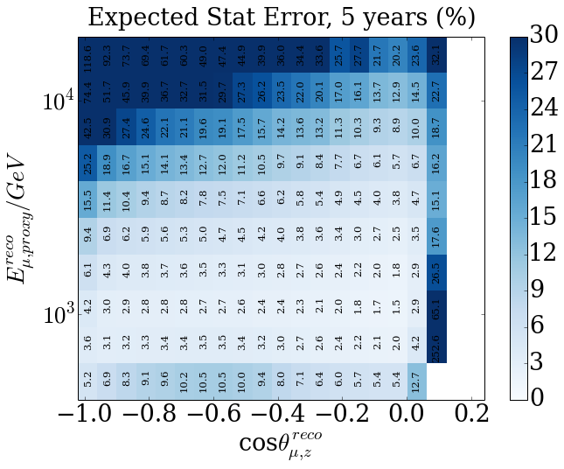
The Future for IceCube Sterile Searches:
Most interesting region for eV scale sterile neutrinos
This analysis: 1 year of data, requiring control of systematics at ~6-7% per bin
Data already in hand: 4 more years, requiring control of systematics at ~2-3% per bin
We are only just getting started!

Slide 34
Conclusions
Sterile neutrinos are a compelling explanation of several anomalies in short-baseline experiments
A ~1eV² sterile neutrino would lead to dramatic matter-resonant signatures in the atmospheric neutrino flux
A search for these features was made using the IceCube neutrino telescope and no evidence for sterile neutrinos was found.
New limits have been set on the 3+1 model, ruling out appearance region at >99% CL (IceCube only, 1 year)
For more, see Physical Review Letters 117, 071801 (2016).

Slide 35
Thank you for your attention

Slide 36
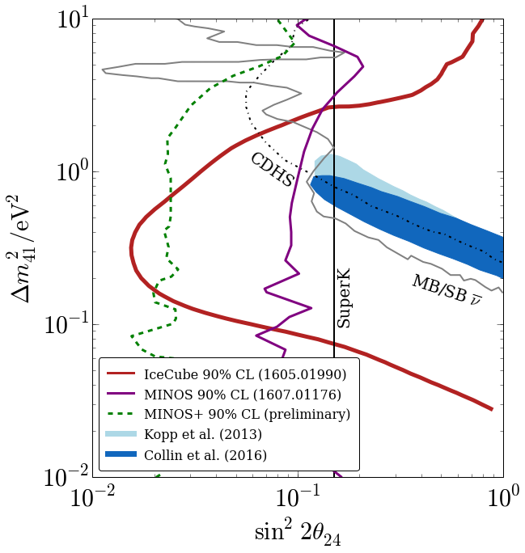
Recent developments in ν_{μ} disappearance
Since IceCube result, two significant disappearance results:
Finalized MINOS result shown at Neutrino2016
Preliminary MINOS+ result also shown

Slide 38
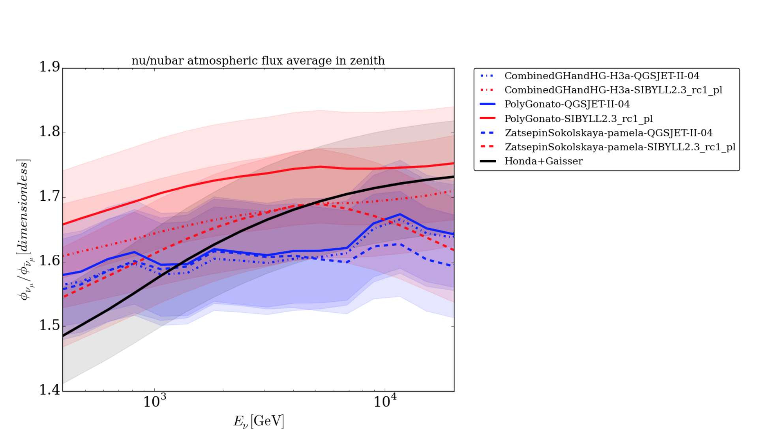

Slide 39
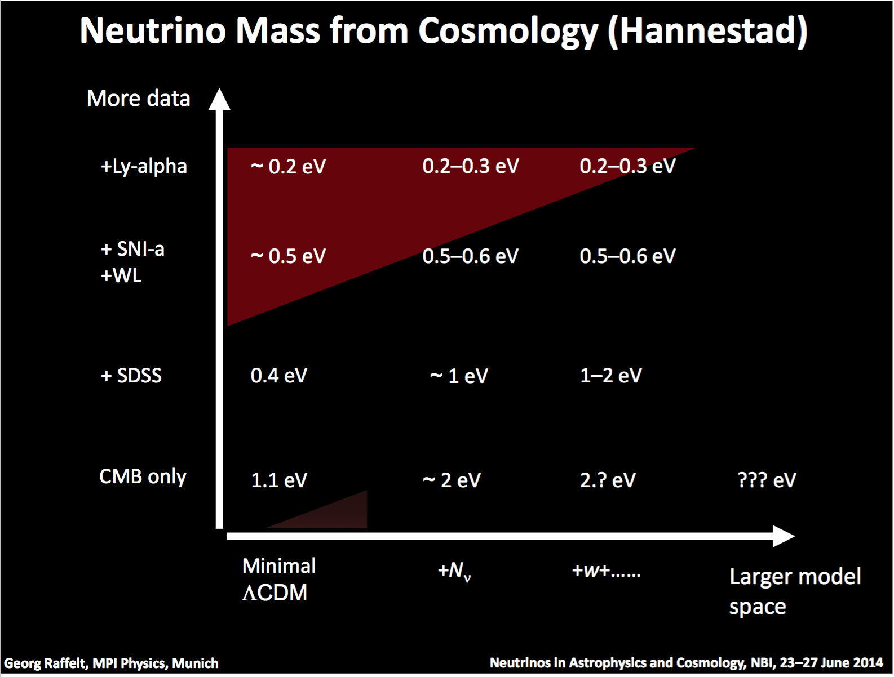

Slide 40

An additional neutrino?
Anomalous oscillations were at wavelengths shorter than expected given known Δm².
Another neutrino state with larger mass (~1eV²)?
Constraints from LEP show that if such a particle exists, the corresponding extra flavor state must not be weakly interacting.
→ A sterile neutrino?

Slide 41

Ice properties
More absorbing
Tap water
Distilled water
Clearest man-made ice (in 1997)
VERY TRANSPARENT!
SuperK ultra clean water
More transparent
But the detector is big: 1km across!
Absorption on dust is a significant effect and a source of uncertainty
IceCube
Notes:
5x more transparent than

Slide 42

Bubble Scattering
IceCube
South pole ice is compacted snow: initially has many bubbles
At high pressures, air diffuses from bubbles into ice crystal creating clathrate hydrate phase.
No bubbles in IceCube bulk ice!
Clathrate has refractive index within 0.4% of ice → negligible scattering.

Slide 43


“Hole ice” effect
DOM
But - refrozen ice in hole does have bubbles, extra scattering behavior occurs in vicinity of DOMs → effective change to angular response function.
“hole ice”
Bulk ice
DOM

Slide 44

Neutrino Cross Sections
Neutrinos interact very weakly, so g is very small
Our experiments are typically more sensitive to refractive index than effects of incoherent scattering

Slide 45


Slide 46

Phys. Rev. D86, p. 114 024, 2012.
Fedynitch et al
Phys. Rev. D75, p. 043006, 2007
Honda et al

Slide 47

Optical module uncertainty
Efficiency of DOM is imprecisely known.
Lab measurements need correction due to local ice conditions and cable shadow.
We continuously vary optical efficiency using a reweighting technique
In practice, tightly constrained by position of energy peak → we fit within 0.1% of dedicated in-ice calibration measurements

Slide 48

Checking the shape-only best-fit
The best fit point is a consistent realization of the no-steriles hypothesis ➔
Its frequentist p-value is 14% ⬇
(this part of hypothesis space is a very fast vacuum-like oscillation, nearly indistinguishable from no-effect)

Slide 49
A Subtlety of Shape-Only Analysis
~No effect at all
Large rate effect
High-mixing null-like solutions lead to significant normalization pull.
mid-size effects (often best fit to fluctuations)
Large shape
effect
~No effect at all
By incorporating other available information (knowledge of flux normalization), exclusion power of result could be reduced.

