Slide 1

High power beam operation at J-PARC: status and future
Yoichi Sato (KEK / J-PARC)
for J-PARC accelerator group
concerning MR beam commissioning
NuFact16, August 23, 2016

Slide 2
Outline
Introduction
  J-PARC MR and FX operation
Recent tunings
  Beam loss sources
  instability: chromaticity correction and transverse feedback
  optics correction during acceleration
  resonance corrections
  2nd harmonic rf: larger bf, less sc effect
  New operation point explore
Midterm plan
  High repetition scenario
  For > 1MW
Summary

Slide 3
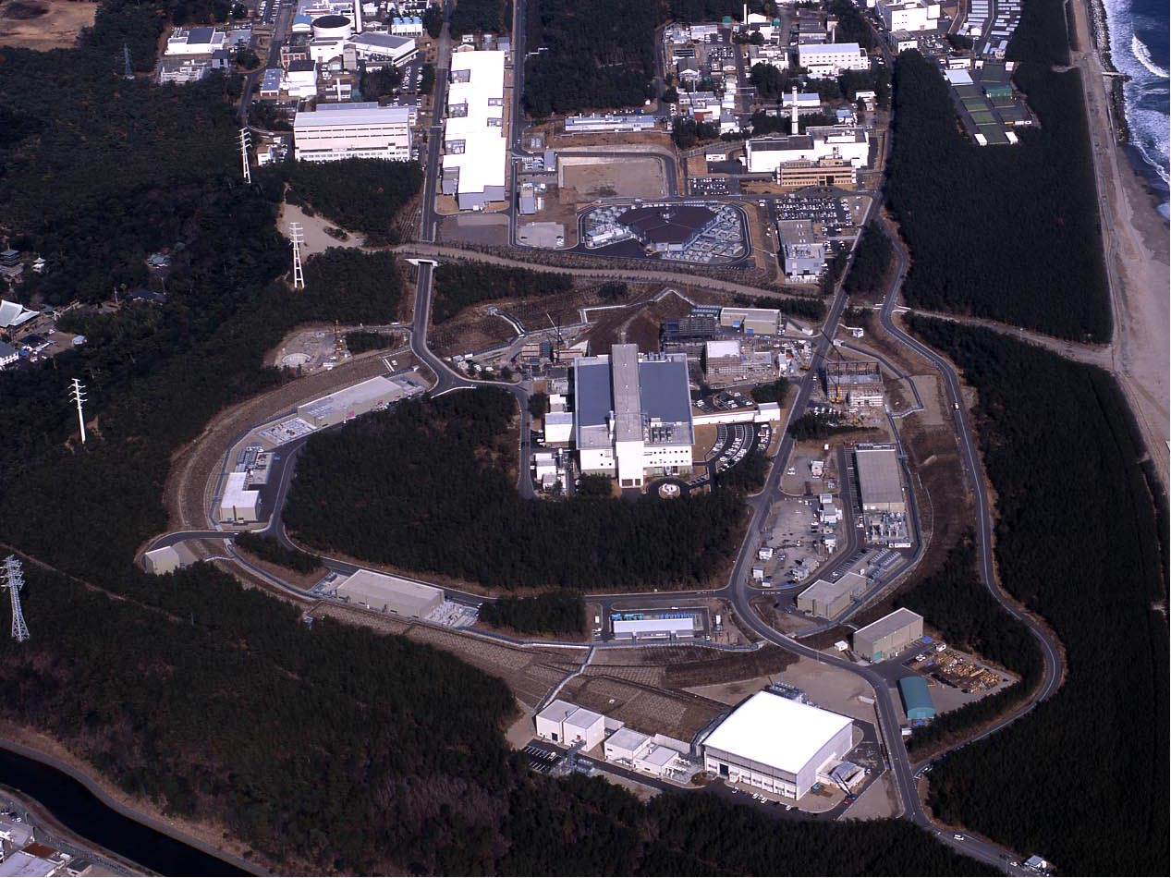
400 MeV H⁻ Linac
Japan Proton Accelerator
Research Complex
(J-PARC)
3 GeV Rapid Cycling Synchrotron (RCS)
Neutrino Beam Line for T2K Experiment (30 GeV)
Main Ring Synchrotron (MR)
Materials & Life Science Facility (MLF) (3 GeV)
Hadron Experimental Hall (HD) (30 GeV)
Notes:
T2K experiment (long base line Nu oscillation experiment)

Slide 4
Main parameters of MR
Circumference 1567.5 m
Injection energy 3 GeV
Extraction energy 30 GeV
Super-periodicity 3
harmonic 9
Number of bunches 8
Rf frequency 1.67 - 1.72 MHz
Transition γ j 31.7 (typical)
Physical Aperture
3-50 BT Collimator 54-65 π.mm.mrad
3-50 BT physical ap. > 120 π.mm.mrad
Ring Collimator 54-70 π.mm.mrad
Ring physical ap. > 81 π.mm.mrad
Three dispersion free straight sections of 116-m long:
- Injection and collimator systems
- Slow extraction（SX)
to Hadron experimental Hall
- RF cavities and Fast extraction(FX) (beam is extracted inside/outside of the ring)
outside: Beam abort line
inside: Neutrino beamline ( intense ν beam is send to SK)

Slide 5
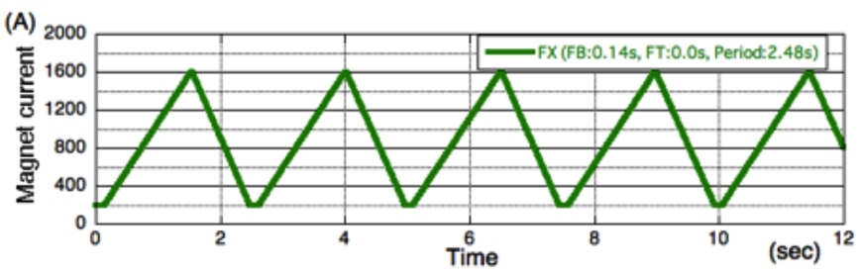
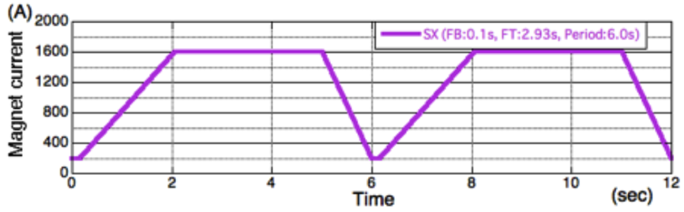
Main parameters of MR
Circumference 1567.5 m
Injection energy 3 GeV
Extraction energy 30 GeV
Super-periodicity 3
harmonic 9
Number of bunches 8
Rf frequency 1.67 - 1.72 MHz
Transition γ j 31.7 (typical)
Physical Aperture
3-50 BT Collimator 54-65 π.mm.mrad
3-50 BT physical ap. > 120 π.mm.mrad
Ring Collimator 54-70 π.mm.mrad
Ring physical ap. > 81 π.mm.mrad
TWO OPERATION MODE:
Fast extraction mode (FX) for the neutrino oscillation experiment: 1 turn extraction
Slow extraction mode (SX) for the hadron hall experiments: 2 s extraction.
FX Cycle time 2.48 s
SX Cycle time 5.52 s
Beam power [W]
= Ave. Beam Current [A=C/s] × Beam Energy [eV]
= Number of charged particles [C/pulse]×Number of pulse [pulse/s] × Beam Energy [eV]
More particles, higher repetition → High power

Slide 6
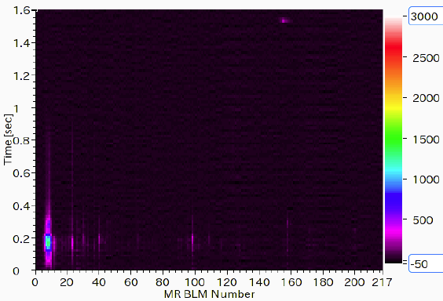
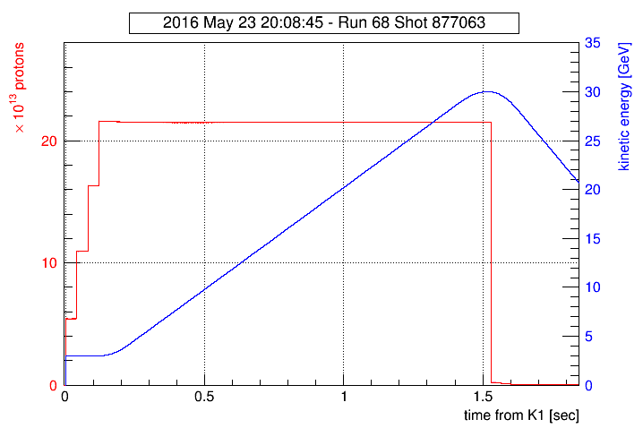
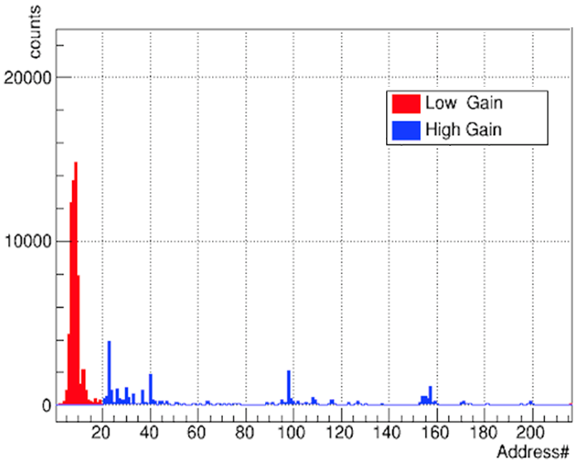
Typical Operation Status for Fast Extraction
2.15e14 ppp at extraction = 416 kW
(4 batches = 8 bunches)
Time structure
BLM count
Smoothing
Time (s)
Beam Intensity with DCCT
Integrated BLM count
2.7e13 protons/bunch
*2 bunches at each injection
Collimator area
Smoothing
2.48 sec cycle
Extraction
Non-collimator area
Monitor sensitivity×8
Injection
Acceleration
Recovery
0.13 s
1.4 s
0.95 s
Address in the whole MR
Notes:
KEYS:
Basics: COD corr., Optics meas. and corr., Injection matching,
Tune flatness at optimal tune, Collimator balance
For Instability: Chromaticity patterned corr., Transverse FB
Resonance corr: Skew Q

Slide 7
Typical Operation Status for Fast Extraction
2.15e14 ppp at extraction = 416 kW
(4 batches = 8 bunches)
Time structure
BLM count
Smoothing
Time (s)
MR total loss ~600 W
(inj. ~170 W + acc. ~420 W) W
Beam Intensity with DCCT
Integrated BLM count
2.7e13 protons/bunch
*2 bunches at each injection
Collimator area
Smoothing
Beam loss localized
in collimator area
2.48 sec cycle
Extraction
Non-collimator area
Monitor sensitivity×8
Injection
Acceleration
Recovery
0.13 s
1.4 s
0.95 s
Address in the whole MR
MR total beam loss ~600 W < MR collimator capacity 2 kW
3-50BT beam loss ~100 W < 3-50BT collimator capacity 2 kW
Beam losses are well localized in collimator area and low energy time zone
Notes:
KEYS:
Basics: COD corr., Optics meas. and corr., Injection matching,
Tune flatness at optimal tune, Collimator balance
For Instability: Chromaticity patterned corr., Transverse FB
Resonance corr: Skew Q

Slide 8
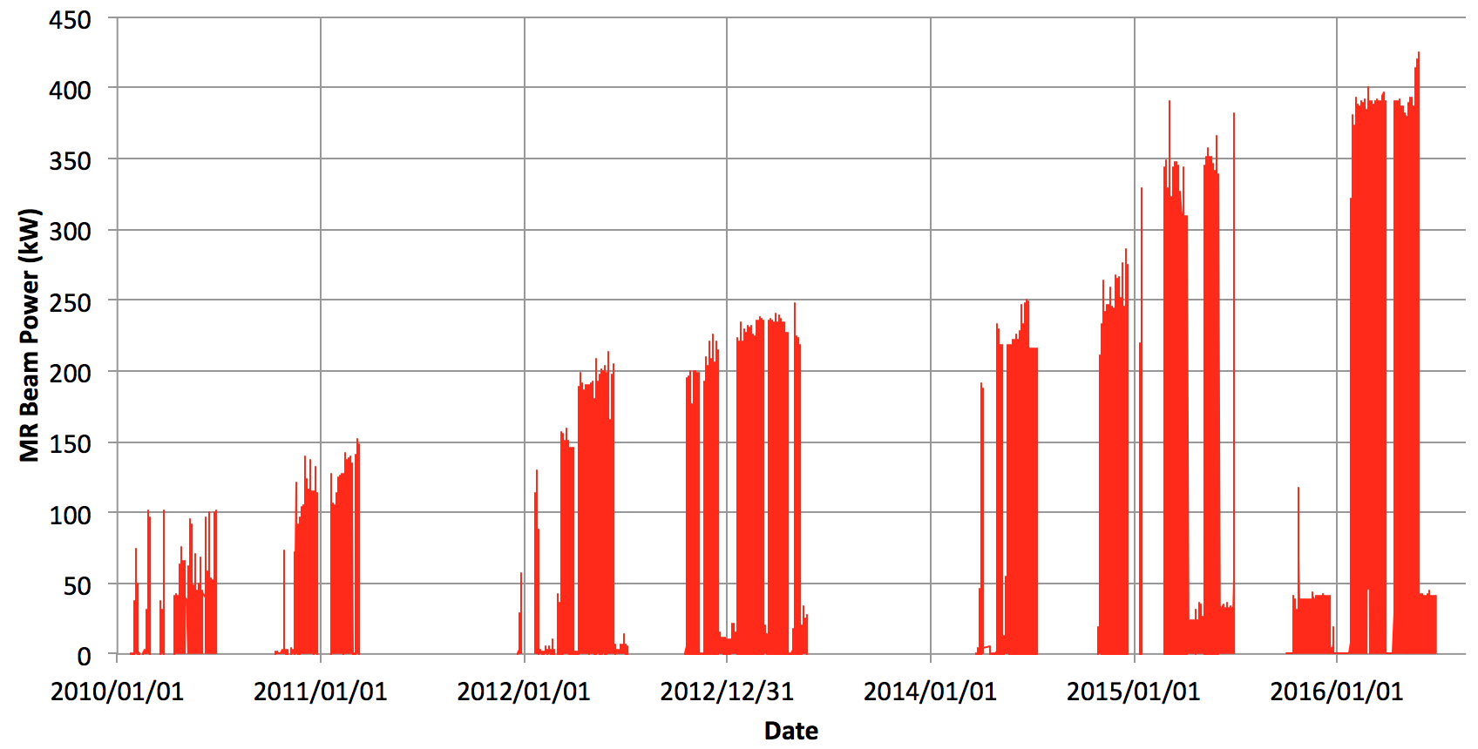
MR Beam Power History
In the operation of Jan ~ May 2016, the beam power was mostly about 390 kW with 2×10¹⁴ protons per pulse. With the same protons per pulse, the designed beam power 750 kW can be achieved after the faster cycling from 2.48 s to 1.3 s.
The user operation of 415~425 kW was successful in May 2016.
The max. delivered beam power
~ 425 kW (2.2x10¹⁴ ppp)
The first beam in MR:
May 2008: Injection;
Dec. 2008: acceleration and extraction

Slide 9
Outline
Introduction
  J-PARC MR and FX operation
Recent tunings
  Beam loss sources
  instability: chromaticity correction and transverse feedback
  optics correction during acceleration
  resonance corrections
  2nd harmonic rf: larger bf, less sc effect
  New operation point explore
Midterm plan
  High repetition scenario
  For > 1MW
Summary

Slide 10
Beam loss sources and Tuning Items for Fast Extraction
Beam loss sources in MR
Upstream beam quality from RCS:
→ In Transverse, to choose optimal conditions with 3-50BT OTR monitor
Physical aperture
→ to hold effective aperture with closed orbit correction, optics correction
Emittance growth by Betatron resonances
→ To choose optimal operation point considering
- Tune spread by space charge
→ to control high bunching factor with higher harmonic RF
- Tune spread by chromaticity
→ patterned Chromaticity correction with sextupoles
- Resonance strength
→ to enlarge dynamic aperture by
leakage field corrections with Trim-quadrupoles
resonance corrections with Skew-quadrupoles, Trim-Sextupoles
optics meas. & correction not only injection period but acceleration period
Emittance growth by beam instability (impedance from resistive wall)
→ transverse feedback system (bunch by bunch, intra-bunch)
→ large tune spread (but acceptable level in betatron resonance)
to suppress instabilities: optimizing bunching factor & chromaticity
Some items are relating with multiple sources, especially Tune spread & instability.
Beam loss localization with collimators is needed, also.

Slide 11
Beam loss sources and Tuning Items for Fast Extraction
Beam loss sources in MR
Upstream beam quality from RCS:
→ In Transverse, to choose optimal conditions with 3-50BT OTR monitor
Physical aperture
→ to hold effective aperture with closed orbit correction, optics correction
Emittance growth by Betatron resonances
→ To choose optimal operation point considering
- Tune spread by space charge
→ to control high bunching factor with higher harmonic RF
- Tune spread by chromaticity
→ patterned Chromaticity correction with sextupoles
- Resonance strength
→ to enlarge dynamic aperture by
leakage field corrections with Trim-quadrupoles
resonance corrections with Skew-quadrupoles, Trim-Sextupoles
optics meas. & correction not only injection period but acceleration period
Emittance growth by beam instability (impedance from resistive wall)
→ transverse feedback system (bunch by bunch, intra-bunch)
→ large tune spread (but acceptable level in betatron resonance)
to suppress instabilities: optimizing bunching factor & chromaticity
Some items are relating with multiple sources, especially Tune spread & instability.
Beam loss localization with collimators is needed, also.

Slide 12
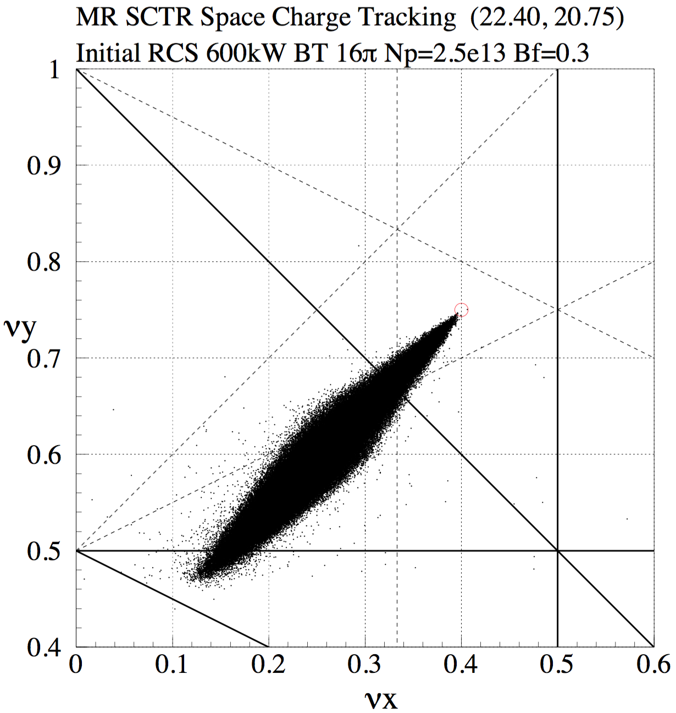
Resonance lines and Estimated Tune Spread 380 kW
2νx−2νy=3
MR Power 380 kW
MR Cycle: 2.48 s
Number of protons: 2.5e13 ppb
Transverse Emittance: 16π mmmrad
Bunching Factor: 0.3
Space Charge Tune Shift: 0.33
21.0
νy=21
νx−2νy=−19
νx+2νy=64
E = 3 GeV
(v/c)²γ³=69.751
2πRN = 2.5×10¹³×9 : Intensity
4πσ²/β = 16π mmmrad : Emittance
B_{f} = 0.3 : Bunching factor
20.5
2νy=41
22.0
22.5
νx+νy=43
νx=22
3νx=67
2νx=45

Slide 13
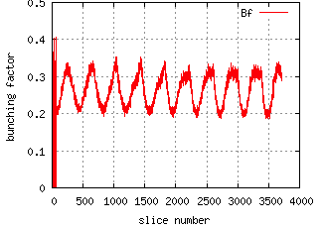
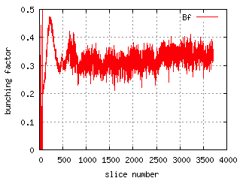
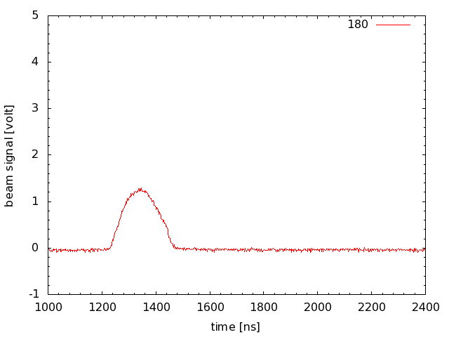
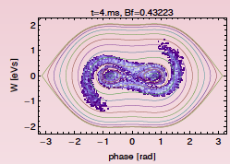
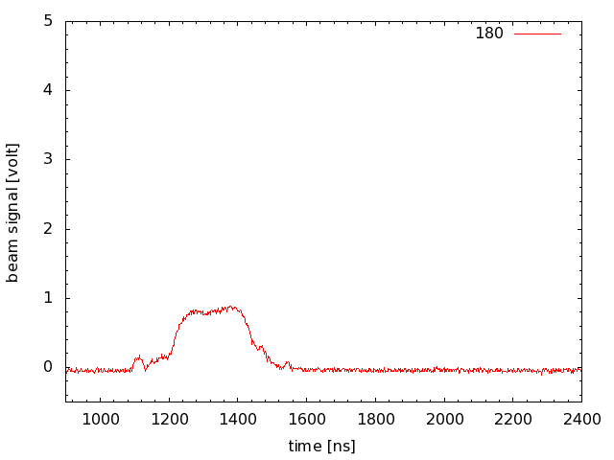
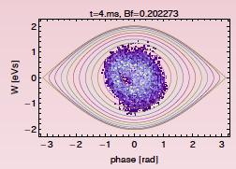
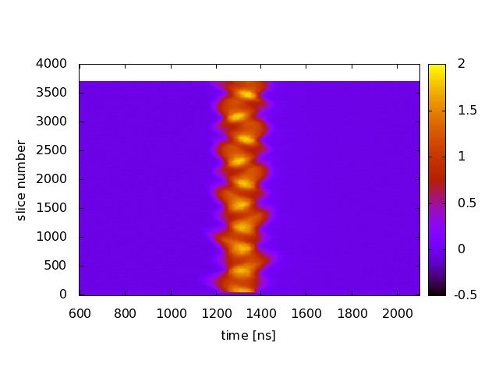

Longitudinal Profiles with
High Intensity Beam of 500 kW equivalent
(100 kV, 0 kV)
Bunching factor
0.2 ~ 0.3
Bunch length
~200 ns
(100 kV, 70 kV)
Bunching factor
0.3 ~ 0.4
Bunch length
~400 ns
Simulation
(100 kV, 0 kV)
Simulation
(100 kV, 70 kV)

Slide 14
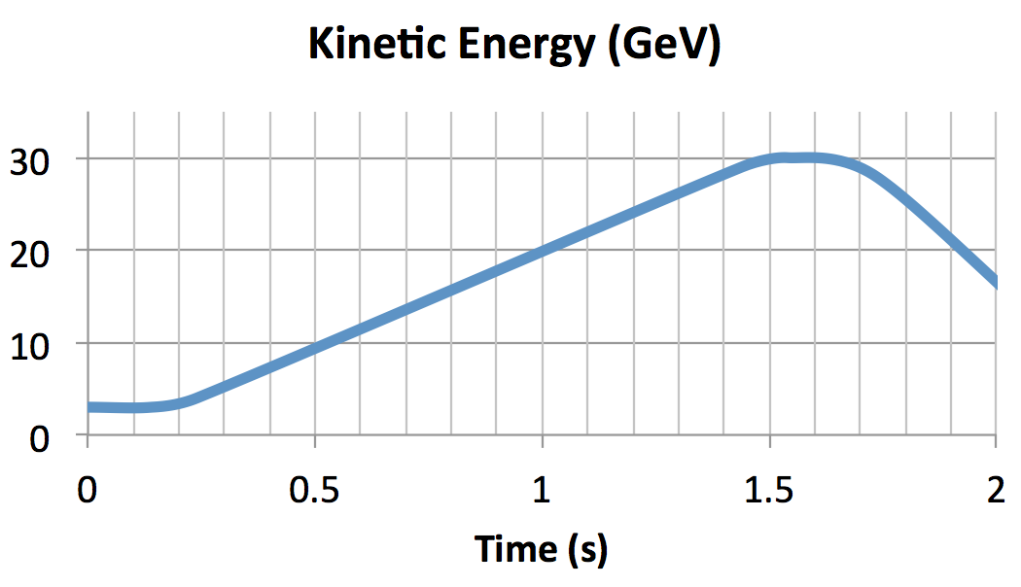
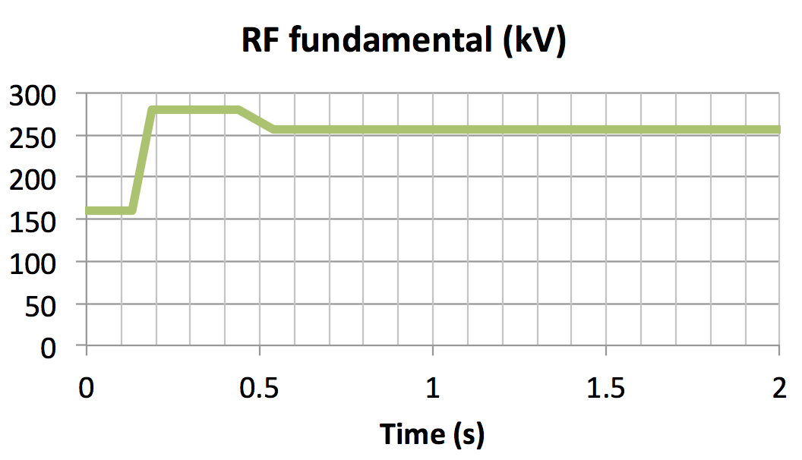
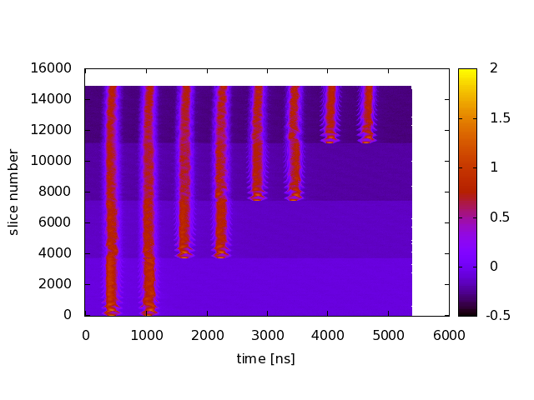
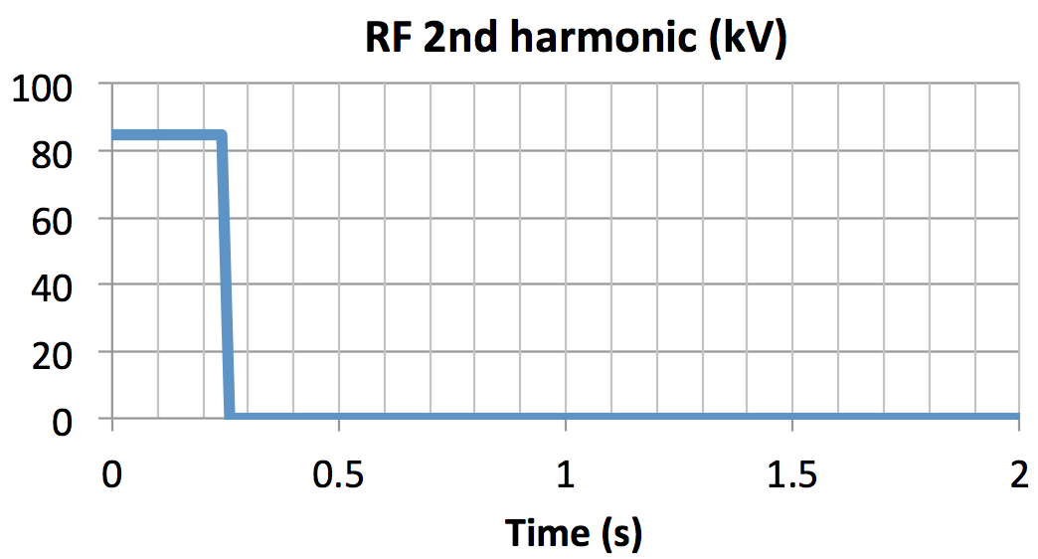
RF Pattern
RF pattern :
  Injection : 160 kV (fundamental), 85 kV (2nd harmonic)
  Acceleration : 280 kV → 256 kV (fundamental)
Beam loading compensation effectively works to reduce longitudinal oscillations.
Bunching factor was measured to be 0.3 during injection.
Longitudinal wave forms
during injection
with wall current monitor
K4
K3
K2
K1

Slide 15
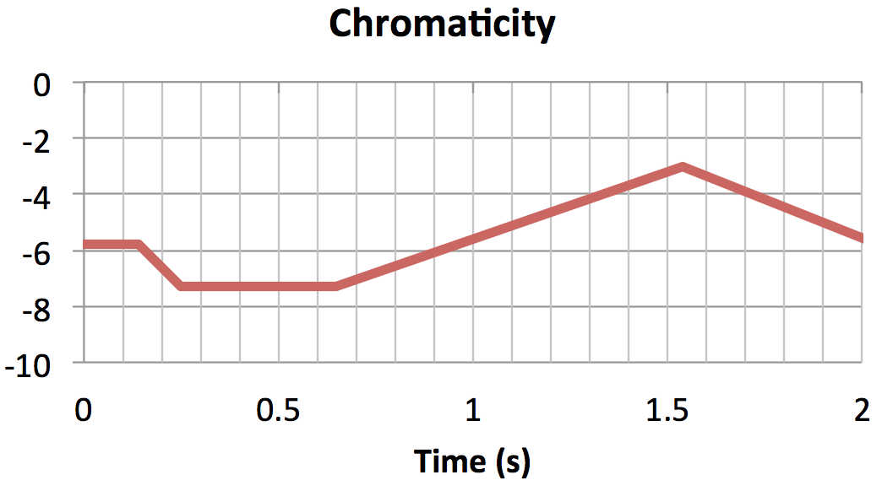
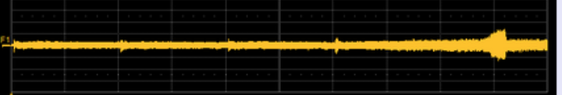
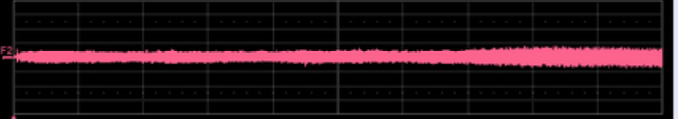
Chromaticity Pattern for Instability Suppression
The chromaticity pattern was optimized to minimize the beam loss.
To suppress instabilities the chromaticity is kept to be negative, typically −6 during injection.
If the chromaticity is too small in negative value, we observe instability.
If the chromaticity is too large in negative value, we observe beam losses those are probably due to chromatic tune spread.
Instabilities are suppressed with bunch by bunch feedback and intra-bunch feedback system.
The optimization is iterated after the change of parameters feedback systems.
Single Pass Monitor
2.53e13 ppb * 8 bunches
X
Instability
Right – Left
K1
P2
Y
Top – Bottom
40 ms
Chromatic tune spread larger

Slide 16
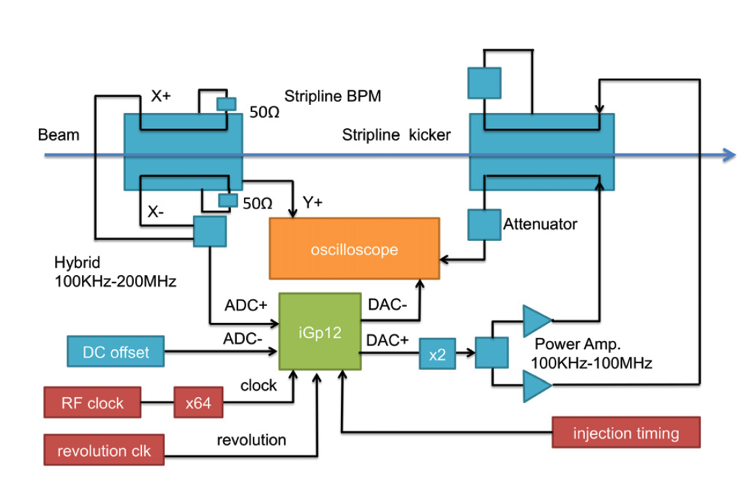
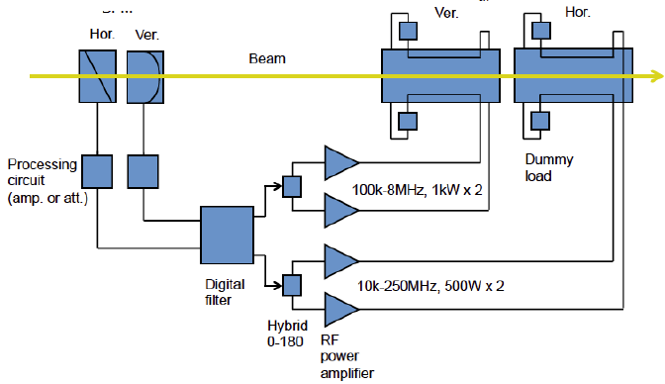
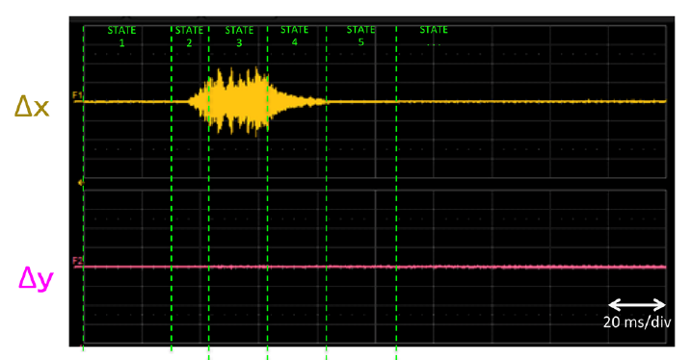
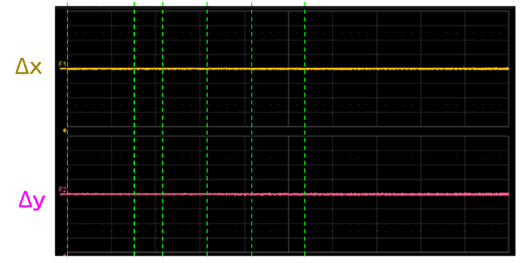
Bunch by Bunch and Intra-bunch Feedback
Coherent Oscillation is damped with the bunch by bunch and intra-bunch feedback system during injection and in the beginning of acceleration.
Intra-bunch FB has been applied during injection and up to 0.2 s after acceleration start.
Bunch by bunch feedback system
Intra-bunch feedback system (wideband)
Beam Position with Intra-bunch FB off
Beam Position with Intra-bunch FB on
2.1e13 ppb × 2 bunches
P1+100 ms P2
P1+100 ms P2

Slide 17
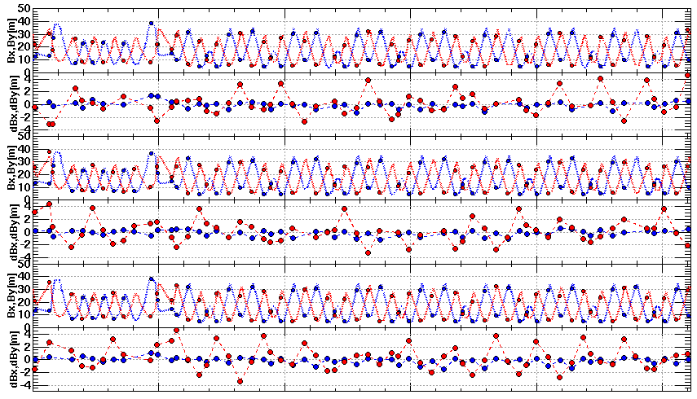
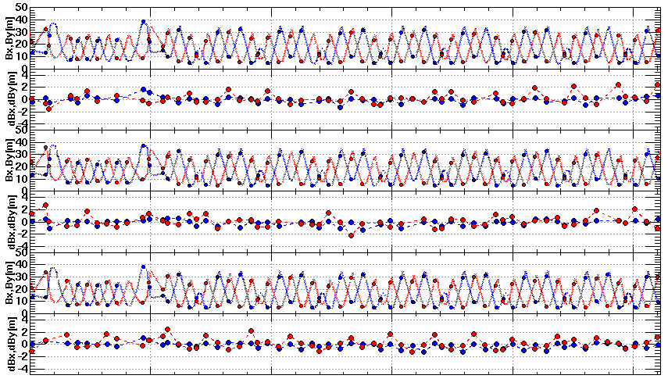
FX Septum Leak Field
FX septum magnets makes undesirable Q fields for circulating beam with the leak fields.
Leak field of 8 FX septum magnets corresponds to ~3% of K1 of the main Q magnet.
Trim coils of 3 Q magnets have been used to correct the leak field of FX septum magnets.
Optics before Correction at (22.19, 20.54)
βx, βy
dβx, dβy
βx, βy
QFR
154
SM11-22
QDT
155
SM30-33
QFP
156
dβx, dβy
βx, βy
SM30 (336A) with duct
dβx, dβy
Optics after Correction at (22.19, 20.54)
βx, βy
BL[Tm]
dβx, dβy
βx, βy
dβx, dβy
βx, βy
x[m]
dβx, dβy

Slide 18
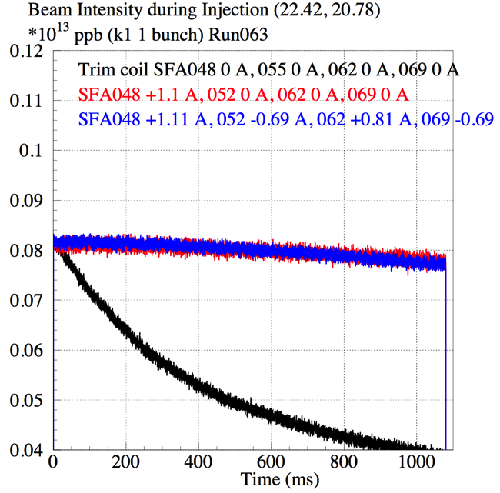
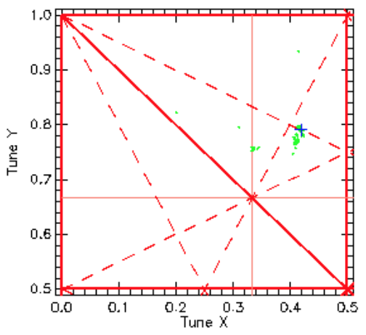
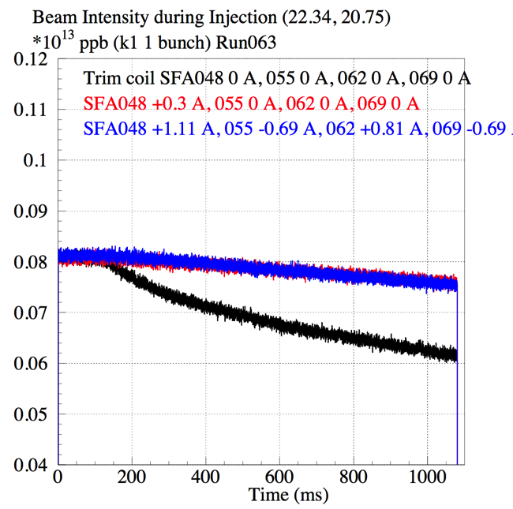
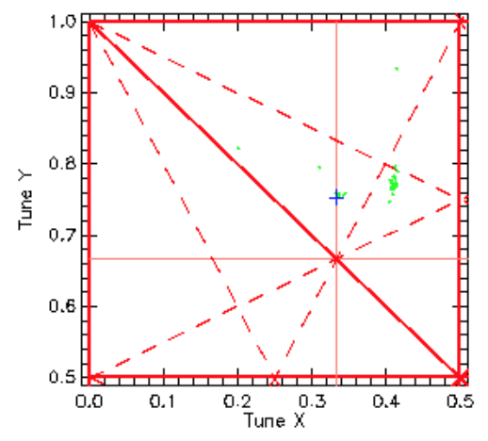
3rd Order Resonance Corrections with Trim Coils of Sextupole Magnets
ν_{x}+2ν_{x}=64
8e11ppb, 1 bunch injection at k1
3 GeV DC
Search the resonance with worse beam survival around (22.42, 20.78).
Beam survival recovers with SFA048: +1.1 A, SFA055: 0 A.
3ν_{x}=67
Search the resonance with worse beam survival around (22.34, 20.75).
Beam survival recovers with SFA048 −0.3 A, SFA055 −0.0 A.
Both resonances of νx+2νy = 64 and 3ν_{x}=67 were corrected with SFA048 +0.86 A, 055 −1.15 A, 062 +1.26 A, 069 −0.85 A.

Slide 19
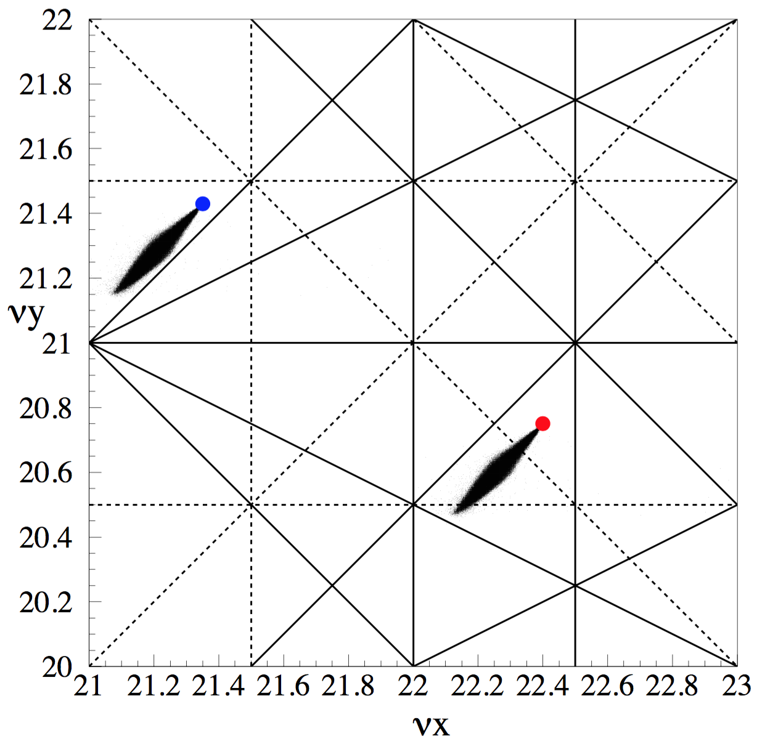
Operation with the Betatron Tune of (21.35, 21.43)
(21.35, 21.43)
(22.40, 20.75)
Structure resonances of up to 3rd order (Solid lines)
Non-structure resonances of half integer and linear coupling resonances (Dashed lines)

Slide 20
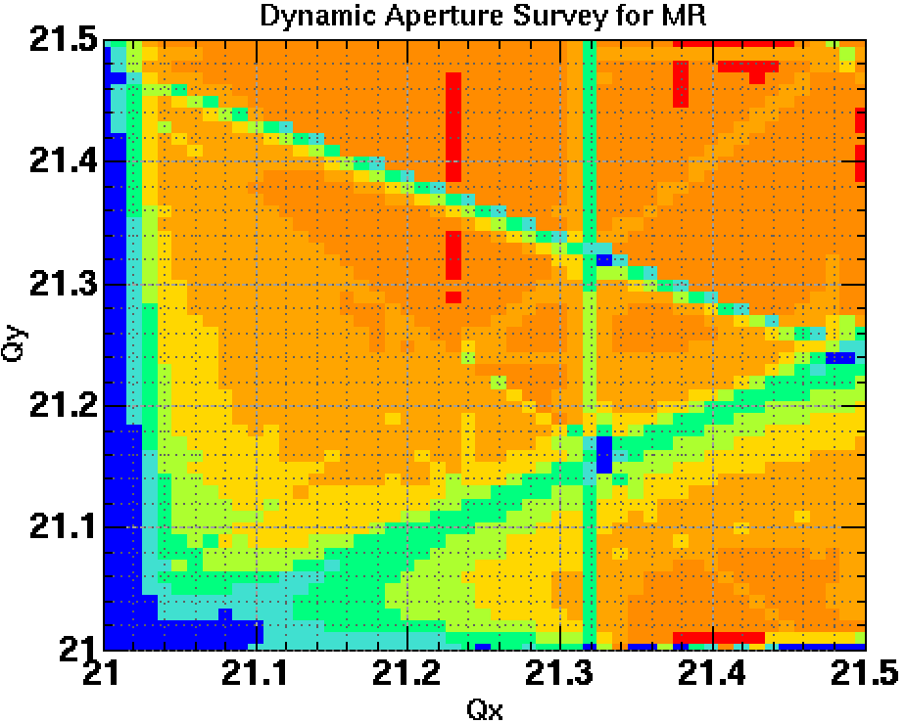
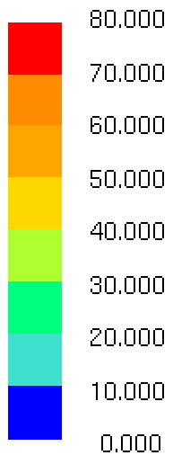
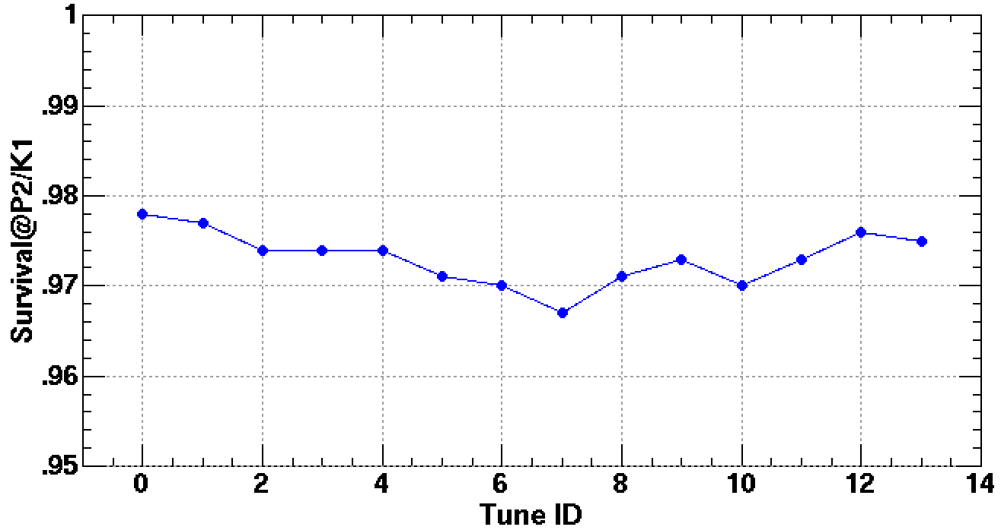
Optimization for (21.x, 21.x)
Optics correction
Tune scan
2nd rf operation
Trim Q correction for FX septum mag.
Trim S correction for 3rd order res.
Skew Q correction for νx − νy = 0
Octupole correction
Instability suppression
  Chromaticity: −7
  Bunch by bunch and intra-bunch FB
Extraction orbit for neutrino beamline
Compensation kicker is not optimized yet.
Dynamic Aperture Survey Simulation
B,Q,S field errors : ON
Alignment errors : ON
dp/p₀ = 0.0%
FX septum leakage : OFF
3rd resonance corr. (Trim-S) : OFF
Emittance : 80π (2π step), Turn : 2000
2νy = 43
νx + 2νy = 64
νx - νy = 0
Survival during inj. for 390 kW equiv. beam
νy
νx = 21
3νx = 64
2νx = 43
3νx = 64
νx + 2νy = 64
νx – 2νy = -21
νy = 21
νx
(21.23,21.30)
(21.36,21.43)

Slide 21

440 kW Trial with (21.35, 21.43)
2016/5/25 21:28: Trial shots to MR-abort with the betatron tune of (21.35, 21.43)
Power : 440 kW
Repetition : 2.48 sec
4 batch (8 bunch) injection during the period of 0.13 s
2.9e13 protons per bunch (ppb) × 8 @ Injection
2.27e14 ppp @ P3 (end of acceleration)
Loss during the injection period : 443 W
Loss in the beginning of acceleration (0.12 s) : 795 W
Loss power is within the MR collimator limit of 2 kW.
Beam Intensity with DCCT
Time (s)
Acceleration
Extraction
Injection
Recovery
0.01 + 0.13 s
1.4 s
0.94 s

Slide 22
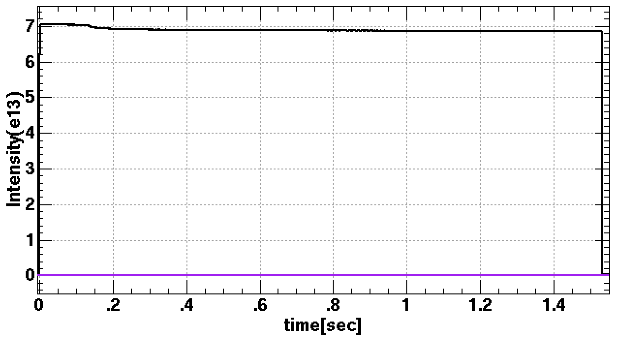
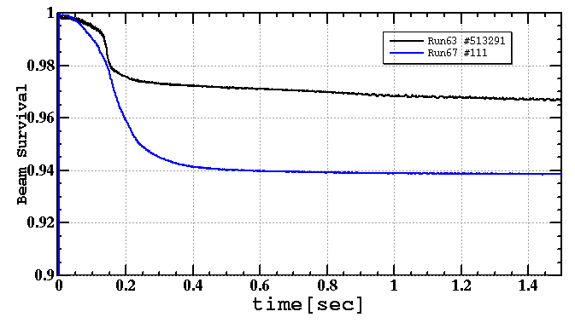
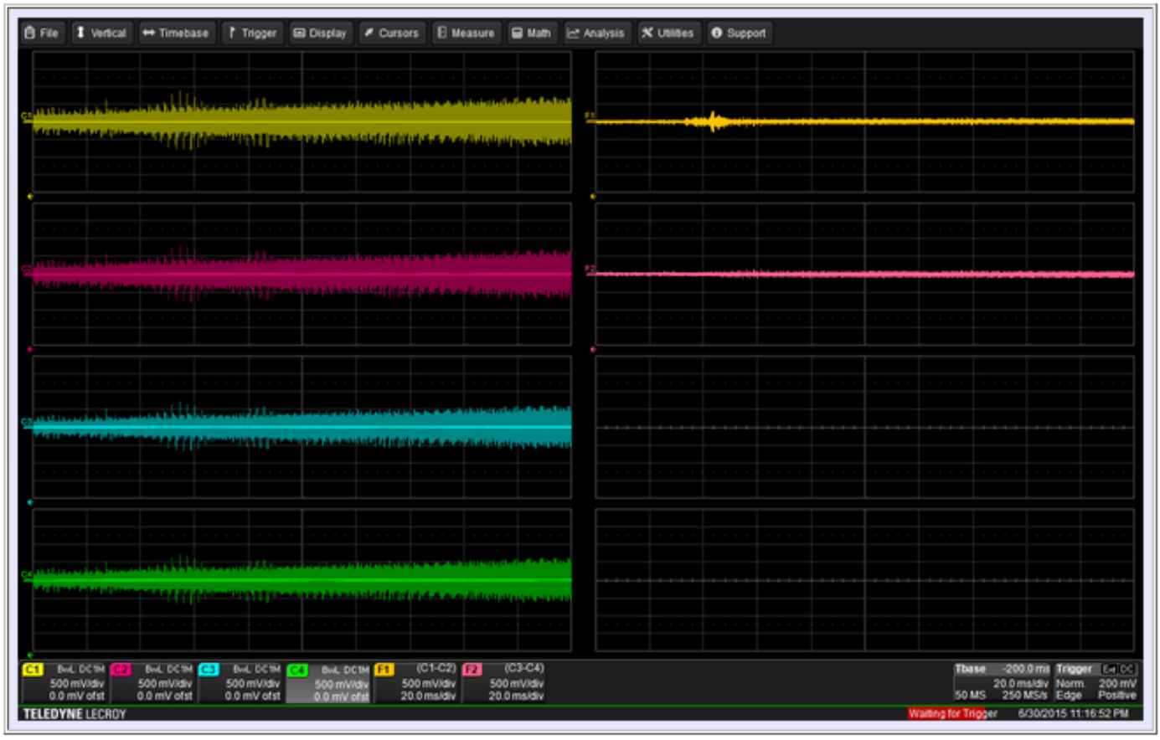
30GeV acceleration in (21.24, 21.31)
MR intensity : 530kW-eq. (2bunches)
Ion source 40 mA
Tune: (21.24, 21.31)
Structure res. corr. by 3 Trim-Qs
Correction of 3rd resonance lines by 4 Trim-Sexts
Chrom. Corr. 75% DC for reduction of instability
No 2nd harmonic RF
Tunable knobs to be optimized:
Transverse feedback
Patterned resonance correction
2nd harmonic RF cavity
Compensation kickers for injection
(21.24, 21.31)
Instability beam loss
132kW @ 2bunches injection
0.42 kW beam loss
H-V-60pi collimation at Collimator
Horizontal
Number of bunches | Repetition period (s) | Beam power (kW) | Beam loss (kW) | Notes
2 | 2.48 | 132 | 0.42 | Measurement
8 | 2.48 | 530 | 1.7 | Estimation
8 | 1.3 | 1000 | 3.2 | Estimation
(22.40, 20.75) w 2nd harmonic RF
Vertical
Beam oscillation
signal
Using 2nd harmonic RFs, we can increase BF ~1.5 times. Ion source 50 mA available.
→ 1.3 MW operation is in scope under ~full chromatic corr. w/o causing instability.
Notes:
Instability but lots of tuning nobs: 520 kW w ~ 2kW loss → 1MW in scope w nobs

Slide 23
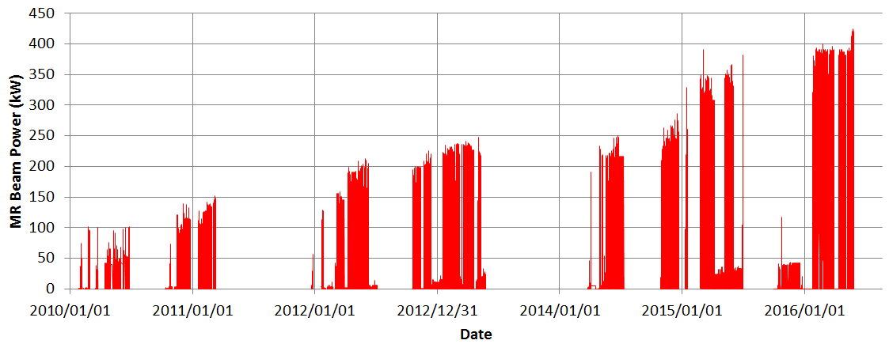
Recent keys of FX tunings
2014 summer - 2015 spring (Linac Current Upgrade 30 -> 40~50 mA)
Installation OTR monitor at 3-50BT: choosing best upstream conditions
Installation Transverse intra-bunch feedback: instabilities well suppressed
Optics correction; Optimizing correlation of RF setting, chromaticity correction pattern, and transverse feedback to suppress instability
New Trim-quadrupoles to correct leakage field of FX septum
New Trim-sextupoles to correct 3rd resonance line
2nd harmonic RF 30 kV: bunch length kept avoiding extra kick from injection kickers

Slide 24
Recent keys of FX tunings
2015 summer - 2016 spring
- Adding angle moving collimators in MR: capacity 2 -> 2.5 kW, beam loss well localized
- Installation of compensation kicker: to compensate extra kick of injection kickers, longer bunch available
- Optics correction during acceleration, Tune tracking
- 2nd harmonic RF 70 - 85 kV, longer pattern: longer bunch and controlled momentum spread
- Operation point shift trial: (22.40, 20.75) -> (21.35, 21.43) to avoid half-integer resonance
- Trim-Q & Trim-S acceleration pattern
- Optimizing Octupoles

Slide 25
Outline
Introduction
  J-PARC MR and FX operation
Recent tunings
  Beam loss sources
  instability: chromaticity correction and transverse feedback
  optics correction during acceleration
  resonance corrections
  2nd harmonic rf: larger bf, less sc effect
  New operation point explore
Midterm plan
  High repetition scenario
  For > 1MW
Summary

Slide 26
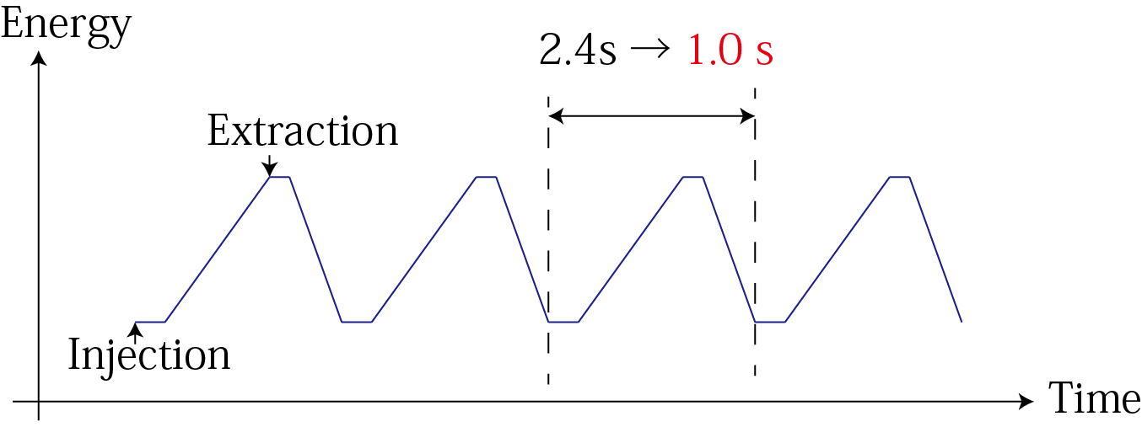
Mid-term plan of MR FX operation
Faster Cycling 2.48 s → 1.3 s or Faster
Linear increase both beam power & loss
We are going to upgrade
Magnet Power Supply
RF
Injection and Extraction Devices
MR collimator upgrade
2.48 s →1.3 s
JFY | 2015 | 2016 | 2017 | 2018 | 2019 | 2020 | 2021
FX power [kW] | 390 | 425-450 | 450-500 | 700 | 800 | 900 | 1060
Cycle time of main magnet PS New magnet PS | 2.48 s |  |  | 1.3 s | 1.3 s | 1.25 s | 1.20 s
High gradient rf system 2nd harmonic rf system
Ring collimators | Add.collimators (2 kW) |  | Add.colli. (3.5kW)
Injection system FX system
New PS buildings
Mass production
installation/test
Installation
Manufacture, installation/test
Kicker PS improvement, Septa manufacture /test
Kicker PS improvement, FX septa manufacture /test

Slide 27
Mid-term plan of MR FX operation
In 2.48 s cycle, MR has been accelerated 2.7e13 ppb (420 kW) in user operation, and 3.4e13 ppb (530 kW equivalent) in demonstration.
Achieving > 750 kW user operation and aiming > 1 MW are reasonable as beam dynamics in 1.2 ~ 1.3 s cycle.
For the faster cycle, we are going to upgrade Magnet Power Supply, RF, Injection and Extraction Devices, MR collimator as follows.
JFY | 2015 | 2016 | 2017 | 2018 | 2019 | 2020 | 2021
FX power [kW] | 390 | 425-450 | 450-500 | 700 | 800 | 900 | 1060
Cycle time of main magnet PS New magnet PS | 2.48 s |  |  | 1.3 s | 1.3 s | 1.25 s | 1.20 s
High gradient rf system 2nd harmonic rf system
Ring collimators | Add.collimators (2 kW) |  | Add.colli. (3.5kW)
Injection system FX system
New PS buildings
Mass production
installation/test
Installation
Manufacture, installation/test
Kicker PS improvement, Septa manufacture /test
Kicker PS improvement, FX septa manufacture /test

Slide 28
Summary
Beam power of 420 kW has been achieved for FX user operation with
  Injection beam distribution by RCS tuning
  Rf pattern optimization for fundamental and 2nd harmonic
  Bunch by bunch feedback and intra-bunch feedback
  Optics correction and resonance line corrections
  and so on.
Operation with the betatron tune of (21.35, 21.43) has been started.
  There is more free space without serious resonances.
  This operation area can accelerate 530 kW equivalent beam.
We plan to achieve the target beam power of 750 kW and more with the faster cycling 2.48 s to 1.3 s. We are upgrading the following hardware by JFY 2018.
  Main magnet power supplies
  Rf
  Injection and extraction devices
  Collimators
> 1MW beam operation is good target in our scope.

Slide 29
References

Slide 30
Recent keys of FX tunings
2014 summer - 2015 spring (Linac Current Upgrade 30 -> 40~50 mA)
Installation OTR monitor at 3-50BT: choosing best upstream conditions
Installation Transverse intra-bunch feedback: instabilities well suppressed
Optics correction; Optimizing correlation of RF setting, chromaticity correction pattern, and transverse feedback to suppress instability
New Trim-quadrupoles to correct leakage field of FX septum
New Trim-sextupoles to correct 3rd resonance line
2nd harmonic RF 30 kV: bunch length kept avoiding extra kick from injection kickers

Slide 31
Recent keys of FX tunings
2015 summer - 2016 spring
- Adding angle moving collimators in MR: capacity 2 -> 2.5 kW, beam loss well localized
- Installation of compensation kicker: to compensate extra kick of injection kickers, longer bunch available
- Optics correction during acceleration, Tune tracking
- 2nd harmonic RF 70 - 85 kV, longer pattern: longer bunch and controlled momentum spread
- Operation point shift trial: (22.40, 20.75) -> (21.35, 21.43) to avoid half-integer resonance
- Trim-Q & Trim-S acceleration pattern
- Optimizing Octupoles

Slide 32
History of MR beam power
Hadron Exp. Facility upgrade
Earthquake recovery
2010 summer - 2011 spring
FX kicker upgrade: 6 -> 8 bunch operation
Additional shields of 3-50BT collimator: capacity 0.45 -> 2 kW
Installation of Transverse bunch by bunch feedback
Cycle: 3.52 -> 3.2 ~ 3.04 s

Slide 33
History of MR beam power
Hadron Exp. Facility upgrade
Earthquake recovery
2011 summer - 2012 spring
Injection kicker upgrade: less extra kick and less impedance
Installation of 7th and 8th RF system
Installation of 4 Skew Qs: correct sum resonance
Installation of 3 Octupoles: beam stability
Cycle: 3.04 -> 2.56 s

Slide 34
History of MR beam power
Hadron Exp. Facility upgrade
Earthquake recovery
2012 summer - 2013 spring
Additional shields and absorber of MR collimator: capacity 0.45 -> 2 kW
Installation of 9th RF system
Installation of additional 3 Octupoles: beam stability
Cycle: 2.56 -> 2.48 s

Slide 35
History of MR beam power
Hadron Exp. Facility upgrade
Earthquake recovery
2013 summer - 2014 spring (Linac Energy Upgrade 181 -> 400 MeV)
Additional shields and collimators of MR collimator: capacity 2 -> 3.5 kW
Replacement of a part of beam ducts: SUS -> Ti reducing residual radiation dose
Improvement of injection kicker system: its rise time shorter

Slide 36
History of MR beam power
Hadron Exp. Facility upgrade
Earthquake recovery
2014 summer - 2015 spring (Linac Current Upgrade 30 -> 40~50 mA)
MR collimator repair: capacity 3.5 -> 2 kW
OTR monitor at 3-50BT: choosing best upstream conditions
Installation of Transverse intra-bunch feedback
Optics correction; Optimizing correlation of RF setting, chromaticity correction pattern, and transverse feedback to suppress instability
Installation of Trim-Qs to correct leakage field of FX septum
Installation of Trim-Ss to correct 3rd resonance line
2nd harmonic RF 30 kV: bunch length kept avoiding extra kick from injection kickers

Slide 37
History of MR beam power
Hadron Exp. Facility upgrade
Earthquake recovery
2015 summer - 2016 spring
Adding angle moving collimators in MR: capacity 2 -> 2.5 kW
Installation of compensation kicker: to compensate extra kick of injection kickers
Optics correction during acceleration, Tune tracking
2nd harmonic RF 70 - 85 kV, longer pattern
Operation point shift trial: (22.40, 20.75) -> (21.35, 21.43) to avoid half-integer resonance
Trim-Q & Trim-S acceleration pattern
Optimizing Octupoles
The max. delivered beam power ~ 425 kW (2.2x10¹⁴ ppp)

Slide 38

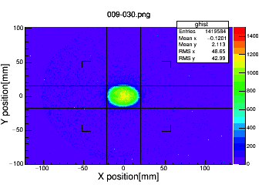
RCS調整による入射ビーム分布の改善
RCSビームスタディにより、MR大強度運転のためのRCSでの入射ペイントおよびチューン設定等のパラメータの最適化を行っている。
3-50BTの optical transition radiation monitor (OTR) で横方向分布を測定。
ビーム強度 3.48e13 ppb
RCS 830 kW 相当、MR 540 kW 相当。
RCS 50π correlated paint
水平方向エミッタンス (100%) : 26.8π mmmrad
垂直方向エミッタンス (100%) : 24.6π mmmrad
OTRでのβを設計値 βx = 27.2 m, βy = 17.9 m を仮定。
Hori. emit. (full)
26.8π mmmrad
Vert. emit. (full)
24.6 mmmrad

Slide 39
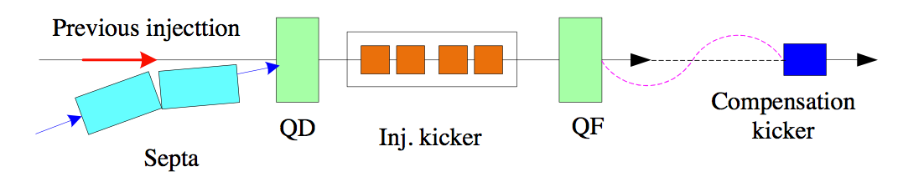

入射キッカー波形
バンチ長が長くなり入射キッカーに改善が必要となった。
立ち上がり時間とテールは回路の改良で改善した。
反射波が周回ビームをキックする。
補正キッカーにより余計なキックを戻すようにした。
入射時のビームロスも減少した。
Previous Injection

Slide 40
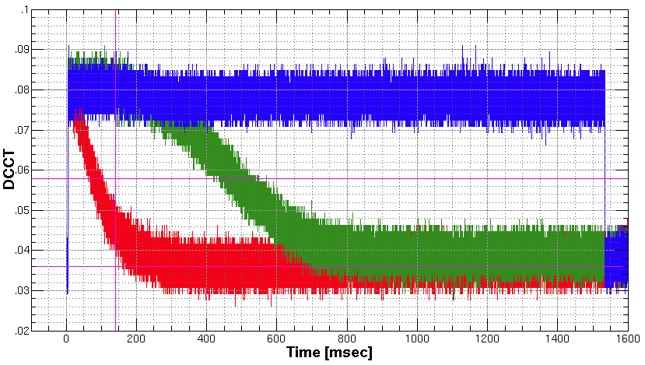
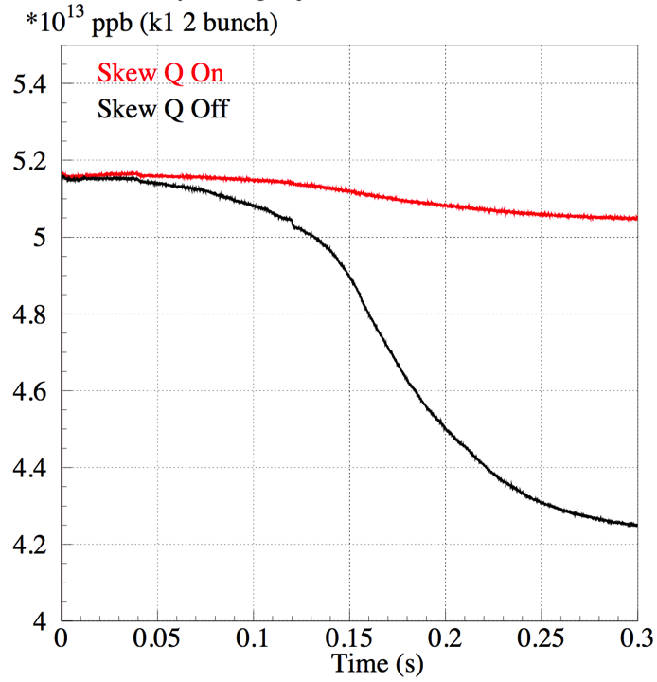
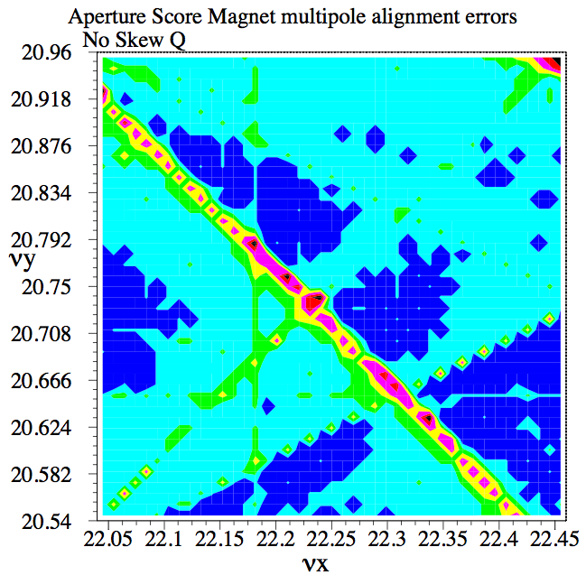
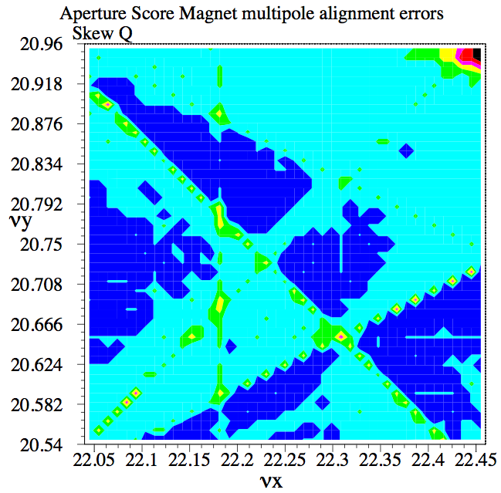
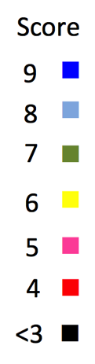
Linear Coupling Resonance Correction with Skew Quadrupole Magnets
1E12ppb
2E11ppb
Beam Intensity
Measured beam survival
on LCR (22.28, 20.71)
w changing Skew Q
No correction
Corrected with 3 GeV DC
Corrected from 3 to 30 GeV
Skew Q setting reduces beam loss in high intensity operation and is used for the user operation.
Flat Base
Acceleration
2 bunch injection 380 kW equiv.
Simulation for tune survey for aperture w/o Skew Q, with Skew Q
Injection
Acceleration

Slide 41
3rd Order Resonance Corrections with Trim Coils of Sextupole Magnets
ν_{x}+2ν_{x}=64
8e11ppb, 1 bunch injection at k1
3 GeV DC
Search the resonance with worse beam survival around (22.42, 20.78).
Beam survival recovers with SFA048: +1.1 A, SFA055: 0 A.
3ν_{x}=67
Search the resonance with worse beam survival around (22.34, 20.75).
Beam survival recovers with SFA048 −0.3 A, SFA055 −0.0 A.
Both resonances of νx+2νy = 64 and 3ν_{x}=67 were corrected with SFA048 +0.86 A, 055 −1.15 A, 062 +1.26 A, 069 −0.85 A.

Slide 42
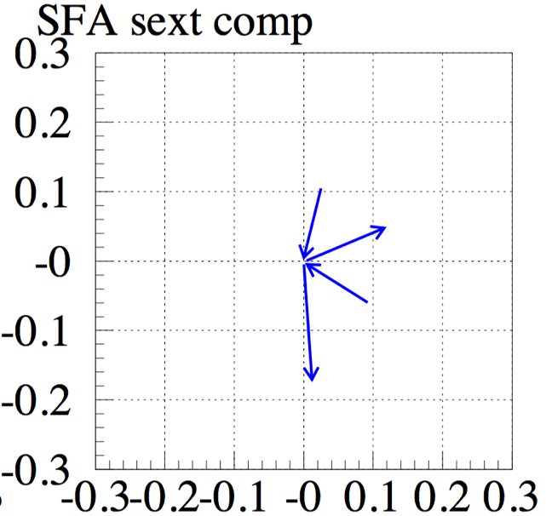
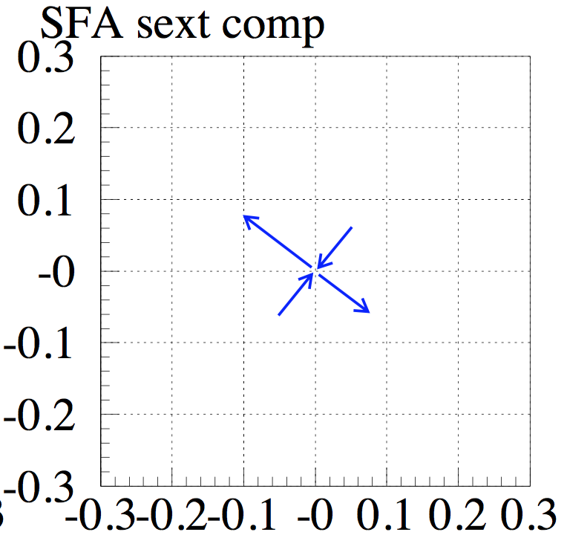
Correction of the 3rd Order Resonances of both νx+2νy = 64 and 3νx = 67
Equations for canceling both resonances, for k₂(1), k₂(2), k₂(3), k₂(4).
1 = SFA048, 2 = SFA055, 3 = SFA062, 4 = SFA069
k₂(j)
k₂(1)
k₂(j)
k₂(1)
k₂(j)
k₂(1)
k₂(j)
k₂(1)
1+2
069
3+0
069
062
048
Im(G)
Im(G)
055
062
055
048
Re (G)
Re (G)

Slide 43


Correction of the 3rd Order Resonances of both νx+2νy = 64 and 3νx = 67 (or 64)
Beam losses were reduced with the correction during injection and the beginning of acceleration for high intensity beam of 380 kW equivalent.
Correction of both ν_{x}+2ν_{x}=64 and 3ν_{x}=67 for tune of (22.40, 20.75)
Correction of both ν_{x}+2ν_{x}=64 and 3ν_{x}=64 for tune of (21.36, 21.43)
Injection
Acceleration
Injection
Acceleration

Slide 44
Mid-term plan of MR
JFY | 2015 | 2016 | 2017 | 2018 | 2019 | 2020 | 2021
 |  |  |  | HD target (80kW) |  |  | HD target (>100 kW)
FX power [kW] SX power [kW] | 390 42 | 425-450 42-50 | 450-500 50 | 700 50-70 | 800 80 | 900 80 | 1060 ~100
Cycle time of main magnet PS New magnet PS | 2.48 s |  |  | 1.3 s | 1.3 s | 1.25 s | 1.20 s
High gradient rf system 2nd harmonic rf system
Ring collimators | Add.collimators (2 kW) |  | Add.colli. (3.5kW)
Injection system FX system
SX collimator / Local shields
Ti ducts and SX devices with Ti chamber |  |  | ESS
New PS buildings
Mass production
installation/test
Installation
Manufacture, installation/test
Kicker PS improvement, Septa manufacture /test
Kicker PS improvement, FX septa manufacture /test
Local shields

Slide 45



Faster Cycling 2.48 s → 1.3 s or Faster
2.48 s →1.3 s
Magnet Power Supply
RF
Injection and Extraction Devices
Issue：Large power variation @ AC main grid
2.56sec cycle
1.3 sec cycle
Requirement to the magnet power supplies
磁気エネルギーの流れ
~Δ140MW
Not allowed by Tokyo Electric Power Company
Energy Recovery with Bank Capacitor
Present
Magnetic Energy
New
Magnetic Energy
AC main
AC main
All magnetic energy recover to AC main.
All magnetic energy recover to capacitor bank

Slide 46



RF Cavities
INS-C FY2012
FT3M 9 × 3-cell cavity: 315 kV
Required voltage for 2.48 s cycle: 280 kV
❺
❻
❼
❽
Four cavities ⑤〜⑧ will be installed in this summer.
FT3L (for High Gradient Cavity)
7 × 5-cell cavity + 2 × 4-cell cavity: 602 kV
Required voltage for 1.3 s cycle: 540 kV
①
②
③
④
⑤
⑥
⑦
⑧
⑨ in 2013
Photo of ①〜③ cavities installation in 2015
Plan FY2016
& 2nd Harmonic Cavity in Ins.-A

