Slide 1

Review of experimental status on precision muon physics and EDMs
Peter Winter
Argonne National Laboratory

Slide 2
Overview
The muon in a nutshell
SM measurements with muons
BSM searches with EDMs
BSM searches with muons

Slide 3
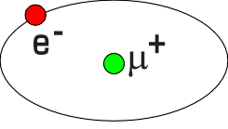
The muon in a nutshell
Discovered in 1936 by Anderson and Neddermeyer
Big brother of the electron, m_{μ} = 207∙m_{e}
Weak decay gives "long" lifetime (μs): beams and probe
Main decay μ → e ν_{e} ν_{μ} (parity violating)
Polarized muon beams from pion decay
Forms bound states (μ⁻p, μ⁻d, muonium: μ⁺e⁻)
Enhanced sensitivity to new physics (m_{μ}/m_{e})² ≈ 40,000
Lepton number violation (μ→e) extremely small in SM
Easy to detect: P_{detection} ≈ 1
μ⁻
p

Slide 4
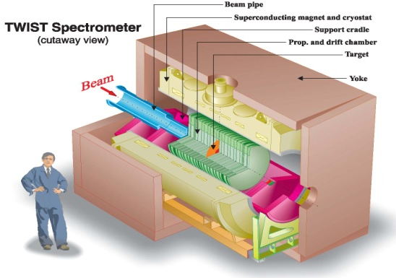
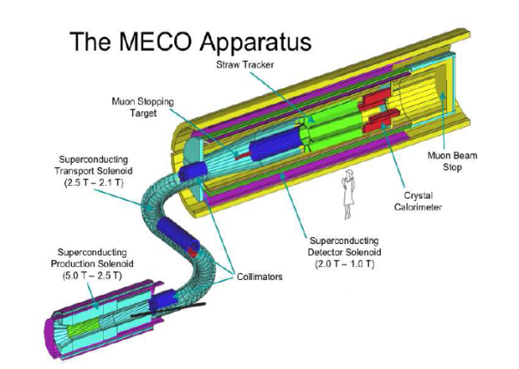
Muon Physics: Worldwide Effort*
* Incomplete list of
past, present & future
muon experiments
Lifetime – Fermi constant
  MuLan & FAST at PSI
Decay parameters (ρ, δ, η, P_{μ}ξ ...)
  TWIST at TRIUMF and polarization measurements at PSI
Muon Capture
  MuCap at PSI: g_{P}, pseudoscalar coupling
  MuSun at PSI: basic EW interaction in 2N system
Lepton Flavor Violation
  μ->eγ – MEG and μ3e at PSI
  μe conversion: Mu2e (FNAL), COMET, DeeMee (JPARC)
Anomalous magnetic moment (g-2)
  E821 at BNL and Muon g-2 at FNAL & JPARC
Search for Electric Dipole Moment
  E821 at BNL and Muon g-2 at FNAL & JPARC
Lorentz / CPT violation tests
  E821 at BNL and Muon g-2 at FNAL & JPARC
Proton charge radius
  Muonic Lamb shift (CREMA), MuSE at PSI
Muonium Spectroscopy
  Muonium hyperfine at LAMPF & MuSEUM at JPARC
...
TWIST
Mu2e

Slide 5








Muon Physics: Worldwide Effort

Slide 6
Different categories of muon experiments
Measurement of SM parameters like with other particles:
  Masses: M_{Z} M_{W} M_{H} m_{b} m_{t} m_{e} m_{u} m_{v} …
  Couplings: α_{QED} α_{Strong} G_{F} G_{grav}
  Structure of interactions: SU(3)_{C} x SU(2)_{L} x U(1)_{Y}

Slide 7
Different categories of muon experiments
Measurement of SM parameters like with other particles:
  Masses: M_{Z} M_{W} M_{H} m_{b} m_{t} m_{e} m_{u} m_{v} …
  Couplings: α_{QED} α_{Strong} G_{F} G_{grav}
  Structure of interactions: SU(3)_{C} x SU(2)_{L} x U(1)_{Y}
Search for Physics Beyond the Standard Model (BSM):
  Test for deviations from a pure V-A structure
  Charged Lepton Flavor violation (CLFV) (see talk by S. Mihara)
  Searches for new particles through quantum loop effects

Slide 8
Different categories of muon experiments
Measurement of SM parameters like with other particles:
  Masses: M_{Z} M_{W} M_{H} m_{b} m_{t} m_{e} m_{u} m_{v} …
  Couplings: α_{QED} α_{Strong} G_{F} G_{grav}
  Structure of interactions: SU(3)_{C} x SU(2)_{L} x U(1)_{Y}
Search for Physics Beyond the Standard Model (BSM):
  Test for deviations from a pure V-A structure
  Charged Lepton Flavor violation (CLFV) (see talk by S. Mihara)
  Searches for new particles through quantum loop effects
Applied material research:
  Muon spin Resonance (muSR) to probe magnetic properties

Slide 9
Overview
The muon in a nutshell
SM measurements with muons
BSM searches with EDMs
BSM searches with muons

Slide 10
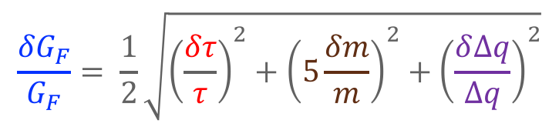
Electroweak Theory needs 3 input parameters
Fine structure constant α (0.37 ppb)
Ultra precise penning trap
Neutral weak boson mass M_{Z} (23 ppm)
LEP experiments
Fermi constant G_{F} (9 ppm)
From muon lifetime measurement
Hanneke et al. PRL 100 (2008) 120801
Giovanetti et al., PRD29, 343 (1984)
Bardin et al., PL B137, 135 (1984)
Balandin et al., JETP 40, 811 (1975)
$$\frac{{δG}_{F}}{G_{F}}= \frac{1}{2}\sqrt{{\left(\frac{δτ}{τ}\right)}^{2}+{\left(5\frac{δm}{m}\right)}^{2}+{\left(\frac{δ∆q}{∆q}\right)}^{2}}$$
9 ppm
0.5 ppm
0.14ppm (radiative corrections)
0.09 ppm muon mass
1 ppm (MuLan, FAST)
18 ppm muon lifetime

Slide 11
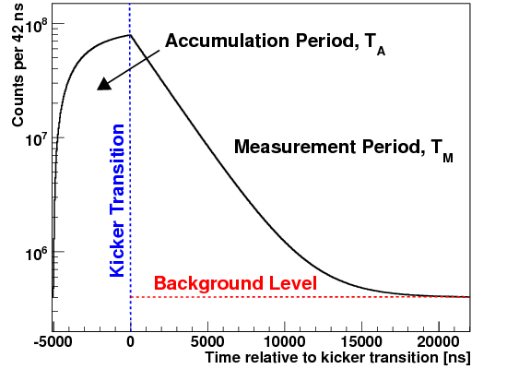
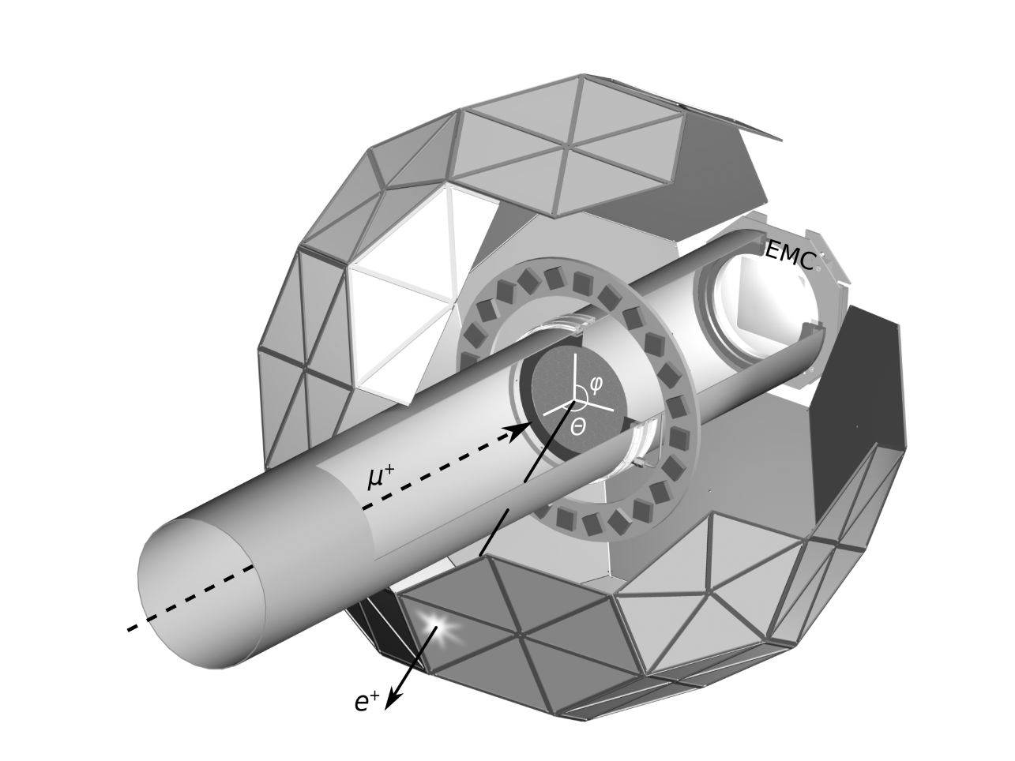
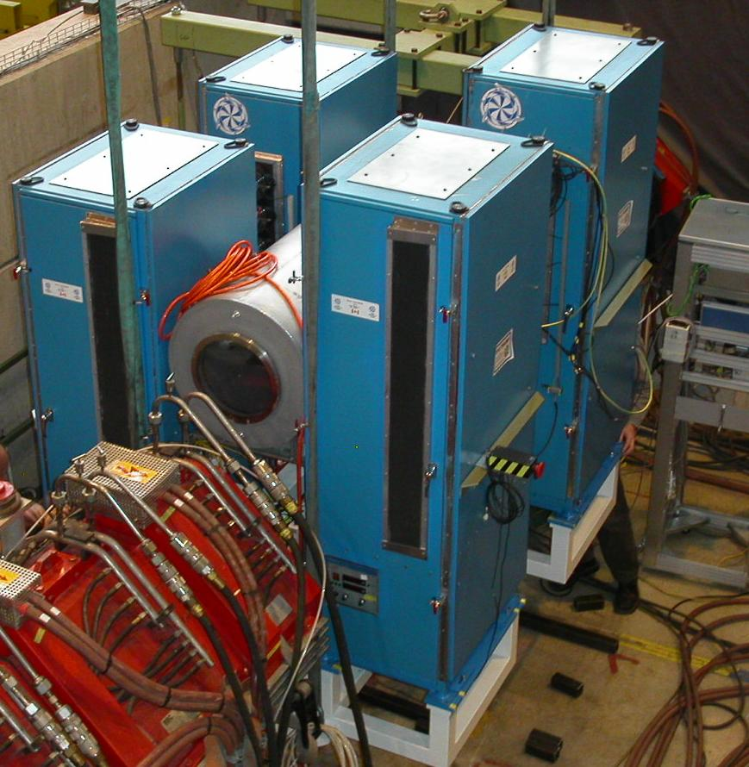
The MuLan concept in one slide...
Real data
Kicker On
Collect 10¹² decay electrons
Fit decay spectrum to extract τ_{μ}
Avoid “early-to-late” systematics
Measurement Period
τ_{μ+} = 2196980.3 ± 2.2ps
G_{F} = 1.1663818(7) x 10⁻⁵ GeV⁻² (0.6 ppm)
Number (log scale)
D.B. Chitwood et al., Phys. Rev. Lett. 99, 03201 (2007)
D. Webber et al., Phys. Rev. Lett. 106, 041803 (2011)
Tishchenko et al., Phys. Rev. D. 87, 052003 (2013)
time
Fill Period
-12.5 kV
12.5 kV

Slide 12
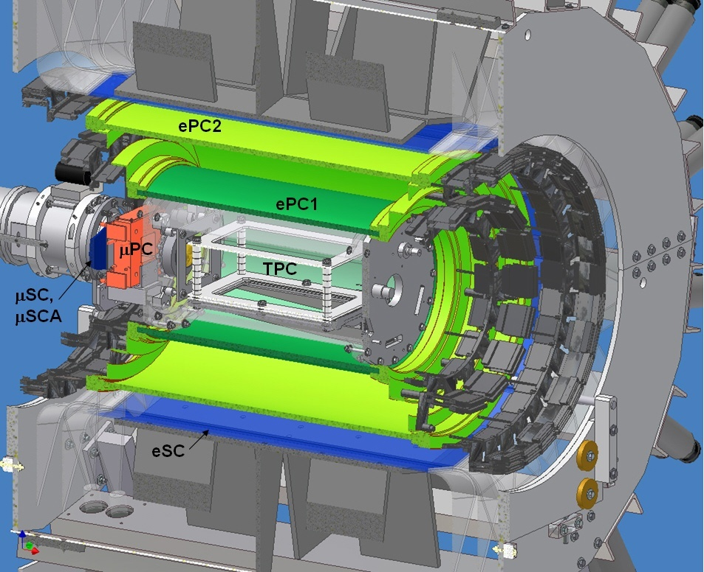
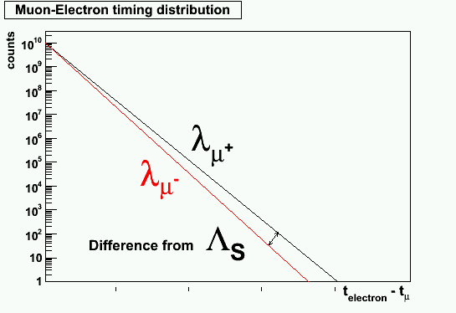
MuCap: Measuring the nucleon structure
MuLan result λ_{μ+} = 1/τ_{μ+} is input for MuCap
Form muonic hydrogen μ⁻p in ultra-pure hydrogen TPC
Measure disappearance rate λ_{μ-}
Extract singlet capture rate Λ_{S} ≈ λ_{μ-} - λ_{μ+}
Determine the nucleon’s pseudo-scalar form factor g_{P}
μ⁻
p
e
μ
Λ_{S}
Peter Winter (ANL), CTEQ 2013 Summer School -- Part 1, July 2013

Slide 13
MuCap: Muon capture on the proton
μ⁻
ν
M ~ G_{F}V_{ud} · ψ_{ν} γ_{α}(1-γ₅)ψ_{μ} · ψ_{n}(V^{α}-A^{α})ψ_{p}
V^{α} = g_{V}(q²) γ^{α} + i g_{M}(q²) σ^{αβ}q_{β}/2M_{N}
A^{α} = g_{A}(q²) γ^{α}γ₅ + g_{P}(q²) q^{α}/m_{μ}γ₅
q² = -0.88m_{μ}²
Since g_{V}, g_{M}, g_{A}, and V_{ud} are well known, Λ_{S} determines the
pseudo-scalar form factor g_{P}
Test of χPT theory prediction
p
n
g_{P}(MuCap) = 8.06 ± 0.55
Andreev et al., Phys. Rev. Lett. 110, 012504 (2013)
g_{P}(χPT theory) = 8.26 ± 0.23

Slide 14
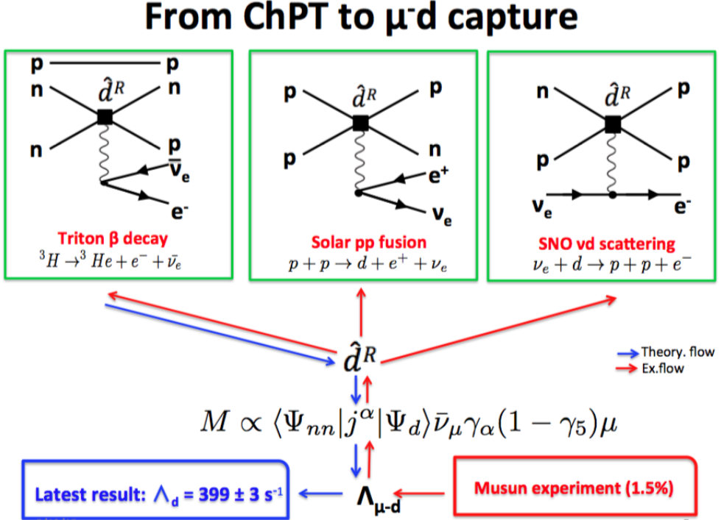
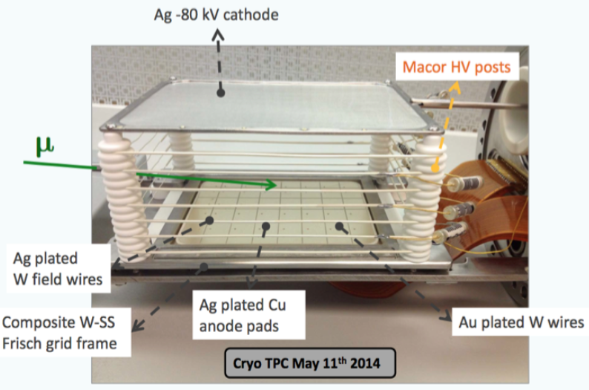

MuSun: Muon capture on the deuteron
μ⁻
ν
Next step: Measure simplest two-body system
EFT relates this process to low energy constant $\hat{d}$_{R} relevant for other processes
Similar to MuCap with ultra-pure deuterium, cryo-TPC (30K)
Data taking mostly completed, analysis ongoing
d
n
n

Slide 15
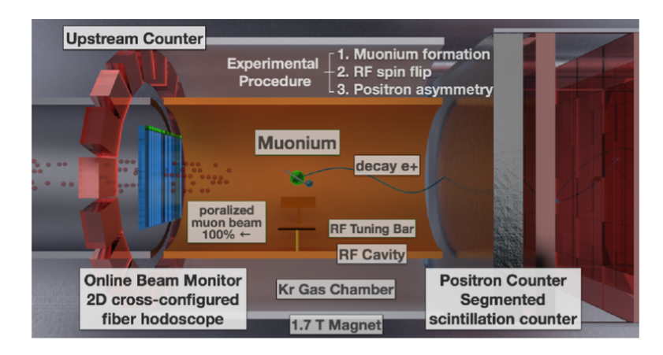
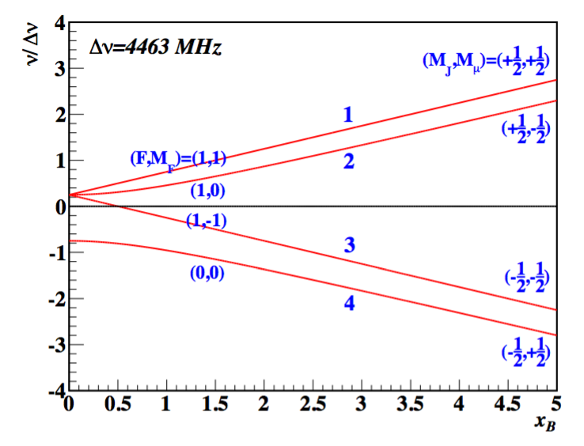
Muonium hyperfine spectroscopy (LAMPF, J-PARC)
Form muonium and excite hyperfine transitions Δν₁₂ and Δν₃₄
Purely leptonic system allows for precision tests of bound-state QED
Extract hyperfine splitting Δν = Δν₁₂ + Δν₃₄ and μ_{μ}/μ_{p} ∝ Δν₁₂ − Δν₃₄
μ_{μ}/μ_{p} is an important input to the Muon g-2 experiments
MuSEUM @ J-PARC aims for order of magnitude more precise measurement
Δν(LAMPF) = 4 463 302 765(53) Hz (12ppb)
μ_{μ}/μ_{p}(LAMPF) = 3.183 345 13(39) (120 ppb)
Liu et al., PRL 82, 711 (1999)
MuSEUM @ J-PARC
See also talk by H. Torii
WG4, today @ 11:45am

Slide 16
Muonic Hydrogen Lamb Shift – Proton Charge Radius
μ⁻
Bohr radius in muonic hydrogen is smaller by m_{red} = 186m_{e}
than in hydrogen
The muon overlap with the proton is larger by m³_{red} and hence
μ⁻p is more sensitive to the proton’s charge distribution
Extract proton charge radius r_{p} from 2S – 2P transition (Lamb shift)
Knowledge of the charge and magnetic
distributions inside the proton are needed
for precision tests of bound-state QED
p

Slide 17
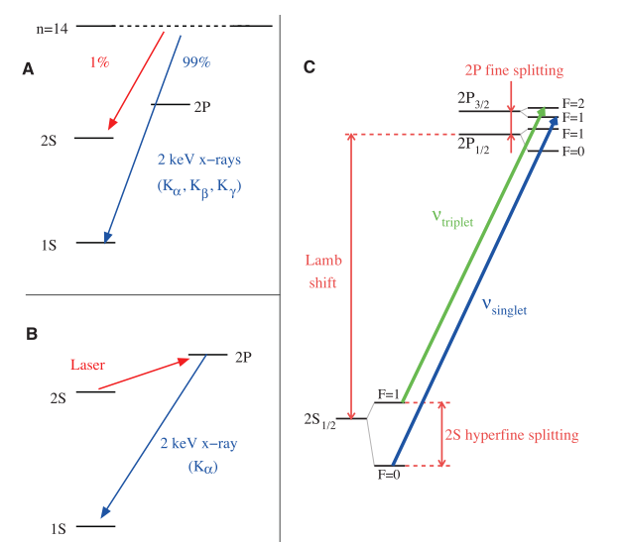
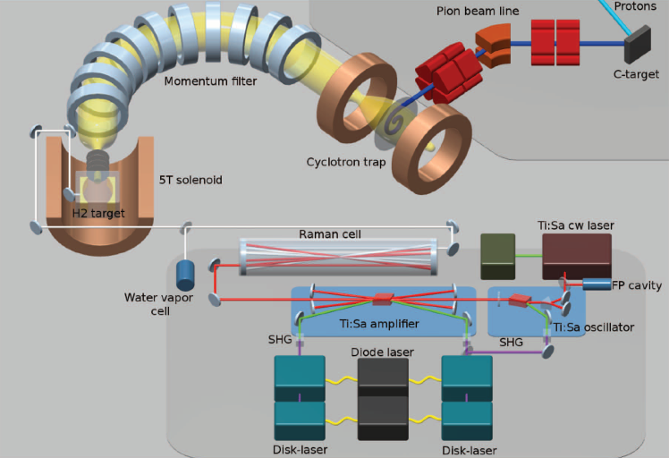
Muonic Lamb Shift – Experimental technique
Excited μp atoms deexcite to 1S ground state (99%) and meta-stable 2S (1%)
Delayed (0.9 μs) laser induces 2S – 2P transition followed by immediate deexcitation via 1.9 keV X-ray (2P – 1S) transition
Transitions measured: ν_{triplet} (6 μm) and ν_{singlet} (5.5 μm)
Laser calibration with well known water absorption lines

Slide 18
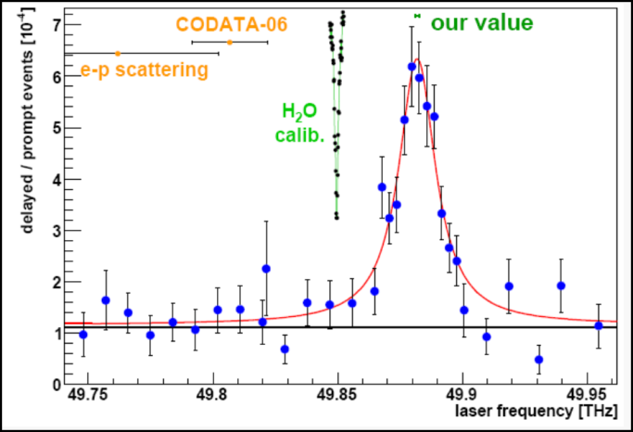
Muonic Lamb Shift – Results for μp
Pohl et al., Nature 466 (2010)
Antonigni et al., Science 339 (2013)
7σ smaller r_{p} compared to H spectroscopy and e-p scattering!
This proton radius puzzle is still unsolved

Slide 19
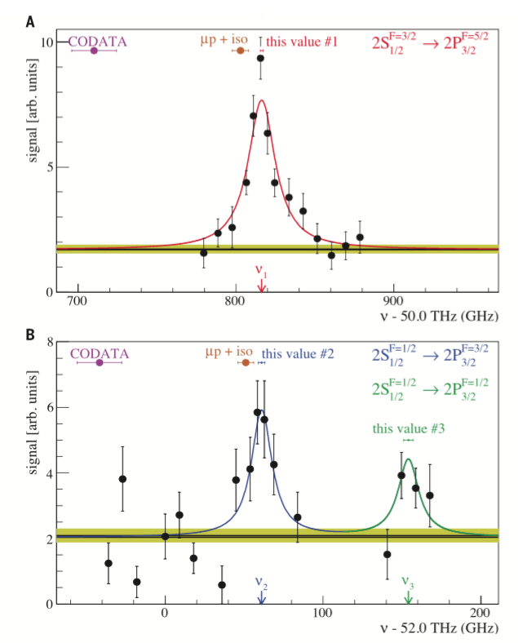
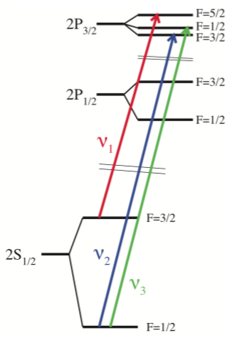
Muonic Lamb Shift – Recent results for μd
Pohl et al., Science 353 (2016)
μd is also 7.5σ smaller than electron systems
Confirms μp muonic Lamb shift measurement
More measurements in μ³He and μ⁴He...

Slide 20
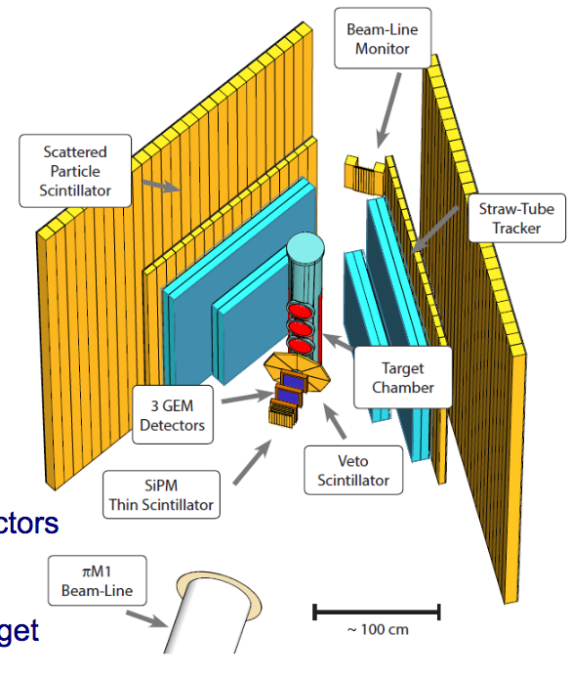
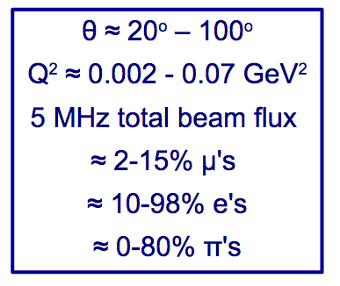
MUSE @ PSI
r_{p} (fm) | electron | muon
spectroscopy | 0.877±0.007 | 0.841±0.0004 (μp) 0.8356±0.0020 (μd+iso)
scattering | 0.875±0.006 | ?
New experiment at PSI to measure low-energy scattering of μ±p and e±p
Goal: Δr_{p} ≈ 0.007 fm
(similar to current CODATA)

Slide 21
Big picture of BSM searches
Hints for new physics:
  Proton charge radius puzzle?
  3.3σ difference between BNL g-2 experiment and SM
  ...
Unanswered big questions:
  Baryon-antibaryon asymmetry (missing CPV in the SM)
  What type of new physics will we find and properties of new particles?
  ...
Experimental approaches:
  Direct search at the LHC (TeV scale new particles)
  EDMs
  CLFV
  Muon g-2
Can probe >TeV scale physics (if LHC doesn’t find anything)
Help to disentangle the type of new physics (if LHC discovery)

Slide 22
Overview
The muon in a nutshell
SM measurements with muons
BSM searches with EDMs
BSM searches with muons

Slide 23
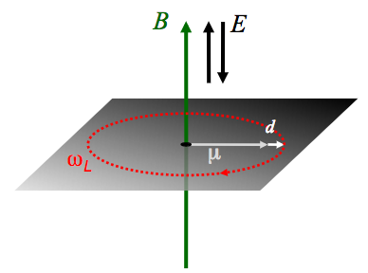
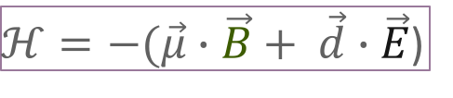
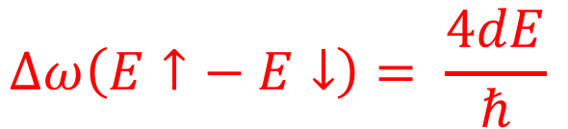
Electric Dipole Moments
EDMs are
  P- and T- violating (and CP-violating via CPT theorem)
  EDMs are flavor-conserving CPV
Many types of systems can be studied (nucleon, leptons, atoms, molecules)
Typical EDM experiment:
  Bring particle into magnetic field
  Prepare spin state so that it induces
  precession signal
  Superimpose E-field (alternating direction)
  Look for EDM signature: Δω = 4dE/ℏ
  Study systematics, systematics,
  systematics...
$ℋ=−(\vec{μ}∙\vec{B}+ \vec{d}∙\vec{E}$)
$$∆ω\left(E↑− E↓\right)= \frac{4dE}{ℏ}$$

Slide 24
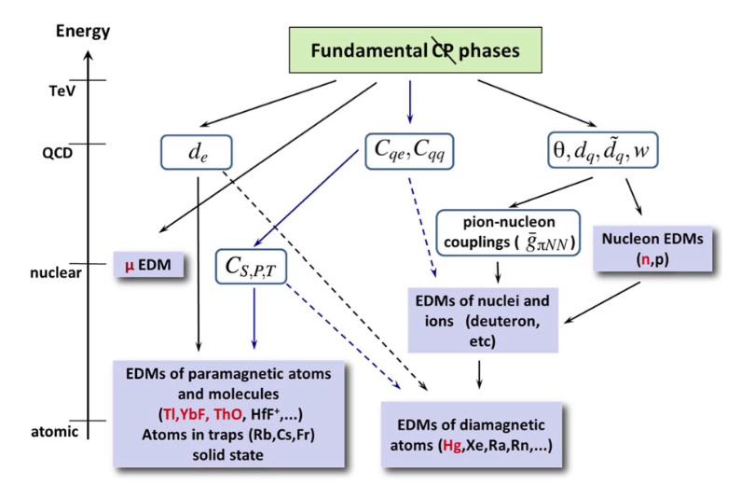
Why EDM measurements in different systems?
Interpretation of experimental observables (EDMs, Schiff moments, ...) in terms of CPV sources of the underlying physics requires theory
Observables have multiple underlying CPV sources (e.g. paramagnetic molecules sensitive to electron EDM d_{e} and scalar eN interaction C_{S})
Need to measure different systems to disentangle the underlying physics

Slide 25
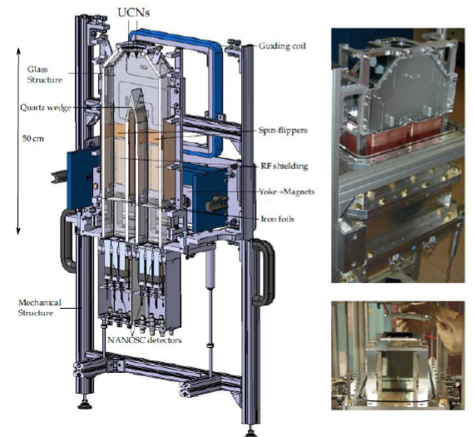
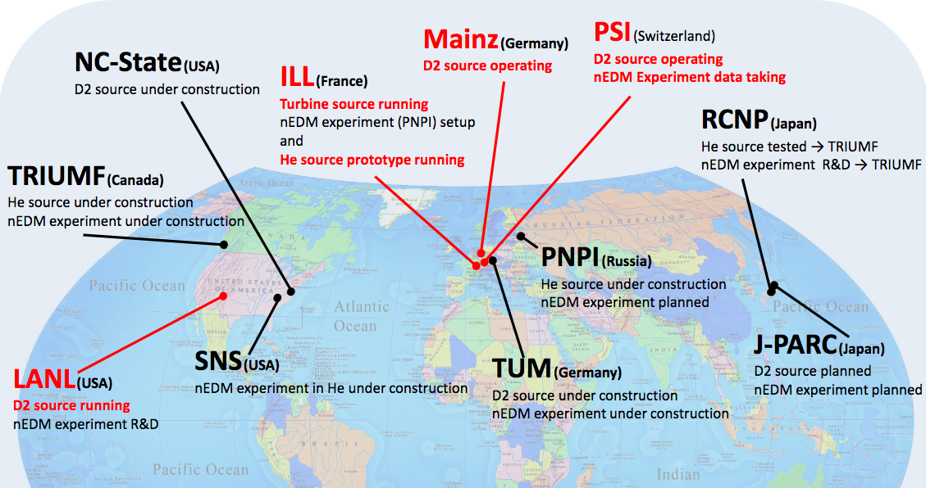
Neutron EDM Efforts
Current sensitivity ~2 x 10⁻²⁶ e∙cm
nEDM@PSI should reach sensitivity
10⁻²⁶ e∙cm in 2016
Next generation n2EDM (start 2018-19)
  Mu-metal Shield
  Double chamber setup (two E direction)
  Magnetometers (improved ¹⁹⁹Hg, He-3)
Goal: 3 x 10⁻²⁷ e∙cm early 2020s
Also: SNS EDM effort in critical component demonstration phase now, integration ~2018, data early 2020s
Many other nEDM efforts worldwide
nEDM @ PSI

Slide 26
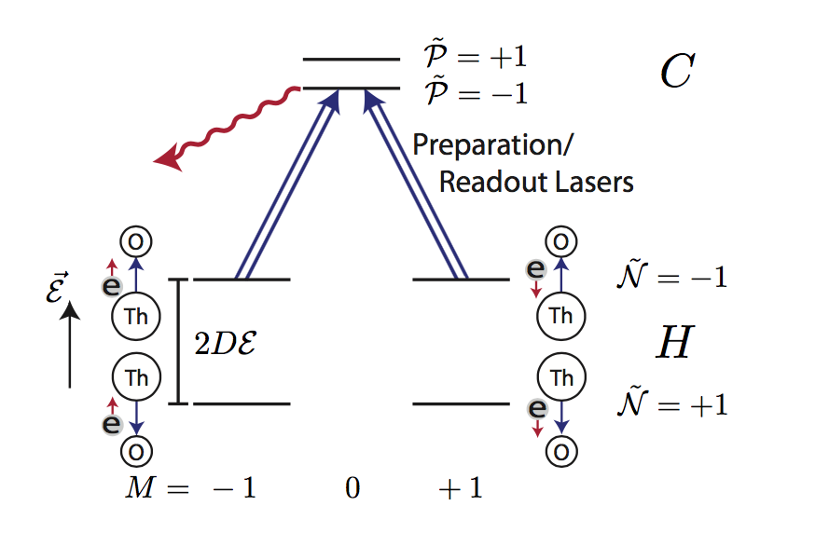
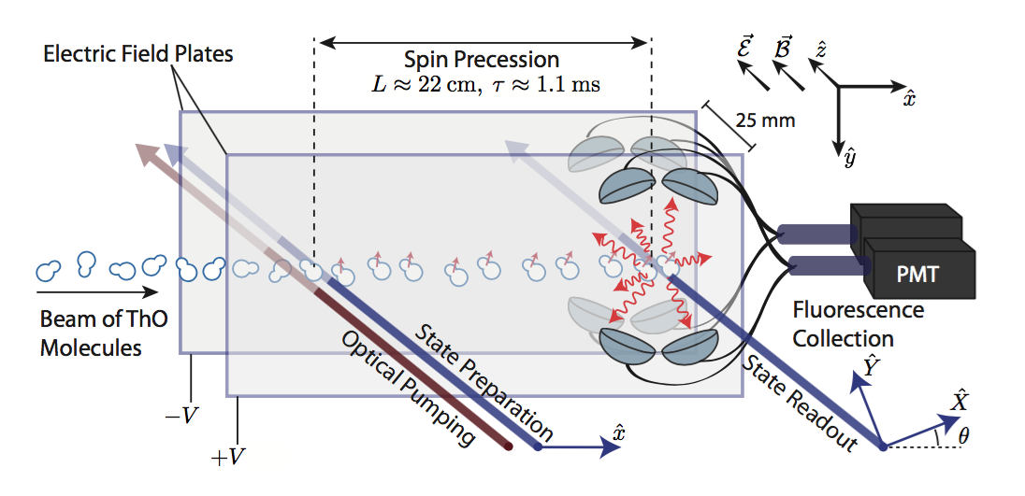
Paramagnetic ThO EDM
Paramagnetic system (sensitive to d_{e})
Modest E_{applied}=10 V/cm
Large E_{effective} ≈ 84 GV/cm
Prepare state by transition from H to C states of ThO molecule
d_{e} = (2.1 ± 3.7_{stat} ± 2.5_{syst}) × 10⁻²⁹ e∙cm
Baron et al., Science 343, 269 (2014)

Slide 27
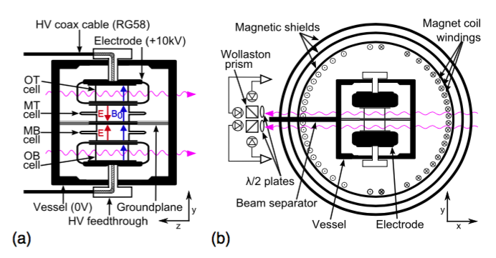
Improved EDM limit from the ¹⁹⁹Hg experiment
Diamagnetic molecule (sensitive to d_{n} and TVPV ππN interaction)
4 vapor cells with Hg gas, only inner cells have E field in opposite direction
Spin polarize Hg with pump laser and observe Faraday rotation angle
Improved systematics (leak currents, sparks, parameter correlation, ...)
d_{Hg} = (-2.2 ± 2.75_{stat} ± 1.4_{syst}) × 10⁻³⁰ e∙cm
B. Graner et al., Phys. Rev. Lett. 116, 161601 (2016)

Slide 28
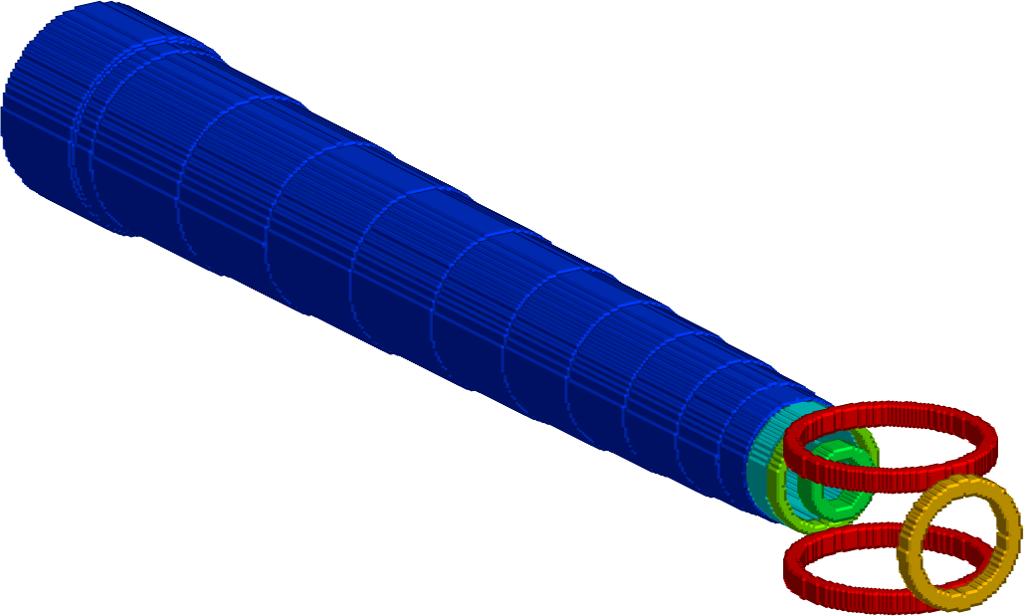
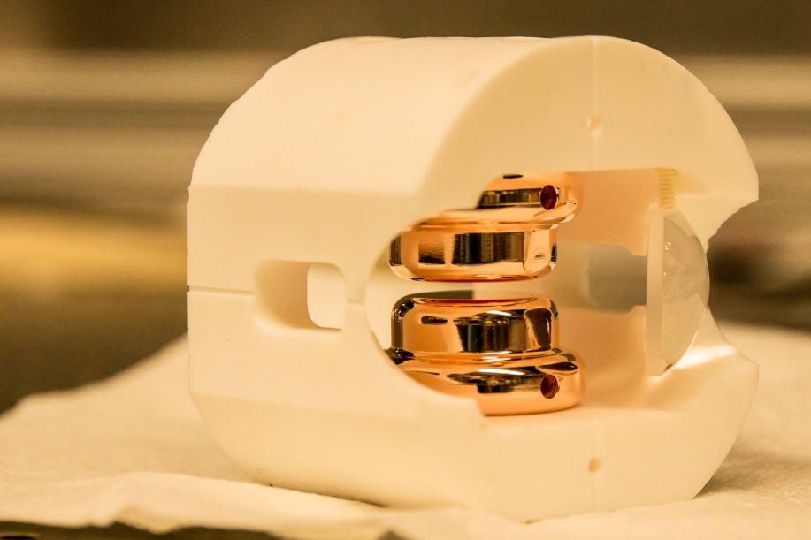
First measurement of ²²⁵Ra EDM
Efficient use of the rare 225Ra atoms
High electric field (> 100 kV/cm)
Long coherence time (~100 s)
Octupole deformed nucleus enhances sensitivity to EDM
Long-term goal: d = 3 x 10⁻²⁸ e∙cm
Oven:
²²⁵Ra
Transverse
cooling
Zeeman
Slower
Magneto-optical
Trap (MOT)
Optical dipole
trap (ODT)
EDM
measurement

Slide 29
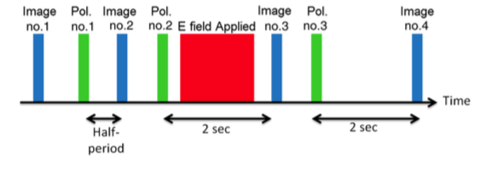
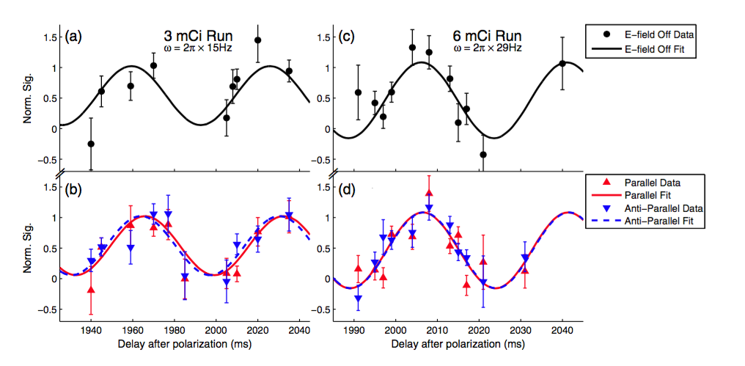
First measurement of ²²⁵Ra EDM
Parker et al., PRL 114, 233002 (2015)
d_{Ra-225} = (-0.5 ± 2.5_{stat} ± 0.2_{syst}) × 10⁻²² e∙cm
| d_{Ra-225}| < 5.0 × 10⁻²² e∙cm (95% confidence)

Slide 30
EDMs – Summary and outlook
EDM limits for various systems (some limits assume a single source)
Full interpretation to understand underlying CPV interaction requires theory
While experiments have set impressive limits, order of magnitude improvements expected over the next decade:
  Several nEDM experiments with up to 2 orders of magnitude improvement
  Octupole enhanced systems ²²⁵Ra and ²²¹Rn/²²³Rn
  Light charged particle EDMs in storage rings
  ...
Type | System | EDM limit (e∙cm)
Paramagnetic molecule | YbF | d_{e} = (-2.4 ± 5.9) × 10⁻²⁸
 | ThO | d_{e} = (-2.1 ± 4.5) × 10⁻²⁹
Diamagnetic atom | ¹⁹⁹Hg | d_{Hg} = (2.2 ± 3.1) × 10⁻³⁰
 | ²²⁵Ra | d_{Ra225} = (-0.5 ± 2.51) × 10⁻²²
Nucleon | n | d_{n} = (0.21 ± 1.82) × 10⁻²⁶

Slide 31
Overview
The muon in a nutshell
SM measurements with muons
BSM searches with EDMs
BSM searches with muons

Slide 32
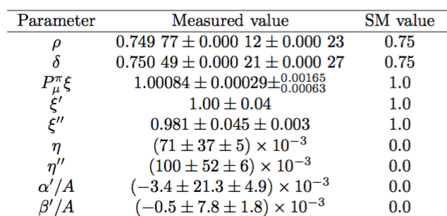
Test of the V-A structure of the weak interaction
Most general interaction involves S, P, V, A, and T terms giving rise to 9 parameters for the muon decay spectra and polarization observables
The weak interaction in the SM is a pure V-A current-current interaction implies specific values for these 9 parameters
Experiments at TRIUMF and PSI have improved the precision by a factor of 10 and more
TWIST collaboration
A. Hillairet et al., PRD85, 092013 (2012)
J .Bueno et al., PRD84, 032005 (2011)
R Prieels et al., PRD90, 112003 (2014)
N. Danneberg et al., PRL, 021802 (2005)

Slide 33
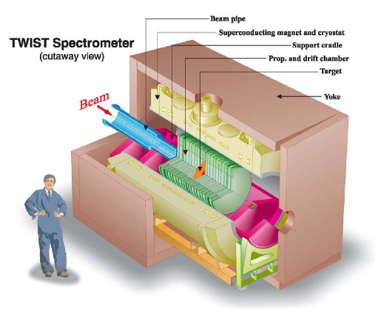
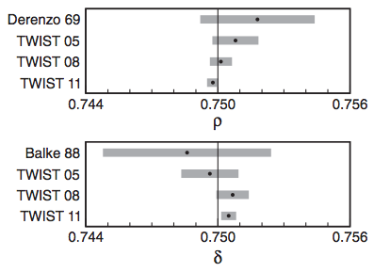
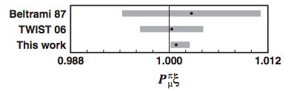
TWIST: Michel parameters
Compare precise measurement to SM prediction:
ρ = 0.75 η = 0
P_{μ}ξ = 1 δ = 0.75
Highly polarized μ⁺ beam stopped in in a very symmetric detector
Measure angular distribution and energy spectrum of decay electrons
Analysis requires comparison with simulations
Results compatible with SM, set limits on Left-Right-Symmetric Models
Hillairet et al., Phys. Rev. D 85, 092013 (2012)
J.F. Bueno et al., Phys. Rev. D 84, 032005 (2011)

Slide 34
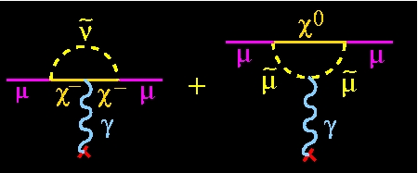
Muon g-2: Motivation measuring a_{μ} = (g-2)/2
BNL: a_{μ}^{Expt.} - a_{μ}SM = (260 ± 78) x 10⁻¹¹ (3.3 σ)
π
μ
γ
μ
Z
π
B
QED
Weak
Had VP
Had LbL
Known well beyond current experimental precision
Known slightly better than current experimental precision – needs work
a_{μ}^{Expt.} = a_{μ}SM + a_{μ}^{New Physics}
  If current discrepancy remains new experiments would yield >5σ
  Together with theory improvements could give >8σ
???

Slide 35
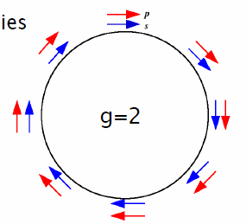
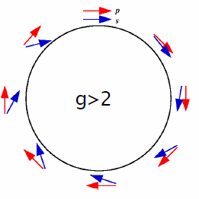
Muon g-2: The basic measurement
Momentum p
Spin S
ω_{a} = e/m a_{μ} B
Determination of a_{μ} requires measurement of both
  the spin precession frequency ω_{a}
  the magnetic field B

Slide 36
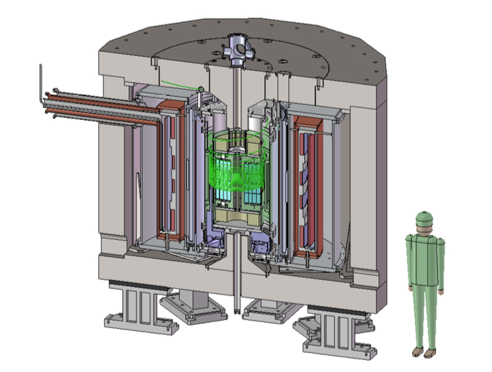
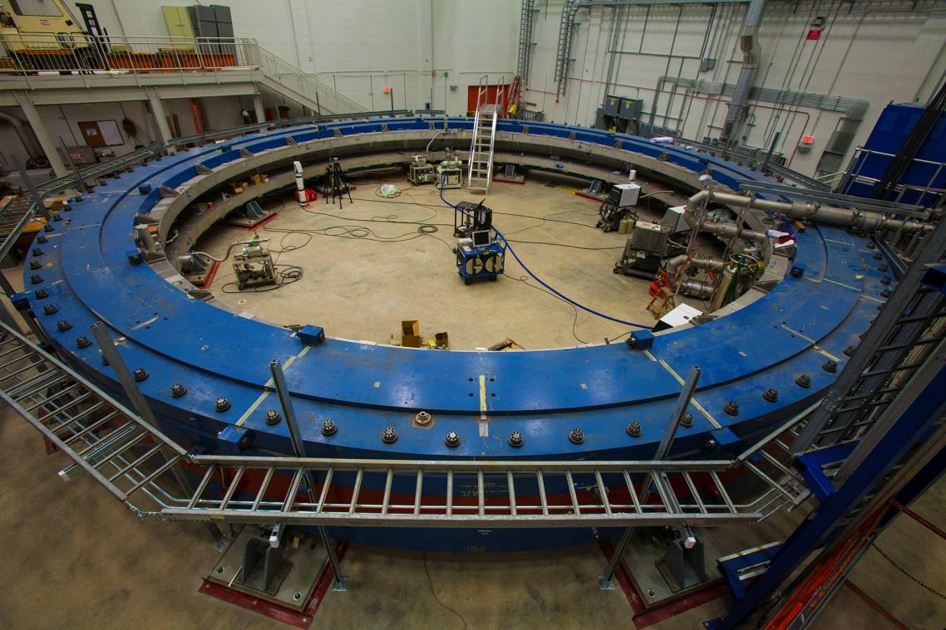
The new Muon g-2 experiments: A comparison
See also WG4 talks today:
R. Kitamura @ 10:45am
W. Gohn @ 11:15am
 | E34 @ JPARC | E989 @ Fermilab
Beam | High-rate, ultra-cold muon beam (p = 300 MeV/c) | High-rate, magic-momentum muons (p = 3.094 GeV/C)
Polarization | P_{max} = 50% | P ≈ 97%
Magnet | MRI-like solenoid (r_{storage} = 33cm) | Storage ring (7m radius)
B-field | 3 Tesla | 1.45 Tesla
B-field gradients | Small gradients for focusing | Try to eliminate
E-field | None | Electrostatic quadrupole
Electron detector | Silicon vanes for tracking | Lead-fluoride calorimeter
B-field measurement | Continuous wave NMR | Pulsed NMR
Current sensitivity goal | 400 ppb | 140 ppb

Slide 37
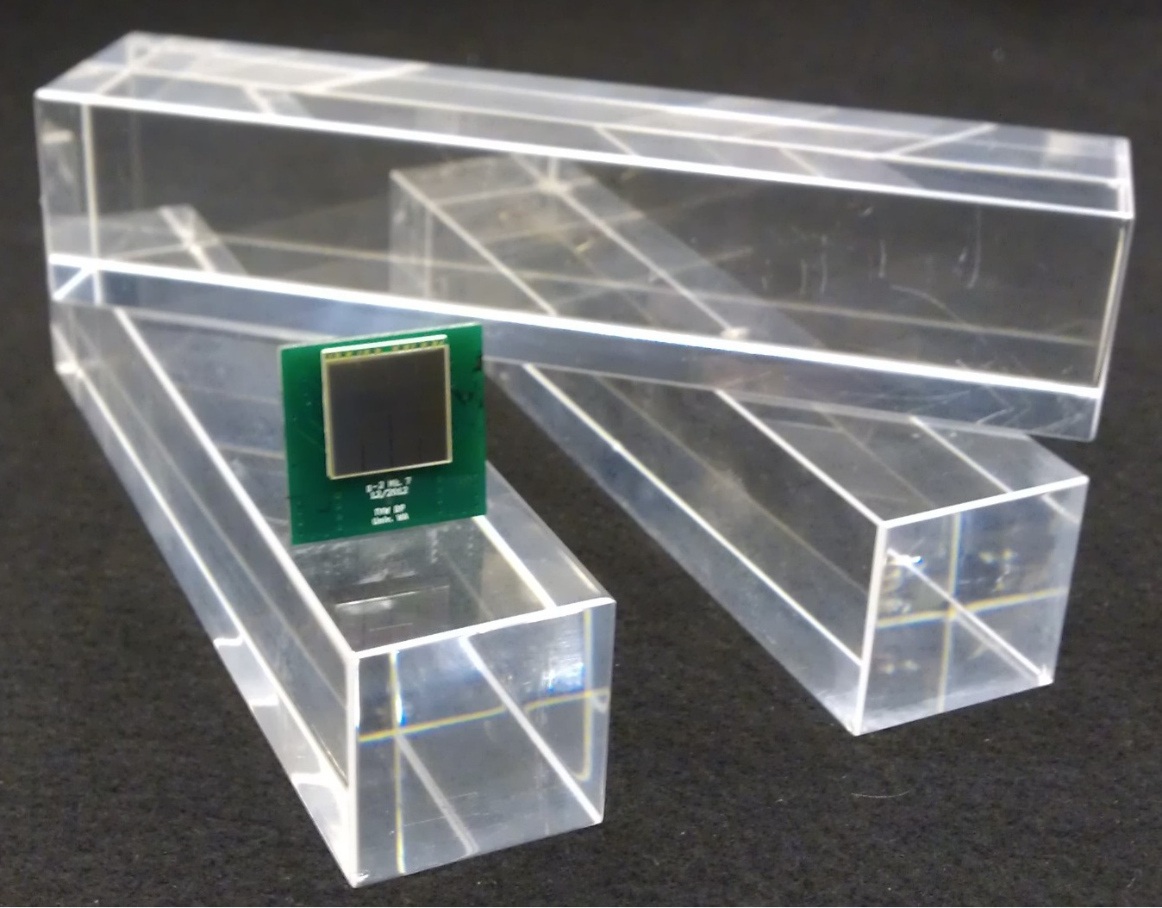
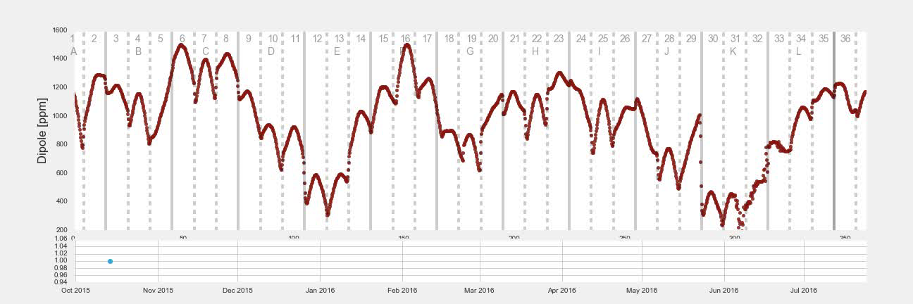
g-2 at Fermilab: Getting ready for data taking 2017
Many improvements on entire experiment to reach 140 ppb
New segmented PbF₂ electron calorimeter
Precision alignment to reach dipole gradients of ΔB < ±25 ppm
  72 poles
  840 wedge shims
  9000 thin iron foils
PbF₂ crystals and SiPM
10 months of improving the dipole field...
As of this week: Shimming completed with ΔB < ±20 ppm ✓
Calibrations Poles Wedges Laminations

Slide 38
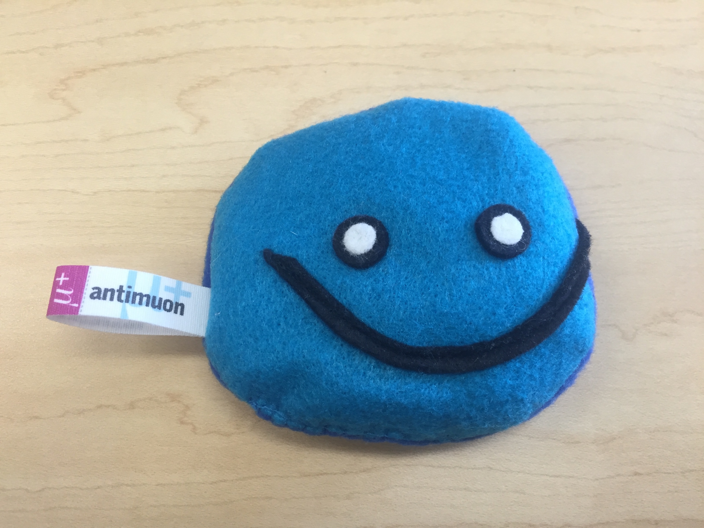
Summary
Precision muon experiments and searches for EDMs have a wide physics reach
Muon and EDM experiments have sensitivity to masses much higher than 1 TeV and are complimentary to LHC experiments
A multitude of upcoming muon and EDM experiments will contribute significant constraints for BSM models over the next decade
Cảm ơn!
Thank you!

Slide 39
Backup slides

Slide 40
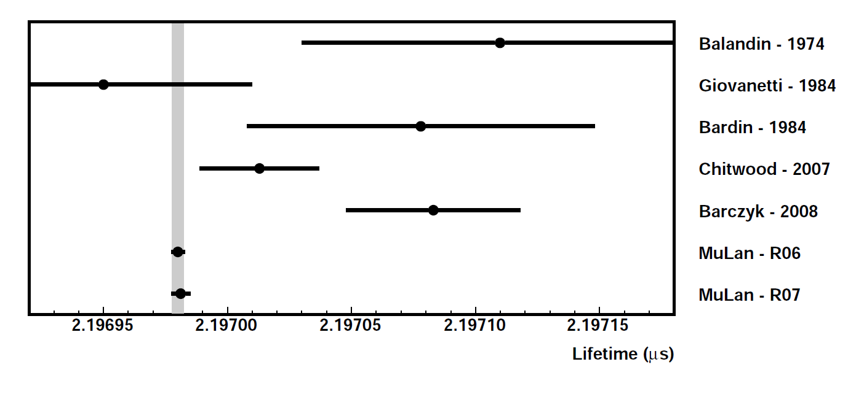
G_{F} = 1.1663818(7) x 10-5 GeV⁻² (0.6 ppm)
MuLan 2007 and 2011
D.B. Chitwood et al., Phys. Rev. Lett. 99, 03201 (2007)
D. Webber et al., Phys. Rev. Lett. 106, 041803 (2011)
V. Tishchenko et al., Phys. Rev. D. 87, 052003 (2013)

Slide 41
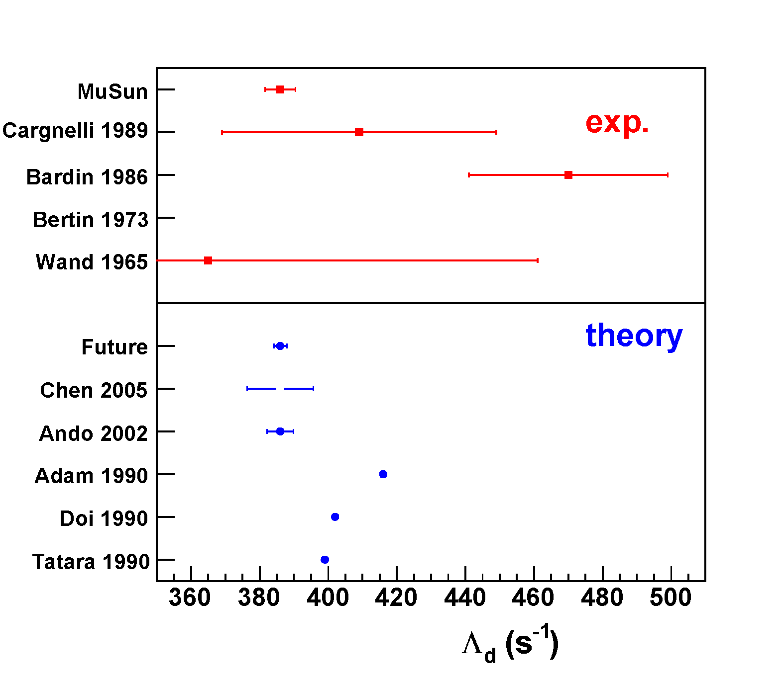
MuSun: Muon capture on the deuteron
Use similar technique of MuCap
Pure deuterium cryo-TPC (30K)
Most of the data taking completed, analysis ongoing
Goal: Measure doublet capture rate Λ_{d} to 1.5%
consistent ChPT

Slide 42
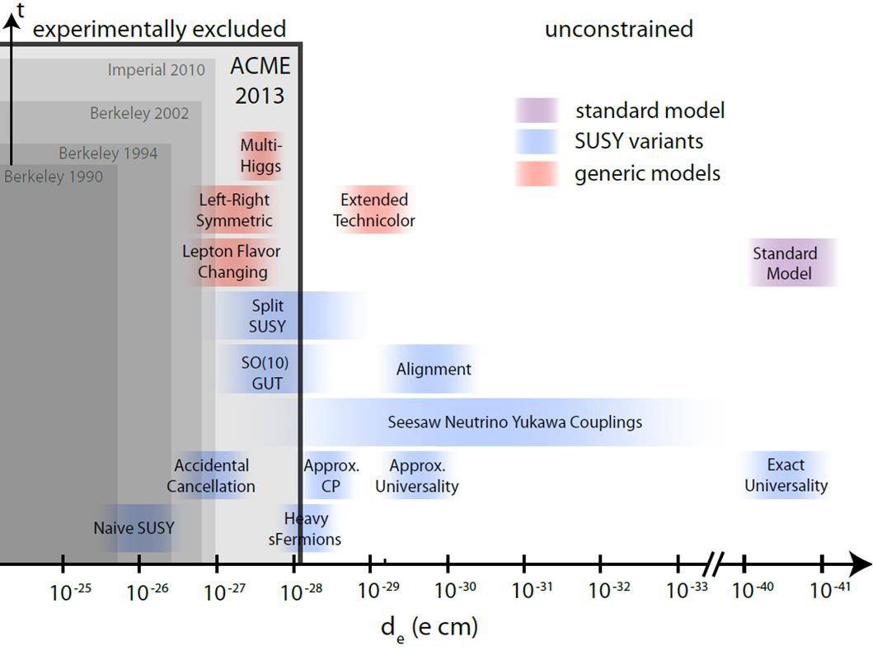
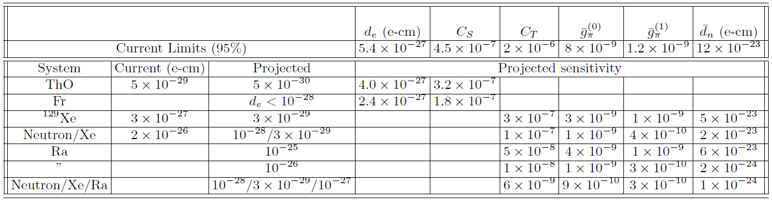
Why do we need EDM measurements in different systems?
Theory required to connect experimental observables to underlying CPV sources
Model-independent approach via EFT
Effective Lagrangian 𝓛_{eff} maps to low-energy parameters characterizing EDMs: d_{e}, C_{S}, C_{T}, d_{n}, g_{π}^{(0,1)}
Need several EDM measurements to disentangle the various possible sources
T. Chupp and M. Ramsey-Musolf, arXiv.1407.1064

Slide 43
ThO EDM excludes certain SM extensions

Slide 44



TWIST results
A. Hillairet et al., Phys. Rev. D 85, 092013 (2012)
This puts limits on specific Left-Right-Symmetric (LRS) models
J.F. Bueno et al., Phys. Rev. D 84, 032005 (2011)

Slide 45

Magic momentum
Term vanishes at magic momentum!
E field introduces new term
Solution: Magic momentum with γ = 29.3 (p = 3.09 GeV/c)

