Slide 1
Status and prospects for MW-class accelerators
- Intensity frontier proton accelerators -
NuFact2016
Quy Nhon, Vietnam, August 23, 2016
Tadashi Koseki
J-PARC center, KEK&JAEA

Slide 2
- Status and future plan of intensity frontier accelerators
Multi-MW accelerator facilities
Summary

Slide 3
Status and future plan of intensity frontier accelerators

Slide 4
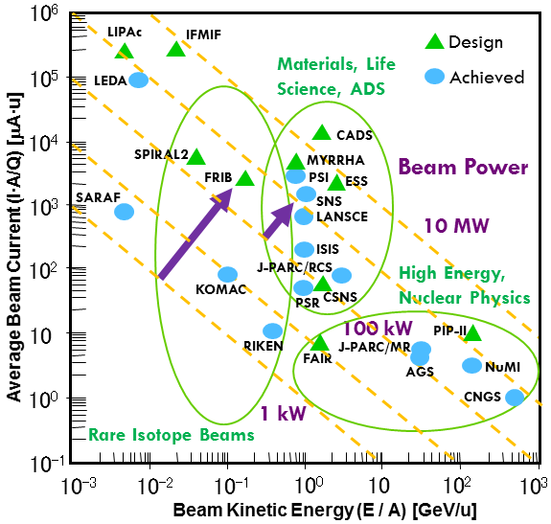
Hadron accelerators in the world
1 MW
J. Wei / Y. Yamazaki

Slide 5
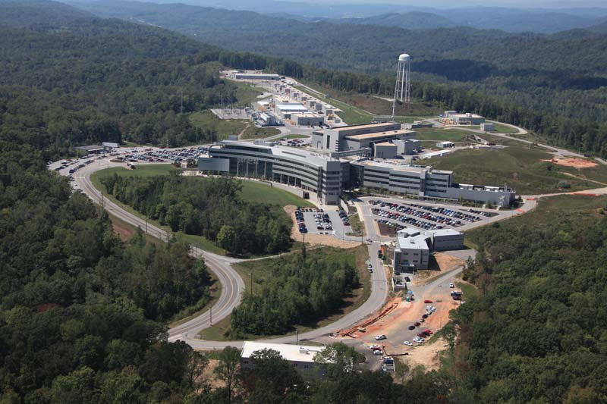
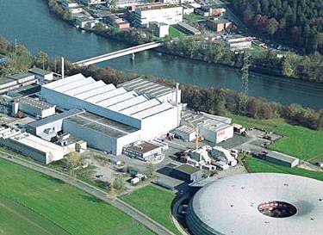
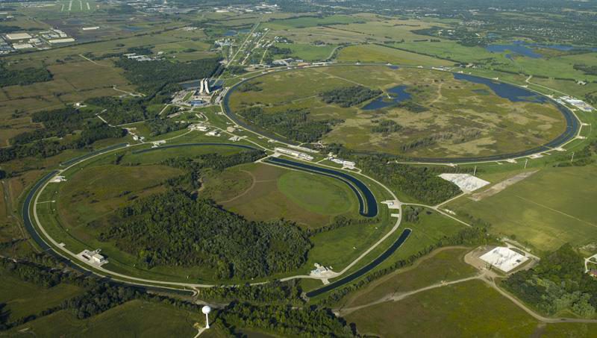
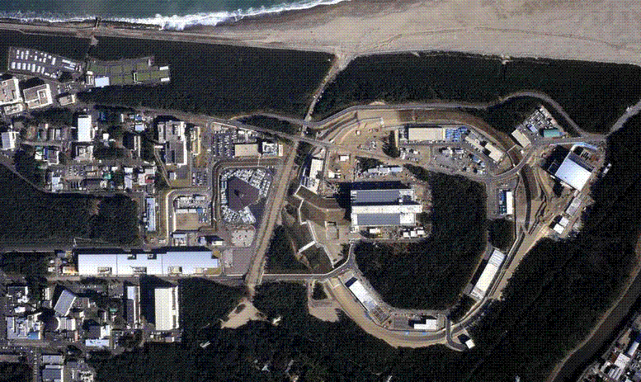
MW-class proton accelerators operating as front-runners
Spallation Neutron Source, ORNL
1-GeV AR, 1.4 MW
HIPA, PSI
590 MeV/u cyclotron, 1.4 MW
Main Injector, FNAL
120-GeV Synchrotron, 700 kW
J-PARC, KEK&JAEA
3-GeV RCS, 1 MW / 30-GeV MR , 750 kW

Slide 6
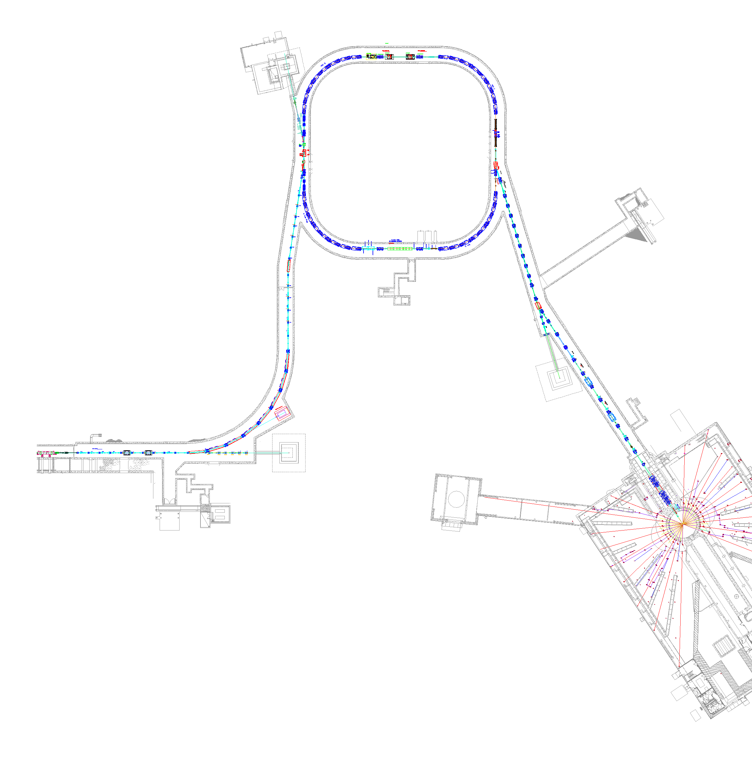


SNS Accelerator Complex
The first hadron accelerator facility which adopts SRF linac technology extensively.
Accumulator Ring
Accumulator Ring: Compress 1 msec long pulse to 700 nsec
Collimators
Front-End:
Produce a 1-msec long, chopped,
H⁻ beam
Extraction
Injection
RF
1 GeV LINAC
1000 MeV
RTBT
2.5 MeV
HEBT
Liquid Hg Target
Front-End
LINAC
Chopper system makes gaps
945 ns
mini-pulse
Current
Current
1 ms macropulse
1ms
M. Plum

Slide 7
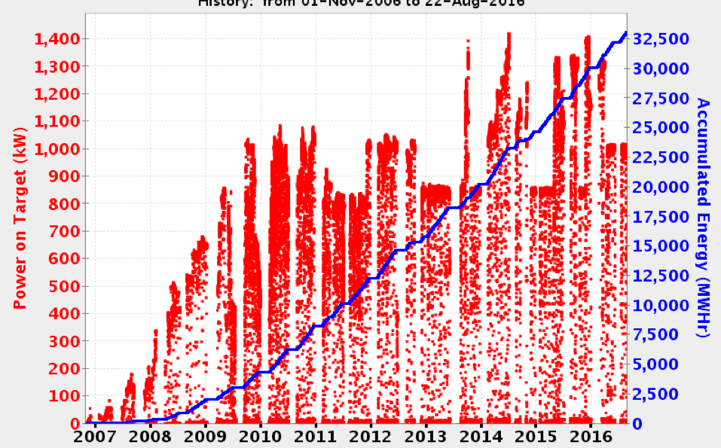
SNS beam power vs time
1.4 MW
1.0 MW
Courtesy of M. Plum
SNS reached 1 MW user operation within 5 years from the beginning in 2006.
Demonstrated full design beam power of 1.4 MW for >24 hours for neutron scattering experiments in June 2014.
Failures on target were stronger limit on operational beam power than the accelerator in the last 4 years.

Slide 8
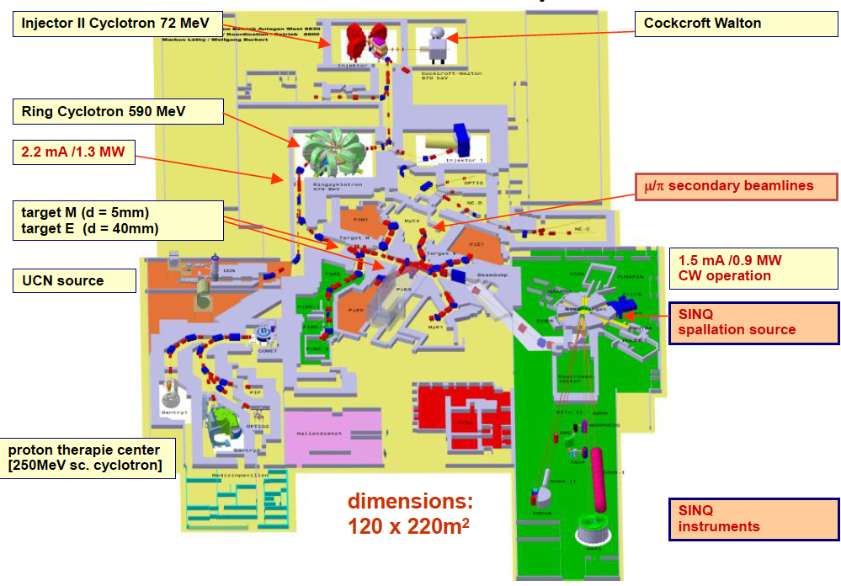
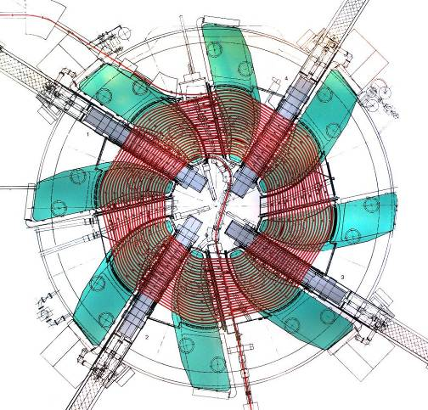
PSI proton accelerator facility
The first accelerator facility which realized 1-MW stable user operation in the world.
A separated sector cyclotron
A flattop cavity, 3rd harmonic resonator, decreases energy spread and increases acceptance. The beam current can be increased from 1 mA to 2.4 mA.
Courtesy of M. Seidel

Slide 9
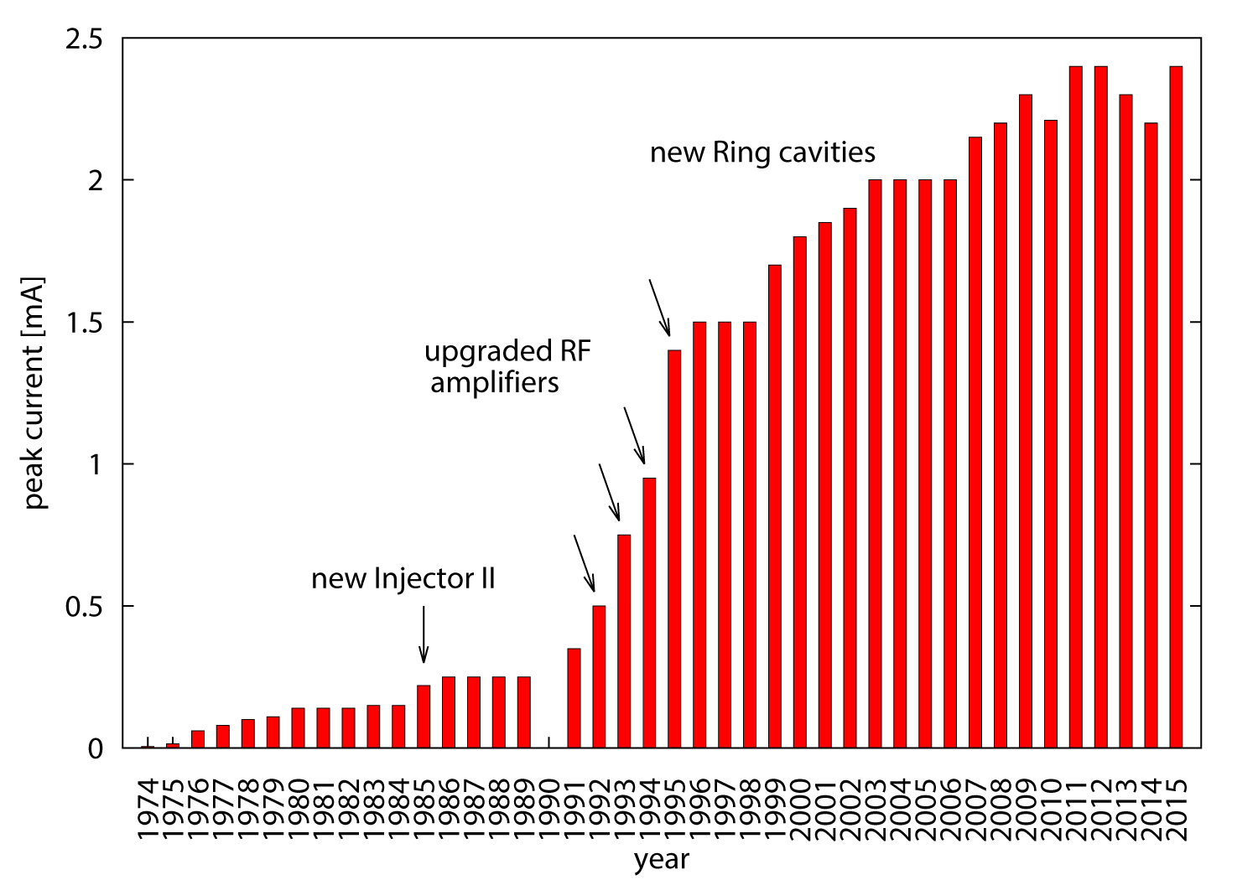
History of peak current in the PSI accelerator
license operation with 2.2mA given: 1.3MW
aperture limitation removed; new ECR source; 50Hz ripple problem solved: 1.4MW
4 new Cu Resonators in Ring complete
plasma problems
M. Seidel
Accelerator upgrade towards 3mA/1.8 MW are now studied; injector upgrade, new flattop cavity, new collimators behind muon production target.

Slide 10
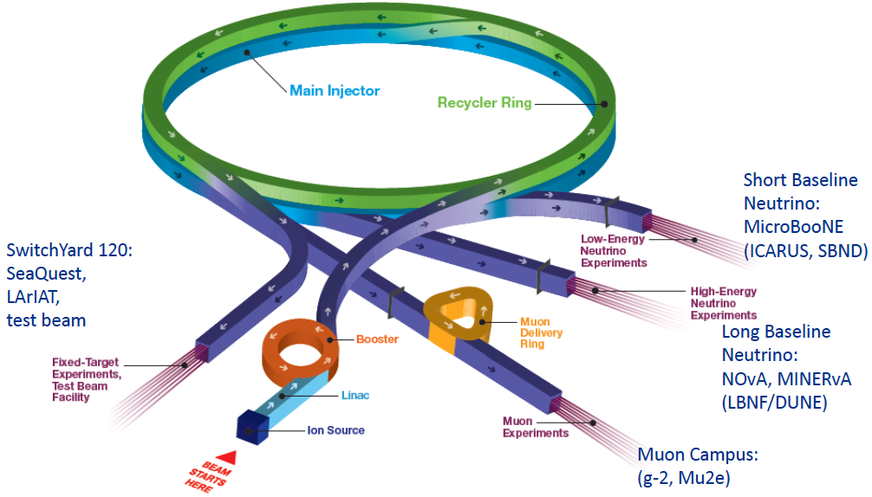
Fermilab Accelerator Complex (enabled by PIP-I)
H⁻ linac : Accelerates H⁻ to 400 MeV
Booster : 400 MeV → 8 GeV at 15 Hz since June 2015 , h=84
Beam delivery to RR/Low energy neutrino experiments
Recycler Ring: a permanent magnet accumulator ring in the MI tunnel, h=588 ( 7*84)
6+6 booster batches are injected to RR using slip-stacking
Beam delivery to the MI and the Muon campus simultaneously.
Main Injector: 8 GeV →120 GeV at 1.33 s cycle time
Beam delivery to High energy neutrino experiments /SY120
Simultaneous operations of NOvA and SY120 (slow extraction beam)
0.5 sec.
Courtesy of S. Nagaitsev

Slide 11
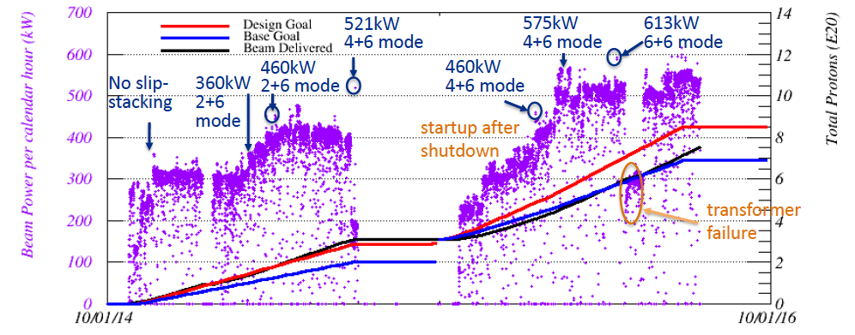
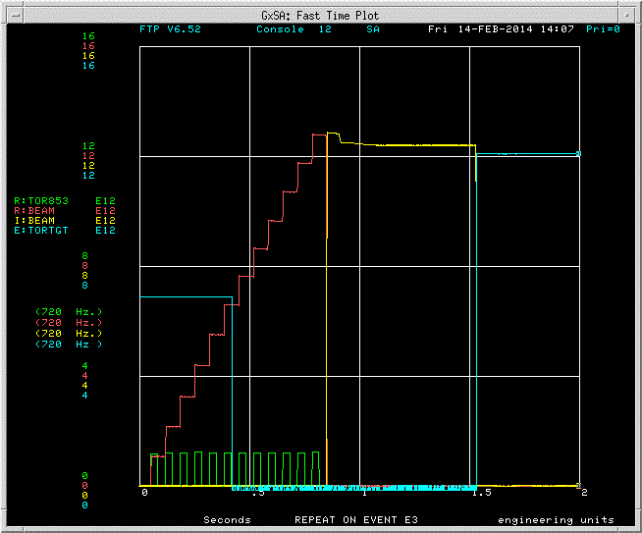
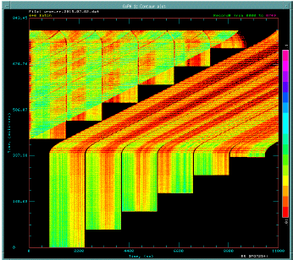
Beam power for NOvA
M. Convery at ICHEP2016
MI
RR
0.8 s
Slip-stacking with 6+6 batches
Booster
Revolution time of RR

Slide 12
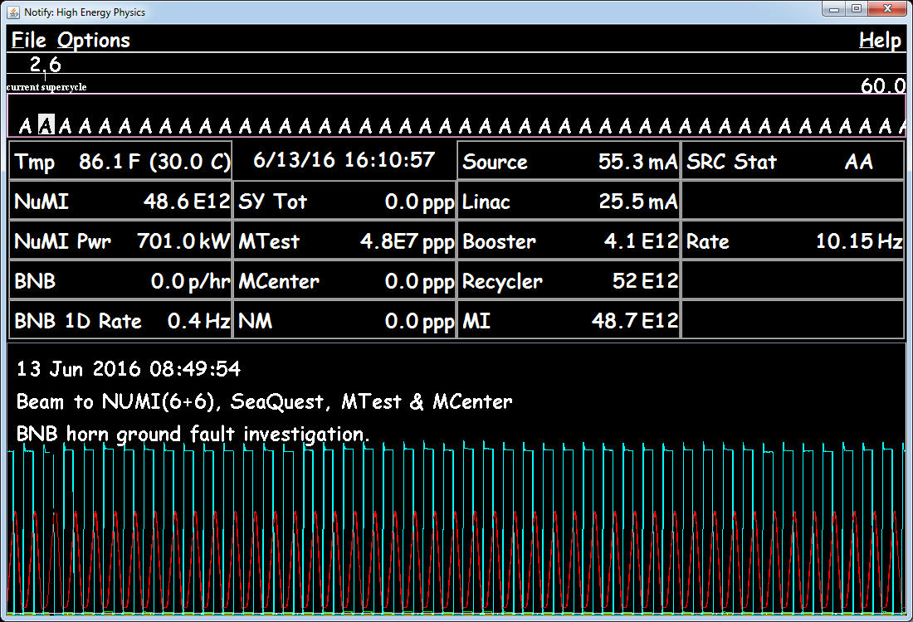
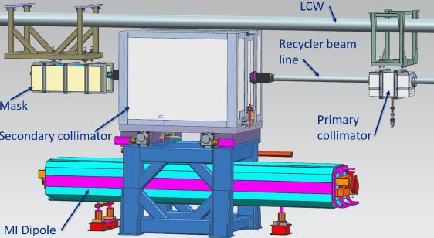
Ramp up to > 700 kW
~one minute demonstration
On going upgrade for > 700 kW user operation:
Add new collimators in the RR
Add two more cavities in booster for reliability and eliminating losses
New injection scheme of the booster
etc.

Slide 13
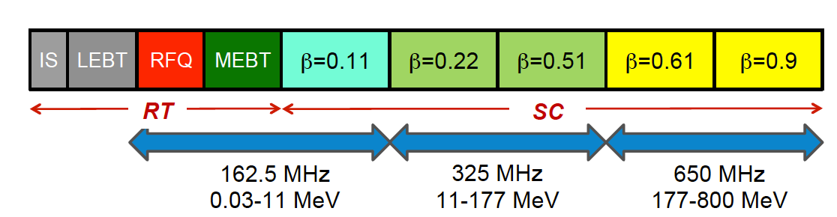
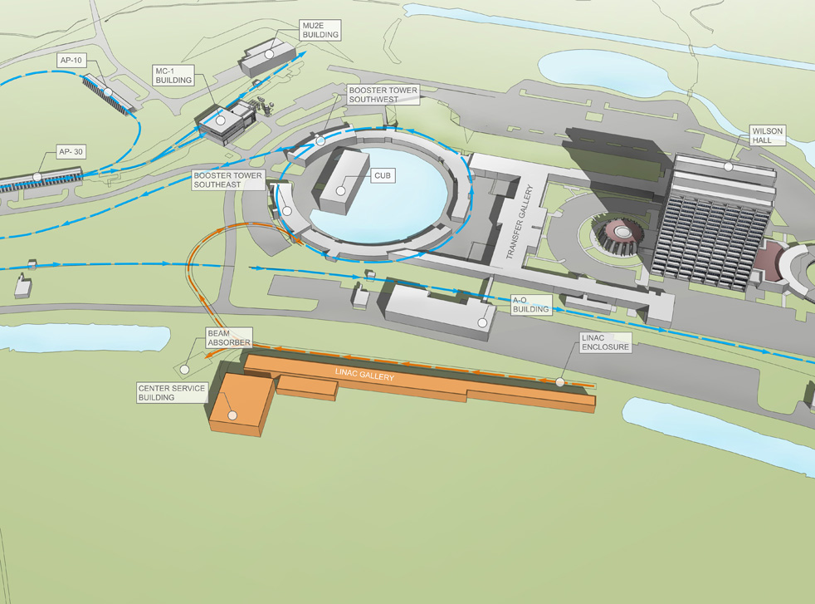
PIP-II
Goal: Provide >1 MW at the time of LBNF startup (~2023)
800 MeV superconducting pulsed linac + enhancements to existing complex
Performance Parameter | PIP-II
Linac Beam Energy | 800 | MeV
Linac Beam Current | 2 | mA
Linac Beam Pulse Length | 0.5 | msec
Linac Pulse Repetition Rate | 20 | Hz
Linac Beam Power to Booster | 13 | kW
Linac Beam Power Capability (@>10% Duty Factor) | ~200 | kW
Mu2e Upgrade Potential (800 MeV) | >100 | kW
Booster Protons per Pulse | 6.4×10¹²
Booster Pulse Repetition Rate | 20 | Hz
Booster Beam Power @ 8 GeV | 120 | kW
Beam Power to 8 GeV Program (max) | 80 | kW
Main Injector Protons per Pulse | 7.5×10¹³
Main Injector Cycle Time @ 120 GeV | 1.2 | sec
LBNF Beam Power @ 120 GeV* | 1.2 | MW
LBNF Upgrade Potential @ 60-120 GeV | >2 | MW
Courtesy of S. Nagaitsev

Slide 14
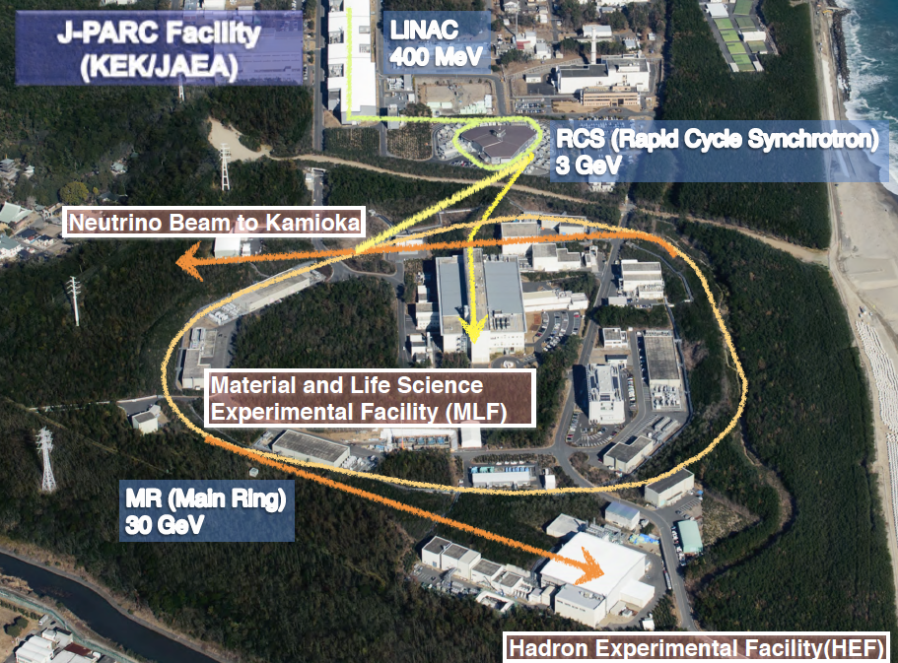
J-PARC
RCS is proton driver for neutron/muon production in MLF and booster for the MR.
400-MeV H- linac
3-GeV RCS with 25 Hz
30-GeV MR with cycle time of 2.48/5.52 sec
MR has a lattice of imaginary transition γ and two extraction modes (FX and SX).

Slide 15
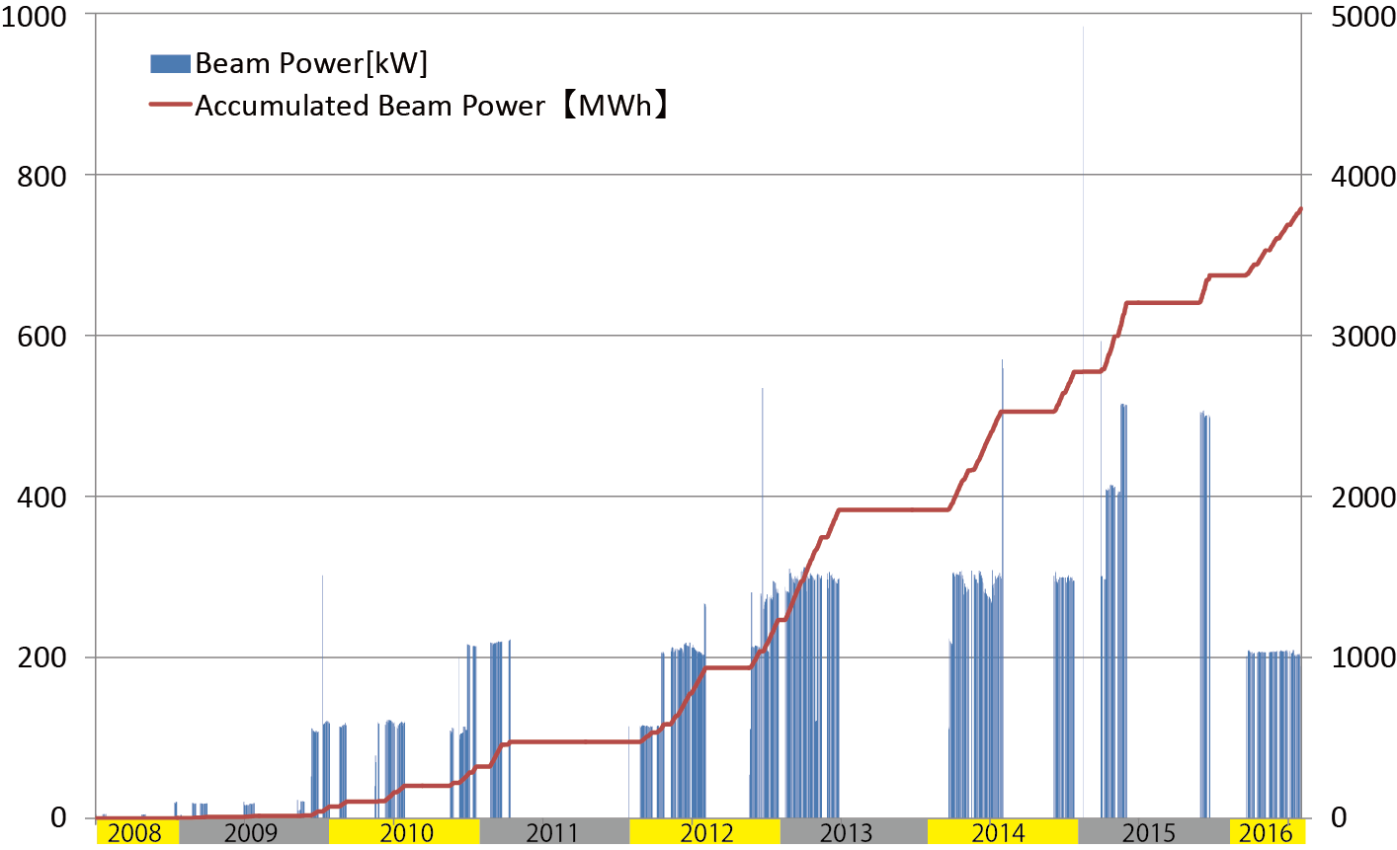
Beam Power History at MLF
1 MW eq. (~8.4e13 ppp) demonstration
500 kW
Radioactive material leak incident at
Hadron Facility
Accumulated Beam Power [MWh]
Beam Power [kW]
300 kW
Hg-target
replacement
Earthquake
～1 month interruption
due to the fire in MLF
Interruption due to troubles of Hg-target
as of 30th of June 2016

Slide 16
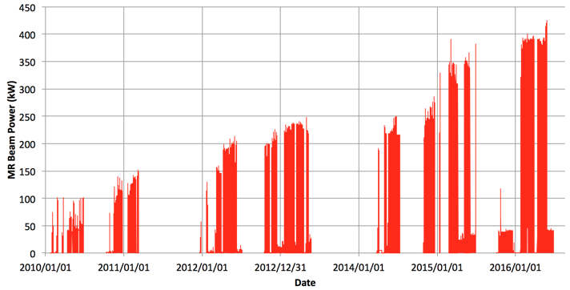
Beam power history of MR
Beam stop due to the radioactive material leak incident in HEF
Beam stop due to the earthquake
Achieved beam power:
Fast extraction ~ 425 kW (2.2x10¹⁴ ppp) for users , 440 kW for demonstration.
Slow extraction ~42 kW (4.9 x10¹³ ppp) for users , 50 kW for demonstration.

Slide 17
Mid-term plan of MR
FX：The high repetition rate scheme is adopted to achieve the design beam intensity, 750 kW. Rep. rate will be increased from ~ 0.4 Hz to ~1 Hz by replacing magnet PS’s, RF cavities and some injection and extraction devices.
SX： The beam power of the MR will be gradually increased toward 100 kW watching the residual activity. In the HEF, the primary target will be replaced new ones which have more cooling capability in 2018 and 2021.
JFY | 2015 | 2016 | 2017 | 2018 | 2019 | 2020 | 2021
 |  |  |  | HD target (80kW) |  |  | HD target (>100 kW)
FX power [kW] SX power [kW] | 390 42 | 425-450 42-50 | 450-500 50 | 700 50-70 | 800 80 | 900 80 | 1060 ~100
Cycle time of main magnet PS New magnet PS | 2.48 s |  |  | 1.3 s | 1.3 s | 1.25 s
High gradient rf system 2nd harmonic rf system
Ring collimators | Add.collimators (2 kW) |  | Add.colli. (3.5kW)
Injection system FX system
SX collimator / Local shields
Ti ducts and SX devices with Ti chamber |  |  | ESS
New PS buildings
Mass production
installation/test
Installation
Manufacture, installation/test
Kicker PS improvement, Septa manufacture /test
Kicker PS improvement, FX septa manufacture /test
Local shields
COMET / high-p physics run

Slide 18
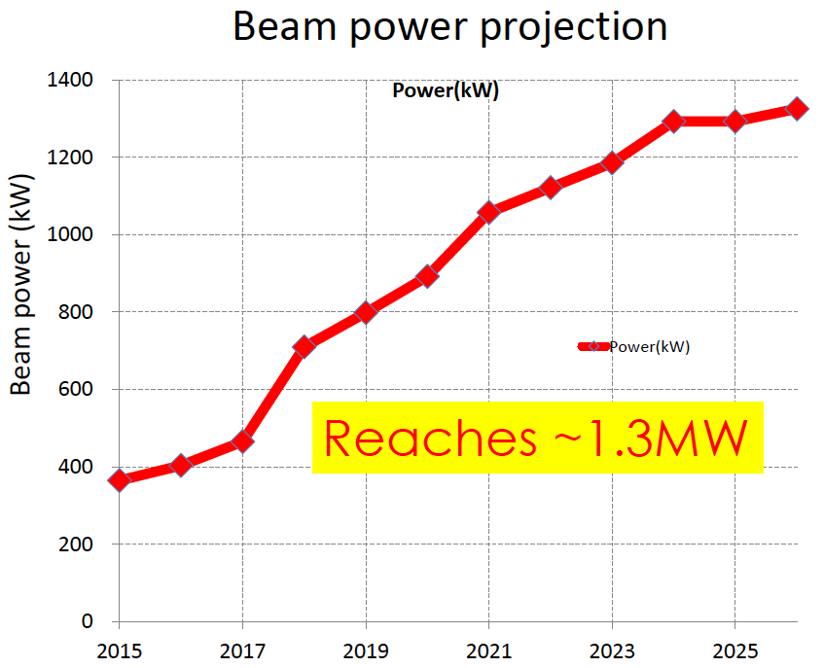
Beam power projection of MR fast extraction
RF anode power supply upgrade
Air-cooled 2nd RF
1.16 s cycle
10th RF system
1.20 s cycle
1.25 s cycle
Magnet PS upgrade
2.48 → 1.3 s cycle
JFY
Notes:
This picture shows expected power.
Horizontaｌ is JFY and vertical is beam power.
Now we are here.
Here , we have magnet PS upgrade and after that cycle time is gradually shortened.
And we plan to upgrade RF anode power supply here. And we reach 1.3 MW in 2023, if budget is approved as the plan.

Slide 19
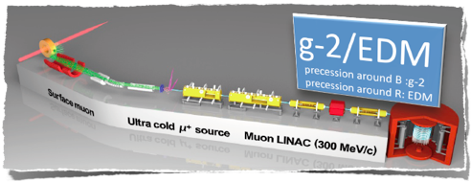
COMET(I <10⁻¹⁴; II < 10⁻¹⁶)
Search for muon to electron conversion
Adopted staging approach
Phase-I: 10⁻¹⁴ (already funded)
Phase-II: 10⁻¹⁶
32 m SC solenoid magnet
Beam extinction < 10⁻⁹
8 GeV, 3.2 kW(Phase-I) and 56 kW(Phase-II)
Phase I
g-2/EDM (0.1ppm/10⁻²¹ e cm)
at MUSE in the MLF
Ultra-Cold Muon Beam
with muon linac RFQ,IH,disk-loaded
- Ultra-Precision Magnetic Field
  3T, 1 ppm
Phase II

Slide 20
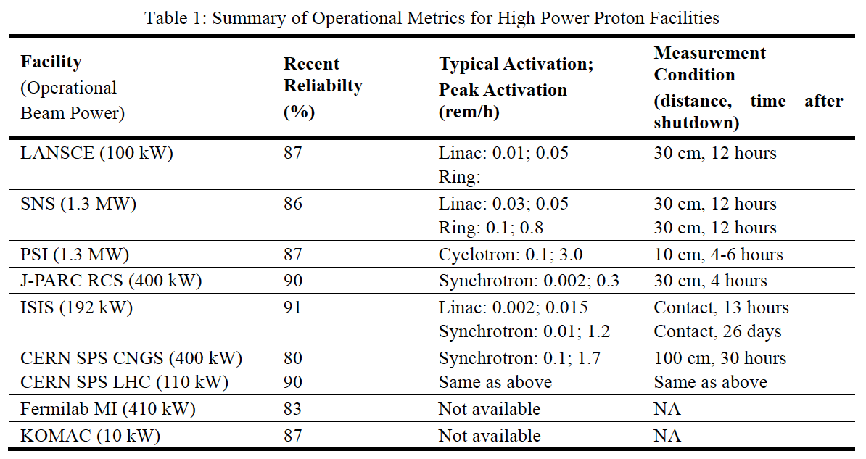
Reliability and residual activation for high intensity proton facilities
S. Cousineau, “High Power Proton Facilities: Operational Experience, Challenges, and the Future”, Proc. IPAC2015
Synchrotron and rings have much higher residual activation. But they should be improved by better understanding beam loss mechanism and reducing uncontrolled beam losses in spite of beam intensity increasing.

Slide 21
Challenges in the high beam intensity accelerators
Challenges on beam dynamics
Eliminating beam loss due to collective effects
- Space charge effects,
Beam instabilities – due to coupling impedance, electron cloud effects
Beam halo – to understanding the mechanism of halo formation is important for high power operation.
Gamma transition jump in synchrotron
Challenges on hardware
Cutting edge technologies should be developed for accelerator systems.
- Charge exchange injection
Beam collimators
Extraction devices and methods (specially for slow extraction)
Precise beam monitors with wide dynamic range
Superconducting rf technology with high performance and cost effective
High power targetry / Beam window

Slide 22
Space charge issues on high power beam operation
Space charge tune shift at J-PARC MR :
Number of protons: 2.5e13 ppb
(380 kW @2.48s cycle)
Intensity of synchrotrons/accumulator rings are limited by space-charge effect at injection energy. In order to avoid beam loss due to betatron resonances in the presence of space charge tune shift ;
- Correction of resonances
- Increase bunching factor
- Rise the injection energy
- Increase physical aperture…

Slide 23
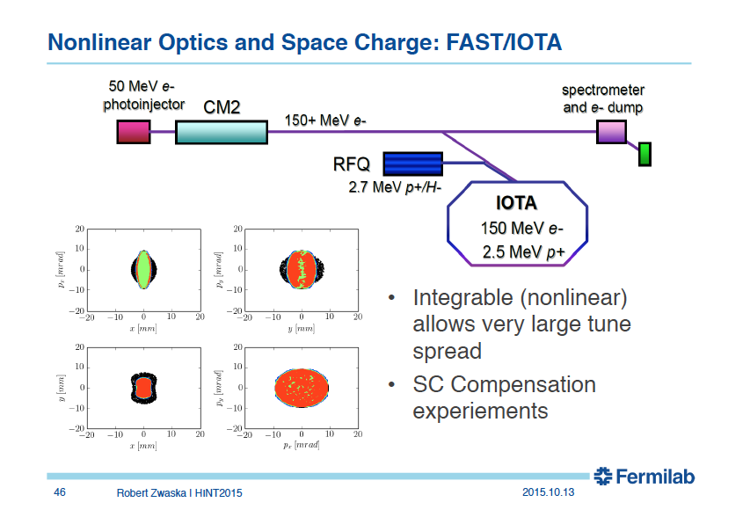
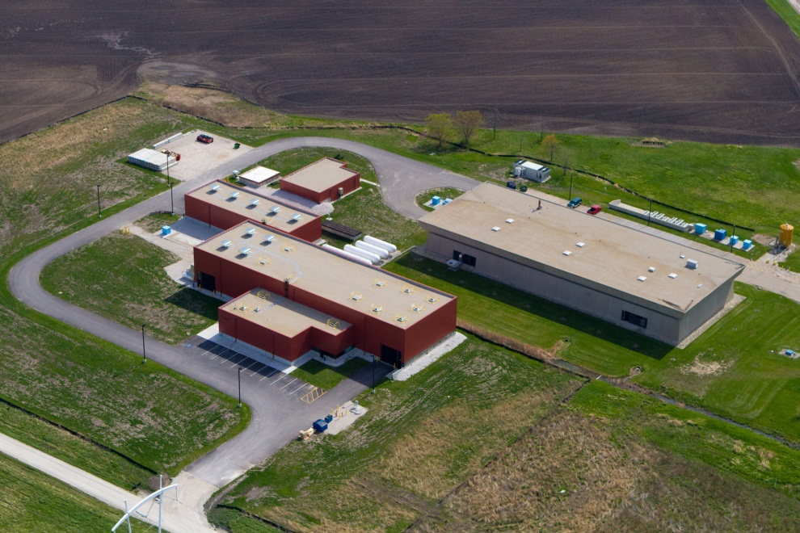
ASTA/IOTA project at Fermilab
ASTA/IOTA project is aiming at breakthrough research to increase beam power (x 3-5 times) in future proton rings.
R. Zwaska in HINT2015 workshop
IOTA (Integrable Optics Test Accelerator)
Can operate with either electron or proton
Large aperture
Significant flexibility of the lattice
Precise control of the optics quality and stability
Set up for very high intensity operation with proton
Slide from R. Zwaska in HINT2015

Slide 24
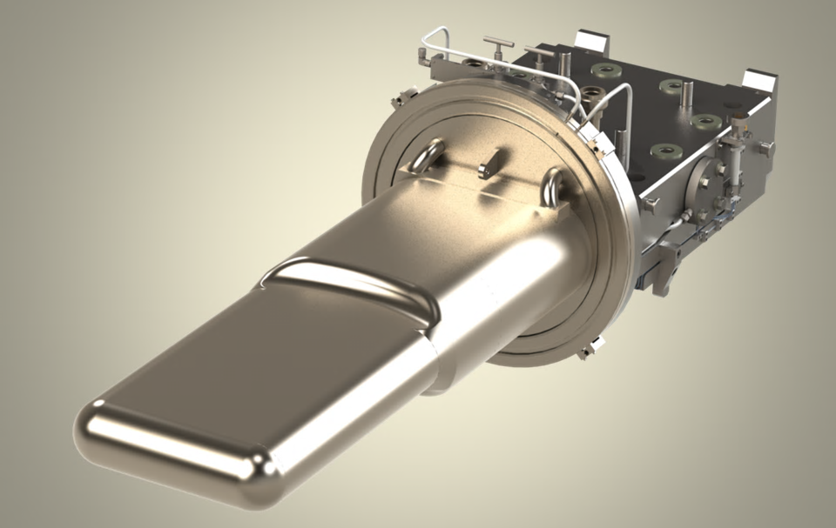
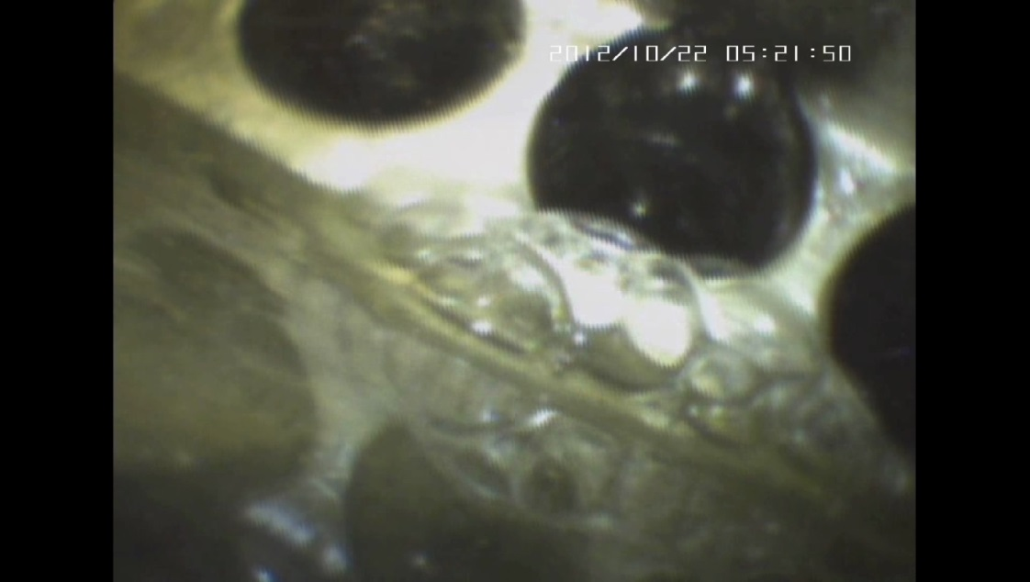
Target improvement
SNS Target failures
  Five out of the last eleven targets have failed at weld joints
M. Plum
2014
Leak detector fluid “bubbling” through weld failure on the target
J-PARC also had unscheduled beam shutdown due to troubles on mercury targets two times in 500 kW user operation in 2015. Causes of the both cases are weld failures.
  New targets are designed to improve / eliminate weld joints for higher reliability.
High Power Targetry is one of key technologies for the future high power facilities.
R&D’s on a material behavior regarding a thermal shock and radiation damage in target should be conducted tenaciously.

Slide 25
Multi-MW accelerator facilities

Slide 26
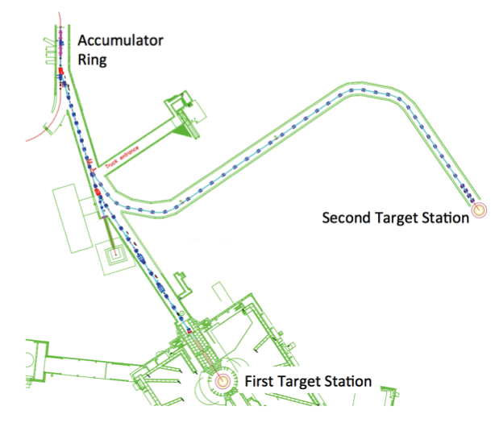
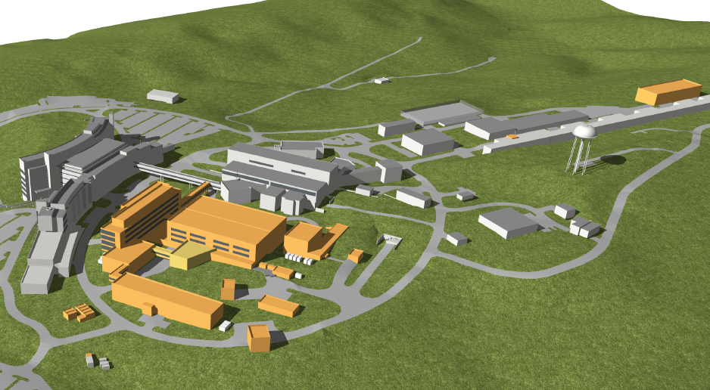
2nd target station and beam power upgrade
 | Present | Upgrade
Number of particles | 1.5e14 ppp | 2.4e14 ppp
Beam energy | 1 GeV | 1.3 GeV
Beam power | 1.4 MW | 2.8 MW
Linac 60 Hz: FTS 50 Hz, 2-2.3 MW
STS 10 Hz, 0.47 MW
RFQ peak current : 33 → 46 mA
Chopping fraction : 0.7 → 0.82
Courtesy of M. Plum

Slide 27
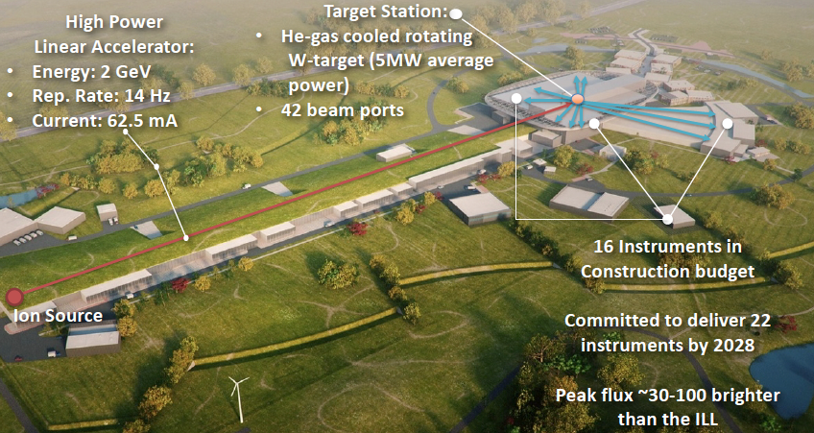
ESS(European Spallation Source)
Construction started in 2014.
First beam on target at 572 MeV in June 2019
Start user operation in 2023
Courtesy of H. Danared
ESSnuSB project → N. Vassilopoulos in the WG3 session

Slide 28
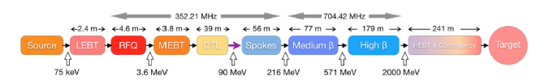
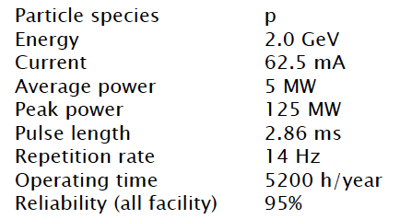
ESS accelerator
Beam dynamics rule of thumb:
The zero current phase advance per period in all the planes must be less than 90 deg
The phase advance per meter (average phase advance) variation should be smooth and continuous
The tune depression, k_{sc}/k₀ , must stay above 0.4 in all the planes during acceleration
Courtesy of H. Danared

Slide 29
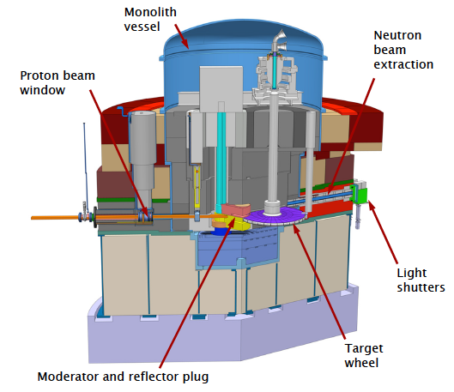
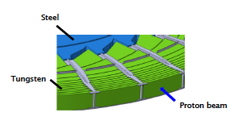
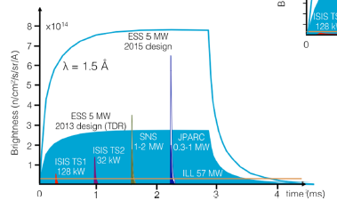
Neutron production target
Neutron intensity/pulse for ESS and other operating facility
Features and requirements
Rotating target wheel
36 tungsten sectors
5 MW heat removal
Helium gas cooling
High brightness modurators
Confinement and shielding
Courtesy of H. Danared

Slide 30
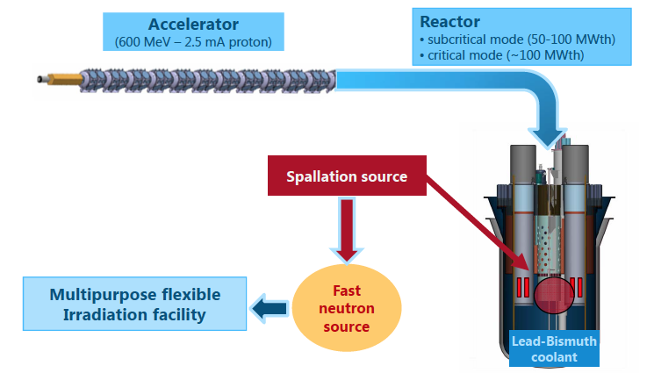
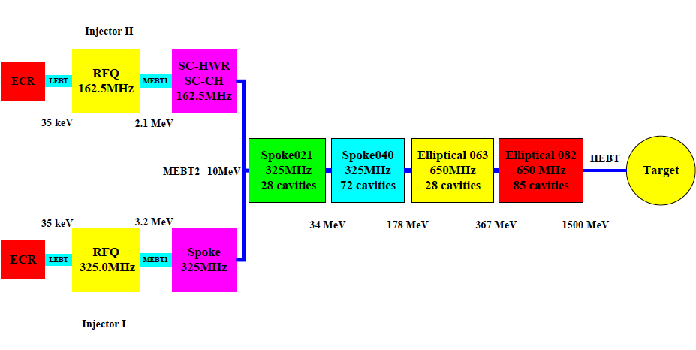
Accelerators for ADS
MYRRHA (Belgium)
Proton linac 600 MeV, 2.4 MW
- Demonstrate the ADS concept at pre- industrial scale
Demonstrate transmutation
Multipurpose and flexible irradiation facility
C-ADS (China)
Proton linac 1.5 GeV, 15 MW
Two alternatives developed:
→ test operation and technical selection in 2016
- Phase I : R&D facility
Phase II : Experimental facility
      ~10 MW (~2032)
Phase III: Demo facility
IMP
W. Pan and J. Dai,”ADS based on linear accelerator”, Review of accelerator Science and technology, Vlo. 8 (2015) World Scientific.
IHEP

Slide 31
PIP-III
From “High Power Proton Beams for Particle Physics ” Sergei Nagaitsev,
11th ICFA seminar on Future Perspective in High Energy Physics

Slide 32
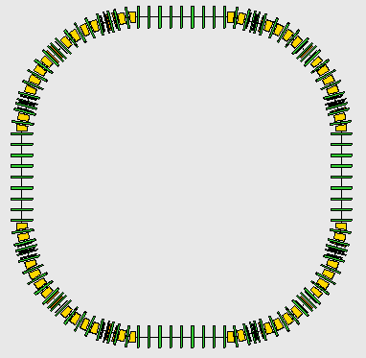
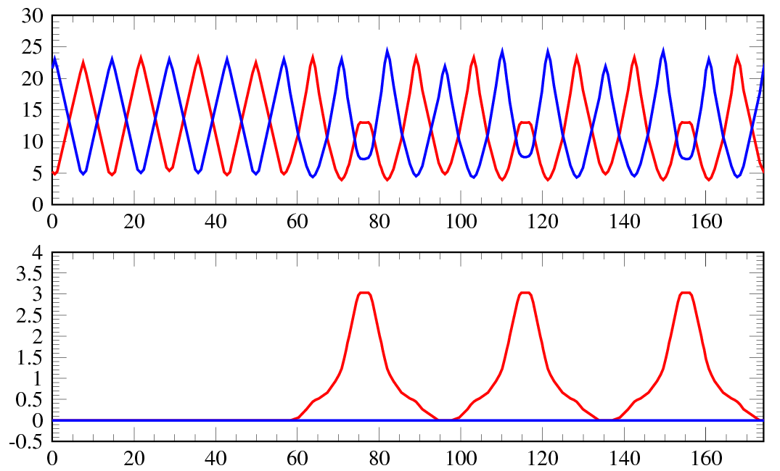
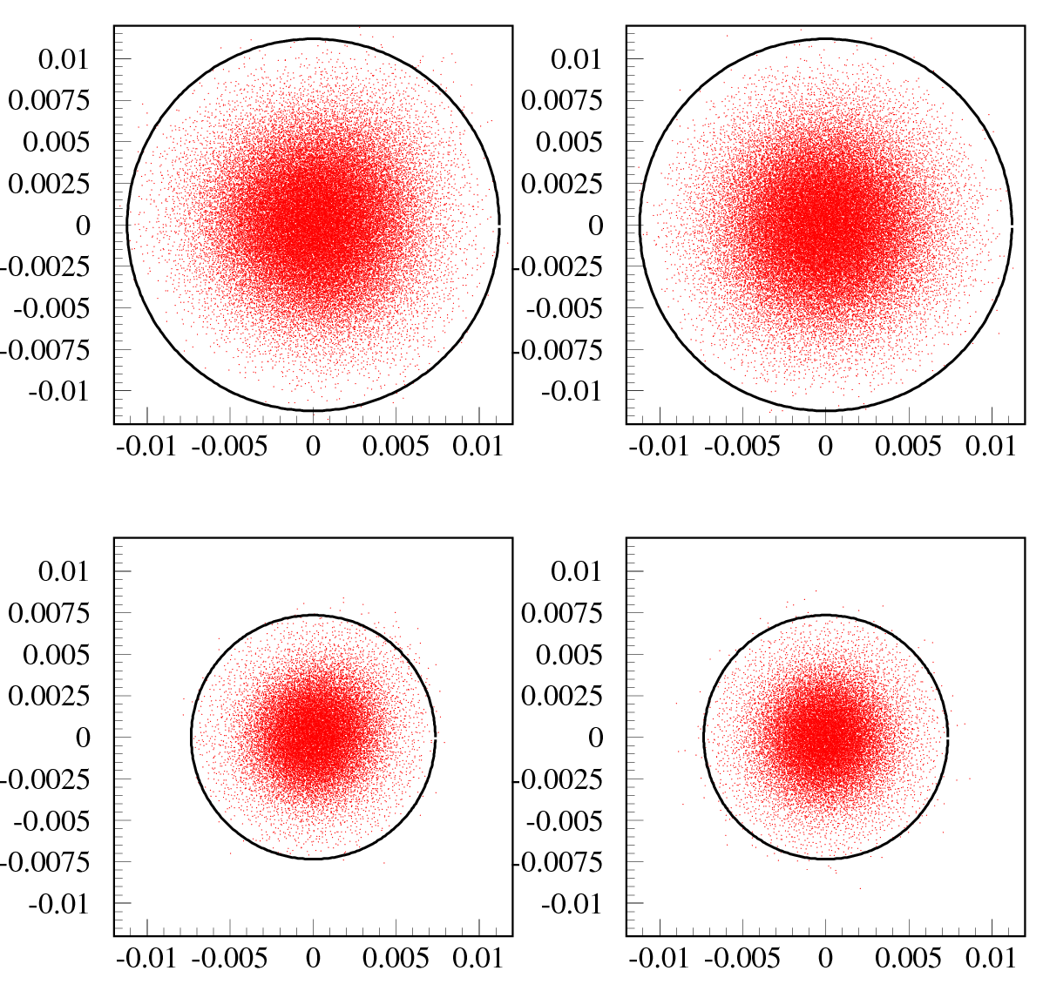
J-PARC: The 8-GeV booster ring
Beta & Dispersion for 1-superperiod
H & V
RF CAVs
β_{x,y} (m)
8-GeV BR
Injection energy 3 GeV
Extraction energy 8 GeV
Circumference 696.666 m
Superperiodicity 4
Transition gamma ~15 GeV
Collimator Aperture 126π.mm.mrad
Physical Aperture 189 π.mm.mrad
INJ+COLL
RF CAVs
η_{x,y} (m)
s (m)
EXT
Phase plot @ inj.(3GeV) & extr.(8GeV)
(x,x’)
(y,y’)
@ 3GeV
8 GeV injection in the MR using new septa&kickers
ε>125.5π ~0.04%
RCS : 1.6 MW
MR > 2.6 MW
RCS : 2 MW
MR > 3.2 MW
@ 8GeV
ε>54π ~0.06%

Slide 33
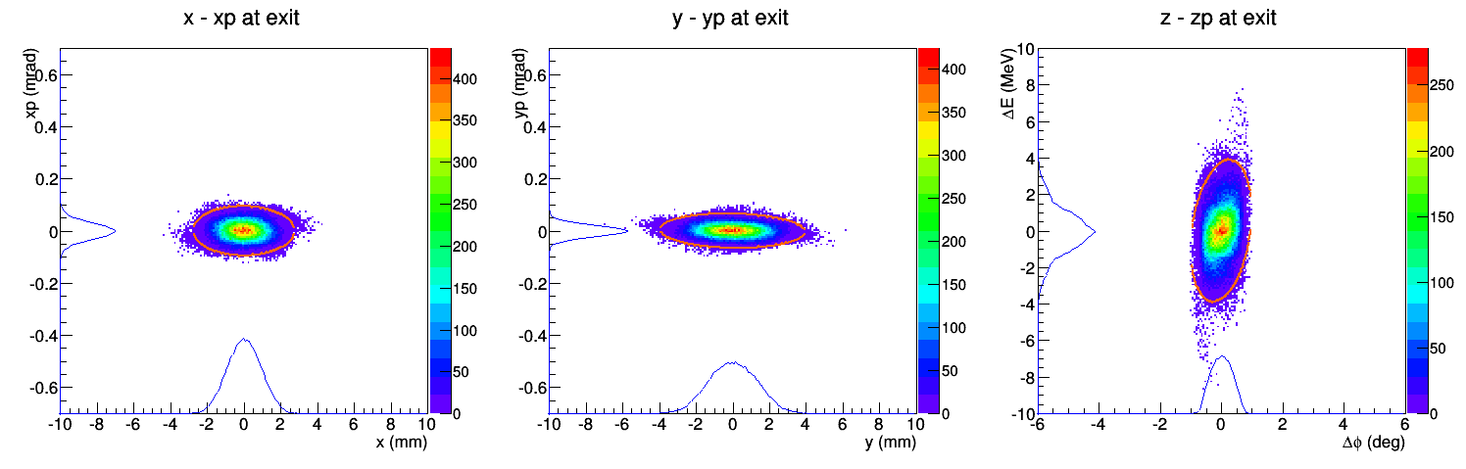
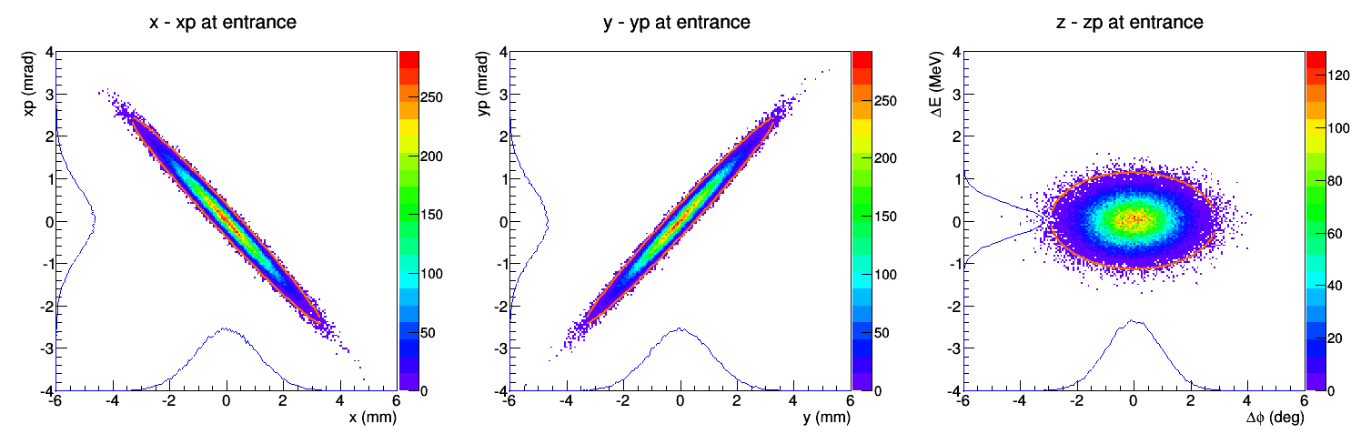
The proton driver in the KEKB Tunnel
For the acceleration in the 2nd to 4th straight section, the ILC cavity is adopted.
- Outline of acceleration :
  1.2 GeV in 1st straight.
  3.3 GeV in 2nd straight.
  2.9 GeV in 3rd and 4th straight.
  3.3 + 2.9 x 2 = 9.0 GeV
- Peak current : 100 mA (pulse)
- Beam duty : 1 %
- Beam power :
9 GeV x 0.1 A x 1 % = 9 MW
6.2 GeV
Three 1.3 GHz
rebunchers
9 GeV
Three 1.3 GHz
rebunchers
To Kamioka
3.3 GeV
Three 650 MHz
rebunchers
1.2 GeV
Layout of front-end and the 1st straight section
Details were given by G. T. Park in WG3 session

Slide 34
Summary
During past decade, accelerator facilities for neutron/muon generation, PSI and SNS, advanced the frontier of beam intensity and realized 1 MW with high operational availabilities.
High energy accelerators for neutrino experiments were also frontier of beam intensity. They will reach beam power > 1 MW by the beginning of 2020s if the budgets are approved as planed.
Multi-MW facilities like ESS, accelerators for ADS, PIP-III and J-PARC 8 GeV booster / 9 GeV proton driver are studied / constructed.
Deep understanding of beam dynamics and R&Ds of cutting edge technologies should be pursued continuously and also in international collaboration.
Thanks all the contributors;
H. Danared, Mats Lindroos (ESS), S. Nagaitsev, R. Zwaska (FNAL), M. Seidel (PSI), M. Plum (SNS), M. Ikegami (FRIB), S. Igarashi, H. Harada, H. Hotchi, T. Maruta, F. Maekawa, G. T. Park, Y. Sato, H. Takada (J-PARC).

Slide 35
Backup

Slide 36
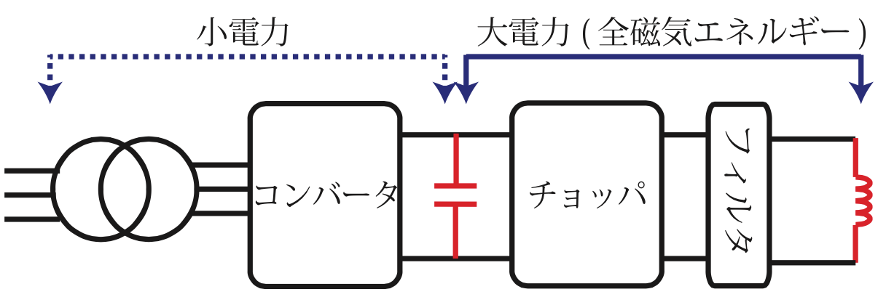
New power supply for high repetition rate operation
Large scale PS for bending magnets and quad. magnets in arc setions
Small power
Large power (full mag. power)
小電力
大電力（全磁気エネルギー）
Two large converters and large capacitance for energy recovery, symmetric power module circuit
AC-DC
Convert-or
DC-DC
Convert-or
Filter
Magnet
D1-3: existing buildings
D4-6: Newly constructed buildings
磁石
Transformer
C−bank
トランス
C-bank
Results of prototype PS
Y. Kurimoto
Budget for three buildings of the magnet PS’s and for starting mass production of the PS’s have been approved by the government in JFY2016.
The 1st quadrupole PS will be transferred to J-PARC and tested in the 2016 summer shutdown period.
Construction of the three buildings will be finished in August of 2017.

Slide 37
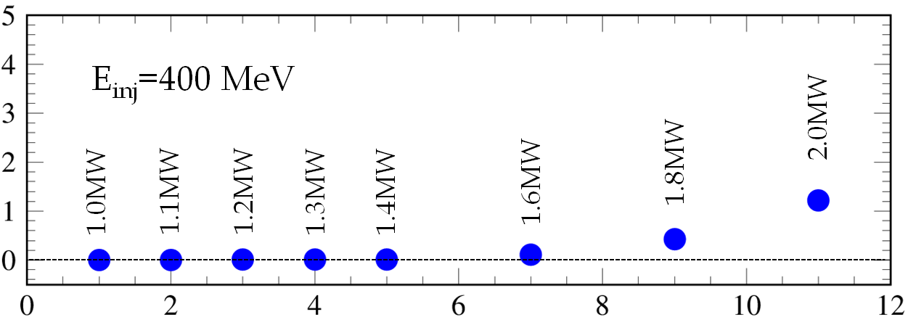
Feasibility of the RCS
Injection beam parameters:
Energy : 400 MeV
Peak current : 50 mA~100 mA
Pulse length: 0.5 ms
Chopper-beam on duty : 0.53
RCS intensity | Loss | Loss power at 25 Hz
1.0 MW | ~0.3% | 400 W
1.1 MW | ~0.3% | 440W
1.2 MW | ~0.3% | 480 W
1.3 MW | ~0.3% | 520 W
1.4 MW | ~0.3% | 560 W
1.6 MW | ~0.5% | 1067 W
1.8 MW | ~0.7% | 1680 W
2.0 MW | ~1.5% | 4000 W
Loss (%)
Beam intensity
RCS collimator limit ~4 kW
→ RCS has a feasibility to operate 2 MW
Linac 100 mA/0.5 ms (50 mA/1.0 ms) operation is required.
R&D of ion source / long pulse operation of linac
The rf system should be replaced to compensate a heavy beam loading.
The collimator capability should be upgraded to get a margin for the beam loss.
Activation downstream of the charge exchange foils should be reduced.
….

Slide 38
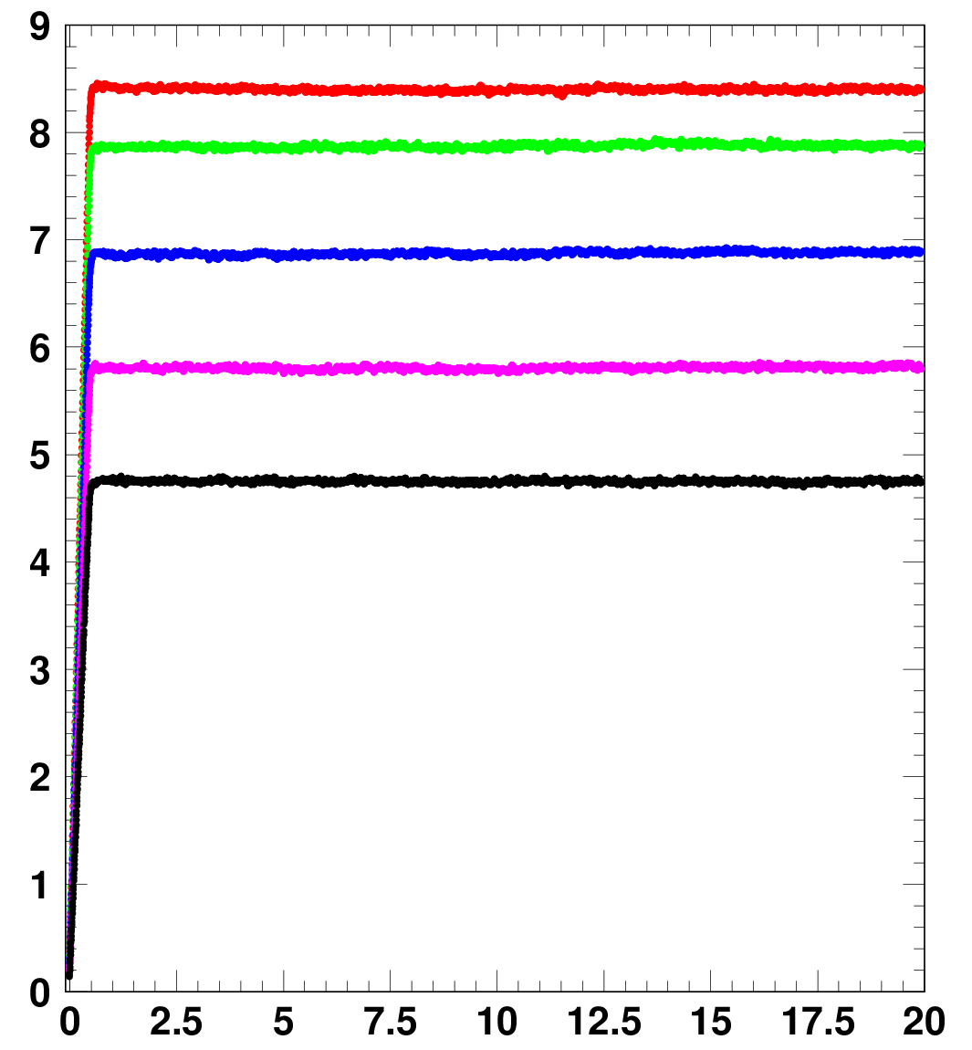
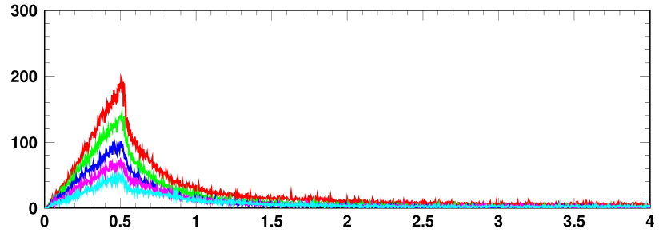
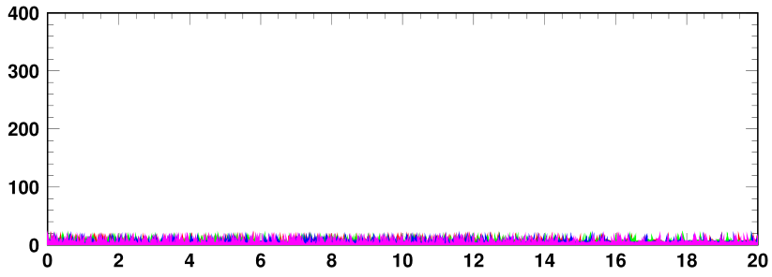
H. Hotchi
Demonstration of 1 MW-eq. beam in RCS
BLM signals @ collimator & arc sections
8.41 x 10¹³ :1010 kW-eq.
7.86 x 10¹³ :944 kW-eq.
Mainly due foil scattering during injection
6.87 x 10¹³ :825 kW-eq.
Collimator section
8.41 x 10¹³
Collimator section
ー 1014 kW-eq. : 8.45 x 10¹³
ー 870 kW-eq. : 7.25 x 10¹³
ー 731 kW-eq. : 6.09 x 10¹³
ー 606 kW-eq. : 5.05 x 10¹³
ー 473 kW-eq. : 3.94 x 10¹³
7.86 x 10¹³
6.87 x 10¹³
5.80 x 10¹³ :696 kW-eq.
5.80 x 10¹³
4.73 x 10¹³
Number of particles / pulse (x10¹³)
4.73 x 10¹³ :568 kW-eq.
Time (ms)
Beam loss < 0.1 % ( < 133 W ) << 4 kW collimator limit
First arc section (near the dispersion peak)
First arc section
Time (ms)
Time (ms)
We are ready to start 1 MW operation in the RCS.

Slide 39
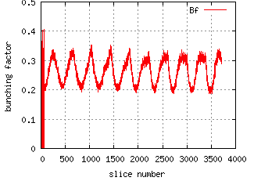
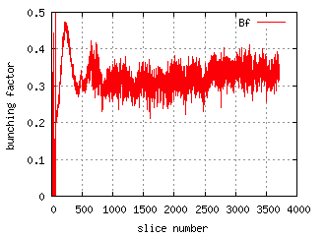


Toward the beam intensity > 1MW
Beam Power (kW) | 425 (Achieved) | 813 | 1000 | 1326
#ppp(10¹⁴) | 2.2 | 2.2 | 2.6 | 3.2
Rep T (s) | 2.48 | 1.3 | 1.3 | 1.16
Higher rf voltage and more operating margin
Reinforcement of anode power supplies to increase anode current of power amplifier
Additional rf system (# 10)
Air-cooled second harmonic rf system
mitigating space charge effect.
VHF rf system
mitigating space charge effect.
(Suppression of the longitudinal instabilities)
BPM upgrade
more precise and faster measurement.
FX kicker upgrade
Low beam coupling impedance
Measured bunching factor and longitudinal distribution of 3.2x10¹³ ppb (~1 MW for 1.3 s cycle)
Without 2nd harmonics
With 2nd harmonics

Slide 40

Decreasing beam loss due to space charge in J-PARC MR
Correction of linear coupling resonance by skew quadripoles
Two bunches,
3-GeV accumulation
2nd harmonic rf voltage
Bunching factor

Slide 41



High Intensity beam study
- at the new betatron tune (21.239, 21.310) -
High power trial with two bunches
Extracted beam : 3.41e13 ppb
6.82e13 ppp (132 kW eq. ,2 bunches)
Beam loss due to the horizontal instability
Total beam loss ~ 420 W
Horizontal
Vertical
Near future tunable knobs to reduce the beam loss:
Injection kicker, BxB feed-back, 2nd harmonic cavity, etc.
Δ BPM signal
Details will be given by Y. Sato in WG3 session
 | Bunch number | repetition period (sec) | Beam power (kW) | Beam loss (kW) | Notes
1 | 2 | 2.48 | 132 | 0.42 | measurement
2 | 8 | 2.48 | 529 | 1.7 | estimation
3 | 8 | 1.3 | 1009 | 3.2 | estimation
The MR has capability to reach 1MW with the high repetition rate operation.

